Slide 1





High Frequency Beam Position Monitor Solutions for the Advanced Wakefield experiment
JAI Fest 2025
Bethany Spear

Slide 2
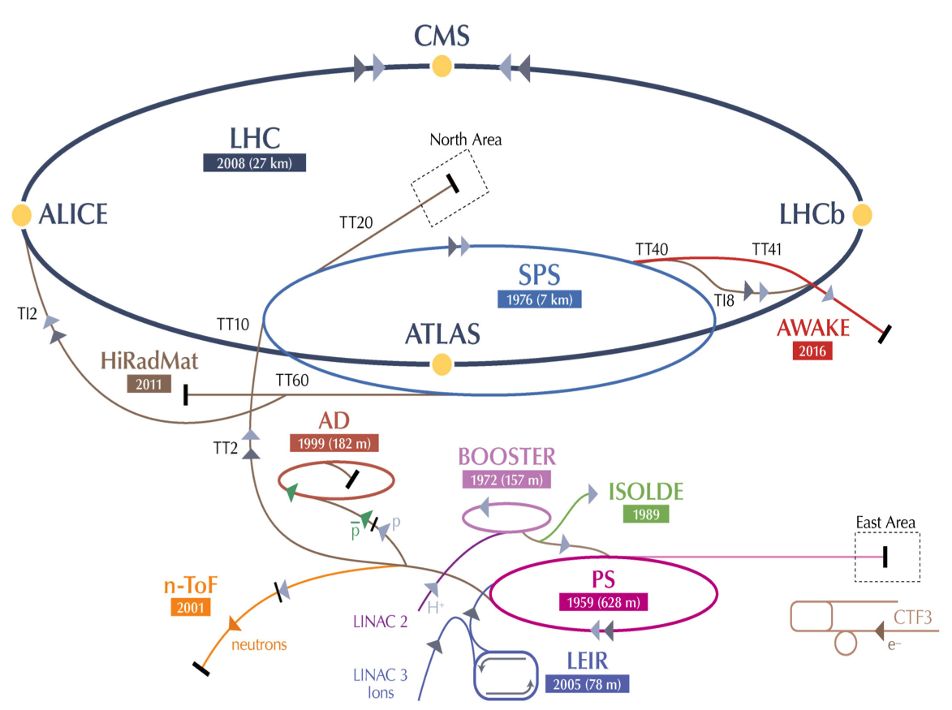
The AWAKE experiment
The Advanced WAKEfield experiment
R & D Experiment into PWFA
Using Protons from the SPS
Accelerate electrons

Slide 3
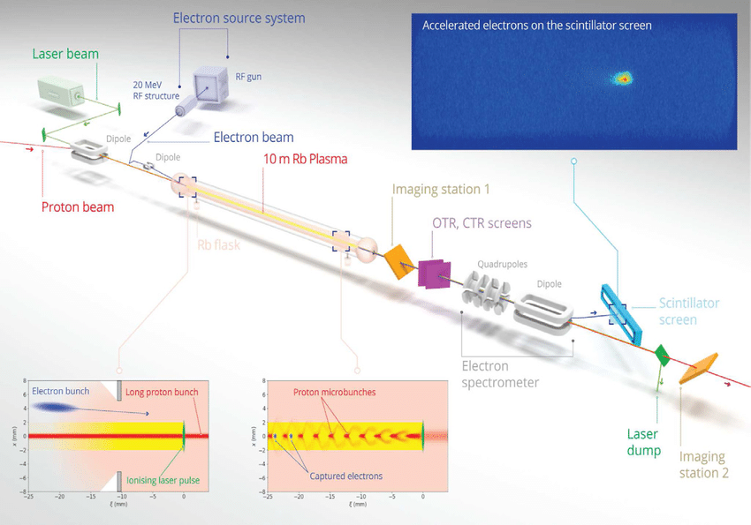
The AWAKE experiment
10m Rubidium vapour source
Ionised by a Laser pulse to create Plasma
SPS Protons (400GeV) drives wakefields in the plasma
Externally injected electrons (20MeV) for acceleration
Run 1: 2017-2021
Demonstrated seeded self-modulation of the proton bunch and drive strong wakefields
Accelerate externally injected electrons to 2 GeV (average accelerating gradient of 200 MV/m)

Slide 4
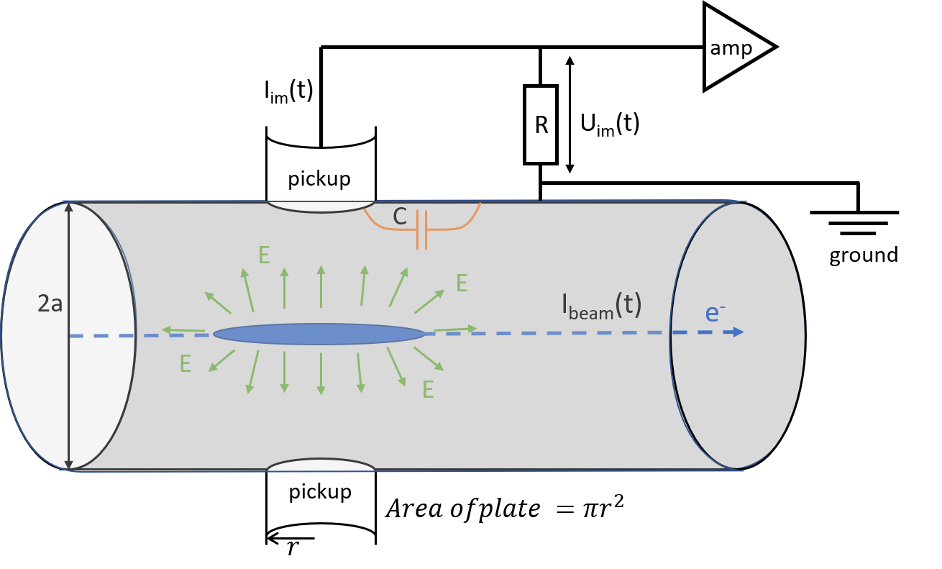
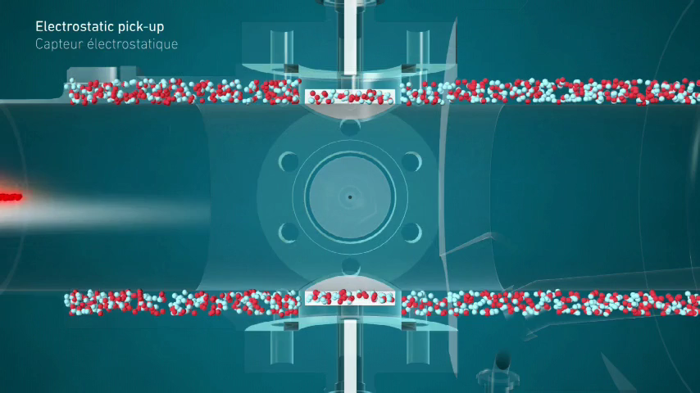
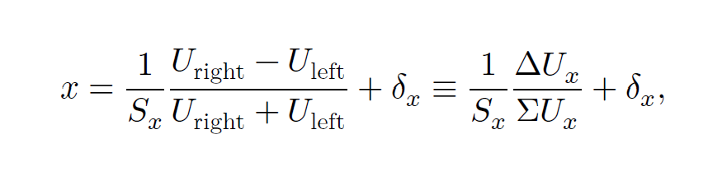
Capacitive BPMs
If the beam is centred, opposite electrodes see equal induced signals. If the beam shifts toward one side, the nearer electrode sees a larger signal and the farther one sees a smaller signal.
The beam is a moving line of charge. As it passes, it induces image charge on nearby conductive surfaces. Each electrode forms a small capacitance to the beam/beam pipe, so beam motion creates a time-varying induced voltage on the electrode

Slide 5
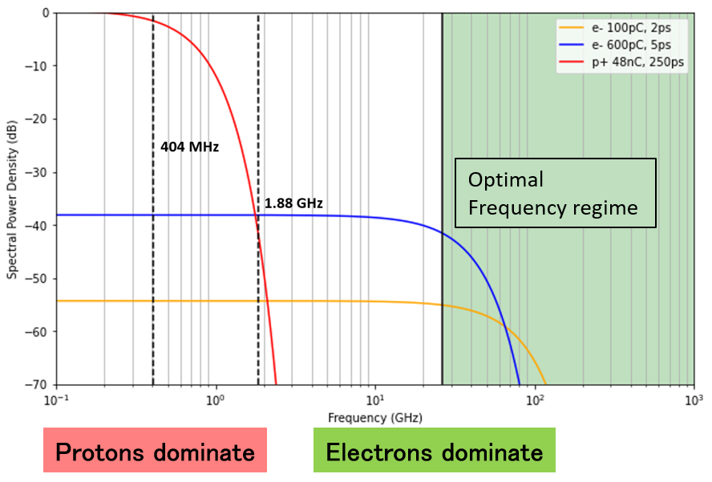
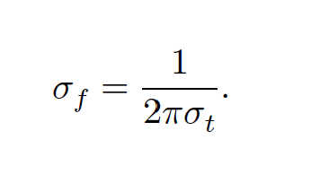
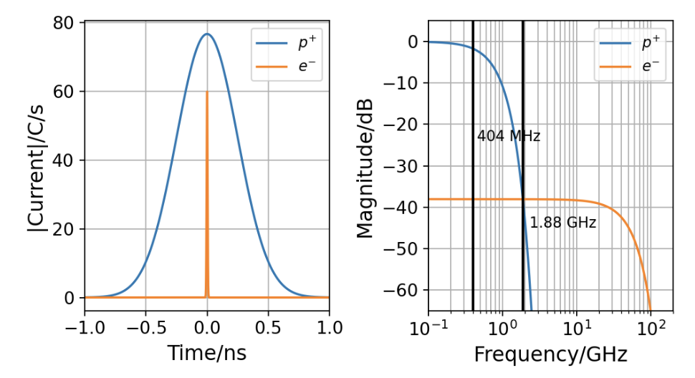
Current Electron BPMs
Precise injection of the electron beam onto the plasma wake is essential for acceleration
The problem:
Proton bunches are longer(~250ps), and higher charge (48nC) than the electron bunch (~1-5ps), (100pC).
At 404 MHz signal dominated by protons.
Current stripline eBPMs unable to measure beam position when protons are present.
|Current|/A
The solution:
Need for a system performing the detection at sufficiently high frequencies (MHz → GHz)

Slide 6
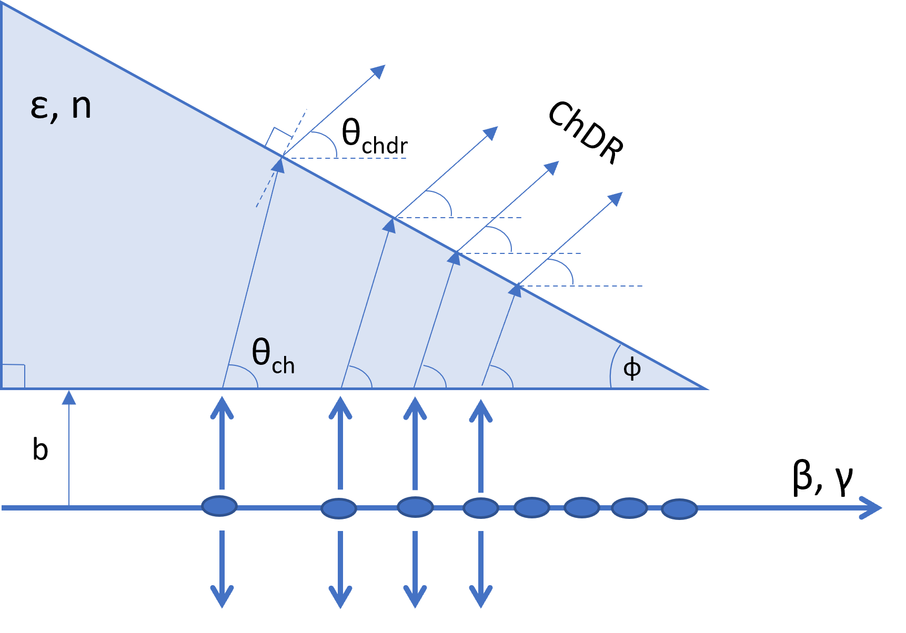
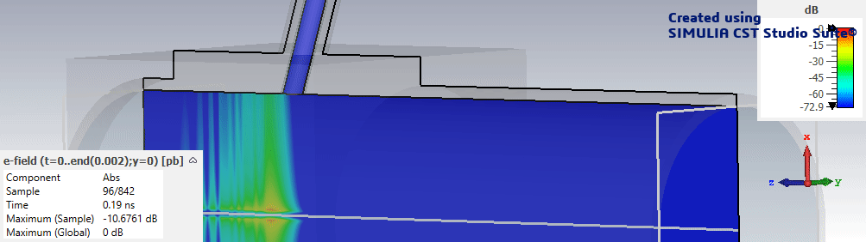

High Frequency Beam Position Monitors 1
Option 1: Cherenkov Diffraction based BPM
Cherenkov Diffraction Radiation is a type of polarization radiation generated by the field of a particle beam as it passes in close proximity to a dielectric radiator.
Propagates inside the dielectric at the Cherenkov angle.
BPM based on ChDR is advantageous as it is non-interceptive and the radiation is emitted at a well-defined angle.
$$θ_{Ch}=\cos^{−1}\left(\frac{1}{nβ}\right)$$

Slide 7
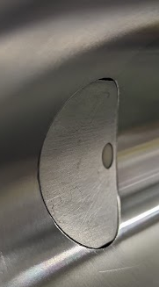
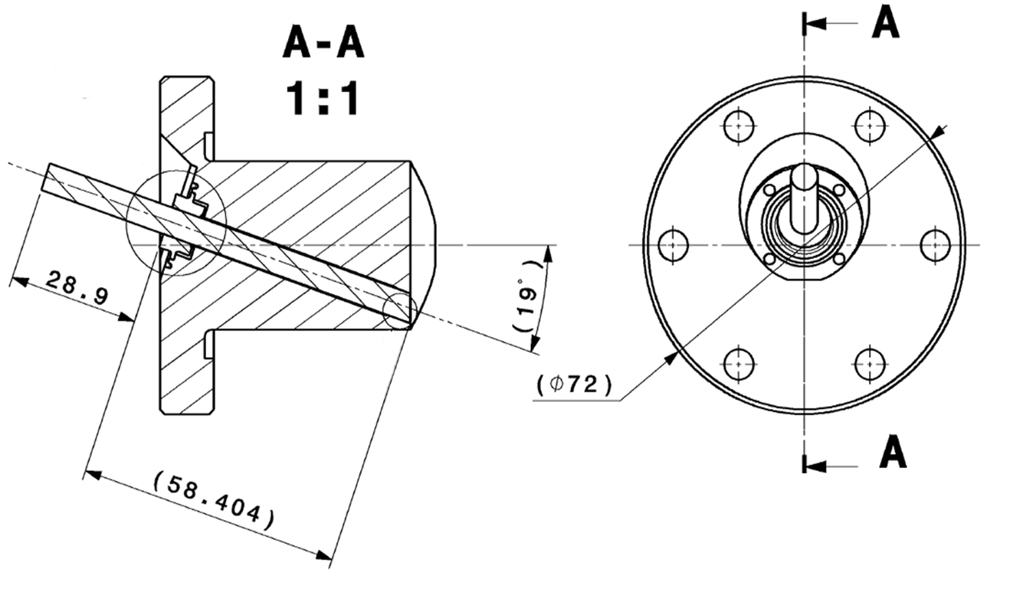
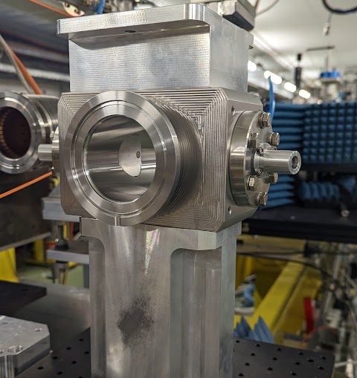
High Frequency Beam Position Monitors 1
Option 1: Cherenkov Diffraction based BPM
ChDR alumina target
⌀6 mm, 86 mm long alumina rods angled at the Cherenkov angle (71°), 9.6 GHz cut-off
Respects the geometry of existing pBPM body

Slide 8
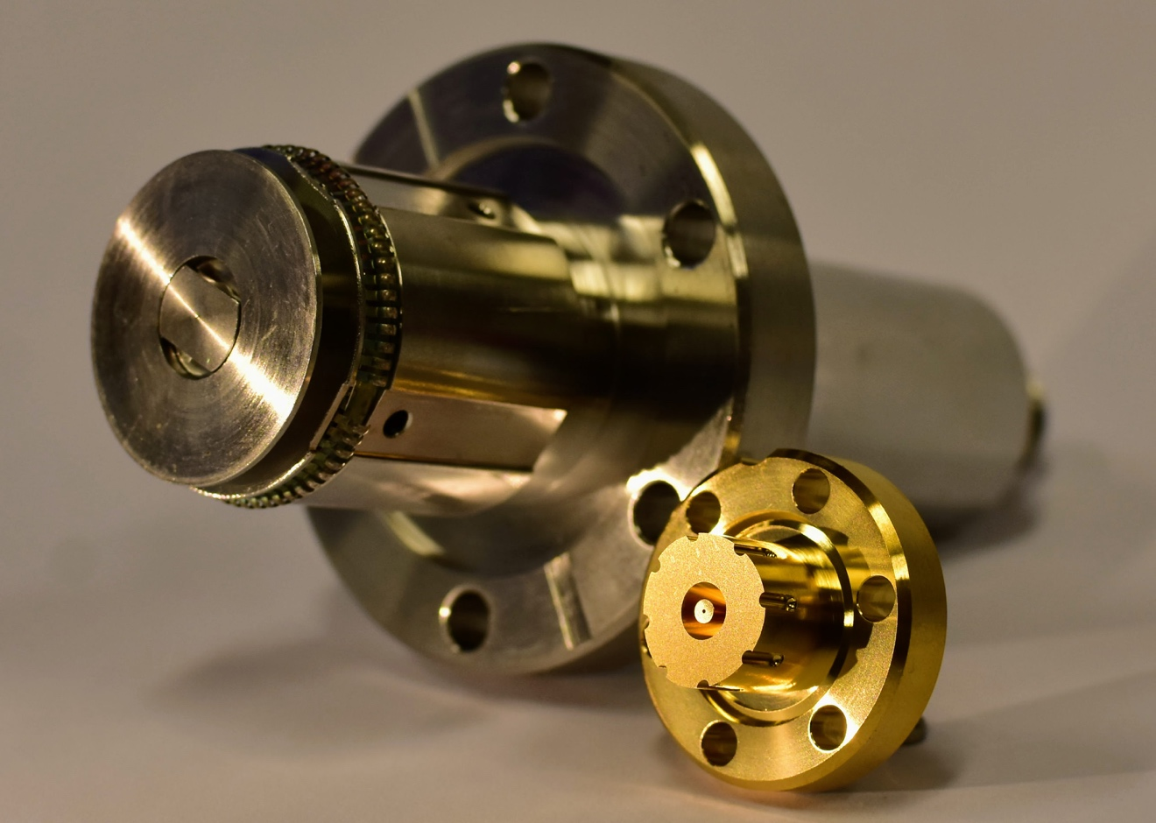
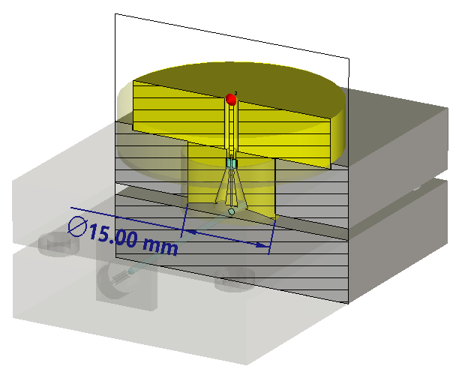
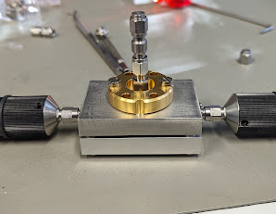
High Frequency Beam Position Monitors 2
Option 2: High Frequency Button BPM
Conical shaped High Frequency button BPM
One design in literature working above 40 GHz cutoff frequency
See A. Angelovski et al., Phys. Rev. ST Accel.
Beams 15, 112803 (2012)
Glass bead
Conical Cutout
Comparison to LHC-type Button BPM
the cone-shaped pickup avoids resonances within the pickup due to the tapered transition from the beam pipe to the connector

Slide 9
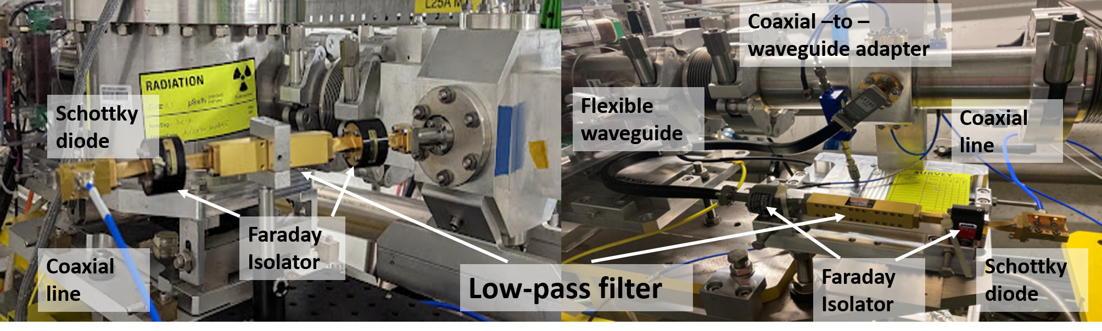
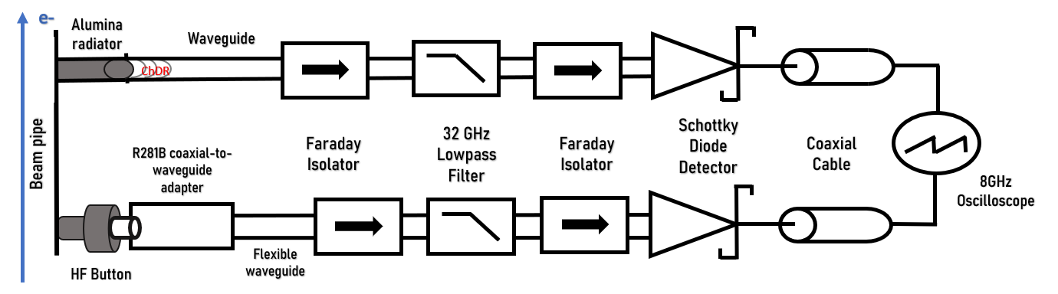
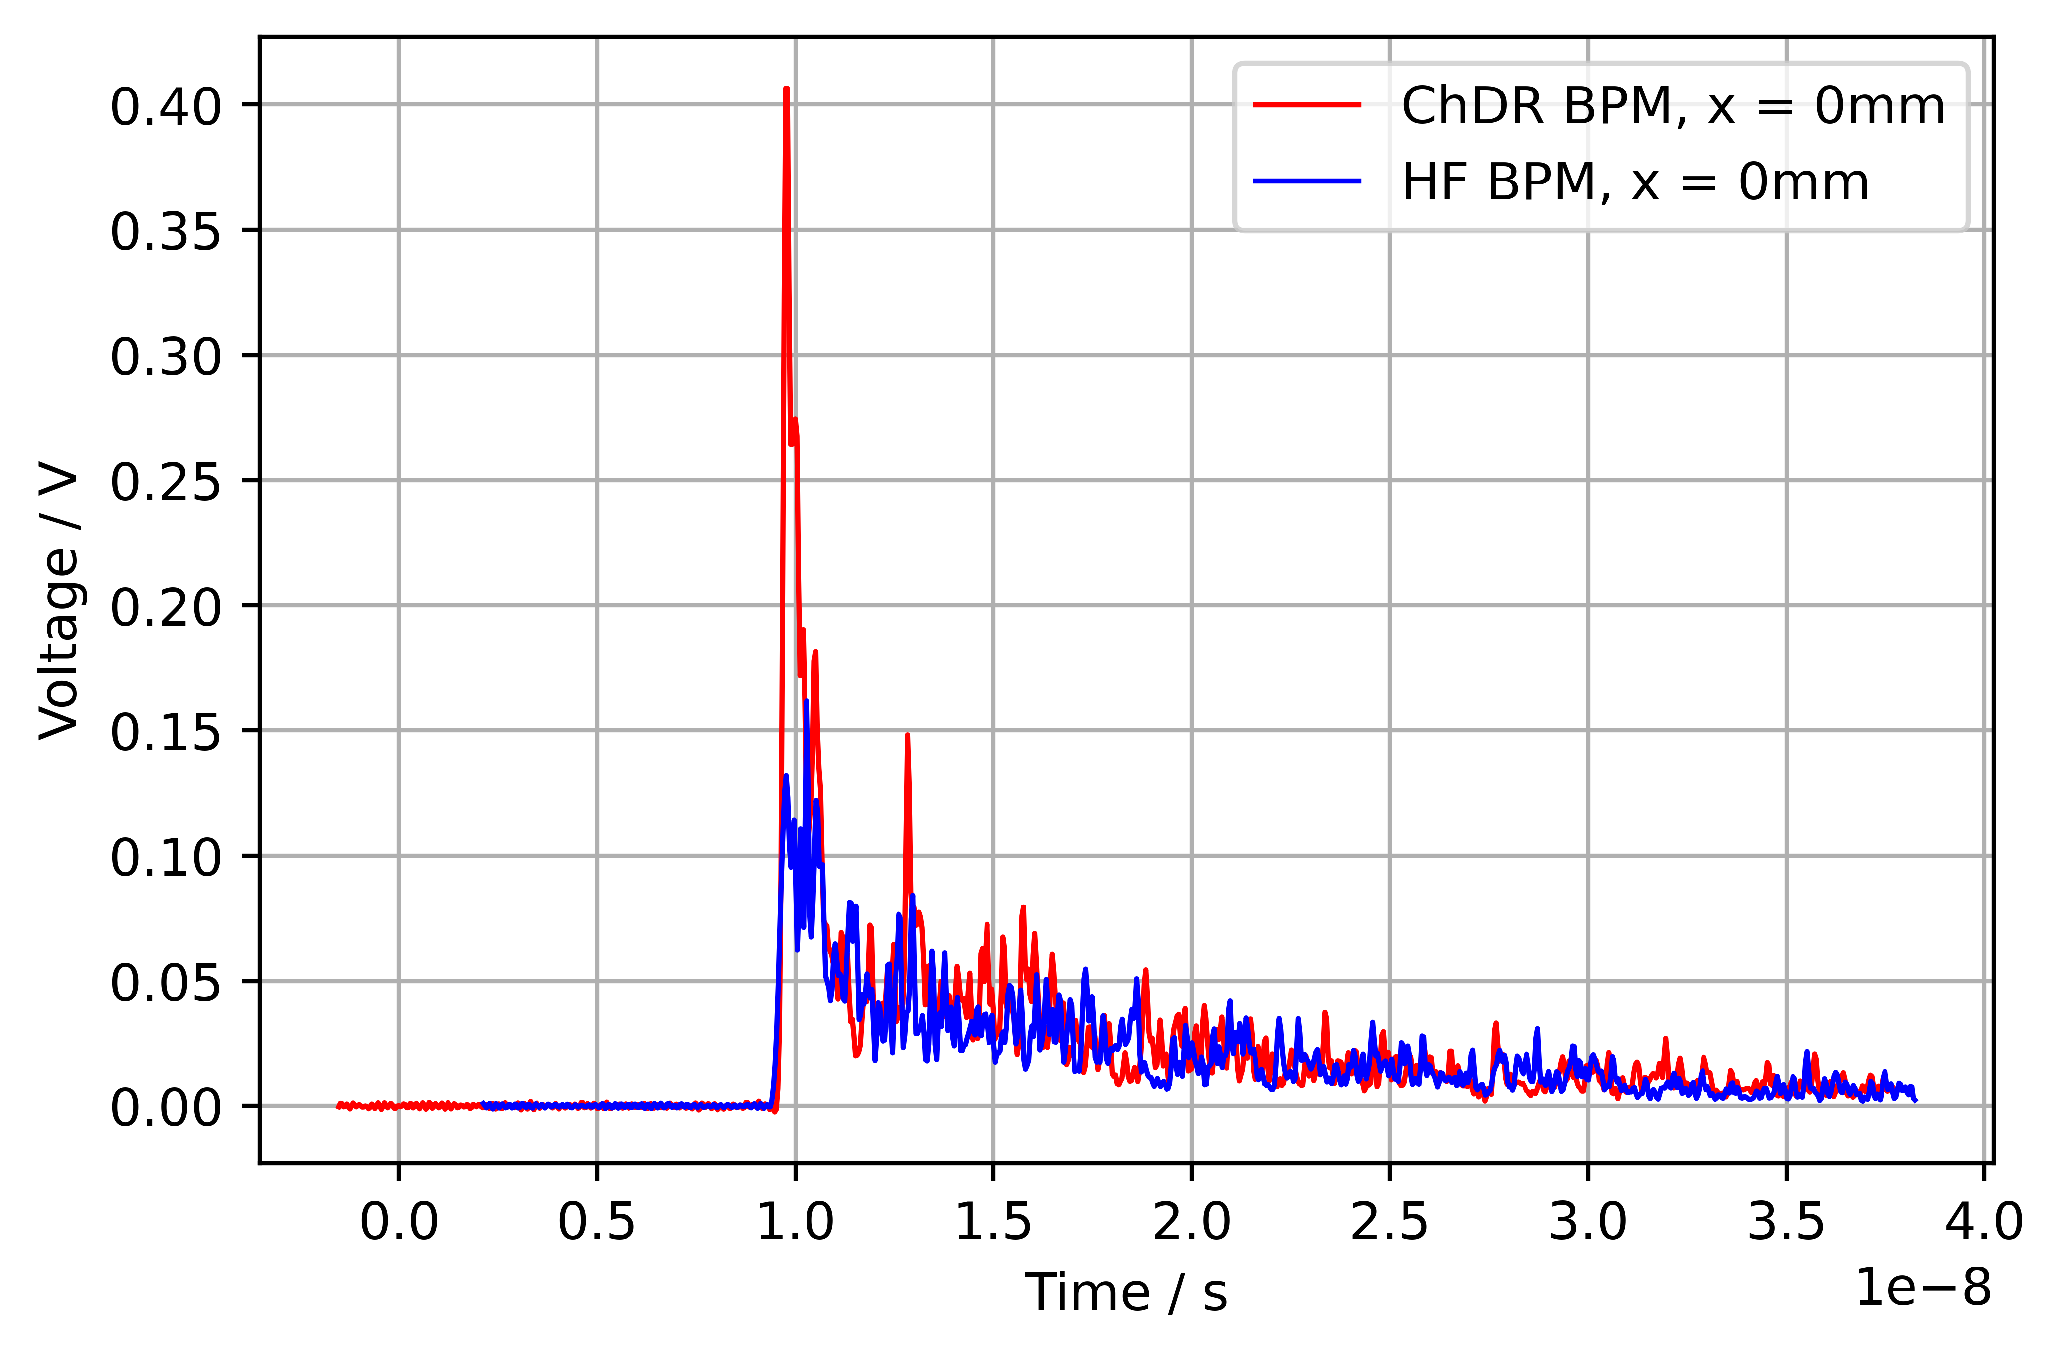
Beam Testing - Setup
The Ka-Band read-out arms are identical and pass a frequency range ~20...32 GHz, given by the low-pass filter and the WR28 dimensions. At the end there is a Ka-Band diode detector

Slide 10
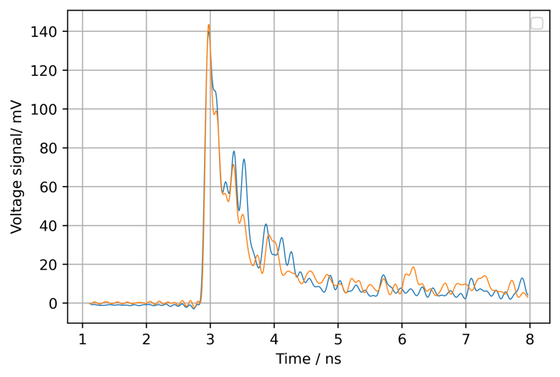
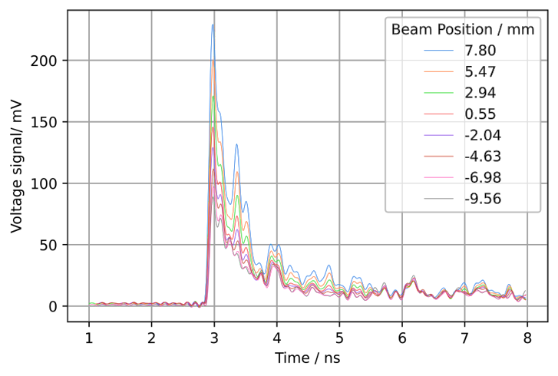
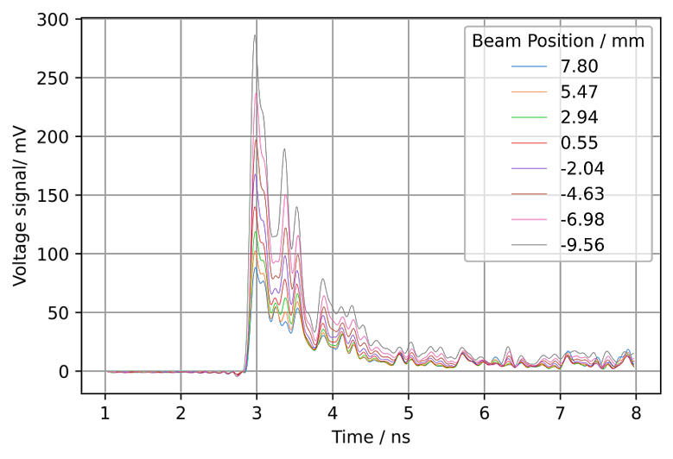
Beam Testing – Response to the electron beam
The electron beam is moved across the horizontal plane of the beam pipe using correcting magnets upstream of the BPMs
At each position we record the signal waveform over 30 seconds and taken an average.
We predict that the opposite pickup would produce an equal but opposite respone
The position sensitivity of each BPM is then calculated using the value of the peak voltage at each position as the % change in the signal per mm
We compare the waveform response from 2 opposite Cherenkov pickups and show that when a (100 pC) electron beam is centred in the beam pipe, the signal response is nearly identical.

Slide 11
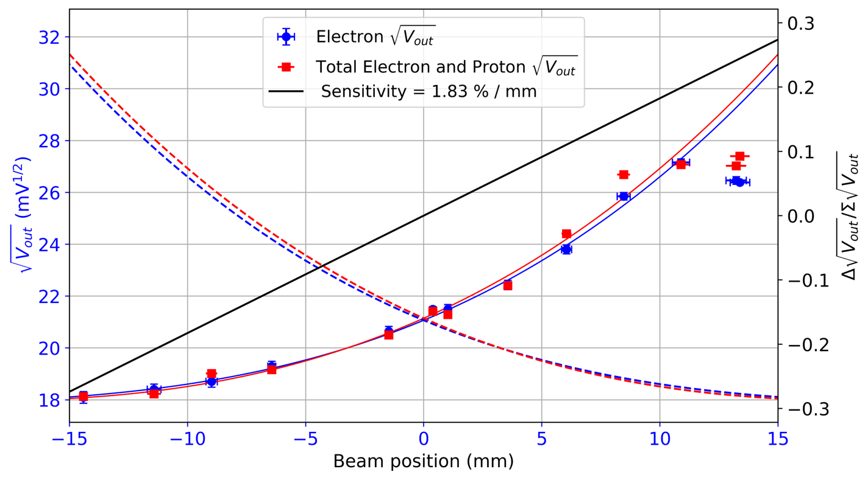
The proton beam is extracted from the SPS up to every 15 seconds with a bunch population of between 1 and 3 x 10¹¹ protons.
When these arrive we extract the waveforms from the BPM and compare them to the waveforms when only the electrons are present.
Beam Testing – Introducing the Protons
Barely any change in the signal when the 1 x 10¹¹ protons are present
Consistent sensitivity with electron only operation
Successfully discriminates electron position from the proton bunches
True for both ChDR and conical HF BPMs

Slide 12
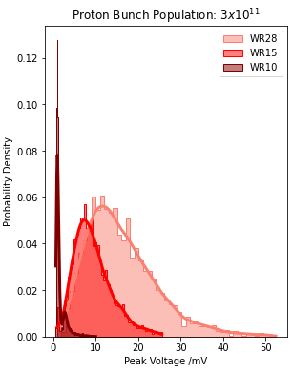
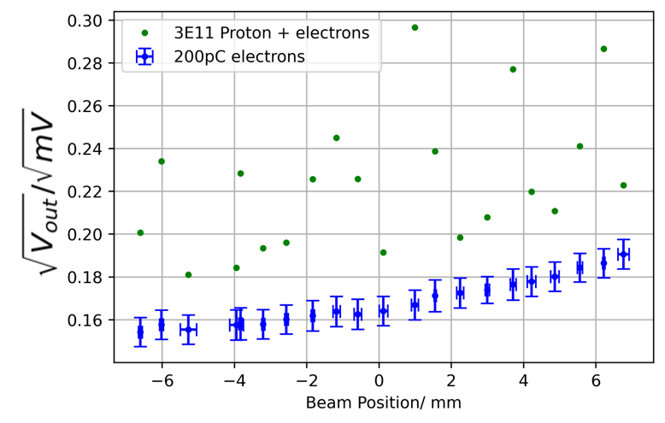
Issues arise when the intensity of the proton bunch is increased
Beam Testing – Introducing the Protons
So what is happening?
The frequency spectrum of the proton bunches are extending much higher than predicted!
We can look to mitigating this by going to even higher frequencies…
We now see an additional contributed voltage on top of the electron signal

Slide 13
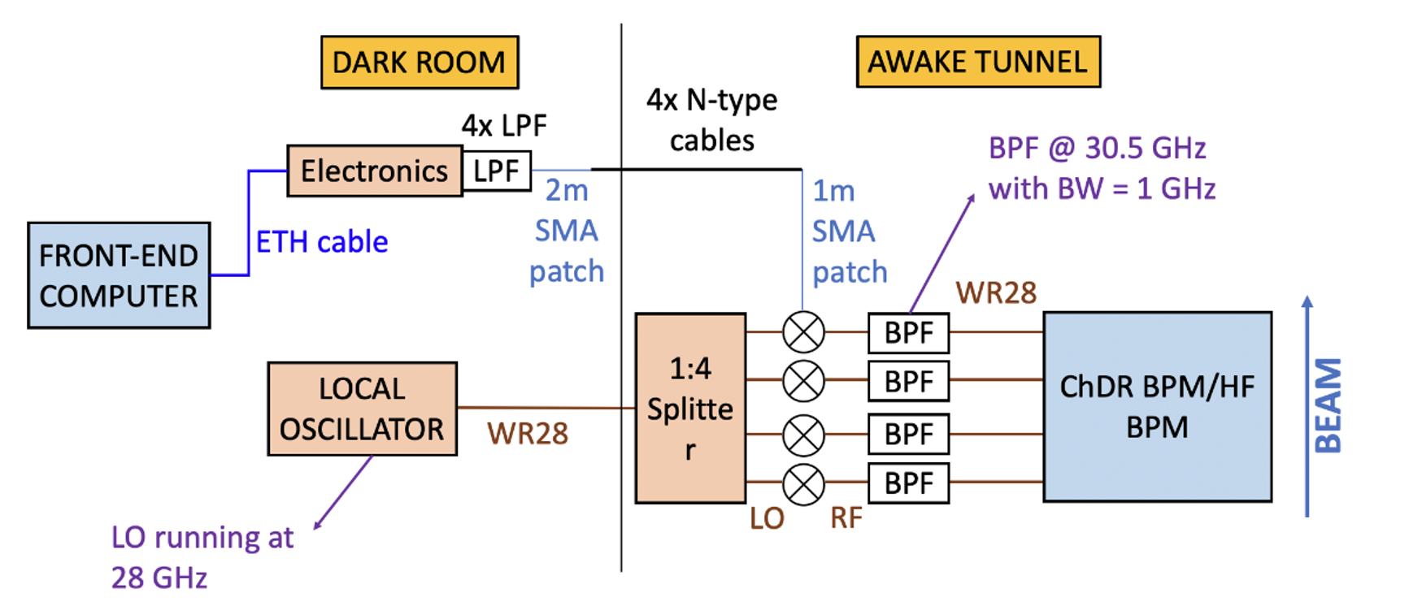
TRIUMF commissioning + installation
Continuous logging of the electron beam at 10 Hz via an external trigger.
The HF pick-ups are connected to coaxial-to-WR28 waveguide adapters.
Both pick-ups are connected to two identical signal processing electronics, which detect the BPM pick-up signals at the WR28 waveguides in the frequency band between 26.5-40 GHz.
In the RF front-end, the signals are passed through bandpass filters (BPF) with 30.5 GHz central frequency and 1 GHz bandwidth (BW) before being down-converted to an intermediate frequency (IF) of 2 GHz.
The IF signals are demodulated and digitized in the following back-end electronics, designed by TRIUMF.
Full integration in FESA.

Slide 14

Next steps
I have finished my PhD (yay) but there is currently no plans for further development of either BPM
Additional R&D would be needed to improve performance for 3 x 10¹¹ proton intensity.
Could include moving to a higher frequency acquisition but no clear indication of how high we would need to go.
Redesign of the front-end.
Only feasible for the ChDR BPMs as bandwidth of HF conical pickups above 40 GHz begin to include large resonances.
Alternatively, an online measurement of the proton profile to compliment the measurements.

Slide 15
Thank you and Merry Christmas!

