Slide 1




Curved hydrodynamic
optical-field-ionised waveguides
Darren Zeming Chan,¹ J. Chappell,¹ L. Feder,¹ B. Greenwood,¹ A. Harrison,¹ S. Kaloš,¹
R. Lahaye,¹ D. McMahon,¹ J. Thistlewood,¹ S. Thorpe,^{2, 3} R. Walczak,¹ and S. Hooker¹
¹ Department of Physics, University of Oxford
² Department of Chemistry, University of Oxford
³
18 December 2025
Notes:
Parallel developments since many projects at once, ongoing work
Can remove some text on slides
“Mindmap” slide that is referenced multiple times with some pictures, cartoon
Include Oxford name, not just crest
Alphabetical authors in middle
Hi, I’m Darren and I’m presenting on behalf of the Laser-Plasma Accelerator Group at the University of Oxford and our collaborators.
Put all authors on first page, acknowledge support from NSERC, acknowledgements slide at the end
Might not want overview slide, cite 2023 curved channels PRL
What is different? Free-standing channels, theoretically and experimentally
Could mention off-ramp and radiation generation, broaden scope, show simulations for off-ramp and experiments

Slide 2
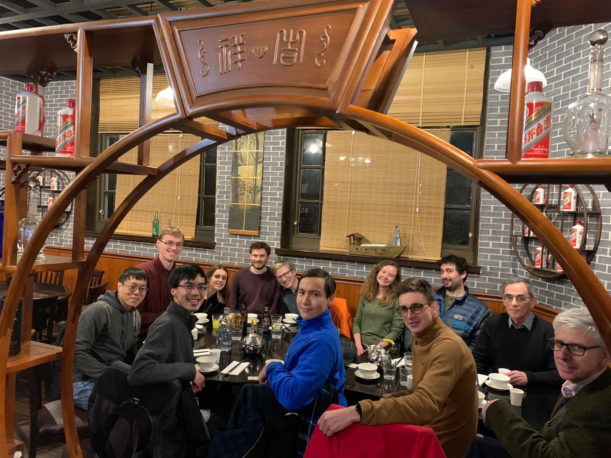
Overview
Usefulness of curved plasma
waveguides for LWFA
Plasma accelerator staging
simulations
Pulse extraction simulations
Experimental generation of curved
plasma waveguides
Darren Chan
Notes:
Large-scale high power laser facilities
Low density to increase dephasing and depletion lengths

Slide 3
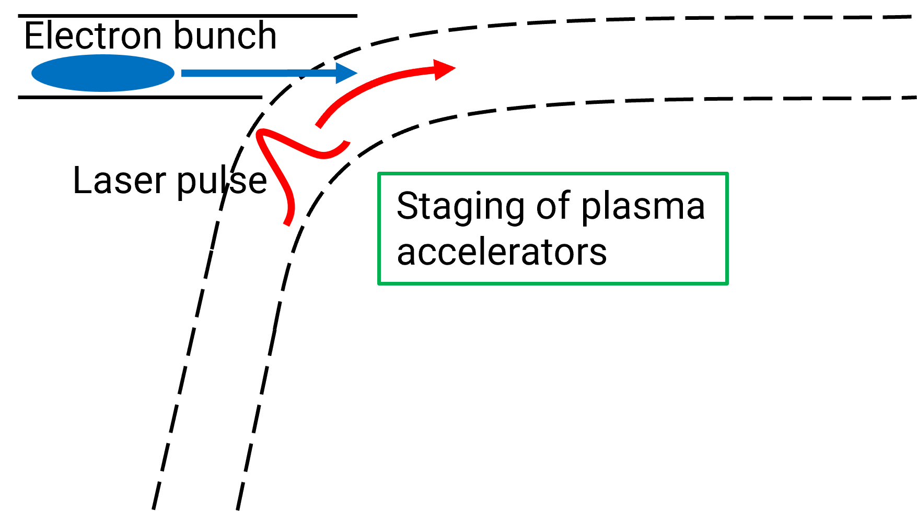
Applications of curved plasma waveguides
Darren Chan
Notes:
Think about including radiation generation propagation results
Declutter figure and first stage
Remove many, many more…
Discuss three applications and experiments
Distinguish indented sub-bullets
Pulse extractor Bunch follows pulse down a channel with a kink

Slide 4
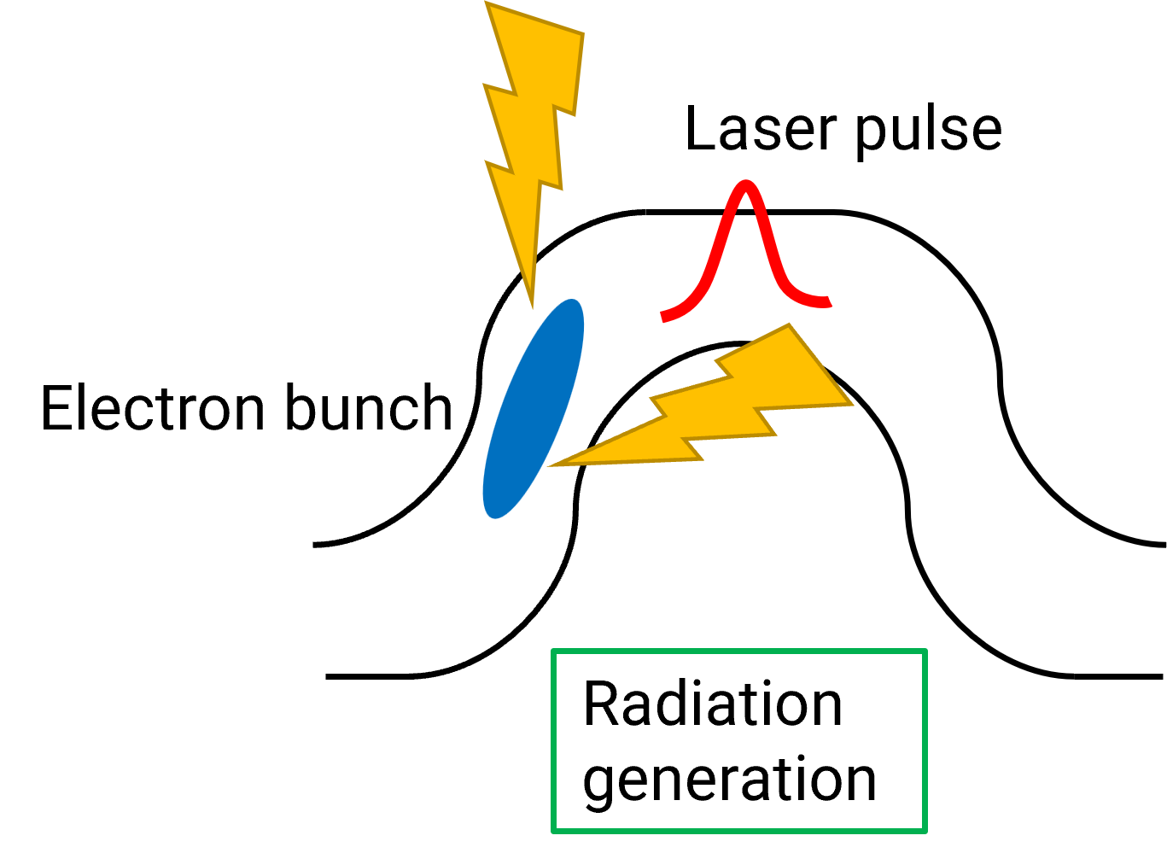
Applications of curved plasma waveguides
Darren Chan
Notes:
Think about including radiation generation propagation results
Declutter figure and first stage
Remove many, many more…
Discuss three applications and experiments
Distinguish indented sub-bullets
Pulse extractor Bunch follows pulse down a channel with a kink

Slide 5
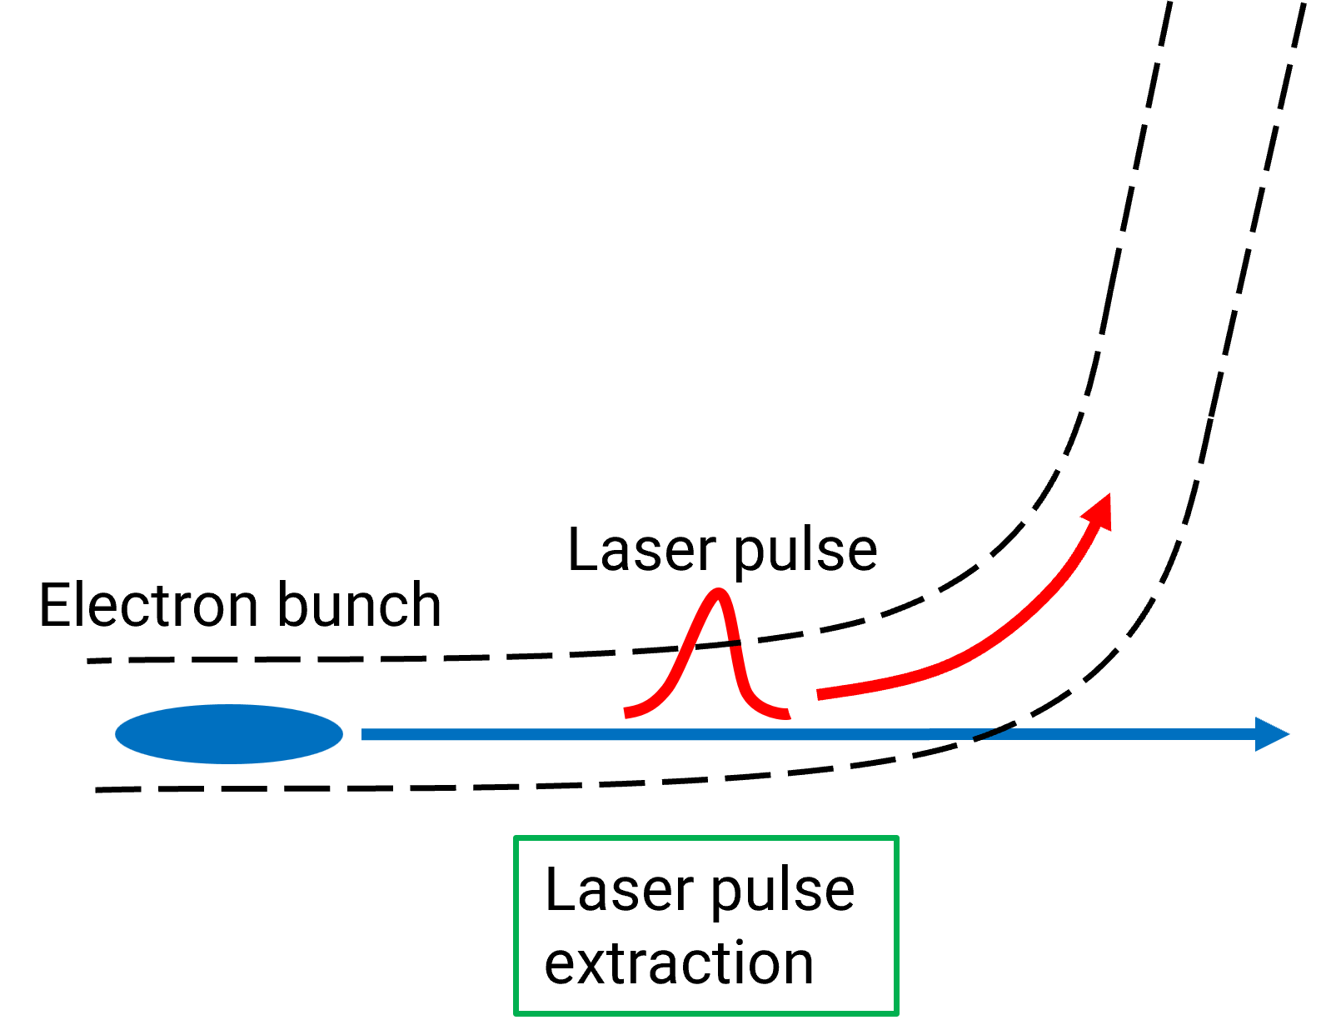
Applications of curved plasma waveguides
Darren Chan
Notes:
Think about including radiation generation propagation results
Declutter figure and first stage
Remove many, many more…
Discuss three applications and experiments
Distinguish indented sub-bullets
Pulse extractor Bunch follows pulse down a channel with a kink

Slide 6
Simulations of staging with curved plasma waveguides

Slide 7
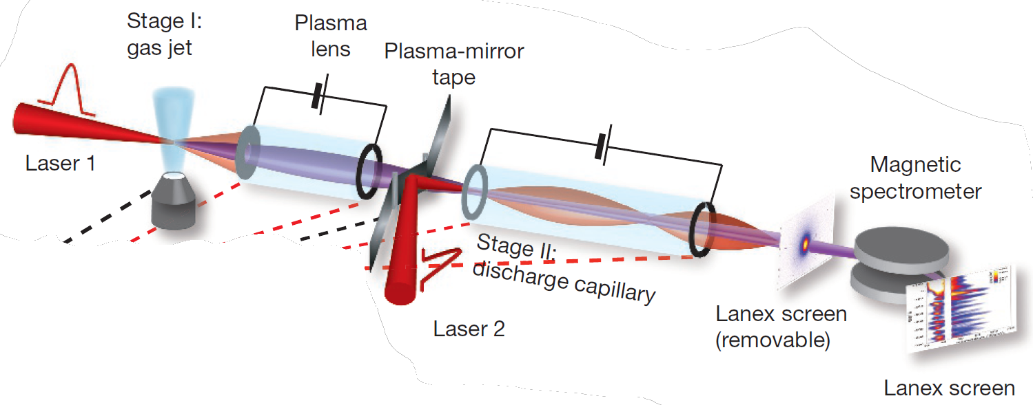
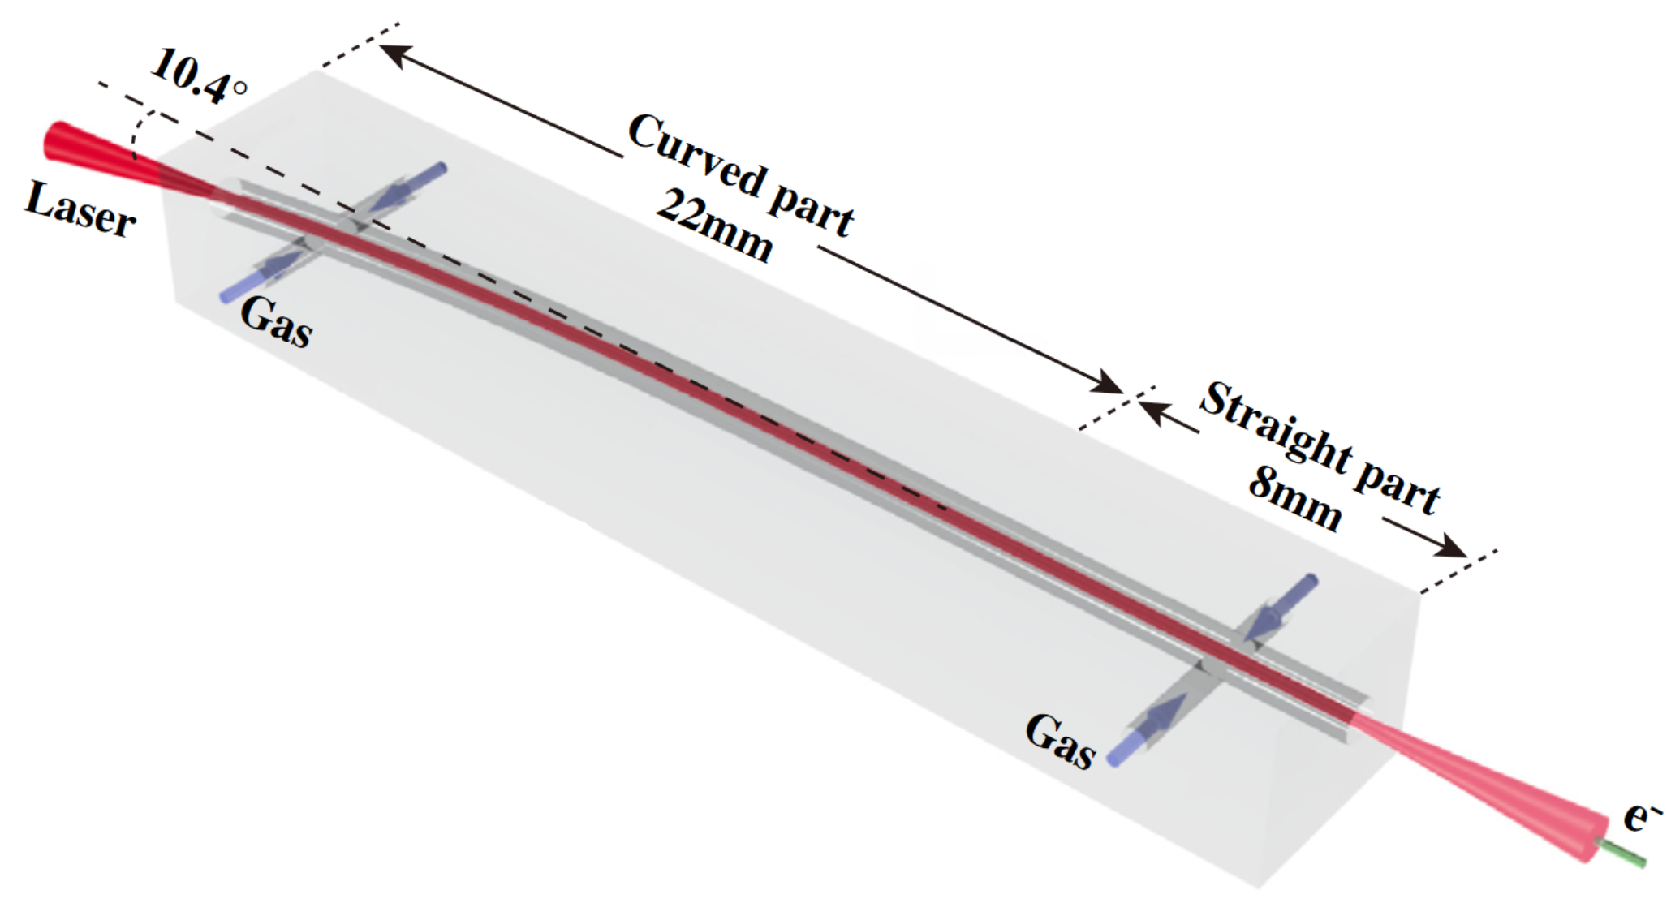
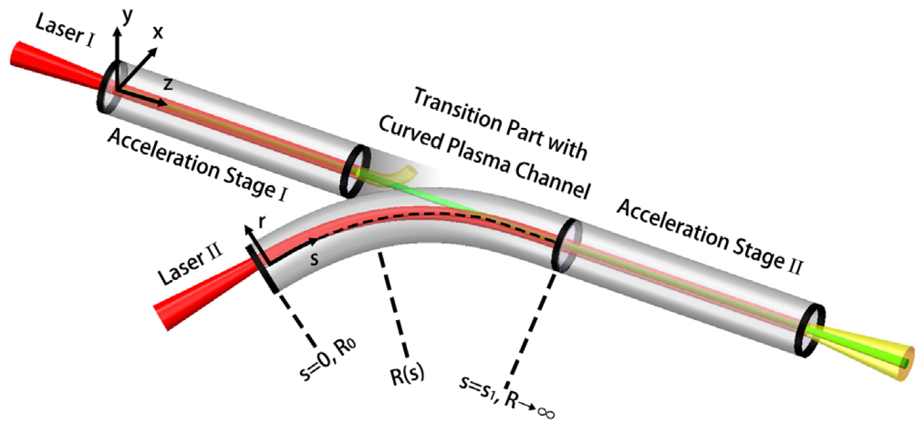
Multistage LWFA schemes
No curved channels staging experiment has yet been performed (guiding )
All studies so far have used discharge capillaries, which are prone to laser damage especially at high pulse repetition rates
From: Nature 530, 190–193 (2016)
From: Phys. Rev. Lett. 120, 154801 (2018)
From: Phys. Rev. Lett. 130, 215001 (2023)
Darren Chan
Notes:
All studies so far have used discharge capillary waveguides
Mention kHz for HOFI
Pay the price in terms of emittance growth
Could probably combine slides 6-8, can make three figures small
Mention variable radius of curvature
Just include references, don’t detail
From here, jump straight to HOFI description

Slide 8
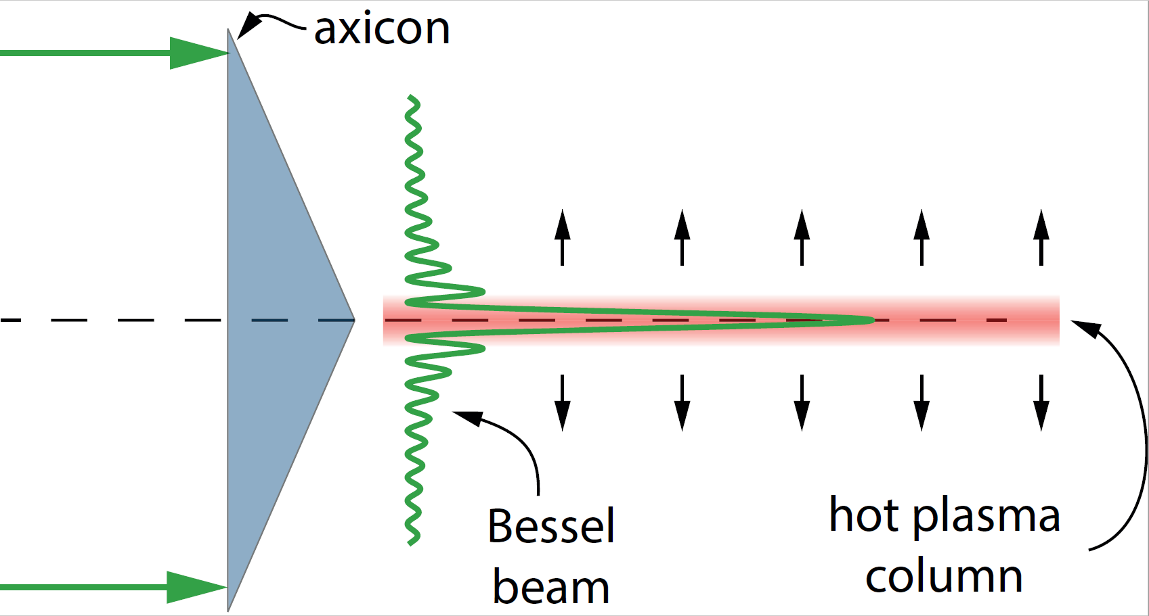
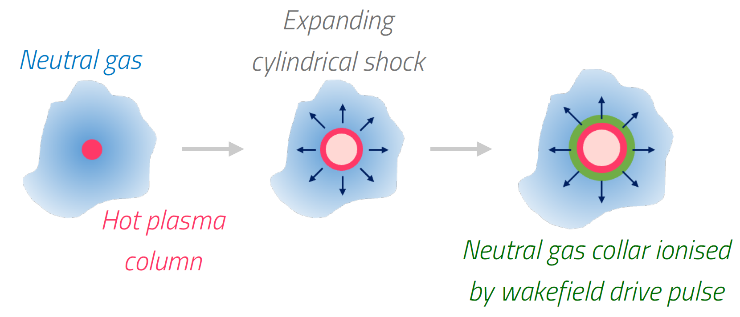
Hydrodynamic optical-field-ionised plasma channels (HOFIs)
Alternative plasma channel developed by the Oxford Group suitable for kHz rep rates
Immune to laser damage
Guiding of pulse in curved section is important due to ionisation of neutrals
Darren Chan
Notes:
Emphasise importance with curved channels vs parabolic, refer to Alex’s talk
Do not go through HOFI mechanism, reference other HOFI talks
Emphasise ionisation is important, different from full-ionised
Do mention axicon
Show electron density profiles
Can remove Simon’s name from credit
Focus along a line in longitudinal direction
Shock wave that spreads outwards, creating a density depression close to the axis, i.e. a plasma waveguide
Leading edge is guided and ionizes collar of neutral gas atoms that surround the HOFI.
Move slide to just before mention of rescaling to HOFI parameters
Replace with cartoon, mention axicon focus

Slide 9
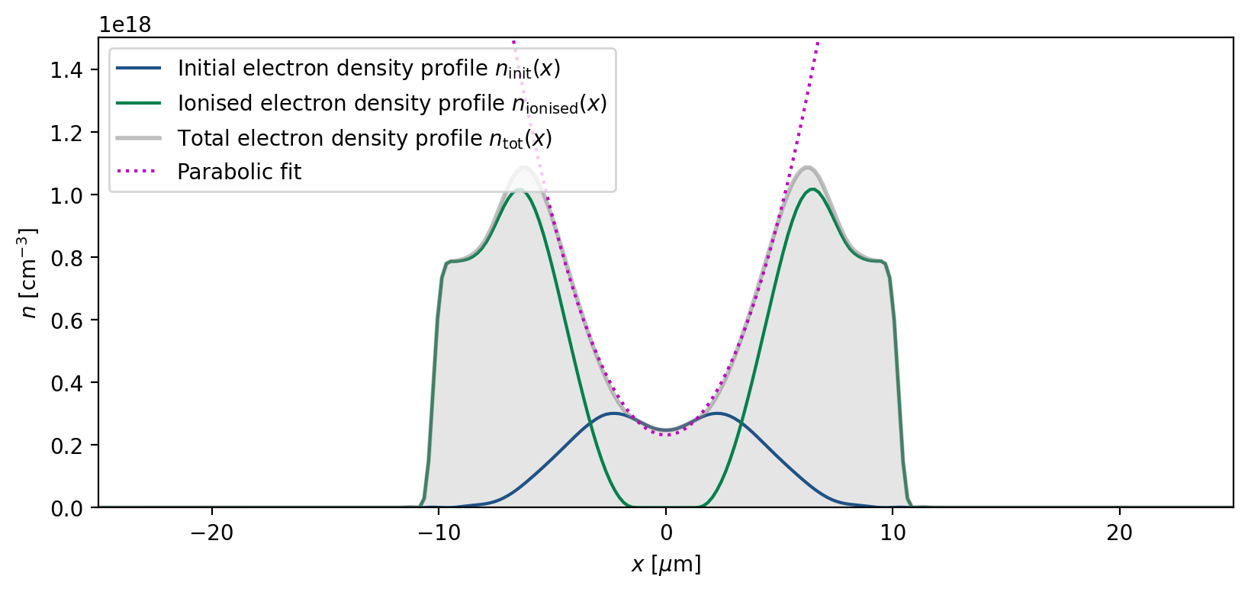
Hydrodynamic optical-field-ionised plasma channels (HOFIs)
Alternative plasma channel developed by the Oxford Group suitable for kHz rep rates
Immune to laser damage
Guiding of pulse in curved section is important due to ionisation of neutrals
From additional neutrals
From Bessel beam
Darren Chan
Notes:
Emphasise importance with curved channels vs parabolic, refer to Alex’s talk
Do not go through HOFI mechanism, reference other HOFI talks
Emphasise ionisation is important, different from full-ionised
Do mention axicon
Show electron density profiles
Can remove Simon’s name from credit
Focus along a line in longitudinal direction
Shock wave that spreads outwards, creating a density depression close to the axis, i.e. a plasma waveguide
Leading edge is guided and ionizes collar of neutral gas atoms that surround the HOFI.
Move slide to just before mention of rescaling to HOFI parameters
Replace with cartoon, mention axicon focus

Slide 10
Curved channel goals and setup
Need capture efficiency ~100% and percent-level emittance growth for applications
2D sims with full PIC code WarpX to model channel wall ionisation and 3D sims with HiPACE++
Darren Chan
Notes:
For FELs

Slide 11
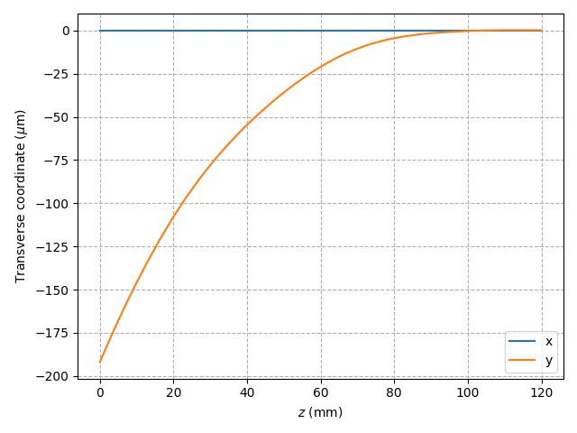
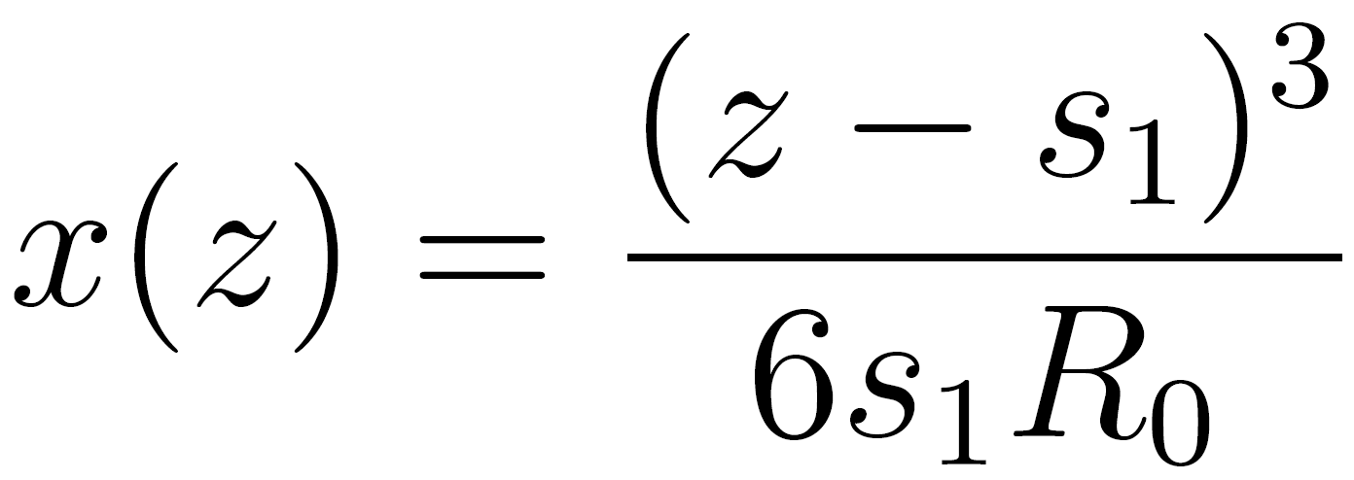
Curved channel goals and setup
Need capture efficiency ~100% and percent-level emittance growth for applications
2D sims with full PIC code WarpX to model channel wall ionisation and 3D sims with HiPACE++
Channel follows cubic curvature function with a displacement of 200 μm over 120 mm
Minimises transverse laser pulse oscillations
Darren Chan
Notes:
For FELs
Explain parameters and why chosen,
Inset with zoomed in r_offset vs axis of channel
Cite Luo
Scan across range of channel curves, could be gaussian envelope

Slide 12
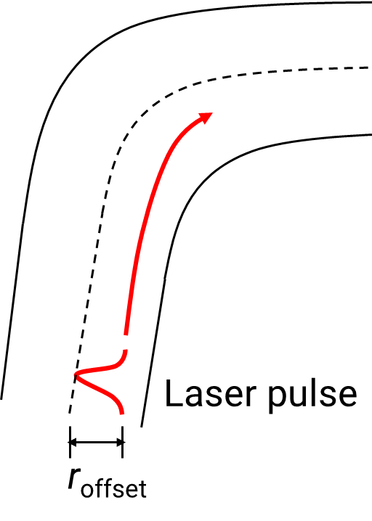
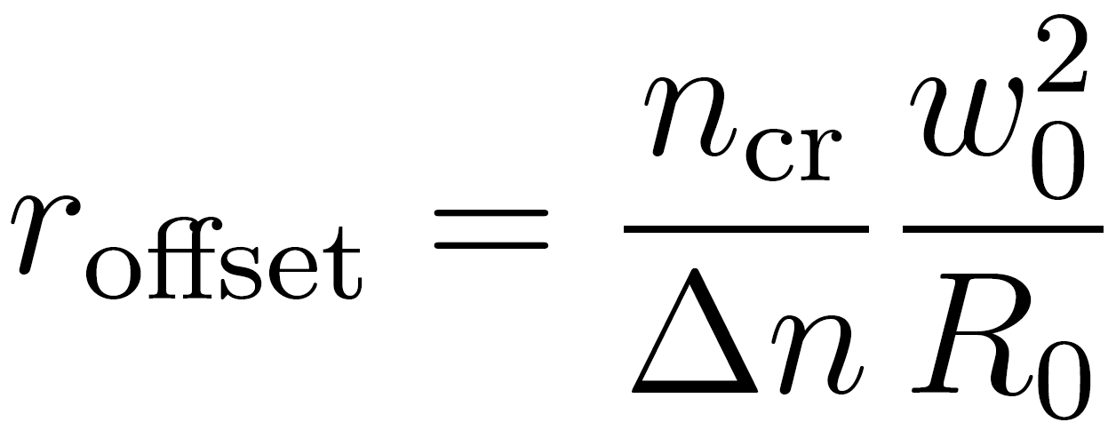
Curved channel goals and setup
Need capture efficiency ~100% and percent-level emittance growth for applications
2D sims with full PIC code WarpX to model channel wall ionisation and 3D sims with HiPACE++
Channel follows cubic curvature function with a displacement of 200 μm over 120 mm
Minimises transverse laser pulse oscillations
Pulse offset derived in:
Phys. Rev. Lett. 120, 154801 (2018)
Darren Chan
Notes:
For FELs
Explain parameters and why chosen,
Inset with zoomed in r_offset vs axis of channel
Cite Luo
Scan across range of channel curves, could be gaussian envelope

Slide 13
Optimisation of the staging scheme
Laser pulse and channel parameters:
a₀ = 1, w₀ = 30 μm, E₀ = 4.2 J, τ_{FWHM} = 130 fs, n₀ = 1.0 × 10¹⁷ cm⁻³
Bunch charge increased from 1pC to 45 pC
for beam-loading and blowout enhancement
Darren Chan
Notes:
Large-scale high power laser facilities
Low density to increase dephasing and depletion lengths

Slide 14
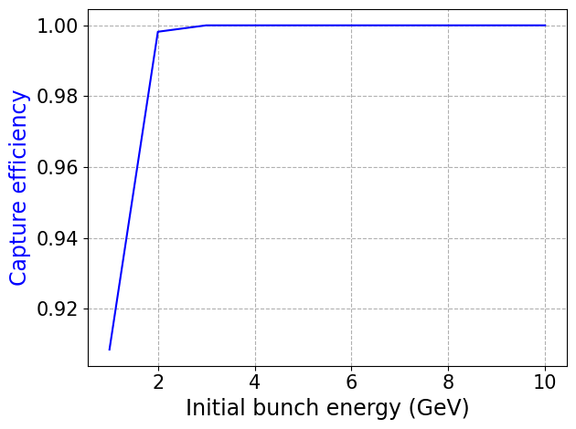
Optimisation of the staging scheme
Laser pulse and channel parameters:
a₀ = 1, w₀ = 30 μm, E₀ = 4.2 J, τ_{FWHM} = 130 fs, n₀ = 1.0 × 10¹⁷ cm⁻³
Bunch charge increased from 1pC to 45 pC
for beam-loading and blowout enhancement
σ_{x} and σ_{px} chosen to give initial emittance
of 1 mm mrad
Bunch energy increased from 1 GeV to
10 GeV for rigidity and magnetic self-focusing
100% capture efficiency achieved, but…
Darren Chan
Notes:
Symbols for initial widths
Show snapshot with conditioning, use fig from thesis
Bunch charge scanned, mention transverse size
Show E_z with properly-loaded
Spot size does not change, properly guided
Twiss parameter formalism, state initial emittance due to undulators
Plot emittance on the same axes

Slide 15
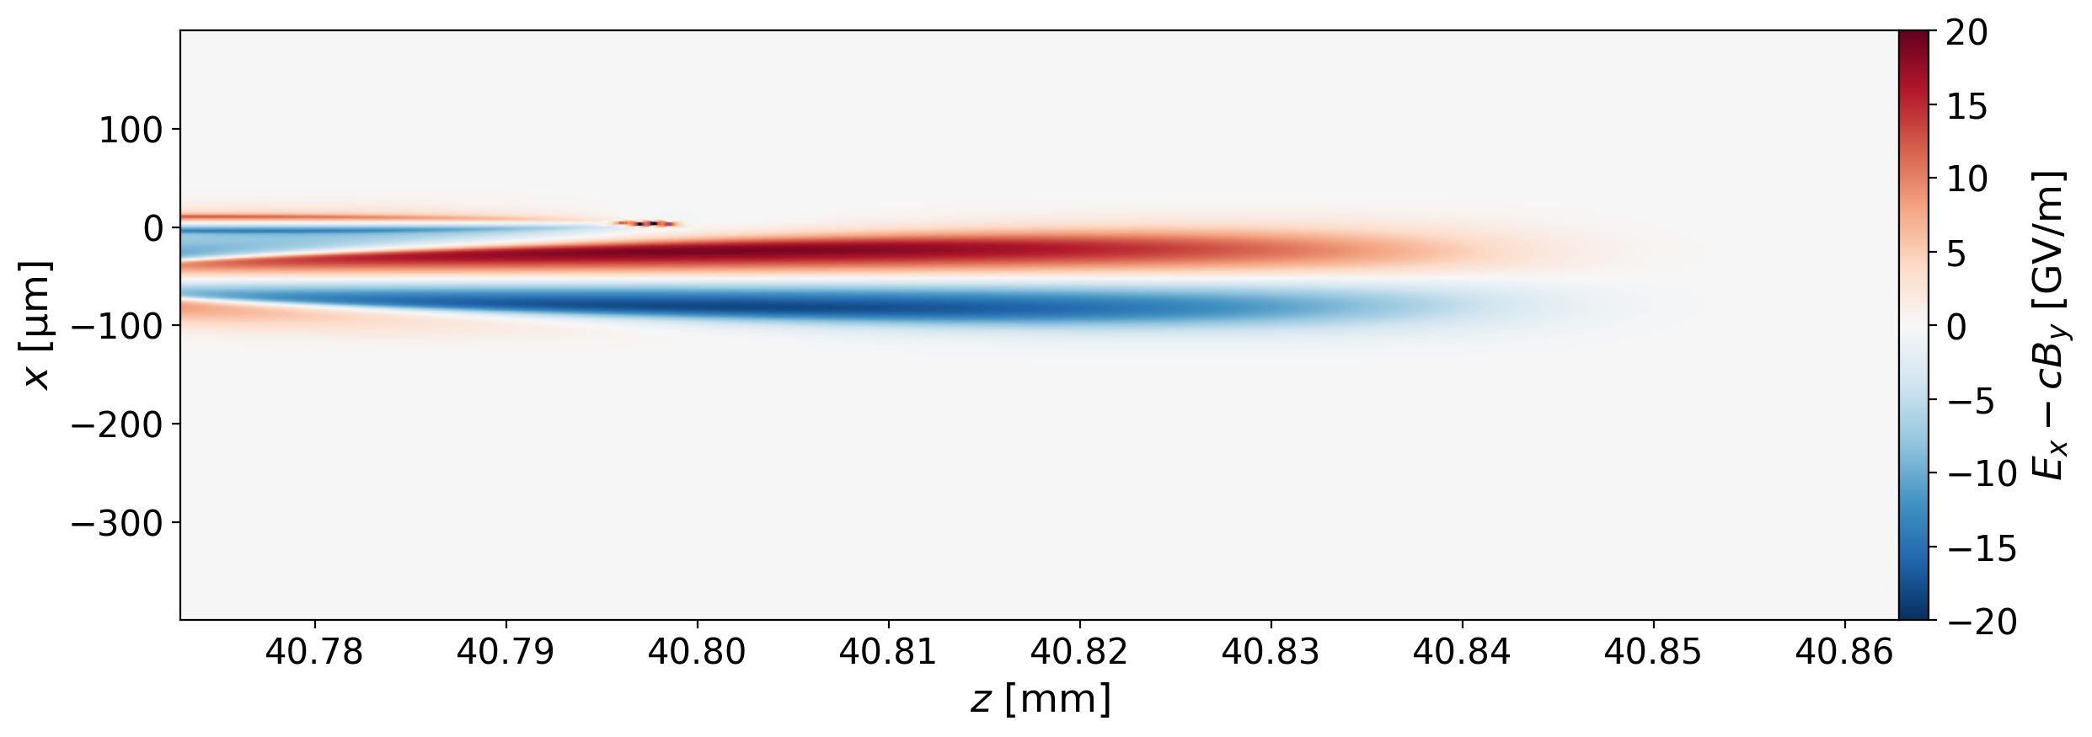
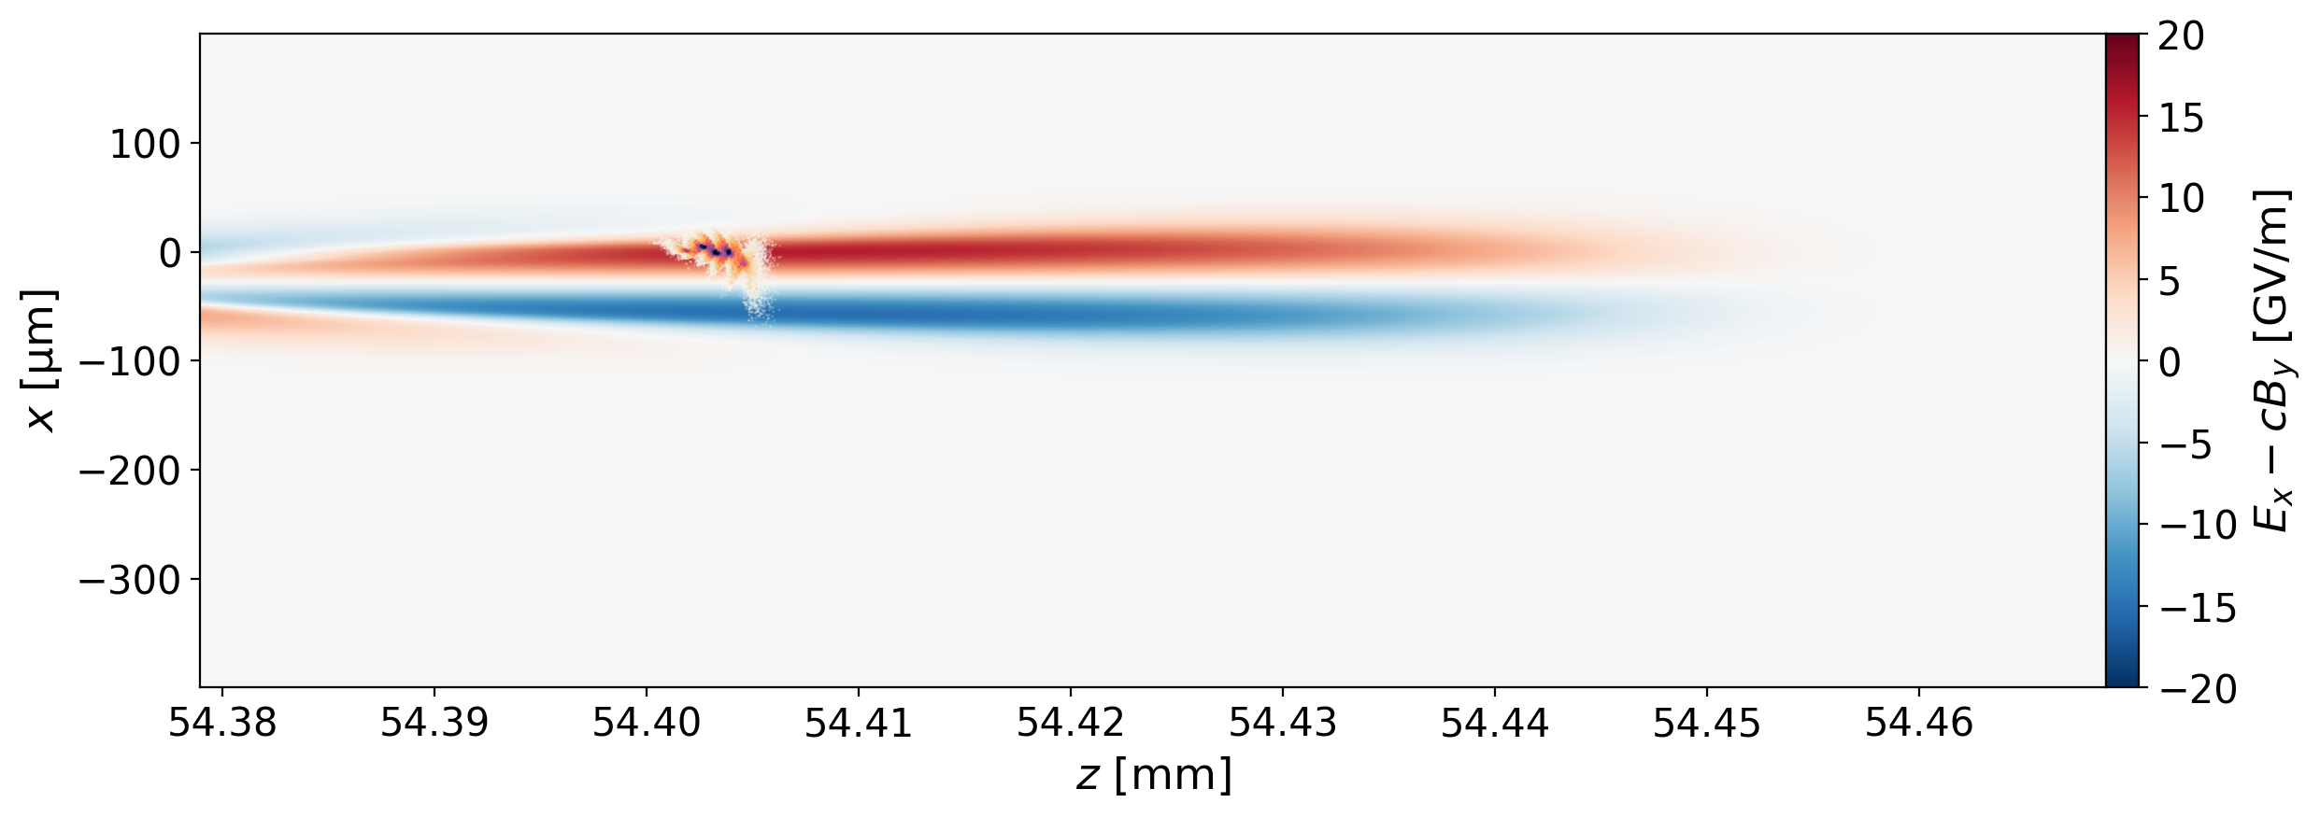
Challenges for the staging scheme
Bunch passes through strong asymmetric transverse wakefields
Emittance increases by >1000X
Bunch
Darren Chan
Notes:
We will be studying beam-loading transverse, increasing charge, John Farmer, overload longitudinally by big factor
Include transverse field figures
Mention energy gain over X range
Emphasise conclusion sentence: Can guide, can capture, emittance messed up
One or two gifs or still with annotations
Two slides to send to Simon and Roman, clear explanation, preliminary work only
Flared channel, on-resonant scan, angle of bunch
Reduce the transverse field by reducing excitation of the wake, sketch of pulse, show emittance growth vs z on log-lin
Take experiment stuff out, one slide of phase plate

Slide 16
Challenges for the staging scheme
Bunch passes through strong asymmetric transverse wakefields
Emittance increases by >1000X
Laser pulse guiding
Bunch capture
Emittance preservation
Need to identify methods to suppress the transverse fields in coupling region
Bunch
Darren Chan
Notes:
We will be studying beam-loading transverse, increasing charge, John Farmer, overload longitudinally by big factor
Include transverse field figures
Mention energy gain over X range
Emphasise conclusion sentence: Can guide, can capture, emittance messed up
One or two gifs or still with annotations
Two slides to send to Simon and Roman, clear explanation, preliminary work only
Flared channel, on-resonant scan, angle of bunch
Reduce the transverse field by reducing excitation of the wake, sketch of pulse, show emittance growth vs z on log-lin
Take experiment stuff out, one slide of phase plate

Slide 17
Suppressing wakefields in coupling region
Electron bunch
Drive wake with a pulse train
Darren Chan

Slide 18
Suppressing wakefields in coupling region
Electron bunch
Plasma density off-resonant in coupling section
Drive wake with a pulse train
Darren Chan

Slide 19
Suppressing wakefields in coupling region
Electron bunch
Plasma density off-resonant in coupling section
Plasma density resonant in accelerator section
Drive wake with a pulse train
Darren Chan

Slide 20
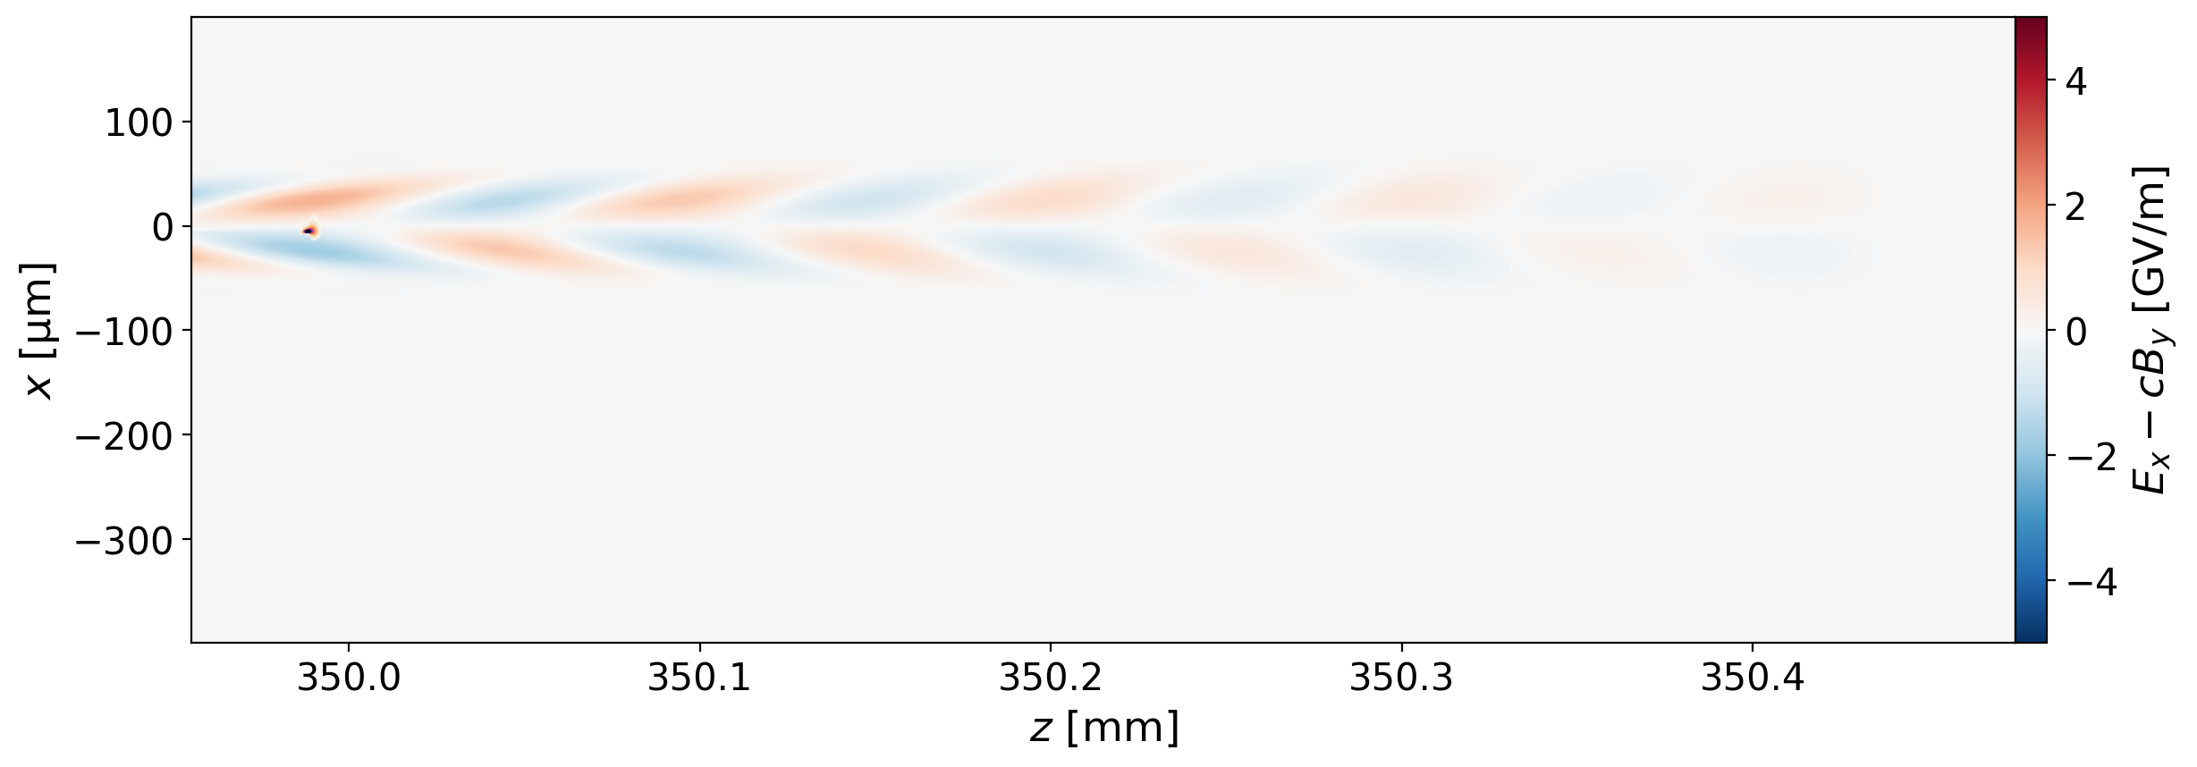
Staging in the quasilinear regime
Scanned by hand:
Off-resonant plasma density
Bunch position relative to pulse train
Transverse fields strongly suppressed!
Preliminary
N_{pulse} = 5, w₀ = 30 μm, τ_{FWHM} = 130 fs, E₀ = 0.84 J per pulse, n₀ = 1.0 × 10¹⁷ cm⁻³
Bunch
Darren Chan
Notes:
Factor of 100X better
Scanned by hand:
List what scanned

Slide 21
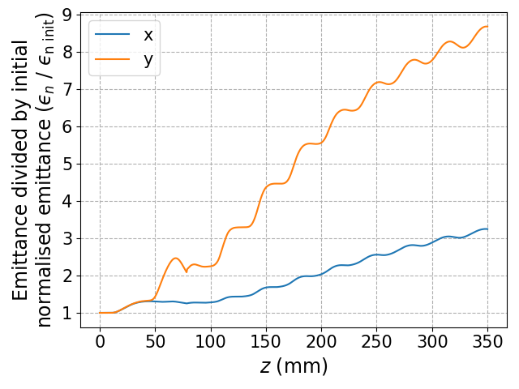
Staging in the quasilinear regime
Scanned by hand:
Off-resonant plasma density
Bunch position relative to pulse train
Transverse fields strongly suppressed!
Emittance growth <10X (vs >1000X)
Preliminary result, improving with Bayesian opt.
Preliminary
Plane of curve
Preliminary
N_{pulse} = 5, w₀ = 30 μm, τ_{FWHM} = 130 fs, E₀ = 0.84 J per pulse, n₀ = 1.0 × 10¹⁷ cm⁻³
Bunch
Perp. to curve
Darren Chan
Notes:
Factor of 100X better
Scanned by hand:
List what scanned

Slide 22
Simulations of pulse extraction with curved plasma waveguides

Slide 23
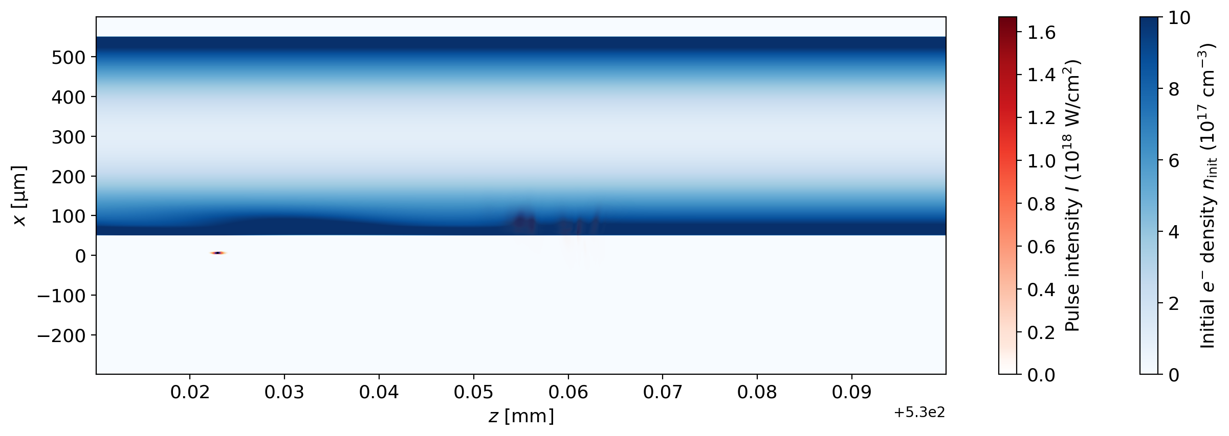
Pulse extraction setup
Goal: Maximise transverse displacement of laser pulse while
minimising transverse displacement and emittance growth of bunch
Same pulse and bunch parameters as in staging scheme
HiPACE++ for 500-mm long propagation in straight section
Bunch
Pulse
Darren Chan
Notes:
Here is the bunch, here is the pulse
Introduce code in application itself
Ellipse for electron bunch
Put labels back, make bunch solid blue

Slide 24
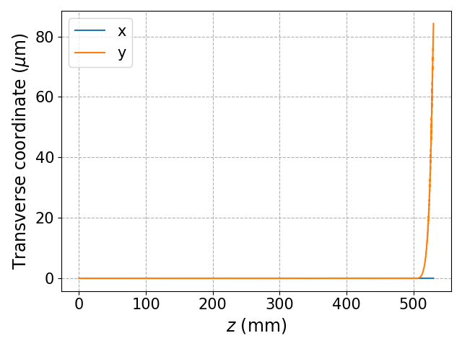
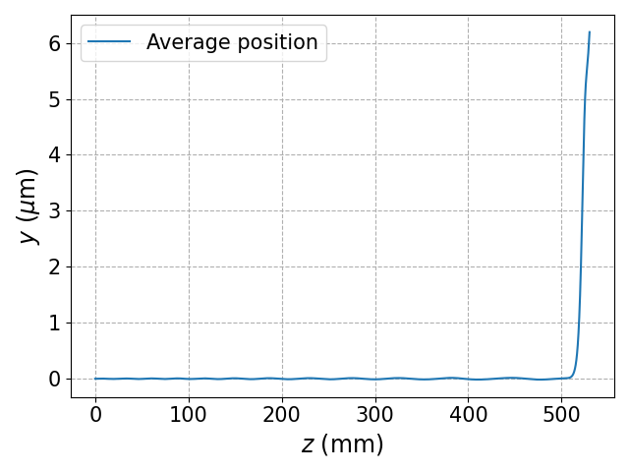
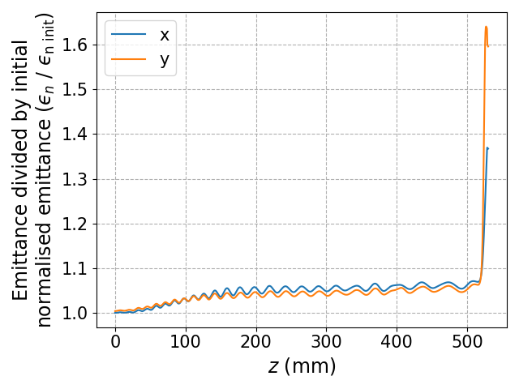
Pulse extraction results
If laser pulse is properly depleted, emittance growth of bunch is controllable!
Next step: compare emittance growth to plasma-mirror tape ejection schemes
Transverse pulse position
Transverse bunch position
Relative emittance growth
Perp. to curve
Plane of curve
Not fully optimised
Darren Chan
Notes:
Main takeaway: If laser pulse is properly depleted, then transverse fields are not a problem.
Not yet properly optimised
Mention these are preliminary results

Slide 25
Experimental demonstration of curved plasma waveguides
Notes:
Switch gears

Slide 26
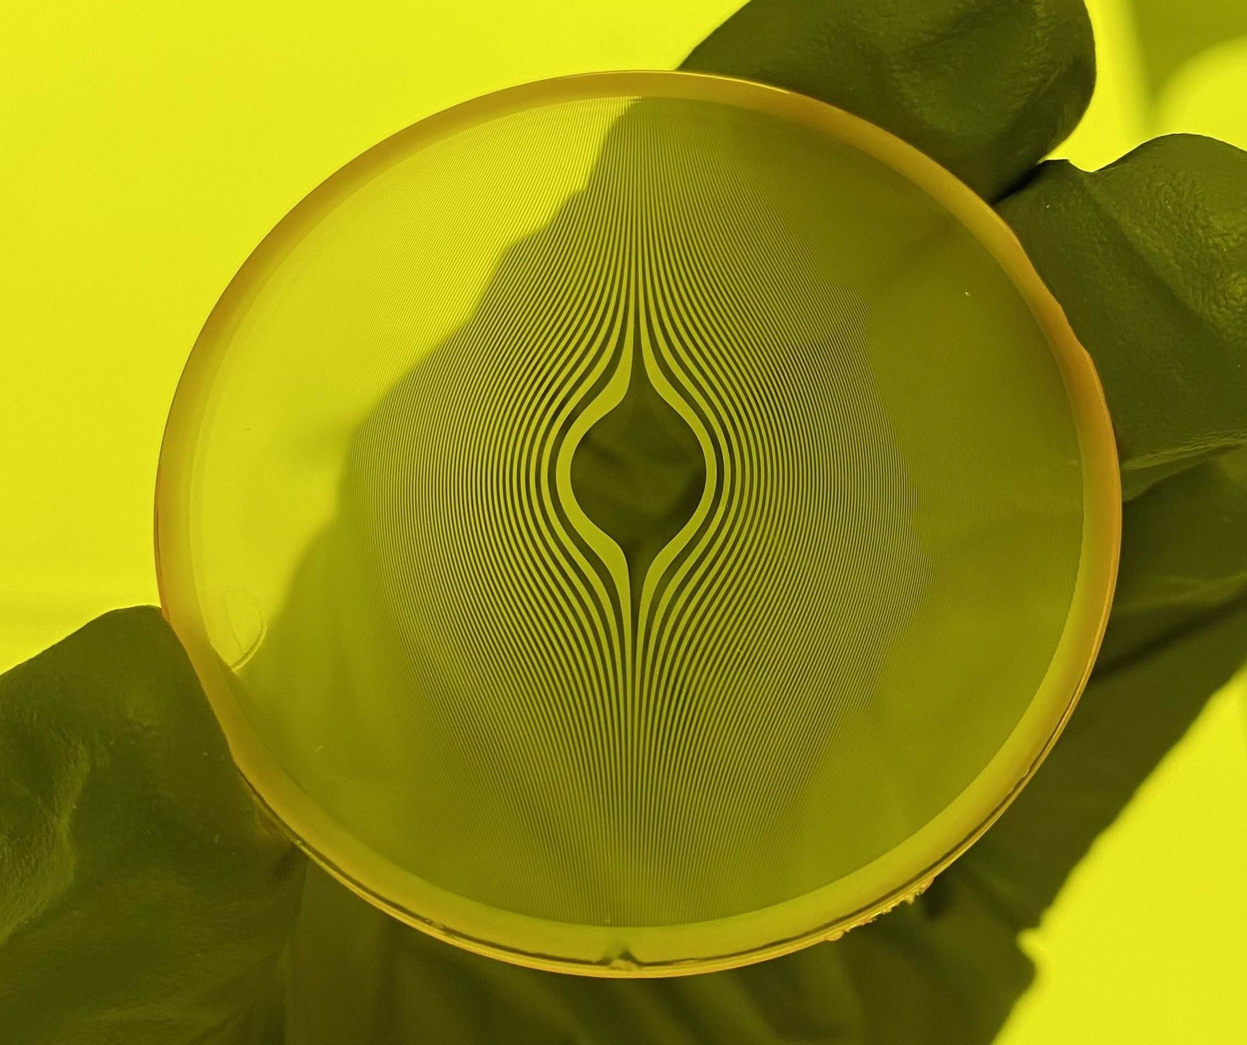
Trajectory control of Bessel foci
To generate curved HOFI channels in the lab, channel-forming Bessel beam must follow a curved trajectory
Exploits linear relation between r, the radial position at which light enters the axicon, and z, the longitudinal position along focus
Two-level phase plate
Axicon
Displaced slices
Darren Chan
Notes:
Conducted a series of experiments to demonstrate that the channel forming beam can be made to
Light entering the axicon at the same radial distance r from the axis will be focused to the same longitudinal position z.
Use a phase plate to introduce modulation phase.
Don’t use spiral phase plate fig nor SLM
Show 2D diagram of shifted slices

Slide 27
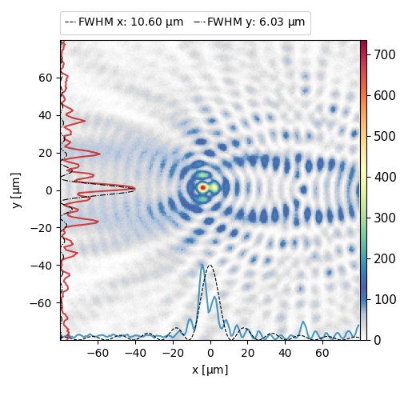
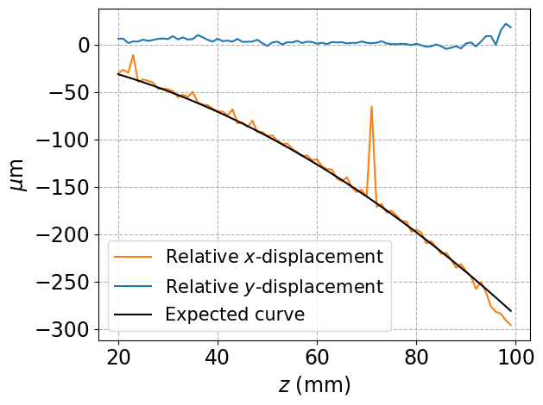
Phase plate curve results
Tested in our pulsed Ti:sapph beamline with kHz rep rate and 15 nm bandwidth
Observed curved trajectory displacements >10 spot sizes over a distance
of 120 mm with Bessel focus robust against laser pulse chromaticity
Other diffraction orders
Displaced focus
Darren Chan
Notes:
Diffractive optics
Non-zero bandwidth of the laser pulse.
Emphasise kHz beam, tisaph, laser params
Label other diffracted foci, move to backup slide.

Slide 28
Phase plate curve results
Tested in our pulsed Ti:sapph beamline with kHz rep rate and 15 nm bandwidth
Observed curved trajectory displacements >10 spot sizes over a distance
of 120 mm with Bessel focus robust against laser pulse chromaticity
Conducting a high-
power HOFI
generation
experiment with
displaced
channel-forming
beam
Other diffraction orders
Displaced focus
Darren Chan
Notes:
Non-zero bandwidth of the laser pulse.
Emphasise kHz beam, tisaph, laser params
Label other diffracted foci, move to backup slide.

Slide 29
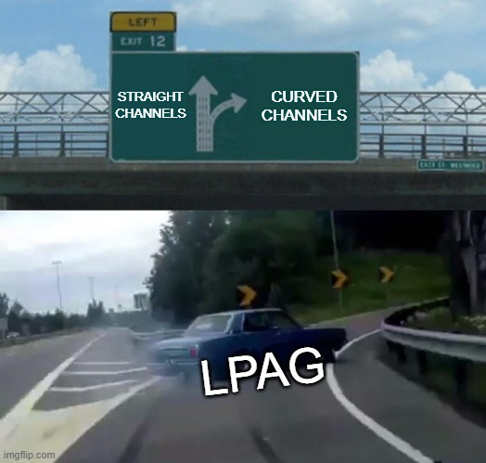
Conclusions and future work
Curved HOFI waveguides are useful for a variety of applications
Staging: Emittance growth is issue in quasilinear regime
Can be mitigated by using pulse train to
suppress wake excitation in coupling section
Drive pulse extraction: Feasible without perturbing
electron bunch
Future work:
Generation & guiding in curved HOFI channels
Improve efficiency of phase plates
(grayscale etching)
Darren Chan
Notes:
Can explicitly mention grayscale vs binary math
Emittance growth is an issue, mitigated by linear regime, multipulse, etc.
Many parameters
Remove backup slides in pdf, specify just for attendees
Mention ionized in WarpX vs pre-formed in Hipace++

Slide 30
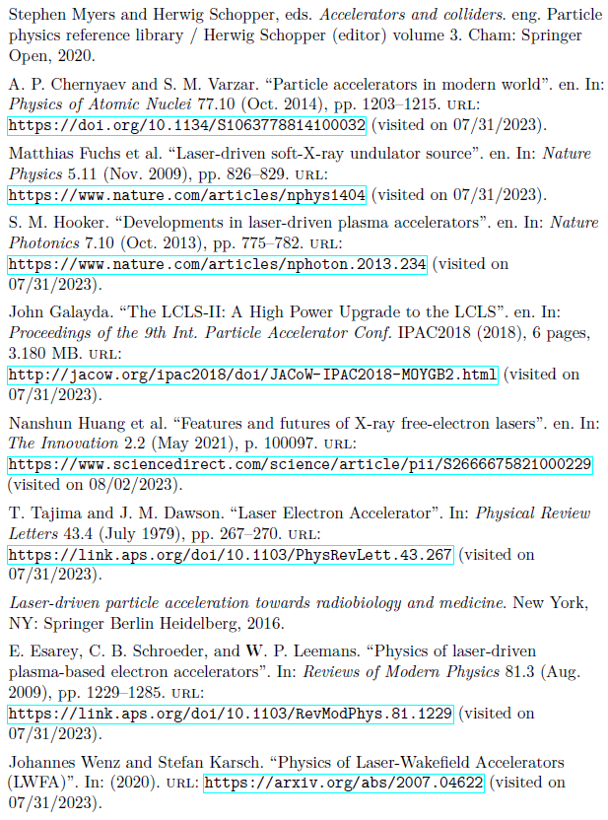
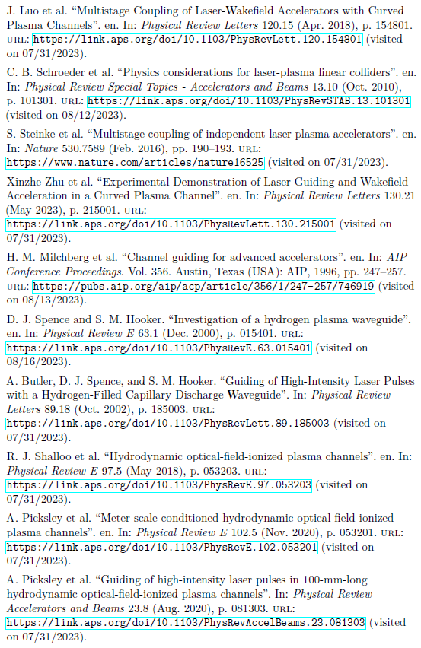
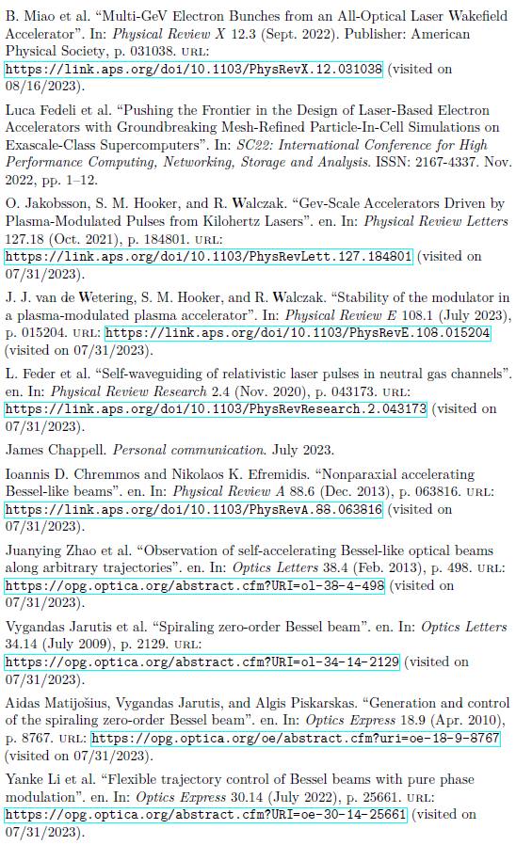
References
Darren Chan

Slide 31
Backup slides

Slide 32
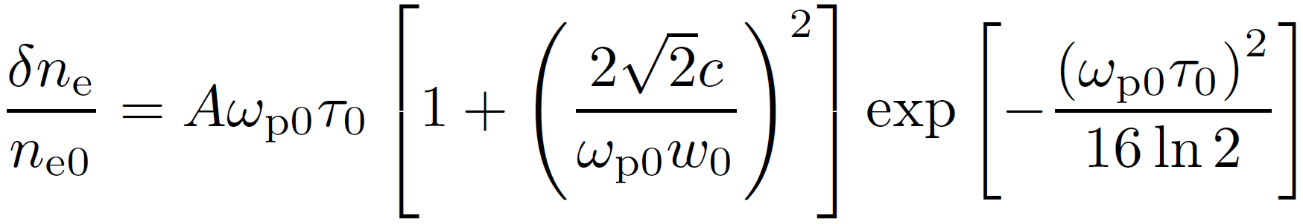
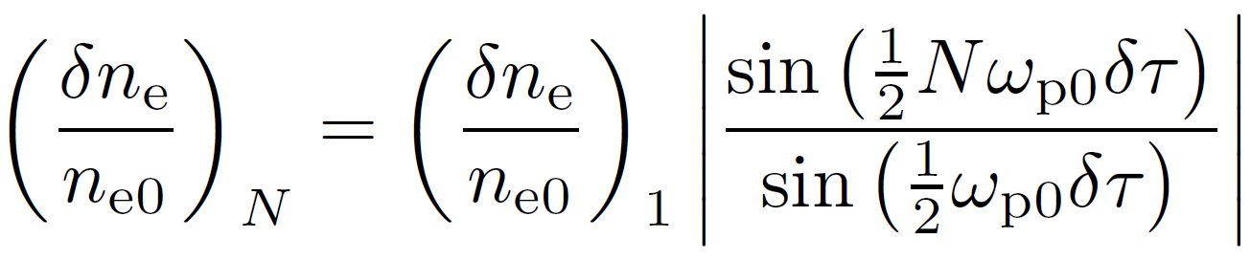
Pulse train resonance model
From: Phys. Rev. Lett. 119, 044802 (2017)
Darren Chan

Slide 33
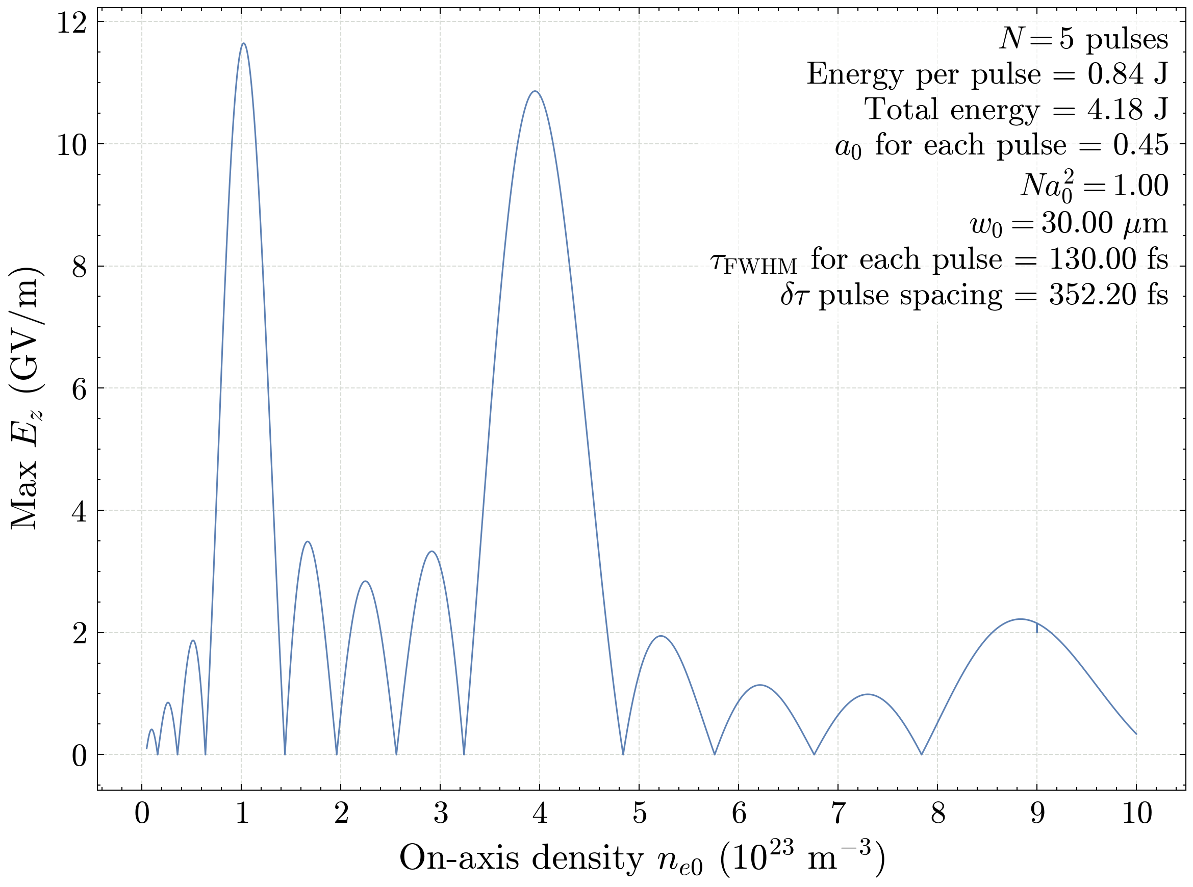
Pulse train resonance model
Darren Chan

Slide 34
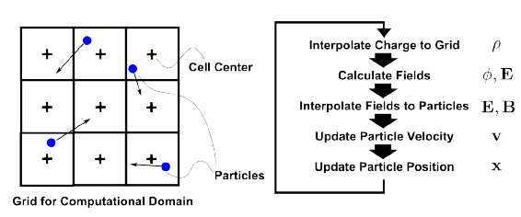
The Particle-in-Cell method
From: https://arc.aiaa.org/doi/10.2514/6.2014-4027/
Darren Chan

