Slide 1

The Status of LhARA Ion-Acoustics, Plasma Lenses and PoPLaR
Presenter: Calvin Dyson
18th December 2025
JAI Fest
Notes:
My name is what? Calvin Dyson

Slide 2
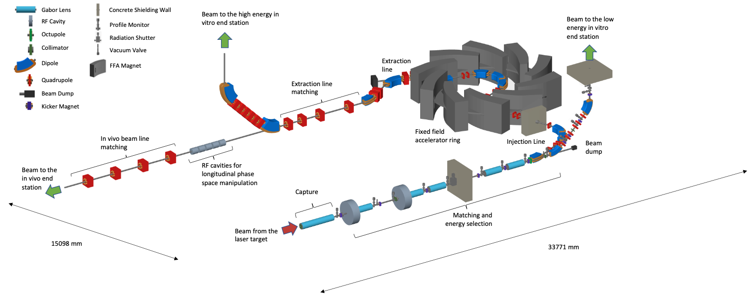
LhARA Facility
Introduction to Ion-Acoustic Work
Notes:
Standard radiotherapy uses x-rays
We are looking at using charged particles like proton or light ions. Provides the benefit of delivering the dose in a more precise location.
Build a facility to investigate delivering different particle beams with different beam widths, pulse durations etc
In the process of building develop novel technologies for capture, acceleration and diagnostics
This requires a real-time dosimetry diagnostic

Slide 3
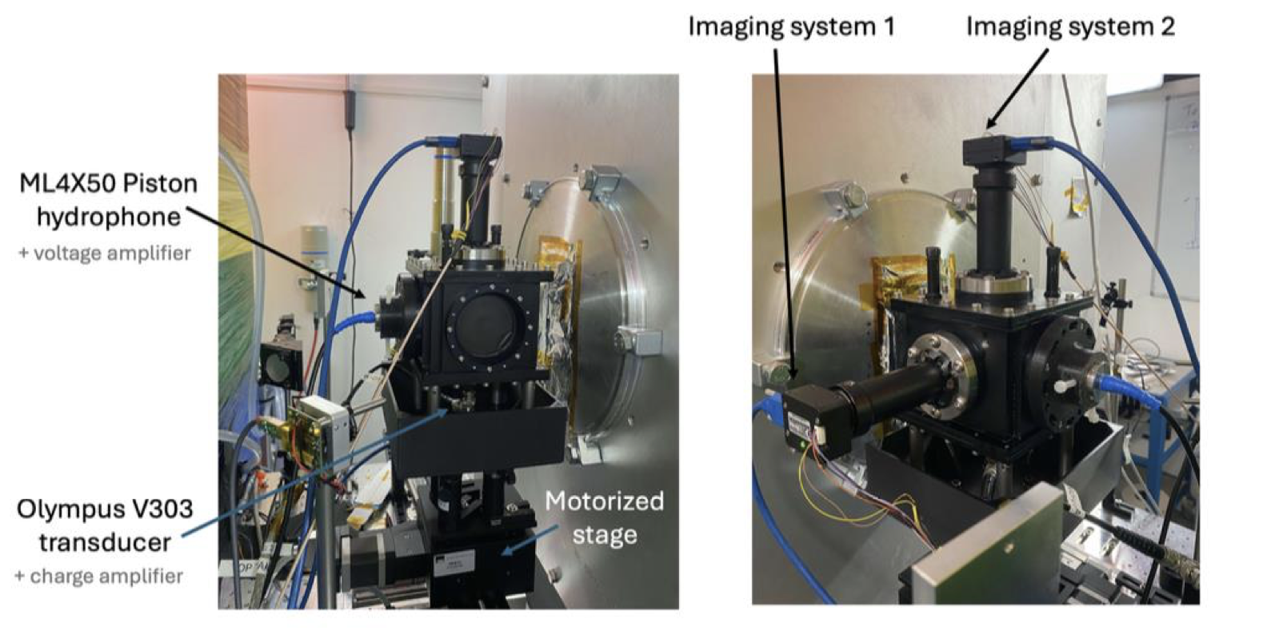
Introduction to Ion-Acoustic Work
Notes:
Test this using the smart phantom which is liquid scintillator that has a piston hydrophone and a camera to take both acoustic and optical readouts.
This was placed at the LION beamline in Munich. This beamline comprises of a laser driven proton source focused by a quad doublet.

Slide 4
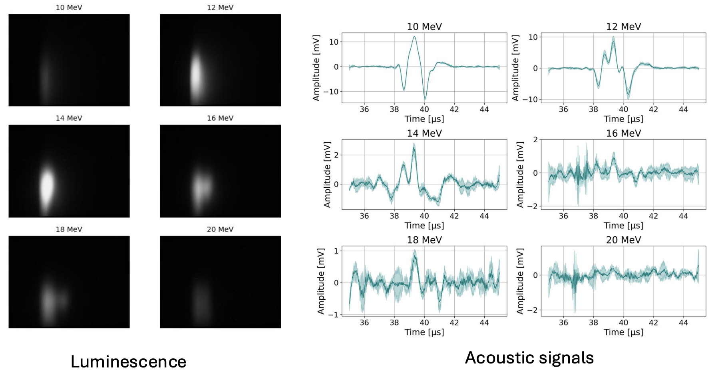
Introduction to Ion-Acoustic Work
Cross-Correlation between acoustic signals and luminescence
Notes:
So on the left we have the optical signal and on the right we have the acoustic signals
From the results we can see a match between optical and acoustic, but the results are effected by the energy spread of the beam and to get a better understanding we need a full understanding of the beam; its shape and its energy spread

Slide 5
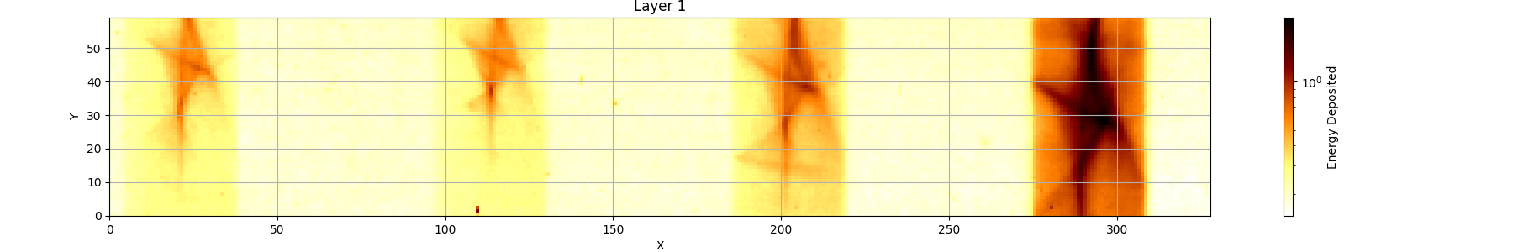
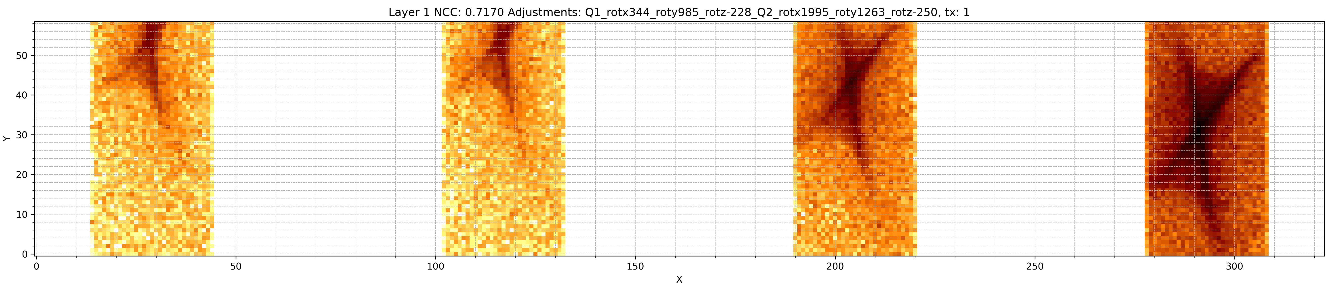
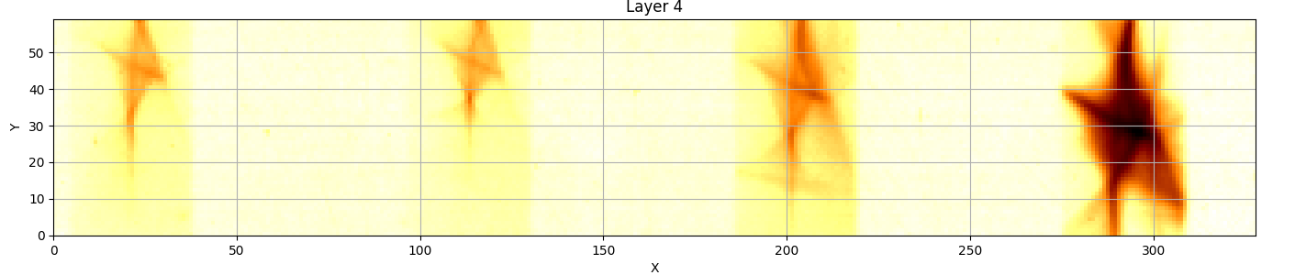
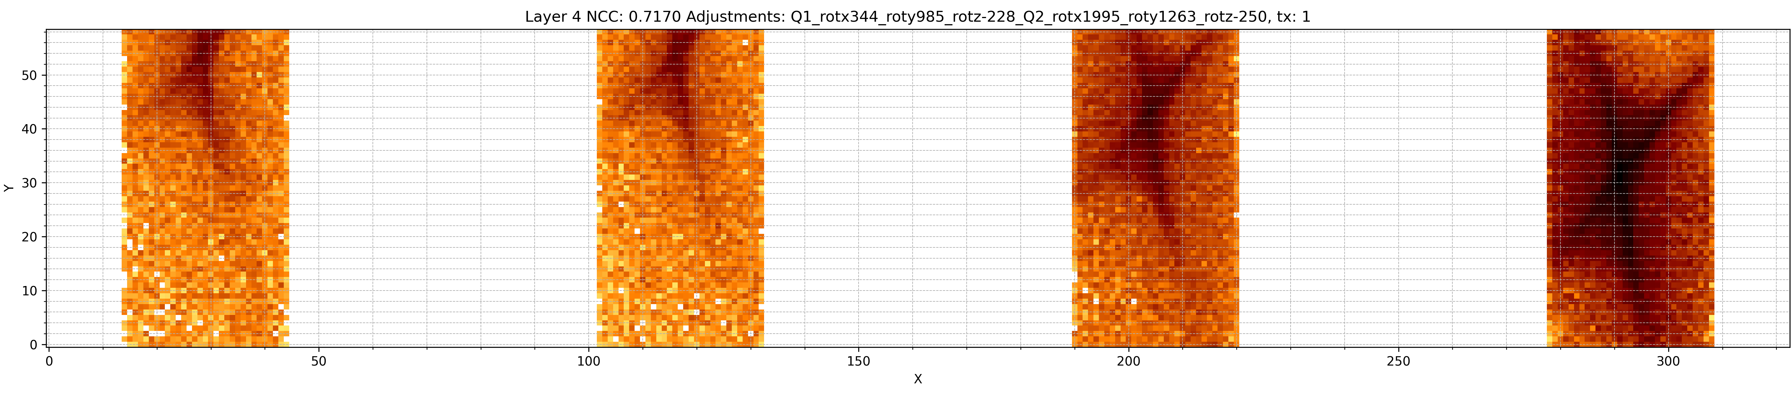
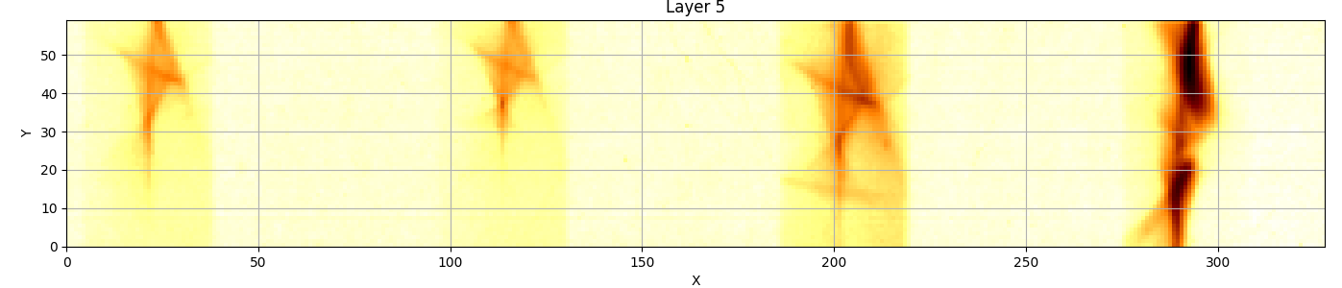
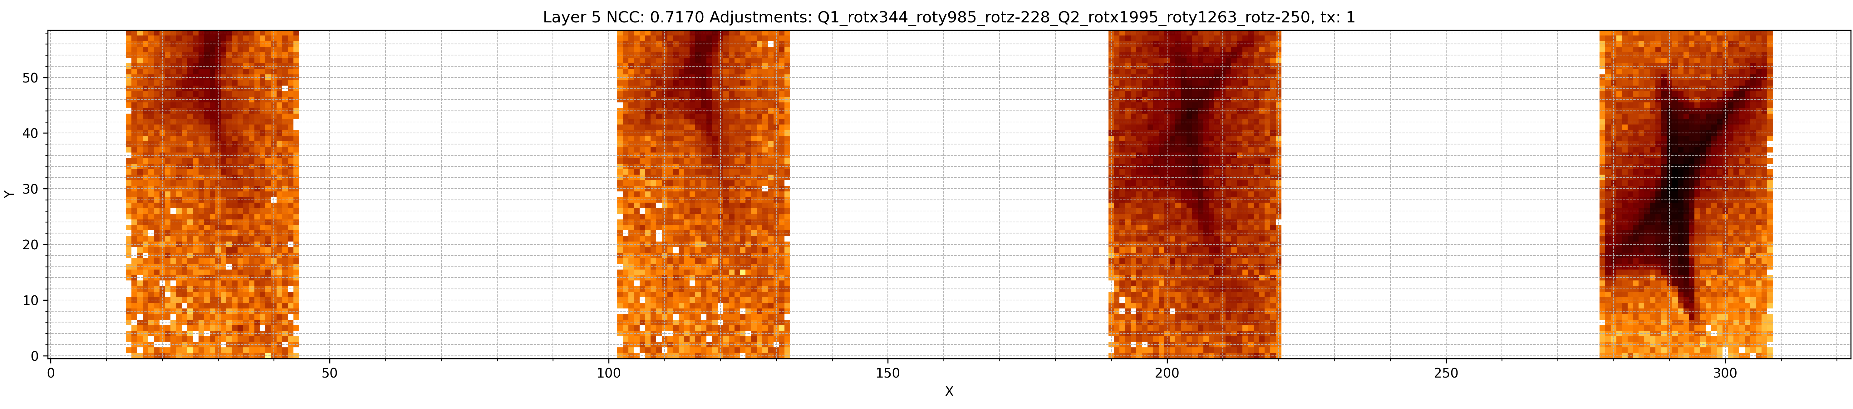
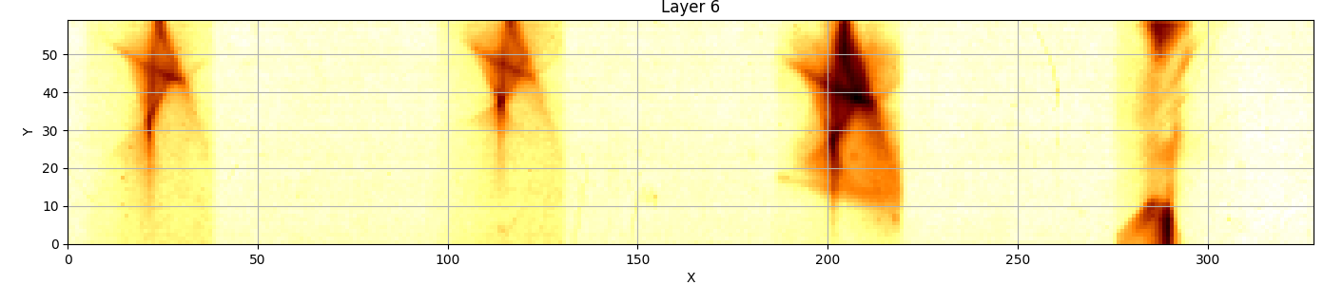
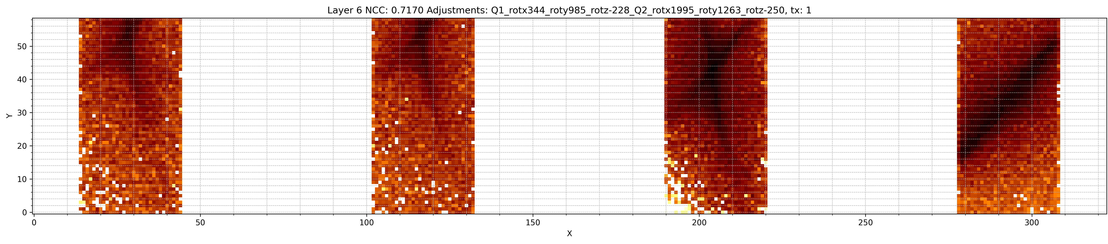
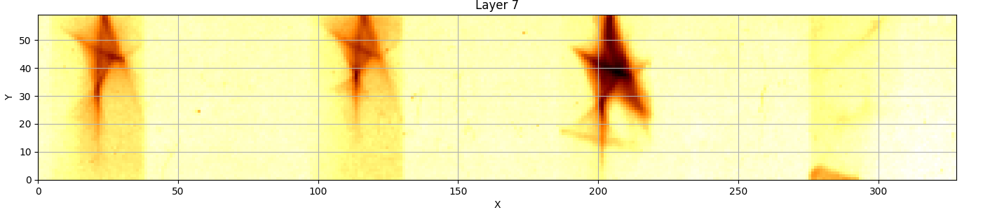
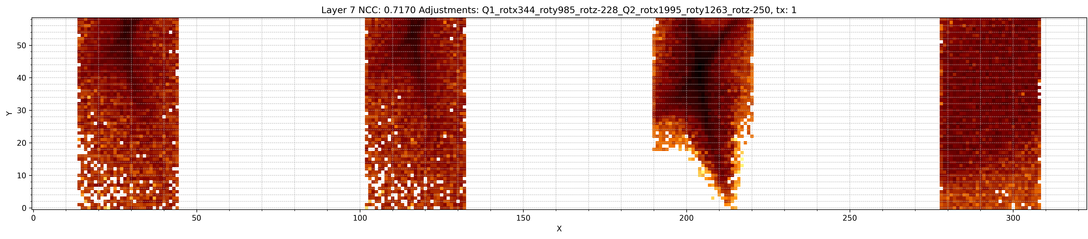
Understanding the Beam Shape
Optimised Beam Shape
20MeV
20MeV
16MeV
12MeV
20MeV
20MeV
16MeV
12MeV
1st Quad
About x:
344 urad
About y:
985 urad
About z:
-228 urad
2nd Quad
About x:
1995 urad
About y:
1264 urad
About z:
-250 urad
Notes:
To get a better understanding of the shape, the smartPhantom was replaced with RCF and irradiated using the setups for different nominal beam energies
We were hoping to get normal circular focussed beam. Unfortunately, we got these star-shapes instead
To understand these we built a simulation of the beamline in a matrix mapping particle tracking software called LhARA Linear Optics that has been developed in the group
I then varied the PMQs positions and tilts to try and match this strange shape, and after a Bayesian optimisation of changing just the tilts I managed to get a beam that roughly matches
Obviously there are differences.
It is worth noting the relatively small changes required to cause a significant shift in the beam. These films are 2cm in height for reference.

Slide 6
Understanding the Beam Shape
Pole-Tip Fields
Notes:
Another potential cause of the strange beam shape are the pole tip fields at the edge of the aperture of the quads.
This image is actually from PoPLaR, which I will discuss later, but is a similar laser-driven quad doublet proton beamline with weaker PMQs
And with a small leap of faith and hand waving one can see that these spokes of the star align well with the segments of the PMQ
Does not seem much of a stretch that the strange beam shapes could be caused by slight offsets in the segments of the PMQ at LION

Slide 7

Conclusions and Future
Investigate the impact of the beam shape on the optical signal using Ansys Zemax OpticStudio
Implement a model PMQ in FEMM (or similar) and test offsetting the magnet segments
People
M. Maxouti
P. Hobson
K. Long
S. Gerlach
J. Schreiber
Notes:
Next steps include implementing these different beam shapes into an optical signal simulator to understand their effects as well as undertsnading the impacts of offsetting the magnet segments
Hopefully once this analysis is complete we will produce a paper on the results

Slide 8
Introduction to Plasma Lens Work
LhARA Facility
Notes:
The next new bit of tech I will mention here is the plasma lens or more specifically the plasma lens.
LhARA uses a laser-driven beam to achieve higher currents and allow faster energy variation in the beam.
Because TNSA produces a large divergence lenses are required to capture as much of the beam as possible and to also allow the energy selection
LhARA plans to use Gabor lenses as these have symmetrical focusing compared to quads, and we have seen the issue with quads, and they can achieve the same focal length as solenoids but at a much lower magnetic field

Slide 9
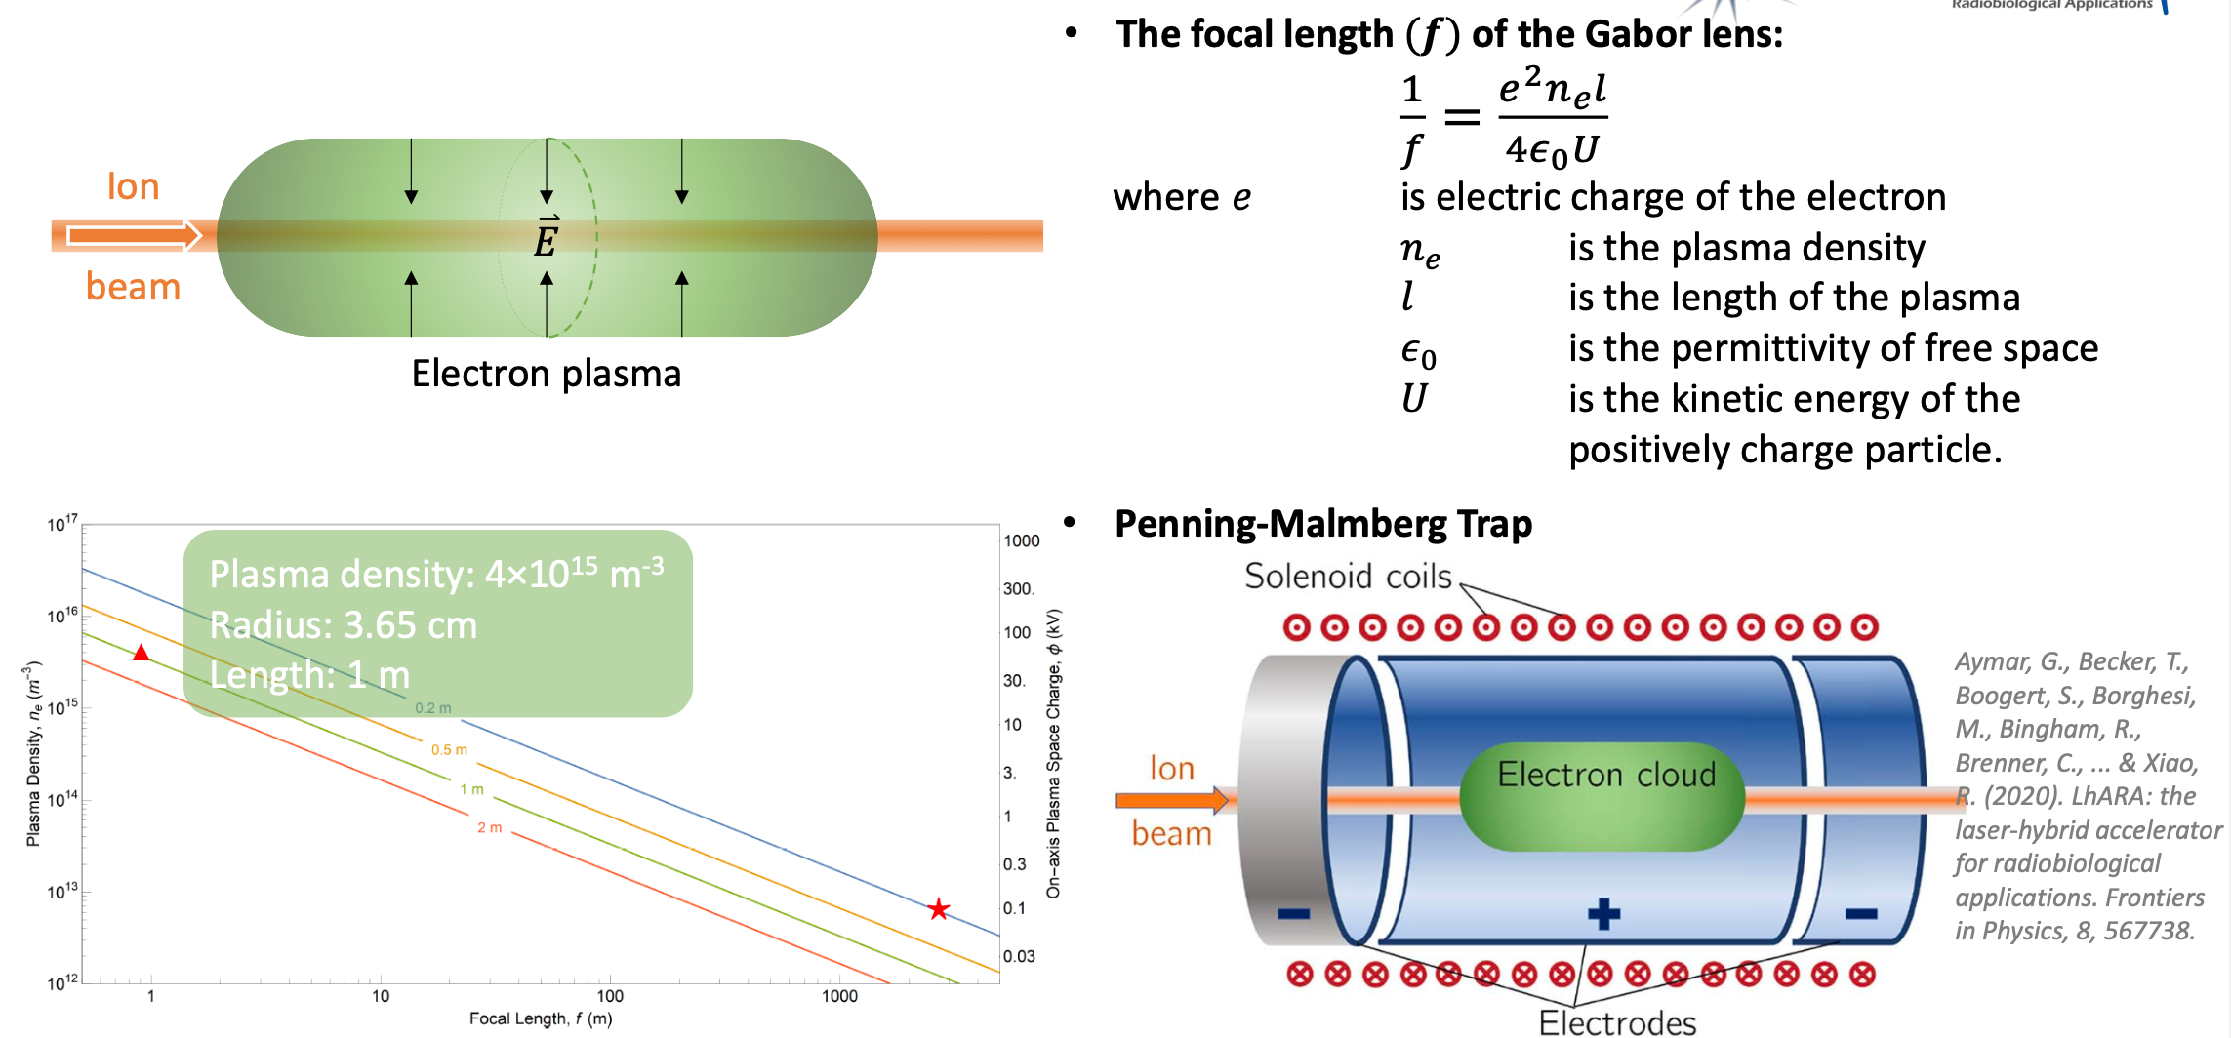
Introduction to Plasma Lens Work
Principles
Notes:
So the Gabor lens is simply put a uniform electron cloud, when you pass through a postiviely charged beam it feels a force proportional to the distance from the centre of the cloud and therefore a perfect symmatric focusing force
The cloud is trapped in a penning-Malmberg trap, so a combination of electrodes and solenoid coils to trap the electrons both longitudinally and radially
The equation for the focal length is here and the important parts are the dependence on the kinetic energy of the psotive particle, providing the chromaticity that allows energy selection and crucially here the electron density
The aim for LhARA is to have a lens with a focal length of 1m. The required electron density is shown by the triangle

Slide 10
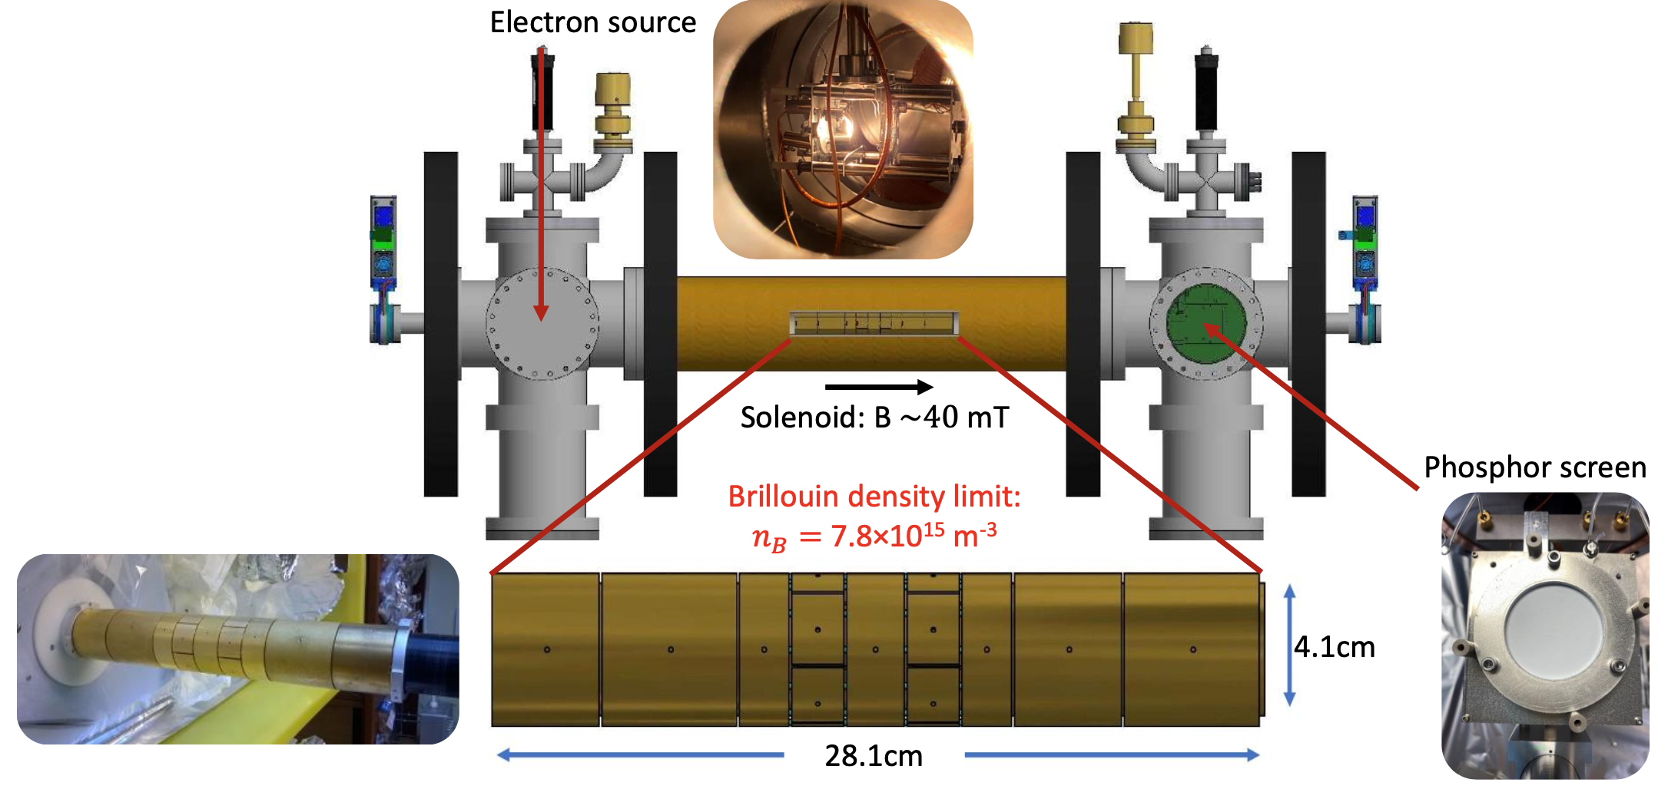
Introduction to Plasma Lens Work
University of Swansea Setup
Notes:
So there is a testbench at the University of Swansea that we have used to test trapping electron clouds
This consists of segmented electrodes to provide a varied potential, an electron gun as a source, though the majority of electrons are produced through ionization of the background CO2 gas. Finally, there is a phosphor screen from which we can measure the number of electrons are in the cloud

Slide 11
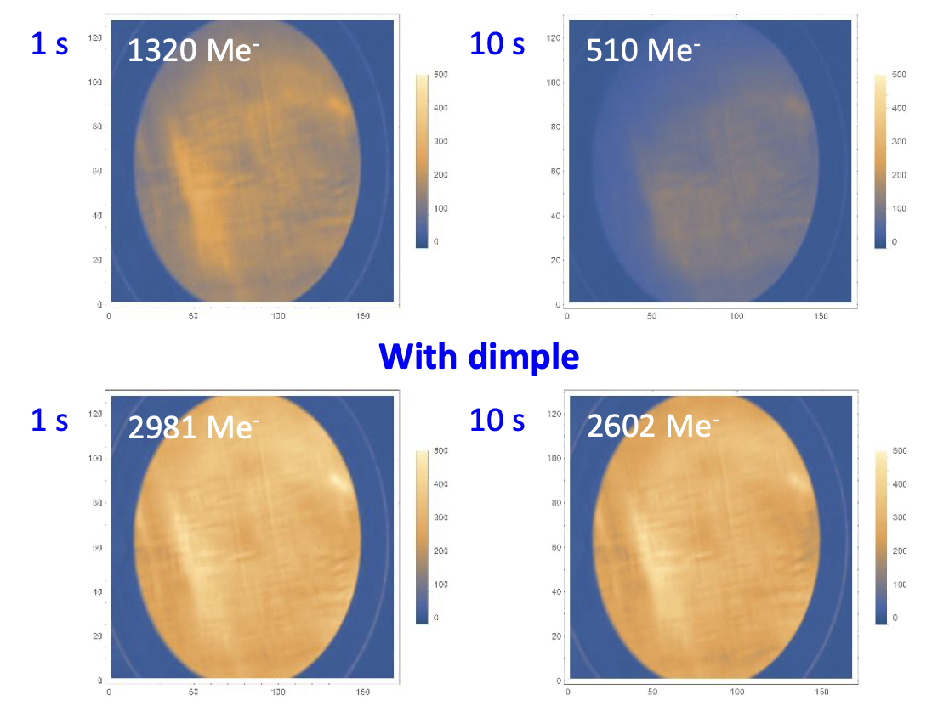
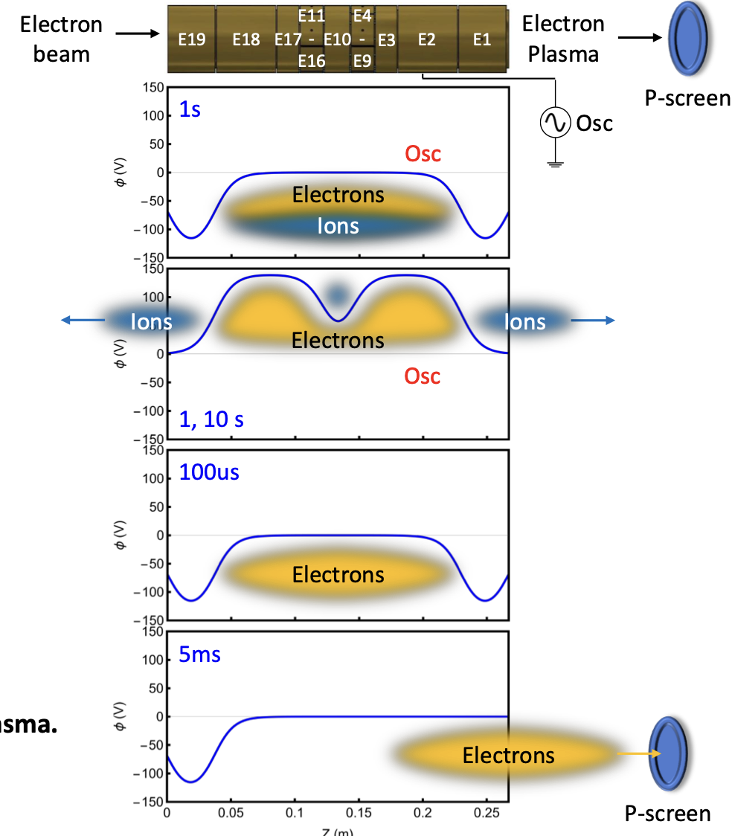
Generating a Stable Plasma Lens
An oscillating field can generate a plasma; however, the plasma has low electron density and lacks stability
The dimple is essential for producing a stable, high-density plasma
Notes:
To test the stability, the electrons are produced, and the electrodes are turned on to trap them and cause ionization of the background CO2 gas. The potentials are then lifted to allow the ions to escape the trap. The plasma is kept in this position for a set amount of time (10 seconds) and then lowered again before turning off one potential to allow the electrons to reach the phosphor screen and measure the number
From the work done so far there are two crucial aspects to making the plasma stable in time
By combining an oscillating field potential with a dimple in the potential we see far better stability

Slide 12
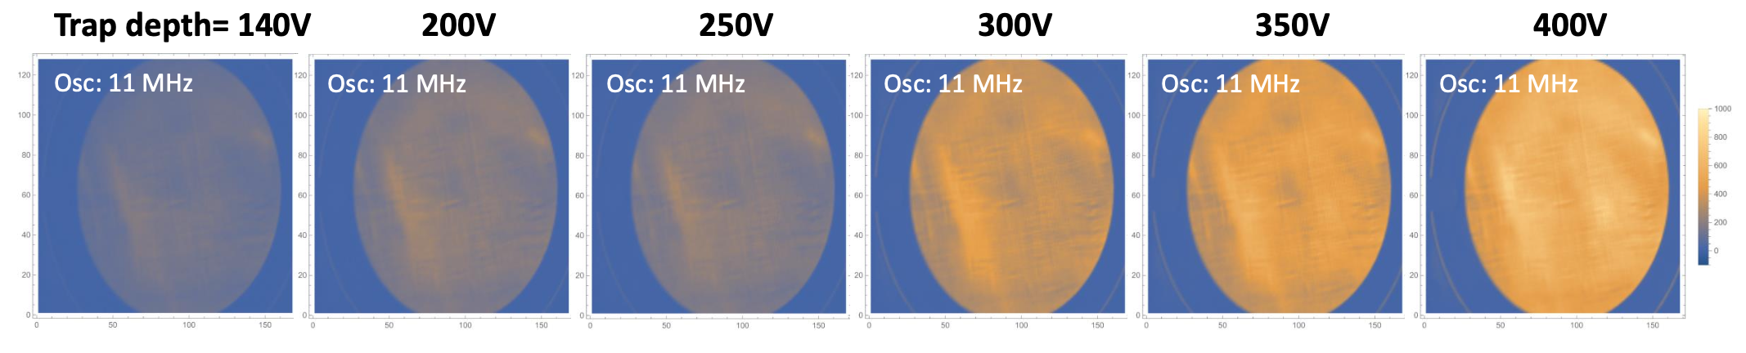
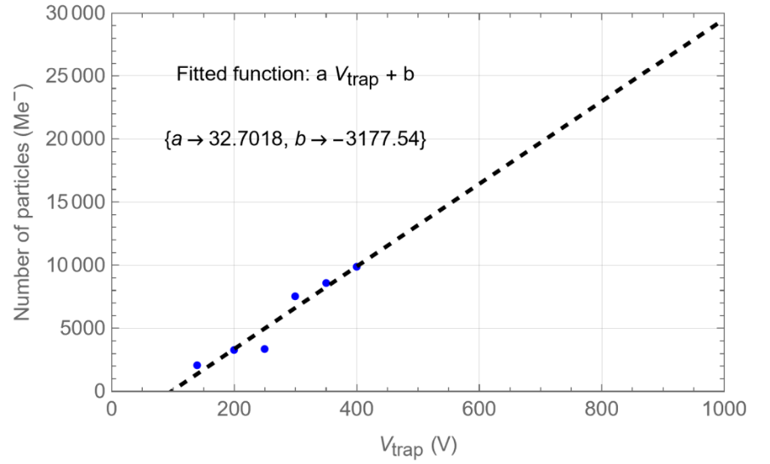
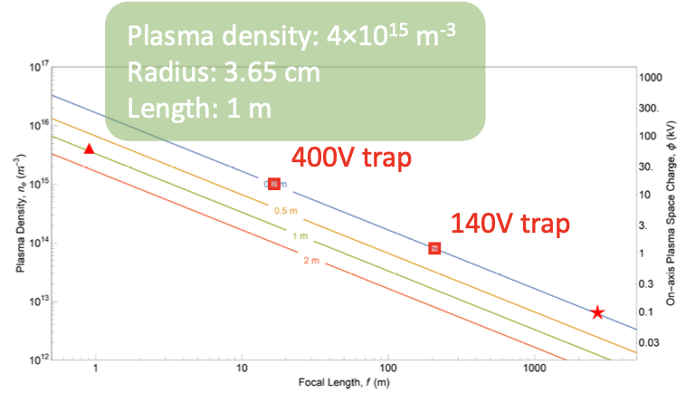
Reaching Desired Focal Length
Notes:
140V Peak density ~ 8e13m3
400V Peak density ~ 1e15m3
The group were operating at 140V due to a fault in the machinery at the time, and once fixed could increase the potential to 400V. As you can see higher voltages trap more electrons and by increasing the potential to 400V the peak density is now within an order of magnitude of the desired density.

Slide 13

Conclusions and Future
Conduct Experiments using Ar instead CO₂
Implement numerical simulations (WarpX) to verify the diagnostics
People
P.Ruksasakchai
W.Bertsche
M. Charlton
S. Eriksson
C. A. Isaac
D. P. van der Werf
Notes:
Next steps include trying to better understand these results and the impact of the dimple and the osciallting potential via numerical simulations.

Slide 14
Introduction to PoPLaR
LhARA Facility
Notes:
Finally, I am going to give a brief update on PoPLaR which is LhARA’s proof-of-principle experiment and is about testing the feasibility of using laser-driven protons for cell irradiations

Slide 15
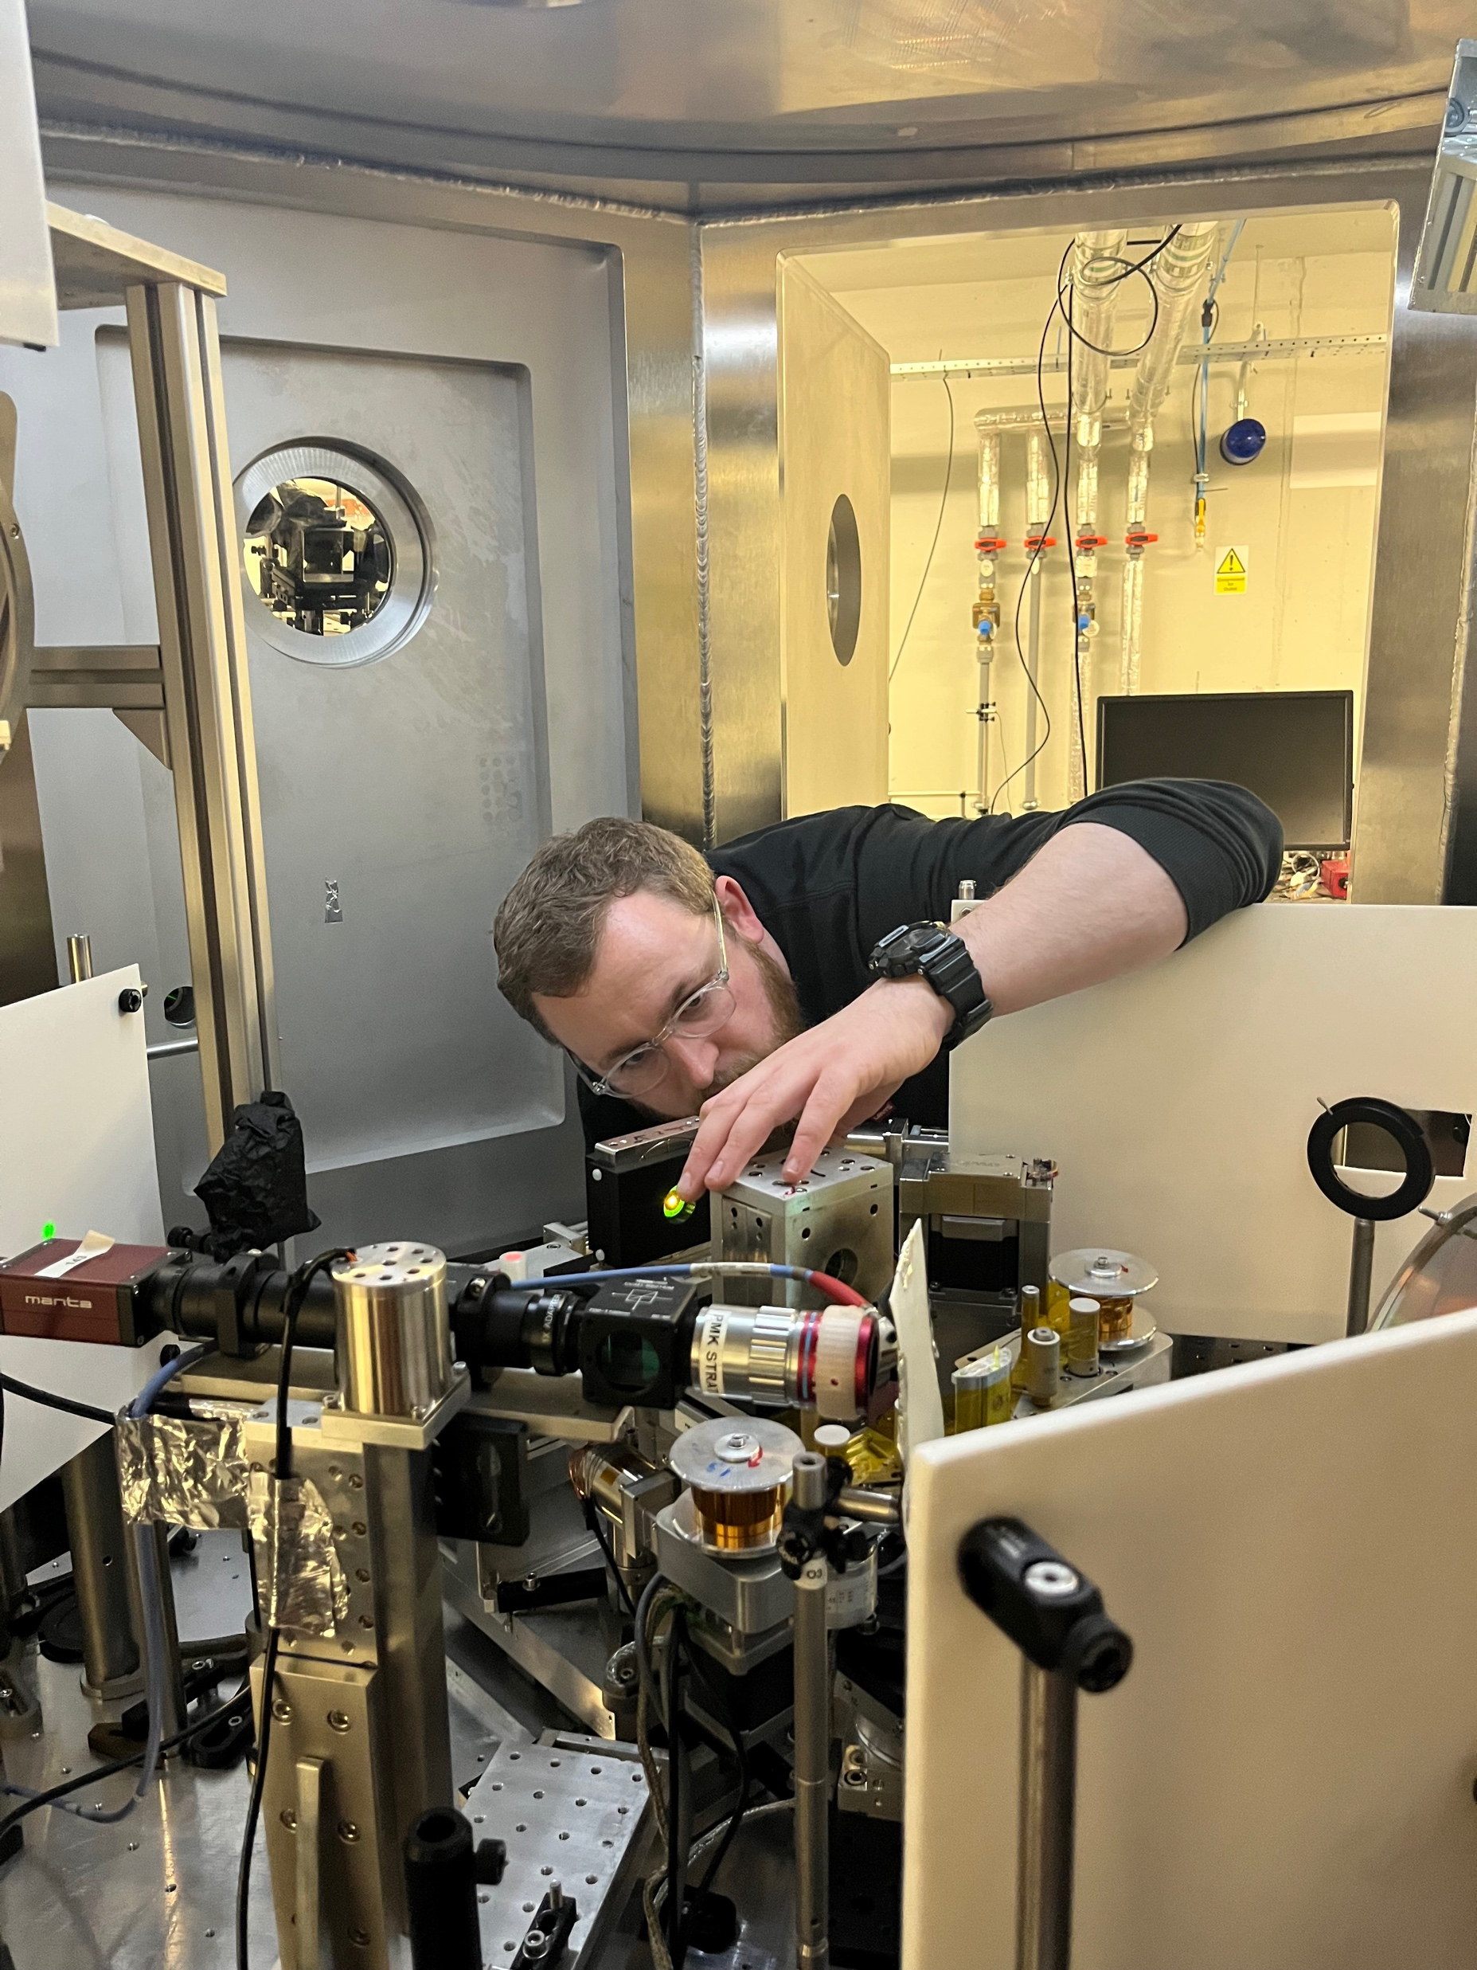
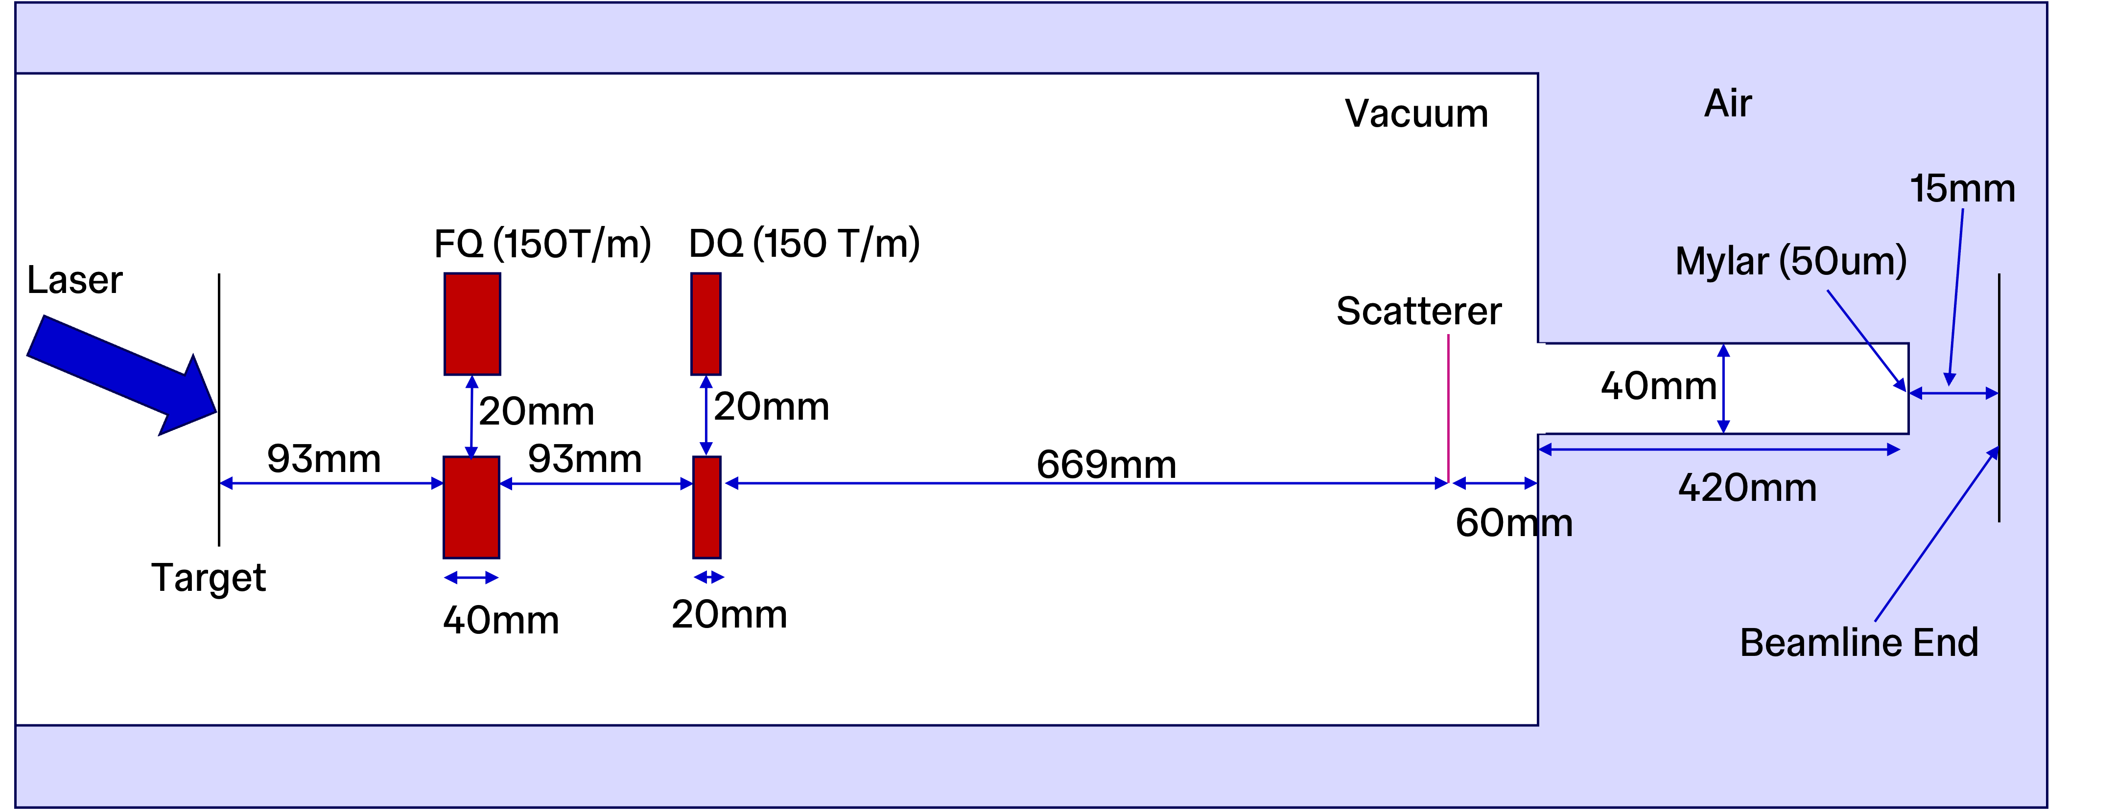
Introduction to PoPLaR
Proof-of-principle Laser Radiobiology Experiment
Provide a base to complete a systematic comparison of laser-driven and conventional (cyclotron) proton beam radiobiology
Based at Scottish Centre for the Application of Plasma-based Accelerators (SCAPA) at the University of Strathclyde
Notes:
The aim is to provide a base in which to do a systematic comparison between cyclotron and laser-driven proton beam cell irradiations
Based at SCAPA
Simple beamline based on LION’s with a quad doublet.
Here on the right you can see the beamline with the target here, the first quad here, Robbie aligning the second quad, and Robbie deserves a special shout-out for the extroadinary work he has done in getting this beamline up and running
Finally that hole is this hole here. The scatterer isn’t in place yet.

Slide 16
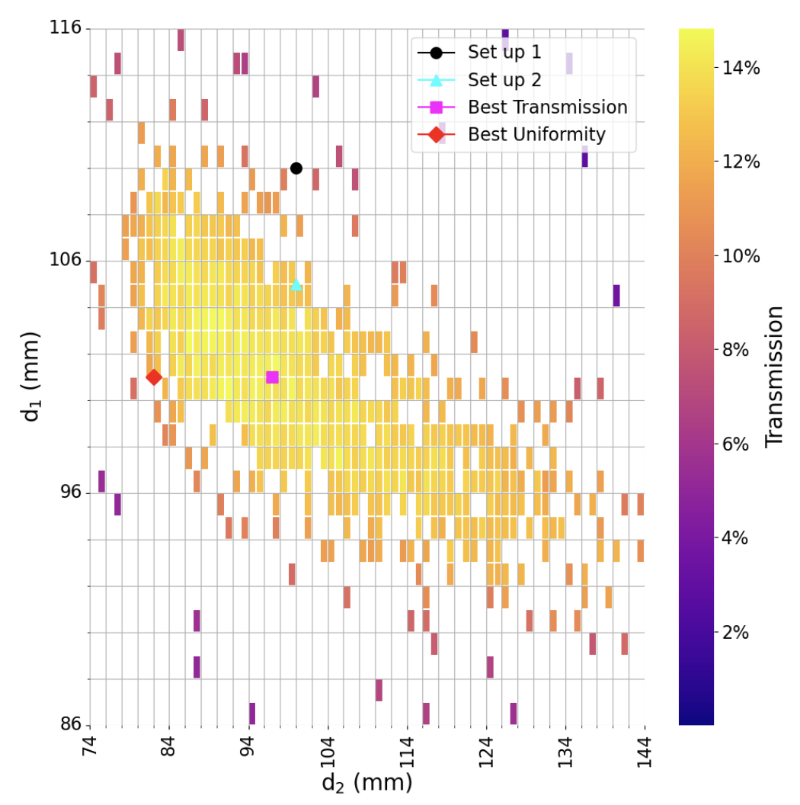
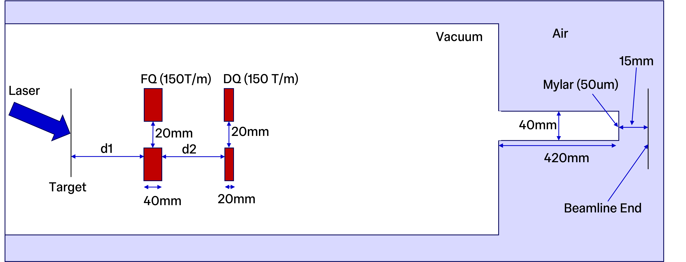
Pre-Phase 1
Optimising
PMQ Positions
Notes:
First tme installing quads on this beamline so the first test was to try and produce a focus. I ran a Bayesian optimization of the quads position to focus a 10MeV beam and produced the map on the right
D1 is the distance to the first quad and d2 is the distance between the quads.
The beamline started here due to physical constraints but I could use the map to argue that d1 needed to be smaller to achieve focus

Slide 17
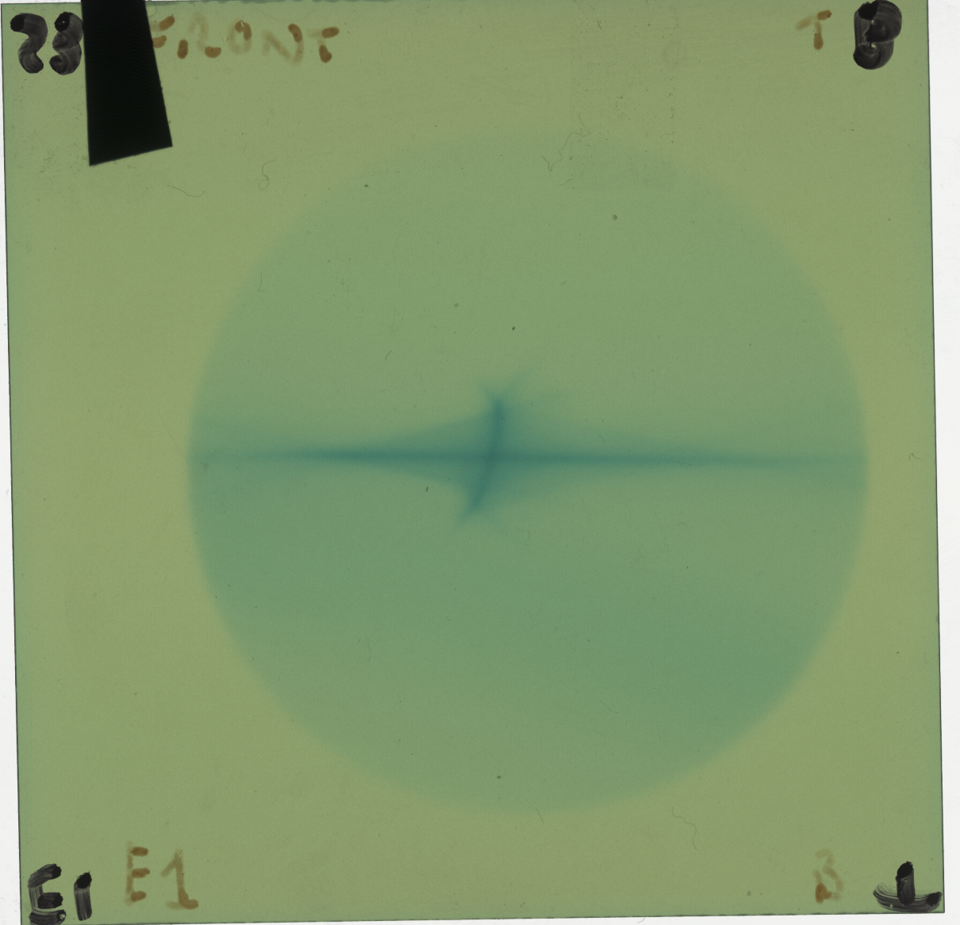
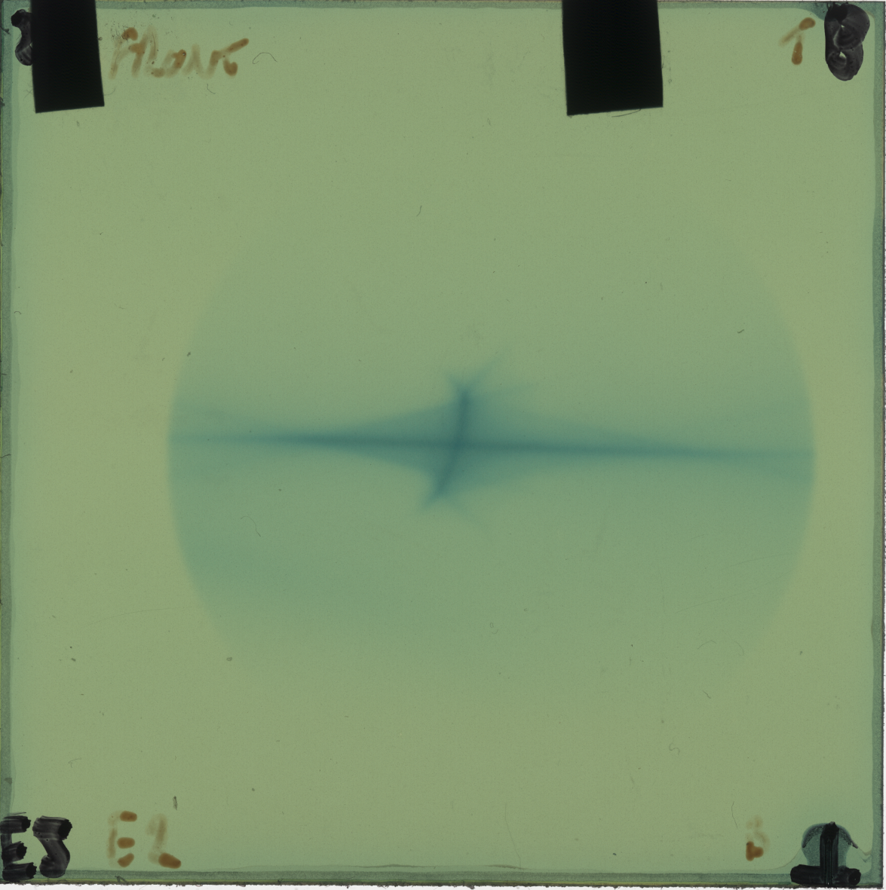
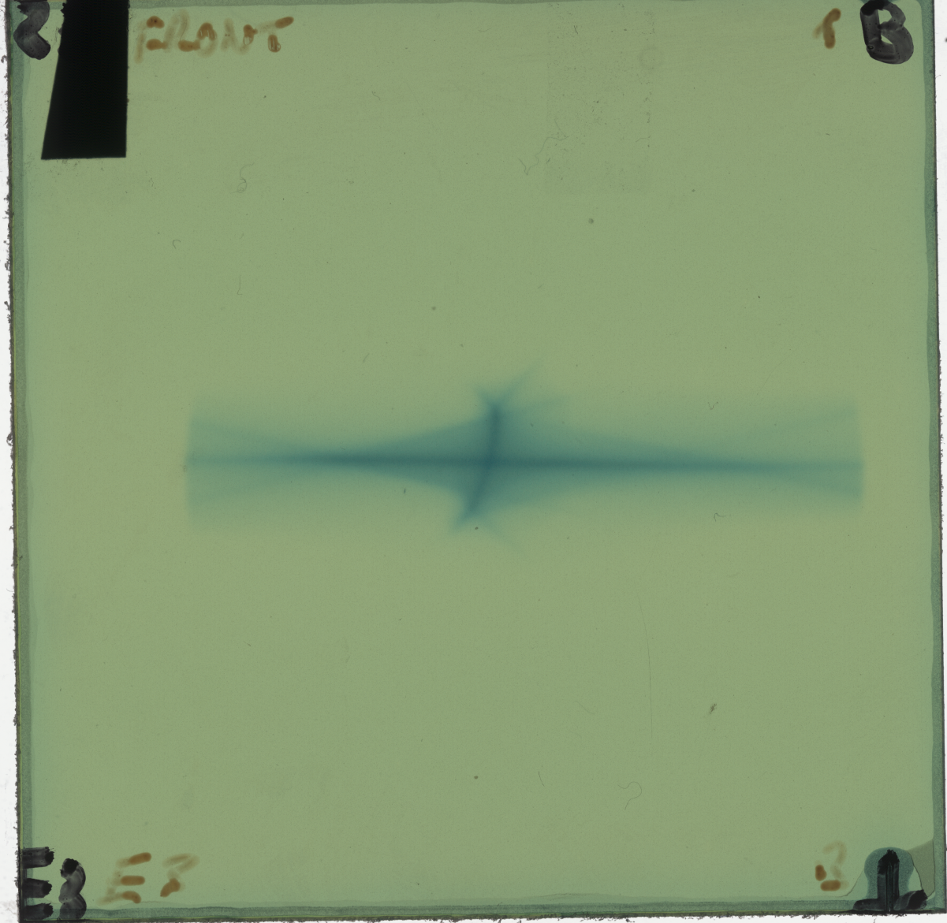
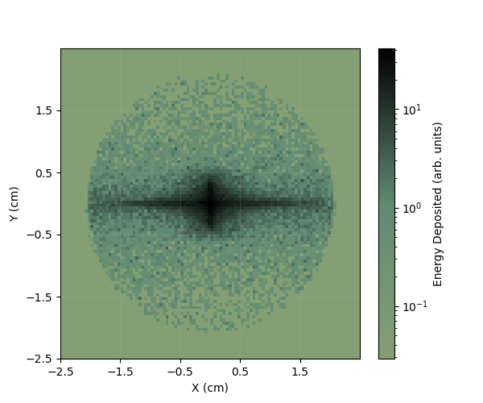
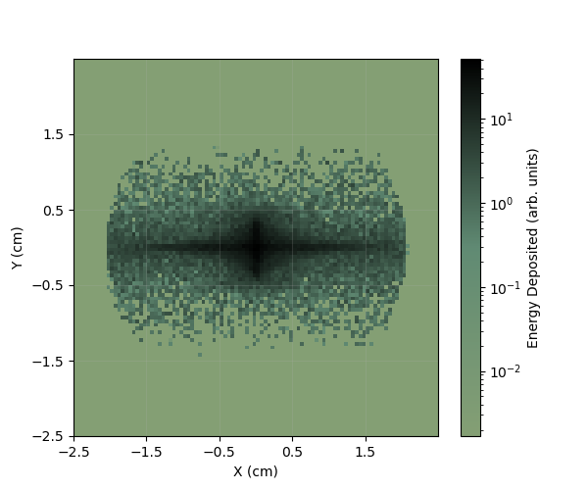
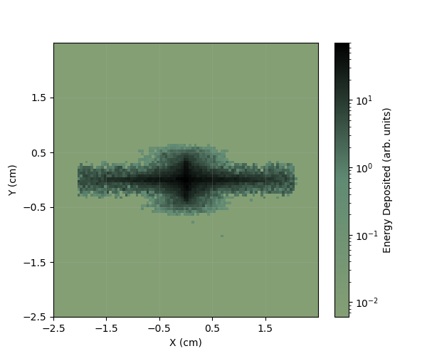
Phase 1
Comparison with Final RCF
Notes:
And this let us go from barely any beam reaching the beamline end to a nice focus, that matches what the simulations also produce. The next step was to improve the uniformity so that when we irradiate the cells they all receive the same dose. Ideally this would be by introducing more quads but the sensitivity of the beam to the quad positions means that the need to be driveable stages which are expensive.

Slide 18
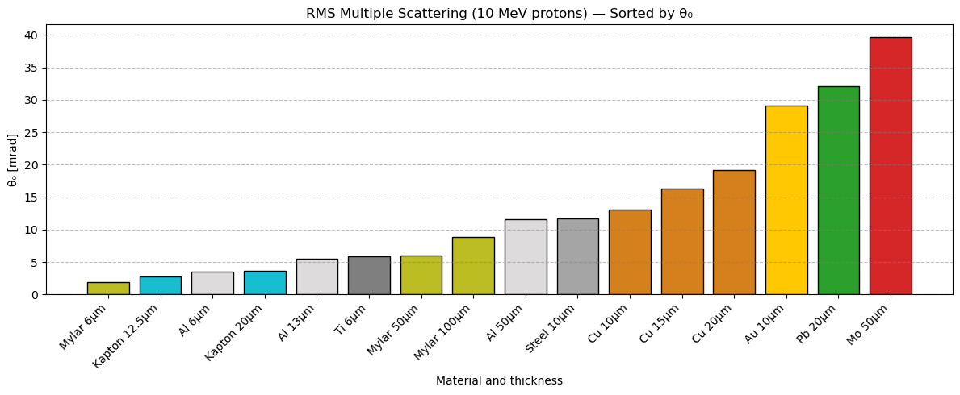
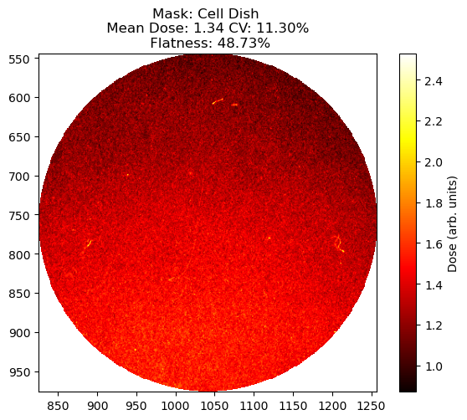
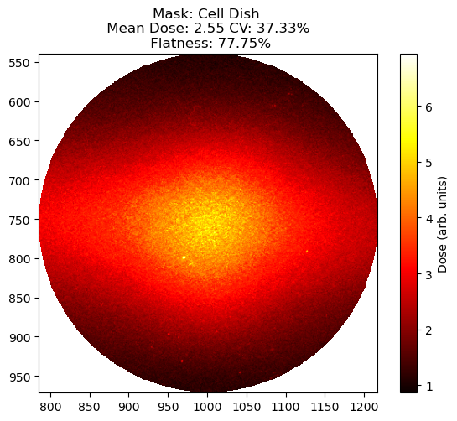
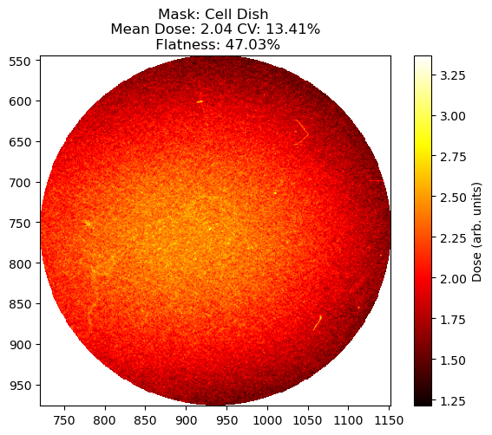
Improving Uniformity
Optimising Scatterer
Au (10μm)
Al (6μm)
Cu (10μm)
Notes:
Instead a scatterer was put in the beamline. First testing Gold as that is the setup used at Biriingham where we will conduct the cyclotron side of the systematic comparison
Then laid out the options from the ones available at SCAPA based on the coulomb scattering angle
Chose Al to get the full spectrum before settling on 10um Cu.

Slide 19
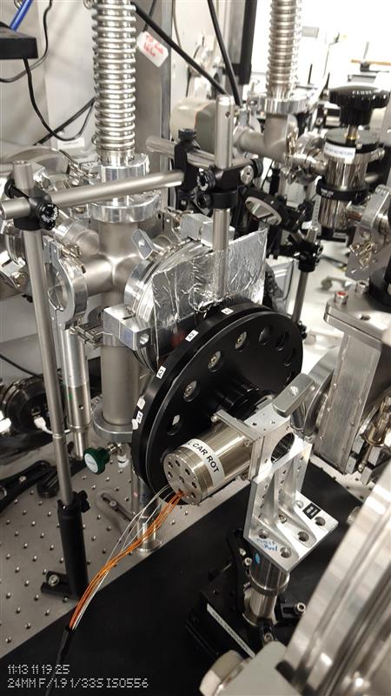
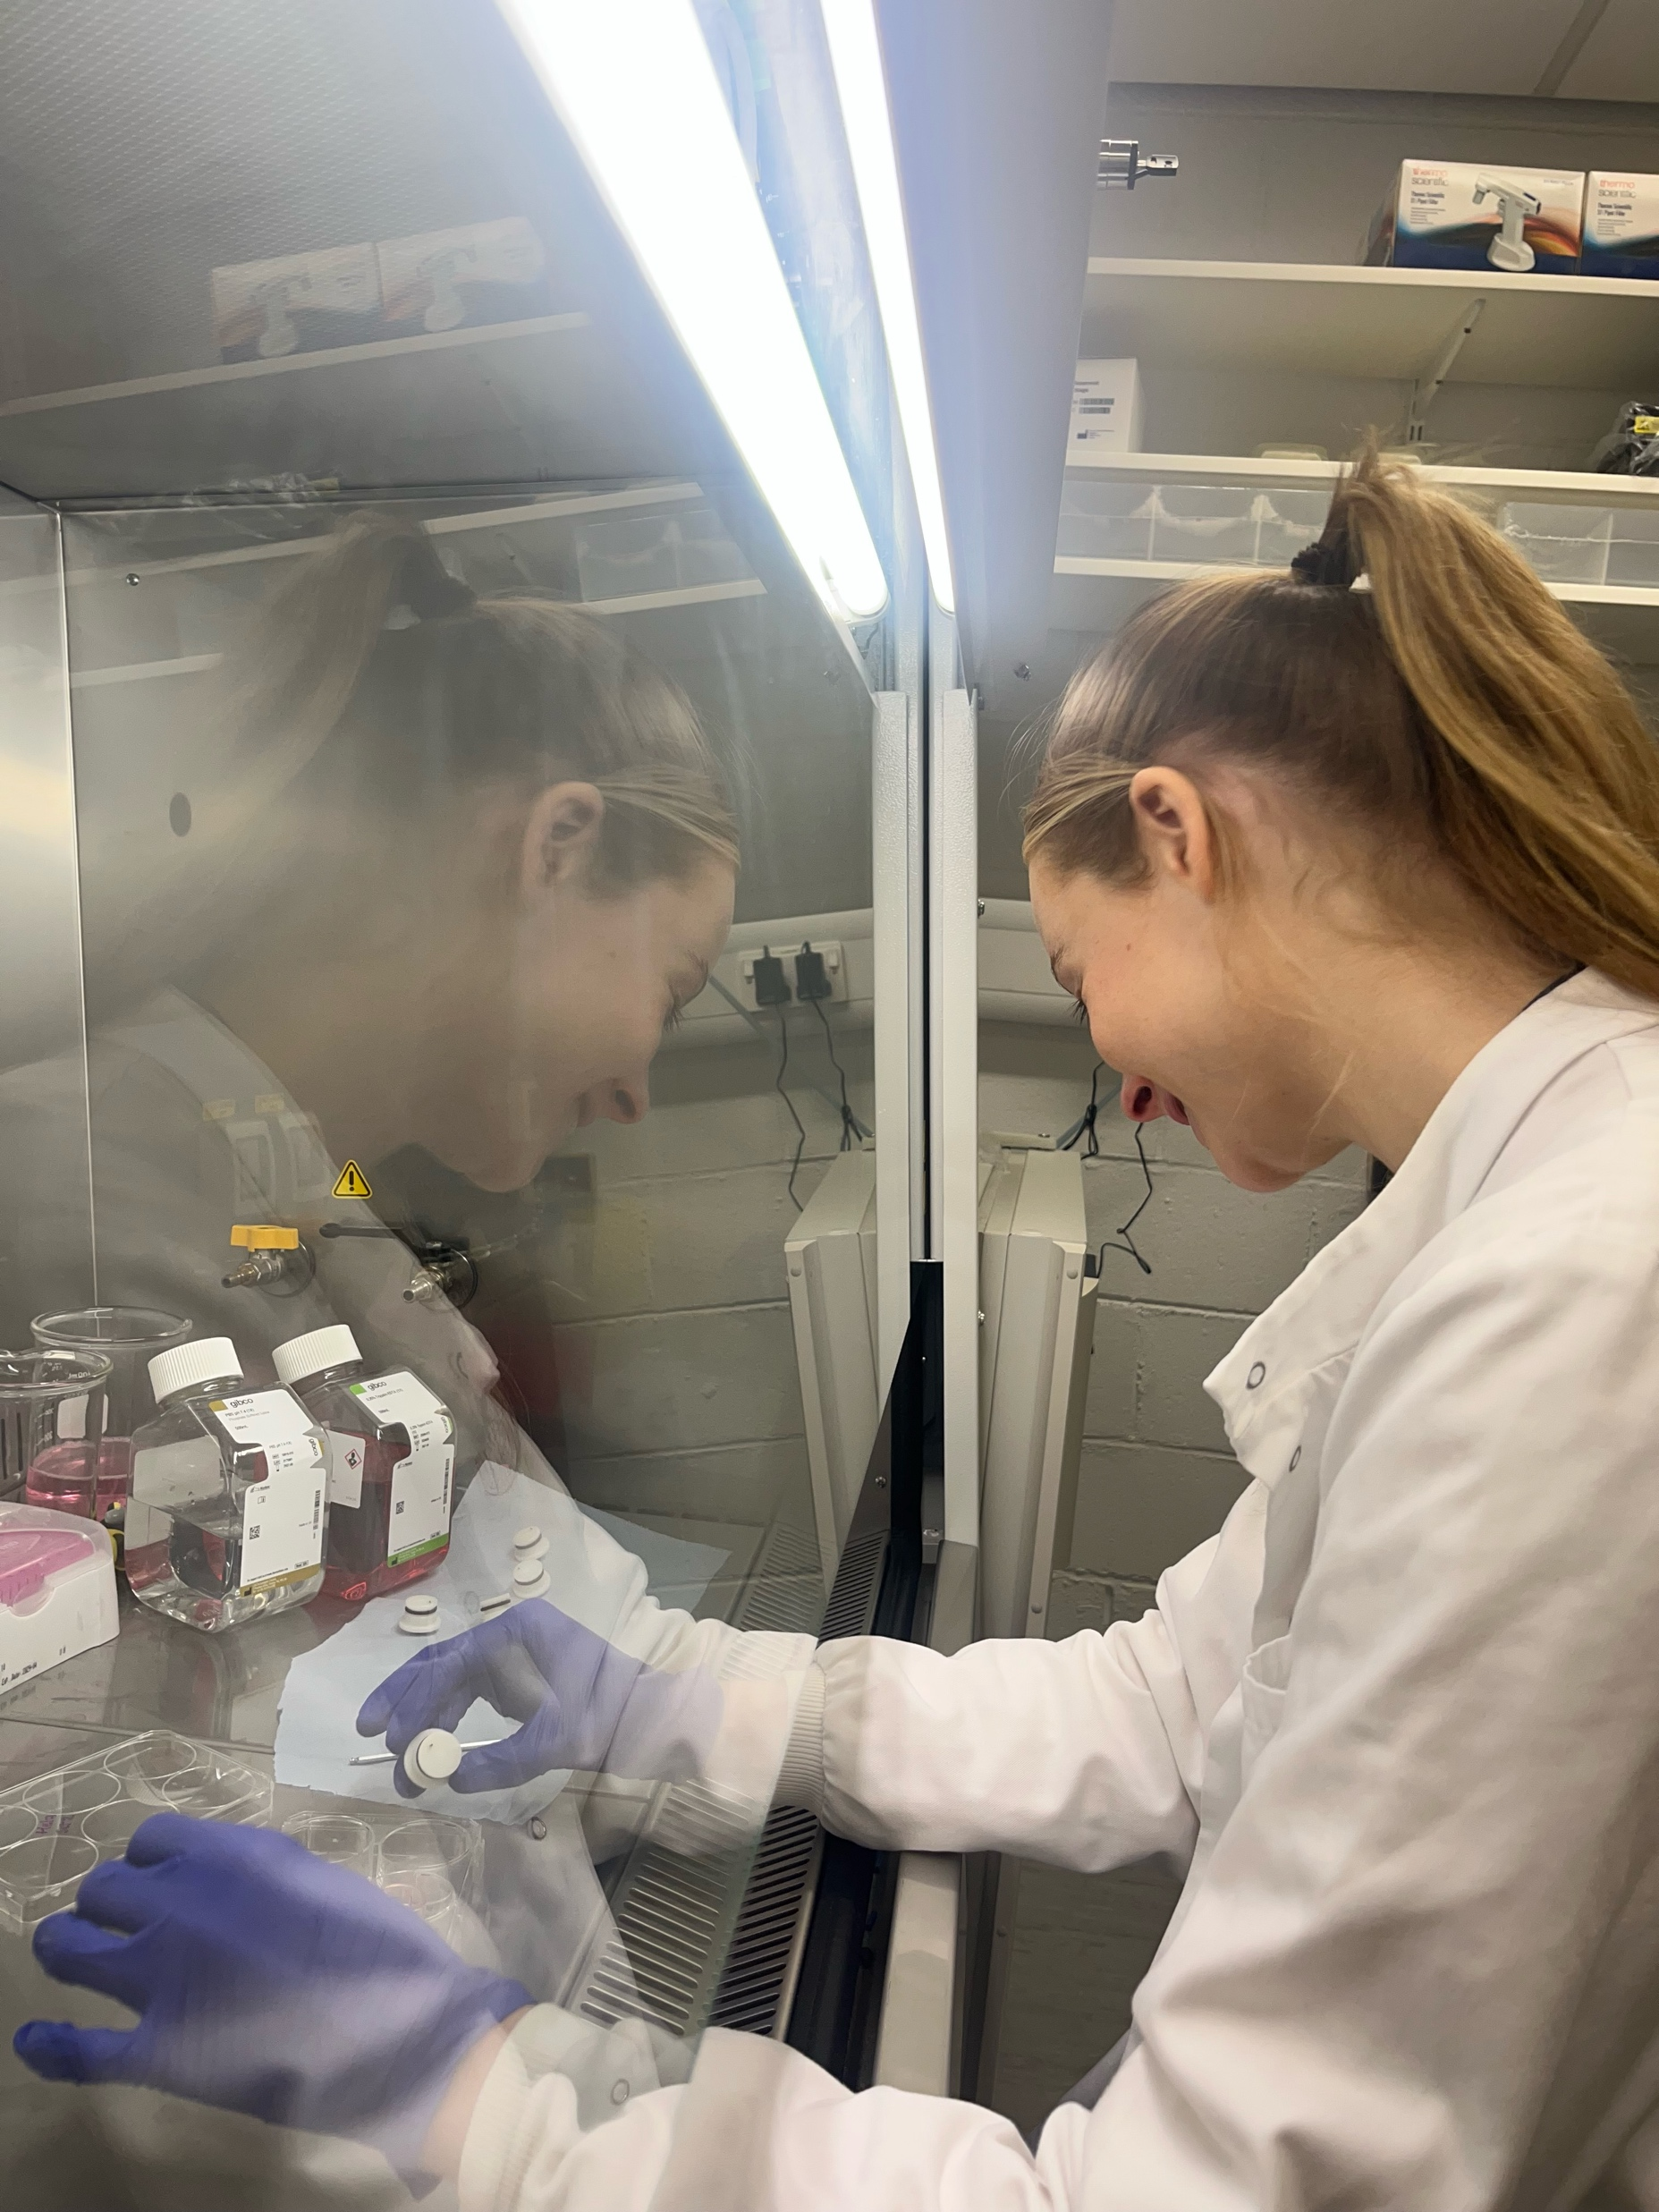
Cell Irradiations
Notes:
Work started on the cell irradiations.
The cells were placed in this carousel, and we shot three different cell dishes at three different doses each time. These were accompanied by RCF that fitted into the same holes as the cells to provide a double check that we were delivering the desired dose.
The cells are then taken to be post-processed which involves seeding them with specific densities and then leaving them to grow. After a set number of days one then counts the cells to produce a dose-survival curve.
Based on some RCF collected already we believed that we were delivering around 0.3Gy per shot and we wanted to deliver around 1Gy, 2Gy and 4Gy. This is important as you should seed the cells based on the estimated dose. If the seeding densitiy is too high then by the time you count them the cells clump and you can’t tell the difference between one cell and another. If the seeding is too low then none survive to be counted.

Slide 20
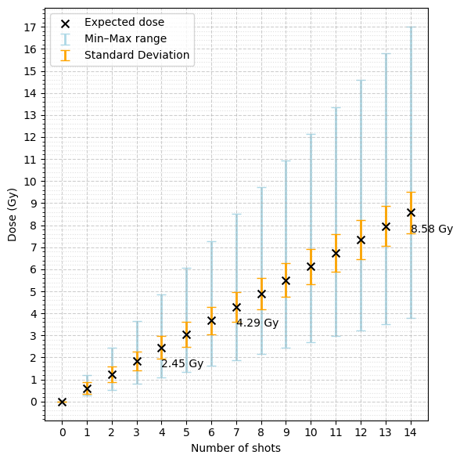
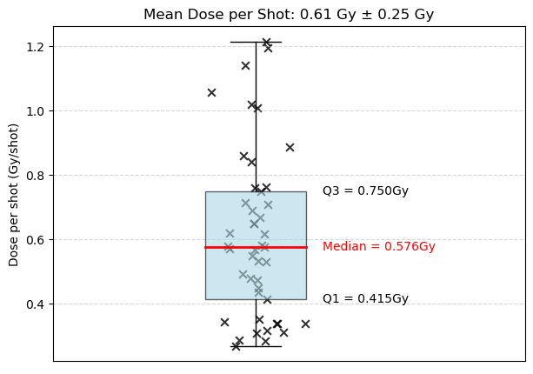
Shot-to-Shot Variation
Notes:
So as said at the start we believed we were delivering 0.3Gy per shot
However, after analysing all the RCF in the carousel and subsequent tests we saw a large shot-shot variation with the average being closer to 0.61Gy, the min being closer to 0.3Gy and the max dose seen over 1.2Gy per shot.

Slide 21
Estimating the Dose per Shot
Number of Shots | Desired Dose /Gy | Received Dose /Gy | Seeding Densities
4 | 1.2 | 2.45 | 250, 500, 1000
7 | 2.1 | 4.29 | 500, 1000, 2000
14 | 4.2 | 8.58 | 1000, 2000, 4000
4 | 1.2 | 2.45 | 500, 1000, 2000, 4000
Notes:
This meant that we at a conservative guess delivered twice the expected dose
The seeding densities are shown and forntuanately there is some overlap
We are still waiting for the all the biology results to be analysed, but so far we have seen survival in the all the higher density seedings
However, with this variation in dose it is hard to say the dose these cells recieved

Slide 22
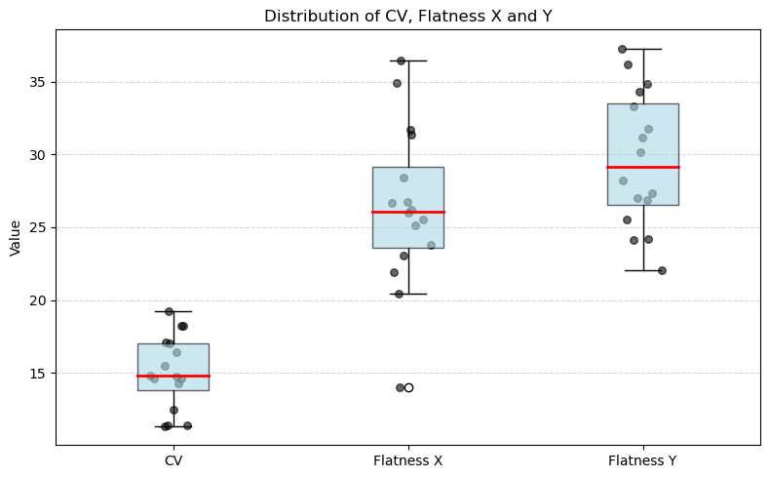
Uniformity
CV: 15.1 ± 2.5%
Flatness in X: 26.4 ± 5.5%
Flatness in Y: 29.6 ± 4.7%
Notes:
Another uncertainty is the uniformity
These are 3 measures of uniformity. CV is another term for the normalized standard deviation, then flatness is the max dose minus the min dose devided by the max plsu the min.
All three we would prefer to be lower, CV hopefully should be less than 10% and flatness should be less than 20%

Slide 23


Conclusions and Future
Perform a Repeat
Shot-to-shot Variation
Requires an in-beam diagnostic
Improve Beam Uniformity
Can be achieved by moving the Cu scatterer closer
Longer term: Introduce more quadrupoles and potentially a dipole chicane
Also achieves a higher dose
People
J. McGarrigle
R. Wilson
C. Whyte
E. Melia
E. Dolier
A. Fernandez-Rodriguez
K. Long
M. Boyd
Notes:
So moving forward we are looking to do a repeat but with our much better understanding
An in-beam diagnostic is necessary to handle the shot-shot variation.
Options discussed are a sparse scintiallating fibre detector in the beamline that can be viewed by a remote camera, similarly a thin phosphor sheet, or by using the disgarded beam around the cell dish to give an estimate.
Finally, we need to improve beam uniformity. In the short-term the simplest way to do this is to move the scatterer further up the beamline

Slide 24
Thank you
18/09/2025

Slide 25
Additional Slides
25
18/09/2025

Slide 26
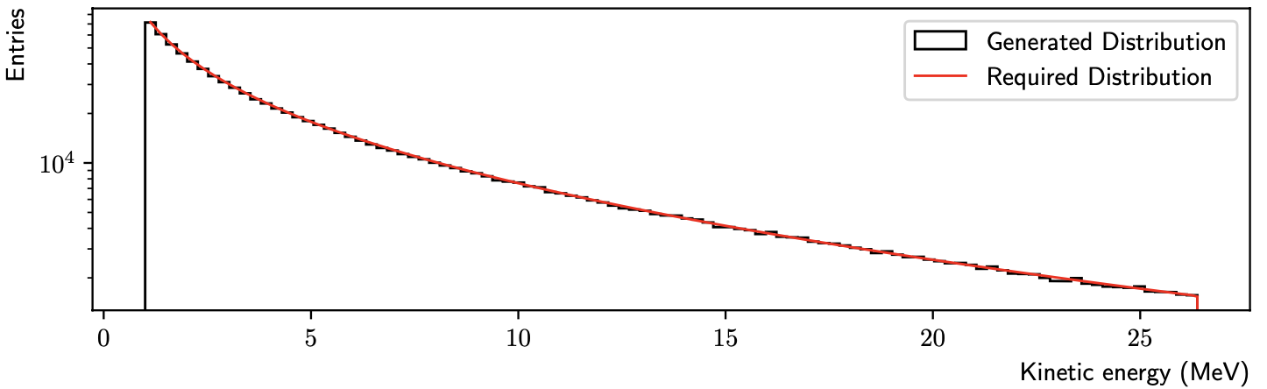
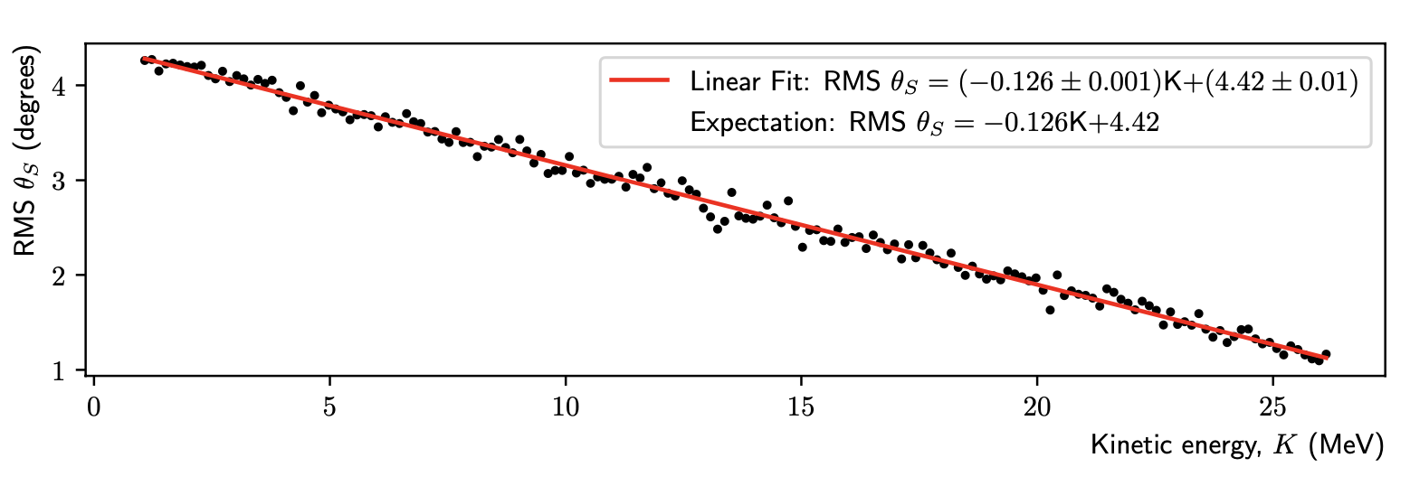
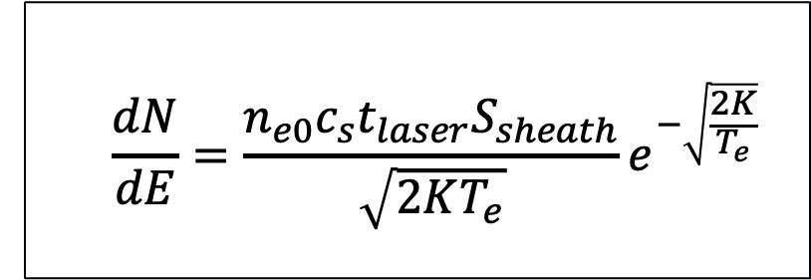
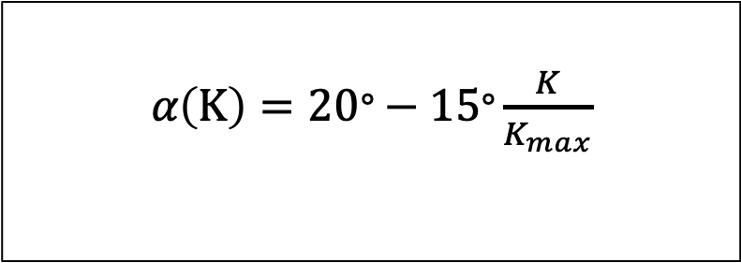
Simulation Model
Source
$$\frac{dN}{dE}=\frac{n_{e0}c_{s}t_{laser}S_{sheath}}{\sqrt{2KT_{e}}}e^{−\sqrt{\frac{2K}{T_{e}}}}$$
𝛼$\left(K\right)=20\text{°}−15\text{°}\frac{K}{K_{max}}$
N. Dover et al., “LhARA linear optics documentation,” 2024.
LhARA Collaboration Meeting
Calvin Dyson - LhARA Collaboration Meeting
26
18/09/2025
18/12/2025
Notes:
Typical TNSA energy spectrum looks like so with a rapid decrease with energy and then a cut-off at a max kinetic energy
The slope is given by this equation here, which is using a time-limited fluid-dynamical model
And the cut-off is given by considering laser pulse duration and other factors
Then uses inverse transform sampling to obtain the random energies in the spectra
This model requires the calculation of the electron temperature and that equation is given here
Symbols:
n_e0 – hot electron density
c_s – ion-acoustic velocity
t_laser – laser pulse duration
S_sheath – electron acceleration area
T_e – electron temp

Slide 27
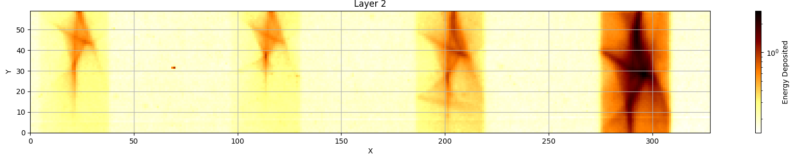
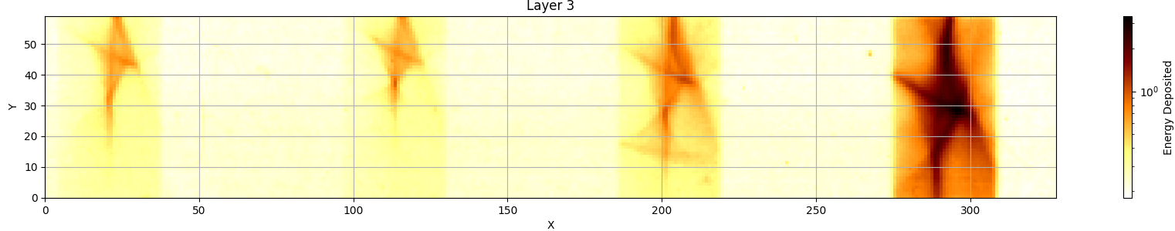
Understanding the Beam Shape
20MeV
20MeV
16MeV
12MeV
20MeV
20MeV
16MeV
12MeV

Slide 28
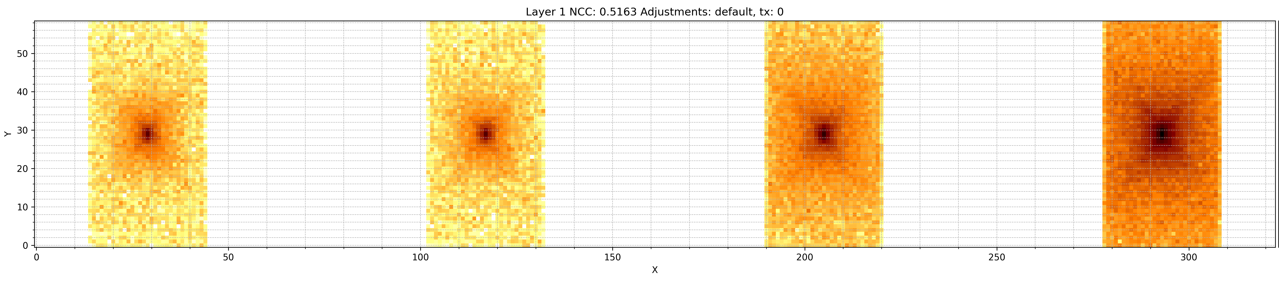
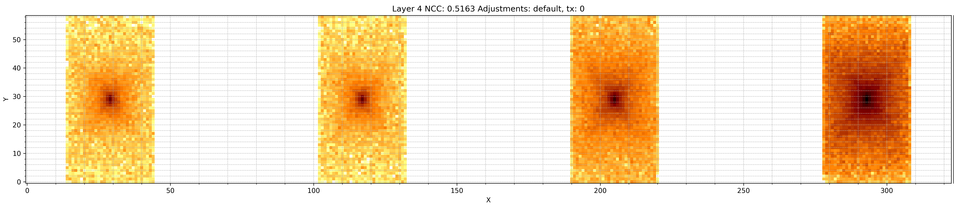
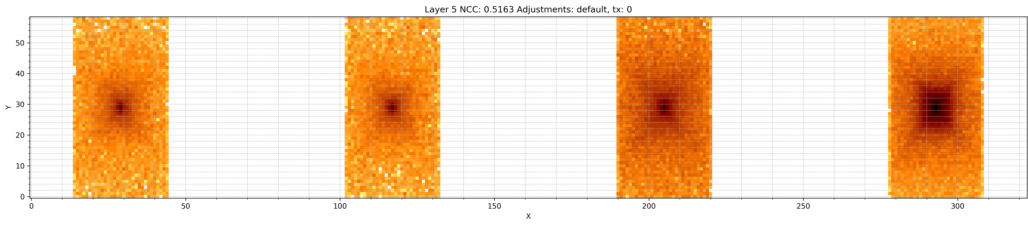
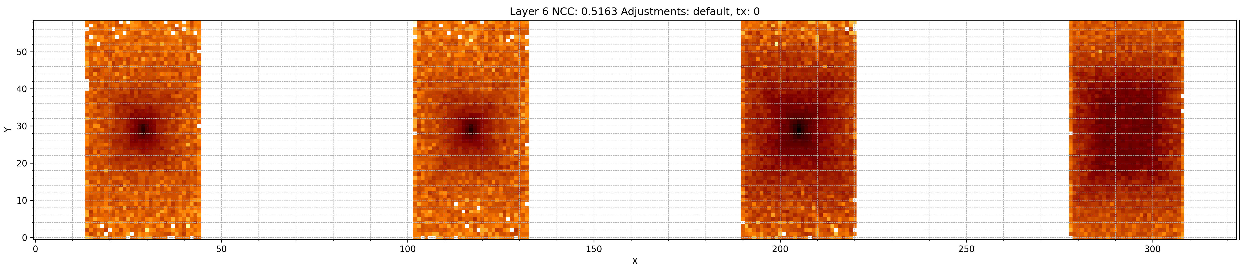
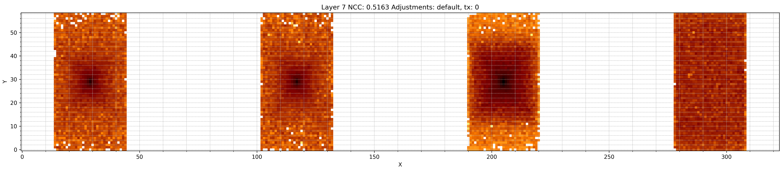
Understanding the Beam Shape
Default Beam Shape

Slide 29


Improving Uniformity
Simulation
Optimising Positions
$$CV= \frac{Standard Deviation of Dose }{Mean Dose} × 100$$
Experimental (RCF)

Slide 30
Estimating the Dose per Shot
Number of Shots Taken | Mean Dose Across the Cell Dish /Gy | Mean Dose per Shot /Gy
10 | 2.88 | 0.29
5 | 1.69 | 0.34
10 | 3.11 | 0.31
5 | 2.18 | 0.44
Desired Dose /Gy | Shots Required
1 | 4
2 | 7
4 | 14

Slide 31

Uniformity Improvement

Slide 32
Vacuum
Air
15mm
FQ (150T/m)
DQ (150 T/m)
Mylar (50um)
Laser
Scatterer
20mm
40mm
20mm
93mm
93mm
669mm
420mm
60mm
Target
40mm
20mm
Beamline End

Slide 33
Vacuum
Air
15mm
FQ (150T/m)
DQ (150 T/m)
Mylar (50um)
Laser
20mm
40mm
20mm
d1
d2
420mm
Target
40mm
20mm
Beamline End

