Slide 1





Improvements in Fault Prediction Capabilities for Radiotherapy Machines
Sam Leadley University of Oxford, JAI & CERN
Supervisors
Manjit Dosanjh University of Oxford, JAI & CERN
Raj Jena University of Cambridge

Slide 2
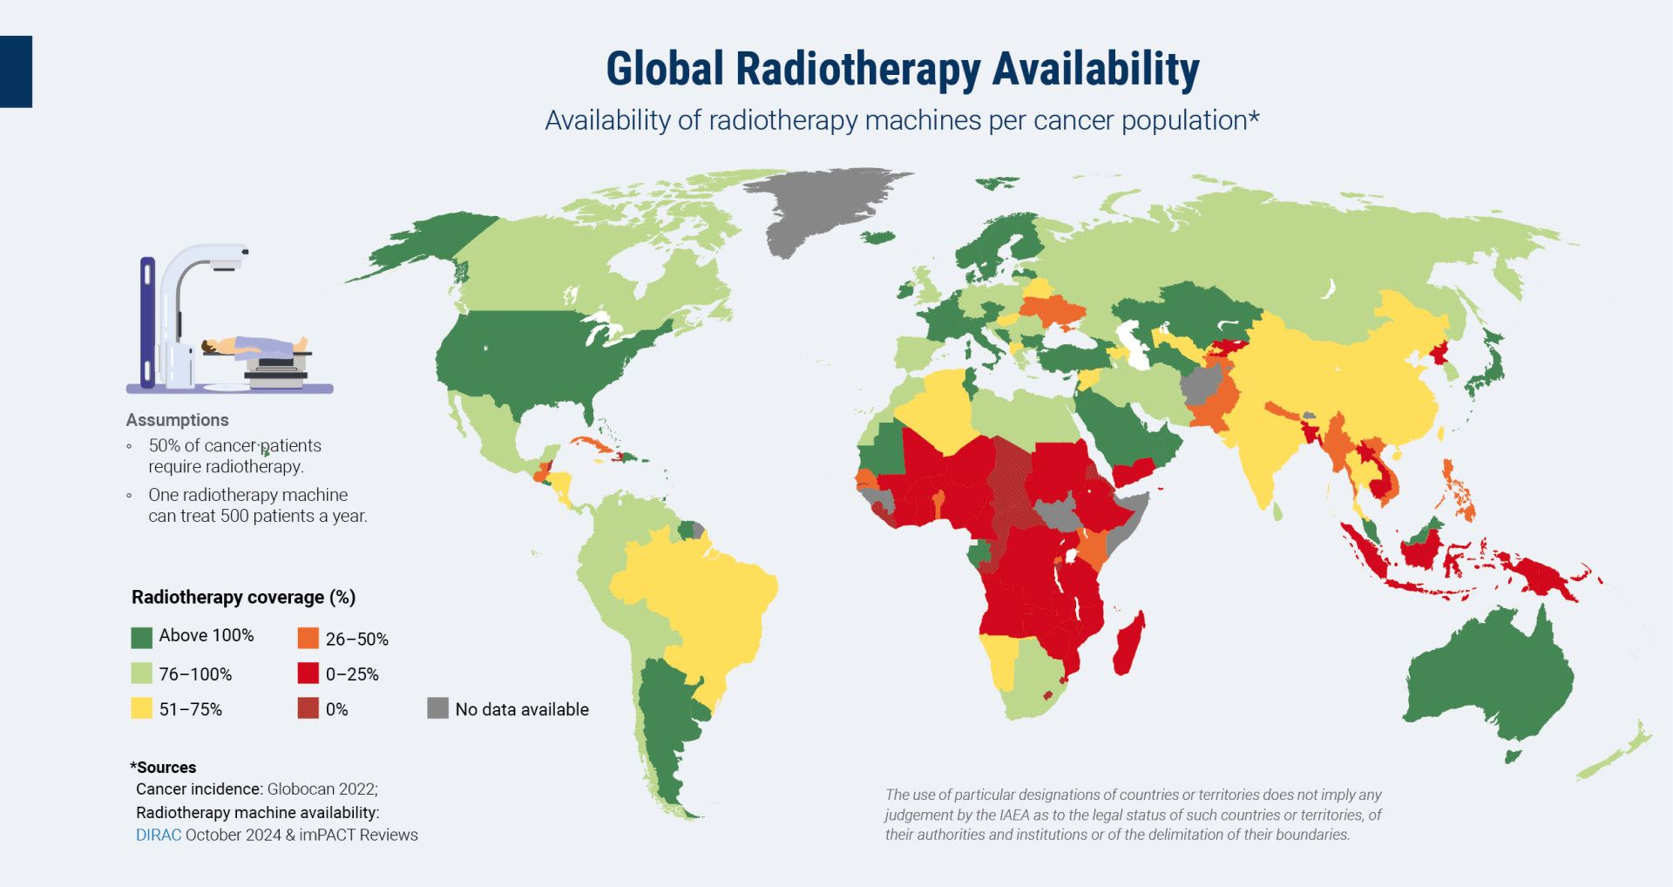
Background
M. Dosanjh, 2025. “Towards Implementing Project STELLA on radiotherapy powered by AI”, GHC Summit. MIT, Boston, 19/09/25.
Notes:
Talk about STELLA motive, etc. DEFINE ACRONYMS!
50% of all cancer cases need RT for treatment
IAEA recommends 4 RT machines/million people
HICs in Europe and America generally meet this target overall
Can lack coverage in more rural areas
Significant issues with RT access in LMICs
Africa, SE Asia etc.

Slide 3
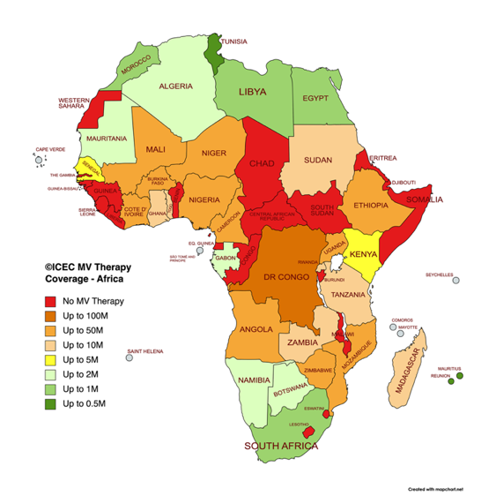
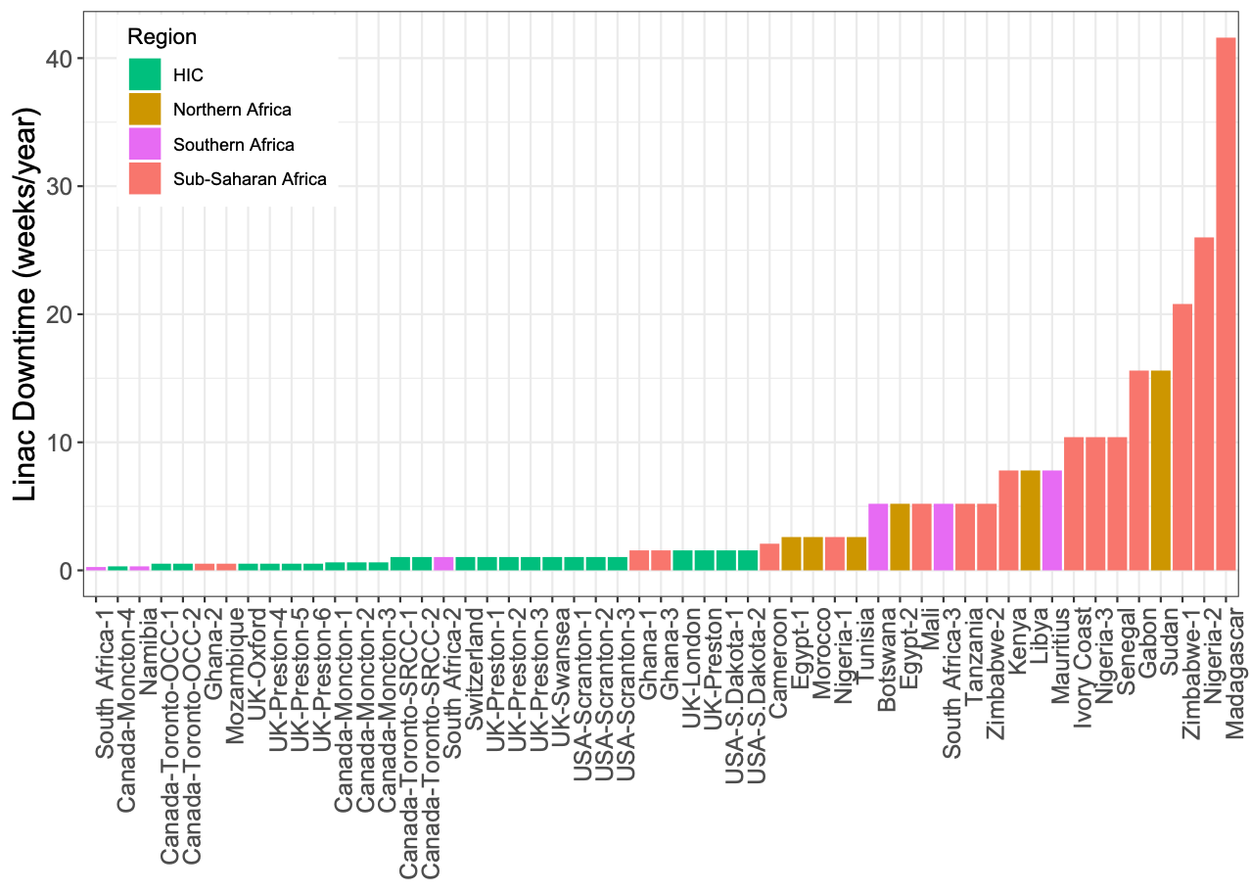
Background
Number of linacs per country in Africa. Credit: ICEC
Machine downtime in countries in Africa compared with that in Canada, UK and US.
Notes:
Talk about STELLA motive, etc. DEFINE ACRONYMS!
50% of all cancer cases need RT for treatment
IAEA recommends 4 RT machines/million people
HICs in Europe and America generally meet this target overall
Can lack coverage in more rural areas
Significant issues with RT access in LMICs
Africa, SE Asia etc.

Slide 4
Project STELLA
Established 2016 with the goal of increasing global radiotherapy access.
Global multidisciplinary NGO collaboration under the umbrella of ICEC.
Oxford, Cambridge, Lancaster, CERN, African partners
Increase access to radiotherapy in LMICs and rural areas.
New LINAC design, more robust, cheaper, same treatment capabilities
Improved training for RT engineers to operate and troubleshoot RT LINACs
Reduce downtime in existing RT centres using advanced computing techniques
Notes:
Talk about STELLA motive, etc.

Slide 5
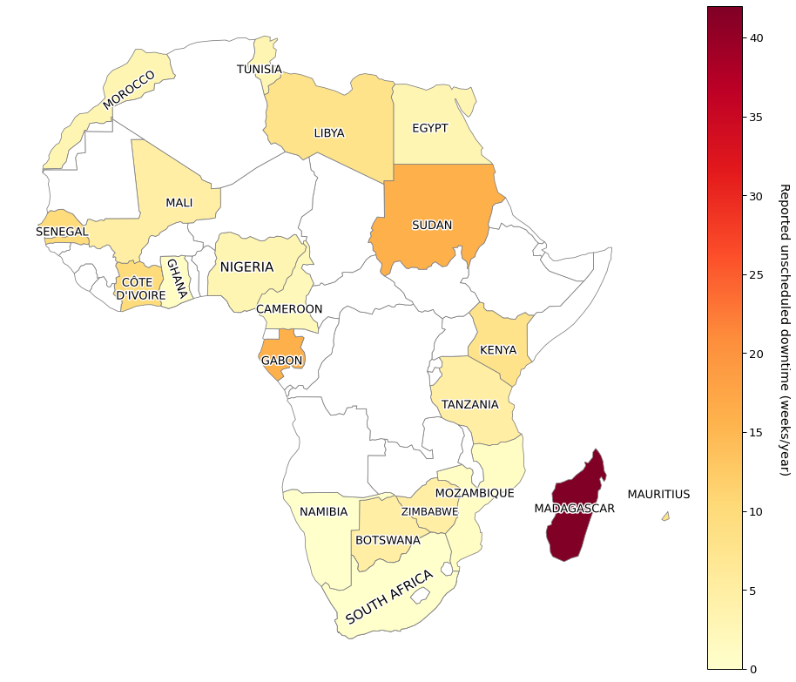
Motivation
Access to RT in LMICs (such as in Africa) is highly limited by available machines.
Of the few available machines, many experience significant downtime, far more than in HICs.
Machines are pushed harder to compensate for lower availability.
Ability to predict machine downtime in advance allows for repair preparation & preventative maintenance.
T.A. Ige et. al. (2021). Surveying the Challenges to Improve Linear Accelerator-based Radiation Therapy in Africa
Notes:
Why my research is relevant

Slide 6
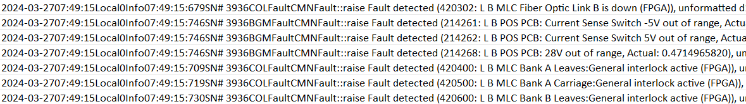
RT Machine Log Files
Automatically recorded onto RT LINACS (Varian TrueBeam), no patient identifiable data.
Contains information on the exact state of the machine at any point in time.
“Interlocks” – reduction in the state of treatment readiness for the RT LINAC
Want to predict when specific interlocks are likely to occur.
Time & date of interlock code
Interlock code
Example of processed Varian Combined Log file. All interlocks have been extracted but are yet to be filtered.
Notes:
Data fed into algorithm – explain what trying to predict

Slide 7
“Severe” Interlocks & Machine Learning
“Severe” interlocks are defined as interlocks causing machine downtime and reducing patient throughput capability (increasing clinical downtime).
A list of these interlocks has been collated by radiotherapy engineers at Exeter Hospital based on past faults that have caused machine downtime.
Prediction of severe interlocks is key to allowing preventative maintenance and preparation
With so much data, this is a high-dimensional pattern recognition problem that a human would struggle to solve.
Machine learning algorithms can recognise long-term relationships and contexts in data and reduce the dimensionality of the problem for interpretation.

Slide 8
Dual-Classifier Variational Autoencoder Approach
Novel dual- classifier VAE splits classification into two tasks:
severe/non-severe interlock
most likely severe interlock (assuming interlock is severe)
Inputs are sets of 100 consecutive interlocks, plus 50 more sampled up to 1 week prior.
Training inputs are labelled with the next interlock code.
Inputs are projected into a low-dimensional latent space:
Severe interlocks with similar causes are spatially close in the latent space.
Position of an input in latent space allows for probabilistic predictions of proceeding interlocks.
Dual-classifier workflow
Input sequence
Neural network 1 (severe/non-severe interlock)
Neural network 2 (interlock assuming severe)
Probability severe/non-severe interlock
All severe interlock probabilities
All probabilities (all severe interlocks & severe interlock)
Notes:
No need to explain exactly how VAE works, not enough time.

Slide 9
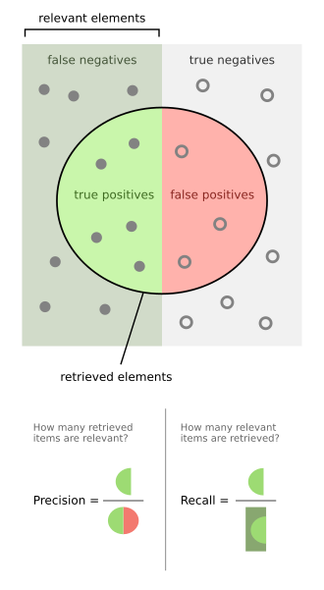

(Aside) Best Model Selection
Best models are selected by macro-F1 score.
F1 defined as the harmonic mean of precision and recall
Range between 0 (no accurate classification) and 1 (perfect classification)
$F_{1}=2×\frac{precision × recall}{precision + recall}$ $F_{1}^{macro}=\sum_{class}{F_{1}^{class}}$
Accuracy also considered to initially drive learning:
$$Acc=\frac{correct preds}{ total preds}$$
Illustration

Slide 10
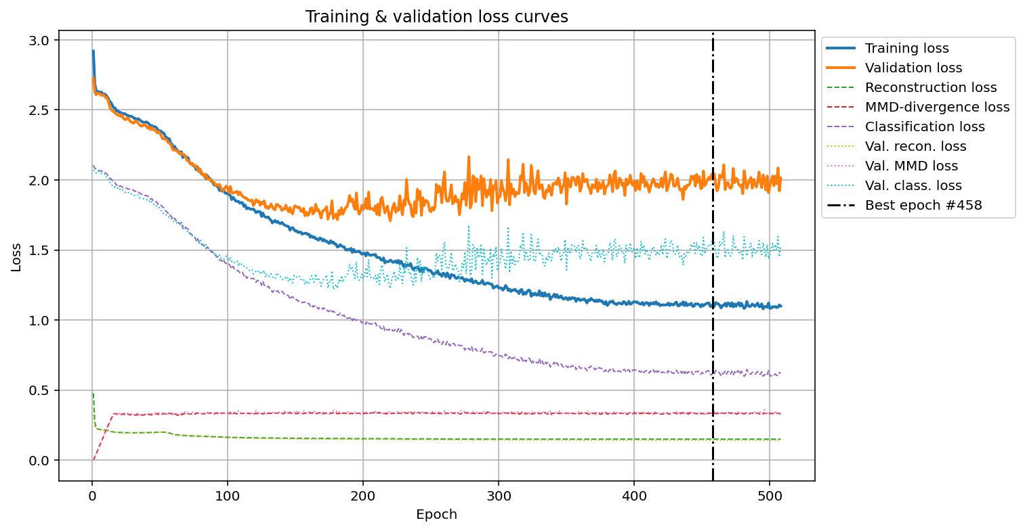

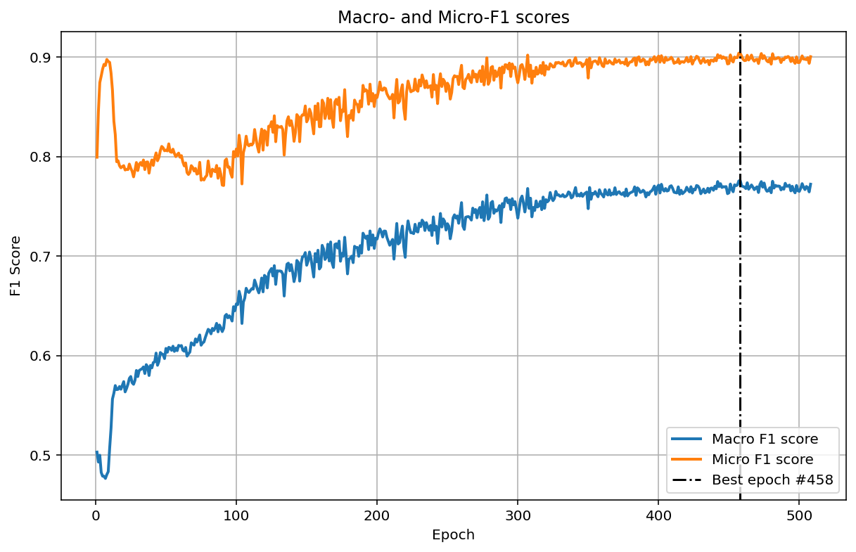
Binary Classifier Performance
F1 scores are very strong:
Model is better at predicting non-severe vs. severe interlocks:
Potentially expected due to large class imbalance.
Tried several methods e.g. class weighting to improve this with limited success.
Improvement will likely require larger volumes of data, specifically with severe interlocks.

Slide 11
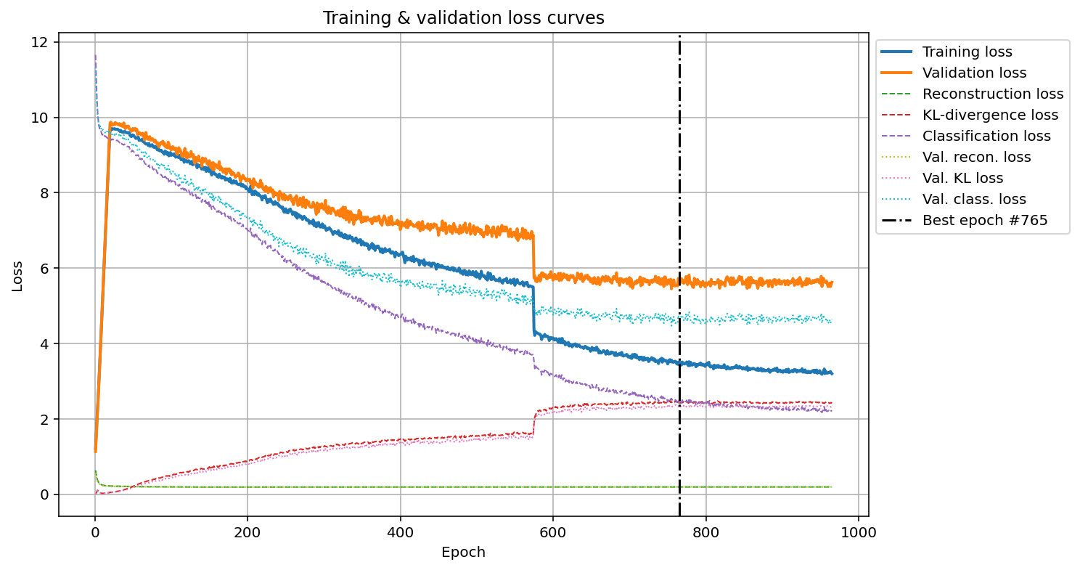

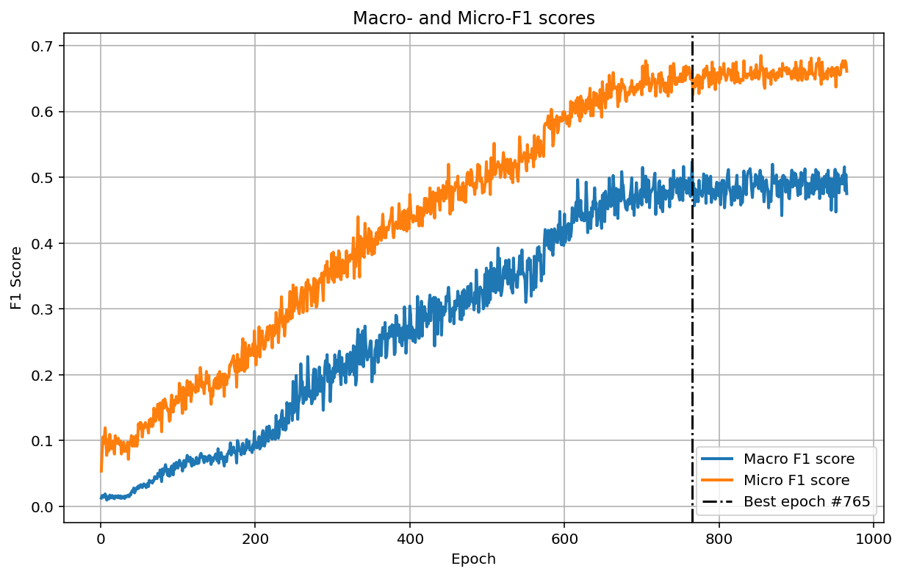
Fault Classifier Performance
F1 Scores:
Model shows significantly better-than-even odds of predicting exactly the correct next severe interlock in series:
Top 3 accuracy is approaching 90%.
Most of the time all top 3 interlocks are very similar e.g. 212110, 212111, 212114 (Dose less than expected).
Significant improvement over this is difficult due to the inherently random nature of breakdowns.

Slide 12
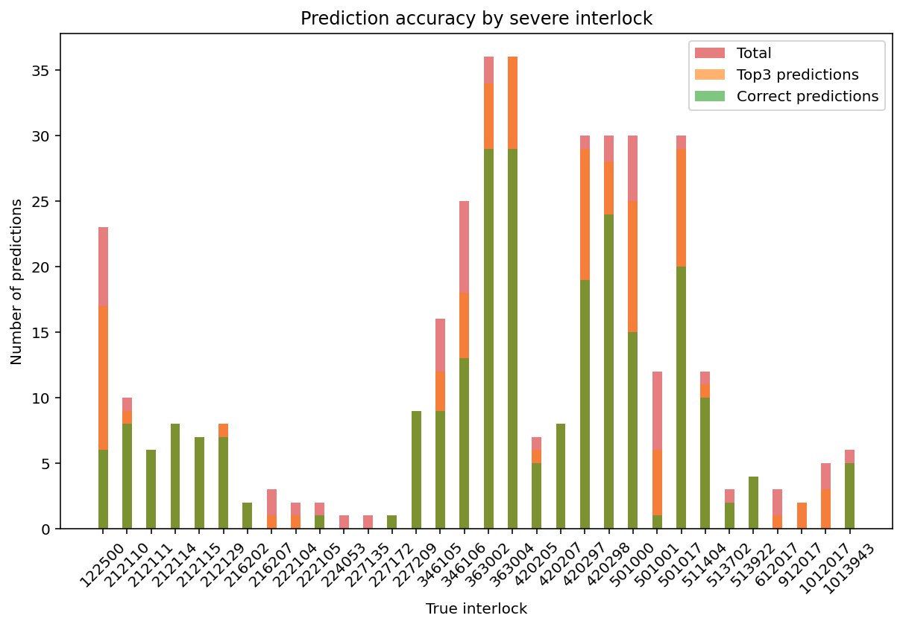

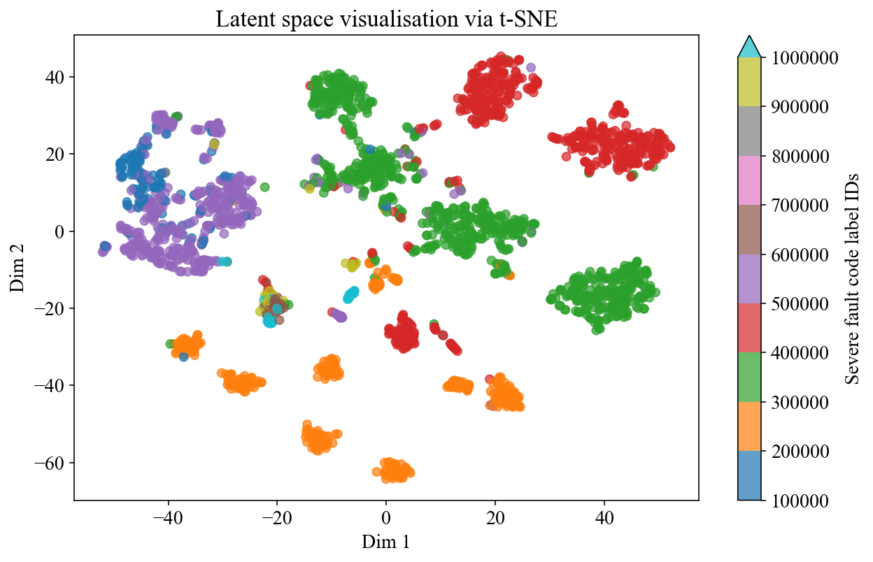
Fault Classifier Latent Space
Gantry stand
Beam generation
Multi-leaf collimator

Slide 13
Comparison to other prediction methods
*Overall accuracy of stratified guessing is boosted due to almost exclusively predicting “no severe fault”

Slide 14
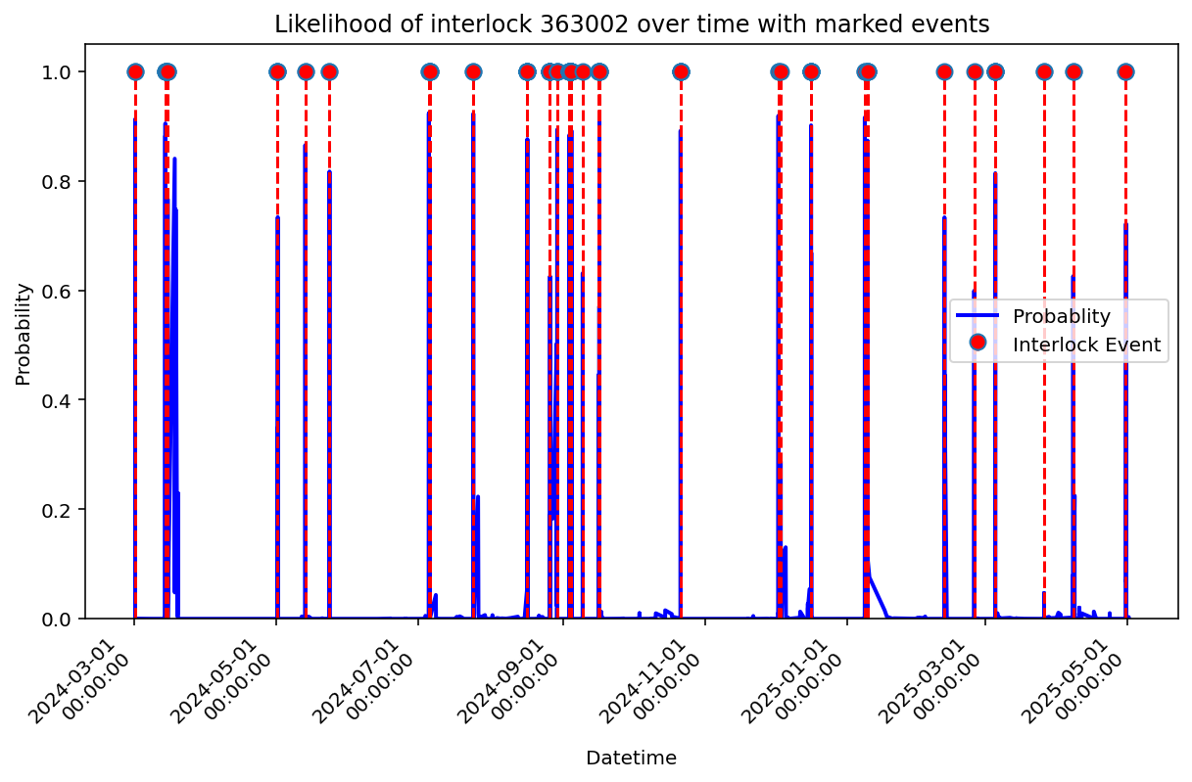
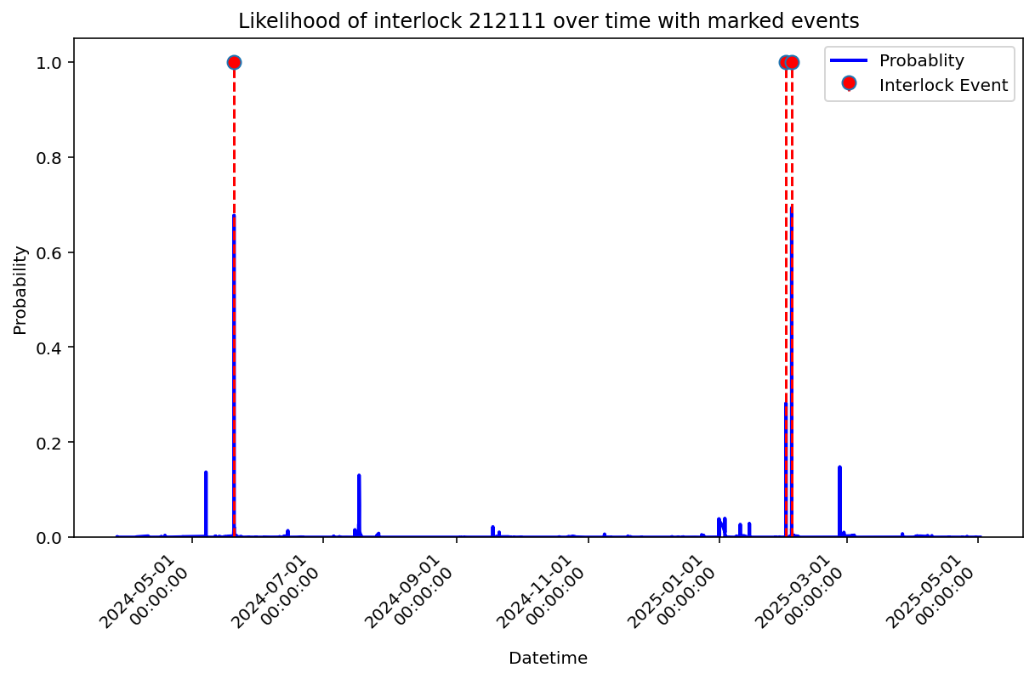
Time-series Probabilities
Interlock 363002 – Laser guard fault, potential failure if often. Medium severity.
Interlock 212111 – Target under dose rate, potential HV Thyratron problem. Medium severity.
Notes:
Graph of interlocks over time
Real interlock events marked with red dotted lines
Probabilities of events occurring shown in blue

Slide 15
Next Steps
This fault prediction process can be generalised away from the Varian TrueBeam.
Algorithm is applicable to any other Varian machine, and any RT machine with a similar logging style.
Approach is data-agnostic so can be applied to any machine with a similar fault reporting system, regardless of function.
Transfer learning will allow customisation of models to a treatment centre’s needs.
Models can be generally trained on a central database, then tweaked by a user with their own data.
This doesn’t require any release of data by a treatment centre, allaying concerns about privacy.
Proof of concept for fault prediction opens the door to more powerful ML algorithms.
Transformers can capture more information about contextual and long-term relationships with inherent temporal encoding and attention mask.
Notes:
Emphasise VHEE/other applications for this conference

Slide 16

Thank you!
Collaborators & Supervisors:
Torsten Liebig, Exeter-Wonford Hospital
Jonathan Lane, Gary Grogan, Oxford-Churchill Hospital
Andrew Robinson, Ian Dulgarn, Cambridge-Addenbrooke’s Hospital
Manjit Dosanjh, University of Oxford, John Adams Institute, CERN
Raj Jena & Doris (Xin) Du, University of Cambridge
Laurence Wroe & Steinar Stapnes, CERN
Leadley, S. (2025). Predictive Modelling of Radiotherapy LINAC Downtime using Variational Autoencoders [Poster]. VHEE’25 conference, Daresbury.
Contact: samuel.Leadley@physics.ox.ac.uk
This work was supported by funding from the John Adams Institute (JAI), Oxford, and the Science & Technology Facilities Council (STFC).

Slide 17
Variational AutoEncoder – Neural Network
Interlock A
x₁
X₁
0.12
μ
Interlock B
x₂
e₁
h₁
h₁
X₂
0.01
Most likely output is next fault interlock prediction. Output size = number of severe fault + 1
Input from string of previous interlocks.
Input size = vocab size.
Interlock C
x₃
e₂
h₂
z₁
h₂
X₃
0.68
Interlock D
x₄
e₃
h₃
z₂
h₃
X₄
0.05
σ
Interlock E
x₅
e₄
h₄
h₄
X₅
0.02
Interlock F
x₆
X₆
0.14
Input vocab.
Seq. encoding
Embedding layer
Hidden layer
Latent space distributions
Distribution samples
Hidden layer
Output layer
Output vocab.
ENCODING
LATENT SPACE
DECODING
Notes:
Input passes through dim reducing layers to find features & patters – latent dimensions
Gaussian dists have means and variances
Distribution gives model flexibility when predicting due to uncertainty
Decoder samples from latent distribution, passes sample through layers to give interlock probs
Evaluation is based on how well the model predicts next code, and how close the latent dist. is to std. normal (smooth/well organised)

Slide 18
Thank you!

