Slide 1
Beam stacking and RF knockout in Fixed Field Accelerators
Carl Jolly, D.J.Kelliher, J.-B. Lagrange, A. P. Letchford, S. Machida, D.W. Posthuma de Boer, C.T. Rogers, A. Seville
JAI fest 2025
18/12/25

Slide 2
Contents
ISIS Neutron and Muon Source and ISIS-II
What are FFAs?
Beam stacking
KURNS experiment to demonstrate beam stacking.
RF knockout during stacking and experiments at ISIS.

Slide 3
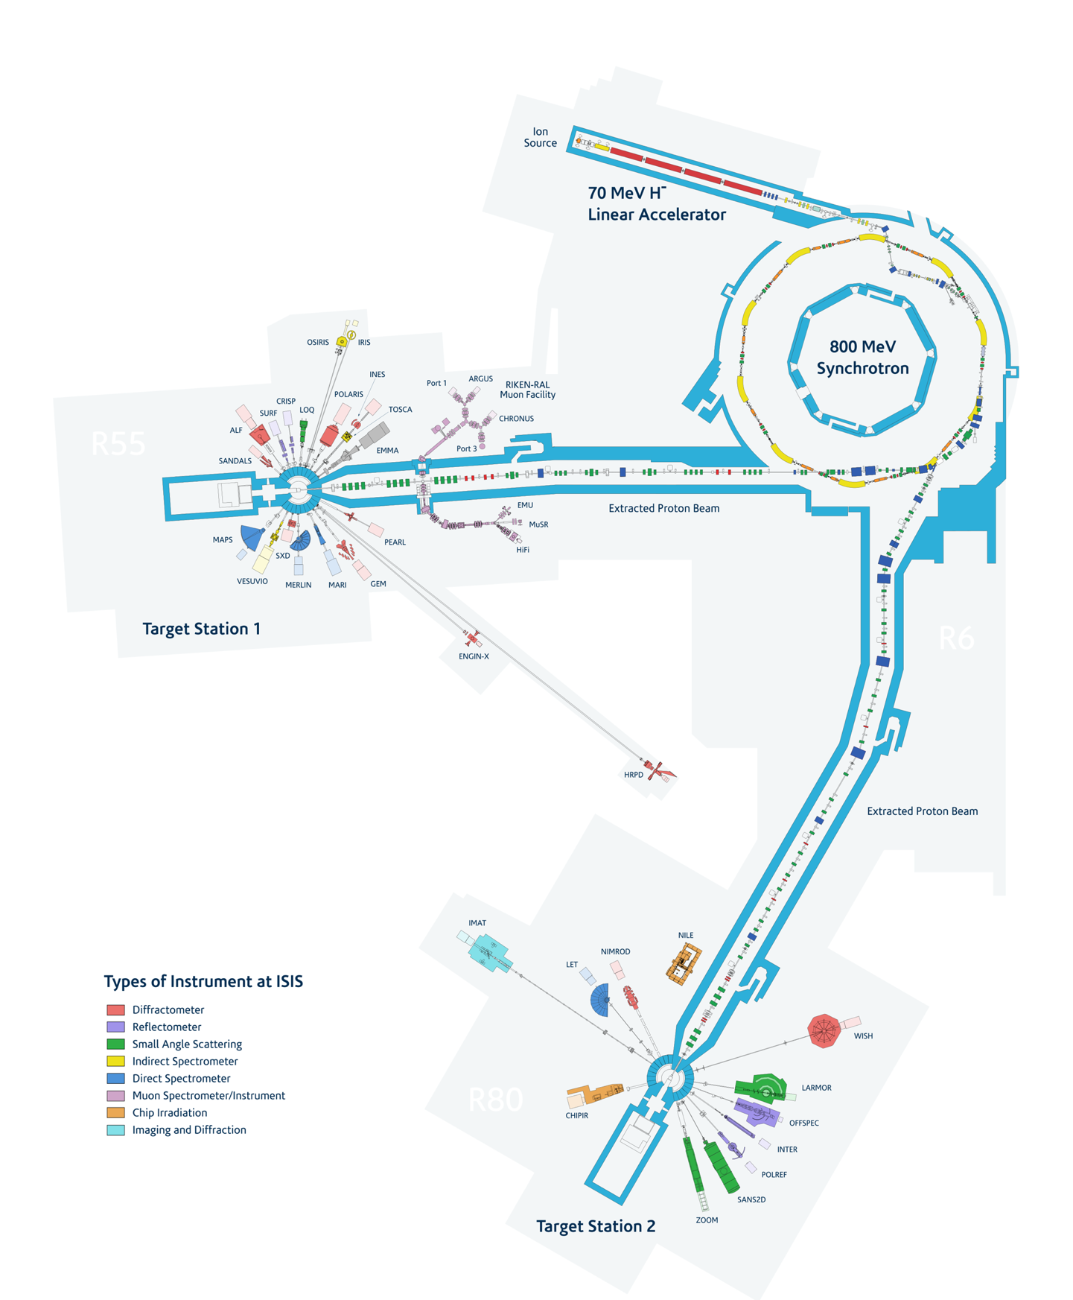
ISIS and ISIS-II
ISIS is a pulsed Neutron and Muon source at the Rutherford Appleton Laboratory.
The ISIS accelerator is a 50Hz rapid cycling synchrotron (RCS) built in 1984.
ISIS parameters | Value
Circumference | 163 m
Energy Range | 70 – 800 MeV
Repetition Rate | 50 Hz
Charge | 2.5 – 3.0e13 protons-per-pulse

Slide 4
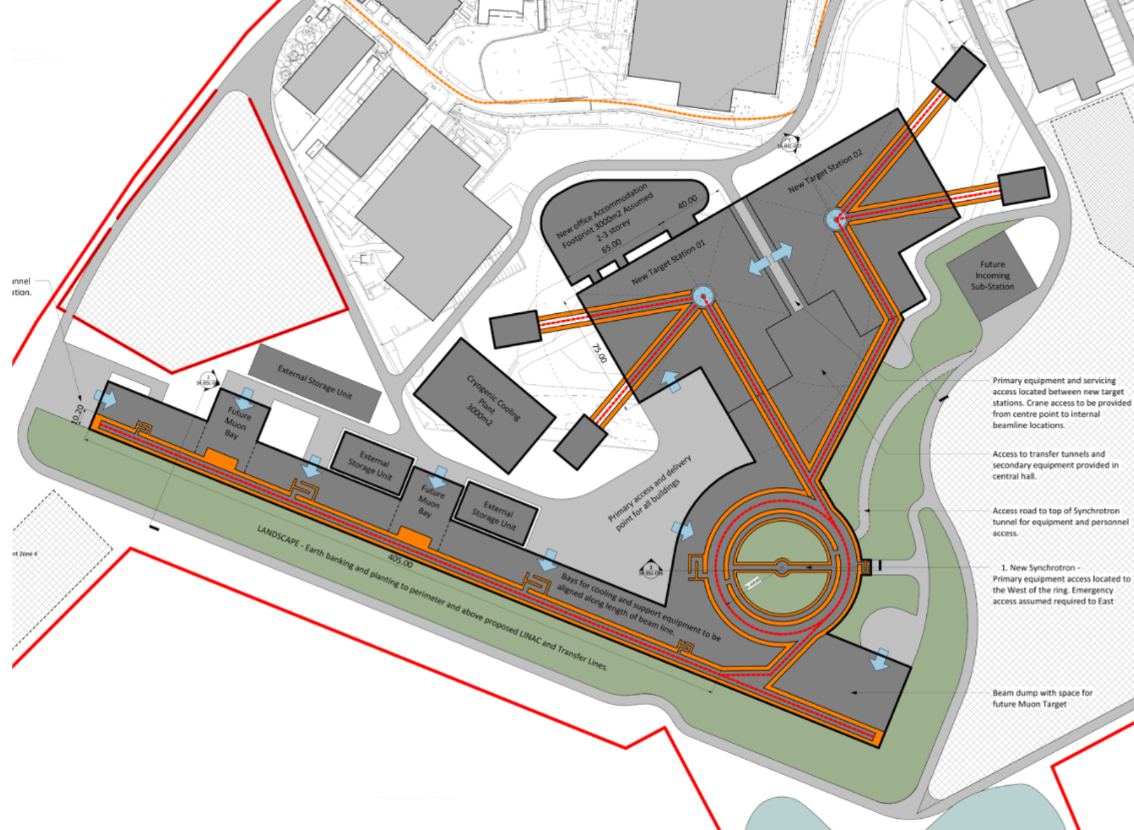
ISIS and ISIS-II
More beam power = more neutrons
Various options for the proton accelerator are under consideration including an RCS, Accumulator ring or even an FFA.

Slide 5
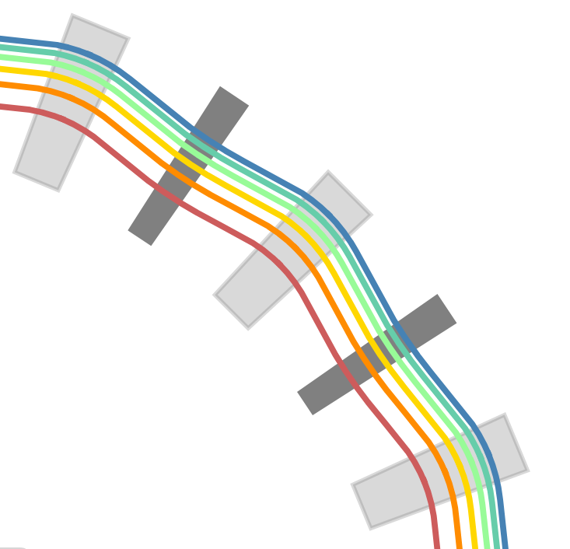
FFAs
Fixed Field alternating gradient Accelerator → FFA.
In an FFA the bending field is fixed.
The closed orbit moves to a higher radius with increasing energy.
The magnets are generally a combined function element.
From: Topp-Mugglestone, M. E. (2024). Scaling fixed field accelerators: theory and modelling of horizontal- and vertical-excursion accelerators [PhD thesis]

Slide 6
FFAs for spallation neutron sources
The goal of the accelerator in a spallation neutron source is to deliver as much beam power as possible with the specified time structure – typically 10s of Hz.
Beam stacking allows an FFA to accumulate more beam in a single pulse.
High power beam → low loss operation.
Cost/power efficiency.
More sustainable?

Slide 7
Beam Stacking
The fixed field of an FFA allows you much more freedom to manipulate the beam.
Techniques such as beam stacking become possible.

Slide 8
Beam Stacking
The fixed field of an FFA allows you much more freedom to manipulate the beam.
Techniques such as beam stacking become possible.
Energy
Inject beam 1
Time

Slide 9
Beam Stacking
The fixed field of an FFA allows you much more freedom to manipulate the beam.
Techniques such as beam stacking become possible.
Energy
Accelerate
Inject beam 1
Time

Slide 10
Beam Stacking
The fixed field of an FFA allows you much more freedom to manipulate the beam.
Techniques such as beam stacking become possible.
Energy
Debunch
Accelerate
Inject beam 1
Time

Slide 11
Beam Stacking
The fixed field of an FFA allows you much more freedom to manipulate the beam.
Techniques such as beam stacking become possible.
Energy
Debunch
Debunch
Accelerate
Accelerate
Inject beam 1
Inject beam 2
Time

Slide 12
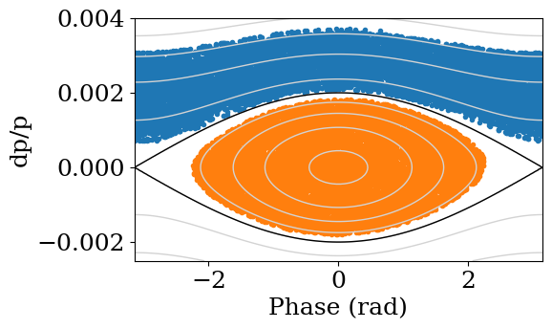
Beam Stacking
Energy
Debunch
Debunch
Accelerate
Accelerate
Inject beam 1
Inject beam 2
Time

Slide 13
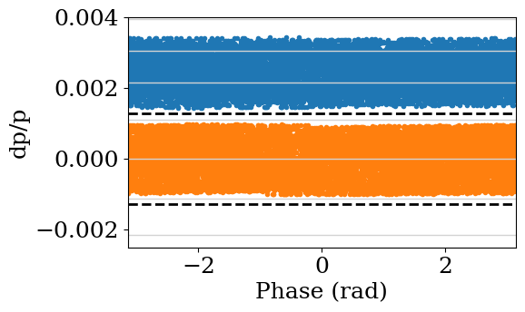
Beam Stacking
Energy
Debunch
Debunch
Accelerate
Accelerate
Inject beam 1
Inject beam 2
Time

Slide 14
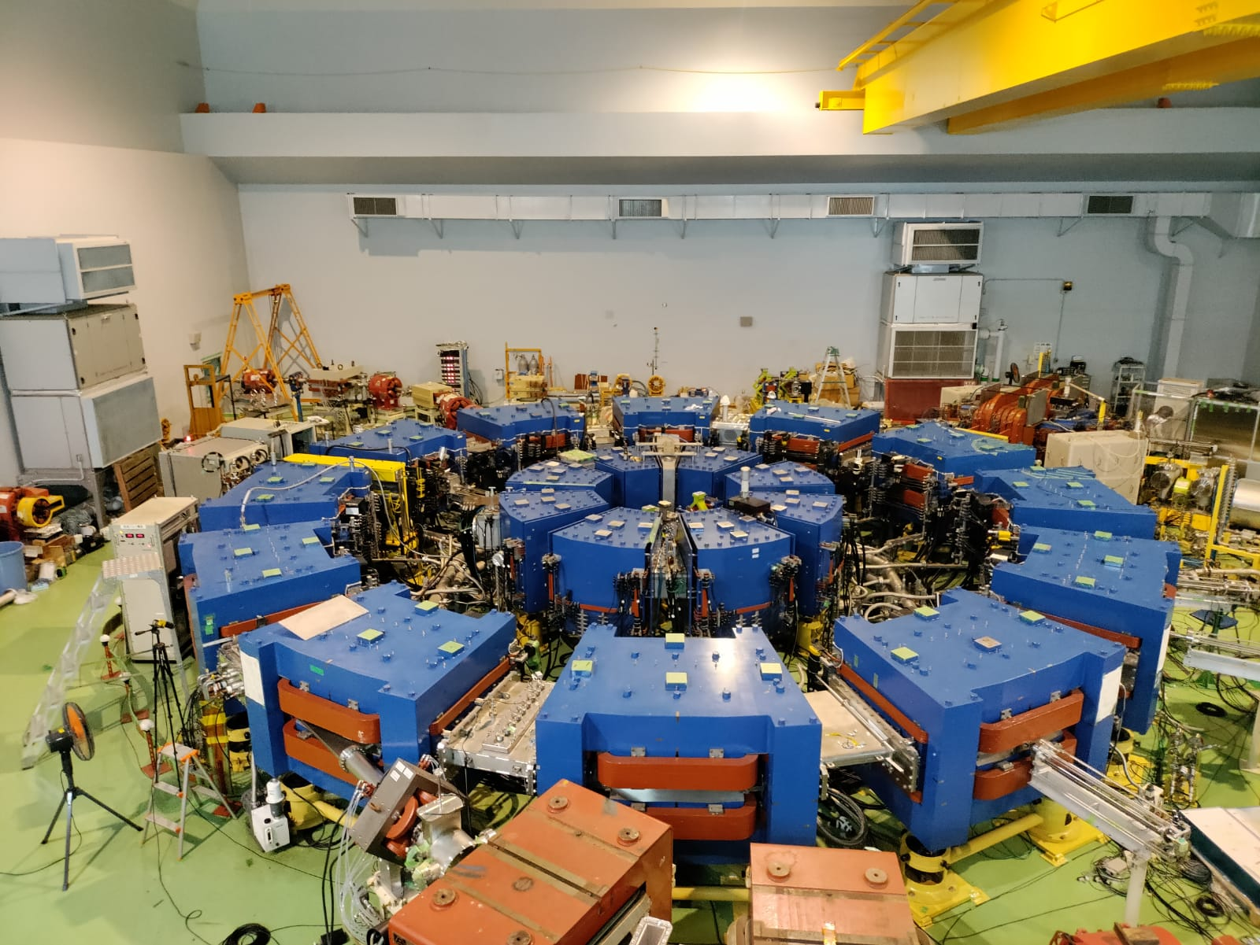
KURNS FFA
Located near Osaka in Japan.
The KURNS FFA was the proton driver for a prototype accelerator driven nuclear reactor.
Now (temporarily?) shutdown.
Our beam stacking experiment was one if its final runs!

Slide 15
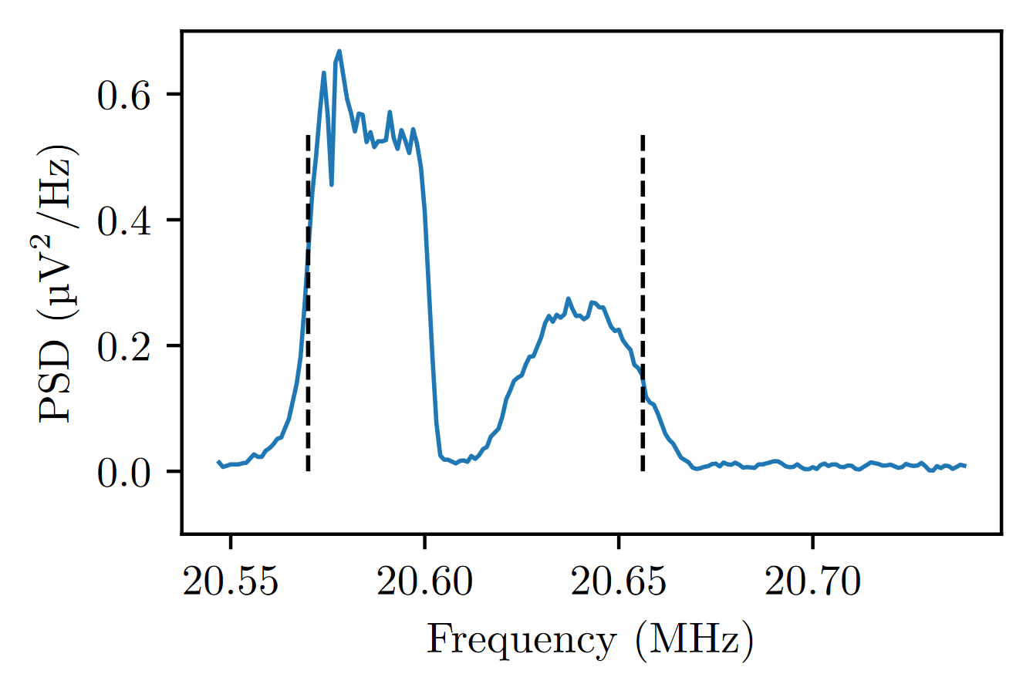
Demonstration of beam stacking at KURNS FFA in 2023
Second beam
Schottky signal from 2 stacked beams
First beam, the area of the peak is smaller as some of the beam has been lost.
Results published in Physical review accelerators and beams here: T. Uesugi et al. - Beam Stacking Experiment at a Fixed Field Alternating Gradient Accelerator
Beam stacking was first demonstrated at the MURA FFA in the 1960s
We attempted to make a more systematic measurement at KURNS.

Slide 16
Beam loss during stacking
Beam loss happens here.
Investigating the cause of beam loss:
The loss only happened in beam 1 → so likely not caused by some transverse effect/aperture limitation.
The loss still happened even if the beam 2 RF bucket was empty → implied that the loss was related to the RF.
Energy
Debunch
Accelerate
Accelerate
Inject beam 1
Inject beam 2
Time

Slide 17
What caused the beam loss? → RF knockout
In a scaling FFA, the orbit is dispersive everywhere in the ring.

Slide 18
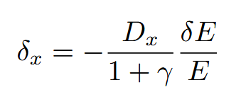
What caused the beam loss? → RF knockout
In a scaling FFA, the orbit is dispersive everywhere in the ring.
Every time the particle gains energy from the cavity, the equilibrium orbit moves because of the finite dispersion.
→ Equivalent to an instantaneous, horizontal displacement when passing the cavity.

Slide 19
What caused the beam loss? → RF knockout
In a scaling FFA, the orbit is dispersive everywhere in the ring.
Every time the particle gains energy from the cavity, the equilibrium orbit moves because of the finite dispersion.
→ Equivalent to an instantaneous, horizontal displacement when passing the cavity.
If these displacements synchronise with the horizontal tune then they could build up turn by turn.

Slide 20
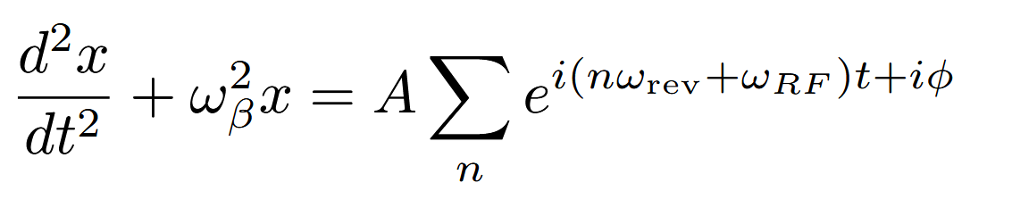
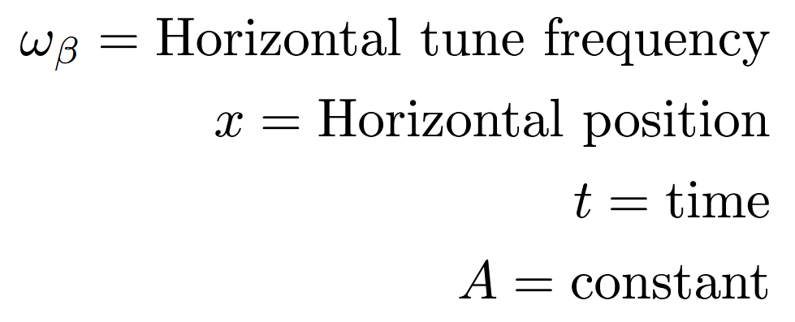
RF knockout mechanism

Slide 21
RF knockout mechanism

Slide 22

RF knockout mechanism
The RF knockout resonance condition is:

Slide 23
To recap
Beam stacking allows an FFA to accumulate more beam and deliver to the target.
But the beam stacking RF program can cause beam loss through RF knockout.
RF knockout happens when the horizontal tune synchronises with the RF knockout displacements.
The displacements build up like an integer resonance.
RF knockout loss happens here.
Energy
Debunch
Accelerate
Accelerate
Inject beam 1
Inject beam 2
Time

Slide 24
Mitigating RF knockout

Slide 25
How can we prevent RF knockout driven beam loss?

Slide 26
How can we prevent RF knockout driven beam loss?
All depends on removing the driving force from RF knockout.

Slide 27
How can we prevent RF knockout driven beam loss?
All depends on removing the driving force from RF knockout.
How can we remove the driving force?
Reduce the RF voltage or accelerate faster.

Slide 28
How can we prevent RF knockout driven beam loss?
All depends on removing the driving force from RF knockout.
How can we remove the driving force?
Reduce the RF voltage or accelerate faster.
Cancel out the RF knockout displacement with down stream cavities (local cancellation).

Slide 29
How can we prevent RF knockout driven beam loss?
All depends on removing the driving force from RF knockout.
How can we remove the driving force?
Reduce the RF voltage or accelerate faster.
Cancel out the RF knockout displacement with down stream cavities (local cancellation).
Leverage the properties of the RF knockout process to cancel out the beam oscillation (global cancellation).

Slide 30
Experiments at ISIS
ISIS is of course a synchrotron and not an FFA.
We cannot perform “proper” beam stacking in ISIS but we can imitate a beam stacking RF program using “storage ring mode”.
Allows for the investigation of RF knockout mitigation methods without an FFA.
… It turns out that the ISIS RF cavity layout is very convenient for testing RF knockout.

Slide 31
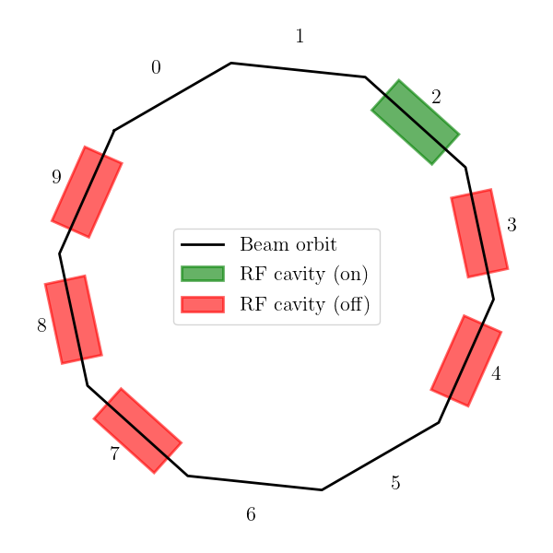
No mitigation case
ISIS fundamental RF cavity layout
This scenario is equivalent to the situation at the KURNS FFA beam stacking.

Slide 32
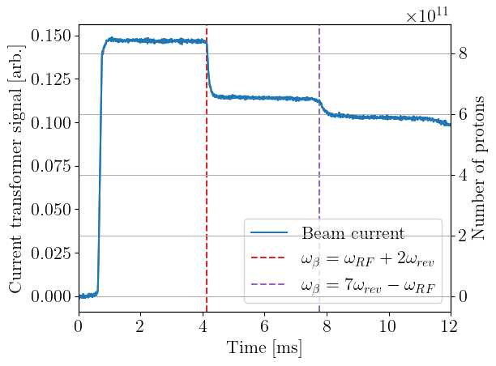
No mitigation case
ISIS fundamental RF cavity layout
Beam loss when the RF knockout conditions are met.
This scenario is equivalent to the situation at the KURNS FFA beam stacking.

Slide 33
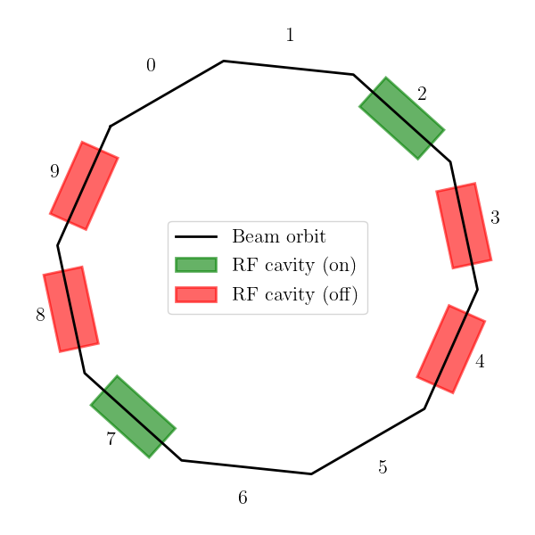
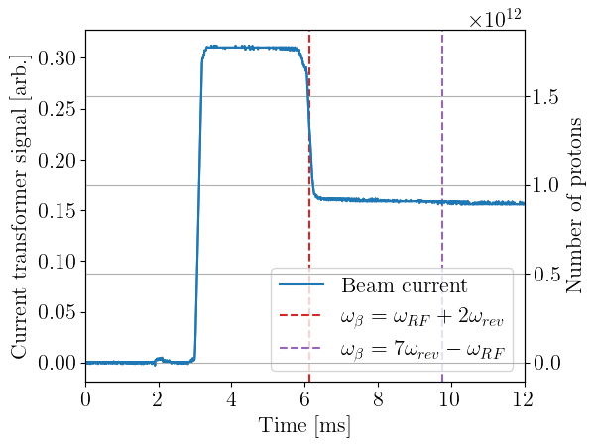
2 opposite cavities (global cancellation)
ISIS fundamental RF cavity layout
2 RF cavities on exact opposite sides of the ring
This one is cancelled
This RFKO condition is not cancelled.
By using more cavities, more conditions will be cancelled.

Slide 34
Summary
FFAs are one option for the proton driver for ISIS-II.
Beam stacking allows an FFA to accumulate beam and deliver more beam power to the target.
RF knockout can cause beam loss during the beam stacking RF programme.
Through a series of experiments at ISIS we’ve shown it is possible to mitigate the loss from RF knockout.
Results published here and submitted to PRAB.

Slide 35
Back ups

Slide 36
Experimental confirmation of RF knockout at ISIS
Procedure:
Set the magnets to a constant field (ie no acceleration).
Inject 70 MeV coasting beam.
Run this RF program to imitate a Beam Stacking RF program.

Slide 37
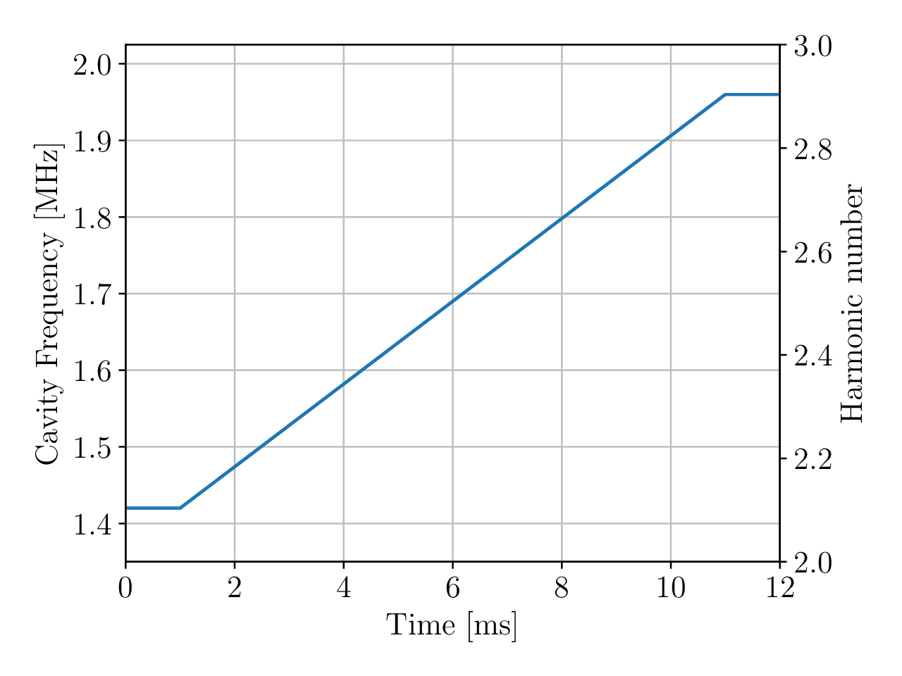


Experimental confirmation of RF knockout at ISIS
Procedure:
Set the magnets to a constant field (ie no acceleration).
Inject 70 MeV coasting beam.
Run this RF program to imitate a Beam Stacking RF program.
2.9*$ω_{rev}$
2.1*$ω_{rev}$
Beam loss when the RF knockout conditions are met.

Slide 38
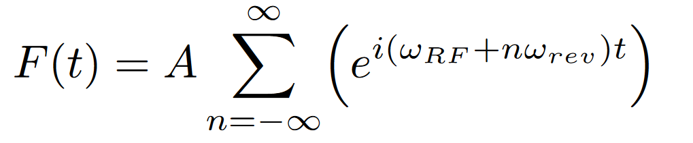
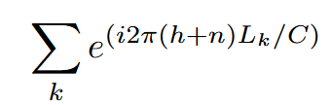
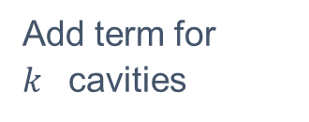

Global cancellation
Using the symmetry of the lattice, it is possible to cancel some of the RF knockout resonances…
Add term for $k^{}$cavities
$L_{k}$ $=$ $k^{th}$ cavity position in the ring.
C = ring circumference
i.e $L_{k}$/C = angular cavity position.
$h^{}=$ harmonic number
Driving force from one cavity only.

Slide 39
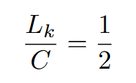
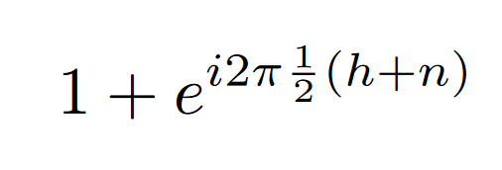
Global cancellation
Using the symmetry of the lattice, it is possible to cancel some of the RF knockout resonances…
Add term for $k^{}$cavities
$L_{k}$ $=$ $k^{th}$ cavity position in the ring.
C = ring circumference
i.e $L_{k}$/C = angular cavity position.
$h^{}=$ harmonic number
Driving force from one cavity only.
For two cavities on opposite side of the ring:

Slide 40
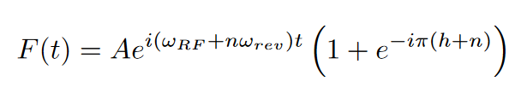
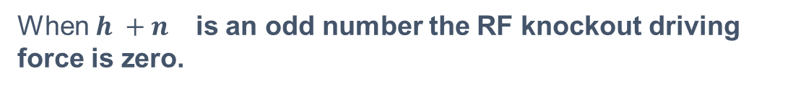
Global cancellation with two opposite cavities
Then the total force becomes:
When ${h +n}^{}$ is an odd number the RF knockout driving force is zero.

Slide 41
Global cancellation results
As the two voltage from the two cavities becomes more unequal, the RF knockout displacements return.
Zooming into the mitigated condition.
Still a small kick even with equal voltages → probably because of the error in the gap volts.

Slide 42
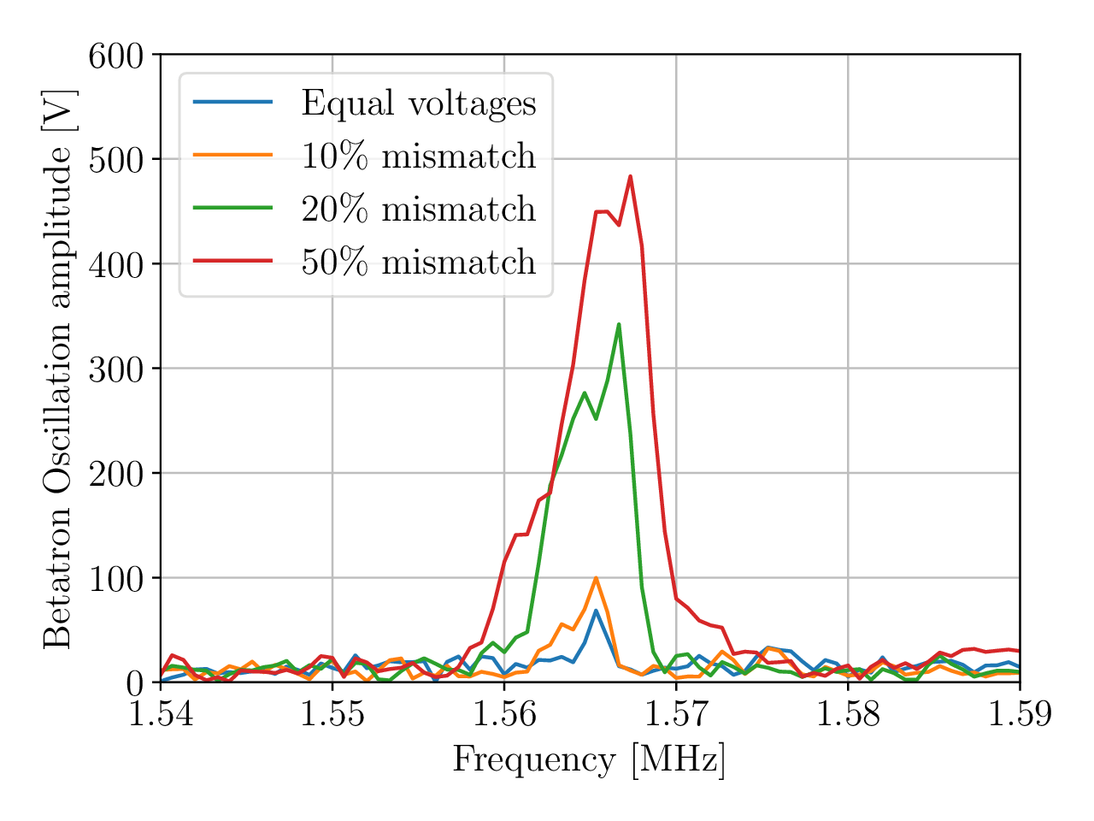
Global cancellation results
As the two voltage from the two cavities becomes more unequal, the RF knockout displacements return.
Zooming into the mitigated condition.
Still a small kick even with equal voltages → probably because of the error in the gap volts.
Unlike the local cancellation this method does not effect the acceleration of the second beam.
→ But it does not cancel every condition.

