Slide 1


Efficient Free-Electron Laser Modelling Using a Lorentz-Boosted Coordinate System
Runfeng Luo
Zulfikar Najmudin

Slide 2
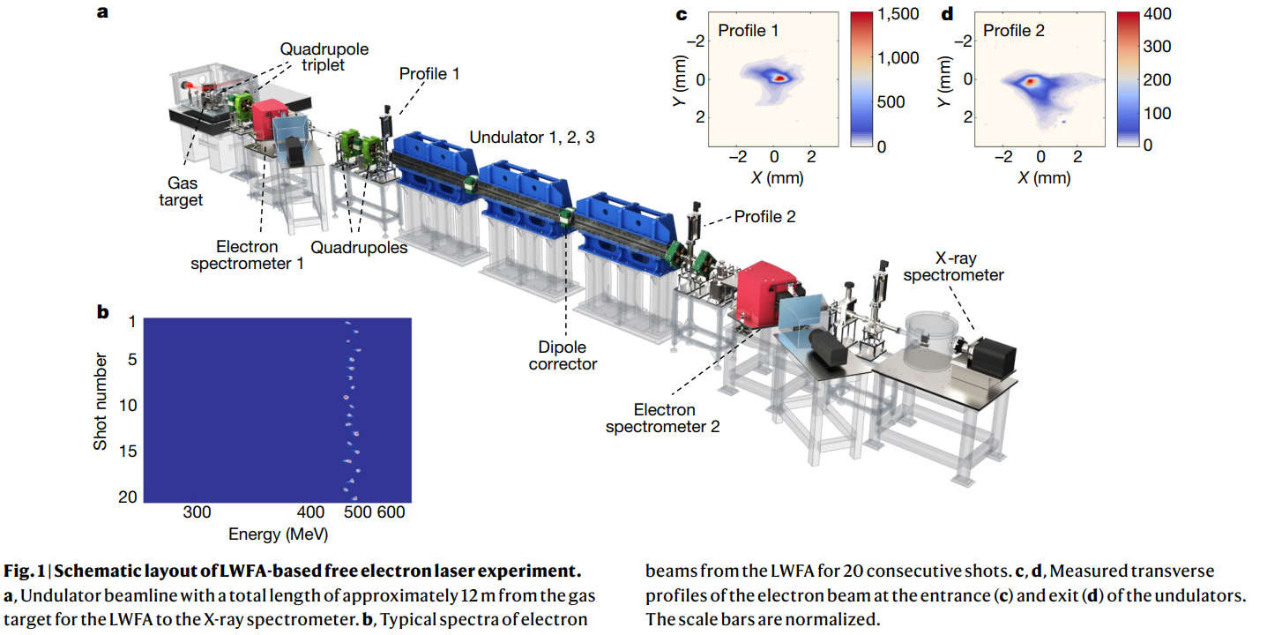
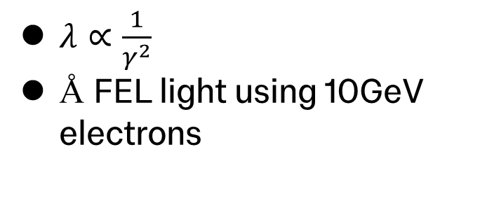
Free-electron Laser (FEL)
$λ∝\frac{1}{γ^{2}}$
Å FEL light using 10GeV electrons
Demonstration of the laser wakefield based FEL.
W. Wang et al. Nature (2021)
undulator
electron beam

Slide 3
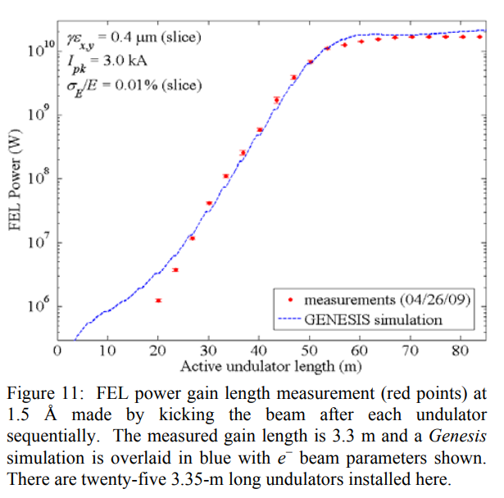
Genesis FEL Code
Time dependent code
Solve Maxwell equations in paraxial approximation
Solve longitudinal slices
Doesn’t fully model longitudinal expansion
S. Reiche, thesis (1999)
P. Emma et al. Proceedings of Particle Accelerator Conference (2009)

Slide 4
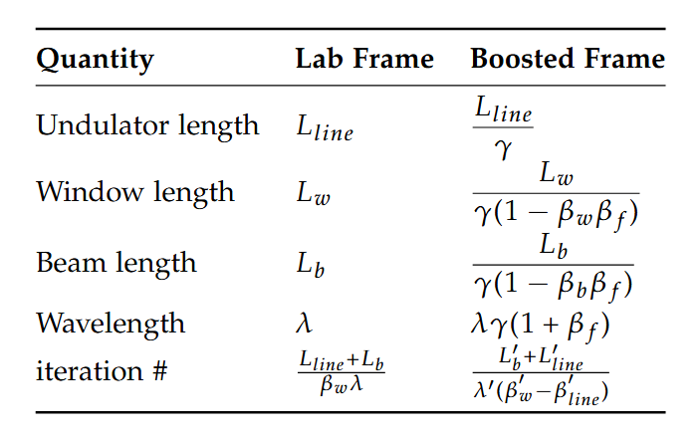




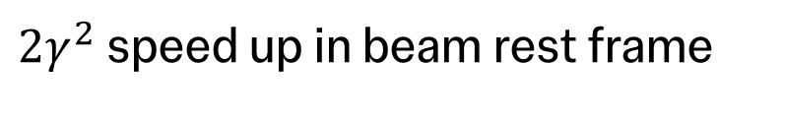




Principle of the Boosted Frame Simulations
$L_{w}$, $λ$
lab frame
$$L_{b}$$
$$L_{line}$$
$$β_{b}$$
$L_{w}′$, $λ′$
boosted frame
$$L_{b}′$$
$$L_{line}′$$
$2γ^{2}$ speed up in beam rest frame
$$β_{b}′$$
R. Luo et al. (in preparation), On the Numerical Behavior and Modeling Considerations of Boosted-Frame PIC Simulations
J.-L. Vay, Phys. Rev. Lett. (2007)

Slide 5
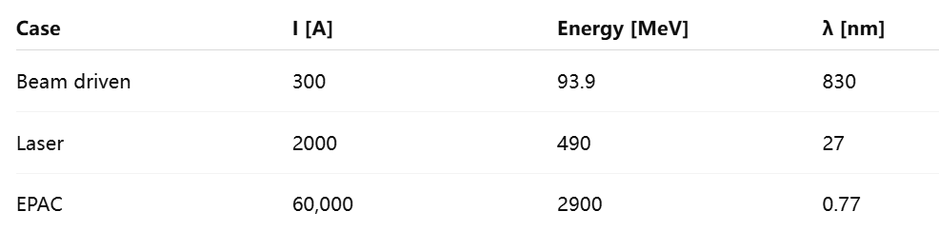
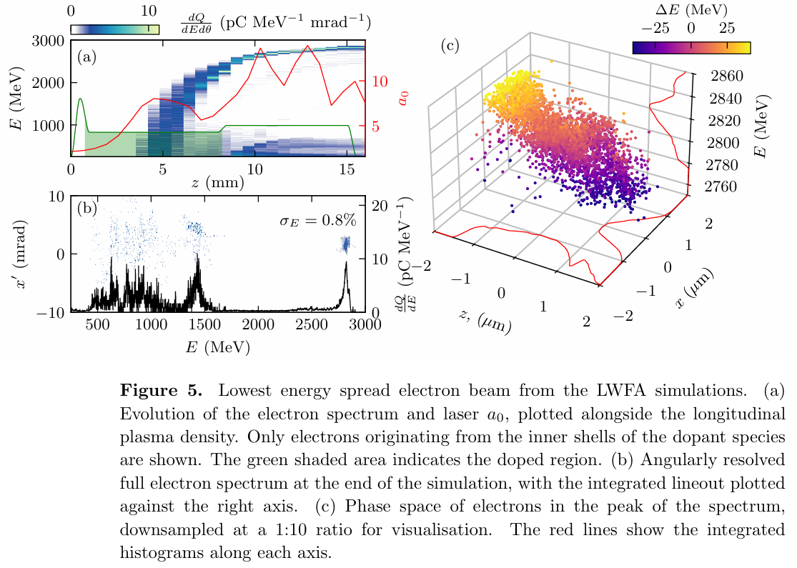
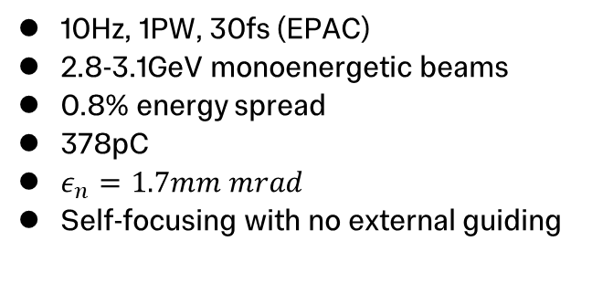
Extreme Photonics Applications Centre (EPAC)
10Hz, 1PW, 30fs (EPAC)
2.8-3.1GeV monoenergetic beams
0.8% energy spread
378pC
$ε_{n}=1.7mm mrad$
Self-focusing with no external guiding
W. Wang et al. Nature (2021)
R. Pompili et al. Nature (2022)
M. P. Backhouse et al. Machine Learning: Science and Technology (submitted)
Courtesy of M. P. Backhouse
Notes:
Ref beams parameters (ref of micheal’s paper), highlight it’s self guided replace epac pic with micheal’s beam remove beamline fig

Slide 6
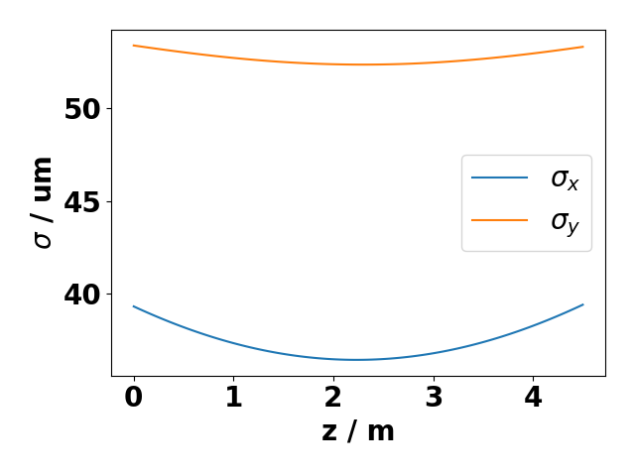
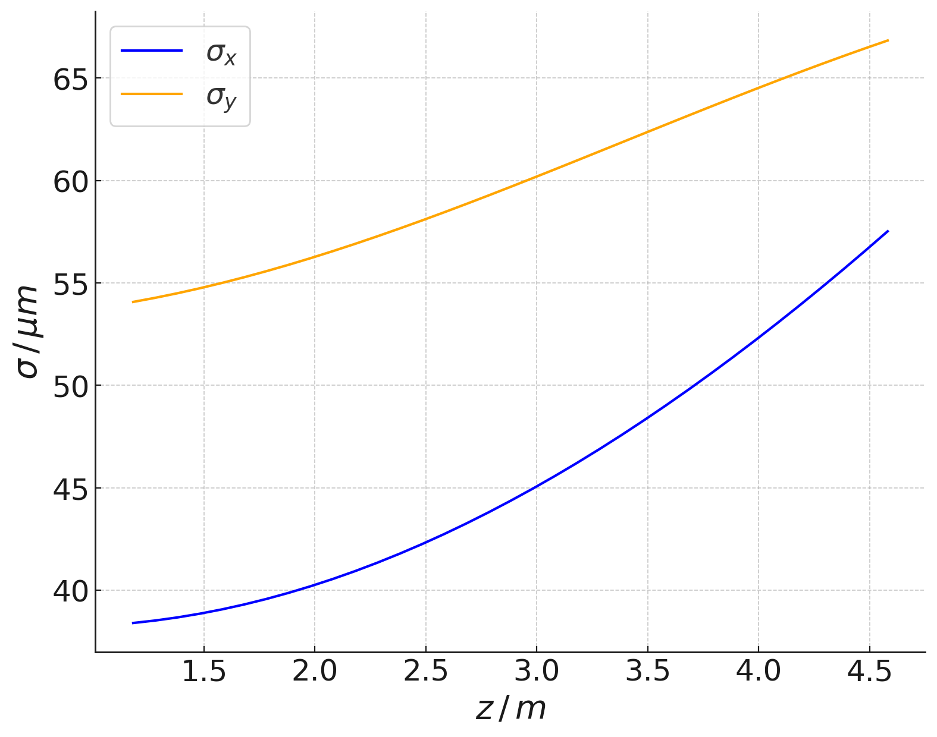
Transverse Beam Size (490MeV)
490MeV beam
Lasing at 27nm
Three 1.5m long undulator
2.5cm period, K=1.4
Assumed a single undulator unit for simplicity
Reduced computation time from months to hours
W. Wang et al. Nature (2021)
Beam matching
PIC
Notes:
Ref again (put one of their results again)

Slide 7
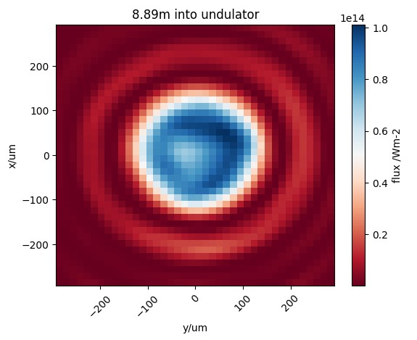
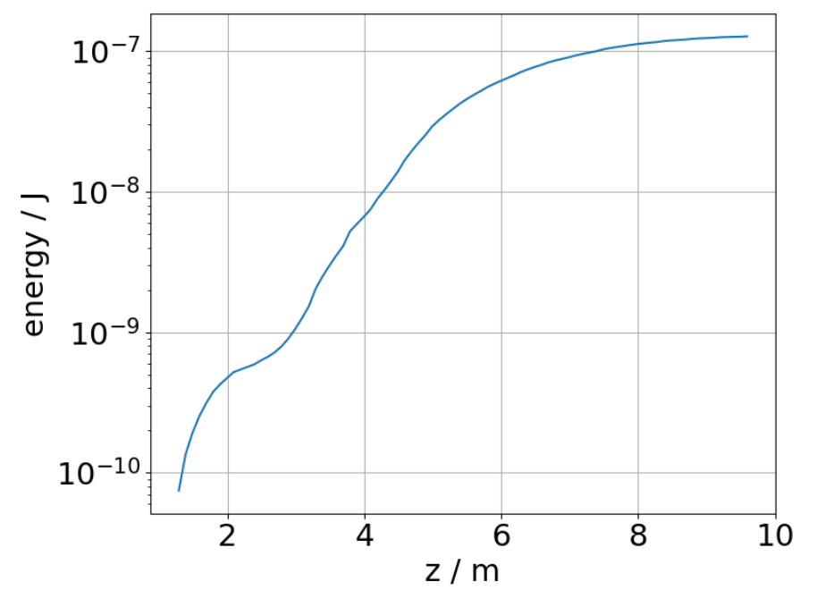
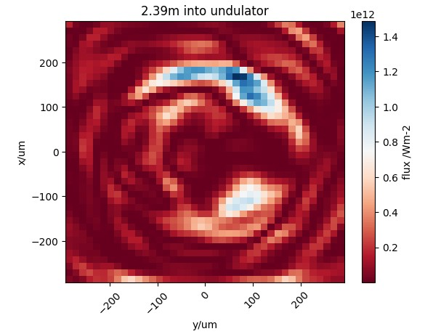
Radiation Energy
Notes:
Put flux plots side by side

Slide 8
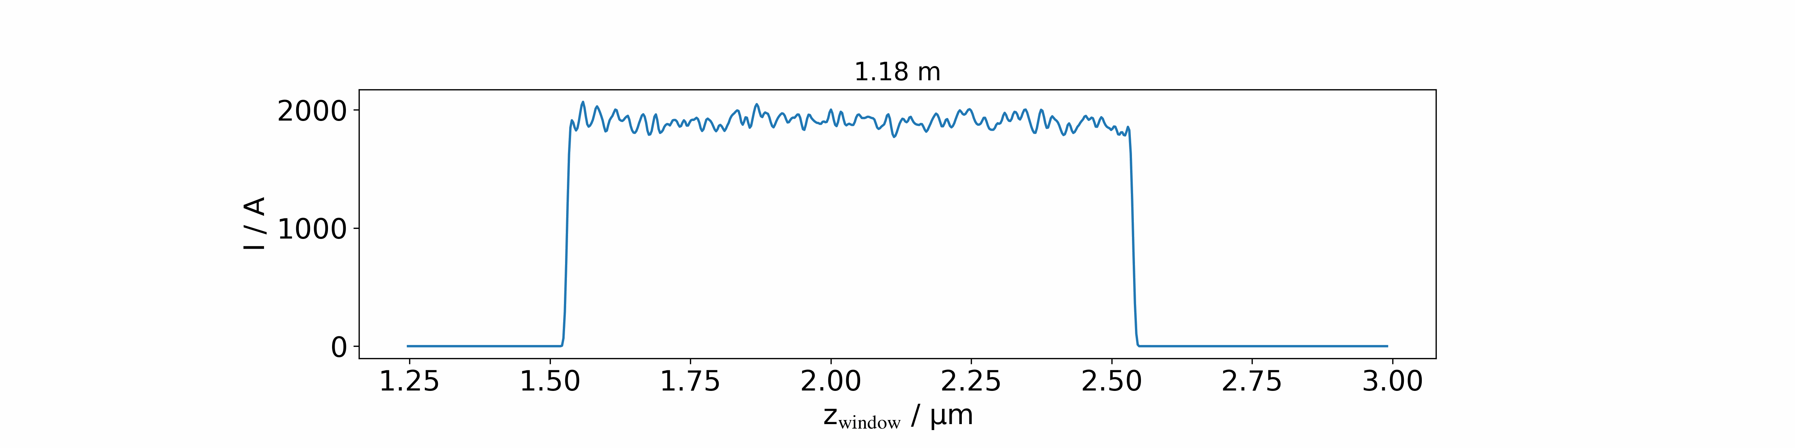

Current Profile
Notes:
Mention space charge straight after this

Slide 9
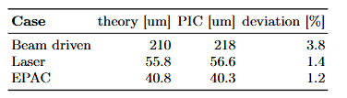
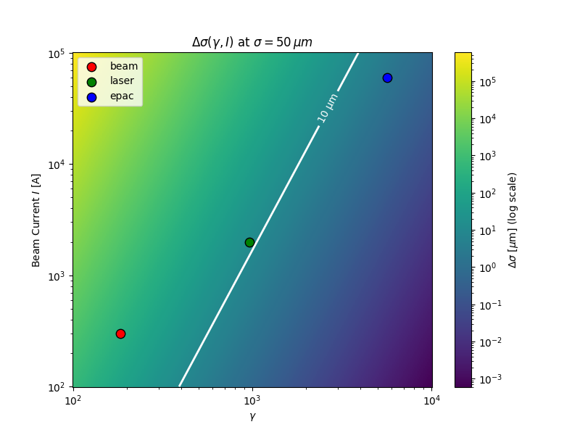


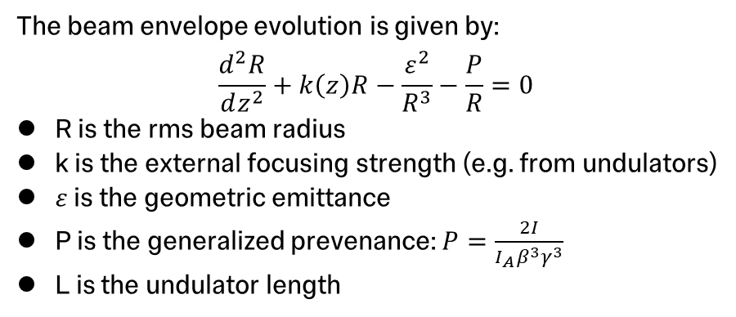
Space Charge
The beam envelope evolution is given by:
$$\frac{d^{2}R}{dz^{2}}+k\left(z\right)R−\frac{ε^{2}}{R^{3}}−\frac{P}{R}=0$$
R is the rms beam radius
k is the external focusing strength (e.g. from undulators)
$ε$ is the geometric emittance
P is the generalized prevenance: $P=\frac{2I}{I_{A}β^{3}γ^{3}}$
L is the undulator length
$$Δσ≈\frac{PL^{2}}{\begin{aligned}8σ_{i} \\ \end{aligned}}$$
Scaling law:
$Δσ=\frac{5.956I}{γ^{3}}$
Assuming a 50um beam size
R. Luo et al. (in preparation), Efficient Free-Electron Laser Modelling Using a Lorentz-Boosted Coordinate System
Notes:
Present epac, say it’s preminlary

Slide 10
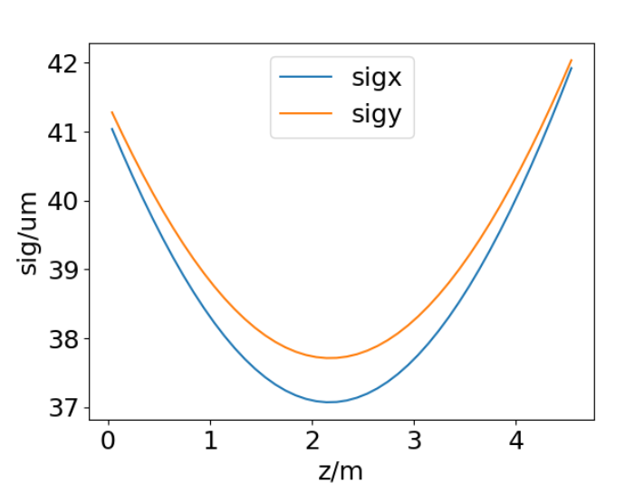
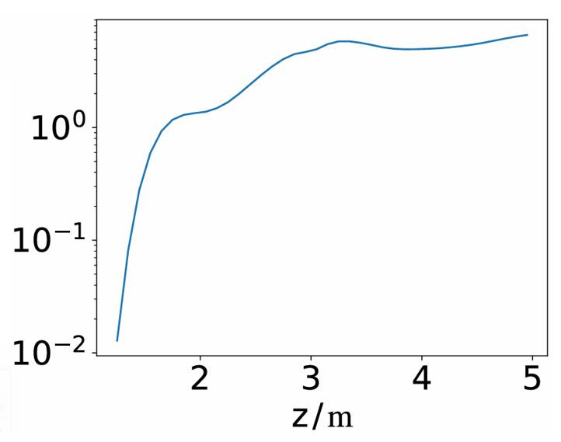

EPAC
Power (a.u.)
Notes:
Present epac, say it’s preminlary

Slide 11
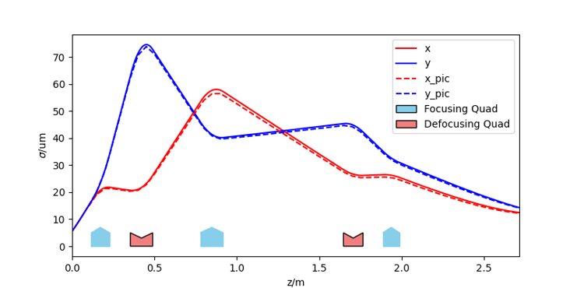
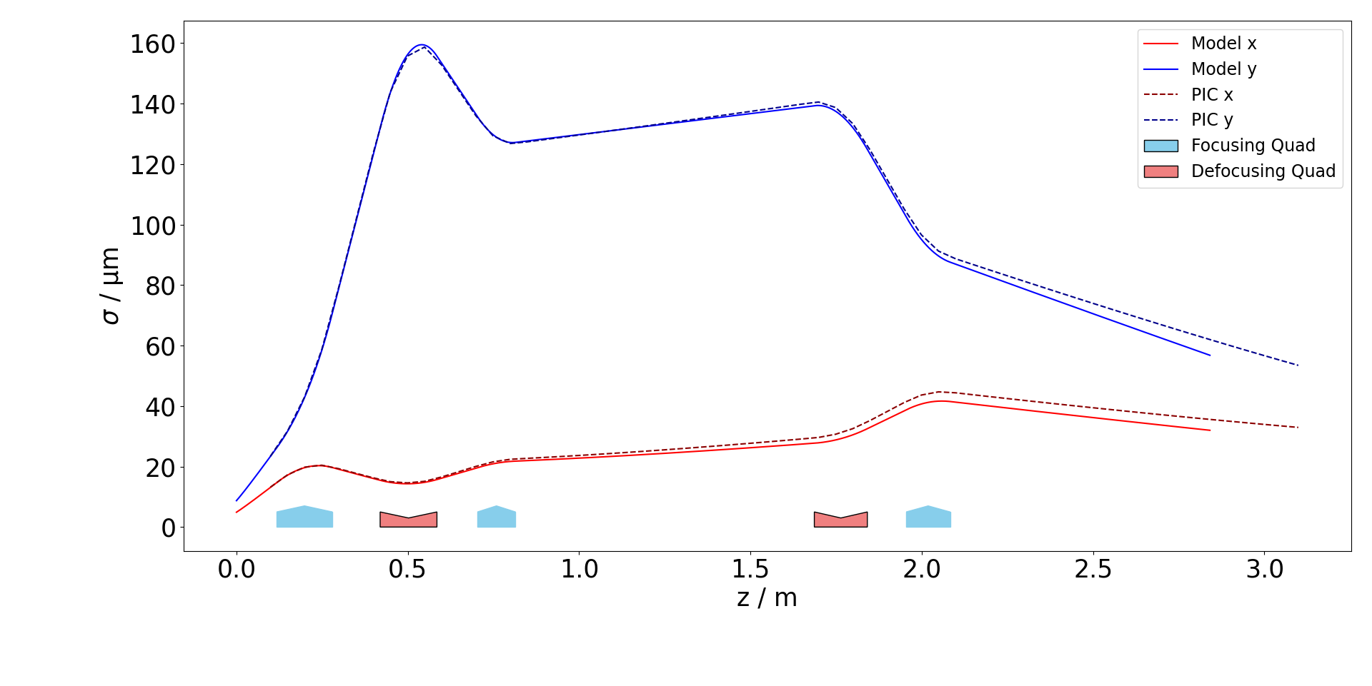
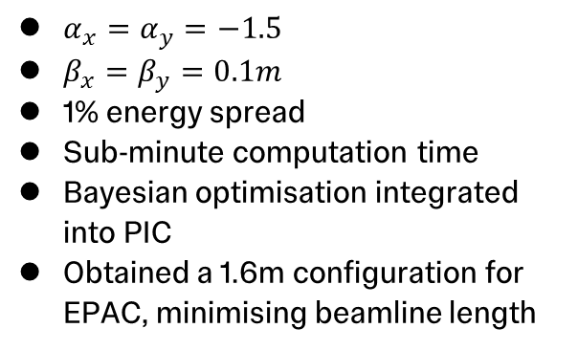
Transport (PIC vs Twiss)
$α_{x}=α_{y}=−1.5$
$β_{x}=β_{y}=0.1m$
1% energy spread
Sub-minute computation time
Bayesian optimisation integrated into PIC
Obtained a 1.6m configuration for EPAC, minimising beamline length
R. Luo et al. (in preparation), Integrated Particle-in-Cell Simulation and Bayesian Optimization for Transport Beamline Design
490MeV
2.9GeV

Slide 12
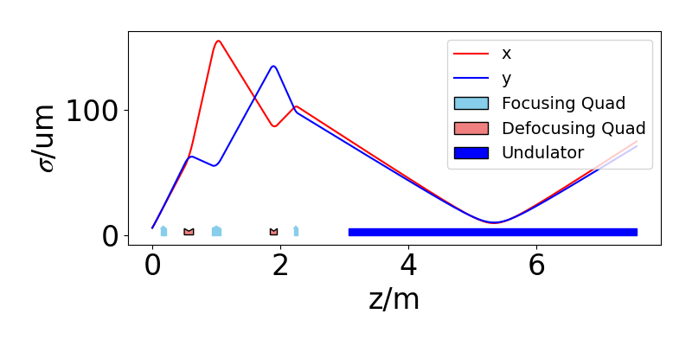
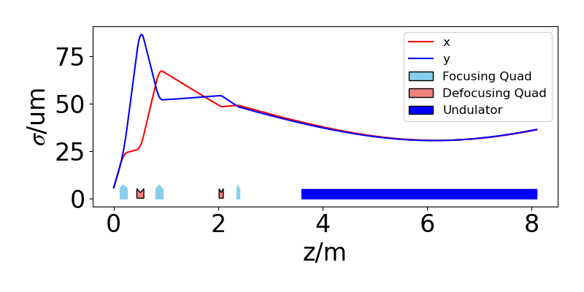
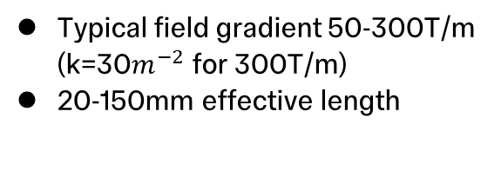

EPAC Transport
Typical field gradient 50-300T/m (k=30$m^{−2}$ for 300T/m)
20-150mm effective length
Peak gradient of 150T/m
Peak gradient of 300T/m, $σ^{∗}=30um$

Slide 13
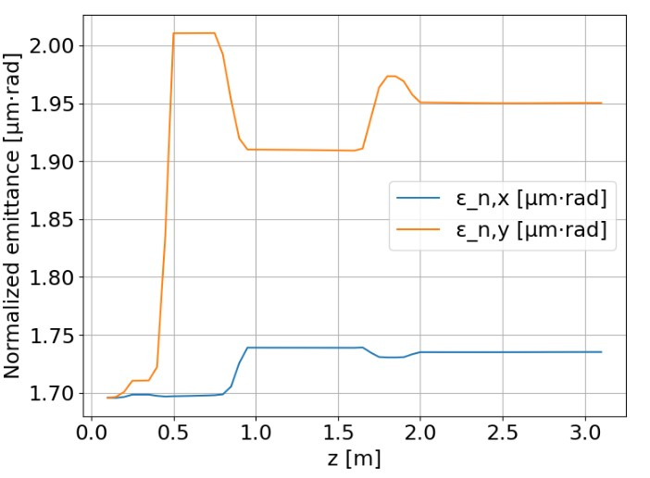

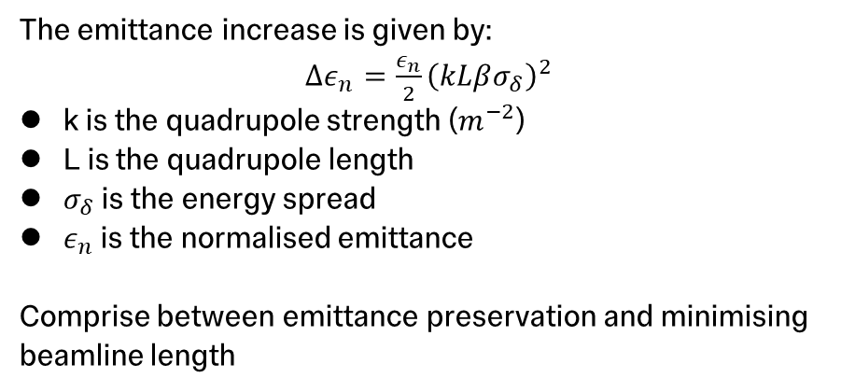
EPAC Transport ($\frac{ΔE}{E}=1\%$)
The emittance increase is given by:
$Δε_{n}=\frac{ε_{n}}{2}{\left(kLβσ_{δ}\right)}^{2}$
k is the quadrupole strength ($m^{−2}$)
L is the quadrupole length
$σ_{δ}$ is the energy spread
$ε_{n}$ is the normalised emittance
Comprise between emittance preservation and minimising beamline length
W. Wang et al. Nature (2021)

Slide 14
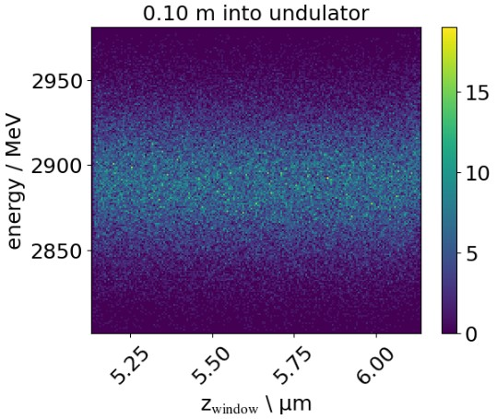
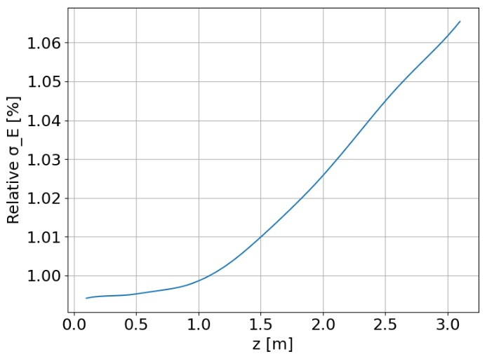
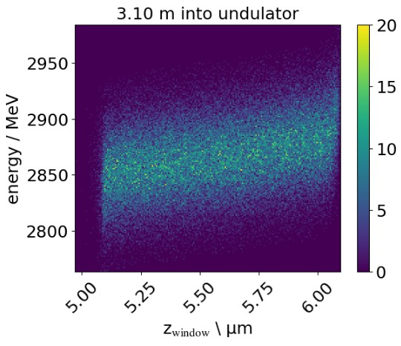
Energy Spread

Slide 15

Conclusion
Space charge effects and energy modulation are significant for wakefield based FELs
Boosted frame simulation fully captures the dynamics
Boosted frame simulation offers ${2γ}^{2}$ speed up
Bayesian optimisation coupled with PIC for beamline design
Notes:
Epac parameters

Slide 16
References
[1] W. Wang et al. Free-electron lasing at 27 nanometres based on laser wakefield accelerator. 2021
[2] R. Pompili, et al. Free-electron lasing with compact beam-driven plasma wakefield accelerator. 2022.
[3] S. Reiche, GENESIS 1.3: a fully 3D time-dependent FEL simulation code
[4] P. Emma, et al. FIRST LASING OF THE LCLS X-RAY FEL AT 1.5 Å. 2009.
[5] J.-L. Vay. Noninvariance of Space- and Time-Scale Ranges under a Lorentz Transformation and the Implications for the Study of Relativistic Interactions. 2007
[6] J.-L. Vay, et al. Warp-X: a new exascale computing platform for beam-plasma simulations. 2018
[7] M. P. Backhouse, and Z. Najmudin. Machine Learning: Science and Technology (submitted)

Slide 17
Thank you

Slide 18
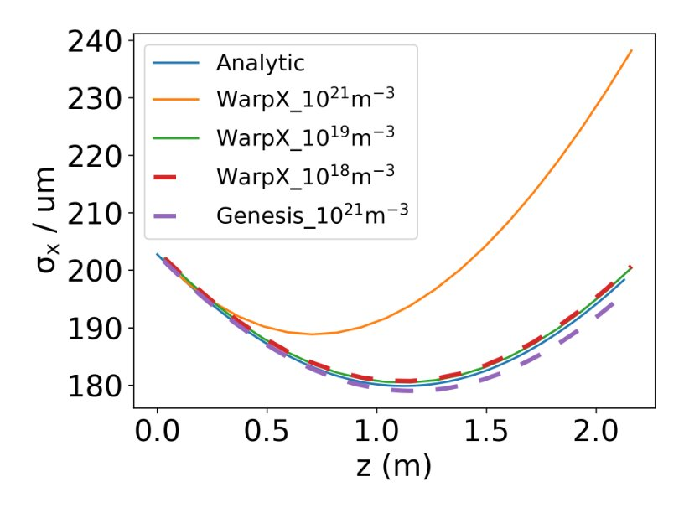
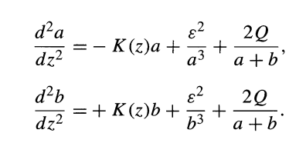
Motion along Electron Wiggling Direction (100MeV)
Space charge term has a large contribution at high densities
Transfer matrices only model the effect of the beam optics

Slide 19
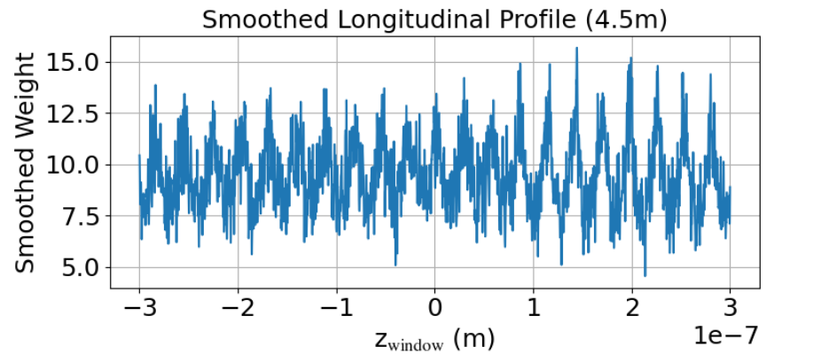
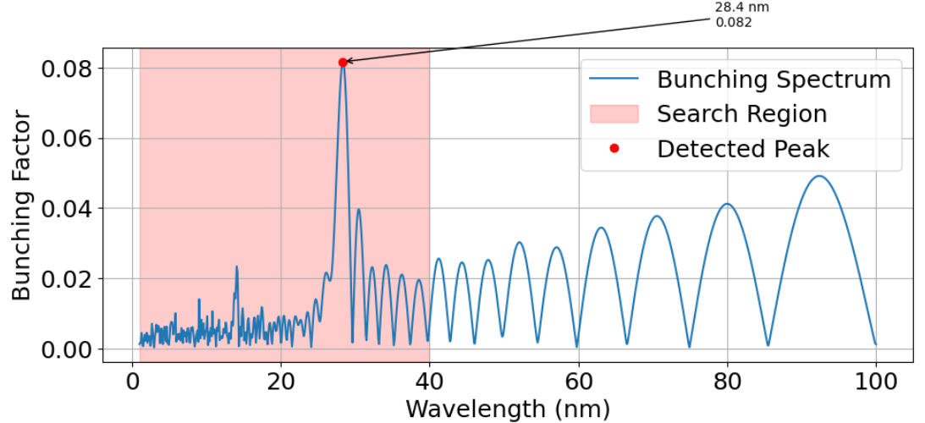
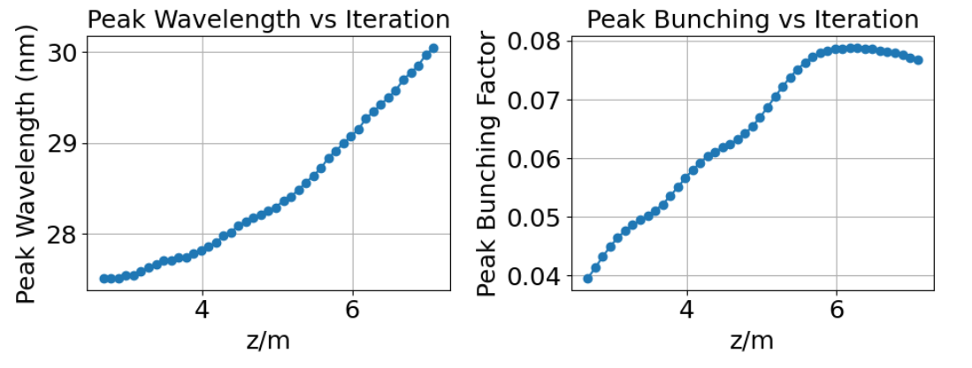
Bunching

Slide 20
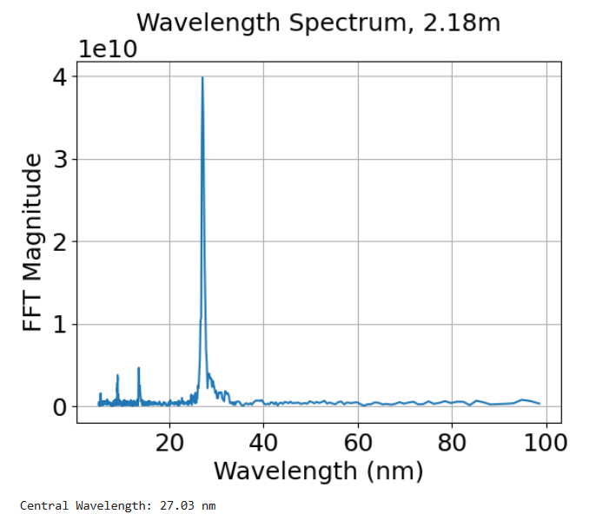
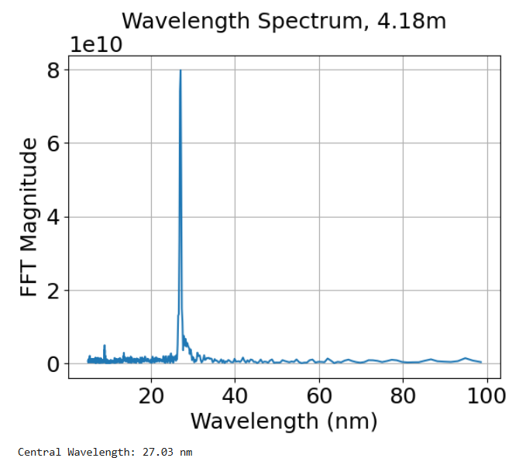
Radiation Wavelength

Slide 21
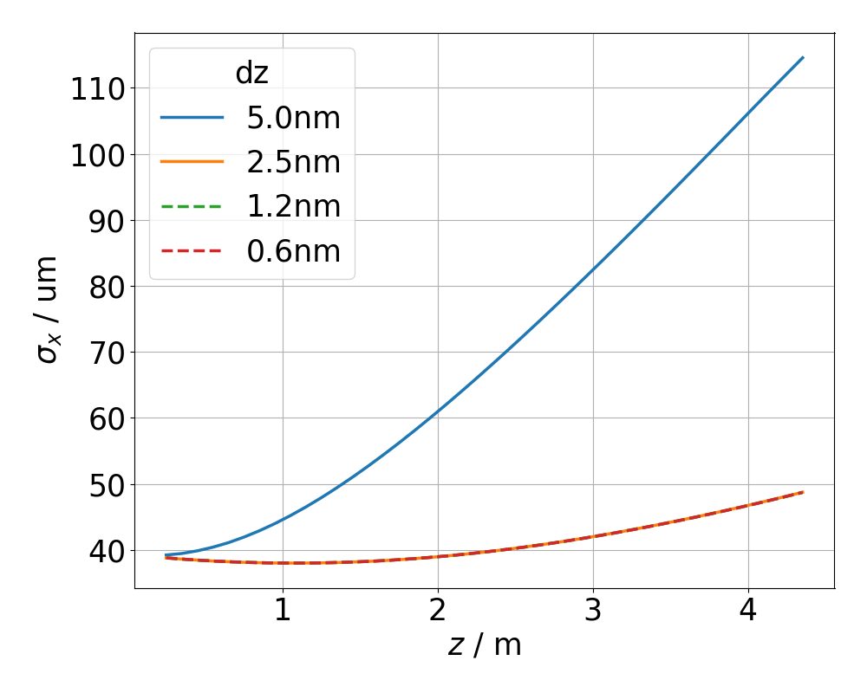
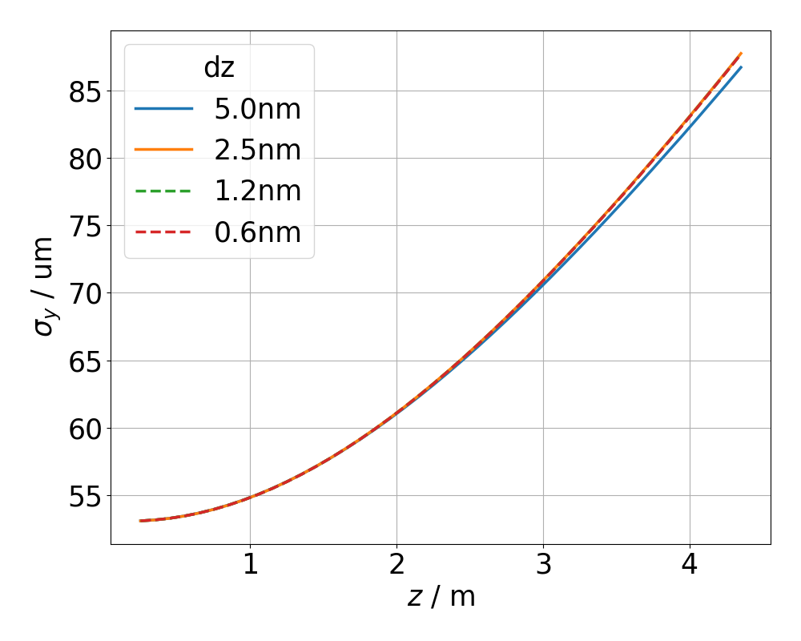
Convergence Scan (490MeV)

Slide 22
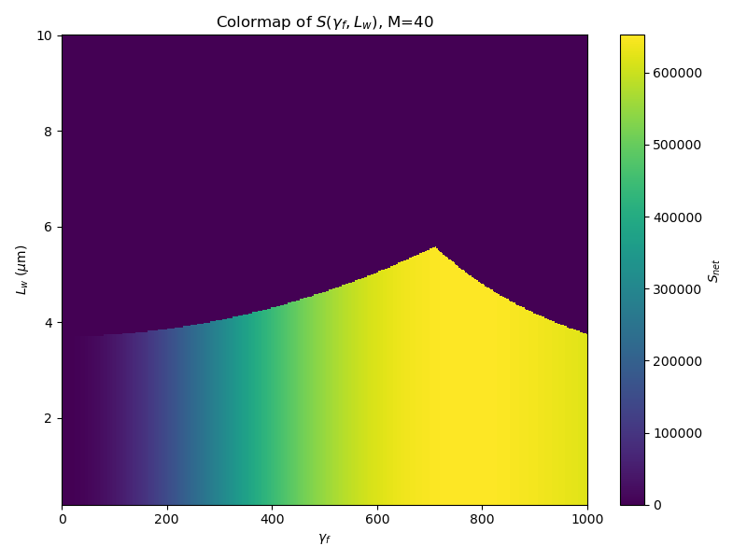
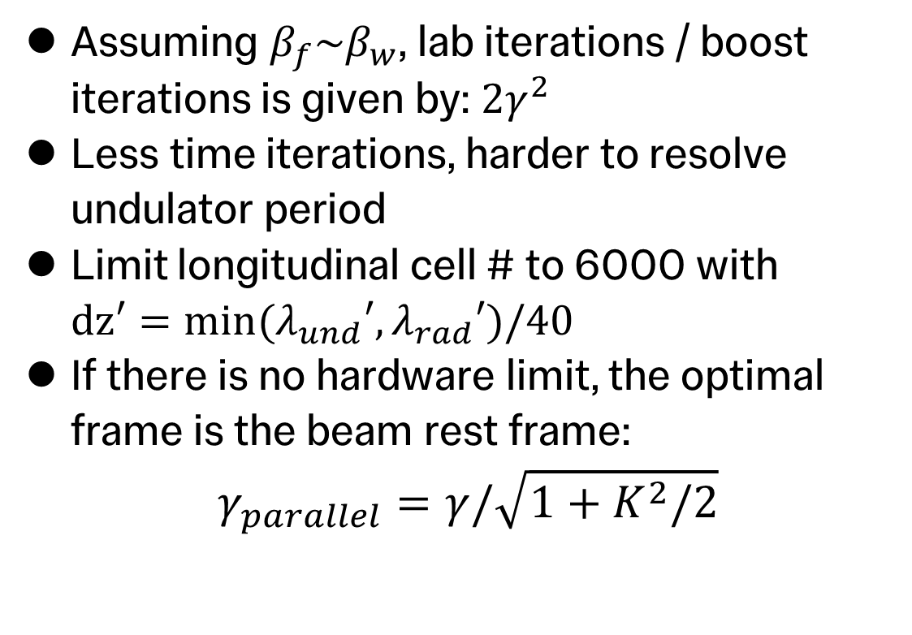
Optimal Frame and Speed Up
Assuming $β_{f}\sim β_{w}$, lab iterations / boost iterations is given by: $2γ^{2}$
Less time iterations, harder to resolve undulator period
Limit longitudinal cell # to 6000 with ${dz′=min⁡(λ}_{und}′,λ_{rad}′)/40$
If there is no hardware limit, the optimal frame is the beam rest frame:
$$γ_{parallel}=γ/\sqrt{1+K^{2}/2}$$

Slide 23
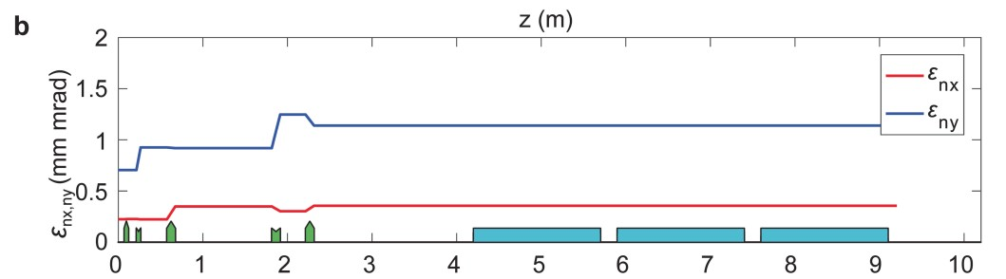
EPAC Transport ($\frac{ΔE}{E}=1\%$)
W. Wang et al. Nature (2021)

Slide 24
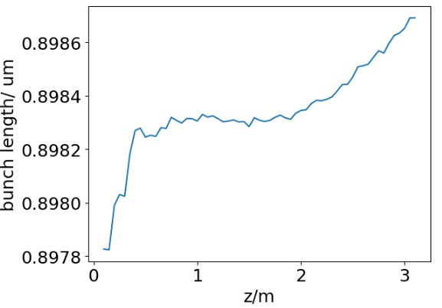
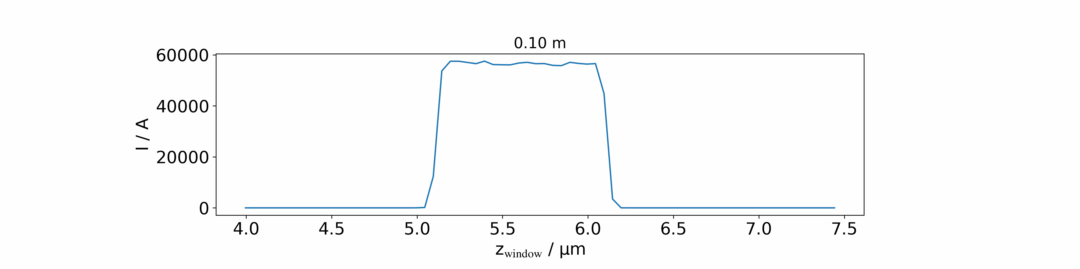
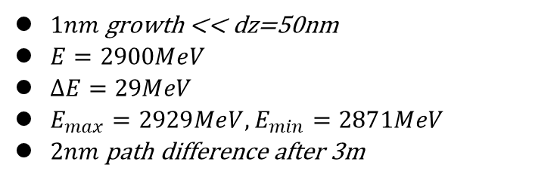
EPAC Transport ($\frac{ΔE}{E}=1\%$)
$1nm$ growth << dz=50nm
$E=2900MeV$
$ΔE=29MeV$
$E_{max}=2929MeV, E_{min}=2871MeV$
$2nm$ path difference after 3m
90% charge

Slide 25
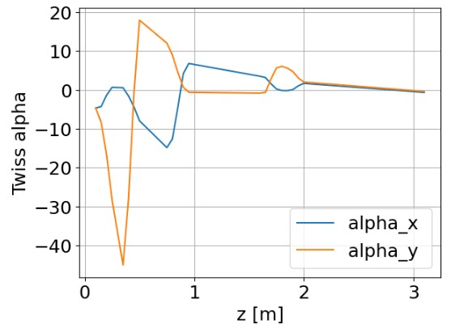
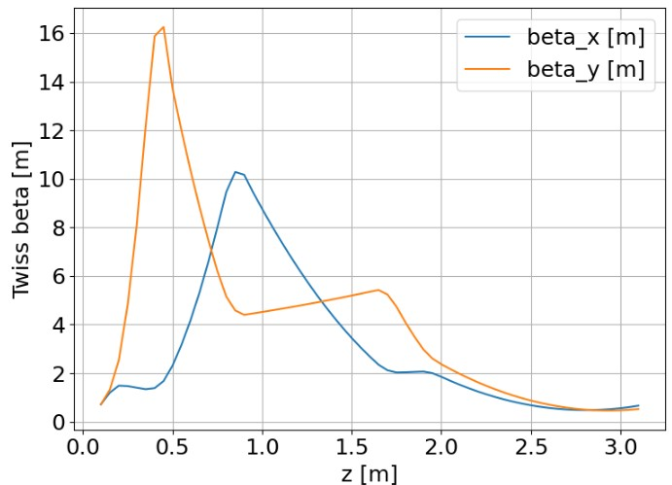
Epac Twiss

Slide 26
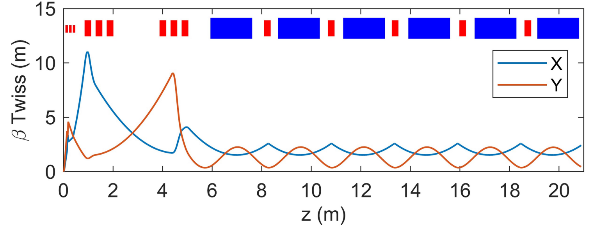


FEL Beamlines
$\frac{λ}{20}$ Boosted frame simulation in beam rest frame
WarpX simulation takes a few hours on RTX6000 to simulate several meters

