Slide 1



Environmental Testing of Satellite Sub Assemblies:
UMBRAGROUP-SERMS’s Experience
Workshop on Small Satellites:
Environmental Testing in New Space
Wiener Neustadt, March 10th, 2026
Presenters: ALESSIA RICCI; SERENA BORSINI

Slide 2

AGENDA
Quick overview of UGI and SERMS.
Environmental testing of a brake assembly for an In-Orbit Servicing satellite: challenges and solutions for the New Space Economy
SERMS as space testing service provider: capabilities and overview
Commercial Optical Multiplexer devices - Screening Test Activities for space application
umbragroup.com This presentation is the Intellectual property of UMBRAGROUP.

Slide 3


Quick overview on UGI and SERMS
umbragroup.com This presentation is the Intellectual property of UMBRAGROUP.

Slide 4
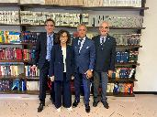
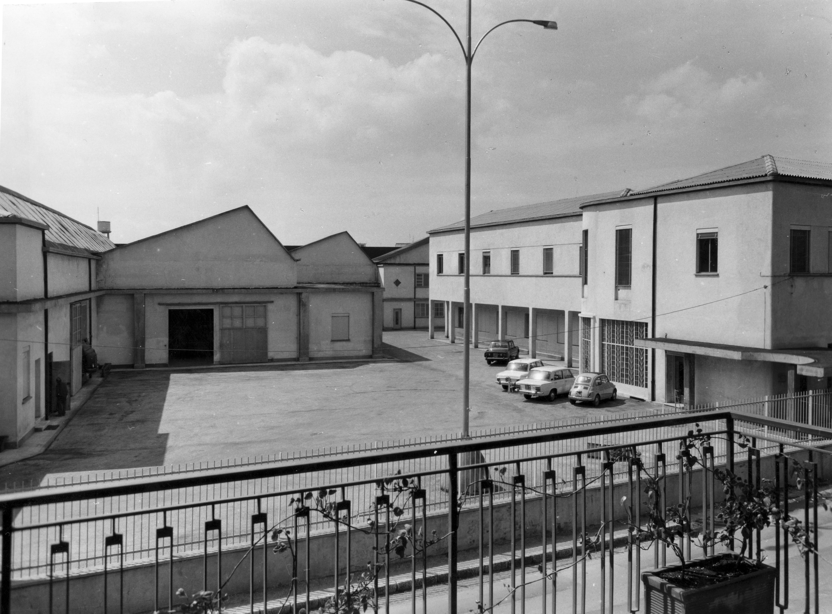
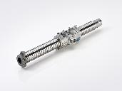
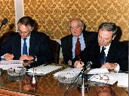
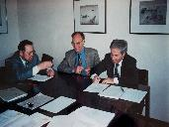
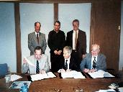
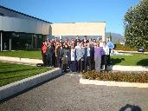
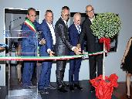
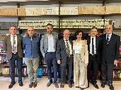
OUR STORY
Through innovation and collaboration, milestones that shaped who we are today
From a visionary founding in 1972 to our most recent strategic evolution in 2025, UMBRAGROUP’s journey is marked by growth, innovation, and a relentless commitment to partnership. Each milestone reflects our identity as motion solution partners, our global expansion, and our continuous investment in people, technology, and values.
1972
1978
1993
1996
1999
2008
2017
2023
2025
FAG Kugelfischer, Schweinfurt [DE] and
la GEP| [IT] found Umbra Cuscinetti SpA
for the production
of high-precision bearings.
The company begins
the production of ball screws for aviation applications.
Valter Baldaccini champions Management Buyout deal with Reno Ortolani and other local investors acquires 100% of Umbra Cuscinetti SpA shares.
Umbra Cuscinetti SpA acquires Kuhn GmbH [DE].
Umbra Cuscinetti SpA
Acquires Umbra
Cuscinetti Inc. [Washington - USA].
Widespread shareholding: Managers and
employees join the
social structure of Umbra Cuscinetti SpA.
Umbra Cuscinetti
SpA celebrates its 45th anniversary with the inauguration
of the Testing Room. Acquisition of SERMS SrI in Terni (TR).
UMBRAGROUP SpA acquires 51% of COMEAR and BSP shares and 100% of ERA Electronic Systems shares.
UMBRAGROUP unveils its refreshed Brand Strategy: “We are not just product manufacturers, but solution partners—driven by purpose, guided by values.”
umbragroup.com This presentation is the Intellectual property of UMBRAGROUP.

Slide 5
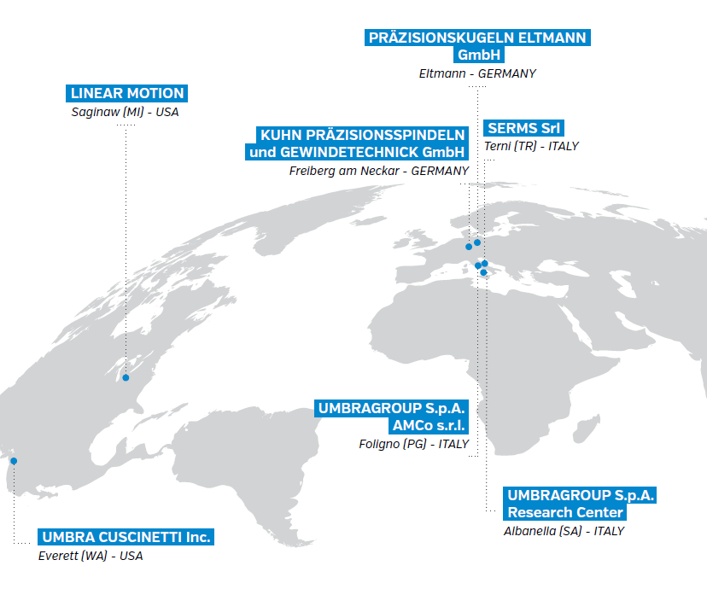
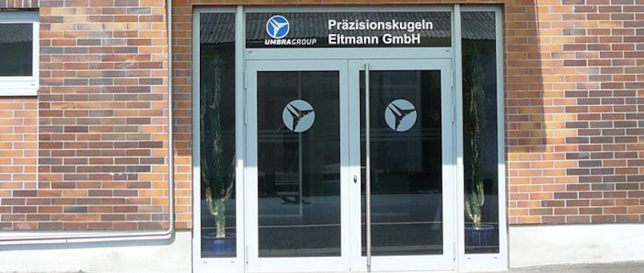
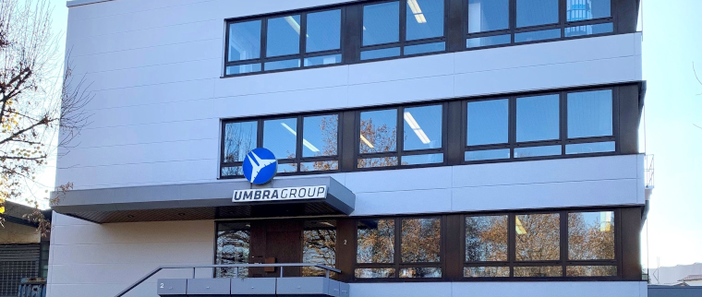
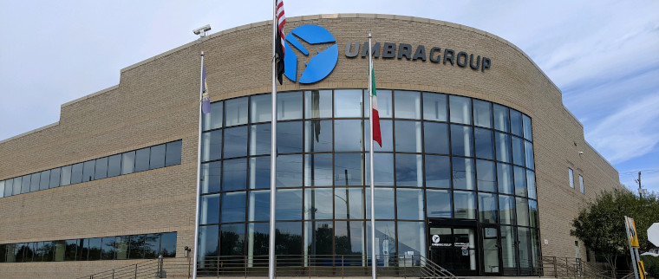
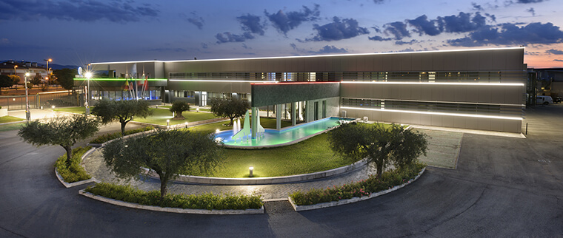
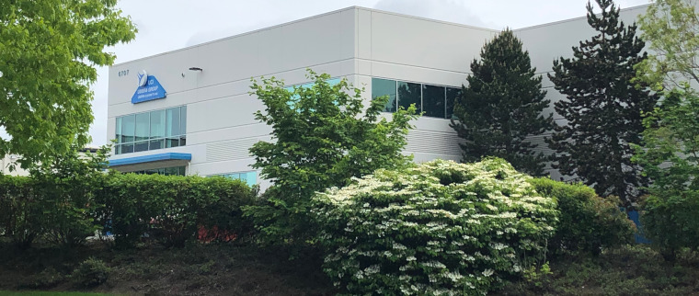
GLOBAL FOOTPRINT AND SIZE
An International Presence with the Agility to Serve Every Market
umbragroup.com This presentation is the Intellectual property of UMBRAGROUP.

Slide 6
Environmental testing of a brake assembly for an In-Orbit Servicing satellite: challenges and solutions for the New Space Economy
umbragroup.com This presentation is the Intellectual property of UMBRAGROUP.

Slide 7
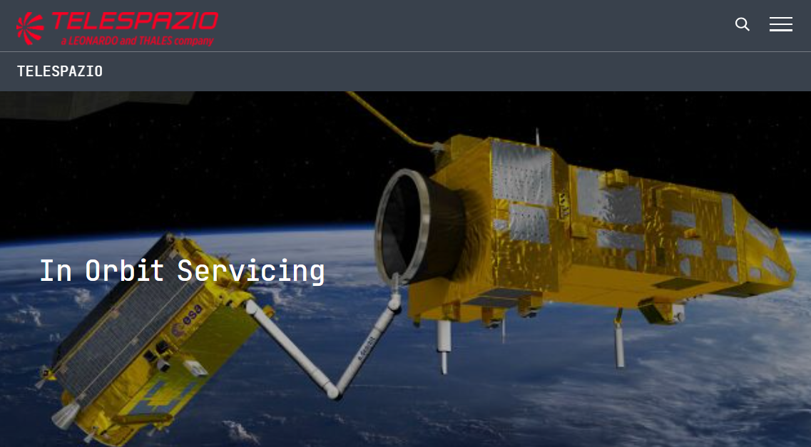
PLATFORM OVERVIEW
IOS as a representative of the New Space Economy
In-Orbit Servicing (IOS) demonstration mission, commissioned by the Italian government, thanks to the National Recovery and Resilience Plan (PNRR) fund, with the support of the Italian Space Agency (ASI).
Led by Thales Alenia Space, the mission also involves Leonardo, Avio and D-ORBIT and aims to develop enabling technologies and operations to make space more sustainable, including, for instance, refuelling satellites directly in space, repairing or replacing their components, moving them to another orbit, or facilitating their smooth atmospheric re-entry.
UGI, as a Tier-2, designs and qualifies an electromechanical actuator and 2 electromechanical
power-off brakes for the robotic arm of the IOS mission.
umbragroup.com This presentation is the Intellectual property of UMBRAGROUP.

Slide 8
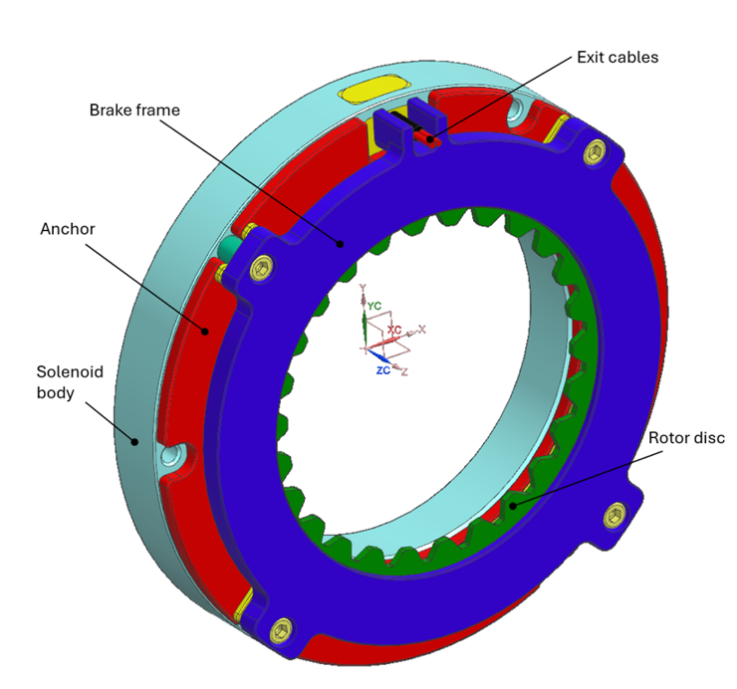
OBJECT OF SUPPLY
Electromechanical power-off brakes
Envelope & Weight
 | LIGHT | HEAVY
Size | 89 mm diameter 19 mm axial length | 89 mm diameter 21 mm axial length
Torque requirement
Minimum braking torque | 0.8 Nm | 3.1 Nm
Maximum braking torque | 1.6 Nm | 3.7 Nm
Environmental conditions (LEO)
Life | 500 static braking events + 100 dynamic braking events, at 1000 rpm 5 Years in LEO environment
Outgassing | Compatibility with 10E-04 pressure, CVCM and RML within the ECSS limits
Temperature range | Operational: -51°C to +100°C Non operational: -60°C to +100°C
Random Vibrations | Up to 35 Grms in all axes, Freq. From 20 to 2000 Hz
Sine Vibrations | 25g sine loads within the spectrum 5-110Hz
Shock | 29g @100Hz; 1414g @1000 and 10000Hz
The main challenge: extremely tight torque range to be guaranteed in these environmental conditions, considering an extremely high variation of the friction properties of the pad material
→ CHOICE OF SUITABLE FRICTION MATERIAL IS THE FIRST DESIGN STEP
Brake overview
umbragroup.com This presentation is the Intellectual property of UMBRAGROUP.

Slide 9

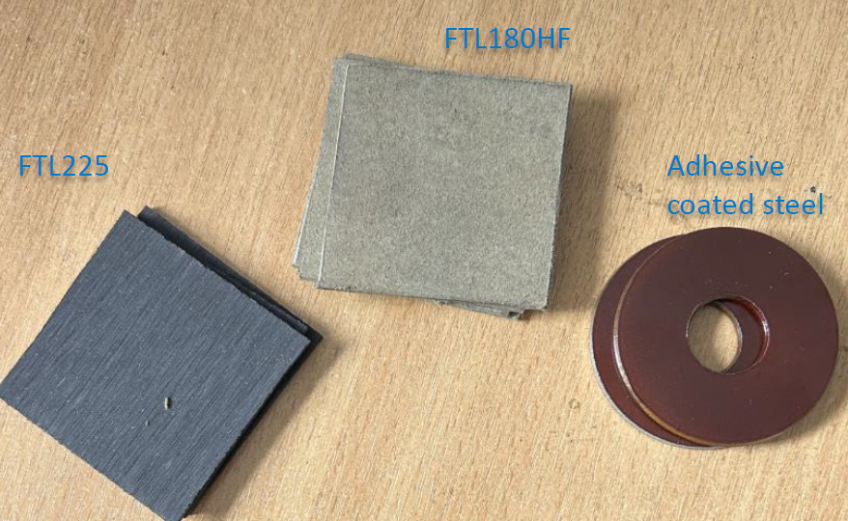
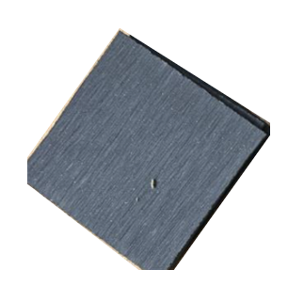
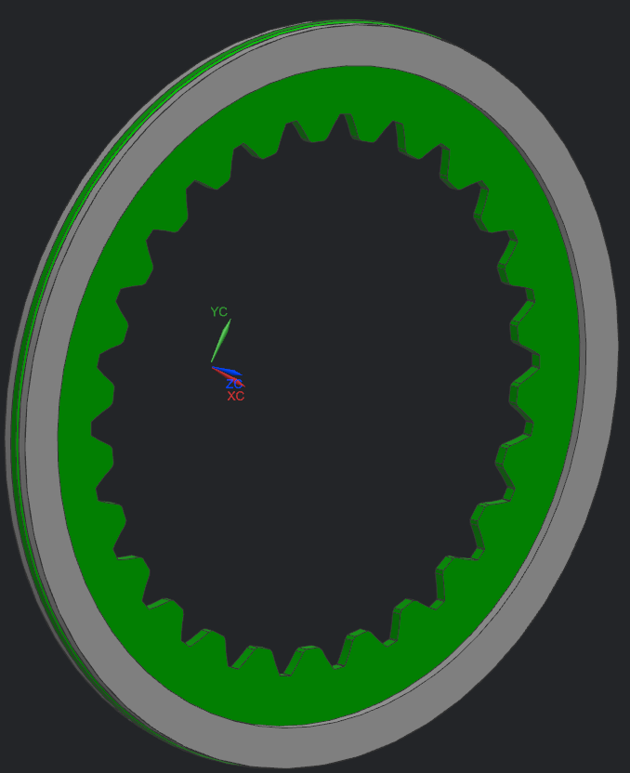

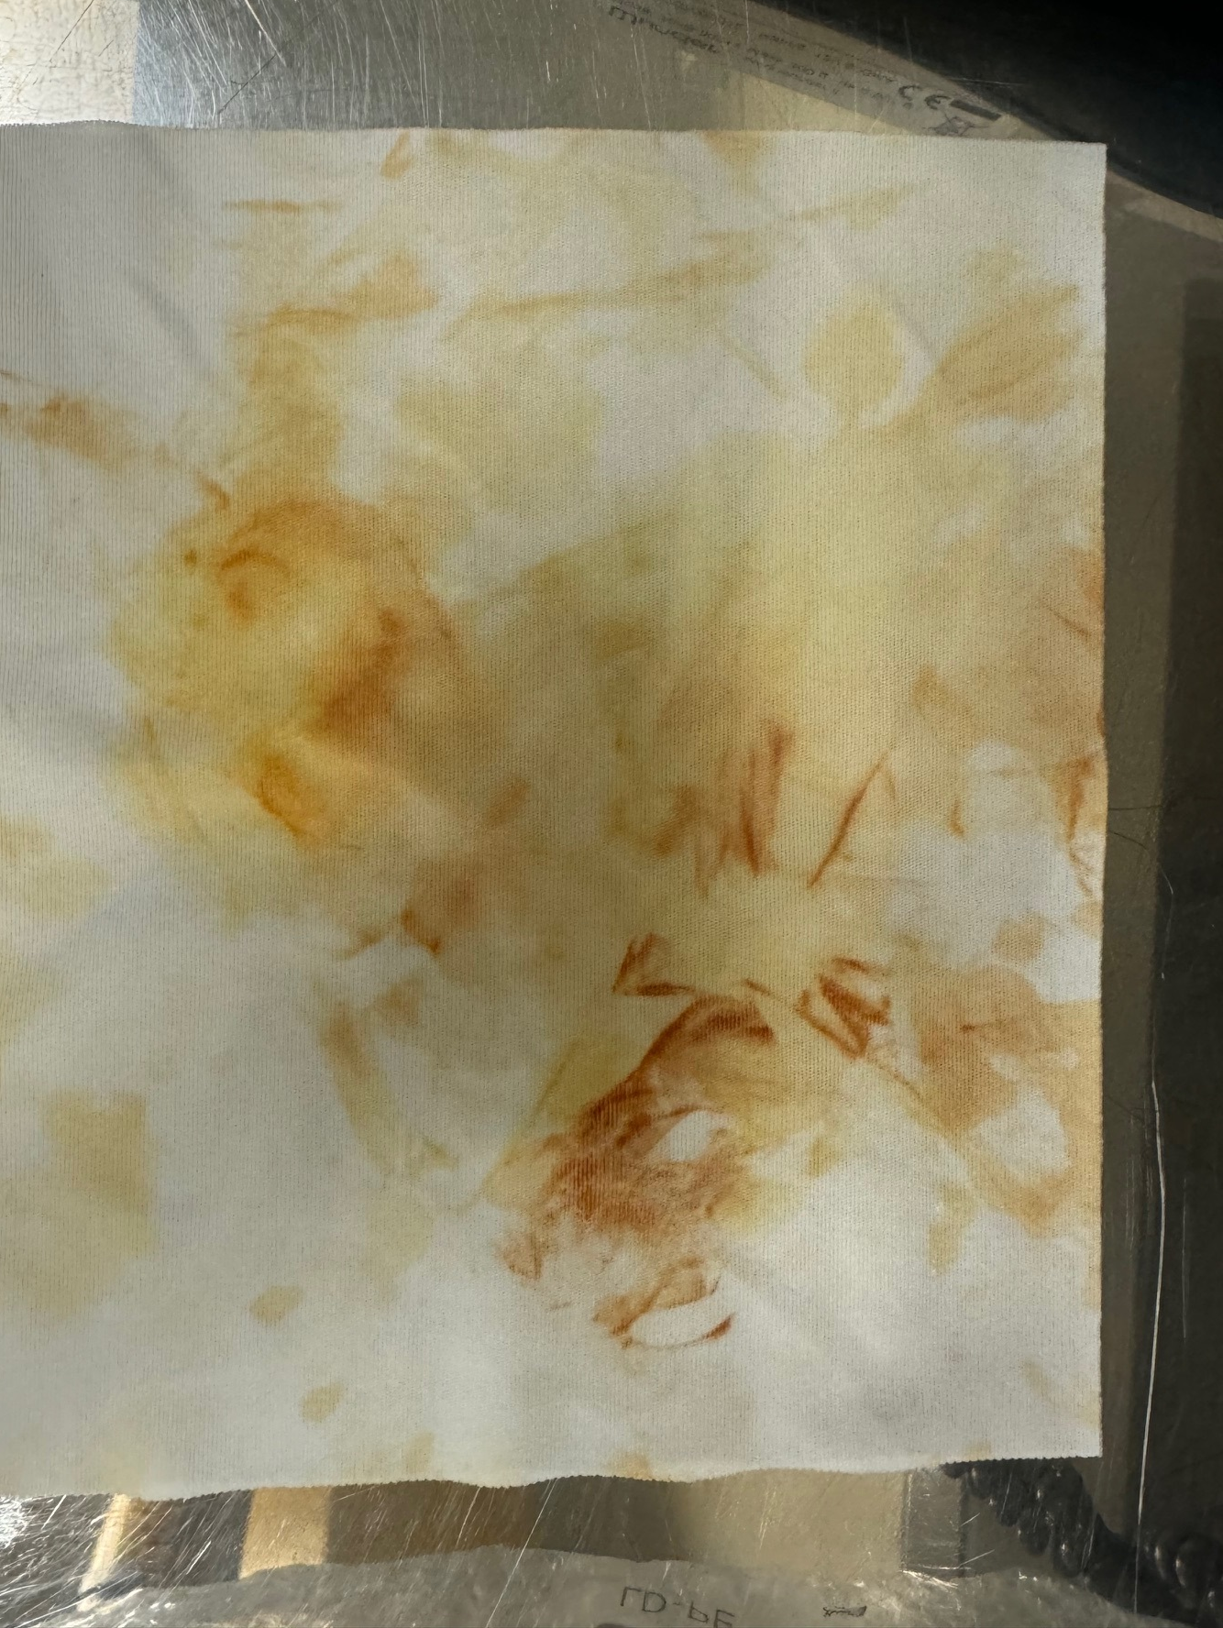
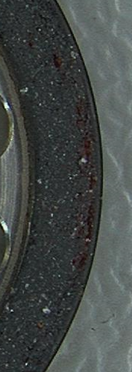
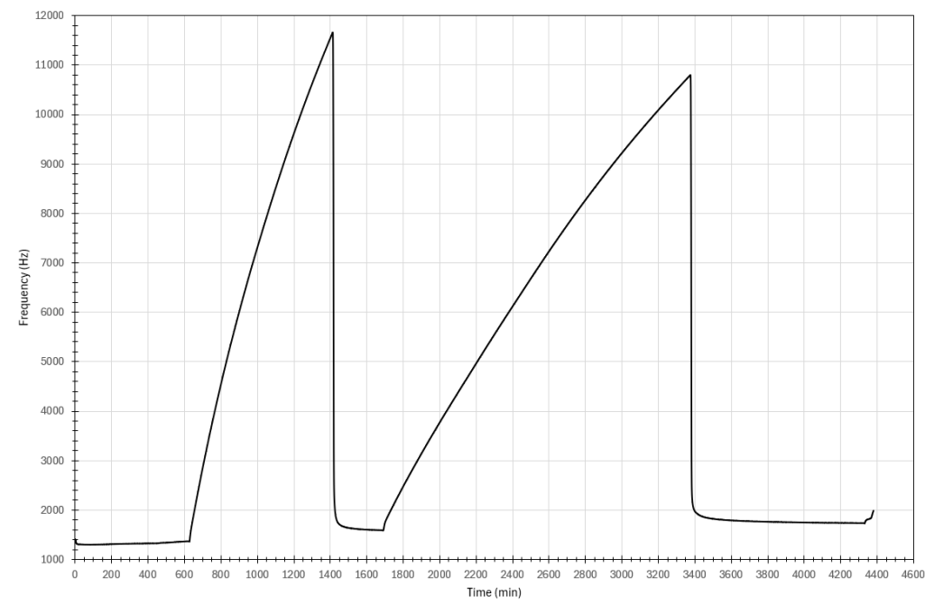
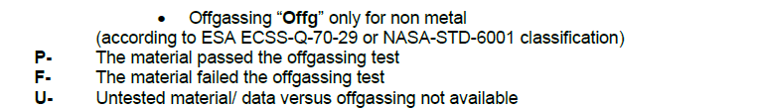
COMPOSITE, ARAMIDIC BASED FRICTION MATERIAL
Compatibility with outgassing requirement as a key design driver
OBJECTIVE:
Compatibility with ECSS-Q-ST-70C outgassing requirements
In DML and DPL, justification for use of a certain material shall be provided → Dedicated test is necessary in case NASA MAPTIS database does not include the material and/or the supplier does not provide chemical properties
ITEM UNDER ANALYSIS:
CONDUCTED TESTS @ SERMS:
Friction material & thermosetting adhesive
Material selected
1. TQCM went into saturation
Rotor disk with friction pads glued
Material provided by external supplier, chemical properties unknown
2. Surface defects and material collected on TVAC cold trap
umbragroup.com This presentation is the Intellectual property of UMBRAGROUP.

Slide 10
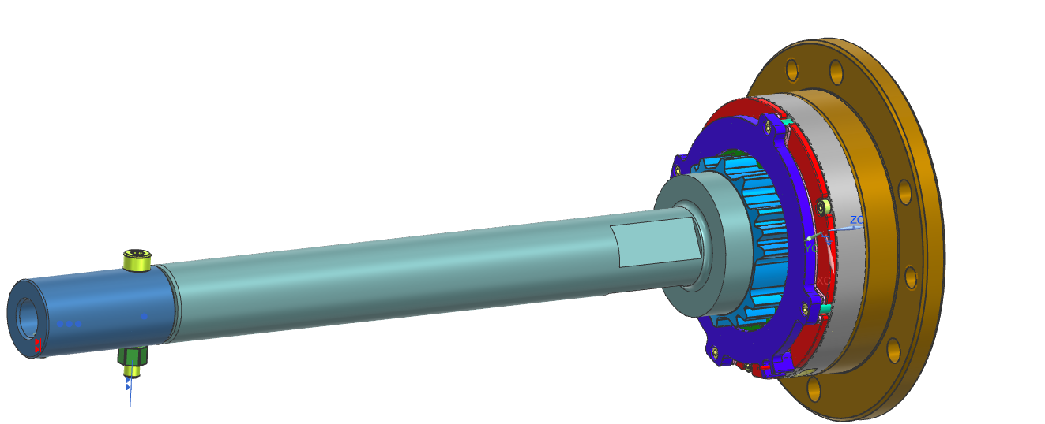
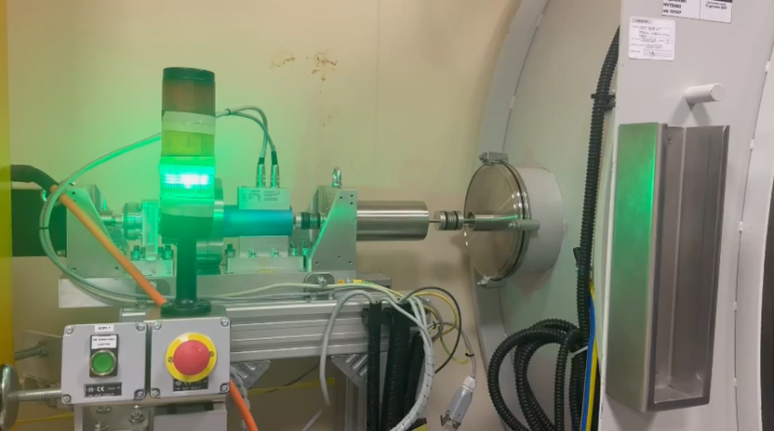
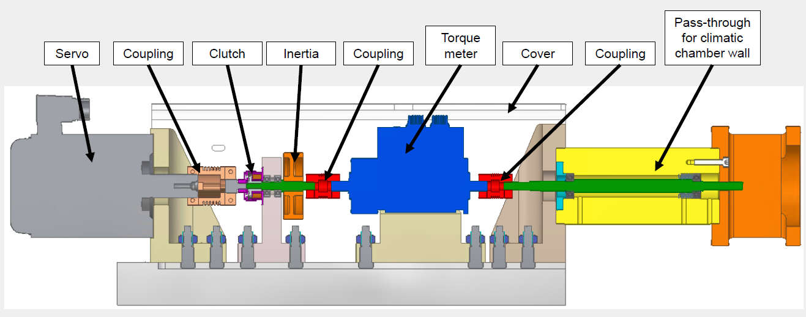
TESTING STRATEGIES: TVAC
UGI solution to reduce testing costs
Rotary feed-through:
The innovation of the rotary feed-through drastically reduced the test bench costs: the full testing line (motors, sensors, bearings, …) is kept out of the TVAC chamber, allowing the use of industrial components and a smaller chamber (only the DUT is inside). The feed-through friction contribution was characterized with a detailed testing campaign in the whole temperature range.
umbragroup.com This presentation is the Intellectual property of UMBRAGROUP.

Slide 11
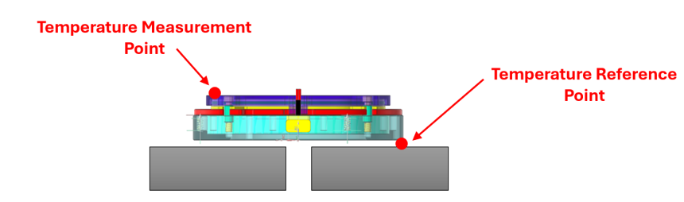
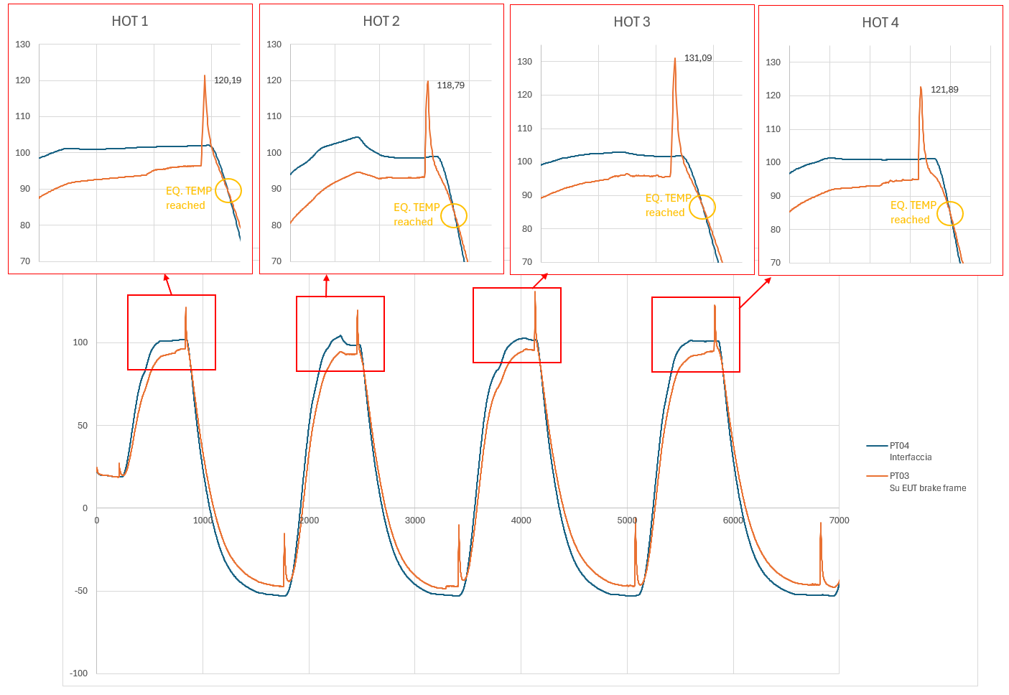
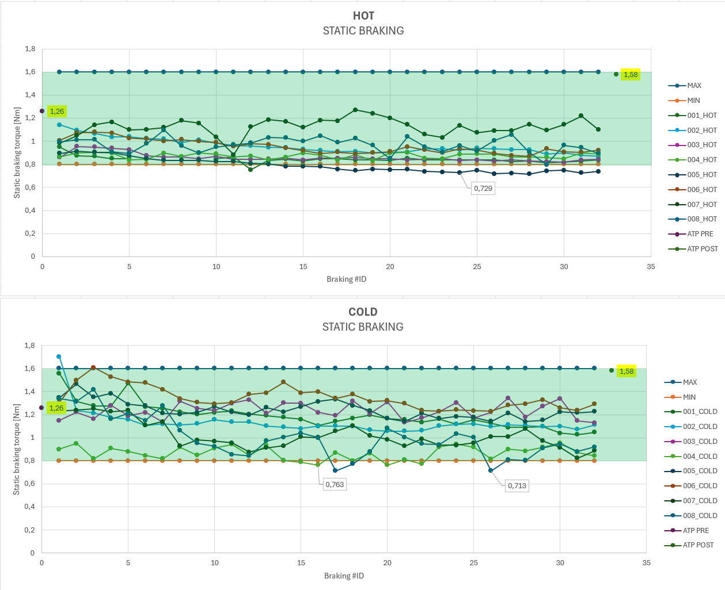
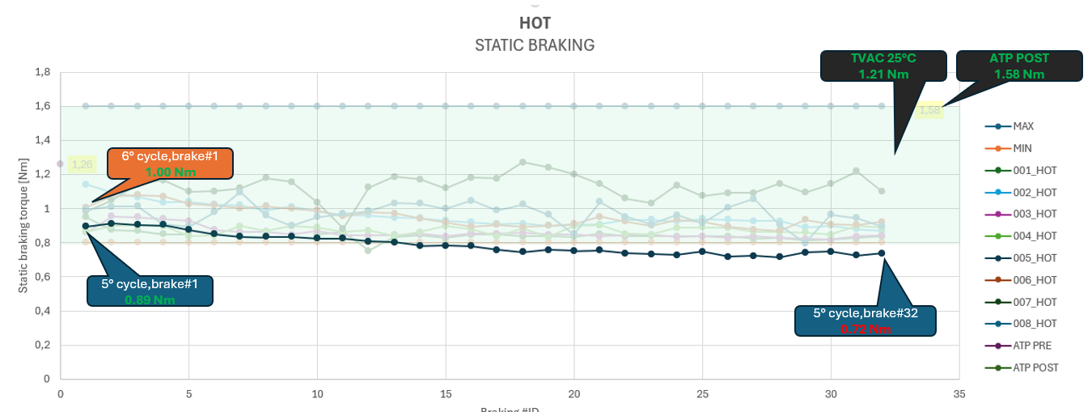
TVAC QUALIFICATION CAMPAIGN
Main outcomes on brake behavior
The friction materials shows a fade with increasing temperature of the pad. The behavior is fully reversible (no permanent degradation due to time exposure or wear).
Temperature acquisitions for the hot cycles: the max hot temperature reached is 130°C, but the brake reaches the chamber temperature back in around 15 minutes.
TVAC is even more severe as in vacuum there is no convection to remove heat, while degassing of binders and tribological properties of the friction pad surface instability are accentuated – hence the fade is stronger than what can be observed in air.
umbragroup.com This presentation is the Intellectual property of UMBRAGROUP.

Slide 12
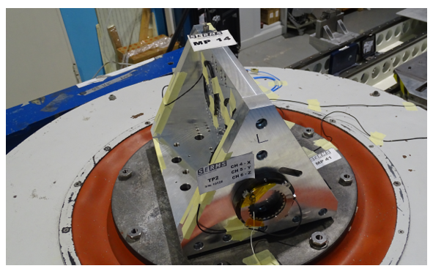
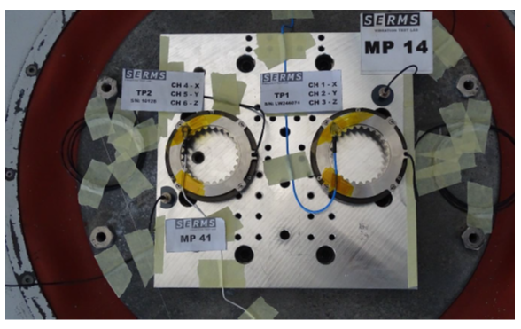
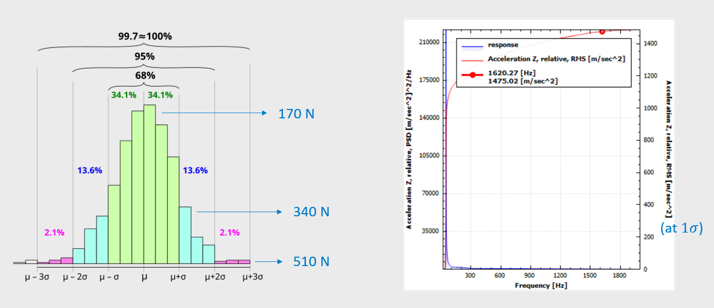
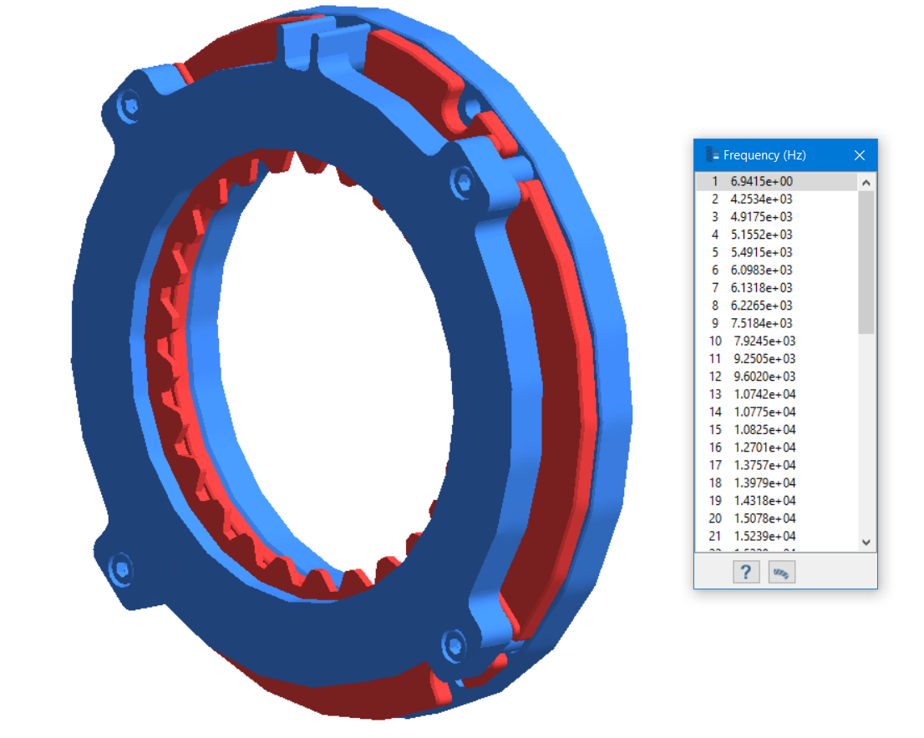
SINE AND RANDOM VIBRATION TESTING
Random Vibrations | Up to 35 Grms in all axes, Freq. From 20 to 2000 Hz
Sine Vibrations | 25g sine loads within the spectrum 5-110Hz
X, Y AXIS
More than 5% in frequency shift and 20% in amplitude shift, for modes with an effective mass greater than 10 % [ECSS requirement] were observed:
Presence of numerous floating elements within the brake, low stiffness components (springs)
Engage-release phenomena during the excitation
→ Functional tests successfully passed
Z AXIS
Numerical-experimental correlation, detailed models and analysis:
Vibrations induce forces able to win the springs pre-load and temporarily open the brake
umbragroup.com This presentation is the Intellectual property of UMBRAGROUP.

Slide 13
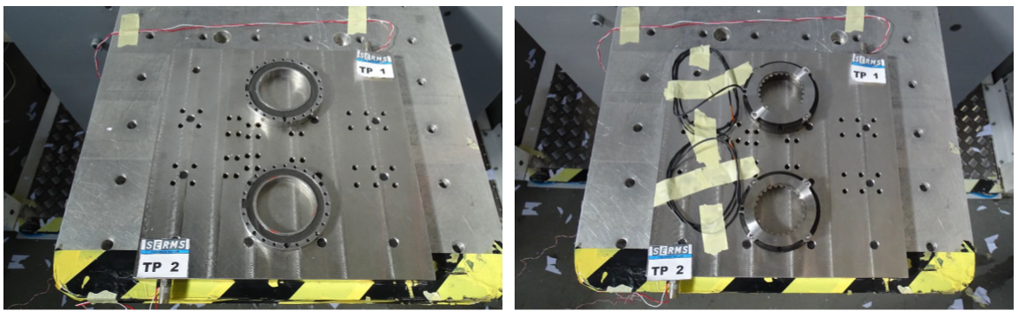
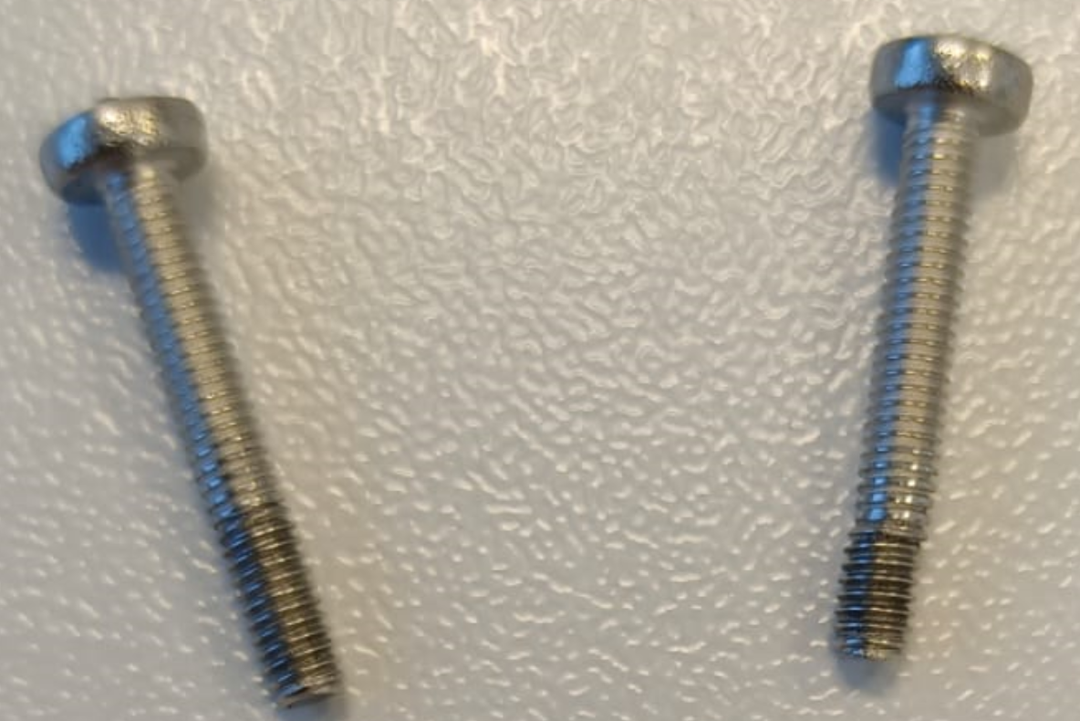
PYROSHOCK TESTING
→ Functional tests successfully passed
Shock | 29g @100Hz; 1414g @1000 and 10000Hz
UMBRAGROUP and SERMS were able to provide suggestions to the customer regarding the mechanical interface with the brake (out of supply perimeter), since the interface screws showed damages to the thread
→ Modifications to the robotic joint agreed
umbragroup.com This presentation is the Intellectual property of UMBRAGROUP.

Slide 14
SERMS as space testing service provider: capabilities and overview
umbragroup.com This presentation is the Intellectual property of UMBRAGROUP.

Slide 15
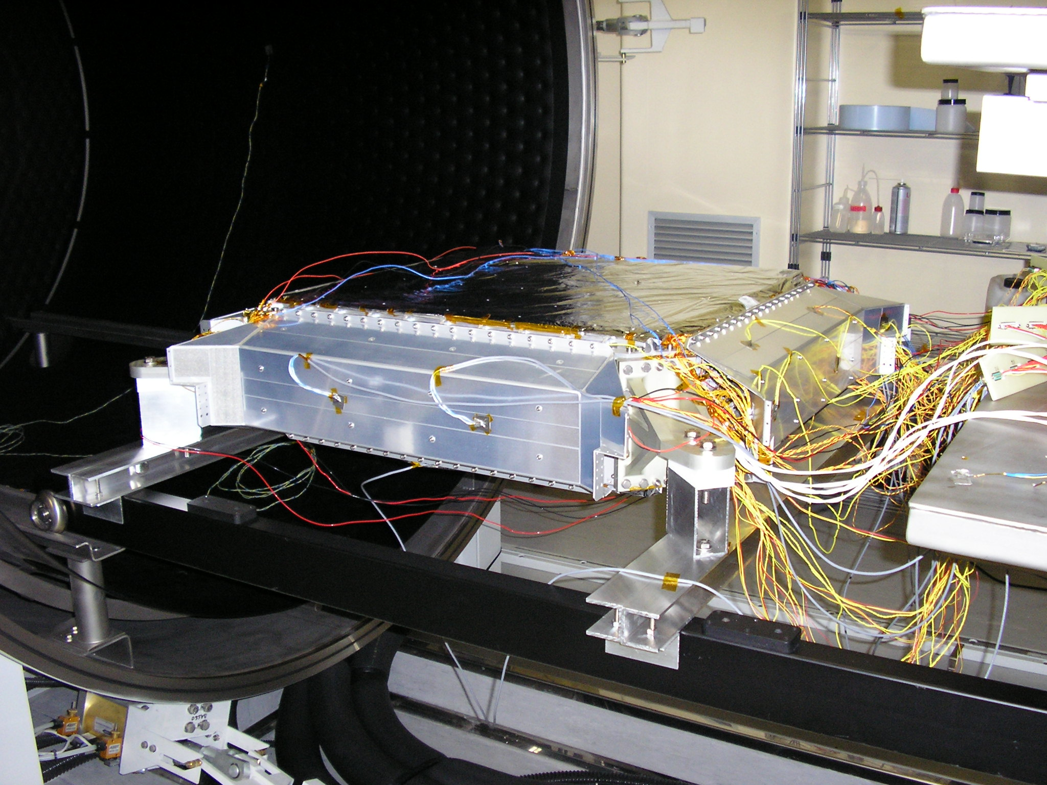
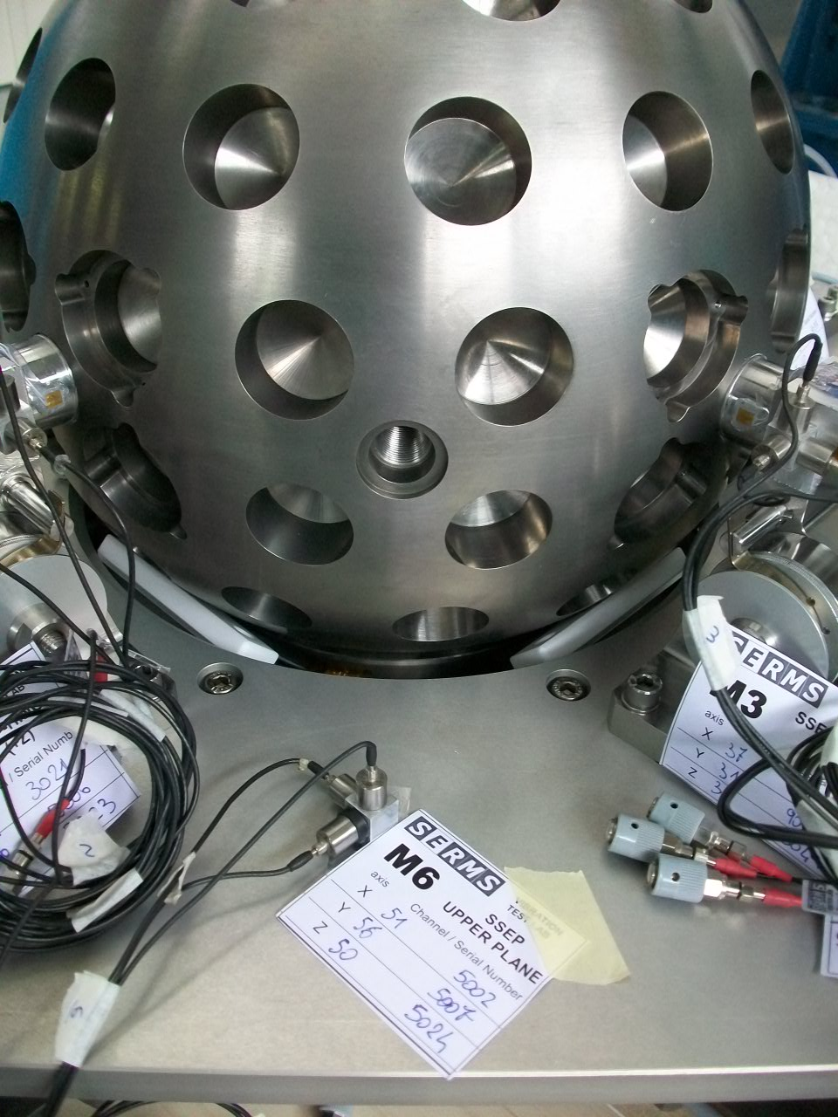
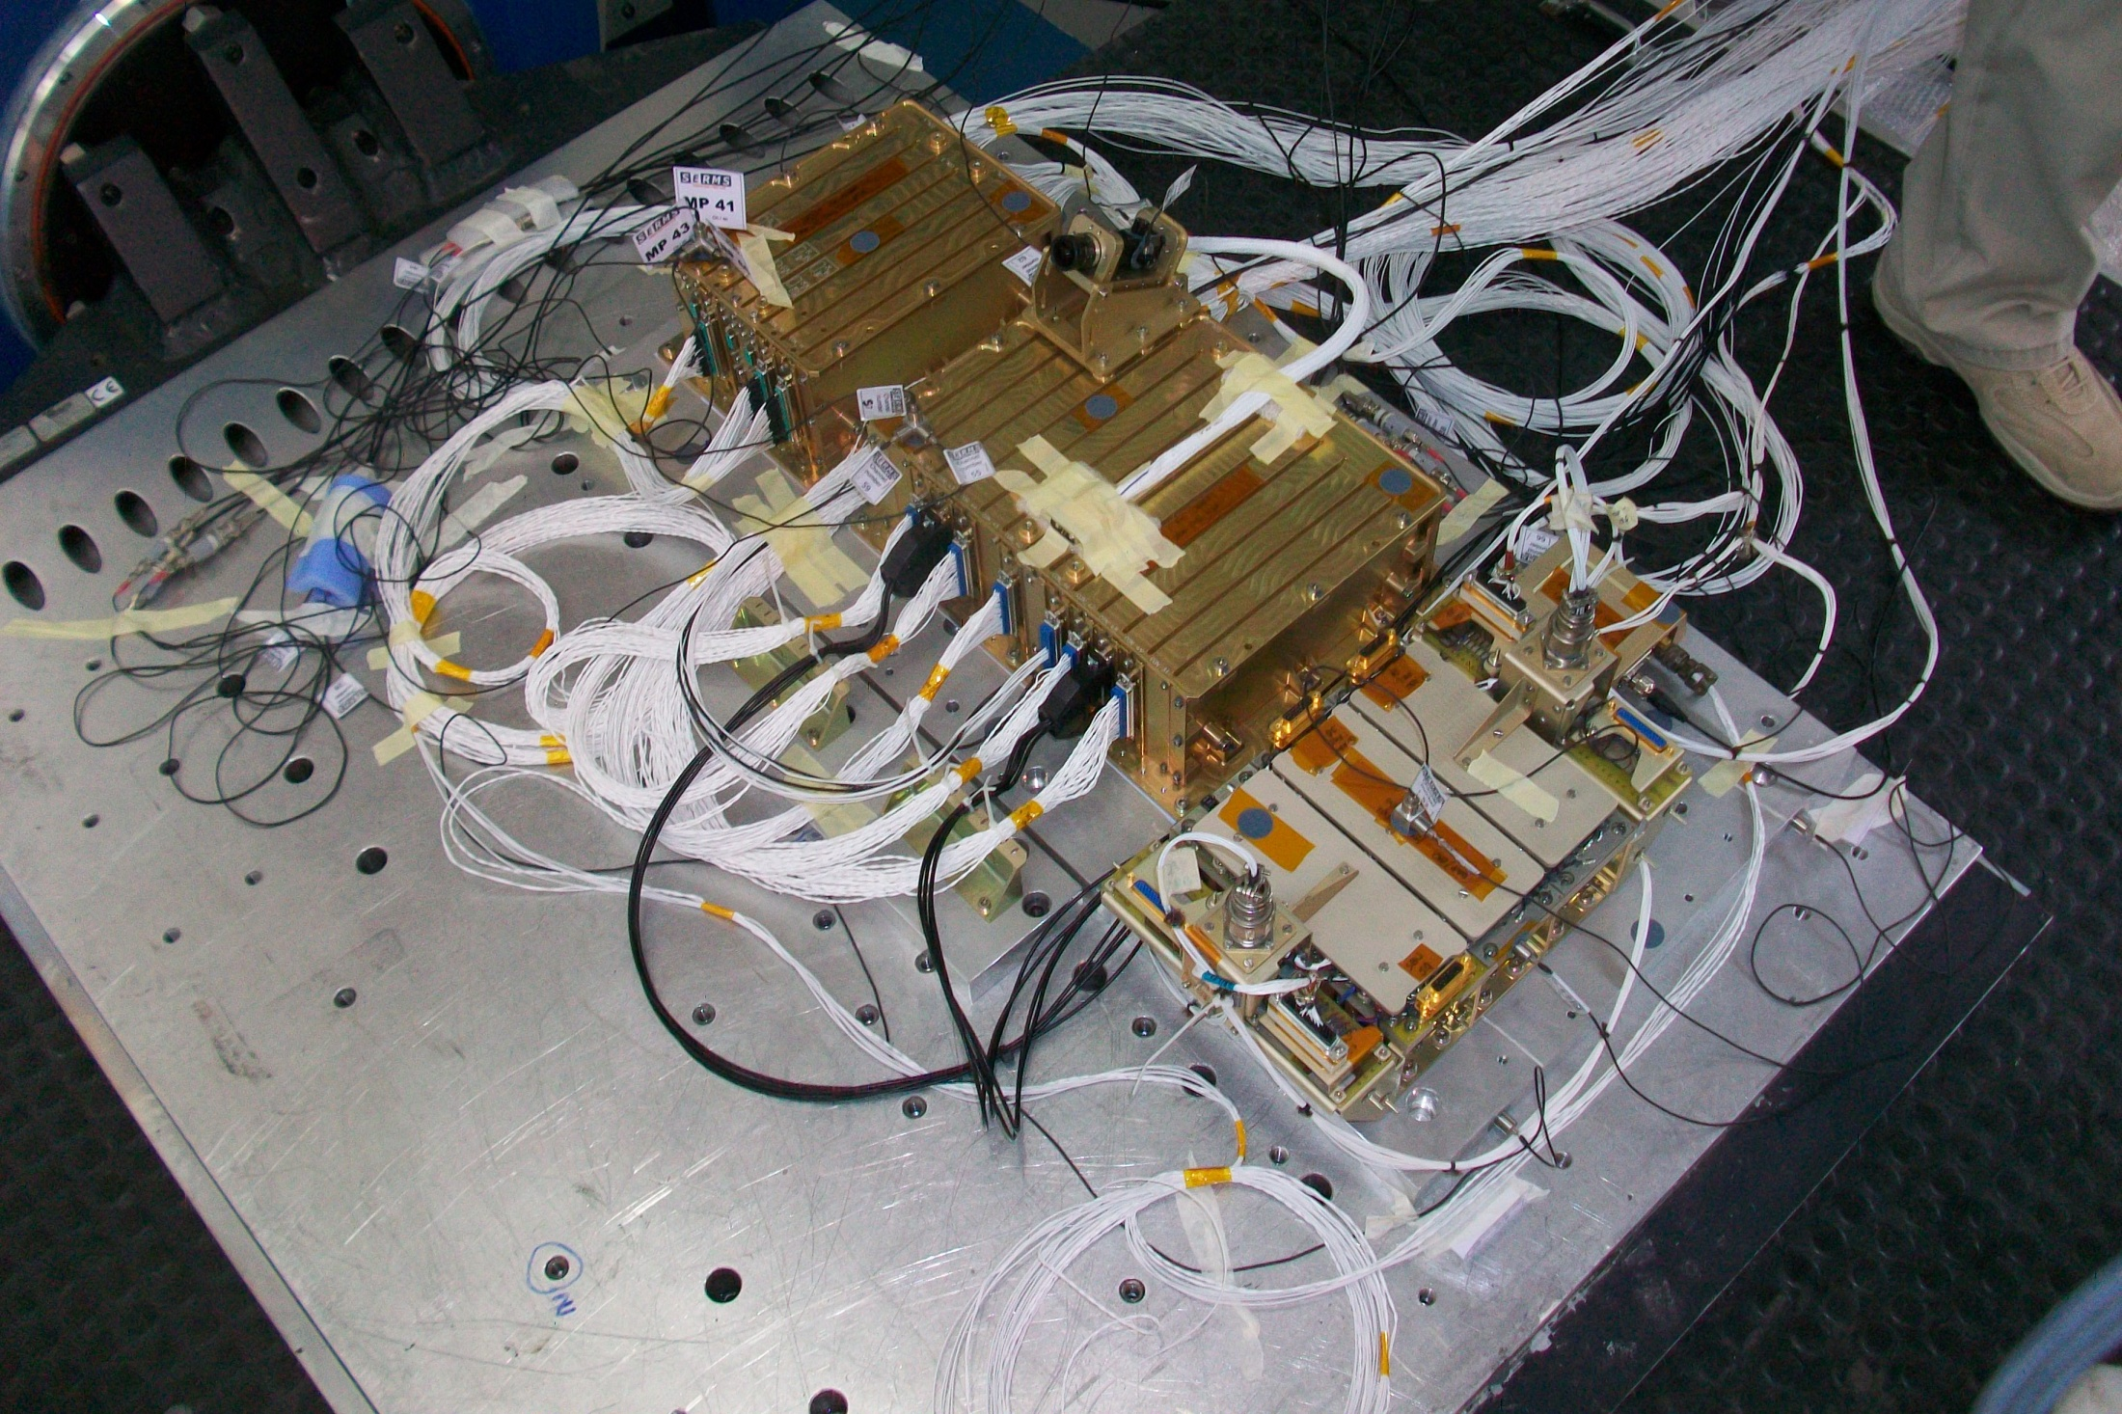

SERMS LAB
Testing and qualification support for space hardware development and validation
SERMS is the space qualification and testing laboratory of UMBRAGROUP, specialized in environmental and reliability testing of mechanical, electronic and electro-optical equipment for space applications.
Key capabilities
Environmental testing for space qualification (vibration, pyroshock, thermo-vacuum, thermal)
Reliability and lifetime assessment of space components
Mechanical and thermal design
Since 2004, involvement in multiple space projects with public and private partners
Some Of Our Test Specification Capabilities:
MIL-STD-810, RCTA/DO-160, SAE, IEC, NASA, ECSS, CEI EN, CEI ASTM
→ All the qualification flow for a space device
umbragroup.com This presentation is the Intellectual property of UMBRAGROUP.

Slide 16
Commercial Optical Multiplexer devices
Screening Test Activities for space application
umbragroup.com This presentation is the Intellectual property of UMBRAGROUP.

Slide 17
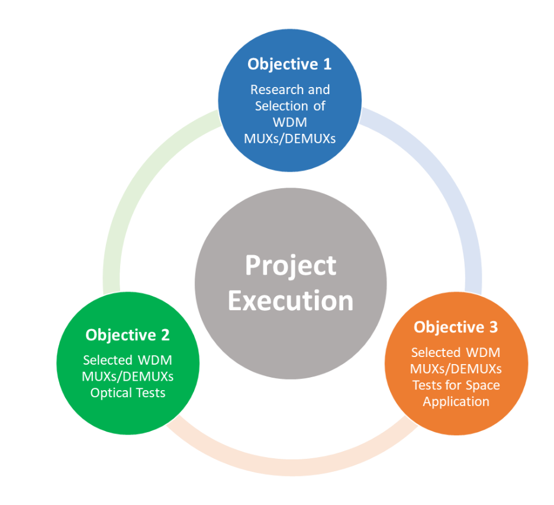
PROJECT CONTEXT AND OBJECTIVES
In space systems, optical components are increasingly used for high–bandwidth signal distribution.
Project Scope
Assess the ability of commercial optical multiplexing devices to withstand space environments.
Focus on mechanical, thermal, radiation and Long-term thermal aging.
Main Technical Challenge
Manufacturers do not provide complete material declaration.
Vacuum compatibility cannot be assessed analytically only.
Adopted a test–based screening approach
umbragroup.com This presentation is the Intellectual property of UMBRAGROUP.

Slide 18
TEST CAMPAIGN PHILOSOPHY
Incoming Inspection
Baseline Functional Test
Construction Analysis
Mechanical Testing
(Vibration + Shock)
Structured and sequential screening logic:
Incoming inspection
Construction analysis
Mechanical screening
Thermal and humidity screening
Accelerated lifetime test
Thermal vacuum exposure
Radiation testing (TID)
Final functional verification
Full traceability and documented procedures.
Thermal Vacuum Testing
Accelerated Lifetime
(Coffin Manson Model)
Thermal Testing
(cycle and humidity)
Radiation Testing
(TID)
Final Functional
Verification
umbragroup.com This presentation is the Intellectual property of UMBRAGROUP.

Slide 19
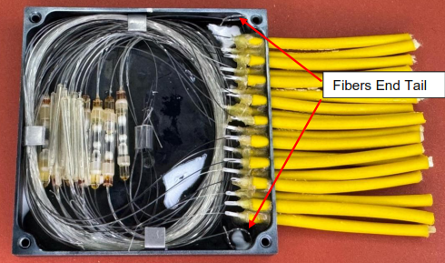
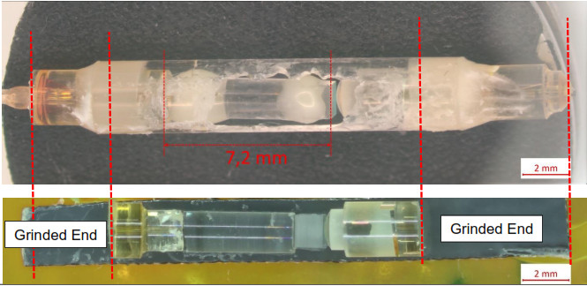
CONSTRUCTION ANALYSIS
Method and objectives
Objective: Identify internal materials and potential failure mechanisms in absence of supplier material declarations.
Non‑destructive inspections: External visual inspection and X‑ray imaging for internal layout
Partial de‑encapsulation: Exposure of adhesives, polymers, and mechanical interfaces for material identification.
Focus areas: Adhesive systems, encapsulants, bonding points, fiber supports, and potential delamination sites.
Vacuum‑related risks: Identification of materials with possible outgassing or thermal‑mechanical instability.
umbragroup.com This presentation is the Intellectual property of UMBRAGROUP.

Slide 20
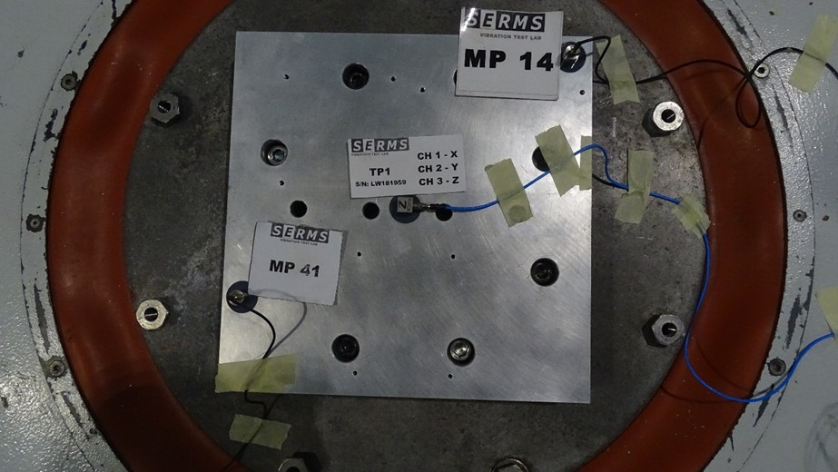
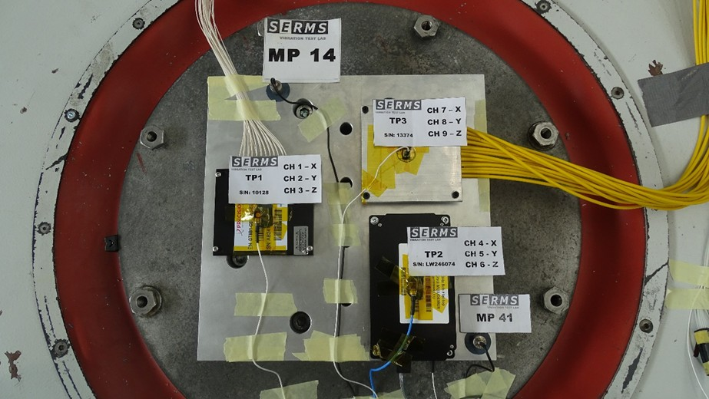
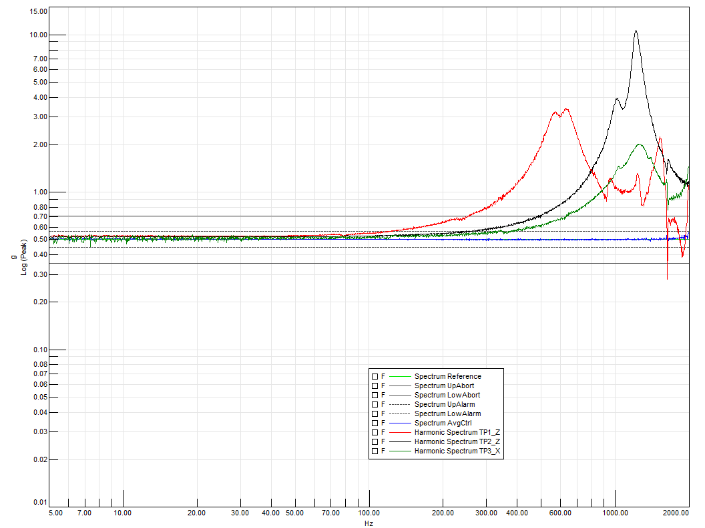
MECHANICAL TESTING
Sine and Random test
Objective: simulate launch and transportation stresses.
Electrodynamic shaker systems for vibration testing.
Standard space vibration profiles.
Controlled shock pulses with defined acceleration peaks.
Real-time monitoring with calibrated accelerometers.
Optical characterization between each axes and at the end
Y Direction - Calibration Layout
Y DIRECTION – Typical Resonance Search Result
Y Direction - Test Layout
umbragroup.com This presentation is the Intellectual property of UMBRAGROUP.

Slide 21
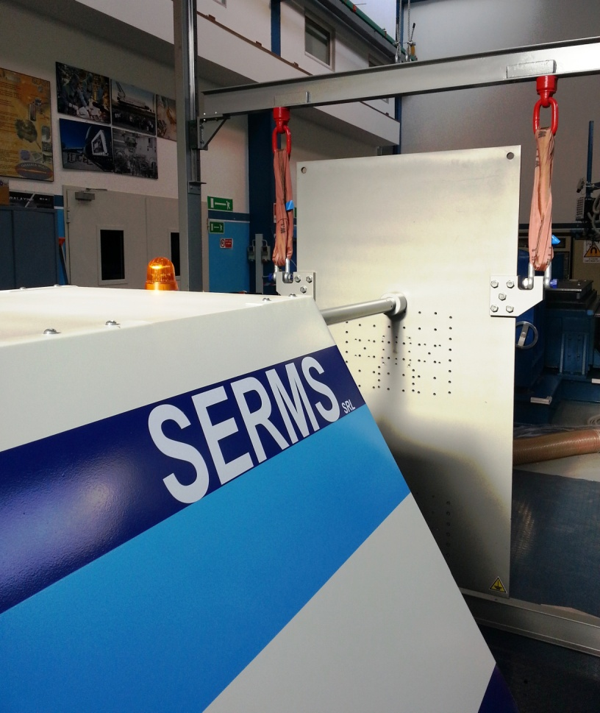
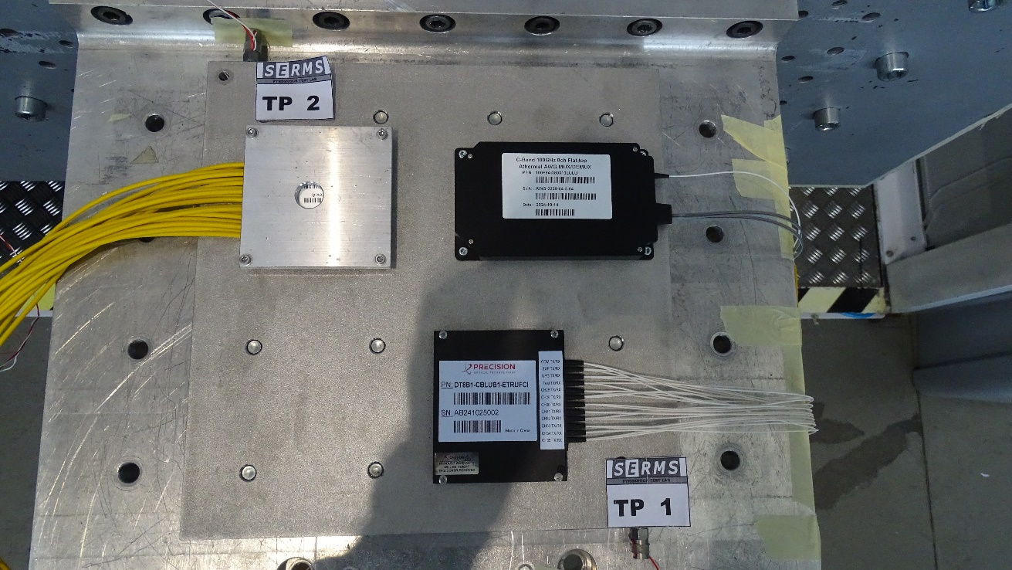
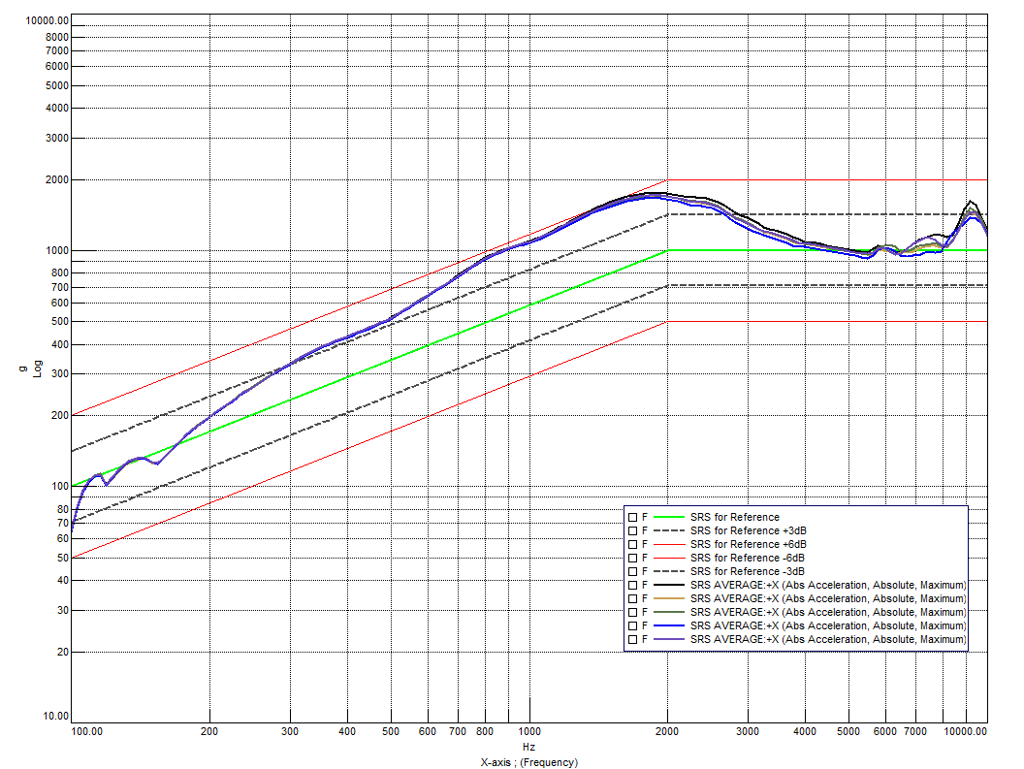
MECHANICAL TESTING
Pyroshock test
Objective: reproduce the mechanical shock generated by pyrotechnic events (stage separation, satellite deployment).
Events produce extremely high‑g, high‑frequency impulses (up to thousands of g, 3–10 kHz).
Ensures components survive the most severe mechanical loads of the mission.
Verifies bonding integrity, fiber attachment stability, and resistance to micro‑cracking.
Critical for optical components with adhesives or fragile internal structures.
X Direction - Test Layout
X Direction - Typical SRS Pyroshock curve
umbragroup.com This presentation is the Intellectual property of UMBRAGROUP.

Slide 22
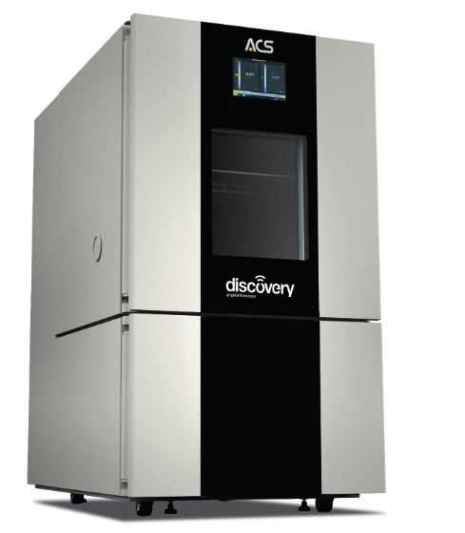
THERMAL TESTING
Moisture and aging test
Objective: Address problems related to internal materials degradation or instability (adhesive-polymeric interface)
Evaluate long-term material stability in op and non -op phases
Moisture Test
85 °C / 85 % RH
500 hours
Continuous optical output monitoring
Full optical characterization before and after test
High Temperature Storage (Aging)
85 °C
2000 hours
Periodic optical verification (5, 10, 20, 30, 50, 75 days + 2000 h)
Monitoring of insertion loss and central wavelength
Rationale
Detect humidity-driven degradation of coatings, adhesives and other interfaces
Simulate long storage and ground phase before launch
Reduce uncertainty prior to vacuum qualification
umbragroup.com This presentation is the Intellectual property of UMBRAGROUP.

Slide 23



THERMAL TESTING
Lifetime test
Objective
Simulate 7-year mission in LEO
Thermally accelerated lifetime approach
Method
Thermal cycling in controlled chamber
Degradation phenomenon → thermal degradation
Optical monitoring during cycle
Pre- and post-test full characterization
Acceleration Model
The Coffin-Manson model describes how to determine equivalent thermal degradation effects in accelerated test conditions
$$Acceleration Factor (AF)=\frac{N_{F}}{N_{T}}={\left(\frac{ΔT_{AT}}{ΔT_{F}}\right)}^{2}{\left(\frac{f_{F}}{f_{AT}}\right)}^{\frac{1}{3}}\exp\left(\frac{E_{A}}{K_{B}}\left(\frac{1}{T_{\max{F}}}−\frac{1}{T_{\max{AT}}}\right)\right)$$
$N_{F}/N_{AT}$: number of cycles in Field/Accelerated Test conditions
$ΔT_{F}/ΔT_{AT}$: temperature excursion in Field/Accelerated Test conditions
$f_{F}/f_{AT}$: cycle frequency in Field/Accelerated Test conditions
$E_{A}$: activation energy (typically 0.7 eV for optical components)
$K_{B}$: Boltzmann constant = 8.617e-5 eV
$T_{\max{F}}$/ $T_{\max{AT}}$: maximum temperature reached in Field/Accelerated Test conditions
umbragroup.com This presentation is the Intellectual property of UMBRAGROUP.

Slide 24
THERMAL TESTING
Lifetime test
Cycle Calculation
MISSION REQUIREMENT
7 years in LEO
DEFINE ON ORBIT T
Worst case orbital T (hot and cold)
SELECT ACTIVATION ENERGY
Conservative Polymer-based mechanism assumption
EQUIVALENT TEST DURATION AND CYCLE
t_test = t_mission/AF
≈ 2500 cycles for 80 days of test
CALCULATE ACCELERATION FACTOR (AF)
Coffin-Manson model
DEFINE TEST T
Maximum chamber T
Rationale
Conservative modeling due to unknown internal materials
Focus on thermally activated aging processes
umbragroup.com This presentation is the Intellectual property of UMBRAGROUP.

Slide 25


THERMOVACUUM TEST
Objective: Simulate Space thermal condition
Thermal vacuum testing combined temperature cycling and high vacuum exposure.
Devices were subjected to:
Controlled temperature ramps
Defined dwell times
Continuous pressure monitoring
This step is essential because vacuum changes material behavior compared to atmospheric conditions.
Functional verification was performed during exposure using optical feedthrough
umbragroup.com This presentation is the Intellectual property of UMBRAGROUP.

Slide 26


RADIATION TEST
Total Ionizing Dose (TID)
Objective: Simulate Space condition
→ Space environment contains ionizing particles (protons, electrons, γ-rays) that can degrade materials and components → TID
→ Cumulative ionizing dose can change optical and material properties over mission life.
→ Even passive optical elements (coatings, fibers) can exhibit radiation-induced changes over time
Test Strategy
Controlled irradiation using γ-ray source (Co-60)
Defined total dose representative of mission scenario (TID) → 1000 krad
Several irradiation steps
Pre/after-annealing optical characterization.
TIMELINE
umbragroup.com This presentation is the Intellectual property of UMBRAGROUP.

Slide 27


CONCLUSION
Structured environmental screening campaign on commercial optical multiplexer devices
Key environmental activities:
Mechanical testing: Simulated launch and transport stresses using vibration and shock profiles.
Thermal vacuum testing: Combined temperature cycles with high vacuum to replicate space conditions.
Radiation testing (TID): Cumulative ionizing dose exposure to evaluate material resilience.
Lifetime acceleration: Thermal aging to simulate the equivalent of ~7 years in LEO.
THE MAIN CRITICAL RISK
Vacuum compatibility
Reliability for long-term application
Construction Analysis, Outgassing Test (TML, CVCV) and TID are essential.
umbragroup.com This presentation is the Intellectual property of UMBRAGROUP.

Slide 28





Thank you
Feel free to reach out for questions!
Let’s move
motion
technology
together.
ALESSIA RICCI aricci@umbragroup.com
SERENA BORSINI sborsini@umbragroup.com
www.umbragroup.com

