Slide 1
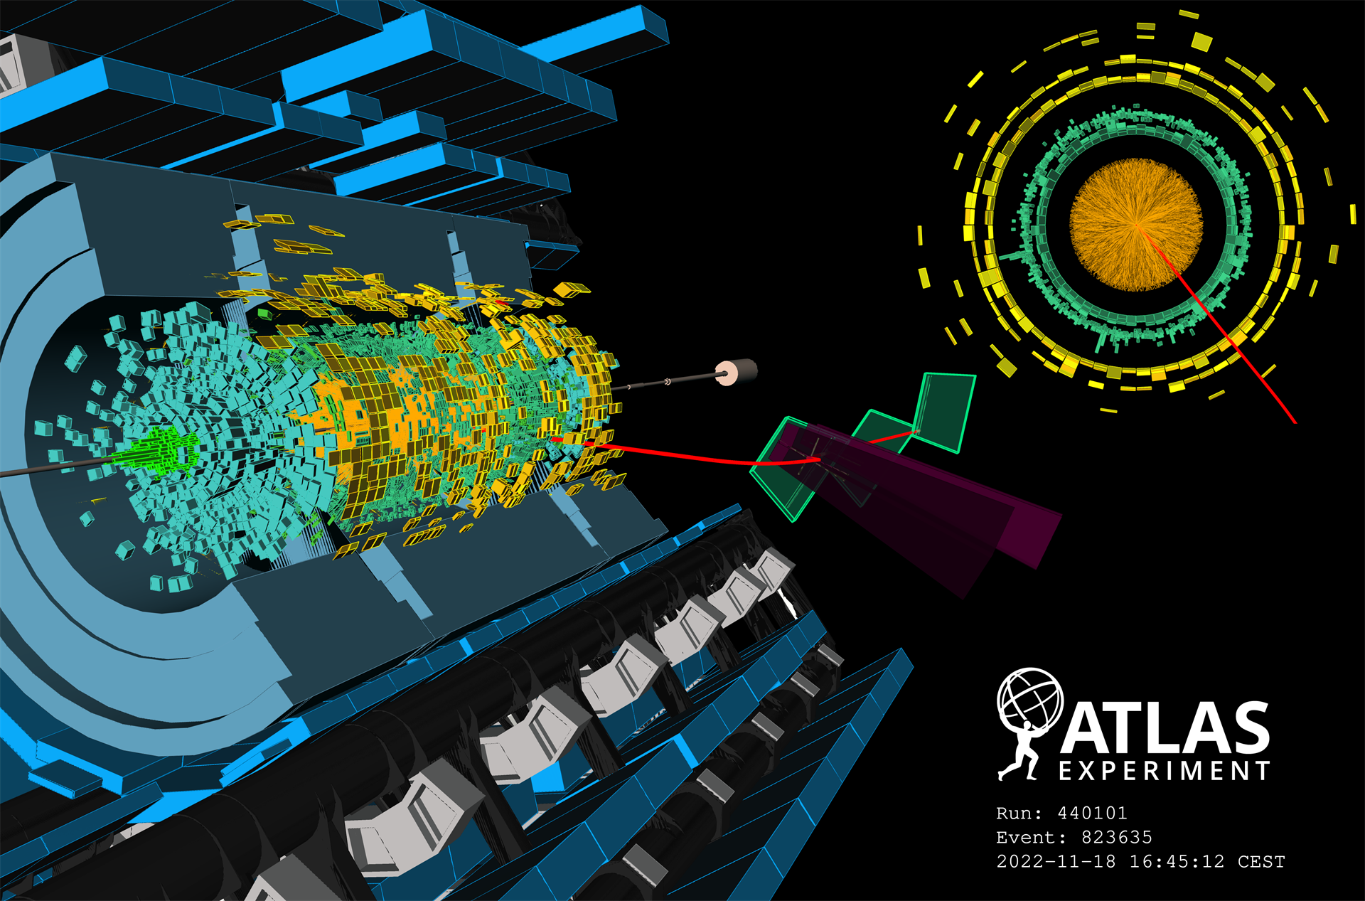

Opening Particle Physics
Outreach, Communication, Inclusion & Participation
KATE SHAW
UNIVERSITY OF SUSSEX
10 April 2026, IOP Annual APP and HEPP Conference

Slide 2
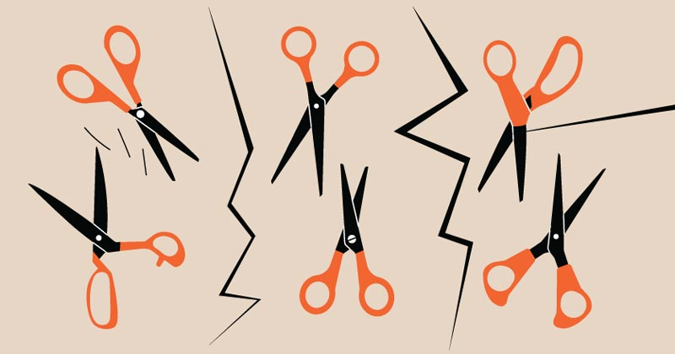
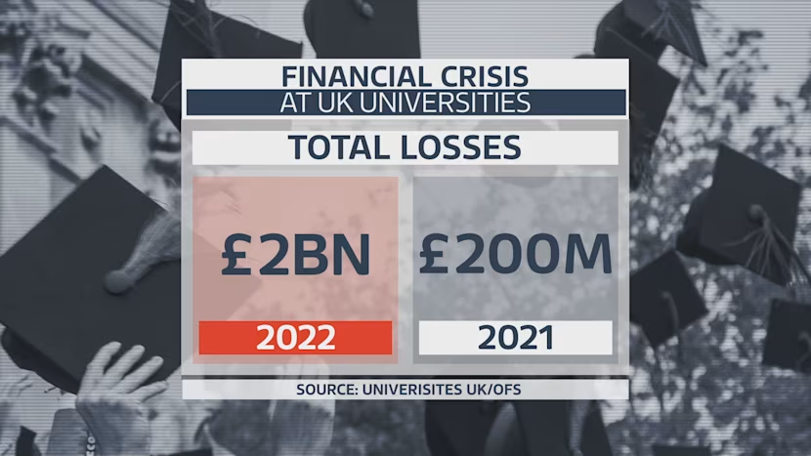
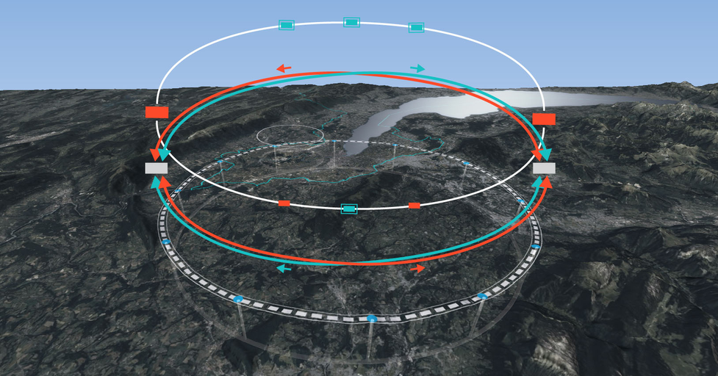

Physics & the UK
Physics is foundational to the UK’s future economically, technologically, and societally.
Our community wants to continue pursuing blue-skies, curiosity-driven research
The government seeks to address national skills gaps and drive economic growth
Our physics community are enduring a period of funding pressures from both UKRI cuts and university pressure.
Without intervention, the UK risks losing talent, innovation capacity, and global leadership.

Slide 3
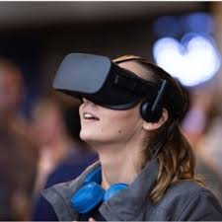
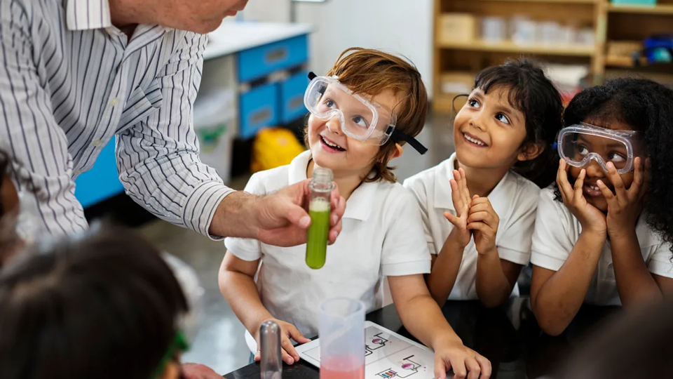
Outreach and Communication
1) Inspiration, curiosity and building science captial
Communicate our inspirational science to the public
Reach people with less access to science
Reach people low science capital
Build science capital in low science captial areas
Communicate with policy makers, interact with the media, and build support for blue skys science

Slide 4
Outreach and Communication
2) Train & motivating the next generation of physicists
With vital skills in particle physics, data science, machine learning and AI, computing and hardware
With professional skills with working in teams, and with big collaborations with a diverse set of colleagues
This makes brilliant physicsts!
for our acaedmic workforce
for industry, teaching careers, and business!

Slide 5
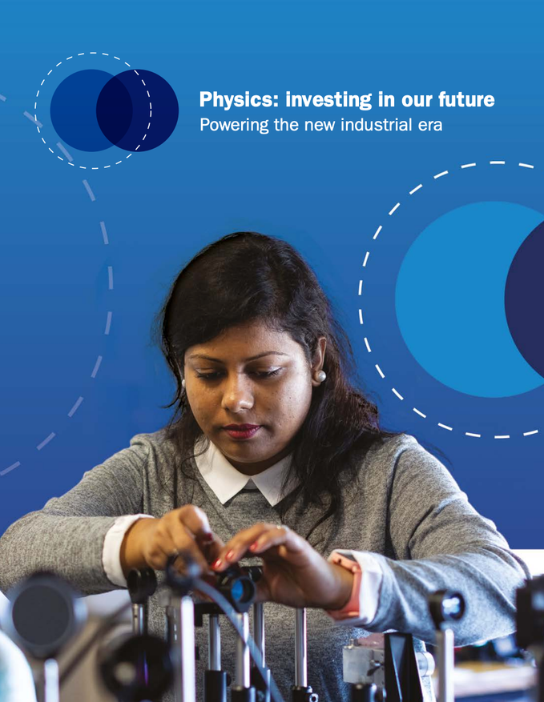
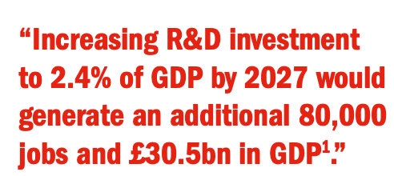
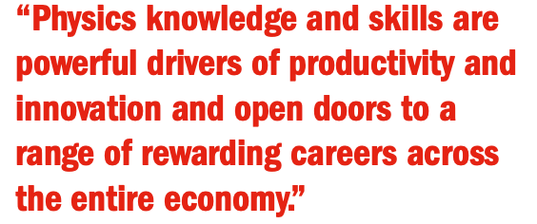
Physics Ecosystem
IOP Report: Physics: investing in our future

Slide 6
Understanding Barriers
What are the most significant barriers preventing the UK from developing the workforce needed for physics R&D to thrive?
Shortage of physics-trained teachers.
Lack of diversity and inclusive culture: women, people from disadvantaged backgrounds, people with disabilities, those who identify as LGBT+, and minority ethnic groups are all underrepresented.
Inflexible research careers limiting movement between academia and industry
IOP Report: Physics: investing in our future

Slide 7

EDI: Very important for our community
Equity: Treating people of all identities and backgrounds fairly and respectfully with regard to opportunities, access, , power, outcomes, and resources.
Diversity: Embracing differences, which may include ethnicity, gender identity or expression, family status, disability status, sexual orientation, age, and socioeconomic situation.
Inclusion: Intentionally creating welcoming and respectful environments and systems in which inequities in power and privilege are addressed and everyone is given an opportunity to flourish.

Slide 8
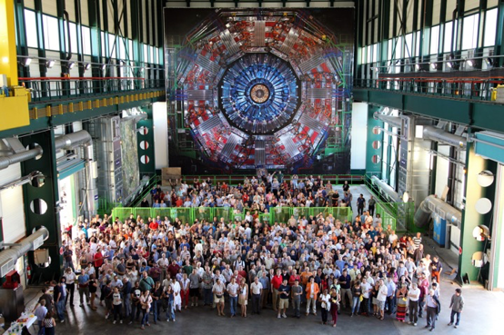
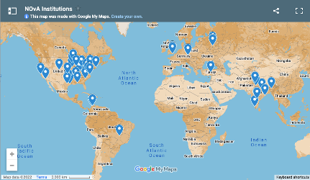

Diversity Drives Discovery
Monoculture can create mono approaches and limited perspectives
A group of people with different experiences and perspectives brings innovation and creativity
Hierarchies & informal networks favour dominant groups. If certain groups are under-represented, our talent pool is smaller
Increased diversity creates a more inclusive and welcoming environment for everyone, and amplifies diversity

Slide 9
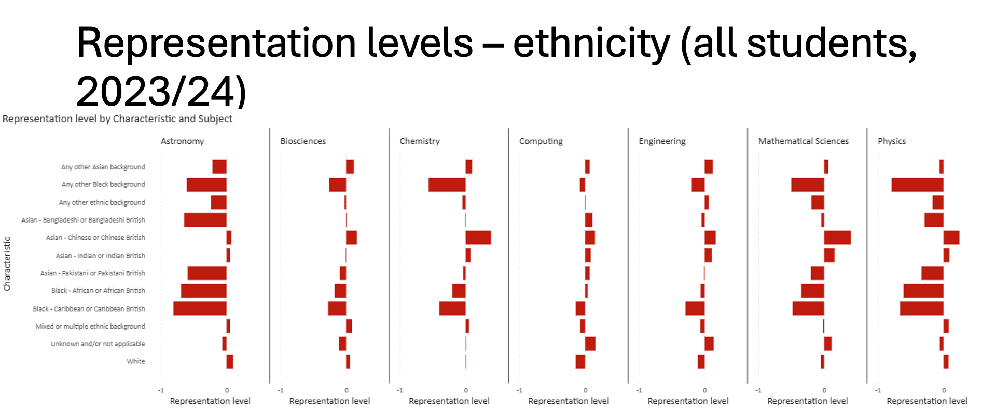
Physics undergraduate students are less ethnicly diverse than all other STEM subjects

Slide 10
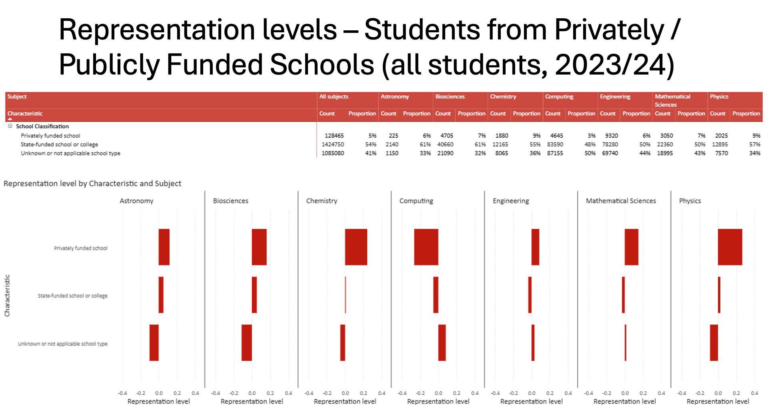
Physics University Students from the UK are especially likely to come from more advantaged parts of the country.
Physics has double the proportion of undergraduate students from private schools than all other subjects

Slide 11
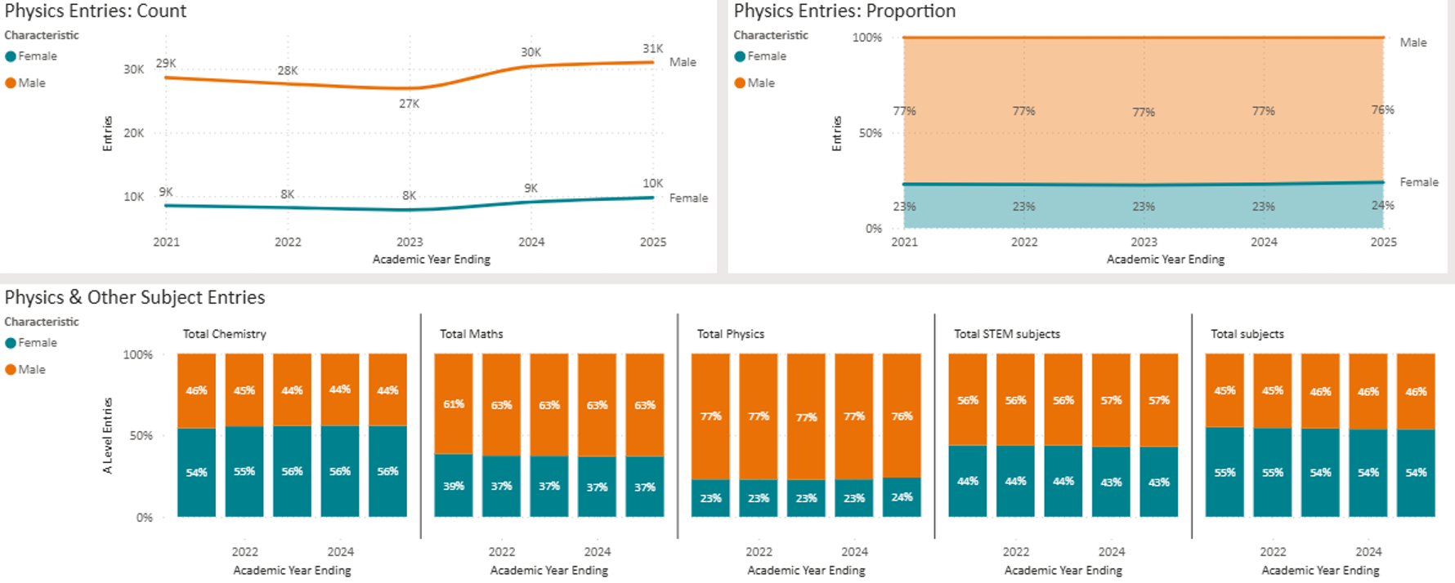
A-Levels (England)

Slide 12
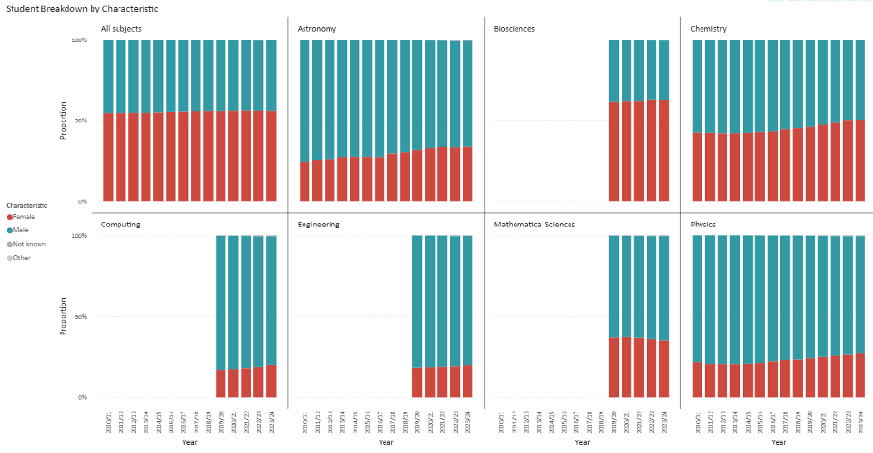
Physics
2020- 2024
25-27 %

Slide 13

Reaching Beyond the Monoculture
Science should be for everyone!
Predominantly male, white, and middle-to-upper class
This can create a monoculture of experience, assumptions, and opportunity
Many talented people never even enter the field because of subtle barriers (financial, cultural, social, or implicit bias)
Diverse backgrounds → different ways of thinking
Groups solve hard problems better when they think differently, not just when they’re individually clever

Slide 14
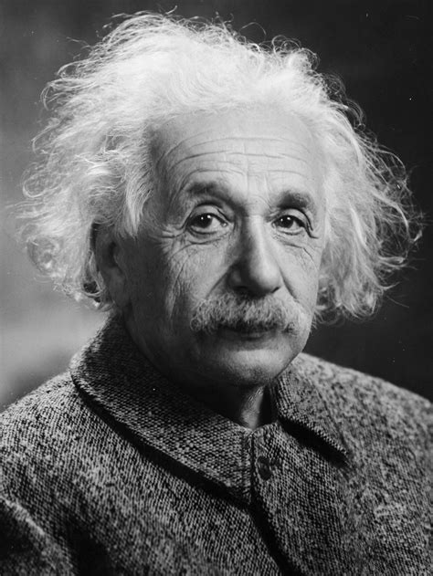
Why do we have this underrepresentation?
Why are we not diverse?
The causes of this underrepresentation are clear.
Many young people from under-represented groups do not pursue physics as they may see that it is not for them or they feel they don’t fit in
I dont look like a scientist
People like me don’t do science
I am not clever enough - scientists are geniuses
→ Many also have less access to opportunity
There is also a lack of guidance available on physics-related technical routes post-16 despite growing employer demand for the skills that higher technical education provides

Slide 15
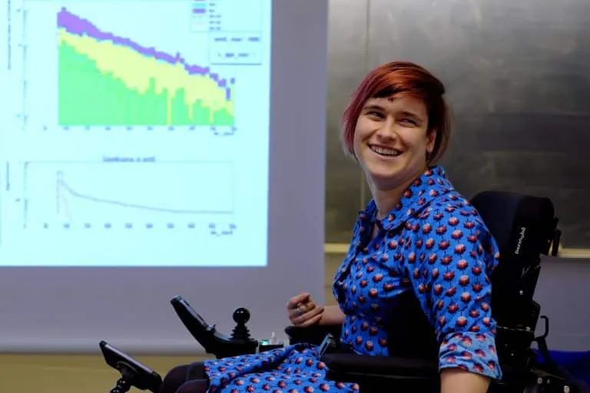
Outreach and communication projects
Let’s reach out
Outreach and communication projects
Access people form diverse background and those with less access to science
Learn about and work with those under-represented in our community, what invisible barriers do they face
Provide diverse role models, who think and act differently to welcome a borader community
Provide accessible and varied educational resources to engage with different audiences
Claire Malone, Science Communicator

Slide 16


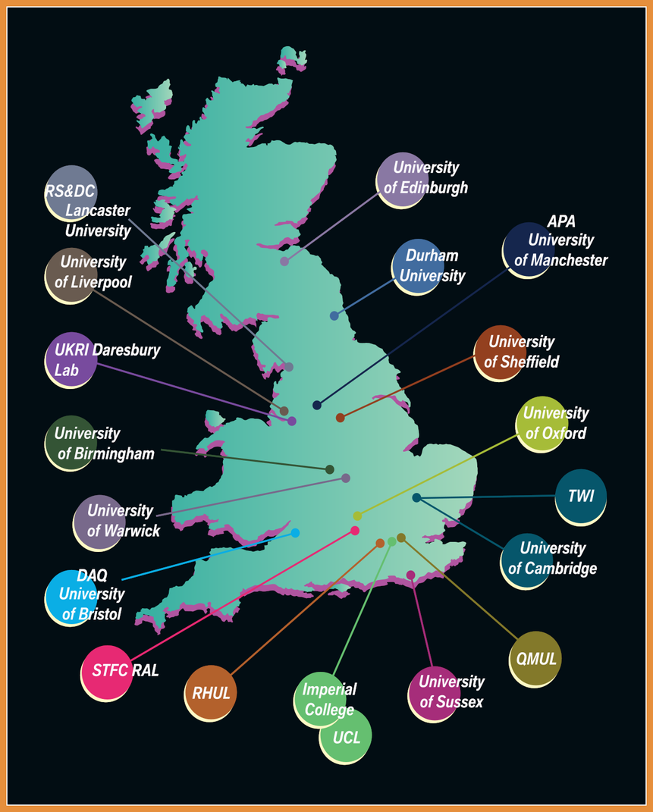
DUNE Exbition at the Royal Society
18 UK institutions worked together to create, build and showcase a DUNE exhibition for public engagement
Creation of exhibition and design elemets, brochure and merchandise, volunteer coordination
Flagship exhibition in July 2024 at the Royal Society Summer Science Exhibition, London
Unversities are often encouraged to compete, but we acheive mutal goals by working together!

Slide 17
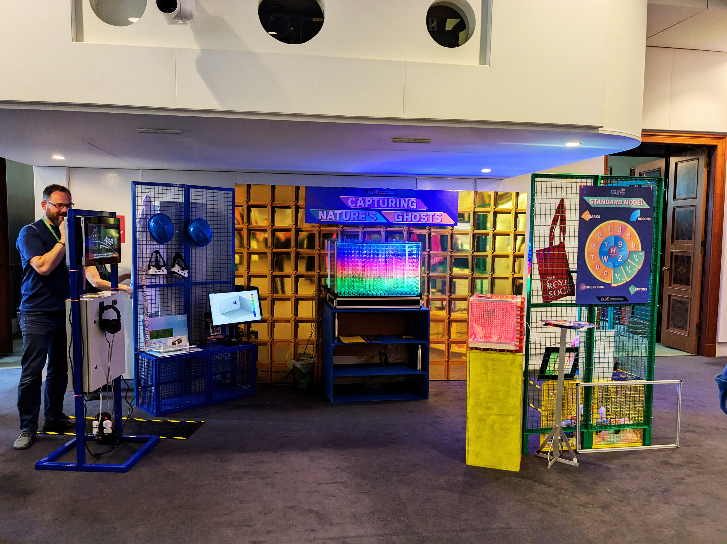
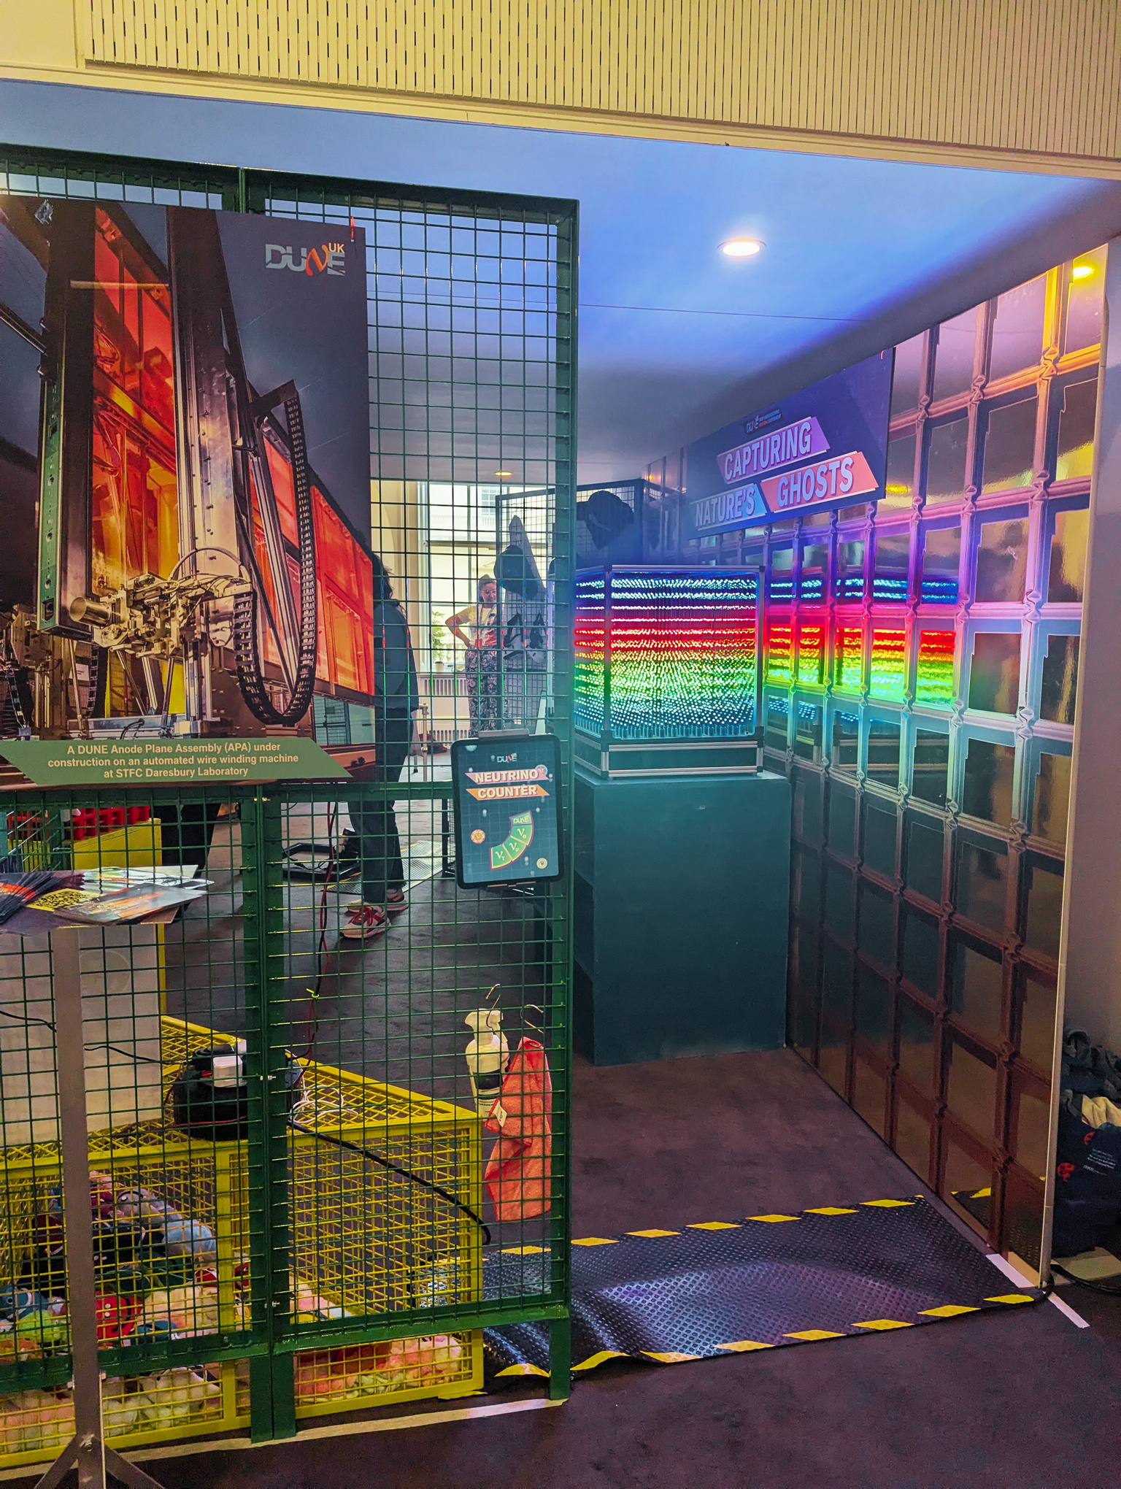
DUNE @ Royal Society Summer Exhibition

Slide 18
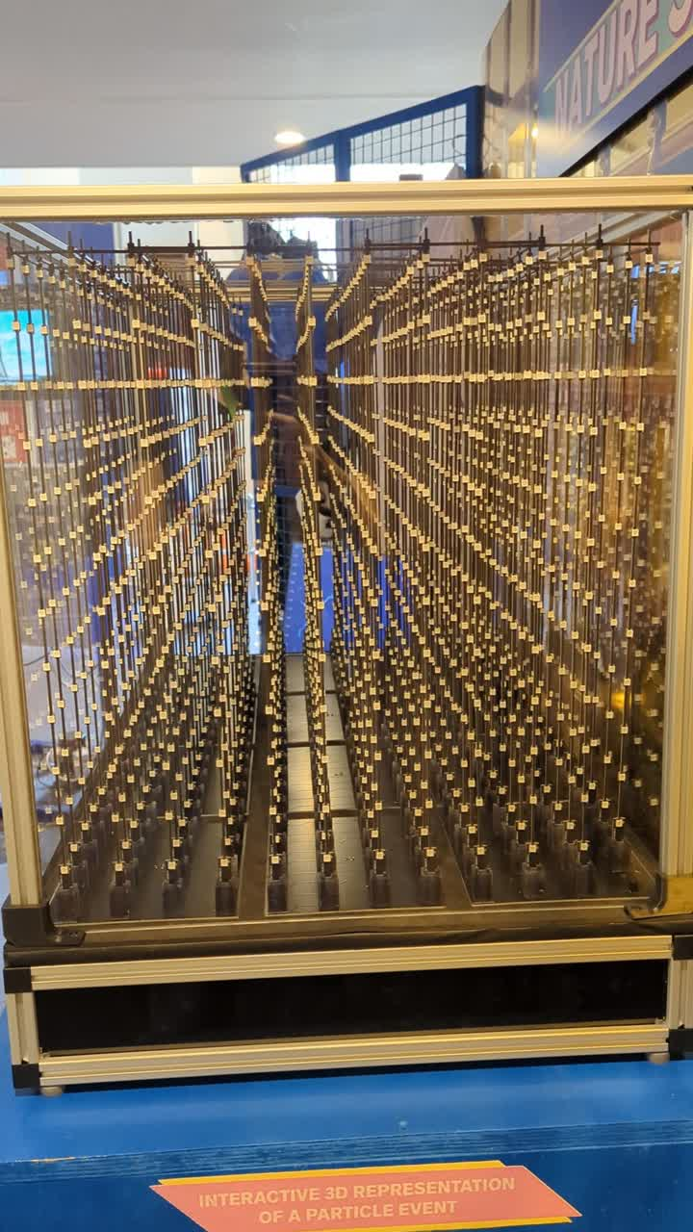
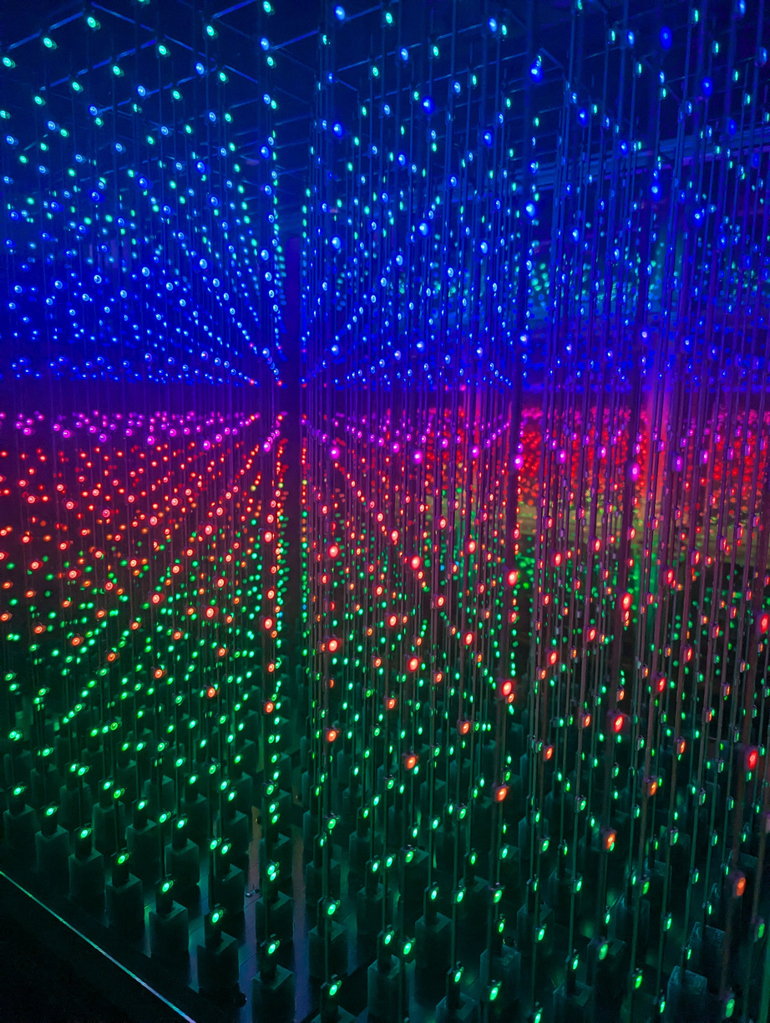
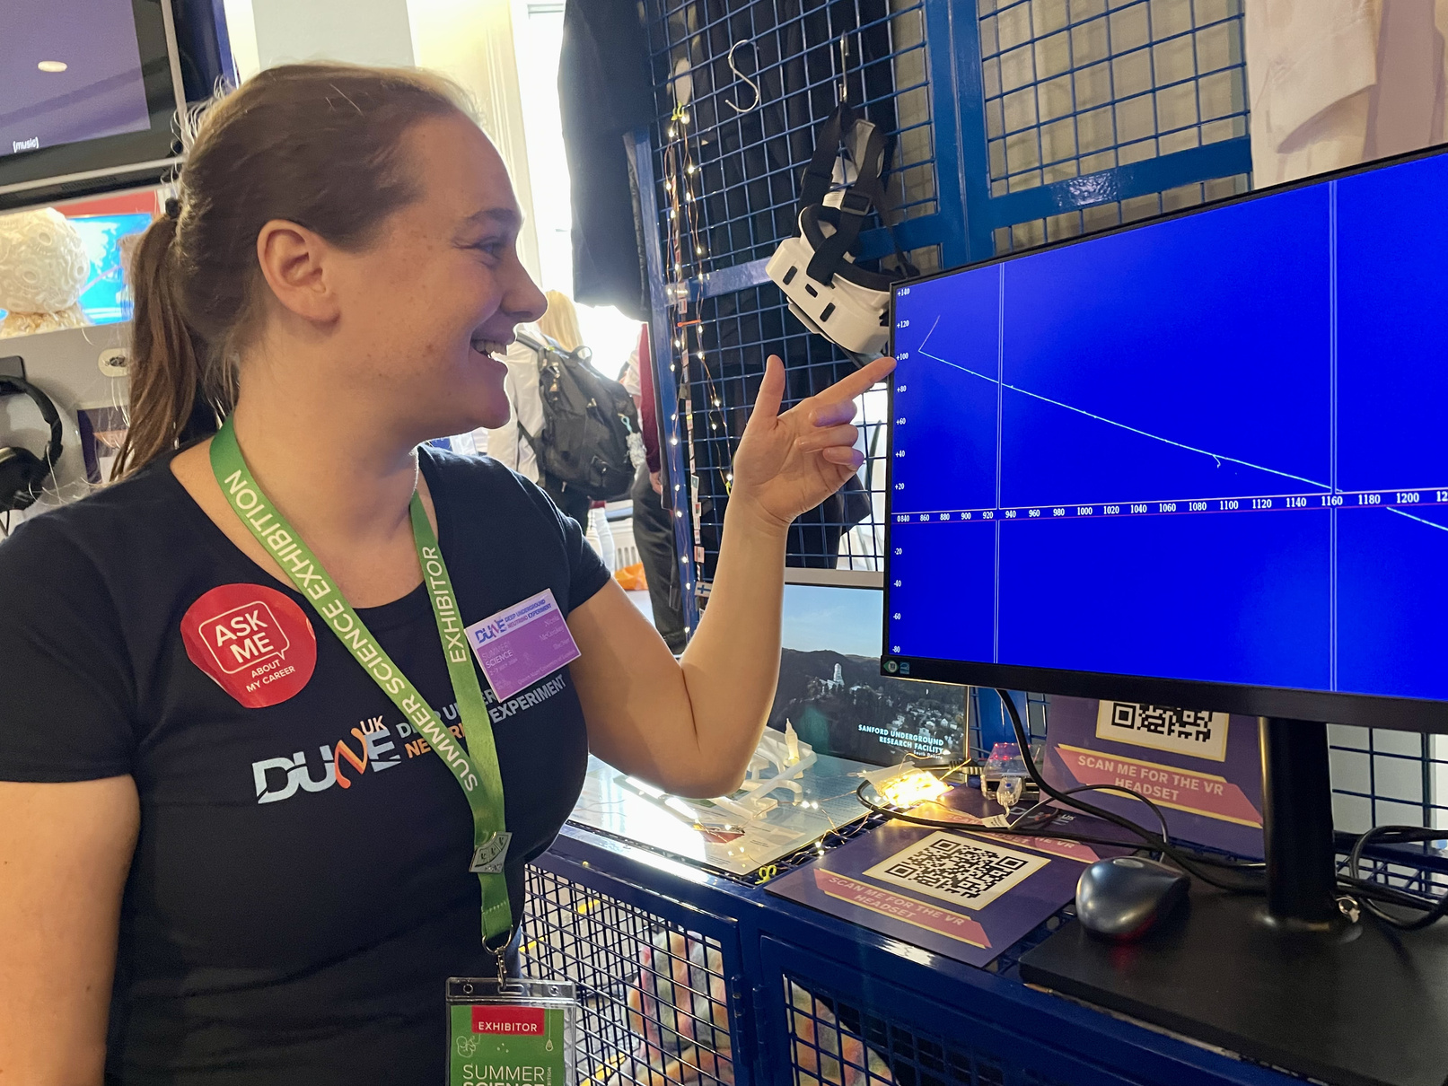
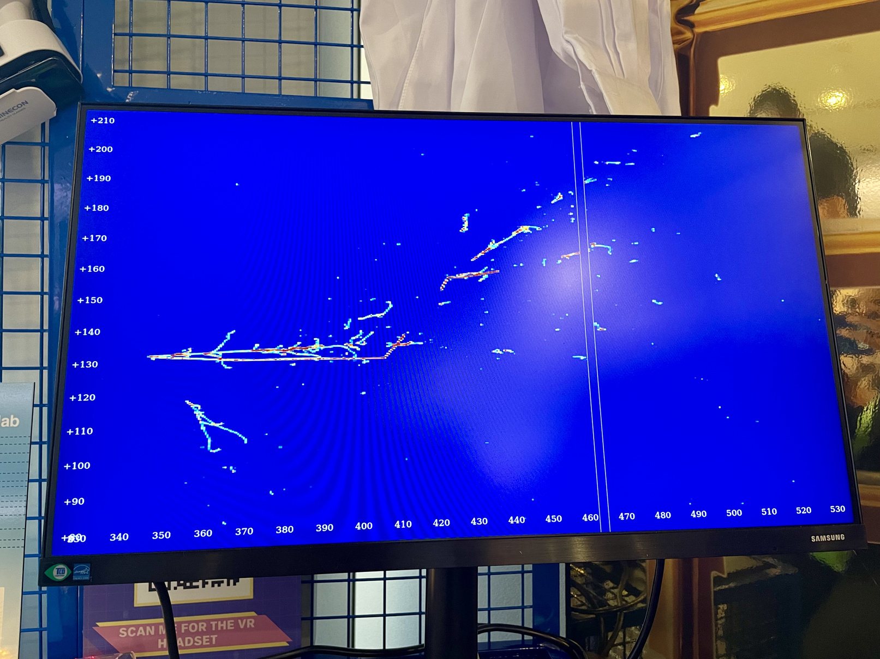
DUNE @ Royal Society Summer Exhibition

Slide 19
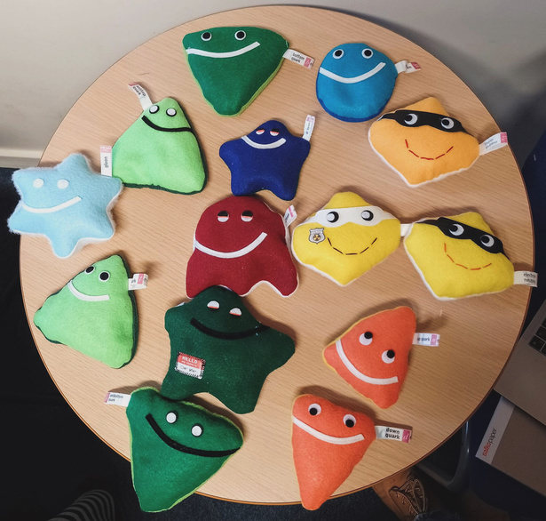
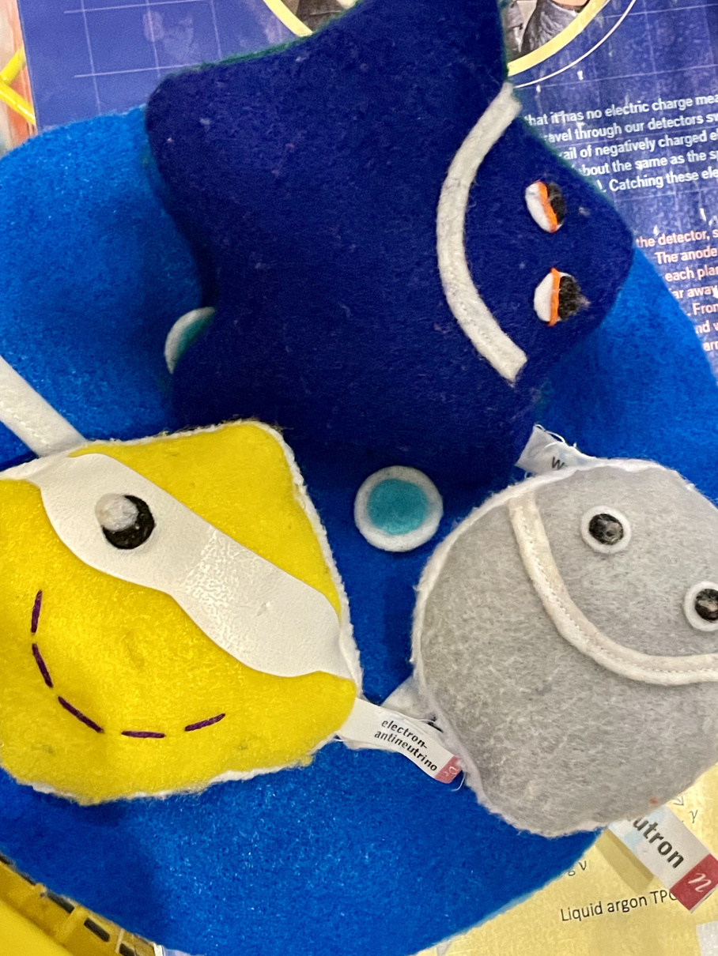
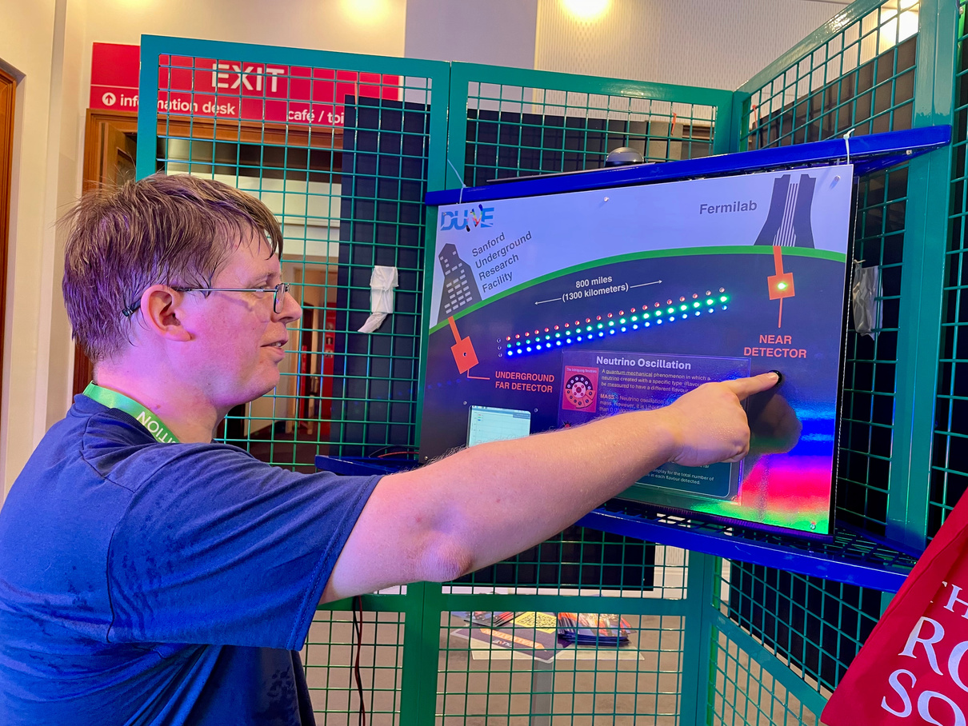
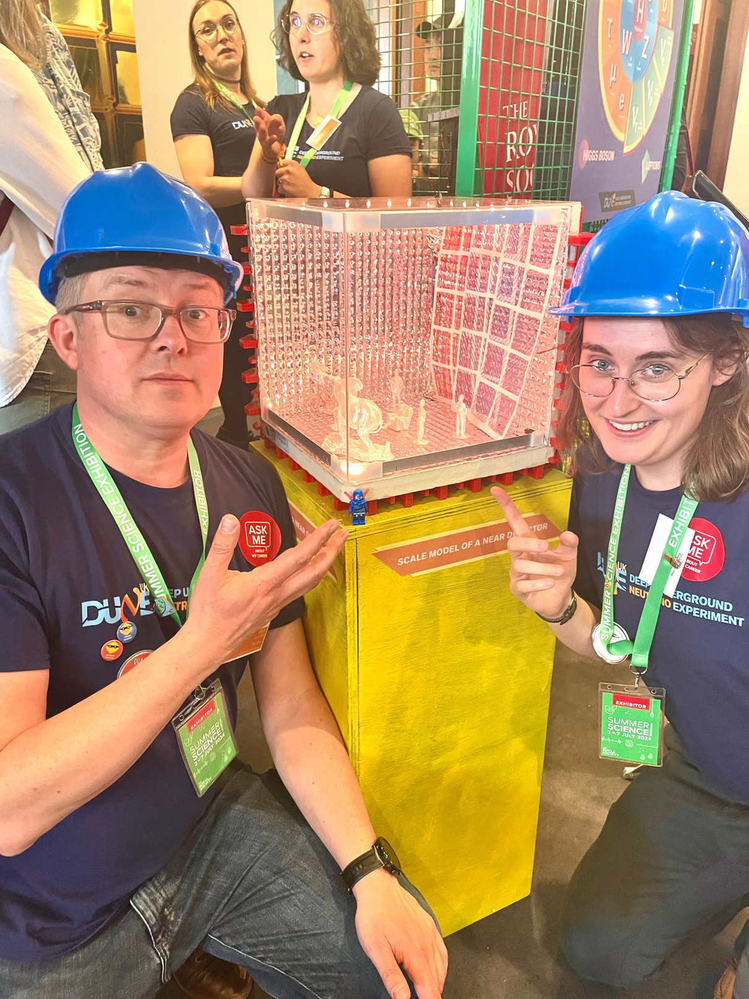
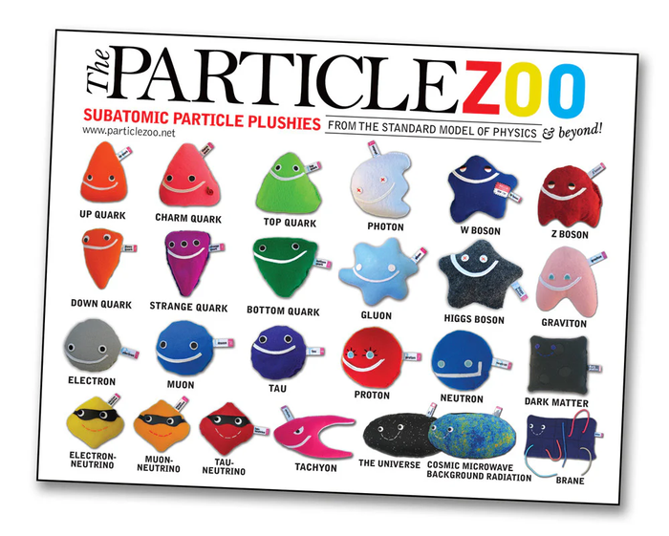
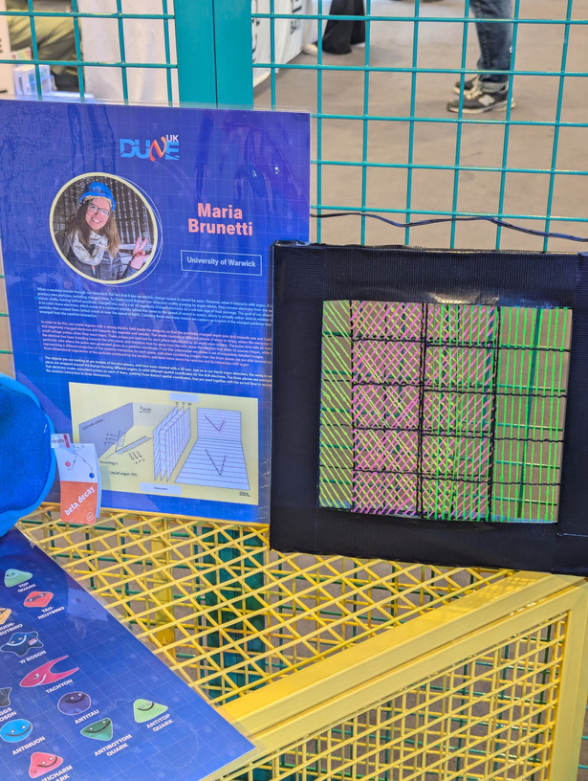
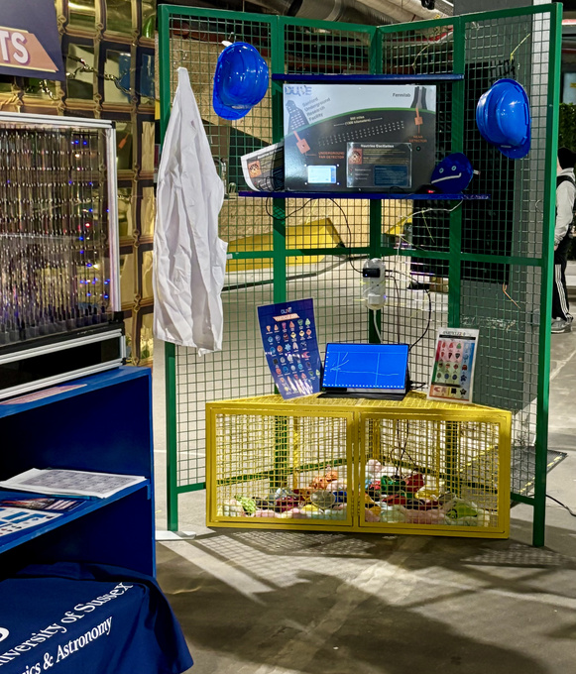
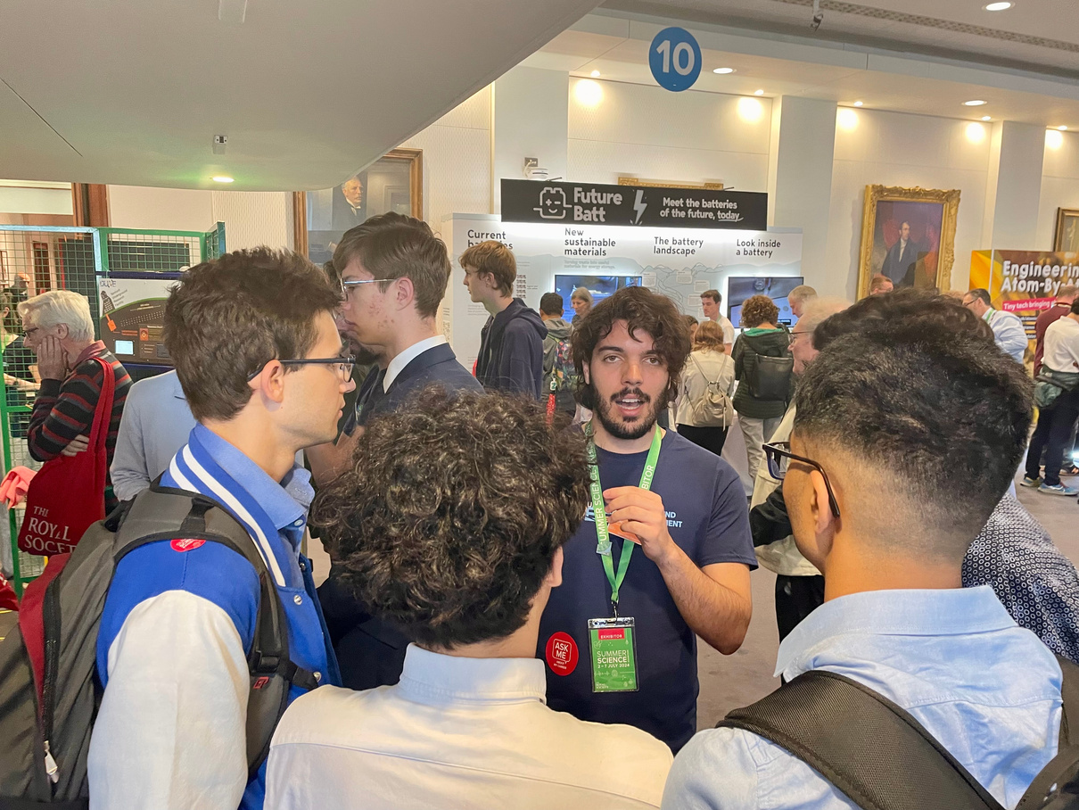
DUNE @ Royal Society Summer Exhibition

Slide 20
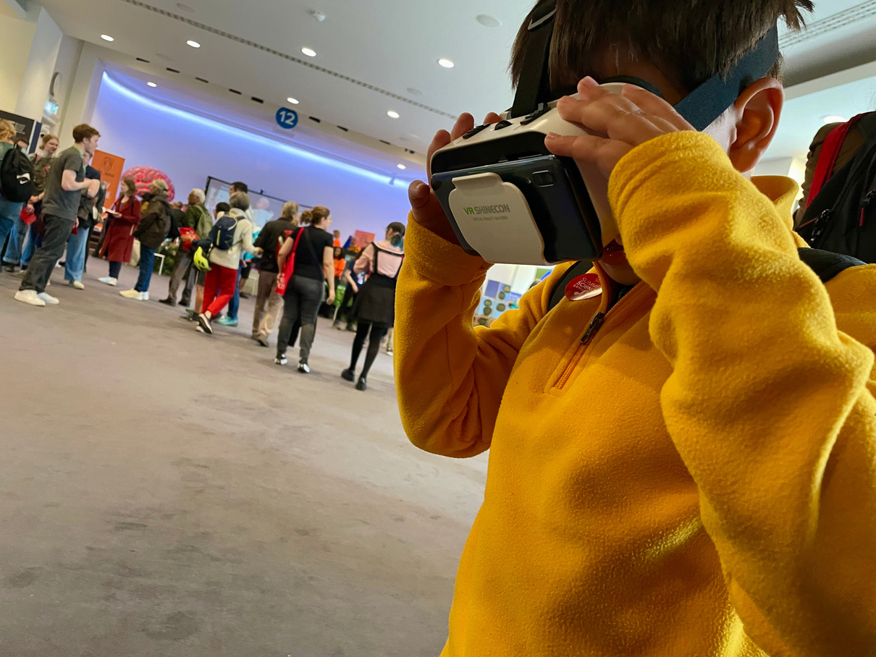
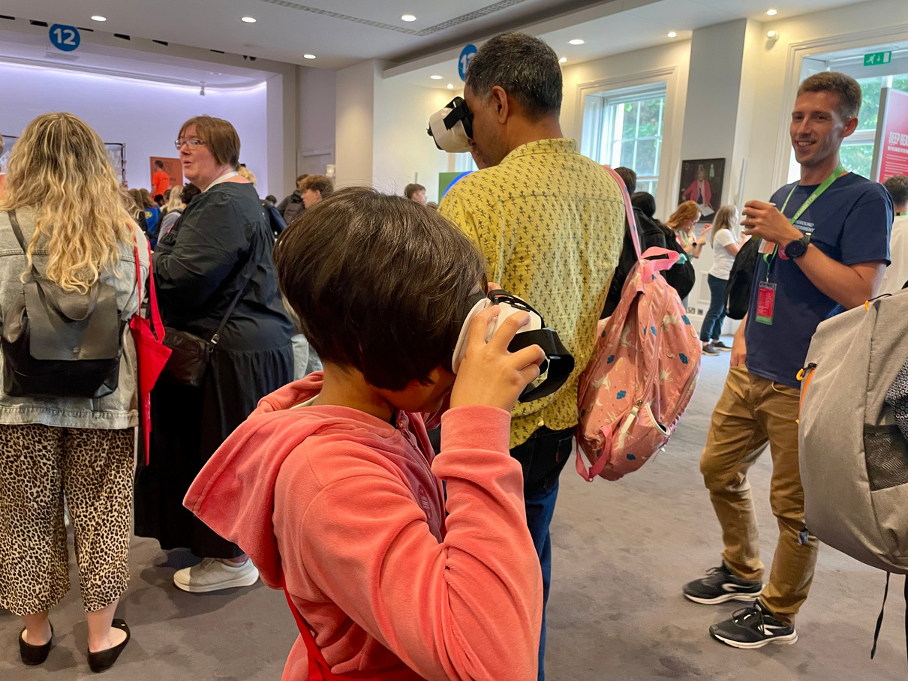
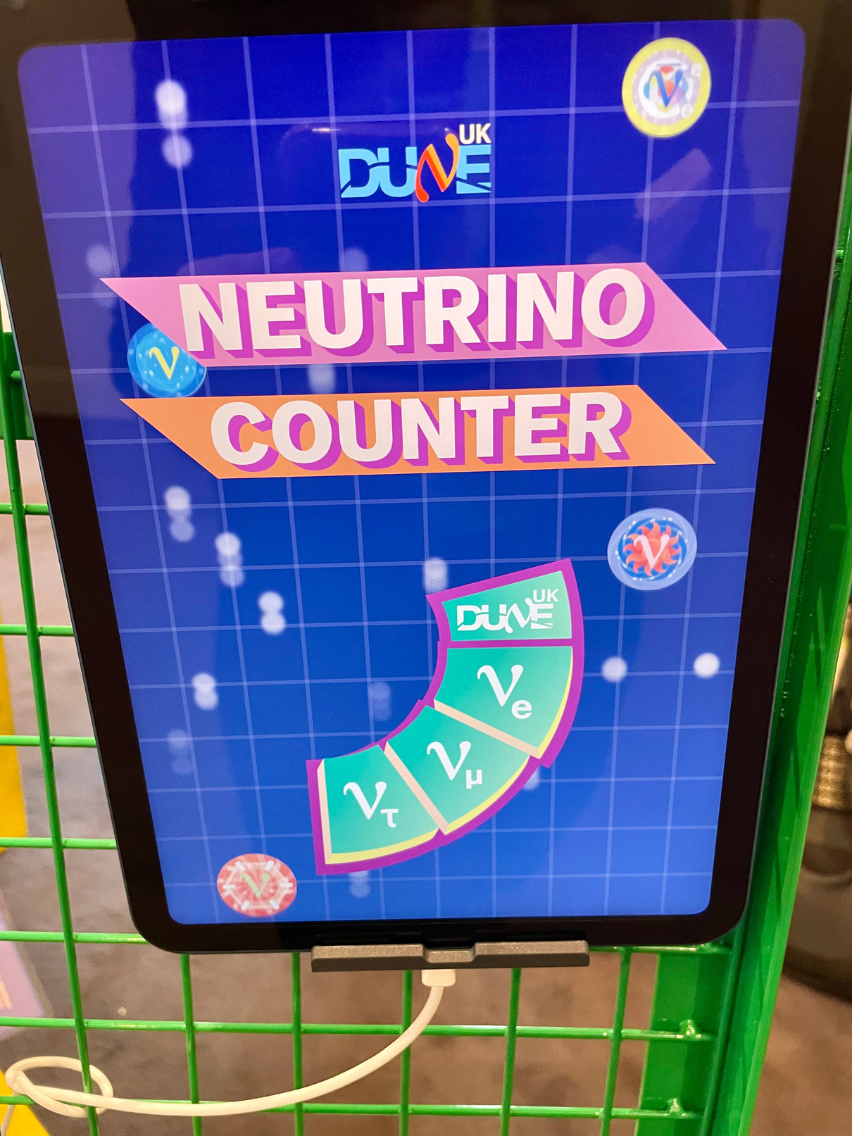
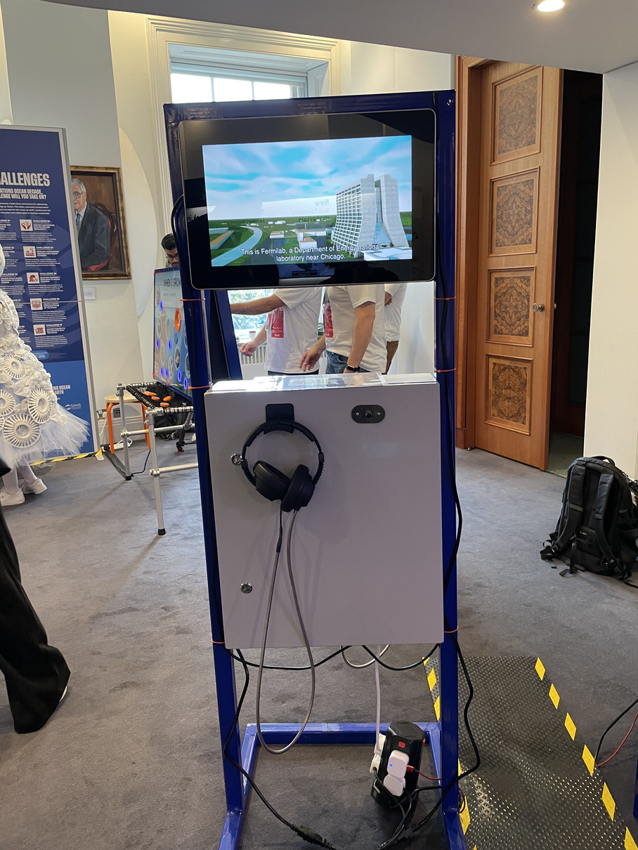
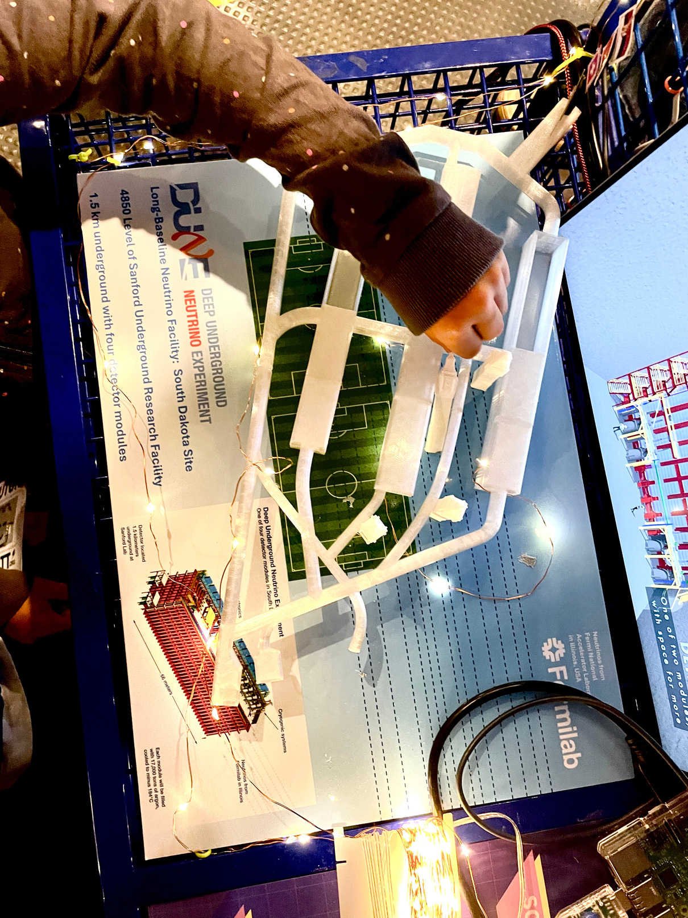
DUNE @ Royal Society Summer Exhibition

Slide 21
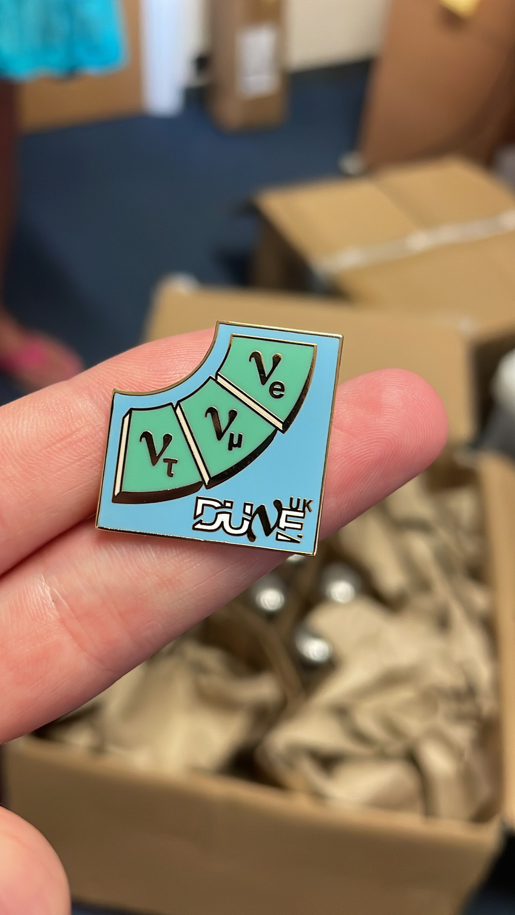
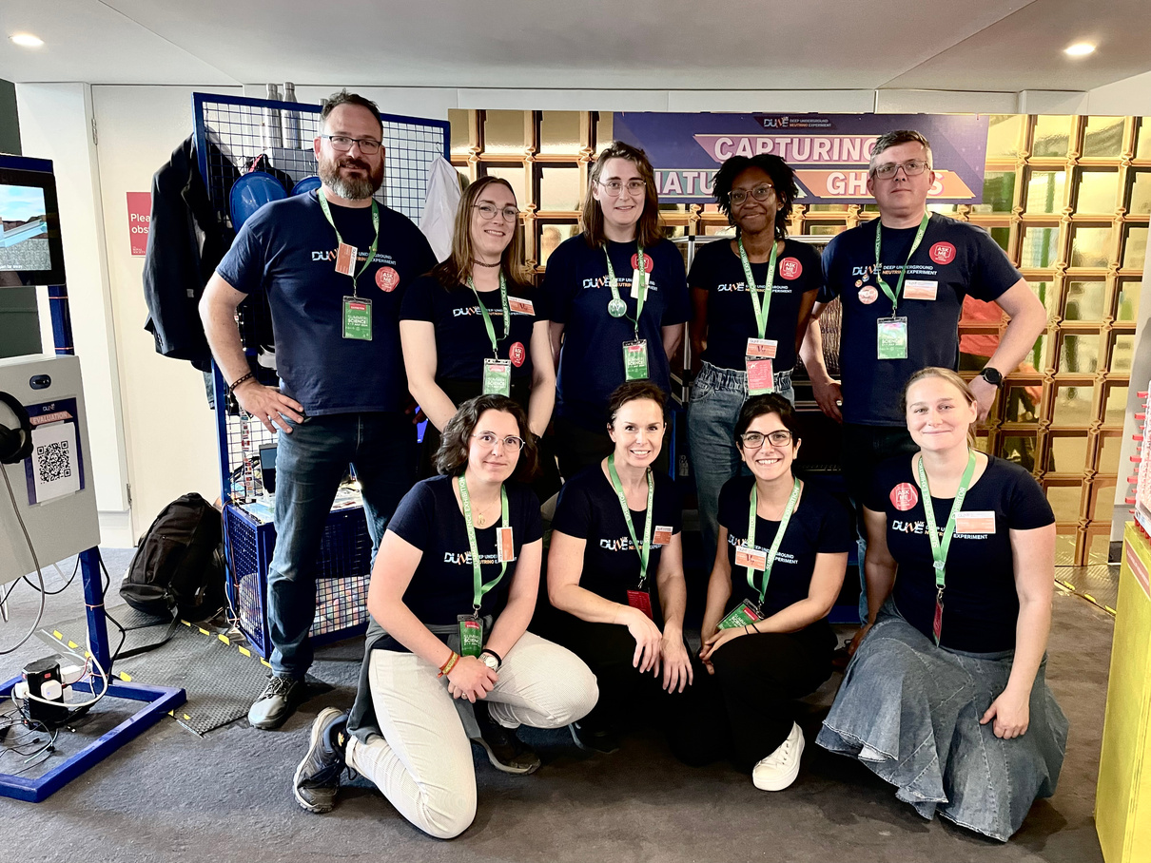
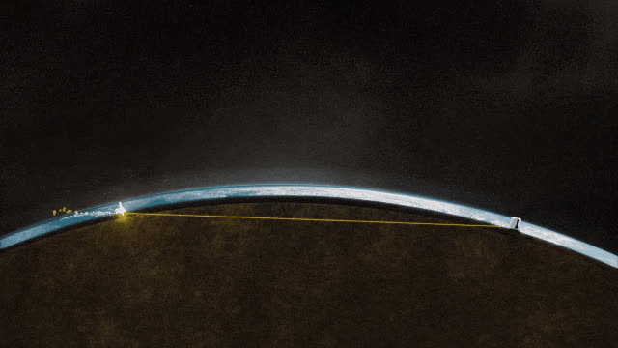
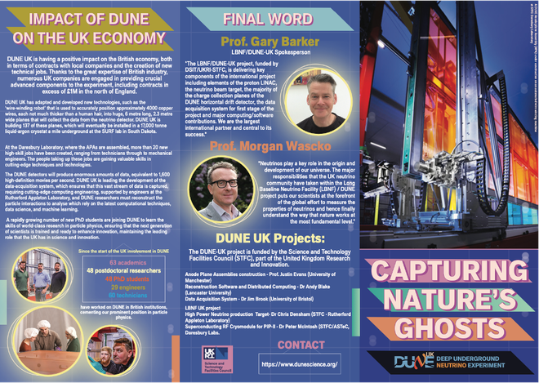
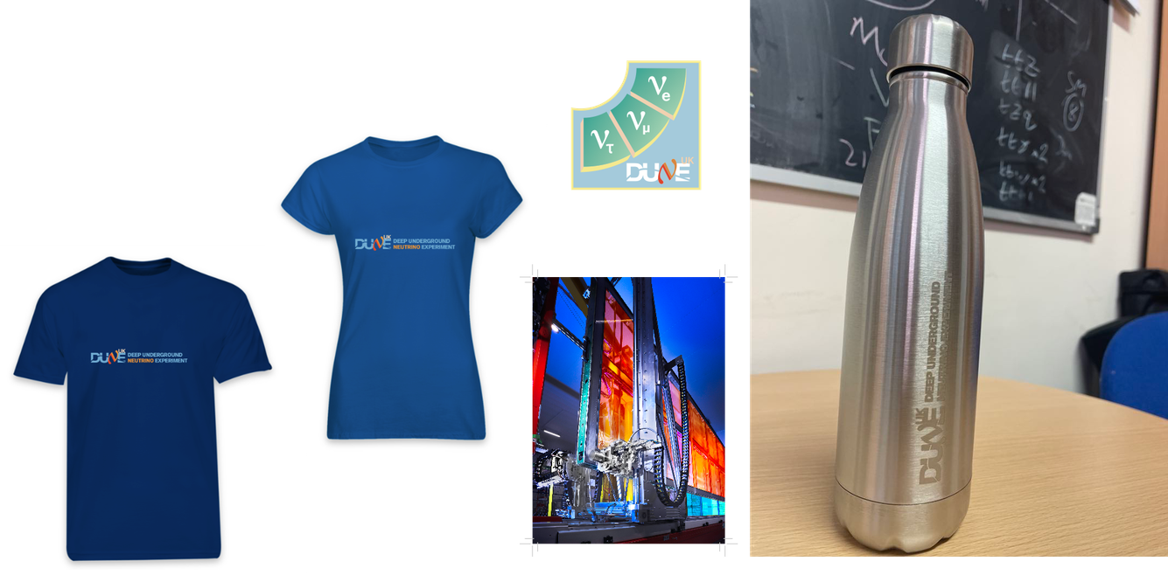
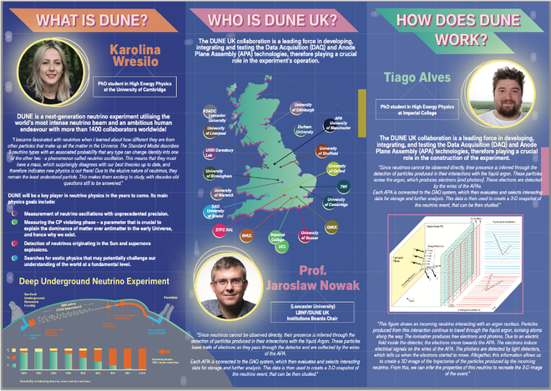
DUNE Exbition at the Royal Society

Slide 22
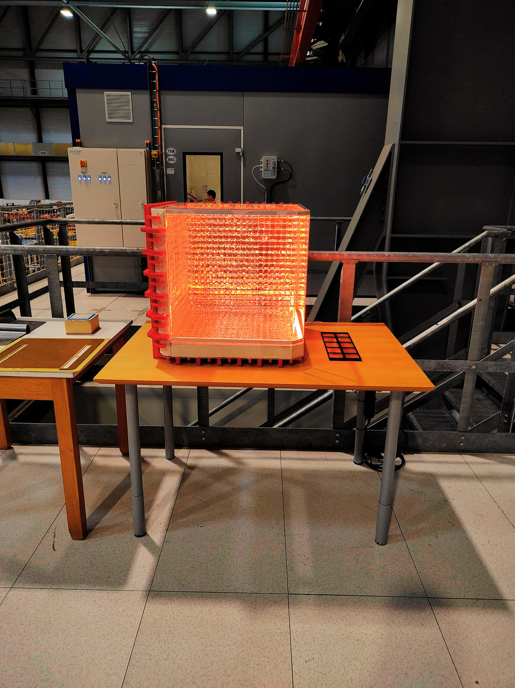
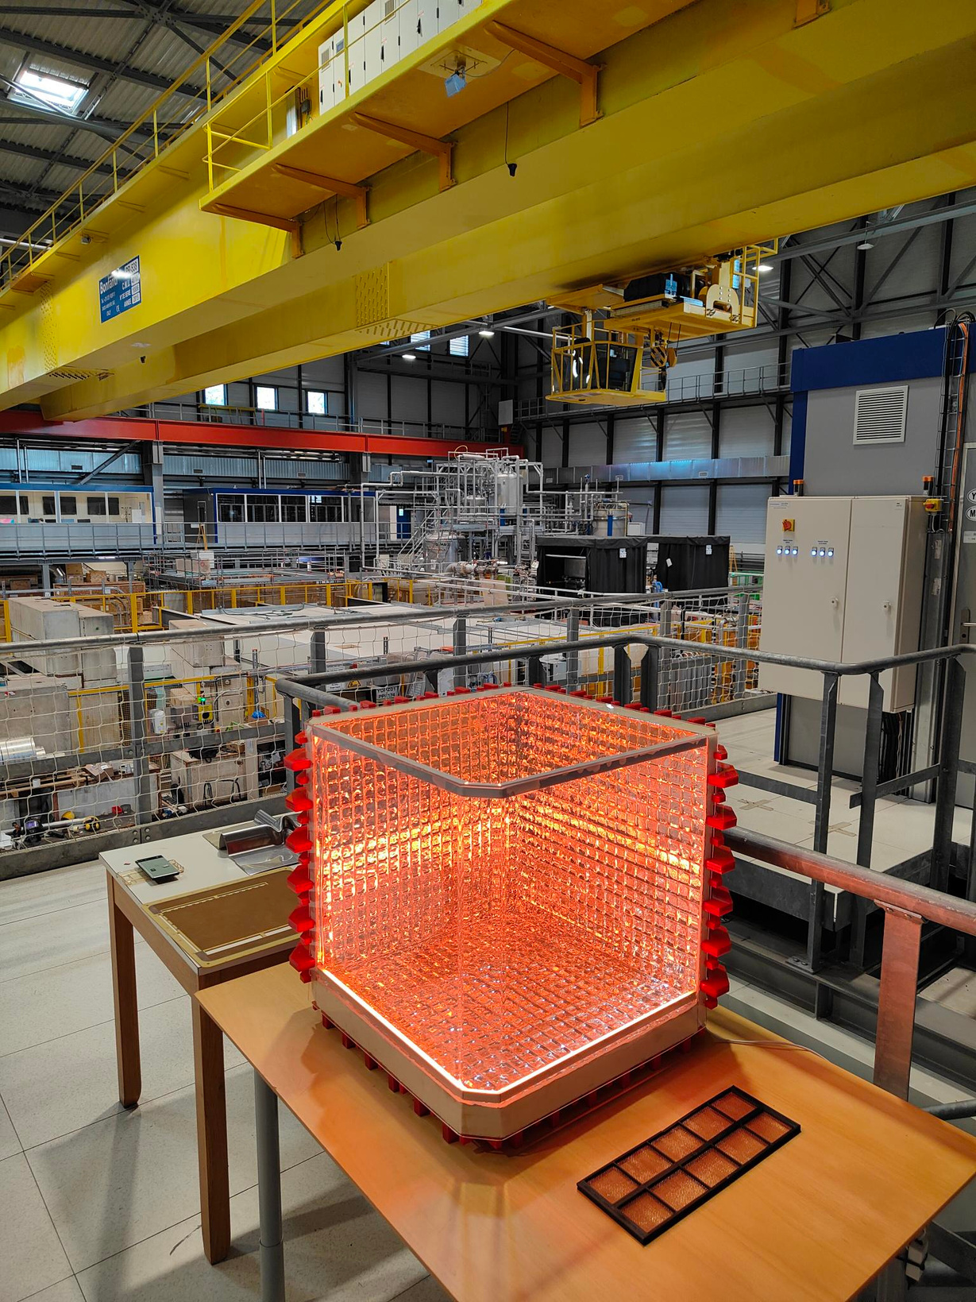
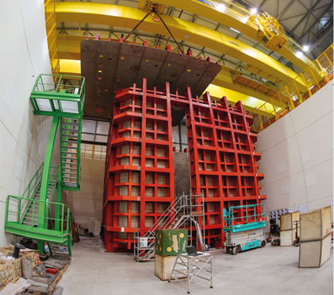
DUNE Exbition at the Royal Society
Model of ProtonDUNE with model APA next to it gifted to the Neutrino Platform at CERN, and leant to local outreach events
Many of the exhibition pieces available to download and use for your own exhibitons:
Neurtino counting IPAD game
3D DUNE model
Videos
Event displays
Posters
Particle Menu
DUNE VR

Slide 23


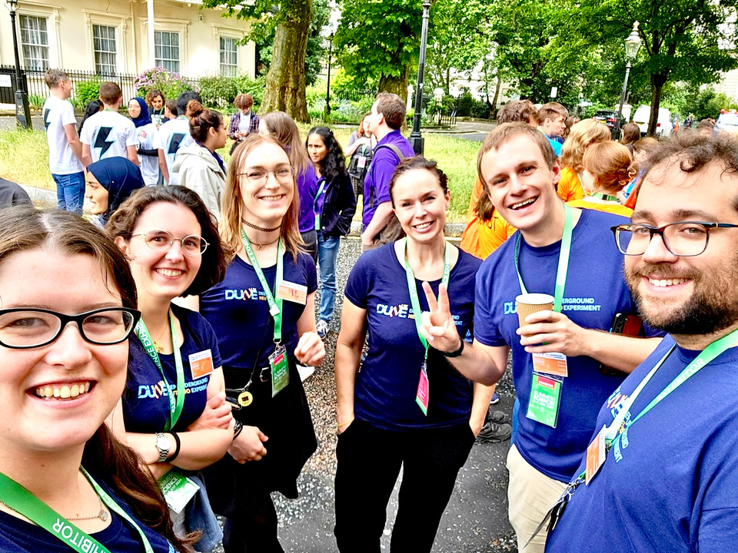
DUNE Exbition at the Royal Society
Travelling exhibition around the UK 2024 - 2027
Over 20,000 people have engaged with exhibition
Reached families, school students, and communities who may never have engaged with particle physics
People who had never heard of neutrinos suddenly asking profound questions about the universe

Slide 24
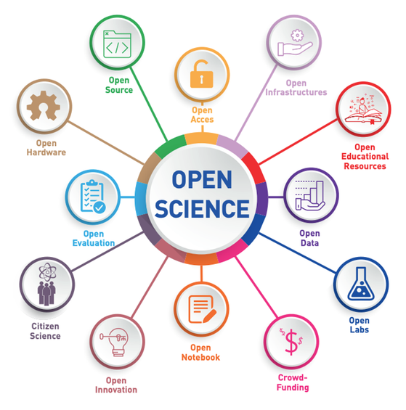
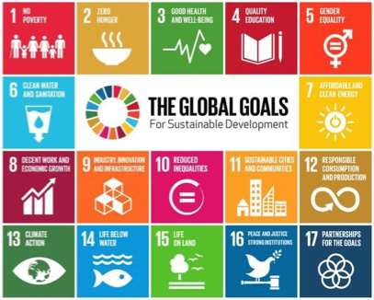
Open Data
Open Science is an accelerator for the Sustainable Development Goals 2030
A powerful tool to bridge the gap between country’s access to science, scientific capabilities, and outputs to support sustainable development.
Helps to promote equal opportunities for all scientists and citizens and increase scientific capacity and science education.

Slide 25

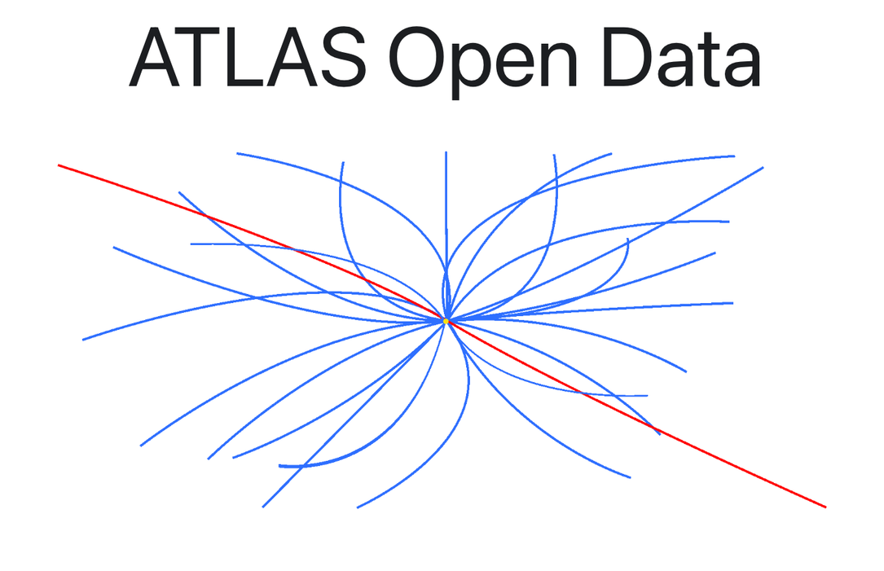

ATLAS Open Data for Education
We developed open educational resources based on real data from the ATLAS experiment
to build advanced data and scientific skills
widen access to frontier research
maximise the societal value of large-scale research infrastructure like the Large Hadron Collider
Can be used to address
Particle physics outreach and education
UK STEM skills training
Data science / AI readiness
Widening participation

Slide 26

ATLAS OPEN DATA for Education
Opens our data & tools for everyone: opendata.atlas.cern
Data, tools, software framework, web applications, Notebooks, tutorials, documentation
Run online and in person training for students: undergraduates, secondary school students
Develops skills
Particle physics
Data analysis and analysis techniques
Programming and computational skills
Machine learning in particle physics

Slide 27





ATLAS OPEN DATA : Particle Physics Training
Accessible - analyses using only your mouse!

Slide 28


ATLAS OPEN DATA : Training in Machine Learning
Find Dark Matter using only your mouse!
Interactive web application to learn about machine learning without the need of coding
https://opendata.atlas.cern/docs/webapps/mlapp

Slide 29







ATLAS OPEN DATA : Training in Machine Learning
Search for Dark Matter with Cut Optimisation
Then learn Machine Learning from scratch and implement in the analysis
Jupyter Notebook Series developed for Secondar School Students
Advanced Machine Learning Notebooks

Slide 30

Open Data for Education
IOP Open Data Workshop for Higher Education
iop.eventsair.com/odw2026
Open to all, we have talks from LHC experiments, G-2, CERN Open Data portal, The Sloan Digital Sky Survey & The Dark Energy Spectroscopic Instrument (DESI)
Discuss and plan how as a UK community we could further integrate HEP/APP Open Data into University and secondary school curriculum, and deliver to new audiences

Slide 31

Summary
It is important that we engage in outreach and communication to the public, policy makers, and students
Diversity strengthens science and innovation: Talent is universal, opportunity is not.
Working inter-university & cross experiment builds outreach capacity
Strategic approaches ensures UK physics remains world-leading.
Opening particle physics is essential. Let’s make the universe open to everyone.

