Slide 1
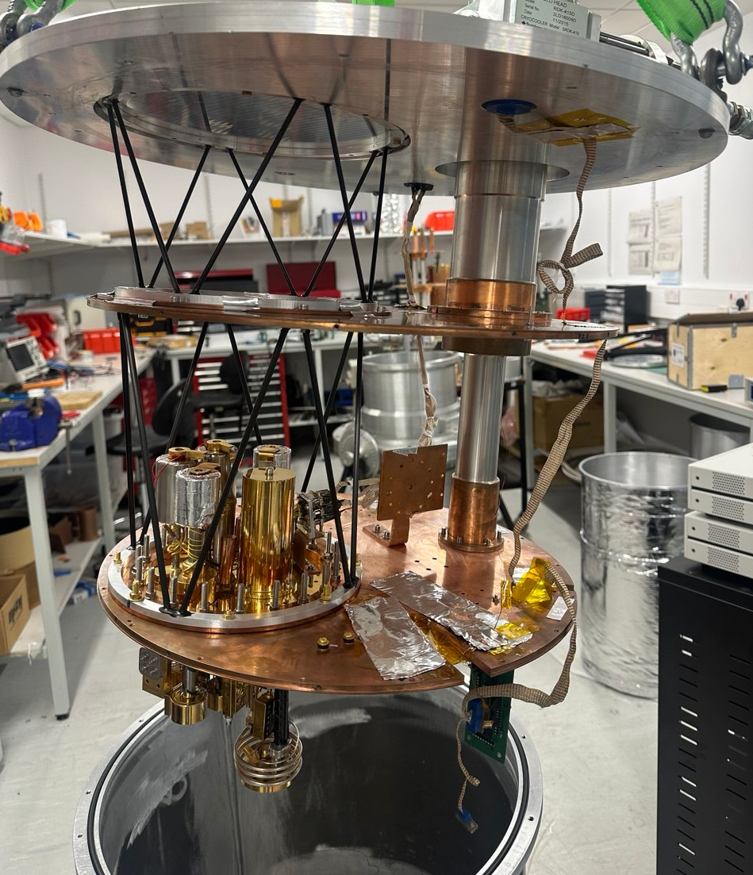
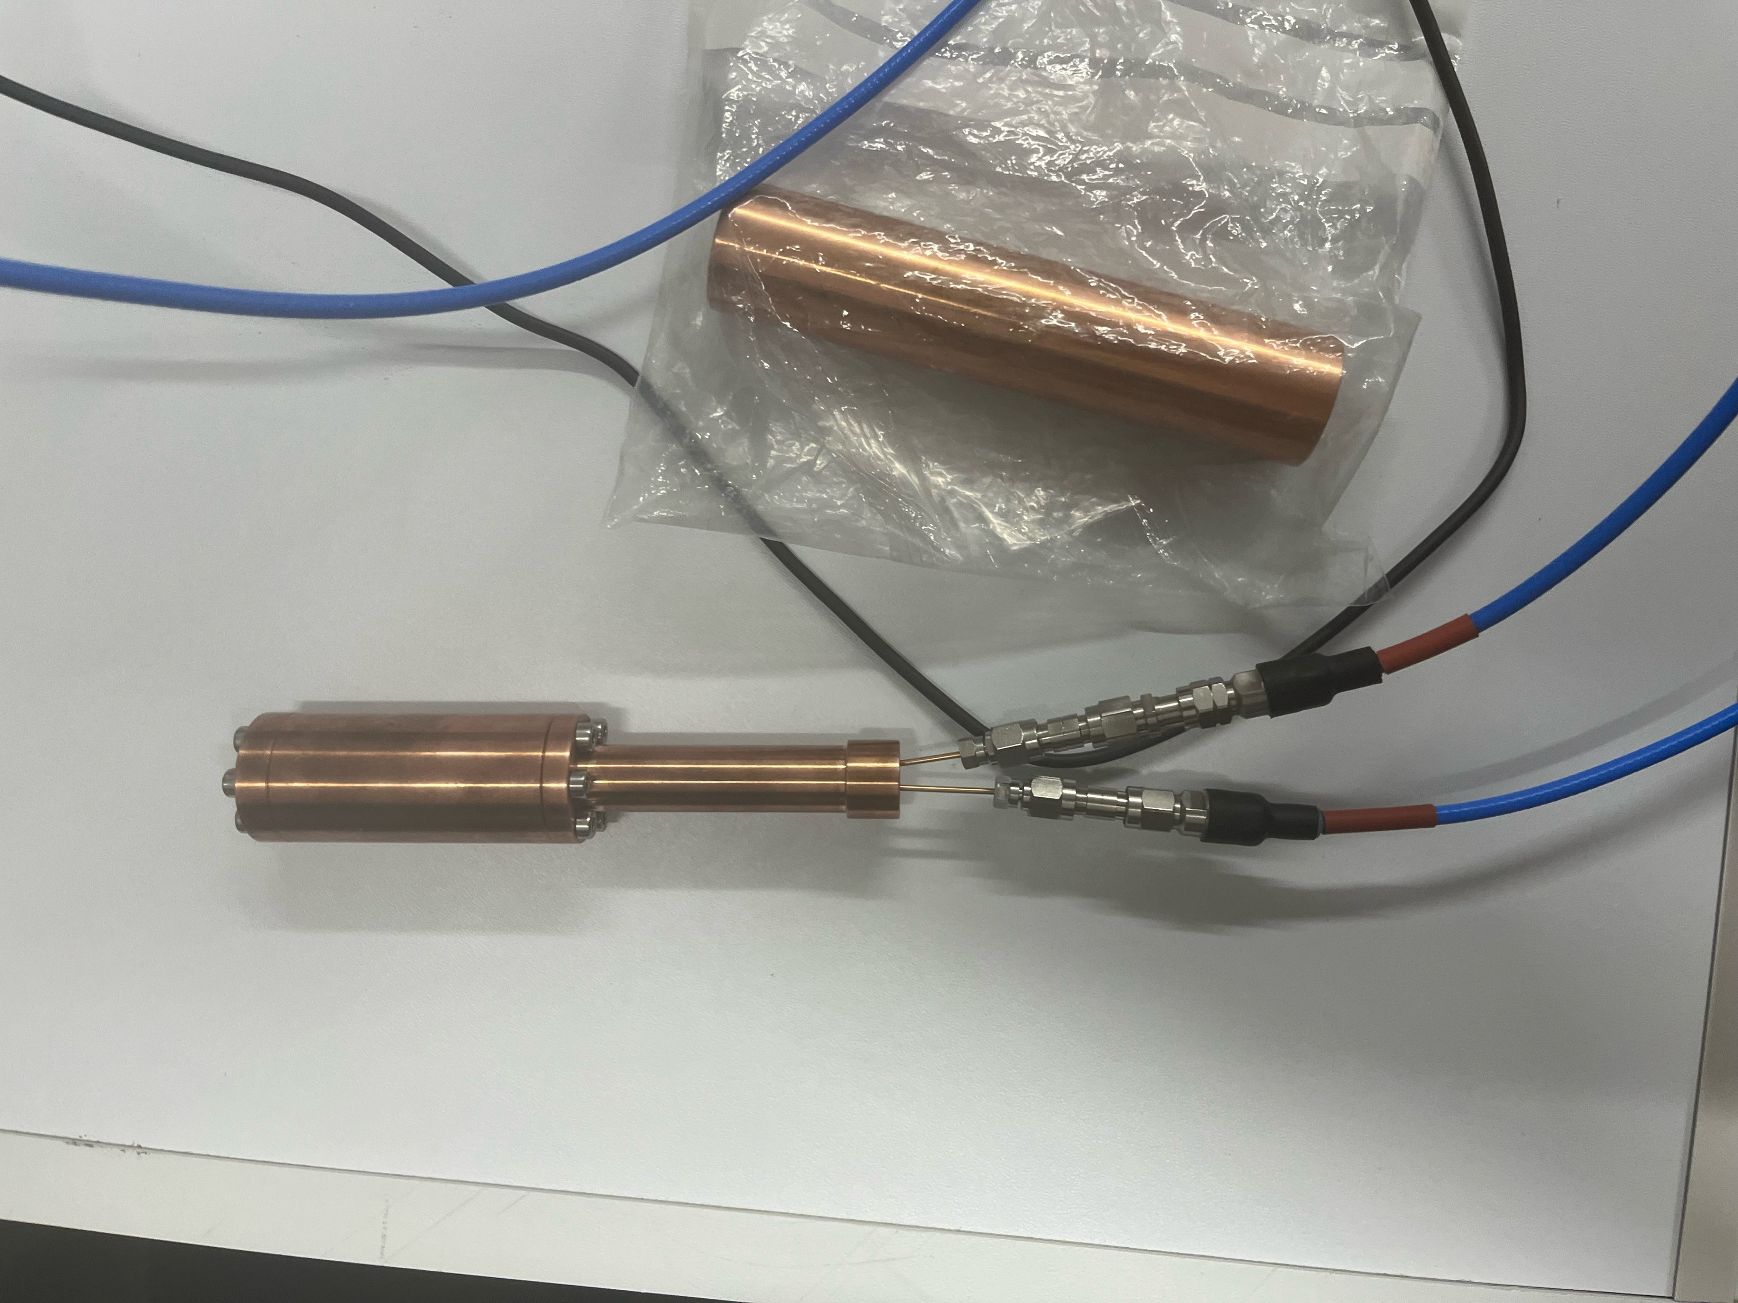
High-Frequency Axion Dark Matter Searches at Manchester
Jamie McDonald | University of Manchester
Annual APP and HEPP Conference| Edinburgh 8 - 10 April 2026
On behalf of
Ades, Battye, Buck, Feasby, Gilles, Gramellini, Marchitelli, JM, McCulloch, Lancaster, Mohammadian, Piccirillo, Preston, Qureshi, Rukhadze, Smith, Upward, Wystemp

Slide 2
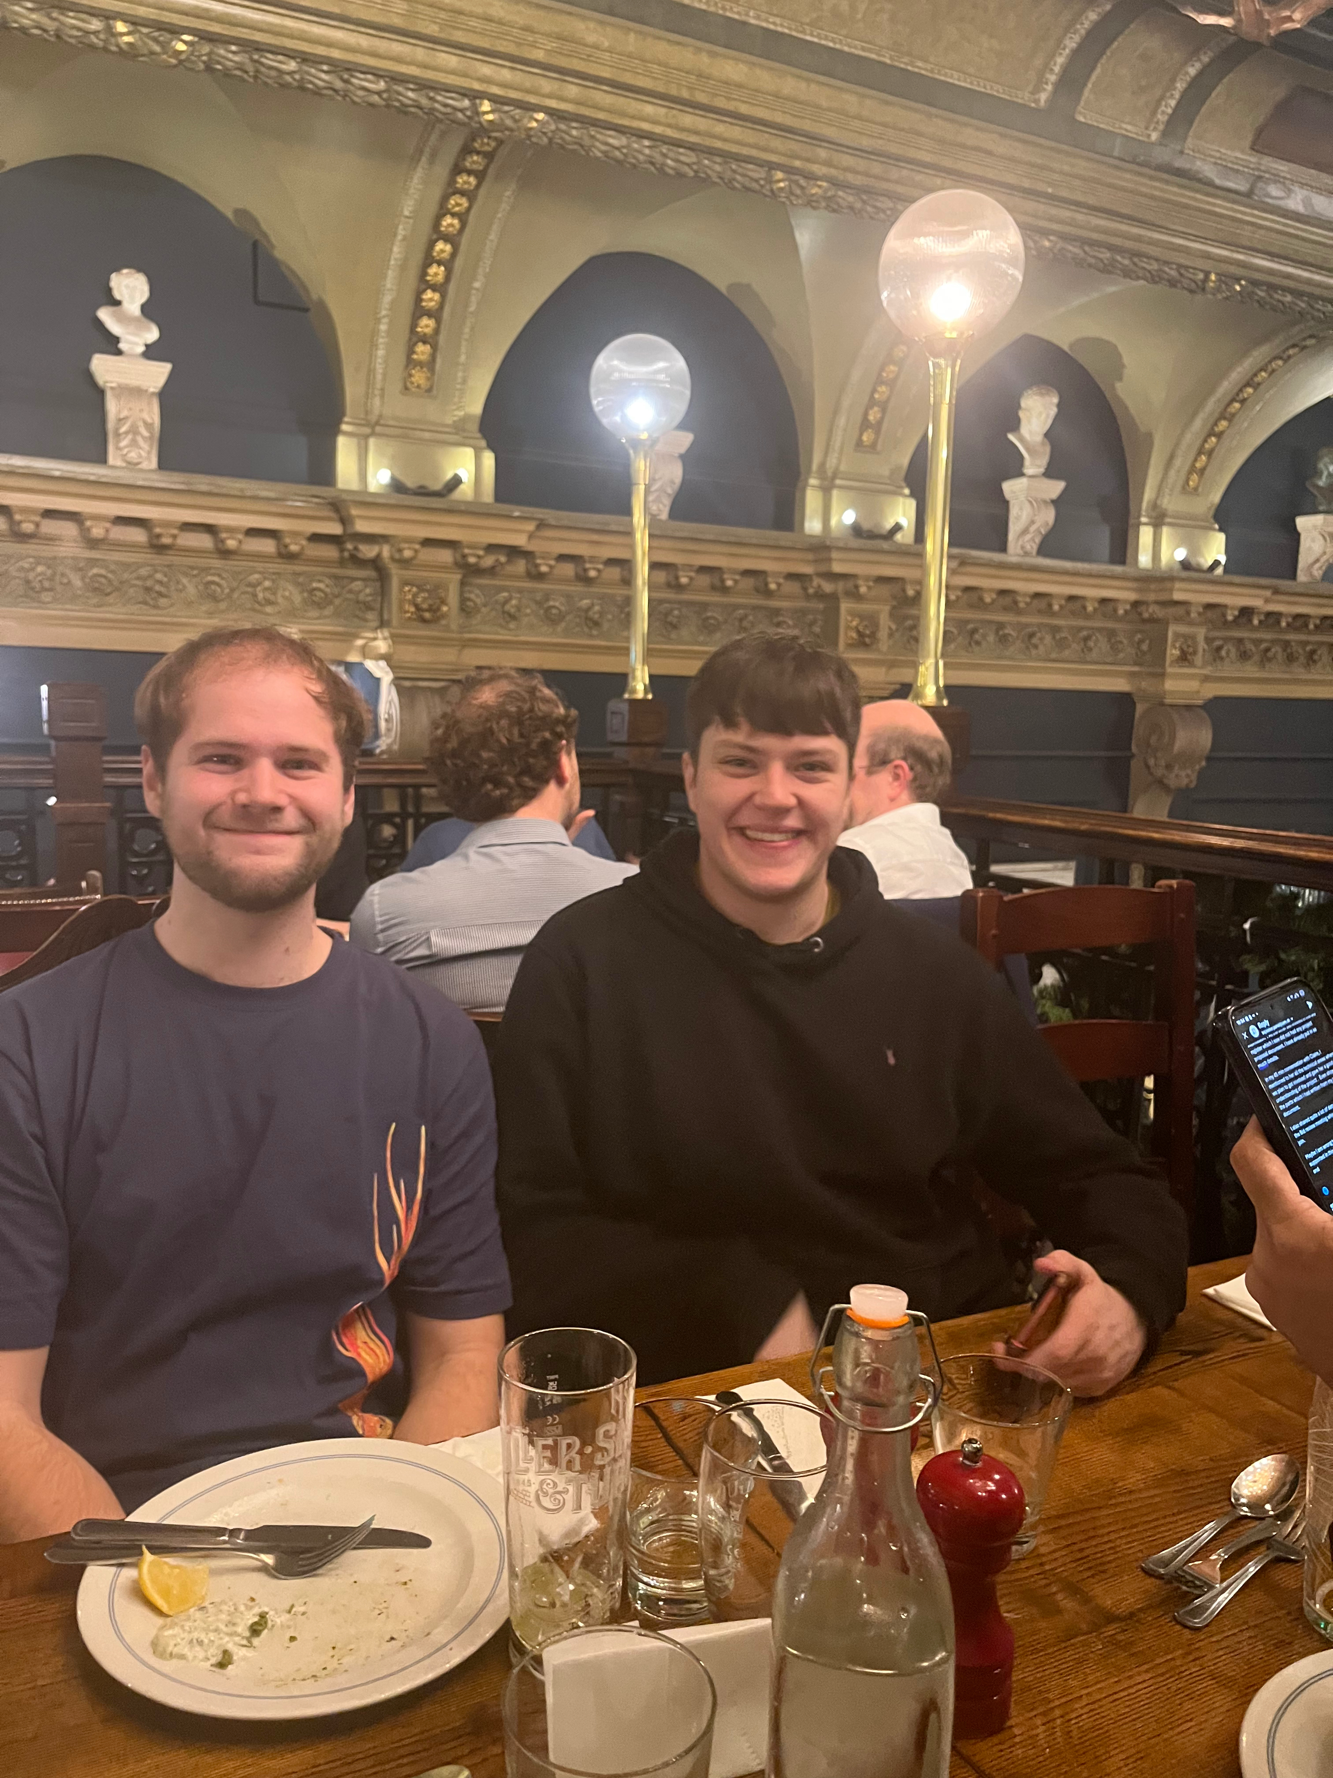
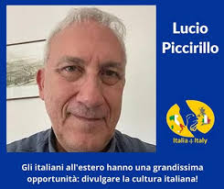
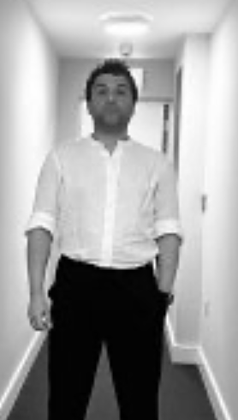
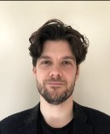
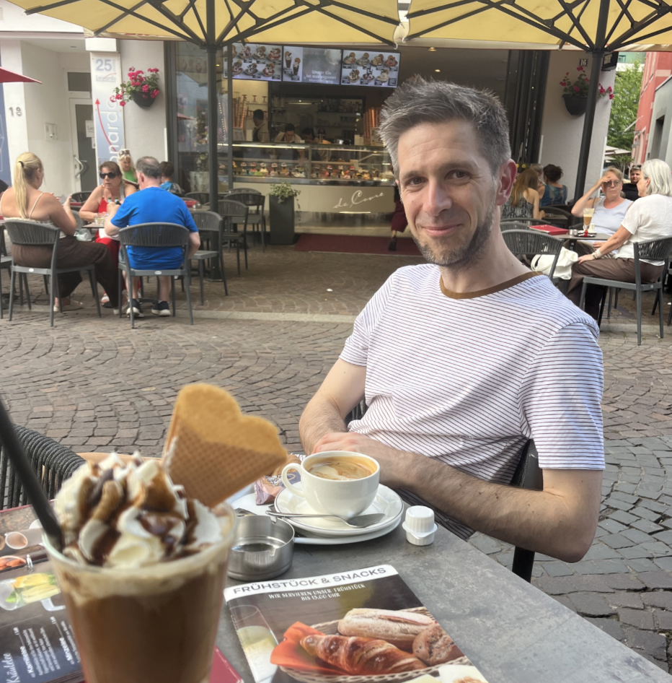
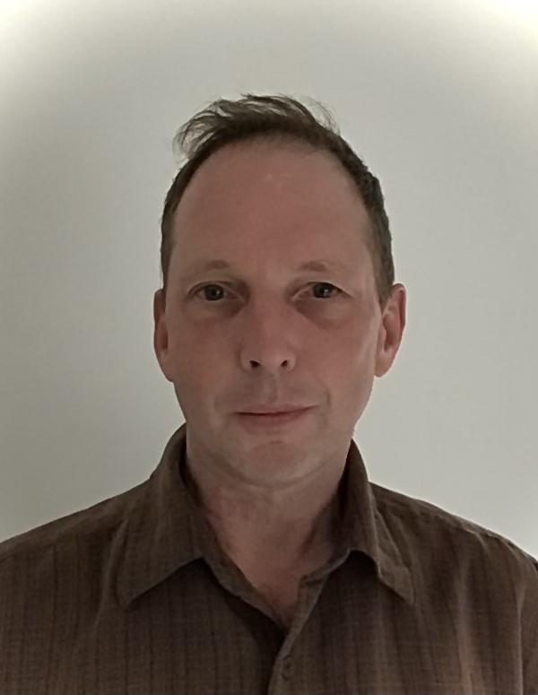
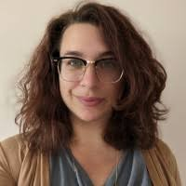
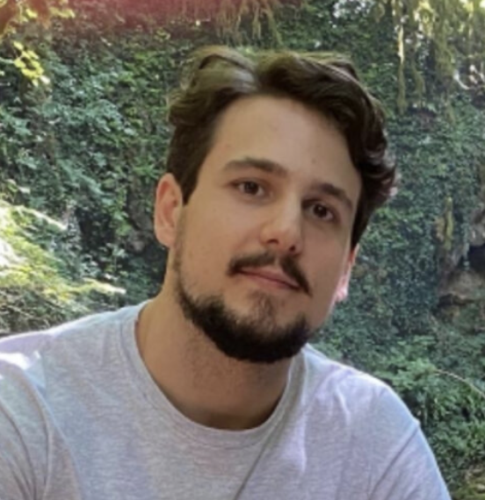
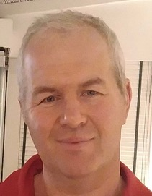
Axion Experiments at the University of Manchester
Ted Smith
Lucio Piccirillo
Babak Mohammadian
Matt Millns
JM
Mark McCulloch
Mark Lancaster
Elena Gramellini
Valerio Gilles
Richard Battye
Technical Staff: Daren Shepherd, Joshua Major, Noel Minzie,
MPhys & MSc Students: Nodar Rukhadze, Oliver Ades

Slide 3
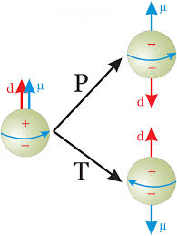
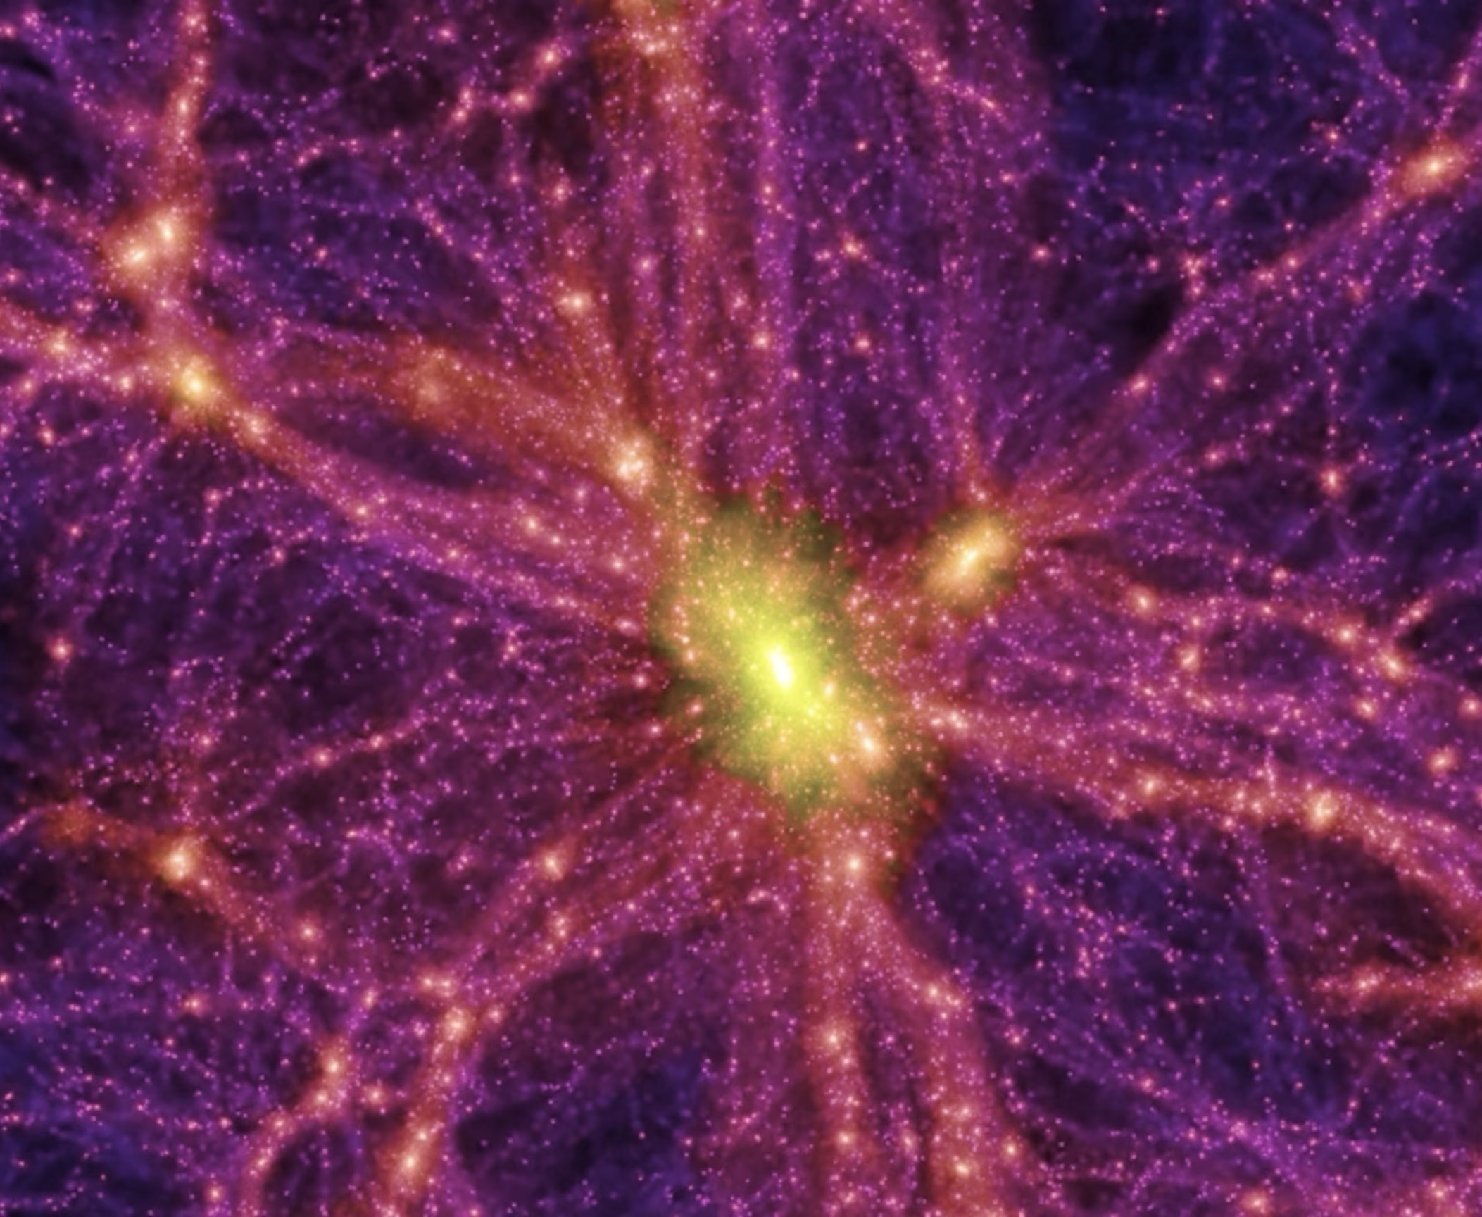
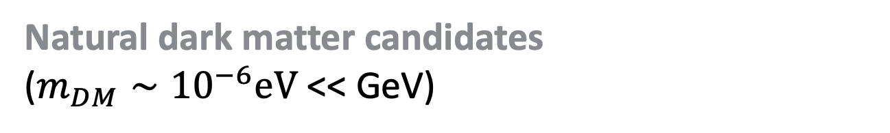
Axions
Solve strong CP problem in QCD
(why neutron EDM so small?)
Peccei & Quinn (1977)
Natural dark matter candidates
($m_{DM}∼{10}^{−6}eV$ << GeV)
Dine & Fischler (1983), Abbott & Sikivie (1983), Preskill, Wise & Wilczek (1983).

Slide 4
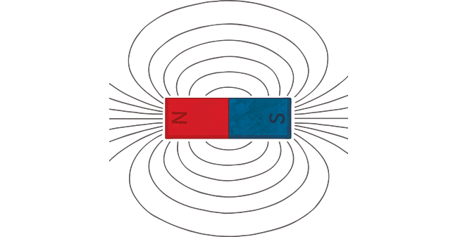
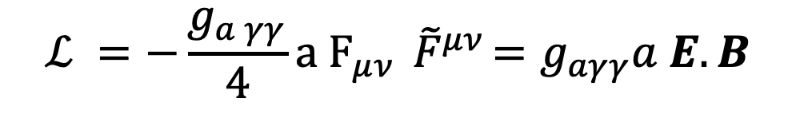
Axions
$$ℒ =−\frac{g_{a γγ}}{4}a F_{μν}{ \tilde{F}}^{μν}=g_{aγγ}a E.B$$
Axions
Photons

Slide 5
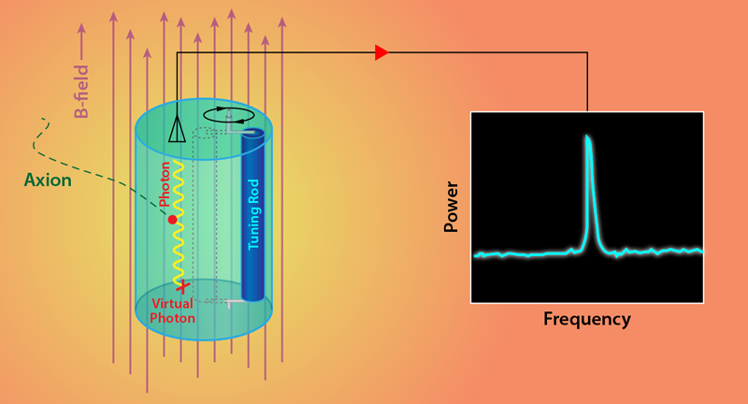


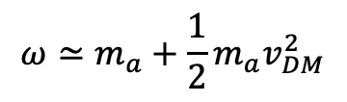



Axion Dark Matter
$$a$$
$$γ$$
$a∝e^{iωt}$
$$ω≃m_{a}+\frac{1}{2}{m_{a}v}_{DM}^{2}$$
$$B_{lab}$$
$$ω≃m_{a}$$
$$\frac{Δω}{ω}∼{10}^{−6}$$

Slide 6
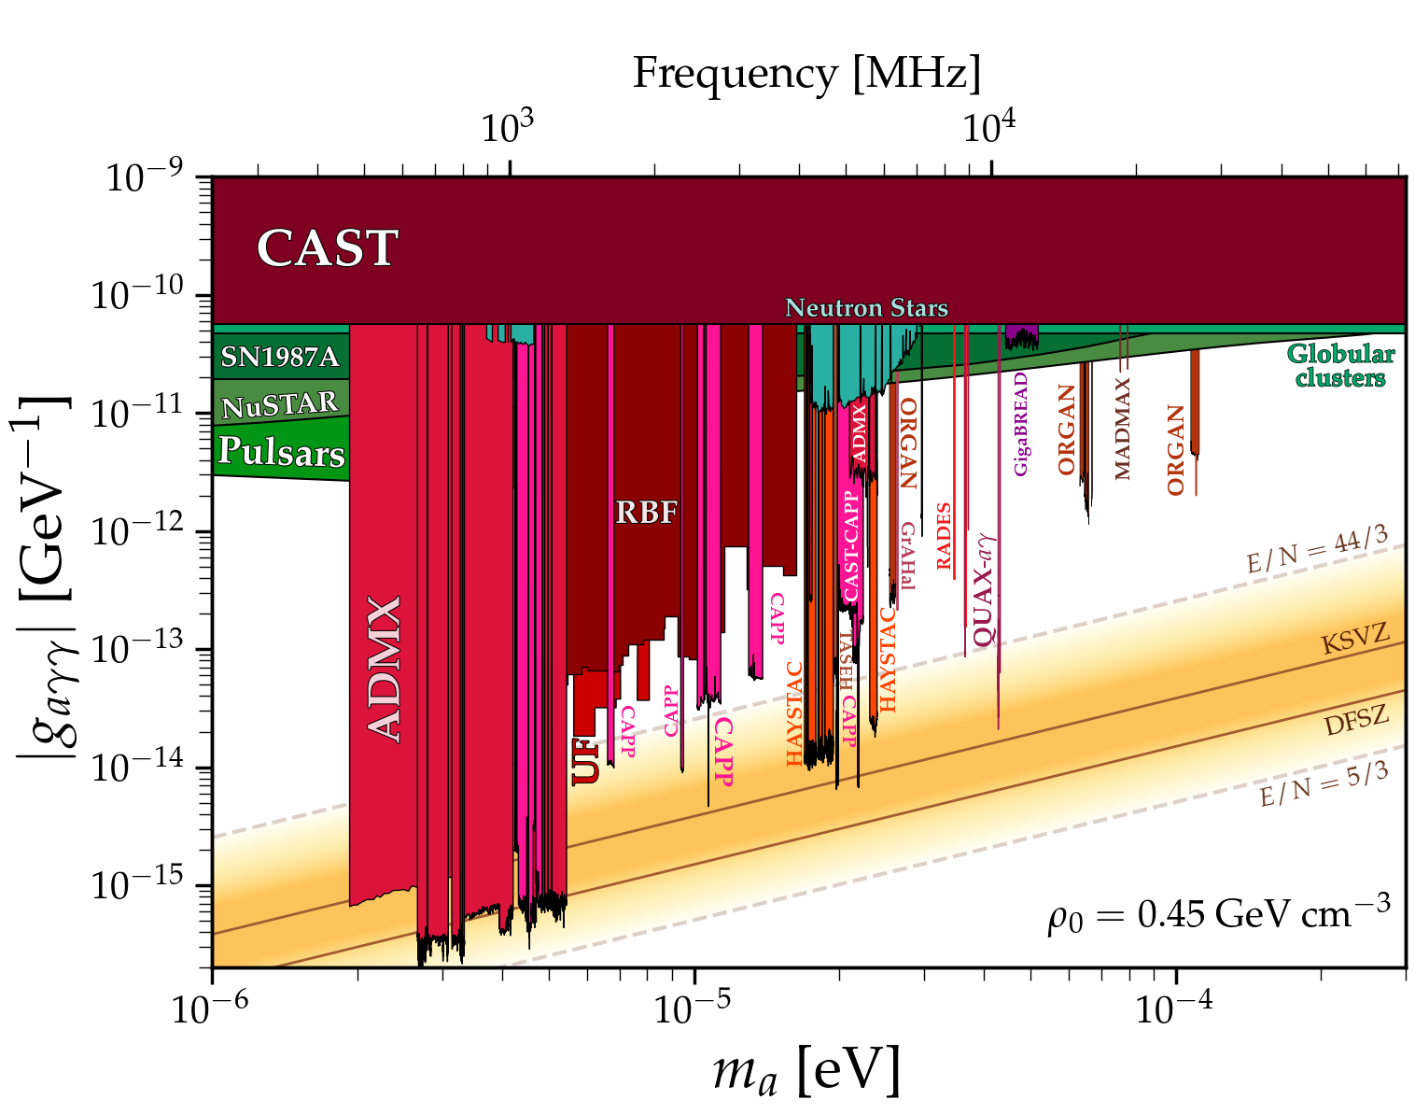
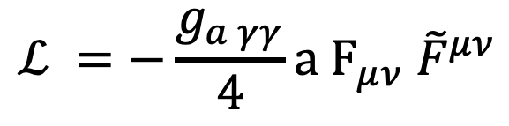
Axion Dark Matter
26 – 40 GHz
This Talk
$$ℒ =−\frac{g_{a γγ}}{4}a F_{μν}{ \tilde{F}}^{μν}$$
Photon Coupling
Dark Matter Mass

Slide 7
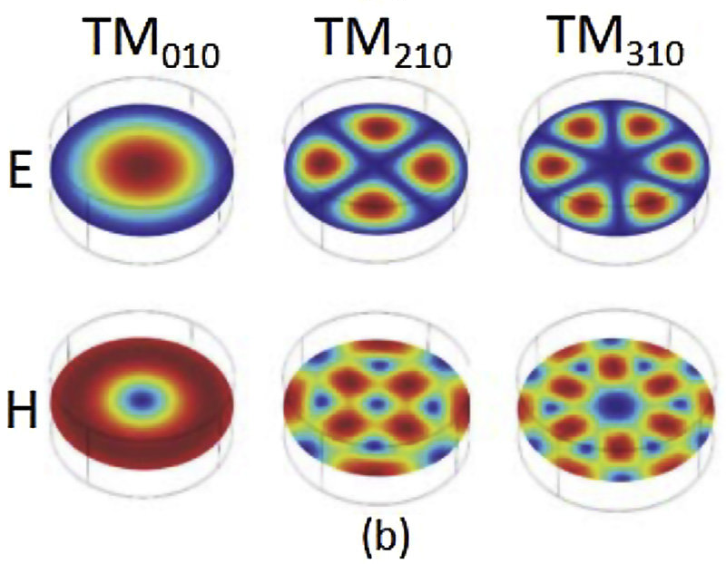
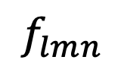

Cavity Searches for Axion Dark Matter
Cavity Modes
$r_{c}$
Cavity
$$f_{lmn}$$
(eigenfrequencies)

Slide 8
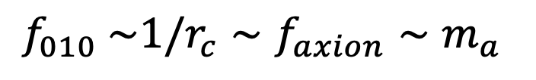



Cavity Searches for Axion Dark Matter
Cavity Modes
Magnet
axion
$r_{c}$
B
Cavity
$$a$$
$$γ$$
$$f_{010} \sim 1/r_{c}∼f_{axion}∼m_{a}$$
(eigenfrequencies)
$$B_{}$$

Slide 9
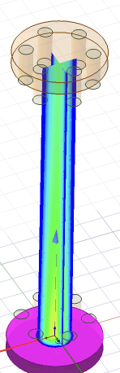
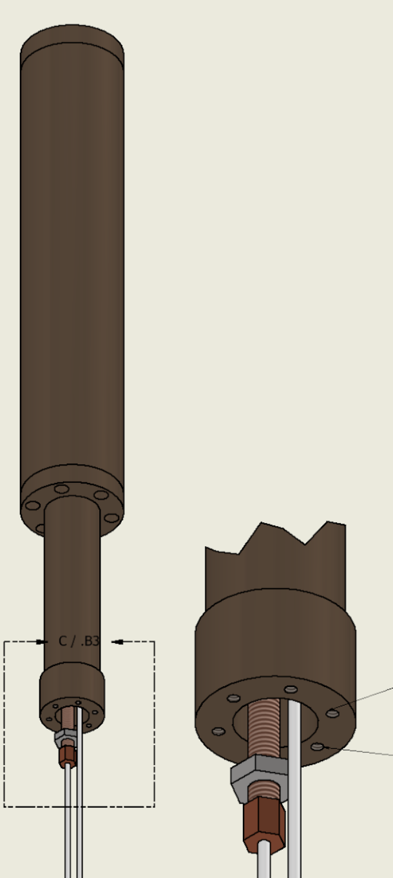
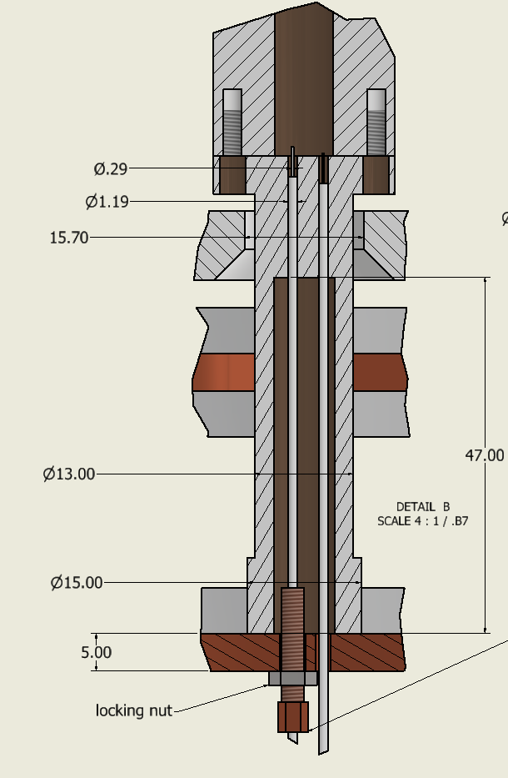
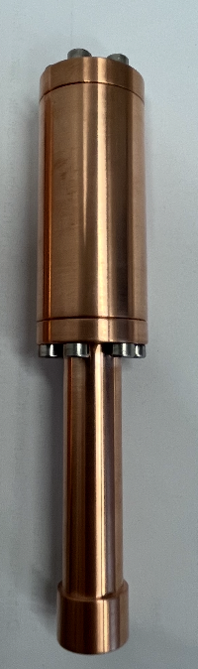
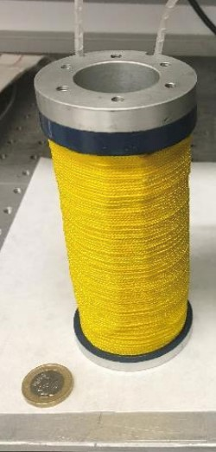
Cavity Searches for Axion Dark Matter
30 GHz Static Pillbox Cavity
3cm
12cm
3 Tesla
Cavities
Magnet

Slide 10
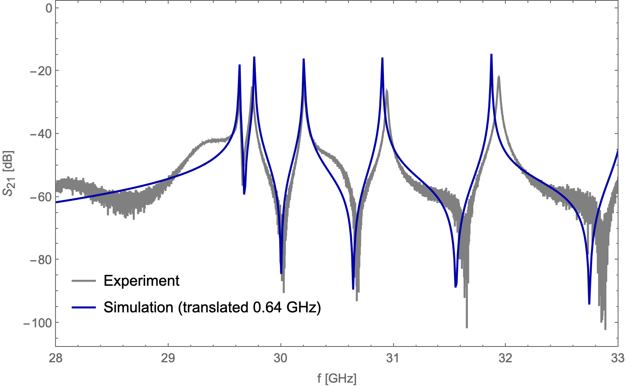
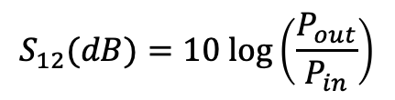
Cavity Mode Structure Verification
T = 300K (room temp)
Fri 27 Apr
Preliminary
$$S_{12}(dB)=10 log\left(\frac{P_{out}}{P_{in}}\right)$$
“transmission spectrum”
First Q measurement likely over-coupled:
more measurements coming soon!

Slide 11
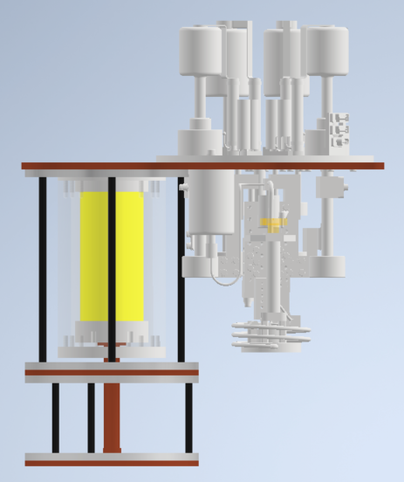

Cryostat
4 K
Cryo-Cooler
to 4 K
Miniature
Dilution
Fridge
magnet
300 mK
cavity
50 mK
${\text{@ 30 }\text{GHz}\text{: }T}_{Quant}$= 1.4 K

Slide 12
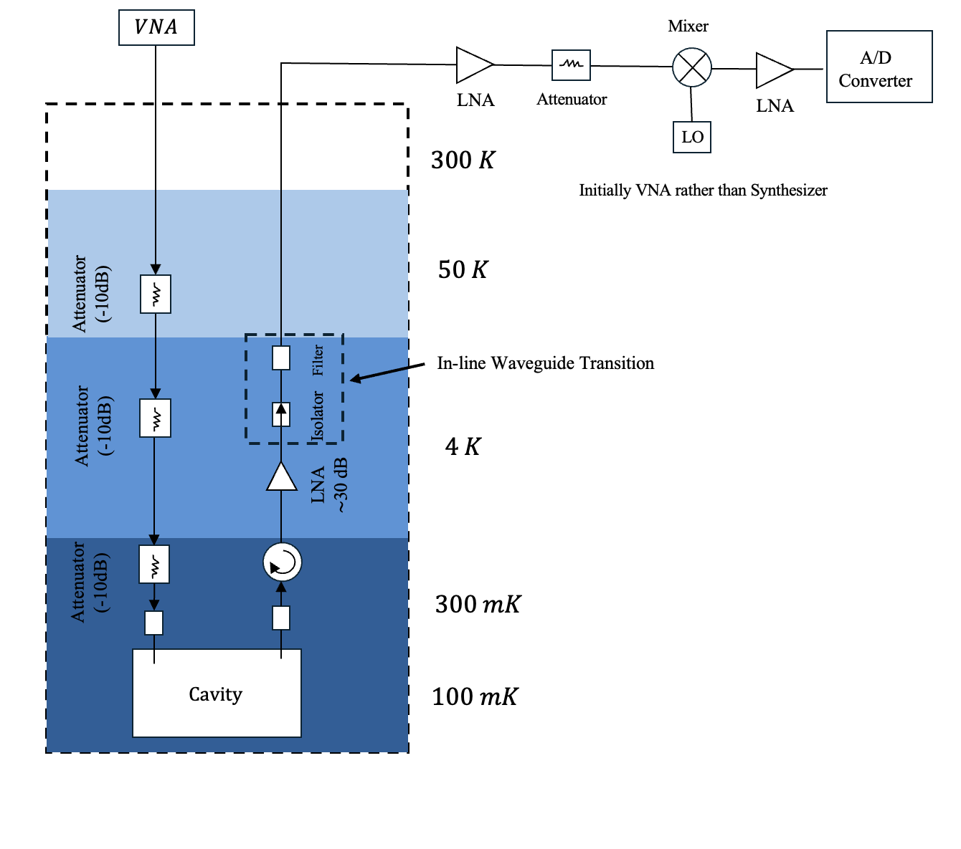
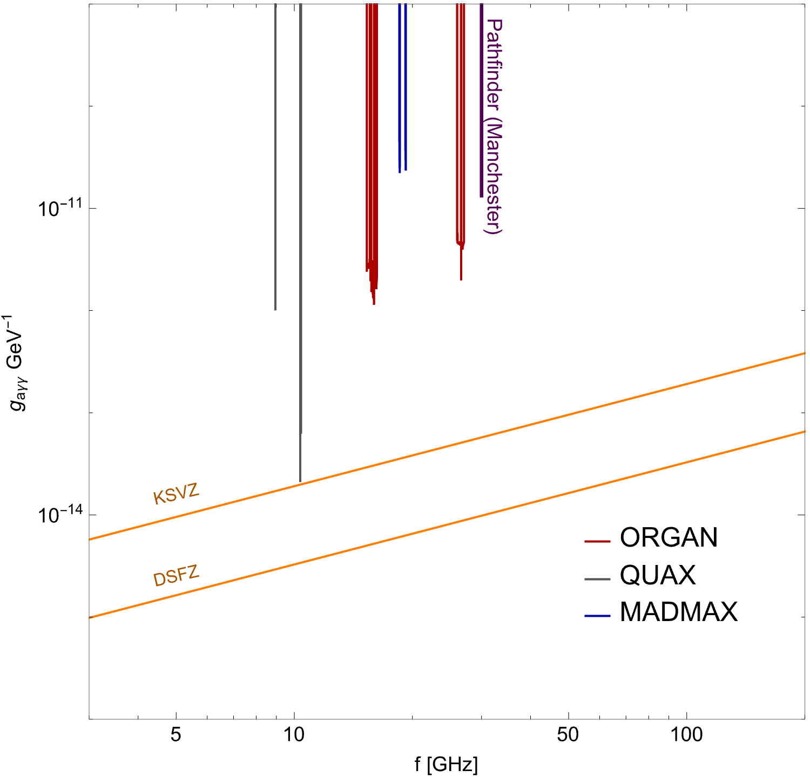
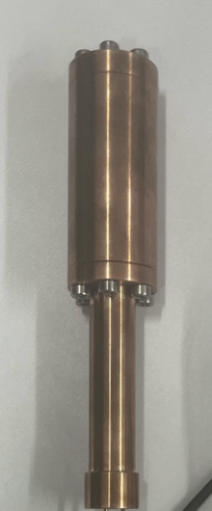
30GHz Pathfinder Underway
Projection
Pathfinder (Manchester)
QCD Axions
Cryostat operating at 50mK (2025) ✅
Two new PhD students (Oct 2025) ✅
Cavity Fabrication and testing (Jan – Mar 2026) ✅
Receiver Chain Hardware Arrived (Mar 2026) ✅
Assembly + data taking planned for 2026

Slide 13
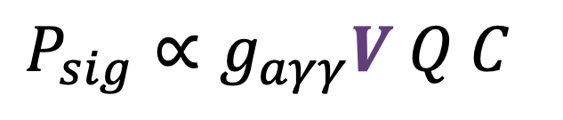
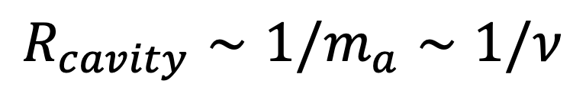
Improved Cavities
$$R_{cavity}∼1/m_{a}∼1/ν$$
1 GHz
30 GHz
Magnet
Cavity
20 cm
20 cm
$$P_{sig}∝g_{aγγ}V Q C$$

Slide 14
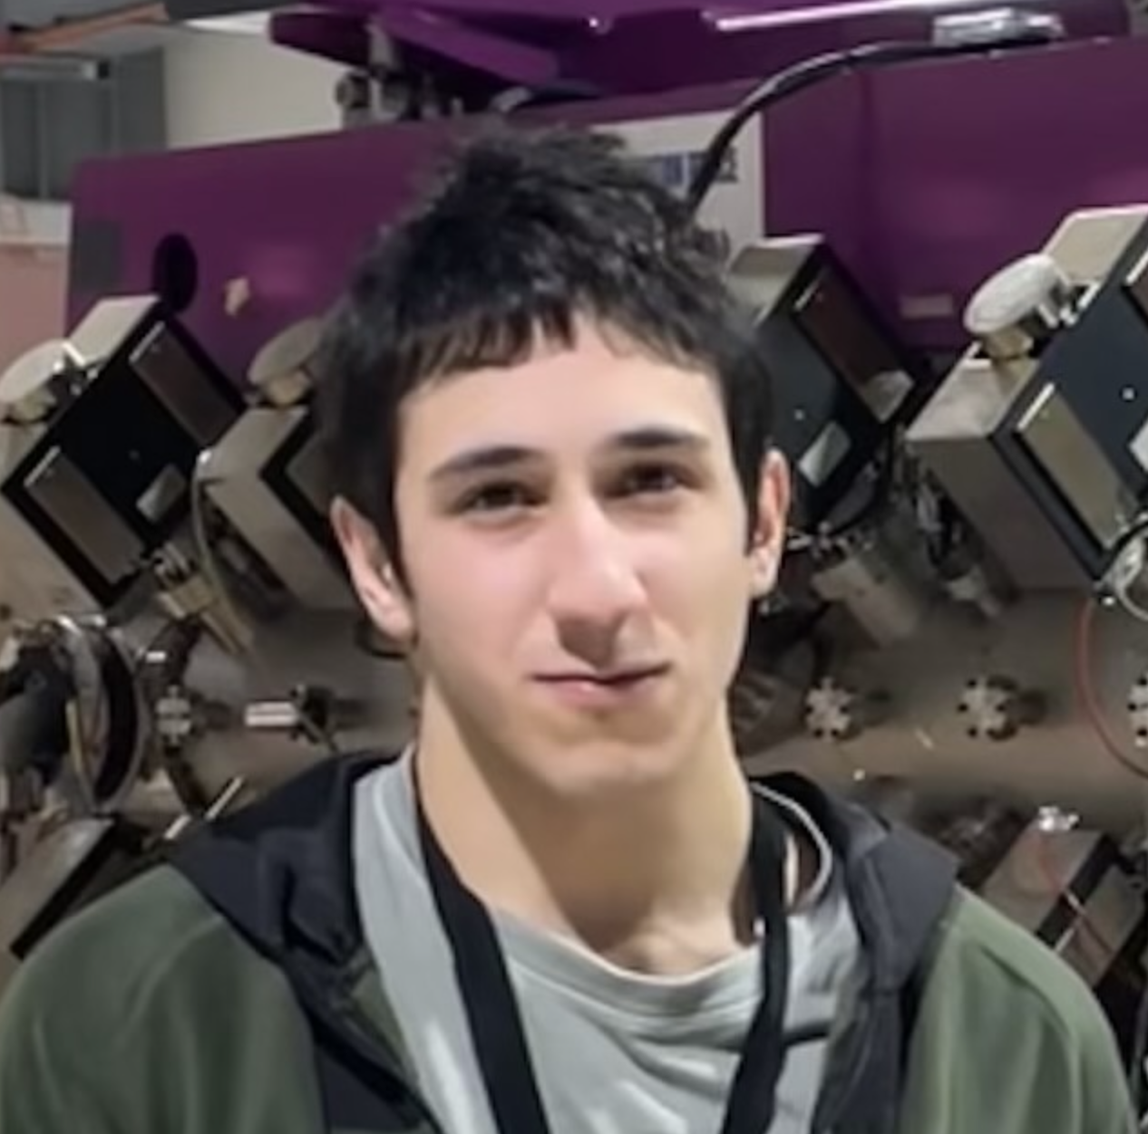
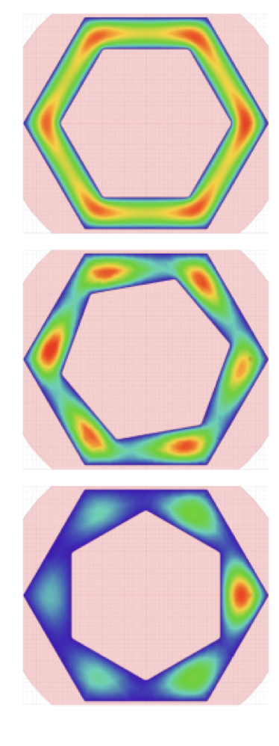
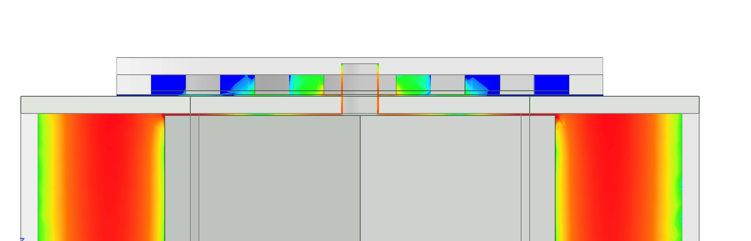
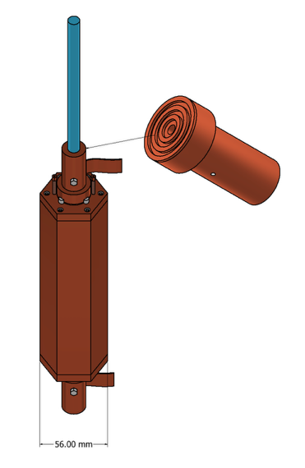
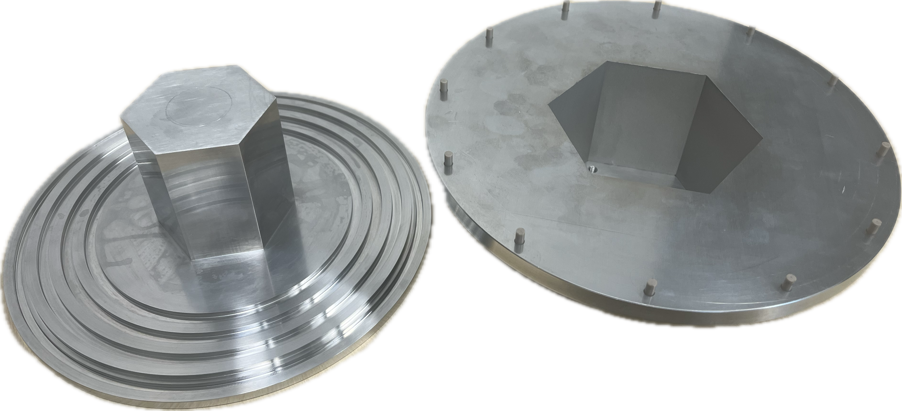
~ 10 GHz
Large Volume Cavity Designs
(thin shell structures)
$$L∼1/m_{a}$$
With Nodar Rukhadze
(MPhys Student)
R. Di Vora
30 GHz
Compact design
(arrived on 7 Apr)
9 - 11 GHz
Toy Prototype
Band Gap Structures (Manchester Adaptation)
JM, Rukhadze, McCulloch (in prep)
Design based on QUAX
concept R. Di Vora et al
PRA 23, 034047 (2025))

Slide 15
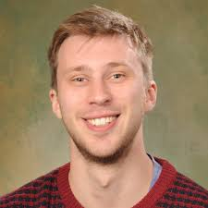
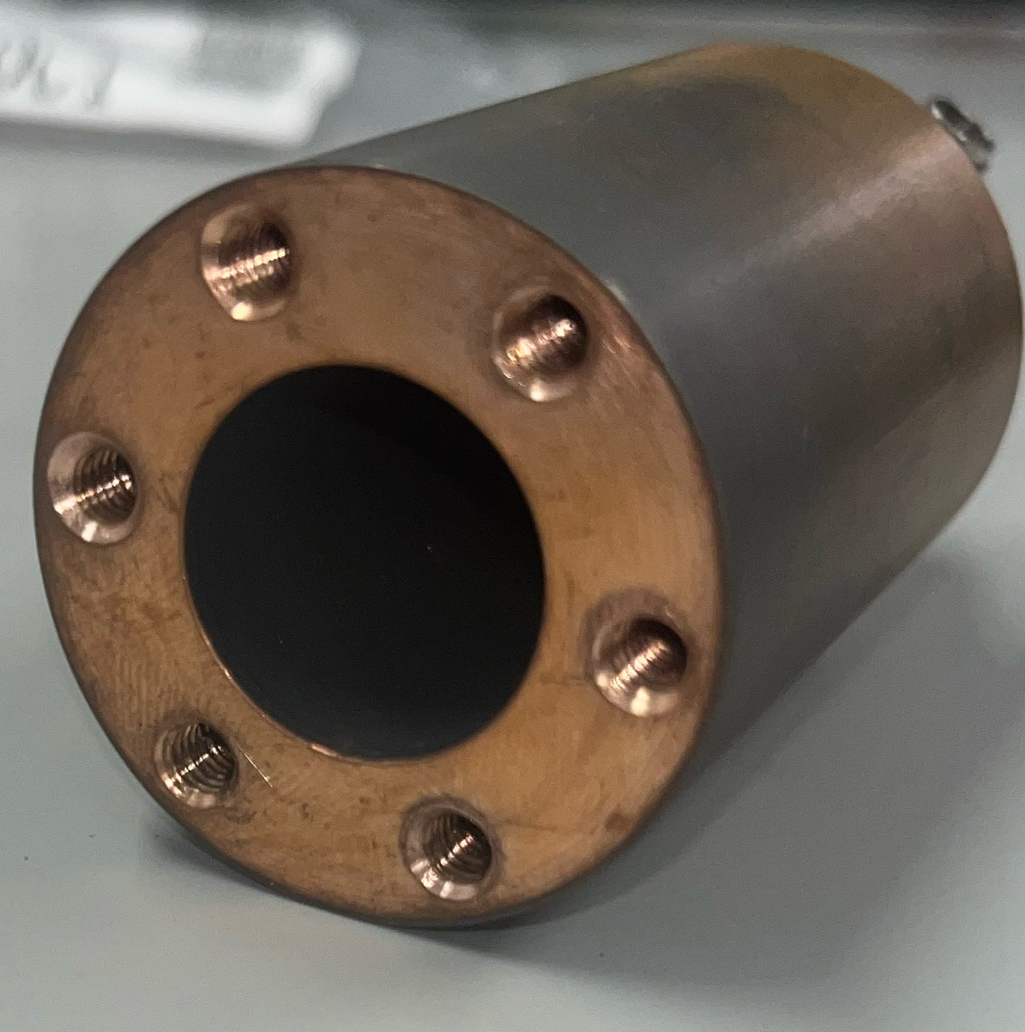

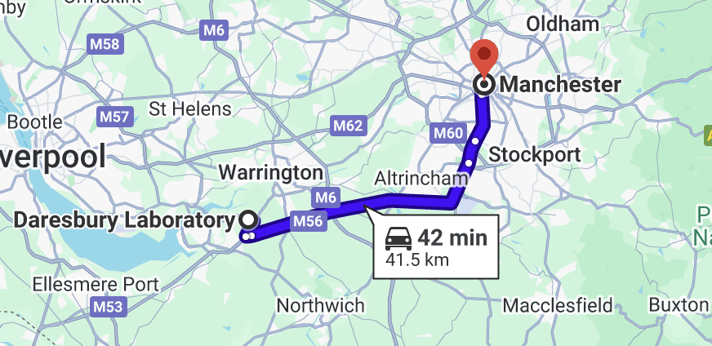
Reducing losses of photons (Q factor)
Deposition Testing and Small Prototype
Early stages collaboration with
Manchester & Daresbury National Lab
Andy Blackett-May
Superconducting coatings

Slide 16
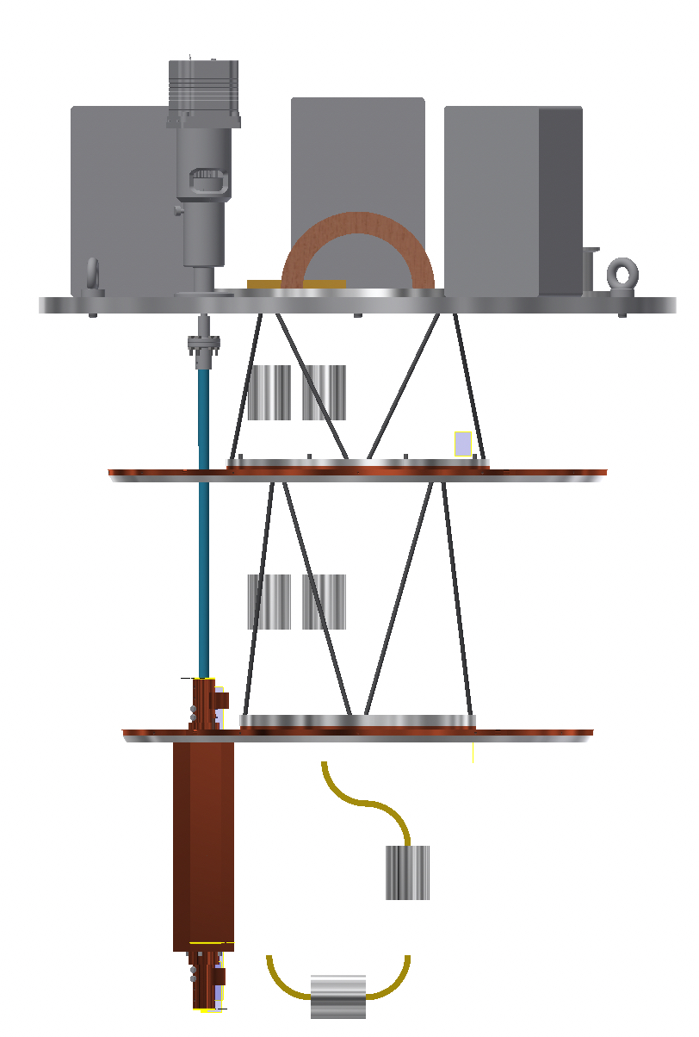
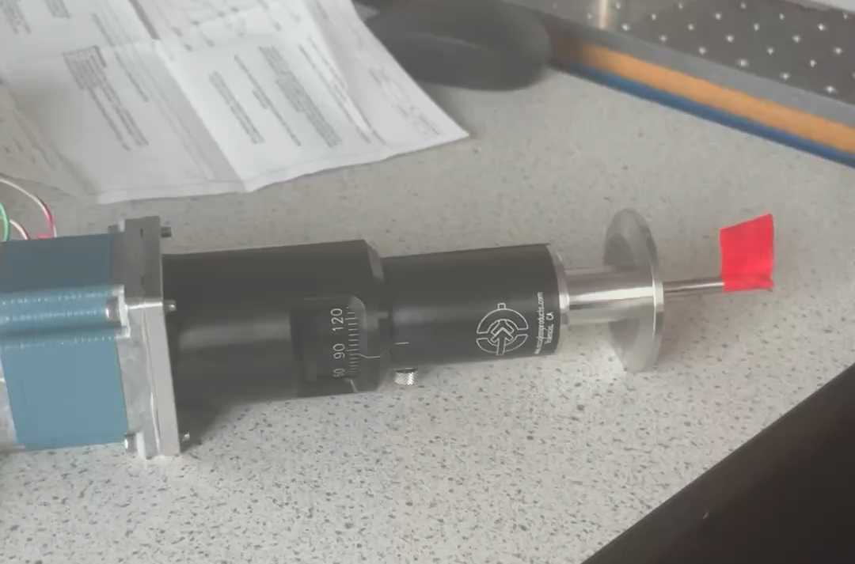
Towards Actuation and Tuning
Cryostat
Atmosphere
Base plate
Vacuum
T = 50K
Stepper Motor
+ rotational feedthrough
G10 Axle
T = 4K
Possible Future
Setup
Cavity Tuning and Q
Testing
@ T = 4K
Cavity Arrived
7/04/2026
With Nodar Rukhadze
(MPhys Student)

Slide 17
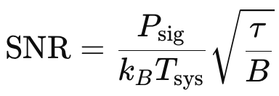
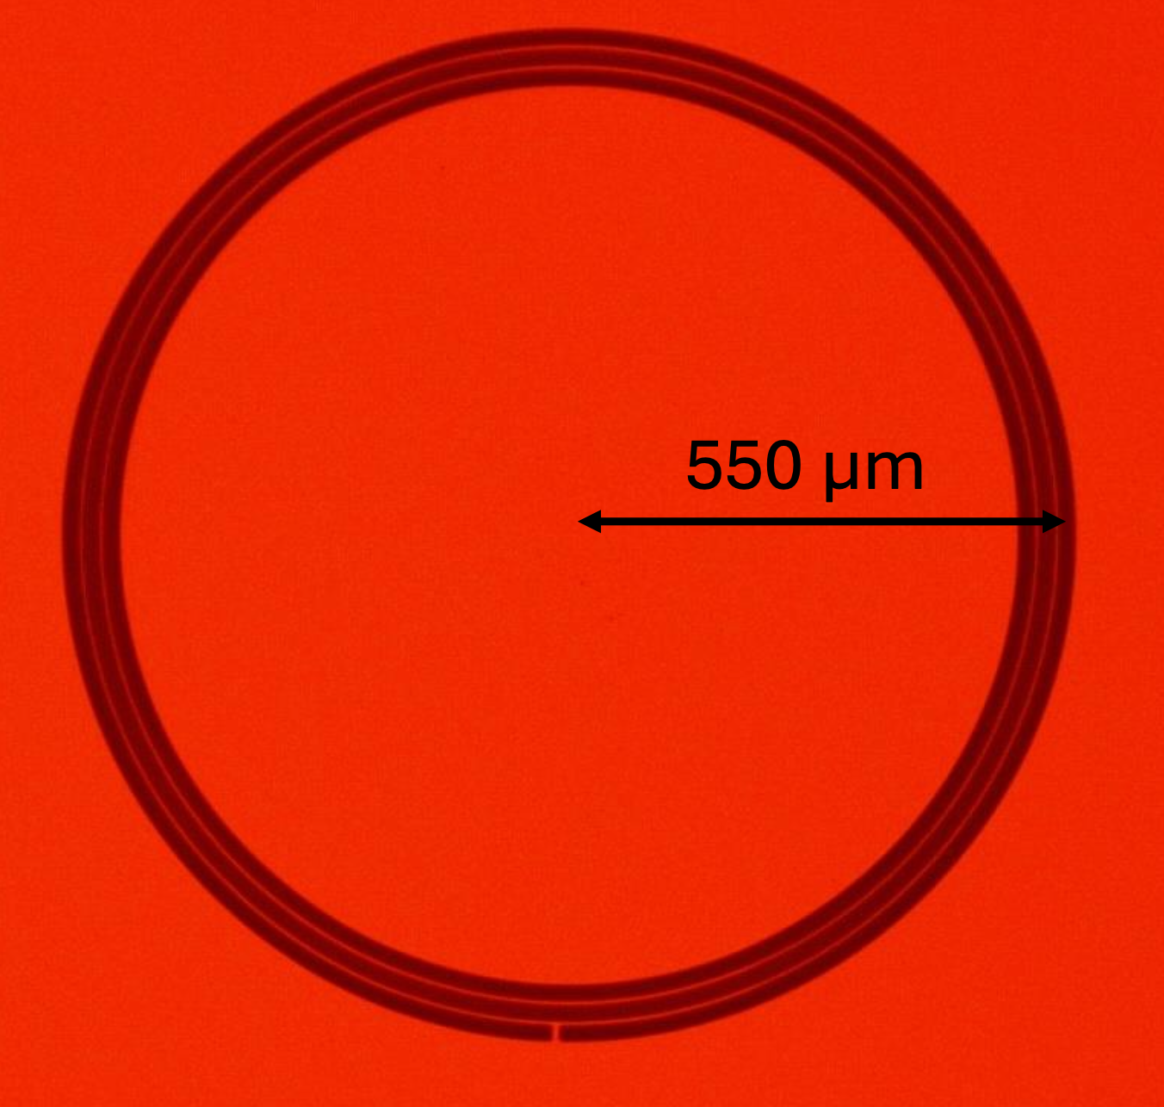
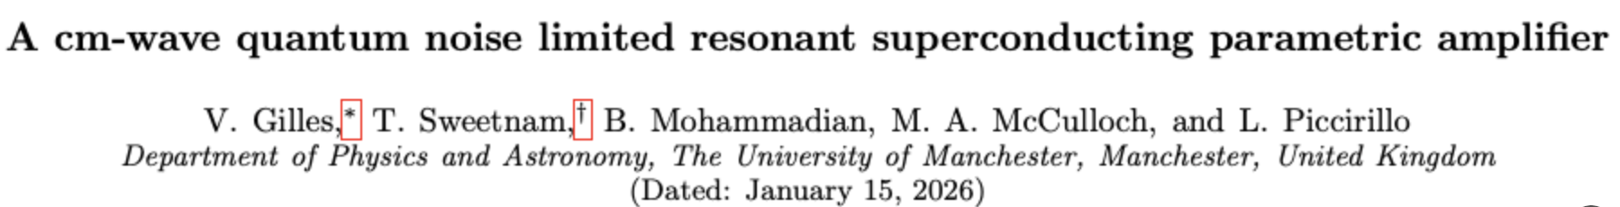

Quantum Noise Limited Amplifiers
amplifier
Noise
Cavity
within 50 % of
quantum limit

Slide 18

A possible view of the future:
Existing Pathfinder (2026)
Possible next phase experiment
+ improved designs
8 Tesla
20 cm bore

Slide 19
Summary
Pillbox Cavity fabricated, testing underway
Quantum noise limited amplifiers demonstrated
Improved cavity designs in progress
Data analysis and acquisition under development
Construction and data taking with path finder to begin in 2026,

Slide 20
Thank You

Slide 21
Backup Slides

Slide 22




Increased Q under high B
Q = 300,000 @ B = 8 T
Q =720,000
Q = 1,000,000
@ B = 6 Tesla
Superconducting Tapes
Sapphire Inserts
Superconducting Films
Posen et al
Phys. Rev. Applied
20, 034004 (2023)
Ahn, J., et al.
Phys. Rev. Applied 17, L061005 (2022)
Marconato et al
IEEE Trans. Appl. Supercond.
34(7) October 2024
D Alesini et al
Nucl. Instrum. Meth.
A 985 (2021) 164641
Manchester + Early Collab with Daresbury Lab

Slide 23








Improved Cavity
Designs
Scan Rate ($m^{3}$)
$$\frac{df}{dt}∝{\left(VC\right)}^{2}Q_{c}$$
Case Study
R. Di Vora et al PRA 23, 034047 (2025))
With MPhys student
Hong-Kai Tan
(now PhD at Warwick)

Slide 24

Amplifier Gain

