Slide 1


The NOvA Test Beam Program
Emerson Bannister
On behalf of the NOvA collaboration
IOP APP & HEP Annual Conference
8th April 2026
1

Slide 2

Overview
Brief overview of the NOvA experiment.
The motivation for NOvA’s Test Beam program.
An overview of the experiment, including the beamline instrumentation used.
The measurement potential from the Test Beam data.
2
8th April 2026 – IOP APP & HEPP – Emerson Bannister
Notes:
Soon we will be submitting the NOvA test beam detector and beamline paper to journal.
We are incorporating particle-based energy uncertainties into the software framework for 3-favour and other analyses.
And we will have measurements of the pion, electron and proton energy responses to report.

Slide 3
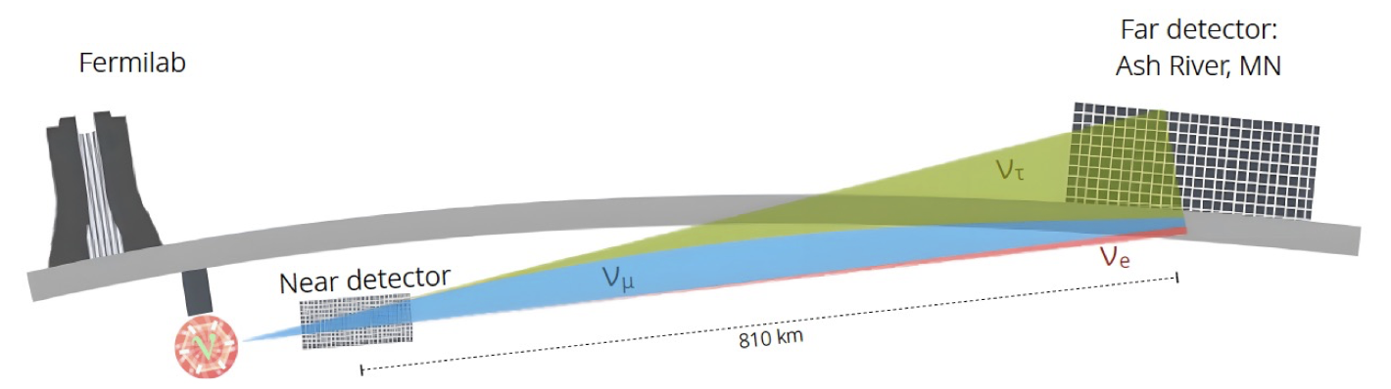
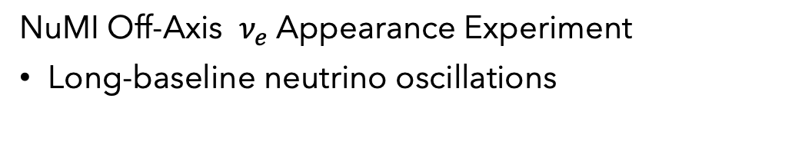
The NOvA Experiment
NuMI Off-Axis $ν_{e}$ Appearance Experiment
Long-baseline neutrino oscillations
14 kton
300 ton
8th April 2026 – IOP APP & HEPP – Emerson Bannister
Notes:
I will start with a brief overview of the nova experiment to set the context for my talk. NOvA is a long-baseline neutrino oscillation experiment. Our neutrino source is the numi beam at Fermilab. We have two functionally identical scintillator detectors, the 300 ton near detector located at Fermilab in Ilinois and the 14,000 ton far detector 810km away in Minnesota.

Slide 4
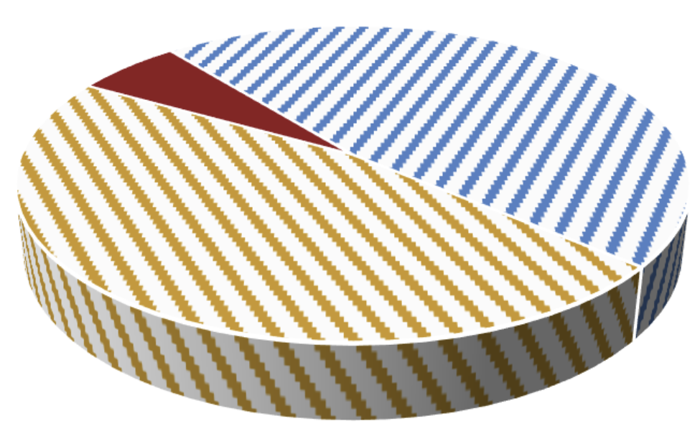
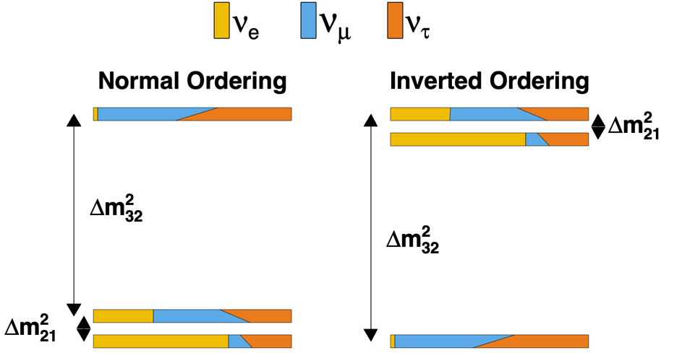
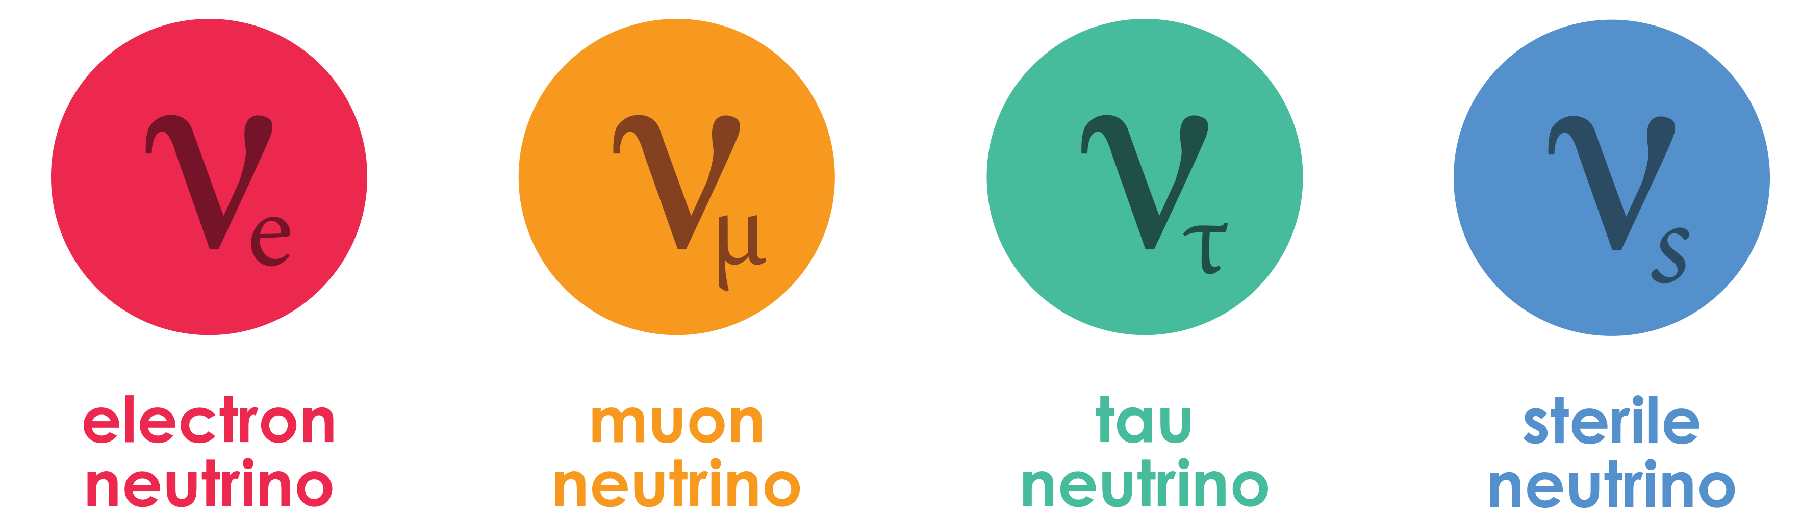





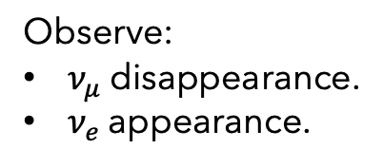
The NOvA Experiment
Is $θ_{23}$ maximal?
Observe:
$ν_{μ}$ disappearance.
$ν_{e}$ appearance.
Neutrino mass hierarchy:
Inverted or normal ordering?
$ν_{μ}=ν_{τ} in ν_{3}?$
More analyses:
Sterile neutrino search.
Neutrino cross-sections.
Exotics, ...
$δ_{CP}$: Do neutrinos violate CP?
Matter
Antimatter
4
8th April 2026 – IOP APP & HEPP – Emerson Bannister
Notes:
NOvA aims to make measurements to answer some of the key questions that remain open around neutrino oscillations.

Slide 5
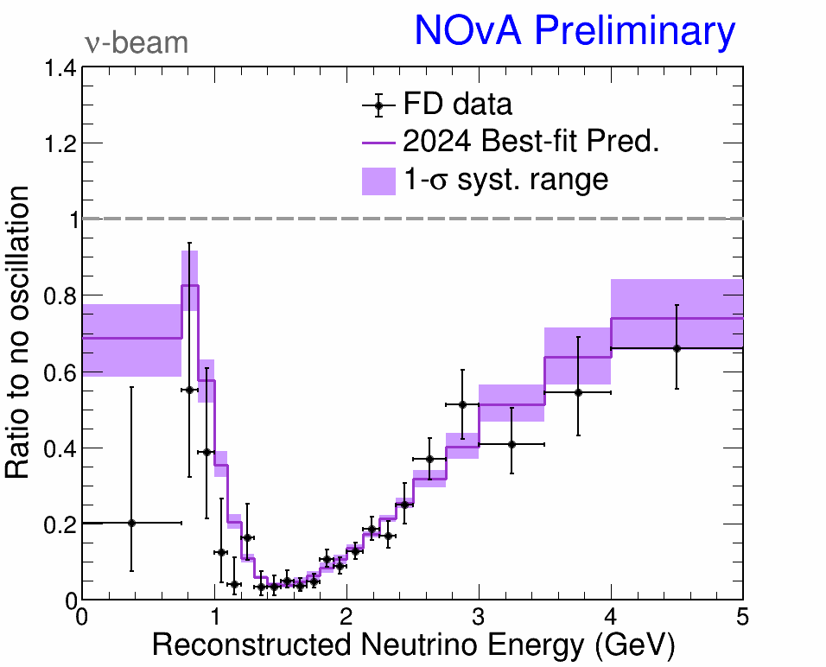
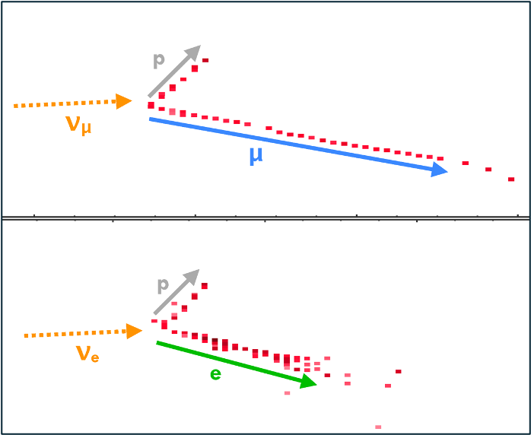
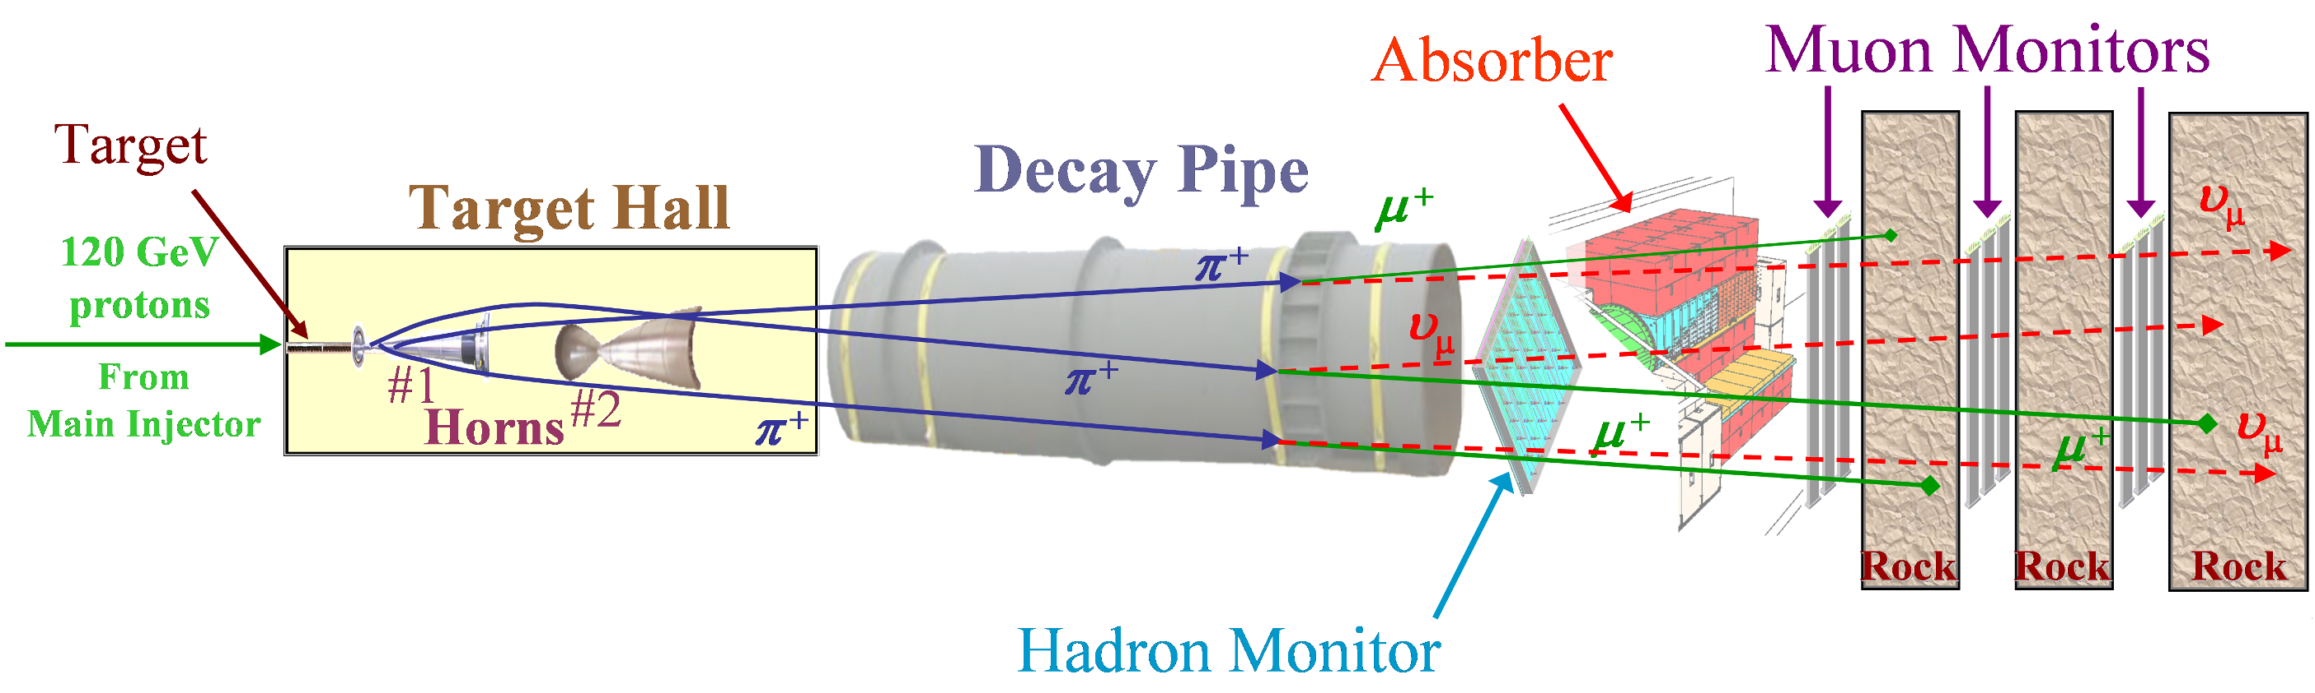
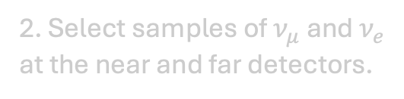
The NOvA Experiment
2. Select samples of $ν_{μ}$ and $ν_{e}$ at the near and far detectors.
3. Fit neutrino energy spectra.
1. Produce a beam of muon (anti)neutrinos.
5
8th April 2026 – IOP APP & HEPP – Emerson Bannister
Notes:
A beam of muon neutrinos or antineutrinos is produced at fermilab

Slide 6
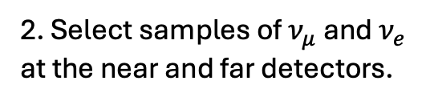
The NOvA Experiment
2. Select samples of $ν_{μ}$ and $ν_{e}$ at the near and far detectors.
3. Fit neutrino energy spectra.
1. Produce a beam of muon (anti)neutrinos.
6
6
8th April 2026 – IOP APP & HEPP – Emerson Bannister
Notes:
We select samples of muon neutrinos and electron neutrinos at the near and far detectors respectively

Slide 7
The NOvA Experiment
2. Select samples of $ν_{μ}$ and $ν_{e}$ at the near and far detectors.
3. Fit neutrino energy spectra.
1. Produce a beam of muon (anti)neutrinos.
7
7
8th April 2026 – IOP APP & HEPP – Emerson Bannister
Notes:
We fit the neutrino energy spectra at the far detector, and take the ratio of muon neutrinos in our data to the non-oscillation predictions

Slide 8
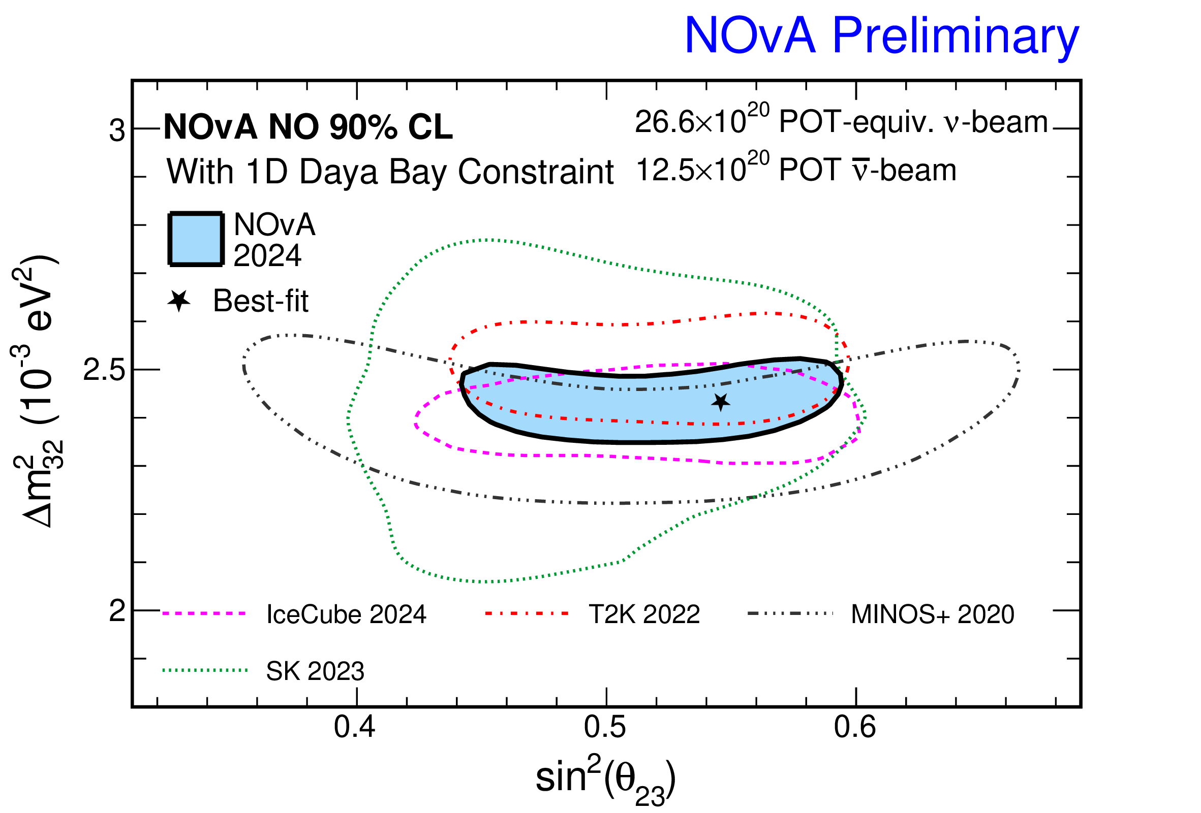


The NOvA Test Beam Program: Motivation
Reduce our systematics
$$Δm_{32}^{2}$$
$$θ_{23}$$
8
8
8th April 2026 – IOP APP & HEPP – Emerson Bannister
Notes:
Now that we've seen NOvA's most recent oscillation results, I’ll start with the motivation for a Test Beam program. On the left is the fit to the neutrino energy spectra that we extract the best fit values for theta 23 and delta m squared 32 from, and on the right are those best fit values with our 90% confidence level limits in blue. The motivation for nova’s test beam program is to shrink the uncertainty region by reducing systematic uncertainties.

Slide 9

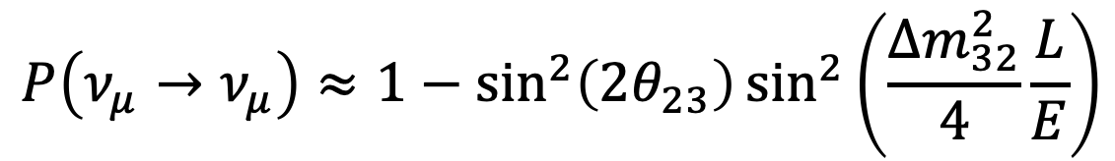

The NOvA Test Beam Program: Motivation
$$P\left(ν_{μ}→ν_{μ}\right)≈1−\sin^{2}\left(2θ_{23}\right)\sin^{2}\left(\frac{Δm_{32}^{2}}{4}\frac{L}{E}\right)$$
$$Δm_{32}^{2}$$
$$θ_{23}$$
Fixed L: Distance between near and far detectors.
Need to reconstruct E.
9
9
8th April 2026 – IOP APP & HEPP – Emerson Bannister
Notes:
The parameters we are measuring depend on L over E. The distance travelled by the neutrino over it’s energy. L is fixed, it’s the distance between the near and far detectors. So we need to know E as well as possible. This motivates the test beam program – to improve our understanding of the detector’s response to neutrinos.

Slide 10
The NOvA Test Beam Program: Motivation
The Test Beam Program can reduce the largest systematic uncertainty on NOvA measurements.
Goals:
Improve NOvA detector calibration.
Improve detector response and energy reconstruction.
10
8th April 2026 – IOP APP & HEPP – Emerson Bannister
Notes:
Here is the breakdown of NOvA’s systematic uncertainties on the measurements of sin squared theta 23, delta m squared 32 and delta CP. You can see that our largest systematic uncertainty is from our detector calibration. The test beam program can help to reduce the size of the detector calibration uncertainty. So the main goals of the test beam program are to improve NOvA detector calibration, and improve the characterization of the detector response and energy reconstruction.

Slide 11
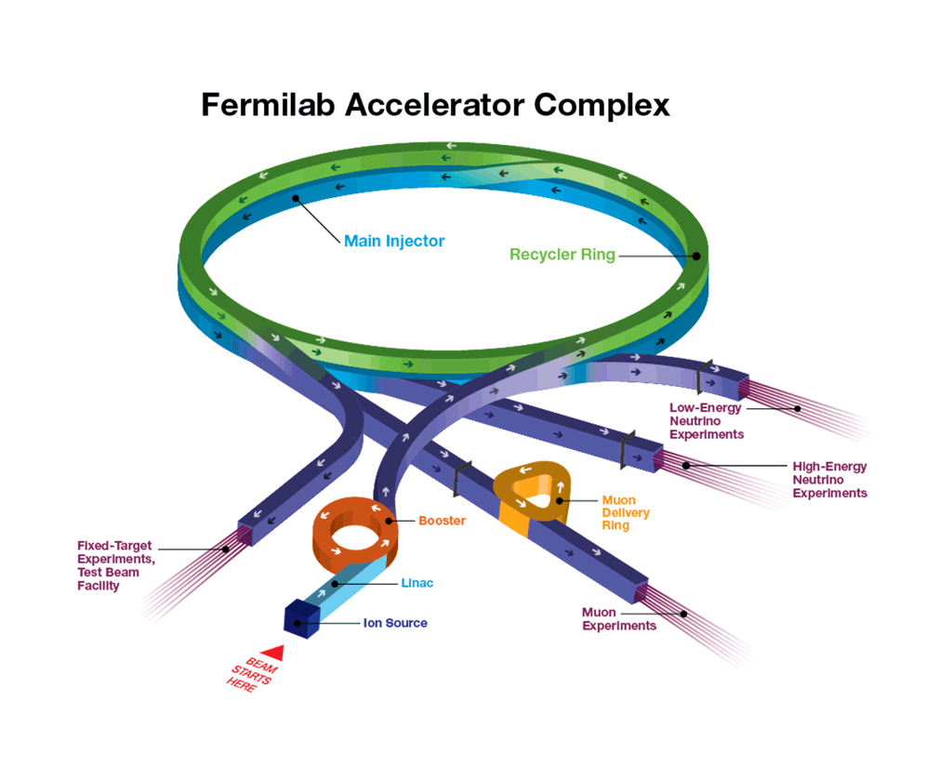
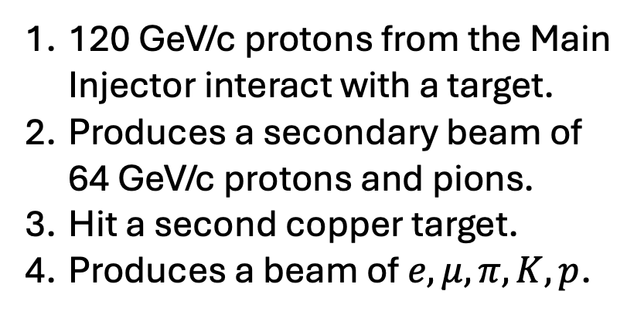
Producing the beam
120 GeV/c protons from the Main Injector interact with a target.
Produces a secondary beam of 64 GeV/c protons and pions.
Hit a second copper target.
Produces a beam of $e,μ,π,K, p$.
Test beam facility
11
8th April 2026 – IOP APP & HEPP – Emerson Bannister
Notes:
Now onto the test beam experiment itself, which took data between 2020 and 2022. It used the Fermilab test beam facility. It start withs 120 GeV protons from the main injector that interact with a primary target which produces a secondary beam of 64 GeV protons and pions which are incident on a second copper target producing a beam of electrons, muons, pions, kaons and protons. This is the beam used for our test beam experiment.

Slide 12
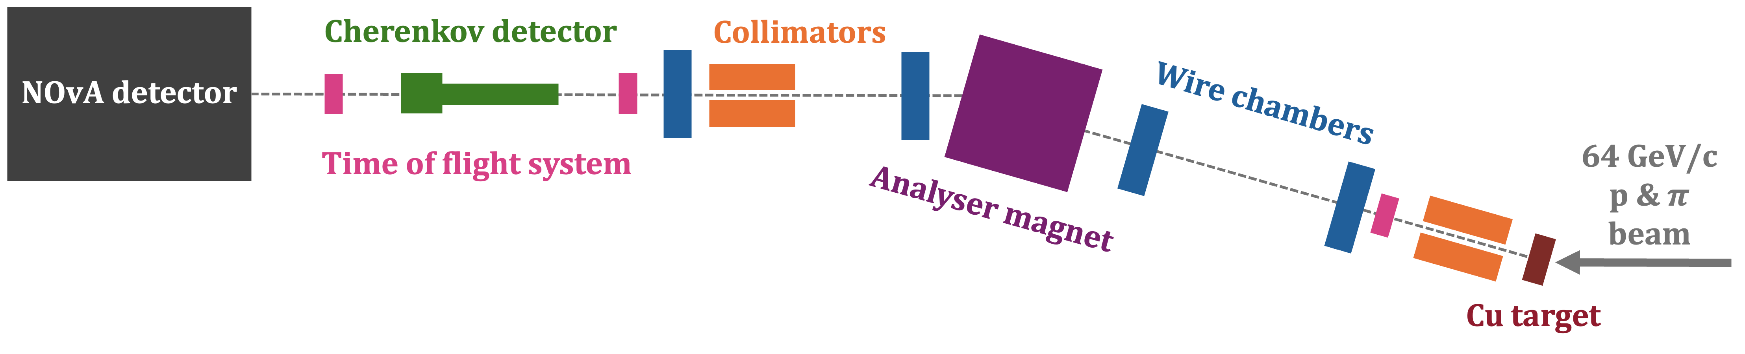
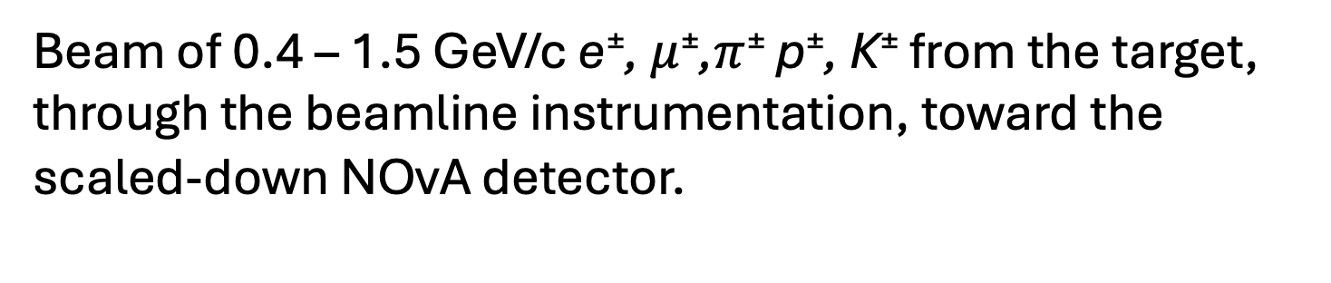
Instrumentation
Beam of 0.4 – 1.5 GeV/c e±, $μ$±,$π$± p±, K± from the target, through the beamline instrumentation, toward the scaled-down NOvA detector.
12
8th April 2026 – IOP APP & HEPP – Emerson Bannister
Notes:
Here is a diagram of the instrumentation. The 64 GeV secondary beam of pions and protons struck a copper target to produce the tertiary beam that we used. The beamline instrumentation selects particles in the 0.4–1.5 GeV/c range and identifies electrons, muons/pions, protons, and kaons using time-of-flight, wire chambers, a dipole magnet, and a Cherenkov detector. Momentum is selected by the magnet, tracking is provided by wire chambers, and particle ID comes from ToF and Cherenkov measurements. This provided tagged particles into the scaled-down NOvA test-beam detector that we can study.

Slide 13
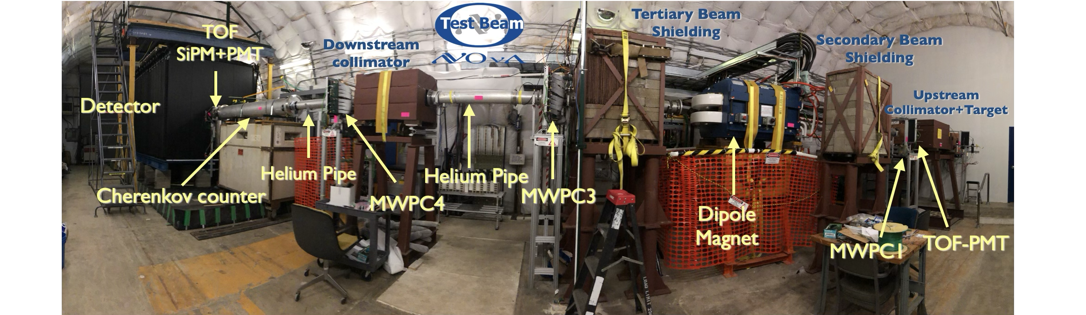
Instrumentation
13
8th April 2026 – IOP APP & HEPP – Emerson Bannister
Notes:
Here is a panoramic photo of the setup, showing all of the beamline components and detectors. So the secondary beam comes in here to hit the target, and there’s the scaled-down nova detector at the other end.

Slide 14
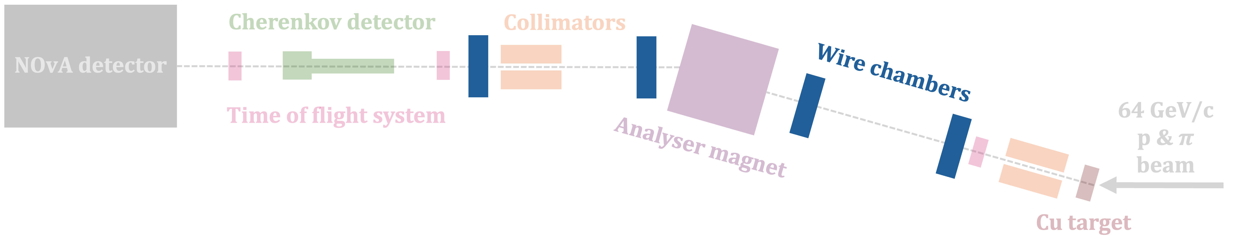
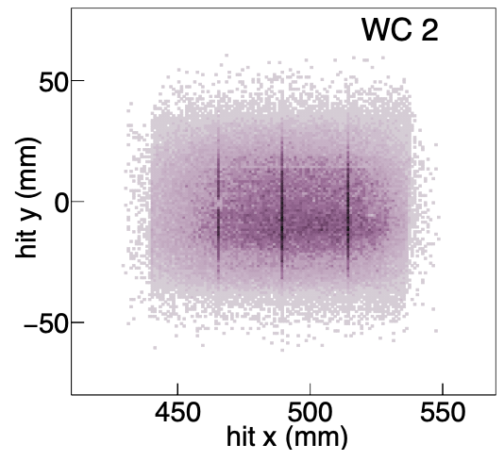
Instrumentation
Multiwire proportional chambers: Particle tracking and momentum reconstruction.
Measure x,y position in each chamber.
Use the change in track angle across magnet to reconstruct momentum.
14
8th April 2026 – IOP APP & HEPP – Emerson Bannister
Notes:
Four multiwire proportional chambers provide particle tracking upstream and downstream of the magnet. Each chamber measures particle position in x and y, allowing track reconstruction through the magnetic field. Using the change in track angle across the magnet, the particle’s momentum is reconstructed. This allows momentum selection before the NOvA test-beam detector.

Slide 15
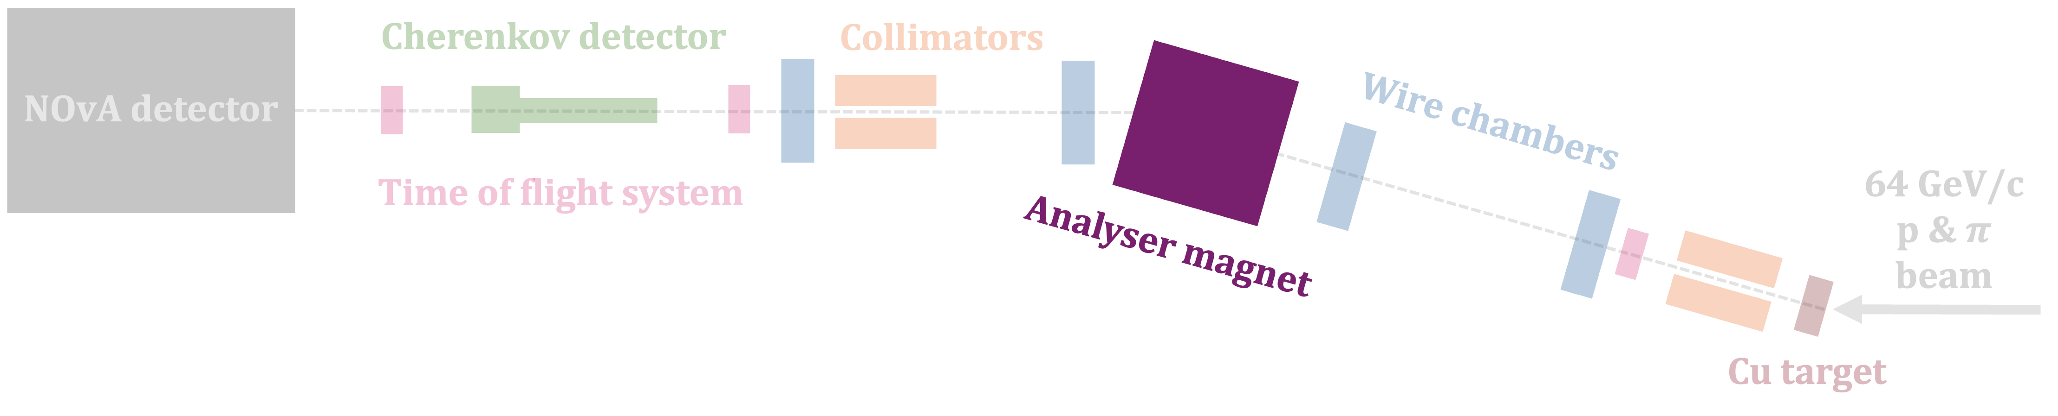
Instrumentation
±1000 A
Analyser magnet: To select the particle momentum and charge of interest.
0.4 – 1.5 GeV/c
±500 A
±750 A
±1250 A
15
8th April 2026 – IOP APP & HEPP – Emerson Bannister
Notes:
A spectrometer dipole magnet was used to select particle momentum and charge sign. The magnetic field bent the tracks between the upstream and downstream wire chambers, for momentum reconstruction. The Field strength was controlled by the magnet current, and polarity was reversed to select positive or negative particles. This plot shows a stacked histogram of the reconstructed momentum of our candidate events for all particles in the beam. Each momentum peak corresponds to the different magnet currents we took data with.

Slide 16
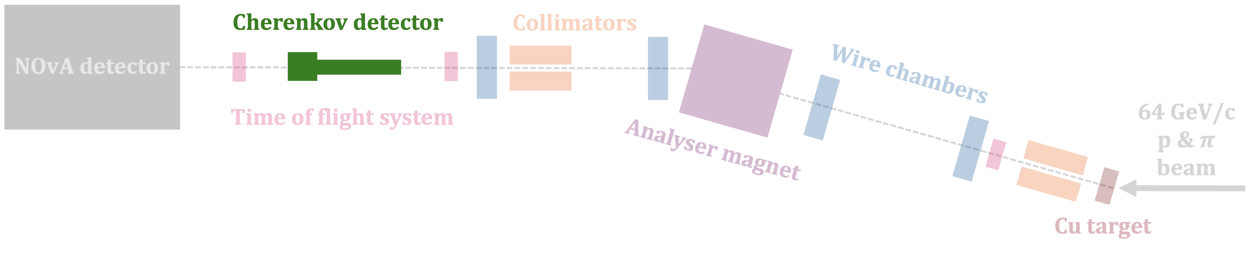
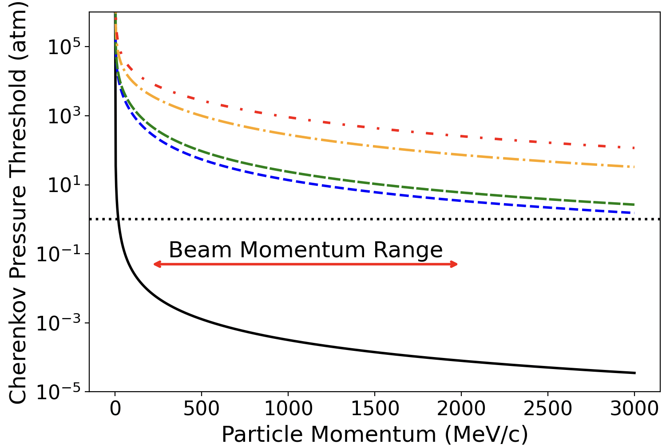
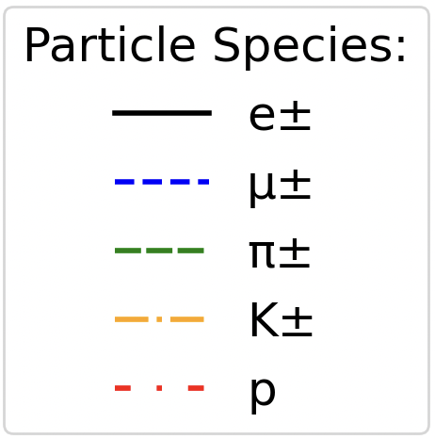
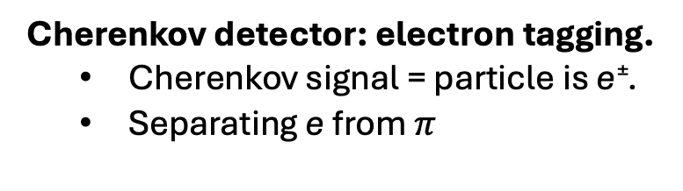
Instrumentation
Operating pressure (1 atm)
Cherenkov detector: electron tagging.
Cherenkov signal = particle is e±.
Separating e from $π$
16
8th April 2026 – IOP APP & HEPP – Emerson Bannister
Notes:
A gas Cherenkov detector filled with CO₂ is used to identify electrons in the beam. Particles passing through the detector emit Cherenkov light only if their velocity exceeds the threshold set by the index of refraction of the gas. This plot shows the relationship between particle momentum and Cherenkov pressure threshold for the particles in the beam. The dashed line is at the 1 atmosphere pressure line, which is how the detector was operated. In our momentum range, this is only above the threshold pressure for electrons, so this provides electron tagging. Cherenkov light is reflected and focused onto a photomultiplier tube, producing a fast signal used for particle identification.

Slide 17
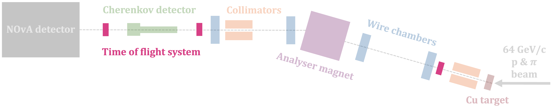
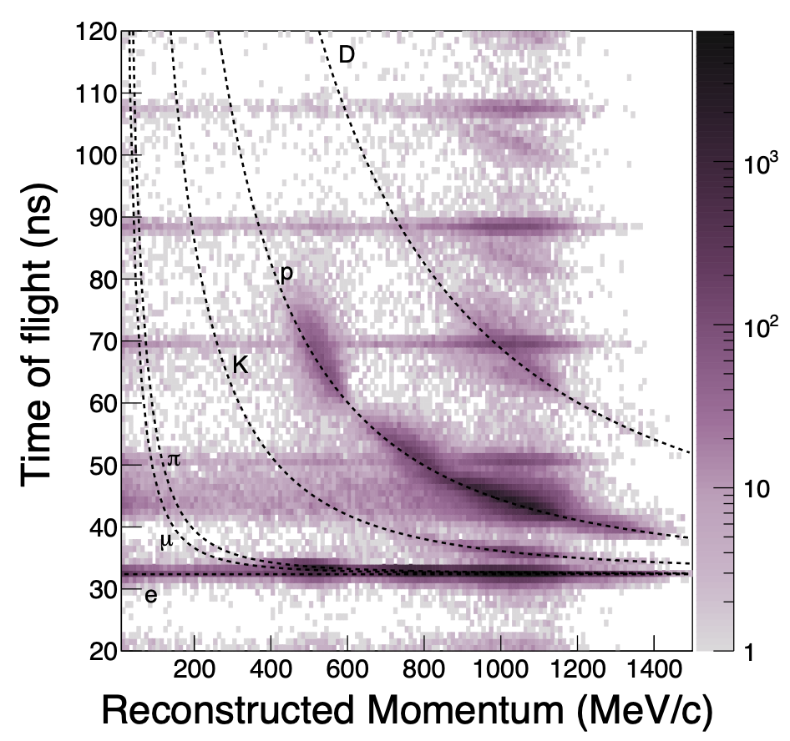
Instrumentation
Time of flight system: Identification of heavier particles (protons and kaons).
Detectors: plastic scintillator with PMTs or SiPMs.
Before data quality and selection requirements.
17
8th April 2026 – IOP APP & HEPP – Emerson Bannister
Notes:
There was a time of flight system spanning the beamline, which used plastic scintillator detectors read out by PMTs or SiPMs. The measured time difference between upstream and downstream detectors provides the particle velocity. This plot shows the reconstructed time of flight versus momentum in data, before applying data quality particle ID selections on mass and time of flight.

Slide 18
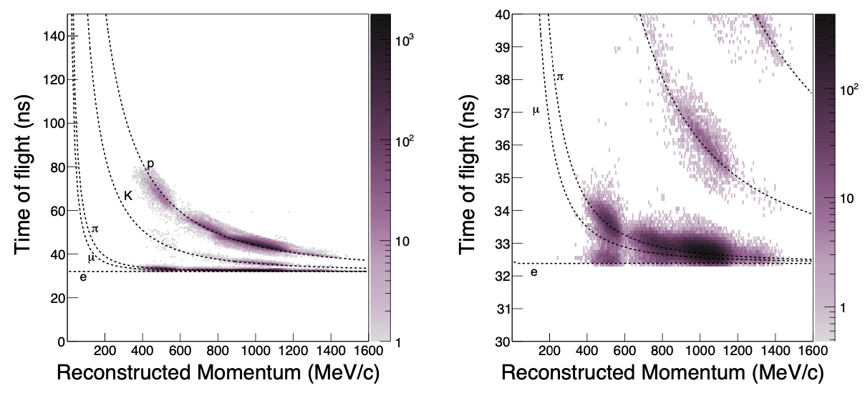
Instrumentation
Time of flight system: Identification of heavier particles (protons and kaons).
Detectors: plastic scintillator with PMTs or SiPMs.
After data quality and selection requirements.
18
8th April 2026 – IOP APP & HEPP – Emerson Bannister
Notes:
Then this is after applying data quality particle ID selections on mass and time of flight. So you can see how we are able to use the time of flight and momentum to identify the heavier particles - protons and kaons. We are unable to separate electrons from muons and pions, which shows the need for the Cherenkov detector for electron tagging.

Slide 19

Instrumentation
Reconstructed momentum and time of flight.
Reconstructed mass of particles.
Used to ID protons and kaons.
Sets upper bound for pions.
Electrons separated by Cherenkov detector.
19
8th April 2026 – IOP APP & HEPP – Emerson Bannister
Notes:
Finally, we use all components of the instrumentation that have provided the reconstructed momentum and time of flight of the beam particles to reconstruct the mass of the particles. This plot shows those reconstructed masses. These are used to identify protons and kaons, and to set an upper bound for pion mass in our selection. We don’t have the time of flight resolution to reconstruct the electron mass so electrons are separated from pions by the Cherenkov detector.

Slide 20
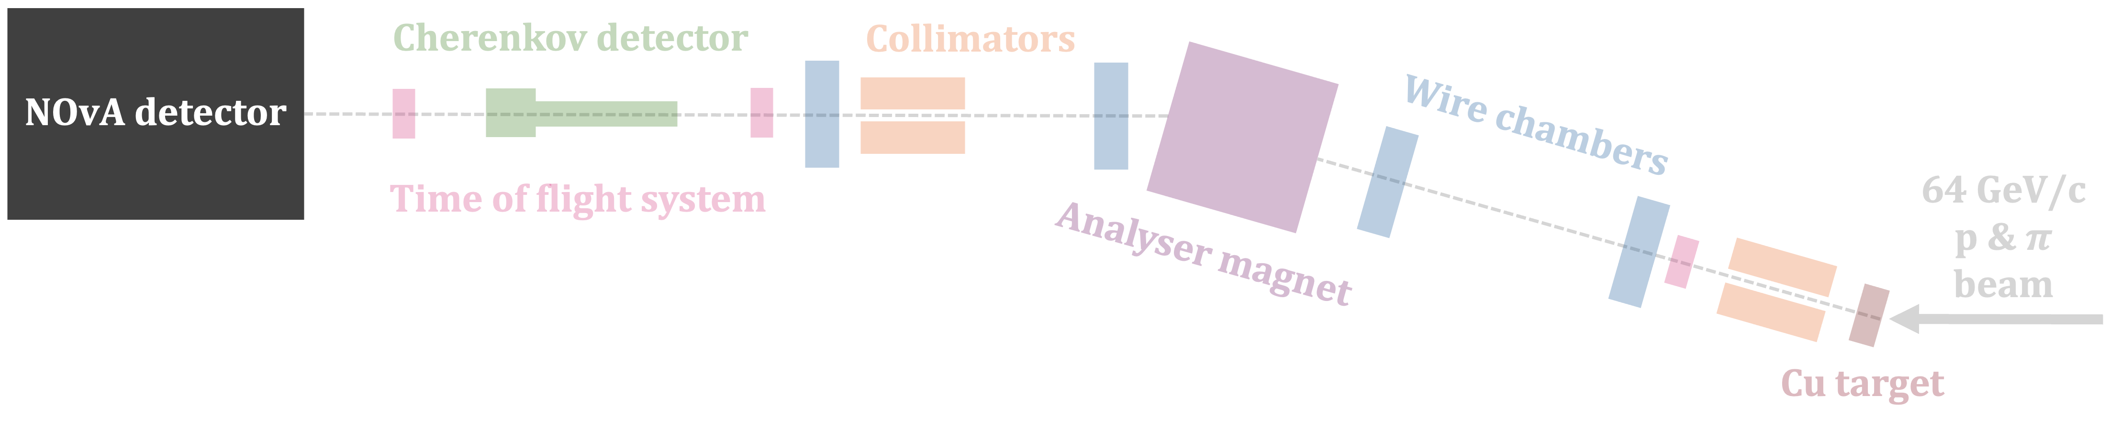
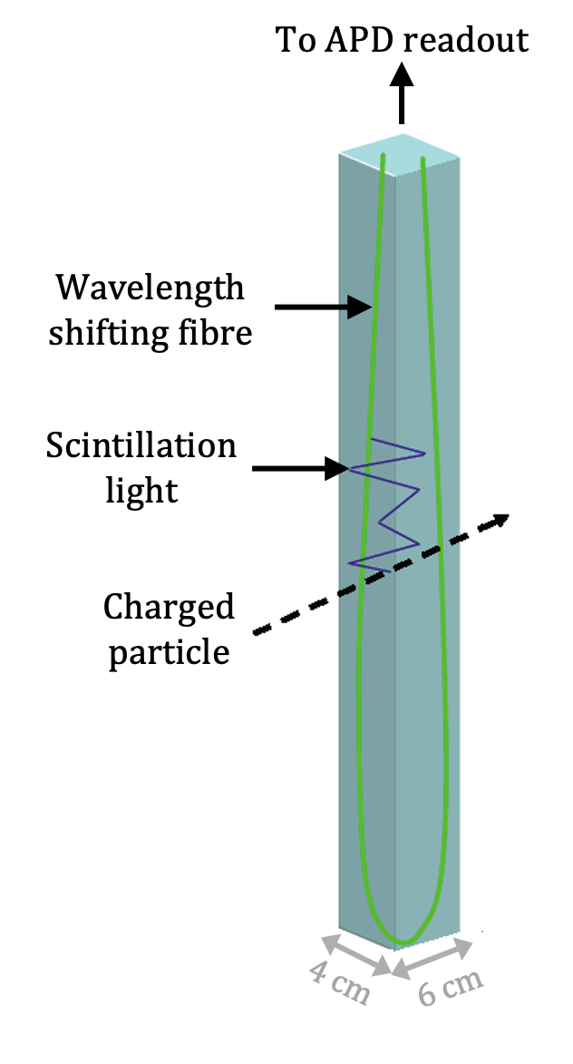
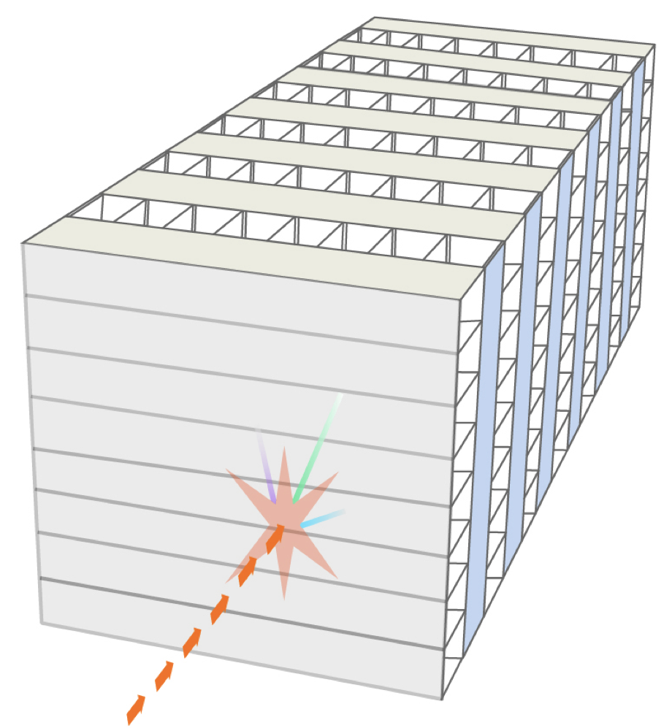
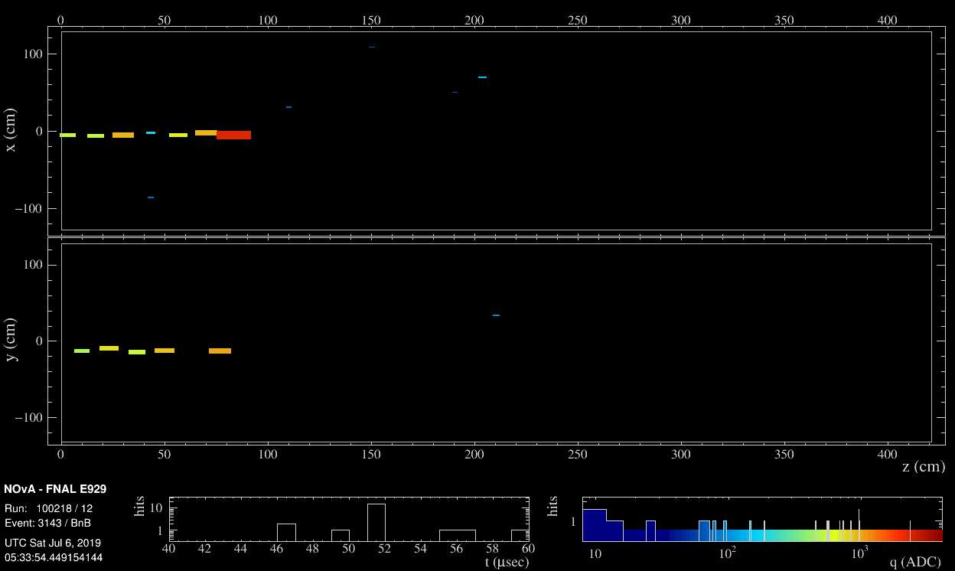
Instrumentation
30 ton scaled-down NOvA detector.
Liquid scintillator.
Segmented.
PROTON
Near detector: 300 ton Far detector: 14 kton
20
8th April 2026 – IOP APP & HEPP – Emerson Bannister
Notes:
Then, most importantly, the particles enter our scaled down nova detector where we can do our individual particle energy response and resolution measurements. The test beam detector was 30 tons, comapred to the near detector of 300 tons and the far detector of 14kton. NOvA detectors are segmented liquid scintillator detectors. They consist of these long PVC cells filled with liquid scintillator and have a wavelength shifting fibre looped inside. These cells are arranged in planes in alternating perpendicular directions, which allows 3D reconstruction. Here is an example event display showing a proton track in the test beam detector.

Slide 21
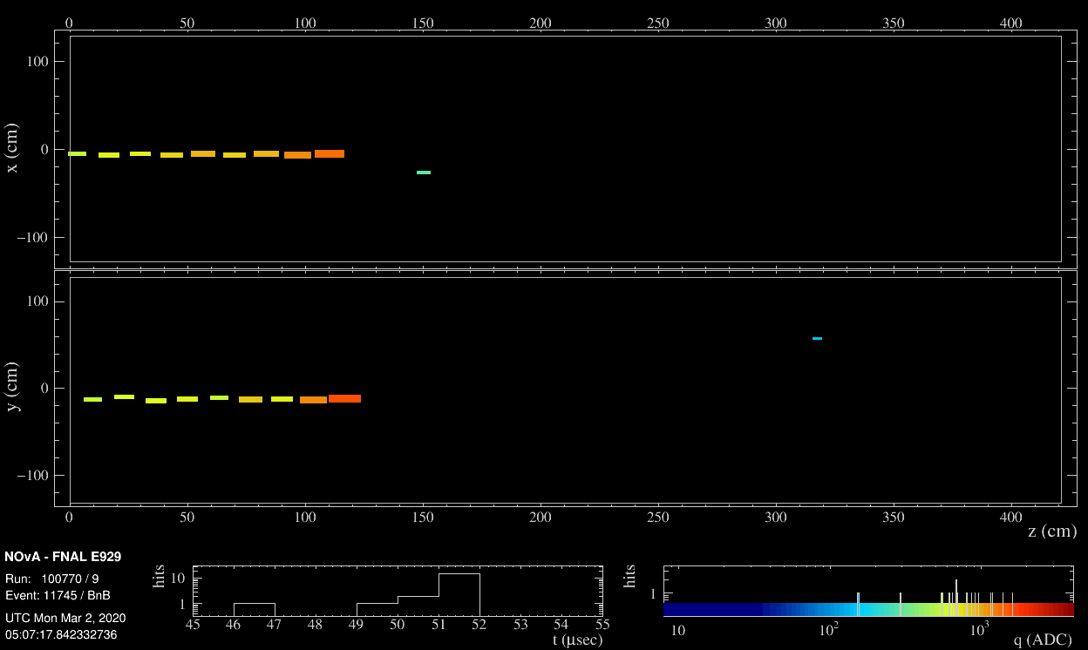
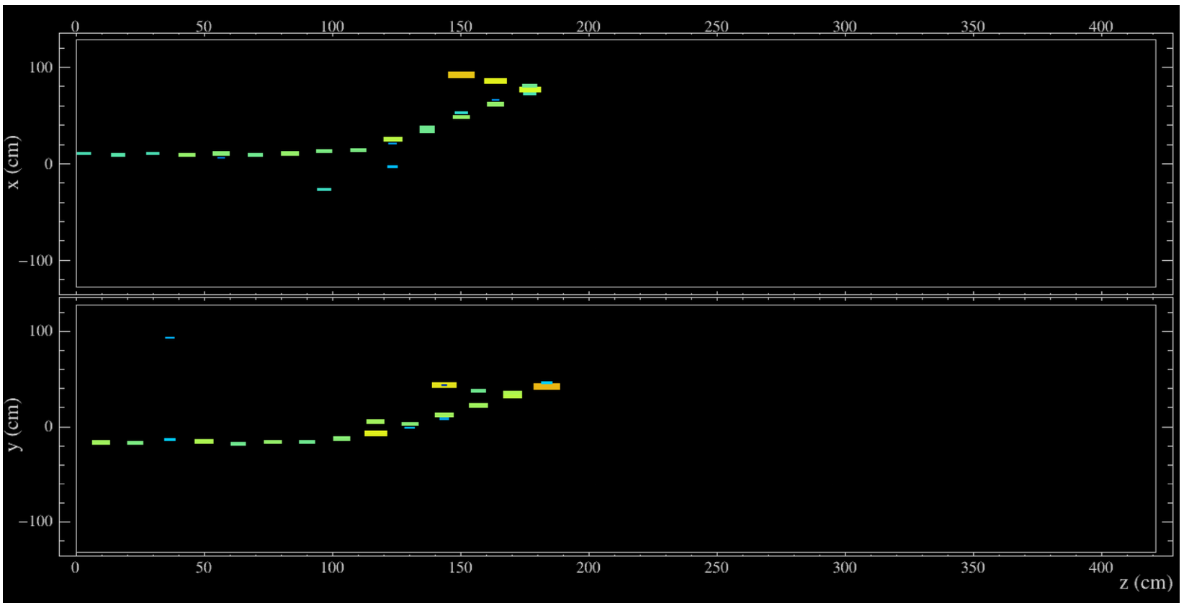
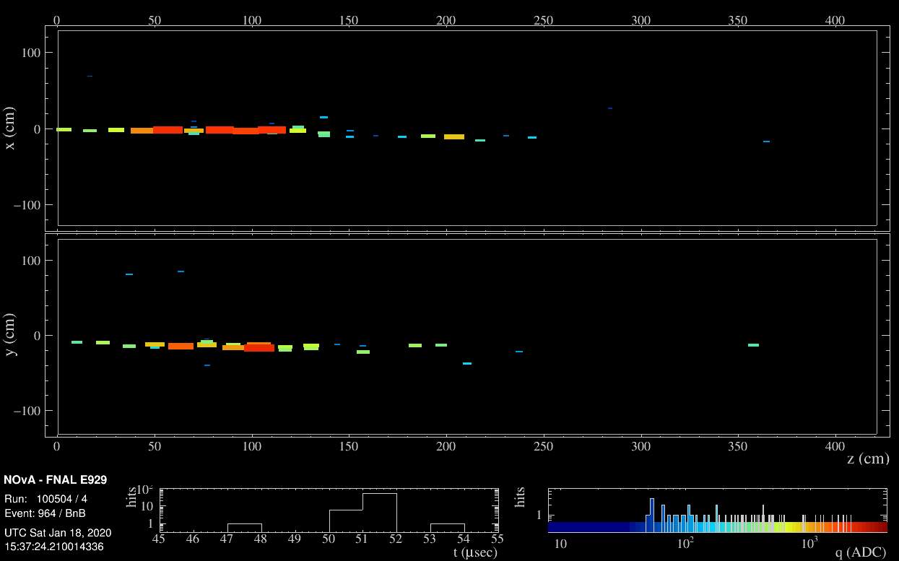
PROTON
PION
1.0 GeV/c PROTON
NOvA’s Test Beam data will provide particle-dependent energy scales for electrons, pions, and protons.
This will improve our understanding of systematic uncertainties on NOvA’s neutrino oscillation measurements.
ELECTRON
21
8th April 2026 – IOP APP & HEPP – Emerson Bannister
Notes:
Here are event displays of the particles we are studying with the test beam data. So overall, NOvA’s Test Beam data will provide particle-dependent energy scales for electrons, pions, and protons.
This will improve our understanding of systematic uncertainties on NOvA’s measurements, including the oscillation measurements.

Slide 22
Summary and Outlook
NOvA’s Test Beam Program: To reduce NOvA’s detector calibration and detector response systematic uncertainties.
Instrumentation for particle momentum and time of flight reconstruction → particle mass reconstruction → particle ID.
22
8th April 2026 – IOP APP & HEPP – Emerson Bannister
Notes:
To summarise, I have shown NOvA’s test beam program which aims to reduce NOvA’s detector calibration and detecto response systematic uncertainties.
I showed the instrumentation we used for particle momentum and time of flight reconstrctuion that is used for particle mass reconstruction and ultimately particle identification.

Slide 23
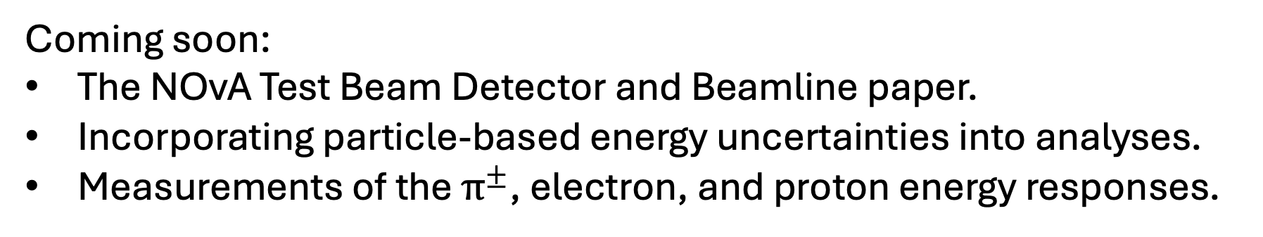
Summary and Outlook
NOvA’s Test Beam Program: To reduce NOvA’s detector calibration and detector response systematic uncertainties.
Instrumentation for particle momentum and time of flight reconstruction → particle mass reconstruction → particle ID.
Coming soon:
The NOvA Test Beam Detector and Beamline paper.
Incorporating particle-based energy uncertainties into analyses.
Measurements of the $π^{±}$, electron, and proton energy responses.
23
8th April 2026 – IOP APP & HEPP – Emerson Bannister
Notes:
Soon we will be submitting the NOvA test beam detector and beamline paper to journal.
We are incorporating particle-based energy uncertainties into the software framework for 3-flavour and other analyses.
And we will have measurements of the pion, electron and proton energy responses to report.

Slide 24
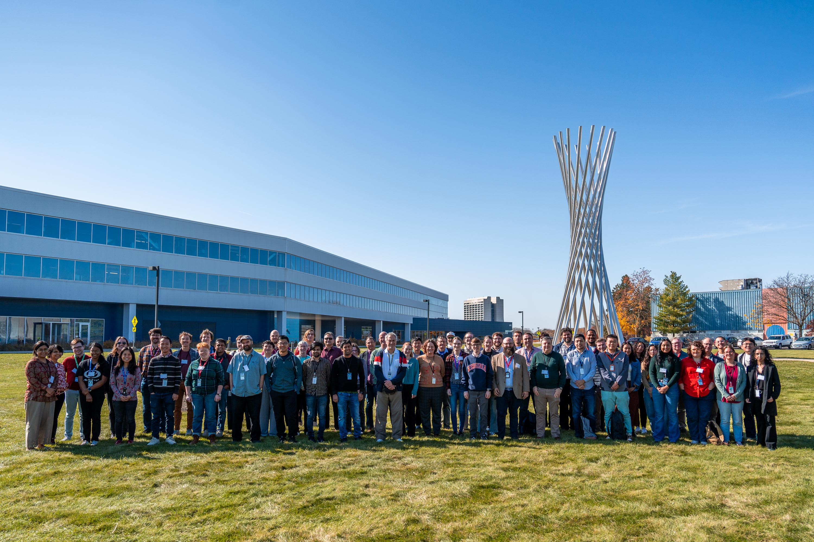
Thank you!
24
8th April 2026 – IOP APP & HEPP – Emerson Bannister
Notes:
Soon we will be submitting the NOvA test beam detector and beamline paper to journal.
We are incorporating particle-based energy uncertainties into the software framework for 3-favour and other analyses.
And measurements of the pion and energy responses will soon be public.

Slide 25
Backup

Slide 26
Event Displays
1.0 GeV/c PROTON
26
8th April 2026 – IOP APP & HEPP – Emerson Bannister
Notes:
Then, most importantly, the particles enter our scaled down nova detector. The test beam detector was 30 tons, DIMENSIONS. NOvA detectors are segmented liquid scintillator detectors. They consist of these long PVC cells filled with liquid scintillator and have a wavelength shifting fibre looped inside. These cells are arranged in planes in alternating perpendicular directions, which allows 3D reconstruction. Here is an example event display showing a proton track in the test beam detector.

Slide 27
Event Displays
1.3 GeV/c ELECTRON
27
8th April 2026 – IOP APP & HEPP – Emerson Bannister
Notes:
Then, most importantly, the particles enter our scaled down nova detector. The test beam detector was 30 tons, DIMENSIONS. NOvA detectors are segmented liquid scintillator detectors. They consist of these long PVC cells filled with liquid scintillator and have a wavelength shifting fibre looped inside. These cells are arranged in planes in alternating perpendicular directions, which allows 3D reconstruction. Here is an example event display showing a proton track in the test beam detector.

Slide 28
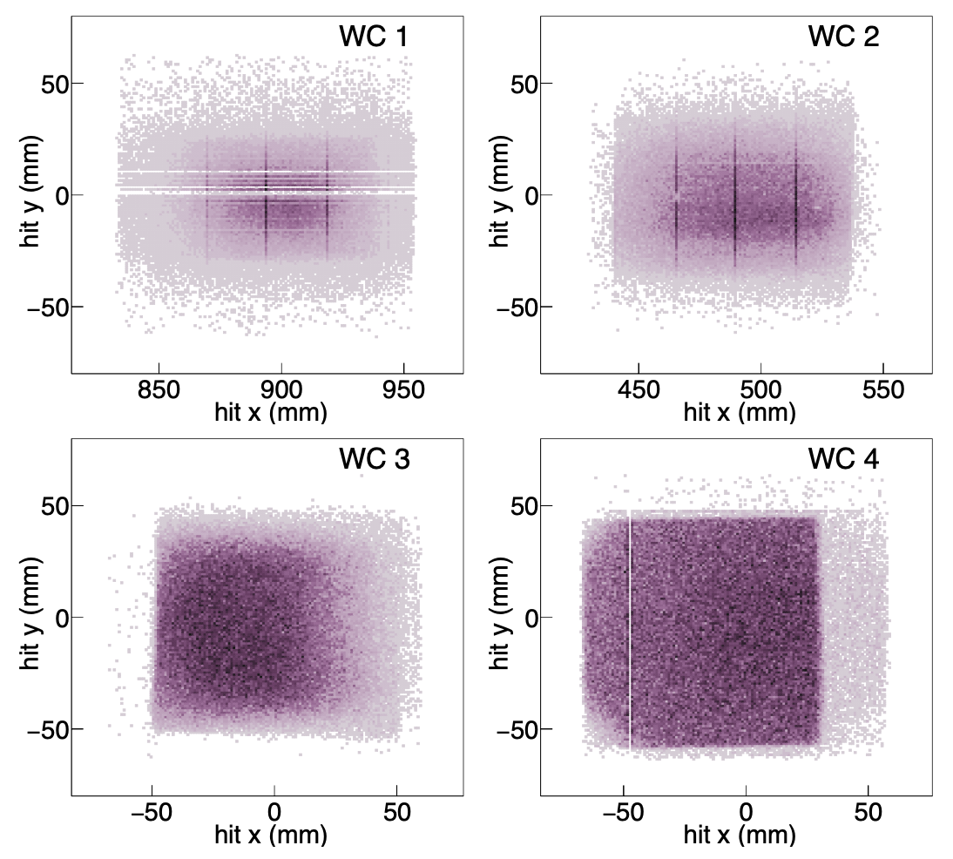
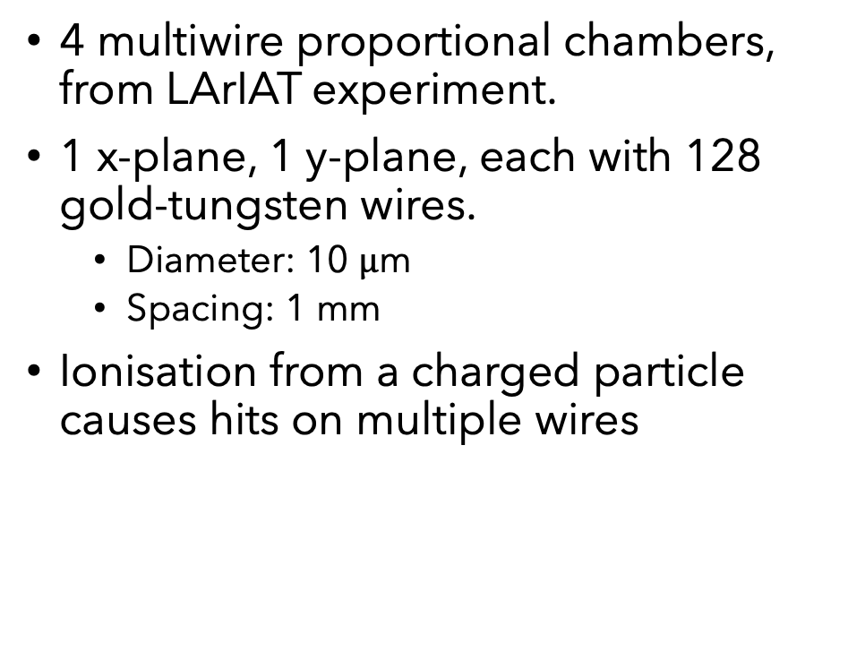
MWPC
4 multiwire proportional chambers, from LArIAT experiment.
1 x-plane, 1 y-plane, each with 128 gold-tungsten wires.
Diameter: 10 $μ$m
Spacing: 1 mm
Ionisation from a charged particle causes hits on multiple wires
28
8th April 2026 – IOP APP & HEPP – Emerson Bannister
Notes:
The NOvA Test Beam used four multiwire proportional chambers (MWPCs), provided by
230 FTBF, and previously used by the LArIAT [12] experiment. Each wire chamber consisted
231 of one x-plane and one y-plane, each with 128 sense wires. The gold-tungsten sense wires
232 were 10 μm in diameter and spaced at 1 mm.
FTBF? Fermilab test beam facility? The chambers were filled with 85% argon,
238 15% isobutane gas mixture that was flowed constantly.
Liquid argon?
The Wire Chamber Track best hit position in each of the four wire chambers, relative to the center of the front face of the NOvA TB detector. The best hit is the hit that was attributed to the best track fit, where the fit required all four wire chambers have a hit. These figures represent the state of the MWPCs in the final period (Period 4) of data taking, and illustrate the missing wires in MWPC1, noisy vertical wires in MWPC1 and MWPC2, a slight rotation in MWPC3, and one missing wire in MWPC4.

Slide 29
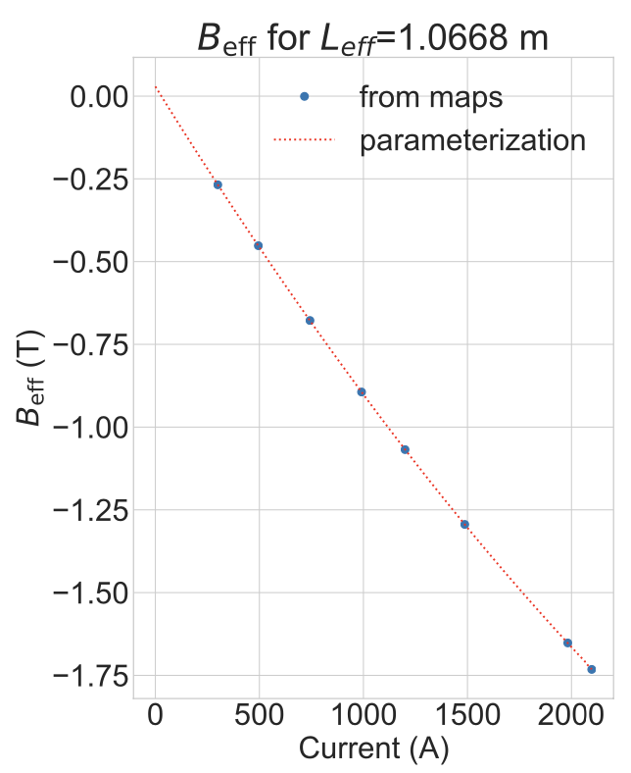

Magnet
29
8th April 2026 – IOP APP & HEPP – Emerson Bannister
Notes:
The NOvA Test Beam used four multiwire proportional chambers (MWPCs), provided by
230 FTBF, and previously used by the LArIAT [12] experiment. Each wire chamber consisted
231 of one x-plane and one y-plane, each with 128 sense wires. The gold-tungsten sense wires
232 were 10 μm in diameter and spaced at 1 mm.
FTBF? Fermilab test beam facility? The chambers were filled with 85% argon,
238 15% isobutane gas mixture that was flowed constantly.
Liquid argon?
The Wire Chamber Track best hit position in each of the four wire chambers, relative to the center of the front face of the NOvA TB detector. The best hit is the hit that was attributed to the best track fit, where the fit required all four wire chambers have a hit. These figures represent the state of the MWPCs in the final period (Period 4) of data taking, and illustrate the missing wires in MWPC1, noisy vertical wires in MWPC1 and MWPC2, a slight rotation in MWPC3, and one missing wire in MWPC4.

Slide 30
Time of Flight (ToF)
Identification of heavier particles (protons and kaons).
Cherenkov detector needed to separate electrons from muons and pions.
30
8th April 2026 – IOP APP & HEPP – Emerson Bannister
Notes:
zoom in on low time-of-flight region, highlighting the difficulty we would have in separating electrons from muons and pions without the inclusion of a Cherenkov detector in the tertiary beamline.

Slide 31
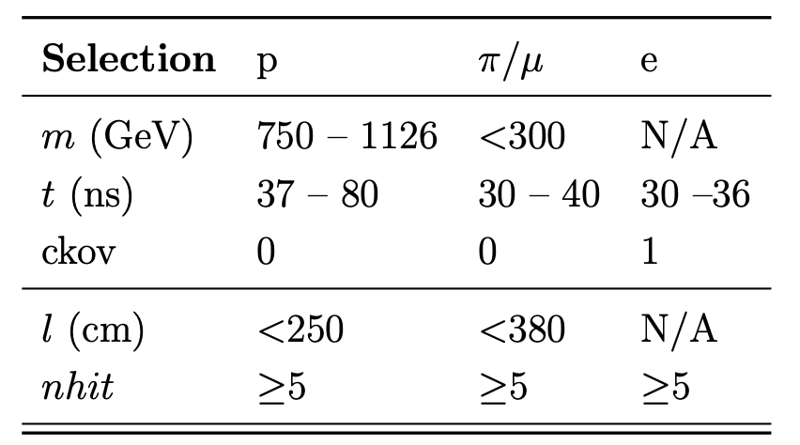
Time of Flight (ToF)
Identification of heavier particles (protons and kaons).
Basic preselection requirements, combined with data quality requirements.
Horizontal structures: time-of-flight signal pairs from light particles from different main injector bunches.
Repeating sloped structures (at ~1000 MeV/c): protons from different main injector bunches.
Diffuse structures (at ~21-42 ns): thought to be one light particle and one proton from different main injector bunches.
31
8th April 2026 – IOP APP & HEPP – Emerson Bannister
Notes:
zoom in on low time-of-flight region, highlighting the difficulty we would have in separating electrons from muons and pions without the inclusion of a Cherenkov detector in the tertiary beamline.

Slide 32
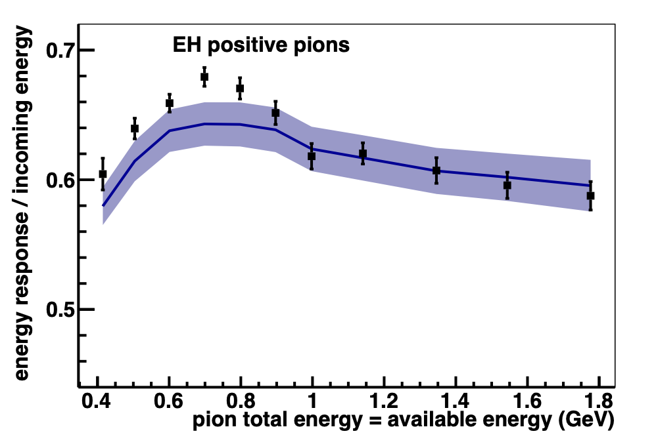
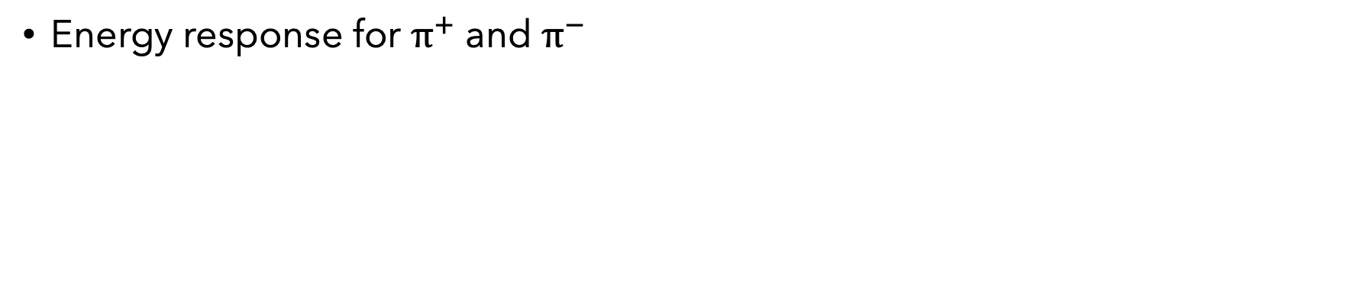
Electrons
ML to increase number of candidates
High energy loss through beamline
Energy response
Protons
Energy response
Measuring the Birks quenching parameter for protons
Pions
MINERvA
https://arxiv.org/abs/1501.06431
Energy response for $π^{+}$ and $π^{−}$
32
8th April 2026 – IOP APP & HEPP – Emerson Bannister

Slide 33
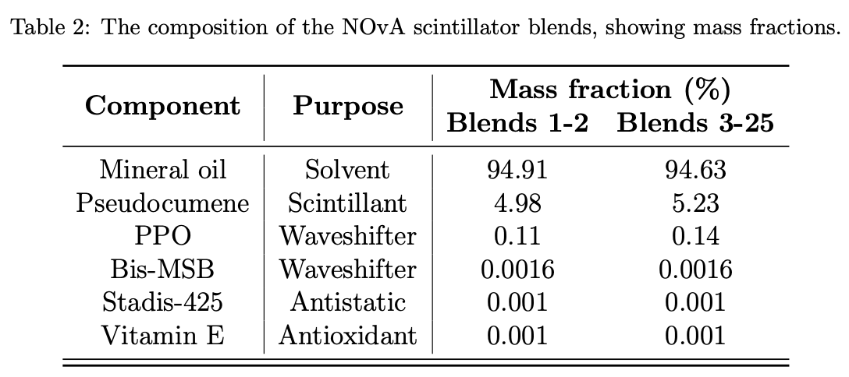
33
8th April 2026 – IOP APP & HEPP – Emerson Bannister

Slide 34
The NOvA Test Beam Program: Motivation
Detector Calibration
Calibrate to ensure uniform energy reconstructed across the detector, for a given energy deposition.
NOvA calibration uses cosmic ray muons to correct for:
Attenuation of light along the fibres.
Differences in response between individual detector cells.
Test Beam:
Smaller detector → reduces the effects of APD thresholds, self-shadowing, and attenuation of light along the detector cells.
Variety of readout electronics (near and far detector) → test the detector response and the calibration procedure in various scenarios.
34
8th April 2026 – IOP APP & HEPP – Emerson Bannister
Notes:
Calibrating the NOvA detectors ensures that a particle depositing a certain amount of energy in the detector will have the same reconstructed energy anywhere in the detector. NOvA calibration uses cosmic ray muons, and corrects for the attenuation of light along the fibres, and differences in response between individual detector cells. With the test beam detector, the same calibration process that is used for the near and far detectors was used. This allowed the calibration process to be validated, and to get a better estimate of the systematic uncertainties from the calibration.
Doing this validation on the test beam detector had some additional benefits; as the detector was smaller this reduced the effects of APD thresholds, self-shadowing, and attenuation of light along the detector cells, which are a larger problem in the bigger detectors. The test beam detector was also filled with a variety of scintillators and used different readout electronics so the detector response and calibration procedure could be tested in various scenarios.

Slide 35
The NOvA Test Beam Program: Motivation
Detector Response
Primary goal of the NOvA Test Beam program: To reduce the detector-based systematic uncertainties on the measurements of neutrino oscillation parameters.
By measuring the energy response of the detector to identified particles over a range of momenta.
35
8th April 2026 – IOP APP & HEPP – Emerson Bannister
Notes:
For the detector response systematic uncertainty, the primary goal of the nova test beam program is to reduce the detector-based systematic uncertainties on the measurements of neutrino oscillation parameters. This will be done byb measuring the energy response of the detector to particles that we have identified in the beam over a range of momenta.

