Slide 1

Improving Final-State Interaction Modelling with INCL in the NEUT Event Generator
Thomas Peacock
tpdpeacock1@sheffield.ac.uk
IOP Joint APP HEPP Annual Conference 2026
08/04/2026

Slide 2
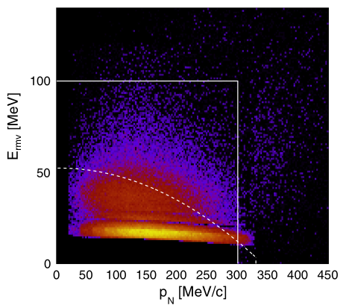
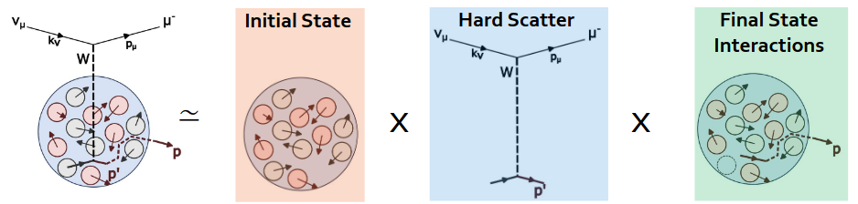
The NEUT Event Generator
Neutrino-Nucleus interaction simulator, maintained “in-house” byT2K/SK with experimental needs in mind
Simulates processes for 100 MeV - few-TeV neutrinos for a range of nuclear targets (H, …, C, O, … ,Pb)
In NEUT, neutrino interactions with nuclei are reduced into:
L. Pickering, NuFact 2024
Kinematic calculations
SF model
Cascade Model
Spectral function: Probability of finding a nucleon with an energy E_M and momentum p_M
Broken into two contributions (both seen here):
P_{MF} + P_{SRC}

Slide 3
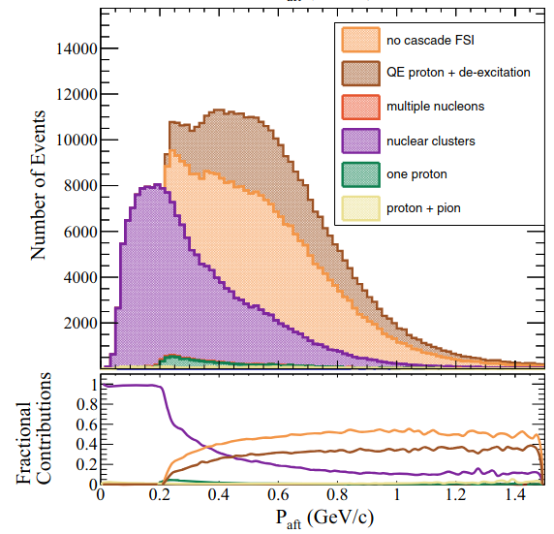
The NEUT Event Generator
Neutrino-Nucleus interaction simulator, maintained “in-house” byT2K/SK with experimental needs in mind
Simulates processes for 100 MeV - few-TeV neutrinos for a range of nuclear targets (H, …, C, O, … ,Pb)
In NEUT, neutrino interactions with nuclei are reduced into:
Other FSI models exist, with previous work integrating the INCL++ cascade into NuWro showing promising results
L. Pickering, NuFact 2024
Kinematic calculations
SF model
Cascade Model
FSI: Re-interactions of the hadron produced at the hard scatter with nucleons in the nucleus
NEUT uses the Bertini cascade model, a semi-classical “billiard ball” approach

Slide 4
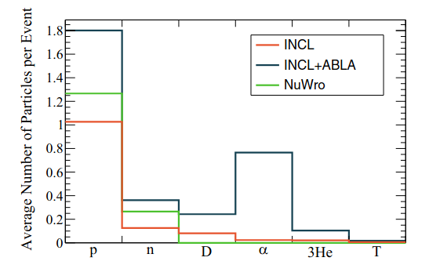
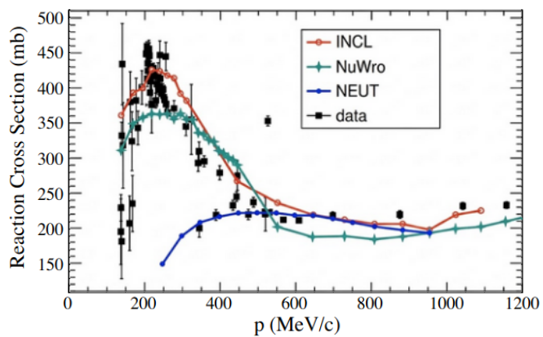
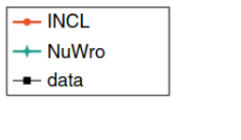
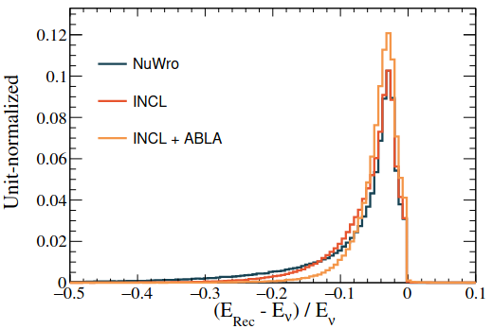

INCL++ for Neutrino Generators
Introduction of Light Nuclei Production (clustering)
Improved p-C low momentum proton cross section prediction
INCL + ABLA predicts T2K events on carbon cause fragmentation and produce clusters fairly often
NEUT
Plot from PHYSICAL REVIEW D 108, 112008 (2023)
Plot from PHYSICAL REVIEW D 106, 032009 (2022), with NEUT prediction overlaid
If detectable, introducing clusters in models improves neutrino energy reco
p-C reaction cross section predictions used to benchmark cascade modelling
A. Ershova, e4nu 2025

Slide 5
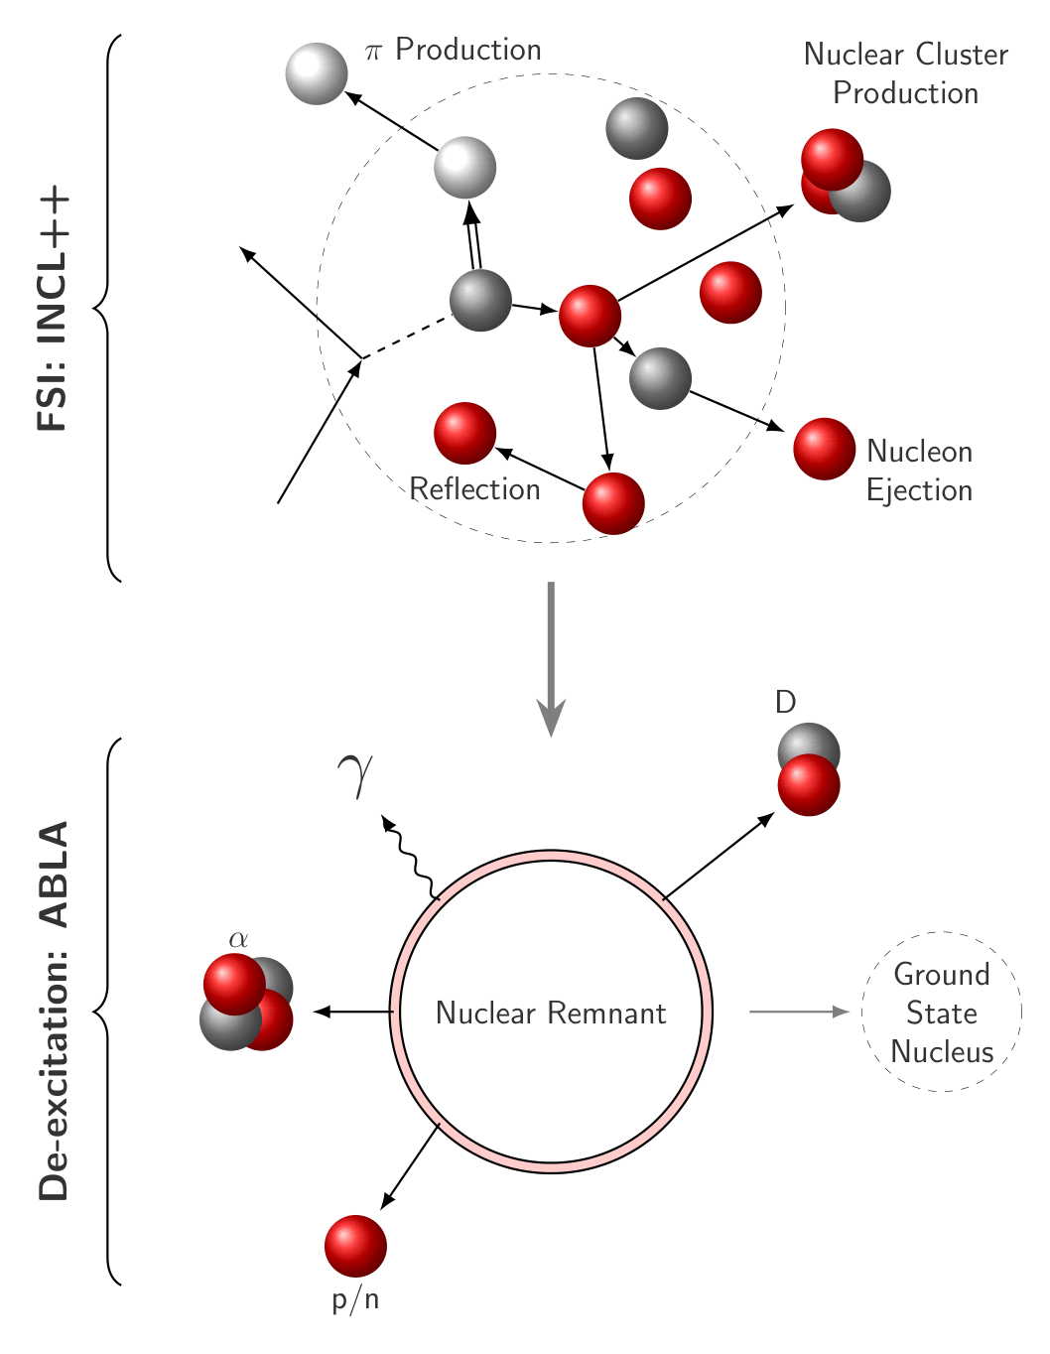
Intranuclear Cascade Liege ++ (INCL)
Liege Intranuclear Cascade (INCL): simulates struck nucleon re-interactions within a target nucleus, designed for hadron/light nucleus-induced reactions on nuclei from a few MeV to 10-20 GeV (ref)
Evolves entire nucleus through time
Nucleons: reflect off the potential, interact with other nucleons, decay
Final states: hadrons, nuclear clusters (D, T, 3He, alpha), and excited nuclear remnants with an excitation energy:
Coupled to a de-excitation routine (ABLA), modelling nuclear remnant relaxation after FSI

Slide 6
The Spectral Function and de-excitation
P_{sf} = P_{MF} + P_{SRC}
Previous work only looked into Mean Field (MF) contribution: simple 1 proton outputs (1p1h)
Spectral function E_{miss} values directly affect mean field excitation energy for 1p1h:
Only considering MF 1p1h
Benhar spectral function model, from PHYSICAL REVIEW D 109, 072006 (2024)

Slide 7
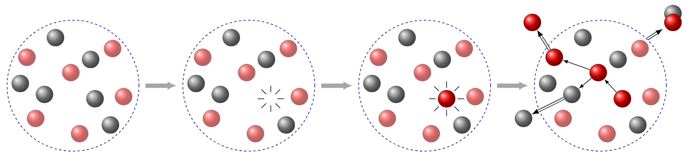
Using INCL for neutrino FSI (1p1h)
INCL is designed for nucleon-nucleus reactions, and is not designed for neutrino projectiles (yet!) so we must adapt both our generator and INCL to accommodate this:
Generate NEUT’s initial interaction, get the outgoing proton
Remove a nucleon from the INCL nucleus closest in p to the struck nucleon
Replace this nucleon with the outgoing proton in the same position
2. Remove a nucleon from the INCL nucleus closest in momentum to the struck nucleon
4. Run the INCL cascade and pass the result to ABLA
1. Create the INCL nucleus
3. Replace this nucleon with the outgoing proton

Slide 8
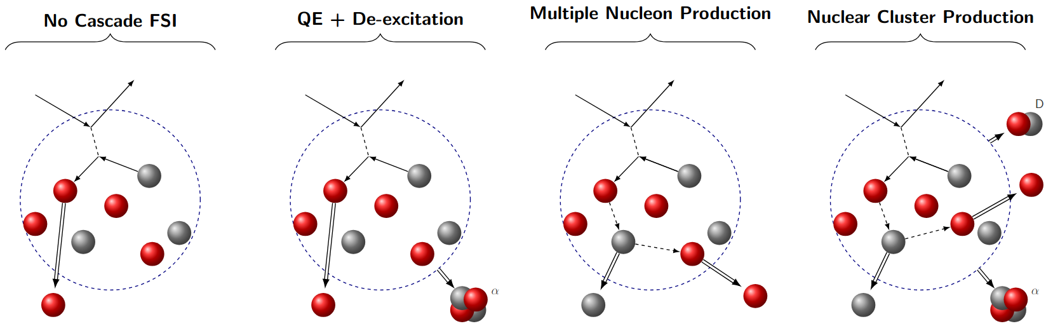
INCL++ Interaction Channel Table
Due to the introduction of clusters and native de-excitation, study the FSI output channels based off numbers and types of ejected channels
P
P
P
n
P
n
Channels with dominant contributions. Also see pion production and single inelastically scattered protons

Slide 9
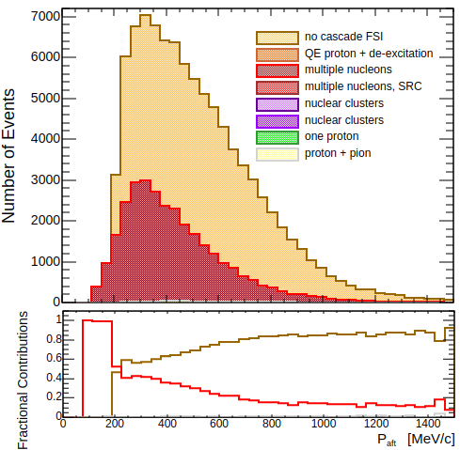
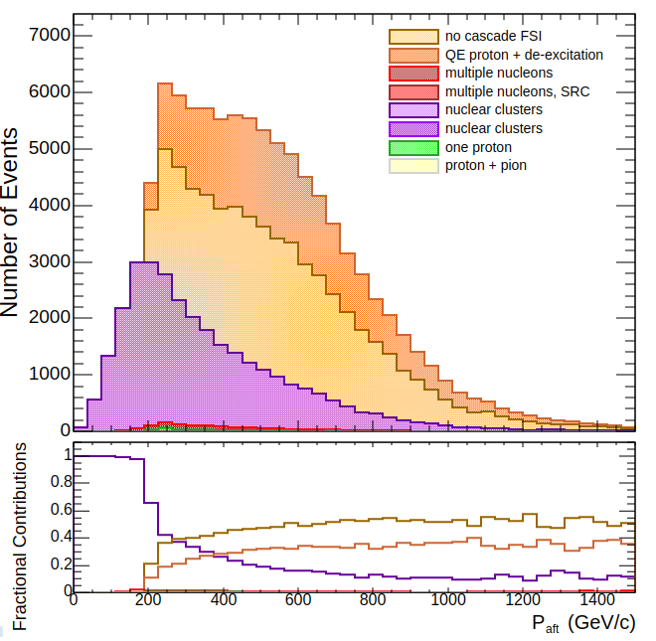
NEUT comparisons: CCQE 1p1h - I
Leading proton distributions post FSI, broken down by channel
Lower peak when using INCL due to events with no final state protons
NEUT and
INCL
NEUT Default
“Transparent” protons in INCL can be produced alongside nuclear clusters if the remnant de-excites
Increase in leading protons below p_{f} , almost always emitted alongside nuclear clusters
P_{aft} [MeV/C]

Slide 10
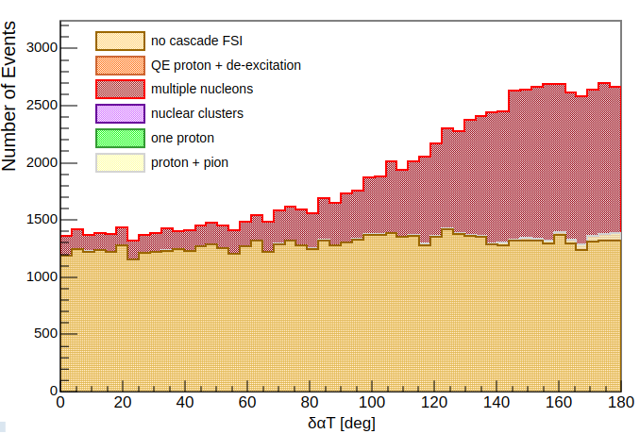
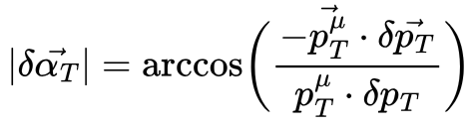
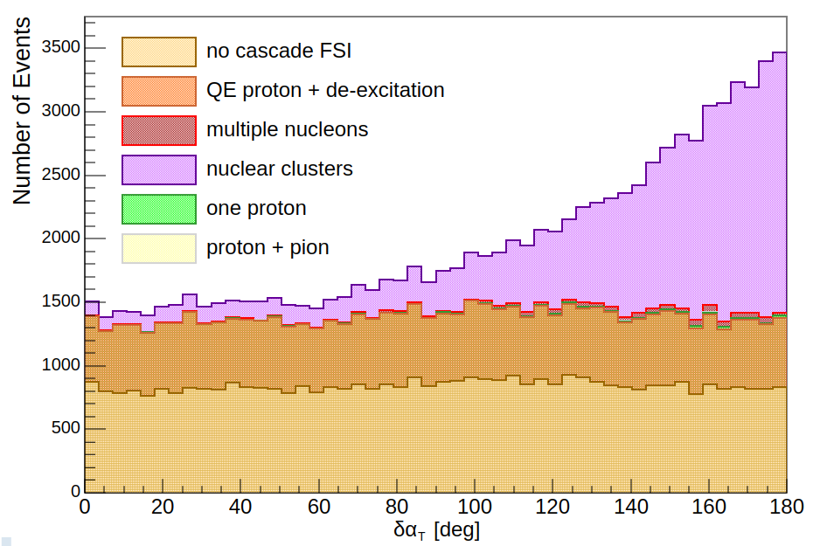
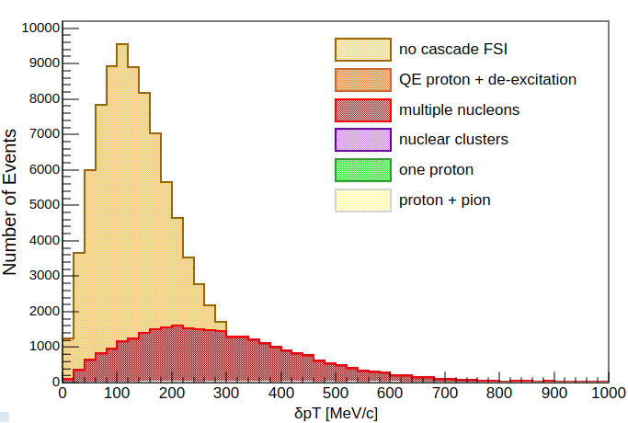
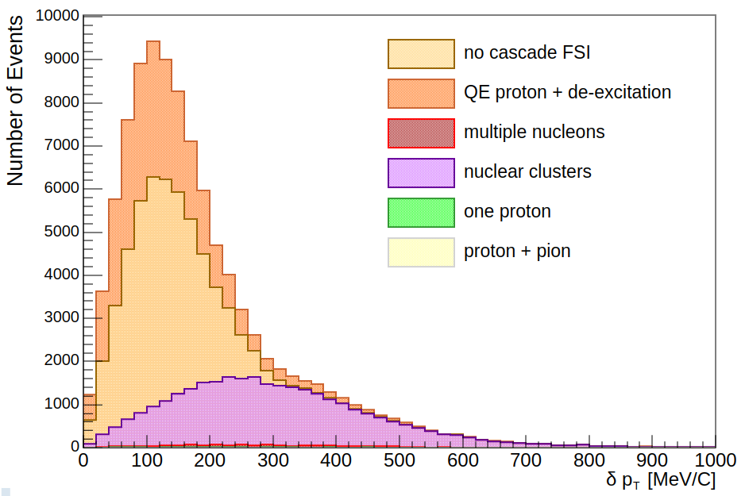

NEUT/NuWro comparisons CCQE 1p1h - II
Transverse kinematic imbalance distributions, broken down by channel
NuWro - paper
More cluster events at higher angles:
deaccelerated de-excitation protons are emitted alongside clusters
Similar shape, but with INCL:
-transparent events split into two channels
-multiple nucleon events now form with clusters

Slide 11
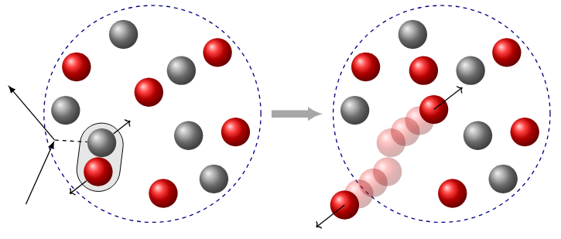
Short-range Correlation Modelling - Mo’ Protons Mo’ Problems
Short Range Correlations (SRCs): Bound pairs of high momentum nucleons found within the nucleus.
SRCs form the other contribution to the spectral function
The contribution to the spectral function from SRCs is not separable from the mean field (yet…)
Freedom in how to define the SRC contribution in generators
Excitation energy of the nucleus is very dependent on SRC definition
CC
interaction
n
p
p
p
SRC bound state
High momentum 2-particle knockout
To simulate SRC events, if an event is within the SRC region, place a nucleon of equal and opposite momentum to the struck nucleon into the nucleus

Slide 12
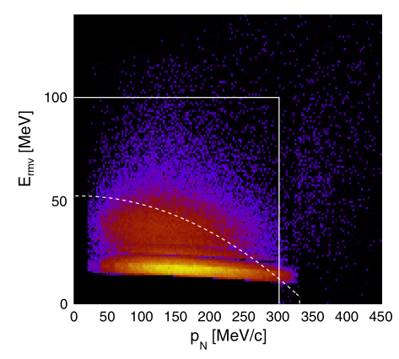
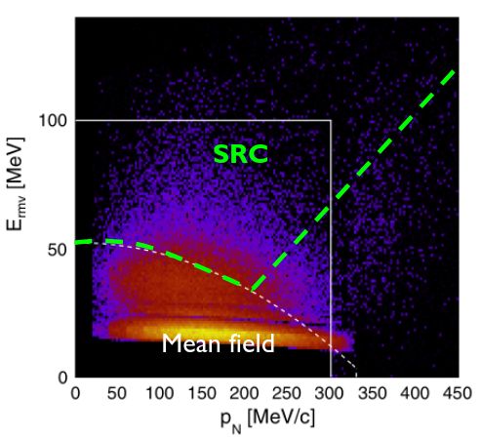
Short-range Correlation Modelling - Mo’ Protons Mo’ Problems
NEUT SRC - MF and SRC contribution
NuWro SRC - MF and SRC contribution
SRC
Mean Field
NEUT’s SRC events are defined as:
p_{N} > 300 MeV
E_{miss} > 100 MeV
NuWro defines SRC with a function and a cut:

Slide 13
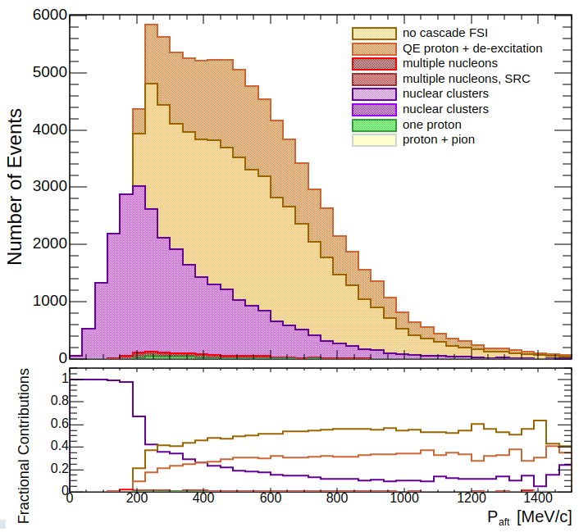
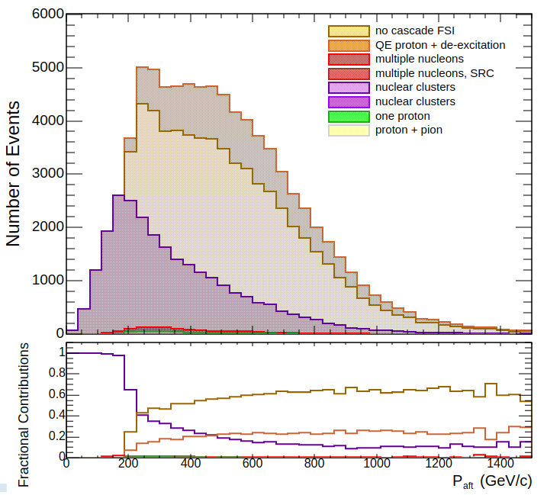
CCQE pure MF: Effects of SRC Modelling
Leading proton distributions highlight effect of SRC modelling on FSI with INCL
1p1h only, NEUT SRC model
1p1h only, NuWro SRC model
Fewer transparent + de-excitation events:
fewer high missing energy, lower momentum protons in the NuWro MF distribution
Fewer events with nuclear clusters with NuWro SRC model:
excitation energies are lower due to change in MF missing energy distribution
Total number of MF CCQE events has reduced as SRC contribution to SF is greater for NuWro SRC

Slide 14
Summary
INCL++ is an FSI model which introduces nuclear clustering and a better handling of low energy nucleon interactions.
The interface developed allows for straight integration of the INCL++ cascade into NEUT, allowing for data comparisons and fake data studies to be performed, with potential for reweightability in the future
The introduction of nuclear clusters in FSI can lead to a better understanding of nuclear effects and improved neutrino energy reconstruction
Introducing the INCL cascade with ABLA into NEUT increases number of final state channels and greatly reduces the number of purely transparent events through de-excitation
SRC model choice affects FSI in INCL due to changes in the excitation energy calculation and the ratio of MF 1p1h to SRC events
Special thanks to Anna Beever for her invaluable support in getting this work to this point!
Also, thanks to Patrick Stowell, Sara Bolognesi, and Jean Davide-Chrisophe for INCL physics input and to Jake McKean and other members of the T2K NIWG for neutrino physics and NEUT input.

Slide 15
NEUT/NuWro validations
Leading proton distributions post FSI, broken down by channel
Implementation in NEUT matches prior work, with some differences from initial interaction modelling
NEUT
NuWro
P_{aft} [MeV/C]
Plot from PHYSICAL REVIEW D 108, 112008 (2023)

Slide 16
Annas comments

Slide 17
BACKUPs

Slide 18
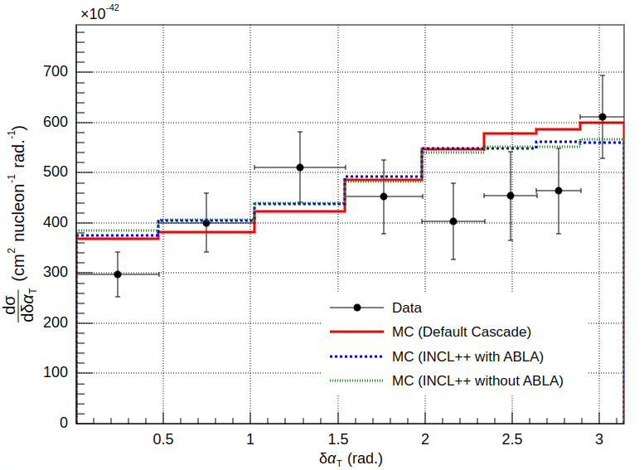
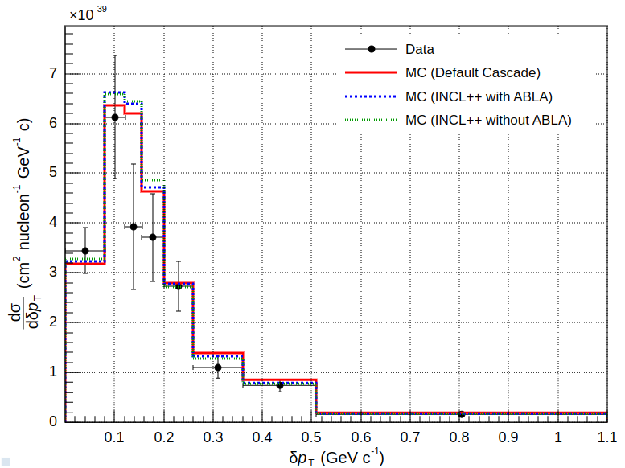
Preliminary Data Comparisons - T2K TKI
INCL++ can only use CCQE events at present, so using NEUT data for other channels
Apparent “reduction” in FSI strength for INCL is due to presence of non proton events in INCL
T2K’s proton tracking threshold is 500MeV
NEUT Cascade: 12.01 / 8
NEUT + INCL 10.85 / 8
NEUT + INCL + ABLA10.73 / 8
NEUT Cacsade: 8.47 / 8
NEUT + INCL 7.28 / 8
NEUT + INCL + ABLA 7.09 / 8

Slide 19
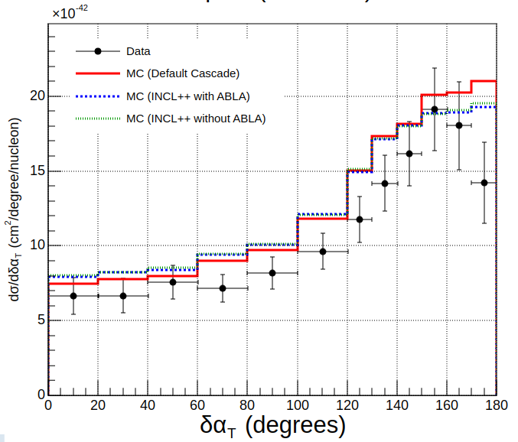
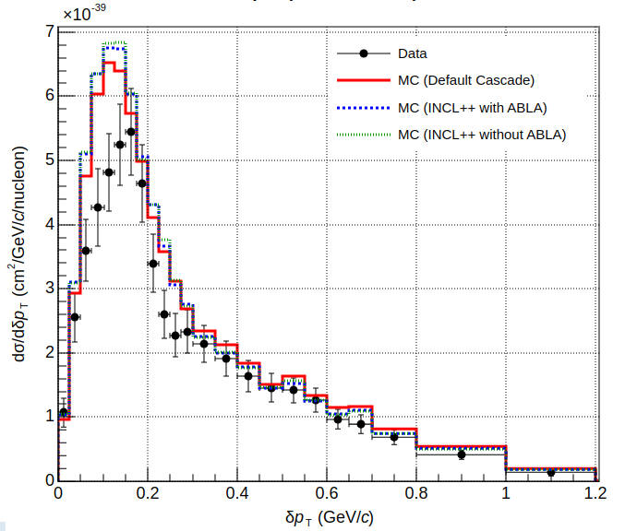
Preliminary Data Comparisons - MiNERva TKI
DaT
Neut cascade: 24.55 / 12
NEUT + INCL: 26.38 / 12
NEUT + INCL + ABLA 27.79 / 12
DpT
NEUT Cascade: 53.72 / 24
NEUT + INCL: 61.92 / 24
NEUT + INCL + ABLA: 65.79 / 24

Slide 20
NEUT Cascade
Plot of nuisance generated total pN, overlaid and normalised, for bertini, INCL and INCL+ABLA

Slide 21
Short-range Correlation Modelling
SRC: High momentum nucleons (> p_{f} ) existing in correlated bound pairs in the nucleus
CC interaction
SRC bound state
High momentum 2-particle knockout
The contribution to the spectral function from SRC is not separable - event generators model this by using cuts on the total SF distribution
NuWro uses:
E_{miss} > 100 MeV
Plot originally from PHYSICAL REVIEW D 109, 072006 (2024)

Slide 22
rgba(255, 213, 150)
rgba(255, 169, 113)
rgba(255, 47, 47)
rgba(211, 122, 236)

