Slide 1
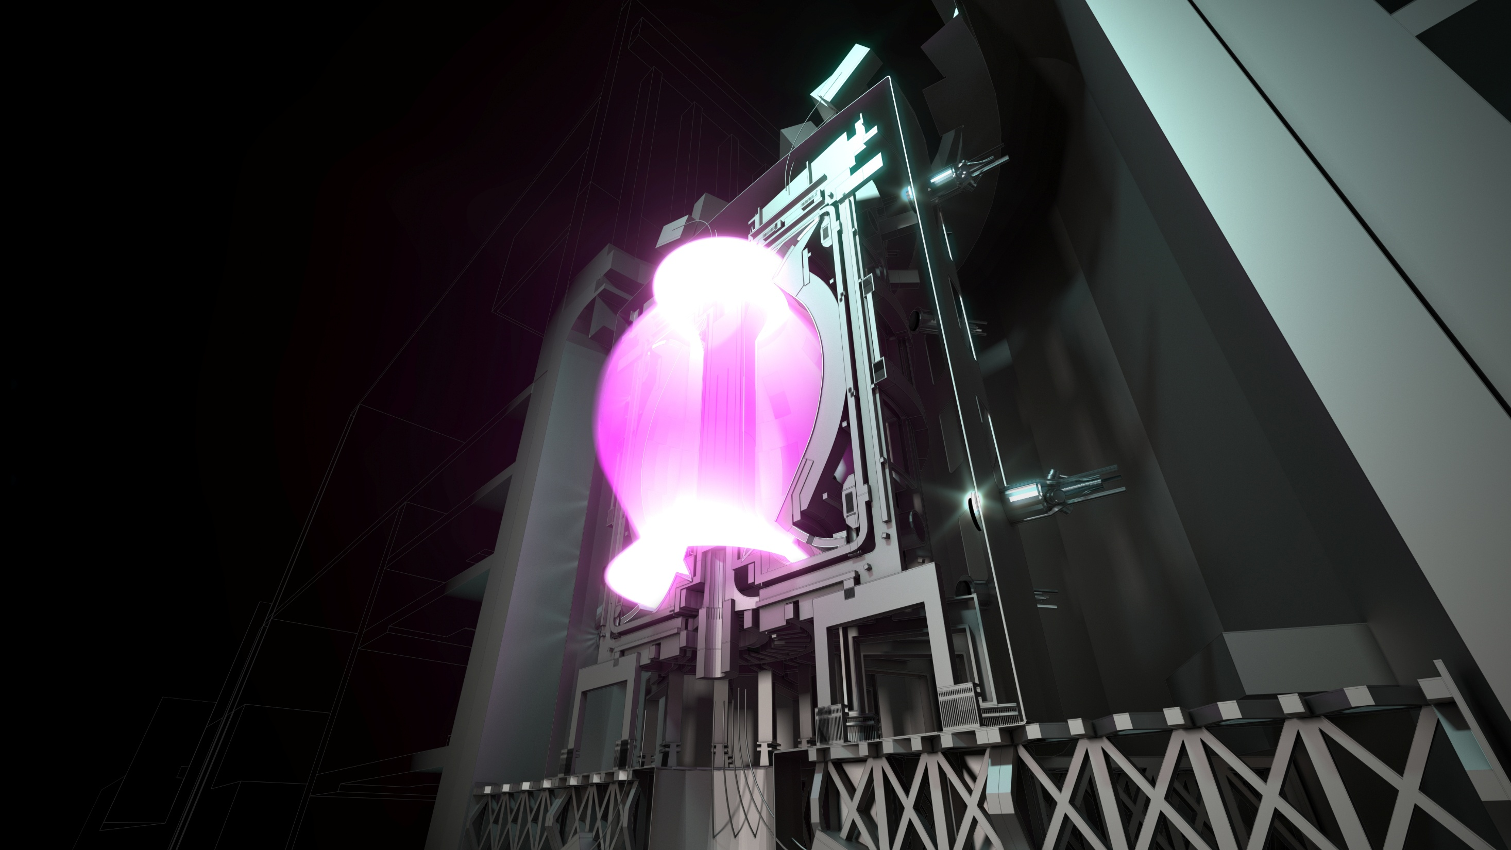
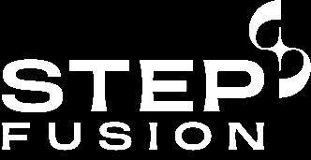
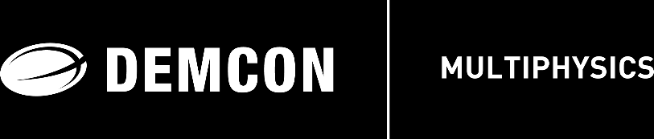
Quench and discharge modelling of toroidal field coils using a modified AV formulation with line elements for cables
Rien Wesselink
DEMCON Multiphysics
Jiabin Yang
UK Atomic Energy Authority
This work has been funded by STEP, a major technology and infrastructure programme led by UK Industrial Fusion Solutions Ltd (UKIFS), which aims to deliver the UK’s prototype fusion powerplant and a path to the commercial viability of fusion.

Slide 2
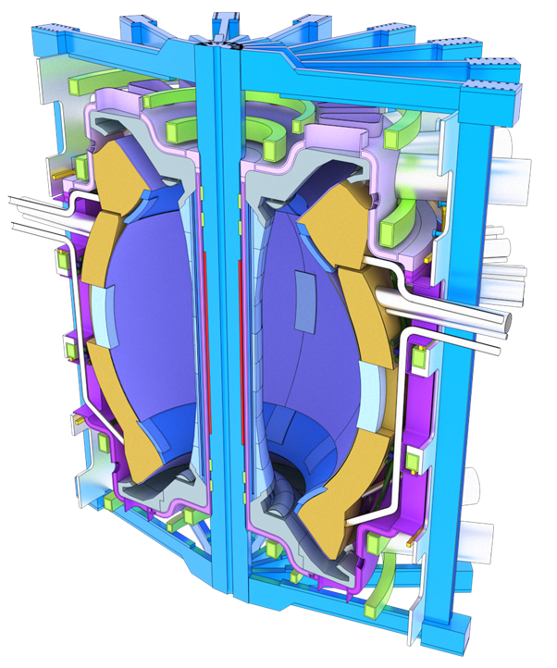
Motivation: quench protection
Toroidal Field coils (TF coils)
Calculate:
Temperature
Voltage
Current
during various quench / discharge scenarios.
Notes:
The purpose of the method I am going to talk about is to do electrothermal simulations of quench or rapid discharge scenarios relevant for the design of a quench protection strategy.

Slide 3
Which method to choose?
FEM-formulations
(H, Hϕ, HA, TA, AVJ, …)
[1] B. Shen et al. (2020), "Overview of H-Formulation: A Versatile Tool for Modeling Electromagnetics in High-Temperature Superconductor Applications," in IEEE Access, vol. 8, pp. 100403-100414.
[2] Alexandre Arsenault et al. (2021), "COMSOL Implementation of the H-ϕ-Formulation With Thin Cuts for Modeling Superconductors With Transport Currents", IEEE Transactions on Applied Superconductivity, volume 31, no. 6, pp. 1-9
[3] P. Dular, et al. (1997), "Magnetostatic and magnetodynamic mixed formulations compared with conventional formulations, " IEEE Transactions on Magnetics, vol. 33, no. 2, pp. 1302–1305
[4] H. Zhang et al. (2017), "An efficient 3D finite element method model based on the T–A formulation for superconducting coated conductors," Supercond. Sci. Technol. 30 024005
[5] V Lahtinen et al. (2012), "Comparison of three eddy current formulations for superconductor hysteresis loss modelling" Supercond. Sci. Technol. 25 115001
Network models
(or PEEC)
[6] T. Wang et al. (2015), "Analyses of Transient Behaviors of No-Insulation REBCO Pancake Coils During Sudden Discharging and Overcurrent," in IEEE Transactions on Applied Superconductivity, vol. 25, no. 3, pp. 1-9
[7] J. van Nugteren (2016), "High temperature superconductor accelerator magnets," PhD Thesis, University of Twente.
[8] R. Miyao et al. (2018), "Thermal and Electromagnetic Simulation of Multistacked No-Insulation REBCO Pancake Coils on Normal-State Transition by PEEC Method," in IEEE Transactions on Applied Superconductivity, vol. 28, no. 3, pp. 1-5
[9] C. Genot (2023), "Numerical and experimental studies for the optimization and protection of NI-MI HTS coils," PhD Thesis, Université Grenoble Alpes.
We want something simpler and more crude to enable quicker iterations,
approximating the cables as lines.
Notes:
For doing simulations, there are basically two direction you can take: FEM or network models.
Both have their hurdles, not going into detail about those.
We thought: can we think of something else that is perhaps a bit more crude, but still gives us valuable insights, and with a quick iteration time.
Direction: approximate the cable cross section as a line.

Slide 4
Content
Method
What is AVI formulation?
Single cable benchmark
How does AVI formulation perform compared to a more detailed approach?
TF coil discharges
How to get temperature distributions after discharge as uniform as possible?

Slide 5
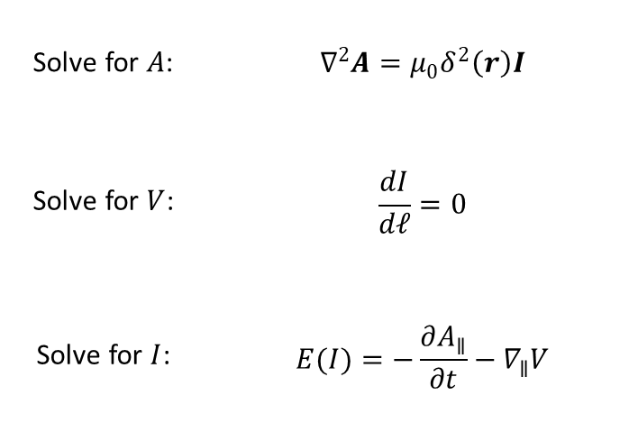
Part 1:
Method
Solve for $A$: | $$∇^{2}A=μ_{0}δ^{2}\left(r\right)I$$
Solve for $V$: | $$\frac{dI}{dℓ}=0$$
Solve for $I$: | $$E(I)=−\frac{∂A_{∥}}{∂t}−∇_{∥}V$$
What is AVI formulation?

Slide 6
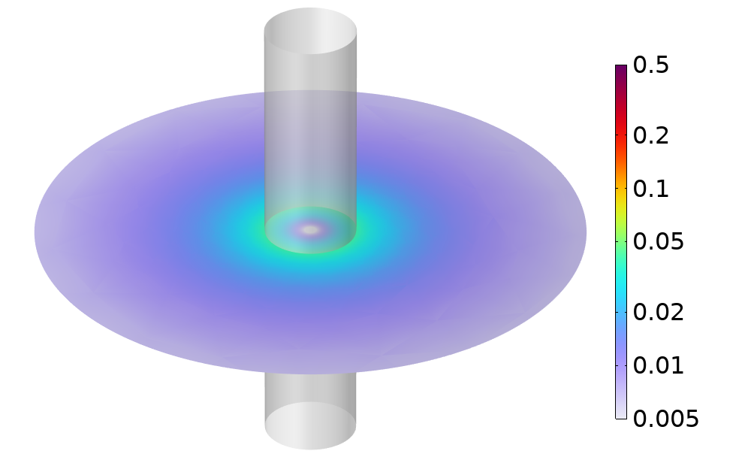
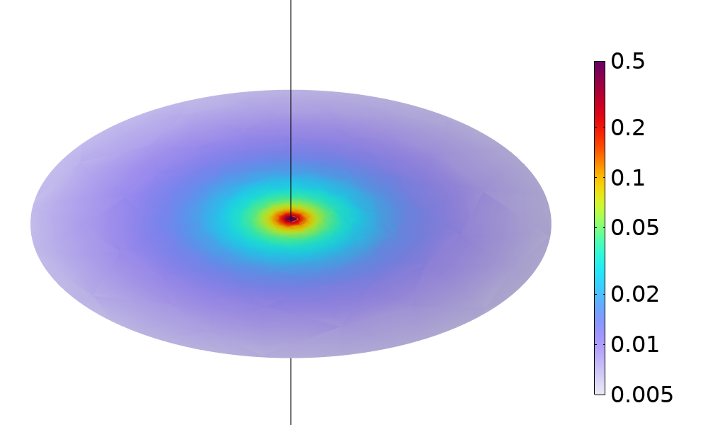
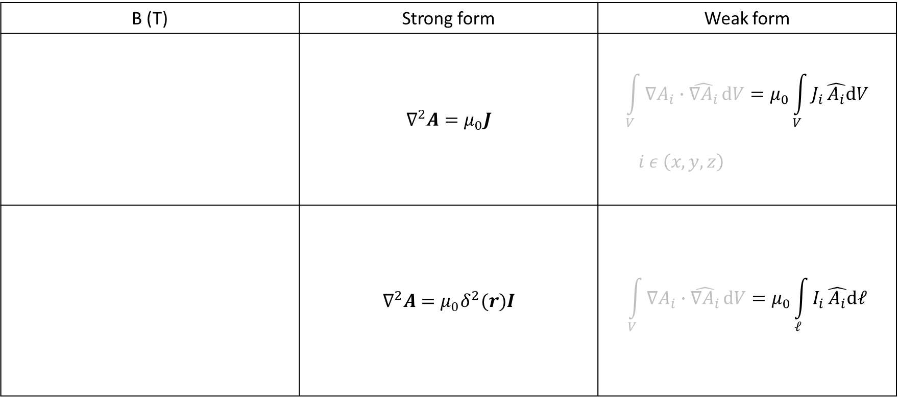
Line current: easy in FEM
B (T) | Strong form | Weak form
 | $$∇^{2}A=μ_{0}J$$ | $$\int_{V}{∇A_{i}∙\hat{∇A_{i}}}dV=μ_{0}\int_{V}{J_{i}}\hat{A_{i}}dV$$ $$i ε \left(x, y, z\right)$$
 | $$∇^{2}A=μ_{0}δ^{2}(r)I$$ | $$\int_{V}{∇A_{i}∙\hat{∇A_{i}}}dV=μ_{0}\int_{ℓ}{I_{i}}\hat{A_{i}}dℓ$$
May seem tricky
But it is easy
Notes:
Having a line current may seem a bit tricky if expressed in the strong form: we have this delta function in the source term and infinities and so on.
But in the weak form it is actually pretty straightforward: just a volume integral that turns into a line integral.

Slide 7
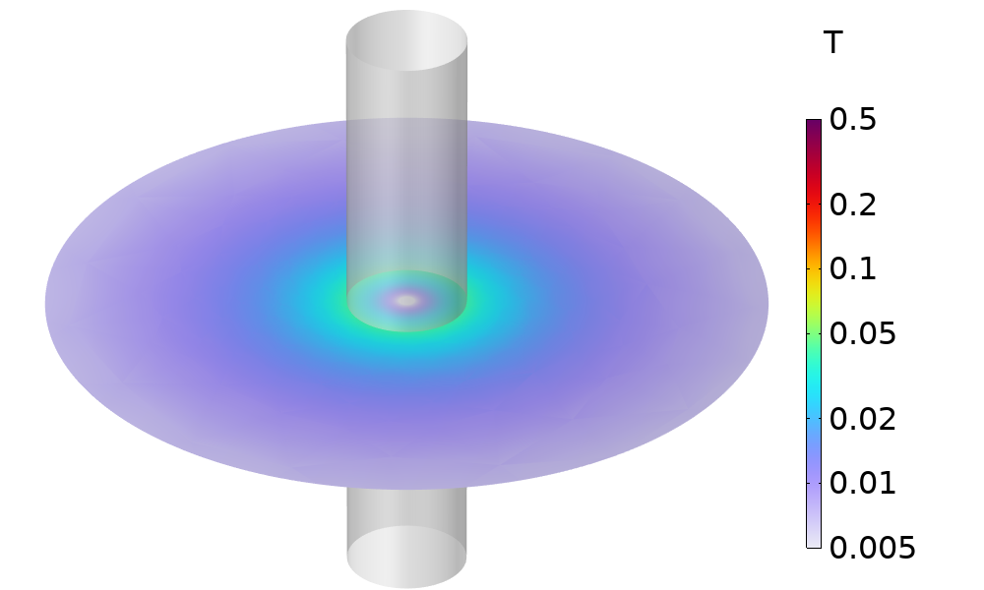
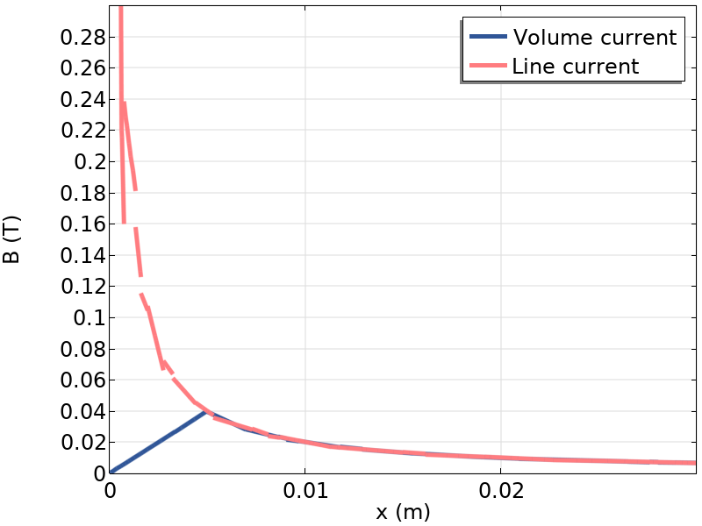
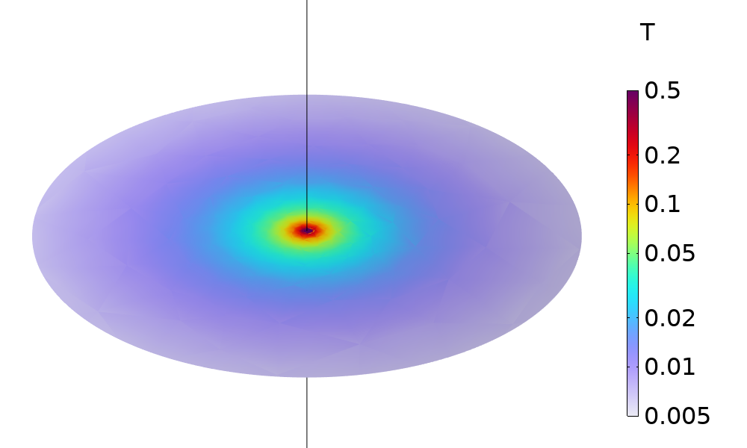
B-field should not be evaluated near line current
x
Cable radius
x
Notes:
The B-field close to the line current is theoretically infinite.
The solution will be noisy and depending strongly on the mesh close to the line.
So one should be careful with variables close to the lines, but further away everything is ok.

Slide 8
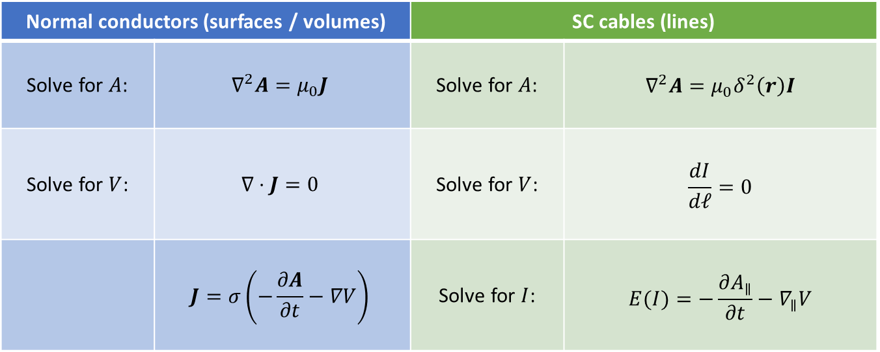
AV formulation
Normal conductors (surfaces / volumes) |  | SC cables (lines)
Solve for $A$: | $$∇^{2}A=μ_{0}J$$ | Solve for $A$: | $$∇^{2}A=μ_{0}δ^{2}\left(r\right)I$$
Solve for $V$: | $$∇⋅J=0$$ | Solve for $V$: | $$\frac{dI}{dℓ}=0$$
 | $$J=σ\left(−\frac{∂A}{∂t}−∇V\right)$$ | Solve for $I$: | $$E(I)=−\frac{∂A_{∥}}{∂t}−∇_{∥}V$$
Notes:
For the equations, the starting point is AV formulation, solving for A and V.
The equation for A makes sure we get all the magnetic fields belonging to a current distribution.
The equation for V is current conservation, (ohms law is filled in here). This takes care of the current flow in the normal conductors.
(So V is only solved in conductors.)

Slide 9
AVI formulation
Normal conductors (surfaces / volumes) |  | SC cables (lines)
Solve for $A$: | $$∇^{2}A=μ_{0}J$$ | Solve for $A$: | $$∇^{2}A=μ_{0}δ^{2}\left(r\right)I$$
Solve for $V$: | $$∇⋅J=0$$ | Solve for $V$: | $$\frac{dI}{dℓ}=0$$
 | $$J=σ\left(−\frac{∂A}{∂t}−∇V\right)$$ | Solve for $I$: | $$E(I)=−\frac{∂A_{∥}}{∂t}−∇_{∥}V$$
Notes:
In case of the line elements, the source term for A changes. We already talked about that.
We also add a current conservation law on the lines, and solve for V there.
The equation shown here looks trivial, but in case of junctions and connections to 2D and 3D structures it is less simple. But it is straightforward to generalize this.
The material behaviour of the superconductor is described via an E(I) curve.
It is known that this produces numerical problems in ordinary AV.
This can be solved by adding an additional variable for the current.
This is why we also call this AVI formulation.

Slide 10
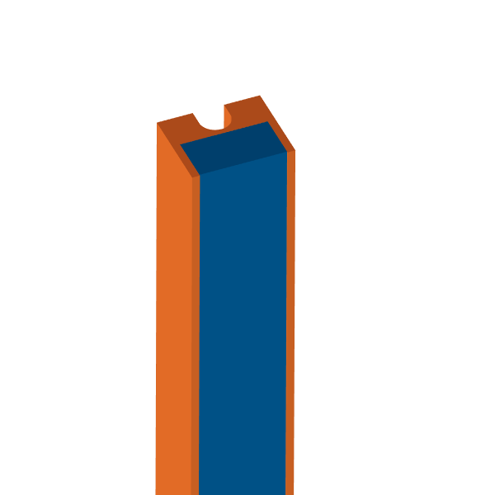
Cable design
Cable design by STEP, UKAEA
Copper support
Tape stack
Tape orientation
Notes:
Now we first need to explain something about the cable design:
It consists of a copper support in which a stack of SC tapes is soldered.
The recess you see is for the cooling channel.

Slide 11


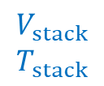
2 voltages, 2 temperatures
Copper support
Tape stack
Tape orientation
$$V_{stack}$$
$$T_{stack}$$
$$V_{sup}$$
$$T_{sup}$$
$$I_{SC}$$
Notes:
In the simulations we actually use 2 voltages and 2 temperatures on every line element.
You can picture this as a string of parallel resistors, one side representing the tape stack, the other the copper support.

Slide 12
2 voltages, 2 temperatures
Copper support
Tape stack
Tape orientation
$$V_{stack}$$
$$T_{stack}$$
$$V_{sup}$$
$$T_{sup}$$
$$I_{SC}$$
Notes:
This is necessary because:
If you have a hotspot somewhere, the current needs to go around it.
The resistance for going out of and into the tape stack again, is relevant: it causes significant dissipation.

Slide 13
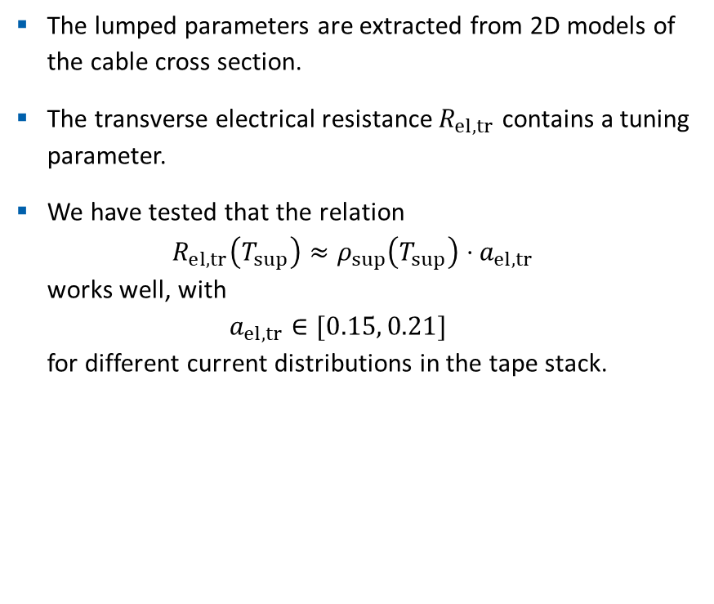

2 voltages, 2 temperatures
The lumped parameters are extracted from 2D models of the cable cross section.
The transverse electrical resistance $R_{el,tr}$ contains a tuning parameter.
We have tested that the relation
$R_{el,tr}\left(T_{sup}\right)≈ρ_{sup}\left(T_{sup}\right)⋅a_{el,tr}$
works well, with
$a_{el,tr}∈[0.15, 0.21]$
for different current distributions in the tape stack.
$$R_{el,tr}$$
$$V_{stack}$$
$$T_{stack}$$
$$V_{sup}$$
$$T_{sup}$$
$$I_{SC}$$
Notes:
The lumped parameters can be calculated from 2D models of the cable.
They do not contain any tuning parameters, except for this transverse electrical resistance.
This is because it depends on the superconducting current distribution in the tape stack.
So there is this tuning parameter a, that can vary between 0.15 and 0.21 depending on the current distribution.

Slide 14
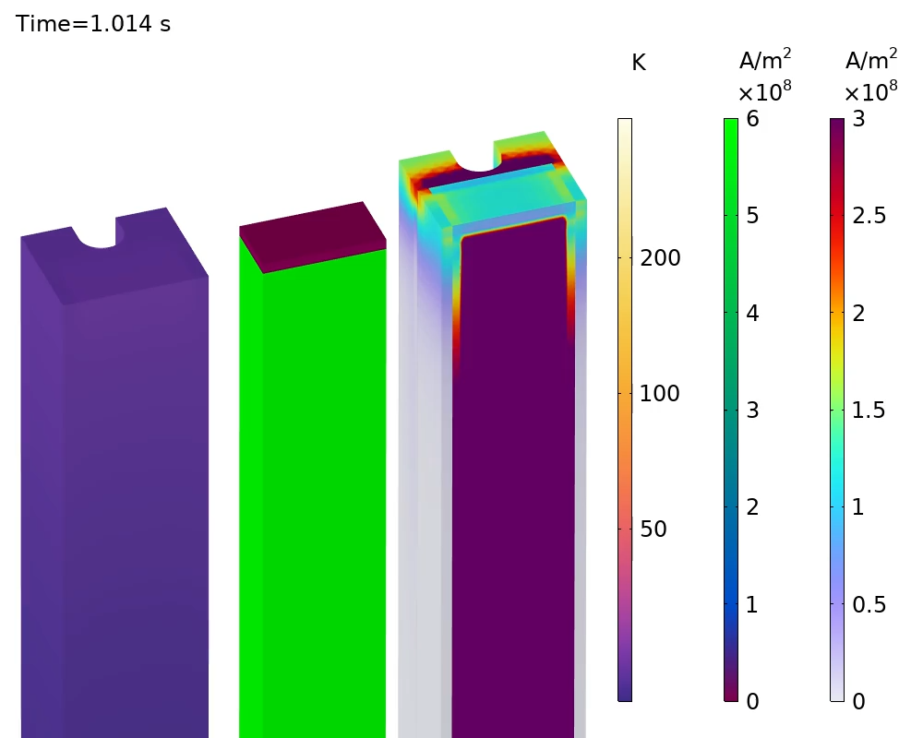
Part 2:
Single Cable Benchmark
J
J_{c}
T
How does AVI formulation perform compared to a more detailed approach?
Notes:
Now we have all the ingredients to talk about a benchmark.

Slide 15
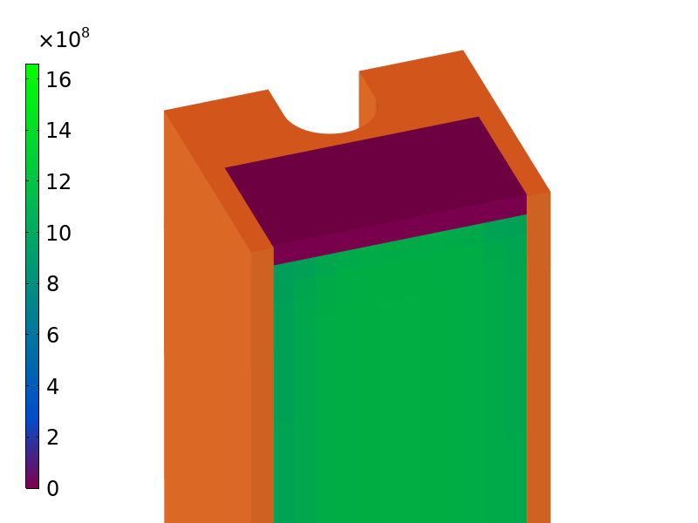
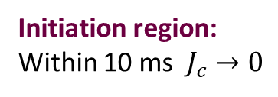
Quench initiation
J_{c} (A/m²)
Initiation region:
Within 10 ms $J_{c}→0$
Notes:
There is a region where Jc is artificially ramped down to 0.

Slide 16
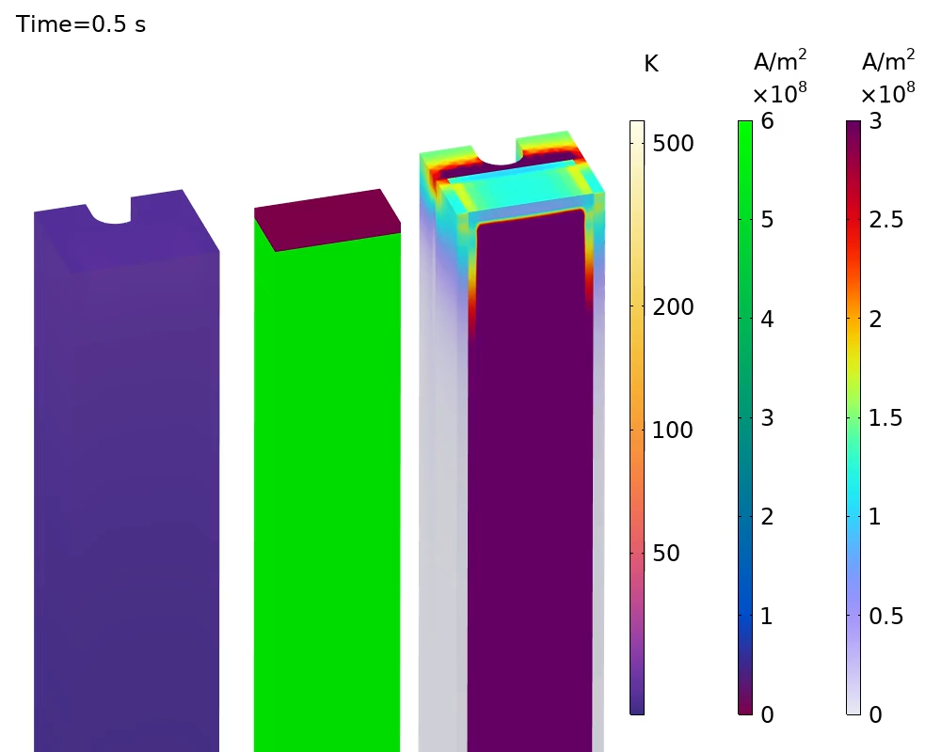



Detailed Hϕ model
$$J$$
$$J_{c}$$
$$T$$
Computation time:
~ 1 hour
Notes:
Because Jc is lower in a region, the current has to divert, causing heating, causing temperature rise, causing further decline of Jc.
As soon as the temperature reaches Tc, propagation starts: the purple region expands.

Slide 17
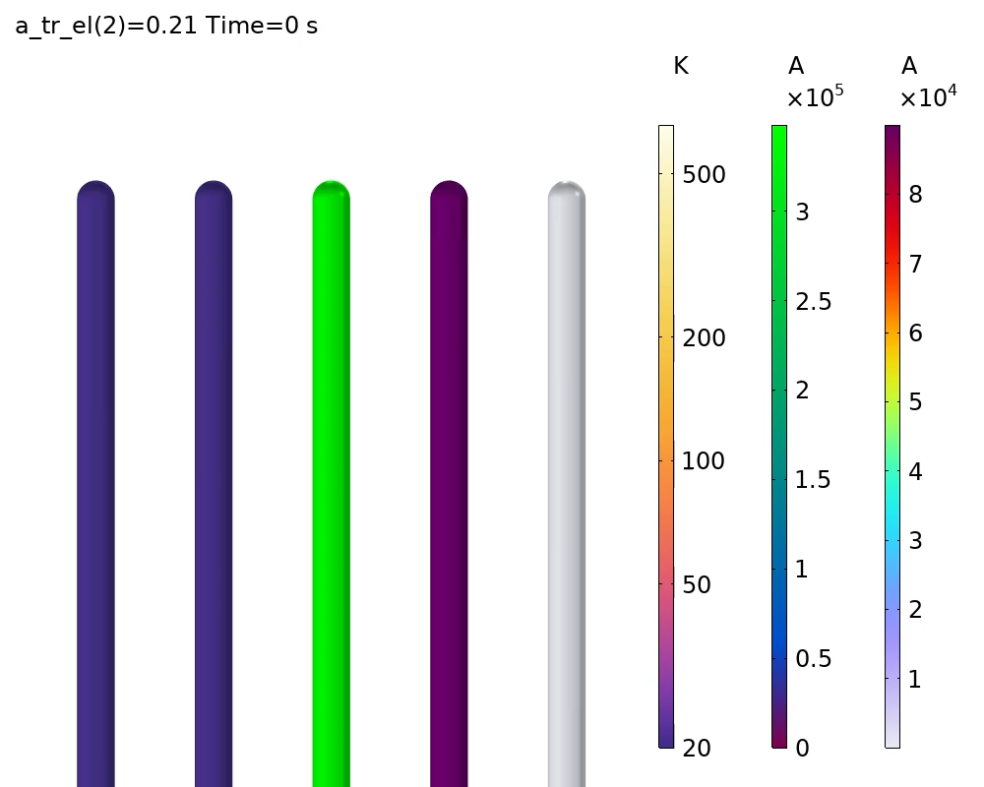





Line element (AVI) model
$$T_{stack}$$
$$T_{sup}$$
$$I_{c}$$
$$I_{stack}$$
$$I_{sup}$$
Computation time:
~ 2 minutes
Notes:
In the AVI model this looks more boring, but then this is also why this is so much more efficient.

Slide 18
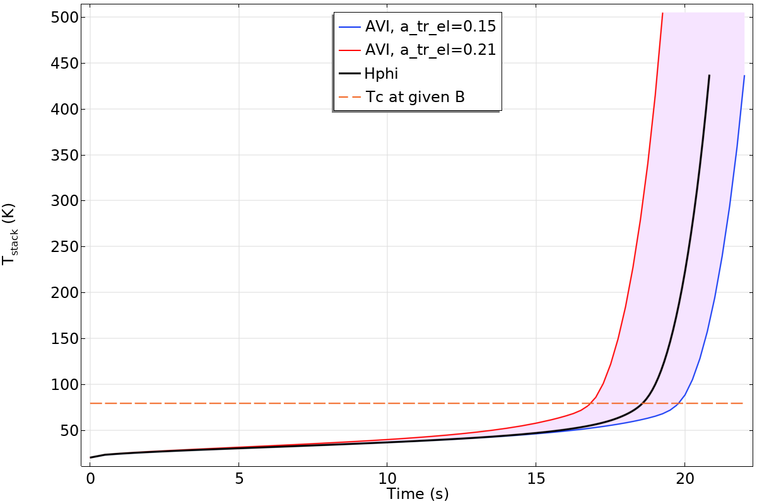
Comparison
Notes:
Higher transverse resistance → earlier timing
Lower transverse resistance → later timing of the runaway
One could tune this a parameter to get a match, but in reality, different current distributions can occur at different places in the coil, so we just need to pick something and check the influence of this parameter.
In the following I show results only for a = 0.21.

Slide 19
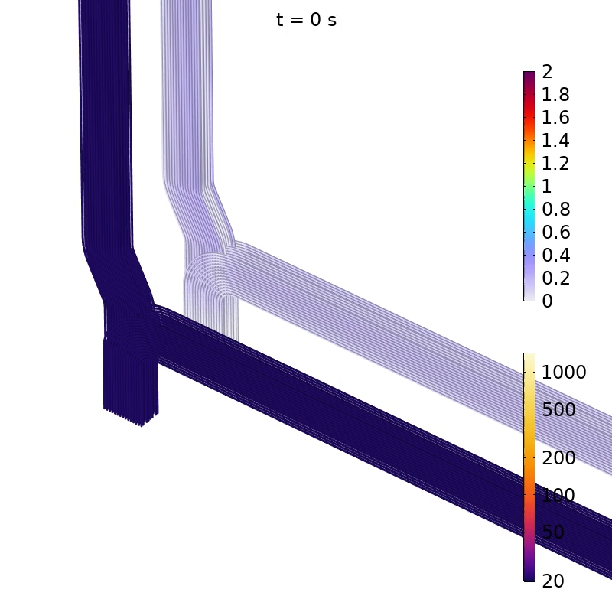


Part 3:
TF coil discharges
$$I/I_{c}$$
How to get temperature distributions after discharge as uniform as possible?
$$T_{stack} (K)$$
Notes:
Now we are ready to apply this method.
We focus on

Slide 20
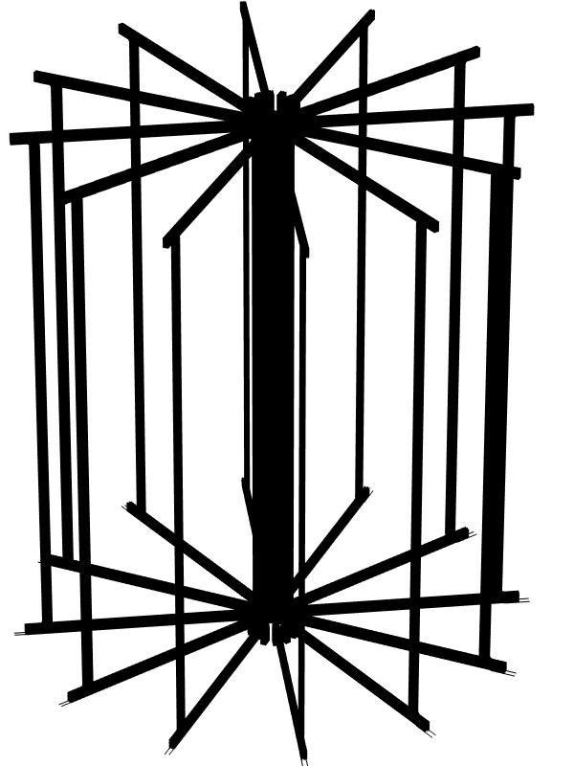
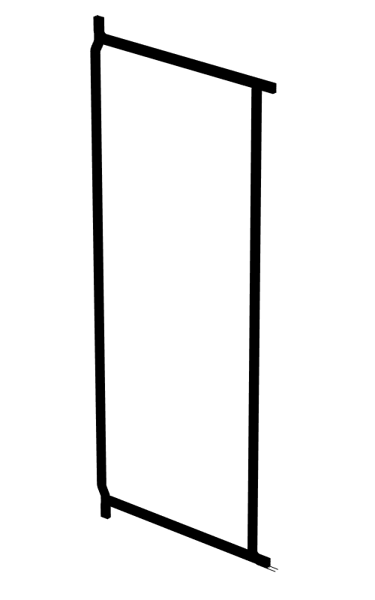
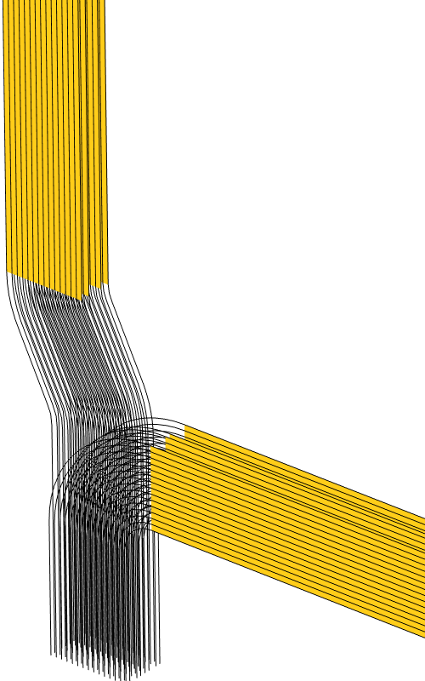
Geometry
60 turns
divided over 4 layers
Heaters
25 m
Notes:
This is the geometry we are dealing with.
There are 12 TF coils arranged in this way.
The straight sections contain heaters that are electrically connected to the first and last turn in a layer, and thermally to every turn in the layer of course.

Slide 21
Geometry
60 turns
divided over 4 layers
Showing T(t) plots at these points:
Heaters
Notes:
In the slides hereafter I show temperature transients at points halfway these long sections.

Slide 22
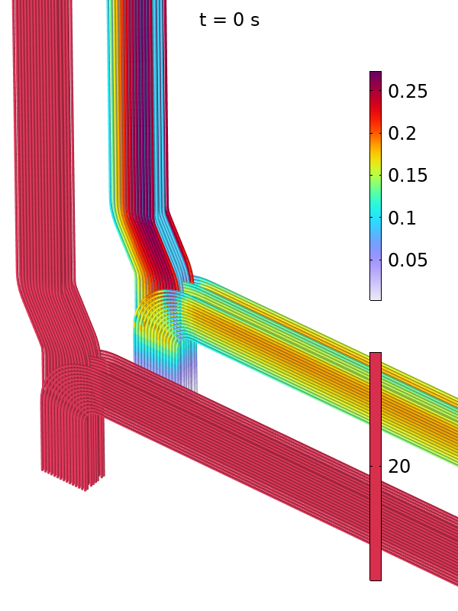
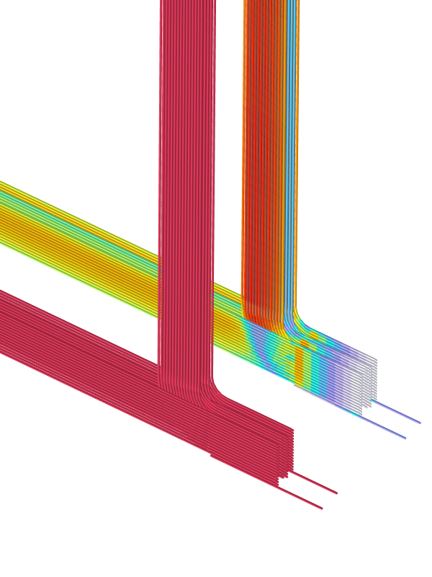
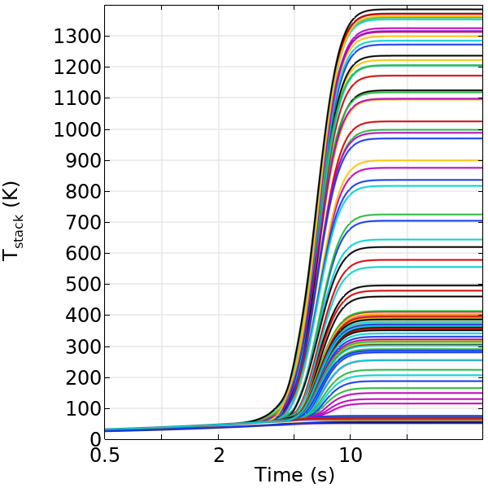


T(t)
$$I/I_{c}$$
$$T (K)$$
Notes:
To the left the transiens I just mentioned.
To the right the initial temperature and I/Ic.
We can see the critical current is lowest in some turns in the central column.

Slide 23
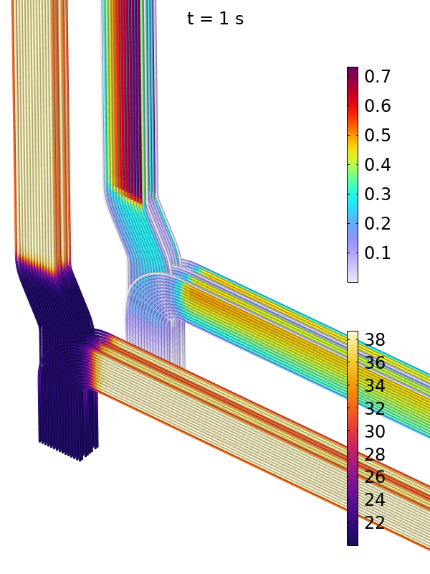
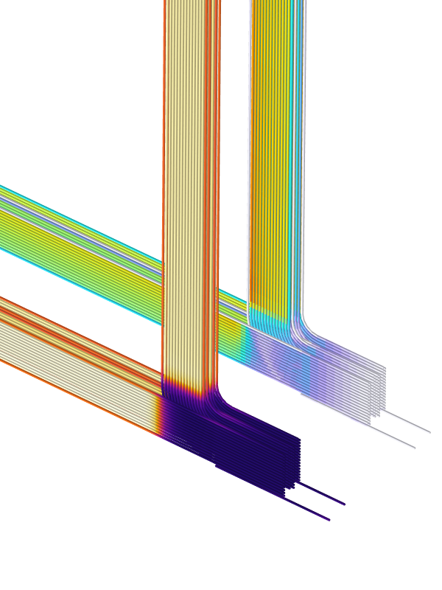
T(t)
$$I/I_{c}$$
$$T (K)$$
Notes:
After a second we see elevated temperatures where the heaters are.

Slide 24
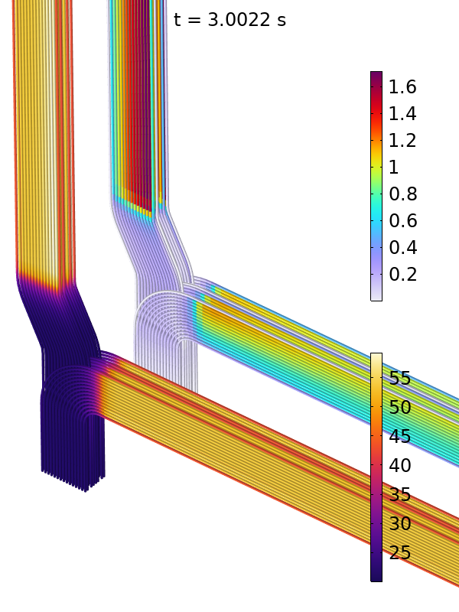
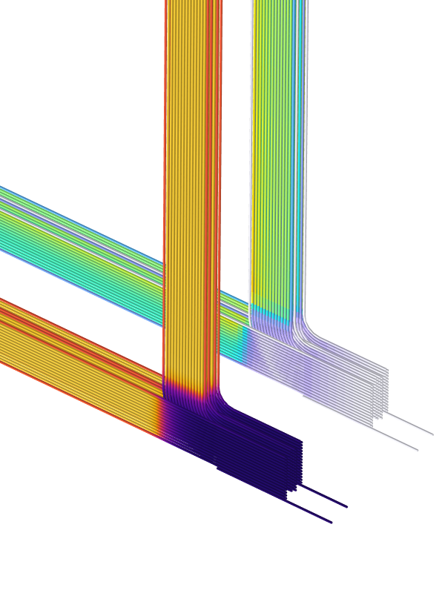
T(t)
$$I/I_{c}$$
$$T (K)$$
Notes:
The temperature rises further and we see I/Ic > 1 in some places.

Slide 25
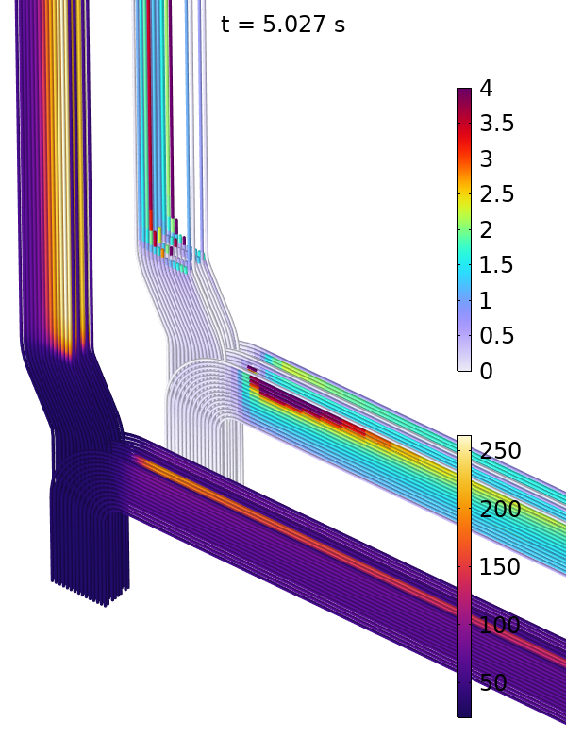
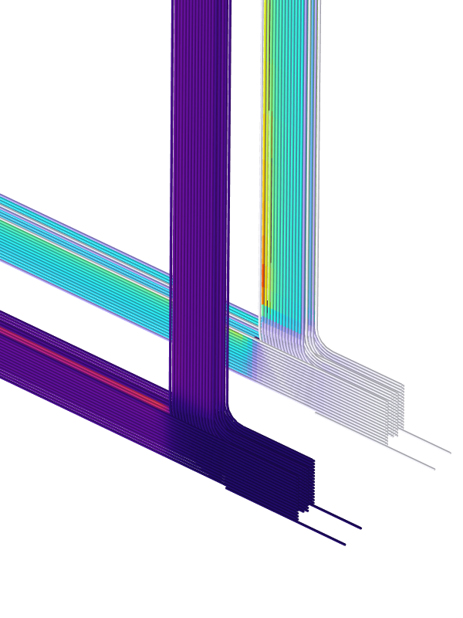
T(t)
$$I/I_{c}$$
$$T (K)$$
Notes:
Now some cables are above Tc.

Slide 26
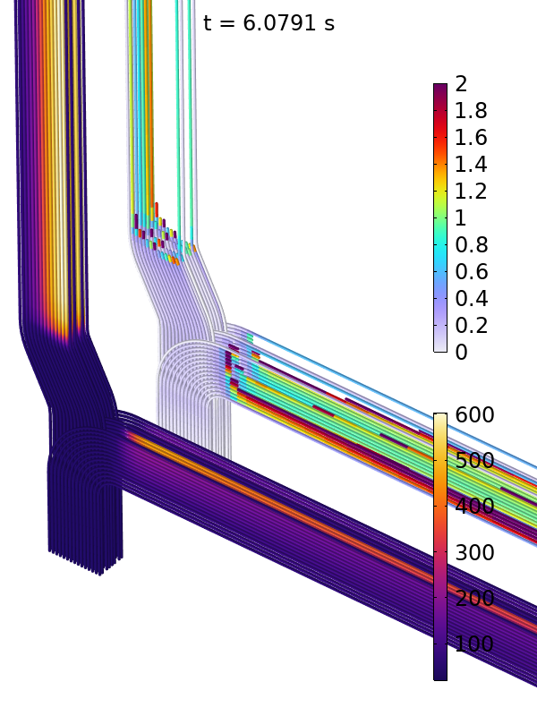
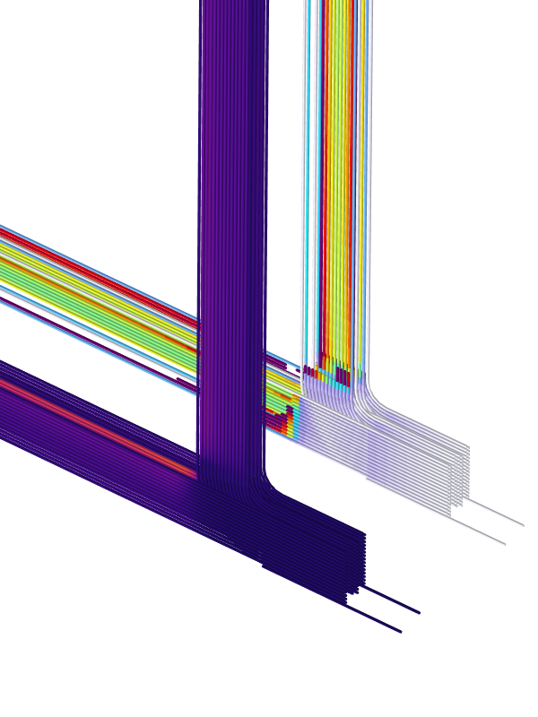
T(t)
$$I/I_{c}$$
$$T (K)$$
Notes:
More and more pieces of cable quench.
The early ones are the hottest.

Slide 27
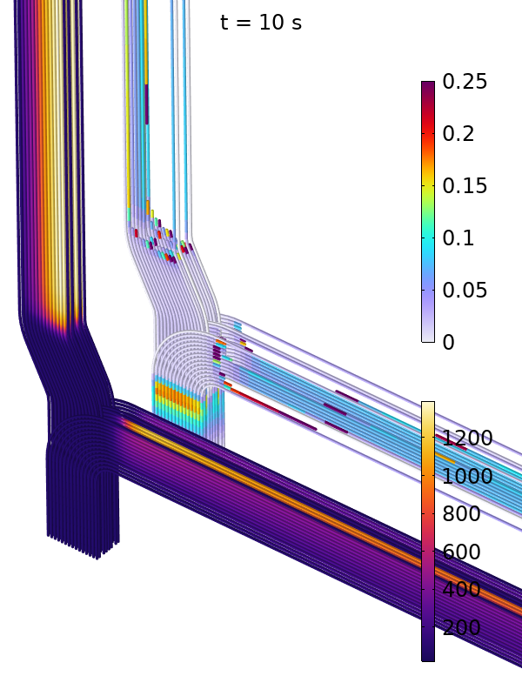
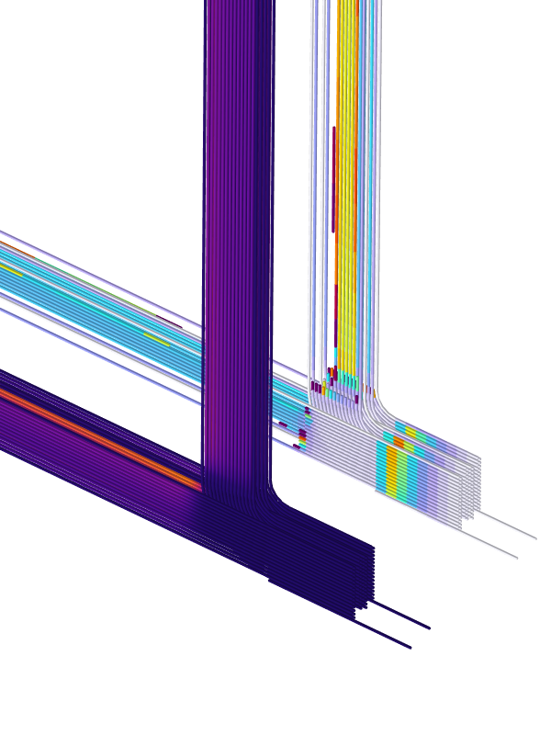
T(t)
$$I/I_{c}$$
$$T (K)$$
Notes:
This process goes further until all 30 GJ in the field is converted to thermal energy.

Slide 28
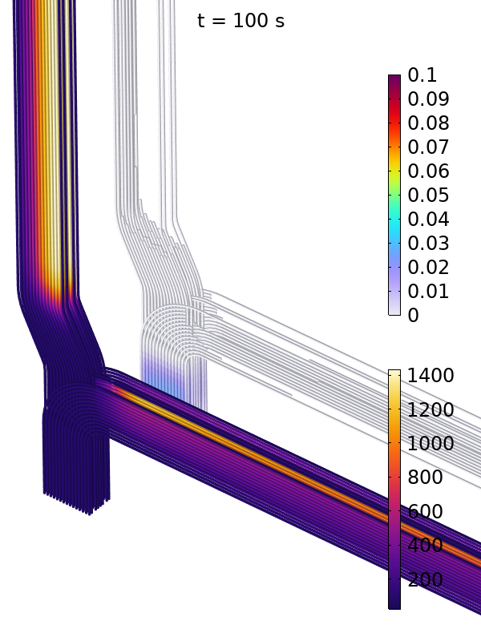
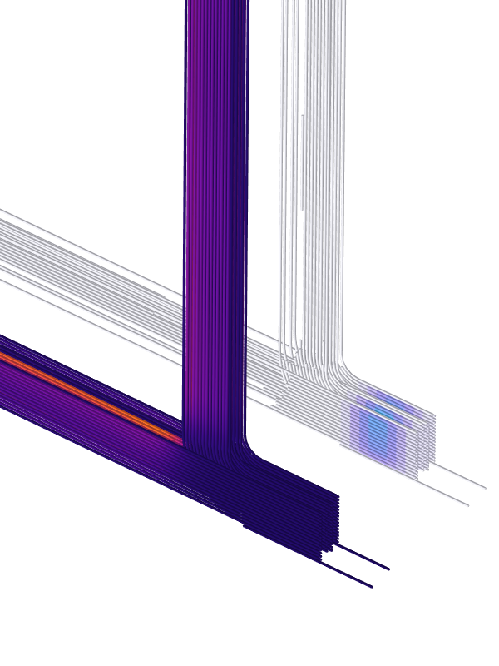
T(t)
$$I/I_{c}$$
$$T (K)$$
Notes:
And we reach some final temperature distribution in the end.

Slide 29
T(t)
Cables that self-heat earlier, run away to higher temperatures.
Heated by the current the cable is conducting.
Notes:
The main insight from this is: cables that heat up earlier, run away to higher temperatures.

Slide 30
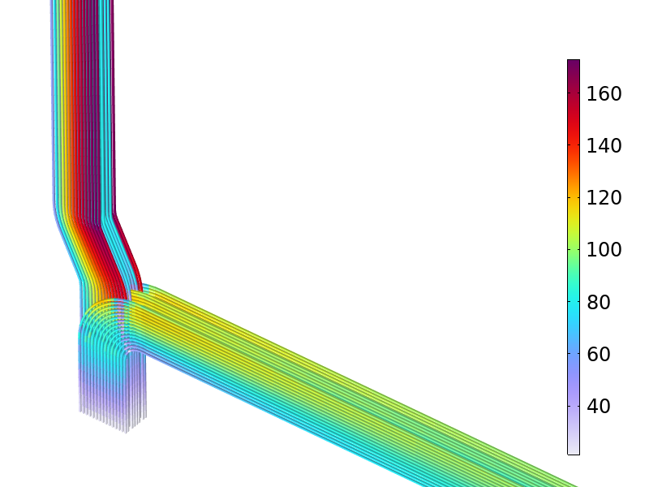
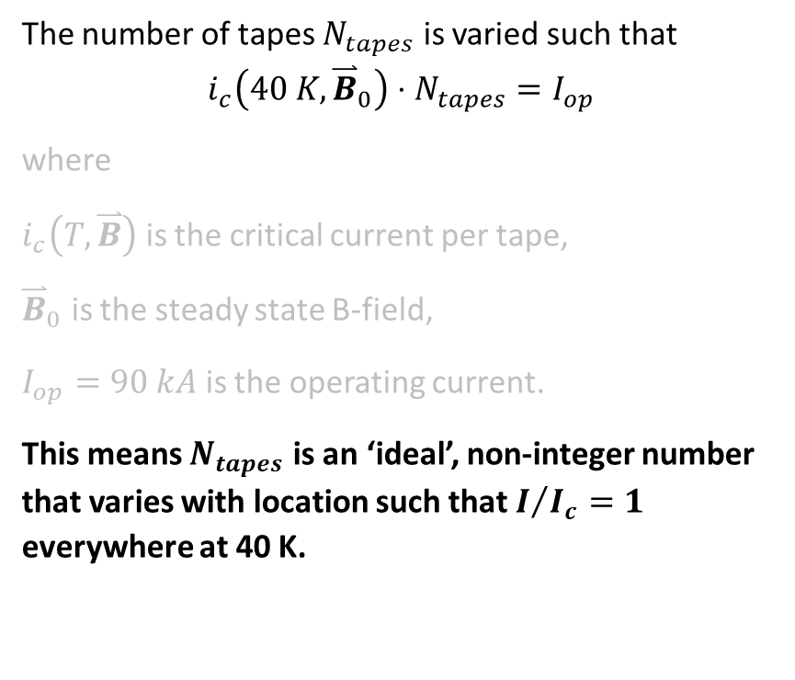

Grading
The number of tapes $N_{tapes}$ is varied such that
$$i_{c}\left(40 K, {\overset{⃑}{B}}_{0}\right)⋅N_{tapes}=I_{op}$$
where
$i_{c}\left(T,\overset{⃑}{B}\right)$ is the critical current per tape,
${\overset{⃑}{B}}_{0}$ is the steady state B-field,
$I_{op}=90 kA$ is the operating current.
This means $N_{tapes}$ is an ‘ideal’, non-integer number that varies with location such that $I/{I_{c}}=1$ everywhere at 40 K.
$$N_{tapes}$$
Notes:
We can try to align the moment that cables heat up by tuning the number of tapes in a cable.
We first do that according to this simple criterion.
It says: the critical current is equal to the operating current at 40 K.

Slide 31
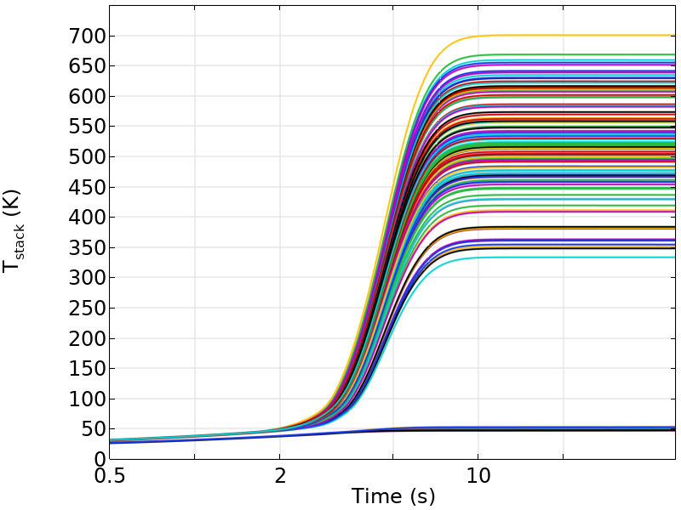
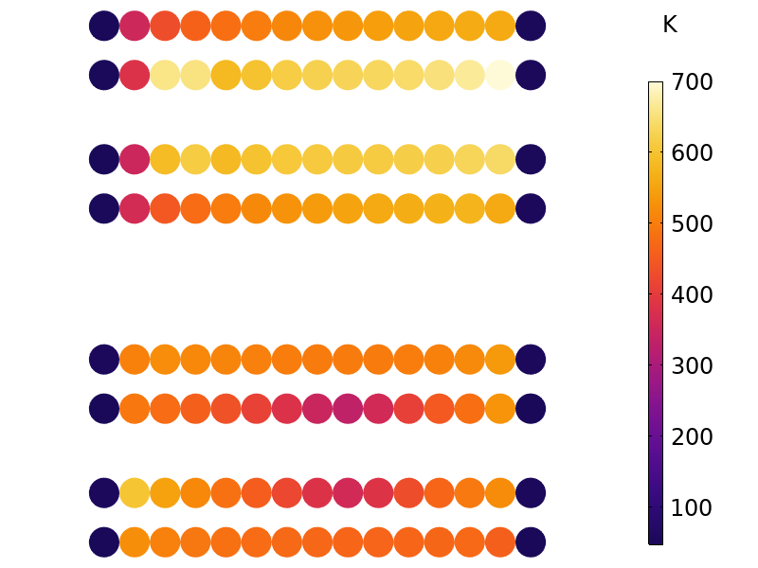
T(t)
Final T, central column
Final T, outer limb
Notes:
If we do the simulation again with this grading built in, we get much lower temperatures: the energy is better distributed over the coil.
But not good enough: we need to be below 500 K to prevent damage to the cables.

Slide 32
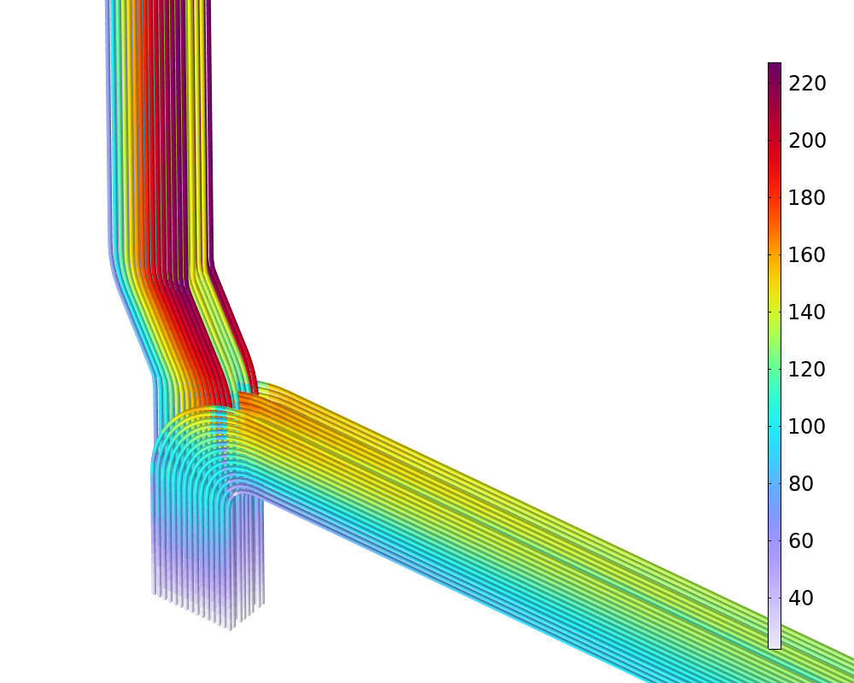
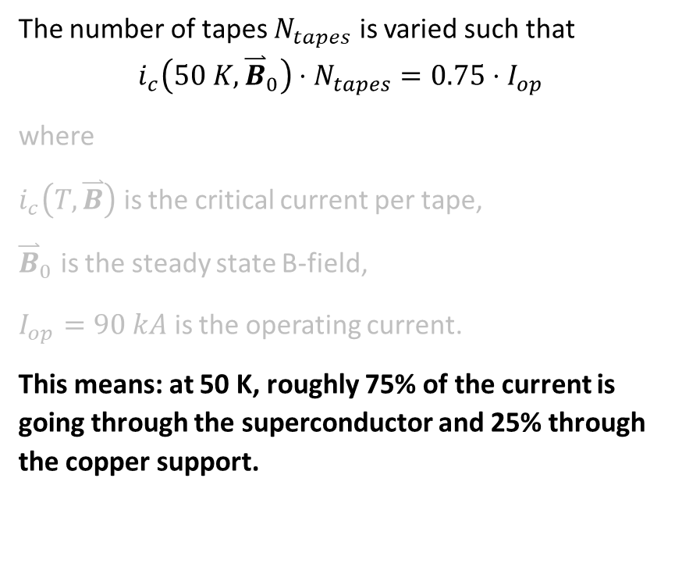
Better grading criterion?
The number of tapes $N_{tapes}$ is varied such that
$$i_{c}\left(50 K, {\overset{⃑}{B}}_{0}\right)⋅N_{tapes}=0.75⋅I_{op}$$
where
$i_{c}\left(T,\overset{⃑}{B}\right)$ is the critical current per tape,
${\overset{⃑}{B}}_{0}$ is the steady state B-field,
$I_{op}=90 kA$ is the operating current.
This means: at 50 K, roughly 75% of the current is going through the superconductor and 25% through the copper support.
$$N_{tapes}$$
Notes:
So we start with complicating the criterion just a little bit.
This means at 50 K, 75% of the current goes through the superconductor and 25% through the copper support.

Slide 33
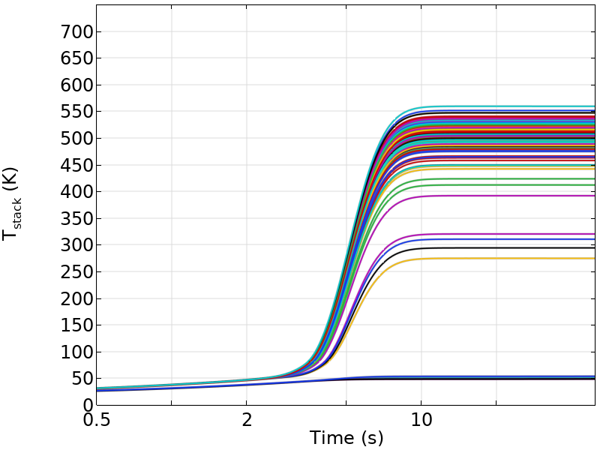
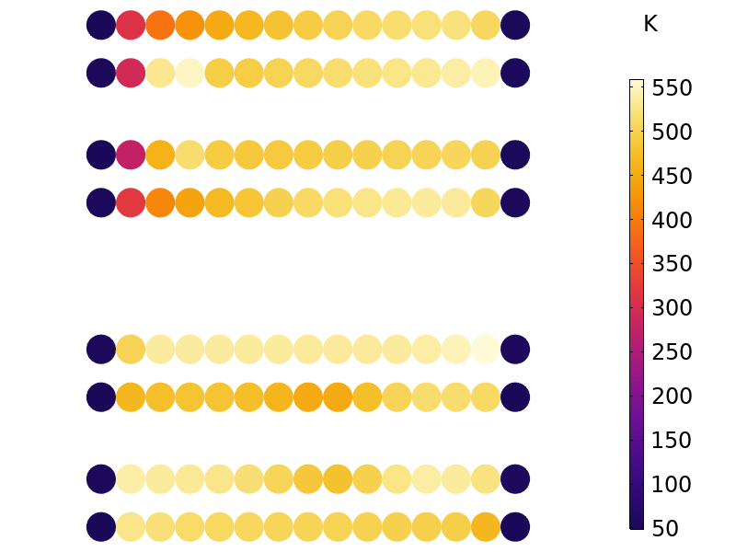
T(t)
Final T, central column
Final T, outer limb
Notes:
Now the final temperatures are closer to each other and the max is thus also lower.
The criterion can be optimised further, but you get the point: these simulations allow this optimization.

Slide 34
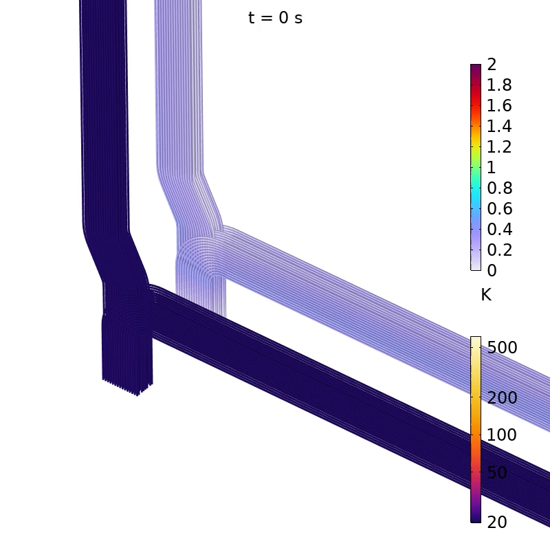
Conclusions
AVI formulation provides an efficient tool to optimize the design of large coils.
An optimized cable grading helps to equalize the final temperatures after discharge.
UKAEA is benchmarking this method using smaller test coils

