Slide 1

Current Status and Prospects of Liquid-Hydrogen-Cooled High-Temperature Superconducting
Rotating Machines
Kyoto University, Japan
Taketsune Nakamura

Slide 2
Table of contents
Background
2. Fundamentals of HTS Rotating Machines
3. HTS generator in LH2 Supply Chain
4. Aviation
5. LH2 Pump
6. Prospects
7. Summary

Slide 3
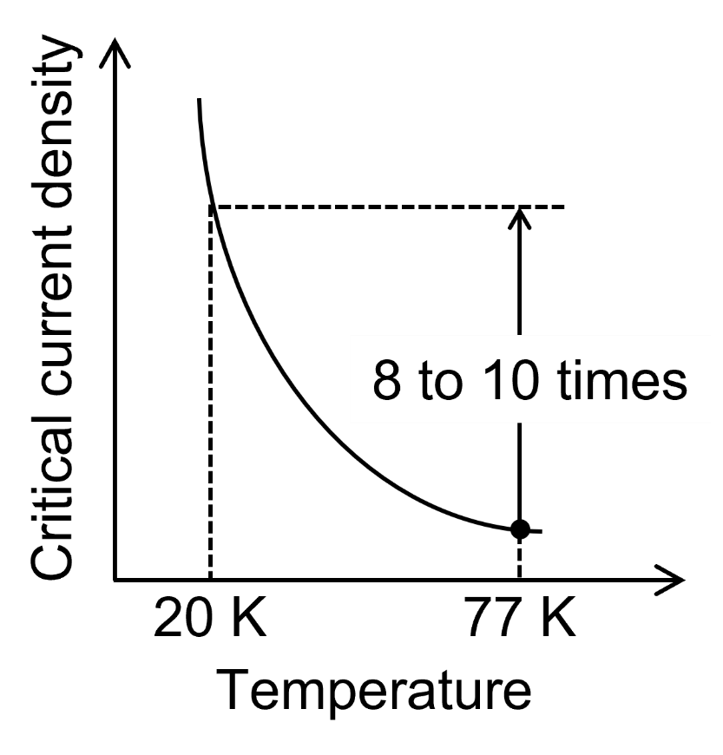
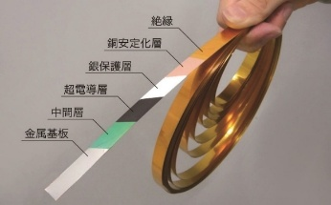
1. Background
Synergy between liquid hydrogen and HTS* motors
*HTS: High Temperature Superconductor
Fig. 1 Schematic diagram of critical current density vs. temperature
Notes:
図番号
図１の文字を大きく
図２いらない

Slide 4
1. Background
Synergy between liquid hydrogen and HTS motors
(Approach to Cooling)
٧ Cryocooler cooling: Need to consider cryocooler operation
٧ Liquid hydrogen cooling: Energy source as a cooling source
Critical current
LH2 as an
energy source
HTS
motor
Cooling capacity
Temperature
(a) Critical Current and Cryocooler COP
(b) LH2 cooled HTS motor
Fig. 2 Conceptual diagram of HTS motor cooling
4
Notes:
液体水素カローラ これちがう
後文字の大きさが小さい

Slide 5

1. Background
Challenges in Developing Liquid-Hydrogen-Cooled HTS Motors
Avoiding wasteful boil-off of liquid hydrogen used as an energy source
(Latent heat of vaporization: approx. 445 kJ/kg)
GH2
20 MW-class HTS motor with 99.0% efficiency
LH2
→ Power loss: 200 kW
Fig. 3 An image of liquid hydrogen evaporating
→ 1 kg of liquid hydrogen completely vaporizes
in approximately 2.2 seconds.
→ It is crucial to strive to bring HTS motor efficiency closer to 100%
i.e., the problem of maximizing the value of 'X’
in an efficiency of 99.X%

Slide 6
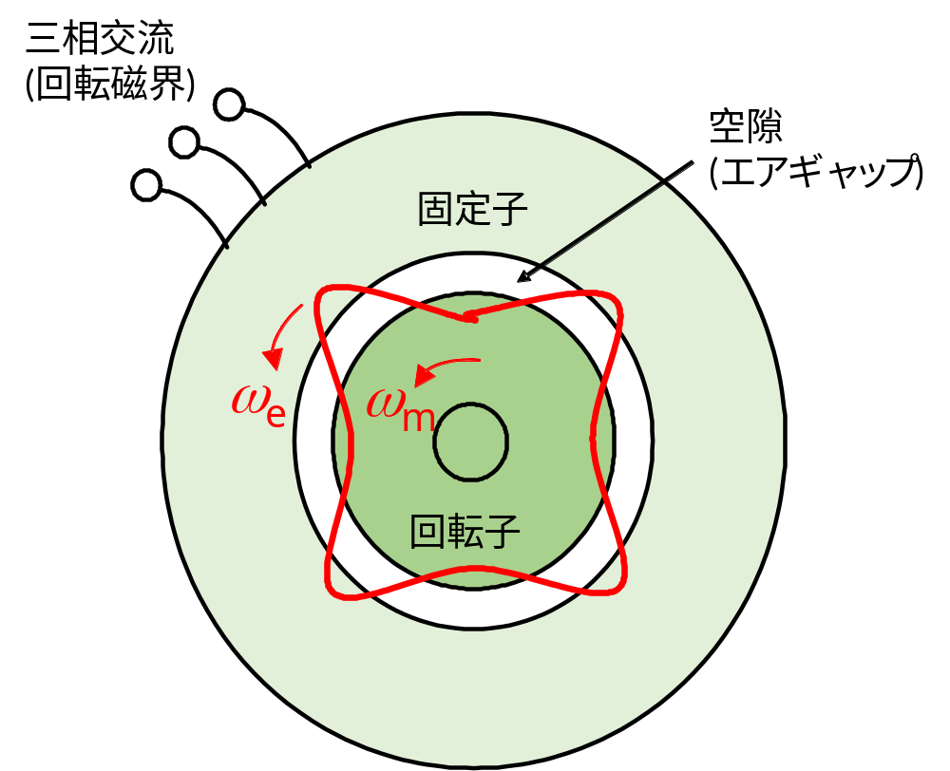
2. Fundamentals of HTS Rotating Machines
Fundamentals of 3-phase AC motors
3φ input
Air-gap
Stator
Rotor
Fig. 4 Rotating magnetic field in a rotating machine

Slide 7
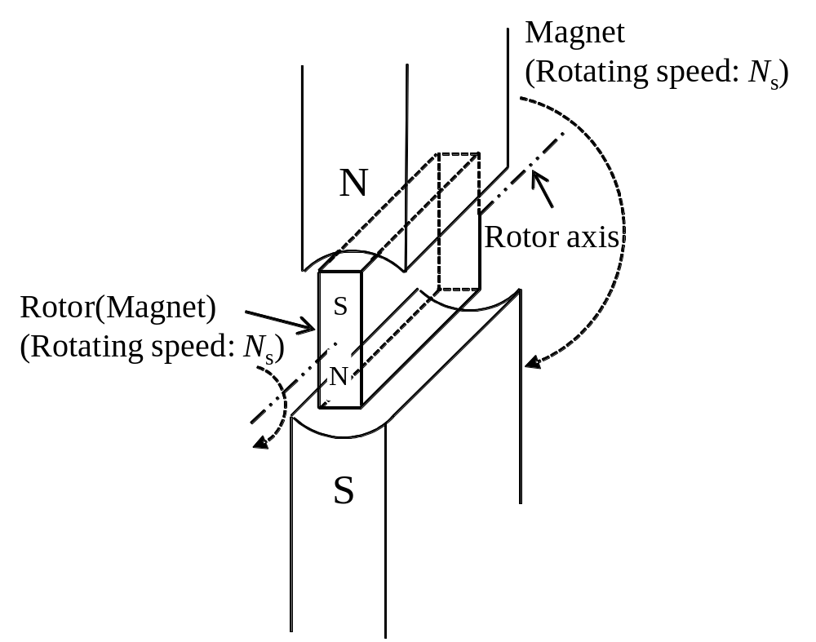
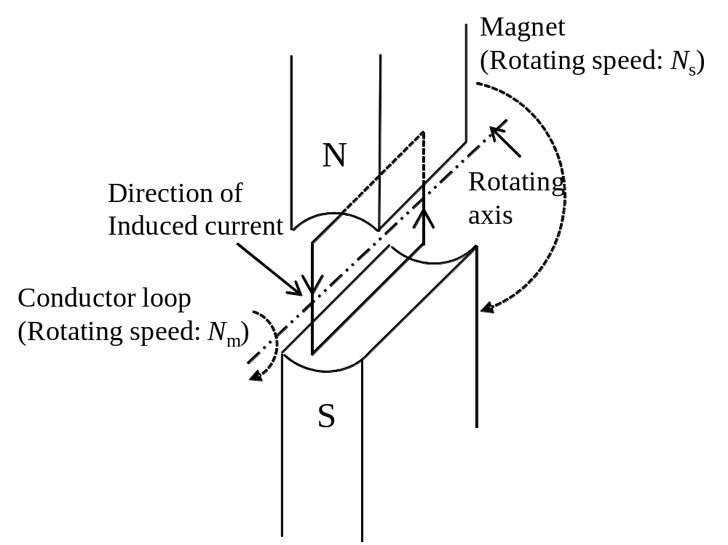
2. Fundamentals of HTS Rotating Machines
Fundamentals of 3-phase AC motors
Slip s= (N_{s}-N_{m})/N_{s}
Synchronous machine
(N_{m}=N_{s}, s= 0)
(b) Induction machine
(N_{m}=N_{s} , 0<s<1 for motor)
Fig. 5 Schematic explanation of typical AC machines [1]
[1] T. Nakamura, OYOBUTURI, 82(7) (2013) 579

Slide 8
2. Fundamentals of HTS Rotating Machines
HTS synchronous motors
1. Normal conducting armature and HTS DC field winding
No AC loss in the HTS coils (when the harmonics of the air-gap rotating magnetic flux can be neglected)
2. Fully HTS type
The ultimate challenge in reducing winding losses
→ Challenge of minimizing AC losses in HTS armature windings
→ Challenge of three-phase current imbalance associated with non-linear resistance
3. HTS armature and permanent magnets rotor
No slip rings
→ Challenge of three-phase current imbalance same as fully HTS type
Fig. 6 Schematic explanation
of HTS synchronous motor

Slide 9
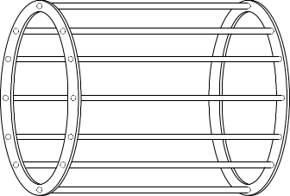
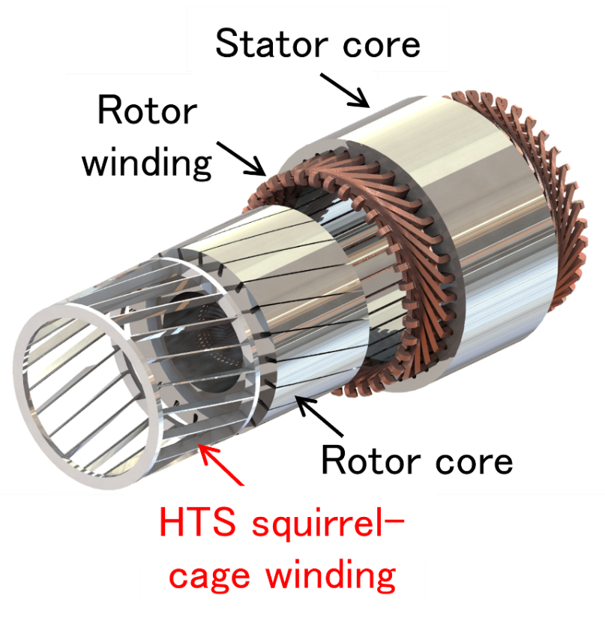
2. Fundamentals of HTS Rotating Machines
HTS induction motors
HTS-rotor bar
Normal conducting armature
and HTS squirrel-cage winding
٧ Achievement of synchronous rotation through magnetic flux trapping in a squirrel-cage winding
٧ Stable rotation against variable speed operation
٧ Availability of non-superconducting operation by using HTS/normal conductor hybrid winding
HTS end-ring
N
S
N
S
Fig. 7 Schematic explanation
of HTS induction motor

Slide 10
2. Fundamentals of HTS Rotating Machines
Development status of HTS motors
Synchronous-type : normal conducting armature and HTS field winding
Ship: AMSC (USA), Siemens (Germany), Southampton U. (UK),
KAWASAKI Heavy Industries et al. (Japan, Ship),
Doosan /Changwon National U. (Korea)
Aviation: Hinetics (USA), Toshiba (Japan), Victoria U. of Wellington (NZ)
Generator for wind energy and Aviation: U. of Edinburgh (UK), KIT (Germany)
Synchronous-type : fully HTS type
Aviation: Kyushu U.&AIST (Japan), U. of Strathclyde (UK)
Synchronous-type : HTS armature and permanent magnets rotor
Bus: Sumitomo Electric Industries (Japan)
Aviation: Airbus UpNext (France)
Induction-type
Bus, Ship, Aviation: Kyoto U./IMRA MATERIAL (Japan)
LH2 pump: Torishima Pump Manufacturing & Kyoto U. (Japan)
TOYOTA & Kyoto U. (Japan)

Slide 11
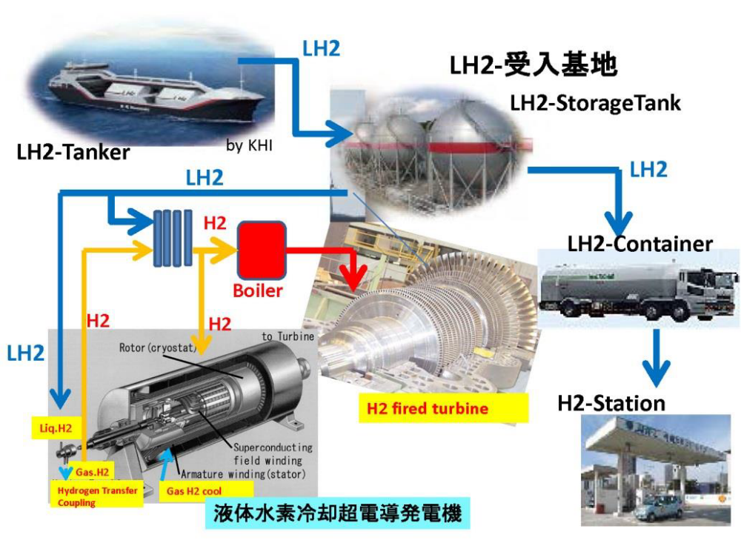
3. HTS generator in LH2 Supply Chain
HTS turbine generator (Prof. Shirai @ Kyoto U.)
H2 cooled
superconductor generator
Fig. 8 Conceptual diagram of liquid hydrogen supply chain and hydrogen cooled superconductor generator [2]
[2] http://www.smart.Kyoto-u.ac.jp/ja/images/activityrecords/presentation/shirai_20160511_presen.pdf

Slide 12
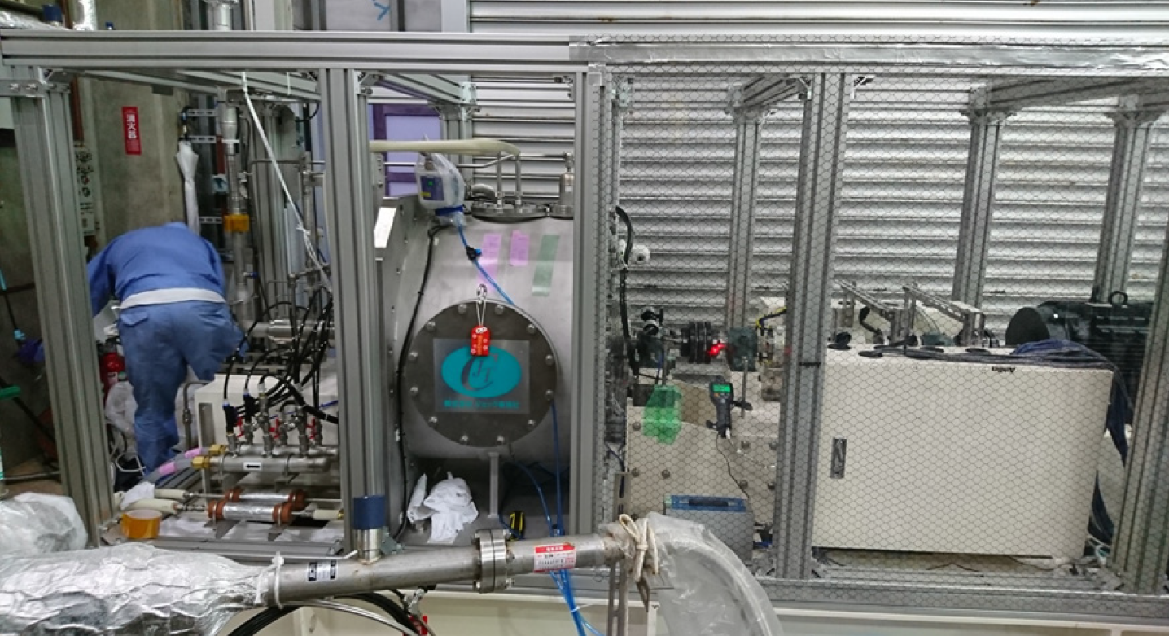
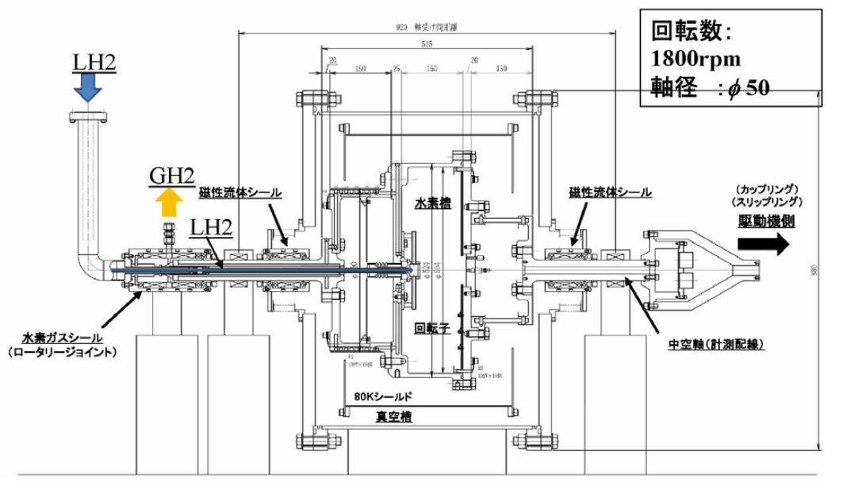
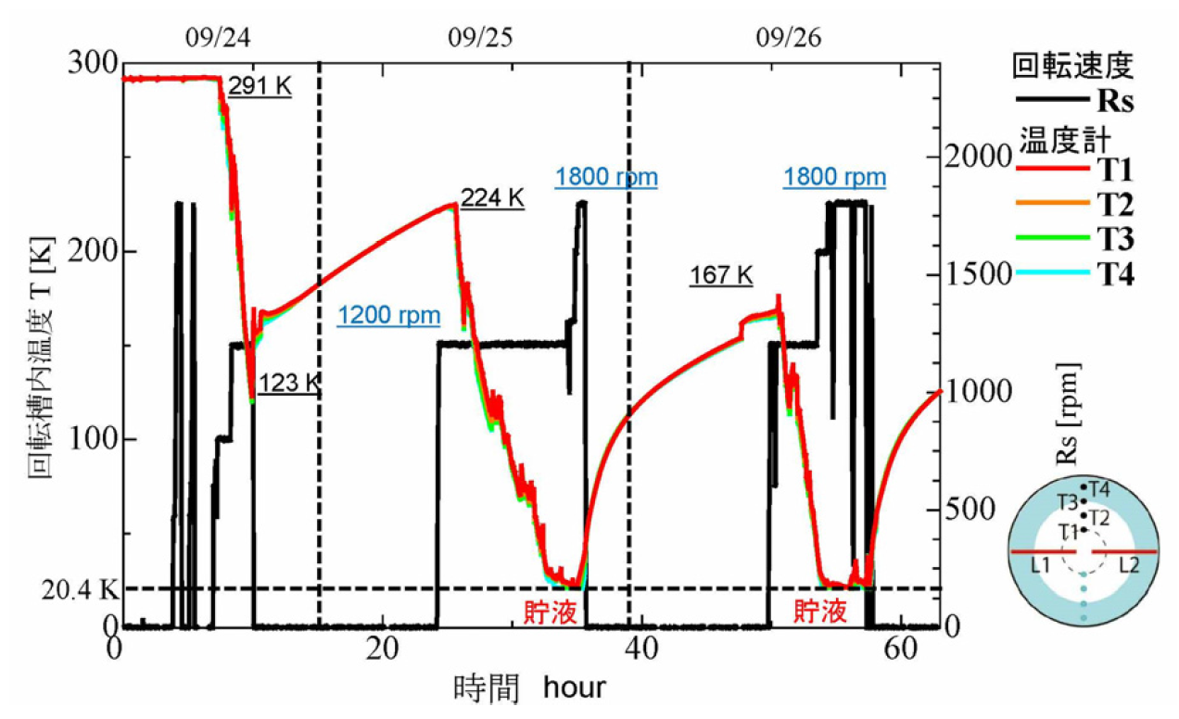
3. HTS generator in LH2 Supply Chain
HTS turbine generator (Prof. Shirai @ Kyoto U.)
Cooling test of simulated rotor.
HTS rotating machine not developed.
(b) Exam Scene
(a) Side section view
(c) Cooling characteristics
Fig. 9 Test system of a LH2 cooled rotor [3]
[3] Y. Shirai, et al., TEION KOGAKU, 55(1) (2020) 44-52 (in Japanese)

Slide 13
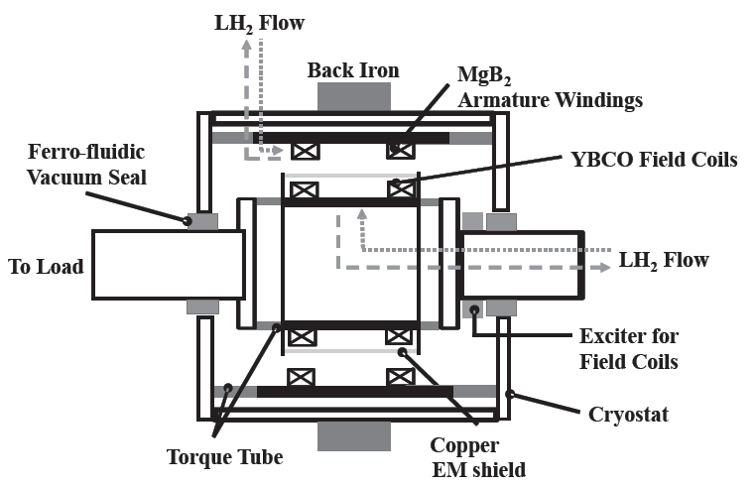
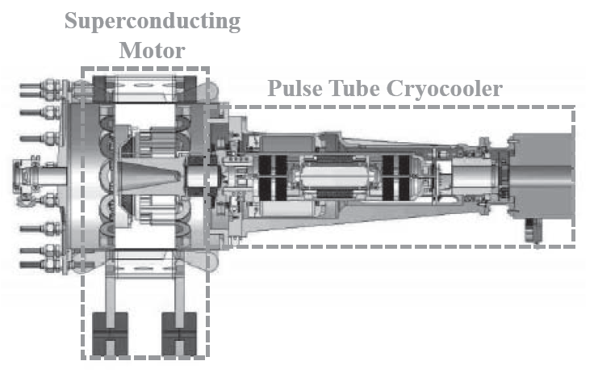
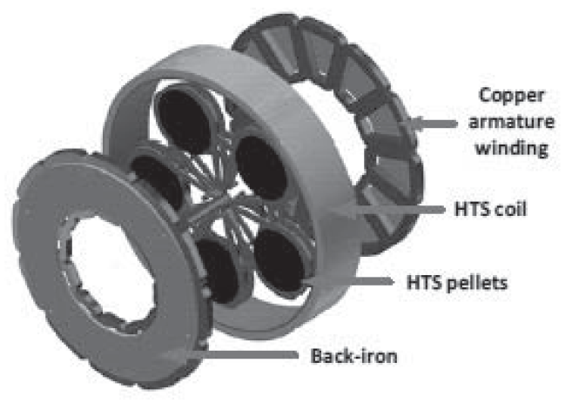
4. Aviation
Concept and fundamental studies
Concept proposed
Analysis and review
NASA
(Partial superconducting)
(b) University of Tokyo
(All superconducting)
Prototyping & testing conducted
(c) University of Lorraine (Partial superconducting)
Fig. 10 Examples of Fundamental Research on Superconducting Motors for Aircraft [4]
[4] Y. Terao, et al., TEION KOGAKU (J. Cryo. Super. Soc. Jpn.), 57(2) (2022) 71-78

Slide 14
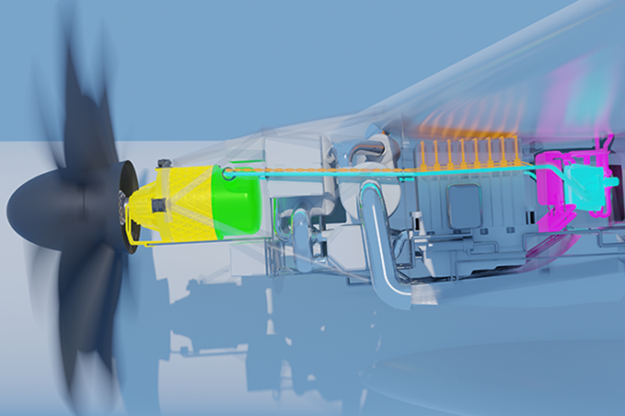
4. Aviation
Hydrogen-powered aircraft (Airbus UpNext): Cryoprop
Operation of a 2 MW-class superconducting motor cooled by liquid hydrogen via a helium circulation loop.
(Motor type: HTS armature and permanent magnets rotor)
Fig. 11 Sectional drawing of the Cryoprop demonstrator [5]
[5] Airbus website: https://www.airbus.com/en/newsroom/press-releases/2024-05-airbus-takes-superconductivity-research-for-hydrogen-powered
14
Notes:
液体水素のカローラ
極低温があるので超伝導に期待

Slide 15
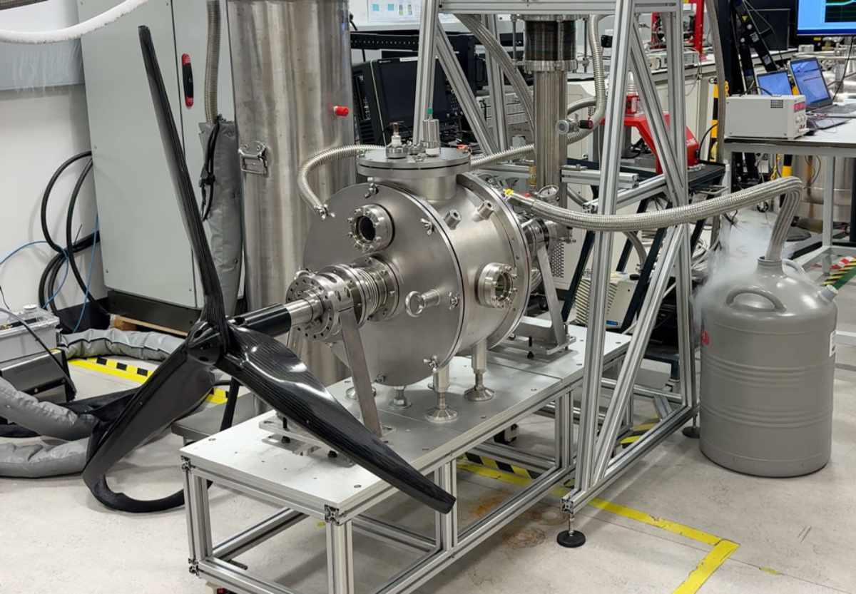
4. Aviation
University of Strathclyde (Prof. Min Zhang)
Successful rotation testing of a 100 kW fully superconducting axial-flux aviation motor
: Disc-type, Brushless excitation
Fig. 12 Photograph of 100kW fully superconducting axial-flux aviation motor [6]
[6] University of Strathclyde website: https://www.strath.ac.uk/whystrathclyde/news/2026/cryoengine/

Slide 16
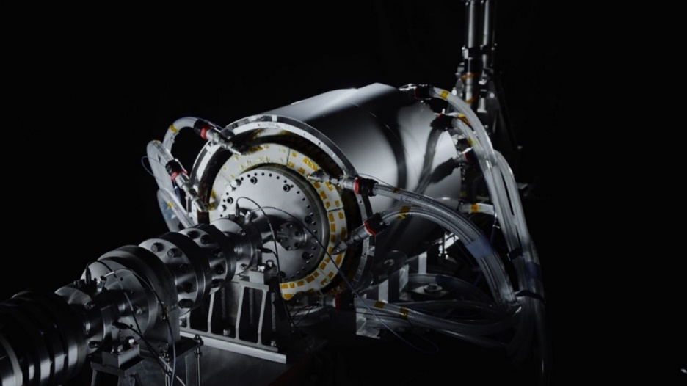
4. Aviation
Toshiba Energy Systems & Solutions Corporation
First prototype: 5.3 kW/kg
Second prototype (currently under development): 7.0 kW/kg (estimated)
: Cooling mechanism using gaseous helium circulation,
Conduction cooling of HTS coils from its shaft
Fig. 13 Toshiba Energy Systems & Solutions Corporation’s 2 MW-Class
High-Temperature Superconducting Motor [7]
[7] https://www.global.toshiba/jp/news/energy/2022/06/news-20220623-01.html

Slide 17
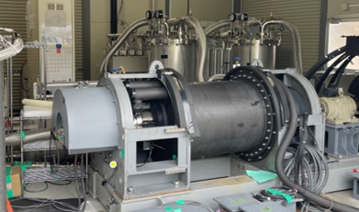
4. Aviation
Kyushu University and other members of the Industry-
Government-Academia collaboration group,
400 kW-Class fully HTS motor : Rotational test at 460 rpm
: Conducted output testing as a generator
Fig. 14 Kyushu University / AIST and Other Group’s 400 kW-Class fully HTS Motor [8]
[8] https://www.Kyushu-u.ac.jp/ja/notices/view/2475

Slide 18
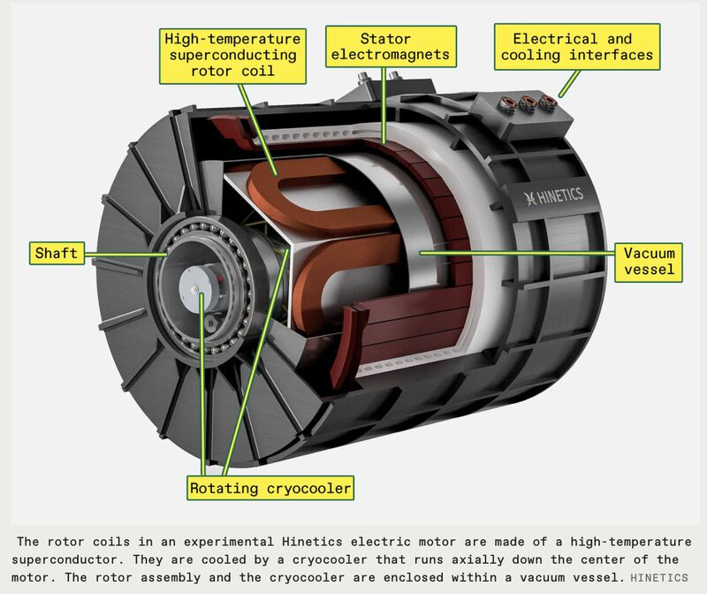
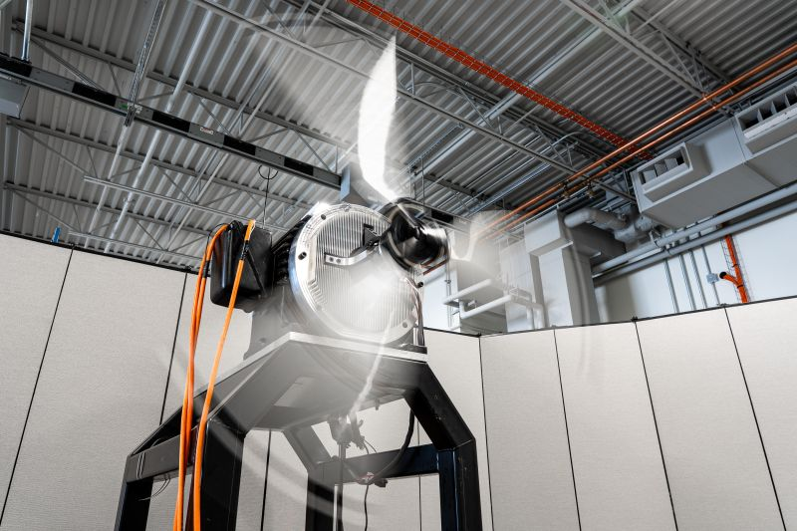
4. Aviation
Hinetics & U. of Illinois (Prof. Kiruba S. Haran)
Propeller testing at 5 MW and 10 MW outputs
→ Achieved 10 kW/kg (future target: 40kW/kg)
Achieved efficiency of 98-99.5% [9]
Fig. 15 Hinetics’ Multi-MW class Field-Winding High-Temperature Superconducting Synchronous Motor [9]
[9] https://innovatopia.jp/energy/energy-news/58875/
Notes:
タイトル 高温をつける

Slide 19
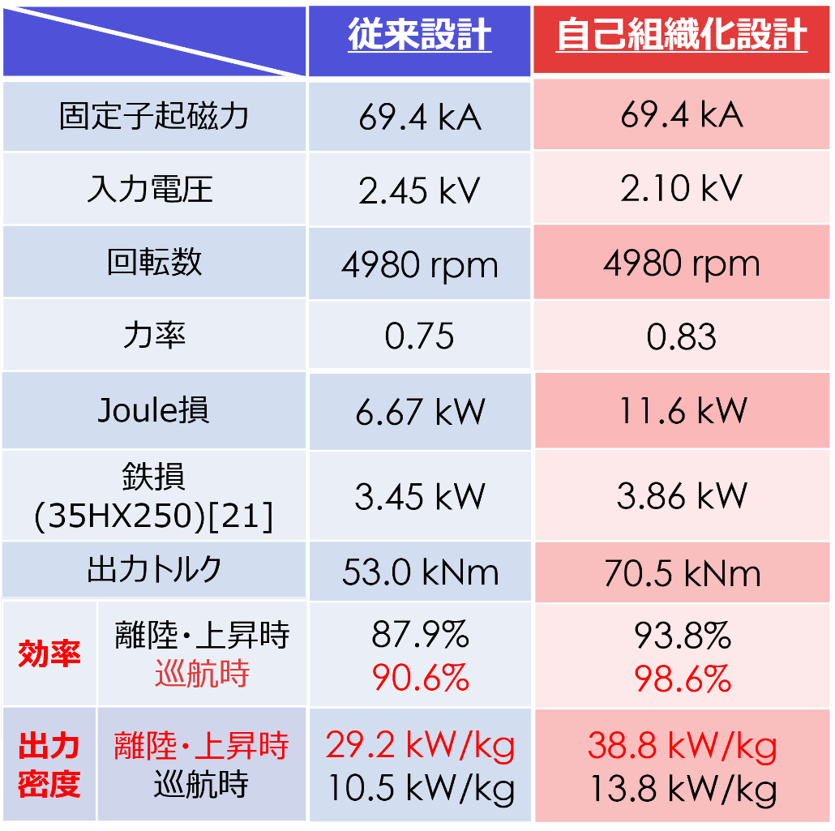
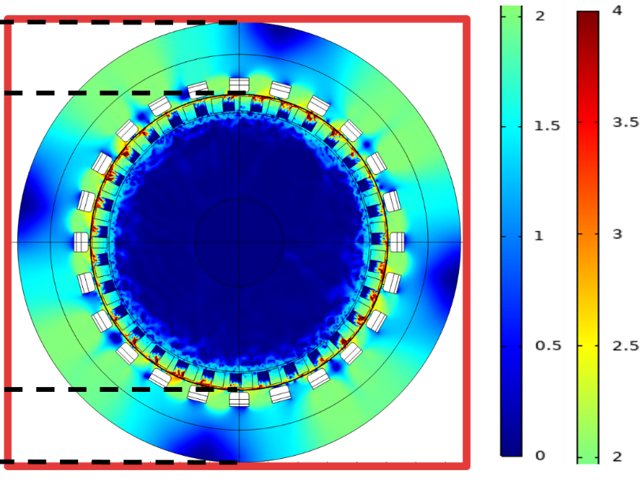
4. Aviation
Kyoto University&National Institute for Fusion Science (NIFS)
JST project (Japan, from Oct. 1, 2026)
: Design of a 20 MW HTS induction
motor with self-assembling method [10]
Table I Electromagnetic Field Analysis Results for a 20 MW-Class Motor [11]
Conventional
design
Self-organizing
design
Stator magneto-motive force
Input voltage
Rotational speed
Power factor
Joule loss
Iron loss
Fig. 16 Magnetic flux density contour
for a 20 MW-class machine [11]
Output torque
Effici
ency
Takeoff
/ascent
Cruise
[10] T. Nakamura, et al., IEEJ Trans. Elec. Elector.
Eng., 20(4) (2024) 579-588
[11] M. Yamamoto, et al., Physica C, 628 (2025)
1354690
Power
density
Takeoff
/ascent
Cruise

Slide 20
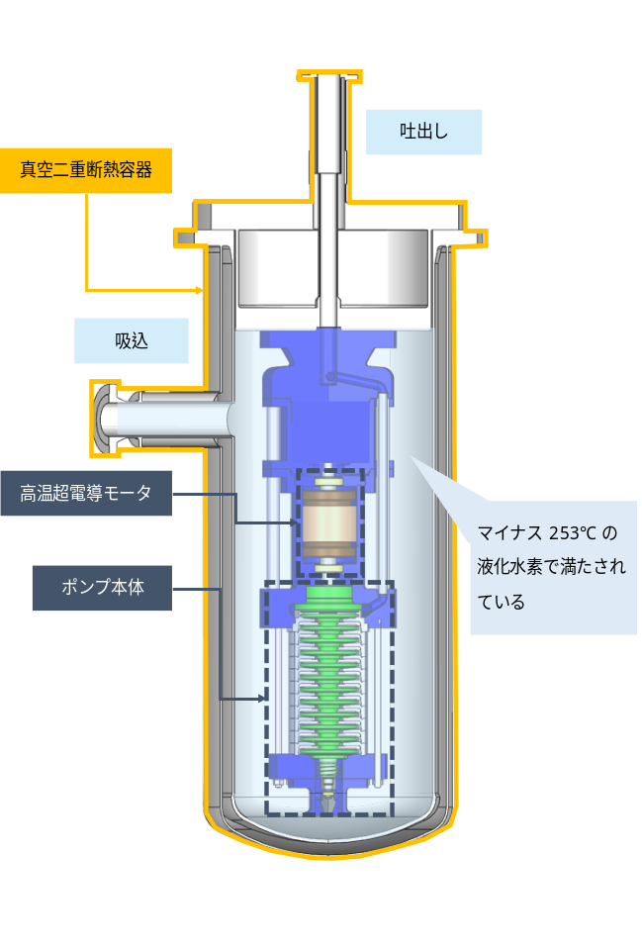
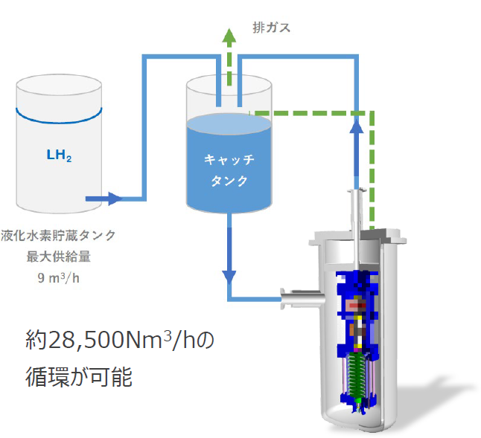
5. LH2 Pump
Torishima Pump Mfg. Co., Ltd. & Kyoto University
Outlet
LH2 storage
tank
Exhaust gas
Vacuum
insulated
container
Inlet
Catch tank
HTS motor
It is filled
with LH2.
Pump body
(a) Schematic figure
(b) Liquefied hydrogen circulation test system
Fig. 17 Overview of liquefied hydrogen HTS submerged pump system [12]
[12] N. Masuda, et al., ISCM2025 (2025)

Slide 21
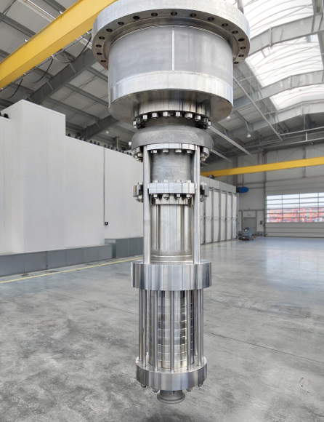
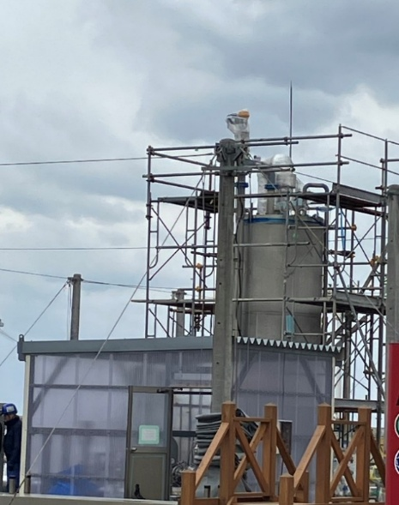
5. LH2 Pump
Torishima Pump Mfg. Co., Ltd. & Kyoto University
LH2 submerged pump for hydrogen energy supply chains
: NEDO national project (Japan)
Pump power: 30 kW (5,000 rpm)
Flow rate: 30.5 m²/h
Pressure: 1.6 Mpa
HTS motor’s efficiency > 99%
HTS-ISM
Centrifugal
pump
(a) Main unit
(b) Test facility
[13] Torishima website: https://www.torishima.co.jp/en/product/energy-pumps/liquid-hydrogen-pump/
Fig. 18 Photographs of Torishima / Kyoto U LH2 submerged pump [13]

Slide 22
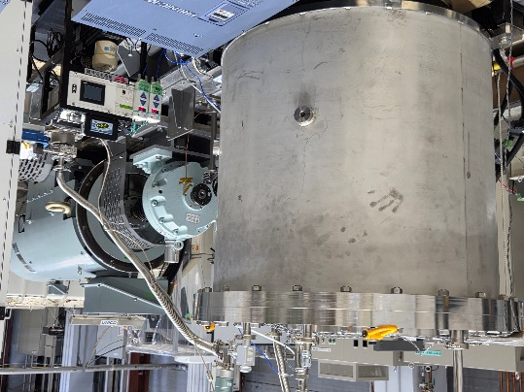

5. LH2 Pump
Torishima Pump Mfg. Co., Ltd. & Kyoto University
(NEDO national project)
Torishima Pump Manufacturing, Kyoto University,
Sanyo-Onoda City University, National Institute for Materials Science
→Testing of a 130 kW-class unit (8,000 rpm) is currently underway.
; Efficiency exceeds 99%
Fig. 19 Gas He cooled test bench for a 130 kW class HTS-ISM

Slide 23
5. LH2 Pump
Torishima Pump Mfg. Co., Ltd. & Kyoto University
Synergy between liquid hydrogen and HTS motors
LH2 submerged pump for hydrogen energy supply chains: NEDO
Realization of societal implementation
*Order for six units from Kawasaki Heavy Industries, Ltd.
Table II Specifications for the superconducting liquefied hydrogen pumps ordered by Torishima Pump Mfg. Co., Ltd. [14]
Pump Name | Liquid hydrogen booster pump | Liquefied hydrogen cargo pump
Number of units | 5 | 1
flow rate | ～51.8 m³/h | 700 m³/h
Total lifting head | ～2,400 m | 510 m
Rotation speed | ～5,300 rpm | 3,350 rpm
Motor Output | 50 kW | 105 kW
[14] Torishima website: https://www.torishima.co.jp/upload/news/20260127a_en.pdf
23

Slide 24

5. LH2 Pump
TOYOTA & Kyoto University
HTS liquid hydrogen pump for hydrogen engine car
Fig. 20 Overview of a hydrogen-engine vehicle equipped with a liquefied hydrogen tank [15]
[15] Provided by Toyota Motor Corporation GR

Slide 25
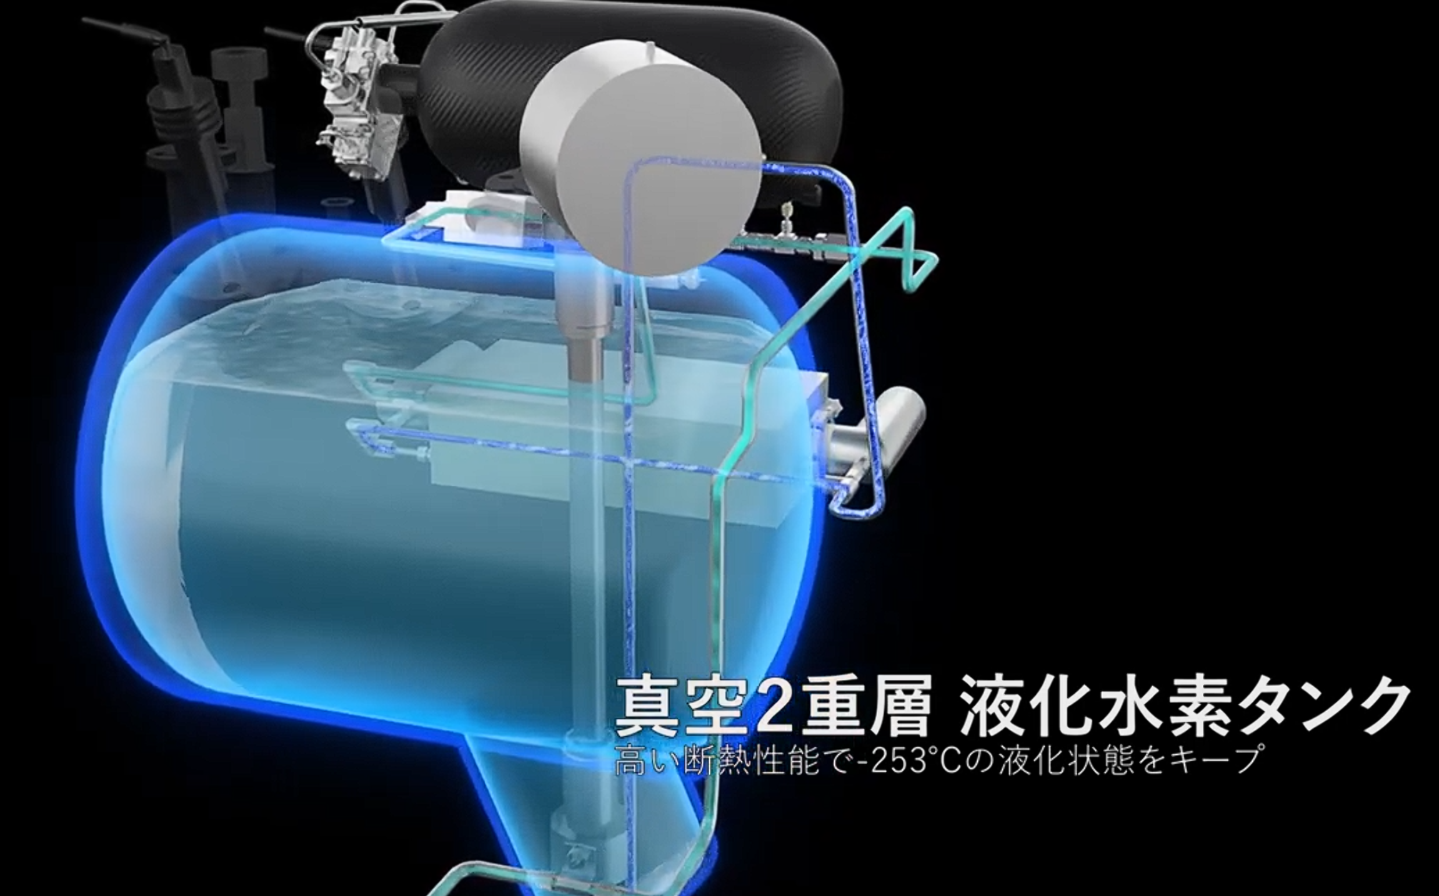
5. LH2 Pump
TOYOTA & Kyoto University
Liquid hydrogen pump with a normal conducting PM motor
: Occupation of the tank top by a heavy motor
: Heat intrusion and explosion risk at the seal interface with the tank
Normal conducting
PM motor
Reciprocating
pump
Liquid hydrogen tank
Fig. 21 Hydrogen engine with conventional liquid hydrogen tank [16]
[16] https://www.youtube.com/watch?v=mB6-bOjFg94

Slide 26
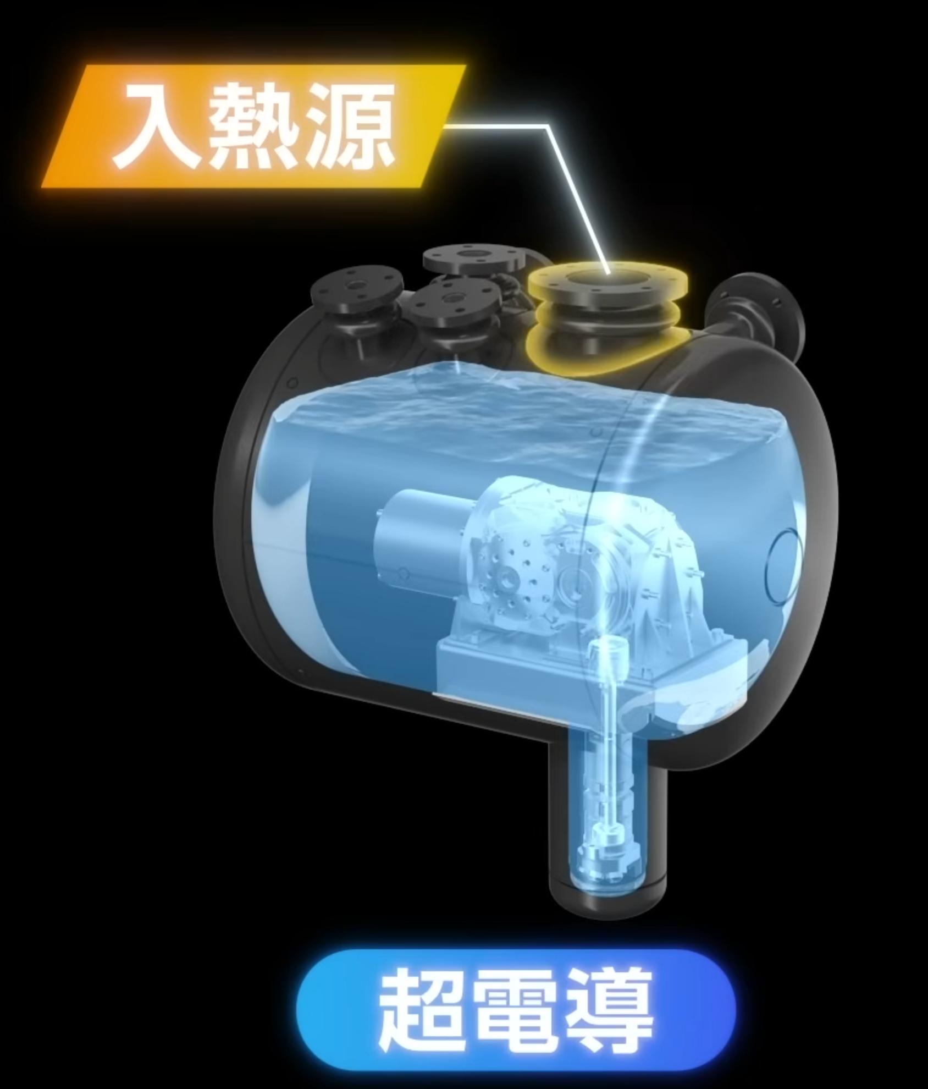
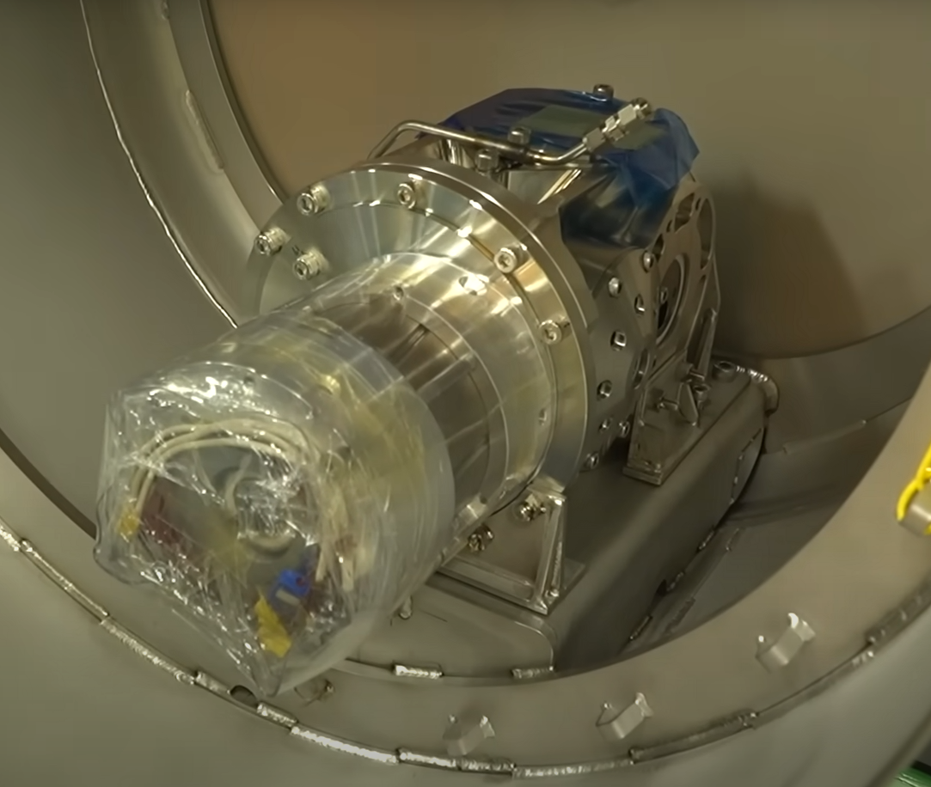
5. LH2 Pump
TOYOTA & Kyoto University
Liquid hydrogen pump with an HTS induction motor
: No risk associated with space occupancy or explosion.
: Requirement for over 99% efficiency to prevent boil-off of LH2
Several-kW HTS induction motor
Several-kW HTS induction motor
Reciprocating pump
Fig. 22 Liquid hydrogen submerged system with an HTS induction motor [16]
[16] https://www.youtube.com/watch?v=mB6-bOjFg94

Slide 27

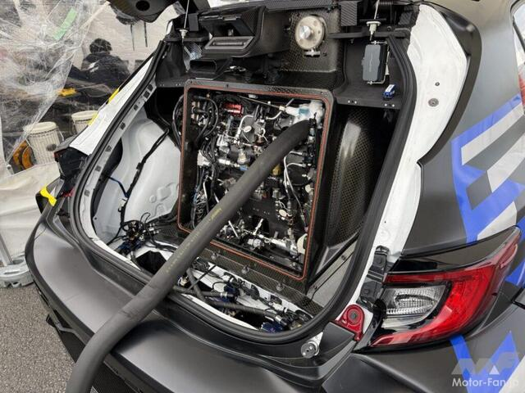
5. LH2 Pump
TOYOTA & Kyoto University
Installation in a hydrogen-engine Corolla for racing
Fig. 23 GR Corolla (liquid hydrogen Corolla) equipped with HTS induction motor [16]
[16] https://www.youtube.com/watch?v=mB6-bOjFg94
27
Notes:
図はいらない
なにをしたかを箇条書きで書く

Slide 28

5. LH2 Pump
TOYOTA & Kyoto University
Nov. 15, 2025: Successful demonstration run of a hydrogen-engine Corolla equipped with an HTS liquid-hydrogen pump
Fig. 24 A hydrogen-engine Corolla equipped with a HTS liquid-hydrogen pump during a demonstration run for the press at Fuji Speedway (video; filmed by Yuta Tomikawa, Toyota Times)

Slide 29

5. LH2 Pump
TOYOTA & Kyoto University
Jun. 6-7, 2026: Completed the 24-hour endurance race (Fuji Speed Way).
; An inverter failure occurred during the race, but the HTS induction motor
showed no issues.
Fig. 25 A view of the liquid hydrogen refueling pit for the hydrogen-engine Corolla equipped with an HTS-ISM reciprocating pump (June 6-7, 2026).

Slide 30
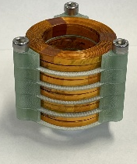
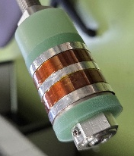
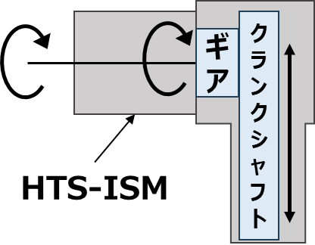
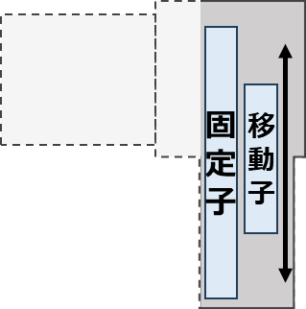
5. LH2 Pump
TOYOTA & Kyoto University
Next target: HTS linear induction motor system (direct drive)
: Elimination of the mechanical components subject to the most severe
wear in liquid hydrogen systems
Transmission
mechanism
Gear
Crankshaft
Stator
Mover
HTS rotary induction motor
HTS linear
Induction
motor
(a) HTS rotary motor drive
(b) HTS linear motor drive
Fig. 26 Schematic diagram of an HTS reciprocating mechanism.

Slide 31
6. Prospects
Examples of major projects utilizing liquid hydrogen
HySTRA/HESC (Japan-Australia Liquefied Hydrogen Supply Chain)
In 2022, the world’s first demonstration of the international maritime transport of liquefied hydrogen was succeeded.
2. Large-scale liquefied hydrogen hub in the Kawasaki coastal area (Japan)
They are currently developing infrastructure for the receipt, storage, and supply of liquefied hydrogen.
3. Port of Rotterdam project (Netherlands)
This is one of Europe’s largest hydrogen hub initiatives, involving the development of hydrogen import terminals and a transport network.
4. LH2 Europe Project
A liquid hydrogen supply chain originating in Europe is being planned.
5. Others: Port of Hamburg project (Germany), etc.

Slide 32
6. Prospects
Synergistic effect of HTS rotating machines and liquid hydrogen
(Challenges in Cooling Methods)
1. Conduction cooling
2. Helium or other gas cooling
3. Immersion cooling
(HTS motor)
٧ To minimize LH2 boil-off to almost zero, an efficiency of 99% or higher is required.
٧ Maximizing power density is required to minimize the space within the cryogenic container as much as possible.
(Liquid hydrogen)
٧ Transport and storage in a cryogenic liquid state are being considered as possibilities.
٧ To reduce energy costs, it is necessary to minimize unnecessary boil-off.
HTS
motor
LH2 as an
energy source

Slide 33
7. Summary
In this presentation, the potential of HTS motors cooled by liquid hydrogen (LH2) were discussed, focusing on the synergy between HTS motors and LH2.
First, an overview of the fundamentals and types of HTS motors, along with examples of R&D efforts worldwide were introduced.
Next, the status of R&D in specific applications, including generators for hydrogen supply chains, aircraft, and liquid hydrogen pumps were introduced and discussed.
Demand for liquid-hydrogen-cooled HTS rotating machines is expected to grow significantly in the future. We should pay tribute to all the researchers who have dedicated themselves to the development of these machines, and work together in a unified effort to ensure they become a leading example of the practical application of superconducting technology.
Acknowledgments
This work was partly supported by the New Energy and Industrial Technology Development Organization (NEDO) (Project code: P23004).
33

Slide 34
Thank you for your attention

