Slide 1
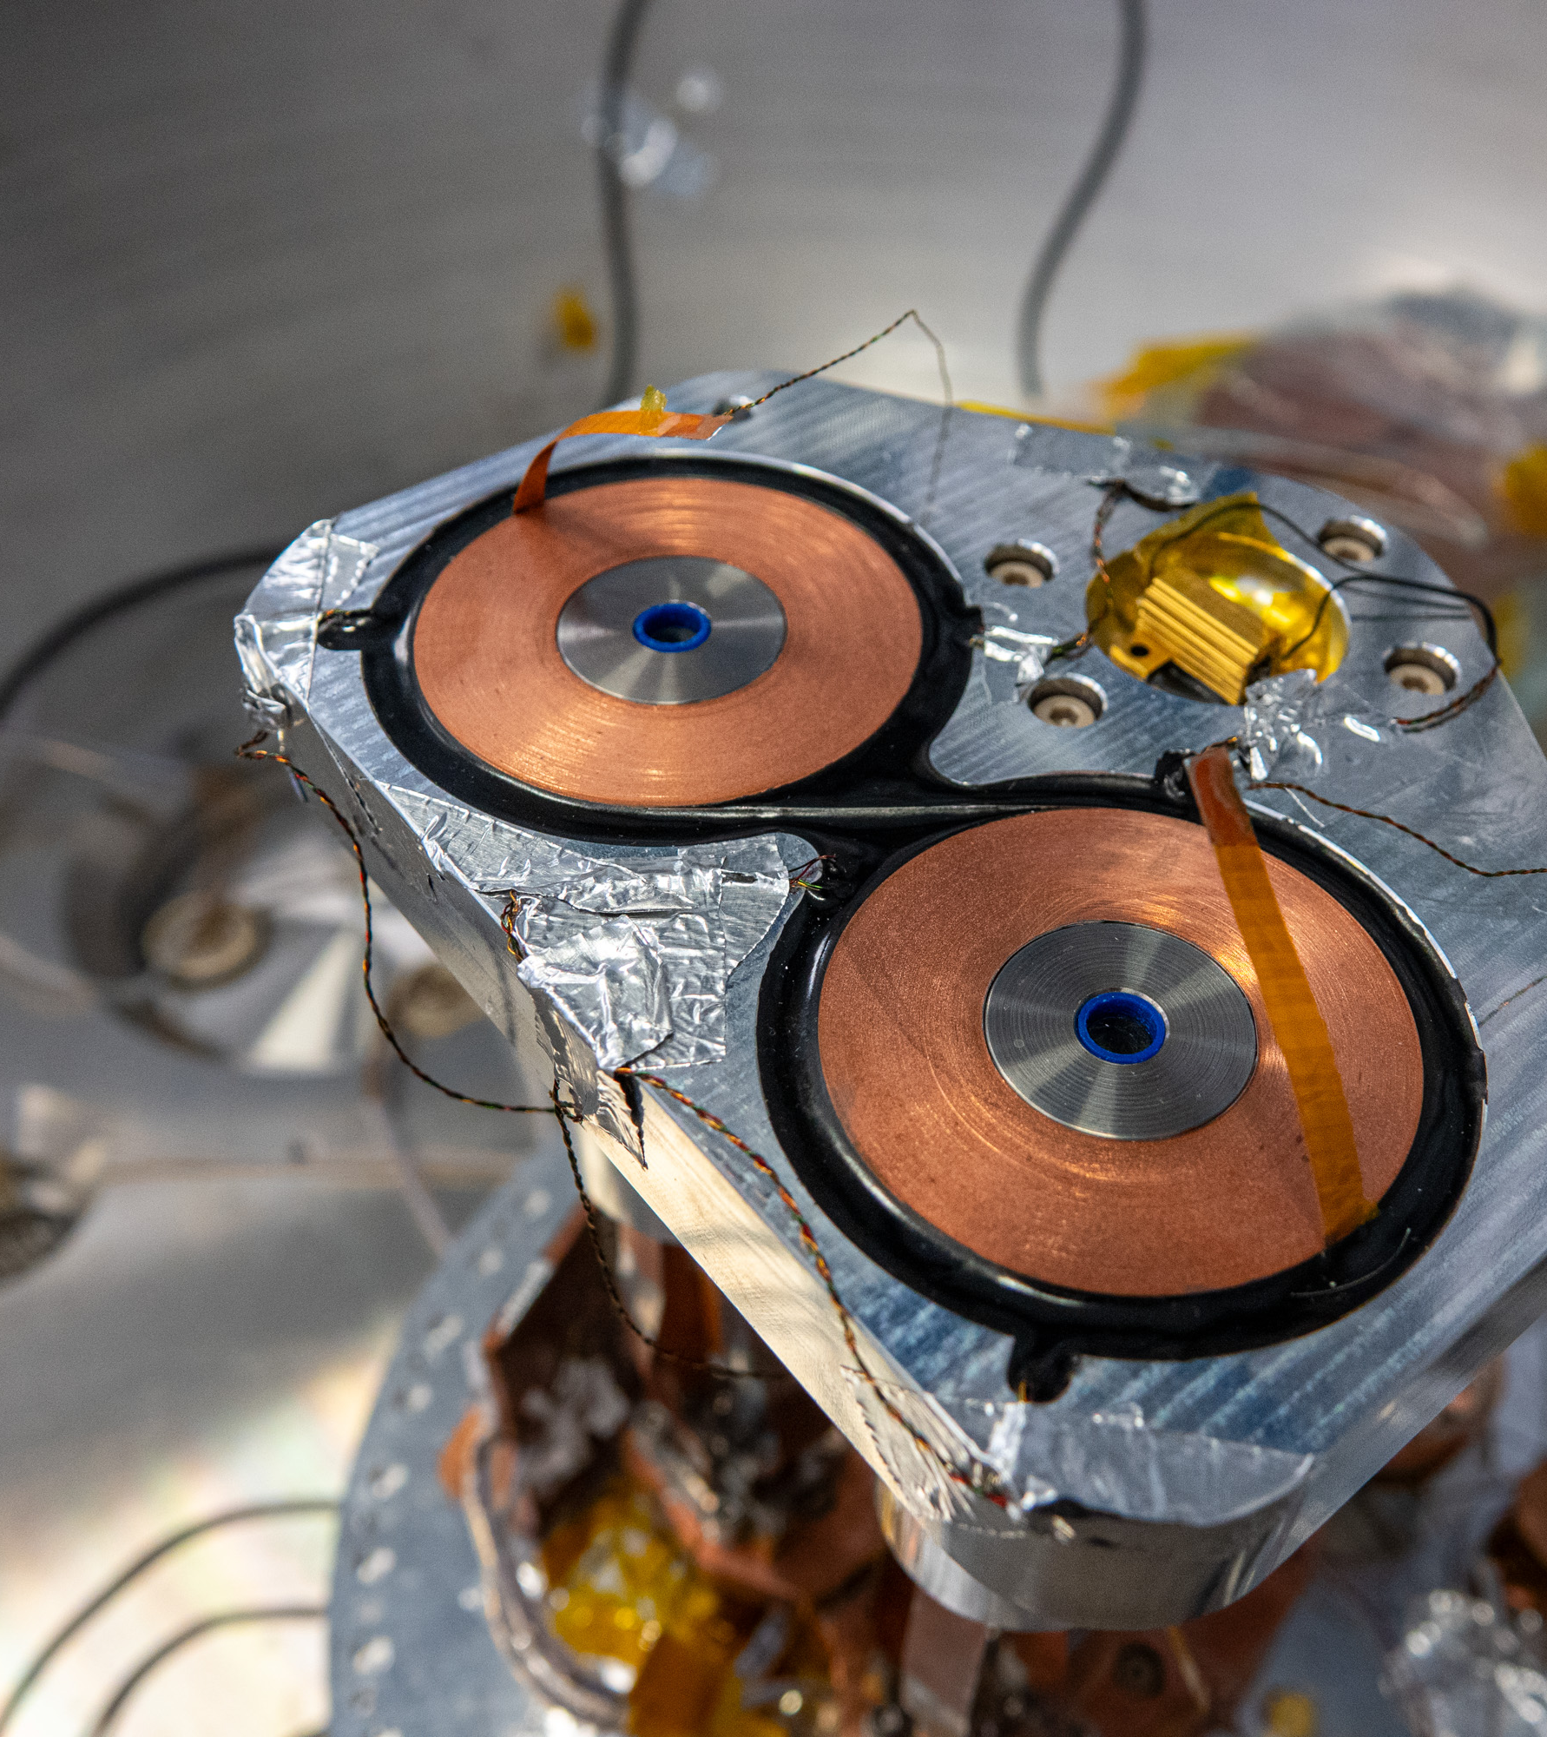
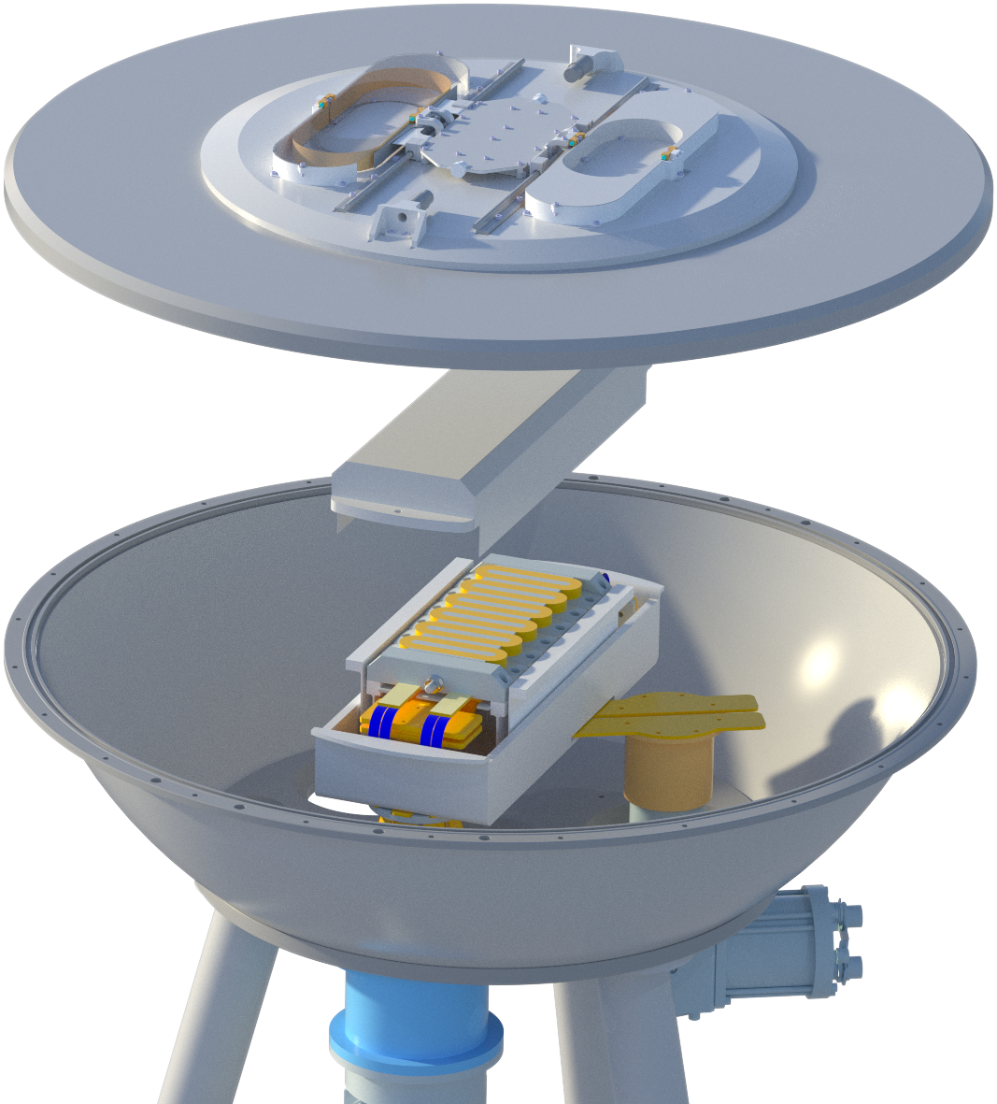
FAST – Fast actuator using superconducting technology
Mathijs van Gorcum
mathijs.van.gorcum@vdletg.com

Slide 2


Facts and Figures VDL ETG
A global design &
manufacturing company,
cooperating with
high-tech companies
2006
1900
1953
12
VDL ETG
consists of 12 companies
VDL ETG was acquired by VDL Groep in 2006
> 5,000
Employees in 6 different countries
Unique combination of
technical design knowledge
and manufacturing craftmanship
under one roof
T&D Engineers
> 700
Production and staff
> 4,300
Production surface area
> 250,000 m²

Slide 3


VDL ETG ALMELO
VDL ETG EINDHOVEN
VDL ETG PRECISION
VDL GL PRECISION
VDL ETG PROJECTS
VDL ETG T&D
VDL ETG
VDL ETG SWITZERLAND
VDL ETG USA
VDL ETG USA
VDL ETG SUZHOU
VDL ETG VIETNAM
VDL ETG SINGAPORE
Manufacturing
Design and Engineering
Business Development

Slide 4
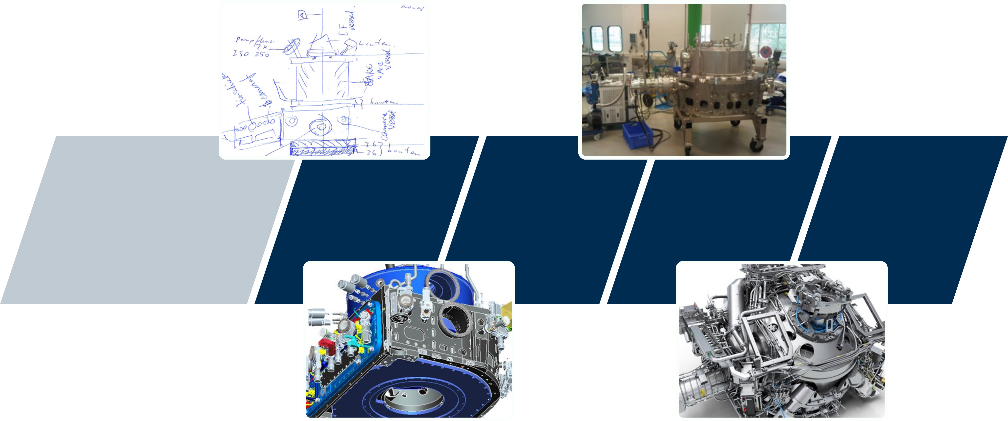
Value Chain
From sketch to design to (volume) manufacturing to usable product for society
First sketch
Concept
Functional model
Release for
volume

Slide 5
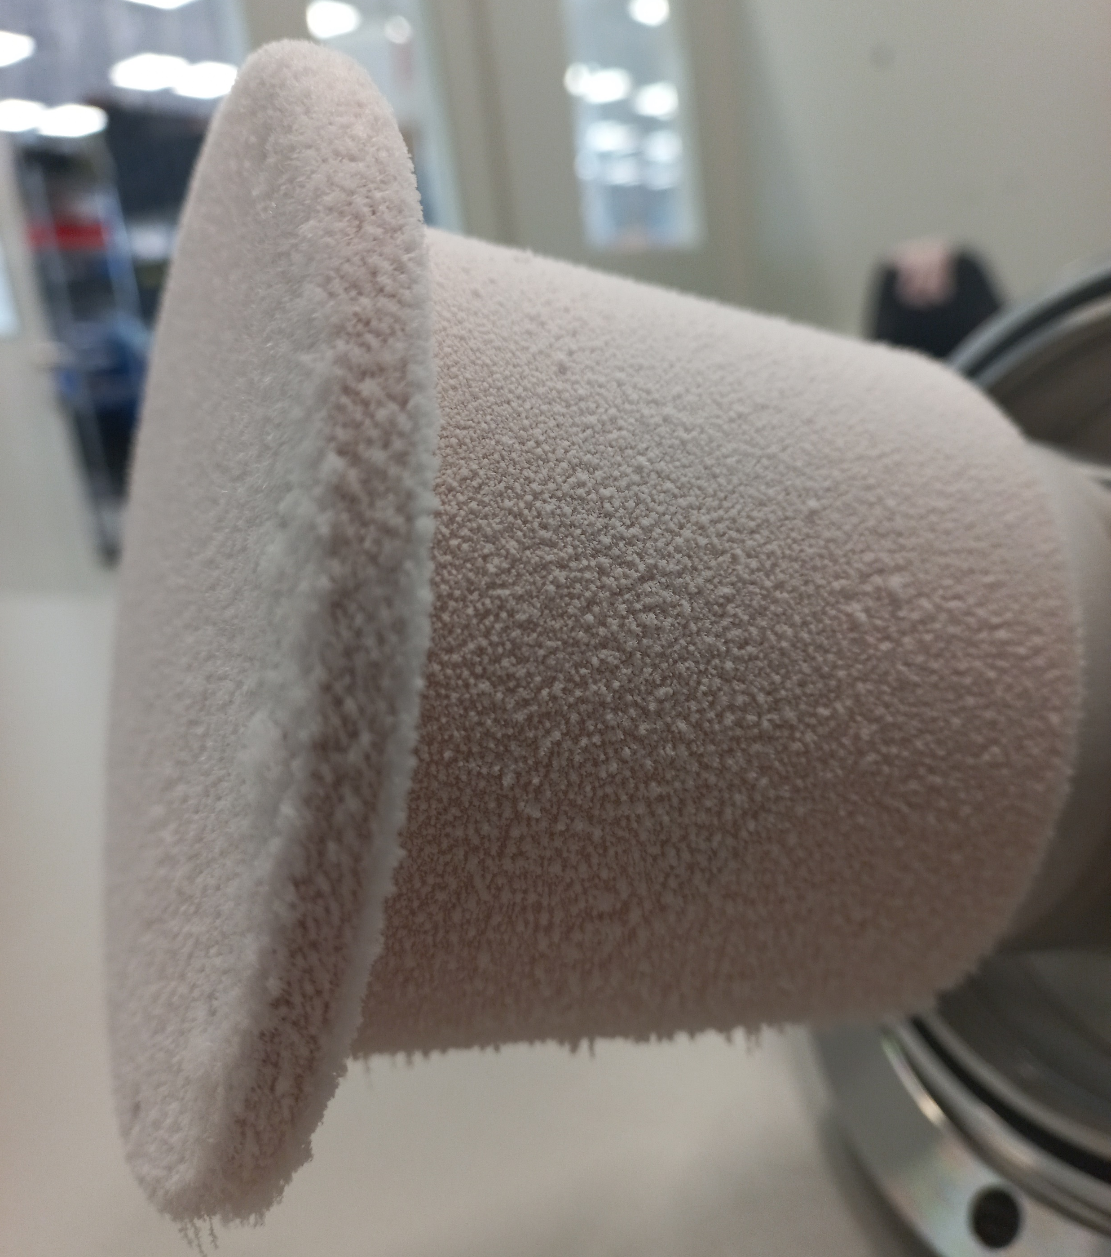
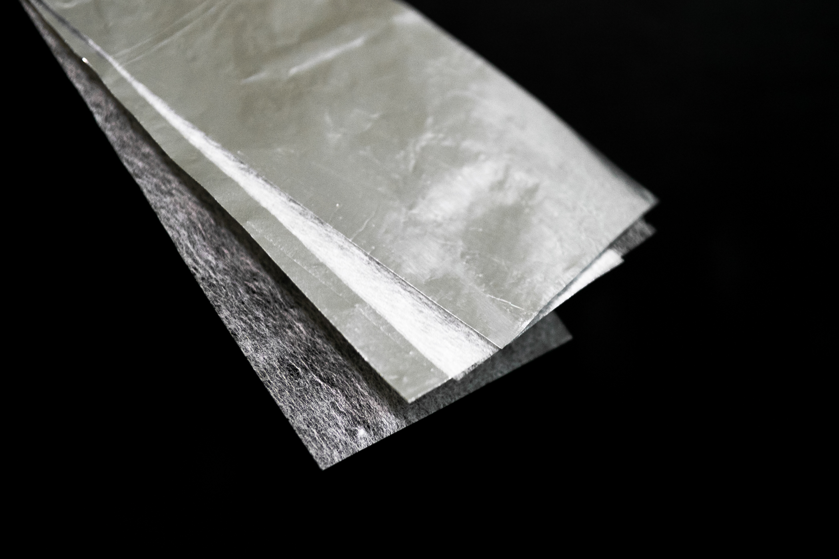
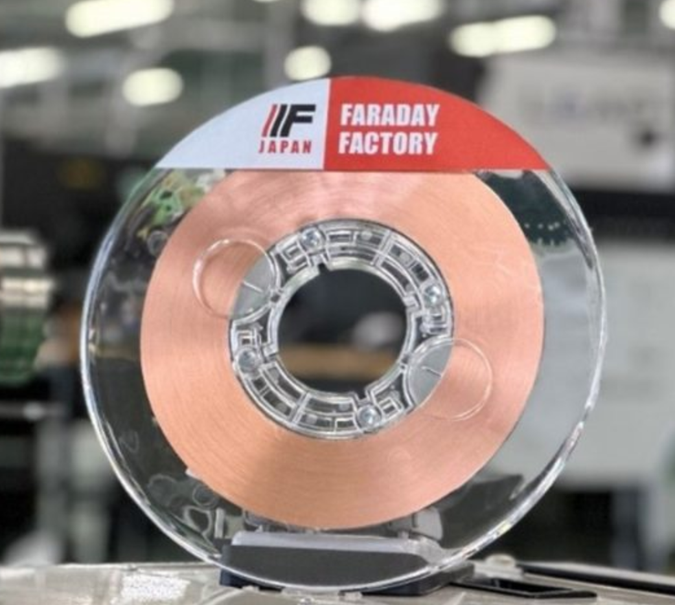
Why superconductivity at VDL?
Off the shelve components
  Cryocoolers
  HTS tapes
  Oxygen free copper
  MLI
  Vacuum pumps

Slide 6
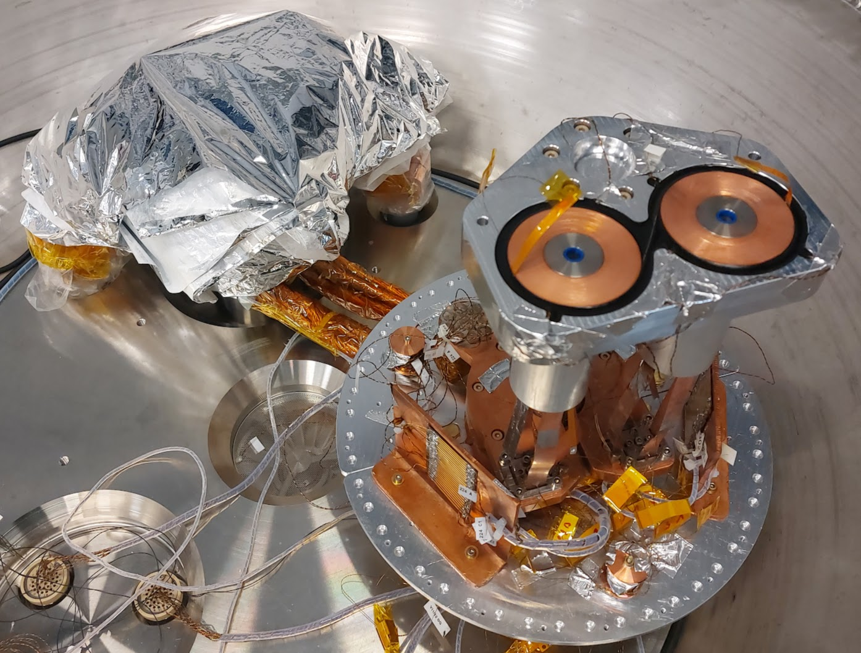
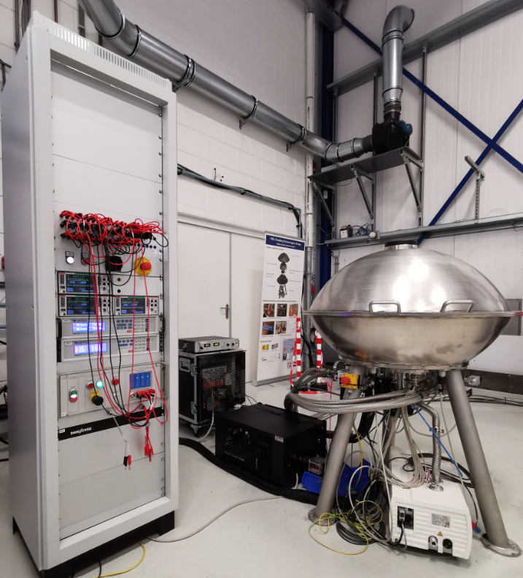
Cryogenics & superconductivity at VDL
Coils
6 years of Frozen
Ongoing project for several years with approx. 10 people
Conduction-cooled set-up: up to 2 kA, down to 10 K
NI pancake coil duet: 10 T peak field
Developed and assembled in-house
Re-use parts of set-up for FAST
  Superconducting linear motor
Inside vacuum chamber
Vacuum vessel
Control rack
Coolers & pumps

Slide 7
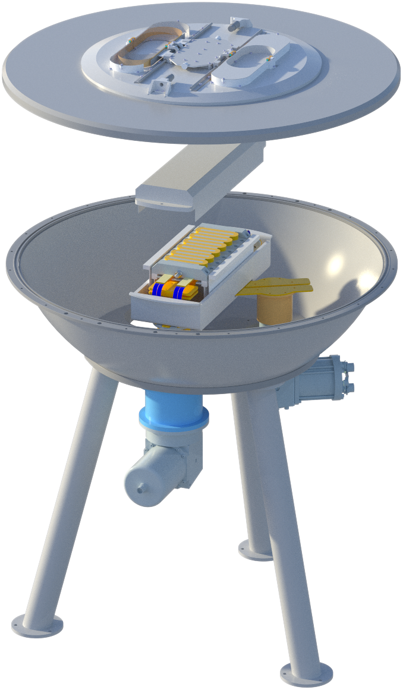

FAST project
100G linear motor

Slide 8
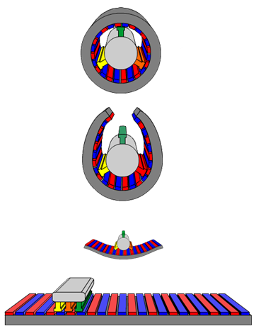
Project overview
Linear motor
FAST project aim:
  Design and fabrication of a superconducting linear motor
    Conventional AC mover & DC HTS stator
    Enable a much higher acceleration than possible with conventional technology
A linear motor provides linear motion (i.e. along a straight line)
  Essentially an ‘unrolled’ rotary motor
  Track with N/S poles and AC mover -> Lorentz force
  Widely used in (semicon) industry
  Experience with such systems at VDL ETG
Mover
Stator
Source: https://commons.wikimedia.org/wiki/File:Linearmotorprinzip.png

Slide 9
Design overview
3-phase mover
Mover flange
(thin wall)
Radiation shield
HTS coil array
(stator)
Force frame
Powerlead and
1-stage cryocooler
2-stage cryocooler

Slide 10
Main Thermal Challenges
Focus of this talk
Large forces on superconducting stator
  Needs strong force-frame
Sufficient cooling at target current
Thin wall cryostat
  Minimize distance between atmospheric mover and HTS stator
Thermal model

Slide 11
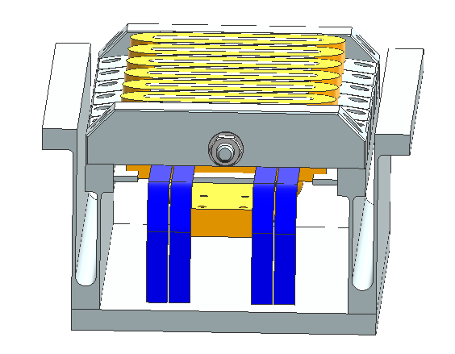
Force frame
Stiff in actuation direction
Thin in y-direction to decrease heat transport
Titanium
293K connection
25K stator coil array
50K intermediate temperature

Slide 12
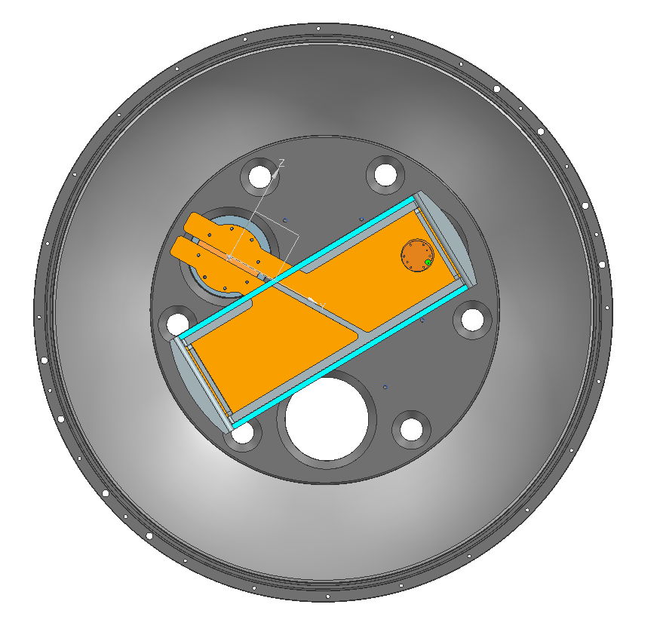
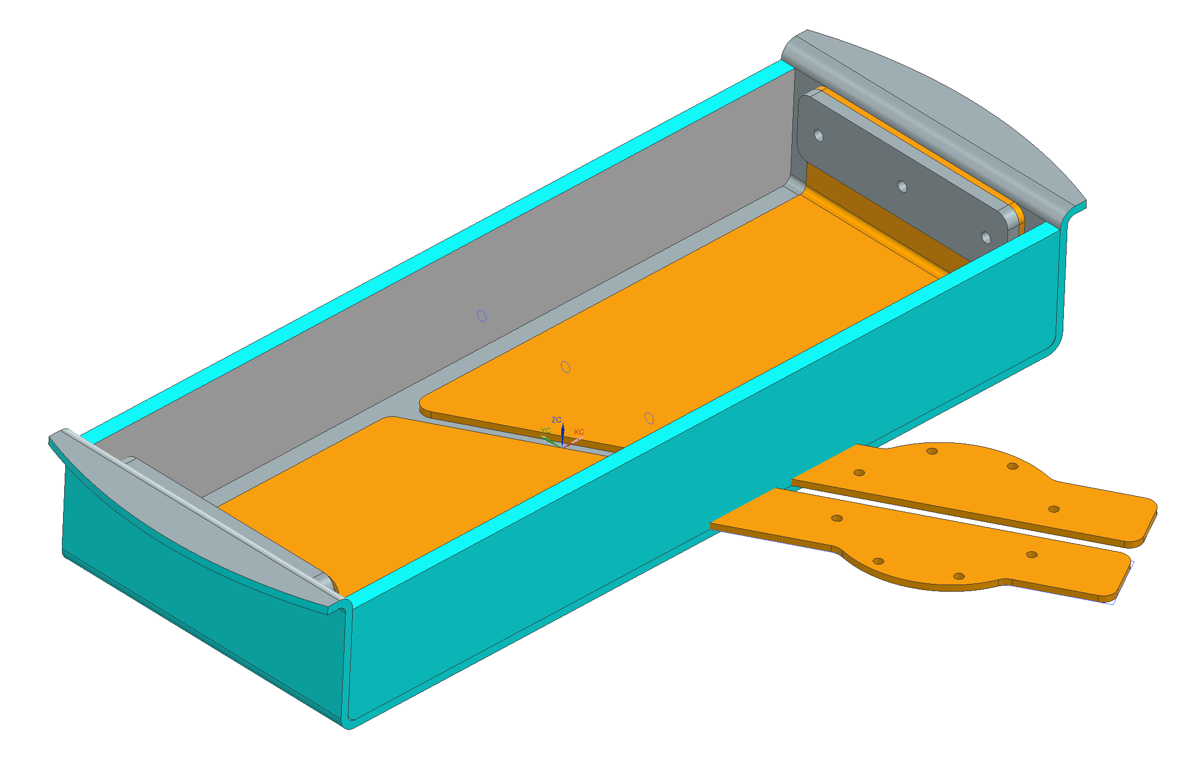
Cooling force-frame
Conduction cooling through powerleads
First stage of 2-stage for additional cooling

Slide 13
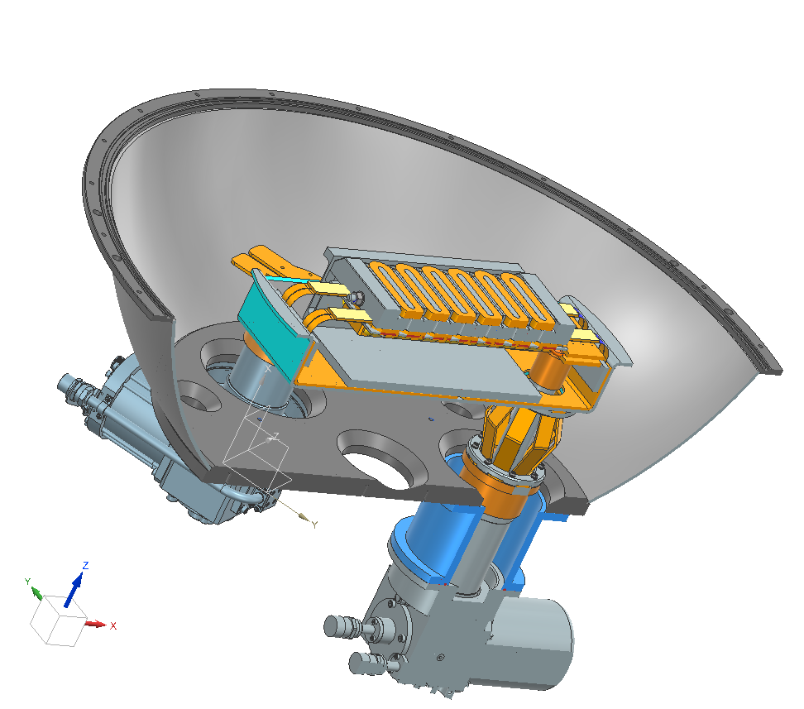
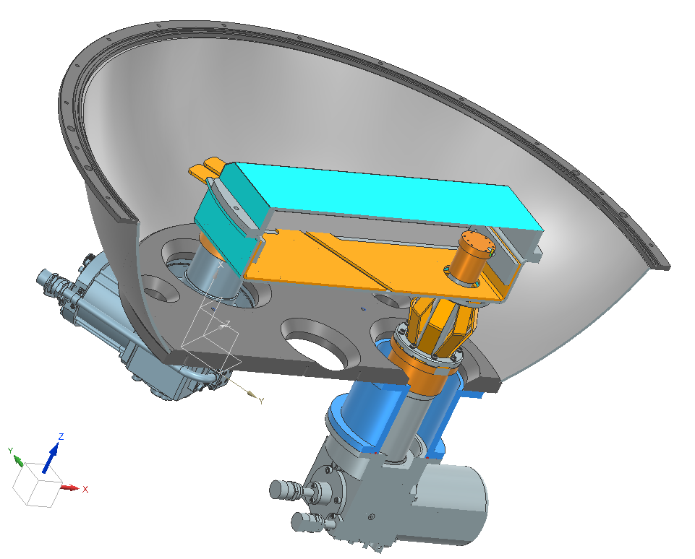
Cooling force-frame
Conduction cooling through powerleads
First stage of 2-stage for additional cooling

Slide 14
Thin wall cryostat
Thin cryostat wall
Thin ‘air’ gap crucial to maximize magnetic field at mover coil position
  Design for ≤ 11 mm mover-stator distance
  Incl. vacuum wall, MLI, and heat shield
Challenge to minimize radiation heat leak
  Multi-layer insulation
  Actively cooled heat shield
Vacuum wall thickness optimized
  Withstand 1 bar pressure difference
  Thin wall section above stator coils
  Minimize total thickness
z
3 phase mover coils
x
Vacuum wall
≤ 11 mm
MLI
Heat shield
Stator coils
To 1st stage cooler
To 2nd stage cooler

Slide 15
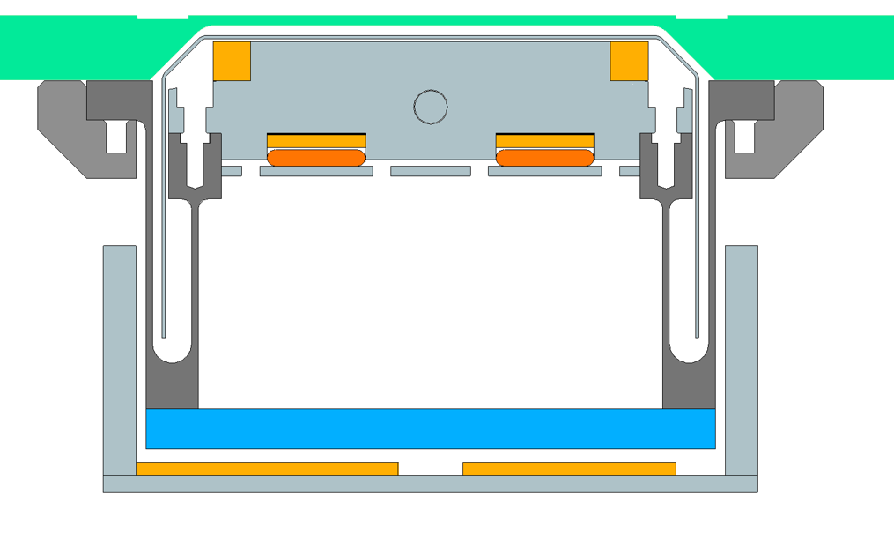
Thin wall cryostat
Top shield
Mover flange
HTS coil array
~293K
~25K
~50K
Bottom shield
Force frame
(Internal shield)

Slide 16
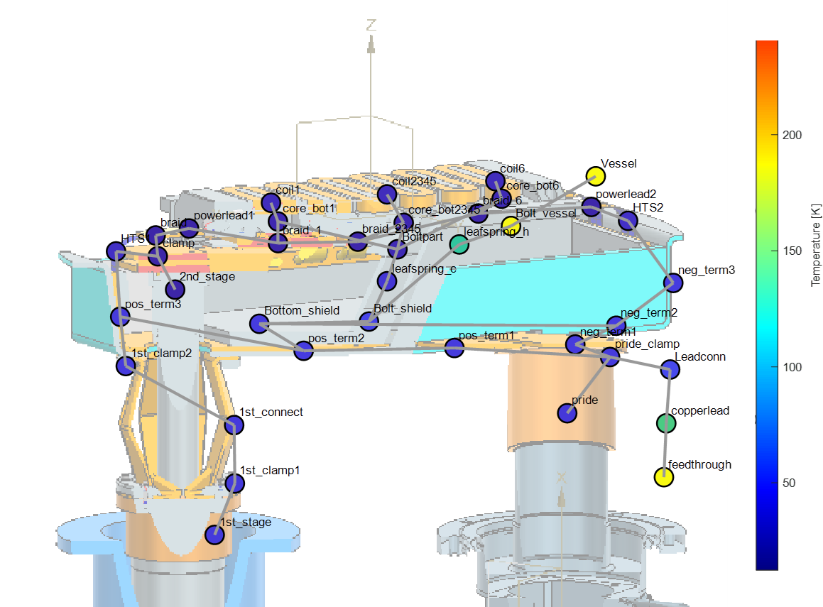
Block-based model
Nodes simulated with thermal connections

Slide 17
Questions
Contact us at our stand or via:
Mathijs van Gorcum – mathijs.van.gorcum@vdletg.com
Aernout Kisteman – aernout.kisteman@vdletg.com
Cees Maris – cees.maris@vdletg.com

