Slide 1

Preliminary Electromagnetic Design of a 15 T HTS Racetrack Superconducting Magnet
Author: Yuan cheng
SSRF Science Center, Shanghai Advanced Research Institute, Chinese Academy of Sciences
Date: Oct 27, 2026

Slide 2

Overview of Institute and Research Group
Shanghai Synchrotron Radiation Facility (SSRF)
432 m, 3.5 GeV, user operation started from 2009
Shanghai Hard X-ray FEL facility (SHINE)
3.1 km, 8 GeV, under construction
Shanghai Soft X-ray FEL facility (SXFEL)
532 m, 1.5 GeV, user operation started from 2023

Slide 3
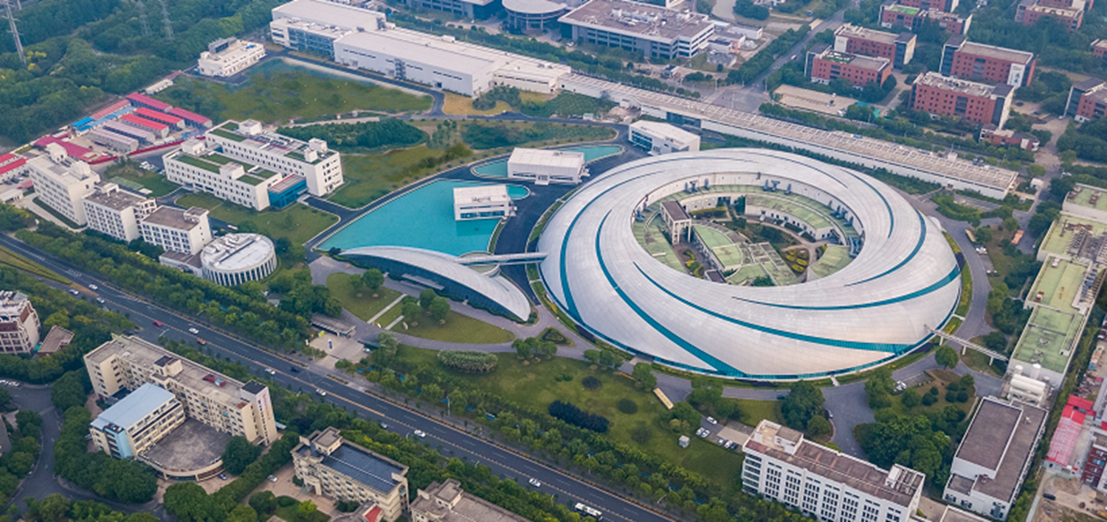
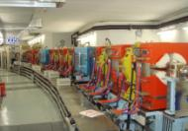
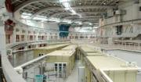
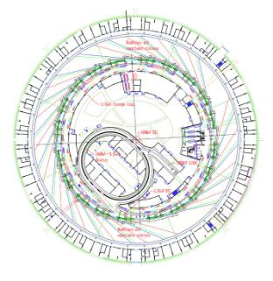
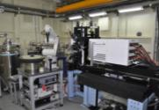
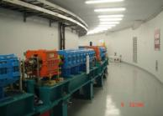
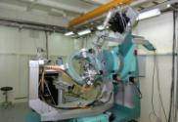

Overview of Institute and Research Group
SSRF is a 3.5 GeV third generation light source, opened to users in May 2009， now it has 38 beamlines and 55 end-stations in operation for user experiments.
SSRF operation Parameter | Value
Storage Ring Energy | 3.5 GeV
Circumference | 432m
Natural Emittance | 4.2 nm-rad
Multi-bunch Single-bunch | 200-300 mA 20 mA
Coupling | 0.3 ~ 0.7%
RF Voltage | 4-5 MV
Beam Lifetime | 10 ~ 20 hrs
Linac Energy | 150 MeV
Booster Output Energy | 3.5 GeV
Injection interval | 10 min (top-up)
Beamlines and Experimental Stations
3.5GeV Storage Ring C=432m
Booster C=180m
150MeV Linear Accelerator

Slide 4
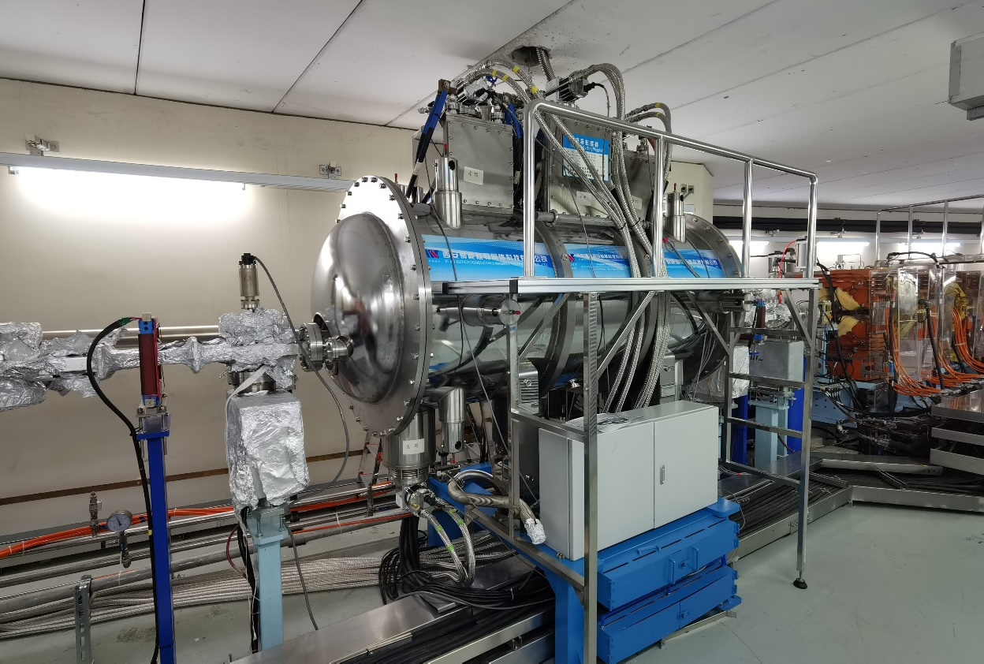
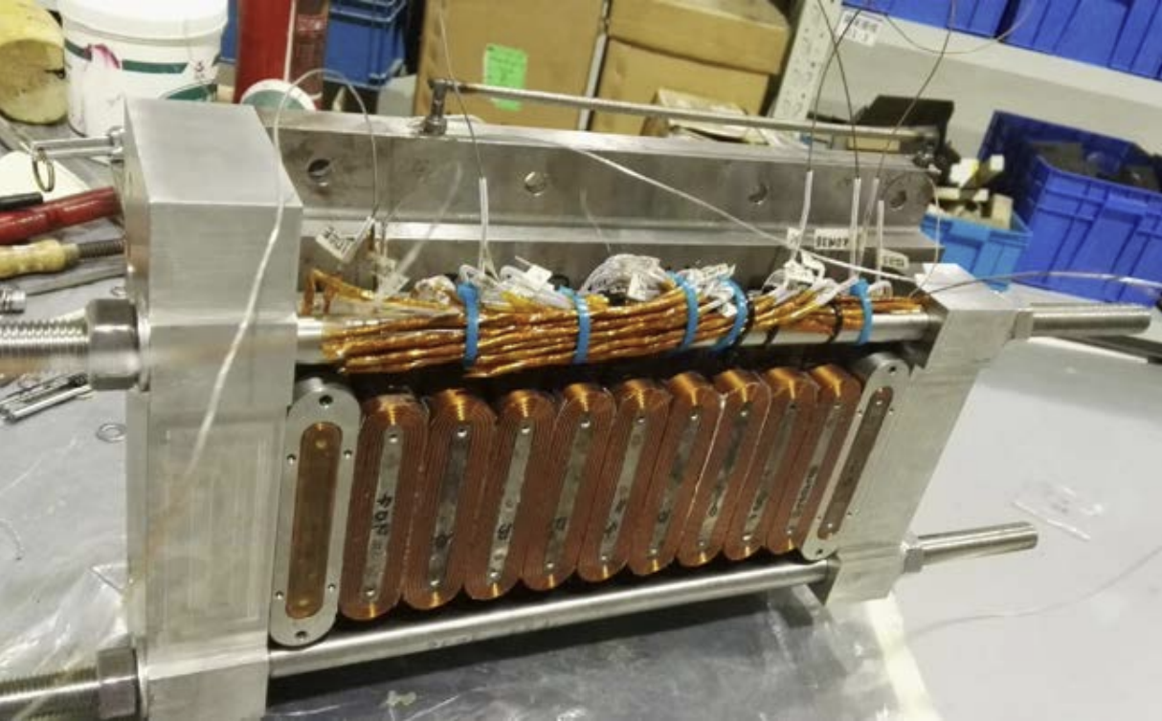
Overview of Institute and Research Group
The superconducting wiggler at SSRF is a home-developed high-field insertion device with a peak field of 4.2 T. It serves as the photon source for the BL12SW hard X-ray beamline
NbTi wiggler in SSRF
The model coil of NbTi wiggler

Slide 5
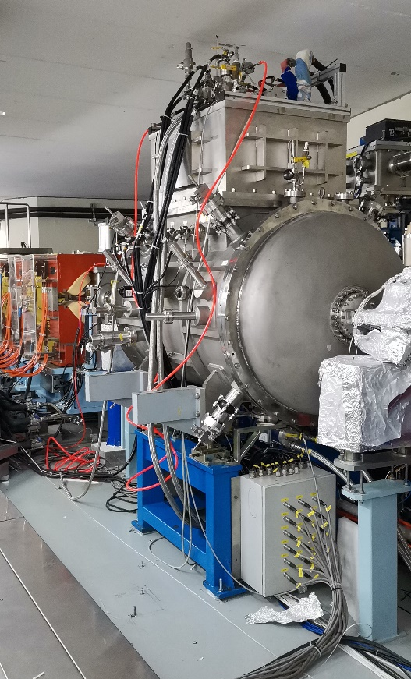
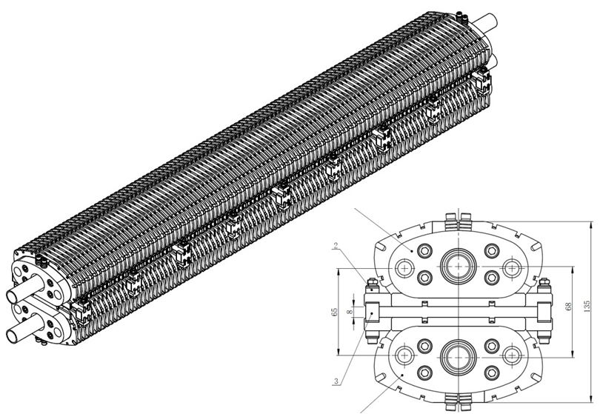
Overview of Institute and Research Group
As China’s first SCU with storage-ring beam commissioning, the SSRF superconducting undulator prototype has a 16 mm period, 9.5 mm gap and 50 periods, with 0.67 T design peak field and 0.57 T measured field.
HTS wiggler in SSRF
The model coil of undupator

Slide 6
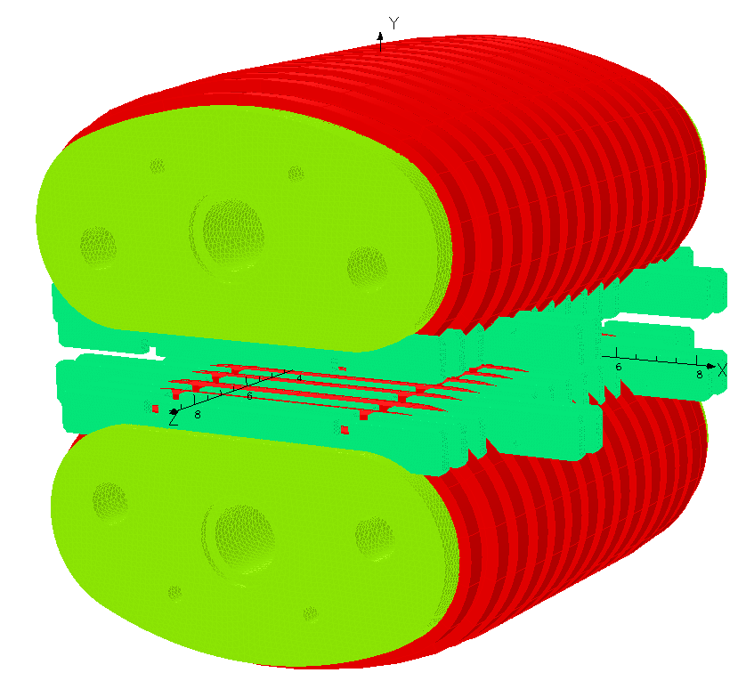
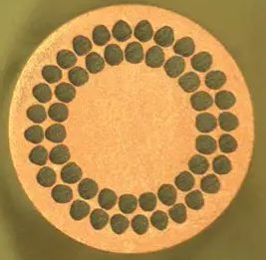
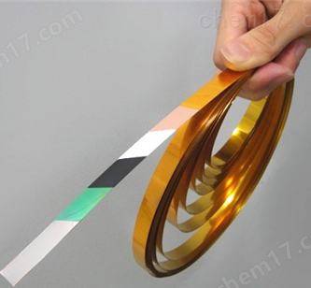
Overview of Institute and Research Group
So far, SSRF has limited experience in HTS magnet applications. We aim to build up relevant technical capabilities starting from the design of a 15 T HTS racetrack coil.
LTS: NbTi
Tc：<10K
Bc：<15T
Engineering application realized
？
HTS: REBCO tape
T_{C}：>25K
Bc：>25T

Slide 7
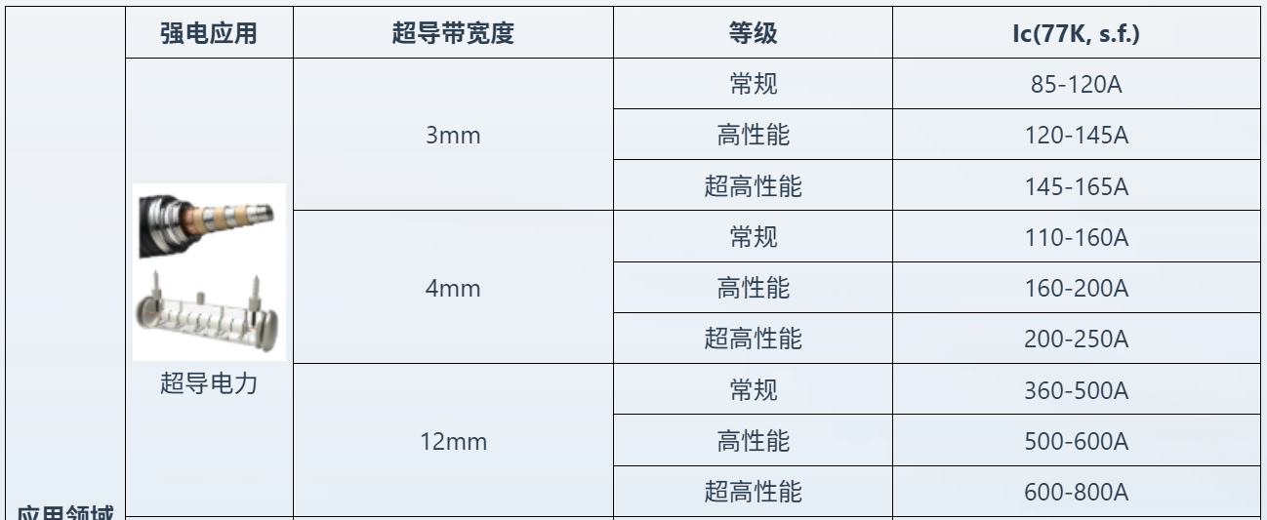
1. Requirements of the 15 T HTS coil
Main parameter for 15 T HTS coil
Parameters of Thin-substrate HTS Tapes of SST
width（mm） | 4
thickness（µm） | 50
I_{c} （77 K，自场） | 200 A
I_{c} （4.2 K，15 T） | 200*2.29 A
Bending radius（mm） | 5
Central Field | >10 T
B_{max} of coil | <20 T
Arc Radius | 5 mm
Max. Stress | <600 MPa
Cooling Method | LHe bath cooling
Operation temperature | 4.2K-20 K
- | VPI
- | Stycast 2850+CAT 24LV
I_{op}/I_{c} | ≤50%

Slide 8
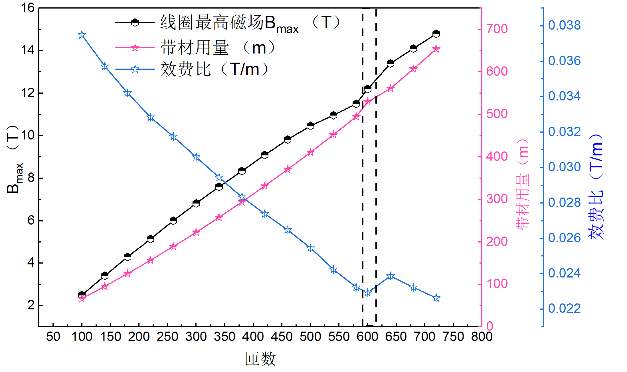
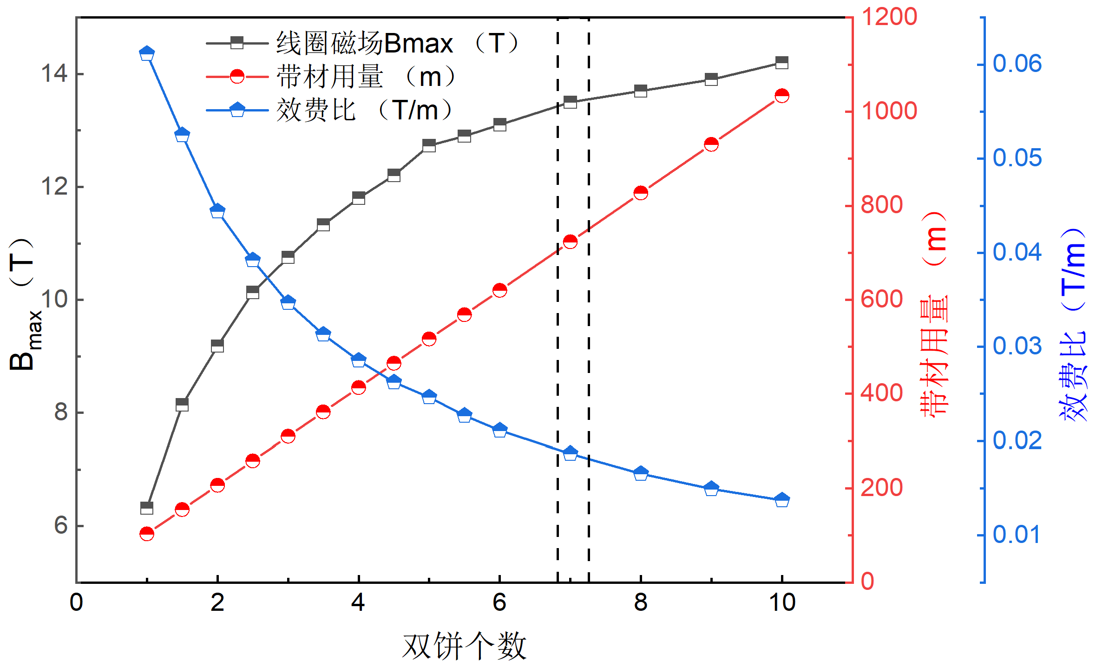
2. EM Optimization of the 15 T Racetrack Coil
Turn optimization reveals saturated field and cost-efficiency at 600 turns (5 DBs, 1 mm gap, 50 mm straight length, 4 mm arc radius, 200 A operating current).
Double-pancake optimization shows saturated field and cost-efficiency at 7 pancakes (600 turns, 1 mm inter-pancake gap, 50 mm straight length, 4 mm arc radius, 200 A operating current).
图 匝数优化
Conclusion: 7 double pancakes with 600 turns each DP minimize HTS tape consumption.

Slide 9
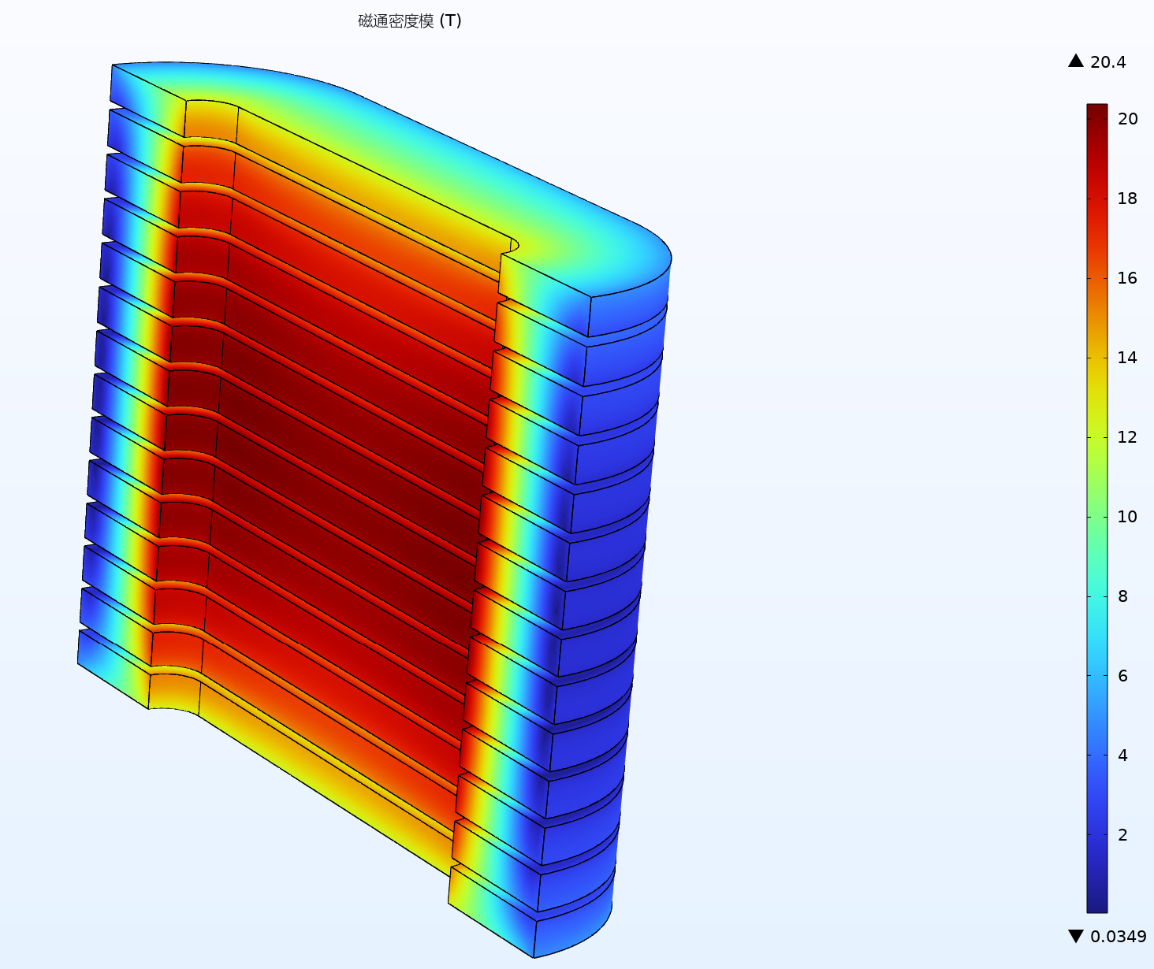
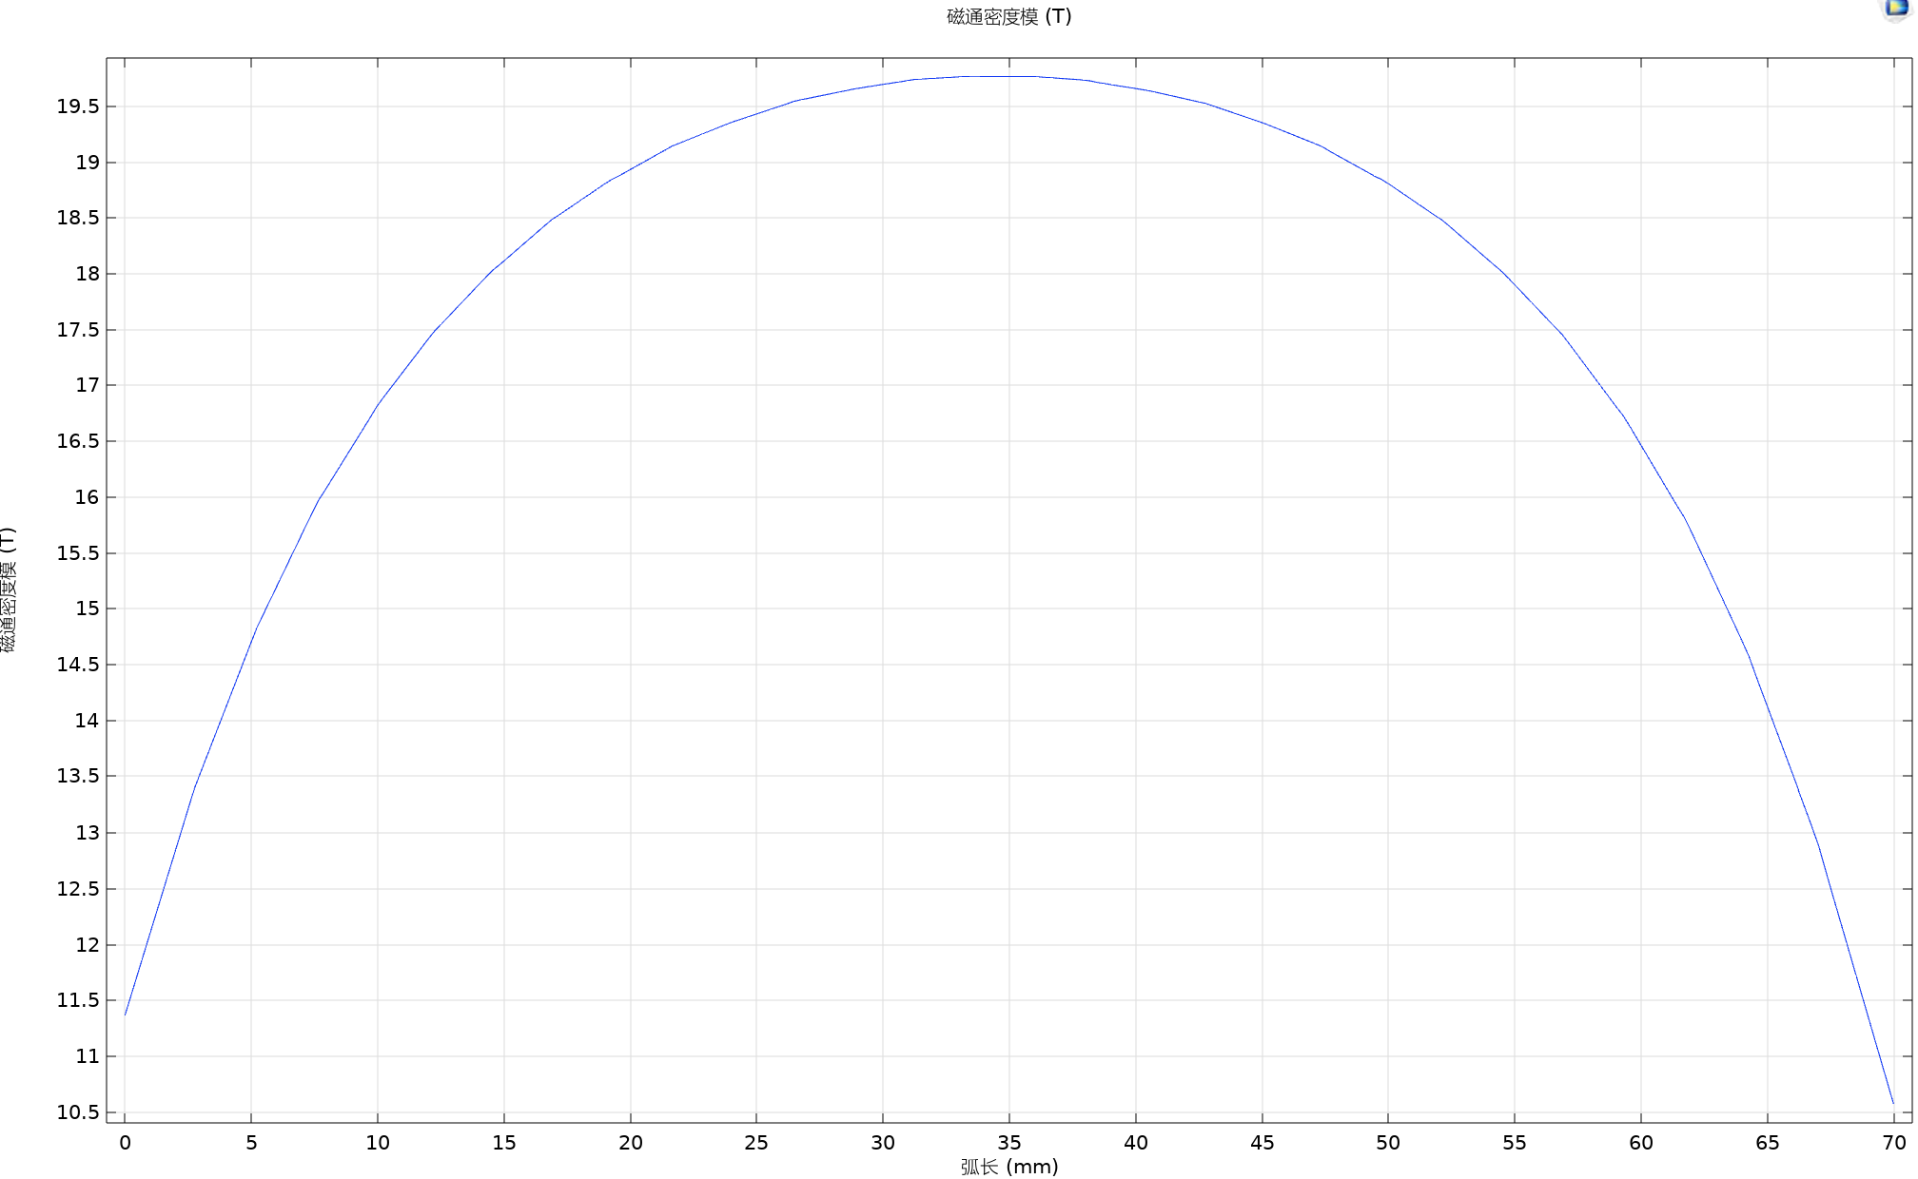
2. EM Optimization of the 15 T Racetrack Coil
Straight-section length | 50 mm
Arc radius | 5 mm
Number of DPs | 7
Turns | 600×7
I_{op} | 300 A
Ic | 326 A
Length of HTS tape | 120*7
B_{max} | 20.4
B_{center} | 19.7
Hoop stress | 220 MPa
Radial stress | 50 MPa
EM results for HTS coil（Bmax=20.4 T)
On-axis Magnetic Field Distribution

Slide 10
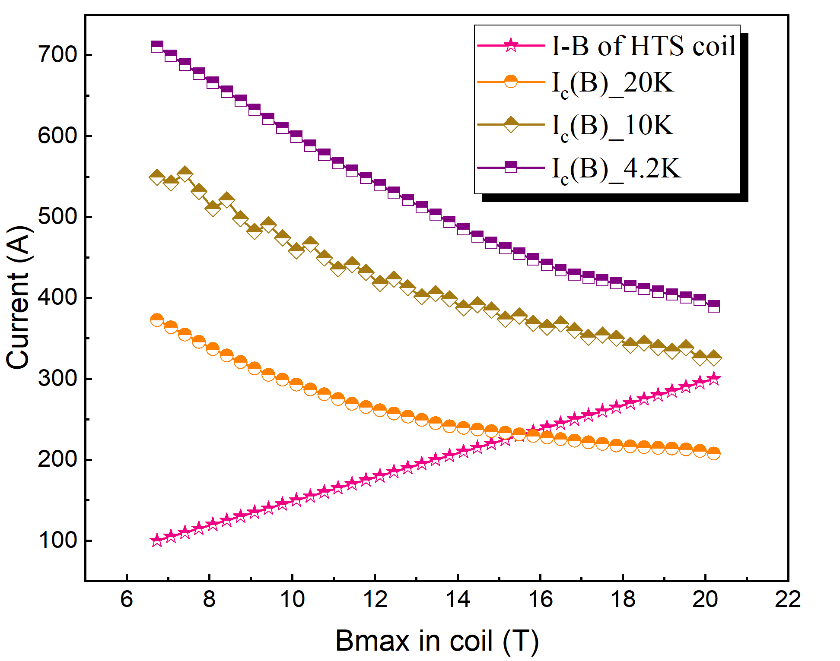
2. EM Optimization of the 15 T Racetrack Coil
The previous current and magnetic field were near the coil’s performance limit. Based on simulation results, we adjusted it to a central field of ~15 T at 235 A.
Straight-section length | 50 mm
Arc radius | 5 mm
Number of DPs | 7
Turns | 600×7
I_{op} | 235 A
T_{op} | 4.2 K
Ic | 478 A
B_{max} | 15.7
B_{center} | 15.1

Slide 11
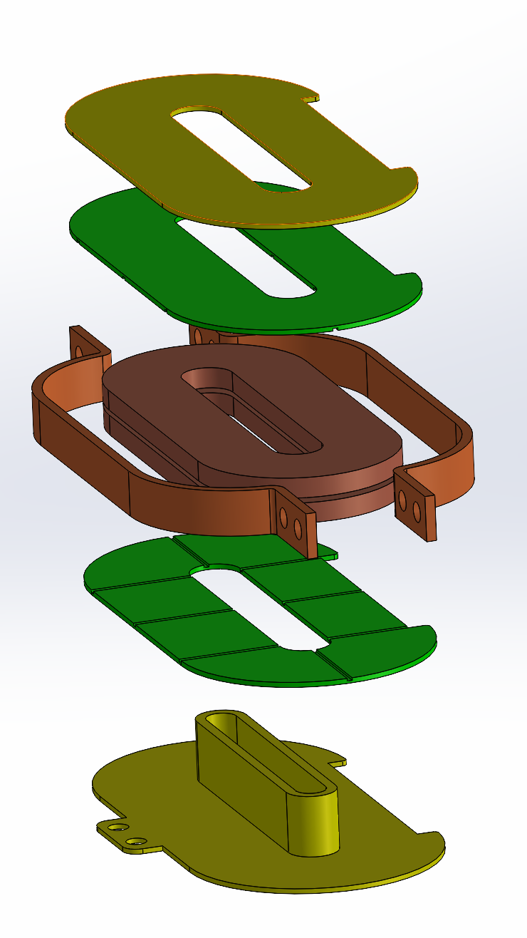
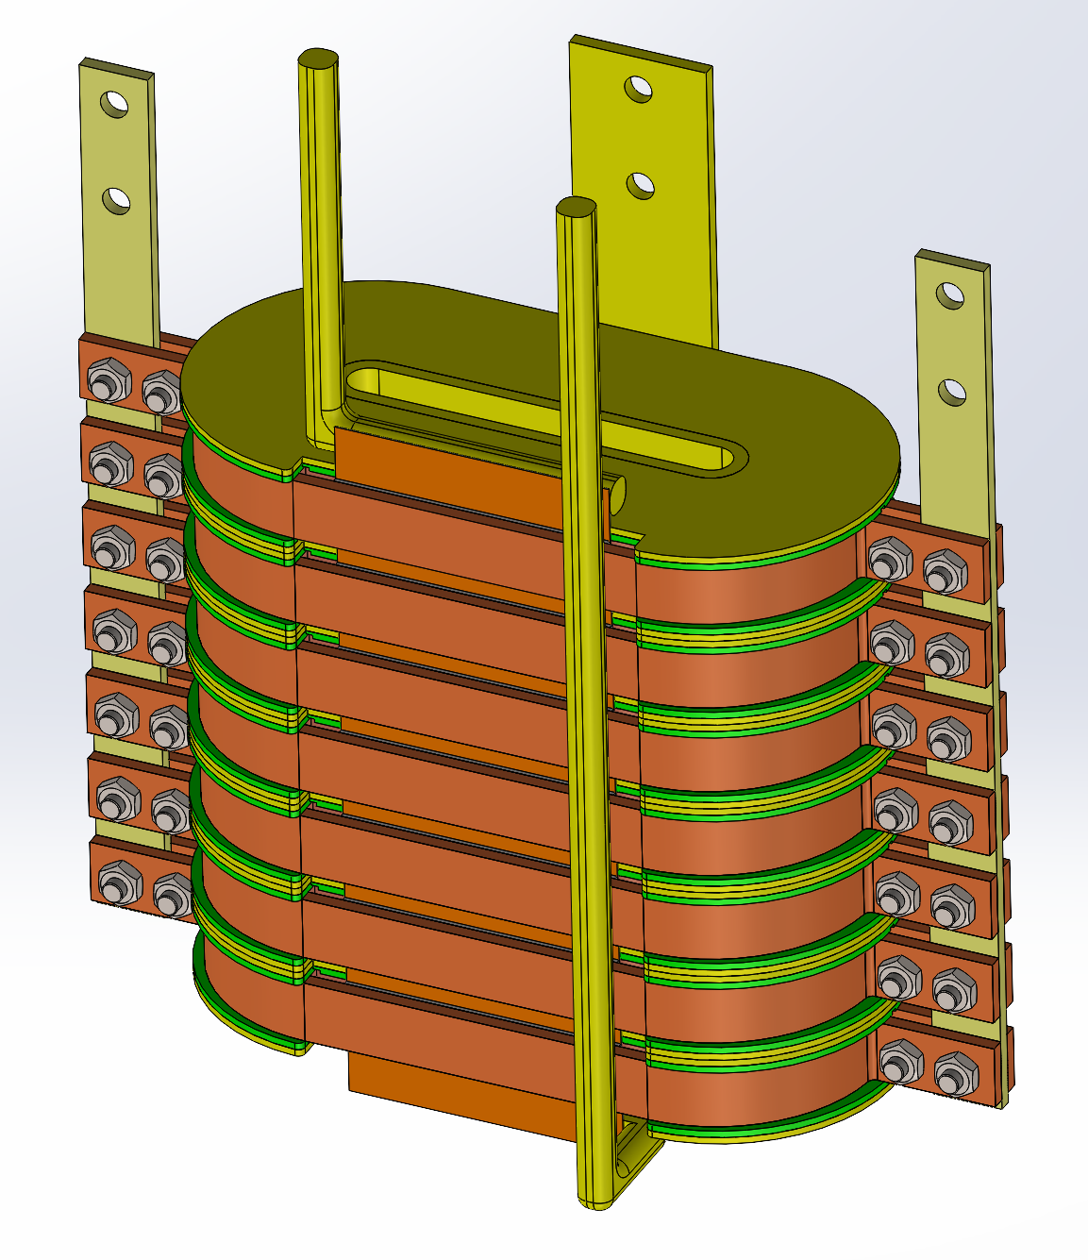
3. Structural Design of the 15 T Racetrack Coil
Conduction-cooled
board
Conduction-cooled collar
Double pancake
G10 board
winding former
HTS joint
Current Led

Slide 12
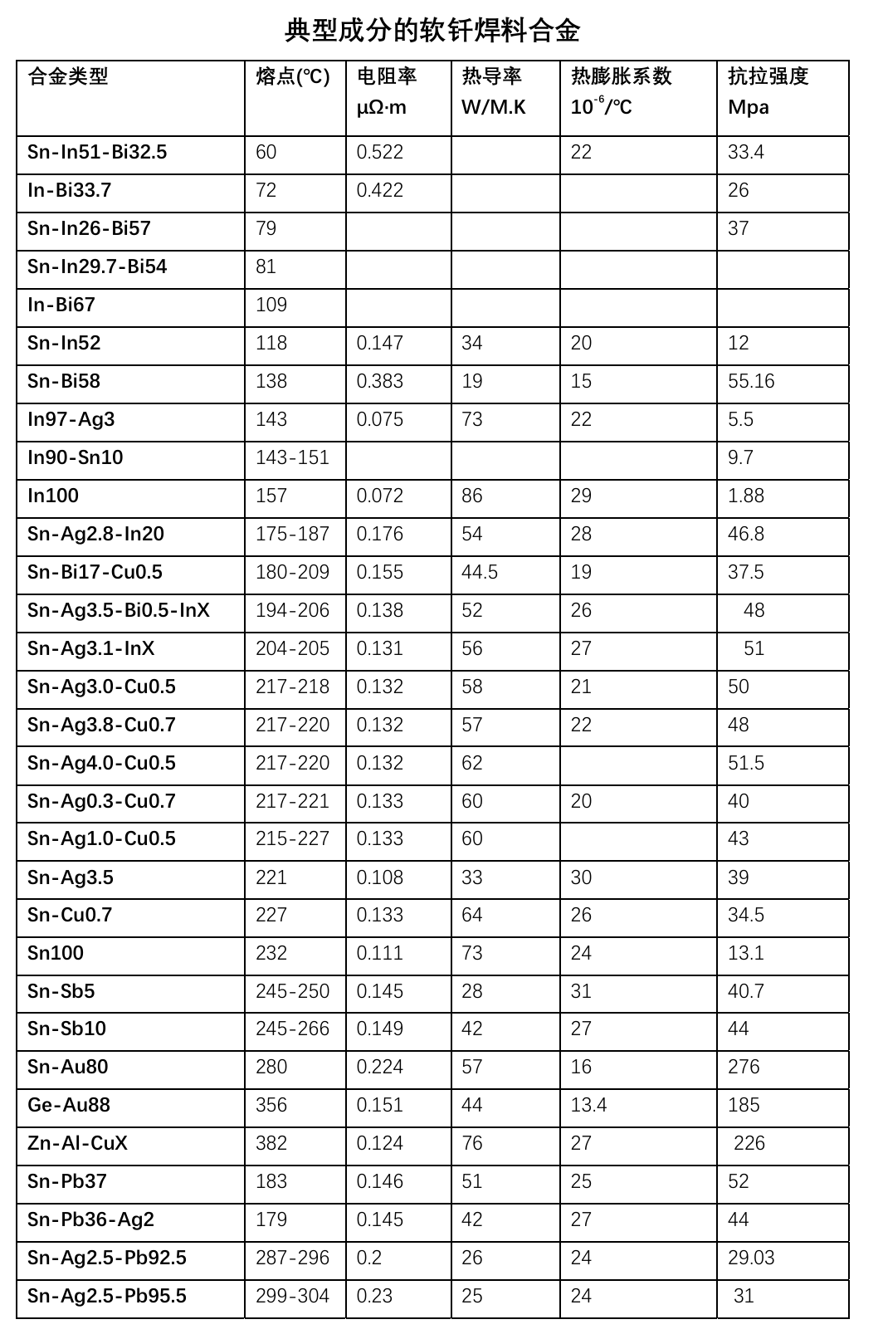
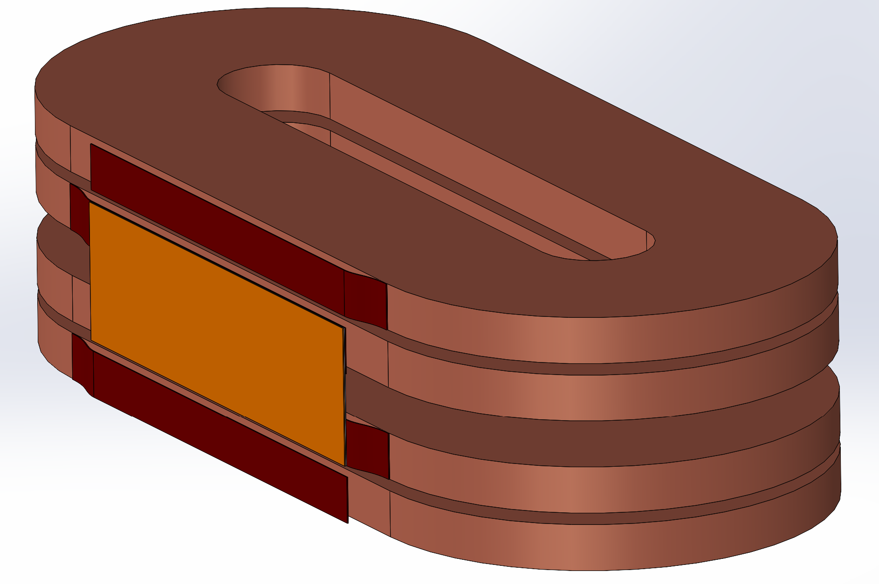
3. Structural Design of the 15 T Racetrack Coil
Bridge-joint structure: adjacent double pancakes bridged by 12 mm-wide tape, Sn63Pb37 solder, melting point 183 °C
DP coil#1
DP coil#2
12 mm HTS tape
Adjacent double-pancake leads
（4mm HTS tape）

Slide 13
Thank you for your attention！

