Slide 1
HFCC Monthly Meeting
Nov 20, 2025
Srini Rajagopalan, Tor Raubenheimer

Slide 2
Introduction
Today’s Agenda:
SuperKEKB performance and impact on FCC-ee: Frank Zimmerman
Next monthly meeting, Thursday, Dec. 4, will hear reports from recent workshops on TDAQ, Vertex and Heavy Flavors.

Slide 3
Events and news
Upcoming Events:
FCC-ee Heavy Flavor workshop @ CERN, 11/19-20
https://indico.cern.ch/event/1588013/
117th Plenary ECFA Meeting, CERN, 11/20-21
https://indico.cern.ch/event/1567662/
FCC-ee Physics Workshop, Munich, 1/26-30, 2026
https://indico.cern.ch/event/1588696/
FCC Week 2026 in Helsinki. 8-12 June 2026
https://indico.cern.ch/e/fccweek2026
Organizational changes
HFSC-A added Vladimir Shiltsev for the Community Engagement role and another member will be added by HFSC-PED.
Other HFSC-PED appointment discussions ongoing, expected to converge by end year.

Slide 4
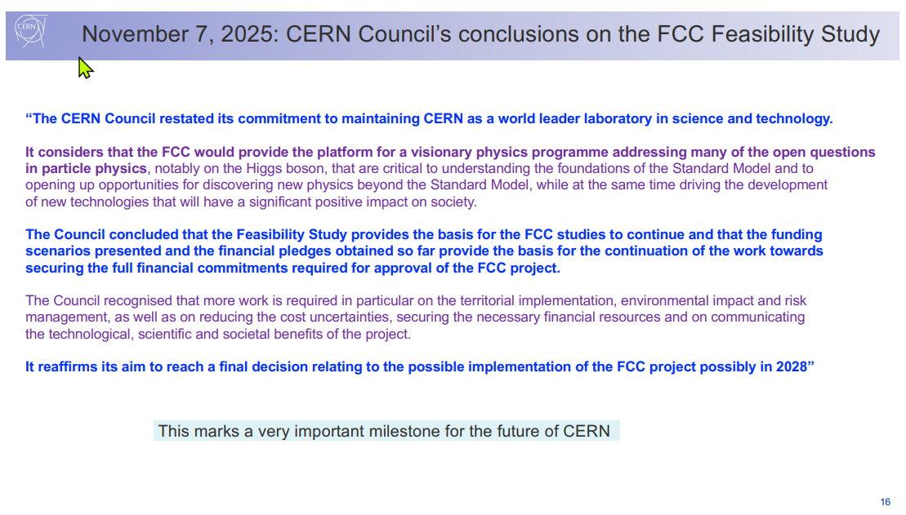
FCC Feasibility Study
Fabiola Gianotti, 4th International Symposium on the History of Particle Physics

Slide 5
Other news
ESG national updates was Nov. 14, 2025
HFCC did not update its input.
DPF/DPB submitted an update: https://indico.global/event/16103/.
ESG Strategy Drafting session: Dec. 1 – 5, 2025
Mike Tuts is the U.S. representative to ESG.
Anadi Canepa, as the U.S. PPG representative will also be present.
Submission of draft ESG document to Council: ~end of January.
Update of the ESPP expected in late spring 2026
CEPC: Not included in the current Chinese 5-year plan.
There is always the possibility that it can be included 5 years later, but Yifang has made it clear that this will not happen if CERN approves FCC.
We have one proposal for the next US-HFCC meeting late summer/early fall

