Slide 1
1
SuperKEKB and Lessons for FCC-ee*
Frank Zimmermann
US HFCC monthly meeting
20 November 2025
*based on https://arxiv.org/abs/2509.07448v4 plus recent updates

Slide 2
1. disclaimer
This presentation reports the current understanding of the speaker.
Alternative or complementary descriptions and interpretations of the SuperKEKB luminosity performance were presented elsewhere [1,2,3]
[1] D. Zhou, K. Ohmi, Y. Funakoshi, Y. Ohnishi, Y. Zhang, Simulations and Experimental Results of Beam-Beam Effects in SuperKEKB. Phys. Rev. Accel. Beams 26, 071001 (2023).
https://doi.org/10.1103/PhysRevAccelBeams.2
[2] D. Zhou, K. Ohmi, Y. Funakoshi, Y. Ohnishi, Luminosity Performance of SuperKEKB. JINST 19(02), T02002 (2024). https://doi.org/10.1088/1748-0221/19/02/T02002 , arXiv:2306.02692 [physics.acc-ph]
[3] J. Gao, Analyses of Super KEK B Luminosities Compared with Theoretical Formulae with DA Limitation Effects, 29 July 2025, unpublished (2025)

Slide 3
1. acknowledgements
Many thanks to Ilya Agapov, Andrea Aguirre Polo, Vincent Baglin, Philip Bambade, Yunhai Cai, Yann Dutheil, Giacomo Broggi, Naoko Iida, Jacqueline Keintzel, Meng Li, Zhiyuan Li, Takashi Mori, Tatsuya Nakada, Kazuhito Ohmi, Yukiyoshi Ohnishi, Katsunobu Oide, Jack Salvesen, Shinji Terui, Rogelio Tomas, and Demin Zhou for valuable discussions, helpful information, and for providing some of the presented material.
Warm thanks to Patrick Janot and Tor Raubenheimer for encouraging this article, and to Katsunobu Oide, Rogelio Tomas and Patrick Janot for a careful reading of the manuscript.
The work reported here was co-funded by the European Union's Horizon-Europe programme under grant no. 101086276 (EAJADE).

Slide 4
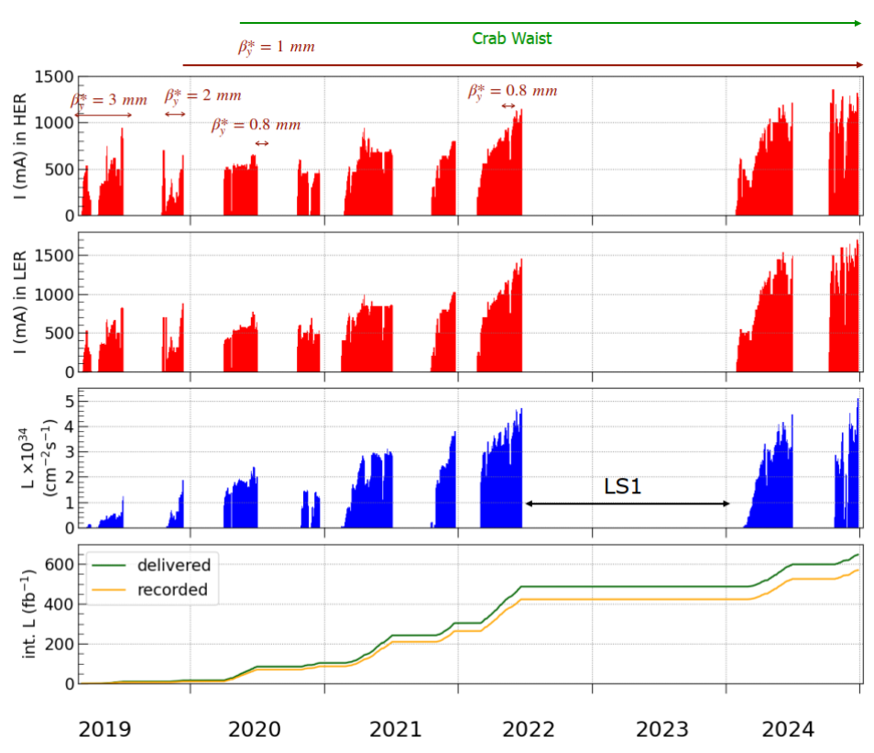
2. achievements: run history
beam currents in HER (e⁻)
and LER (e⁺),
along with instantaneous and integrated luminosity
as a function of time from 2019 through 2024,
as reported by Y. Ohnishi
8 short runs,
in 6 out of 8 runs new luminosity (world) records

Slide 5
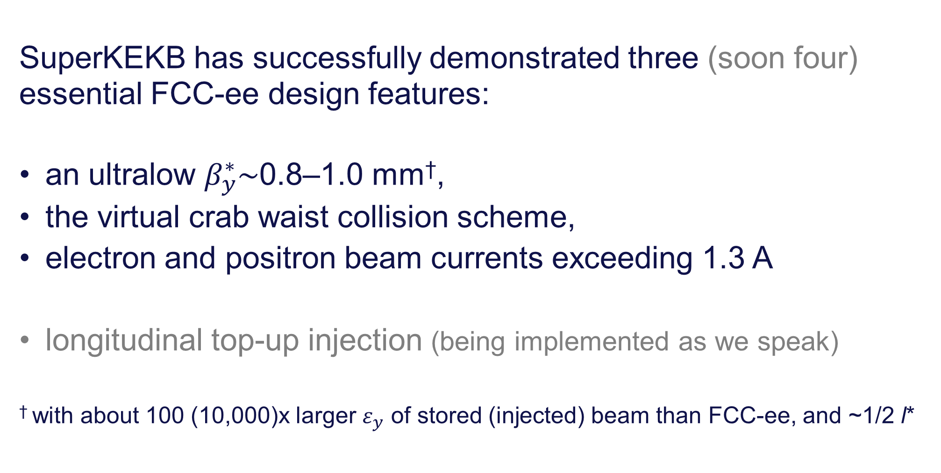
2. achievements: FCC-ee concept validation
SuperKEKB has successfully demonstrated three (soon four) essential FCC-ee design features:
an ultralow $β_{y}^{∗}\sim$0.8–1.0 mm†,
the virtual crab waist collision scheme,
electron and positron beam currents exceeding 1.3 A
longitudinal top-up injection (being implemented as we speak)
† with about 100 (10,000)x larger $ε_{y}$ of stored (injected) beam than FCC-ee, and ~1/2 l*

Slide 6
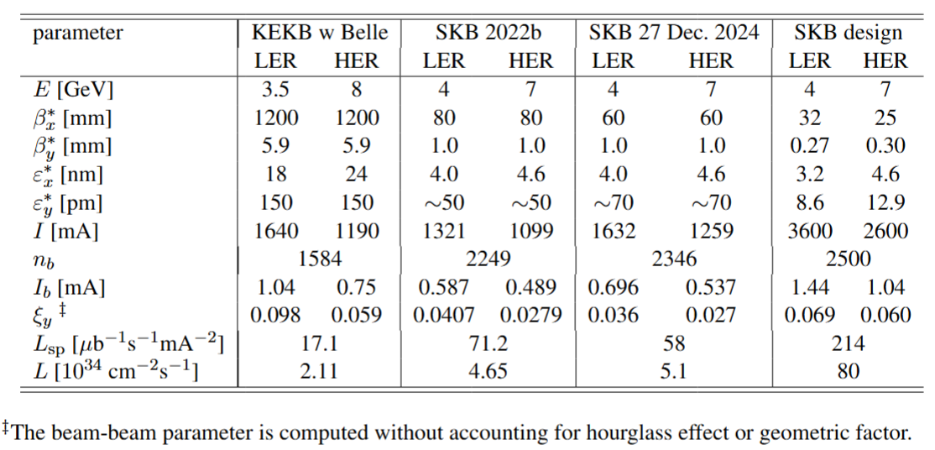
2. achievements and goals: parameters

Slide 7
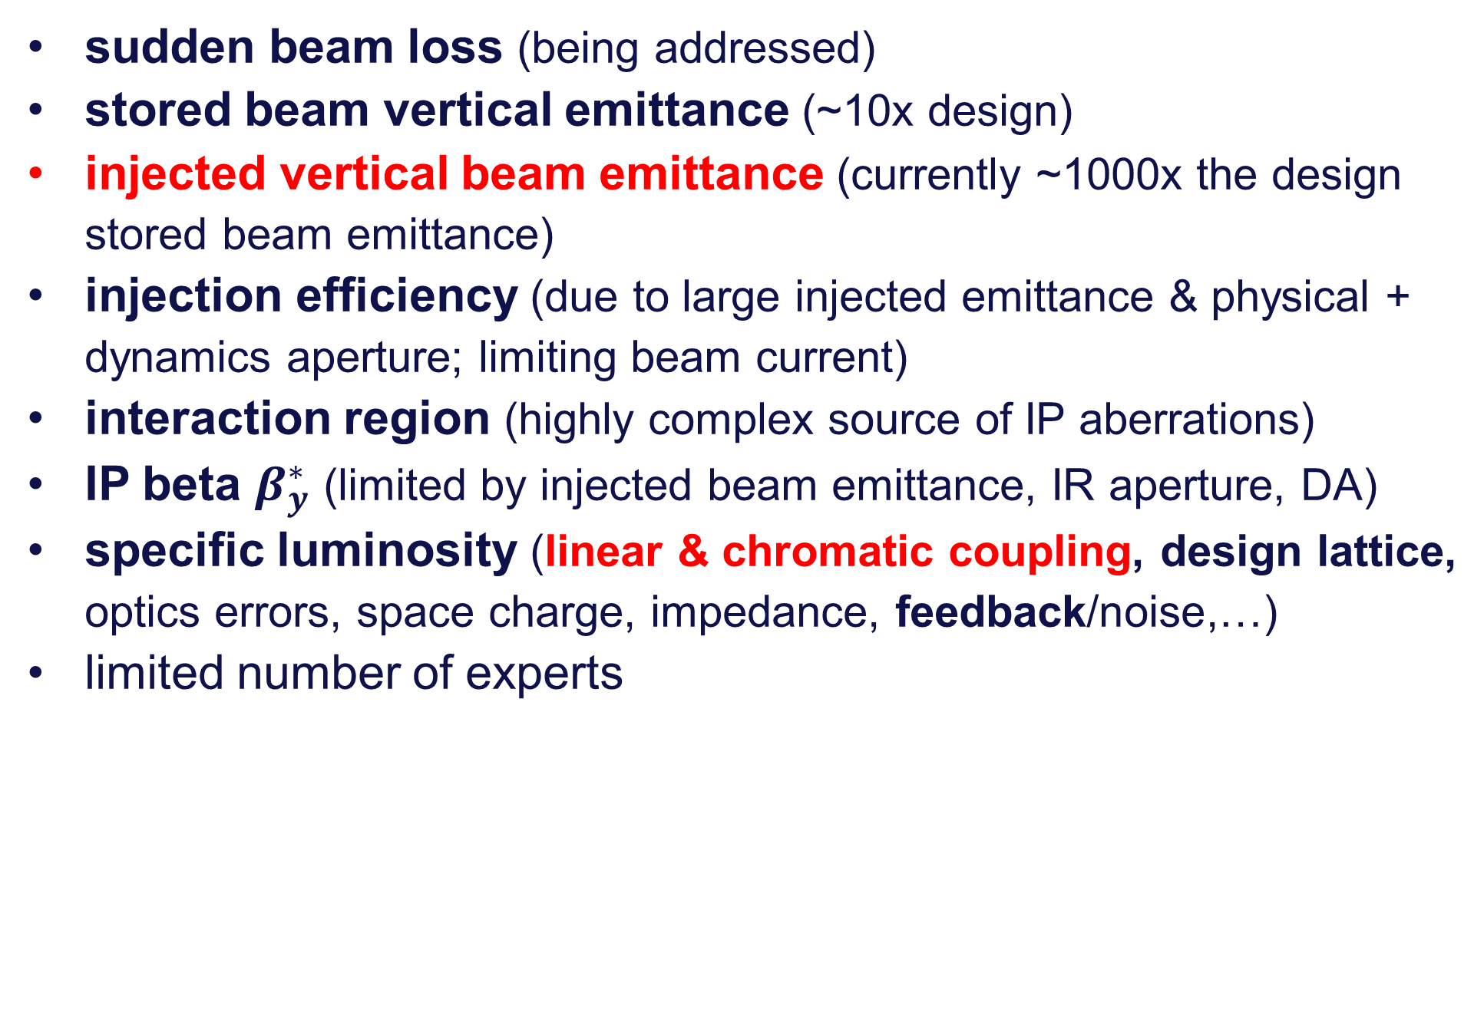
2. challenges encountered
sudden beam loss (being addressed)
stored beam vertical emittance (~10x design)
injected vertical beam emittance (currently ~1000x the design stored beam emittance)
injection efficiency (due to large injected emittance & physical + dynamics aperture; limiting beam current)
interaction region (highly complex source of IP aberrations)
IP beta $β_{y}^{∗}$ (limited by injected beam emittance, IR aperture, DA)
specific luminosity (linear & chromatic coupling, design lattice, optics errors, space charge, impedance, feedback/noise,…)
limited number of experts

Slide 8
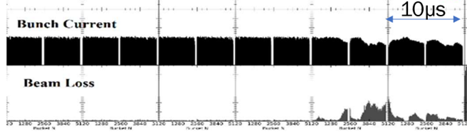
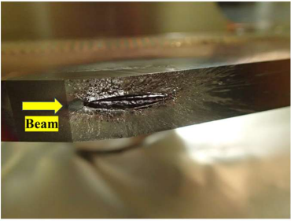
3. sudden beam losses
Large sudden beam loss (SBL) events occur within 1 turn (10 μs).
A significant portion of the beam is lost before the beam abort.
SBLs often lead to damage of collimators and other accelerator components, occasionally also to quenches of the final focusing superconducting magnets (QCS), and to large detector backgrounds plus potential damage inside the Belle 2 experiment.
SBLs occur for both beams, in collision and without collision, with a squeezed and relaxed optics, but more frequently and more impactfully in the Low Energy positron Ring (LER).
In the LER, about 250 such events were observed in 2024. The rate of SBL events is higher the higher the beam current.
Example SBL event, presented by H. Ikeda
SuperKEKB collimator jaw damaged by an SBL event, from H. Ikeda

Slide 9
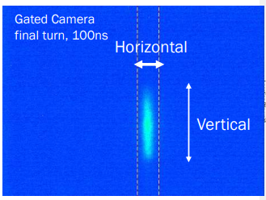
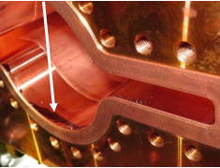
3. sudden beam losses cont’d
Several turns before the sudden beam loss happens, the vertical beam size often increases significantly.
Vertical blow during a sudden beam loss event (left), from H. Ikeda, and black stain next to an “MO’”-type flange (right), shown by K. Shibata

Slide 10
3. sudden beam losses cont’d
No other accelerator has used MO flanges, and no other collider, including PEP-II, KEKB and DAFNE, nor any low-emittance light sources, such as ESRF-EBS, APS-U, etc., reported SBL events like those seen at SuperKEKB, or any sudden vertical blow up, with or without accompanying beam loss. Modern light sources have much smaller emittances –
ESRF-EBS: ε_{x,y}=(110, 5) pm ; SuperKEKB: ε_{x,y}~(4000, 100) pm
For FCC-ee, neither MO-type vacuum flanges nor VacSeal nor clearing electrodes will be used; and sudden beam losses in the form experienced at SuperKEKB are not expected to occur.

Slide 11
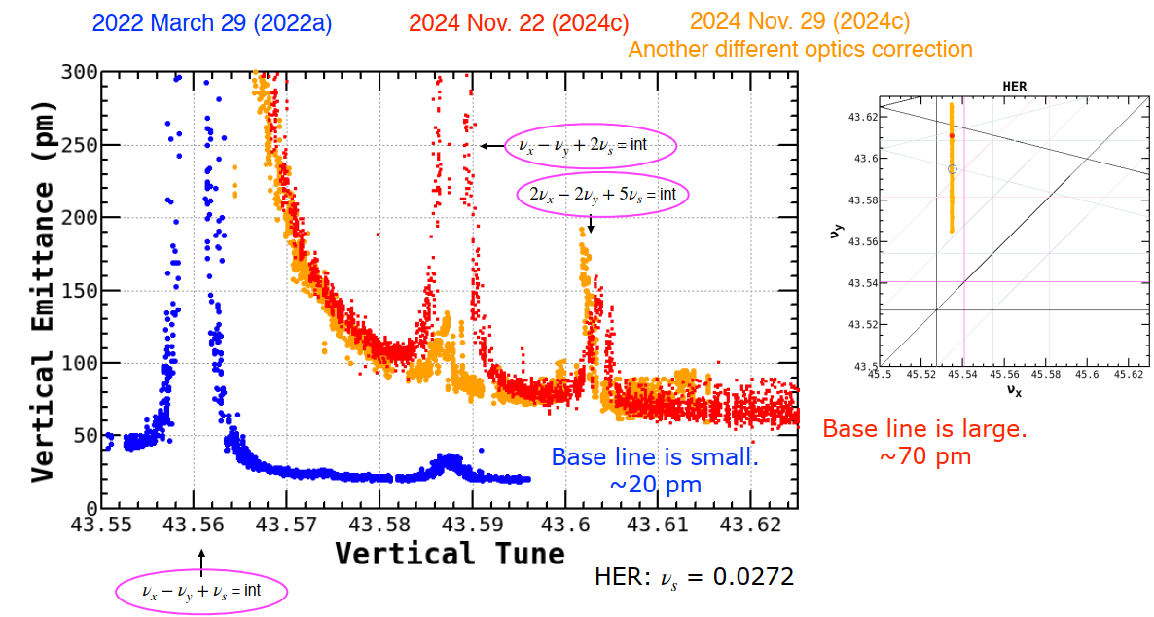
4. stored beam emittance
During the 2024c run, the minimum vertical emittance in the HER increased from 20 pm to a value above 50 –100 pm, and did not decrease below 45 – 50 pm afterwards, even w/o collision and at low current. Strong high order synchro-betatron resonances were observed in the tune scans without collision. Optics corrections could not recover the small vertical emittance, not even with a “relaxed” optics.
The design values for the rms vertical emittance are 8.6 pm in the LER and 12.9 pm for the HER.. The low-current emittances sometimes come close to this value, but often are larger.
The vertical emittance tuning and the achievable vertical emittance are ultimately limited by the available beam diagnostics (Appendix 1) and by the vertical deformation of the SuperKEKB tunnel floor, which worsens every year (Appendix 2).
Y. Ohnishi

Slide 12
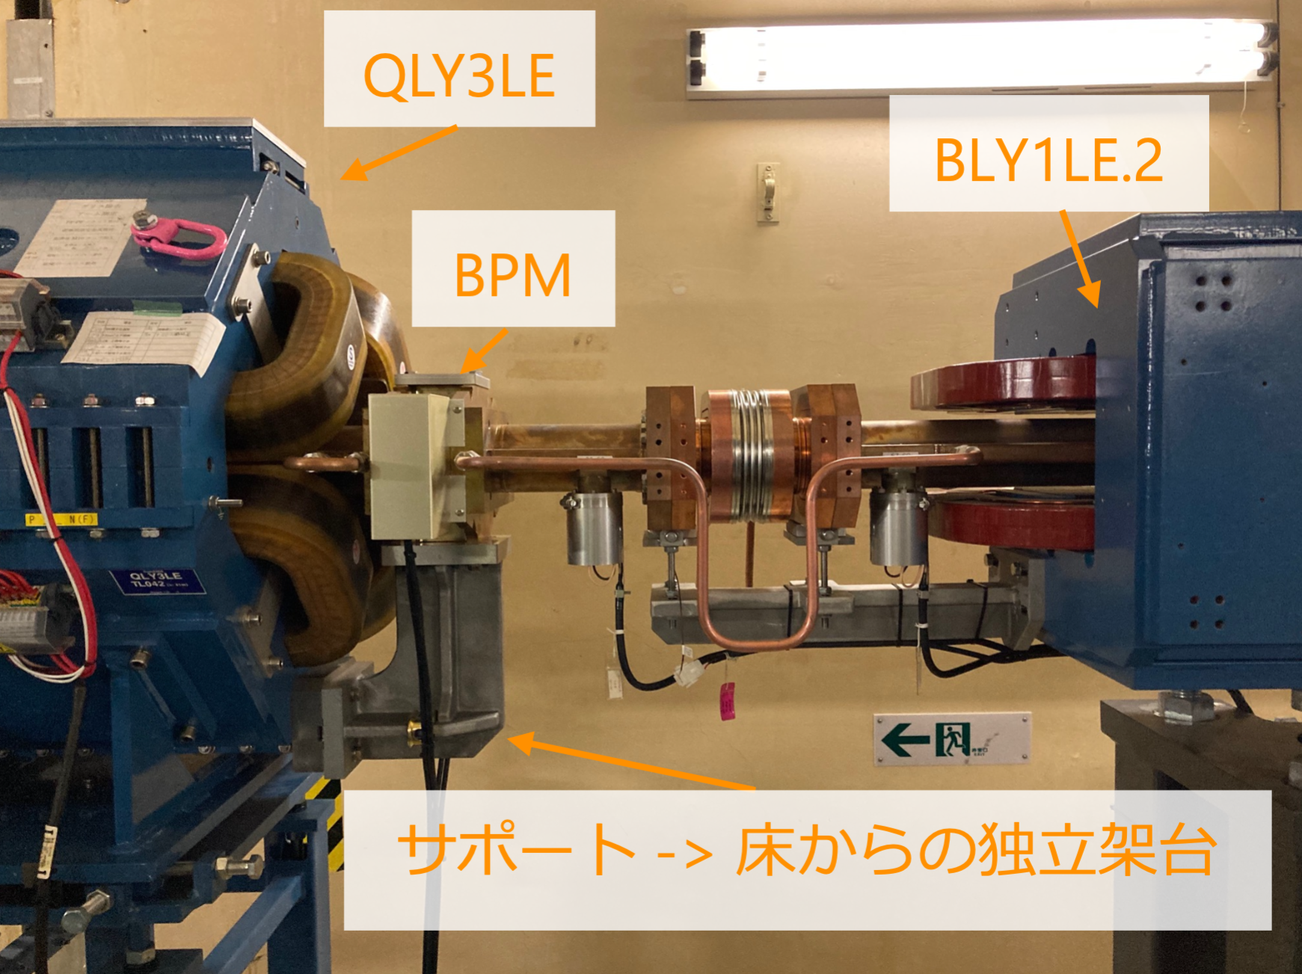
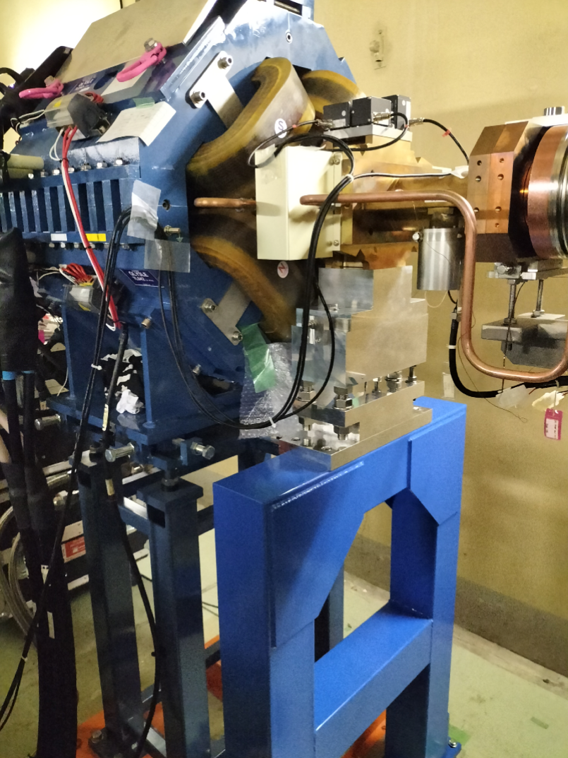
4. stored beam emittance cont’d
One hypothesis (K. Oide): sudden HER emittance growth could be related to a change of the mechanical support of critical BPMs in the final focus prior to the 2024c run.
Final focus BPM supported from the nearby quadrupole magnets prior to the 2024c run (left) and the BPM placed on its own support with vacuum chamber no longer connected to the magnet (right), as reported by Y. Ohnishi.

Slide 13
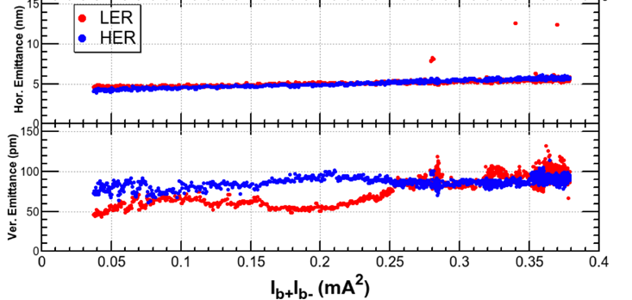
4. stored beam emittance cont’d
At higher currents and in collision, the measured vertical emittances further increase to about 100 pm, and hence are about 10 times larger than the design.
design bunch current product is ~1.5 mA²
Horizontal (top) and vertical emittance evolution (bottom) for SuperKEKB HER and LER, observed in collision after reducing $β_{x}^{∗}$ to 60 mm, as a function of the bunch current product, as reported by Y. Ohnishi

Slide 14
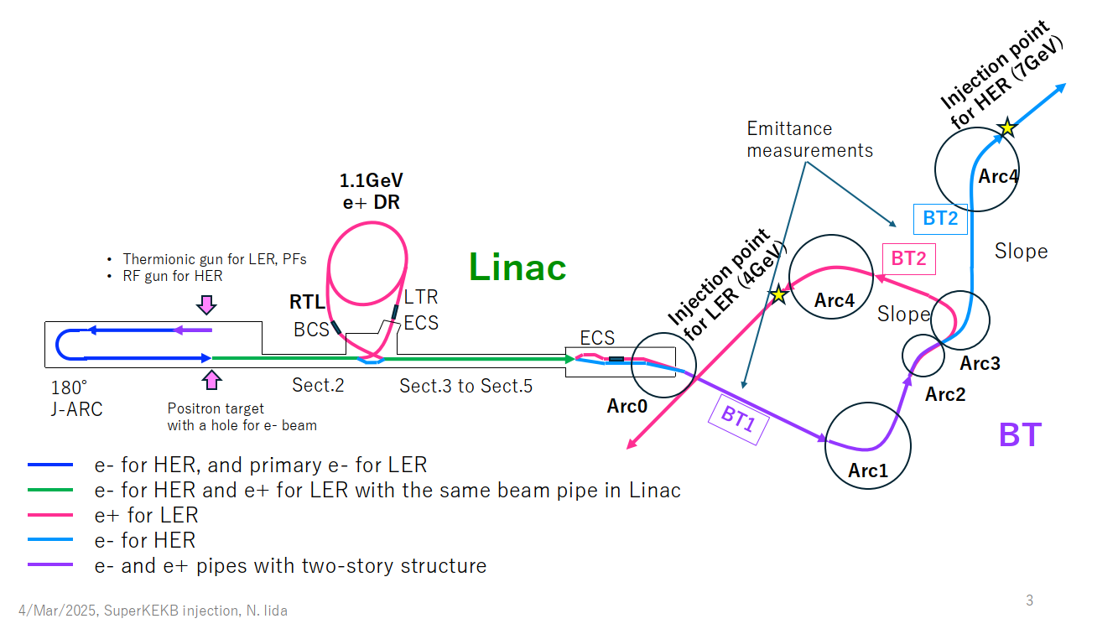
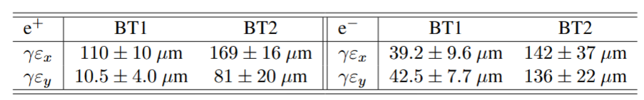


5. injected beam emittance
Layout of the SuperKEKB injector and the beam transport (BT) lines (BTLs),as presented by N. Iida. Each BTL comprises five arcs, which can be a source of emittance growth.
Emittance growth in the beam transport lines of the SuperKEKB injector measured in 2024, as reported by N. Iida.
γε= 100 μm $↔$ ε=13 nm
γε= 100 μm $↔$ ε=7 nm

Slide 15
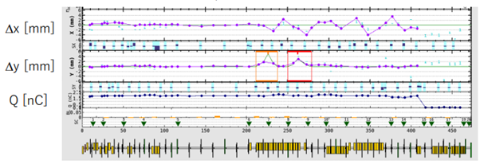
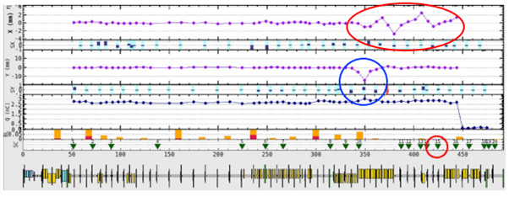
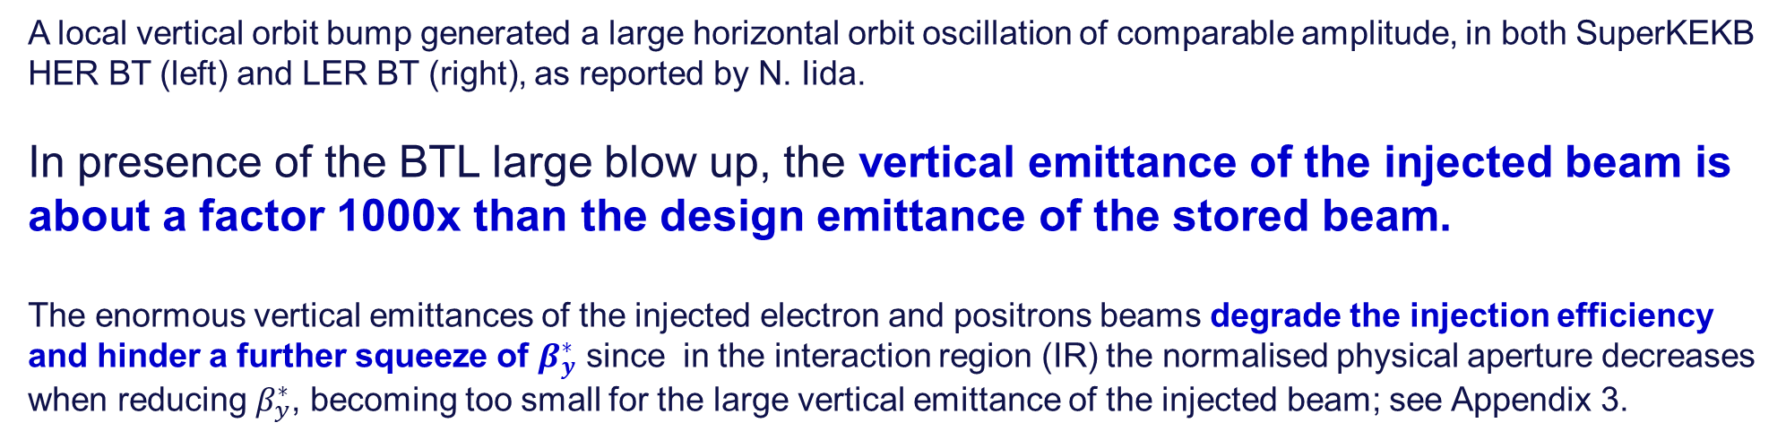
5. injected beam emittance cont’d
Unexpected nonlinear field errors were found to exist in the BT dipole magnets for either beam. In addition, strong local sources of horizontal-to-vertical coupling were detected in both electron and positron transport lines.
A local vertical orbit bump generated a large horizontal orbit oscillation of comparable amplitude, in both SuperKEKB HER BT (left) and LER BT (right), as reported by N. Iida.
In presence of the BTL large blow up, the vertical emittance of the injected beam is about a factor 1000x than the design emittance of the stored beam.
The enormous vertical emittances of the injected electron and positrons beams degrade the injection efficiency and hinder a further squeeze of $β_{y}^{∗}$ since in the interaction region (IR) the normalised physical aperture decreases when reducing $β_{y}^{∗}$, becoming too small for the large vertical emittance of the injected beam; see Appendix 3.

Slide 16
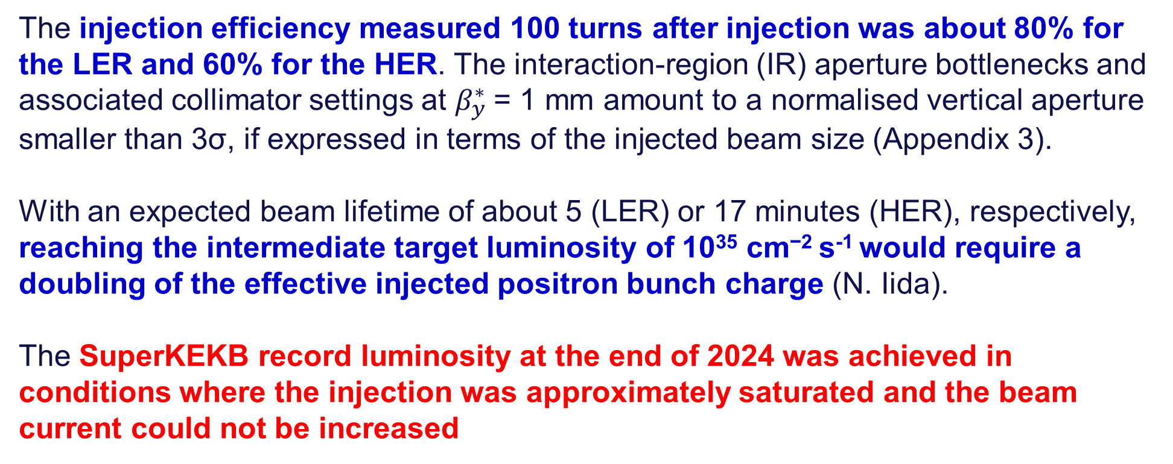
6. injection efficiency and beam current
The SuperKEKB design beam currents are a factor 2, or more, larger than the maximum beam currents that could be achieved so far. The beam currents are limited by both injection efficiency and bunch charges available from the linac.
The injection efficiency measured 100 turns after injection was about 80% for the LER and 60% for the HER. The interaction-region (IR) aperture bottlenecks and associated collimator settings at $β_{y}^{∗}$= 1 mm amount to a normalised vertical aperture smaller than 3σ, if expressed in terms of the injected beam size (Appendix 3).
With an expected beam lifetime of about 5 (LER) or 17 minutes (HER), respectively, reaching the intermediate target luminosity of 10³⁵ cm⁻² s⁻¹ would require a doubling of the effective injected positron bunch charge (N. Iida).
The SuperKEKB record luminosity at the end of 2024 was achieved in conditions where the injection was approximately saturated and the beam current could not be increased

Slide 17
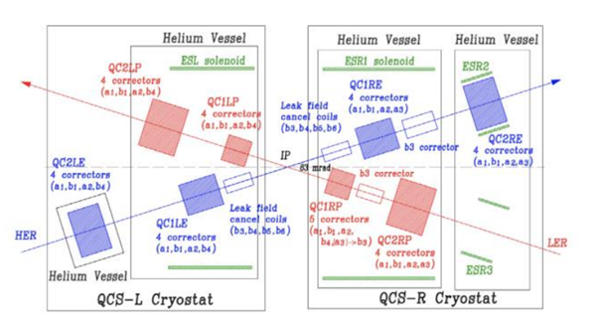
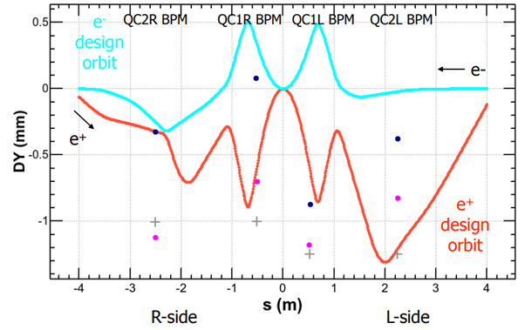
7. interaction region
The interaction region (IR) of SuperKEKB is complex. IR aperture bottlenecks are discussed in Appendix 3.
Layout of the superconducting IR magnet system of SuperKEKB. The effect of the solenoid field of Belle II is compensated by the compensation solenoids ESL, ESR1, ESR2, and ESR3. An imperfect cancellation would give rise to a residual chromatic skew coupling at the collision point, which is not easily measured and corrected.
Vertical design orbits of e⁻ (light blue curve, from right to left) and e⁺ beams (red curve, from left to right) around the SuperKEKB IP and measured beam positions (dots), shown by Y. Ohnishi. Dark blue points represent the HER beam orbit measured at the QC1LE and QC2LE BPMs. Pink points correspond to the measured LER orbit. The ``+'' signs indicate the vertical offset from a straight reference orbit of the LER BPMs at QC1LP, QC2LP, QC1RP and QC2RP. The magnets have the same (or a similar) mechanical offset as their associated BPMs. The BPM readings were corrected for mechanical offsets.

Slide 18
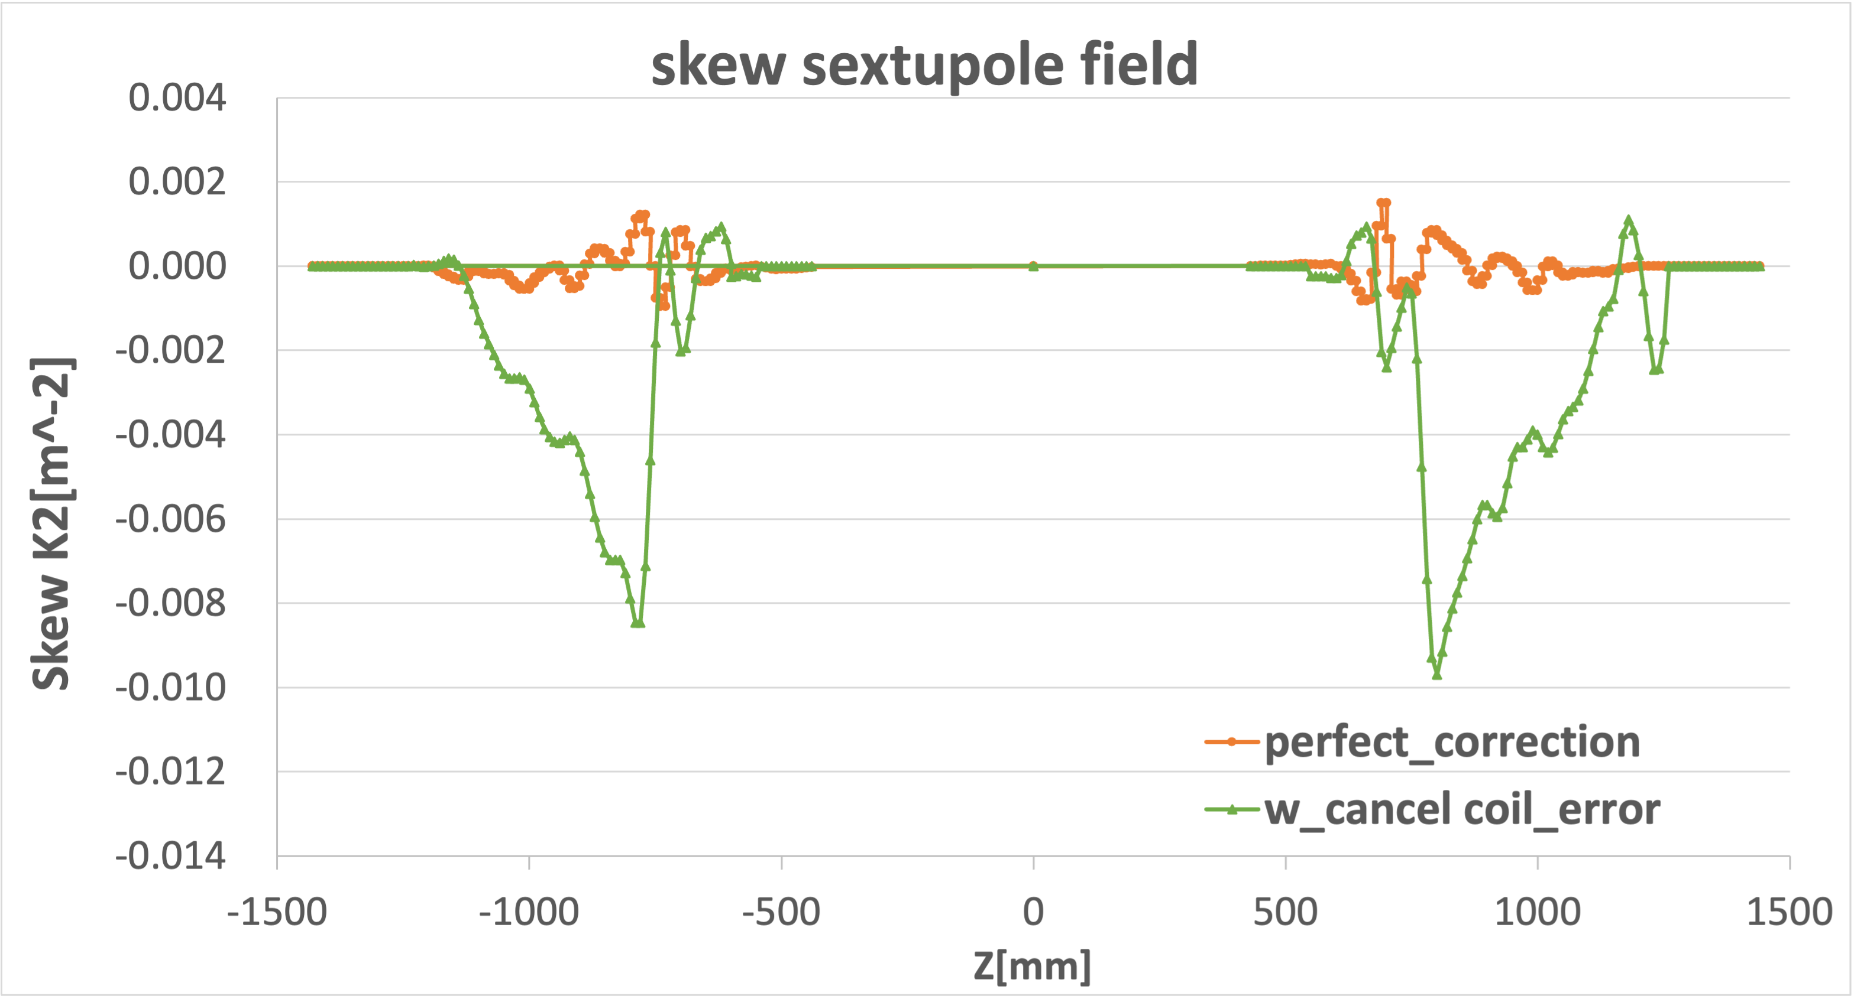
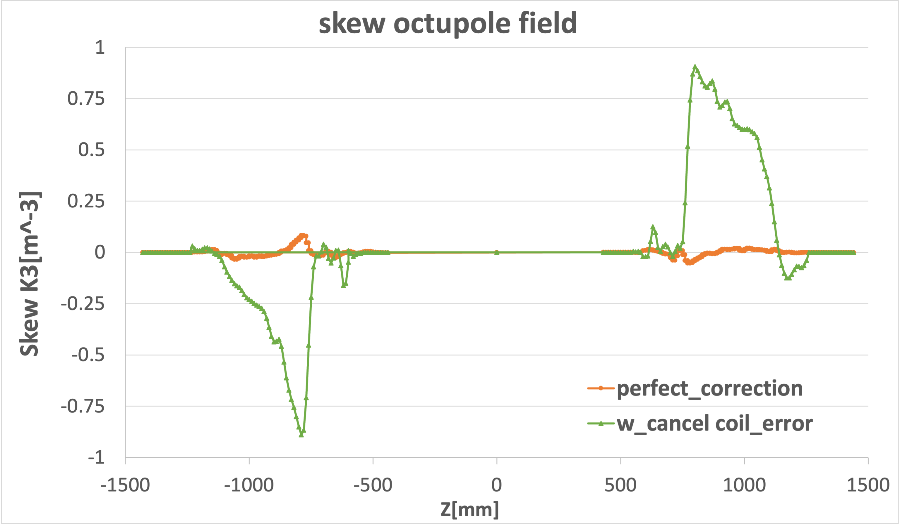
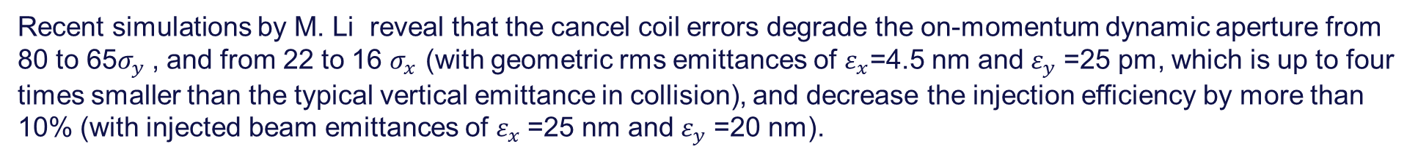
7. interaction region cont’d
The design (orange) and actual (green) leakage skew sextupole and octupole field components, generated by the LER final quadrupoles, as seen by the HER beam, versus the distance from the collision point, shown by L. Meng based on input from Y. Ohnishi.
Recent simulations by M. Li reveal that the cancel coil errors degrade the on-momentum dynamic aperture from 80 to 65$σ_{y}$, and from 22 to 16 $σ_{x}$ (with geometric rms emittances of $ε_{x}$=4.5 nm and $ε_{y}$=25 pm, which is up to four times smaller than the typical vertical emittance in collision), and decrease the injection efficiency by more than 10% (with injected beam emittances of $ε_{x}$=25 nm and $ε_{y}$=20 nm).

Slide 19
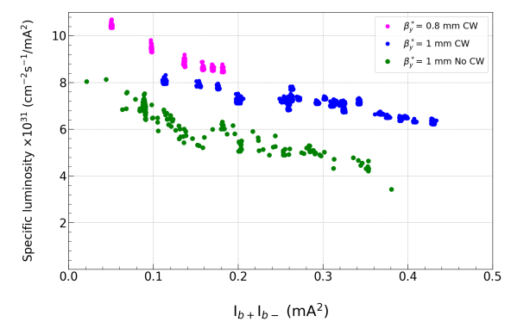
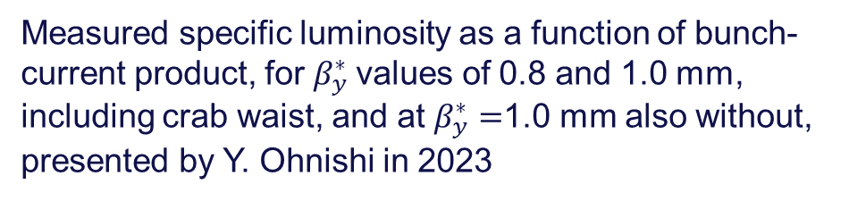
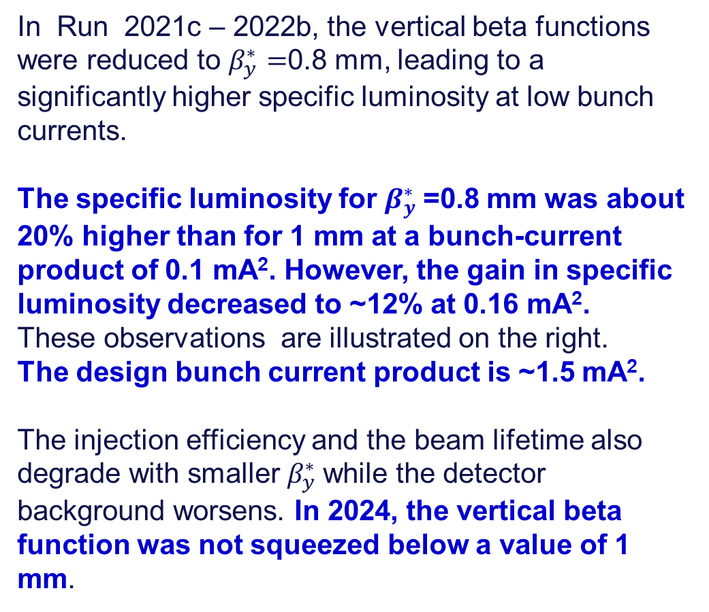
8. beta function at the collision point
In Run 2021c – 2022b, the vertical beta functions were reduced to $β_{y}^{∗}=$0.8 mm, leading to a significantly higher specific luminosity at low bunch currents.
The specific luminosity for $β_{y}^{∗}$=0.8 mm was about 20% higher than for 1 mm at a bunch-current product of 0.1 mA². However, the gain in specific luminosity decreased to ~12% at 0.16 mA².
These observations are illustrated on the right.
The design bunch current product is ~1.5 mA².
The injection efficiency and the beam lifetime also degrade with smaller $β_{y}^{∗}$while the detector background worsens. In 2024, the vertical beta function was not squeezed below a value of 1 mm.
Measured specific luminosity as a function of bunch-current product, for $β_{y}^{∗}$values of 0.8 and 1.0 mm, including crab waist, and at $β_{y}^{∗}=$1.0 mm also without, presented by Y. Ohnishi in 2023

Slide 20
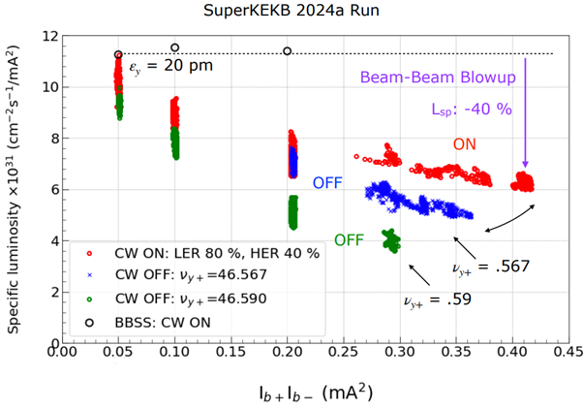
9. specific luminosity: observations
At higher bunch-current products the SuperKEKB specific luminosity decreases. The crab waist collisions scheme improves the situation, but it does not fully restore the value achieved at very low bunch currents.
Measured specific luminosity as a function of bunch-current product without the crab waist at two betatron tunes (green and blue) and with the nominal crab waist (red), presented by Y. Ohnishi

Slide 21
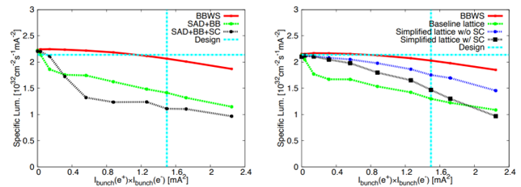
9. specific luminosity cont’d: simulation w lattice and SC
A significant reduction of the SuperKEKB specific luminosity at higher bunch currents had long been expected from simulations (Zhou 2015). The importance of adding the nonlinearity had earlier been demonstrated for the former SLAC PEP-II B factory, where beams collided with zero crossing angle (Cai 2005).
Specific luminosity as a function of bunch current product obtained from weak-strong simulations for the LER, considering an ideal situation with a linear machine (“BBWS’”, red curve), a realistic baseline lattice with detector solenoid (“SAD’”, green curve), the effect of space charge (SC) added to a simplified lattice (black curve, right picture), or the combined effect of the full lattice and space charge (black curve, left picture), presented by D. Zhou in 2015. The black curve with space charge in the right picture can be compared with the blue curve presenting the effect of the simplified lattice only; the latter contains simpler final-focus quadrupoles and no solenoids.

Slide 22
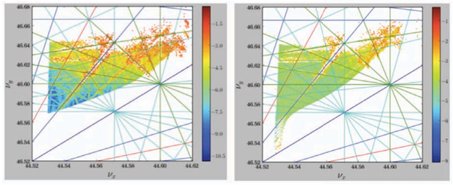
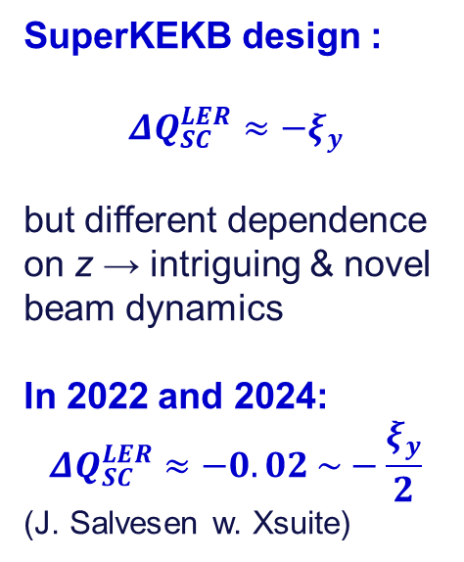
9. specific luminosity cont’d: effect of space charge
SuperKEKB design :
$${ΔQ}_{SC}^{LER}≈−ξ_{y}$$
but different dependence on z → intriguing & novel beam dynamics
In 2022 and 2024:
$${ΔQ}_{SC}^{LER}≈−0.02 \sim −\frac{ξ_{y}}{2}$$
(J. Salvesen w. Xsuite)
Simulated betatron tune footprint for a lattice of the SuperKEKB LER, including the beam-beam collision, without (left) and with (right) space-charge effect, presented by D. Zhou in 2015. Resonance lines up to 7th order are indicated.

Slide 23
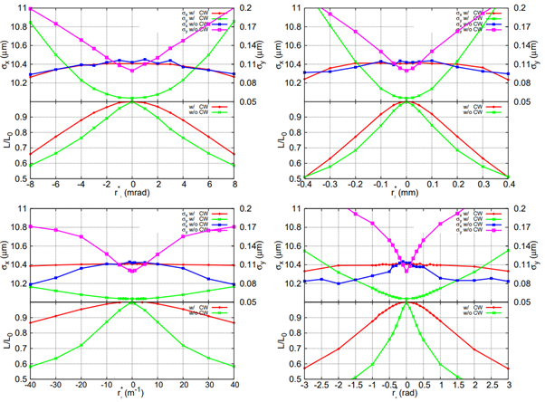
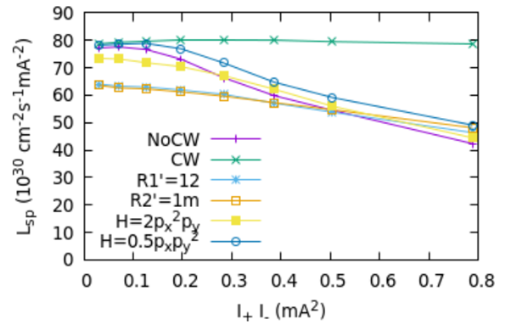
9. specific luminosity cont’d: linear & chromatic coupling
Simulated beam sizes and relative luminosity as a function of the linear x-y coupling parameters at the IP with and without the crab waist collision scheme, presented by D. Zhou in 2010, where he considered slightly different SuperKEKB design parameters.
Simulated specific luminosity as a function of bunch-current product, for different values of the chromatic coupling R₁'=dR₁*/dδ, and R₂'=dR₂*/dδ, presented by K. Ohmi.

Slide 24
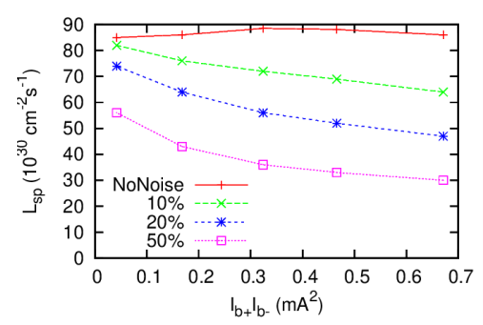
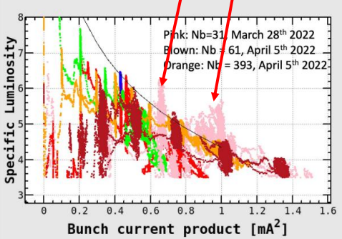
9. specific luminosity cont’d: feedback and noise
Measured (left) and simulated specific luminosity (right) as a function of bunch-current product, presented by K. Ohmi. The pink data on the left were taken with transverse bunch-by-bunch feedback system switched off, while the feedback was active, with more bunches, for the other colors. Different curves on the right consider various levels of feedback noise, expressed in percent of the rms vertical beam size.

Slide 25
10. summary and conclusions
SuperKEKB experience provides important lessons and input for the FCC-ee design.
The SuperKEKB luminosity performance is still an order of magnitude short of the target value.
As discussed, a number of issues are limiting the present SuperKEKB luminosity performance. All of these appear to be very specific to SuperKEKB. They were not observed, in this form, at any previous colliders or at any of the modern light sources.
A few additional and complementary issues faced by SuperKEKB are addressed in the Appendices, e.g., effect of longitudinal impedance in Appendix 4.
We see no reason or argument to suggest that any of these problems should be encountered at FCC-ee. Specifically, we highlight the following points (next page).

Slide 26
10. summary and conclusions cont’d: specific points FCC
FCC-ee, no MO-type vacuum flanges and no VacSeal.
FCC-ee: beam injected from a full-energy booster, providing vertical beam emittance similar to (or even smaller than) the design emittance of the collider and not several orders of magnitude higher. Nevertheless, a factor 10 margin for vertical emittance included in the FCC-ee injection design.
A y/x emittance ratio without collision of ~0.1-0.2% (FCC-ee) should be achievable, according to simulations with realistic errors. Ratios down to 0.01% demonstrated at light sources.
FCC-ee interaction region simpler, with at least an order-of-magnitude larger aperture normalised to injected beam size; full local compensation of coupling & chromatic coupling.
FCC-ee beam-position monitors fixed on a common girder with nearby quadrupole and sextupole magnets; magnet supports more robust.
Most of available beam diagnostics at SuperKEKB does not have turn-by-turn, bunch-by-bunch detection capability; insufficient for measuring the beam optics in collision or analysing nonlinear terms.
FCC-ee will have state-of-the-art optics diagnostics like the BPM system of the LHC.
The SuperKEKB tunnel is floating; significant vertical tunnel deformation increases every year, degrading vertical beam emittances. Deeper FCC-ee tunnel should be stabler (LEP/LHC example)
Space-charge effects at FCC-ee smaller thanks to higher beam energy & longer bunches. Bunch lengthening w current due to impedance is much weaker since beamstrahlung dominant.

Slide 27
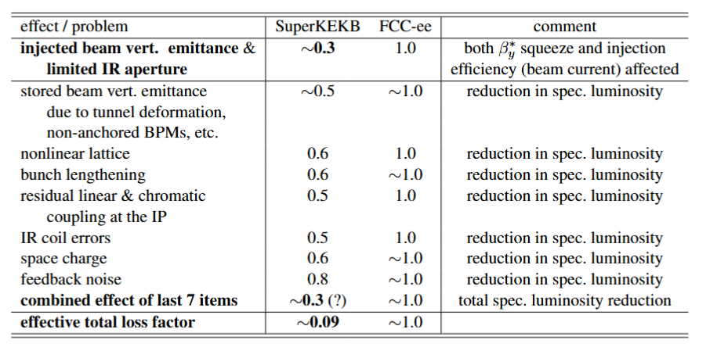
10. summary and conclusions cont’d: issues compared
Issues encountered by SuperKEKB together with the estimated resulting luminosity loss factor with respect to the design luminosity at nominal beam current, and the corresponding expectation for FCC-ee.

Slide 28
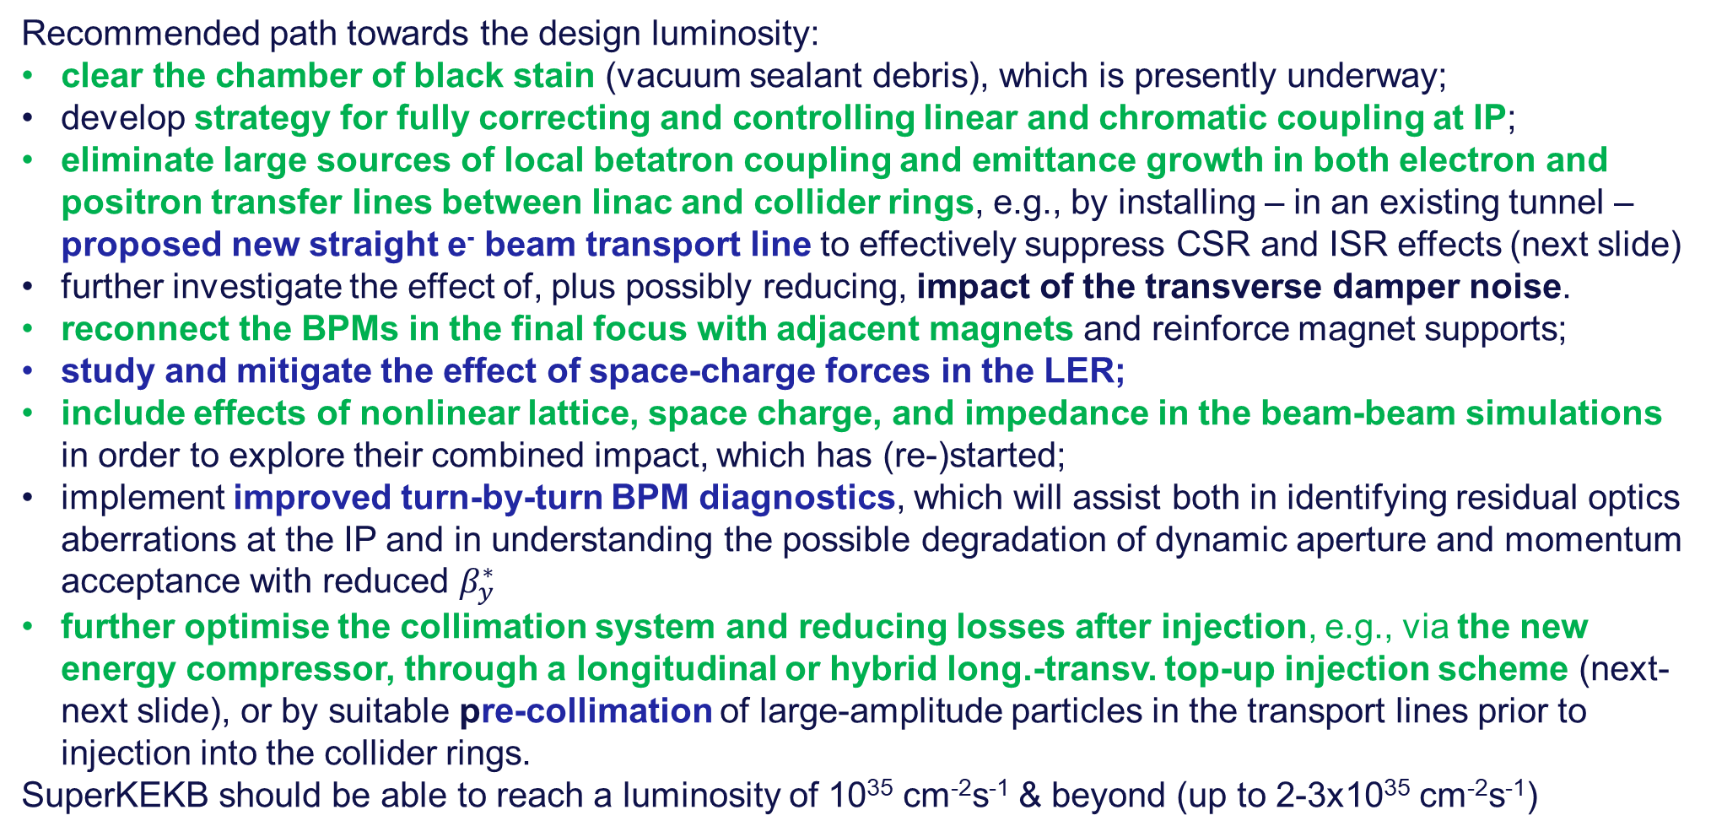
10. summary and conclusions cont’d: SuperKEKB path
green color: immediate action, blue color: medium term
Recommended path towards the design luminosity:
clear the chamber of black stain (vacuum sealant debris), which is presently underway;
develop strategy for fully correcting and controlling linear and chromatic coupling at IP;
eliminate large sources of local betatron coupling and emittance growth in both electron and positron transfer lines between linac and collider rings, e.g., by installing – in an existing tunnel – proposed new straight e⁻ beam transport line to effectively suppress CSR and ISR effects (next slide)
further investigate the effect of, plus possibly reducing, impact of the transverse damper noise.
reconnect the BPMs in the final focus with adjacent magnets and reinforce magnet supports;
study and mitigate the effect of space-charge forces in the LER;
include effects of nonlinear lattice, space charge, and impedance in the beam-beam simulations in order to explore their combined impact, which has (re-)started;
implement improved turn-by-turn BPM diagnostics, which will assist both in identifying residual optics aberrations at the IP and in understanding the possible degradation of dynamic aperture and momentum acceptance with reduced $β_{y}^{∗}$
further optimise the collimation system and reducing losses after injection, e.g., via the new energy compressor, through a longitudinal or hybrid long.-transv. top-up injection scheme (next-next slide), or by suitable pre-collimation of large-amplitude particles in the transport lines prior to injection into the collider rings.
SuperKEKB should be able to reach a luminosity of 10³⁵ cm⁻²s⁻¹ & beyond (up to 2-3x10³⁵ cm⁻²s⁻¹)

Slide 29
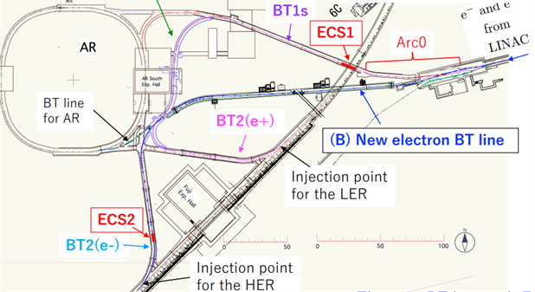
10. summary and conclusions cont’d: new e⁻ BT line
A new straighter electron beam transport line in an existing tunnel, as proposed by N. Iida

Slide 30
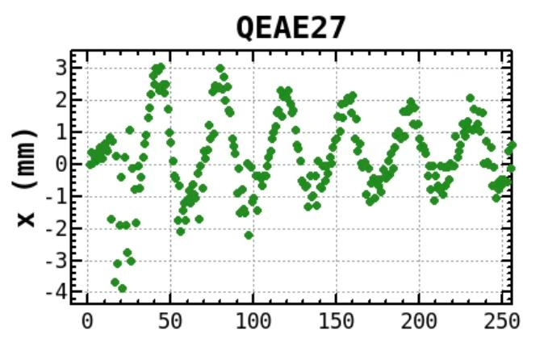
10. summary and conclusions cont’d: longitudinal injection
First longitudinal injection
into the SuperKEKB HER incl. ECS,
5 November 2025
The horizontal injection oscillation shows only synchrotron component!
(private communication, K. Oide)

Slide 31
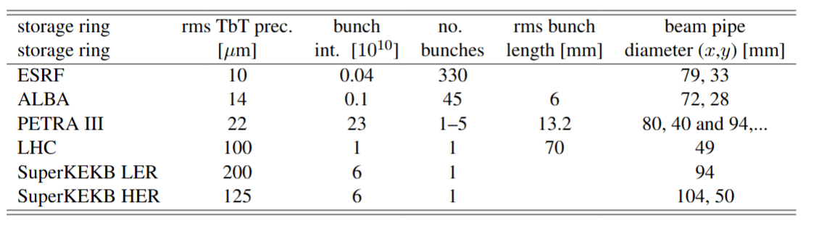
appendix 1: beam diagnostics
SuperKEKB lacks turn-by-turn, bunch-by-bunch BPMs, except for a few out of 450 BPMs per ring. Some of the SuperKEKB BPMs (about 50 per ring) have a turn-by-turn detection capability (albeit with a rather limited resolution, as shown the table below1), but even these cannot record bunch-by-bunch oscillations. Therefore, it is not possible to diagnose the beam optics with colliding beams by exciting, or kicking, the non-colliding pilot bunches or one of the colliding bunches.
Rms precision (noise) of turn-by-turn (TbT) BPM measurements at various storage rings along with other relevant parameters (R. Tomas, M. Hofer et al.)

Slide 32
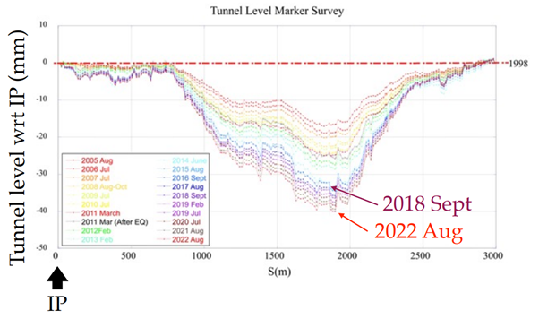
appendix 2: tunnel floor movement
The SuperKEKB tunnel is not supported by stable rock. Instead, it is floating in the soil. A large part of the tunnel is sinking by about 1 mm per year with respect to the interaction point.
Measured year-by-year variation of the (Super)KEKB tunnel level with respect to the interaction point, presented by M. Masuzawa

Slide 33

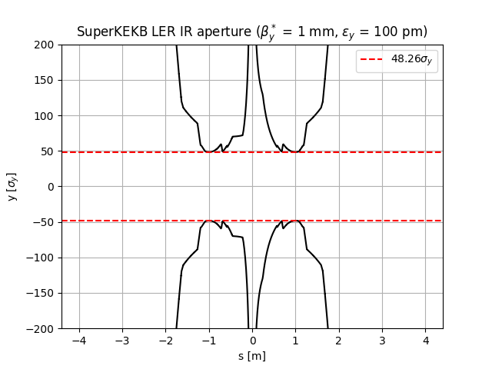
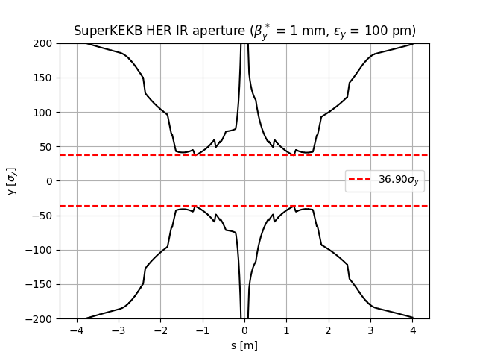
appendix 3: physical aperture in the IR
Interaction-region physical aperture at the SuperKEKB LER (left) and HER (right), in units of rms vertical beam size, $σ_{y}$, computed for a stored-beam geometric emittance of 100 pm and $β_{y}^{∗}$ = 1 mm (Courtesy G. Broggi).
With a normalised vertical injected beam emittance of 100 μm for the LER and 150 μm for the HER, at $β_{y}^{∗}$ =0.3 mm, the collimators protecting the SuperKEKB IR aperture would sit at only 1.5 $σ_{y} .$The injected beam emittance must be reduced before further squeezing $β_{y}^{∗}$ below 0.8-1.0 mm.

Slide 34
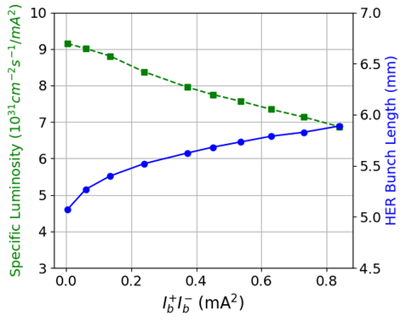
appendix 4: incomplete beam dynamics
The effects of the nonlinear lattice, space charge, and impedance, were not routinely considered for the SuperKEKB performance estimates. A noticeable impact of the nonlinear lattice and space charge on the specific luminosity was pointed out by D.~Zhou ten years ago, but left unresolved. Bunch lengthening due to the longitudinal impedance will further reduce the specific luminosity (See PhysRevAccelBeams.26.071001).
Simulated specific luminosity as a function of bunch-current product (green curve), in APES simulations, including the bunch lengthening predicted from the longitudinal impedance model (blue curve), from C. Lin in 2025, presented by X. BuffaT.

Slide 35





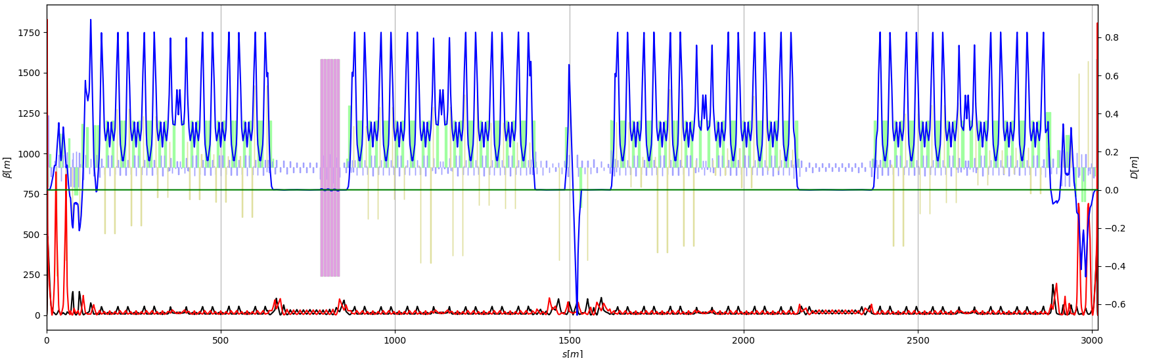
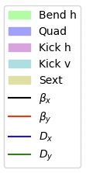
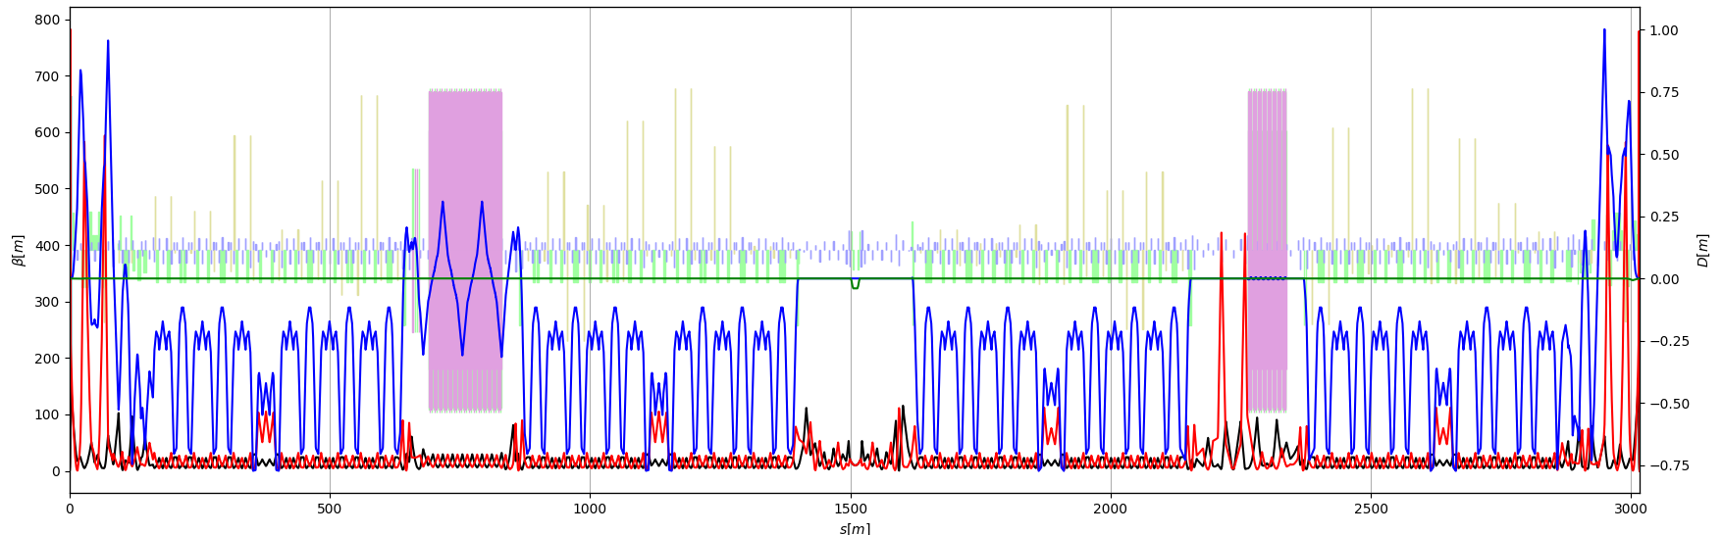
appendix 5: SuperKEKB in Xsuite
strong collaboration between CERN and KEK
alternative modelling strategy for IR
many additional features & improvements to Xsuite have come about as a result of this effort
J. Salvesen, G. Iadarola, G. Broggi, H. Sugimoto, K. Oide

Slide 36

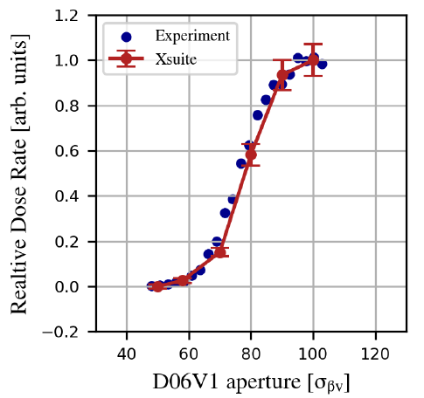
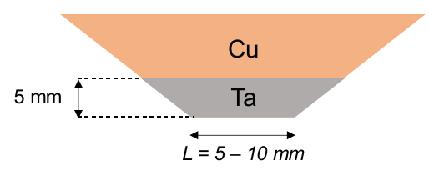
appendix 5 cont’d: Xsuite simulations for SuperKEKB
G. Broggi, J. Salvesen, G. Iadarola, H. Sugimoto, K. Oide
  Touschek & beam-gas scattering for different collimator settings, including collimator-matter interaction
  Xsuite-simulated response of Belle-II diamond detector to change in collimator position
  demonstrating
  importance and strength of international collaboration in the accelerator field

