Slide 1
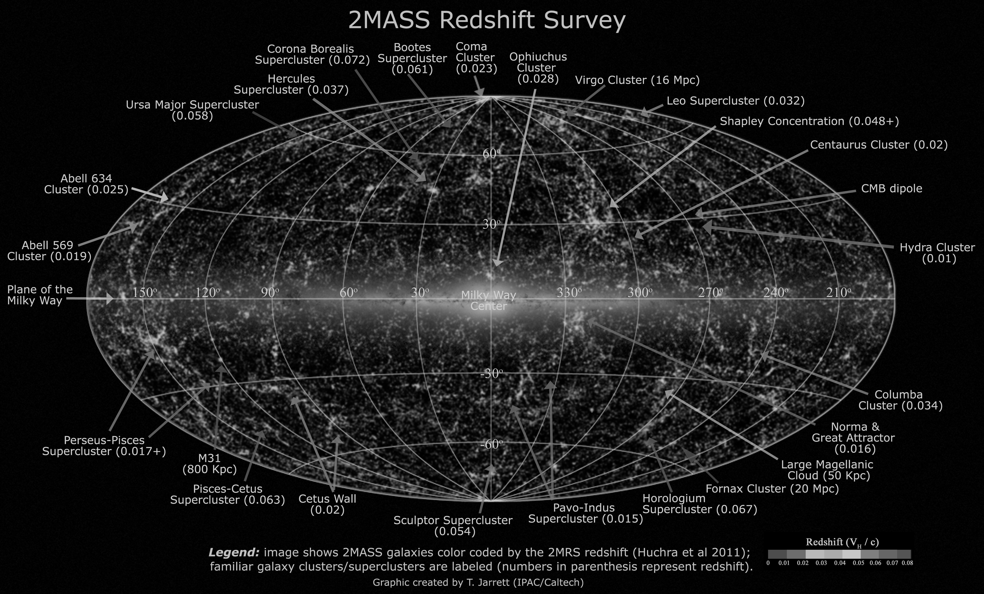
Tracing galaxies back in time: why and how?
Adi Nusser, Technion- Israel Institute of Technology
\w Lilow, Ganeesha, Davis, Branchini

Slide 2
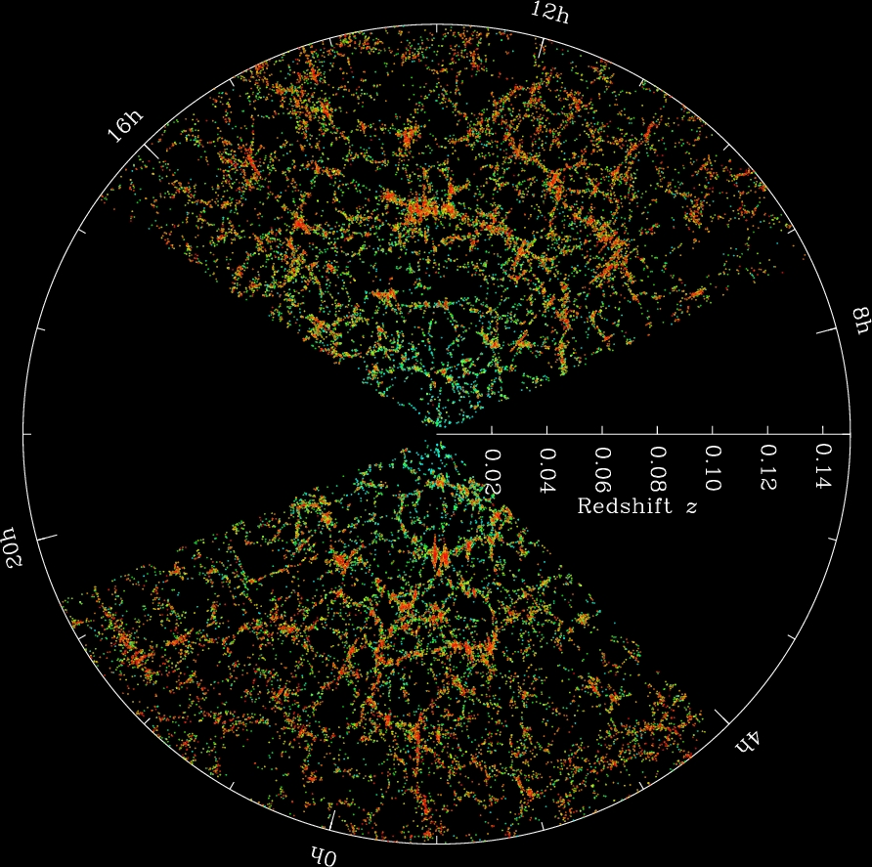
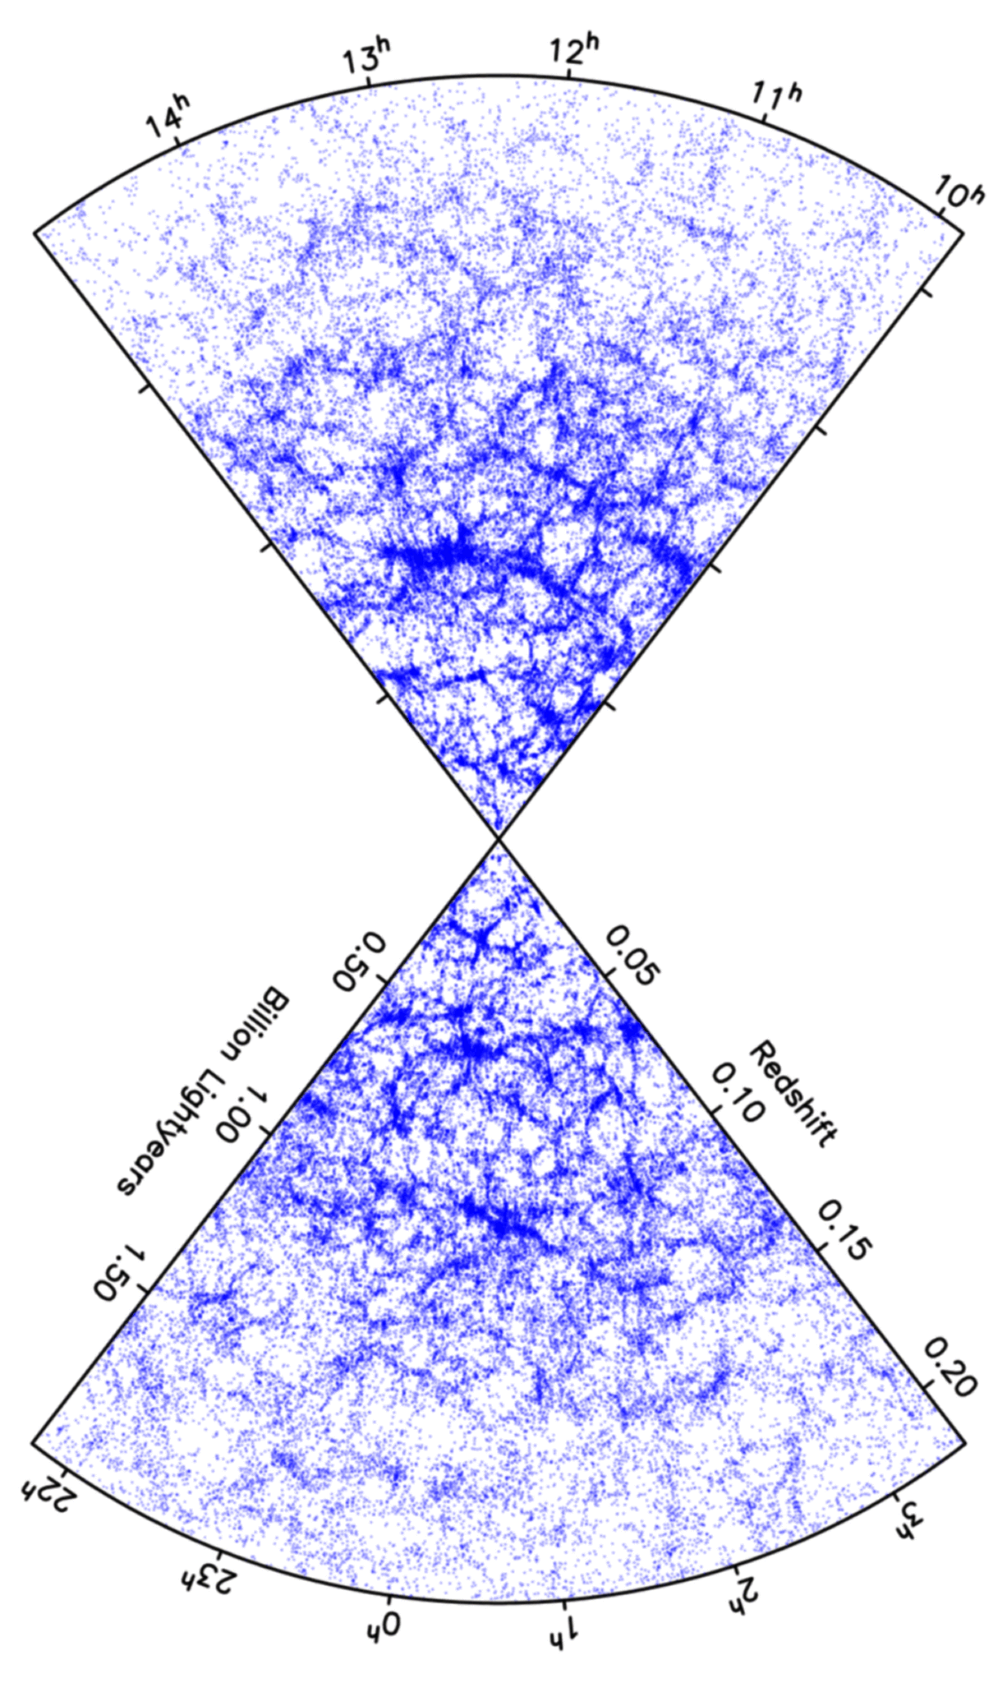
Galaxy redshift surveys:
cz, θ, φ
SDSS
2DF

Slide 3
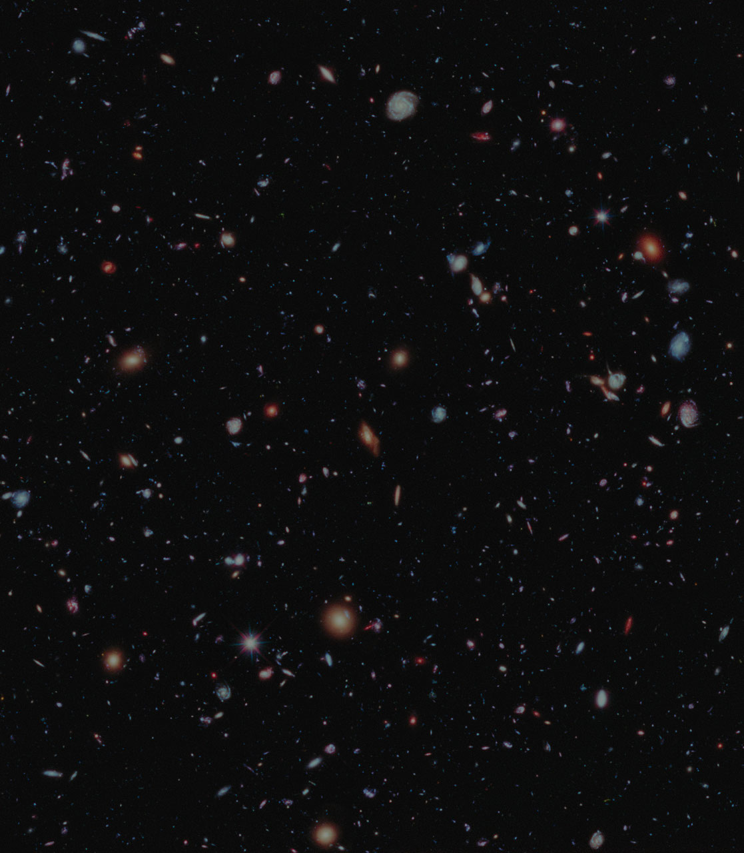
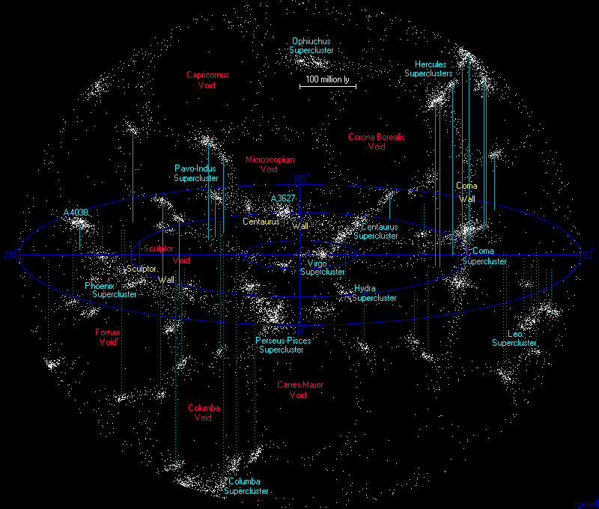
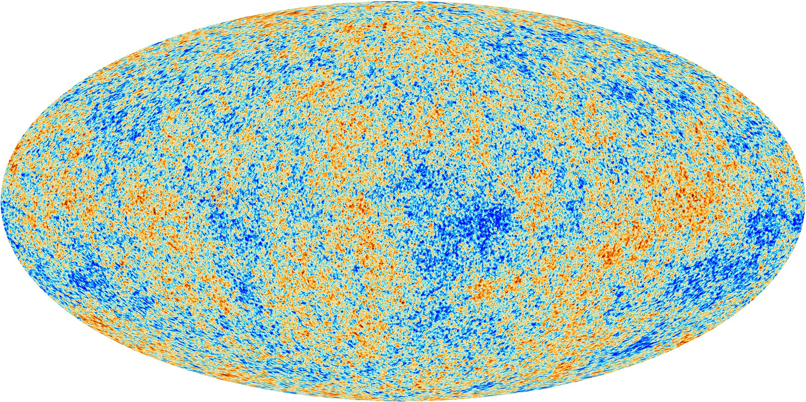

The Problem off Structure Formation
highly clumpy now
initial near homogeneity
gravity

Slide 4
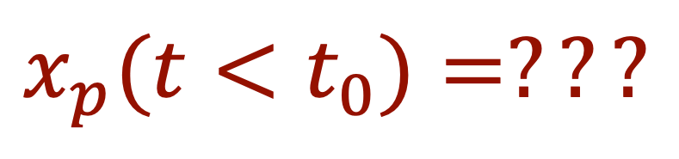
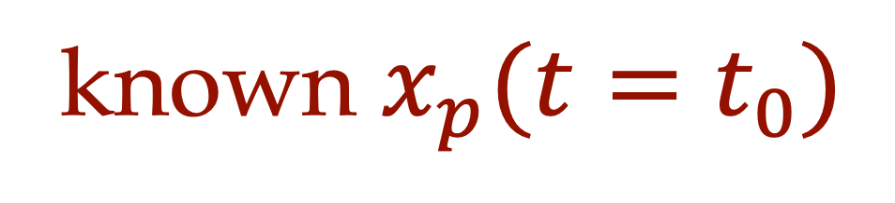
Back-in-time
clustered mass tracers (galaxies)
Nearly homogeneous
initial conditions
known $x_{p}(t=t_{0})$
$$x_{p}(t<t_{0})=???$$

Slide 5
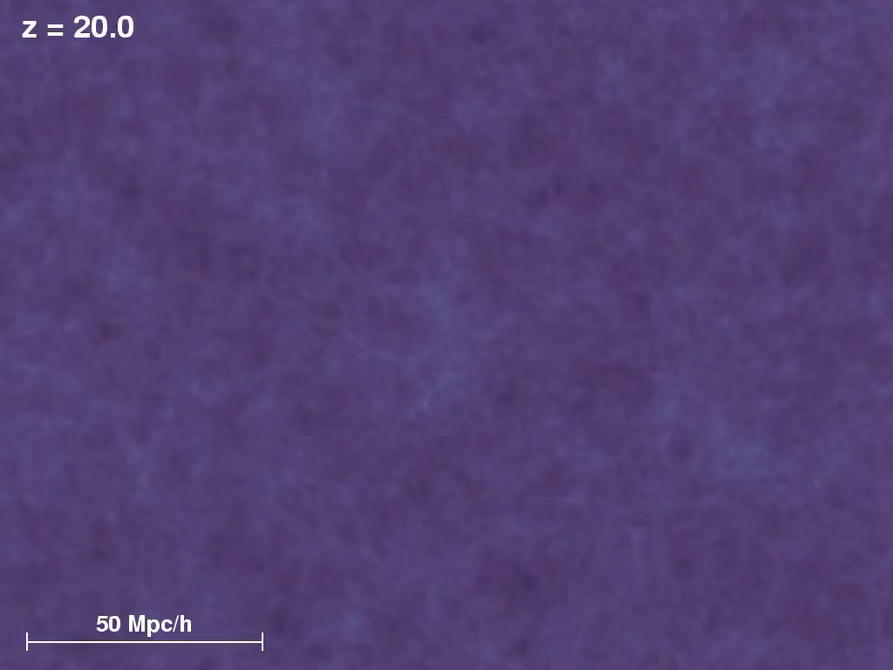
Forward-in-Time

Slide 6
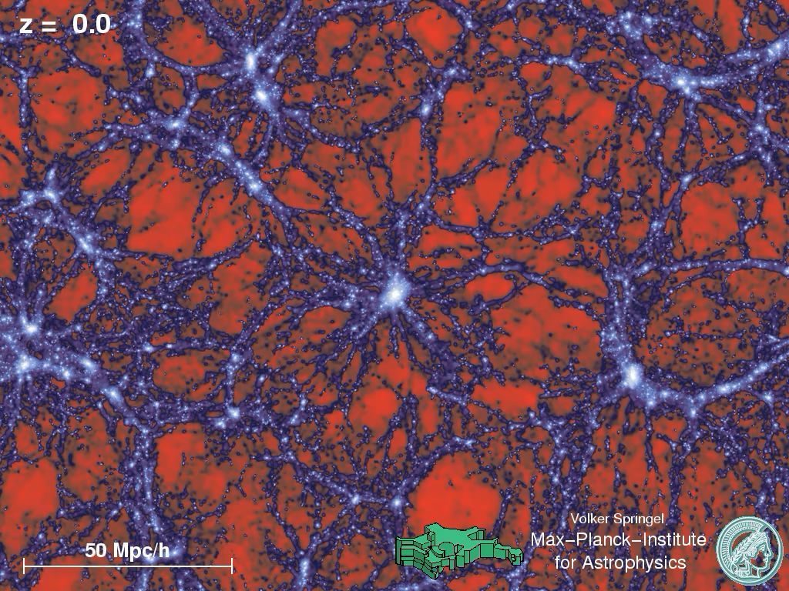
Back-in-Time

Slide 7
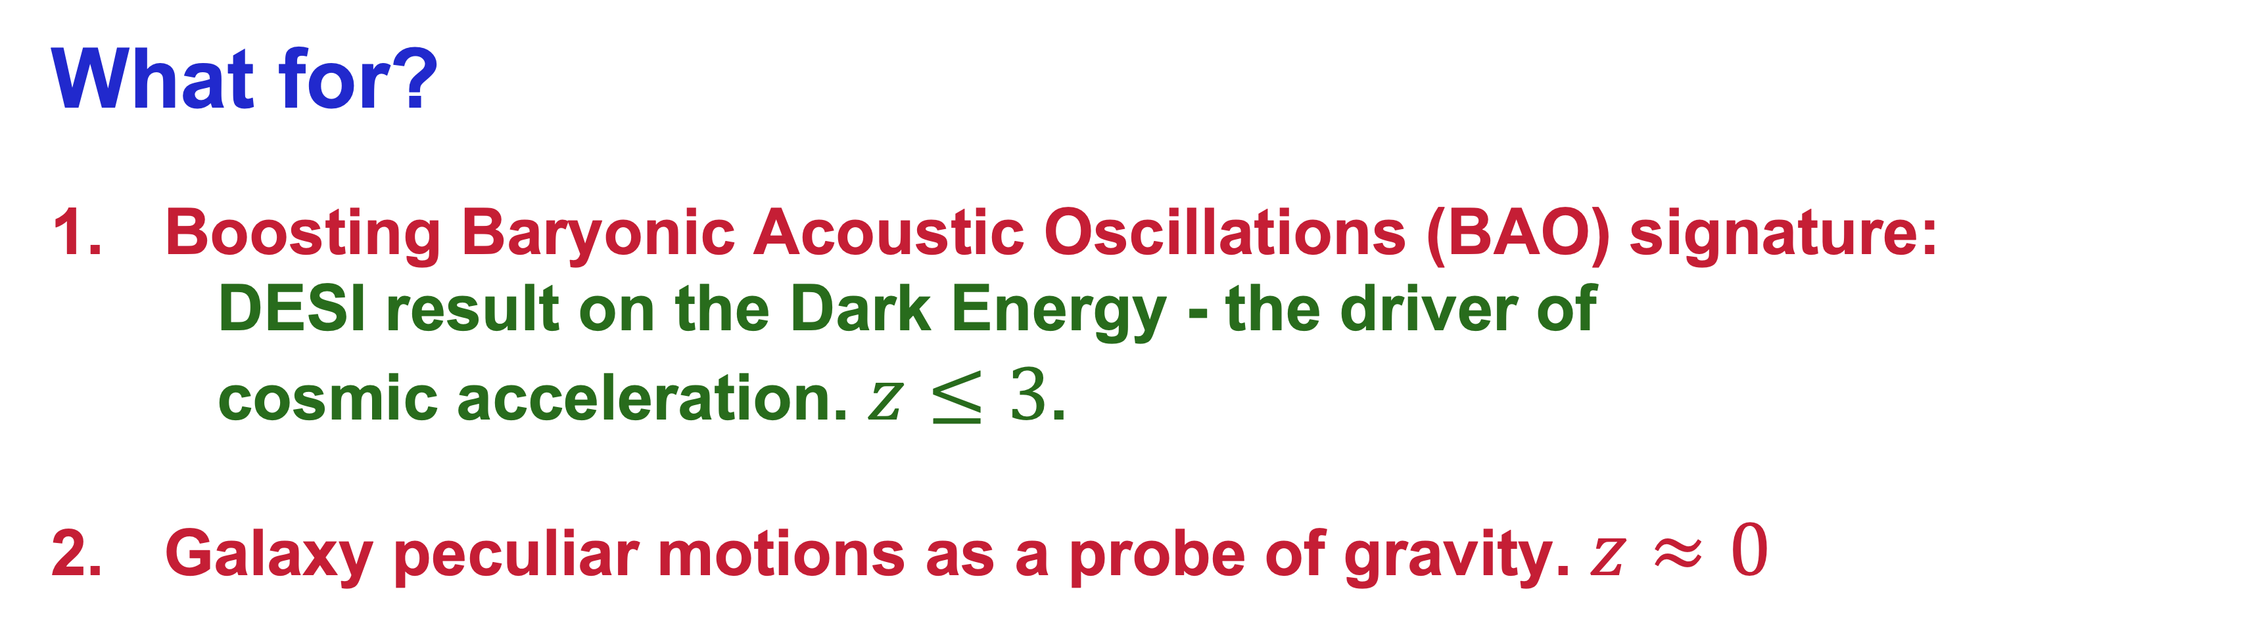
What for?
Boosting Baryonic Acoustic Oscillations (BAO) signature:
DESI result on the Dark Energy - the driver of
cosmic acceleration. $z≤3$.
Galaxy peculiar motions as a probe of gravity. $z≈0$

Slide 8
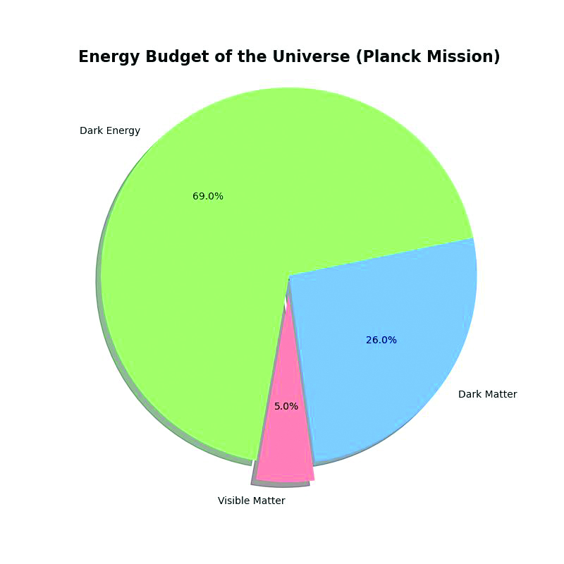
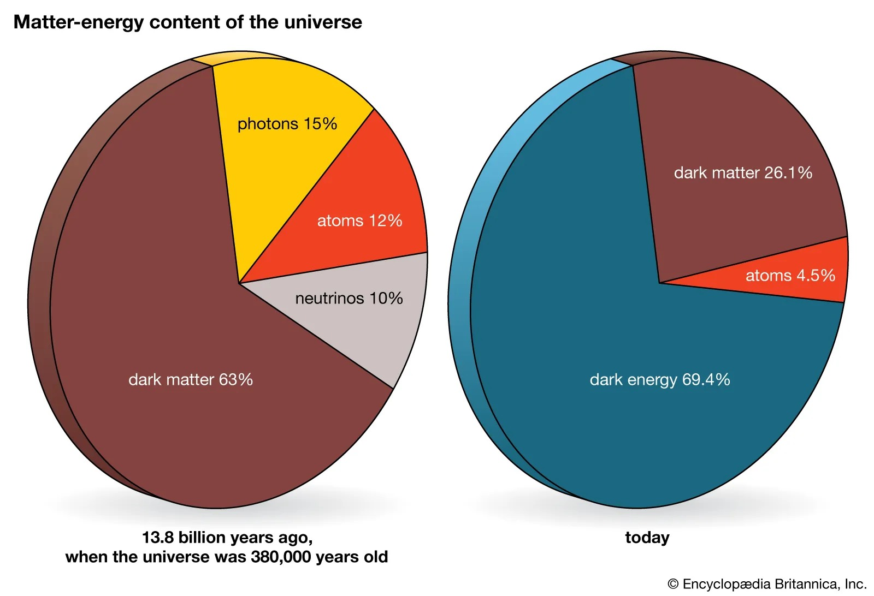
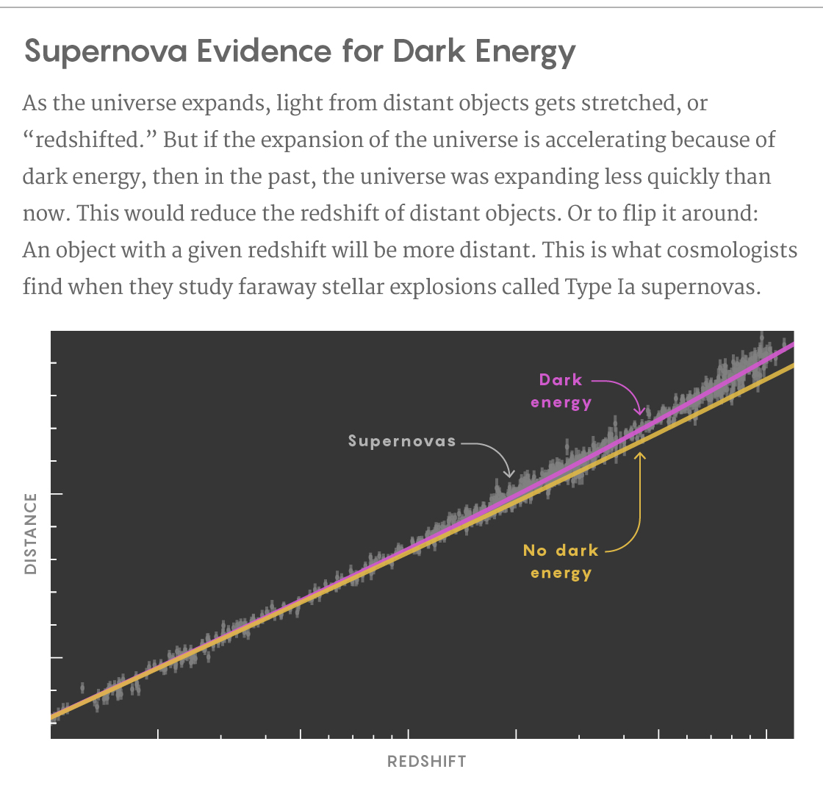
DE as a function of time ??

Slide 9
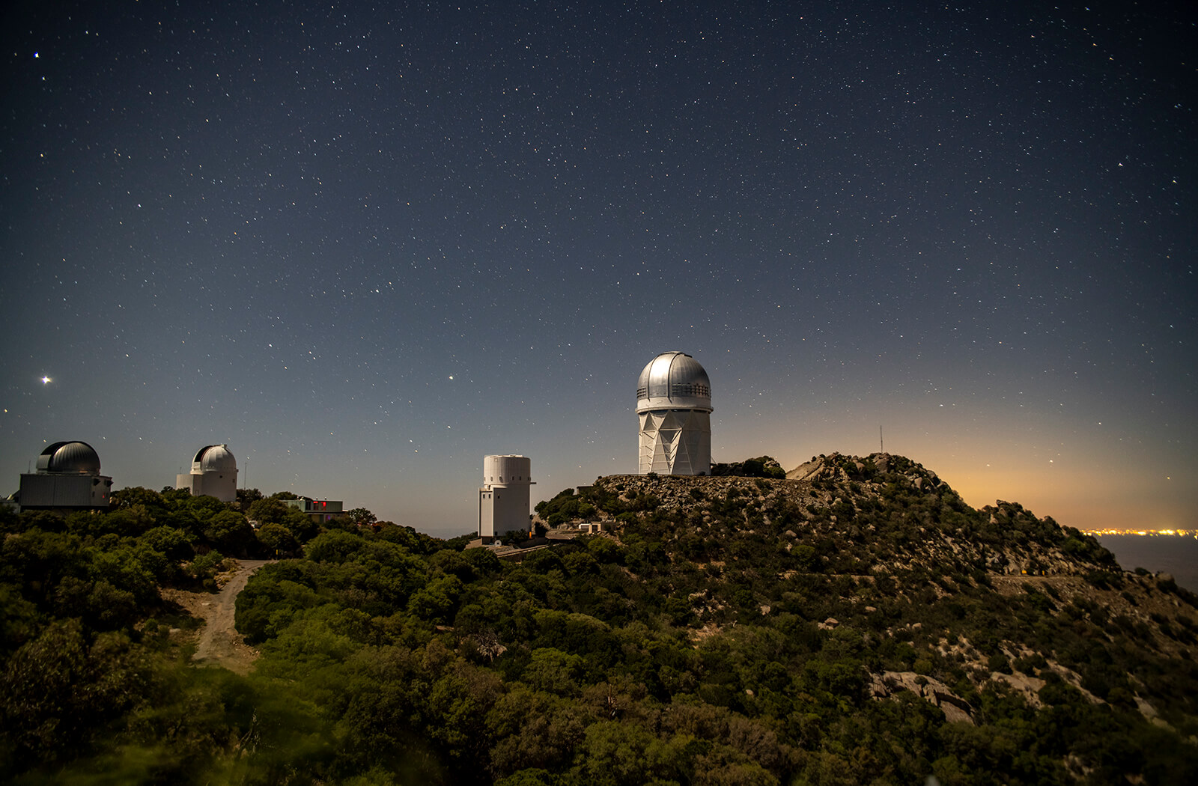
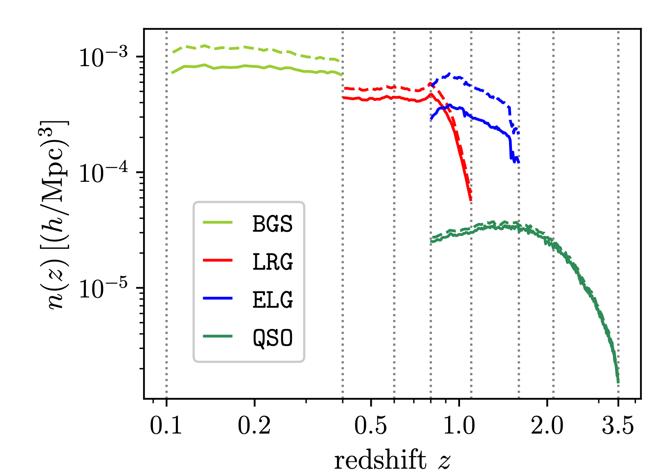
Dark Energy Spectroscopic Instrument
(DESI)

Slide 10
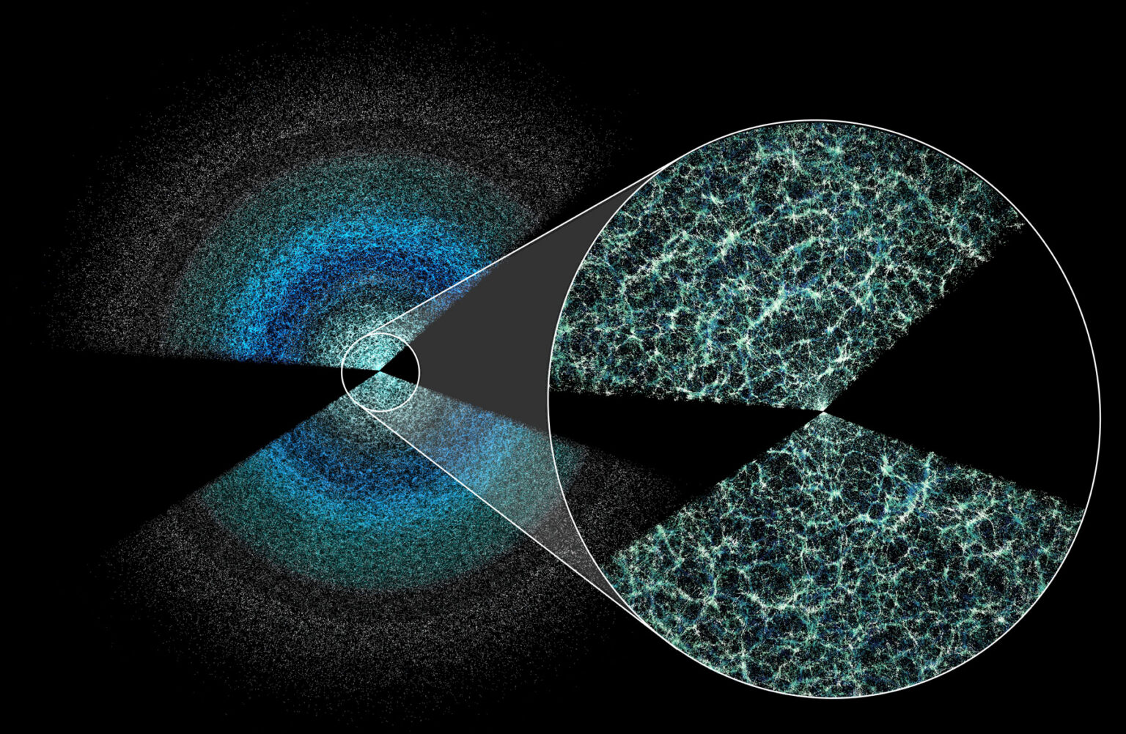
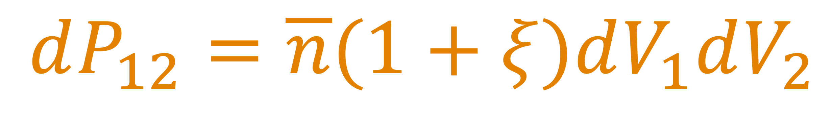
Primary goal:
Dark Energy via the correlation function of galaxies.
$$dP_{12}=\overline{n}(1+ξ)dV_{1}dV_{2}$$
Vanishes for a random Poisson distribution

Slide 11
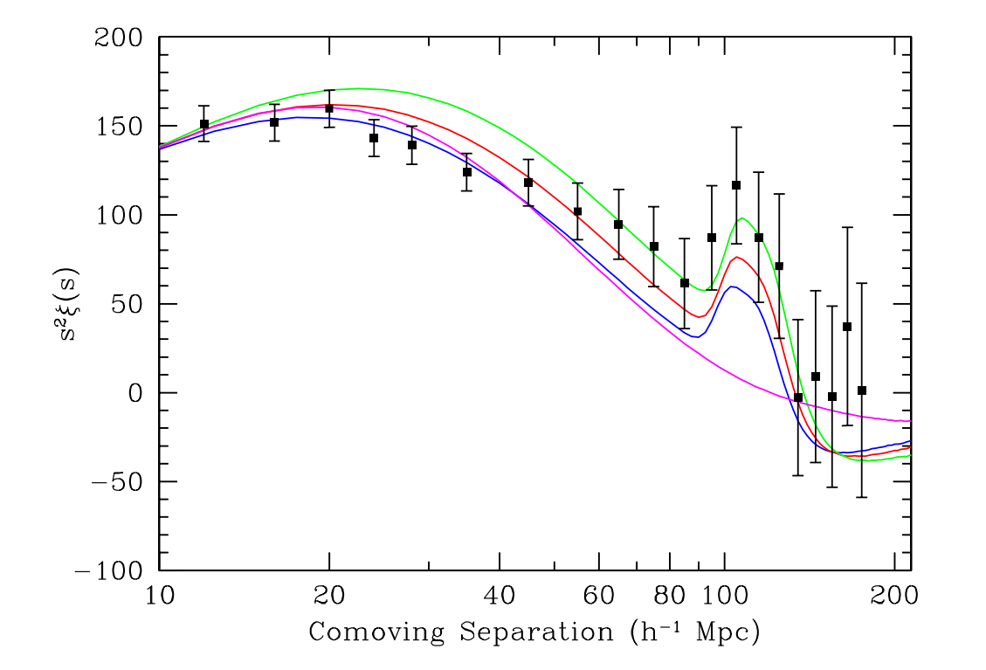
Before DESI: correlation using SDSS (Eisenstein et al 2005)
Notes:
explain what is the correlation function on the board - it’s the excess probability above random to find pairs
4 different plots: 4 models. Magneta = CDM only: no wiggles

Slide 12
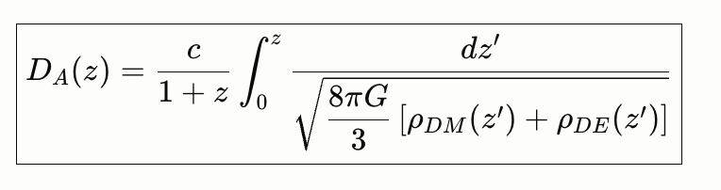
Before DESI: correlation using SDSS (Eisenstein et al 2005)
Baryonic Acoustic Oscillations
distances in Mpc are derived from angular positions
Notes:
explain what is the correlation function on the board - it’s the excess probability above random to find pairs
4 different plots: 4 models. Magneta = CDM only: no wiggles

Slide 13
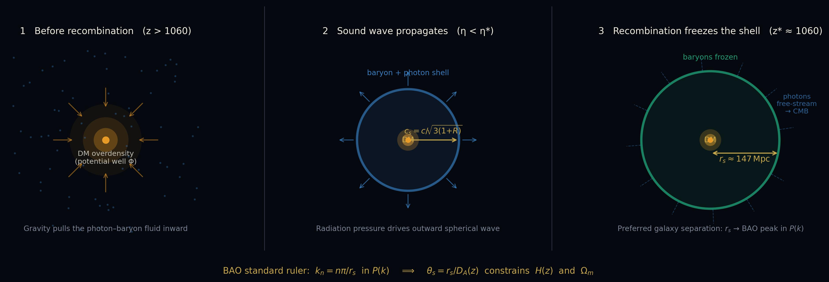

Slide 14
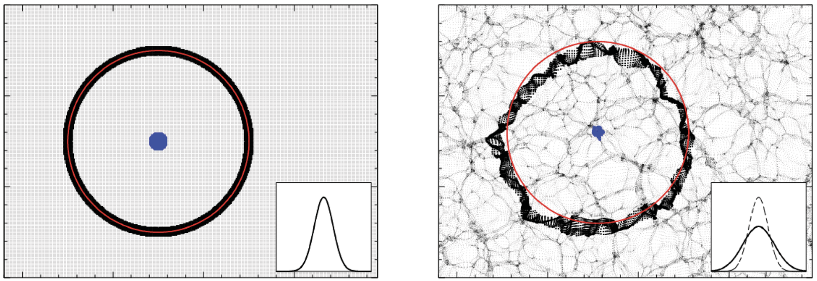
Dilution of BAO signal:Illustration only
“just after decoupling”
“late time evolution”
Padmanabhan et al. (2012)
Notes:
on the broadening of the peak

Slide 15
The Time-Machine

Slide 16
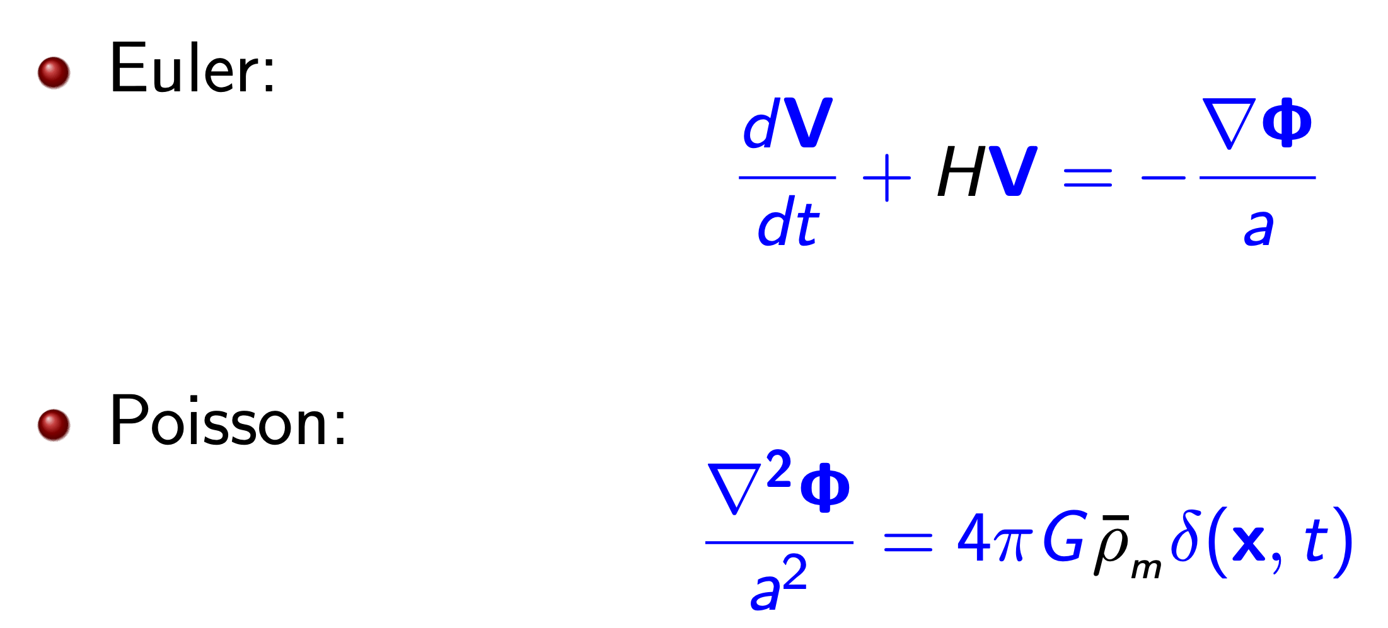
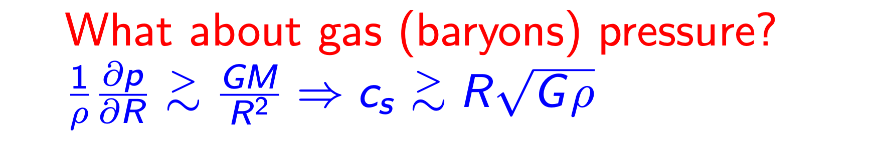
EoM after decoupling
No explicit dependence on Lambda
What about GR?

Slide 17
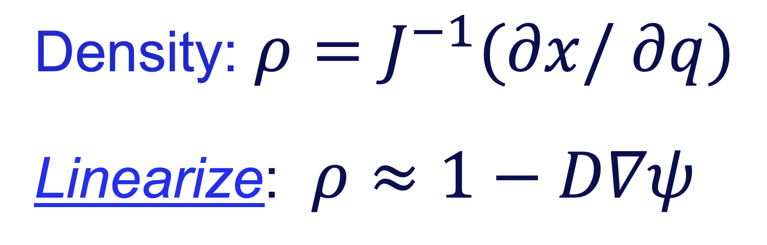
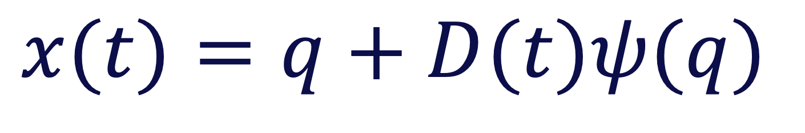
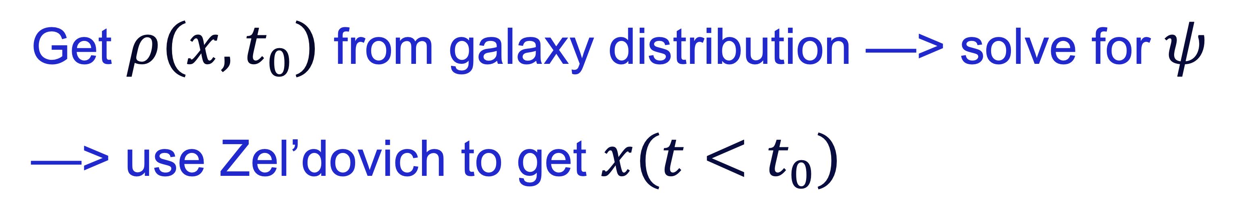
Hybrid time-machine (used by DESI): linear-Zel’dovich
Zel’dovich approximation:
$$x(t)=q+D(t)ψ(q)$$
Density: $ρ=J^{−1}(∂x/∂q)$
Linearize: $ρ≈1−D∇ψ$
Get $ρ(x,t_{0})$ from galaxy distribution —> solve for $ψ$
—> use Zel’dovich to get $x(t<t_{0})$

Slide 18
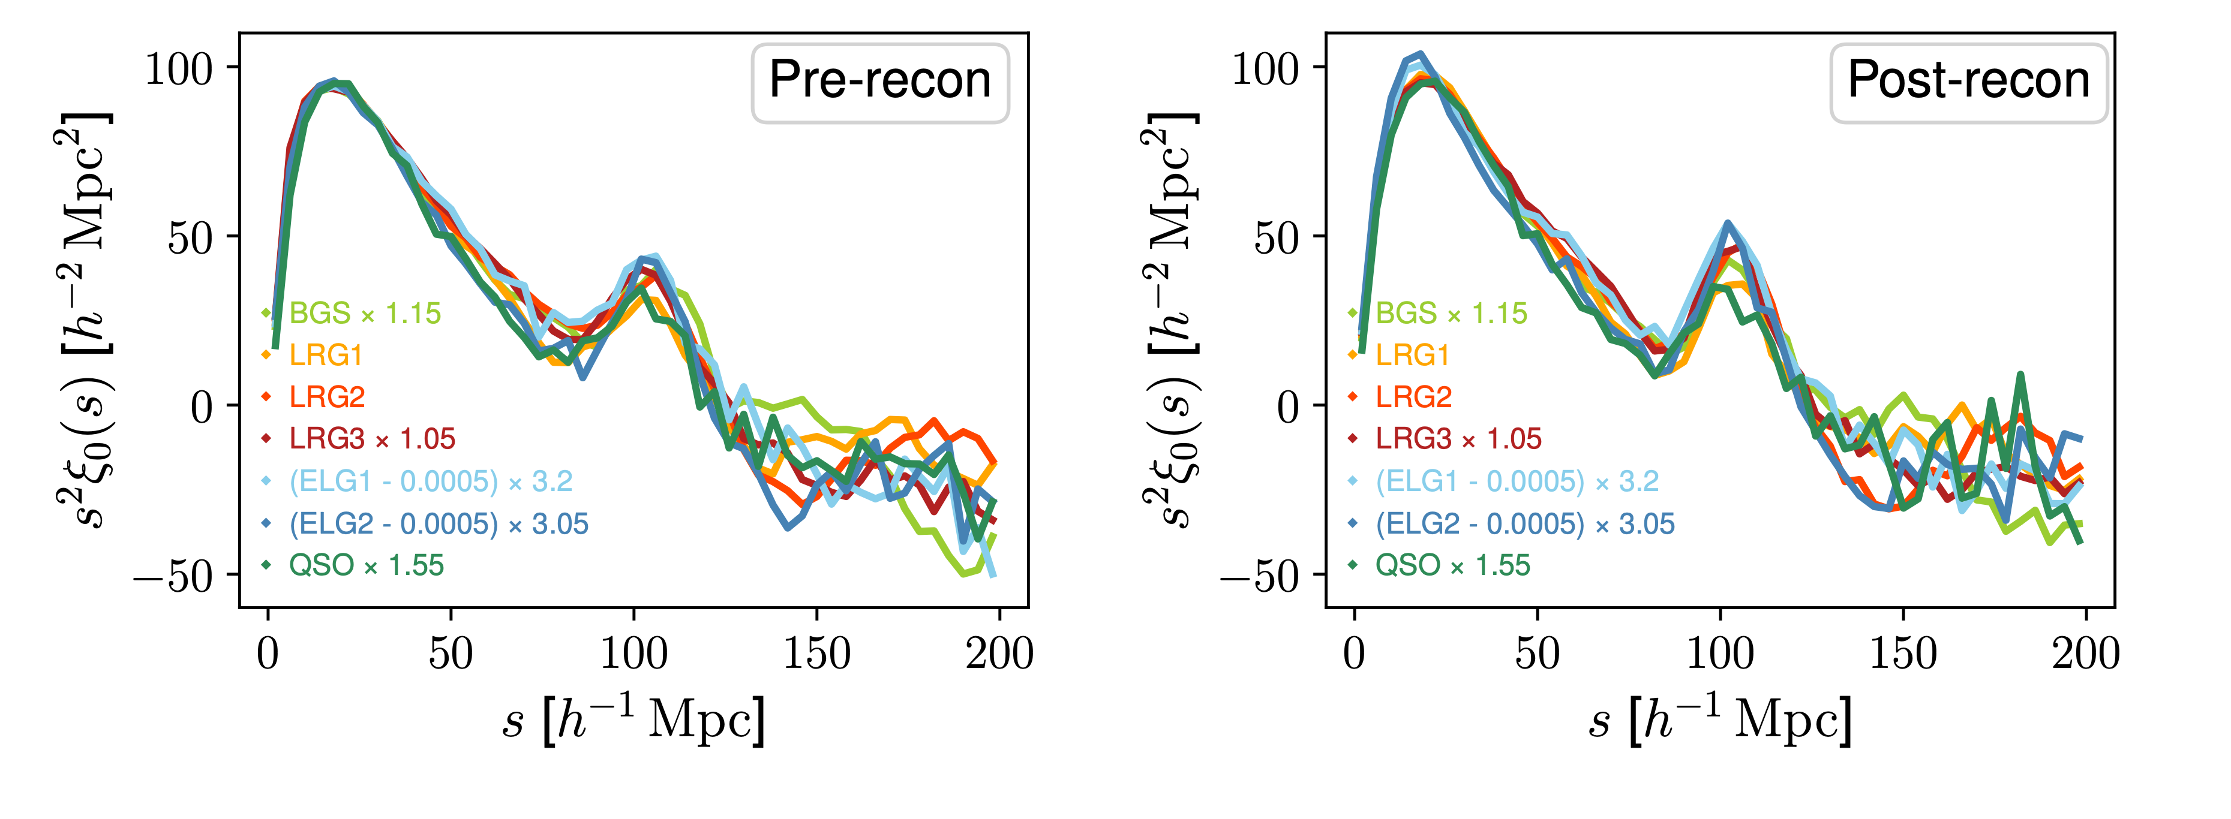
“raw” correlation
Used for DE analysis
BAO S/N boosted by upto 50%

Slide 19
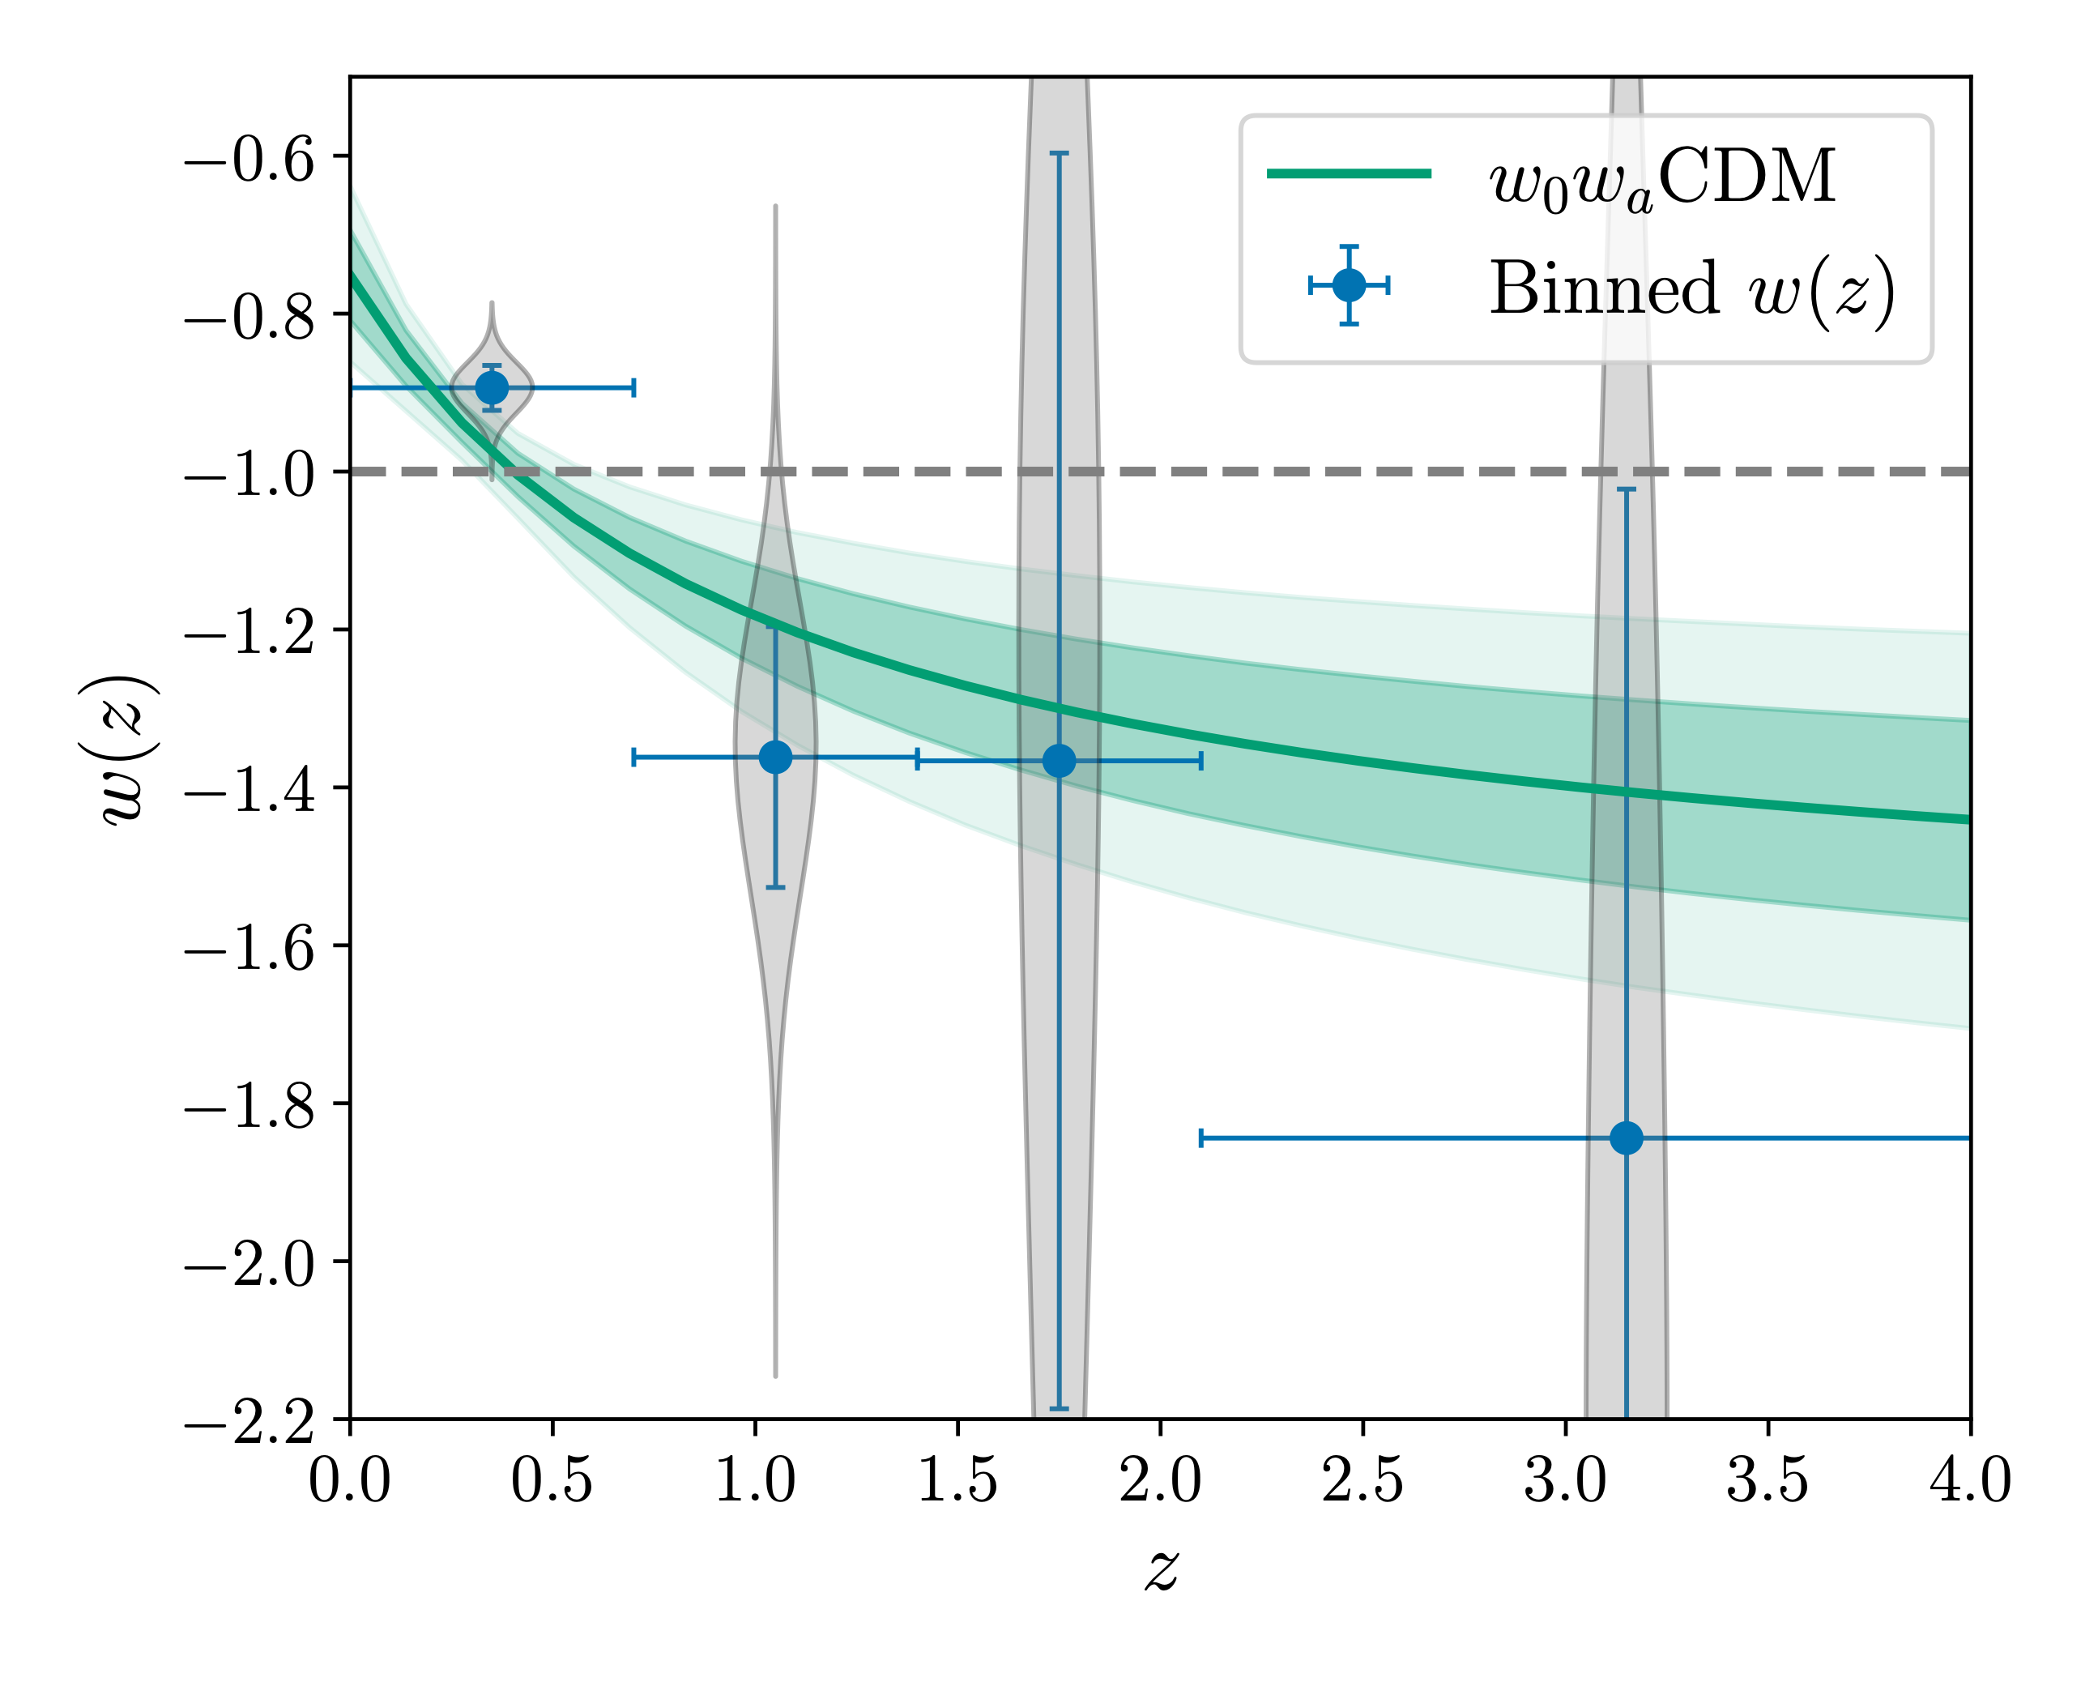


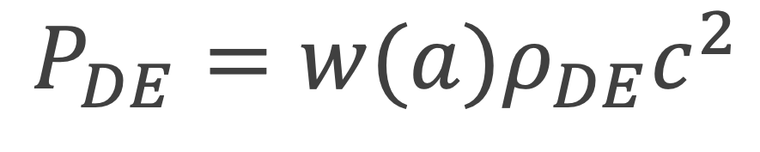
DESI COLLABORATION RESULT
$$P_{DE}=w(a)ρ_{DE}c^{2}$$
$w<−1$ !!!
Weak energy condition???

Slide 20
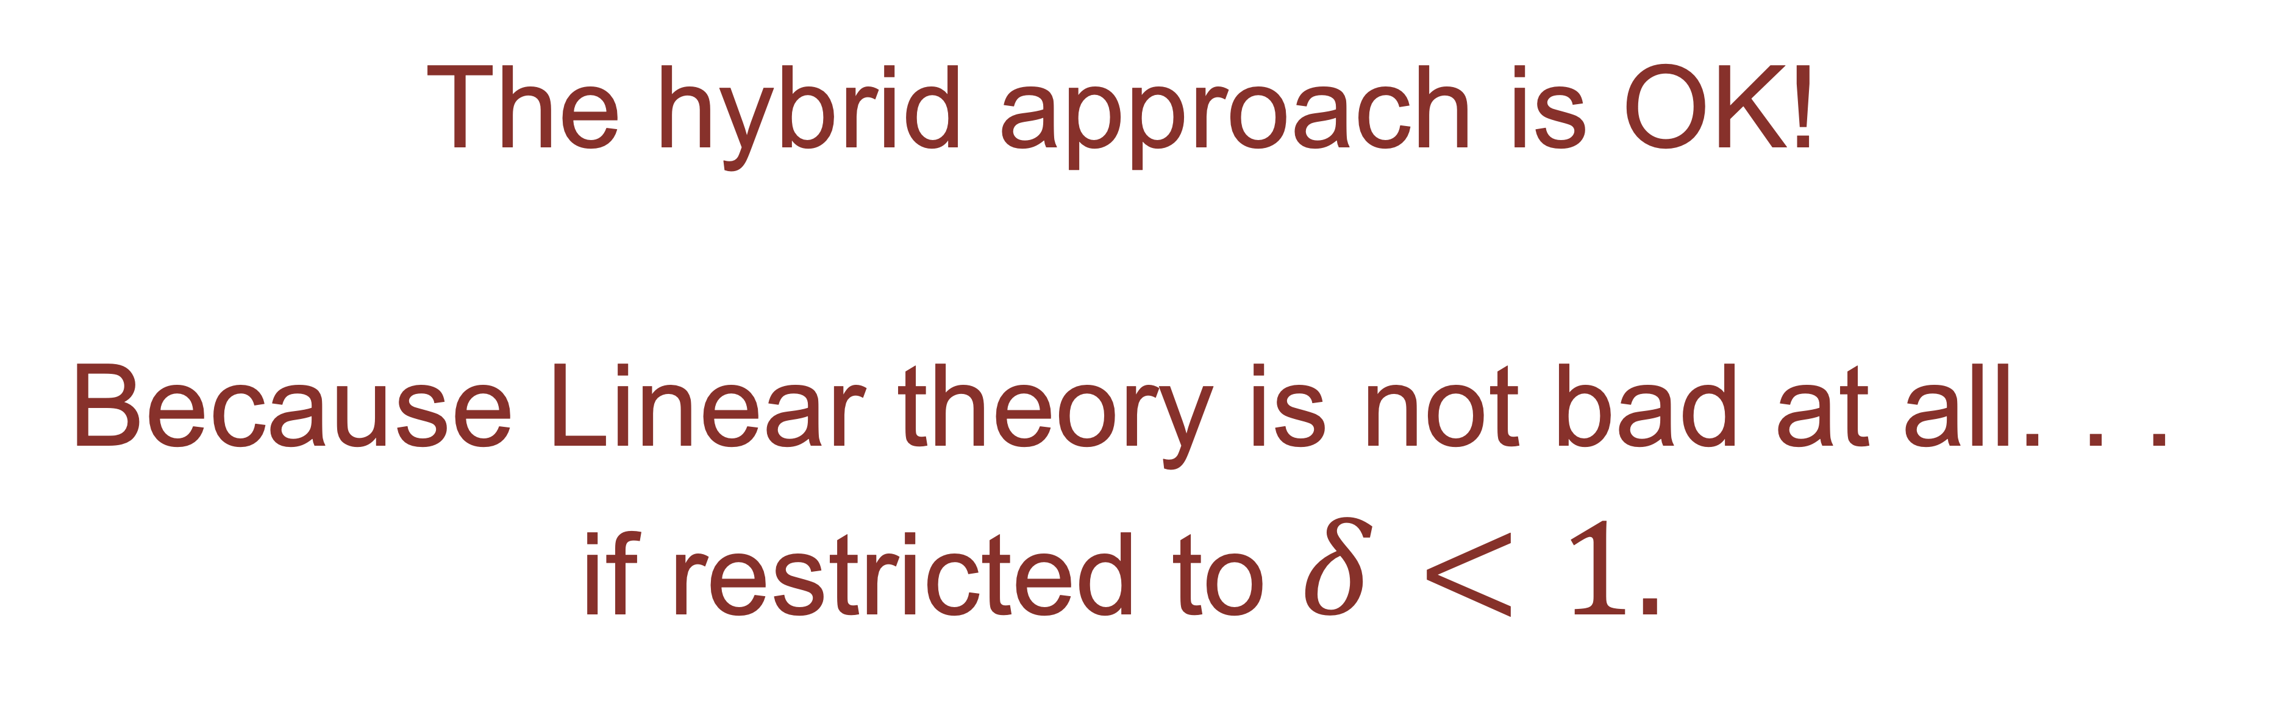
The hybrid approach is OK!
Because Linear theory is not bad at all. . .
if restricted to $δ<1.$

Slide 21
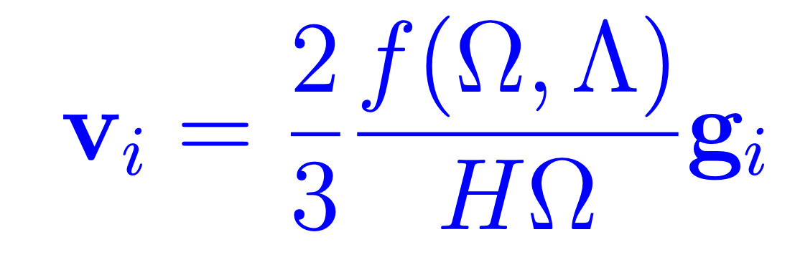
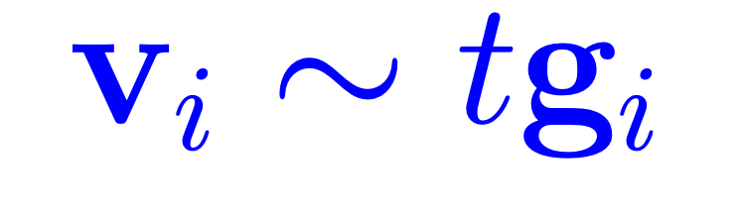
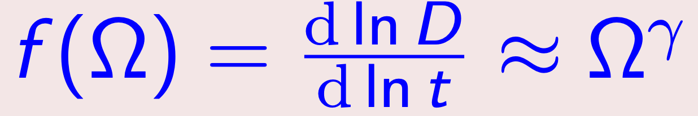
At closer look at linear theory
intuitive linear relation
exact linear relation
The growth rate: A very important
diagnostic for DE
γ=0.55+0.05(1+w)

Slide 22

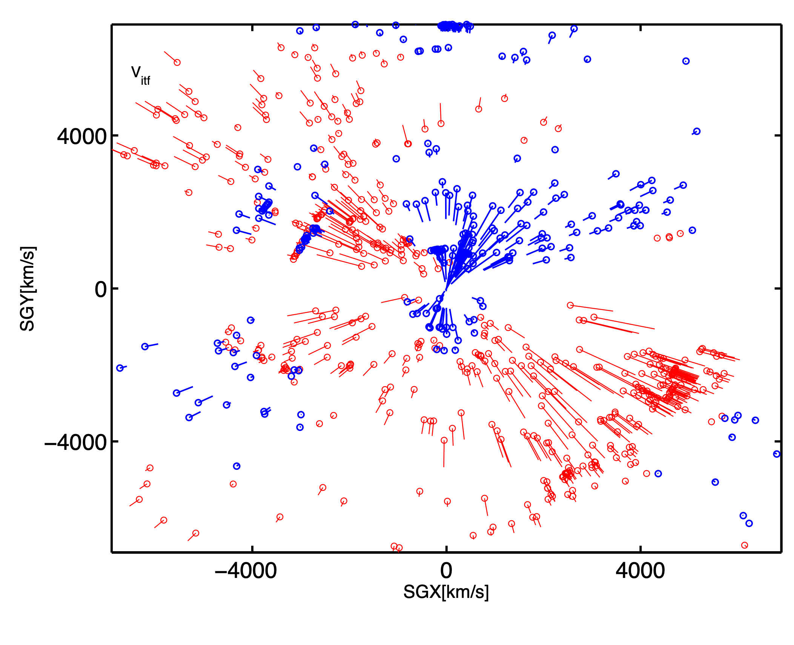
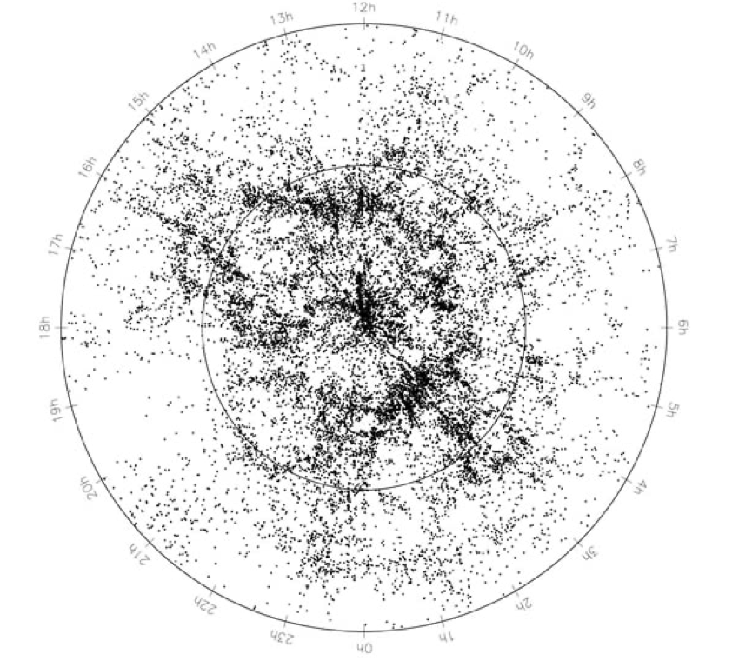
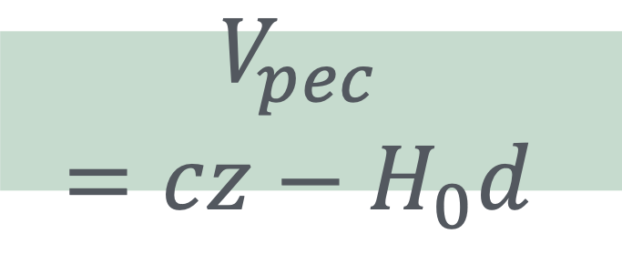
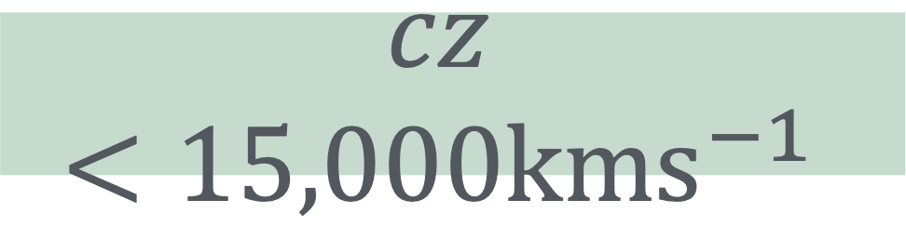
$$V_{pec}=cz−H_{0}d$$
$$cz<15,000{kms}^{−1}$$

Slide 23
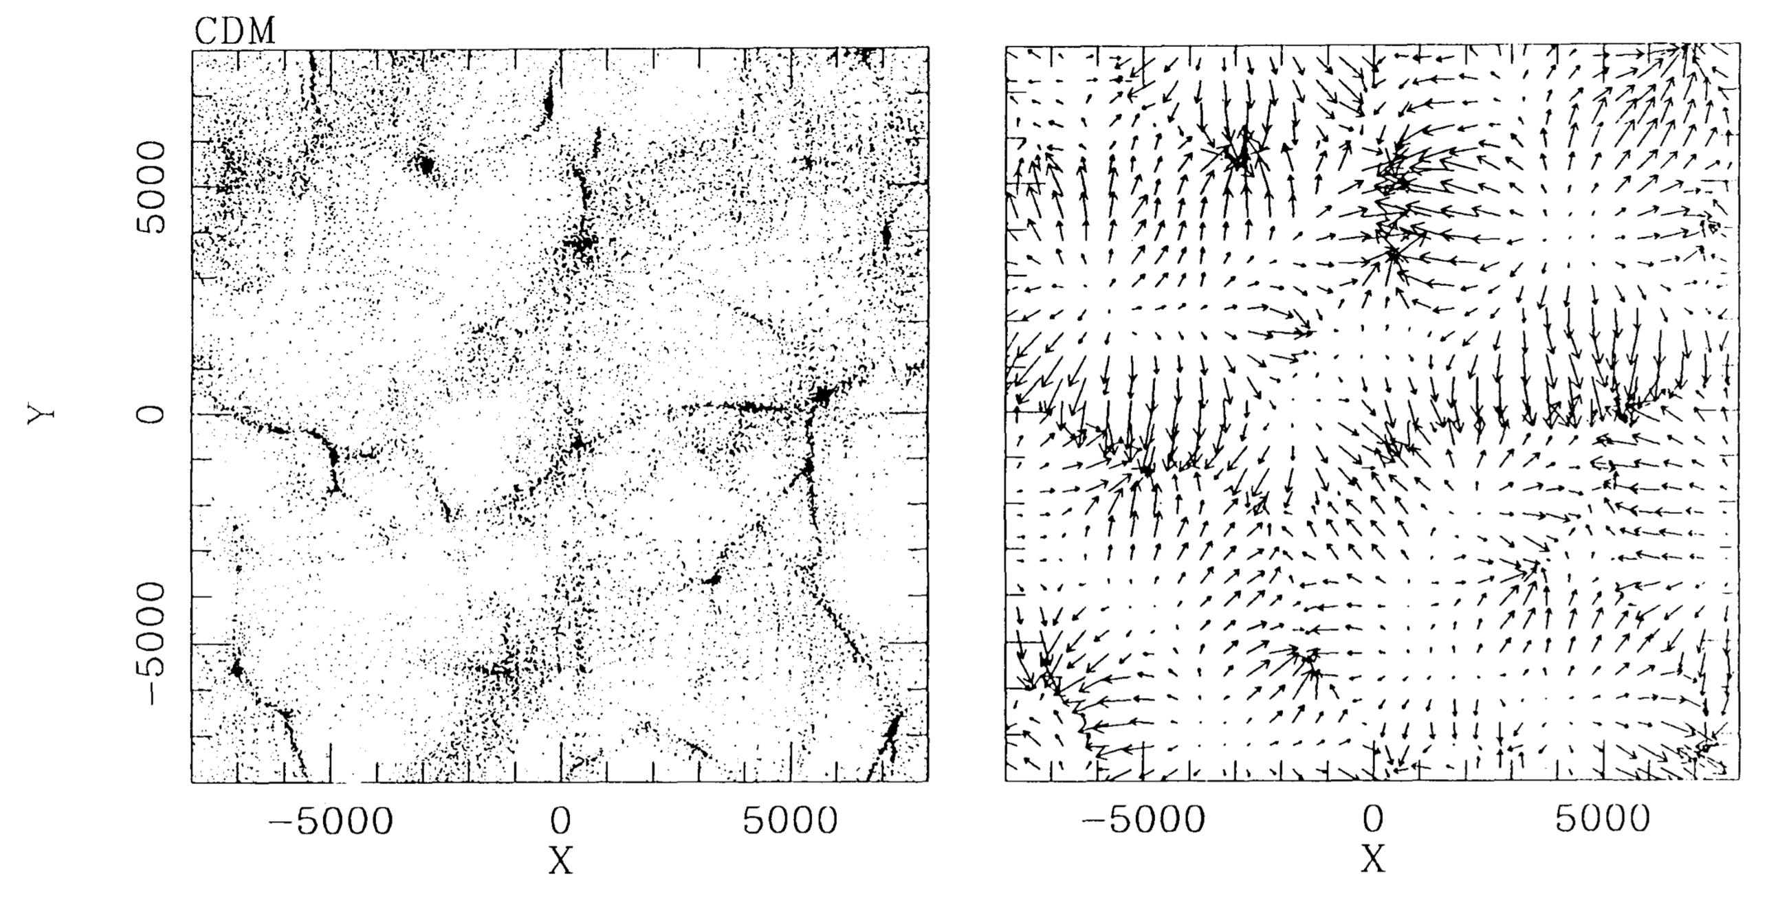
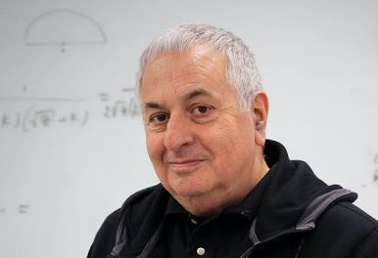

theory

Slide 24
theory

Slide 25
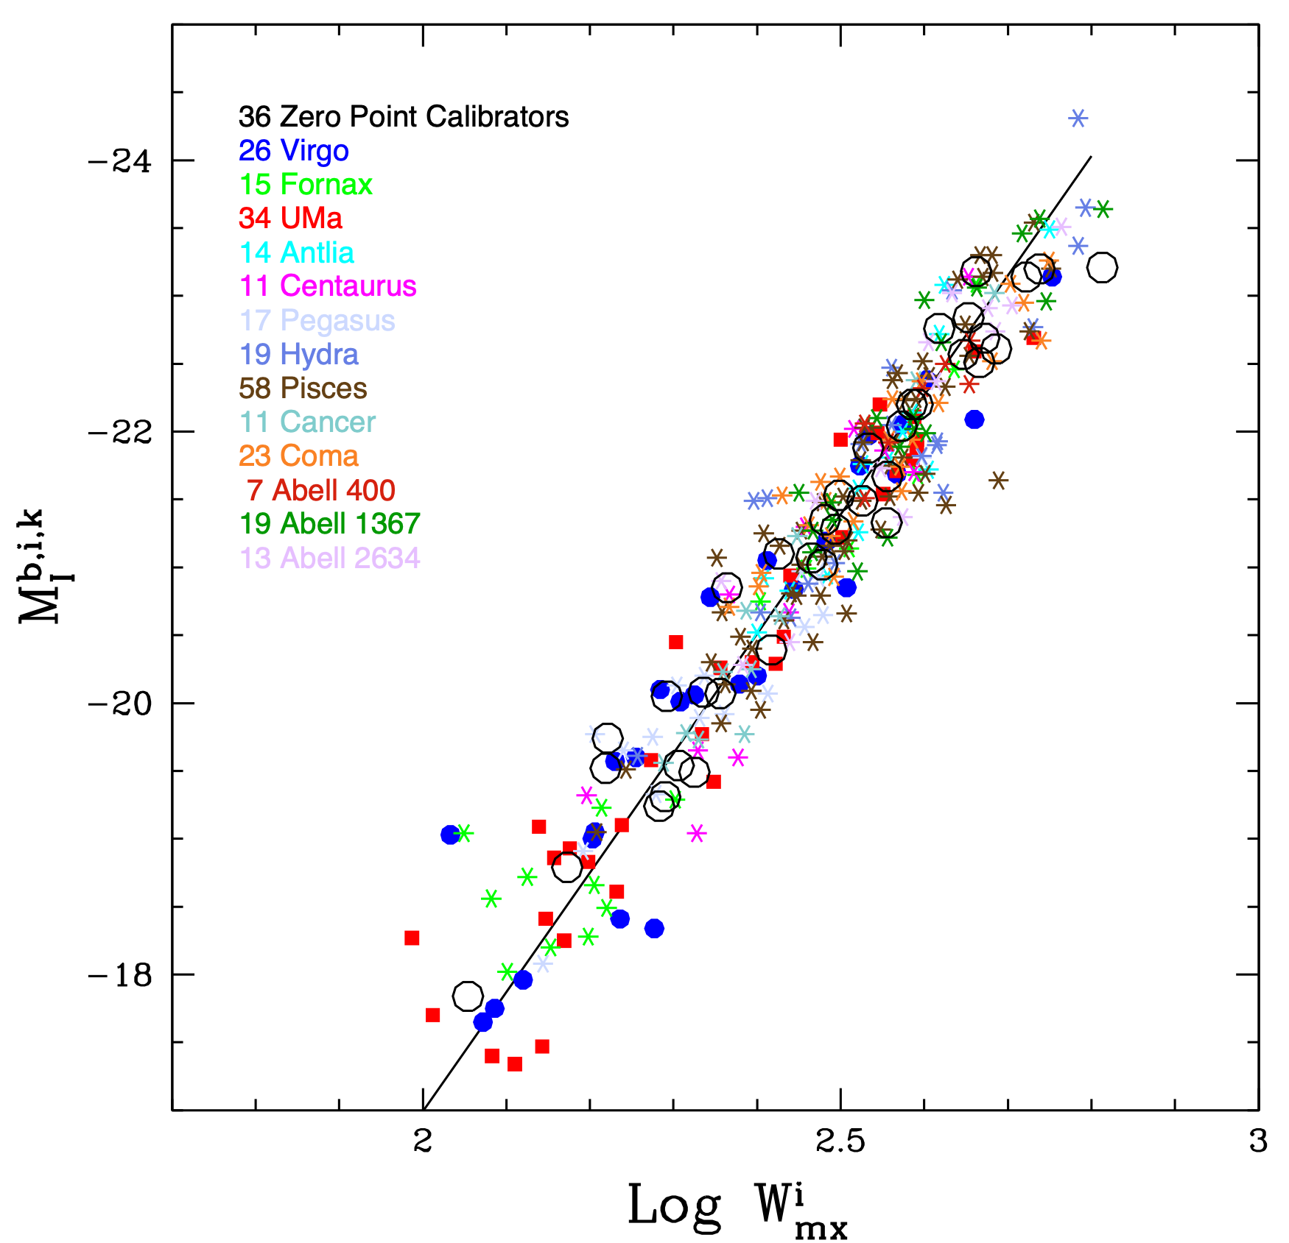
Distance measurements: Tully-Fisher Relation
Tully, Courtois, Dolphin et al 13

Slide 26

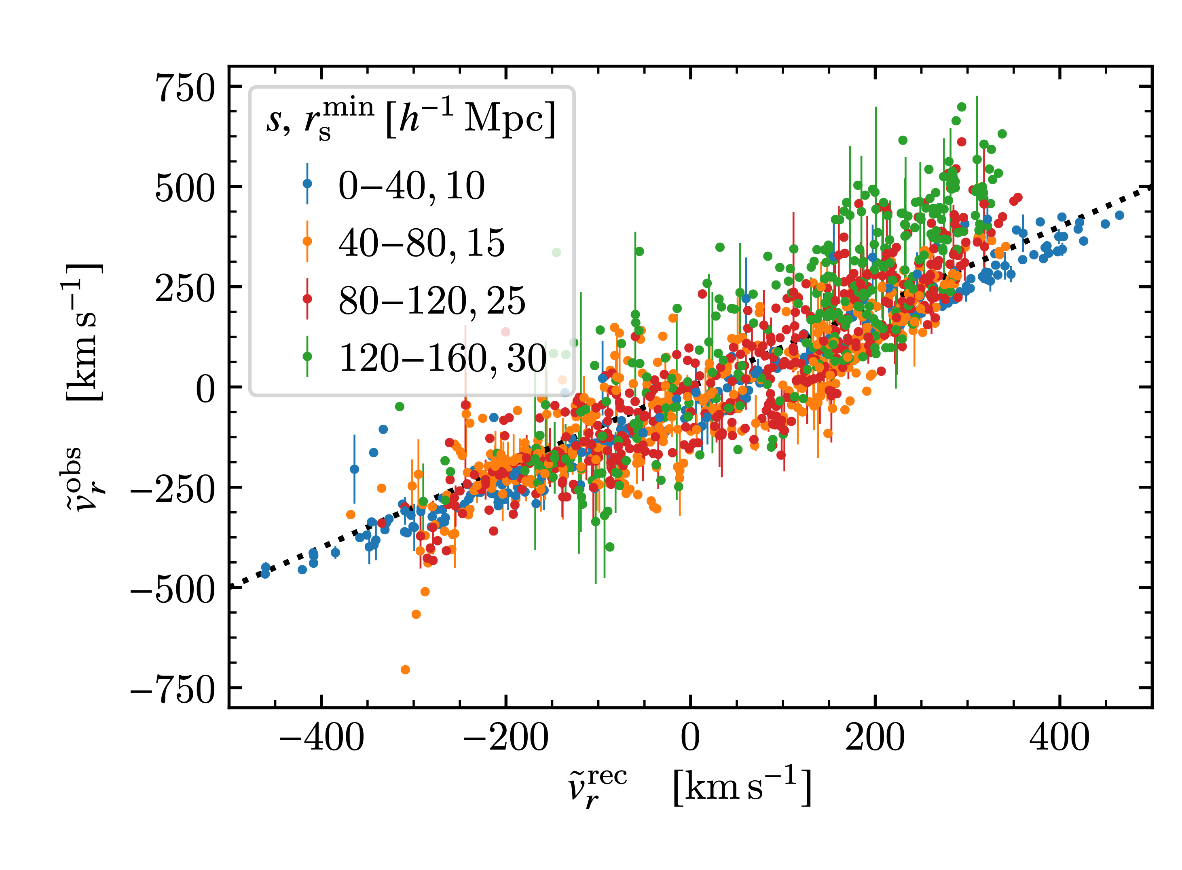
LOW REDSHIFT DATA: 2MRS and Cosmicflows.
Not a Constraint on DE evolution
Completely consistent with GI
Notes:
mention QSO separation 1arcsec

Slide 27
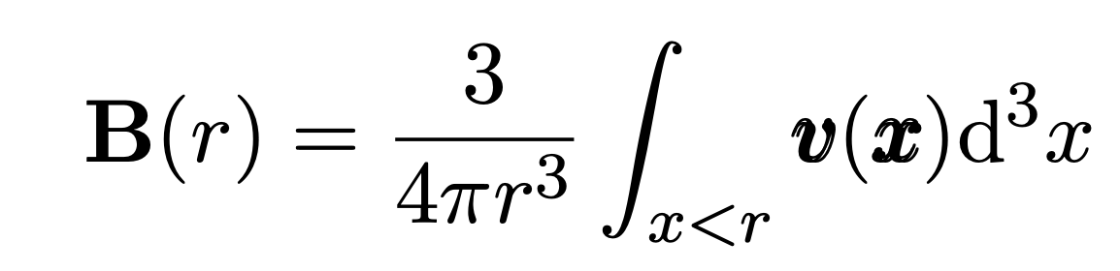
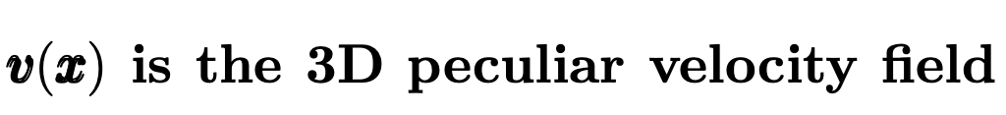
The notorious bulk flow
which we don’t have

Slide 28
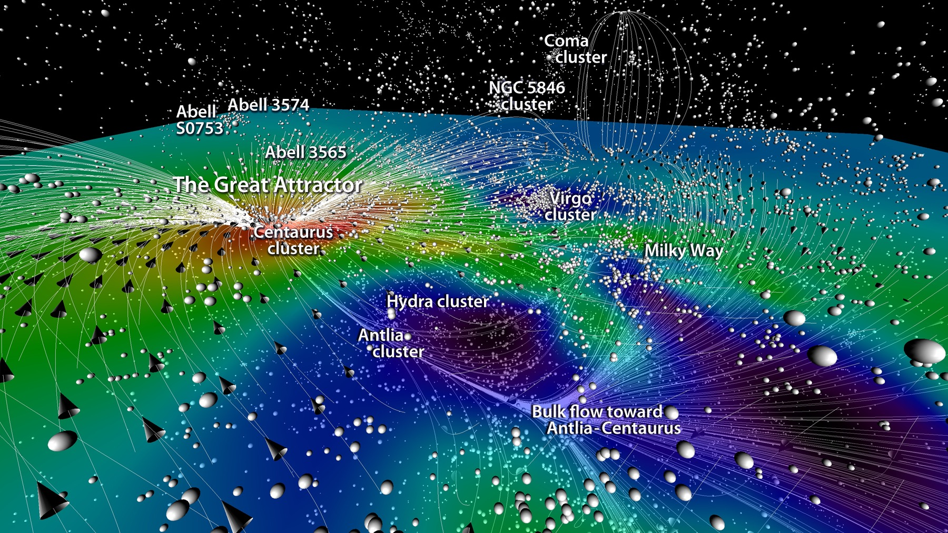
Cosmic Flows by Tully et al

Slide 29
Cosmic Flows by Tully et al

Slide 30
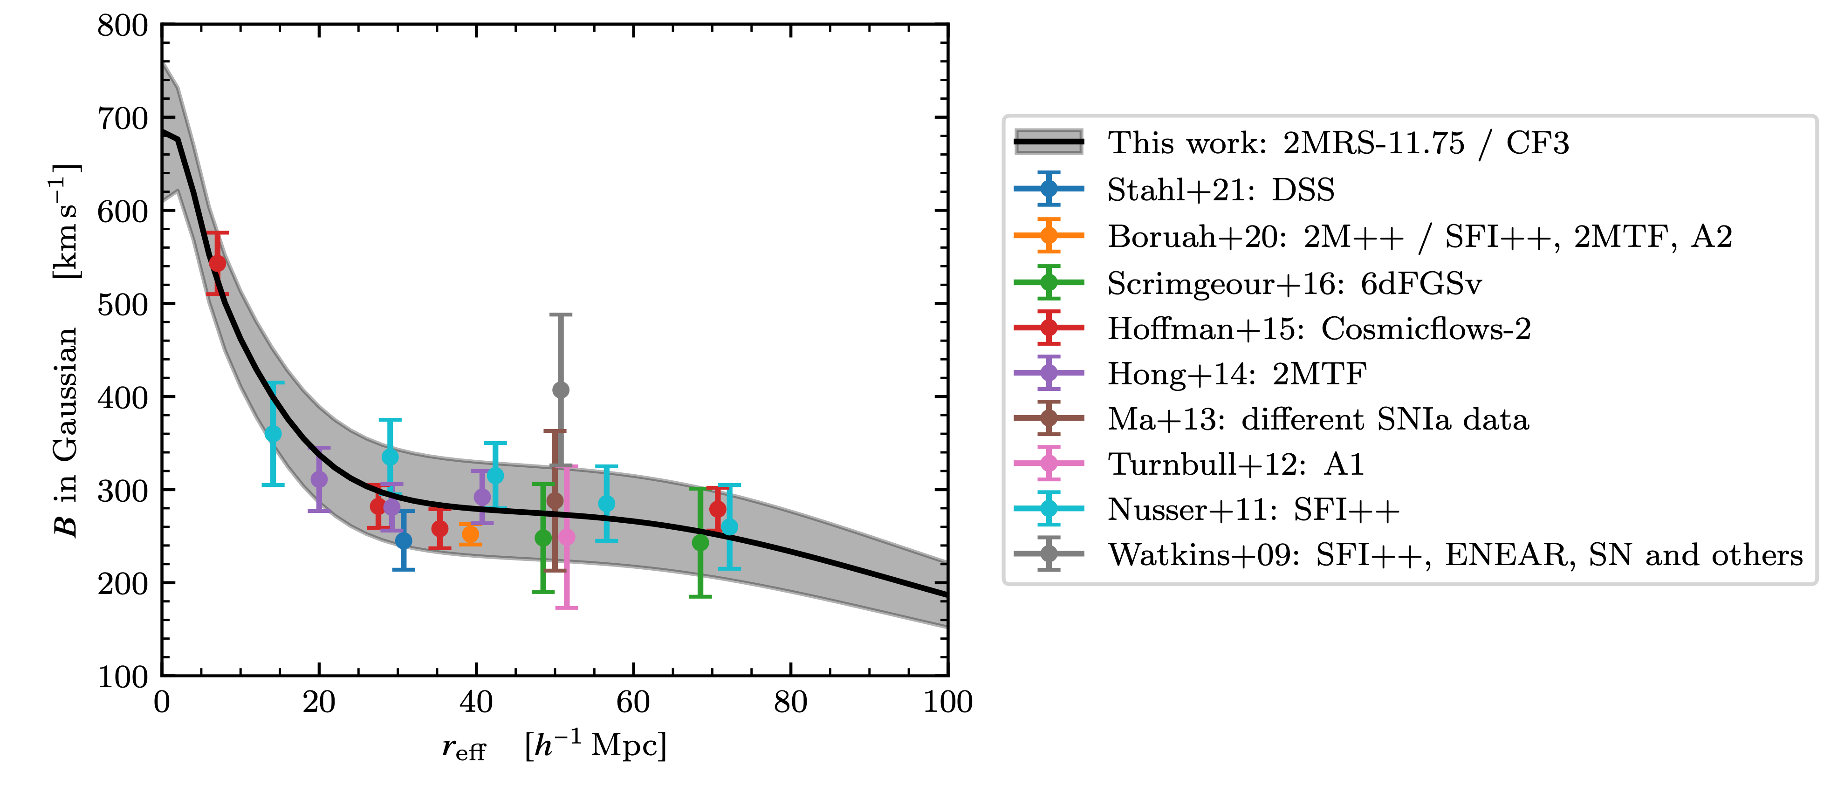
from Lilow & AN
Cosmic Flows by Tully et al

Slide 31

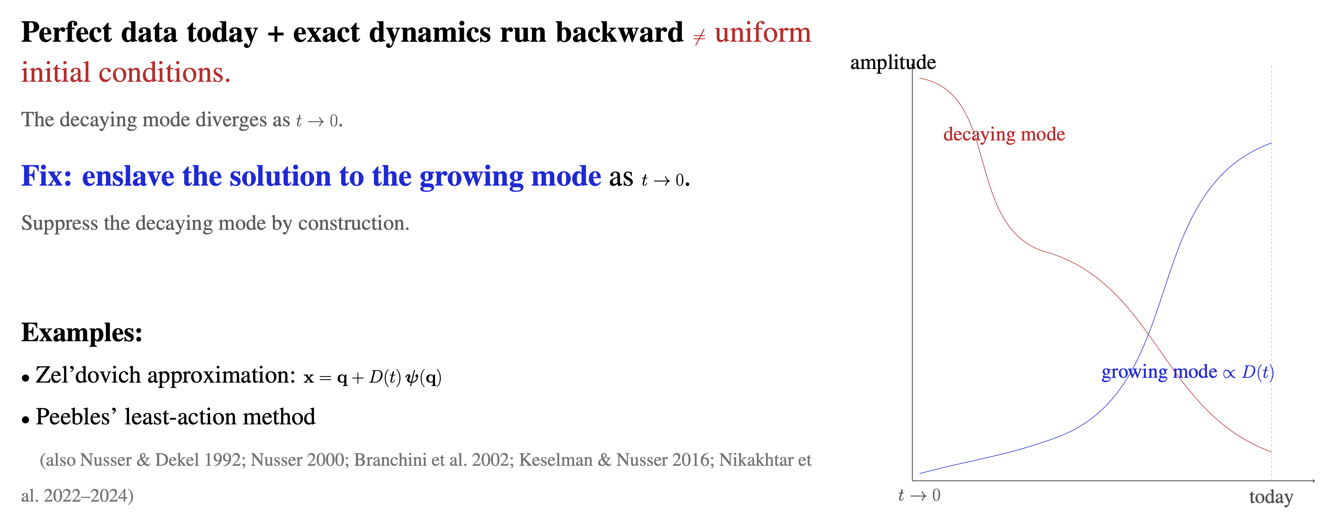

Slide 32

Can any distribution be consistent with cosmological initial conditions? Yes!
Example:
y
x
x
x
x
Full nonlinear EoM solved iteratively under the boundary conditions:
$δ(z=0,x)=δ_{0}(x)andδ(t→0)=0$.
But solution is not unique!

Slide 33
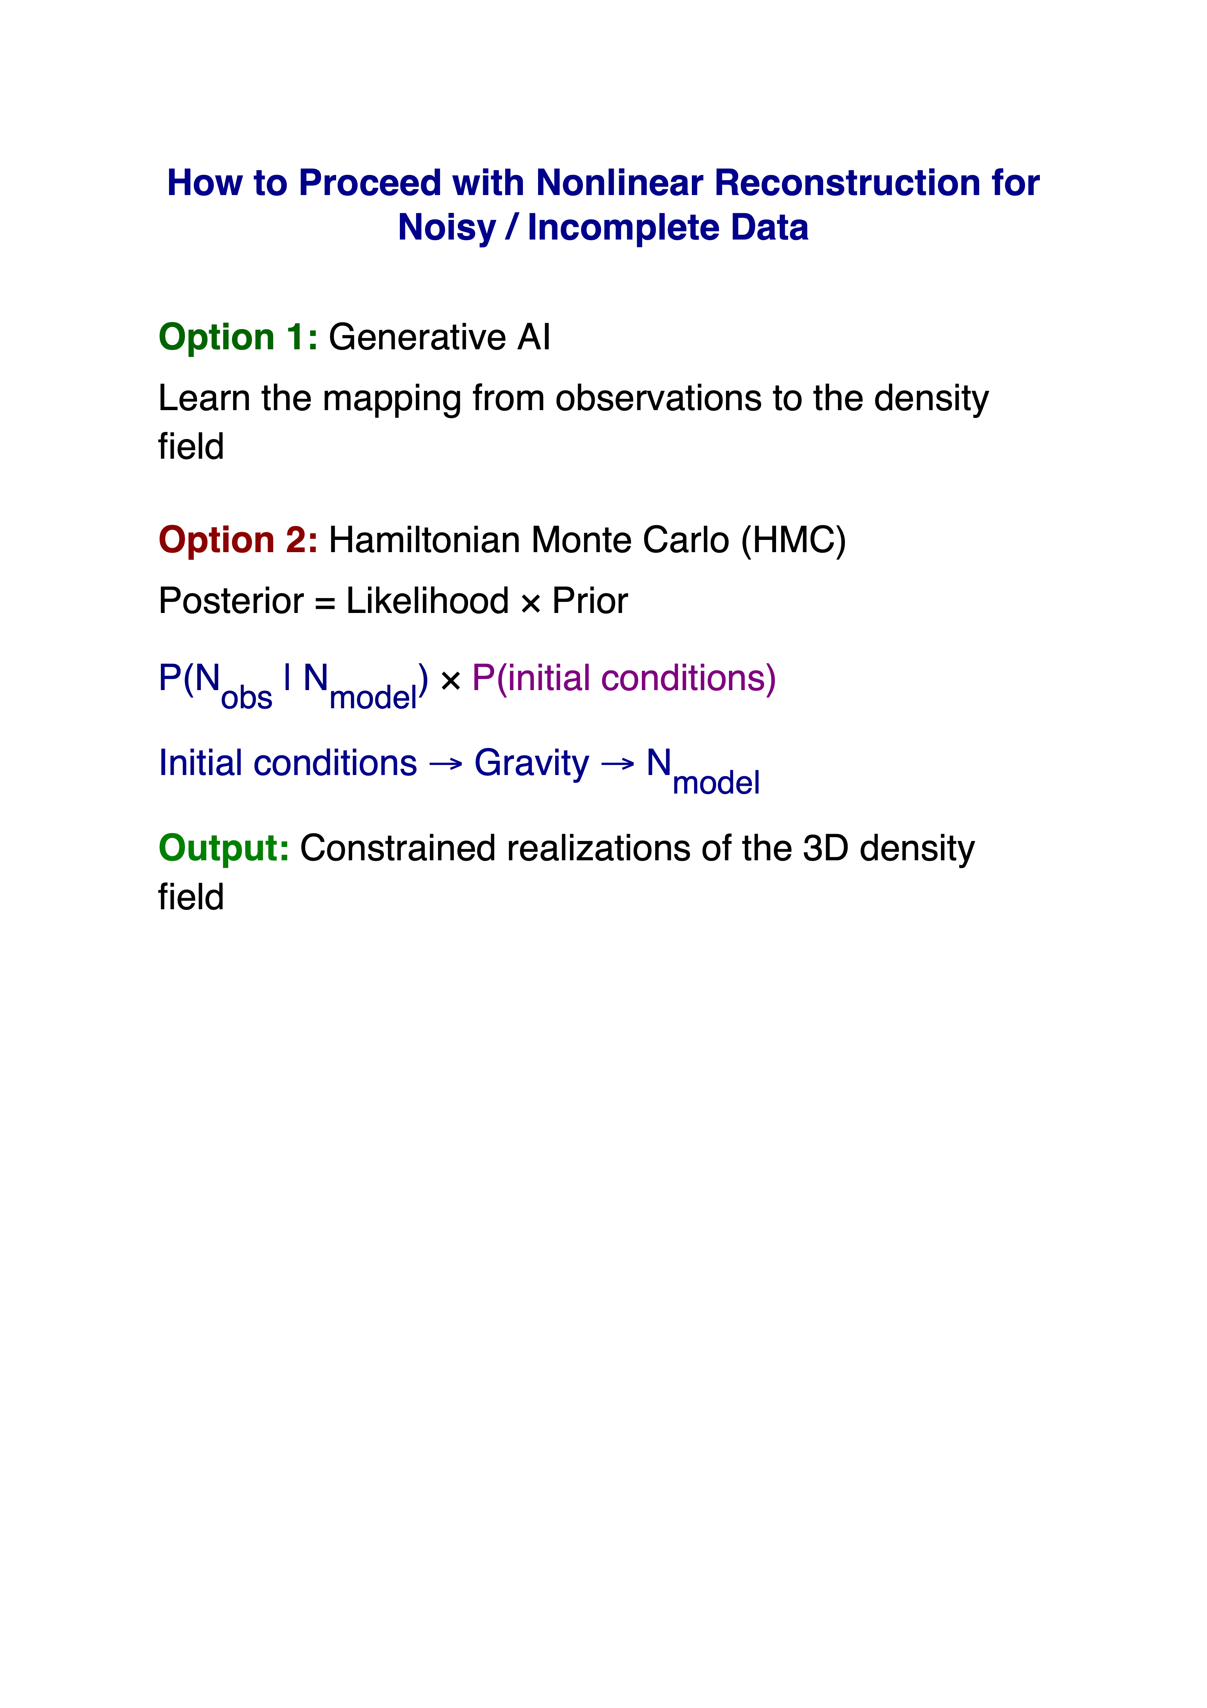

Slide 34
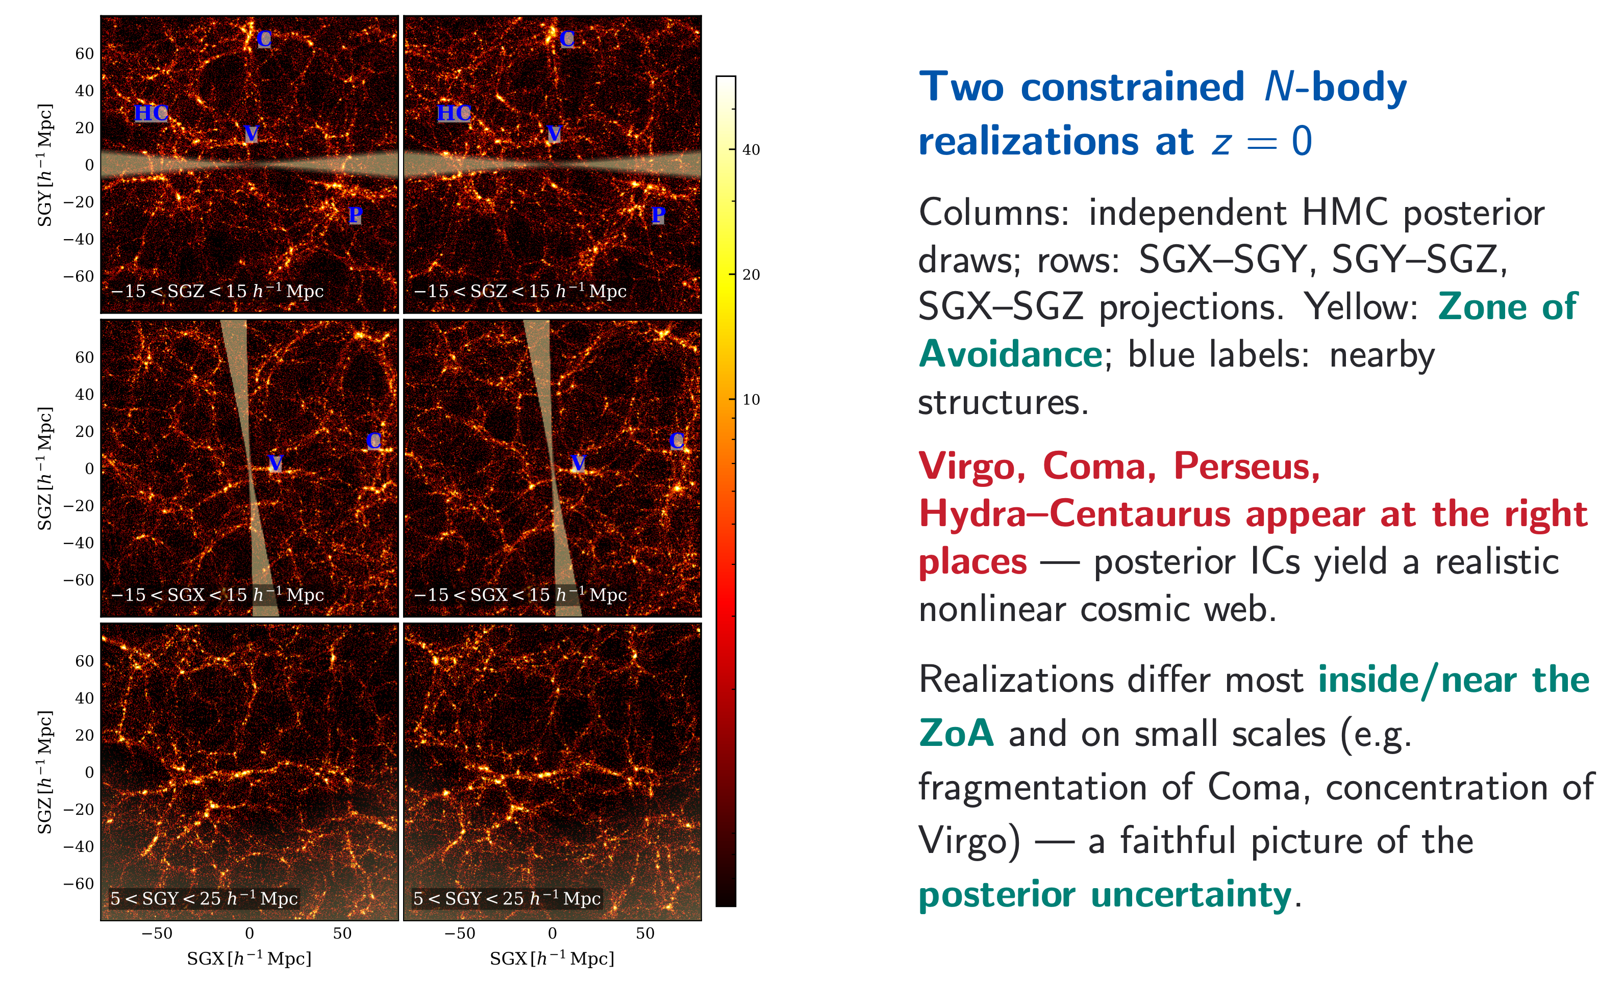
Gadget simulation matching the observed nearby Universe

Slide 35
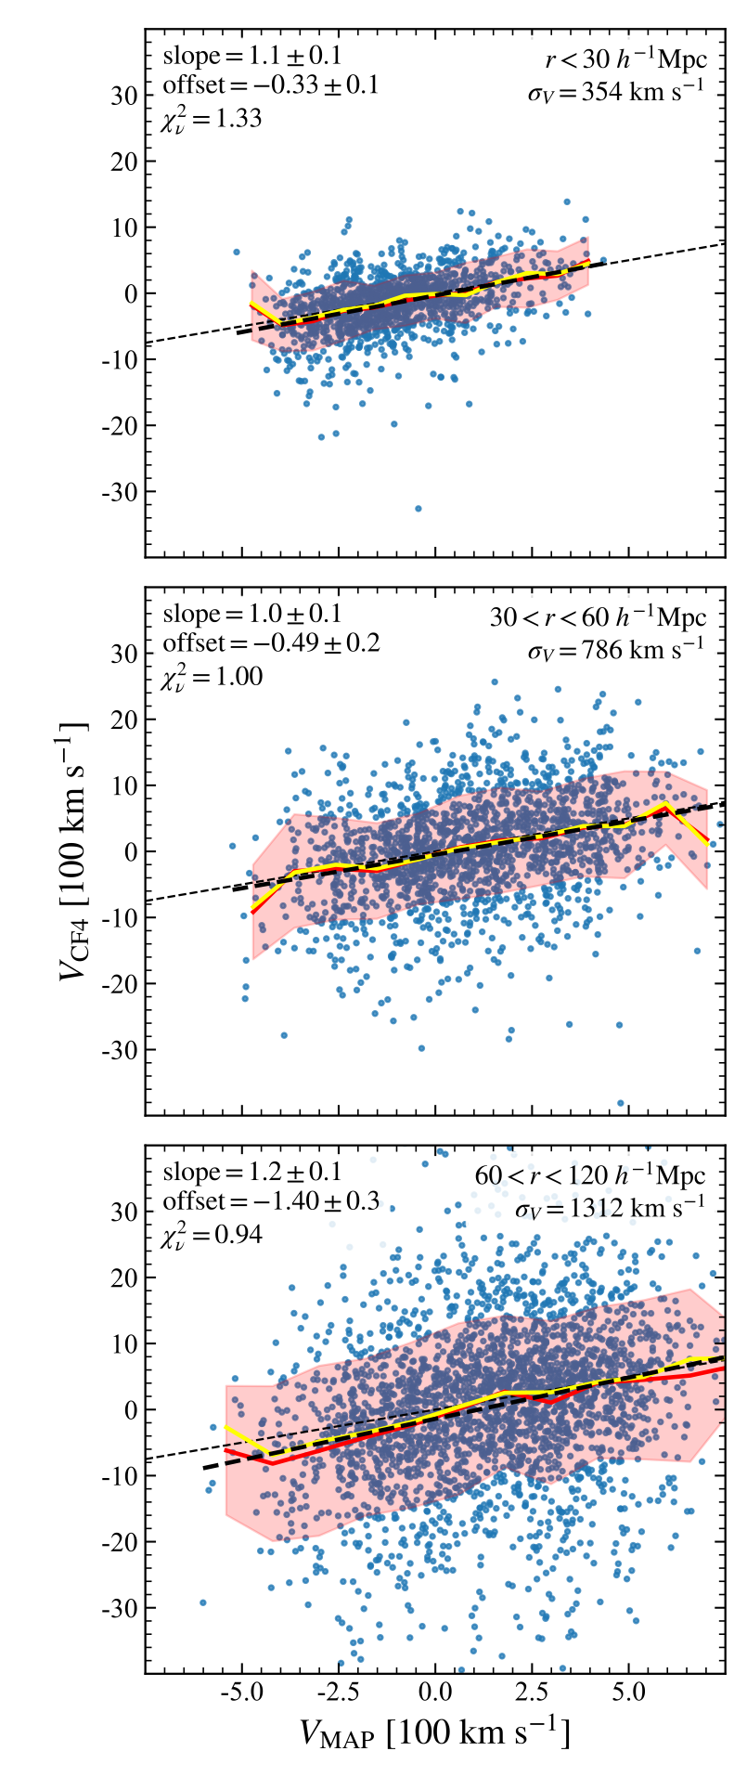

Low redshift test of gravitational instability down to non-linear scale scales
Reflex dipole=mean motion of a shell relative to observer

Slide 36



