Slide 1
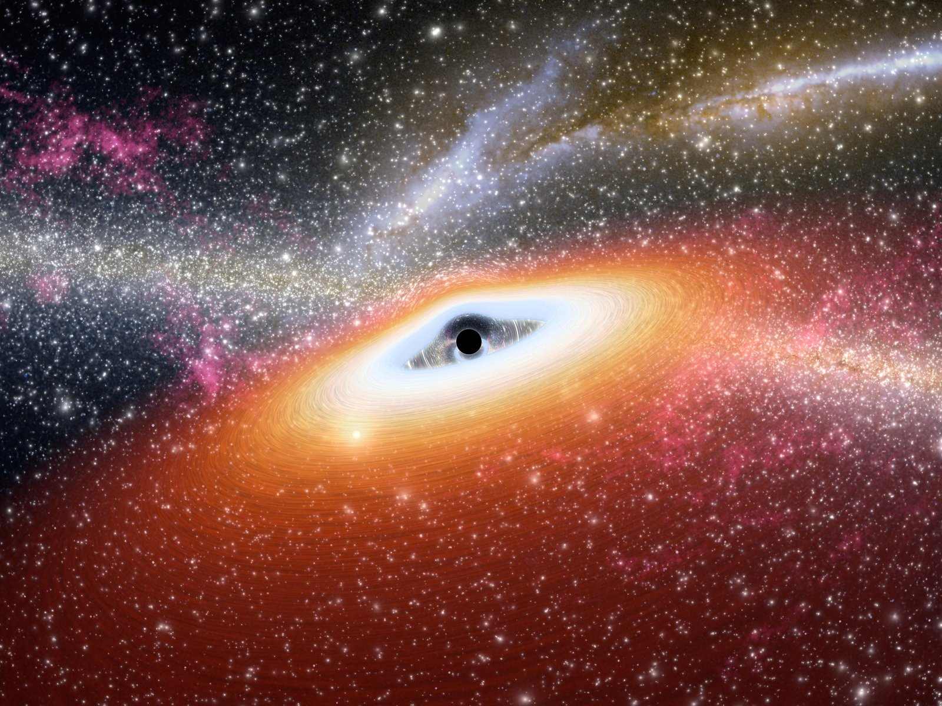
Accretion and Dynamics of Compact Objects in AGN Disks: Multimessenger Implications
Speaker: Shurui Zhang – ICRANet
Collaborators: Shurui Zhang, Yan Luo, Xiao-Jun Wu, Yu Wang, Liang Li, H. Tagawa, Jian-Min Wang, Luis C. Ho, Ye-Fei Yuan
HEACOSS 2026
Yerevan, Armenia
Date 2026/06/18

Slide 2
Outline
Outline:
Background
1、BH Mergers in AGN disks
2、WD Collisions in AGN Disks
3、NS Accretion in AGN Disks
Summary
Contact:
zhangsr@mail.ustc.edu.cn
1
Background
Binary BH Merger Produces Short GRB in AGN Disk
WD Collisions in AGN Disks
NS Accretions in AGN Disks
Summary and Outlook
9

Slide 3
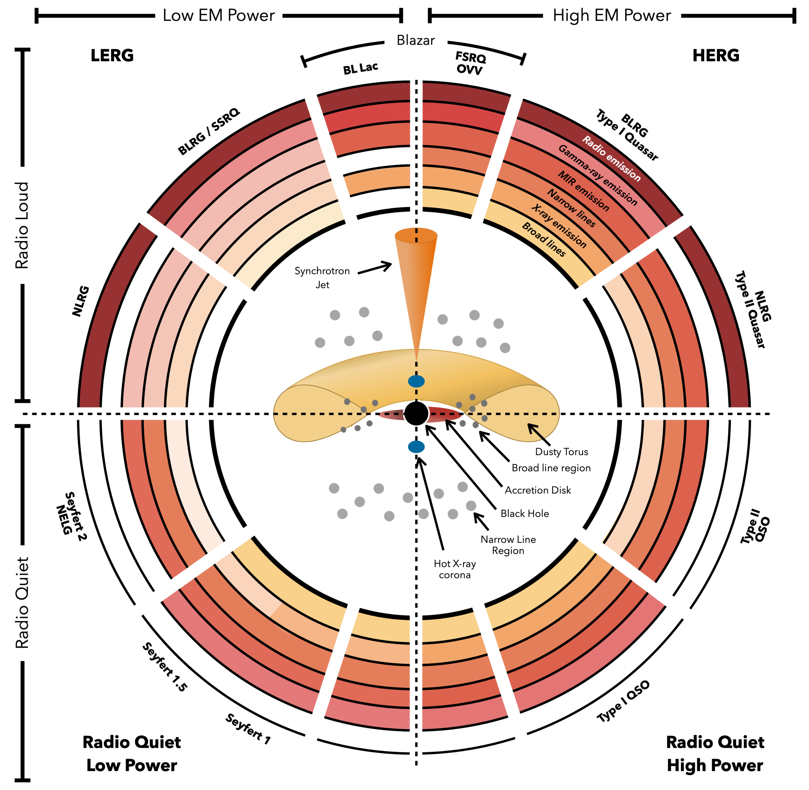
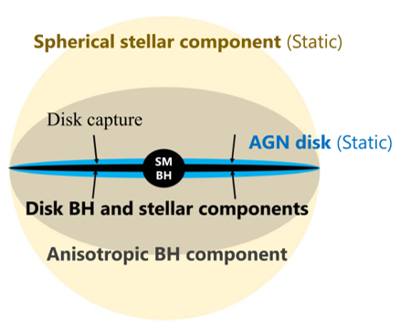
AGN Unified Model and NSC
Part 0
Outline:
Background
1、BH Mergers in AGN disks
2、WD Collisions in AGN Disks
3、NS Accretion in AGN Disks
Summary
Contact:
zhangsr@mail.ustc.edu.cn
2
Thorne J.E. , et al. 2022
Tagawa H., et al. 2020
The AGN unified model is based on EM observations and typically not include the compact object component;
Multi-messenger observations can reveal compact objects in AGNs.
9

Slide 4
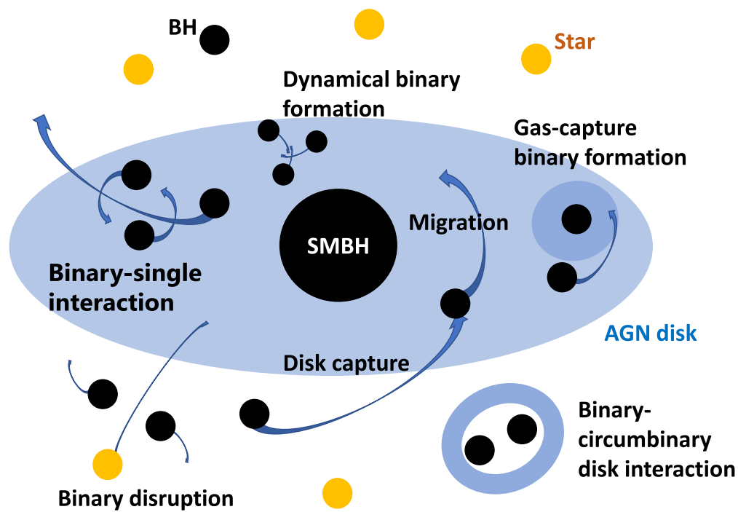
Formation and Evolution of Compact Objects in AGN Disks
Part 0
Outline:
Background
1、BH Mergers in AGN disks
2、WD Collisions in AGN Disks
3、NS Accretion in AGN Disks
Summary
Contact:
zhangsr@mail.ustc.edu.cn
Observational evidence/hint
GW:
• High merger rate (Abbott et al. 2019).
• Significantly massive than those observed in our Galaxy (LIGO 2019)
• Candidate: GW190521 (Samsing, J. et. al. 2022)
EM:
• GRB Candidate: GRB 191019 (Lazzati et al. 2023; Levan et al. 2023)
• Super-solar metallicities (e.g. Hamann & Ferland 1999; Du & Wang 2014)
• QPEs and QPOs (e.g. Song, et al. 2020; Miniutti, et al. 2023)
• Changing-look AGNs (e.g. Ricci et al. 2020; Trakhtenbrot et al. 2019)
Neutrinos:
• 79 TeV neutrinos from NGC 1068 (Tagawa et al. 2023)
3
Tagawa H., Haiman Z., & Kocsis B. 2020, ApJ, 898, 25
9

Slide 5
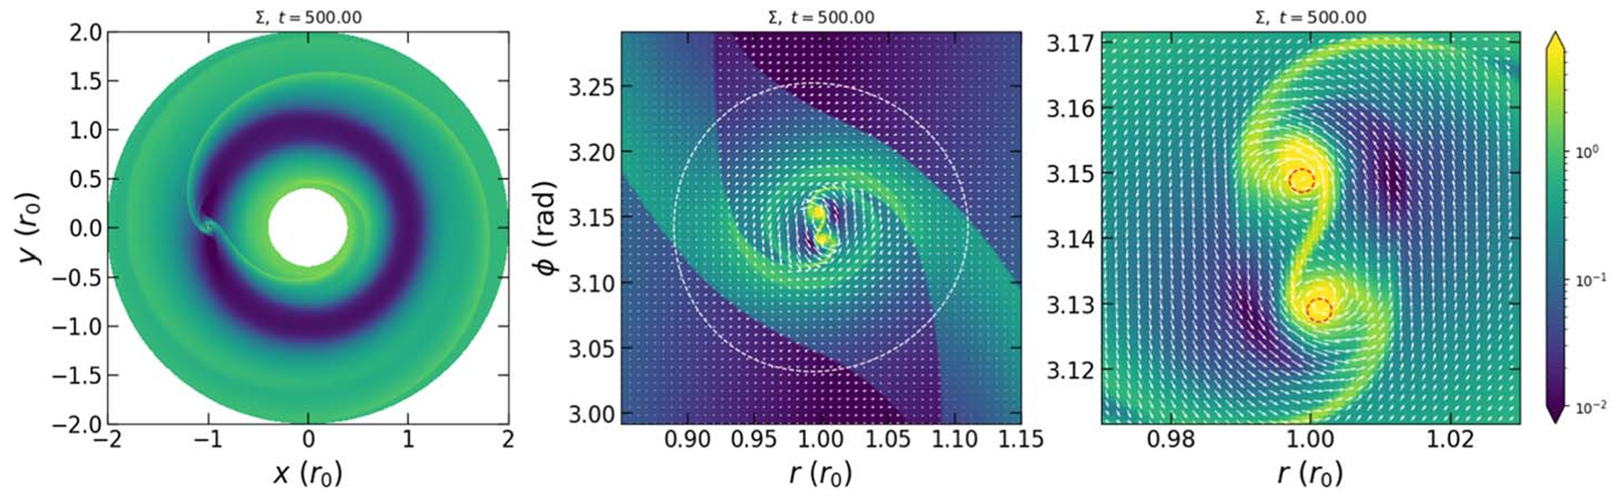
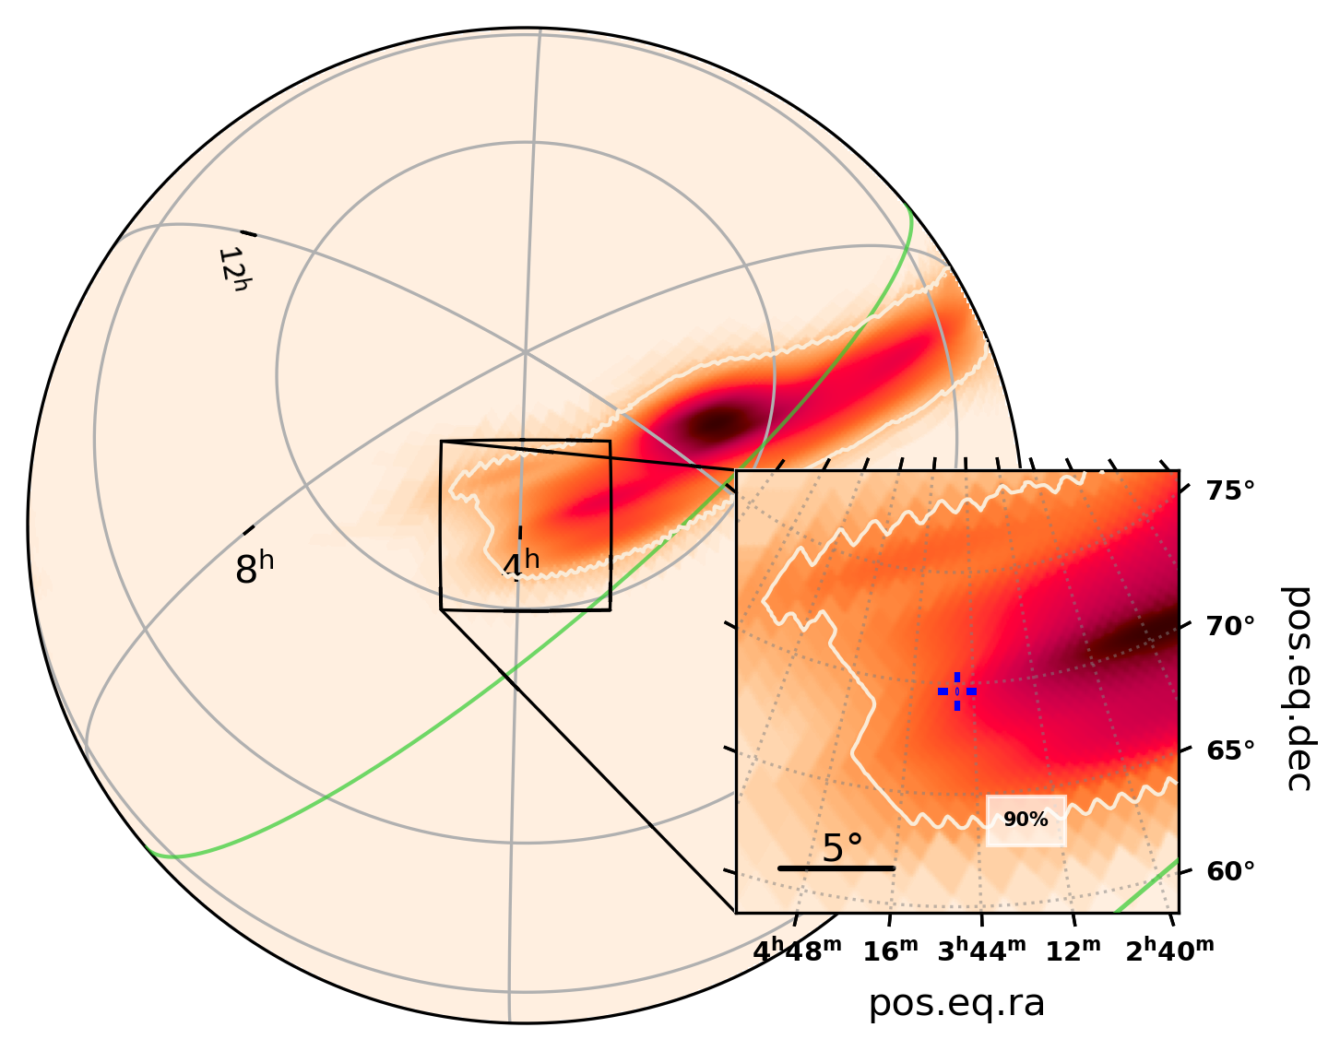
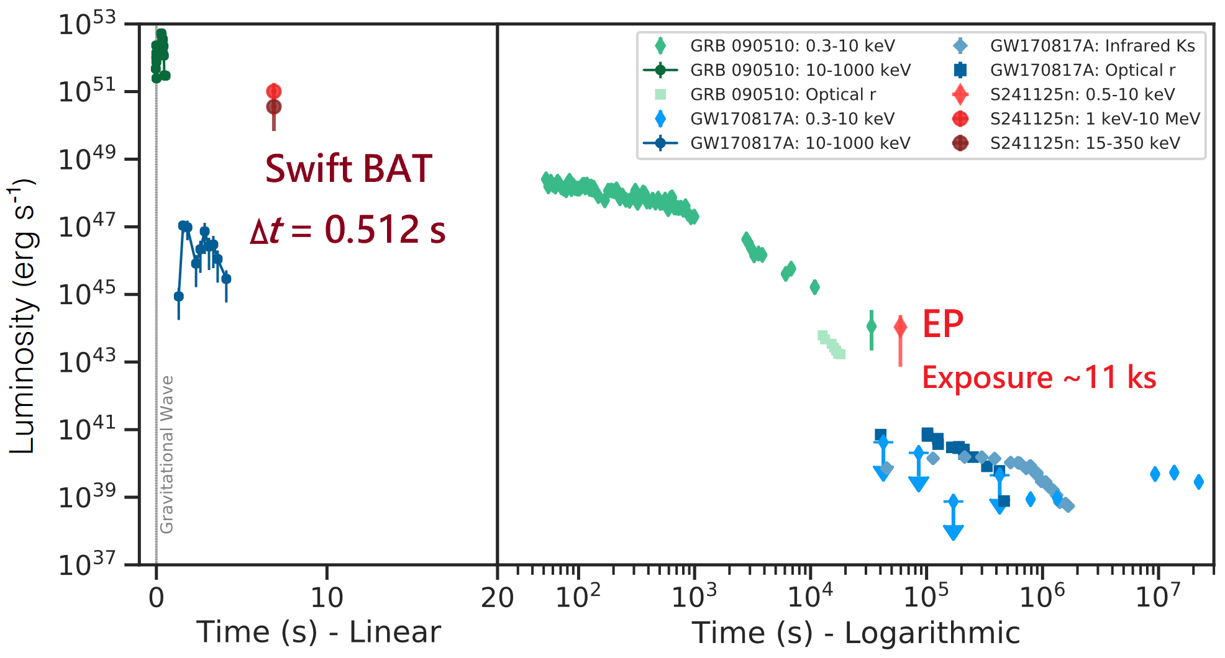
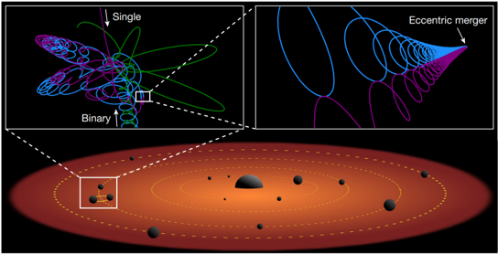
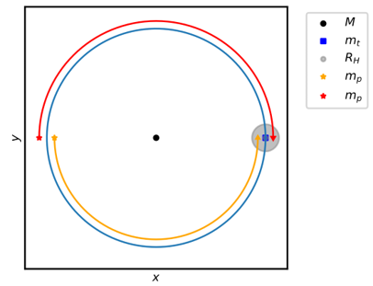
Dynamics of BHs in AGN Disks
Outline:
Background
1、BH Mergers in AGN disks
2、WD Collisions in AGN Disks
3、NS Accretion in AGN Disks
Summary
Contact:
zhangsr@mail.ustc.edu.cn
Merger though gas interactions (e.g., Li et al. 2021)
Candidate: S241125n
4
AGN disks can produce excess eccentric mergers through interactions with stellar-mass objects (e.g., Samsing et al. 2022) or the central SMBH (Boekholt et al. 2023)
Zhang, et al., ApJ (2026).
9

Slide 6
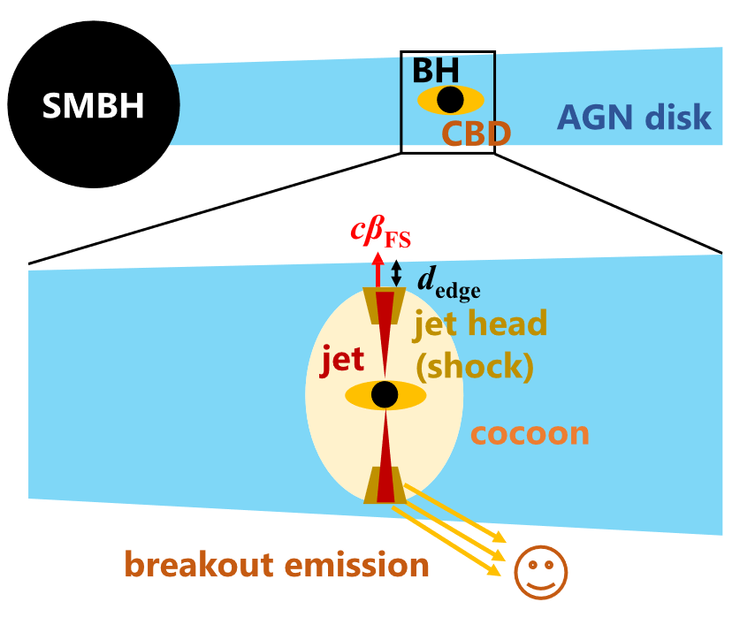
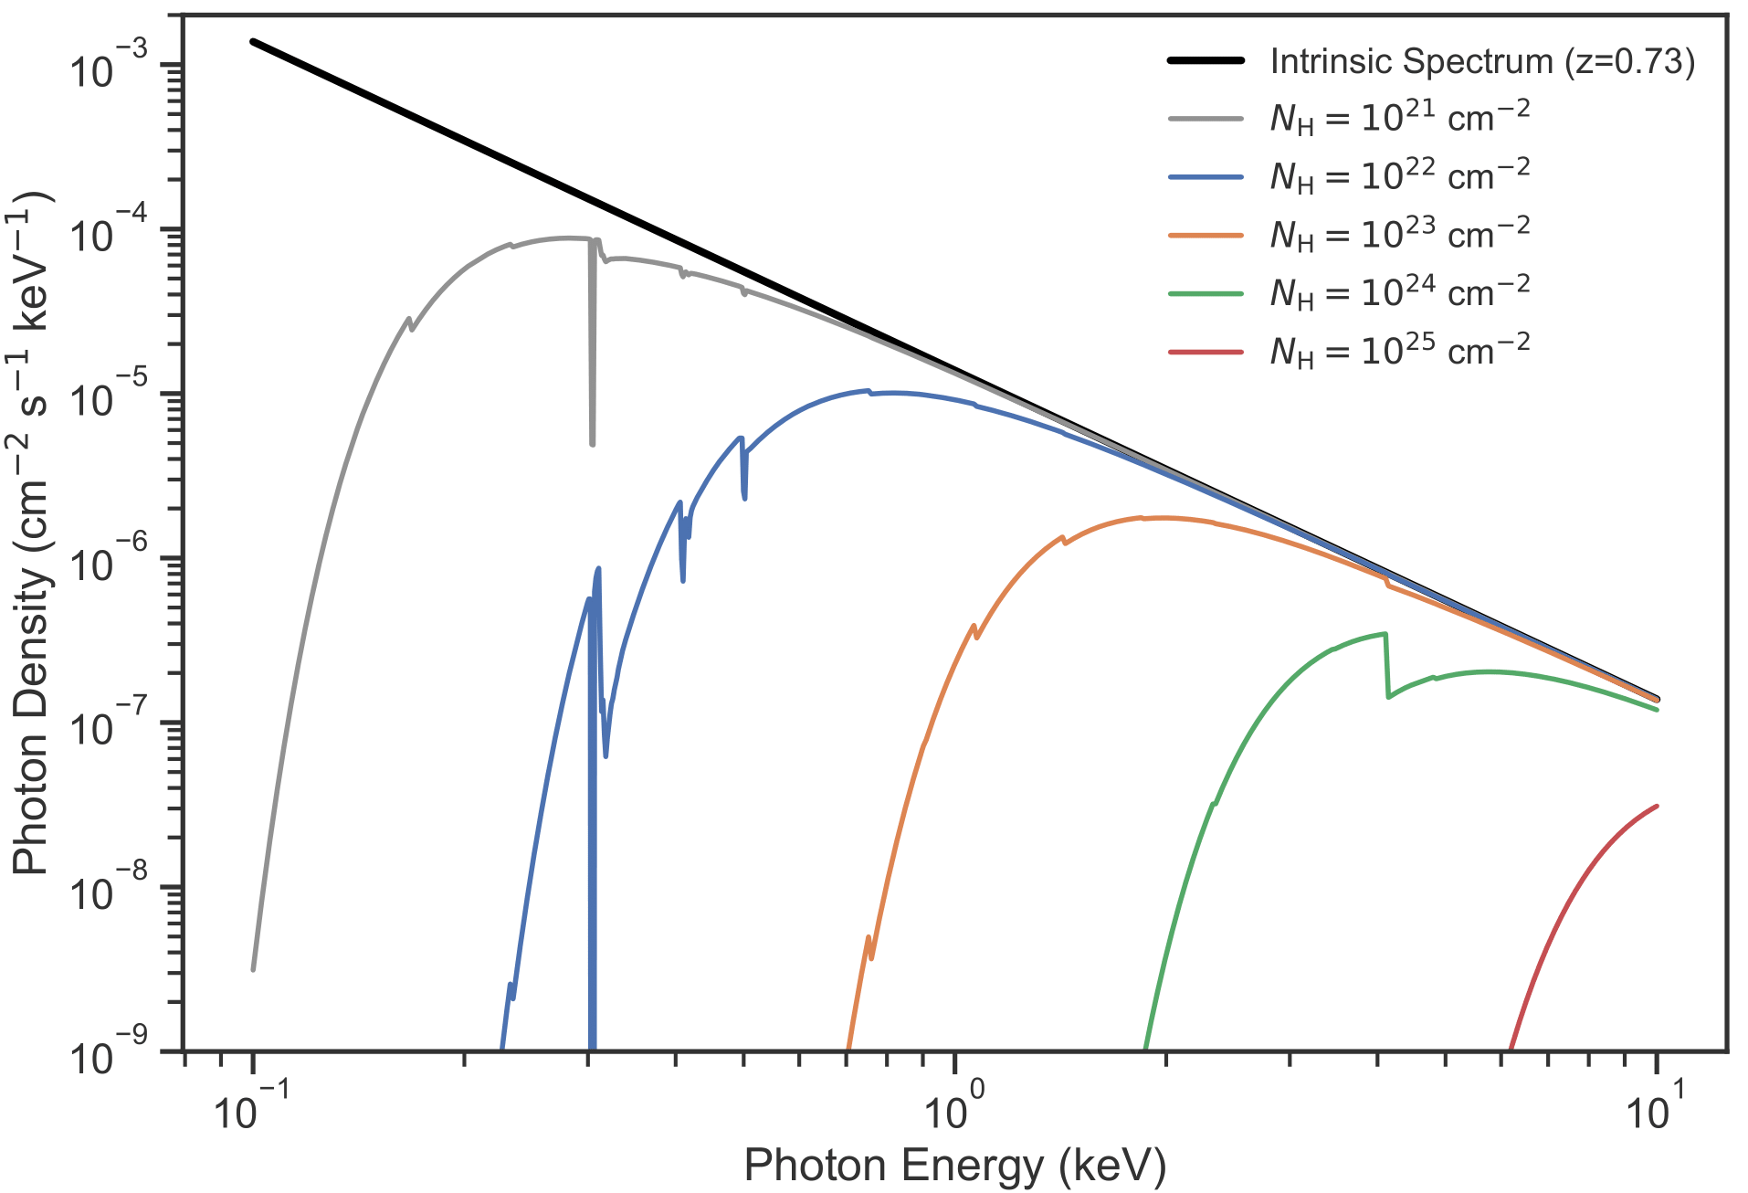
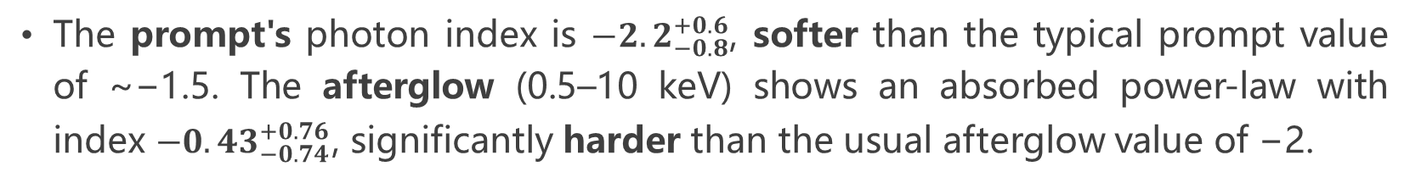
The Case of S241125n
Outline:
Background
1、BH Mergers in AGN disks
2、WD Collisions in AGN Disks
3、NS Accretion in AGN Disks
Summary
Contact:
zhangsr@mail.ustc.edu.cn
The prompt's photon index is ${−2.2}_{−0.8}^{+0.6}$, softer than the typical prompt value of ~−1.5. The afterglow (0.5–10 keV) shows an absorbed power-law with index ${−0.43}_{−0.74}^{+0.76}$, significantly harder than the usual afterglow value of −2.
5
BH accretion and jet launched in AGN disk (Tagawa et al. 2023)
X-ray absorption effects on a power-law spectrum (Zhang, et. al., ApJ. 2026)
9

Slide 7
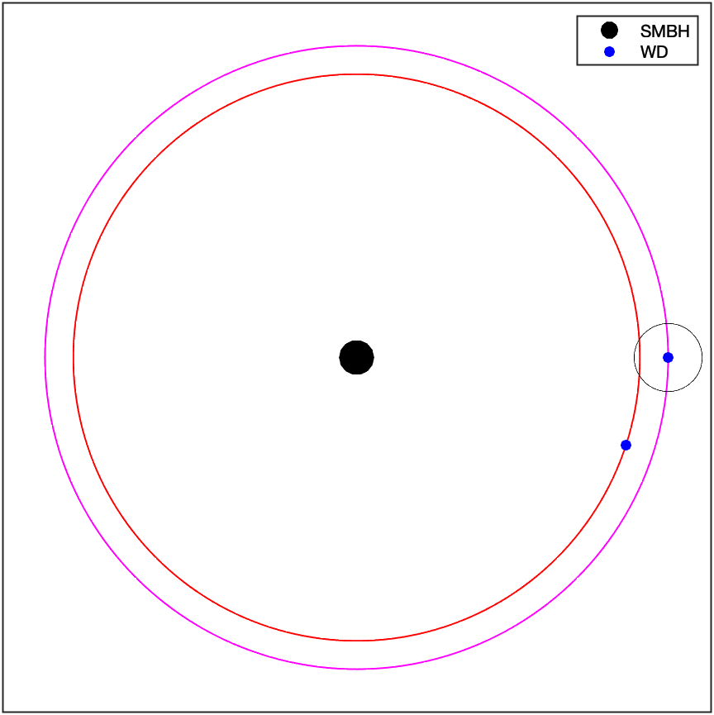
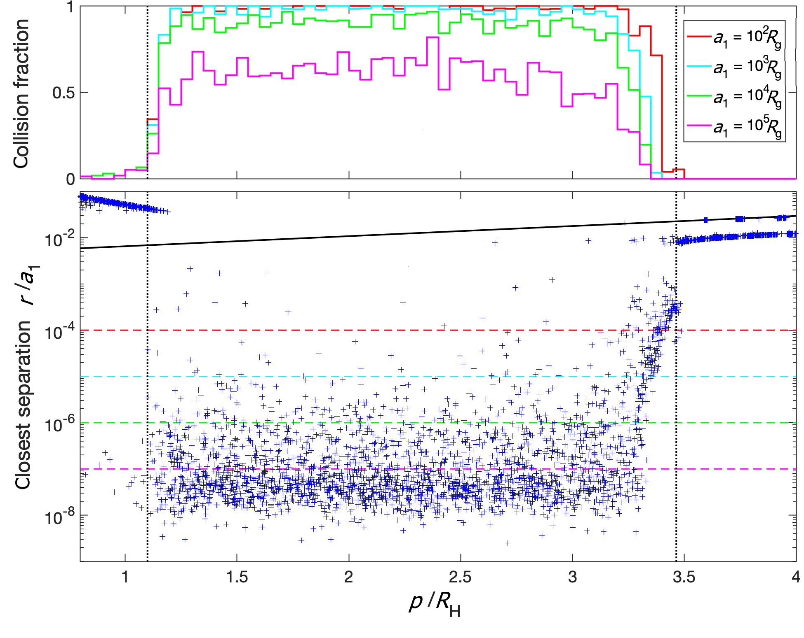
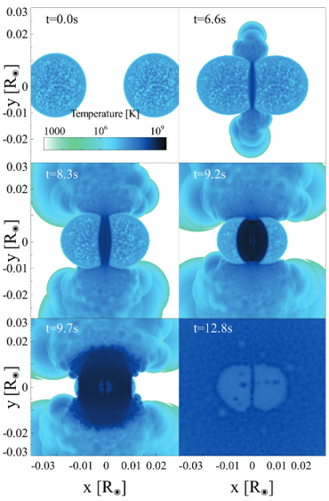
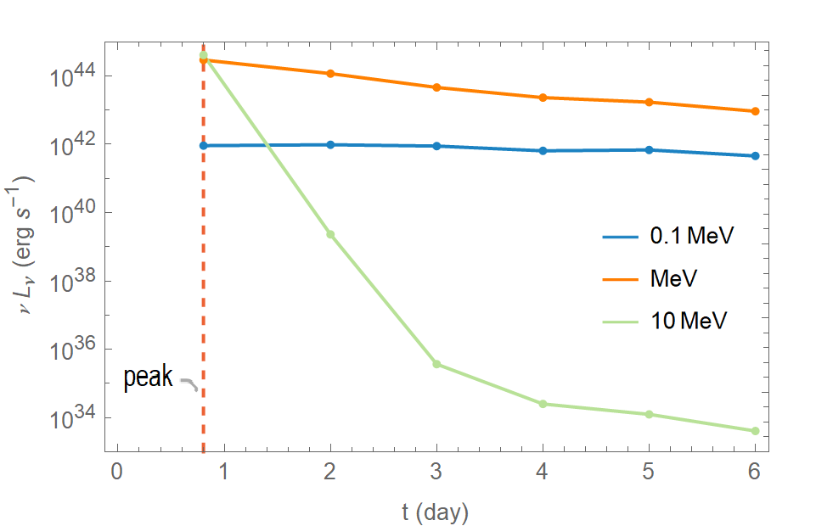
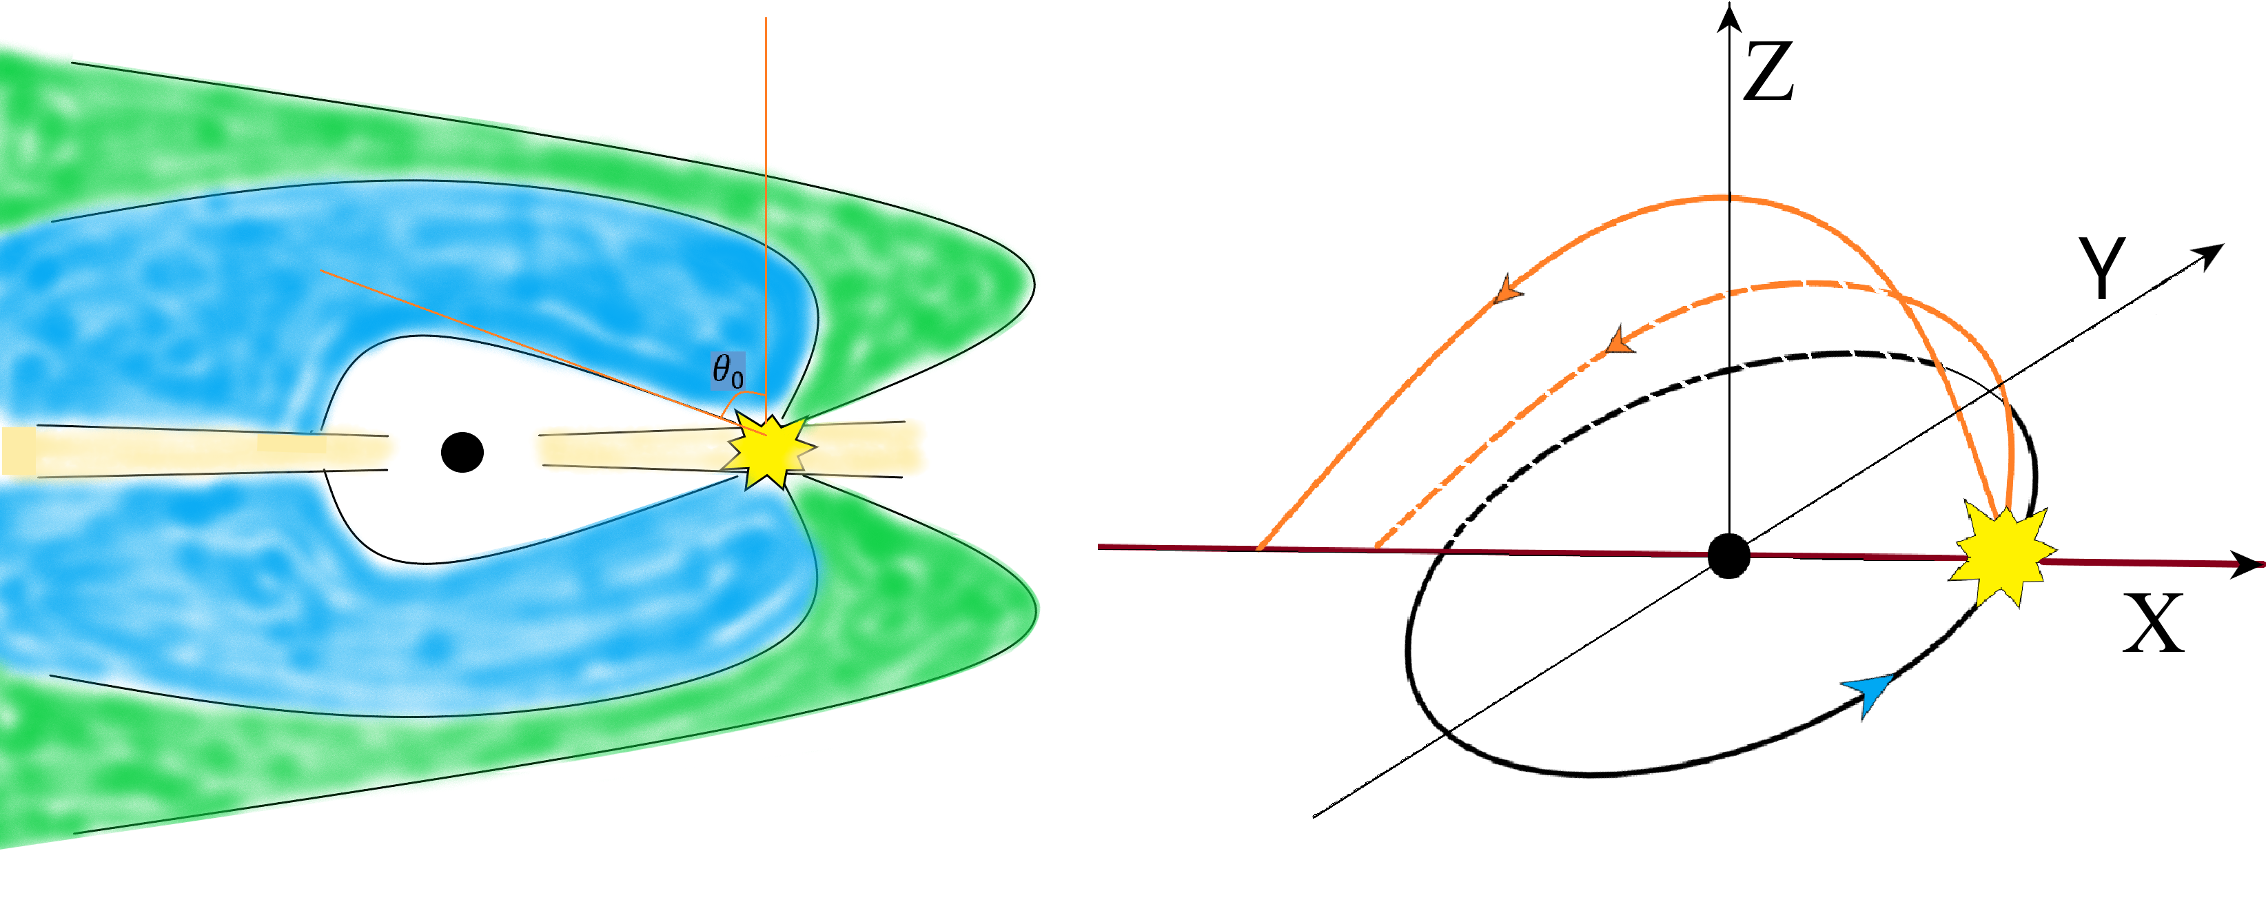
WD Collisions in AGN Disks
Outline:
Background
1、BH Mergers in AGN disks
2、WD Collisions in AGN Disks
3、NS Accretion in AGN Disks
Summary
Contact:
zhangsr@mail.ustc.edu.cn
WD–WD Collision and Thermonuclear Explosions (Raskin et al. 2009)
WDs Close Encounters in AGN Disks
Luo, et al. (2023).
Zhang, et al. (2023).
6
WD–WD collisions occur efficiently in AGN disks through close encounters and trigger thermonuclear explosions.
The enormous kinetic energy released in AGN disks can generate significant MeV radiation.
9

Slide 8
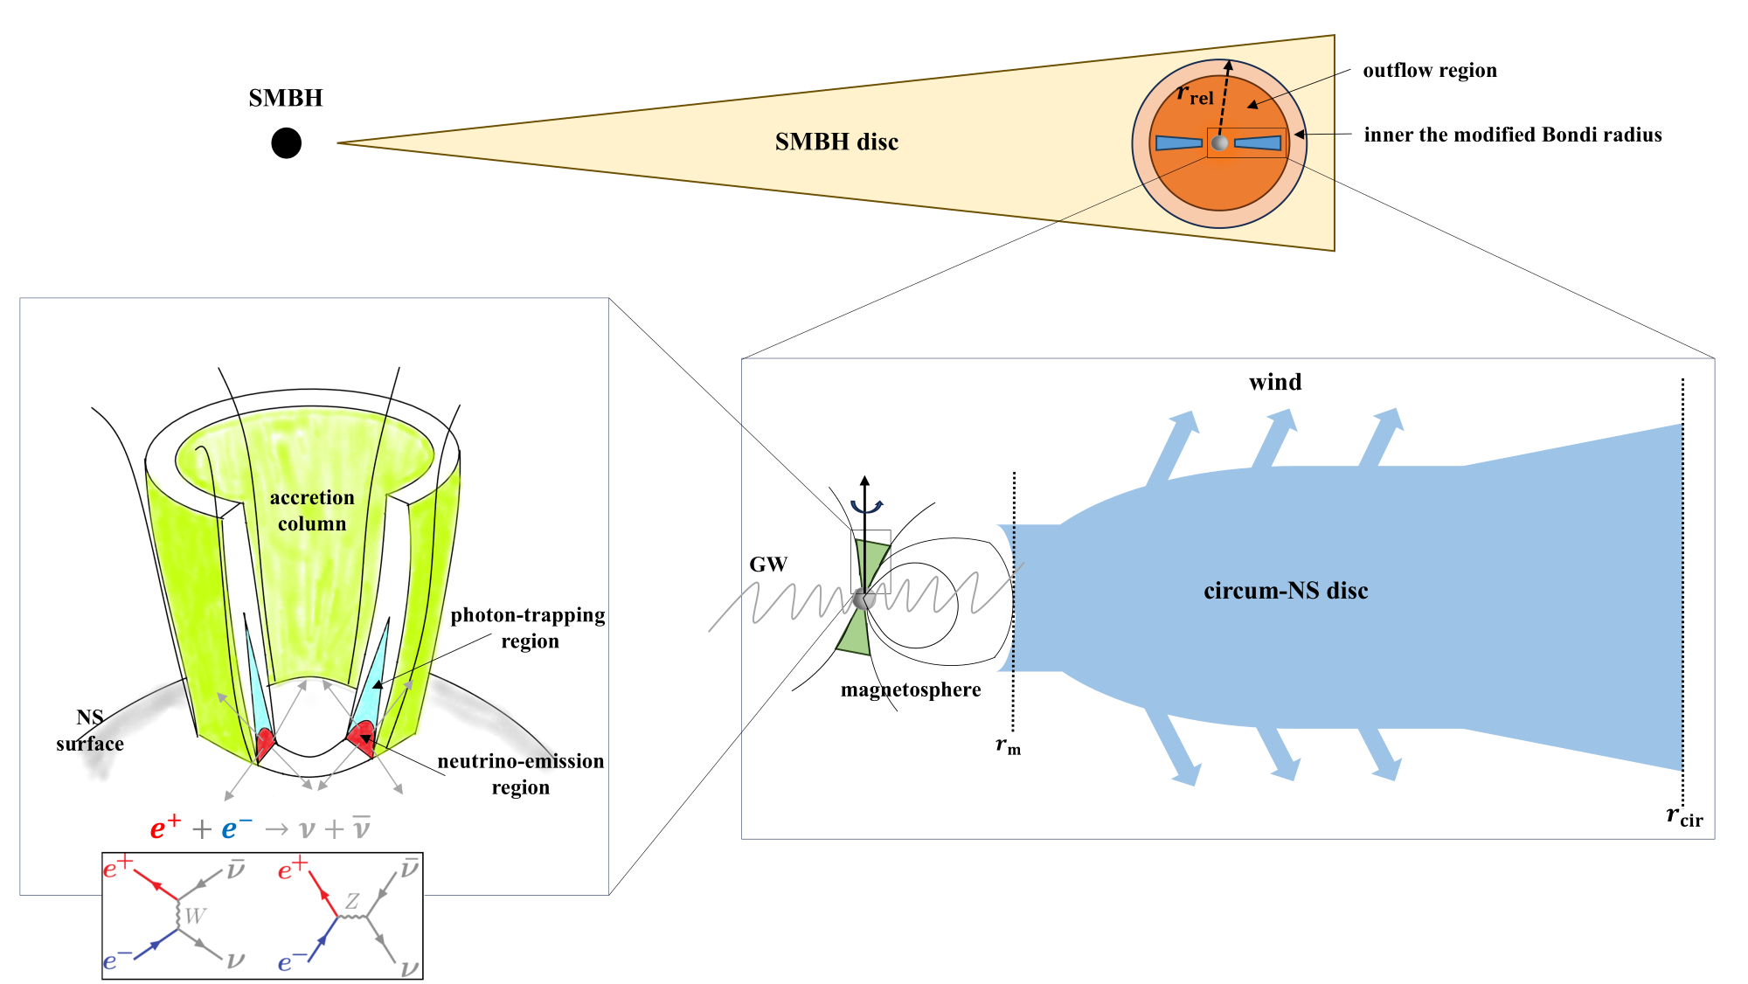
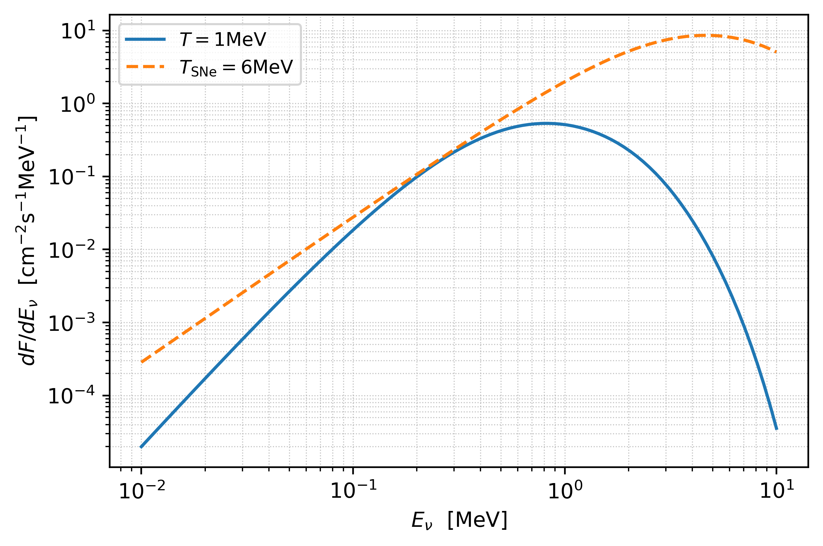
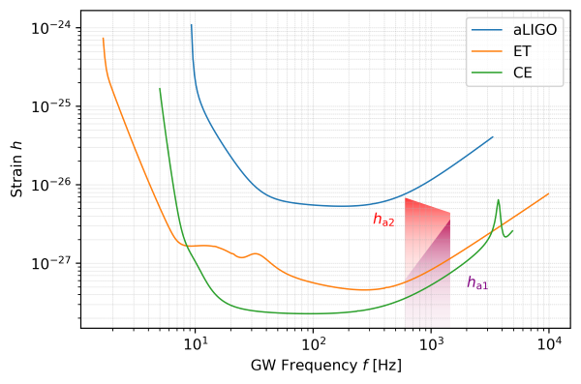
NS Accretion in AGN Disks
Outline:
Background
1、BH Mergers in AGN disks
2、WD Collisions in AGN Disks
3、NS Accretion in AGN Disks
Summary
Contact:
zhangsr@mail.ustc.edu.cn
Diffuse Neutrino Background
GW from NS “Mountains”
7
Zhang, et al., MNRAS (2024).
d = 5 Mpc
Neutrino and GW emissions carry away energy and angular momentum from accretion, weakening the feedback on the AGN disk. This results in an exceptionally high NS accretion rate, making it less likely that binary NS mergers originate from AGN disks.
9

Slide 9
Summary and Outlook
Outline:
Background
1、BH Mergers in AGN disks
2、WD Collisions in AGN Disks
3、NS Accretion in AGN Disks
Summary
Contact:
zhangsr@mail.ustc.edu.cn
By studying the accretion and dynamics of various compact objects in AGN disks, their respective fates and the resulting multi-wavelength and multi-messenger signals are investigated. Probe the Role of Compact Objects in AGNs Through Multi-messenger Approaches has much room for exploration:
How these objects and various explosive events in AGN disks influence the AGN disk structure?
How stellar objects connect between the central SMBH and larger scales of AGNs? What are the roles of stellar objects in the growth of SMBHs?
Observational searches for more stellar objects in AGN disks, pushing into the population-level regime, and further applications to cosmological tests.
8
9
Notes:
Fundamental questions:
where high-energy particles come from and what the host environments of GW sources are;
(2) how SMBHs grow and co-evolve with their host galaxies across cosmic time.

Slide 10

THANKS！！
For more information:
https://orcid.org/0000-0003-0368-384X

Slide 11
Outline
Outline:
Background
1、BH Mergers in AGN disks
2、WD Collisions in AGN Disks
3、NS Accretion in AGN Disks
Summary
Contact:
zhangsr@mail.ustc.edu.cn
Content
5
12

