Slide 1


Faint X-ray sources in the Nuclear Stellar Disk using deep Chandra observations
Speaker:
Valentin Nezabudkin^{1,3}
Co-authors:
R. Krivonos¹, A. Vikhlinin², S. Sazonov¹
Affiliations:
¹IKI RAS, Moscow
²CfA, Harvard & Smithsonian
³MIPT, Moscow
2026

Slide 2
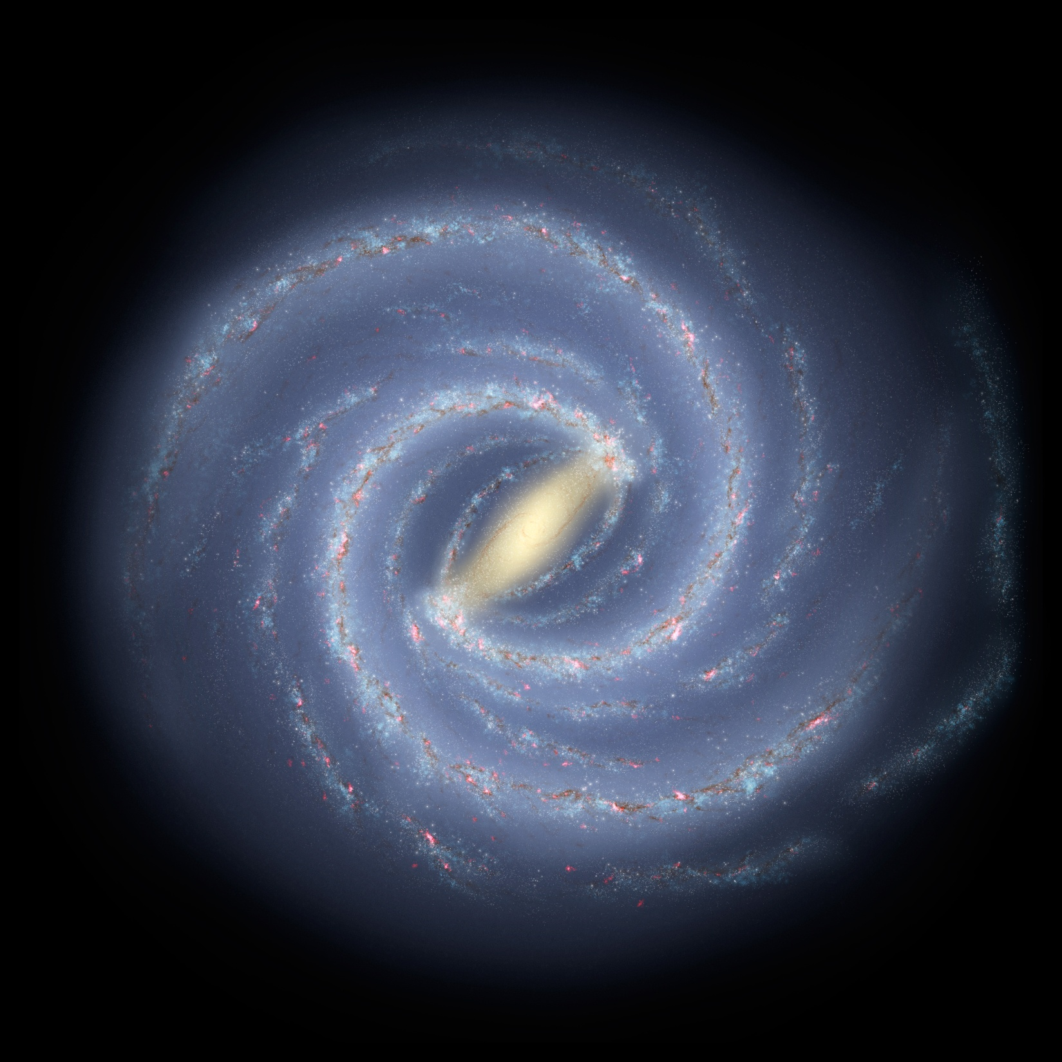

Introduction
Supermassive black hole Sagittarius A*
Nuclear Stellar Cluster
30 pc
Nuclear Stellar Disk
400 pc
Sun
Galactic Bar/Bulge
4 kpc
Galactic Disk

Slide 3
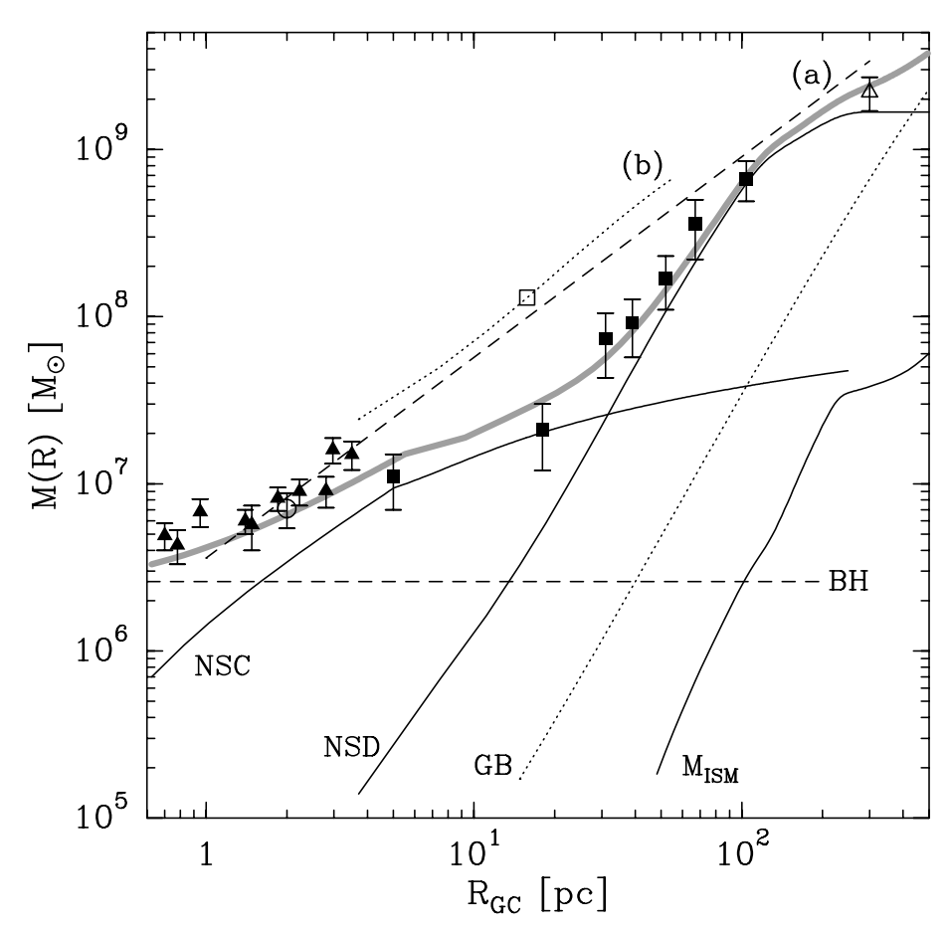
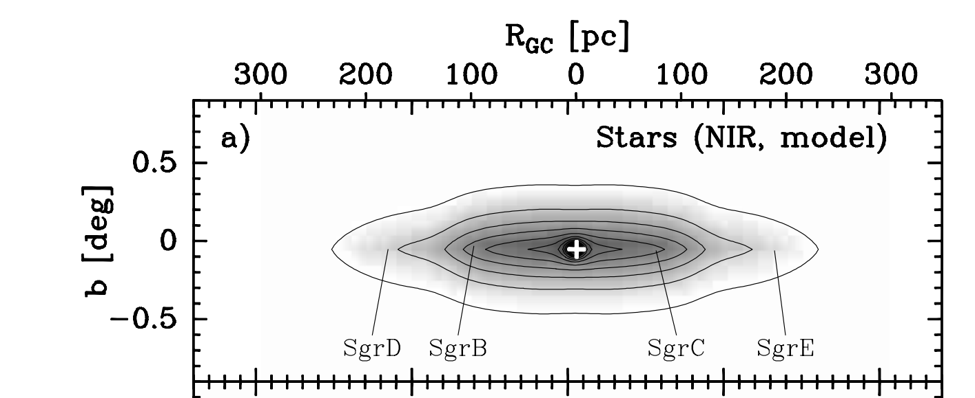
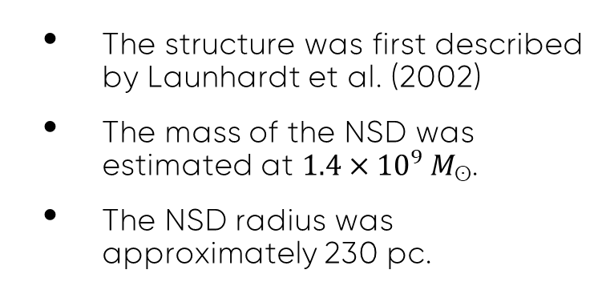
Nuclear Stellar Disk
The structure was first described by Launhardt et al. (2002)
The mass of the NSD was estimated at $1.4×{10}^{9} M_{ʘ}$.
The NSD radius was approximately 230 pc.
Model surface brightness map
Radial profile of cumulative mass

Slide 4
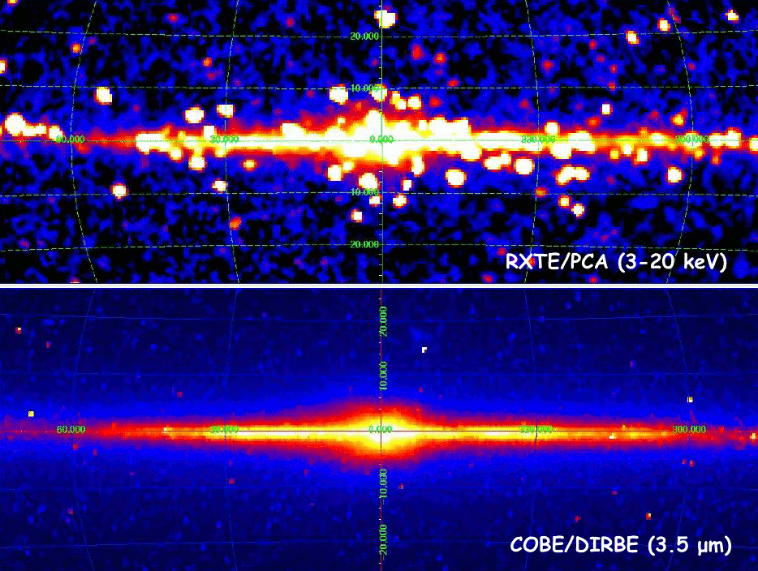
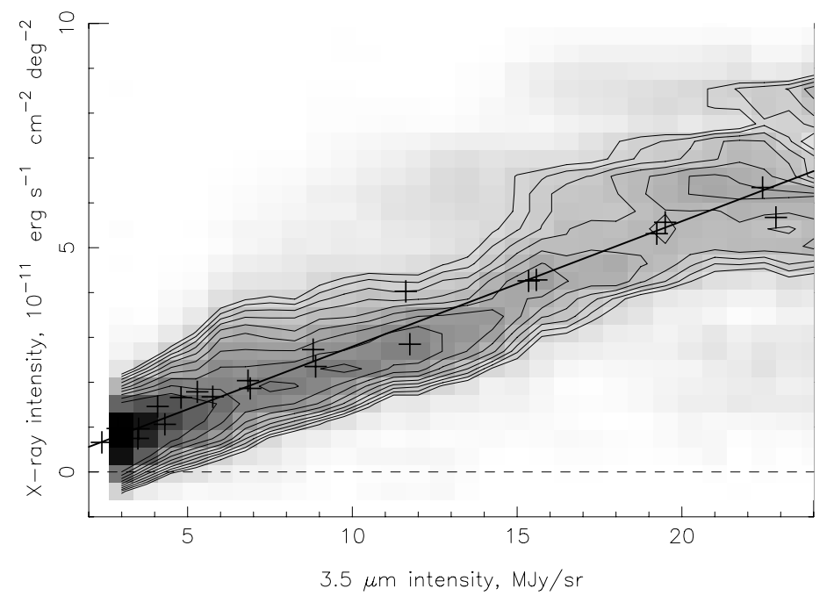
Galactic Ridge X-Ray Emission
Revnivtsev et al.
(2006)
Comparison of X-ray and infrared radiation from the Galactic plane
M. Revnivtsev et al. (2006)

Slide 5
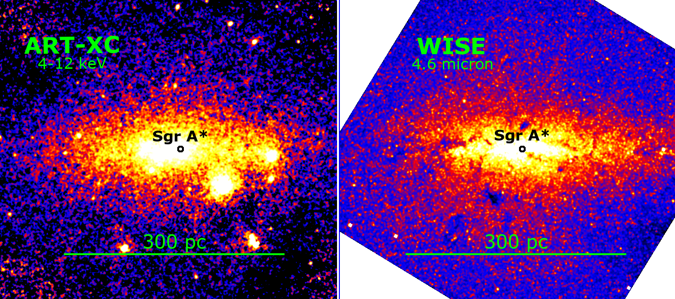
X-Ray Emission of the NSD
Revnivtsev et al.
(2006)

Slide 6
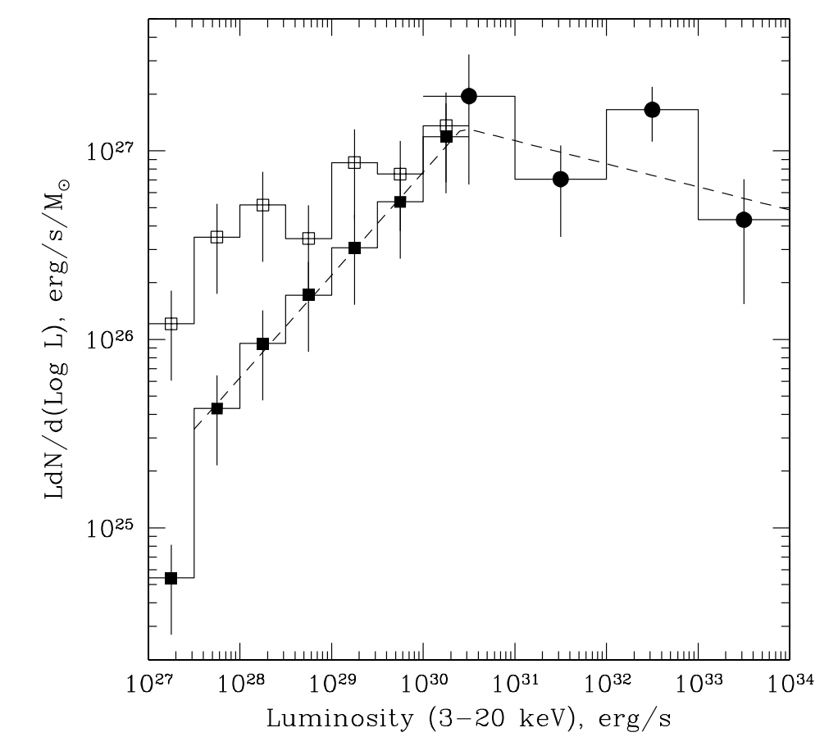
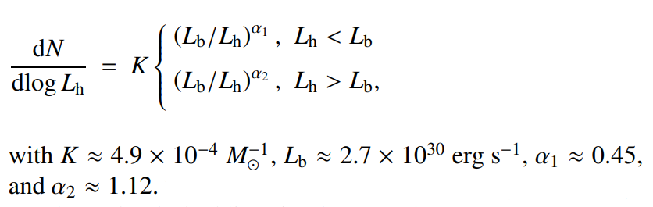
Luminosity Function of faint X-Ray Sources
– CVs by RXTE (25 – 3300 pc)
– ABs by ROSAT (6 – 50 pc)
S. Sazonov et al. (2006)

Slide 7
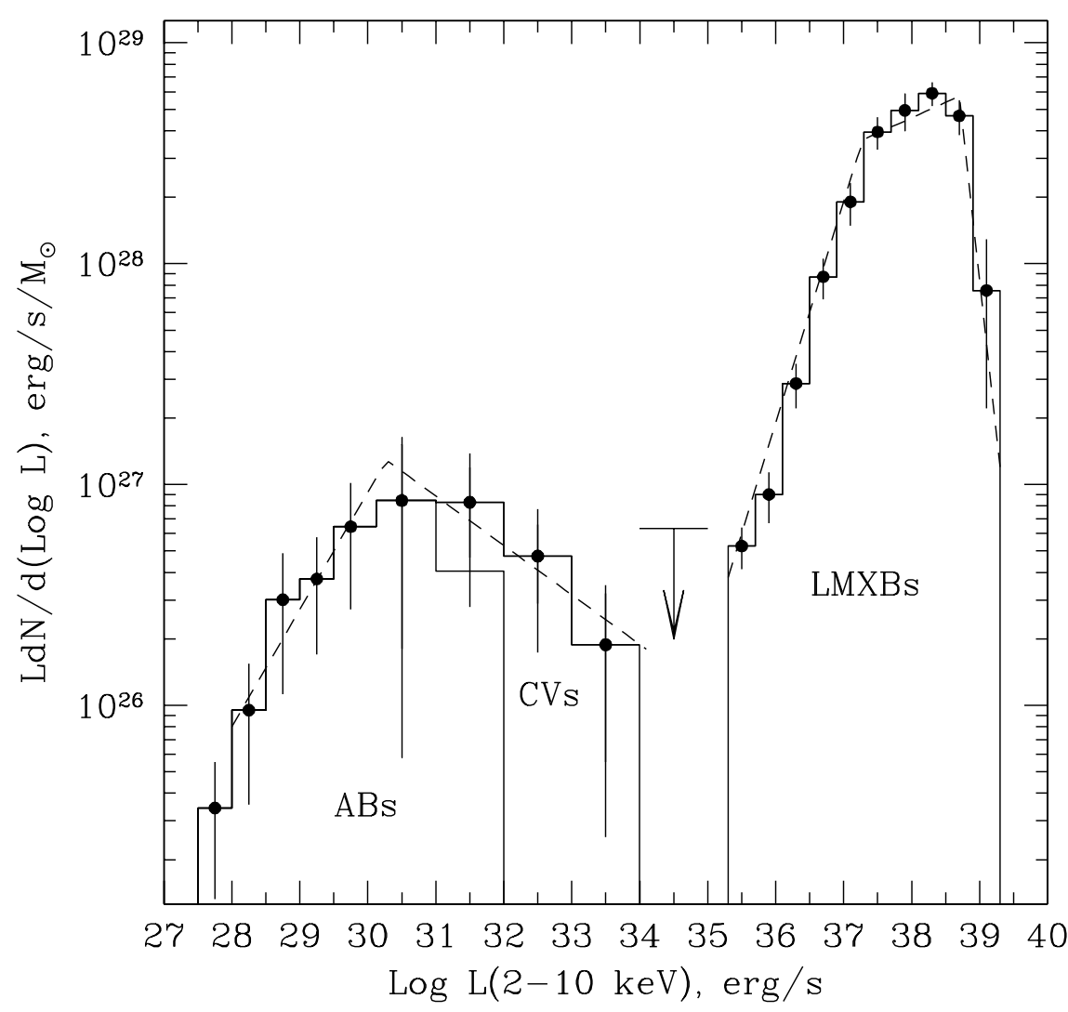
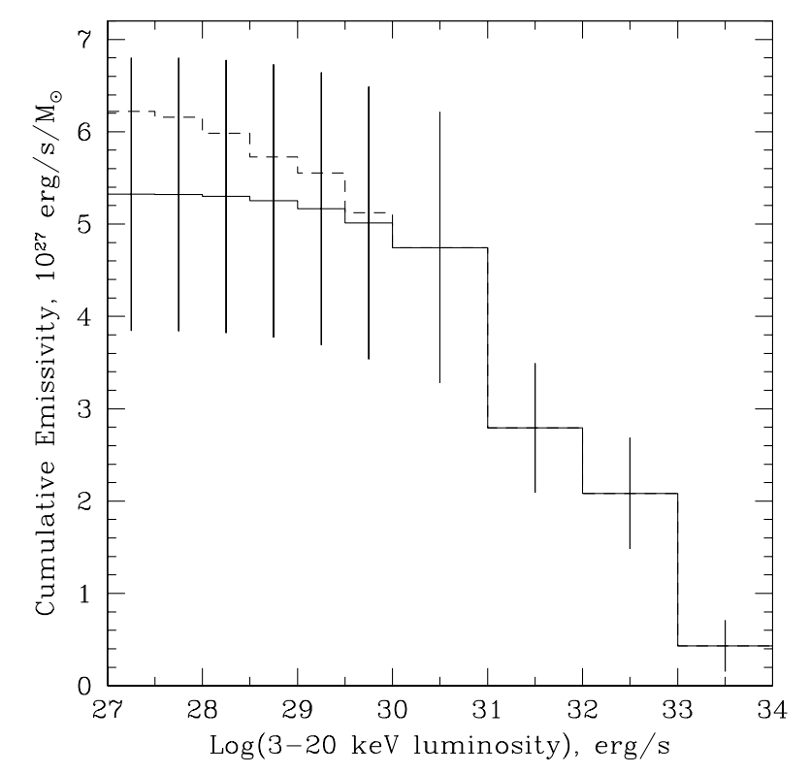
Luminosity Function of faint X-Ray Sources
S. Sazonov et al. (2006)
Integral X-ray emissivity of the Galactic Ridge = $(3. 5±1.5)×{10}^{27} erg s^{−1}M_{ʘ}^{−1}$!

Slide 8
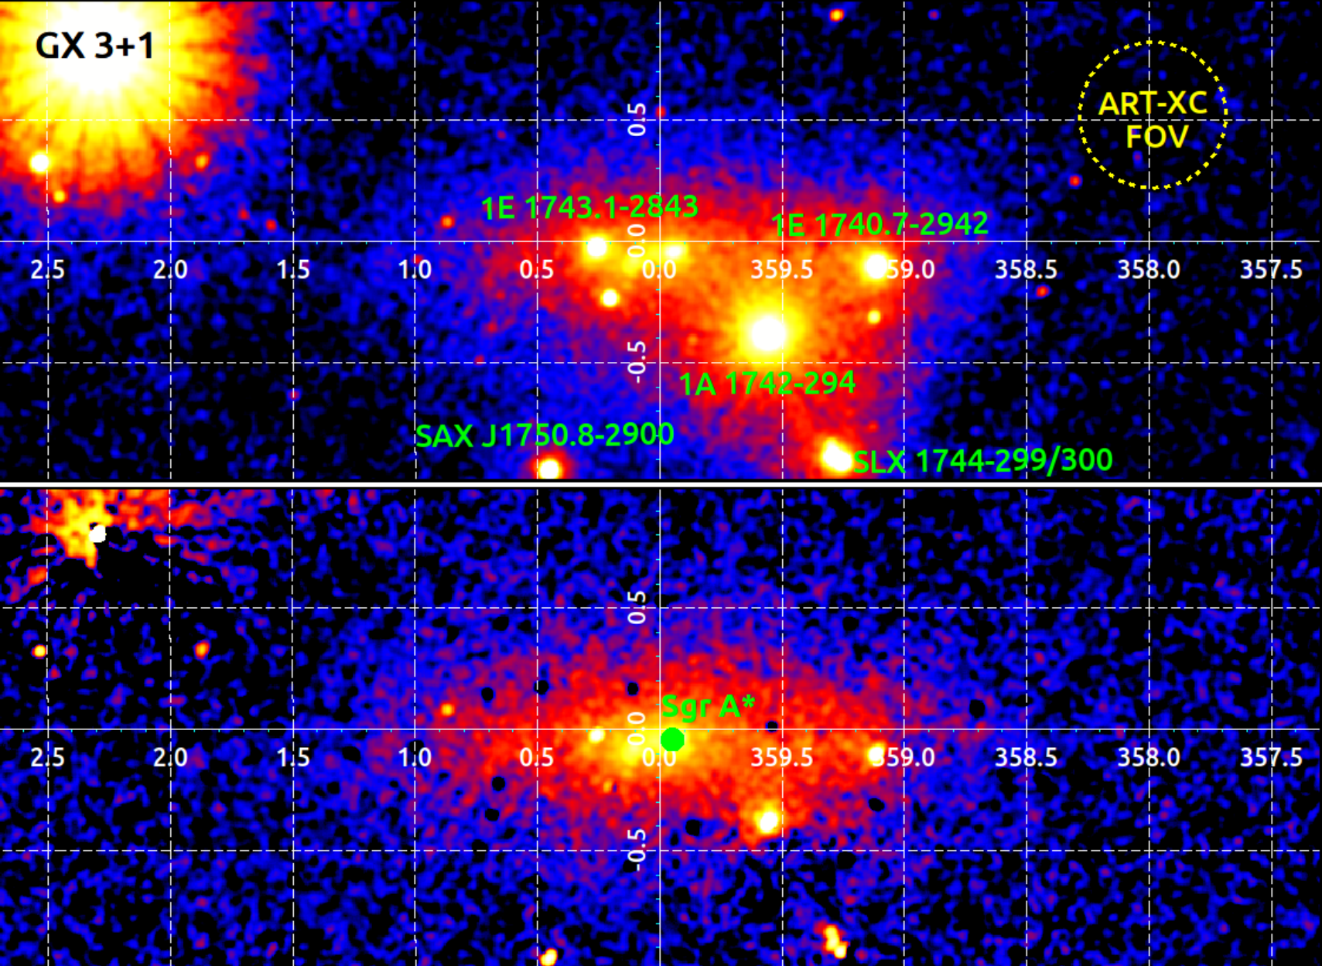
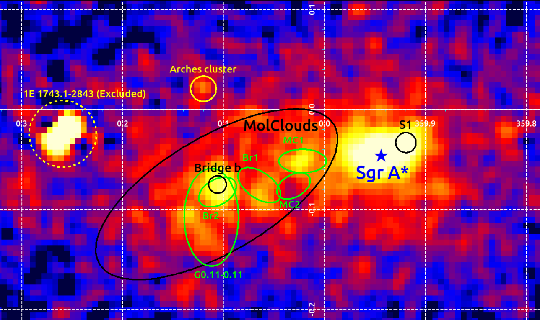
X-Ray Emission of the NSD
M. N. Pavlinsky ART-XC telescope
~1-month scanning during the 2019 calibration phase
4-12 keV energy range
Mean exposure ~3 ks
Nezabudkin et al.
(2025)

Slide 9
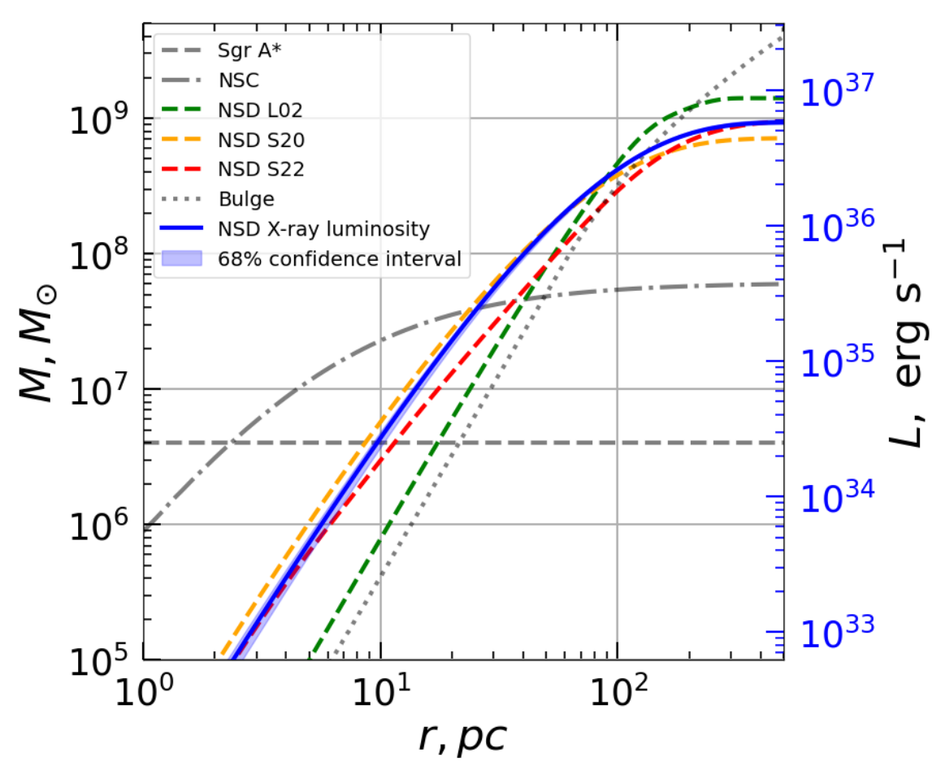
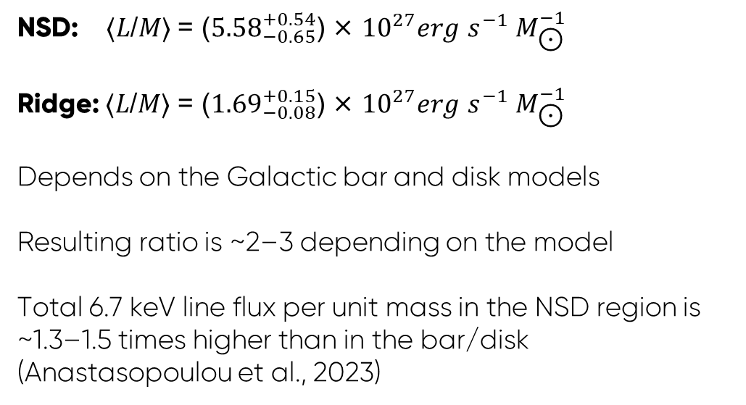
X-Ray Emission of the NSD
NSD X-ray flux model (2D)
Discrete deprojection
NSD X-ray luminosity model (3D)
NSD: ⟨𝐿/𝑀⟩ = (${5.58}_{−0.65}^{+0.54}$) × ${10}^{27}erg$ $s^{−1} M_{\text{⊙}}^{−1}$
Ridge: ⟨𝐿/𝑀⟩ = (${1.69}_{−0.08}^{+0.15}$) × ${10}^{27}erg$ $s^{−1} M_{\text{⊙}}^{−1}$
Depends on the Galactic bar and disk models
Resulting ratio is ~2–3 depending on the model
Total 6.7 keV line flux per unit mass in the NSD region is ~1.3–1.5 times higher than in the bar/disk (Anastasopoulou et al., 2023)
Nezabudkin et al. (2025)

Slide 10
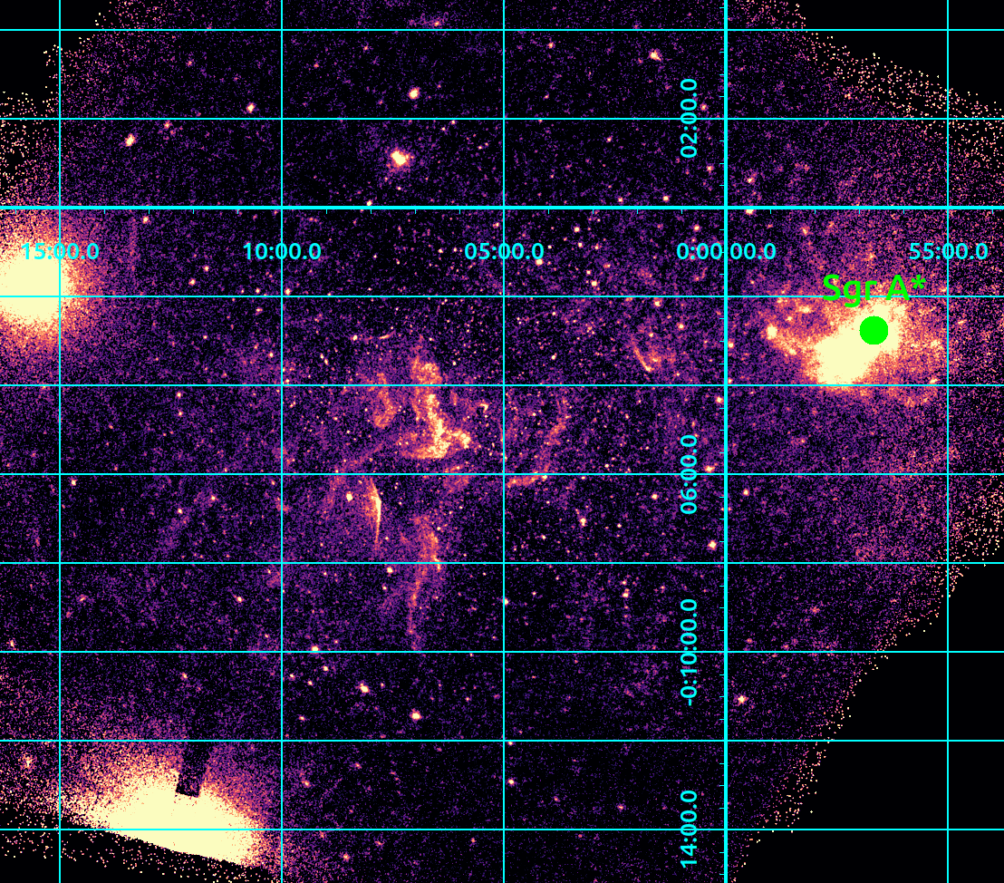
Chandra Observations
Target: CMZ region with molecular clouds
Dataset: Chandra deep field
Energy range:
4-8 keV
Peak exposure:
800 ks

Slide 11
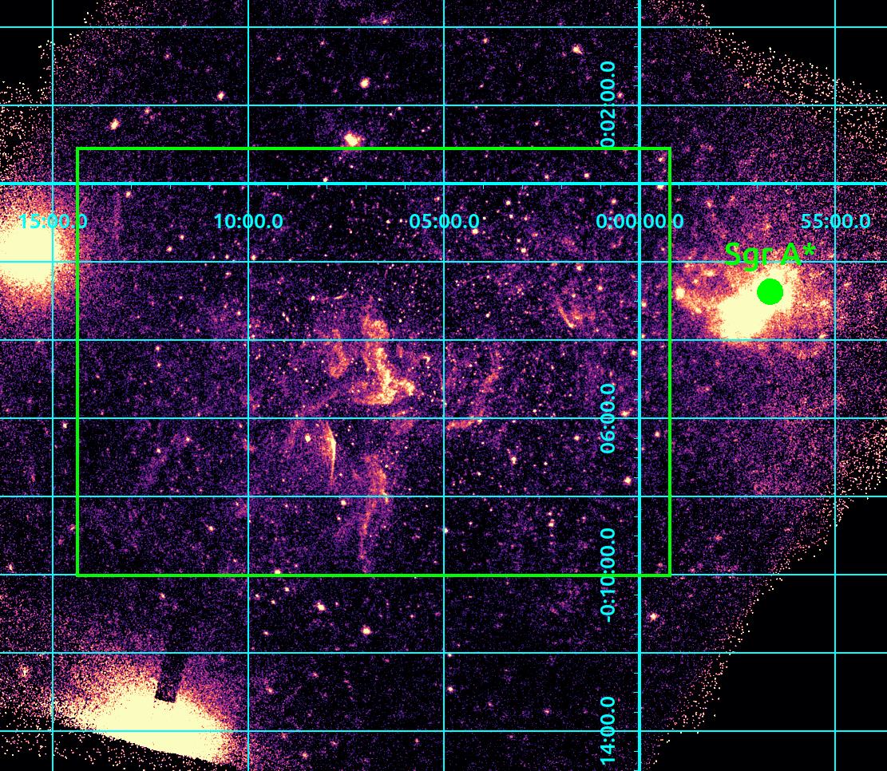
Investigated Area

Slide 12
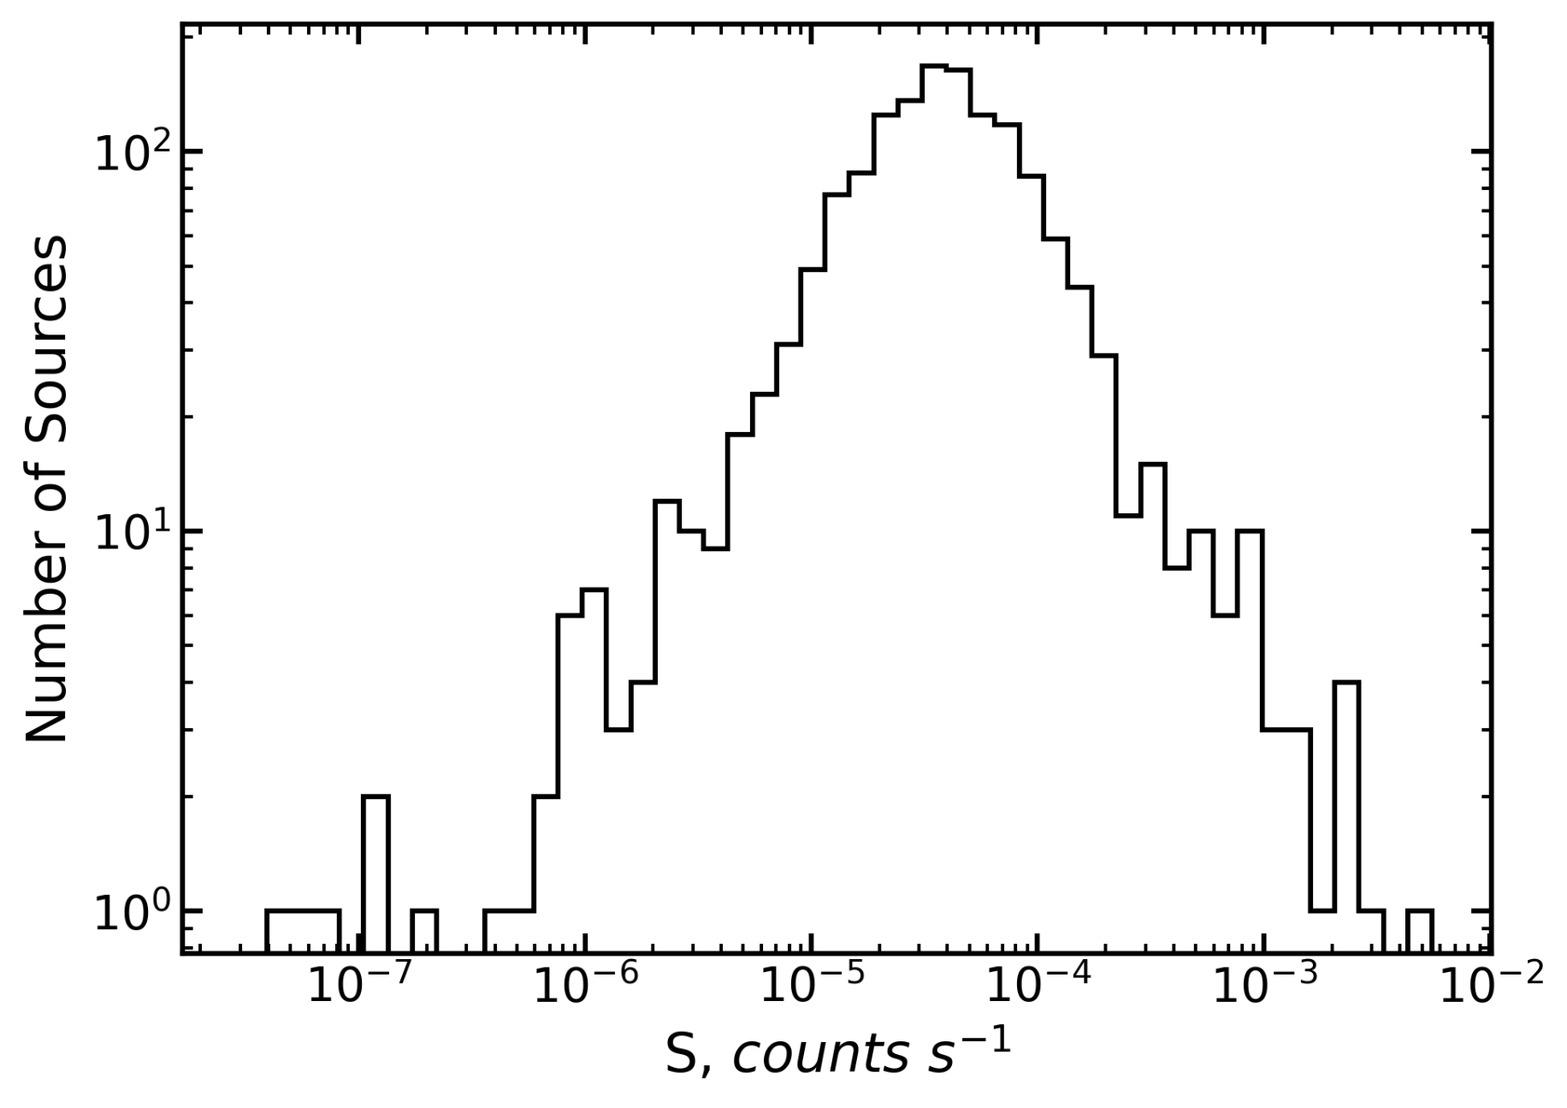
Count Rate Distribution of X-Ray Sources
Total:
1725 sources
(165 arcmin^2)
Source detection:
wavdetect
1% false-source rate

Slide 13
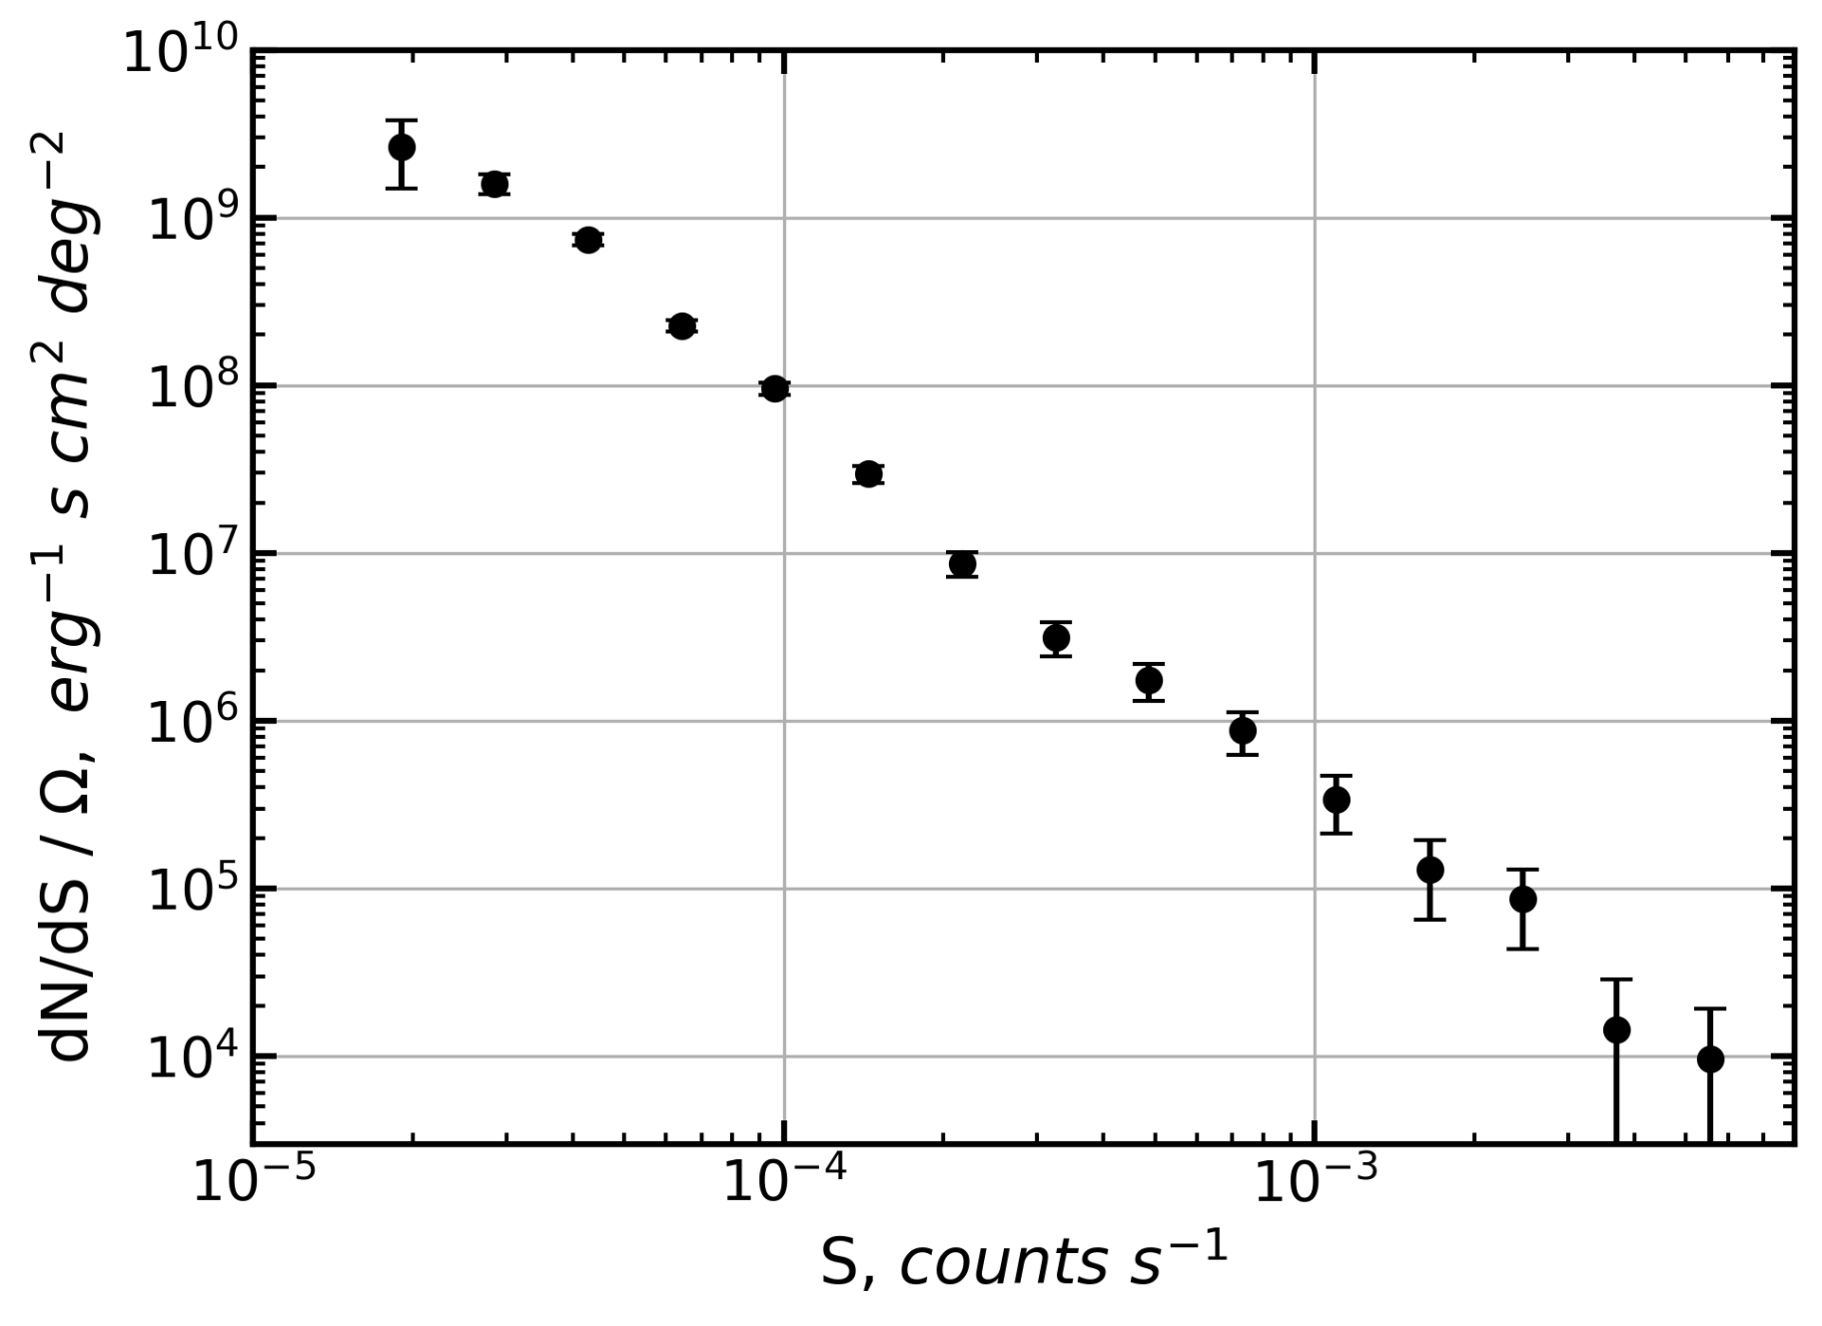
dN/dS Distribution of Sources
Background map generation:
wavelet decomposition
Detection threshold:
4σ
Flux measurement:
aperture photometry
Effective area correction:
based on the 4σ sensitivity map

Slide 14
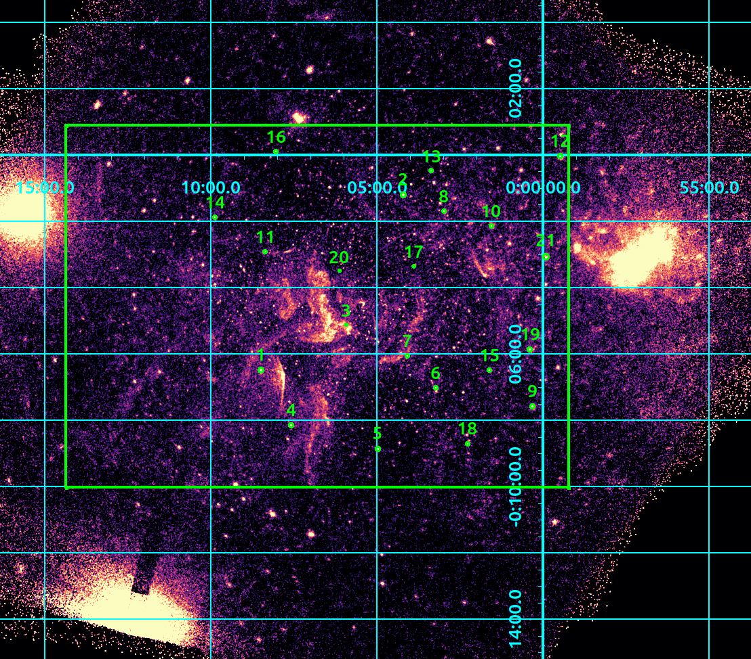
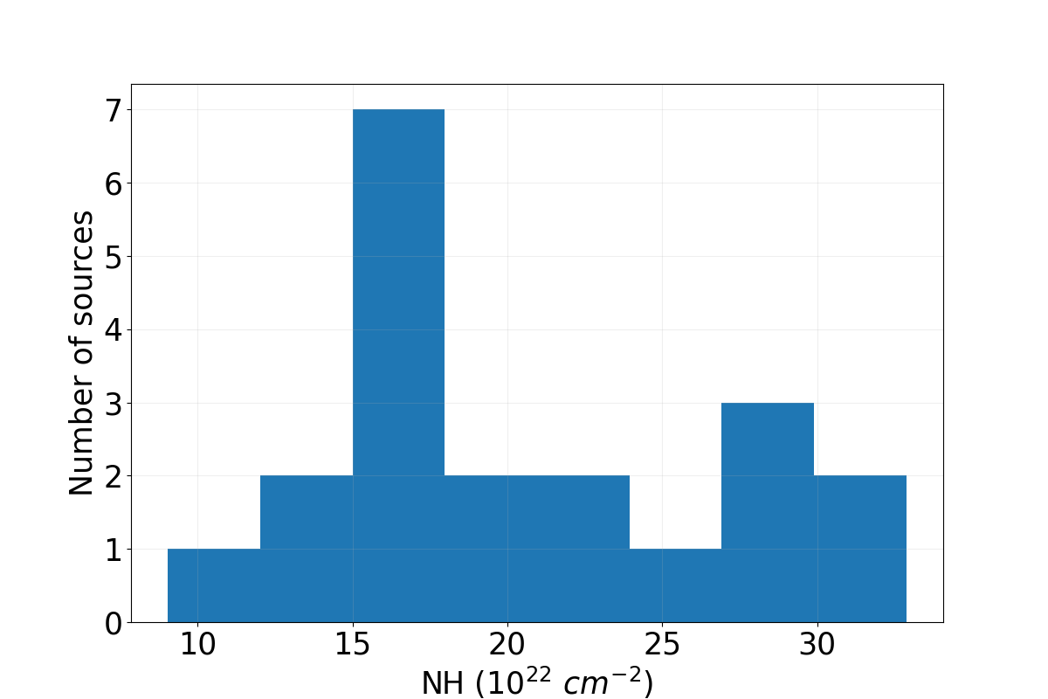
Spectral Properties
Model = tbabs*(powerlaw + gauss1 + gauss2)
gauss1: 6.67 keV (Fe XXV)
gauss2: 2.46 keV (S XV)

Slide 15

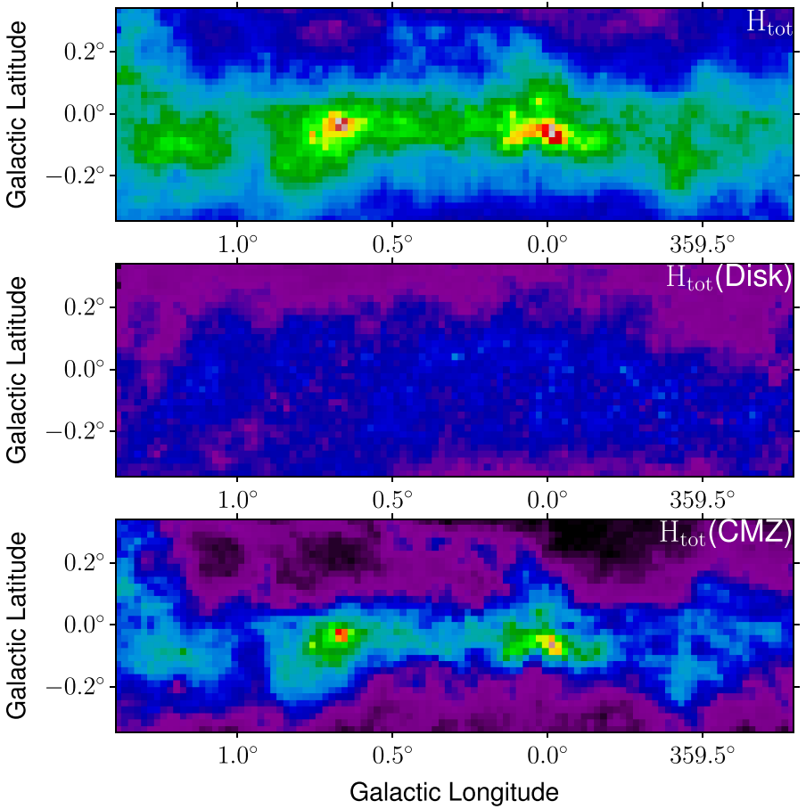
Spectral Properties
Analyzed region
Current results
Ren et al. (2025)

Slide 16
dN/dS Modeling
Mass models:
  NSC – Chatzopoulos et al. (2015)
  NSD – Sormani et al. (2022)
  Bar/Bulge – Sormani et al. (2022)
  Disk – Hunter et al. (2024)
Luminosity function of CVs and ABs
Column density and spectral models

Slide 17
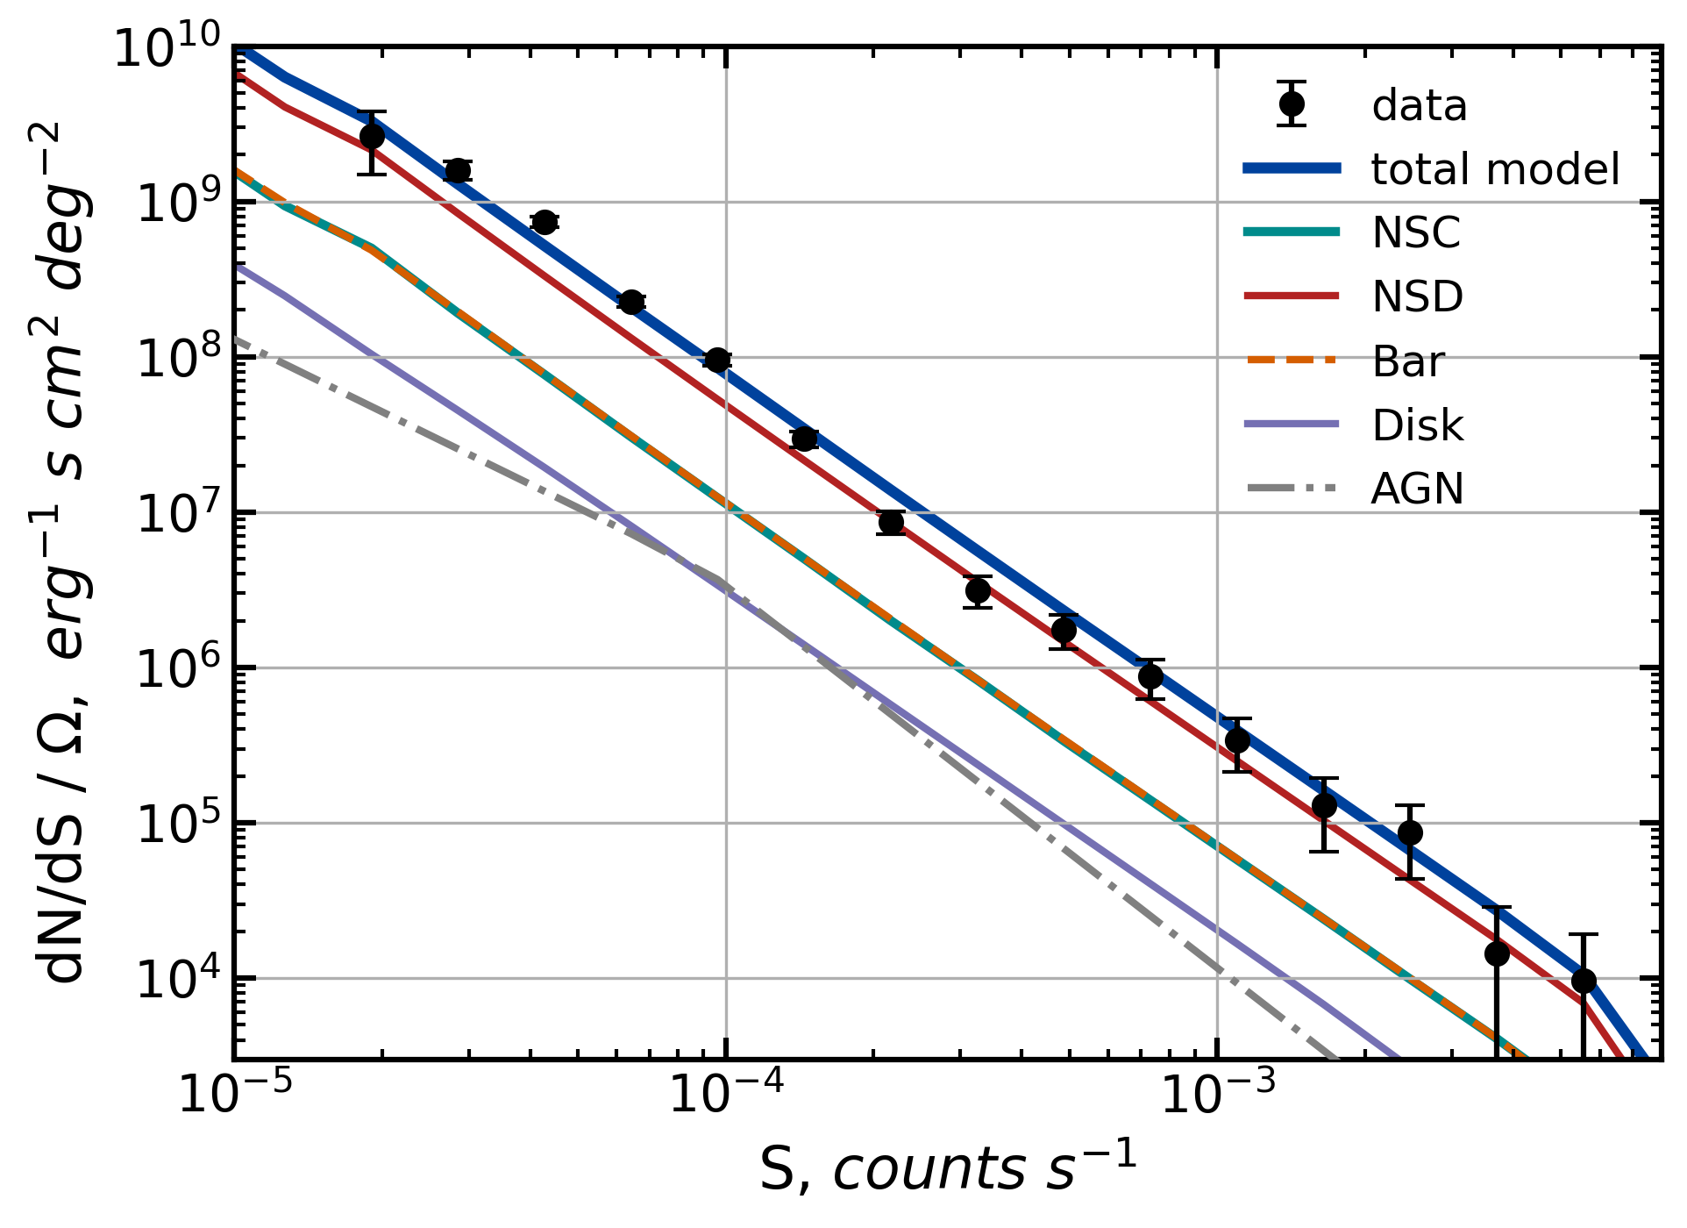
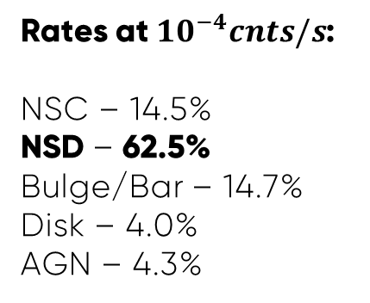
Results
Rates at ${10}^{−4}cnts/s$:
NSC – 14.5%
NSD – 62.5%
Bulge/Bar – 14.7%
Disk – 4.0%
AGN – 4.3%

Slide 18
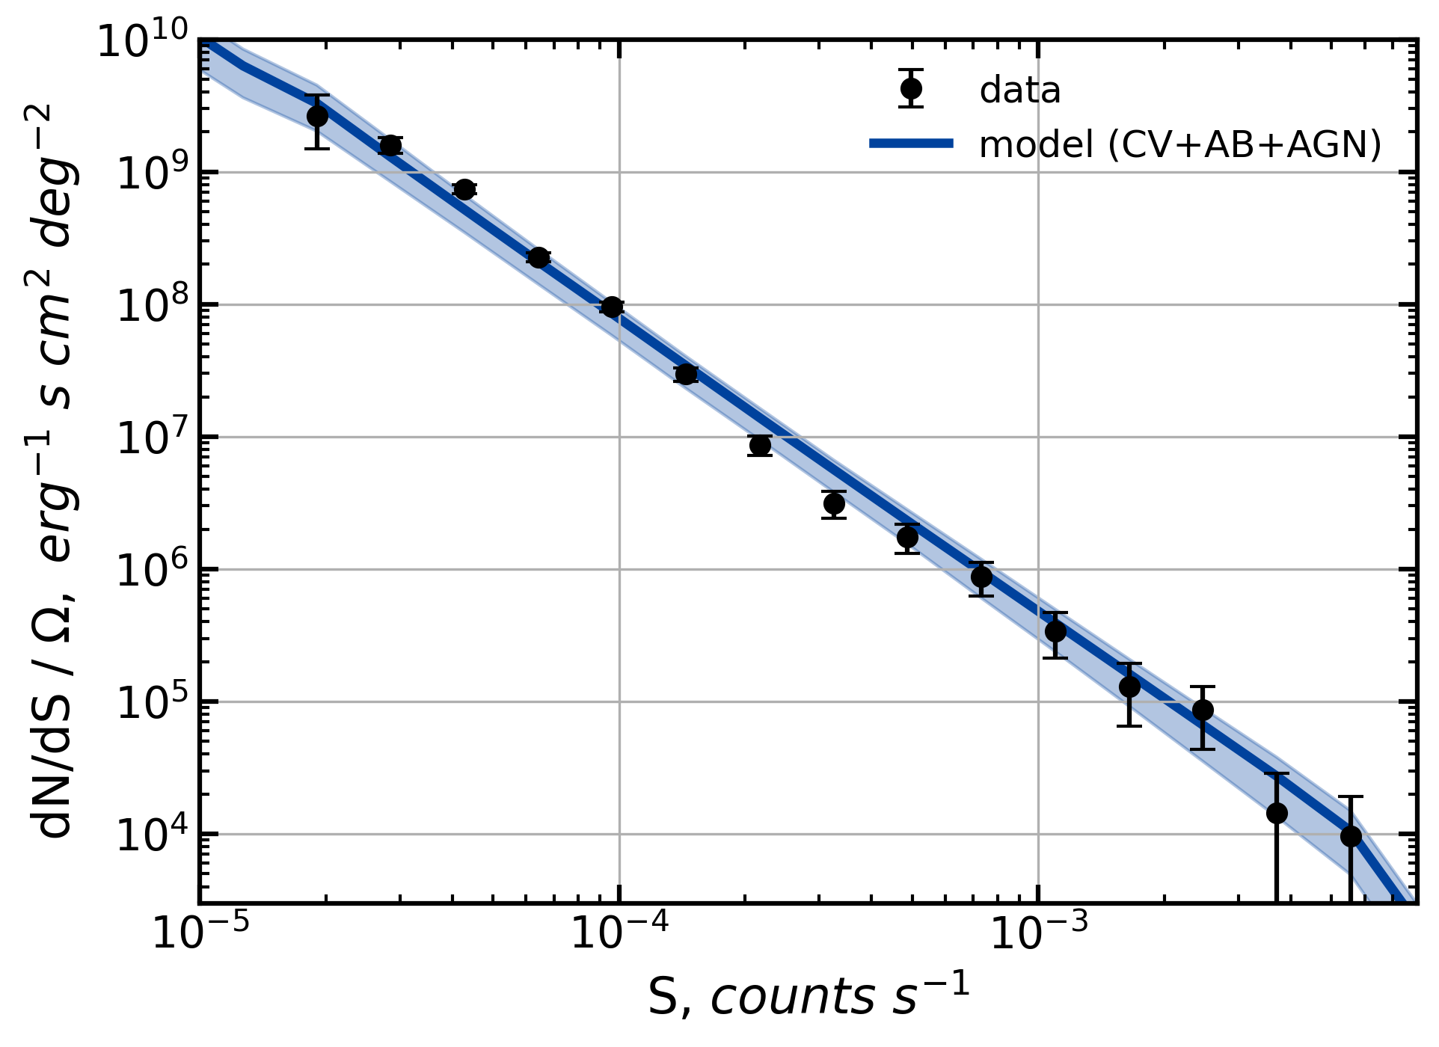
Results

Slide 19
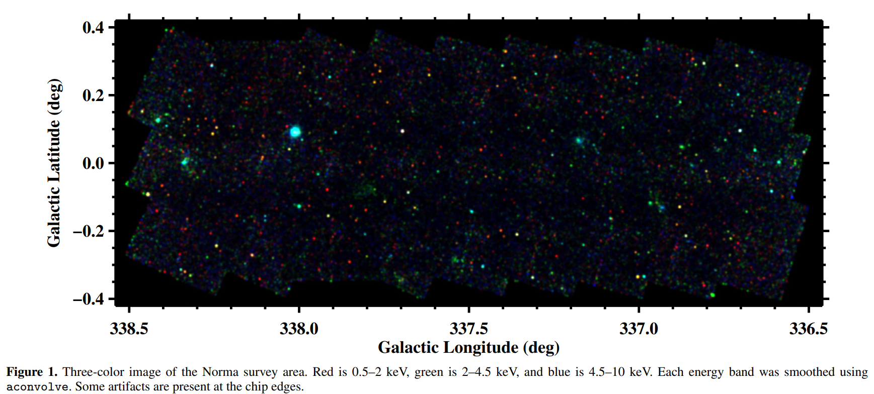
Comparison with the Norma Arm
Fornasini et al. (2014)

Slide 20
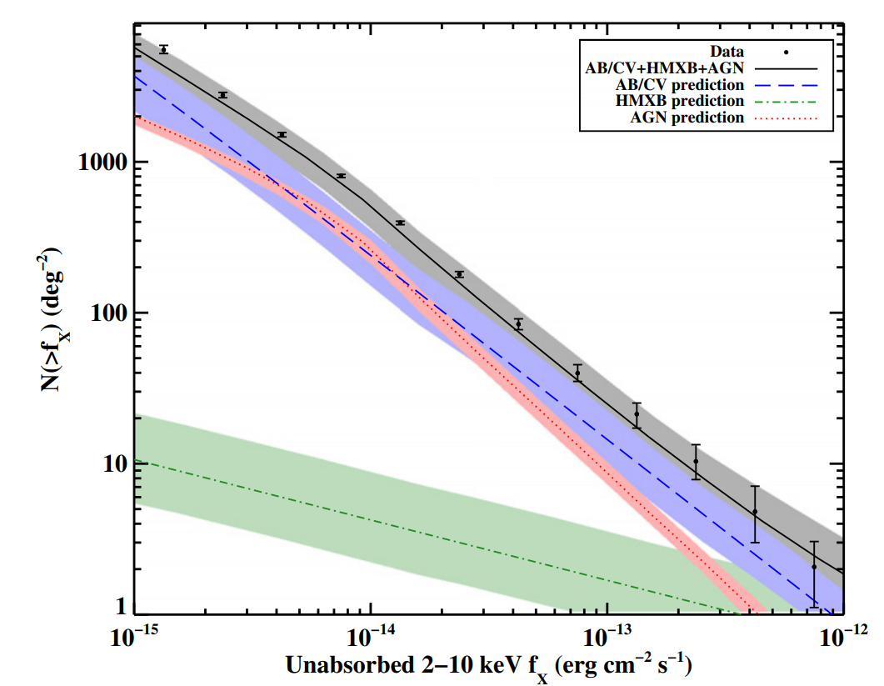
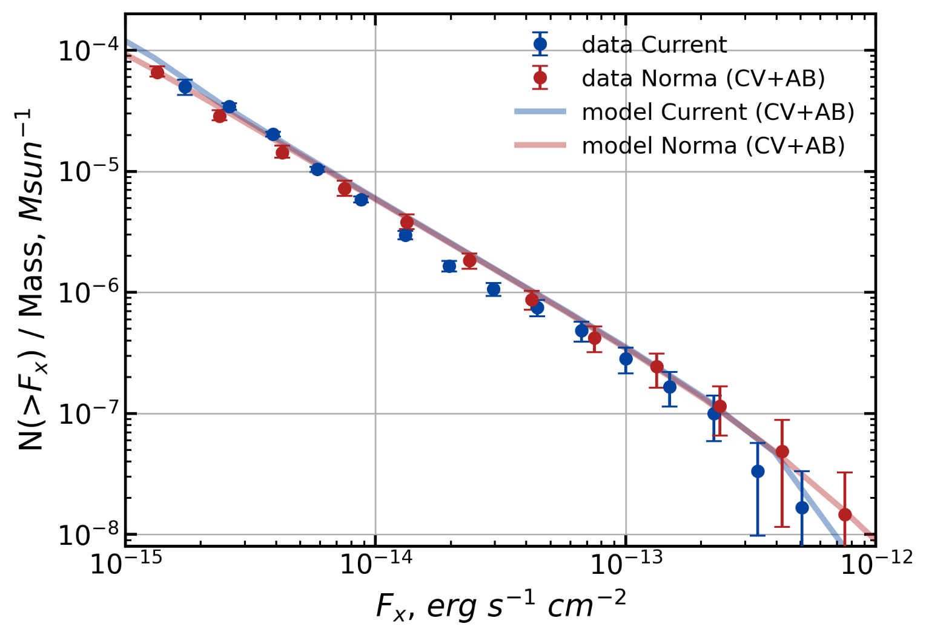

Comparison with the Norma Arm
Fornasini et al. (2014)
X-ray emission at fluxes > ${10}^{−15} erg s^{−1} {cm}^{−2}$is consistent across the NSD, Solar neighborhood, and Norma arm!

Slide 21
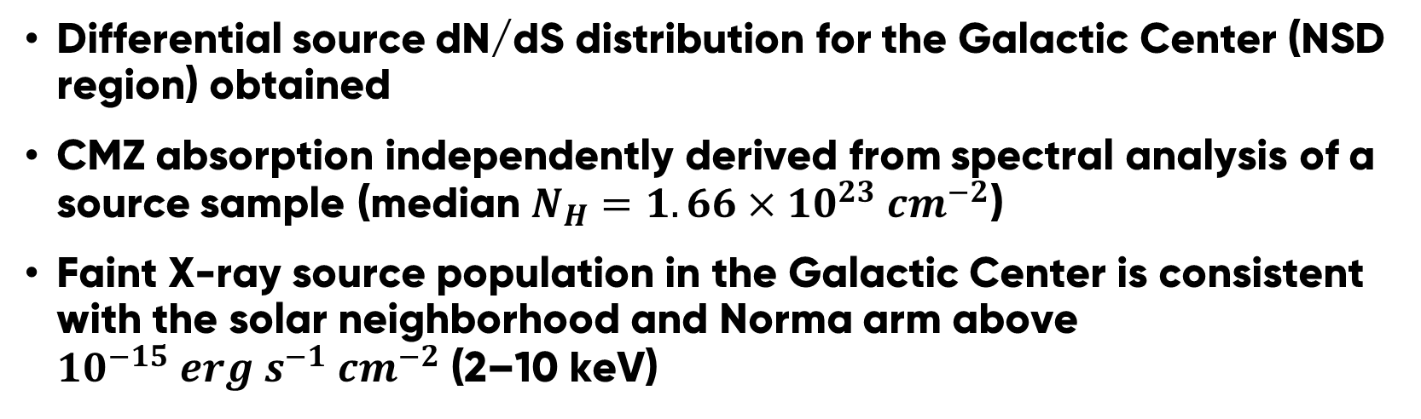
Conclusions
Differential source dN/dS distribution for the Galactic Center (NSD region) obtained
CMZ absorption independently derived from spectral analysis of a source sample (median $N_{H}=1.66×{10}^{23} {cm}^{−2}$)
Faint X-ray source population in the Galactic Center is consistent with the solar neighborhood and Norma arm above ${10}^{−15} erg s^{−1} {cm}^{−2}$ (2–10 keV)

Slide 22
Thank you for your attention!
Valentin Nezabudkin
nezabudkin.vo@cosmos.ru

Slide 23
Additional slides

Slide 24
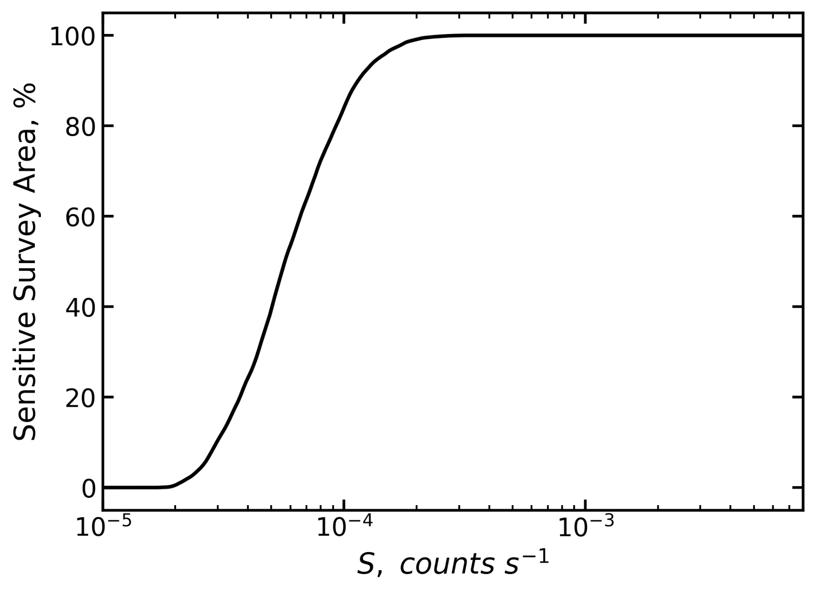
Normalized Sky Coverage

Slide 25
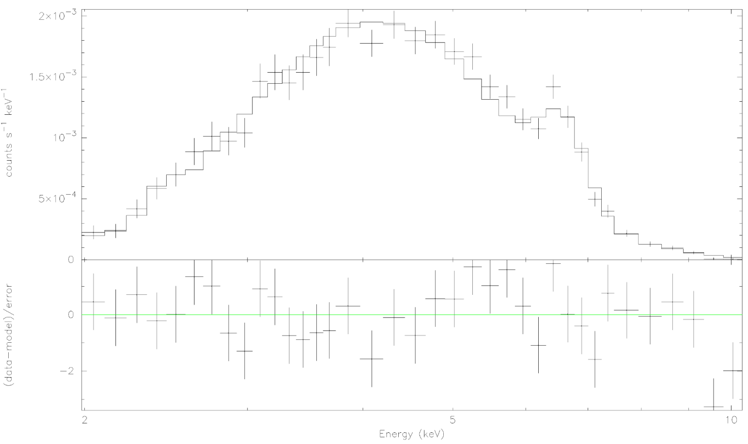
Example Spectrum of the Brightest Source
nH = 13e22
Г = 1.38

