Slide 1
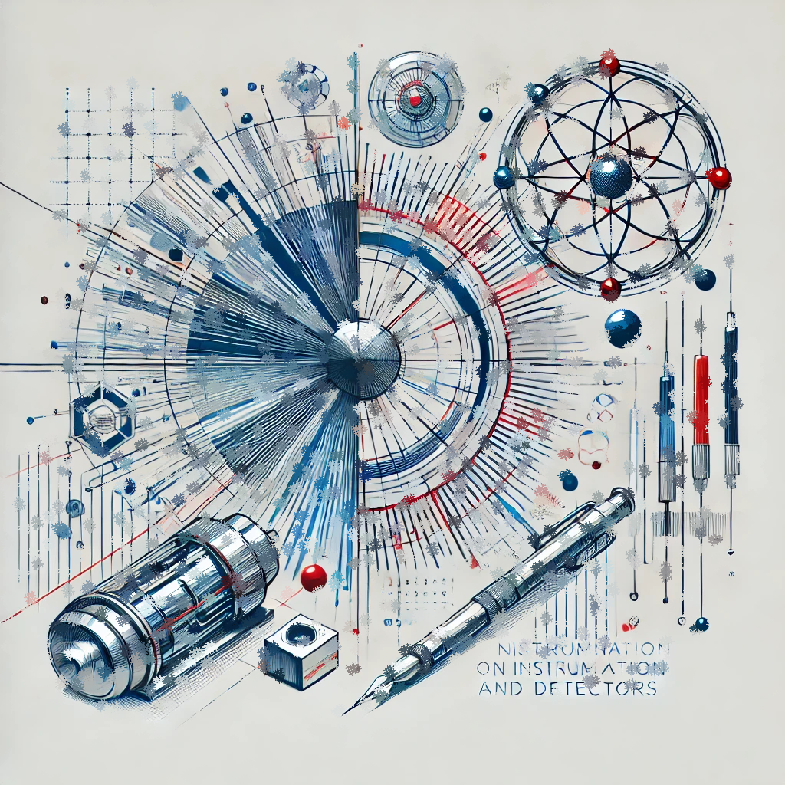

CNID Final Wrap-up
2nd CNID Workshop, CIEMAT
I. Vila, Instituto de Física de Cantabria (CSIC-UC)

Slide 2
Actions list
Completing and approving the network by-laws (Management Team + IB)
Completing the Strategic Analysis (Steering group, call for dedicated meeting soon)
Completing the School preparation (School organizers)
Completing the communication and diffusion tools: web page (Management Team)
Appointment of the diffusion task Force (Management Team)
Reaching out to more industrial/funding agency stakeholders (Mangement Team) – Opportunity on neutron dosimetry to provide input to CSN
Next year work shop – one candidate site already volunteer, if you are interested let us know asap (next week).

Slide 3
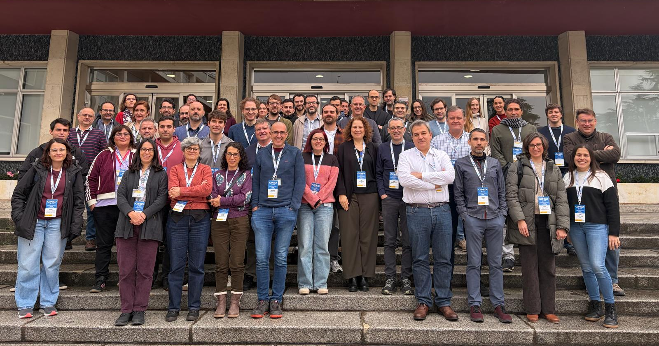
¡Muchas gracias a tod@s!

