Slide 1
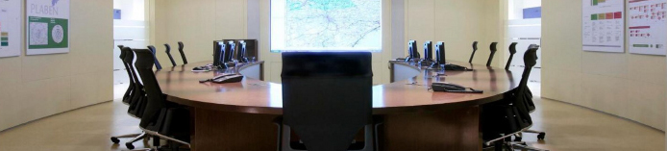
Radation Detectors at CSN
Francisco Castejón
Commissioner of CSN
francisco.castejon@csn.es

Slide 2
Uses of radiation detectors at CSN
Emergencies.
Environmental Radioactive Surveillance (Automatic Station Network).
OpenRed. A citizen science project.

Slide 3
Emergencies
1000 Real time dosimeters connected with Salem (Procurement last week). 3 M€.
Portable detectors that can be deployed during emergencies. Connected with Salem.

Slide 4
Environmental Radioactive Surveillance (Public)
Taking Samples of soils, vegetables, water and food. https://www.csn.es/kprgisweb2/
Automatic Station Network (Also in Emergencies).
Rn measurements.

Slide 5
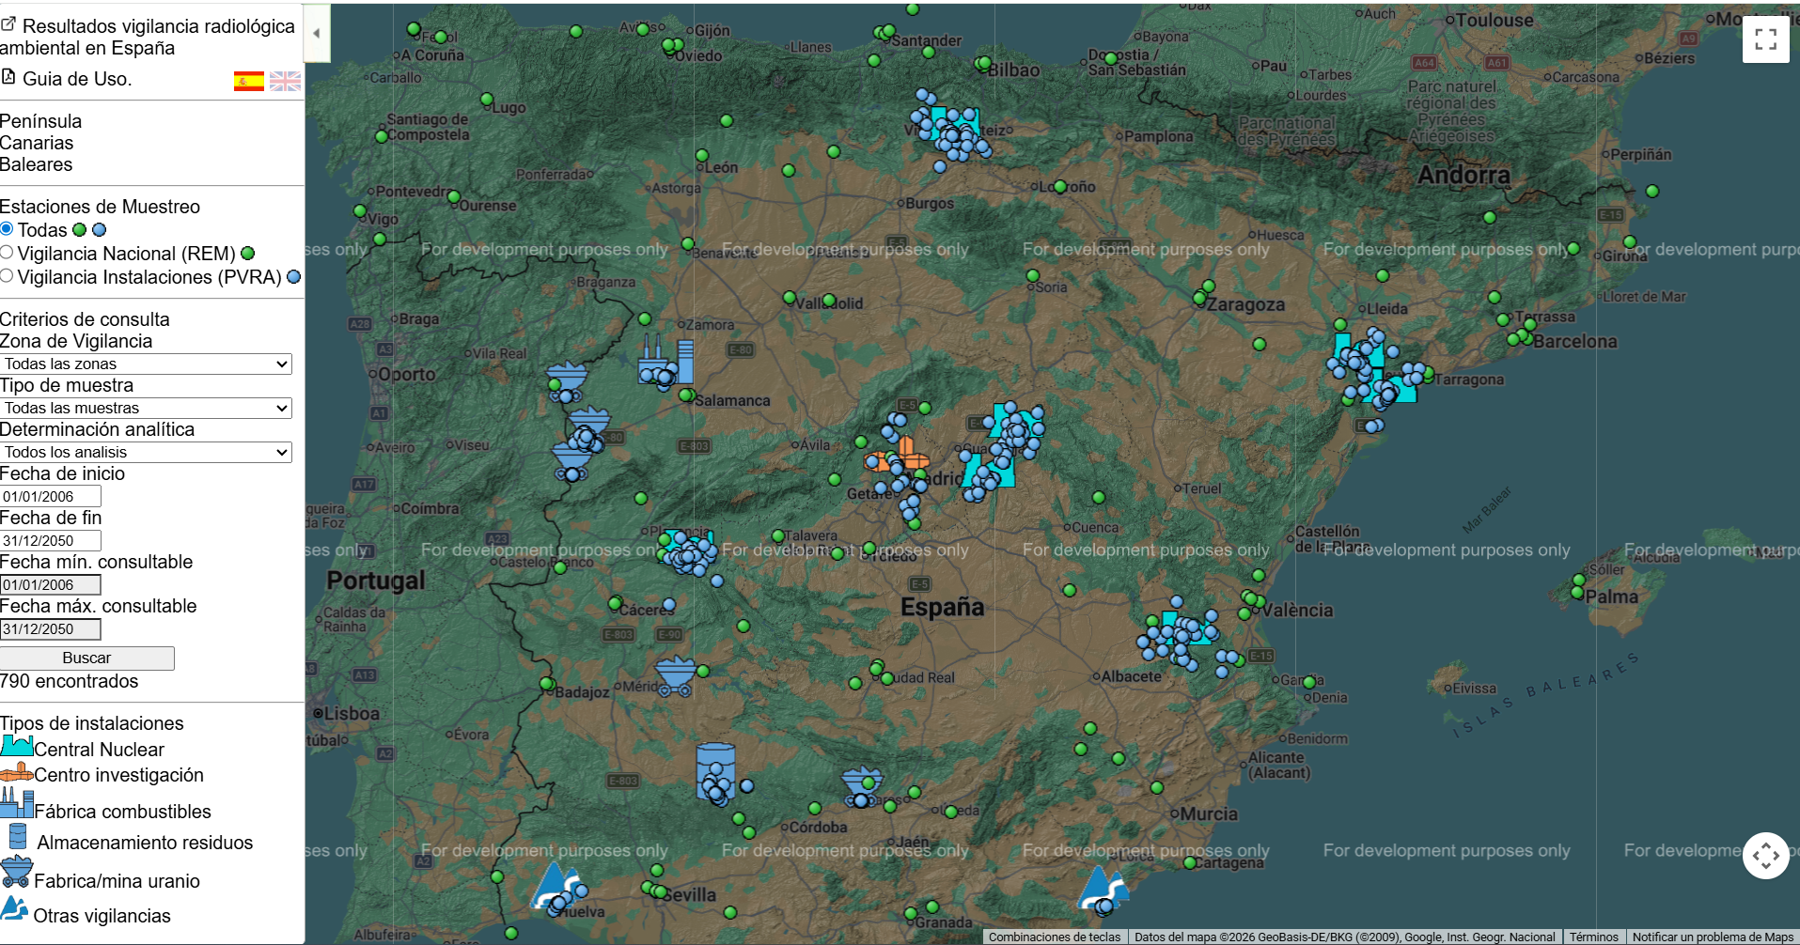
Environmental Radioactive Surveillance (Public)
Taking Samples of soils, vegetables, water and food. https://www.csn.es/kprgisweb2/

Slide 6
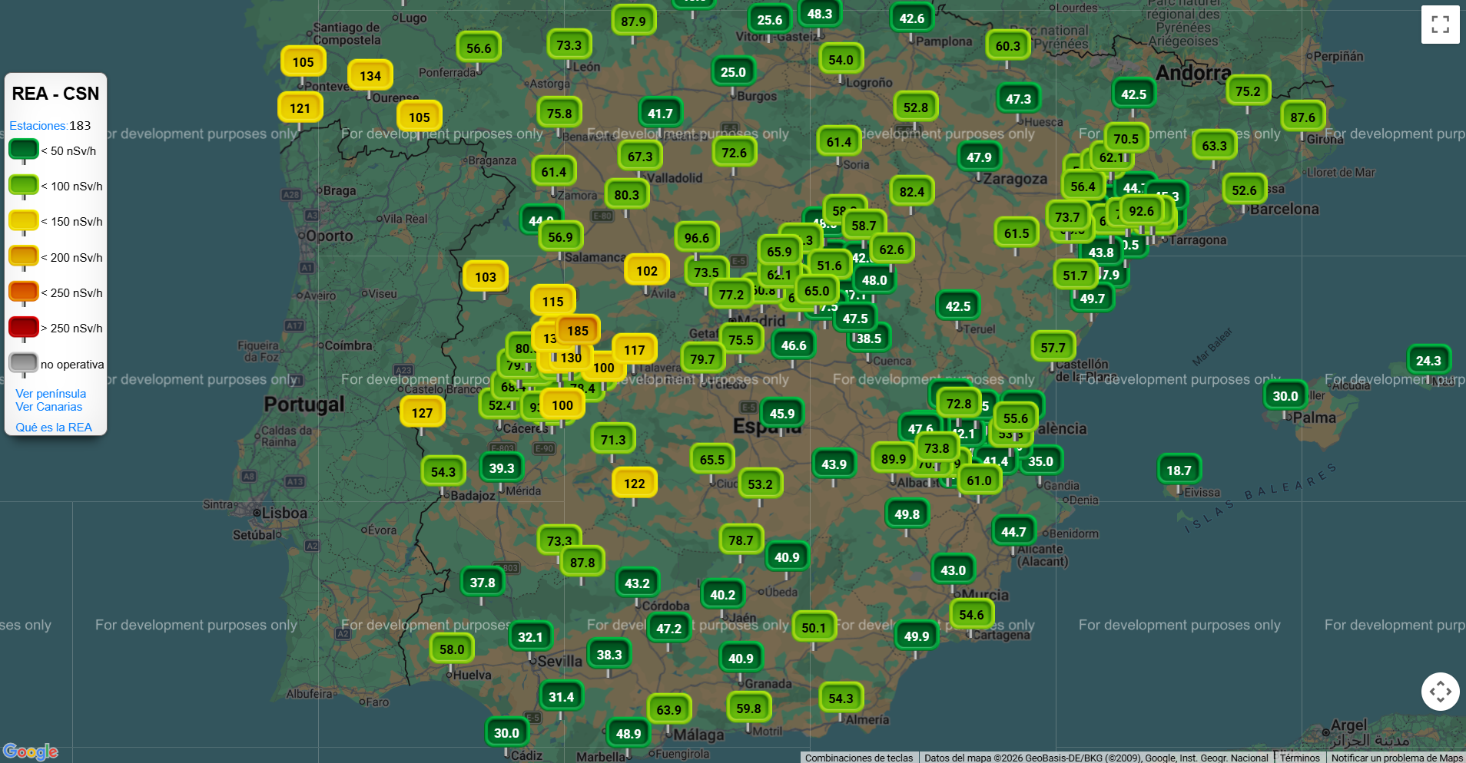
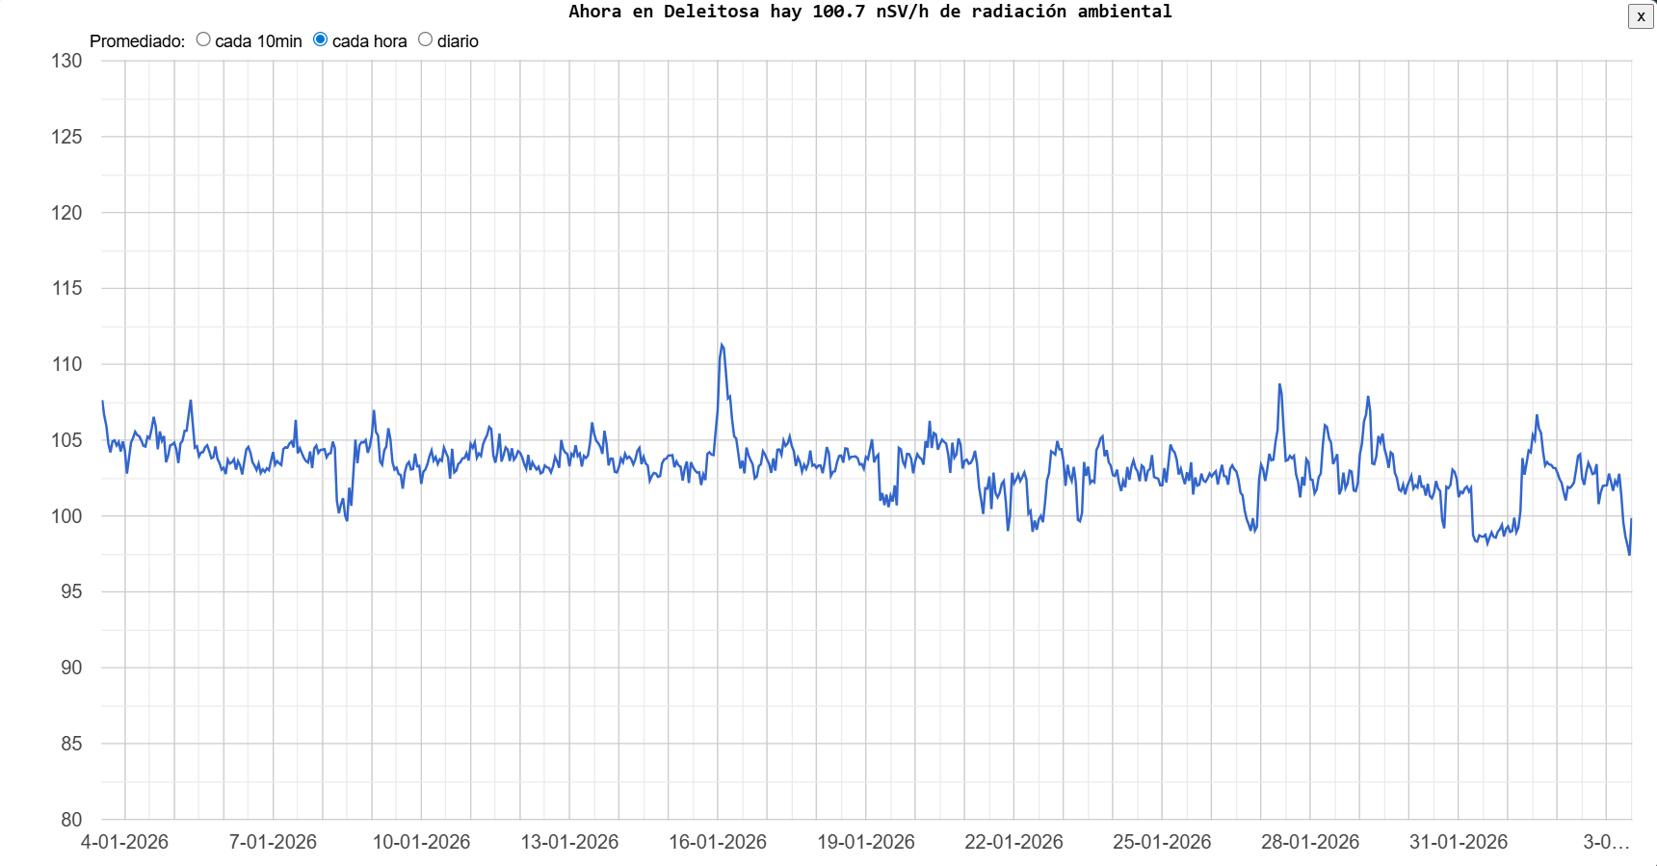
Automatic Station Network
(Also in Emergencies). Real Time. Connected with Salem. Spectrum Available https://www.csn.es/varios/rea/index.html

Slide 7
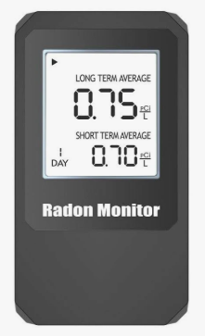
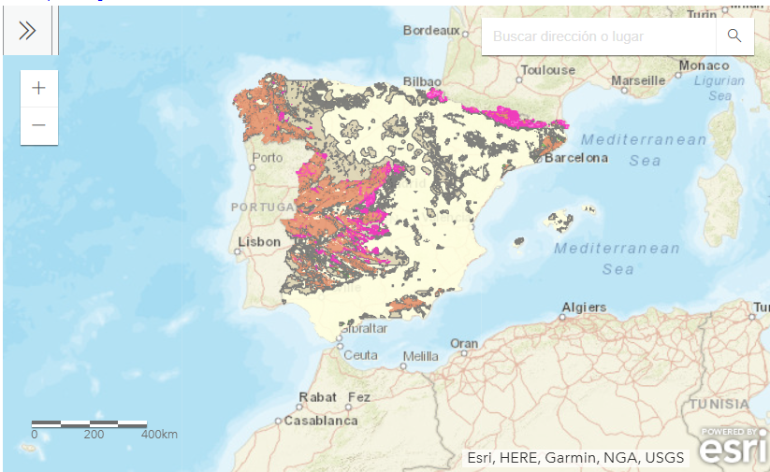
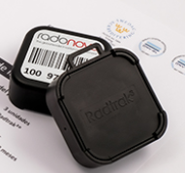
Rn Measurements
Rn Map based on Geological criteria. Need official measurements!
https://www.csn.es/en/mapa-del-potencial-de-radon-en-espana
Measurements in zones with high Rn concentration (ENAC validated):
Continuous-Real time detectors. Direct reading.
Average Measurements Detectors. Need analysis in specialised lab.

Slide 8


Open Red
Development of a Citizen Network for the measurement of environmental gamma radiation in Spain
Importance of the detectors.

Slide 9







Comsortium
www.open-red.es

Slide 10
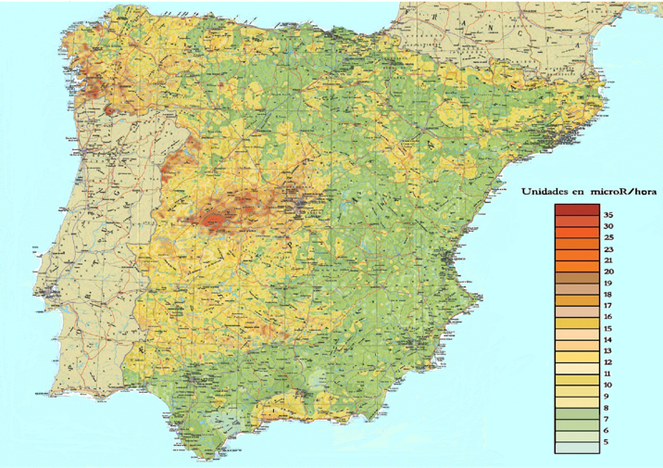
Goals
Create a citizen network for the measurement of enrvironemtal gamma radion in Spain.
Promote a citizen culture around radioactive protection.
Map of Natural Gamma Radiation oin Spain
www.open-red.es

Slide 11
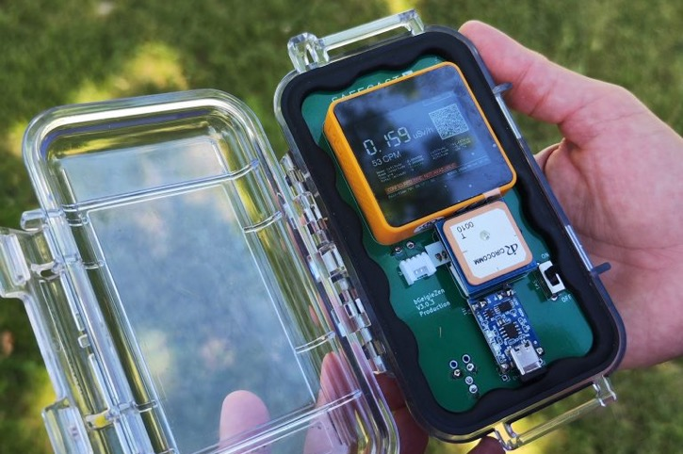
Steps
1
Annalysis of the State of the Art
2
Arrangement of the Infrastructure
3
Participative activities.
www.open-red.es

Slide 12
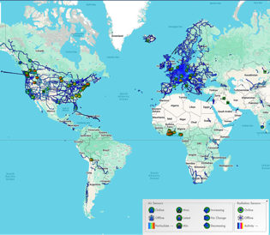
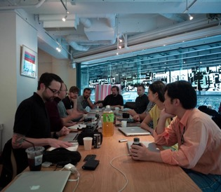
01.Analysis of the state of the art (I)
Analysis of similar projects architecture (Safecast, OpenRadiation, Radio Code, etc.)
Analysis of socio-econiomic factors
(price of detectors, use of smart phone,…)
www.open-red.es

Slide 13
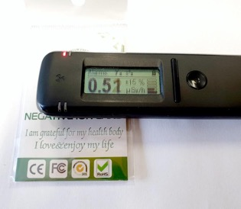
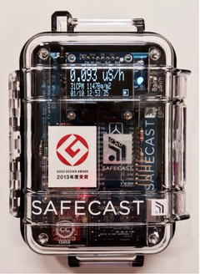
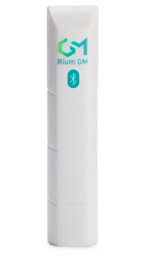
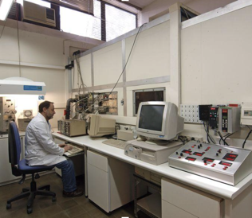
01.Analysis of the state of the art (II)
Radiacode 102
Laboratorio calibración UPC
Analysis of gamma detectors avalaible
(low-cost)
Behavour of detectors to be used in the project:
Radio Code; Safe Cast; Open Radiation
www.open-red.es

Slide 14
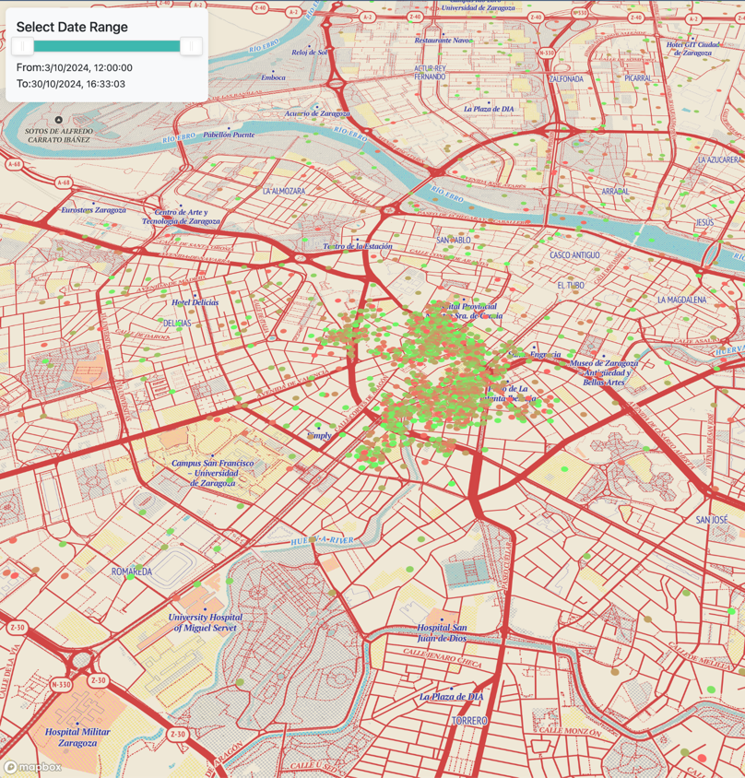
02.Arrangement of the Infrastructure
Platform to upload data.
Improvement of infraastructure by hackatons.
Constant improvement of technology.
Imagen: versión preliminar de la plataforma OpenRed
www.open-red.es

Slide 15

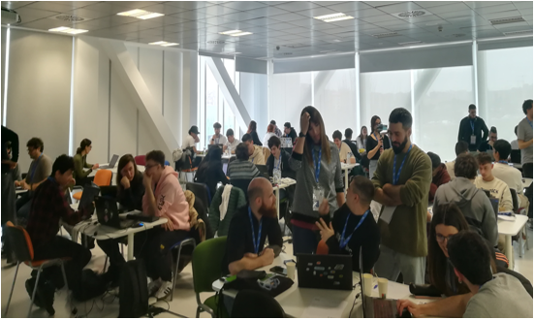
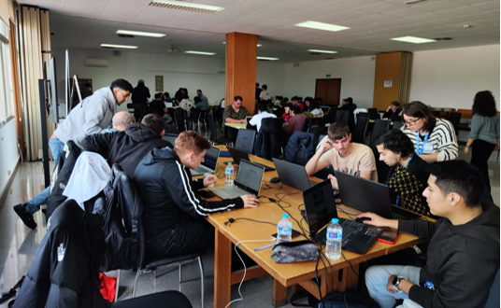
03. Participative Activities
Madrid-CIEMAT
Zaragoza-ETOPIA
Santander-UC

Slide 16
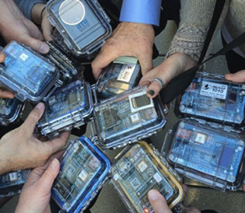
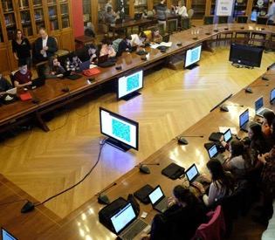
03. Participative activities
Experimento Colectivamente19
Measurement Missions
Sept 2025 - May 2026
Several localizations
Experiments of collective Intelligence.
May 2026
www.open-red.es

Slide 17
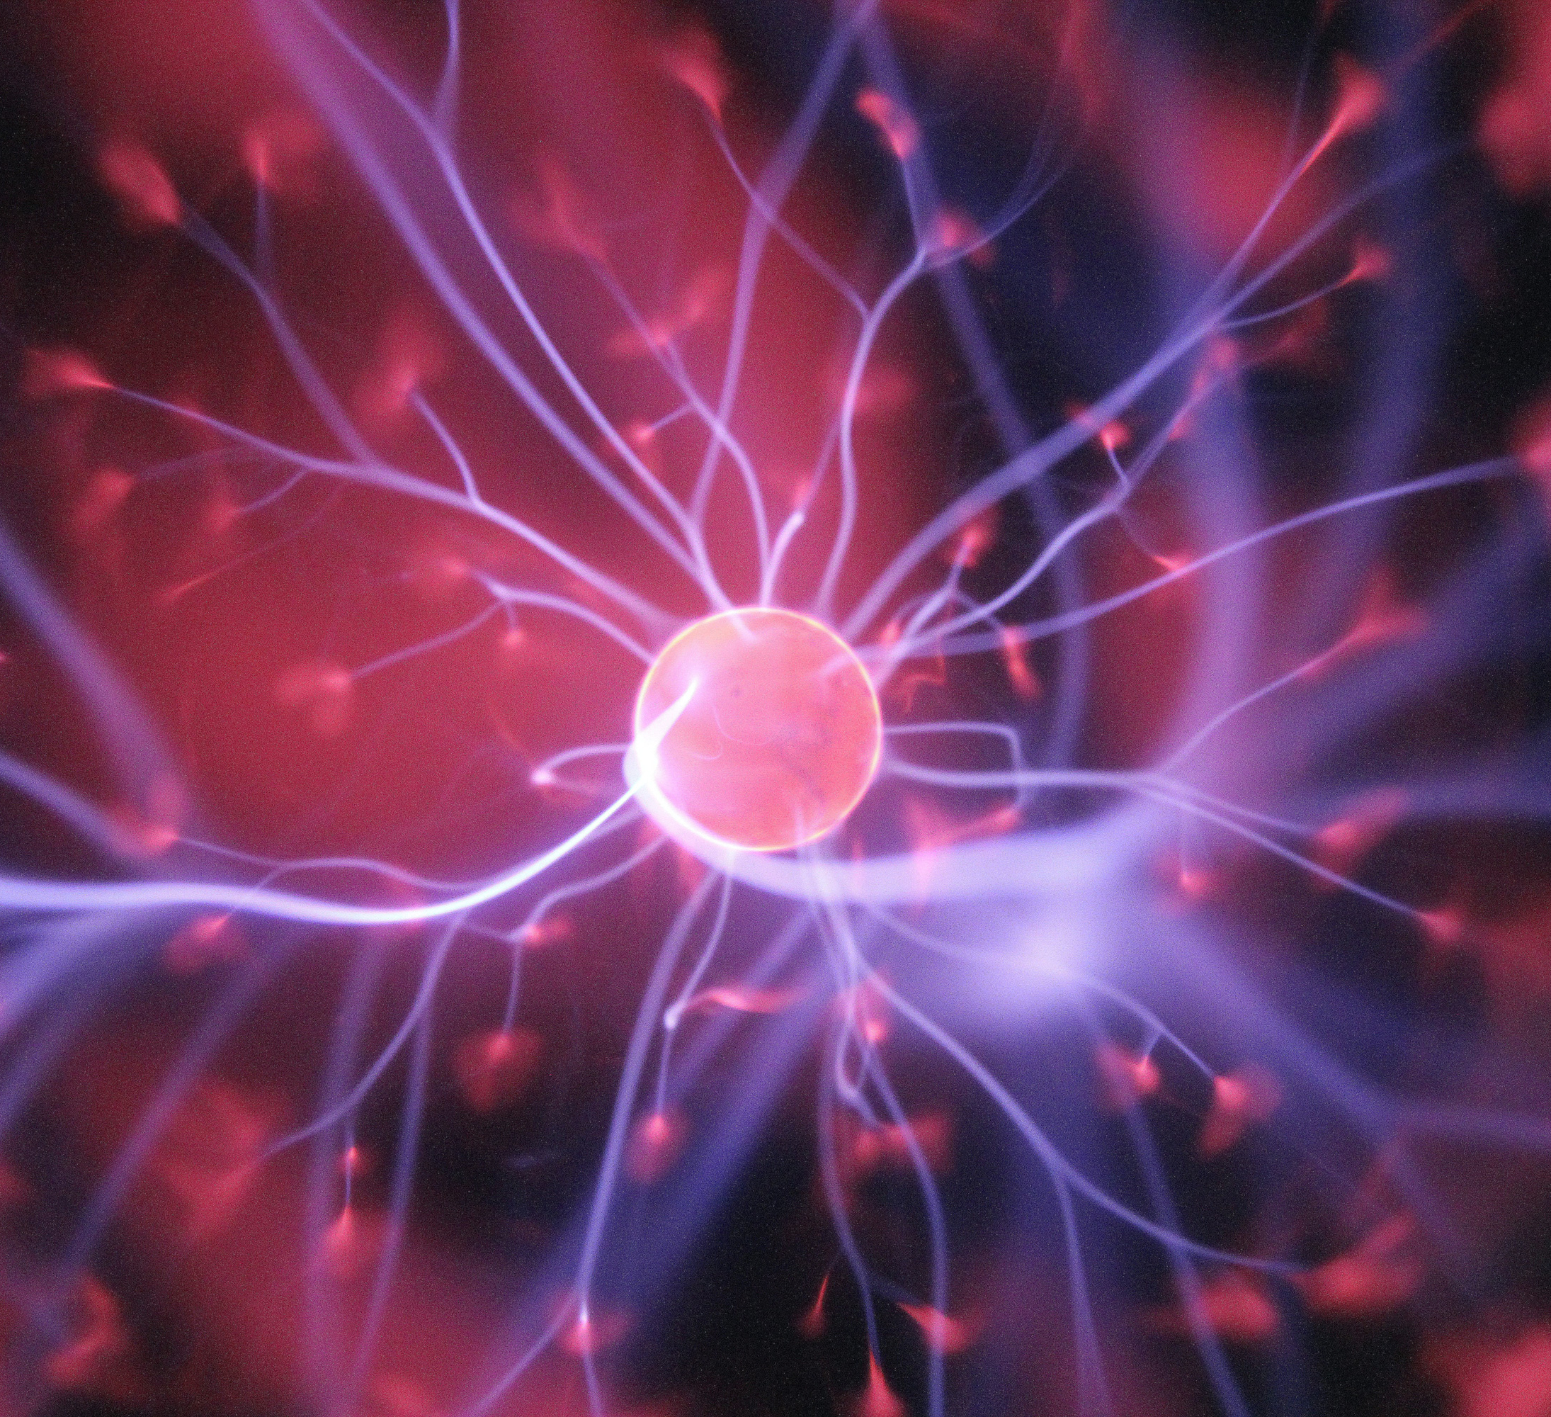
Thank you!

