Slide 1
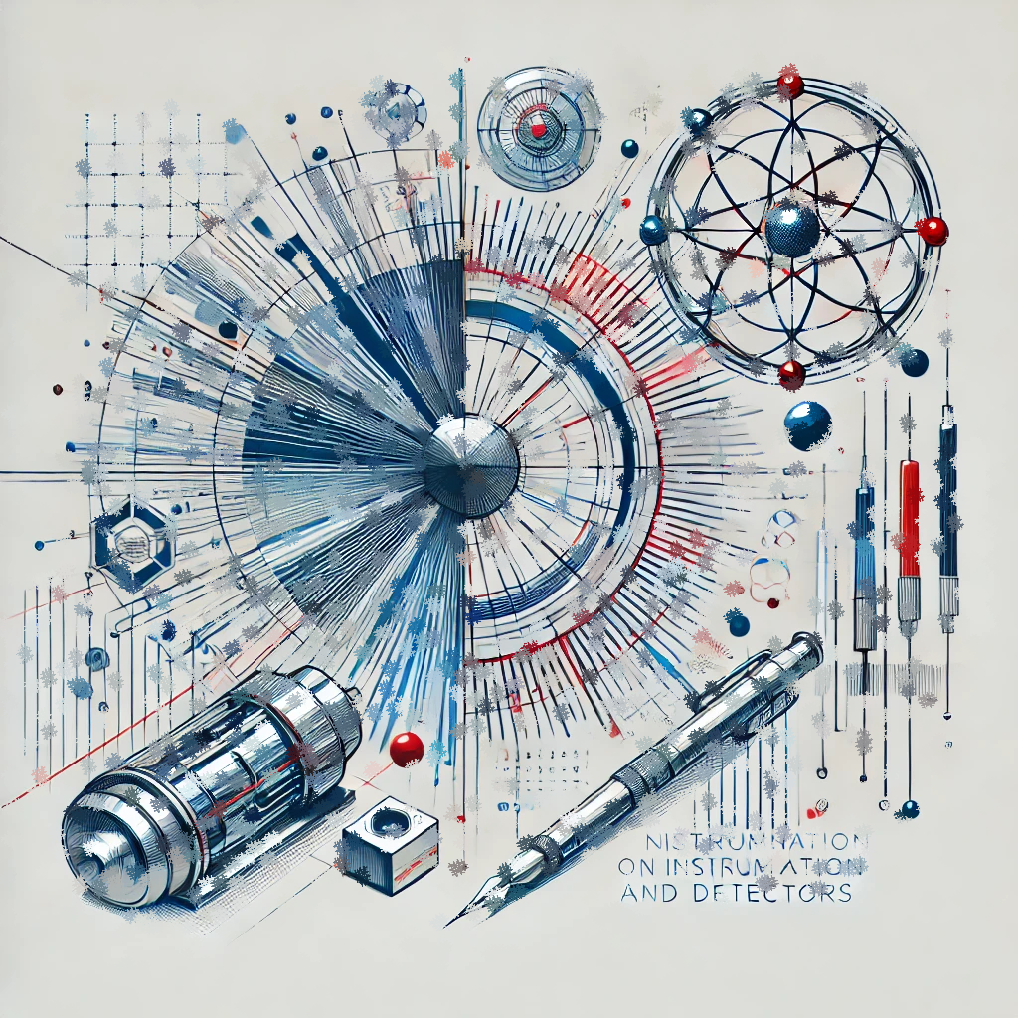

CNID Status Report
2nd CNID Workshop, CIEMAT
I. Vila, Instituto de Física de Cantabria (CSIC-UC)

Slide 2
Outline
Recapitulation of the network news and activities
Status report on activities per WP:
  WP1 Coordination
  WP2 Training
  WP3 Diffusion and outreach
  WP4 Parnership with Industry
  WP5 Community representation
Summary

Slide 3
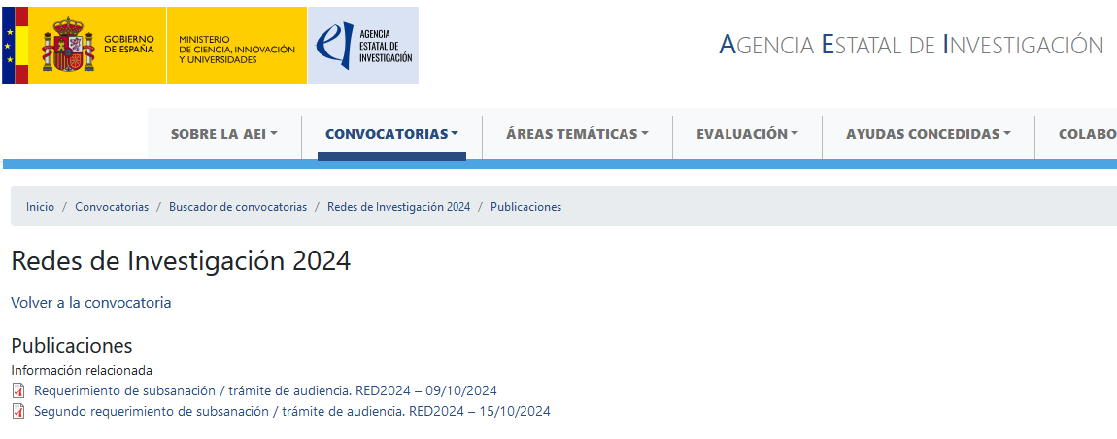
News: AEI Research Network granted !
The AEI “Red Temática 2025” application was granted formally with a score of 99.5/100.
Formally started in May 2025.

Slide 4
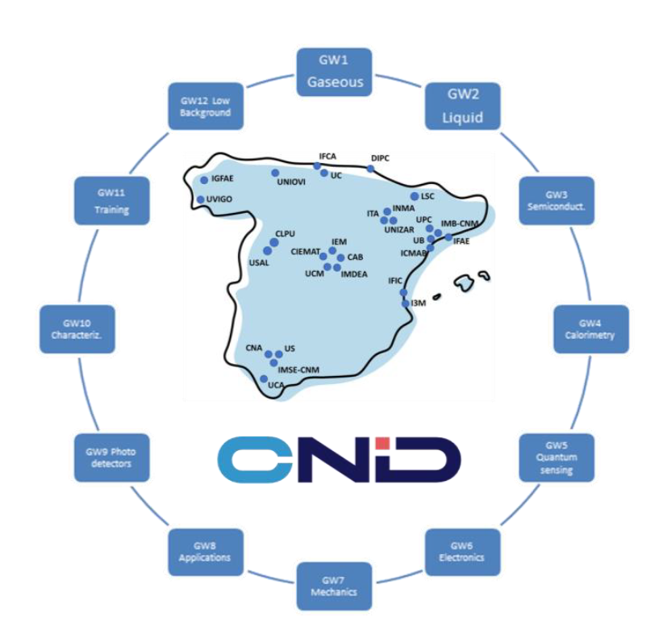
News: AEI Research Network granted !
The management team served as the preparatory team for the proposal.
Due to administrative constraints of the call, not all CNID members were able to participate in the 'Redes de Investigación' application.
It is essential to ensure that these groups also benefit from the 'Red'

Slide 5
Actual CNID Institutions and
Institutional Board (IB) Representatives
IEM - CSIC | Olof Tengblad
Centro de Astropartículas y Física de Altas Energías (CAPA)-UZ | Gloria Luzón
Centro de Láseres Pulsados (CLPU) | José Manuel Álvarez
Centro Nacional de Aceleradores (US, CSIC, Junta de Andalucía) | Carmen Jiménez Ramos
Centro Nacional de Microelectrónica (IMB-CNM-CSIC) | Pablo Fernandez
CIEMAT | M.Isabel Josa Mutuberría
IGFAE-USC (Instituto Galego de Física de Altas Enerxías) | Abraham Antonio Gallas Torreira
Institut de Física d'Altes Energies (IFAE) | Stefano Terzo
Instituto de Física Corpuscular (CSIC-UV) | Carlos Lacasta
Instituto de Física de Cantabria (CSIC-UC) | Iván Vila Álvarez
Instituto de Instrumentación para la Imagen Molecular (i3M) | Laura Moliner
Instituto Tecnológico de Aragón (ITA) | Fernando Arteche
Universidad de Alcalá | Luis del Peral
Universidad de Cádiz | Inmaculada Ramos Lerate
Universidad de Córdoba | Jorge Berenguer Antequera
Universidad de Oviedo - ICTEA | Santiago Folgueras
Universidad de Salamanca | Begoña Quintana Arnés
Universidade de Vigo | Enrique Casarejos
Universitat Politècnica de València | Miguel Ardid
Instituto de Nanociencia y Materiales de Aragón (CSIC-UZ) | Agustín Camón
DICOM (UC) | Luisa Mª de la Fuente
CAB (INTA-CSIC) | Alicia Gómez
IPARCOS (UCM) | Juan Abel Barrio
Universidad de Barcelona - ICCUB | David Gascón
Universidad Autonoma de Madrid | Luis Labarga
Universidad de Sevilla | Rogelio Pinto
Donostia International Physics Center | Ander simon
IMDEA Nanocienica | Daniel Granados
Universidad Politécnica de Cataluña | Sergio Gómez
Instituto de Ciencas del Espacio (ICE) | aldos@ice.csic.es

Slide 6
Other network management bodies
Network management bodies besides the IB:
  Management team: network coordinator and two deputies (from the three CPAN fields).
  Steering group: Two or three conveners for each WG.
Coordinator: Iván Vila (IFCA); Deputies Coordinators: Cesar Domingo (IFIC) + Inés Gil (CIEMAT)
WG1 Gaseous detectors: Yassid Ayyad (IGFAE) + Cristina Fernández (CIEMAT)
WG2 Liquid detectors: Clara Cuesta (Ciemat) + Justo Martín (IFIC)
WG3 Solid state: Stefano Terzo(IFAE) + Carlos Mariñas (IFIC) + Teresa Kurtukian (IEM)
WG4 Calorimetry: Mary-Cruz Fouz (Ciemat) + Héctor Alvarez-Pol (IGFAE)
WG5 Quantum sensing: Gemma Rius (IMB-CNM) + Igor García Irastorza UNIZAR)
WG6 Electronics: Santiago Folgeras (UNIOVI) + Fernando Arteche (ITA) + Diego Real (IFIC)
WG7 Mechanics & Integration: Cristobal Padilla (IFAE) + Enrique Casarejos (UV)
WG8 Applications: Daniel Cano Ott (CIEMAT) + Gabriela Llosá (IFIC)
WG9 Scintillators and photodetectors: Luis Mario Fraile (UCM) + David Gascon (UB)
WG10 Characterization Techniques: Carmen Jiménez (CNA) + Jordi Duarte Campderrós (IFCA)
WG11 Training: from the institution leading the school organization + management team.
WG12 Low-Background experiments: Susana Cebrián (UNIZAR) + Francesc Monrabal (DIPC) + Roberto Santorelli (CIEMAT)

Slide 7
Network Objectives
General Objective:
  Optimize research resources and foster complementary detection technology development across particle, astroparticle, and nuclear physics at a national level.
Specific Objectives:
  Foster Synergies: Promote collaboration among groups in particle, astroparticle, and nuclear disciplines, encouraging new partnerships.
  Coordinate Research: Enhance detector development, innovation, and societal applications of Spanish research groups.
  Train Young Researchers: Establish schools and workshops to develop technological skills.
  Define National Strategy: Develop a medium- to long-term national plan for instrumentation aligned with European and international initiatives.

Slide 8
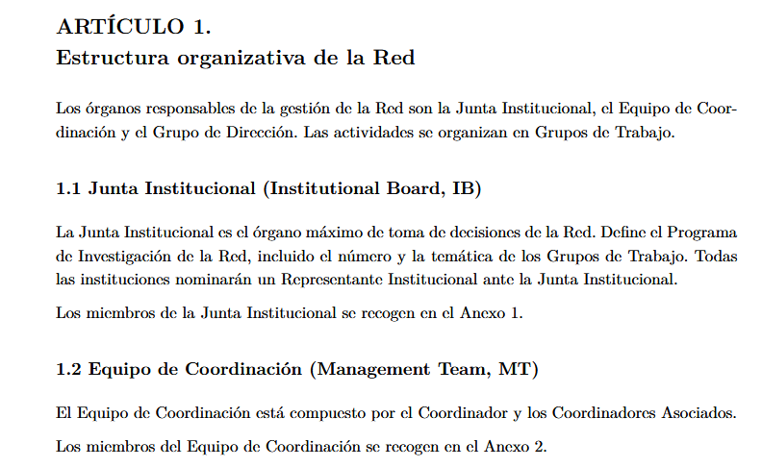
Progress report: WP1 Coordination
Task 1.1: Governance Structure
  Establish governance framework, roles, responsibilities, and decision-making processes.
  Deliverable: Network Framework Agreement for governance and decision-making.
  A final draft of the CNID by-laws is ready for the final revision and aprobal of the IB

Slide 9
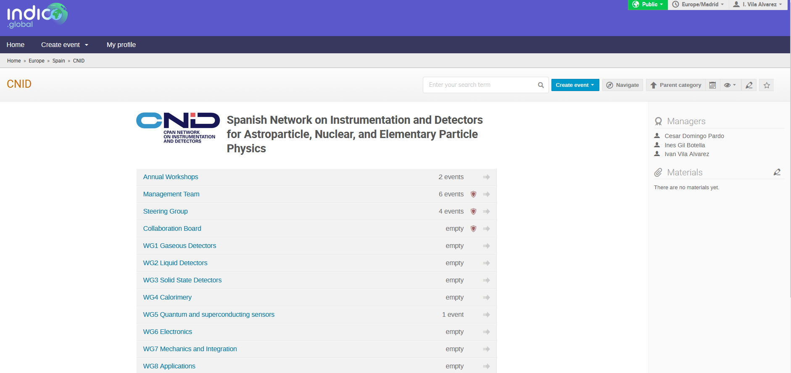
Progress report: WP1 Coordination
Task 1.2: Internal Communication
  Promote collaboration via tools like intranet, videoconferencing, agenda management, and messaging systems.
  Deliverable: Setup of communication tools for network activities.
  Indico (https://indico.global/category/1334/)
  Mattermost Team (https://mattermost.web.cern.ch/signup_user_complete/?id=p6u5qsktu3bw8qfus4dpocycka&md=link&sbr=su)
  Dedicated e-groups (CNID-SG@cern.ch, CNID-IB@cern.ch) and email list ready (cpan-instrumentacion@pegaso.ific.uv.es) :
  Web still under development

Slide 10
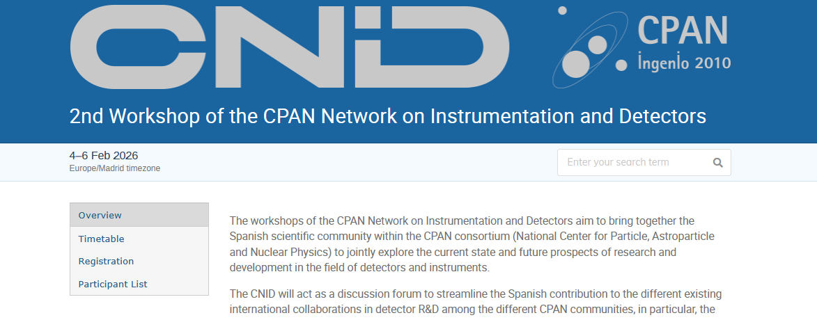
Progress report: WP1 Coordination
Task 1.3: Annual Workshop
  Facilitate knowledge exchange, collaboration, and strategic planning through yearly workshops.
  Deliverable: Organize one workshop annually.
  Today’s Annual workshop at Ciemat (Feb 4-6 2026)

Slide 11
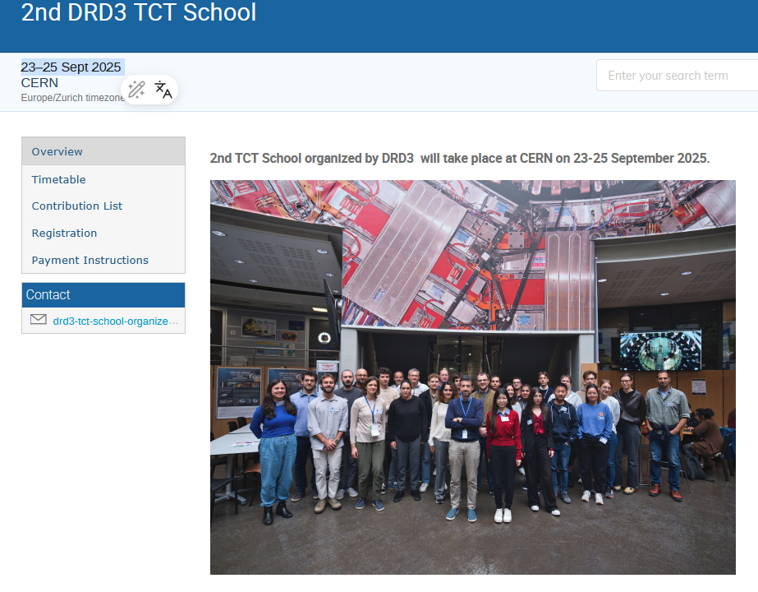
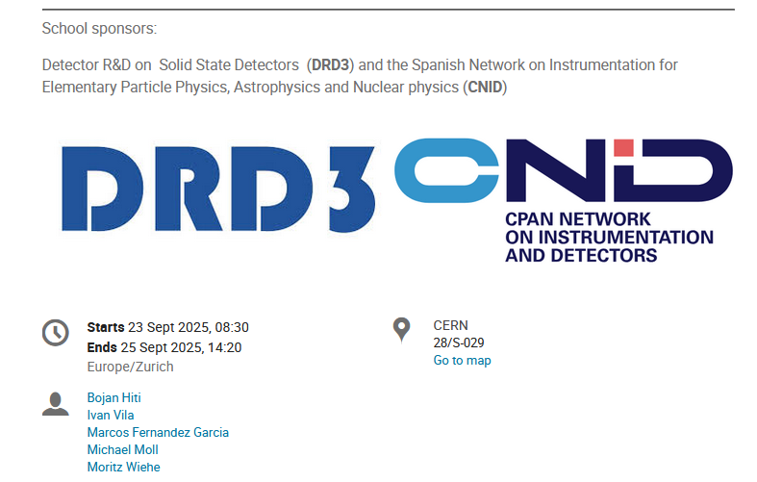
Progress report: WP1 Coordination
Task 1.4: Thematic Mini-Workshops
  Focused events on R&D topics with review talks, discussions, and training.
  Deliverable: One or two mini-workshops per year.
  Contribution to the 2nd DRD3 TCT School at CERN (23–25 Sept 2025 ), funding of Spanish Students.
  Please, come to us with proposals

Slide 12
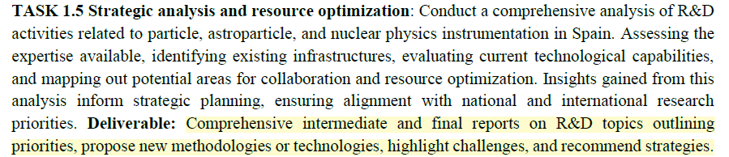
Progress report: WP1 Coordination
Task 1.5: Strategic Analysis and Resource Optimization
  Analyze R&D capabilities, infrastructure, and collaboration opportunities for strategic alignment.
  Deliverable: Reports on R&D priorities, methodologies, and challenges.
  Today: status report of the preparation at each of the Working Group dedicated sessions

Slide 13
Task 1.5: Strategic Analysis - Motivations
Enable dedicated funding lines
  White Book as a strategic instrument to support dialogue with funding agencies and justify specific, stable funding schemes for detector and instrumentation R&D (currently fragmented or non-existent)
Make synergies visible
  Provide a clear map of capabilities, technologies, and infrastructures across CNID groups → identify existing synergies and new collaboration opportunities
National reference document
  First coordinated White Book in Spain focused on detector and instrumentation R&D, aligned with international roadmaps and large-scale
The cost of inaction
  Instrumentation R&D remains under-recognised and under-funded
  Critical know-how risks being diluted or lost
  Spain remains reactive, rather than strategic, in international initiatives

Slide 14
Task 1.5: Strategic Analysis - Timeline
Phase 1 – Information Gathering (WG level)
  Strategic analysis carried out by the CNID Steering Group
  WG Conveners gather input from their groups
  Dedicated WG meetings with relevant contributors
  Status: in progress
  Output: WG-specific status report (this meeting)
Phase 2 – WG Strategic Drafts
  WG Conveners release initial strategic analysis drafts
  Output: 4-page strategic document per WG(Structure shown in next slide)
  Deadline: Deadline: March 16
Phase 3 – Consolidation & Steering Review
  Management Team consolidates all WG drafts
  Preparation of a single integrated document
  Executive summary included
  Output: complete draft for Steering Group review
  Deadline: April 20
Phase 4 – Network Review & Endorsement
  Incorporation of Steering Group feedback
  Circulation to the full CNID network
  Final output: Strategic Analysis Report
  Endorsed by the Institutional Board
  Deadline: May 25

Slide 15
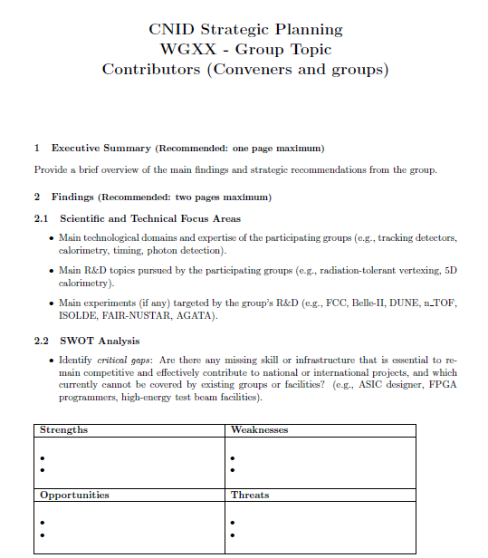
Task 1.5: Strategic Analysis – Requested Inputs
Executive Summary
  Main findings and strategic messages of the WG
Current Situation & Capabilities
  Scientific/technical focus areas and main R&D topics
  Human resources and institutional support
  Infrastructure, equipment, and key technical capabilities
Positioning & Synergies
  National collaborations and potential cross-WG synergies
  International alignment with roadmaps and EU initiatives
  Funding landscape for instrumentation R&D
Strategic Outlook
  SWOT analysis (gaps, risks, opportunities)
  Strategic priorities and recommendations (5-year horizon)
  Actions on infrastructure, training, KTT, and funding

Slide 16
Task 1.5: Strategic Analysis – Convener’s charge
Ensure internal coordination
  Align all WG conveners on scope and objectives
  Share the workload and adopt a comprehensive approach
Build an inclusive WG
  Identify all relevant groups and contributors
  Be proactive at this stage — broad outreach is encouraged
Activate the WG
  Launch and chair WG meetings (online, use the communication tools (Indico, Mattermost, e-groups)
  Check completeness of expertise and identify missing contributors
Guide the content
  Review the WG Strategic Analysis Template and understand each section
  Contact coordinators whenever clarification is needed

Slide 17
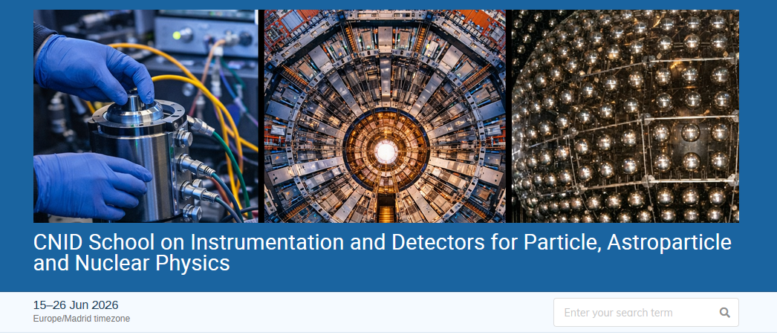
Progress Report: WP2 Training
Training
  Task 2.1 School Organization:
    Organize a two-week annual school for early-career researchers in detector and instrumentation.
    Provide structured education and hands-on training to stay updated on advancements in the field.
    Deliverable: Two-week school annually.
    Network School at IFIC in June, interested community already contacted and hand-on training activities indentified
Dedicated talk on Wednesday by Carlos Lacasta

Slide 18
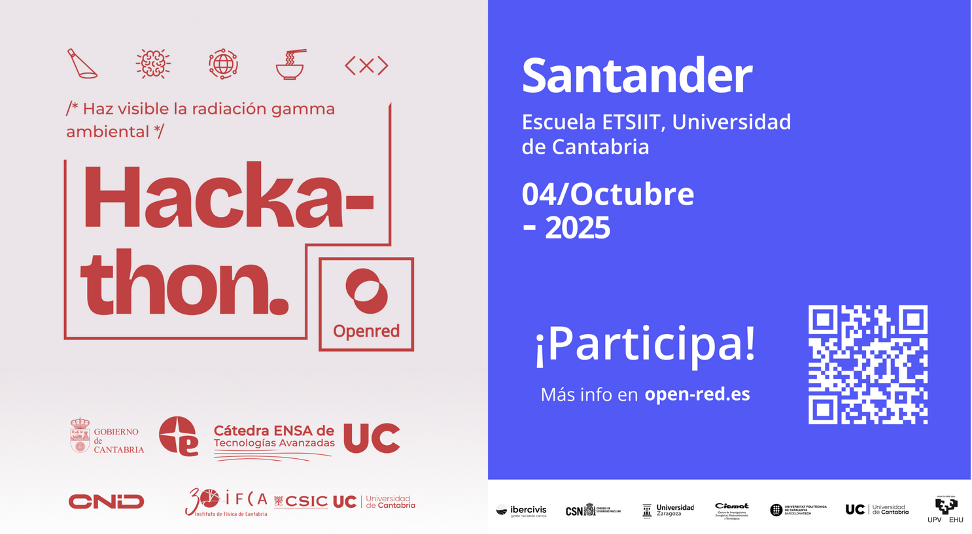
Progress Report: WP3 Diffusion and Outreach
Diffusion and Outreach
  Task 3.1 Diffusion:
    Disseminate research outcomes through websites, publications, seminars, and social media.
    Target stakeholders like industry partners, and policymakers.
    Deliverable: Website and social network presence.
  Task 3.2 Outreach:
    Engage the community through educational events, workshops, and public seminars.
    Promote awareness of instrumentation's importance in science and society.
    Deliverable: University-level seminars on frontier physics technologies.
    A Task Force is being established to develop a presentation targeting graduates from universities and higher-level vocational training programmes, highlighting career opportunities within Spanish groups involved in detector instrumentation R&D.
Sponsoring the Hackathon on ambient gamma detection organized by the Consejo de Seguridad Nuclear (CSN), CIEMAT and Equipos Nucleares S.A.

Slide 19
Progress report: WP4 Industry Partnership
Partnership with Industry
  Task 4.1: Public-private connections
    Facilitate collaborations with industries (especially SMEs) to address societal challenges using detector technologies. Promote advancements in science and industrial applications. Assist industries in accessing scientific experiments and infrastructure.
    TEKNIKER (RTO Organization bridging to industry) request to become an industrial member of CNID

Slide 20
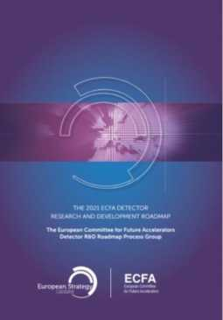
Progress report: WP5 Community Representation
Community Representation
  Task 5.1: Engage with Spanish social agents and administration (Coordinated with CPAN)
    Foster collaboration with policymakers (e.g., Ministries of Science & Industry, CDTI).
    Support policy initiatives, funding opportunities, and regulatory matters in detector R&D.
    Deliverable: Joint meetings with CDTI and relevant stakeholders.
  Task 5.2: Interface with international R&D collaborations
    Maintain active communication with CERN DRDs, NUPECC, APPEC, etc.
    Enhance the network’s visibility and contributions in global R&D communities.
    Deliverable: Reports on international collaborations during the annual network workshop.
Editors of the R&D Instrumentation section of the Spanish input of Update of the European Strategy in Particle Physics

Slide 21
Summary
The CNID network formally approved (funds) since May 2025 is shaping up in all the different activities during 2025:
  Structuring the governance and implementing coordination tools
  Strategic Analysis study.
  Instrumentation School.
  Discussion forum for the ESPPU.
  Professional Outreach
Still a long way go.

Slide 22
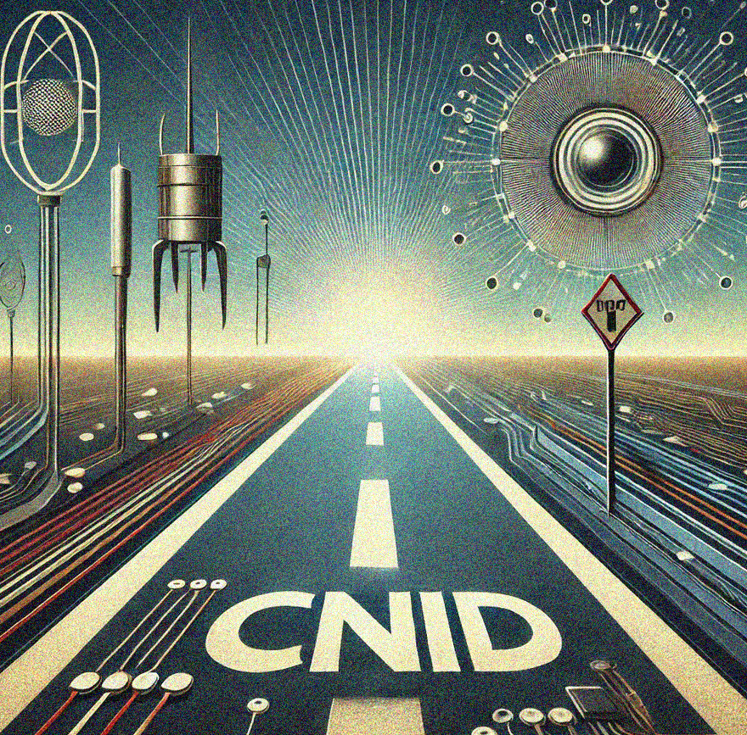
THANK YOU!

