Slide 1
Mechanical Design, Virtual Assembly and Fabrication of a Compact 750MHz IH DTL Accelerating Cavity
WG7 Mechanics and Integration
Andoni Egurrola| Tekniker | 03/02/2026

Slide 2


INDEX
LINAC7 Project Context and Case Study
GD&T Targets and Functional Requirements
Mechanical design for manufacturing and GD&T proposal
Manufacturing of Components and Virtual Assembly
Conclusions and future actions

Slide 3

Accelerators Technology
WG7 Mechanics and Integration
01
LINAC7 Project Context and Case Study

Slide 4

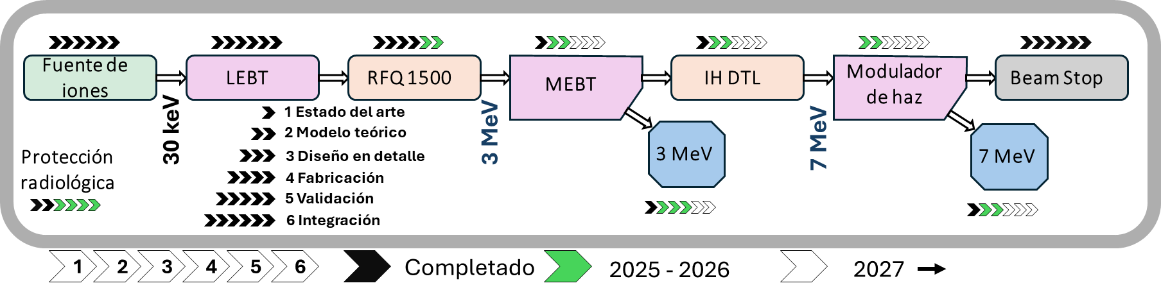
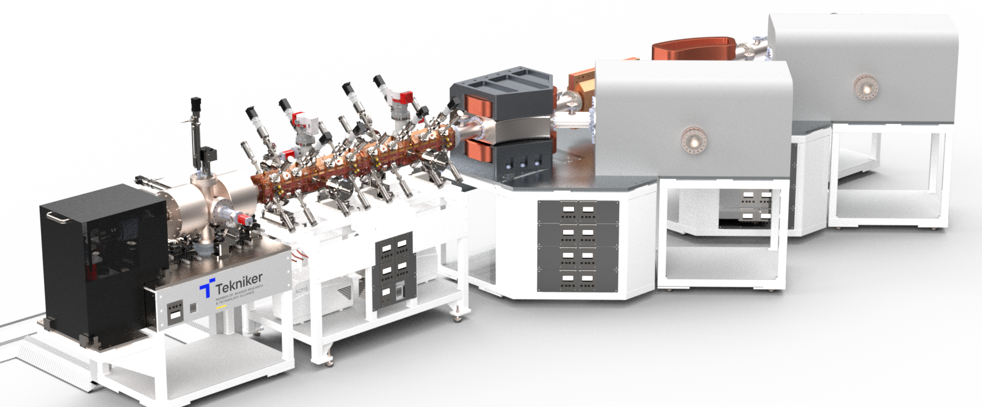
LINAC7 Project Context and Case Study
LINAC7 Project Context
Beam parameters: 15 µA nominal beam current; 750 MHz RF cavities.
Hosted at the University of EHU (Basque Country) within the regional Science Industry strategy.
Compact (10 m) low-energy proton linac (up to 7 MeV)

Slide 5
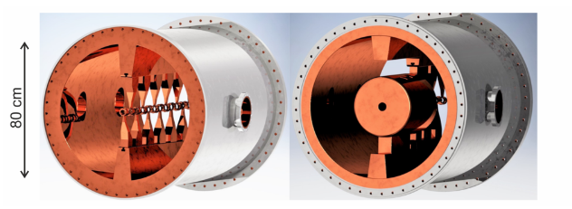
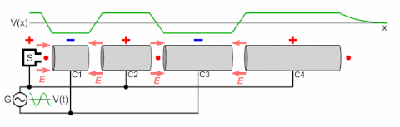
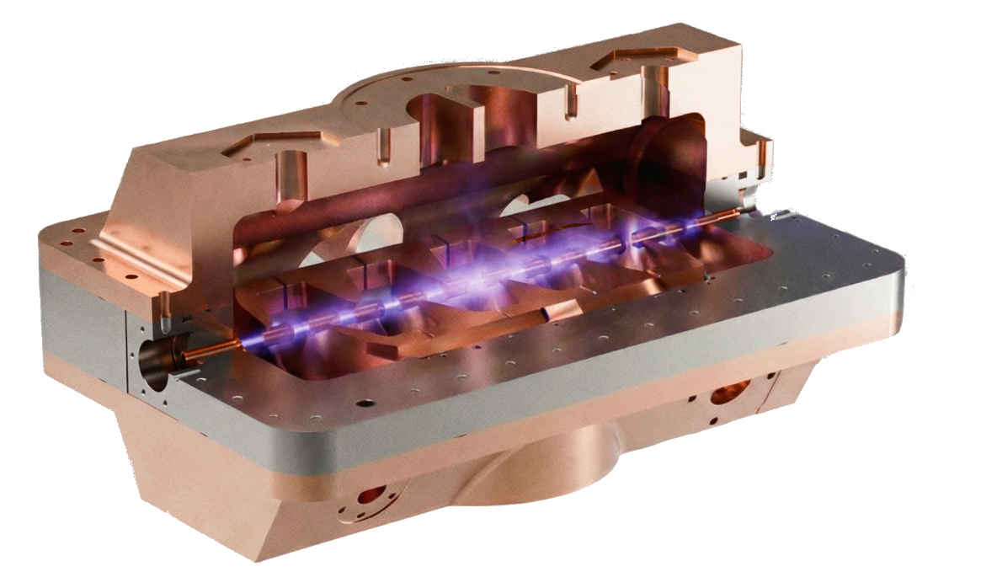
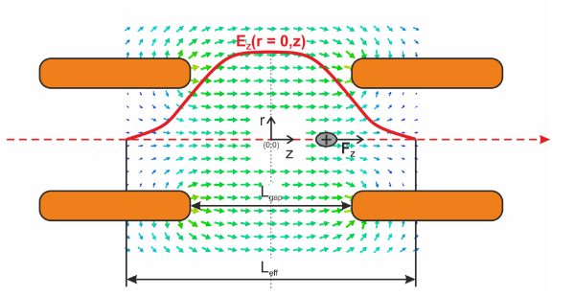
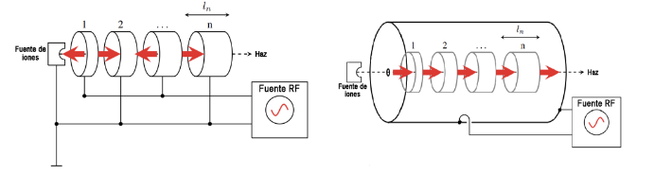
LINAC7 Project Context and Case Study
IH DTL Cavity introduction
Accelerating electric field is mainly concentrated in the gaps between drift tubes
IH-DTL (Interdigital H-mode Drift Tube Linac)
One of the most efficient RF resonant cavity for accelerating low-beta ions/protons
IH DTL Constructed at GSI for UNILINAC (D = 800 mm)
Wideröe accelerator concept
Compact IH DTL Prototype Developed by Tekniker & EHU (D = 100 mm)
Luis Alvarez and the Drift Tube Linac

Slide 6
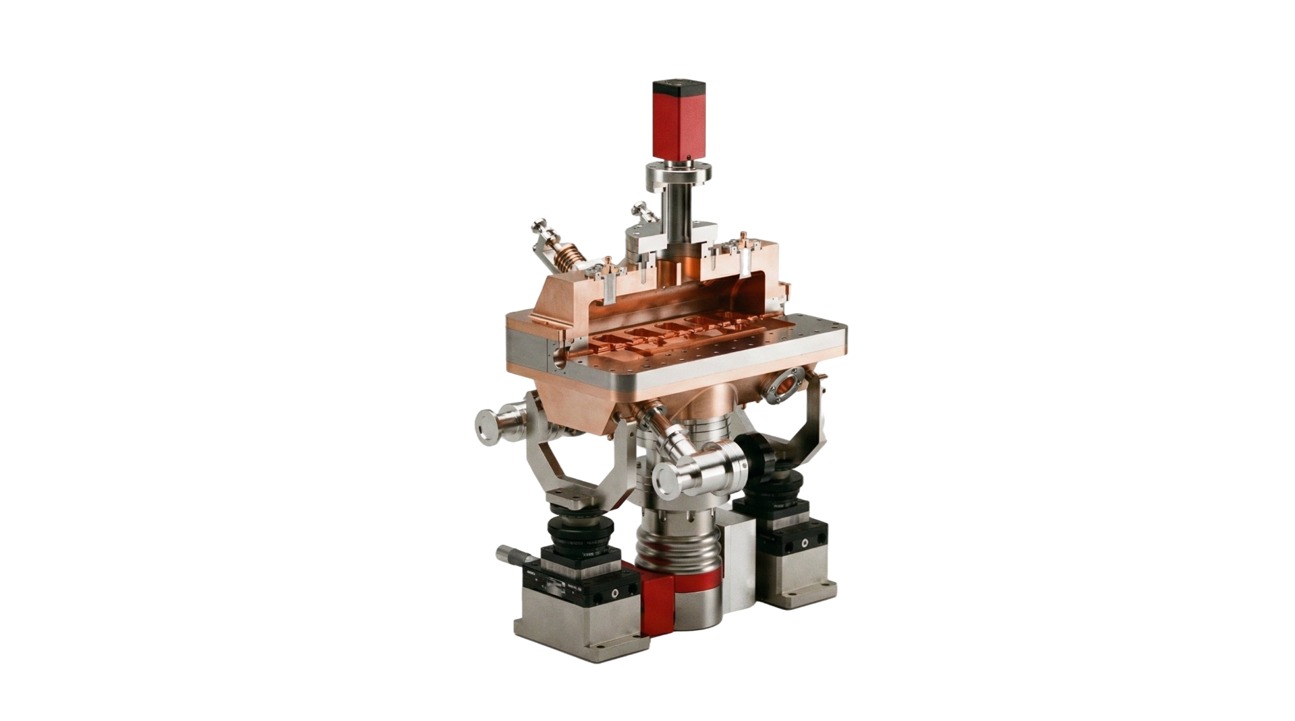
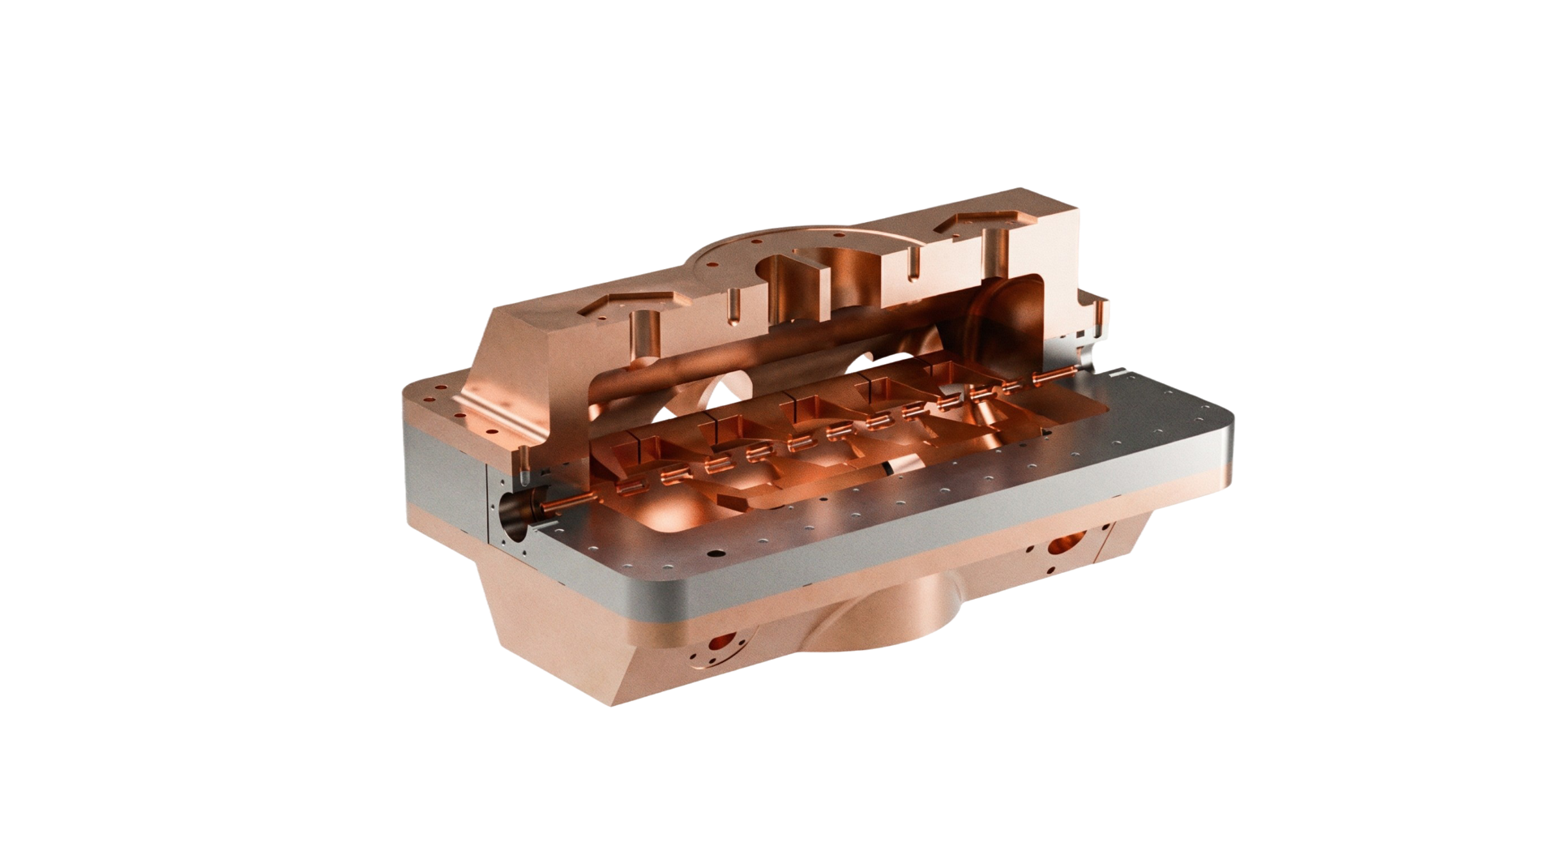
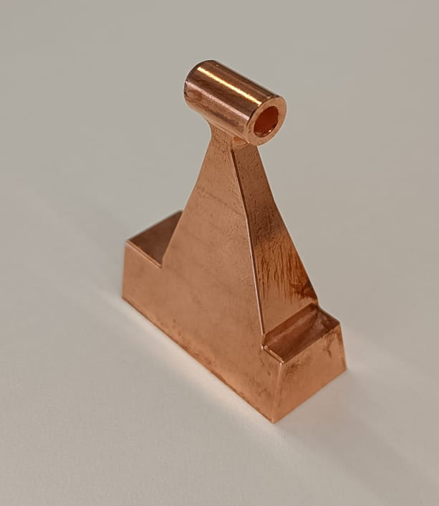
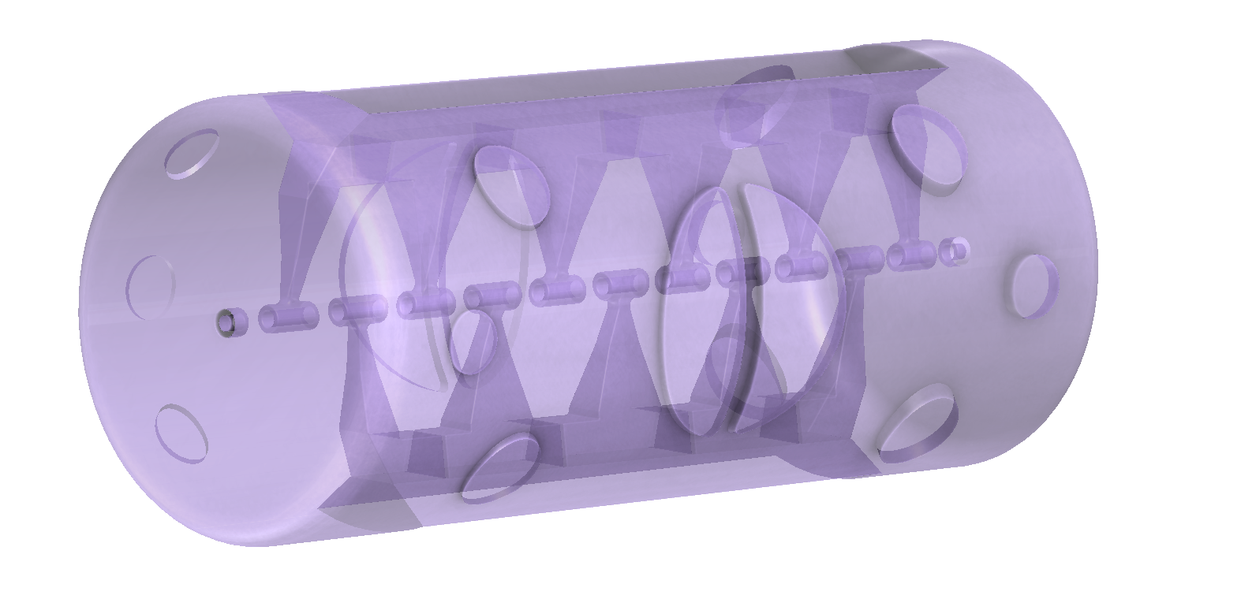
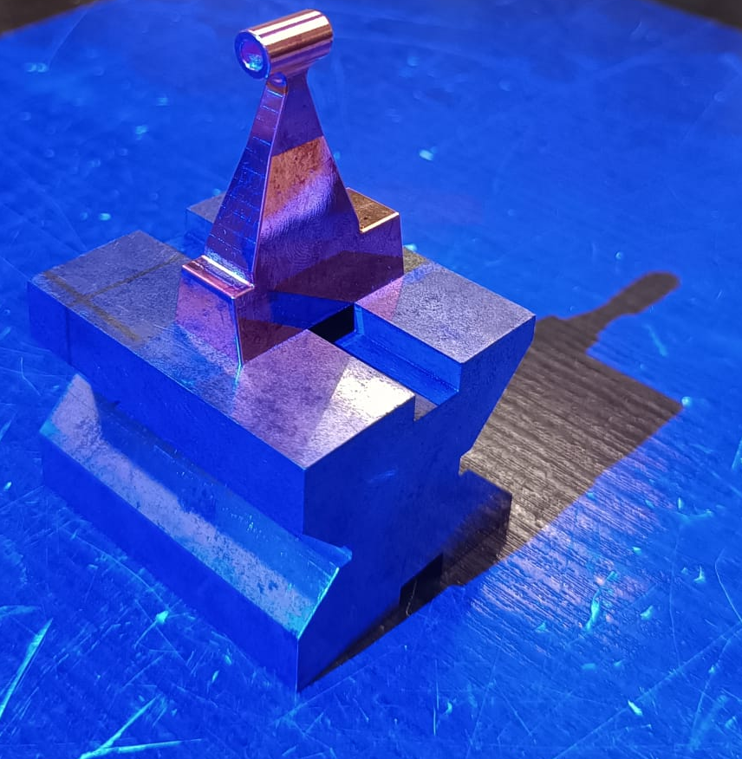
LINAC7 Project Context and Case Study
Case Study: Mechanical Design, Virtual Assembly and Fabrication of a Compact 750MHz IH DTL Accelerating Cavity
GD&T OBJETIVES DEFINITION
DESIGN FOR MANUFACTURING & GD&T PROPOSAL
MANUFACTURING OF COMPONENTS AND VIRTUAL ASSEMBLY
CONCLUSIONS AND FUTURE ACTIONS
Transverse tolerance analysis
Analytical calculations
Digital validation using CST
Longitudinal tolerance analysis
Analytical calculations
Digital validation using RFTrack
Theoretical geometry definition
Design for manufacturing
GD&T definition and variation analysis using 3DCS
Real assembly of fabricated parts
Validation of virtual assembly
Cold model validation with RF characterization
Components fabrication
Point cloud extraction
Virtual assembly using Space Analyser

Slide 7
Accelerators Technology
WG7 Mechanics and Integration
02
GD&T Targets and Functional Requirements

Slide 8
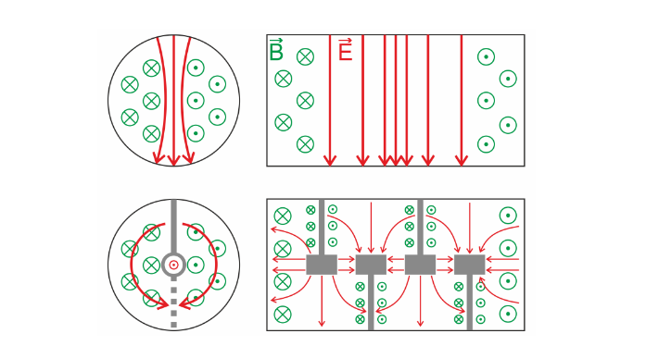
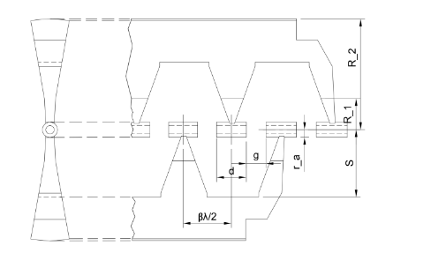
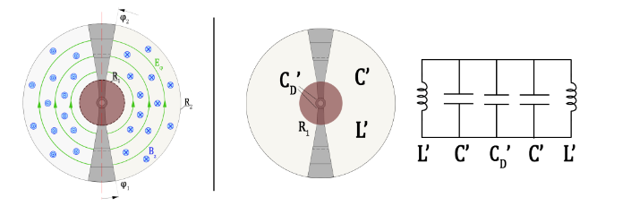
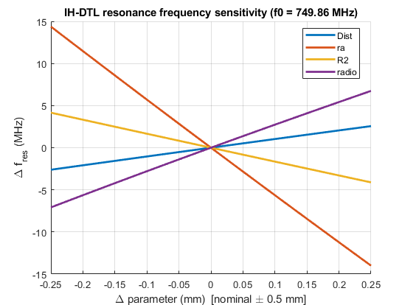
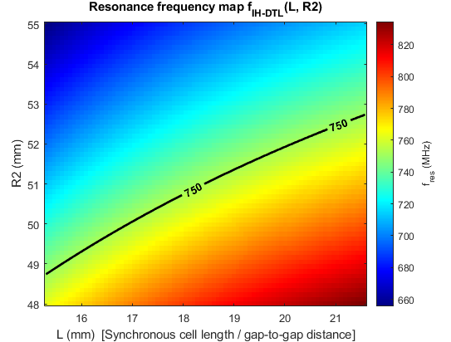
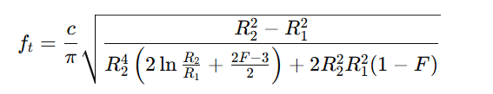


GD&T Targets and Functional Requirements
Transverse tolerance Analytical calculations
Resonance mode ${TE}_{111}$ & ${TE}_{110}$
Geometrical parameters
Equivalent electrical circuit of a IH DTL Cavity
IH DTL resonance frequency sensitivity
(749,86 MHz)
Resonance frequency map L and R2 influence
Basic Resonance Frequency of the Cavity
1 MHz of the difference in the resonating f -> 0,05 mm in ra

Slide 9
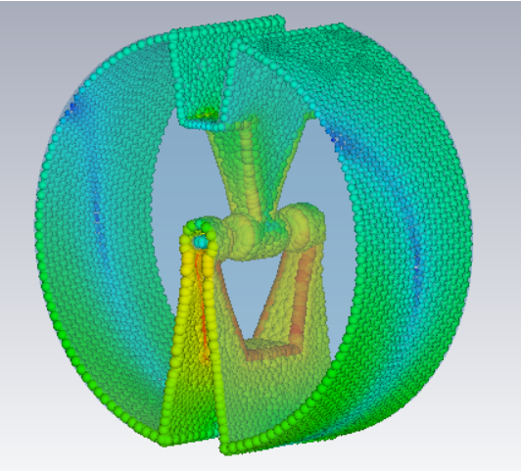
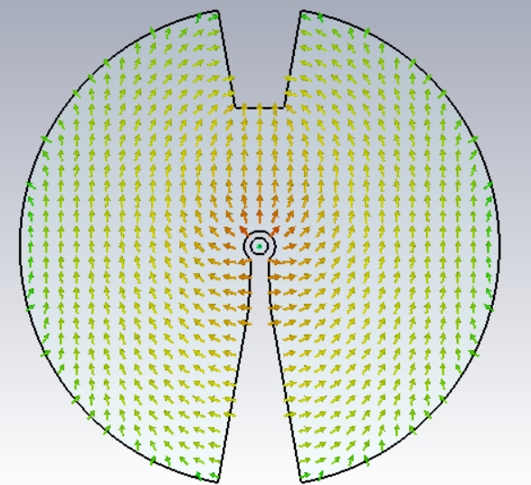
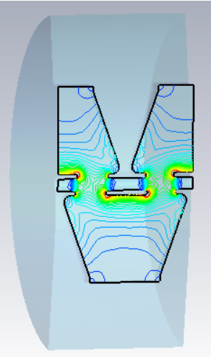
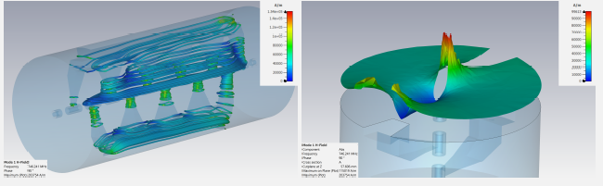

GD&T Targets and Functional Requirements
Transverse tolerance Digital Validation using CST
Modal simulation at CST ${TE}_{110}$ verification at first mode (750 MHz)
First parametrized geometry Definition in CAD

Slide 10
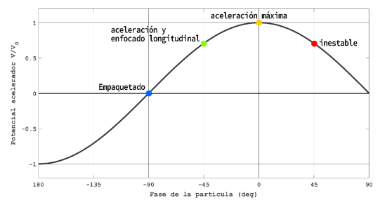
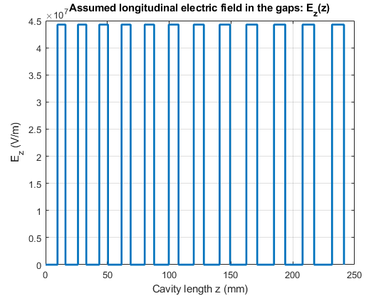
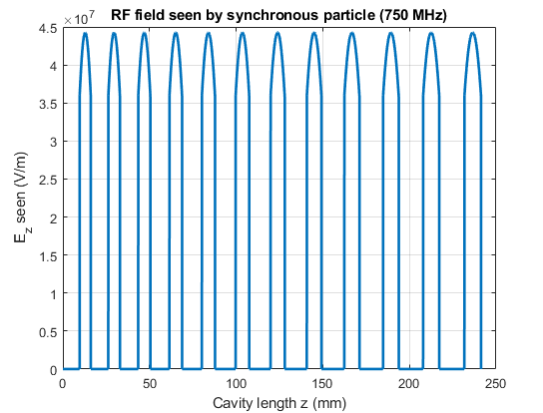

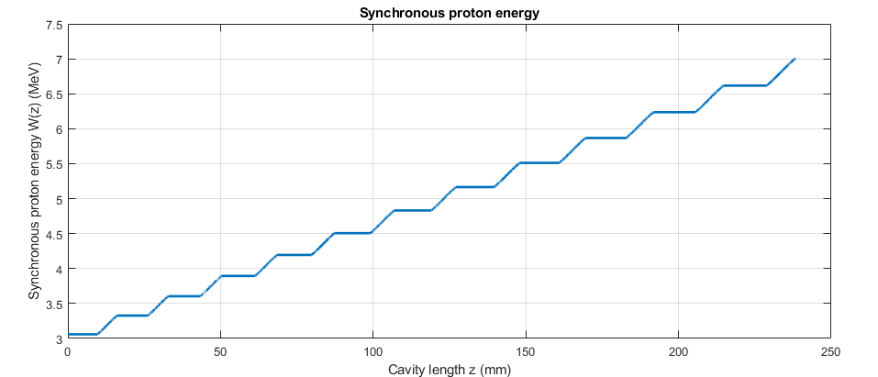


GD&T Targets and Functional Requirements
Longitudinal tolerance Analytical calculations
Longitudinal dynamics in accelerators
Geometrical parameters
Wideröe & DTL Alvarez
Energy gained in each gap (with Transit Time Factor)
1 (deg) of difference at 3MeV and 750 MHz -> 0,0886 mm

Slide 11
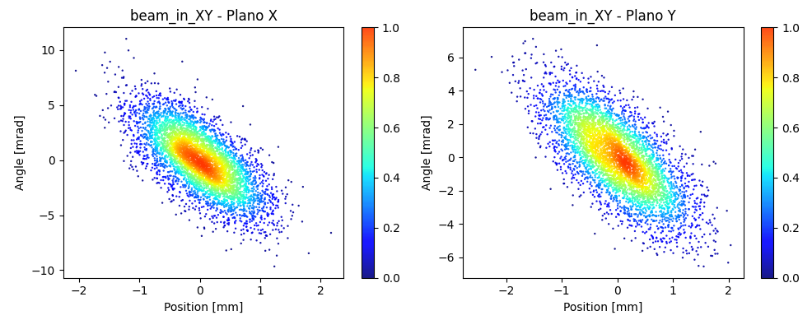
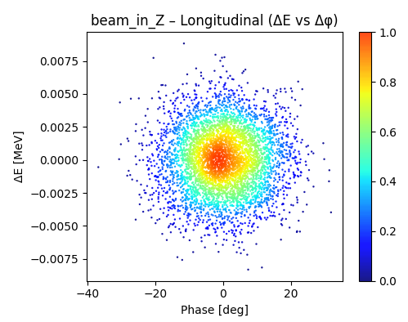
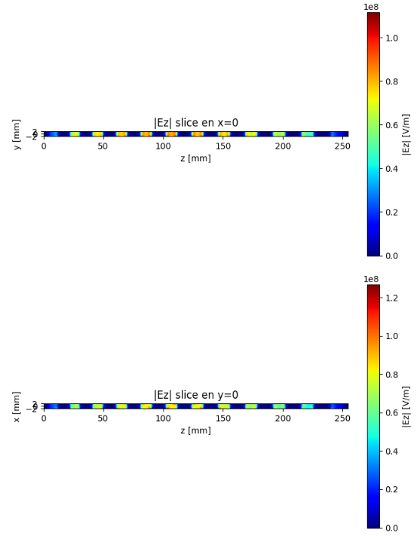
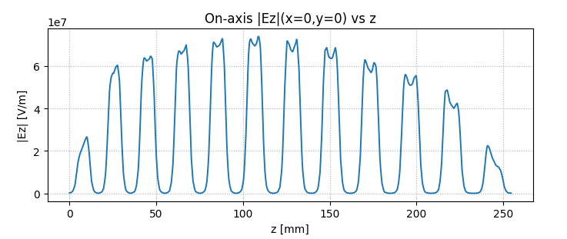
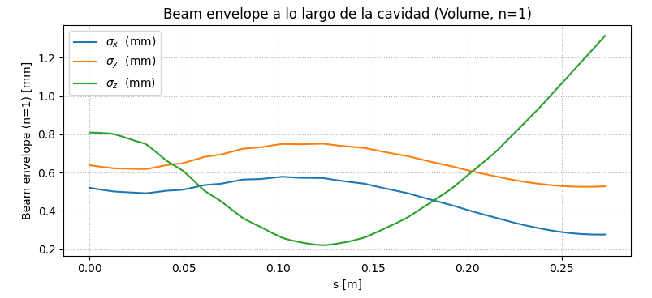
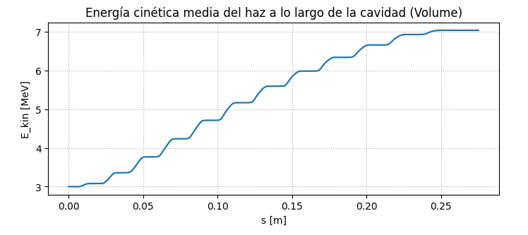
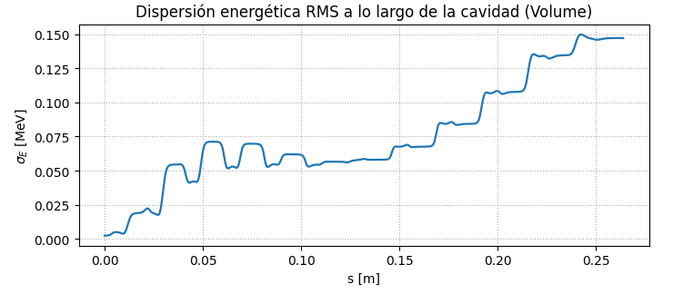
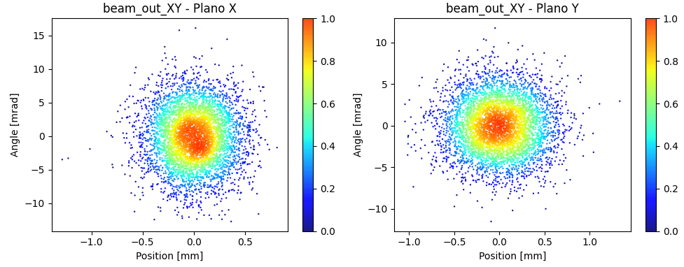
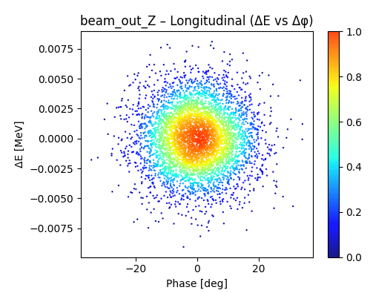
GD&T Targets and Functional Requirements
Longitudinal dynamics Digital Validation using RF Track
Input Beam Phase-Space Distribution
IH-DTL Prototype: Electromagnetic Field Maps Imported into RF-Track
Output Beam Phase-Space Distribution

Slide 12
Accelerators Technology
WG7 Mechanics and Integration
03
Mechanical design for manufacturing and GD&T proposal

Slide 13
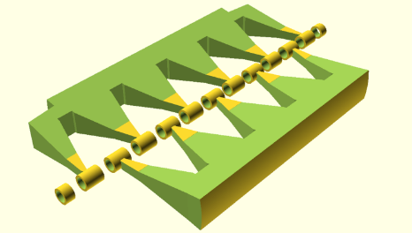
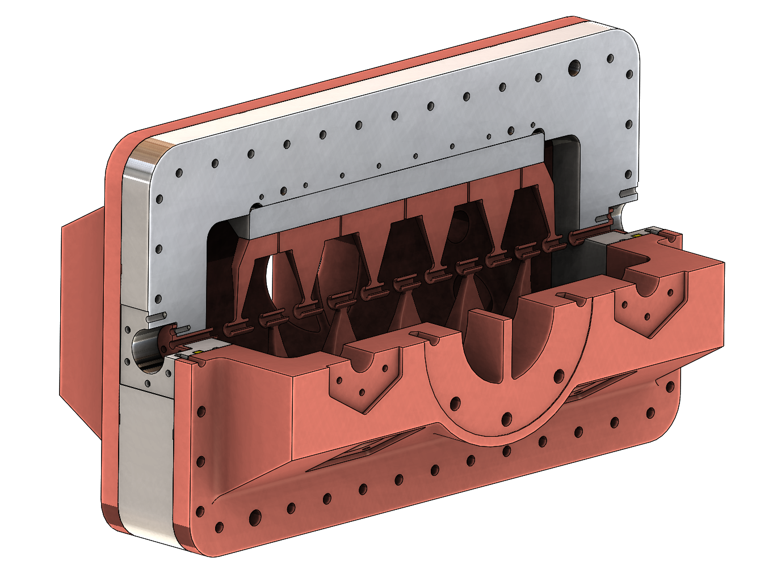
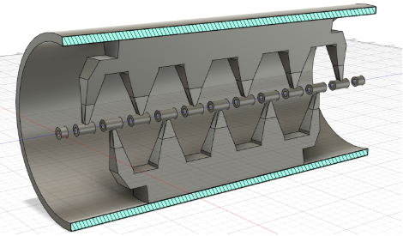
Mechanical design for manufacturing and GD&T proposal
Design for manufacturing
BASIC PARAMETRIZED GEOMETRY FOR SIMULATIONS
THEORETICAL GEOMETRY PROPOSAL FOR DE CAVITY
COMPONENTS ALIGMENT AND DESIGN FOR MANUFACTURING
FINAL DESIGN WITH OF THE PROTOTYPE

Slide 14
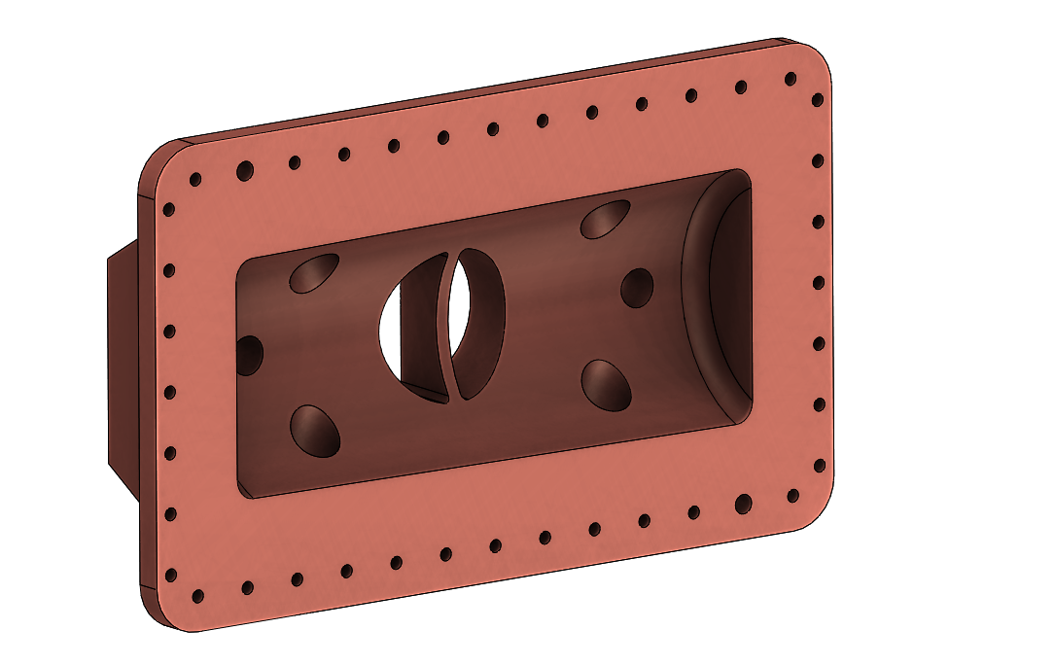
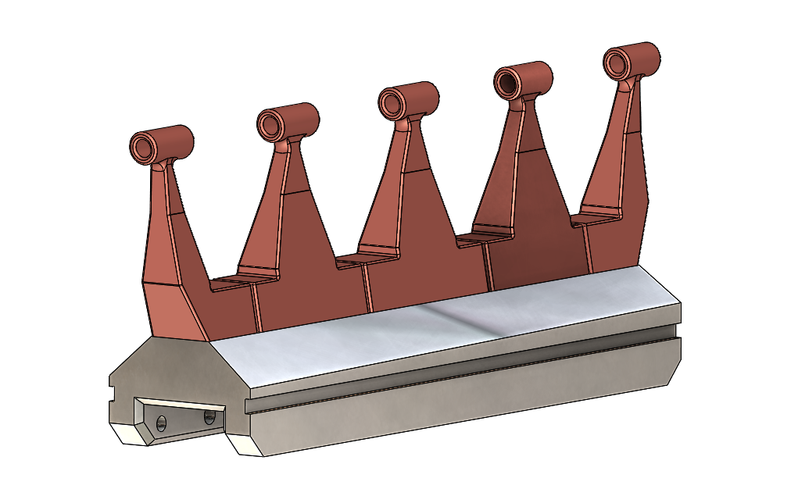
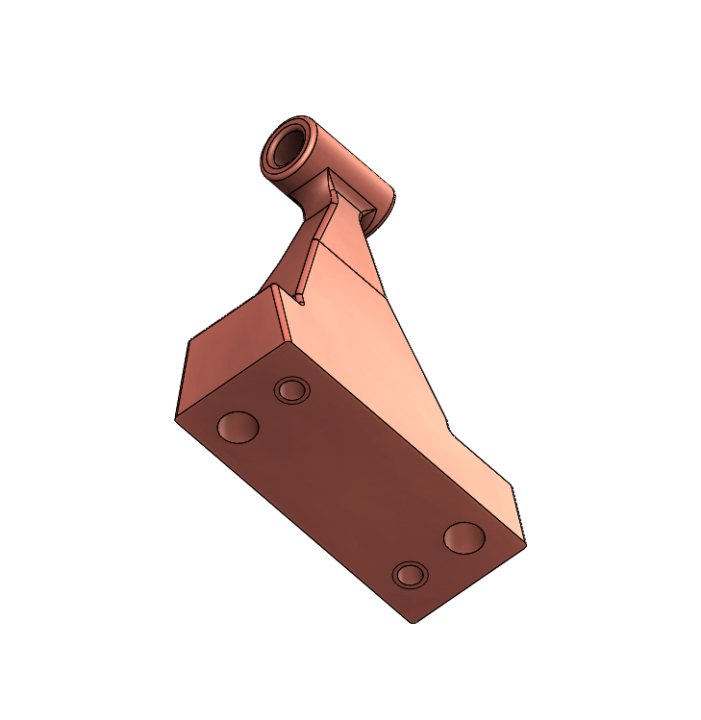
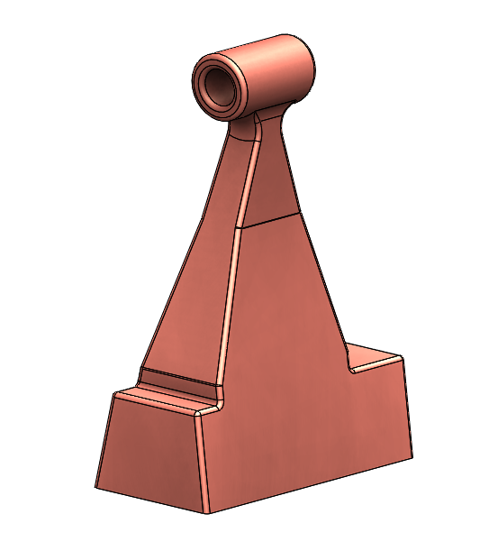
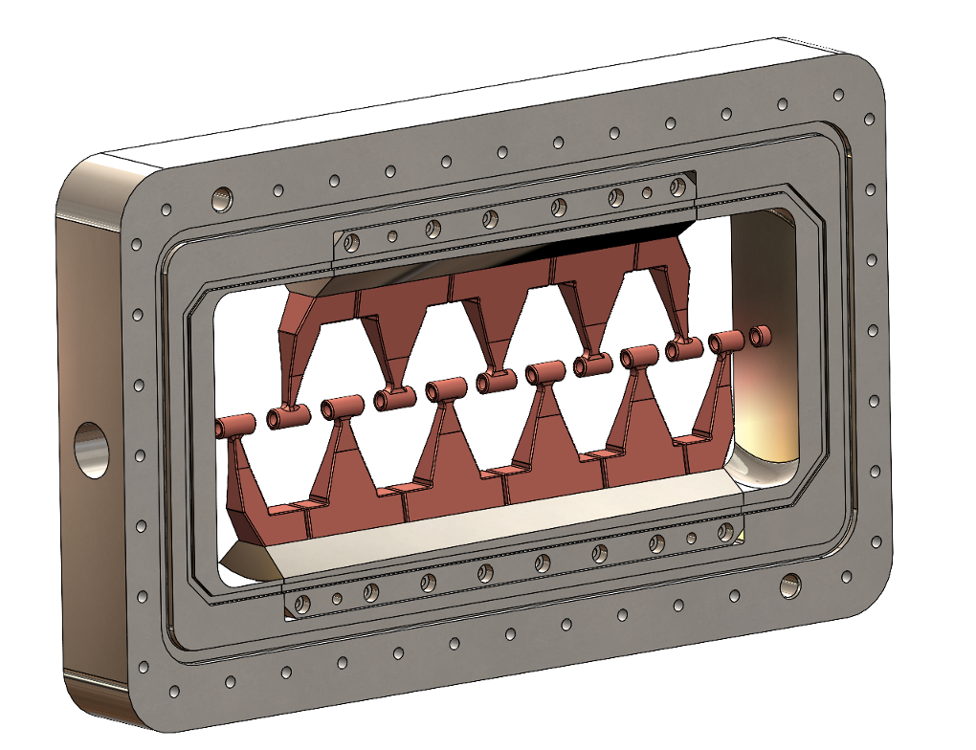
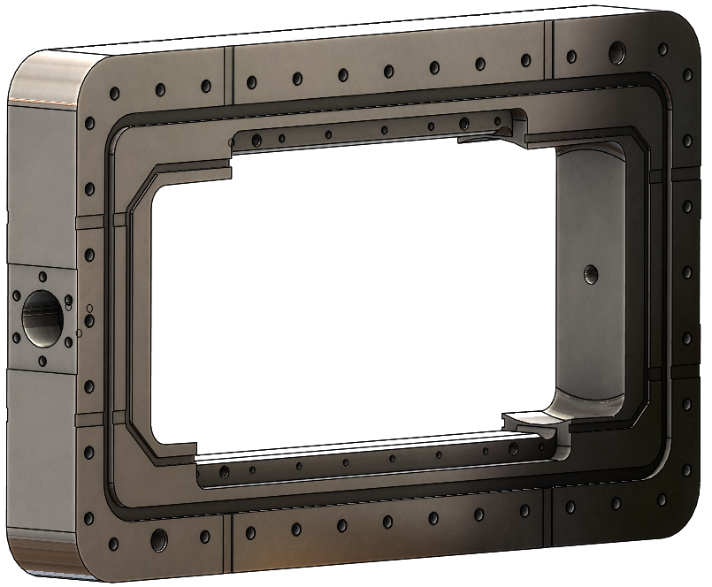
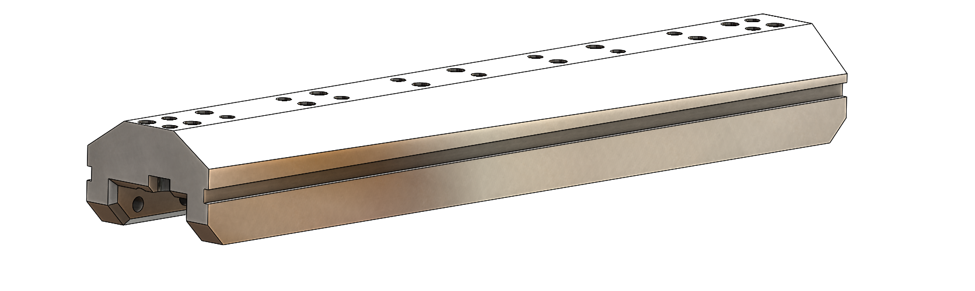
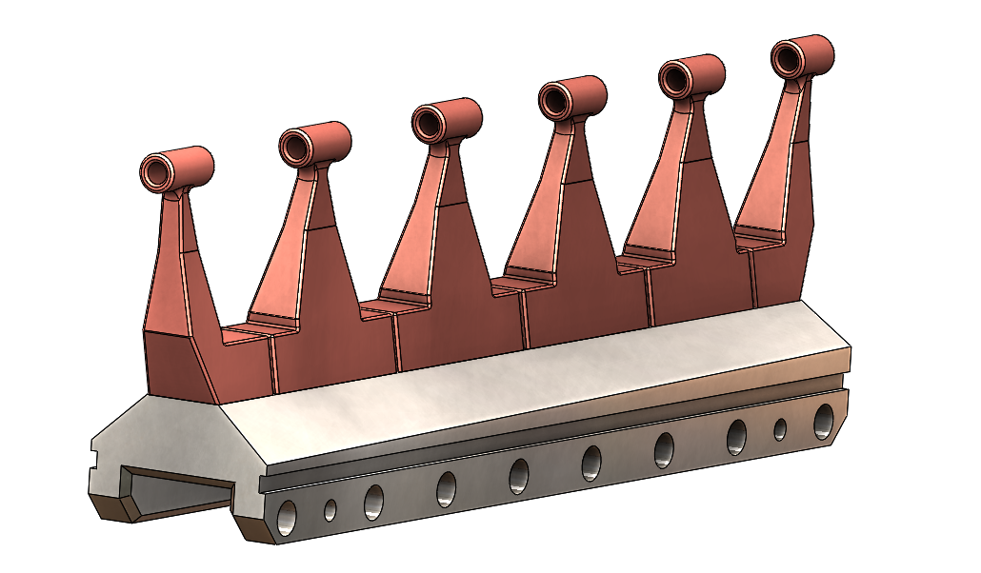
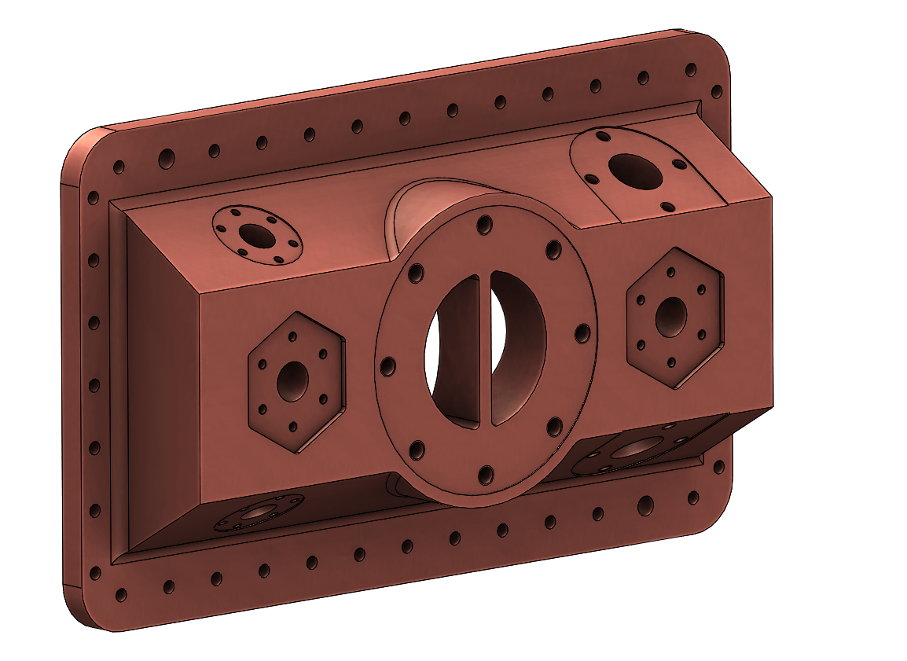
Mechanical design for manufacturing and GD&T proposal
Design for manufacturing & alignment of Drit Tubes

Slide 15
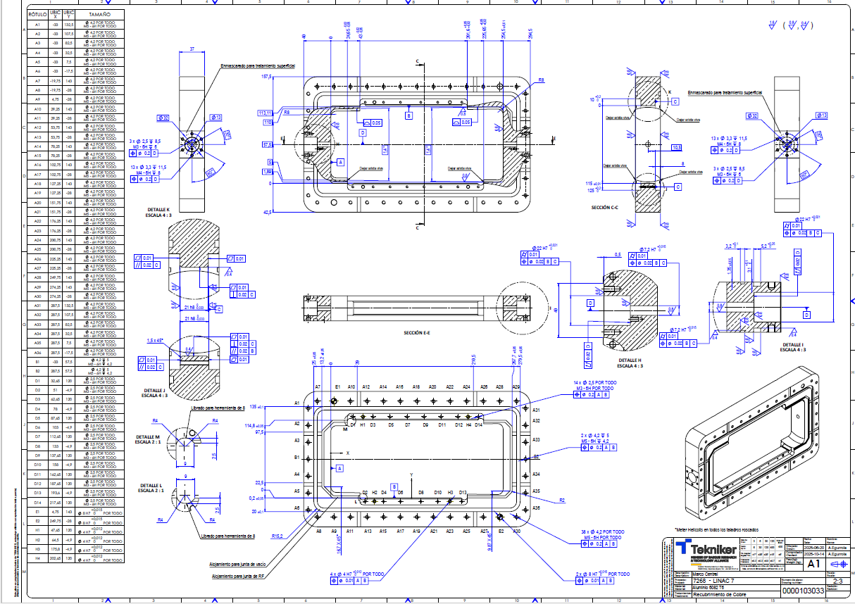
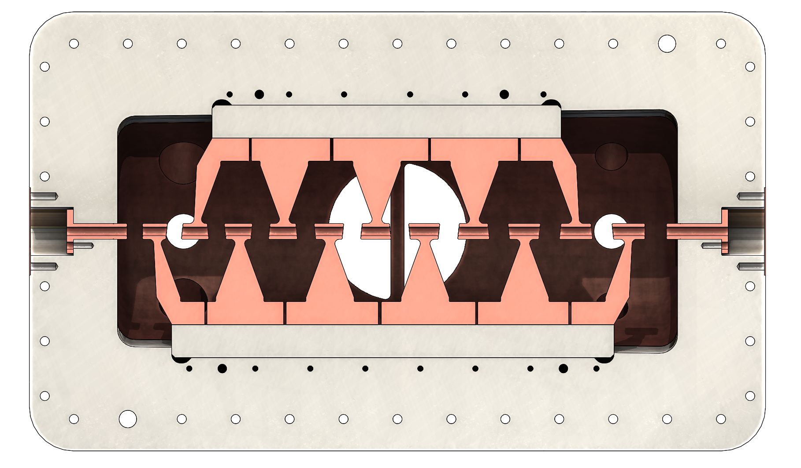
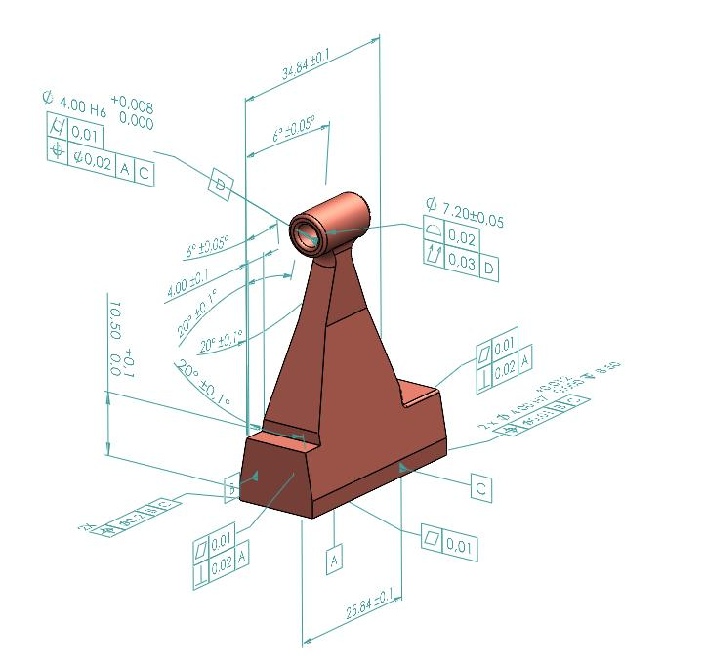

Mechanical design for manufacturing and GD&T proposal
GD&T definition and variation analysis using 3DCS
2.1
2.2
4.1
4.2
6.1
6.2
8.1
8.2
10.1
10.2
12.1
12.2
3.1
3.2
5.1
5.2
7.1
7.2
9.1
9.2
11.1
11.2

Slide 16




Mechanical design for manufacturing and GD&T proposal
GD&T definition and variation analysis using 3DCS

Slide 17
Accelerators Technology
WG7 Mechanics and Integration
04
Manufacturing of Components and Virtual Assembly

Slide 18




Fabrication of Components and Virtual Assembly
Manufacturing of components
Drift Tubes fabrication
Central frame fabrication

Slide 19




Fabrication of Components and Virtual Assembly
Measurement and virtual assembly
CMM measurement of a drift tube
Measurement results vs. nominal CAD geometry
Point cloud acquisition and alignment with the CAD model

Slide 20









Fabrication of Components and Virtual Assembly
Measurement and virtual assembly
Laser Track scanning of a Drift Tube
Mesh acquisition and alignment with the CAD model
Measurement results vs. nominal CAD geometry

Slide 21
Accelerators Technology
WG7 Mechanics and Integration
05
Conclusions and future actions

Slide 22
Conclusions and future actions
Conclusions:
Manufacturing feasibility has been validated through the IH-DTL prototype design (DfM assessment)
All critical components of the cold model have been manufactured with satisfactory results
A compact IH-DTL cavity has been developed and characterized using a Digital Twin workflow
A full IH-DTL prototype has been designed
Dimensional verification of the manufactured components has been completed, achieving satisfactory metrology results
Next Steps:
In the coming weeks, the manufactured prototype and the proposed models will be experimentally validated
The obtained results will serve as the baseline/reference for the final IH-DTL design

