Slide 1


Characterization of WBS using TPA-TCT Methodology and Experimental Applications on SiC samples
Jordi Duarte Campderrós¹
Marcos Fernández García²
Raúl Montero Santos⁴
Cristian Quintana San Emeterio²
Diego Rosich Velarde²
Iván Vila Álvarez³
¹ IFCA (UC-CSIC), ² Universidad de Cantabria and CSIC (ES), ³ Instituto de Física de Cantabria (CSIC-UC), ⁴ UPV

Slide 2
Outline
Introducing TPA-TCT
Basic and advanced studies
Beyond the technique
Examples on WBS (SiC)

Slide 3
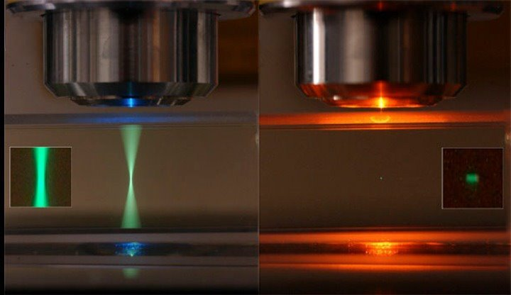
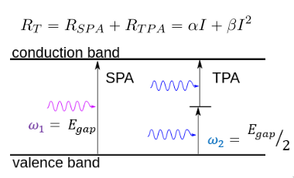

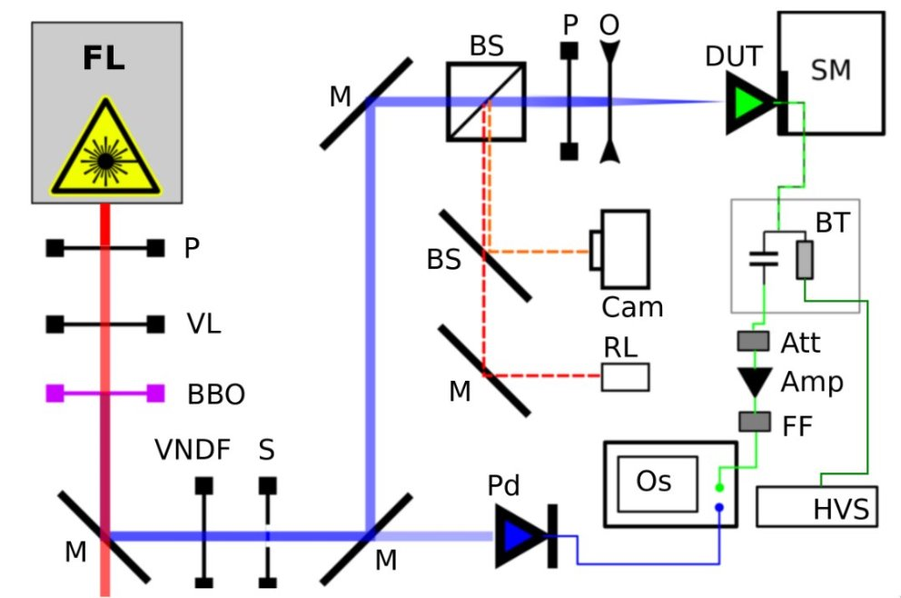
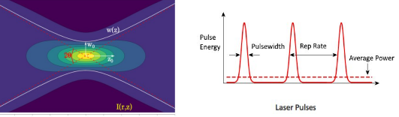
Two Photon Absorption (TPA)
Strategies to maximize TPA gen:

Slide 4
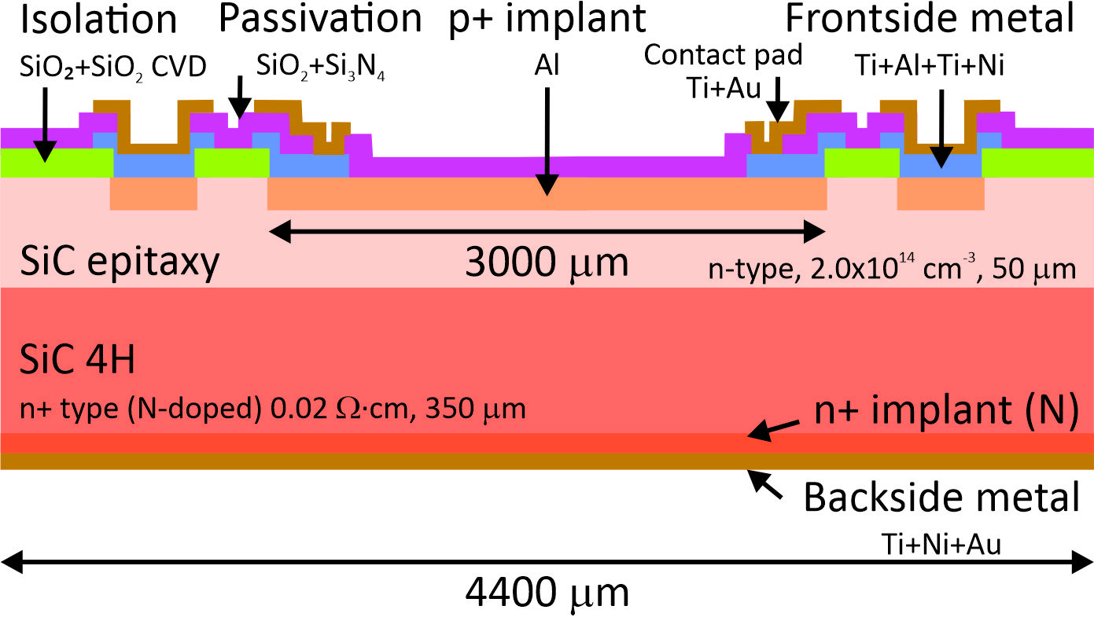
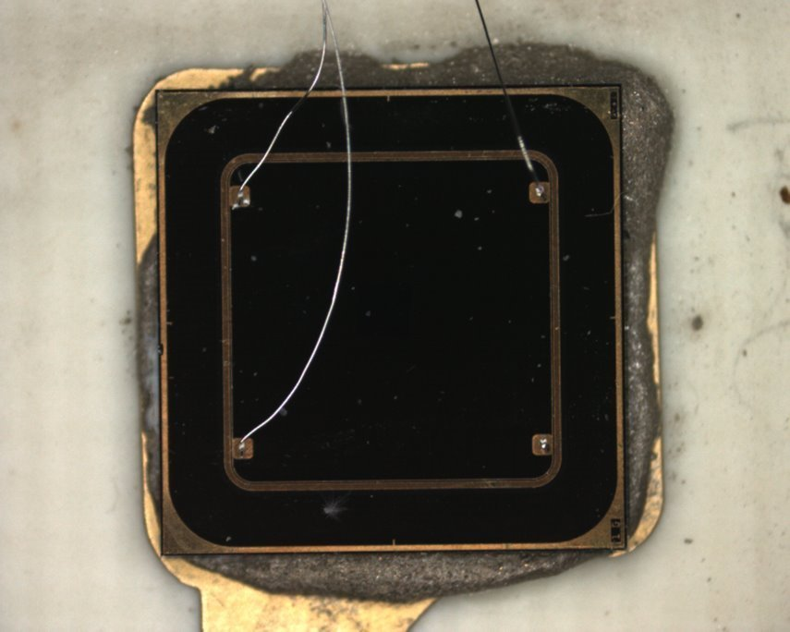
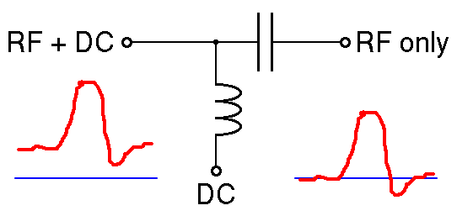

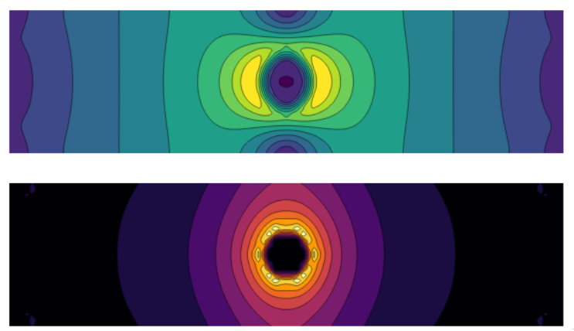
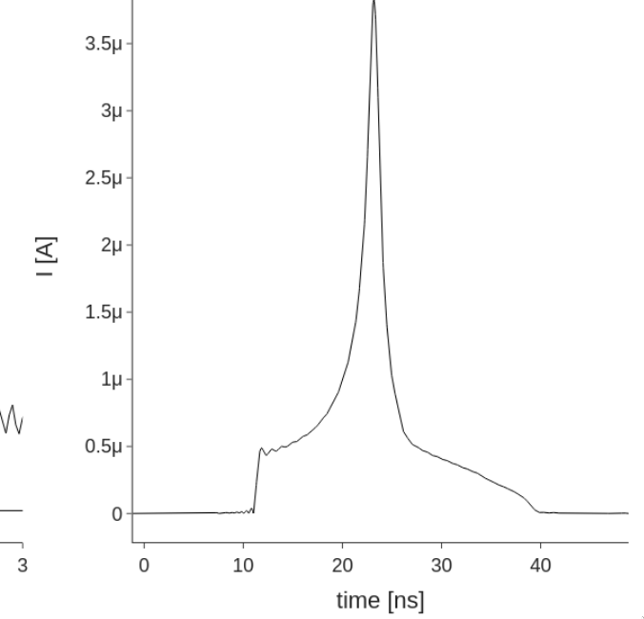

Transient Current Technique (TCT)
DUTs:
Bias tee:
DUT
SCOPE
BIAS
Signal generation:
3D (25x100 um)
Electric field
Weighting field

Slide 5
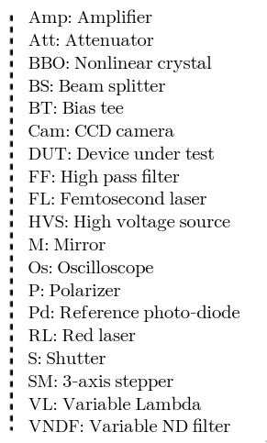
TPA-TCT setup for SiC at SGIker facility (UPV)

Slide 6
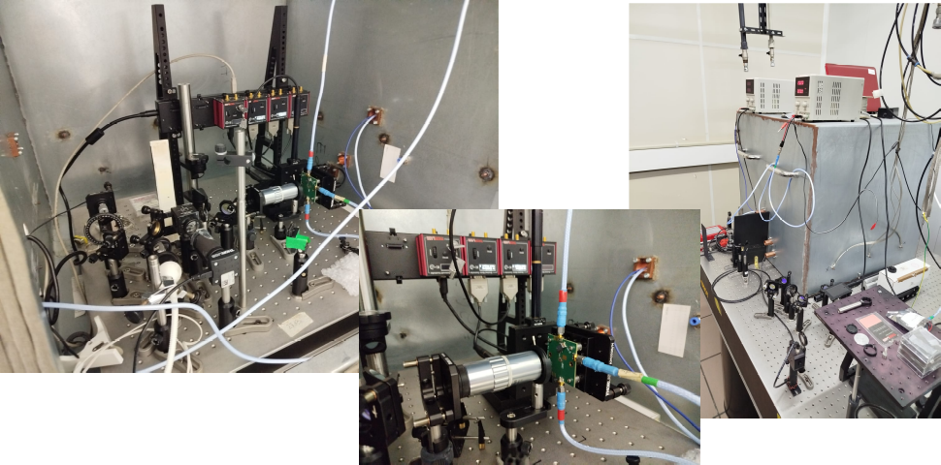
TPA-TCT setup for SiC at SGIker facility (UPV)

Slide 7
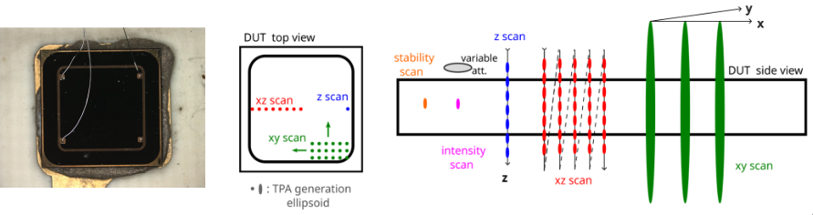
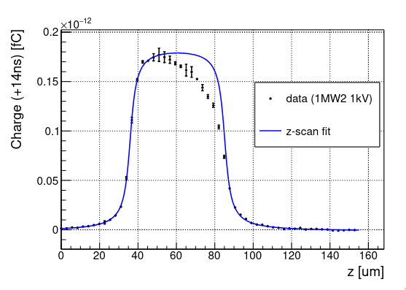
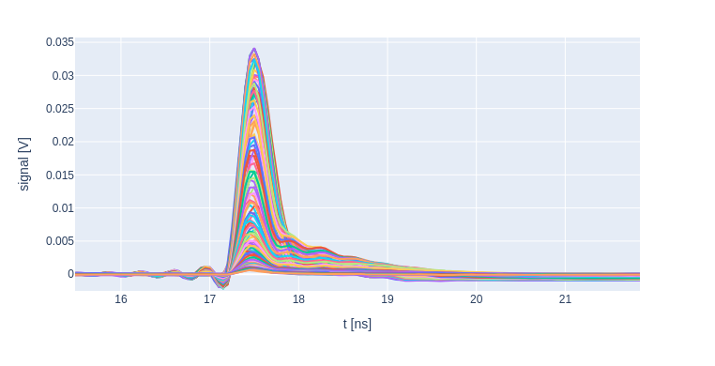
TPA-TCT basic studies
Zscan signals
charge
profiles

Slide 8
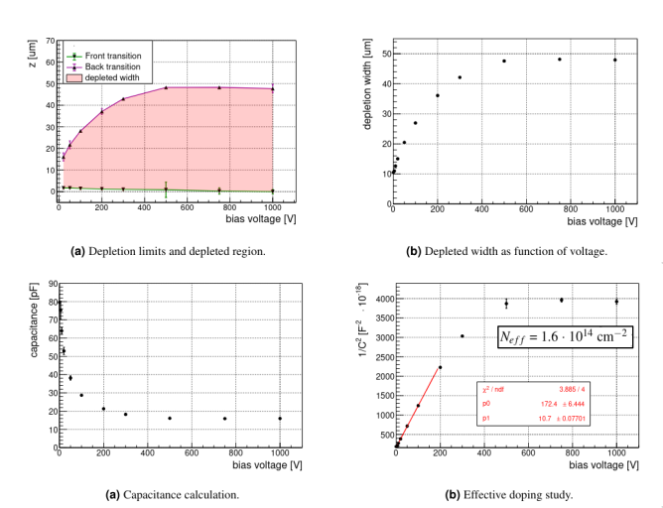
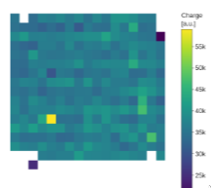
TPA-TCT derived studies
Estudio del vaciado y volumen activo
Determinación de las transiciones
Determinación indirecta de la capacidad vs bias
Estimación del dopado efectivo

Slide 9
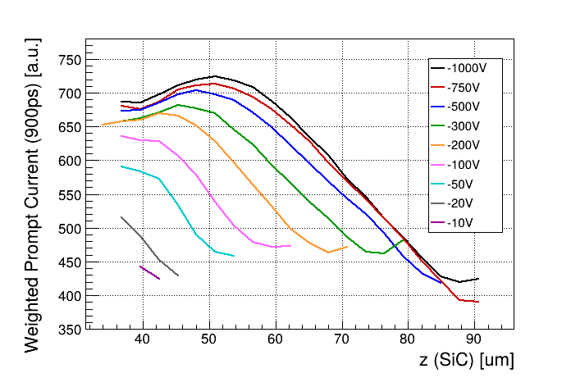
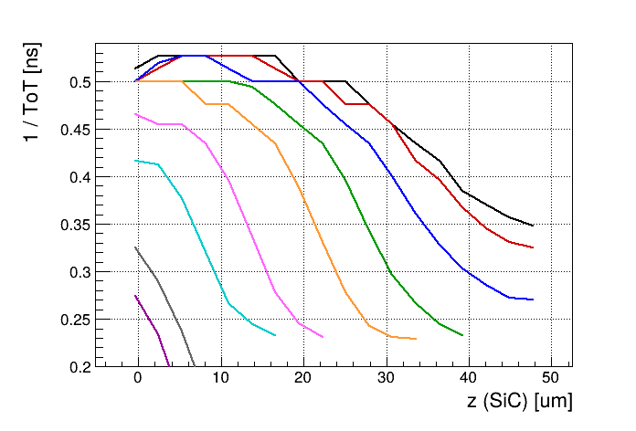
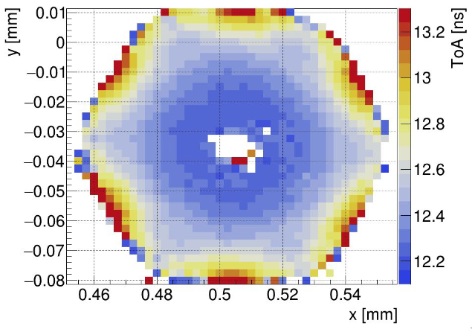
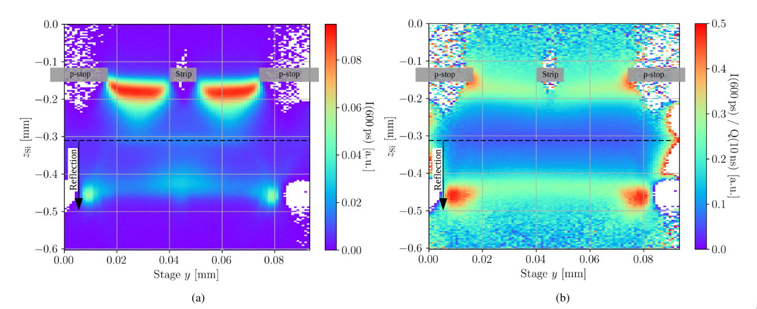
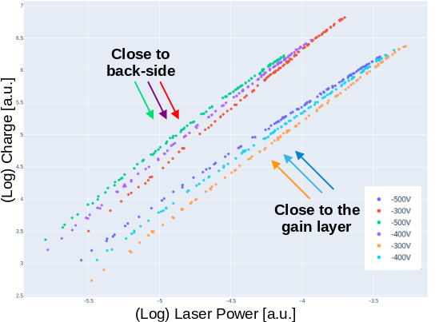
But there are more...
Electric field estimation:
More complex structures:
WPC
Hexagonal 3D pixel
Clara Lasaosa PhD Thesis
1/TOT
C. Quintana: Radiation hardness and radiation-induced charge multiplication in neutron-irradiated SiC p-in-n diodes characterized by TPA-TCT
SiC LGAD
WPC
TOT
S. Pape: Techniques for the Investigation of Segmented Sensors Using the TPA-TCT

Slide 10
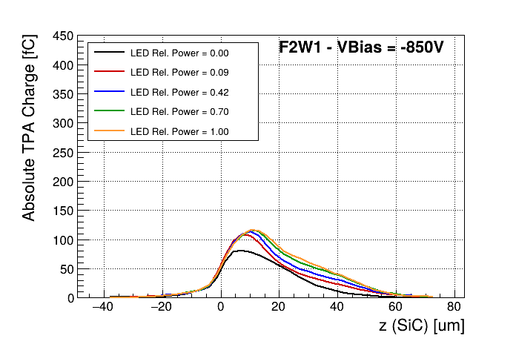
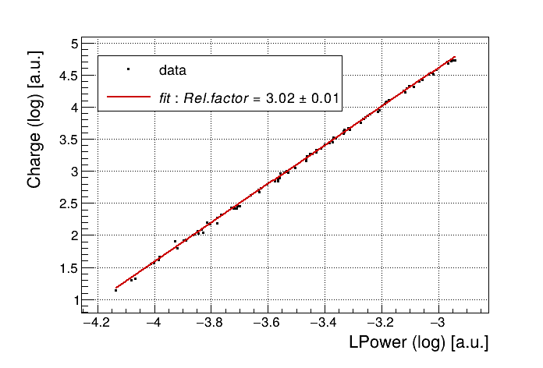
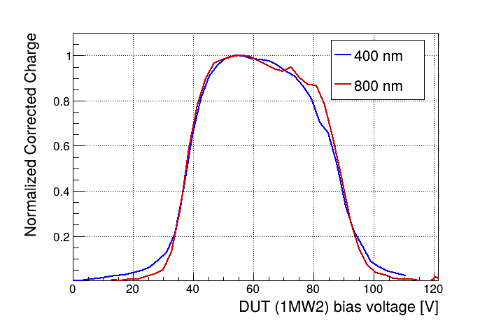
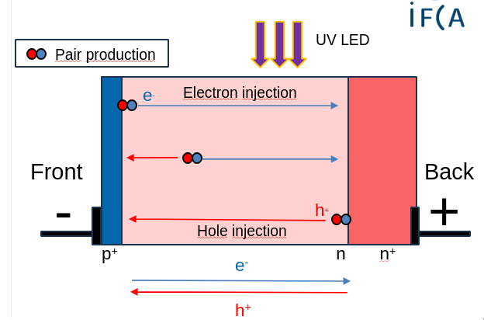
Beyond TPA-TCT
3PA excitation and more...
"Hibrid" experiments
Slope = 3 -> 3PA
Similar profiles
Less SPA
Better "practical"
resolution

Slide 11
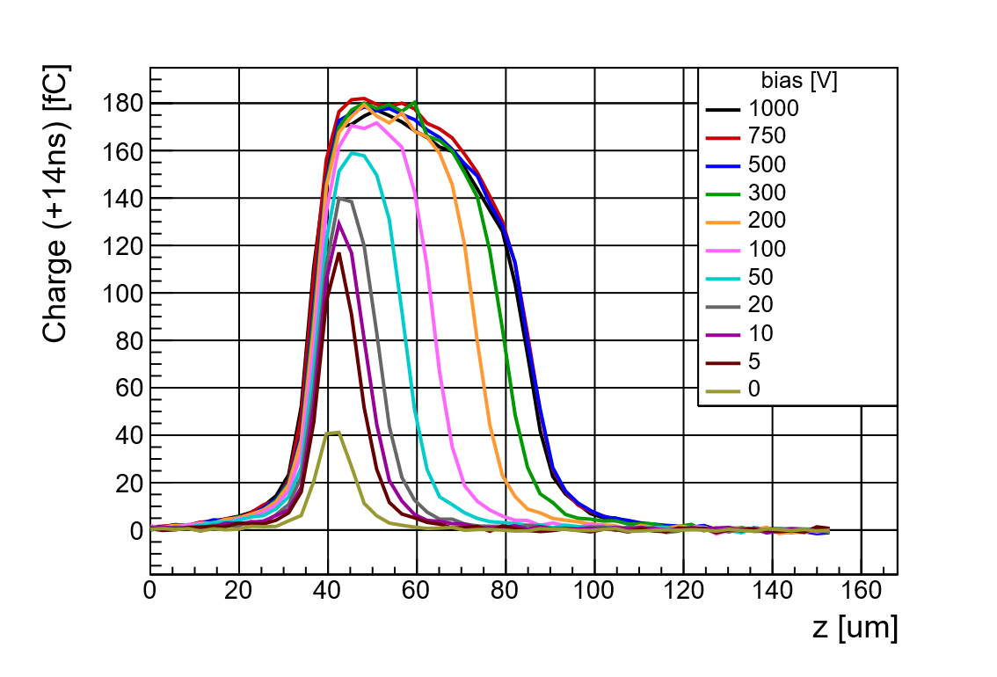
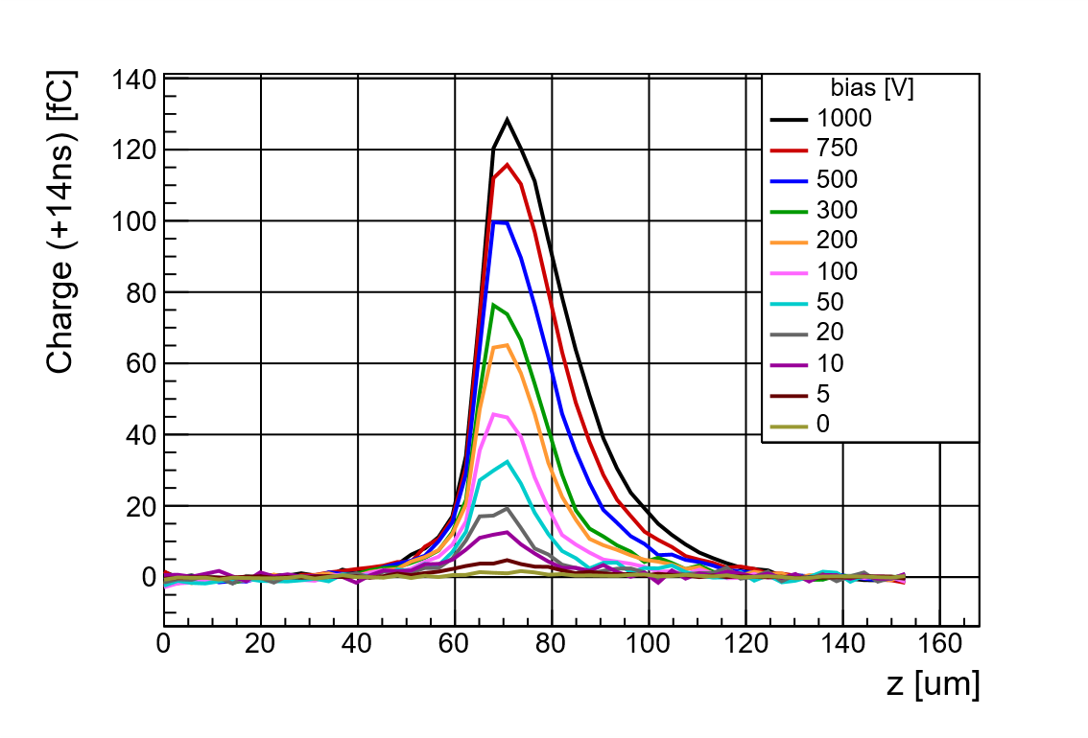
SiC samples – Fresh vs Irradiated detectors
Sample 1MW2 - non-irradiated​
Sample F2W1 – 10¹⁵ n_{eq}/cm²
Irradiated samples show a decrease in the maximum and integrated amount of collected charge
There is no saturation effect in the irradiated samples, they recover more signal as bias voltage is increased
Important leakage current increase, not only after irradiation but during operation in both!

Slide 12
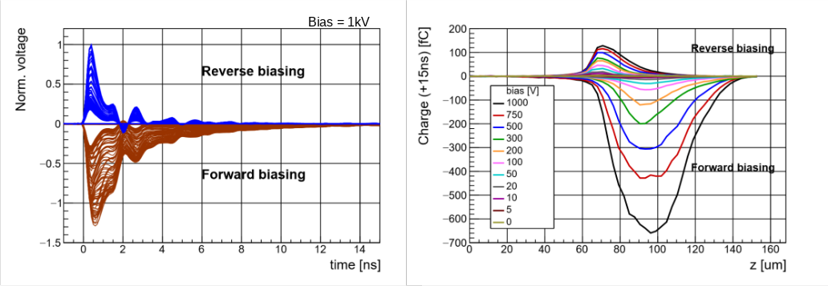
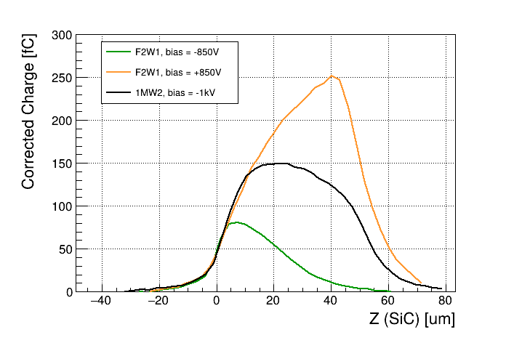
SiC samples – Forward bias and multiplication
WFs
Comparison Irradiated vs Fresh samples
Forward
Multiplication
Charge
Reference
Reverse

Slide 13
Conclusions
Positive points​
High experimental versatility​
Large variety of achievable studies​
High-resolution 3D sampling with strong spatial selectivity​
Non-destructive access to the device bulk​ ​
Negative points​
Optical aberrations at high numerical apertures​
Strong sensitivity to the optical pulse structure​
Sensitivity to beam clipping

Slide 14
¡Gracias por vuestra atención!

