Slide 1

WG 6 - Electronics Report
Co-Coordinators: F. Arteche, S. Folgueras, D. Real
CIEMAT, 2 Febrero 2026

Slide 2
Outline
1. WG6 Coordination activities
1.1. First Survey outcome
2. Session topics
3. Conclusions

Slide 3
1. WG6 Coordination activities
Electronics is a highly transversal activity, with strong interactions across several other work packages.
The main objective of this analysis is to obtain a clear map of electronics capabilities in Spain, in order to:
Foster coordination among groups with similar activities and
Enable groups from other work packages to identify and leverage existing design capabilities
Over the last weeks, several meetings were held to collect data and start structuring the information.
We have been in contact with most of the groups that declared activities related to electronics.
All information from these meetings has been stored in Indico.
We would like to thank all the groups for their responses and collaboration.

Slide 4
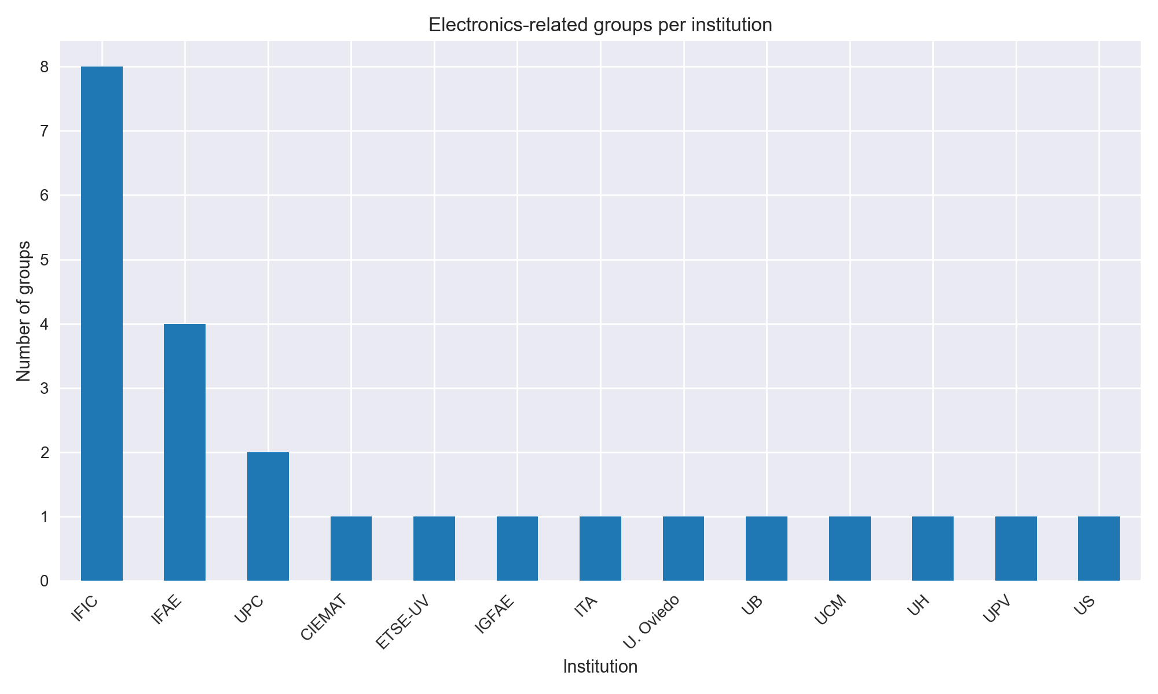
1.1 WG6 Coordination activities: First Survey outcome
A total of 13 institutions (24 groups) were identified with activities related to electronics.
Some groups were initially missing and were contacted to complete the survey.
It is possible that a small number of groups are still not represented

Slide 5
1.1 WG6 Coordination activities: First Survey outcome
Based on the collected data and the meetings held, we started to identify key terms describing the electronics activities of the different groups.
Using these keywords, a first clustering of the groups has been performed.
Additional data processing and harmonization are required.
Groups from different communities use different terminologies and levels of detail.
One or more additional iterations will likely be needed.
Nevertheless, the current results are already providing a first overview of the landscape of groups with electronics capabilities in Spain

Slide 6
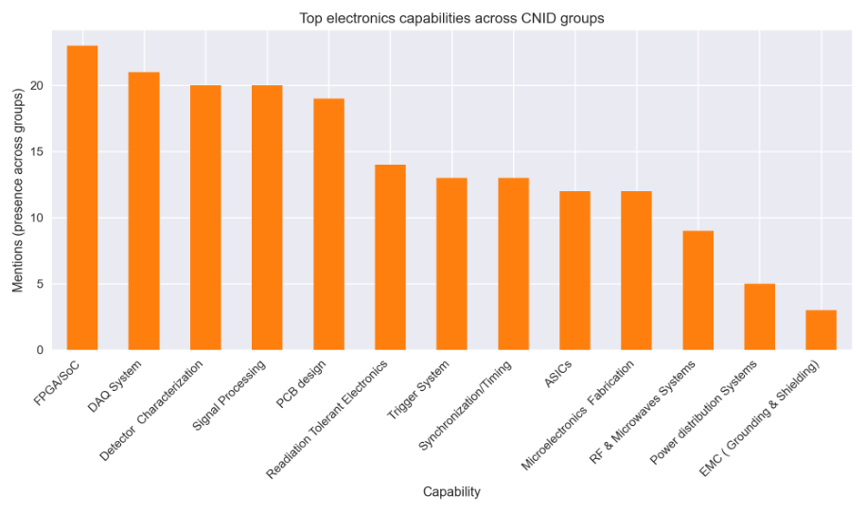
1.1 WG6 Coordination activities: First Survey outcome
FPGA/SoC, DAQ and signal processing are the most widespread electronics capabilities across CNID groups.
Front-end and detector-related electronics (characterization, PCB design, radiation tolerance) are well covered at national level.
More specialised capabilities (ASICs, RF/microwaves, EMC and power distribution) are present in fewer groups

Slide 7
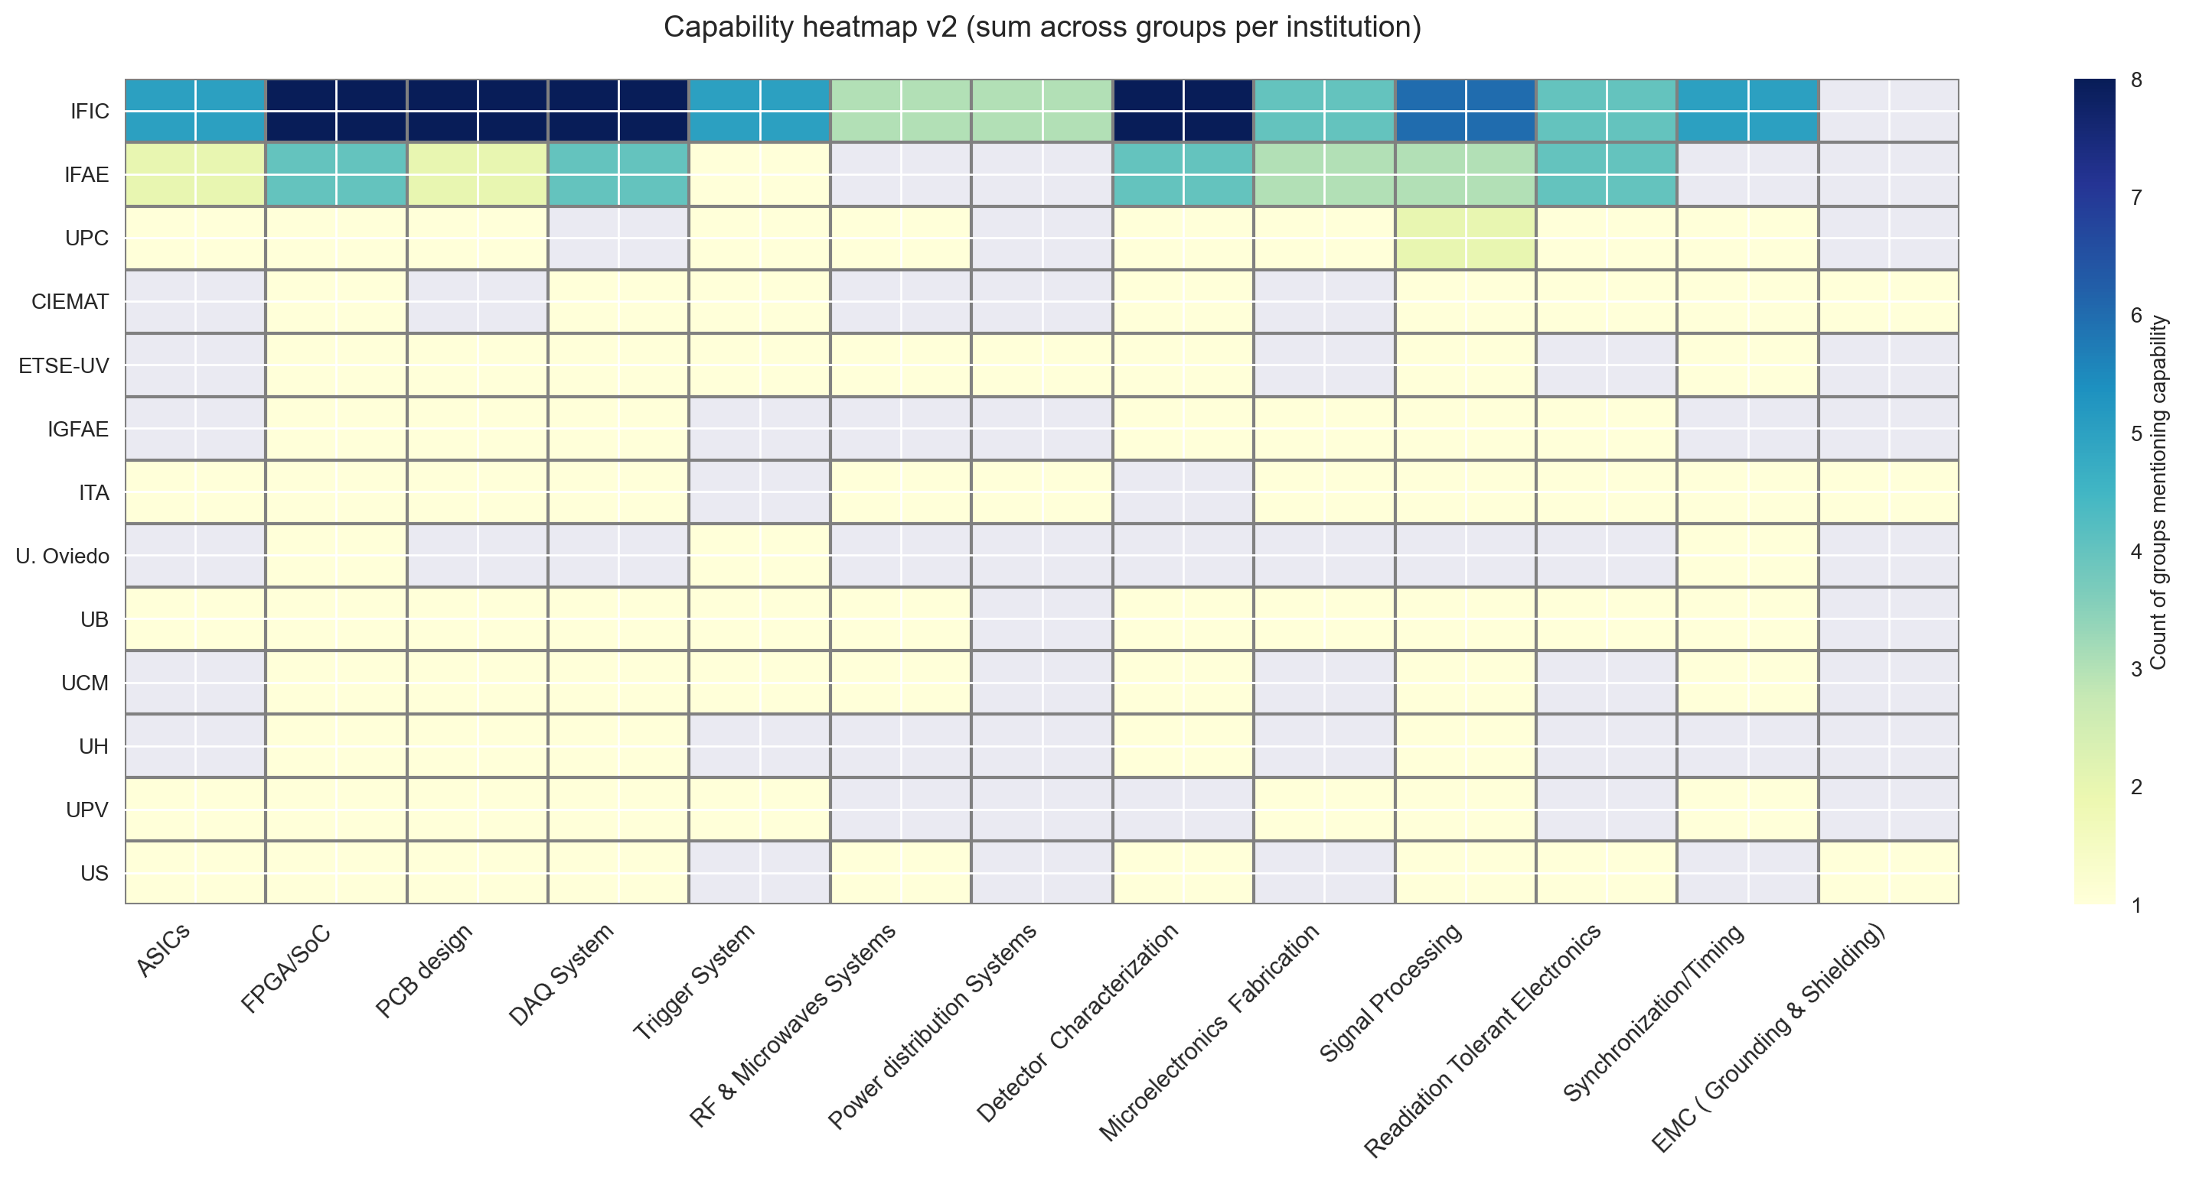
1.1 WG6 Coordination activities: First Survey outcome

Slide 8
1.1 WG6 Coordination activities: First Survey outcome
Strong concentration of electronics capabilities in a few key institutions, with IFIC and IFAE showing the broadest and most diversified coverage.
Core digital and readout capabilities (FPGA/SoC, DAQ, signal processing, detector characterization) are present in most institutions, forming a common technological backbone.
Clear complementarity across institutions, with several centres specialising in specific capabilities rather than covering the full electronics chain.
Advanced and enabling technologies (ASICs, RF/microwaves, EMC and power distribution) are available in a limited number of institutions, highlighting the importance of coordination and shared use.
Overall, the heatmap reflects a distributed but complementary national ecosystem, where collaboration is essential to cover the full electronics lifecycle.

Slide 9
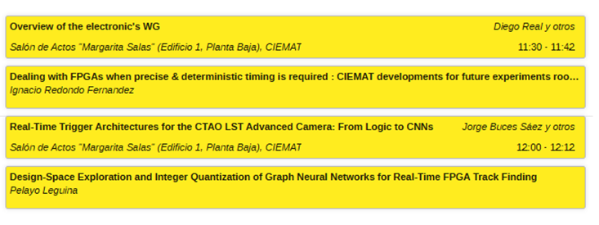
2. Session topics
This session focuses on a specific set of electronics topics, mainly related to trigger, real-time processing and FPGA-based architectures.
The scope of this session is intentionally focused and does not aim to cover the full range of electronics activities.
Additional topics and perspectives will be addressed in future meetings and sessions.
A total of three talks have been selected for full presentation, covering complementary aspects of the session theme.
Although two contributions could not be presented in full due to time constraints, their core ideas will still be highlighted.

Slide 10
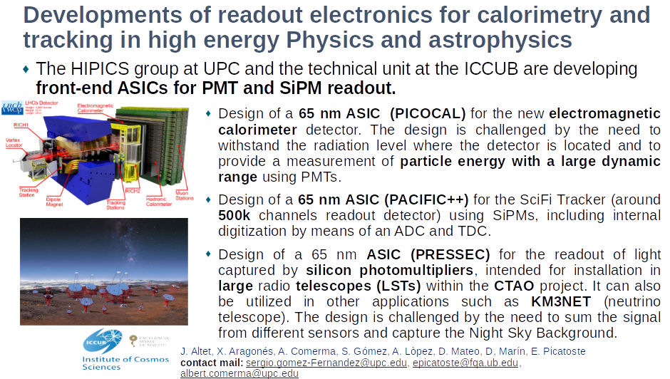
2.1 Session topics

Slide 11

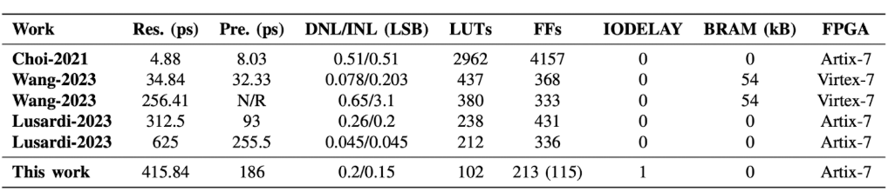
2.2 Session topics
Hybrid TDC Architecture on FPGA: A Resource-Efficient Solution for High-Precision Time Measurements
Accurate time measurement is essential in many scientific and technological applications, particularly when scaling to a large number of channels. Time-to-Digital Converters (TDCs) convert pulse durations into digital values and timestamp pulse arrivals. They are extensively used in high-energy physics experiments, especially in large-scale detectors such as the KM3NeT neutrino telescope which demand TDCs with low resource usage and low power consumption due to extreme operating conditions and high channel counts.
In this work, we have presented a novel TDC architecture implemented on FPGA, designed to maximize logic efficiency while maintaining sub-nanosecond resolution. The design combines a multi-cycle phase counter with configurable FPGA delay elements, improving resolution with minimal logic cost.
Implementation on a Xilinx Artix-7 device achieves a resolution of ~416 ps and a trigger precision of 186 ps r.m.s., with excellent linearity. Using only a few hundred LUTs and registers, this solution is a highly attractive alternative to conventional TDCs. Preliminary results on an Ultrascale FPGA demonstrate the architecture’s scalability and its suitability for large-channel systems such as neutrino telescopes achieving a resolution of 250 ps.
Real, D. (IFIC); Calvo, D. (IFIC); Manzaneda, M. (IFIC); Diaz, A (UGR); Gozzini, S.R. (IFIC); Zornoza, J.D. (IFIC); Ricolfe-Viala, C.(UPV); Lajara, R. (ETSE-UV)
Contact: real@ific.uv.es

Slide 12
3. Conclusions
A first consolidated overview of electronics capabilities within WG6 has been achieved, based on surveys, meetings and direct interaction with the groups.
The analysis confirms that electronics is a highly transversal activity, interacting strongly with several other CNID work packages.
Strong national capabilities are identified in FPGA/SoC, DAQ, trigger, signal processing and detector readout, forming a solid technological backbone.
More specialized areas (ASICs, RF/microwaves, EMC, power distribution) are present in fewer groups, highlighting complementarity rather than duplication.
The resulting maps and analyses already provide a useful picture of the current electronics landscape in Spain, despite remaining gaps.
Further iterations and updates will be needed to refine the picture and include missing activities.
This work lays the basis to foster coordination, synergies and shared use of electronics expertise across CNID, and to support other WG in future developments.

Slide 13


