Slide 1
IMB-CNM LGAD technologies for the future challenges in particle and photon detection
P. Fernández-Martínez, N. Moffat, M.Manojlovic, F. Dougados, J. Villegas*, C. Fleta, S.Hidalgo, G.Pellegrini

Slide 2
Introduction: Challenges for pixel detectors
Large area pixel arrays: fabrication yield and uniformity
Redefinition of the gain layer profile
Careful review of the fabrication steps
Radiation hardening: performance under high fluences
Carbon co-doping
Partial activation
Small pixel/pitch: Solutions towards 100% fill-factor
Inverse LGAD (iLGAD) and Trench isolated inverse LGAD (TiLGAD)
AC-coupled LGAD (AC-LGAD)
Detection of low penetrating radiation (soft X-rays, UV, etc.)
LGAD on n-type substrate (nLGAD)
Redefinition of the entrance window (thinner layers, coatings/passivations, etc.)
Graphine on Insulator on Silicon (GIS)

Slide 3
Large pixel arrays: Fabrication yield and uniformity

Slide 4
Large area pixel arrays: yield and uniformity
Current levels and pixel yield was overall good, but:
Dispersion in V_{BD} higher than desired
Sensor yield was poor: even one pixel with high current is enough to spoil the full matrix performance
Pixel yield on previous CNM LGADs
4 tested devices
4 x 15 x 15 = 900 pixels
5 tested devices
5 x 16 x 16 = 1280 pixels
5% of pixels with
I(100V) > 200 nA
0.7% of pixels with
I(100V) > 200 nA
J. Villegas: PhD Thesis

Slide 5
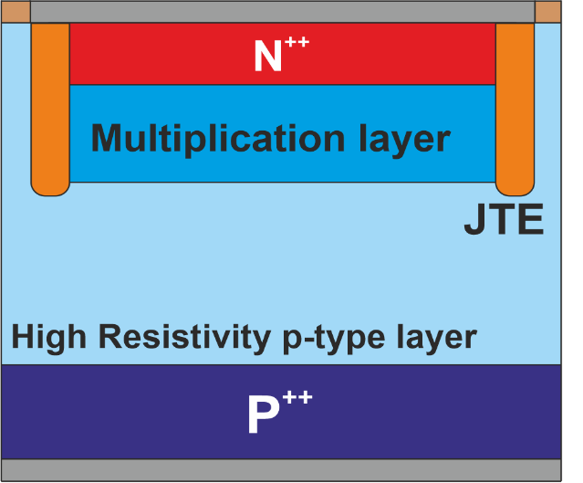
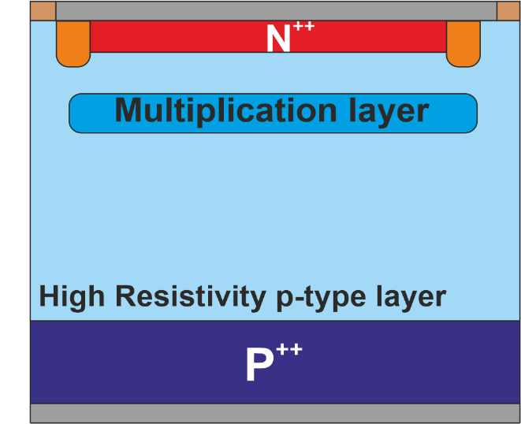
Large area pixel arrays: new profiles
Traditional CNM LGAD: the N⁺⁺ overlaps the Multiplication layer, and the electric field peaks at the PN junction
New standard: the N⁺⁺ and the Multiplication layer are physically separated, and the electric field is nearly flat within this gap
Traditional LGAD
New standard

Slide 6
Large area pixel arrays: new profiles
Traditional CNM LGAD: the N⁺⁺ overlaps the Multiplication layer, and the electric field peaks at the PN junction
New standard*: the N⁺⁺ and the Multiplication layer are physically separated, and the electric field is nearly flat within this gap
Traditional LGAD
*”New standard” as adopted by most manufacturers
But manufactures report fabrication yield still < 50%
New standard

Slide 7
Refining LGAD technology
2025 run:
N+ Arsenic contact (looking for the shallowest region)
3 different Boron doses for the deep multiplication region implant (low, medium, high)
Wafers with and without carbon implant
Higher control of all the technological processes (oxide thickness, quality of deposited layers, etc.)
Characterization (pad devices):
Breakdown voltage> 300V.
Leakage current < μA (20ºC); < 10nA for non-carbonated
Improved uniformity, even better for carbonated devices.
V_{GL} very uniform, but relatively low (22-23 V) → low gain: 2-3 (alpha/p+) to 5 (mip)
55 um epitaxy (active thickness)
Pads and pixel arrays
Compatible ETROC (pixel size=1.3X1.3 mm2; IP=80um)
New run planned → goal: higher gain

Slide 8
Radiation hardening

Slide 9
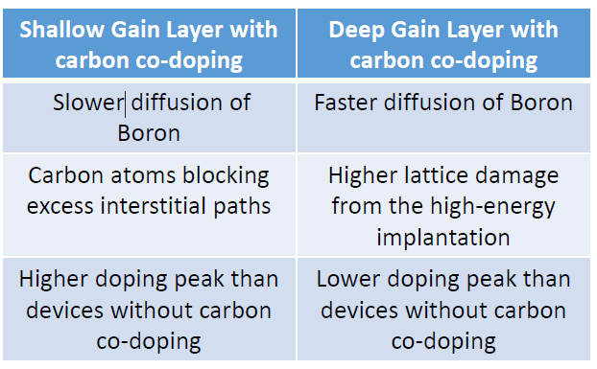
Hardening strategies: carbon co-doping
Boron and Carbon co-doping on the gain layer is a well known strategy to enhance radiation tolerance, however it needs careful revision to ensure compatibility with the new profiles
The effects of high-energy carbon co-doping on IMB-CNM LGAD fabrication and performance
J. Villegas et al Sensors 2025 25(17): 5571
DOI 10.3390/s25175571

Slide 10
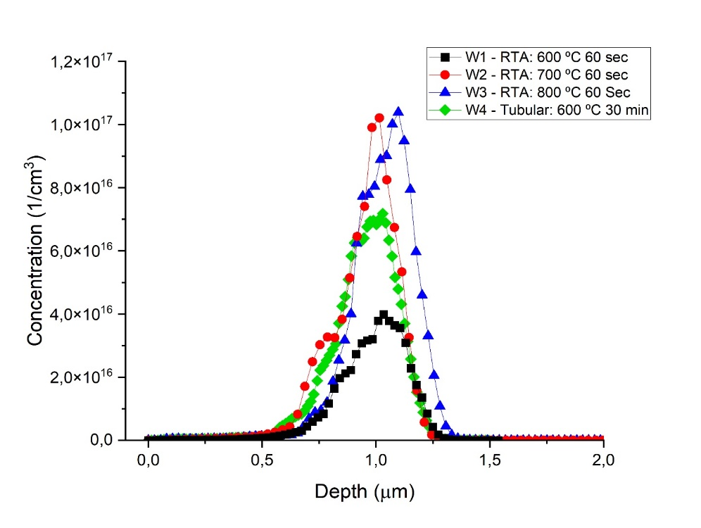
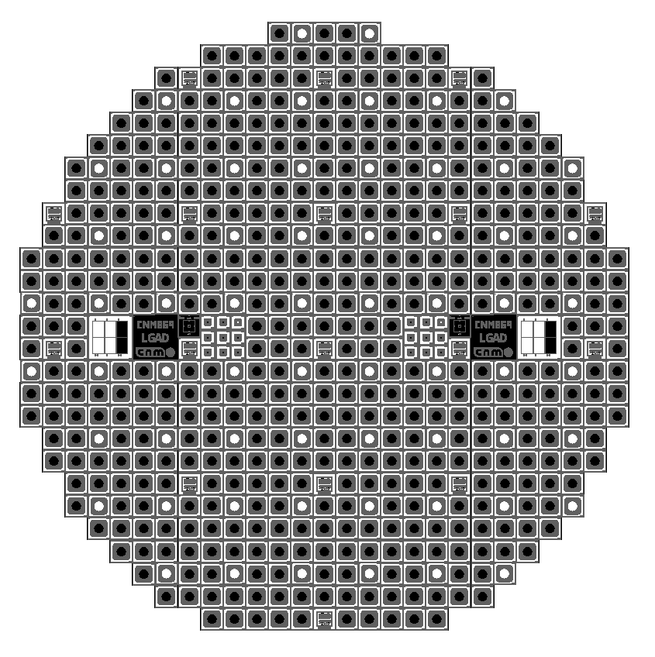
Hardening strategies: partial boron activation
Hypothesis: Doping in excess the gain layer but only achieving a partial activation of impurities
Before irradiation: Same electrical performance and gain than fully activated lower dose
Lower acceptor removal: Non-activated and activated impurities equally trapped by defects
Test run
LGAD run
blank implant on a high-resistivity P-type wafer: looking for a convenient thermal process for partial activation of Boron
Gain layer dose multiplied (triple and double dose)
Low temperature RTA at the end of the process
Spreading resistance results (p-type wafer)
600º C 30min tubular furnace
600 ºC RTA: Peak concentration reduced 1/3

Slide 11
Small pixel: towards 100% fill factor

Slide 12
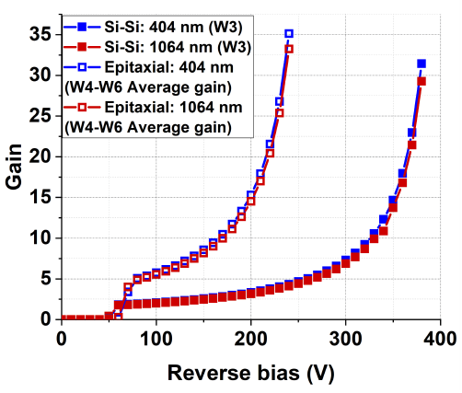
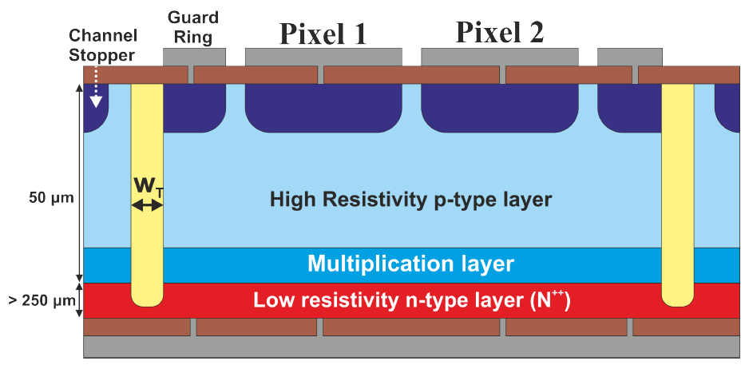
100% fill factor: iLGAD and TiLGAD
Concept: Inverse LGAD (pixels on the P+ electrode) + isolation of active area with trenches
Multiplication region is fully isolated.
Nominally 100% fill factor
Simpler single-side and 50% less fabrication steps than iLGADs with planar termination
Optimization of the multiplication layer is independent of charge collection and cross-talk at the electrodes
Good performance for both high and low penetrating particles
Simulated performance
J. Villegas. PhD Thesis. p 182

Slide 13
TiLGAD first results
First runs showed low breakdown
Gain estimated with a 50 µm PiN measured under the same illumination conditions
Gain > 1 obtained only for V ≥ 38.5 V (V_{FD}?)
(In run 1: Gain > 60 at 20V)
Gain suppression observed when increasing laser power

Slide 14
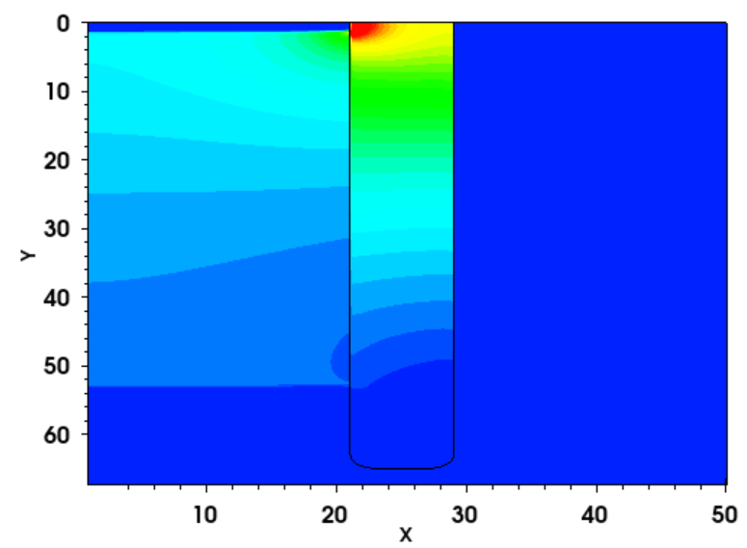
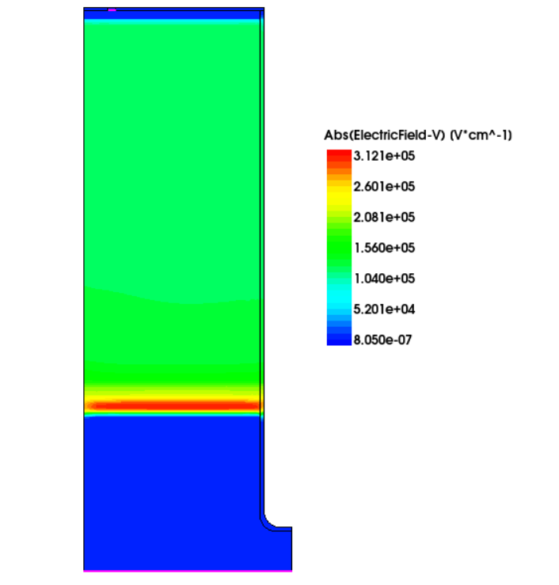
TiLGAD: Next Steps
Low breakdown issue:
8 um-thick trenches seem to be too thin to withstand the voltage drop from the peripheral silicon
Options thicker trenches or having the trench at the dicing edge:
But thicker trenches are hardly compatible with subsequent photolithographic steps
For Run2: DRIE etching, with a new mask→ Mask ready ✓
New run in the queue:
Mask set designed, the trenches will be etched at the end of the run
Exploring different passivation techniques
Further measurements:
Potential interest in TiLGAD + Timepix ASIC even for those with high gain

Slide 15
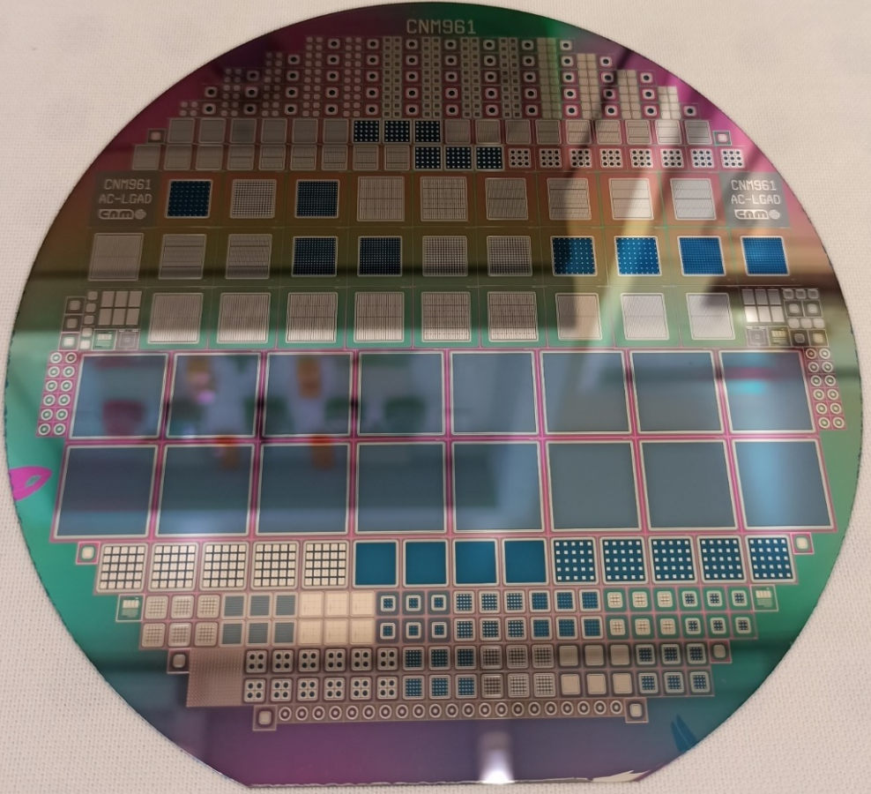
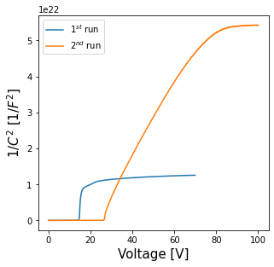
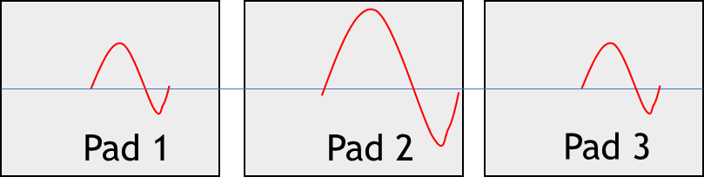




100% fill factor: AC-LGAD Technology
Two AC-LGAD runs completed
1st run (50 um thick sensors) worked but, low gain (<2) ^{[2]}
2nd run finished mid April
5 wafer splits of gain layer.
made with 300um thick wafers, made for backside illumination
Pad 1
Pad 2
Pad 3
Passivation
n+
Passivation
p+
Wafer consists of:
443 Integrated structures
42 Strip detectors
16 Timepix3
1 Timepix3 without gain
5 HGTD, Pad size 0.5 mm
5 HGTD, Pad size 1 mm
61 DC-Pad diodes
6 AC-Pad diodes
12 DC-Arrays
296 AC-Arrays
JTE
JTE
$n^{\text{++}}$ layer is replaced with a resistive continous $n^{\text{+}}$
Gain layer is continous so fill factor is maximized
Metal pads are separated by a thin continous dielectric from the $n^{\text{+}}$
Signal is capacitevely induced on the metal plates connected to redout
p-
p++
Signal exhibits sharing between pads
$$V_{gl}≈\left(14−15\right) V$$
Thin LGAD Timing Detectors for The Atlas Experiment, M. Carulla, PhD Thesis, 2019 2019 Thesis_MarCarulla_ThinLGADtiming.pdf - Files - CERNBox
[2] Manojlovic, M., et al. (2023). Electrical characterization and attenuation factor determination of AC-LGAD run at CNM, 42nd RD50 Workshop on Radiation Hard Semiconductor Devices for Very High Luminosity Colliders (Montenegro, 20–23 June 2023). Link: https://indico.cern.ch/event/1270076/contributions/5450204/
$$V_{gl}≈\left(26−27\right) V$$
${Gain \sim V}_{gl}≈$High gain is expected

Slide 16
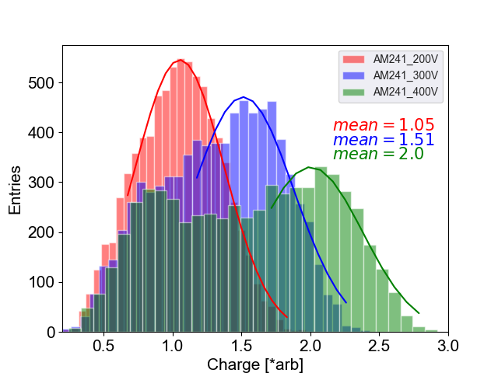
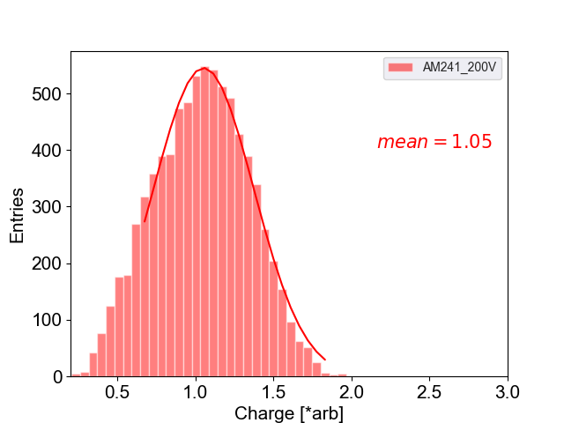
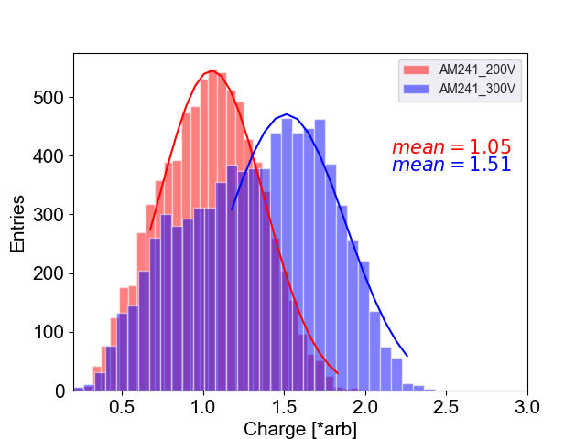
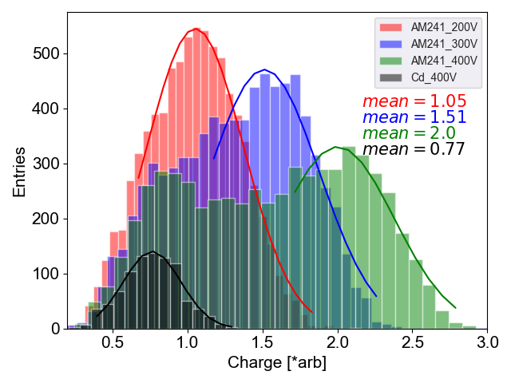
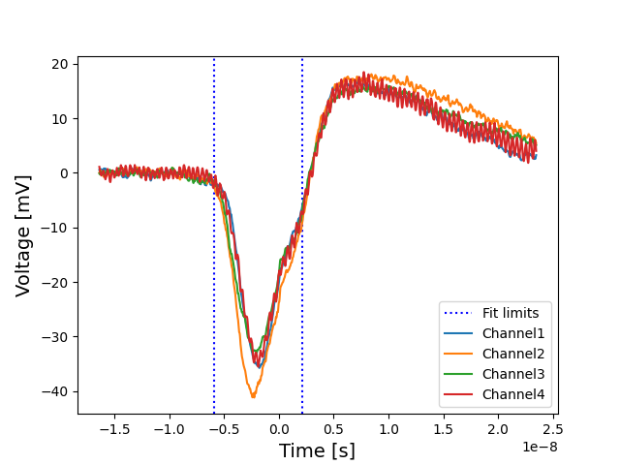
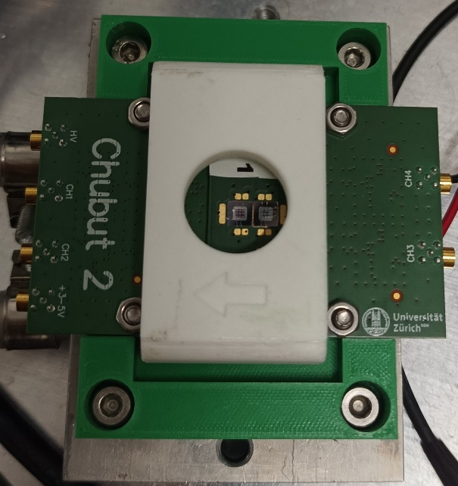
AC-LGAD: Preliminary results with X-rays
X-ray source illuminates backside of detector
Am241 60 KeV source – two peaks (59.5 KeV (36%), 11-2 KeV(39.5%) )
Cd 20 KeV source – 1 peak (22-26 KeV (99.4%))
Trigger on either of the 4 channels, all waveforms recorded.
Waveforms analysed to extract charge seen on each channel for each interaction.
Sum of charges calculated to reconstruct spectrum at a range of voltages
Presence of low peak – expected to be 11-20 KeV peak
Peak shifts - Gain
X-ray Source
Average Waveforms at 400V
Cb peak of 20 KeV, only seen for 400V

Slide 17
Detection of low penetrating radiation: nLGAD and GIS

Slide 18
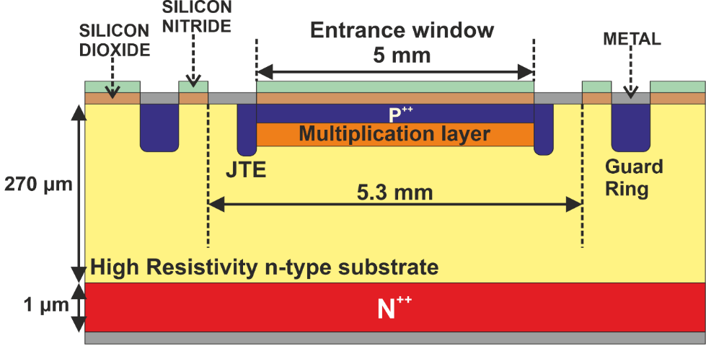
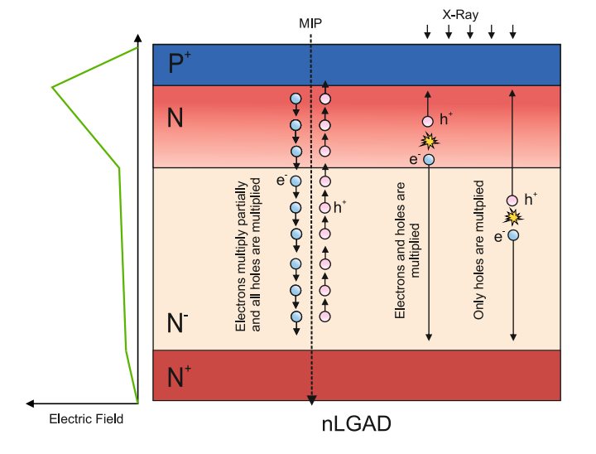
nLGAD: First IMB-CNM PoC runs (2023-2024)
nLGAD: LGAD on n-type substrates, with inverted implantation polarity (P⁺/N/N⁻/N⁺)
Looking for enhancing low penetrating radiation detection (soft x-rays, low energy protons, UV and below…)
Electron-driven multiplication
Pellegrini et al, European patent EP 3 971 997 B1
Villegas et al, TREDI 2024
Villegas et al, https://doi.org/10.1016/j.nima.2025.170208

Slide 19
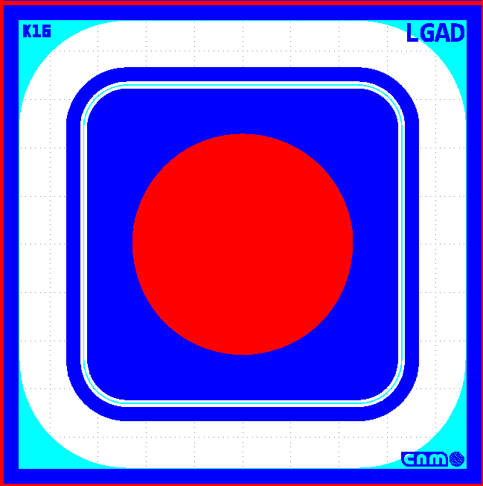
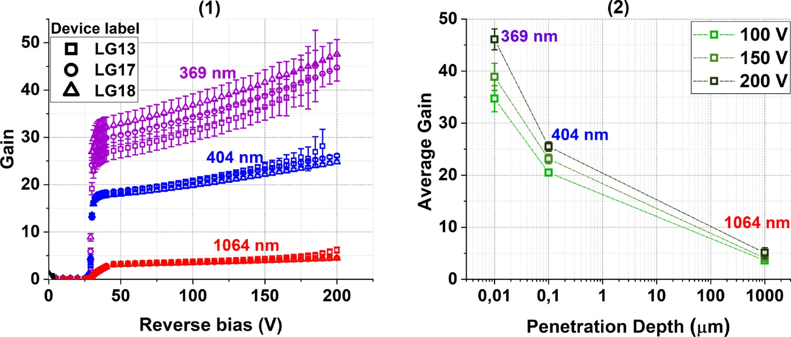
nLGAD: First IMB-CNM PoC runs (2023-2024)
1st nLGAD run results
Concept confirmed
lower penetration depth translates to higher gain
Single pad detectors for now
[1] Villegas, J., Torres, C., Manojlovic, M., Jimenez-Ramos, M. C., Moffat, N., Lopez, J. G., & Hidalgo, S. (2025). NLGAD gain response to low-penetrating particles. Nuclear Instruments and Methods in Physics Research Section A: Accelerators, Spectrometers, Detectors and Associated Equipment, 1072, 170208. https://doi.org/10.1016/j.nima.2025.170208
New stabilization run: On going

Slide 20
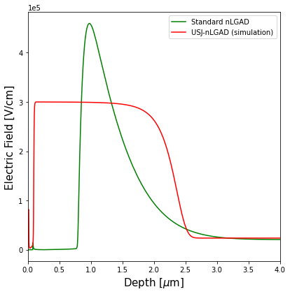
nLGAD: Next steps Ultra-shallow junction
Ultra-shallow junction nLGAD (USJ-nLGAD)
On goning
Explore low diffusivity p-type implant (BF₂)
Explore to ultra low implantation energies (p+ contact)
Explore laser annealing (minimum diffusion)
Moving to deep multiplication implant for more uniform gain response
Pixelated backside from 55 to 440 um pitch (only small arrays)
Explore coatings (AlO3; HfO2)
Objective: Push forward the technology to minimize the entrance window and maximize the detection of low penetrating radiation
Looking for a timepix or medipix compatibility

Slide 21
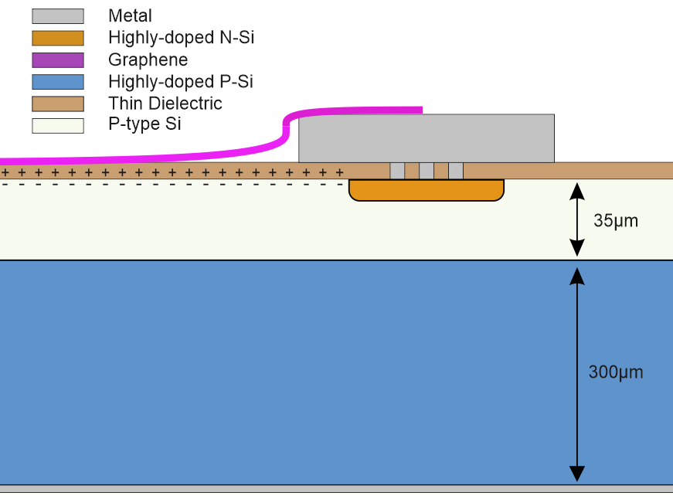
Graphene on Insulator on Silicon (GIS)
Alternative for achieving junctions with mínimum dead layer
Adapted for DUV and soft X-ray detection
Entrance window consists of up to few Graphene layers (~ 3 nm thickness)
Absorption layer (the 35um Si) and bulk Si (the 300um Si)
CVD Graphene isolated by etching and transferred on top of thin dielectric (3nm) in electrical contact with metal.
An inversion layer is present at the interface of Oxide/Silicon
Dead region is defined by the hf02 deposited by atomic layer depostion.
Process of ALD, wet etching, exfoliation and transfer
High k allows for high quality thin dielectric.
Robust and scalable integration.
GIS design - https://pubs.acs.org/doi/10.1021/acsami.1c12050

Slide 22
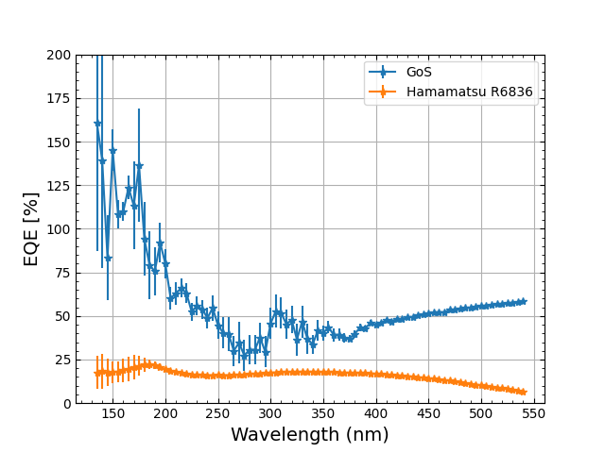
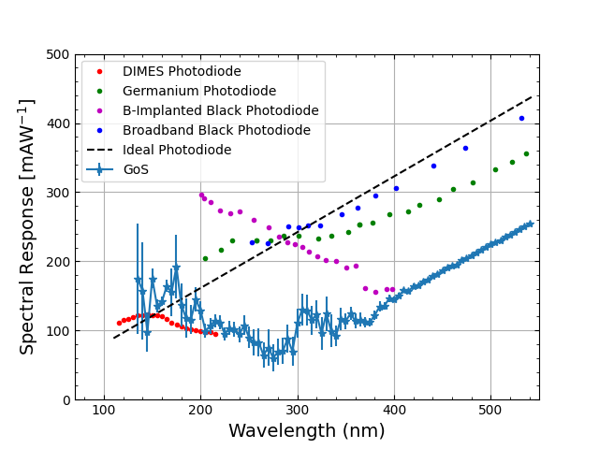
Graphene on Insulator on Silicon (GIS)
Quantum efficiency and spectral response results are excellent in the VUV range > 100% QE @ 130 -180nm
Results come from a collaboration directly related to the CNID workshop- The measurements were performed at IFIC with Justo Martin Albo and Jose Alfonso Soto Oton
https://www.nature.com/articles/s41598-025-33880-0

Slide 23
Conclusions

Slide 24
Conclusions: IMB-CNM LGAD lines
IMB-CNM Radiation Detectors Group is working on the developing of new LGAD technologies to face the upcoming challenges in particle and photon detection
New technologies and techniques:
Redefinition of the doping profiles (deeper gain layer, shallower entrance) to improve fabrication yield and achieve more uniform performance
Hardening techniques, including carbon co-doping (deeper analysis) and partial boron activation
Trench isolated inverse LGAD (TiLGAD) and AC-coupled LGADs (AC-LGAD) for 100% fill factor and smaller pixel size
N-type LGAD (nLGAD) and GIS to enhance low penetrating radiation detection (mainly soft X-rays)

Slide 25



Thank You!
Acknowledgements
This work has been funded by the Spanish Ministry of Science, Innovation and Universities (MICIU/AEI/10.13039/501100011033/)
and by the European Union’s ERDF program “A way of making Europe” Grant references: PID2020-113705RB-C32, PID2021-124660OB-C22, CEX2023-001397-M, PID2023-148418NB-C42, PDC2023-145925-C32.
P. Fernandez-Martinez is funded by the Programa Ramon y Cajal of the Spanish Agencia Estatal de Investigación, under grant RYC2022-037296-I

Slide 26
Back up

Slide 27
New dLGAD run: results
Carbonated Wafer
Wafer w/o Carbon
20 ºC
Clean Room
Floating Guard Ring
I < 200 nA @ -25 ºC for V < 300 V

Slide 28
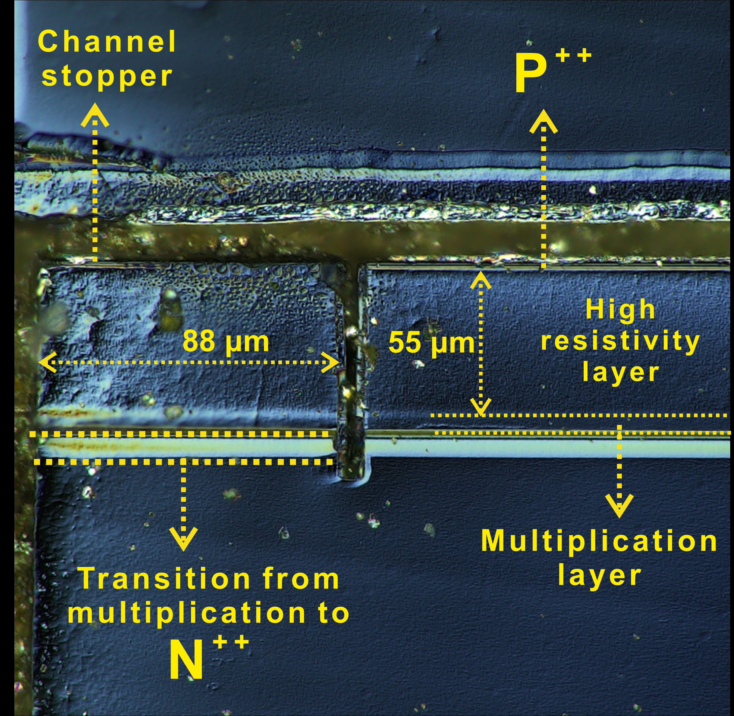
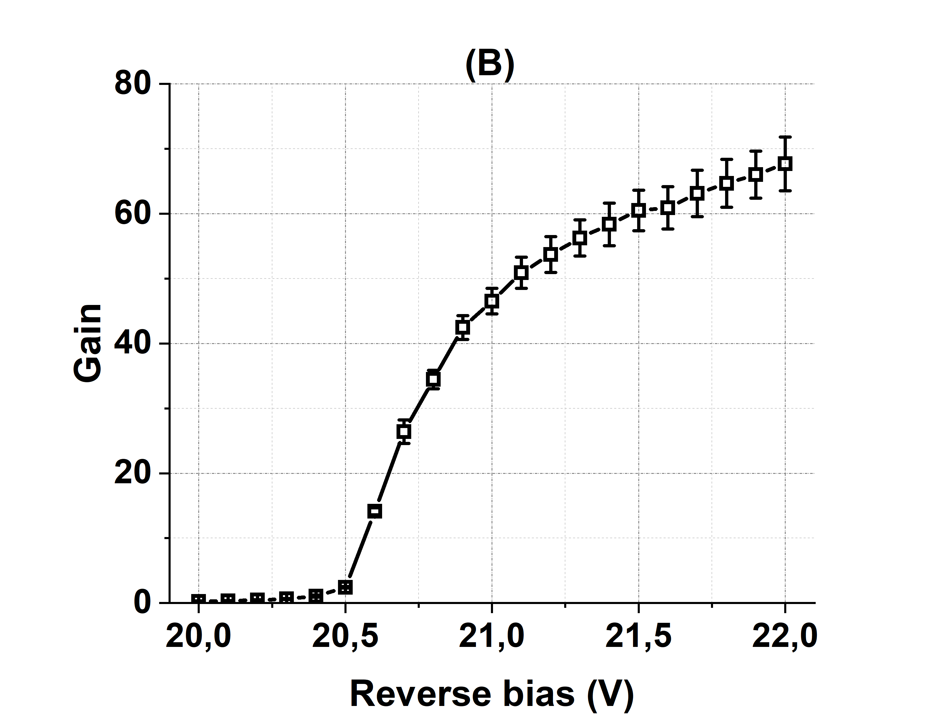
TiLGAd first run
3 Epitaxial wafers
Doping resulted very high → Devices performed like APDs
Annealing tried (1175ºC, 180min) to reduce doping of the mult. region (still APD)
3 Si-Si wafers (each with different boron dose for the mult. region)
2 doses performed like PiN; 1 dose show very high gain in breakdown
Issue during passivation: degradation of the IV’s
Very high gain
Conclusions from 1st Run:
Need to reduce doping concentration
Trench isolation seems to work (ok for PiN-like devices)

Slide 29
TCT Laser measurements: Gain (IR)
Gain estimated with a 50 µm PiN measured under the same illumination conditions
Gain > 1 obtained only for V ≥ 38.5 V (V_{FD}?)
(In run 1: Gain > 60 at 20V)
Gain suppression observed when increasing laser power

Slide 30
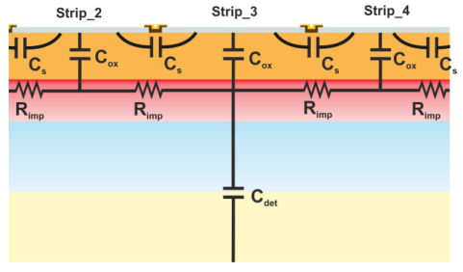
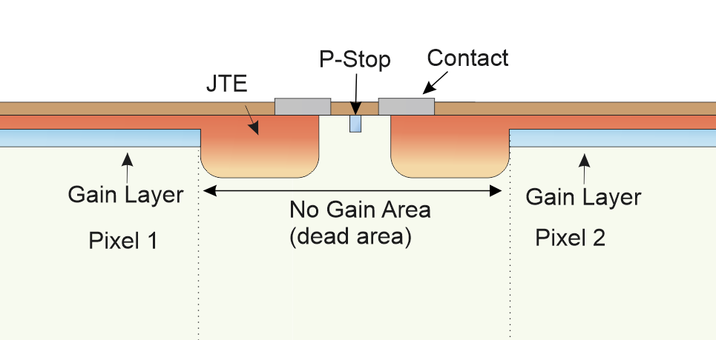
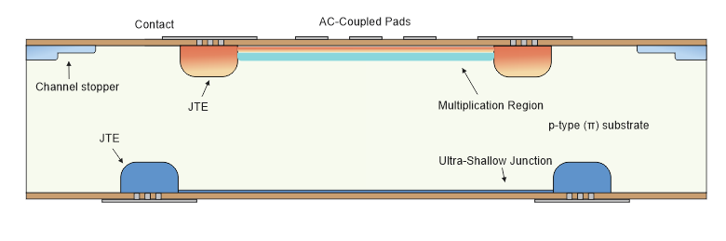
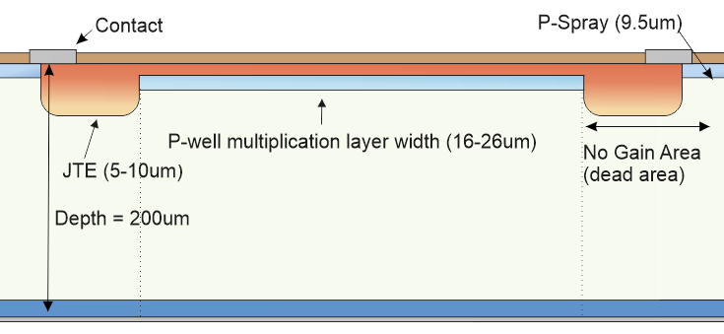
AC-LGADs
AC-LGAD replaces the segmentation of the pad implants into continuous sheets of multiplication layer and n+ layer and only segments the metal connected to the readout
The signal is AC-coupled into the metal pads by another continuous sheet of coupling oxide.

Slide 31
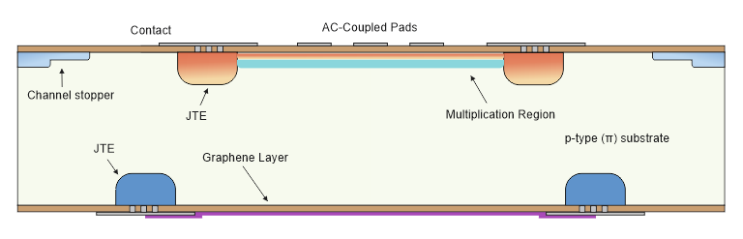
Future of the GiS, Camera for Soft X-rays < 1keV
Energy loss dominated by the oxide thickness.
Readout electronics noise floor ~ equivalent to 2keV X-rays. (Using Timepix 4)
Can be made as thin as 3nm
Observed 200nm photons
Develop Graphene Enhanced Photodetector
“Windowless” junction.
Gain of 10-20 required for sub-threshold detection.

Slide 32
Synchrotron sciences – Sub threshold detection
A typical detector system has a noise floor.
This noise is associated with all components of the system,
For hybrid pixel detectors:
Readout ASIC
Sensor (LGAD in our case)
Voltage supply
In timepix detectors one can remove noise by setting a threshold, so only signals above threshold are detected.
Example - timepix has a noise floor equivalent to a 3 keV X-ray.
Problem – what to do when we want to detect smaller signals.
Sub threshold Detection:
Using the internal gain mechanism of the LGAD one can increase the signal above the threshold.
Key – the noise is dominated by the readout electronics, not the LGAD
For Syncrotron applications we need to detect in the range 200-900eV.
We need a gain of approx 5 – 10.
Hence the LGAD is the perfect candidate
Detectors must be optimised for detection of low energy photons-
i.e. entrance window must be thin.
The AC-LGAD, iLGAD and the nLGAD are both possible candidates for this application.

Slide 33
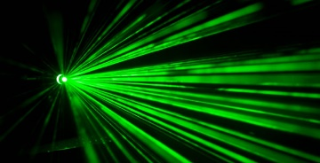


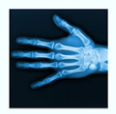

Applications
UV-light detection
in space research
Femtosecond-scale dynamics Attosecond laser experiments?
Gamma radiation detection
Deep-UV detection
In nuclear fusión experiments
Soft X-ray imaging
Collaboration & Ideas ☺

