Slide 1

IMB-CNM-CSIC Clean Rooms and Laboratories: Infrastructure and Impact of PERTE Investments Status of the Micronanofabs strategic plan and ChipXXI
G. Pellegrini

Slide 2
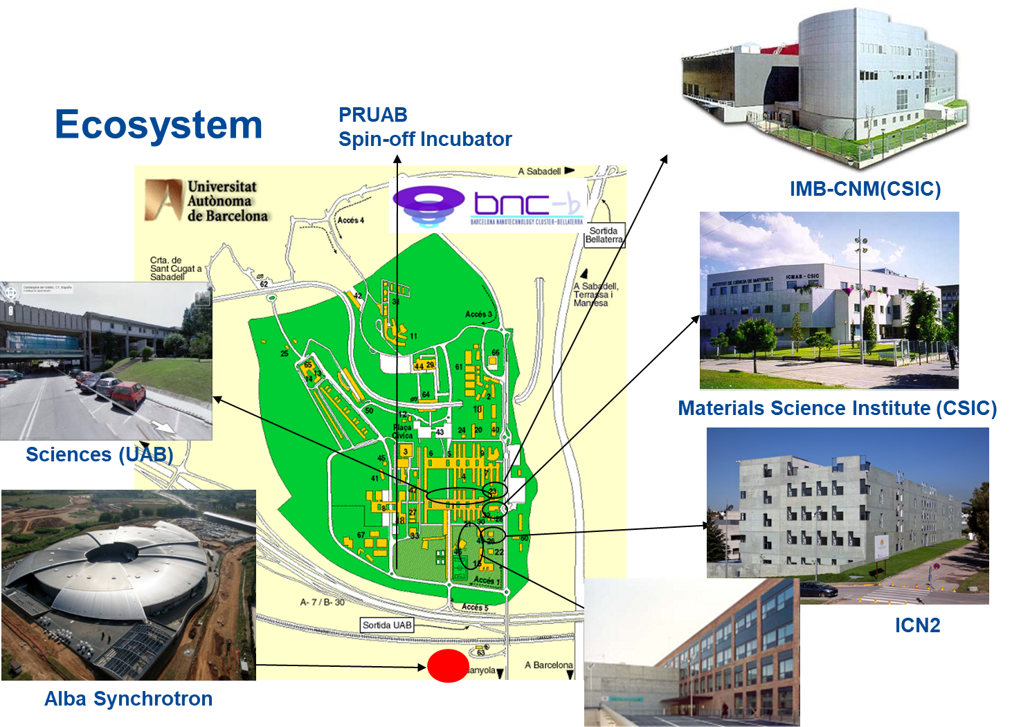
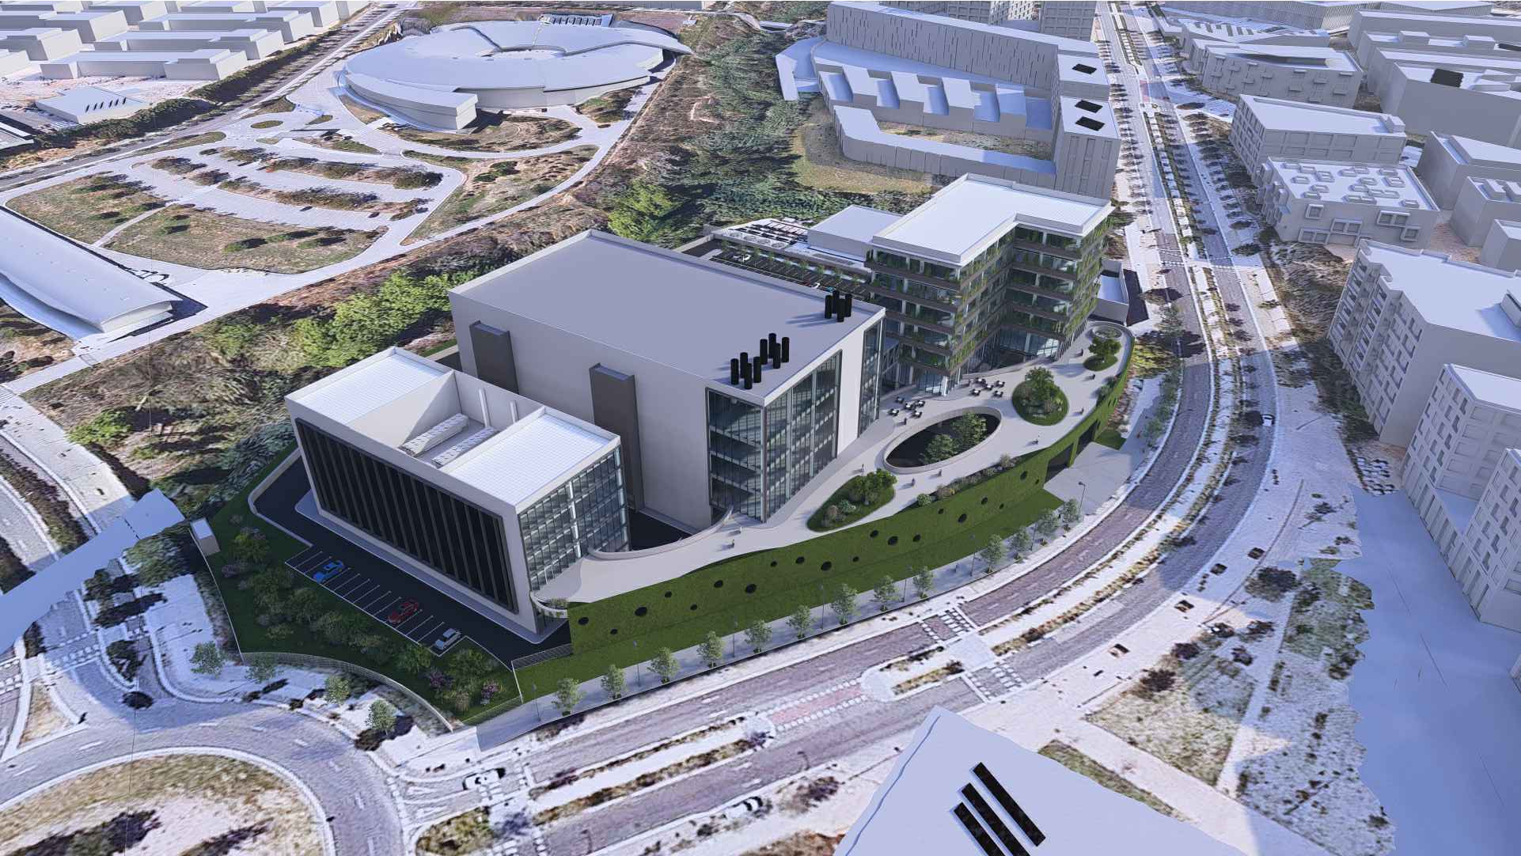
Institute of Microelectronics of Barcelona (IMB-CNM, CSIC)
Public research organism that belongs to the Spanish Council for Scientific Research (CSIC)
Located in Bellaterra, close to Barcelona (Spain) at Autonomous University of Barcelona (UAB) Campus
Devoted to nano- and micro-technologies and electronics
Micro-nano fabrication facility (clean room)
Our mission is to improve the knowledge in micro- and nano-systems and to contribute to solve societal challenges through the implementation of solutions based in these technologies in new products.
?
InnoFAB Foundation- lab-to-fab
https://www.imb-cnm.csic.es/en/highlights/imb-cnm-figures

Slide 3
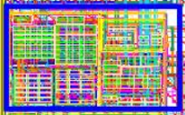
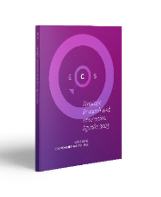
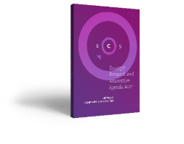

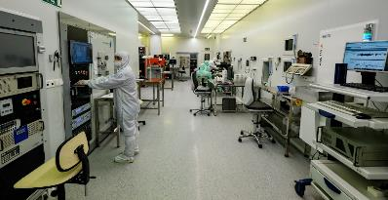
Institute of Microelectronics of Barcelona (IMB-CNM, CSIC)
Leveraging role in the semiconductor ecosystem
Trajectory of 40 years (2025) years with activity in the three fields of microelectronics (More Moore, More than Moore, Beyond CMOS),
Proven experience in design (analog & digital) and fabrication
Transversal and enabling activity (public-private) in Spain
International Representativity (AENEAS, EPoSS, Photonics21)
Versatile, flexible 1500 m² Clean Room unique in Spain (only one where transistor-based circuits could be built)
Notes:
Leveraging role in the semiconductor ecosystem
Trajectory of more than 30 years with activity in the three fields of microelectronics (More Moore, More than Moore, Beyond CMOS), recognized in 2024 with the excellence distinction Maria de Maeztu of the R+D+I Spanish system
Proven experience both in design (analog and digital) and fabrication
Versatile, flexible Clean Room unique in Spain (only one where transistor-based circuits could be built)
Transversal and enabling activity (public-private) in Spain with strategic cooperations with key actors (BSC, Fagor Semiconductores)
International Representativity (Editorial team of the Electronic Components and Systems SRIA – JU KDT, membership in committees of EU technological platforms of this sector: AENEAS, EPoSS, Photonics21)

Slide 4
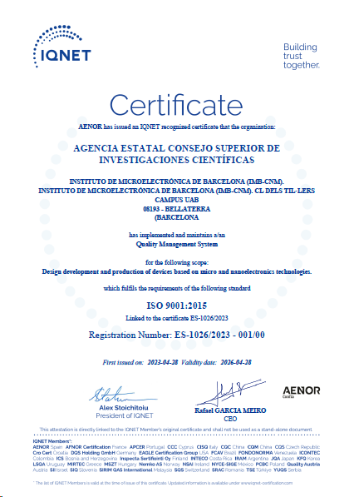
ISO 9001
Organization: IMB-CNM, D+T & SBCNM
Scope: Design development and production of devices based on micro and nanoelectronics technologies
Validity: 28/04/2023 – 28/04/2026

Slide 5





Research at IMB-CNM, CSIC Organization
Micro-Nano (physical-digital) systems for…
Technologies and Advanced Processes
3
Thematic axes
1
Technology Unit
Health and Environment
Energy and Mobility
Physics Frontiers and Civil Security

Slide 6




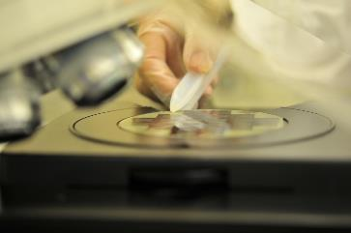




Research at IMB-CNM, CSIC Organization
https://www.imb-cnm.csic.es/en/research
Micro Nano Tools
Chemical Transducers
NanoNEMS
Microenergy Sources and Gas Sensors
8 Research Groups + Clean Room Facility
Radiation Detectors
Integrated Circuits and Systems
Biomedical Applications
Power Devices and Systems

Slide 7



IMB-CNM cleanroom as ICTS: MICRONANOFABS
The clean room facilities at IMB-CNM is a Unique Science and Technology Infrastructure (ICTS) recognized by the Spanish Ministry of Science and Innovation since 1996
ICTS network formed by the clean rooms and labs of three nodes:
 | CNM | ISOM | NTC
Cleanroom construction | 1991 | 2000 | 2009
Cleanroom area (m²) | 1,500 | 400 | 500
Packaging lab area(m²) | 75 | 200 | 200
Characterization lab (m²) | 60 | 300 | 200
Wafer diameter (mm) | 100 & 150 | 50 | 150 & 200
Total ICTS staff | 45 | 19 | 21
Process staff | 23 | 3 | 6
Maintenance staff | 10 | 2 | 5
IMB-CNM
Institute of Microelectronics of Barcelona (CNM, CSIC)
Barcelona
ISOM
Institute of Optoelectronic Systems and Micro-technology (UPM)
Madrid
NTC
Nano-photonics Technology Center (UPV)
Valencia
https://micronanofabs.org/

Slide 8
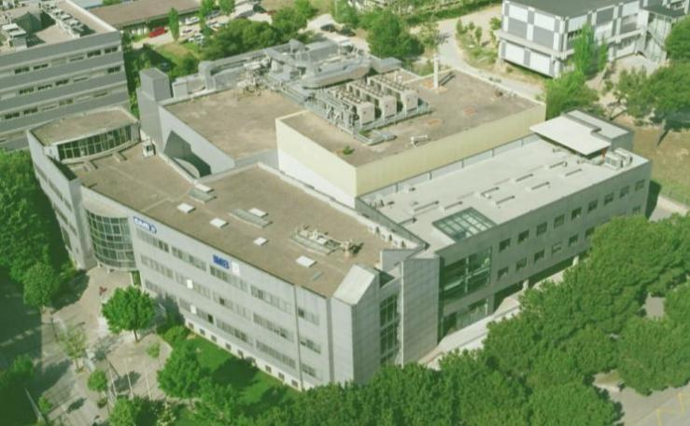
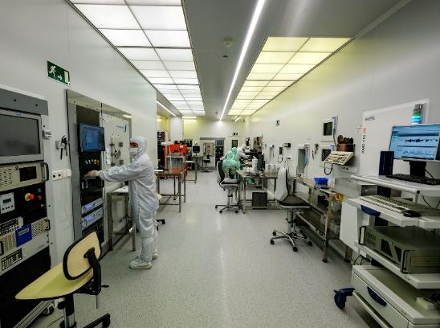
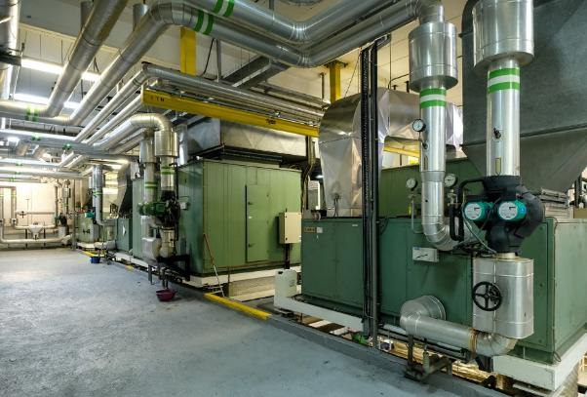
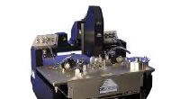
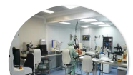
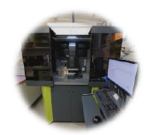
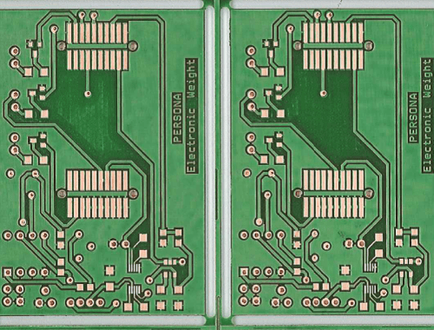
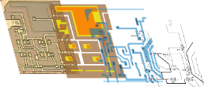
IMB-CNM cleanroom as ICTS: MICRONANOFABS
Integrated cleanroom:
1500m²
Services:
3x600m²
Clean room
Services
Associated laboratories
Reverse engineering
Electrical characterization
Packaging
Printed electronics
Electronics systems

Slide 9
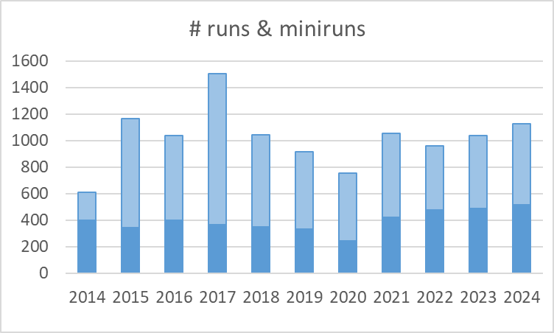
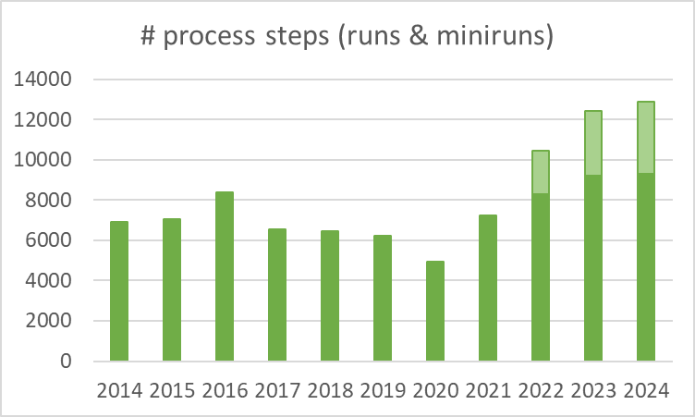
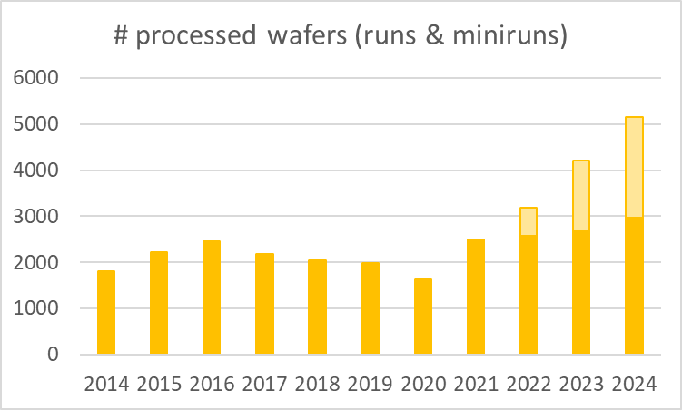

IMB-CNM cleanroom in numbers
>150
Process tool
______
14
Process areas
______
44
Staff
_____
1130
Runs & Mini-runs
_____
315
For third parties (28%)
_____
13117
Single steps
______
5289
Processed wafers
_______
2342
External access
______
4582
Hours
______
101
Individual users
______
KEY FIGURES
IN 2024
Runs & miniruns managed the same way
Runs & miniruns managed the same way
Runs in full colours – Miniruns in light colours

Slide 10
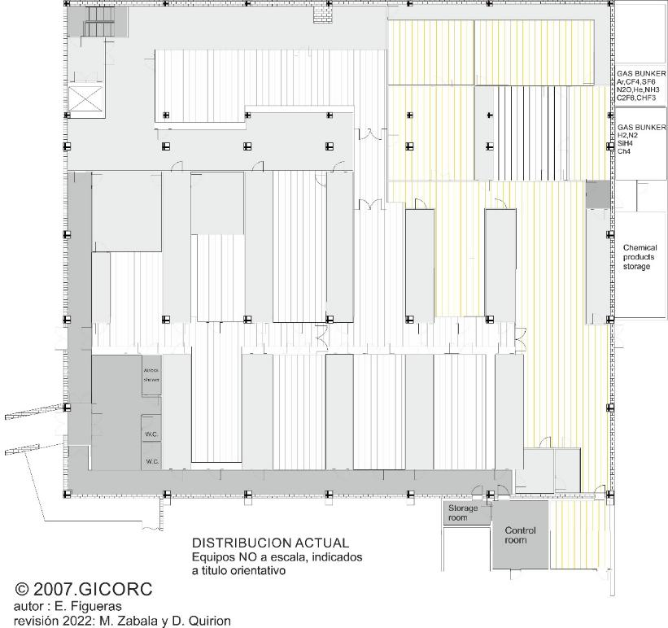
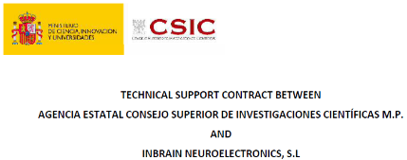
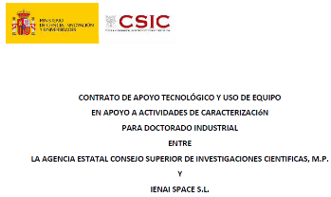
Recent changes in the ICTS: Companies presence in cleanroom
Space rented to Inbrain
Working space to install dedicated tools for manufacturing Block 2
Karl Süss MA6 mask aligner & cabinet
AFK
Nano
Block 2 manufacturing
Cabinet
Mask aligner
Photo MNC
06/2024
RIE/
Sputtering
Space allocated to IENAI
Until end of 06/2025
IMB-CNM
building
Cleanroom access corridor
09/2024

Slide 11
Recent changes in the ICTS: New cleanroom prices (ii)
A single equation to calculate the cost of runes and self-service steps:
Cost = Staff + Utilisation of Tools + Use of Infrastructure
Consumables & Depreciation
Cleanroom equipment hours
Notes:
Introduction of an equipment type factor depending on equipment “size”
Full operational cost of the cleanroom taken into account
Prices by type of users
IMB-CNM prices
Marginal costs (“Plan Nacional” projects…)
Eligible costs (European projects)…
CSIC prices: marginal costs + 17,3% (indirect costs)
AGE/OPI, Universities prices: total cost + “public” commercial margin
Prices for other users: total cost + “private” commercial margin
Choice of commercial margin consistent with previous COU 3 and 4

Slide 12





Investment plan in a nutshell
ChipXXI
IMB-CNM, CSIC
19,5M€
MICRONANOFABS
Strategic plan 2021-24
6,4M€
QTEP
F. Perez-Murano
3,9M€
PIXEurope
C. Domínguez
~20M€
Advanced Packaging & Heterogeneous Integration
E. Ramon & M. Ullán
1,3M€ for project
1,0M€ for tools
General
Tools (~11M€)
Services (~7,5M€)
Staff (~1M€)
General
Tools (5,1M€)
Services (0,8M€)
Staff (0,5M€)
Quantum
EBL-HV
Nano area adaptation
Photonics
DUV, track, CMP…
Planned date of the works in Nano area: 08-12/2025
Deadline: 30/06/2026
PERTE: Proyectos Estratégicos para la Recuperación y Transformación Económica

Slide 13
Upcoming changes in the ICTS: Process equipment
Summary of process equipment to come…
MICRONANOFABS Strategic Plan
ChipXXI
Description | Area
Sputter joker | Metallization
Sputtering tool for Al metallization | Metallization
CMOS contamination control | Inspection
BPTEOS PECVD tool | Thermal processes
Laser annealing system | Thermal processes
RTA tool for SiC annealing | Thermal processes
Multipurpose bonder | Packaging
Electrospinning tool | Research group
Ion-milling system | Dry etching
Description | Area
Scanning electron microscope | Nano
Confocal microscope | Microsystems
E-beam lithography | Nano
Stepper tool | Photolithography
Wet benches | Microsystems
Critical point dryer | Microsystems
Laser micromachining system | Reverse engineering
Wafer dicing machine | Packaging

Slide 14
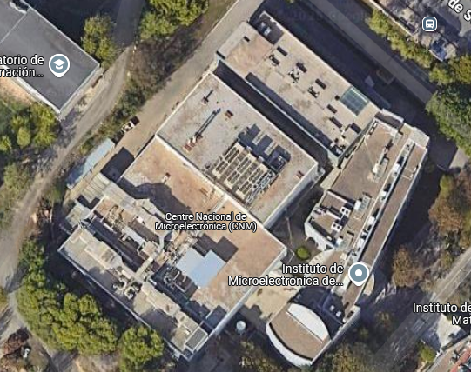
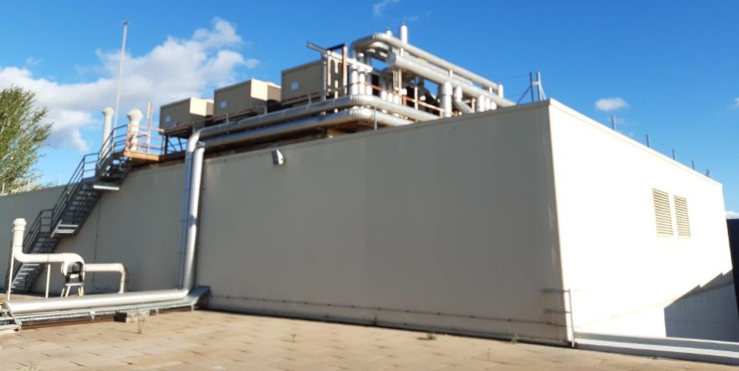
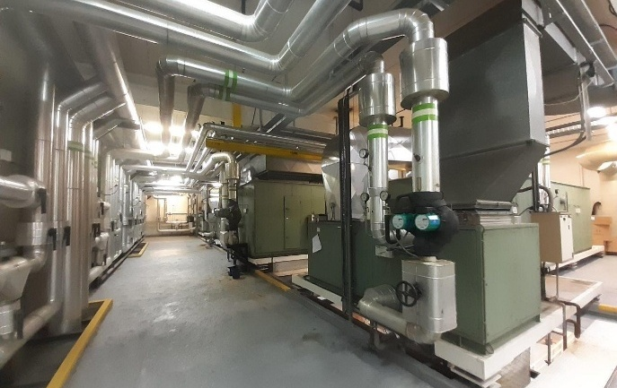
Upcoming changes in the ICTS: Infrastructure: upgrade of chillers & air conditioning
Upgrade of the 3 chillers and the air conditioning system of the clean room
Clean room closed 4 months
Scheduled for February 2026… Exact date will be communicated when known.

Slide 15
Upcoming changes in the ICTS: PERTE: a quick look forward
1 week without ultra-pure water
Note: Compressed air will be maintained in the main building, but not technical nitrogen.
Infrastructure
Best guess (Wrong!)
Cleanroom shutdown for chiller replacement
(4 months)
Works in Nanolithography area
July | Aug. | Sept. | Oct. | Nov. | Dec. | Jan. | Feb. | March | Abril | May | June | July
2025
2026
# equipment
New Best guess (no official))
3
1
1
1
1
1
1
1
Process equipment
Electrospinning
SEM
EBL 100keV
Zenit furnace
Confocal
Ion milling
Stepper
Sputter joker
CPD
Control contamination
+ 8 more equipment…

Slide 16
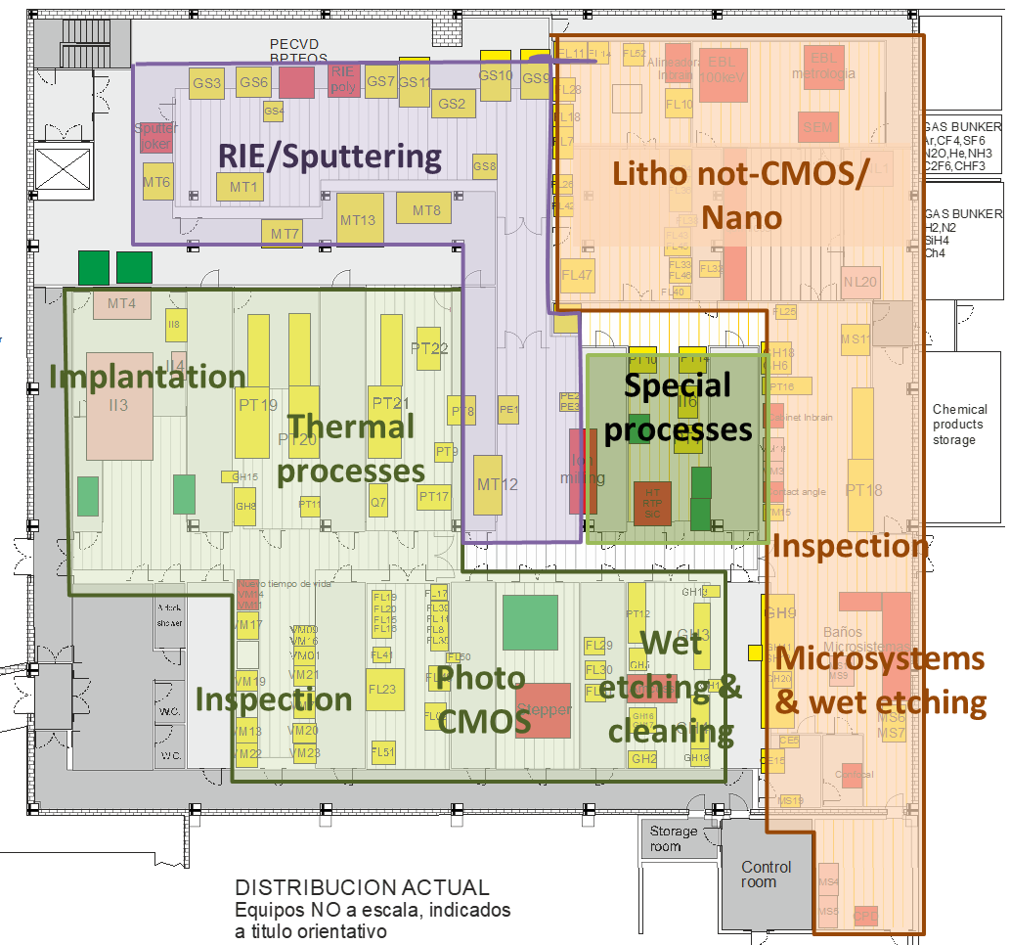
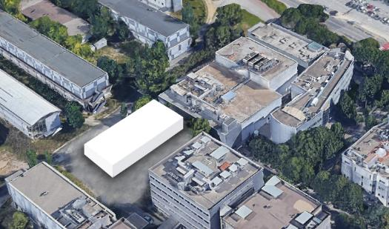
Upcoming changes in the ICTS: Cleanroom extension

Slide 17
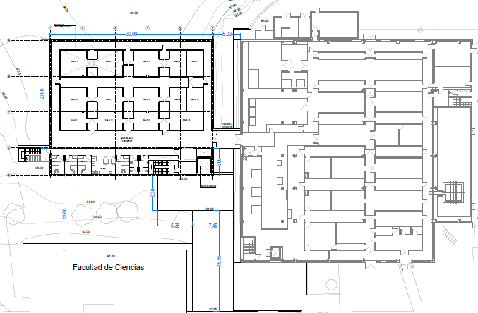
Upcoming changes in the ICTS: Cleanroom extension
Packaging
+ Pilot Line
APECS
Companies + Education
Pilot Line Photonics
Goals:
Packaging
Pilot lines
Companies
Training
Timeline:
DUV expected for summer 2027
Cleanroom extension?
MNC / Self-service
DUV
Nano
Microsystems
& wet etching
Special process
Wet etching & cleaning
Photo MNC
RIE/
Sputtering
Photo
CMOS
Thermal processes
Maintenance offices & workshop
Inspection
Implantation
IMB-CNM
building
Cleanroom access corridor

Slide 18
Conclusion
An intense moment in cleanroom history until June 2026
Cleanroom shutdown (some months) still not scheduled
And more to come…
A workshop on technologies (Technology Unit)
Creation of a user’s office and redefinition of self-service rules
Reflection on manufacturing in the cleanroom
ICTS and IA?
From quality to continuous improvement…

Slide 19
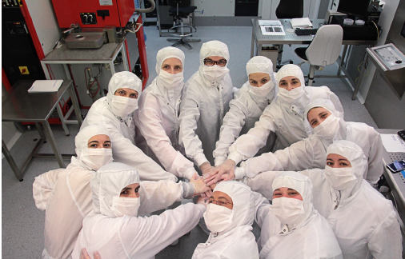

Slide 20
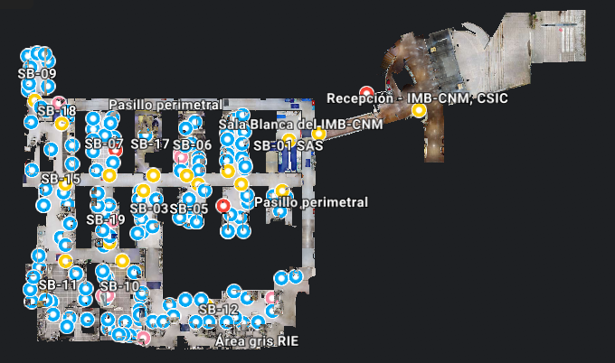
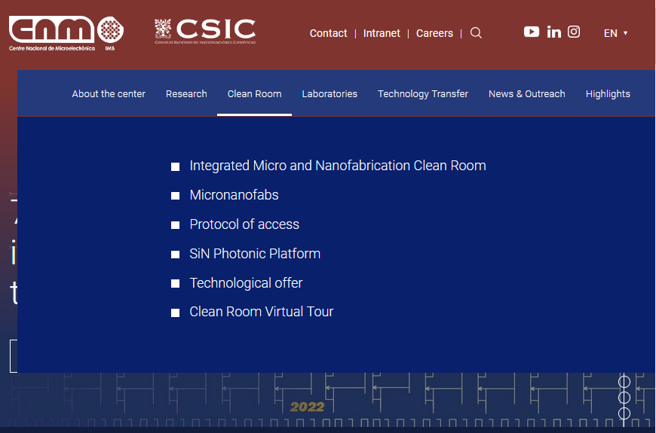
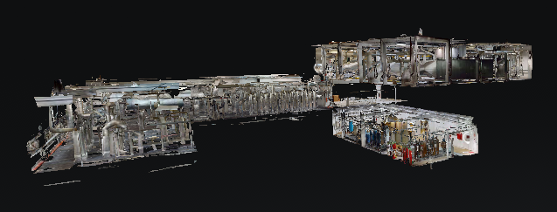
Virtual tour
Clean room
Virtual tour of the clean room
Visit us!
Service areas
https://www.imb-cnm.csic.es/en/micro-and-nanofabrication-clean-room/clean-room-virtual-tour

