Slide 1
Dynamical core-corona initialisation in p+p and O+O collisions
SOPHIA
HADRON
PHYSICS
GROUP
Tetsufumi Hirano (Sophia Univ.)
In collaboration with
N. Ito, K. Kuroki, and A. Shigeyoshi

Slide 2
Plan of this talk
Introduction
Framework of Dynamical Core-Corona Initialisation (ver.2)
Recent Results from DCCI2
  Results in O+O collisions
  Bayesian analysis of p+p data
Summary and outlook

Slide 3
1. Introduction

Slide 4
Basic questions and purpose
p+p physics
A+A physics
High multiplicity
small colliding system
as interdisciplinary
research area
Is collectivity emergent in small colliding systems?
How small can QGP fluids be?
Development of a fully integrated dynamical model toward understanding QGP properties
in high-energy nuclear collisions

Slide 5
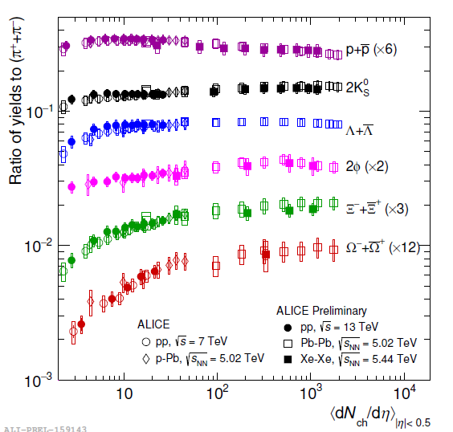
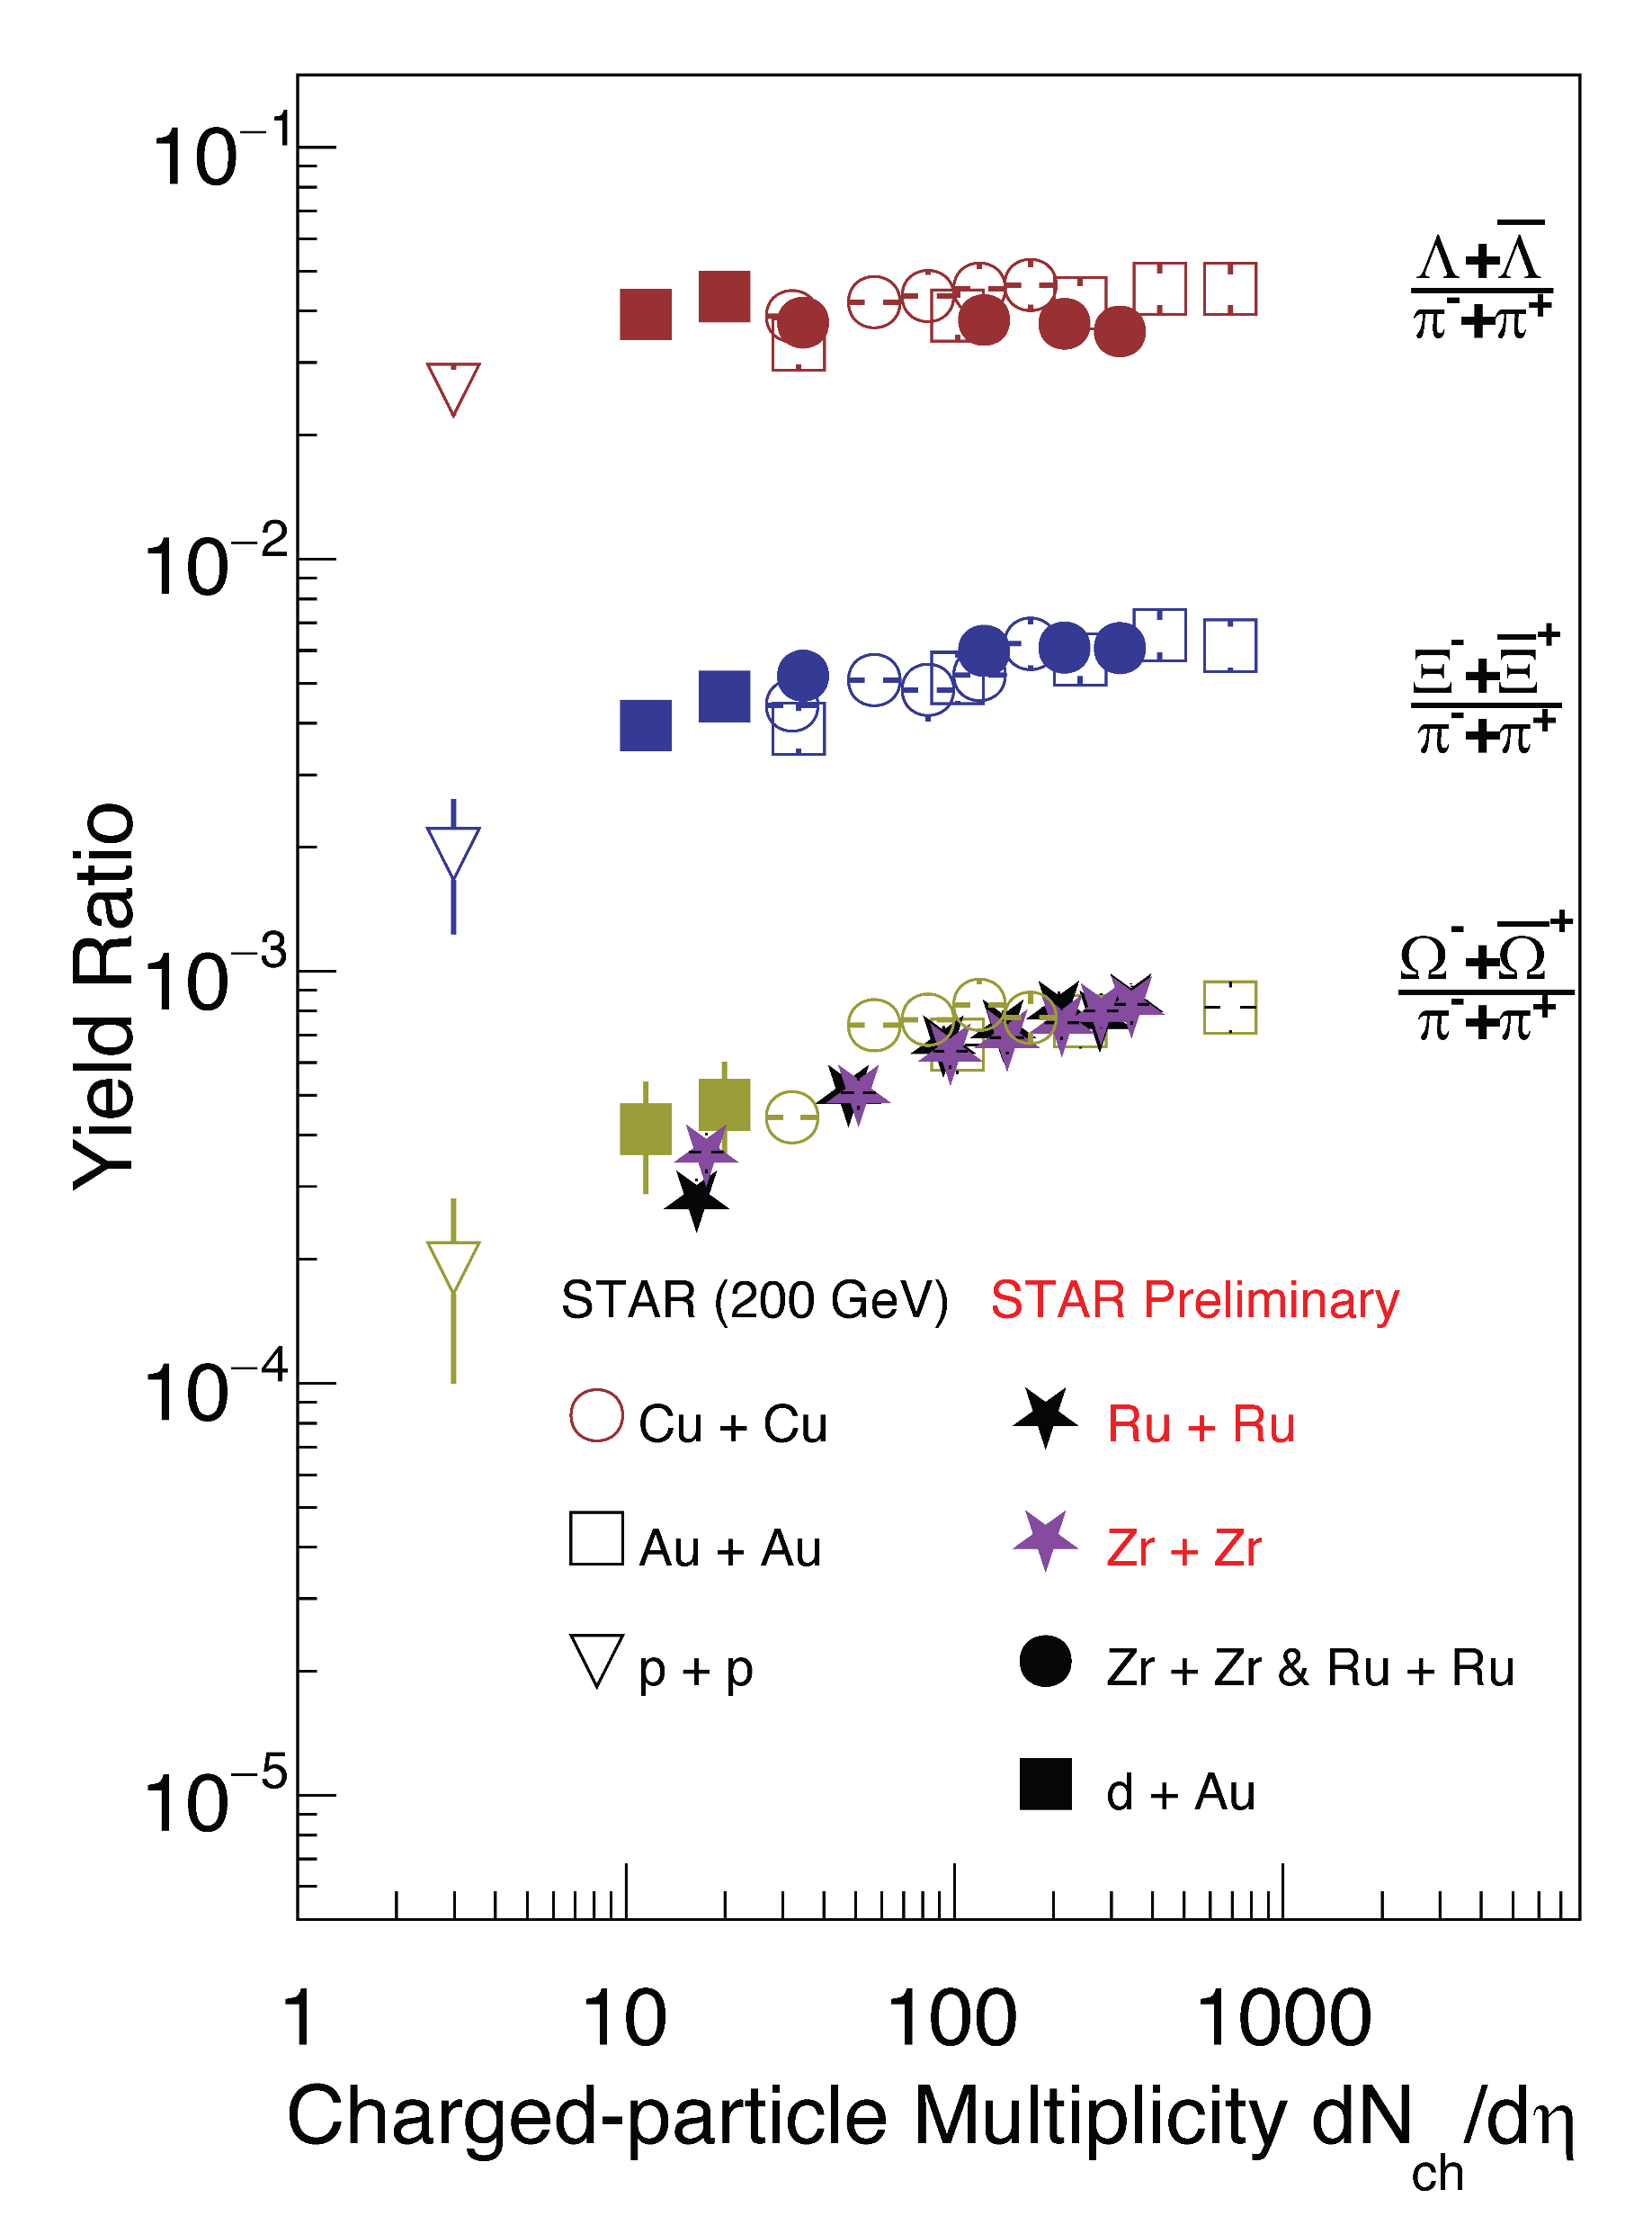
Strangeness enhancement
Multiplicity dependence of particle yield ratio
Interpretation of universal behaviour in a single framework?
Understanding
bulk particle production
before discussion on
collectivity
ALICE overview, talk at QM2018
W.Yuan (STAR), talk at QM2025

Slide 6
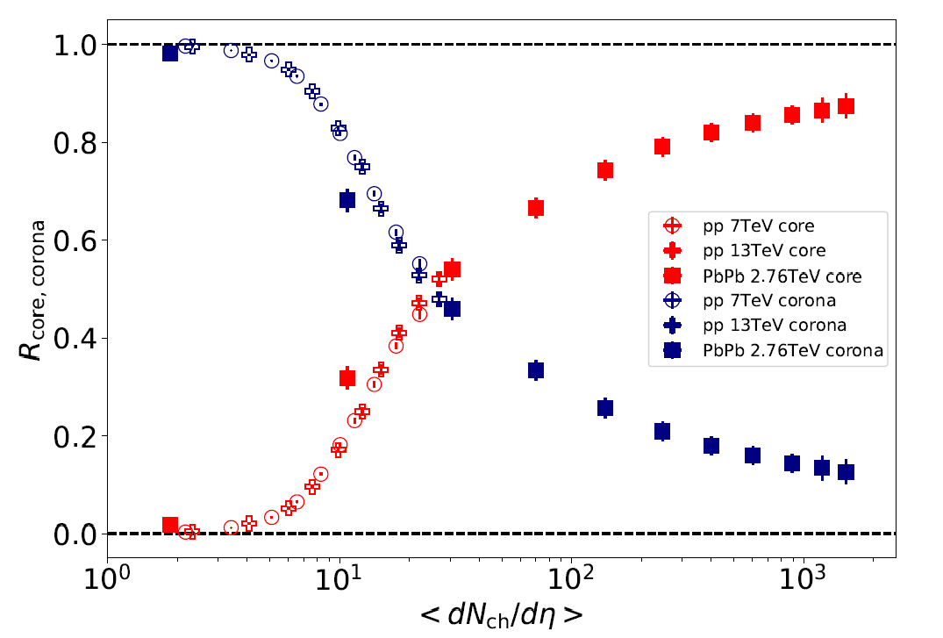
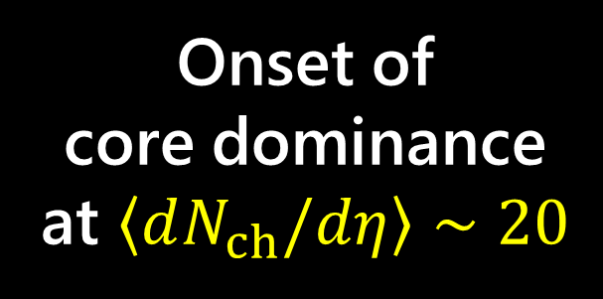
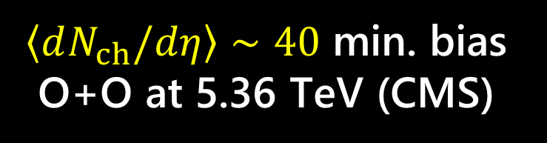
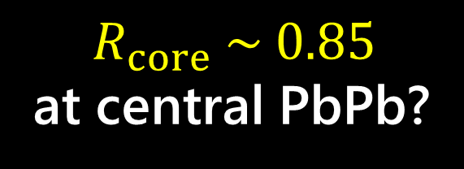
Fraction of core and corona
O+O
Onset of
core dominance at $\left\langle dN_{ch}/dη\right\rangle ∼20$
Core
$$R_{core} \sim 0.85$$
at central PbPb?
Kanakubo et al. (2022).
Corona
$\left\langle dN_{ch}/dη\right\rangle ∼40$ min. bias O+O at 5.36 TeV (CMS)
*O+O at sqrt_snn = 5.36 TeV from ALICE preliminary (Talk by Jan Fiete Grosse-Oetringhausat IS2025)

Slide 7
2. Framework of Dynamical Core-Corona Initialisation (ver.2)

Slide 8

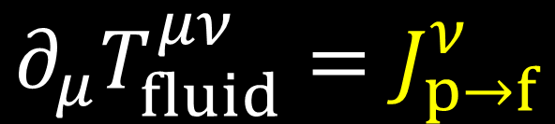





Dynamical initialisation
Conservation of the whole system
Okai et al. (2018); see also Shen, Schenke (2018).
$$∂_{μ}T_{fluid}^{μν}=J_{p→f}^{ν}$$
$$∂_{μ}\left(T_{fluid}^{μν}+T_{parton}^{μν}\right)=0$$
$$∂_{μ}T_{parton}^{μν}=−J_{p→f}^{ν}$$
→ Hydrodynamic equations with source terms
Step 1 Generate
initial partons
Step 2
Model source term
Step 3
Solve hydro eqs. with vacuum initial condition
$$∂_{μ}T_{fluid}^{μν}=J_{p→f}^{ν}$$
$$T_{parton}^{μν}\left(0^{+}\right)$$
$J_{p→f}^{ν}=−∂_{μ}T_{parton}^{μν}(t)$
with
$$T_{fluid}^{μν}\left(t_{0}\right)=0$$

Slide 9
Core-corona picture
Core:
Equilibrated matter
~QGP fluids
Figures: Courtesy of Y.Kanakubo
Corona:
Non-equilibrium partons
Low
Multiplicity
(The number of particles)
High
Bozek (2005, 2009), Aichelin, Werner (2009, + many), Becattini, Manninen (2009),
Pierog et al. (2015), Akamatsu et al. (2018), Kanakubo et al. (2018, 2020, 2022a, 2022b)

Slide 10





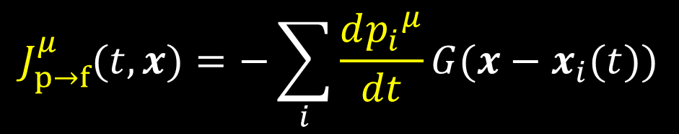

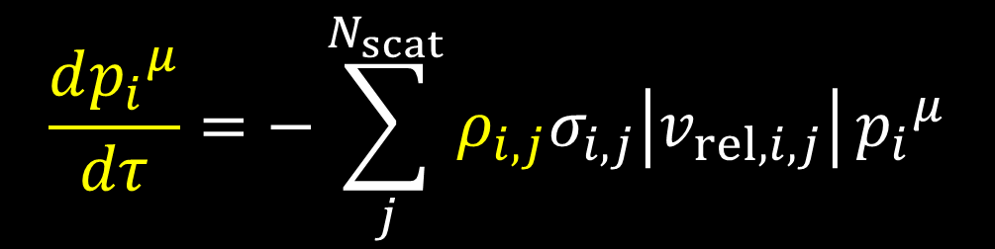






Modeling of energy-momentum deposition
Source term from kinetic approach
Kanakubo et al. (2020).
$$J_{p→f}^{μ}(t,x)=−\sum_{i}{\frac{d{p_{i}}^{μ}}{dt}}G(x−x_{i}(t))$$
$$G$$
: Gaussian smearing of $δ^{(3)}(x−x_{i}\left(t\right))$
$$p_{i}$$
: Four momentum of $i$th parton
$$x_{i}$$
: Position of $i$th parton
Phenomenological fluidization rate per particle
Kanakubo et al. (2022).
$$\frac{d{p_{i}}^{μ}}{dτ}=−\sum_{j}^{N_{scat}}{ρ_{i,j}σ_{i,j}\left|v_{rel,i,j}\right|}{p_{i}}^{μ}$$
$$ρ_{i,j}$$
: Profile of $j$th parton
$$σ_{i,j}$$
: Cross section btwn. $i$th and $j$th
$$v_{rel,i,j}$$
: Rel. velocity btwn. $i$th and $j$th

Slide 11
Dynamical Core-Corona Initialisation
DCCI
Dense/soft
Core:
Equilibrated matter
~ QGP fluids
Initial distribution
in phase space:
Partons or strings
Corona:
Non-eq. matter
~ Partons
Dilute/hard
Separation of initial system just after collision dynamically

Slide 12









Fully integrated DCCI framework
Kanakubo et al., (2020, 2022a, 2022b)
$$t$$
Hadronic afterburner
JAM
Nara et al., (2000)
Hadronisation
PYTHIA8 (string fragmentation)
iS3D (thermal hadron sampling)
M. McNelis et al., (2021)
DCCI + QGP dynamics
(3+1)-D hydro with source terms
EoS: s95p-v1.1
$$z$$
Tachibana and TH, (2014)
Huovinen and Petreczky (2010)
Initial parton production
PYTHIA8/PYTHIA8 Angantyr
Sjöstrand et al., (2015);
C. Bierlich et al., (2016)
Figure: Courtesy of Y.Kanakubo

Slide 13
3. Results in O+O Collisions
N. Ito and T. Hirano, arXiv:2604.05307

Slide 14
Degree of equilibration in intermediate system size?
O+O
Anisotropic flow
?
Spatial
anisotropy
Momentum
anisotropy
Nontrivial if the system does not reach complete local equilibrium

Slide 15
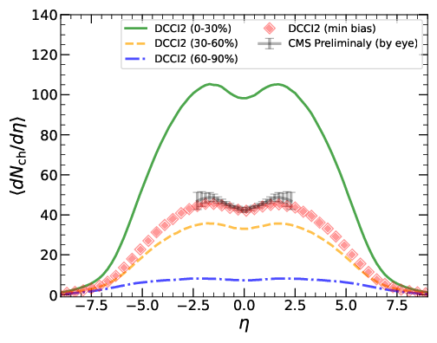
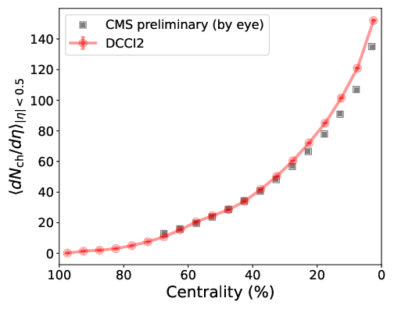
Rapidity and centrality dependence of charged hadrons
Default DCCI2 model → Reasonable reproduction of trends in rapidity and centrality dependence of charged hadron yields

Slide 16
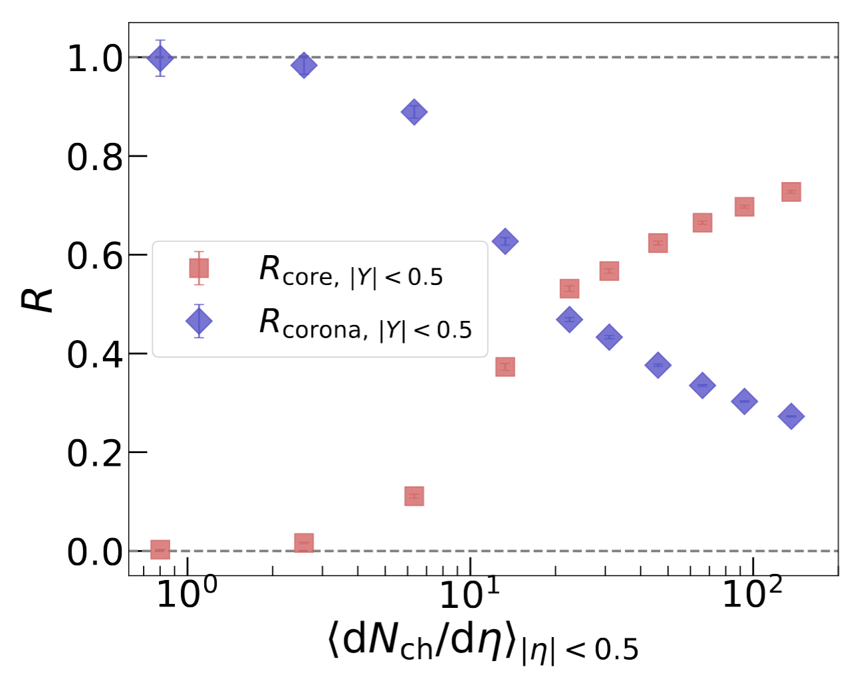
Core-corona fraction in O+O collisions
Monotonic increase (decrease) of core (corona) components as total multiplicity
Transition point
→ dN_{ch}/deta ~ 20
~30% of corona components remains in central collisions
(Never depleting corona)

Slide 17
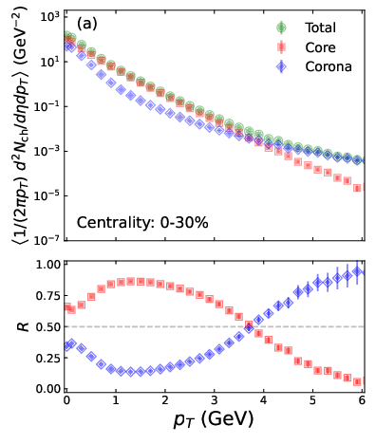
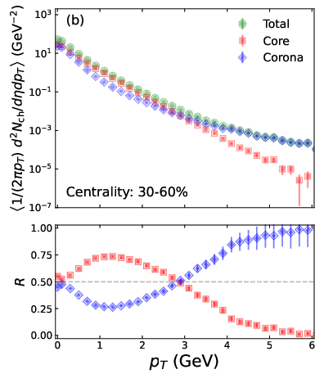
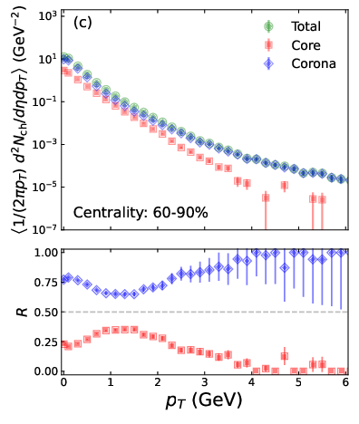
p_{T} distributions of charged hadrons
Core dominance
below ~3.7 GeV
Soft from corona
at very low p_{T}
No more core dominant
p_{T} region

Slide 18
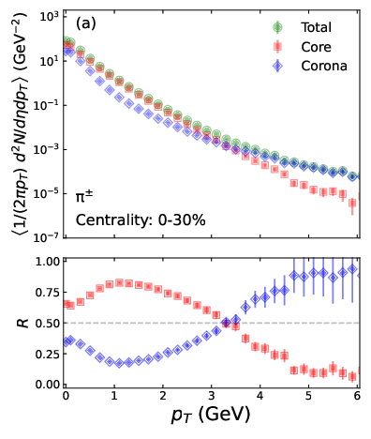
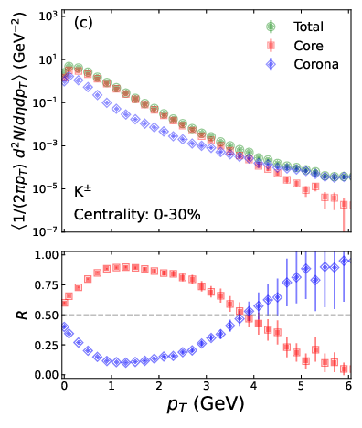
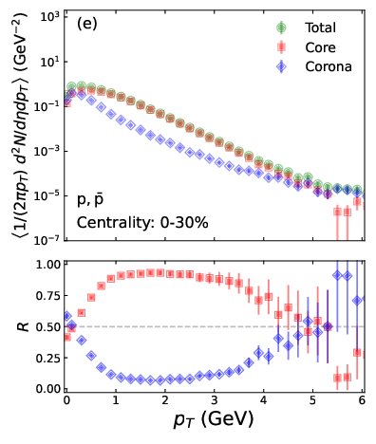
p_{T} distribution of PID hadrons
Hadron mass ↑ → Transition point ↑
Mass ordering due to radial flow
Soft from corona
due to radial flow

Slide 19
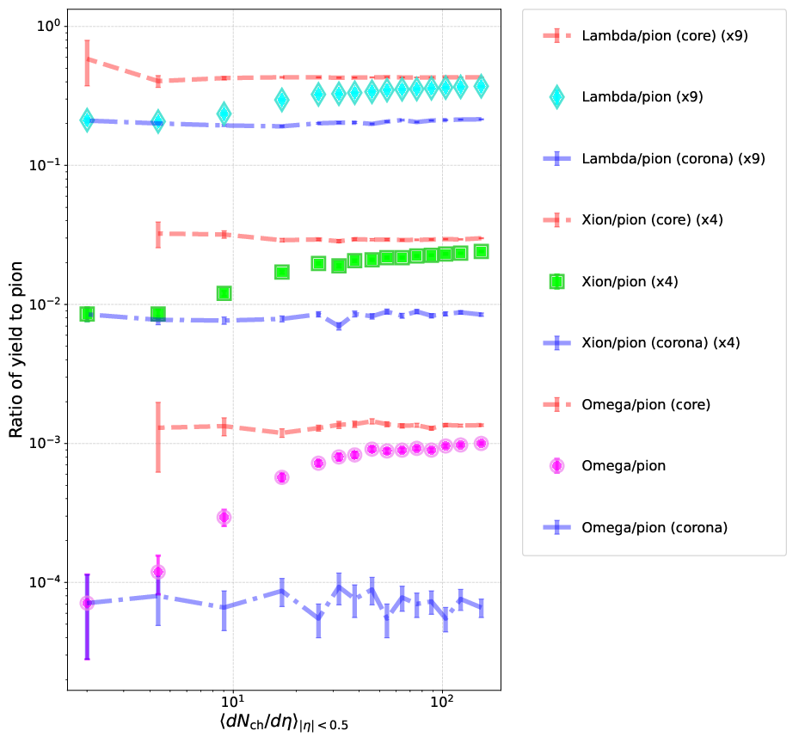
Strangeness enhancement in O+O collisions
Ratios of corona
String fragmentation in PYTHIA
Ratios of core
← Chemical freezeout
Interplay between core and corona
Monotonic increase of ratios
More enhancement for multi-strange hadrons

Slide 20
4. Bayesian Analysis of p+p Data
A. Shigeyoshi, K. Kuroki, and T. Hirano, (in preparation)

Slide 21
Fraction of core and corona
Core
high
multiplicity
p+p
Corona
Kanakubo et al. (2022).

Slide 22

Bayesian analysis of p+p collisions at LHC
Experimental data set in
p+p collisions at LHC
p_{T} dist. of PID hadrons
$Λ/π$, $Ξ/π$, and ${dN_{ch}}/{dη}$
vs. multiplicity class
Purpose:
Scrutinisation of the core production in statistical analysis from DCCI2 model
Bayesian
parameter
estimation
90% credible interval Maximum a Posteriori (MAP)

Slide 23
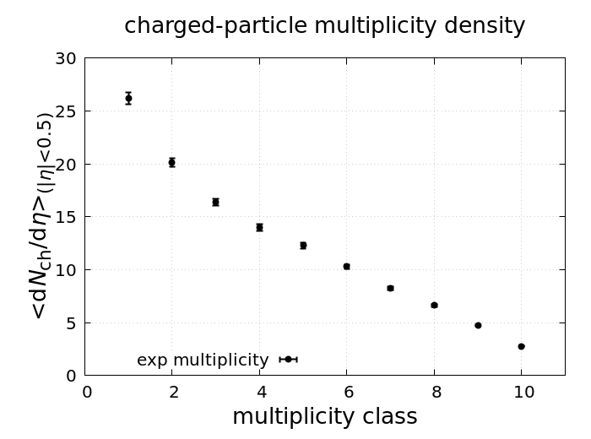
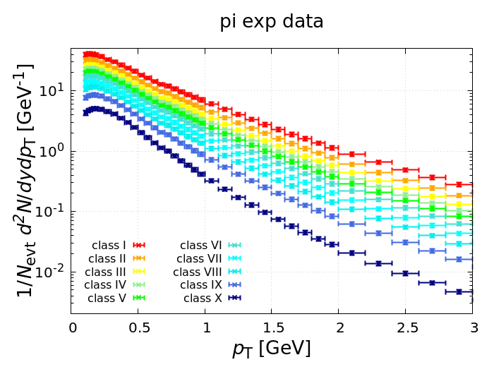
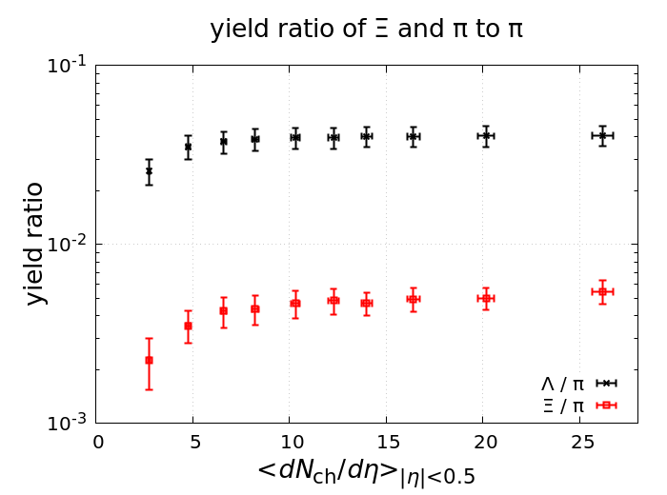

Choice of exp. data
Multiplicity
p_{T} spectra
Yield ratios
V0M class | Ⅰ | Ⅱ | Ⅲ | Ⅳ | Ⅴ | Ⅵ | Ⅶ | Ⅷ | Ⅸ | Ⅹ
$$σ/σ_{INEL>0}(\%)$$ | $$0 \\ −0.92$$ | $$0.92 \\ −4.6$$ | $$4.6 \\ −9.2$$ | $$9.2 \\ −13.8$$ | $$13.8 \\ −18.4$$ | $$18.4 \\ −27.6$$ | $$27.6 \\ −36.8$$ | $$36.8 \\ −46.0$$ | $$46.0 \\ −64.5$$ | $$64.5 \\ −100$$
$$\left\langle dN_{ch}/dη\right\rangle$$ | $$26.02 \\ ±0.35$$ | $$20.02 \\ ±0.37$$ | $$16.17 \\ ±0.22$$ | $$13.77 \\ ±0.19$$ | $$12.04 \\ ±0.17$$ | $$10.02 \\ ±0.14$$ | $$7.95 \\ ±0.11$$ | $$6.32 \\ ±0.09$$ | $$4.50 \\ ±0.07$$ | $$2.55 \\ ±0.04$$
S. Acharya et al. [ALICE Collaboration], (2020).

Slide 24
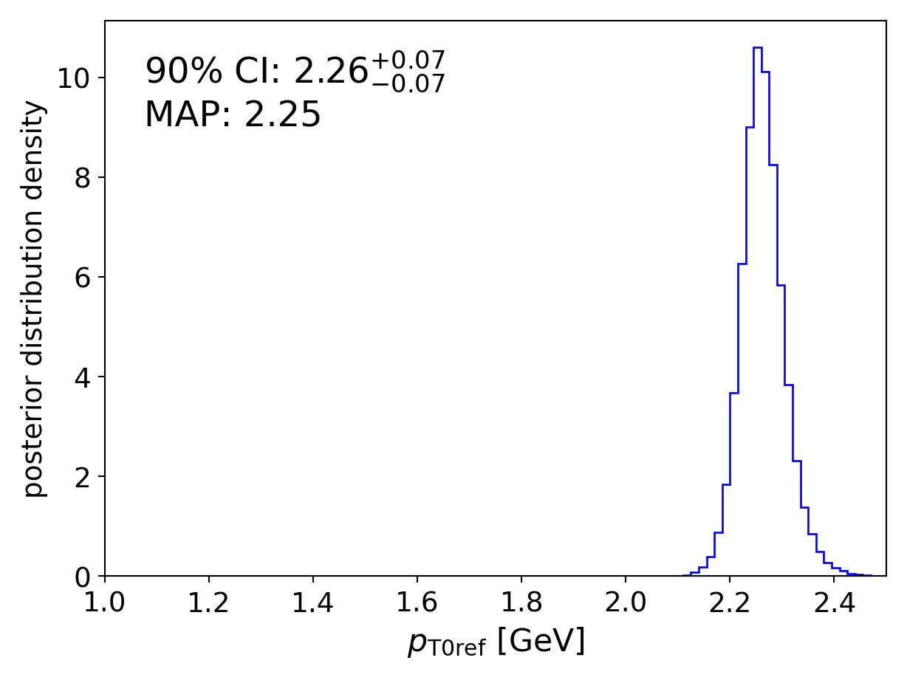
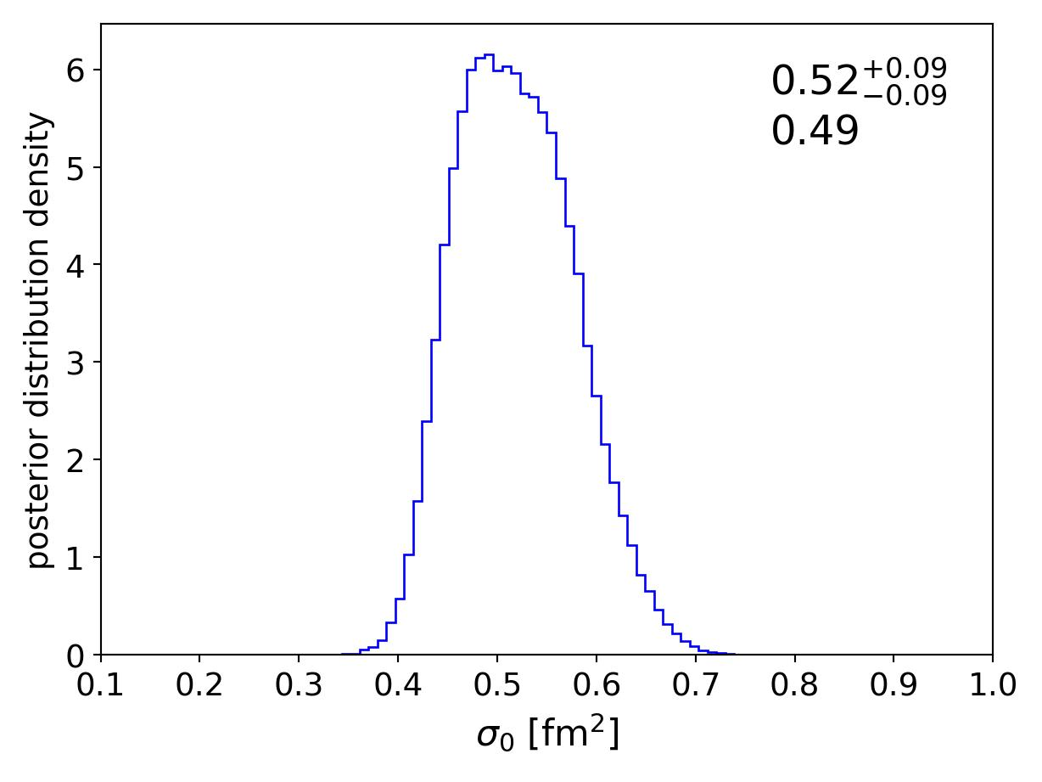
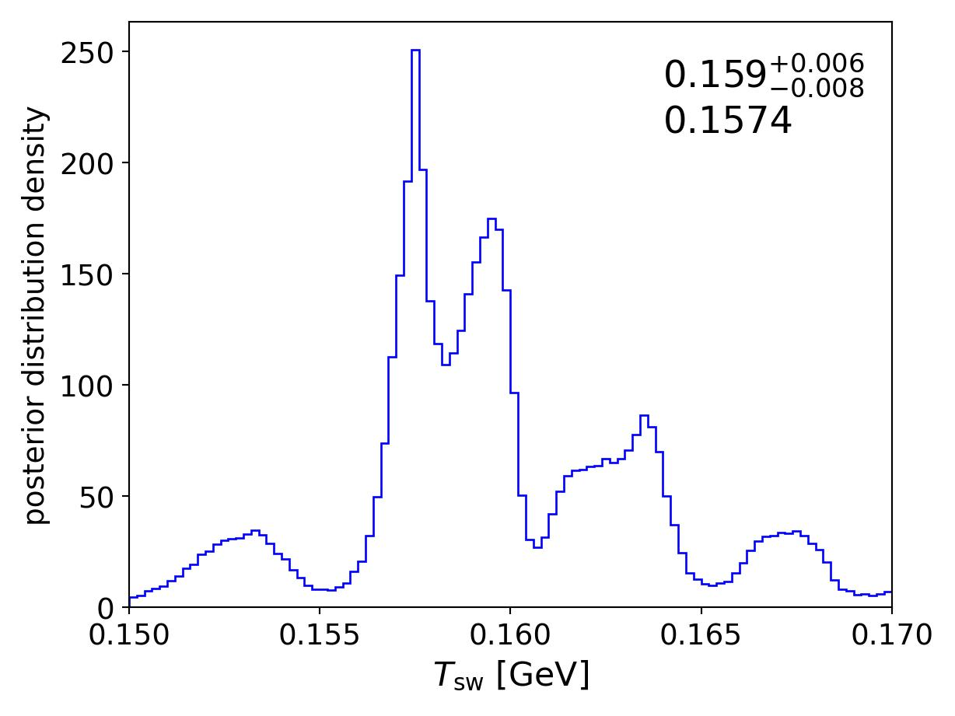
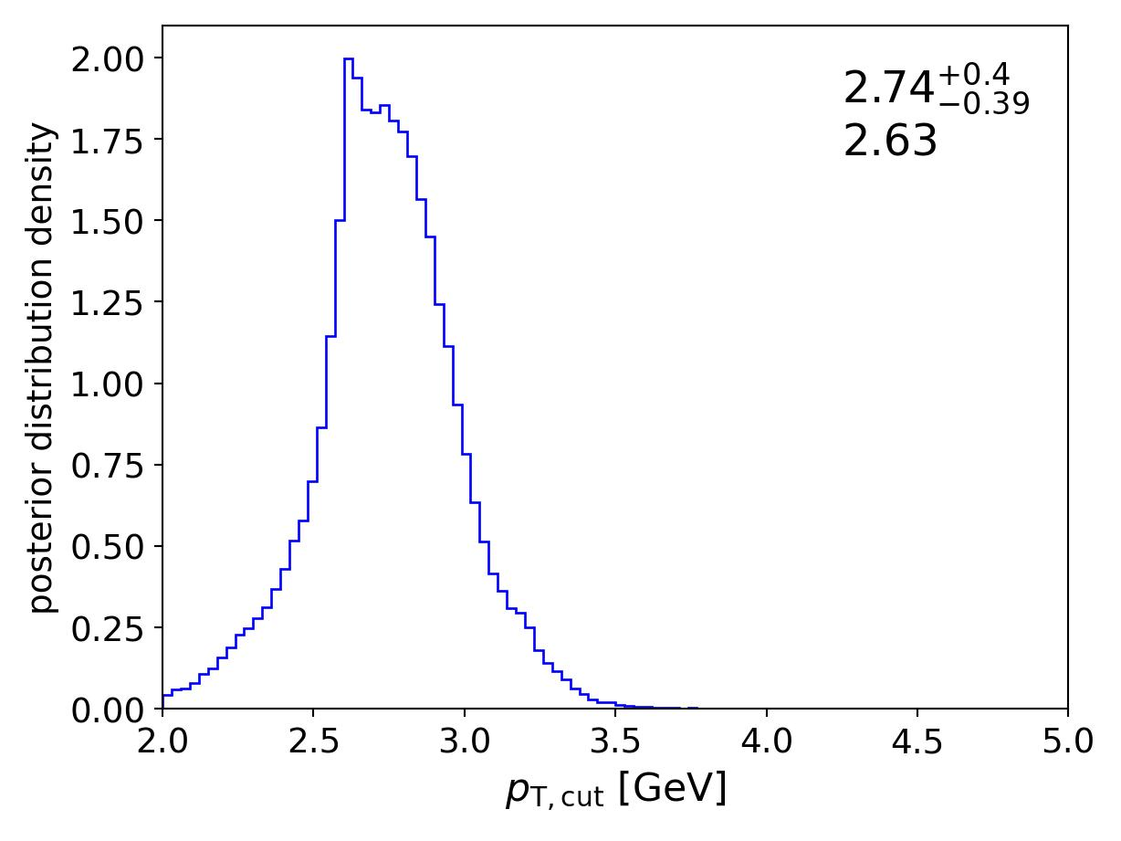
Posterior distribution
4 out of 14 parameters
in DCCI2 model
← Relevant parameters to control particle yields and core production
Clear peaks of posteriors within prior ranges
MAP: Maximum A Posteriori

Slide 25
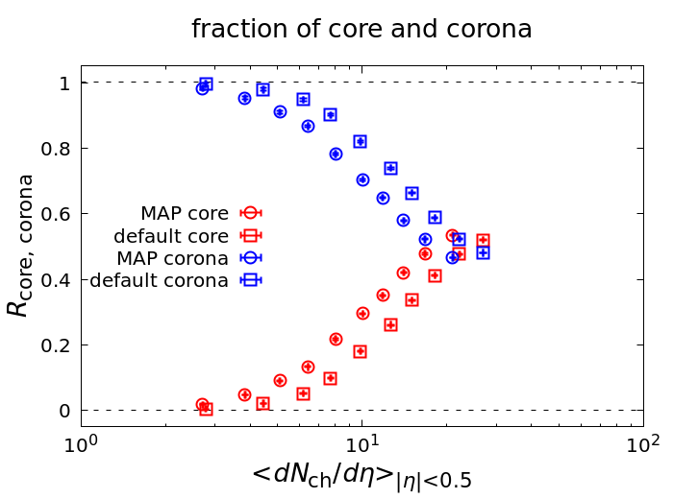
Core-corona fraction in p+p collisions at LHC
MAP vs. Default* comparison
Core production confirmed even after Bayesian parameter estimation
Strong indication
of QGP production
in p+p collisions?
*Kanakubo et al. (2022).

Slide 26
Summary
Investigation of small colliding systems from Dynamical Core-Corona Initialisation model (ver.2)
O+O collisions
  Transition point dN_{ch}/deta ~ 20
  Mass ordering of transition point in p_{T} distributions
  Soft-from-corona in very low p_{T} region
  Yet sizable corona components (~30%) even in central collisions
p+p collisions
  Bayesian parameter estimation
  Confirmation of core production (~50%) in high-multiplicity events

Slide 27
Outlook
Work in progress:
Effects of core-corona on nuclear shape studies
Strangeness enhancement in Au+Au collisions at RHIC
Sophistication of dynamical initialization processes based on string picture (baryon junction)
Hard probes using HIJING instead of PYTHIA
+ more

Slide 28
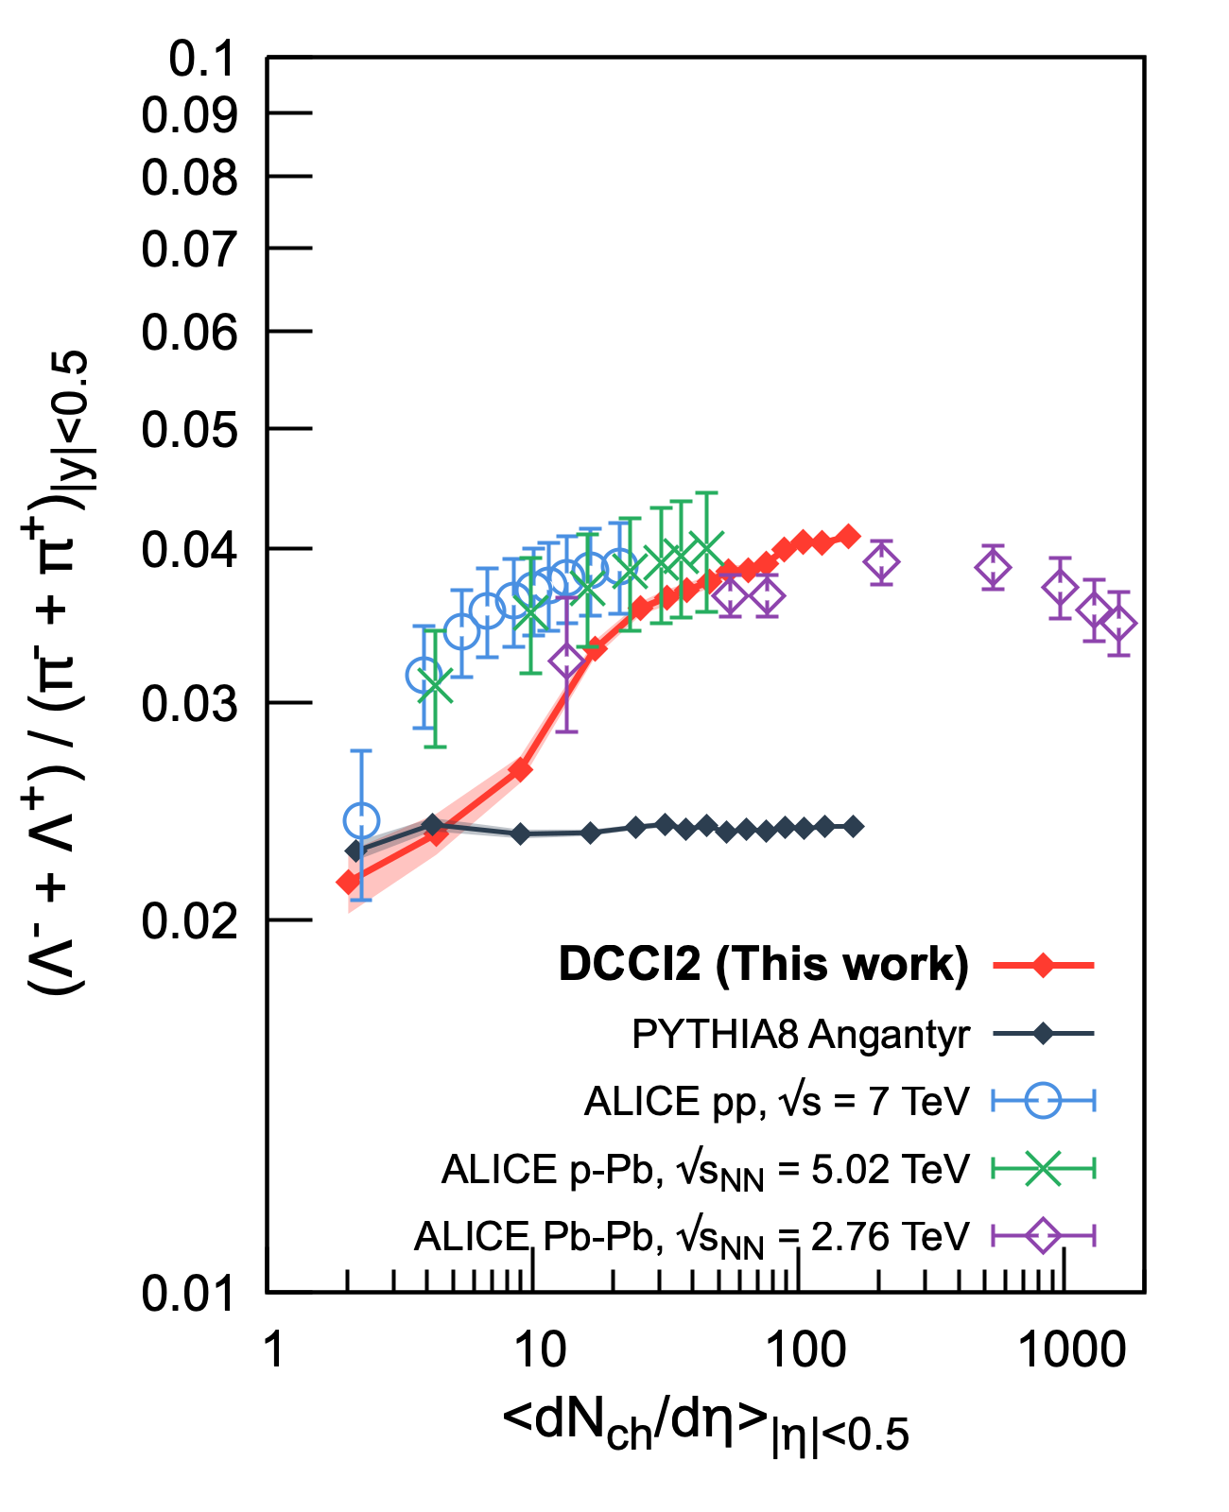
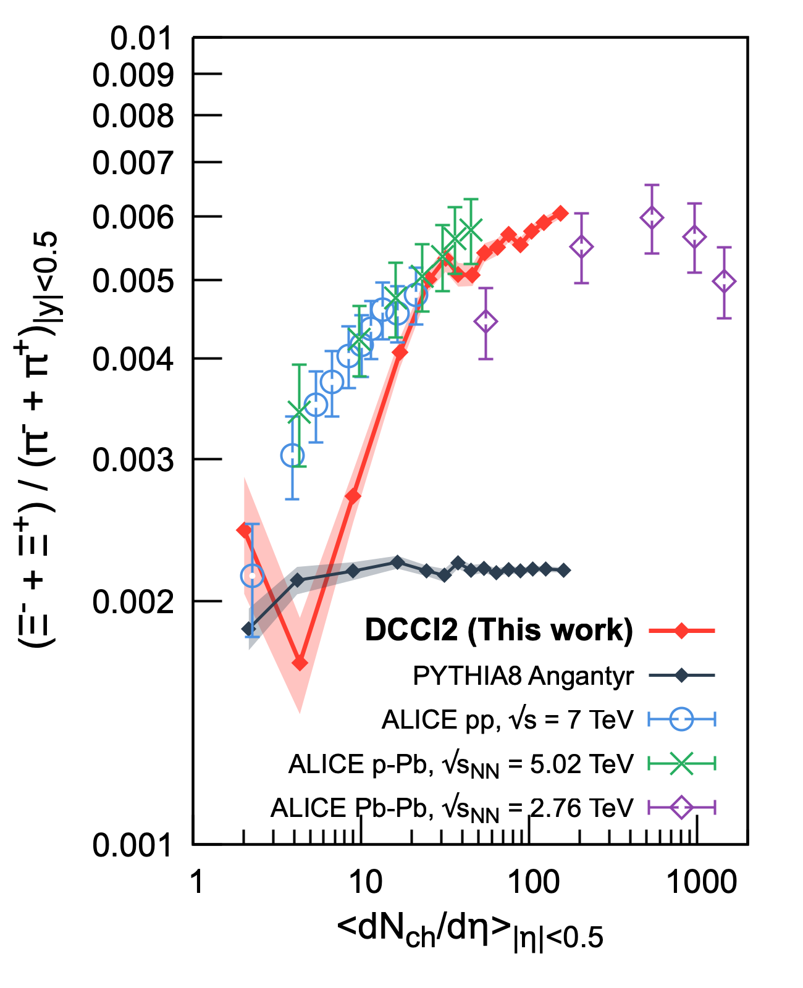
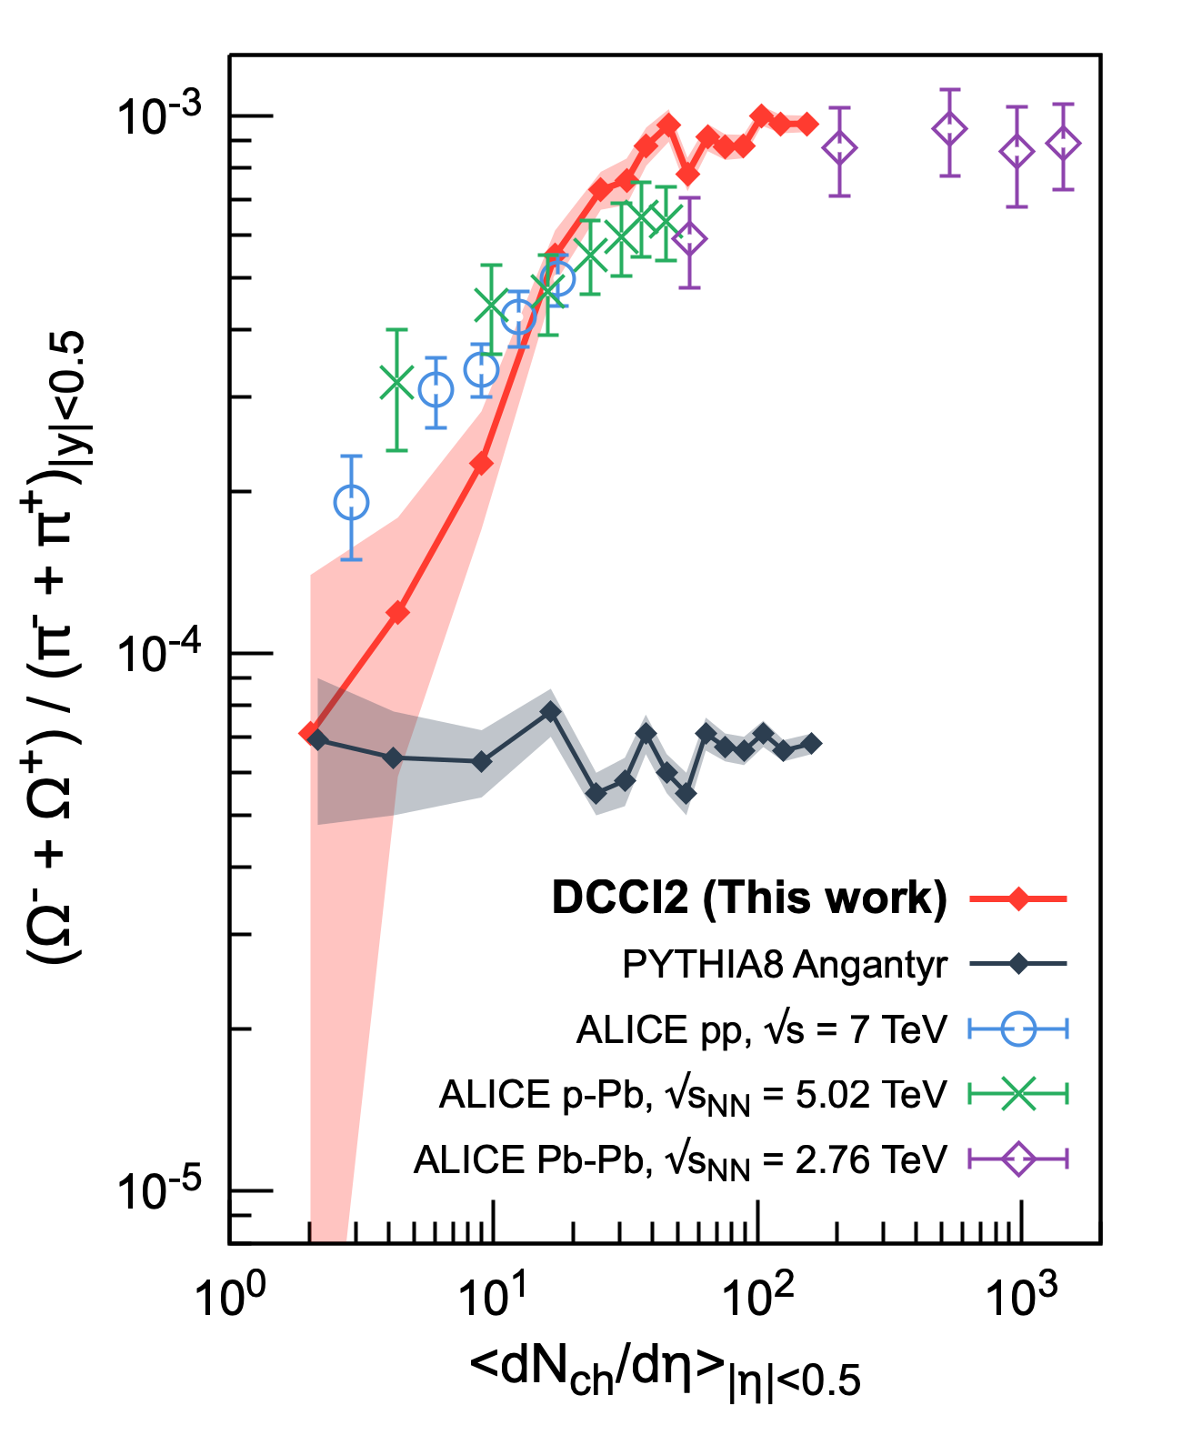
Comparison with ALICE data

Slide 29
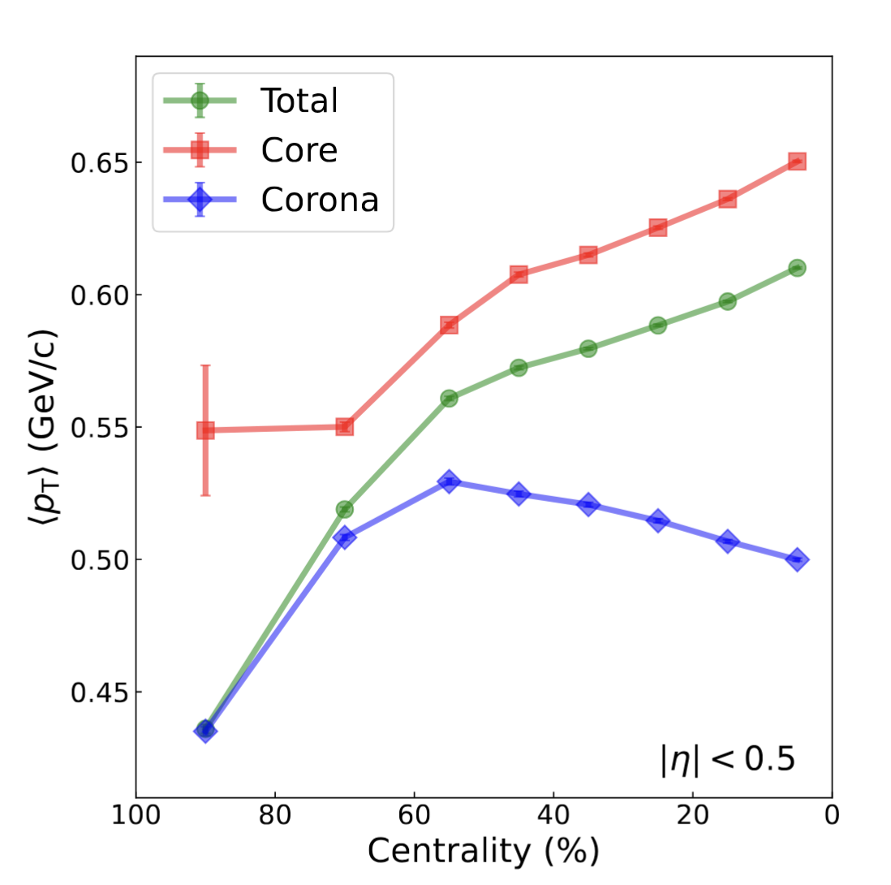
Mean transverse momentum

Slide 30
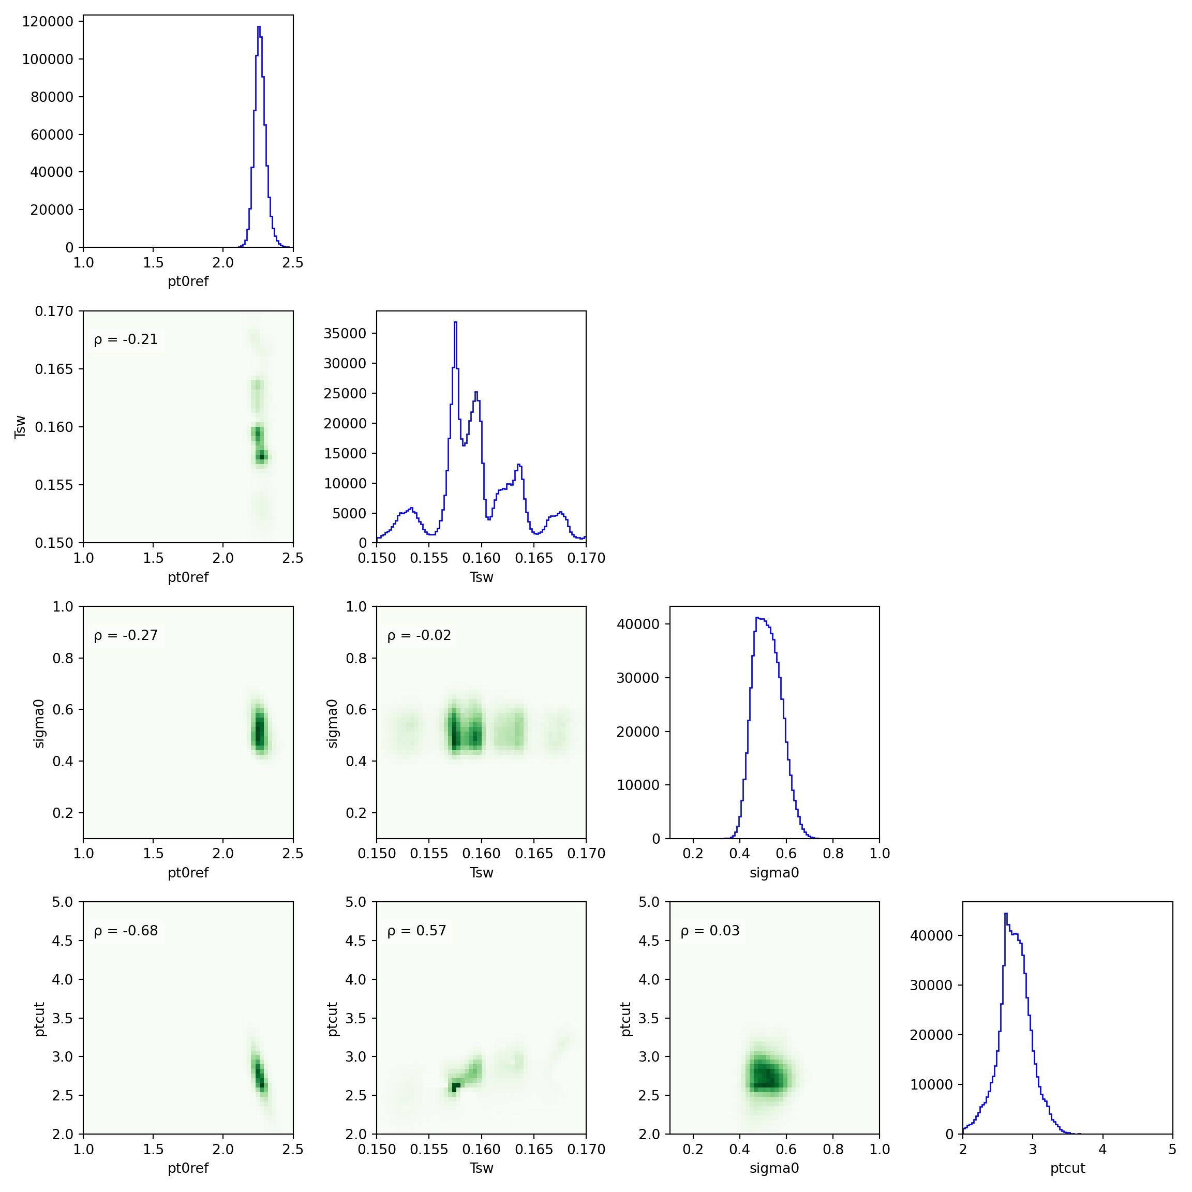
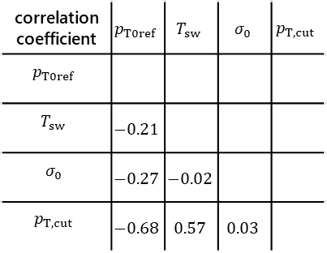
Correlation among parameters
correlation coefficient | $$p_{T0ref}$$ | $$T_{sw}$$ | $$σ_{0}$$ | $$p_{T,cut}$$
$$p_{T0ref}$$
$$T_{sw}$$ | $$−0.21$$
$$σ_{0}$$ | $$−0.27$$ | $$−0.02$$
$$p_{T,cut}$$ | $$−0.68$$ | $$0.57$$ | $$0.03$$
Some correlation
between two parameters
→ Necessity of simultaneous fitting

Slide 31
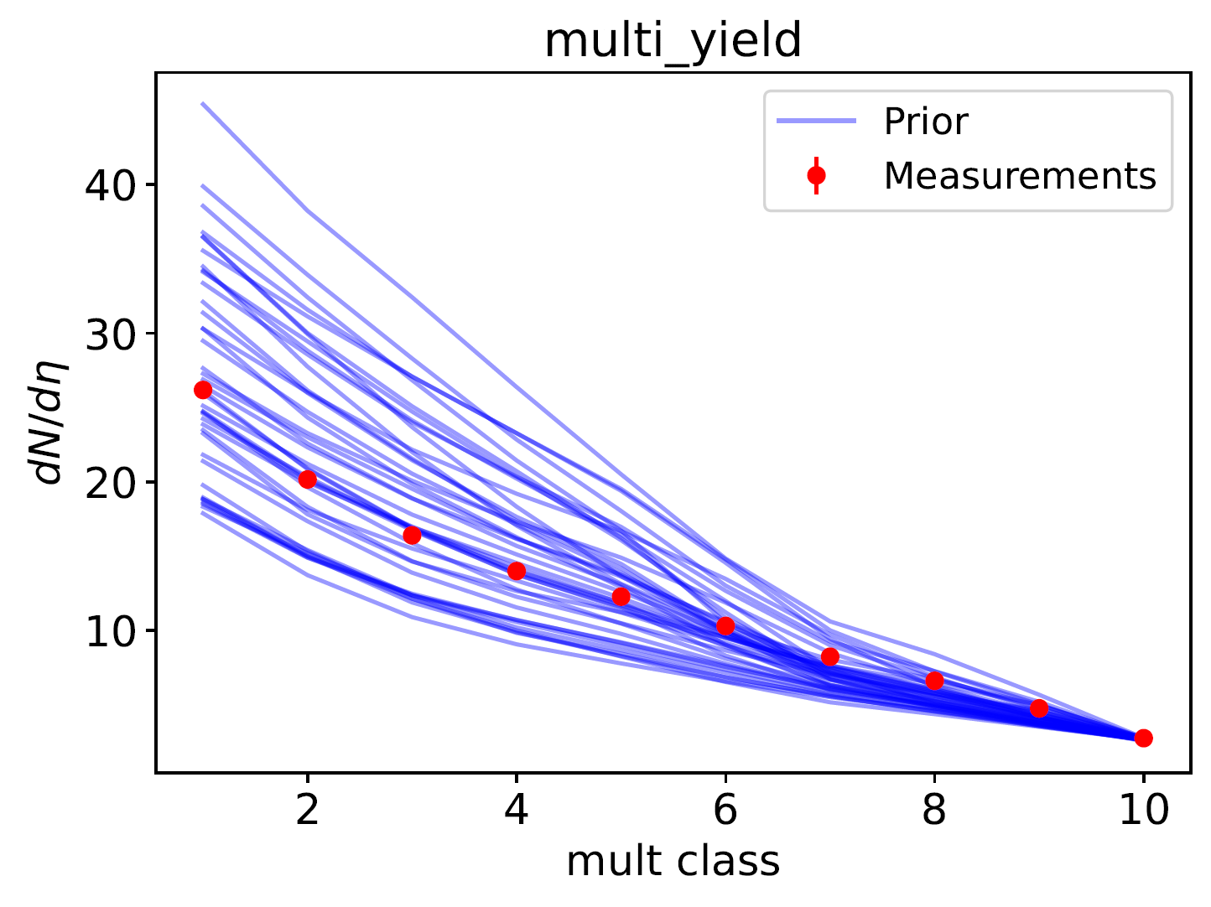
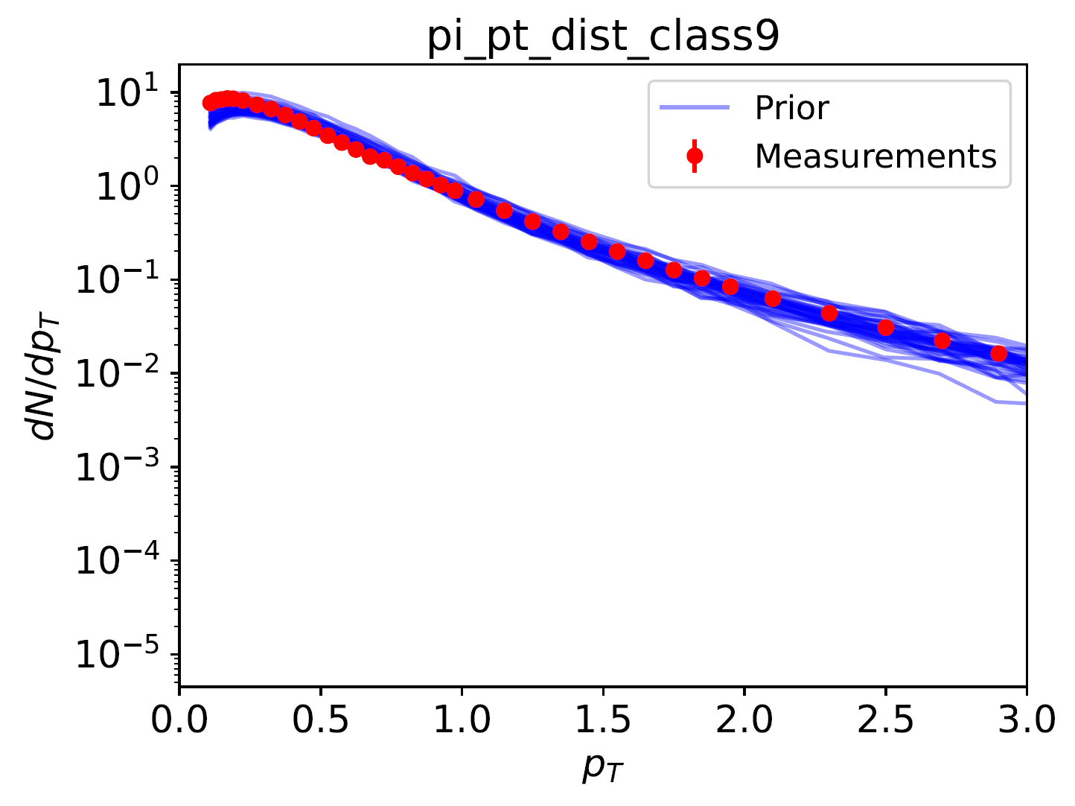
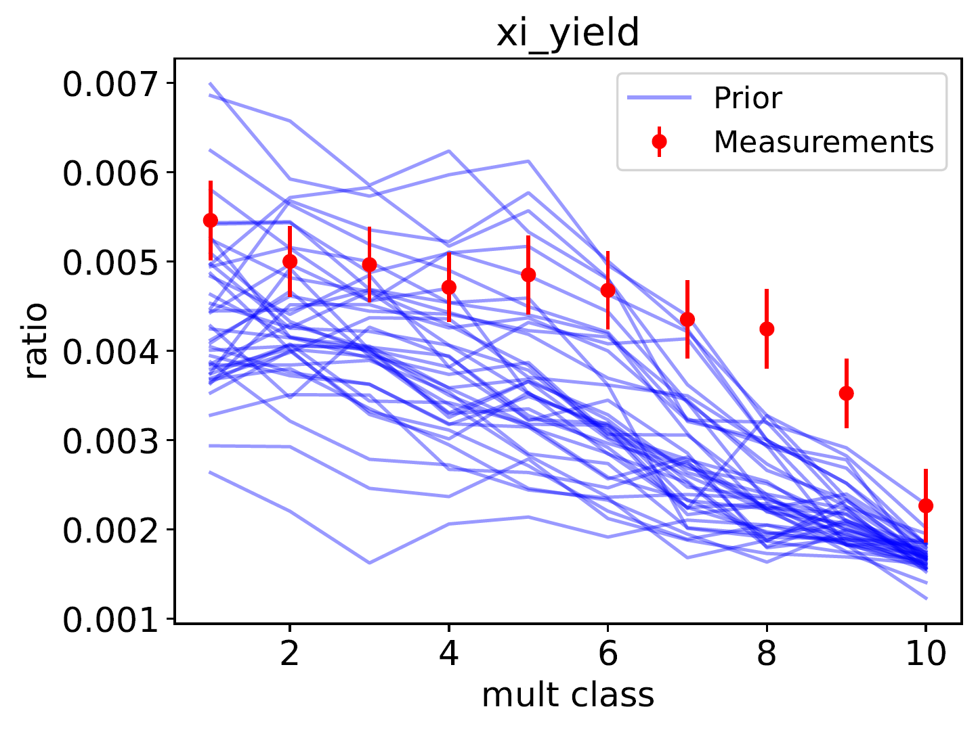
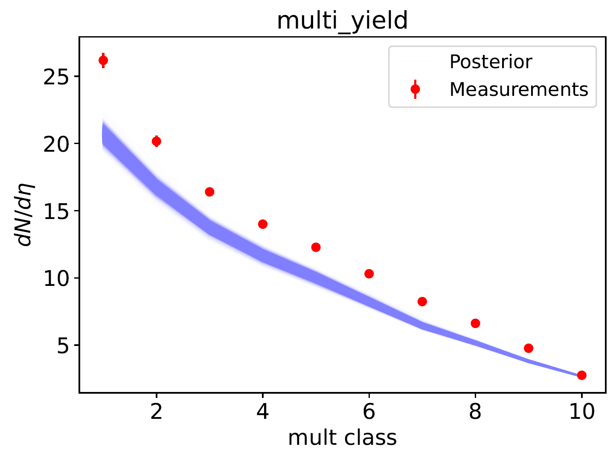
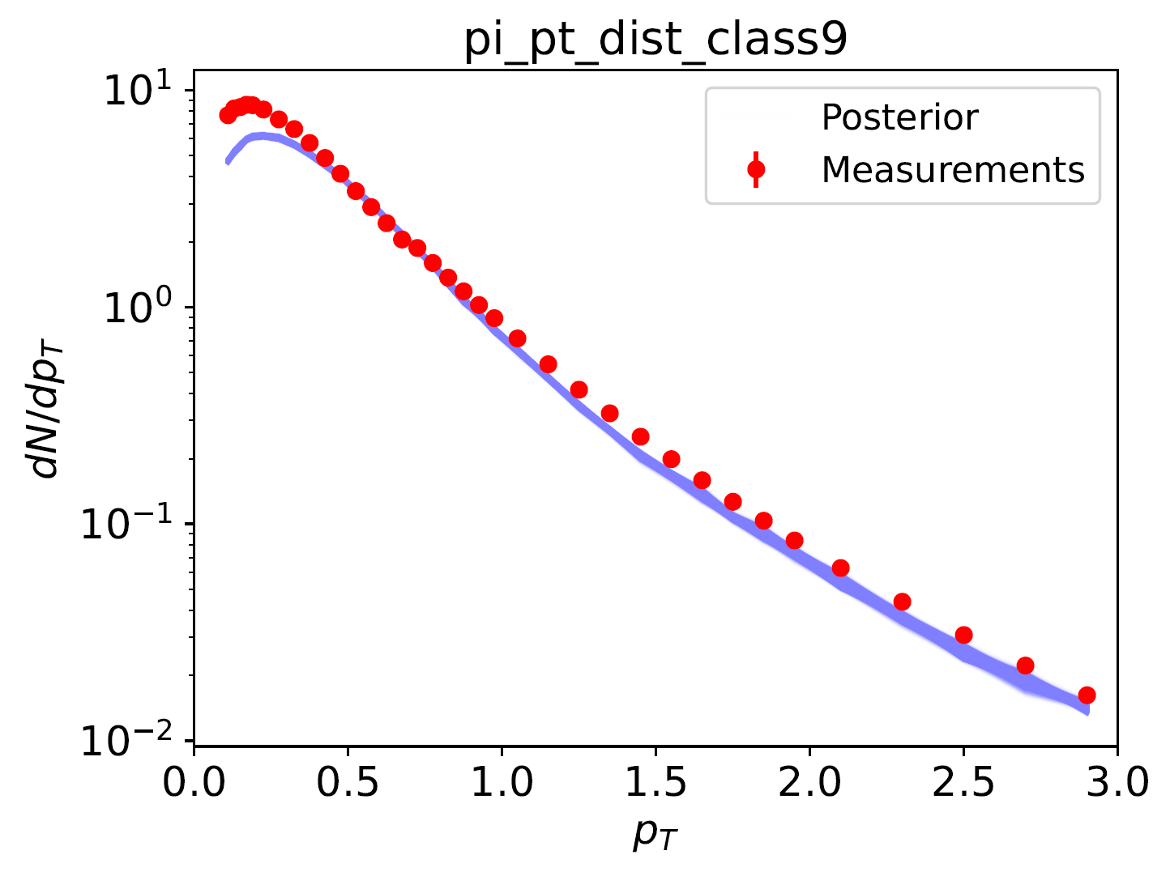
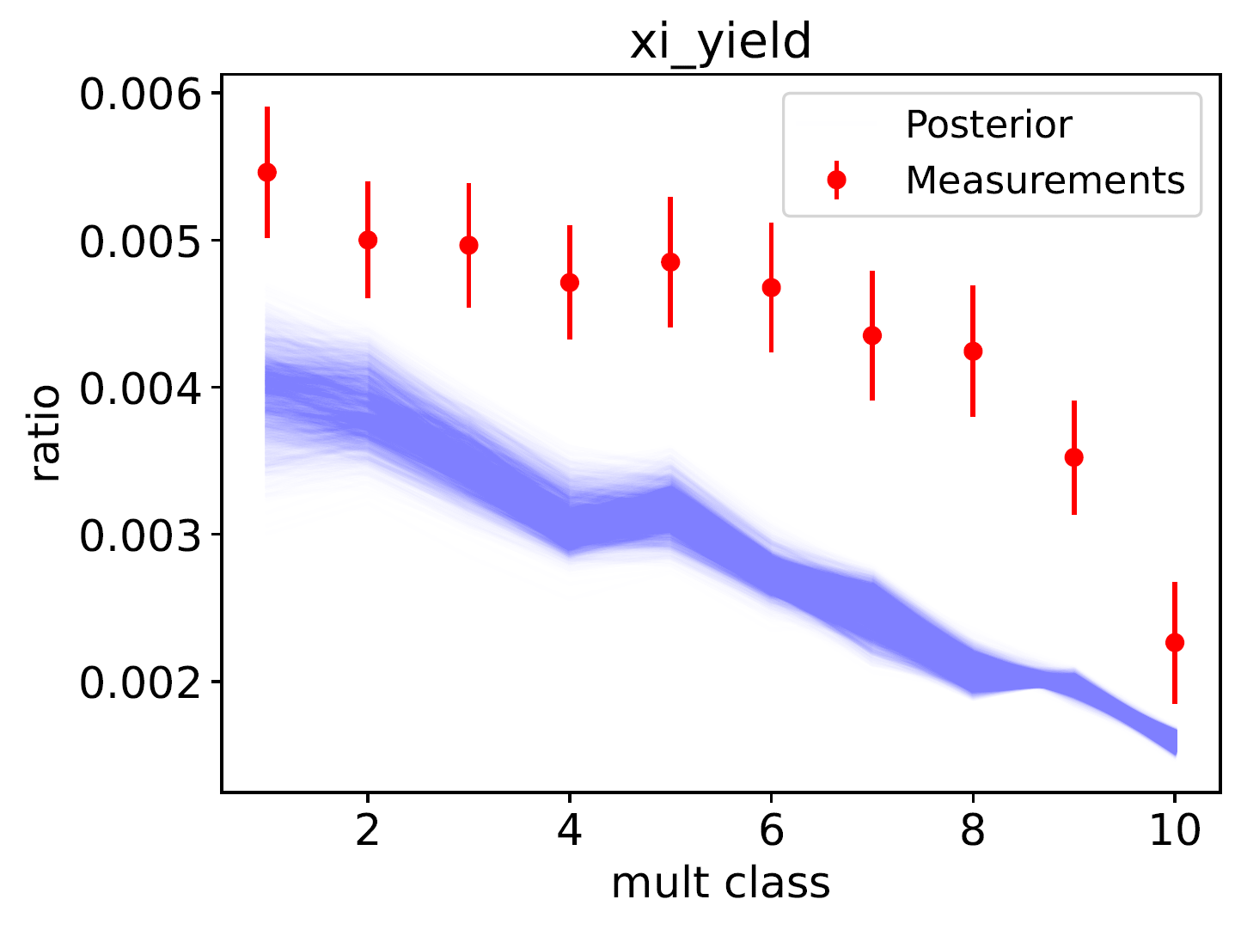
Results from prior and posterior

Slide 32
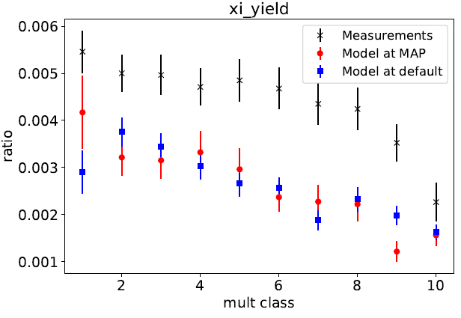
Particle Yield Ratios

Slide 33
Low p_{T} enhancement from corona
Total
(core+corona)
w/scat
PbPb 2.76 TeV
core
w/ scat
Core
Corona
Kanakubo et al., (2022)
R_{corona} ~ 50%
Interplay between exponential thermal spectrum
and power-law string fragmentation

Slide 34
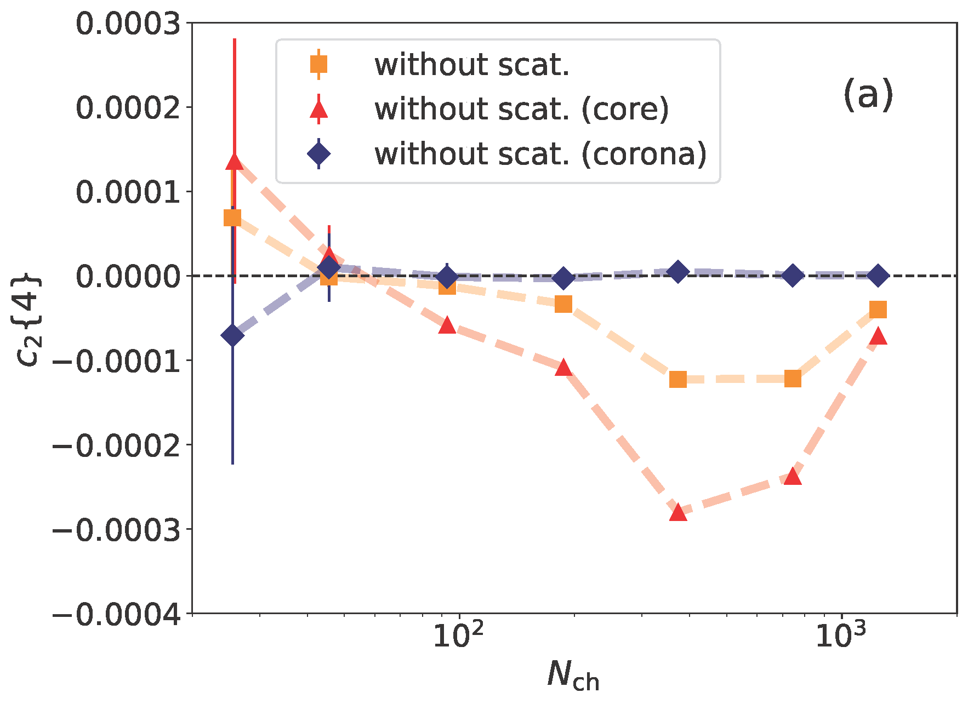

Corona dilutes $c_{2}\{4\}$
PbPb
2.76 TeV
Dilution effect even after non-flow subtraction
Importance in p_{T} integrated observables
Kanakubo et al., (2022)
Larger non-equilibrium
effects than viscosity
0.2<p_{T}<3.0 GeV, |η|<0.8 (ALICE)

Slide 35
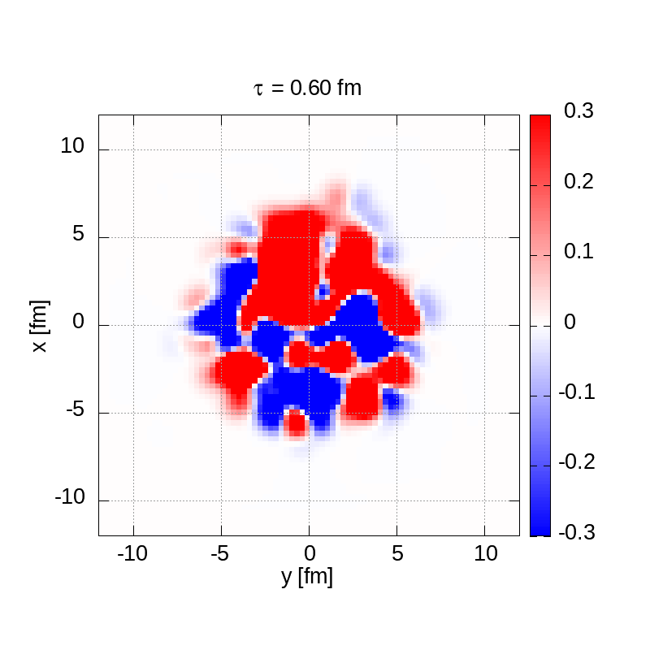
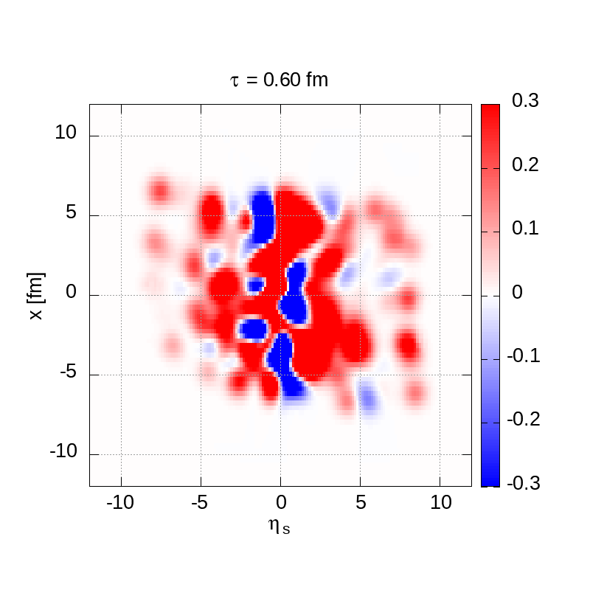

Time evolution of baryon number density
$$n_{B}$$
$$n_{B}$$
Appearance of negative baryon number domain at midrapidity due to fluctuations
← Affects production of anti-nuclei?
Transverse plane
Longitudinal plane
Pb+Pb 2.76 TeV, one central event

Slide 36
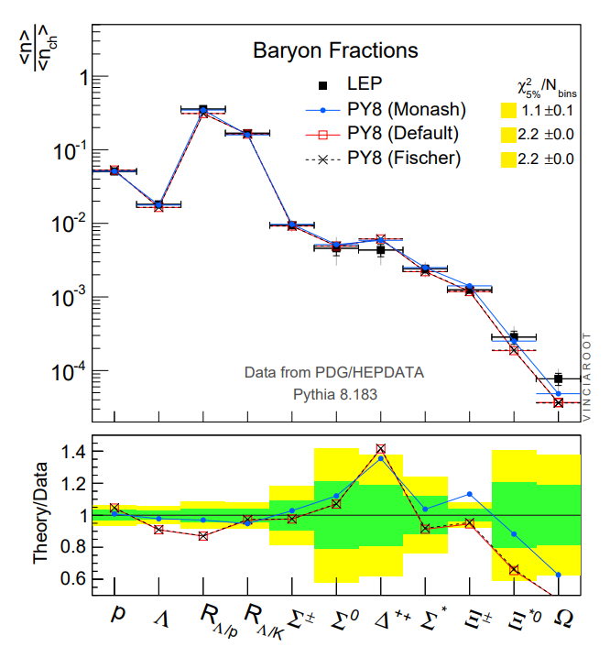
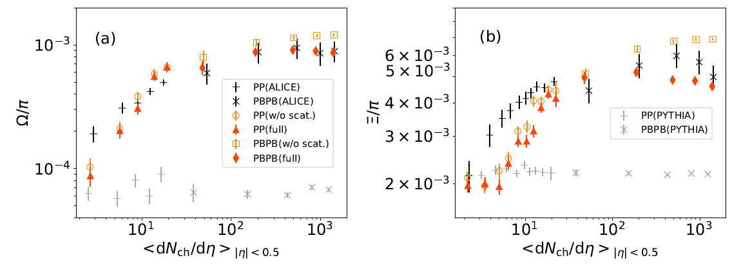

$Ω$ yields from $e^{+}e^{−}$ with Monash Tune
P. Skands et al., Eur.Phys.J.C 74 (2014) 8, 3024

