Slide 1
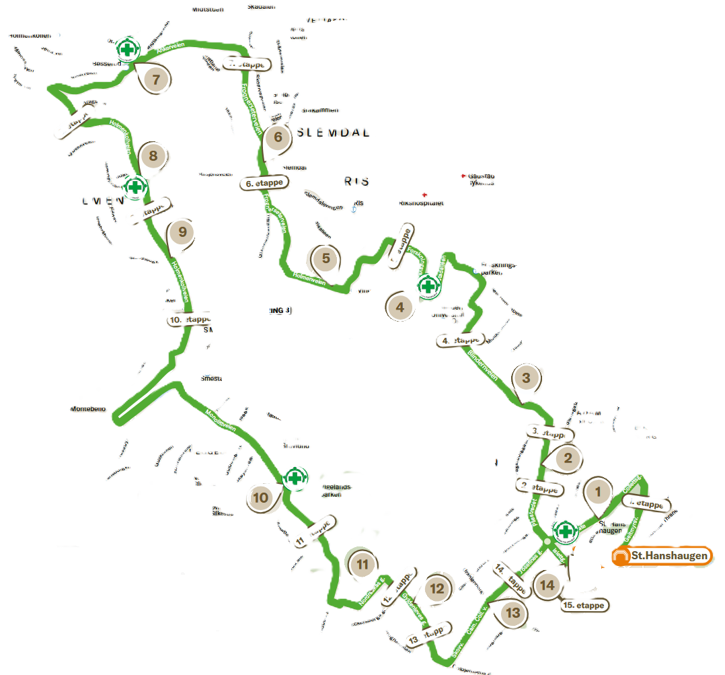
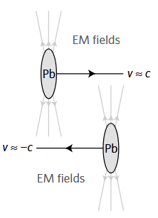
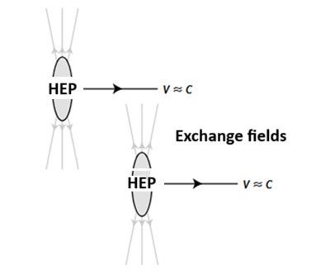
The Large HEP Collider (LHC)
LHC
Centre of mass energy: 5000 EeV (!) Length: 18.52 km Power: 0.2 W Cost: 250 CHF (annum) Interaction Points: 14 Colliding bunces: 1 HEP’er per bunch

Slide 2
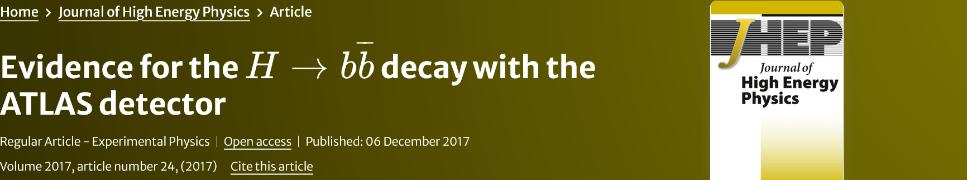
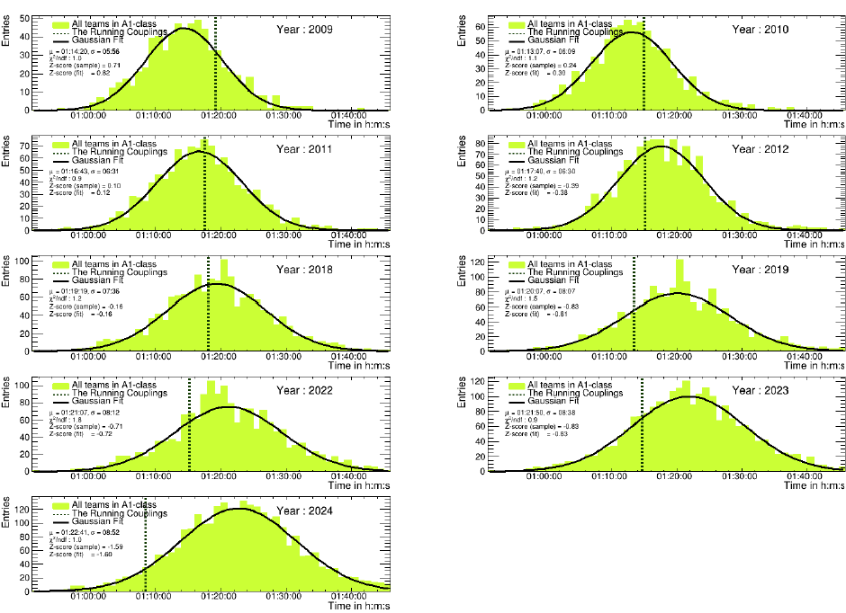
Evidence for a team of 15 physicist called The Running Couplings 1.6σ better than an average team

Slide 3
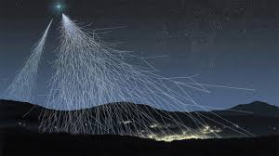
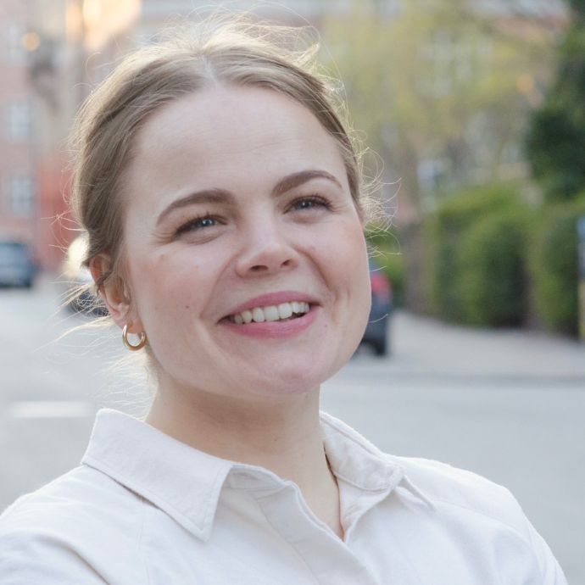

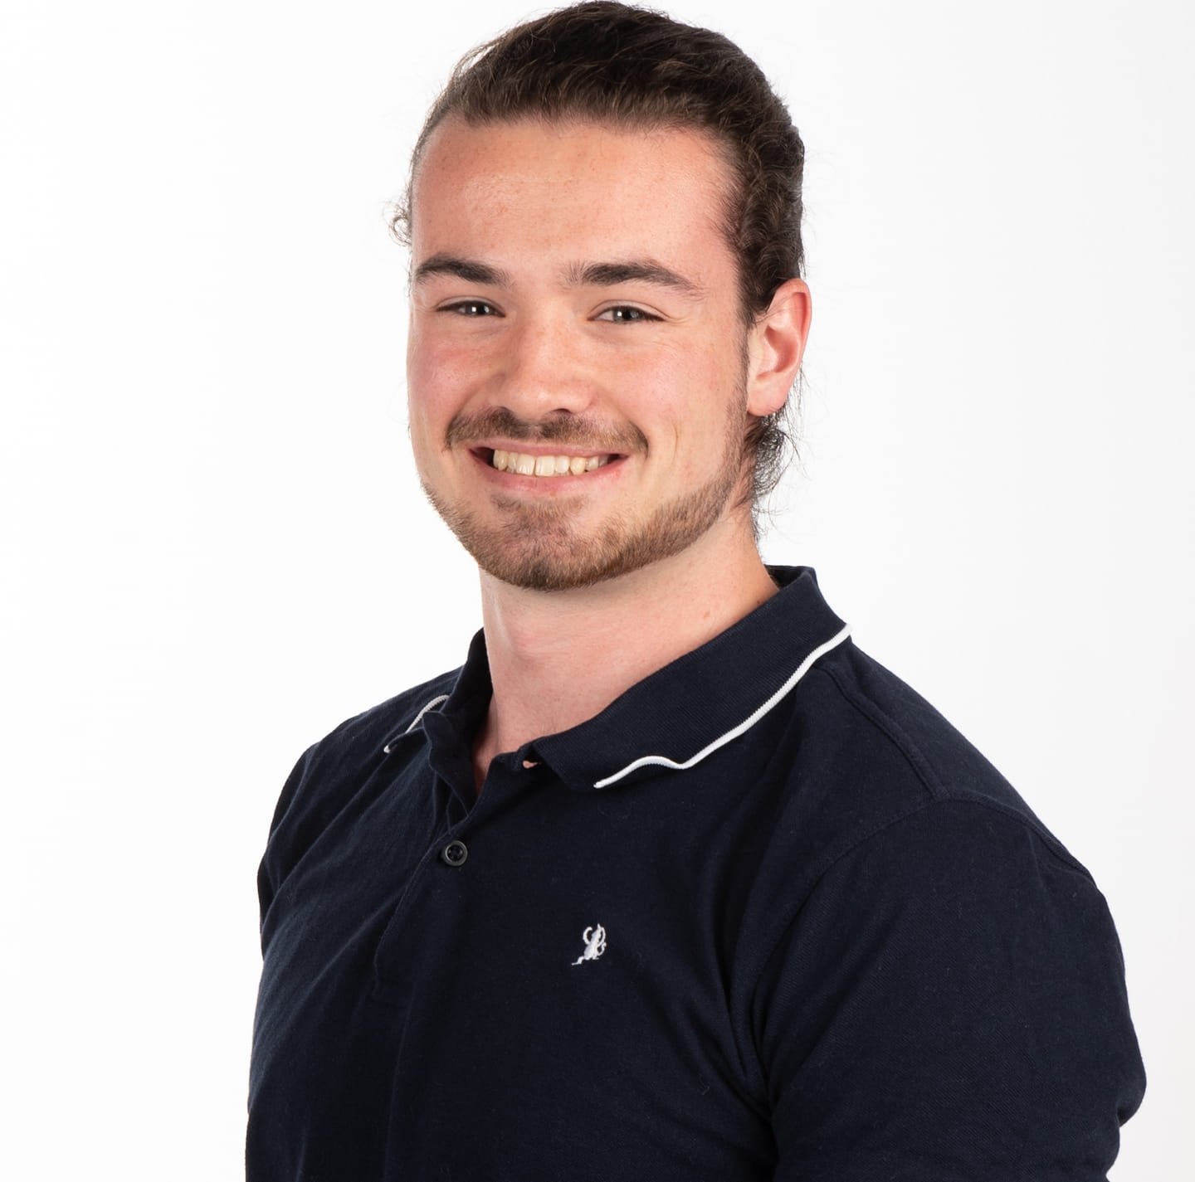

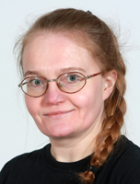
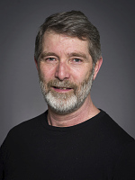
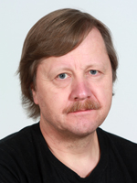
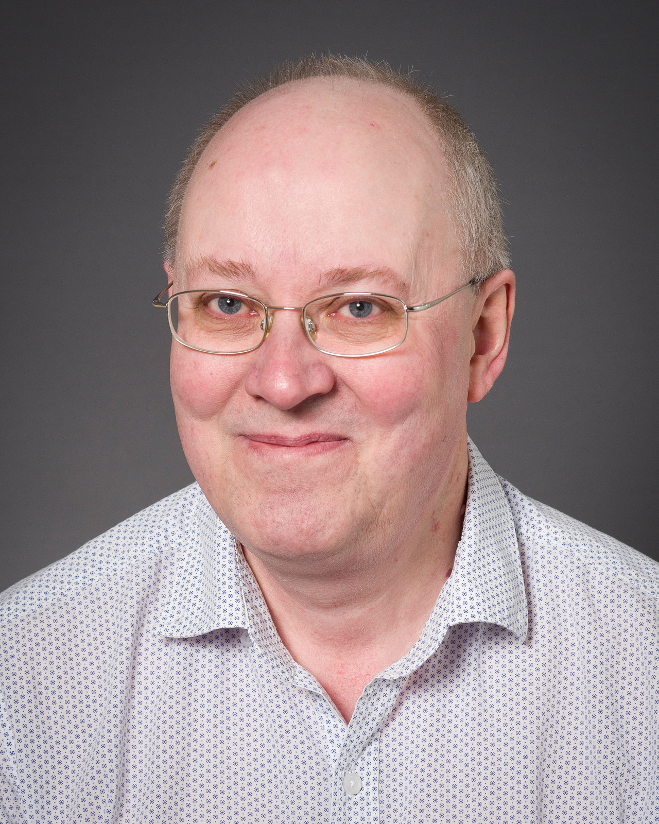
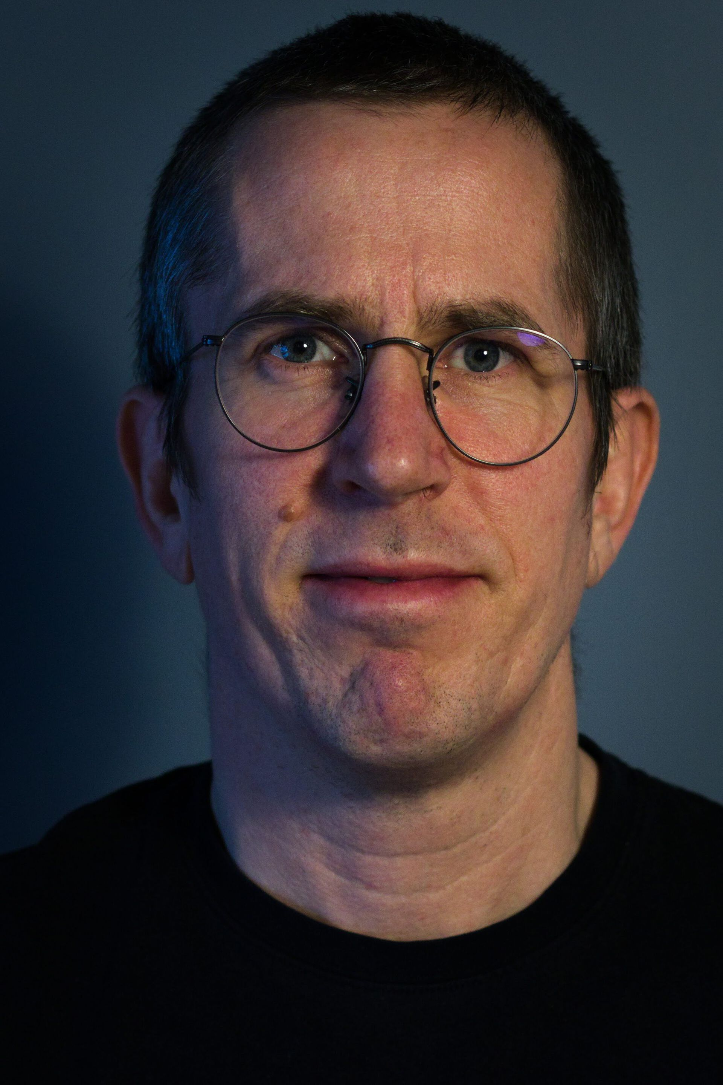

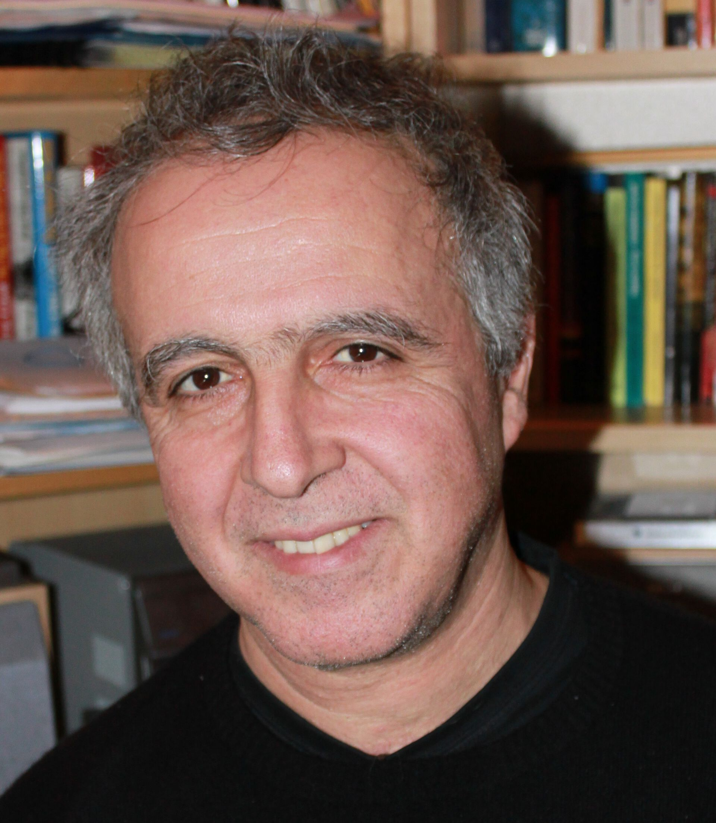
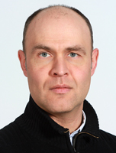
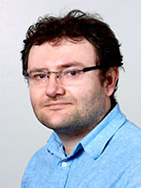
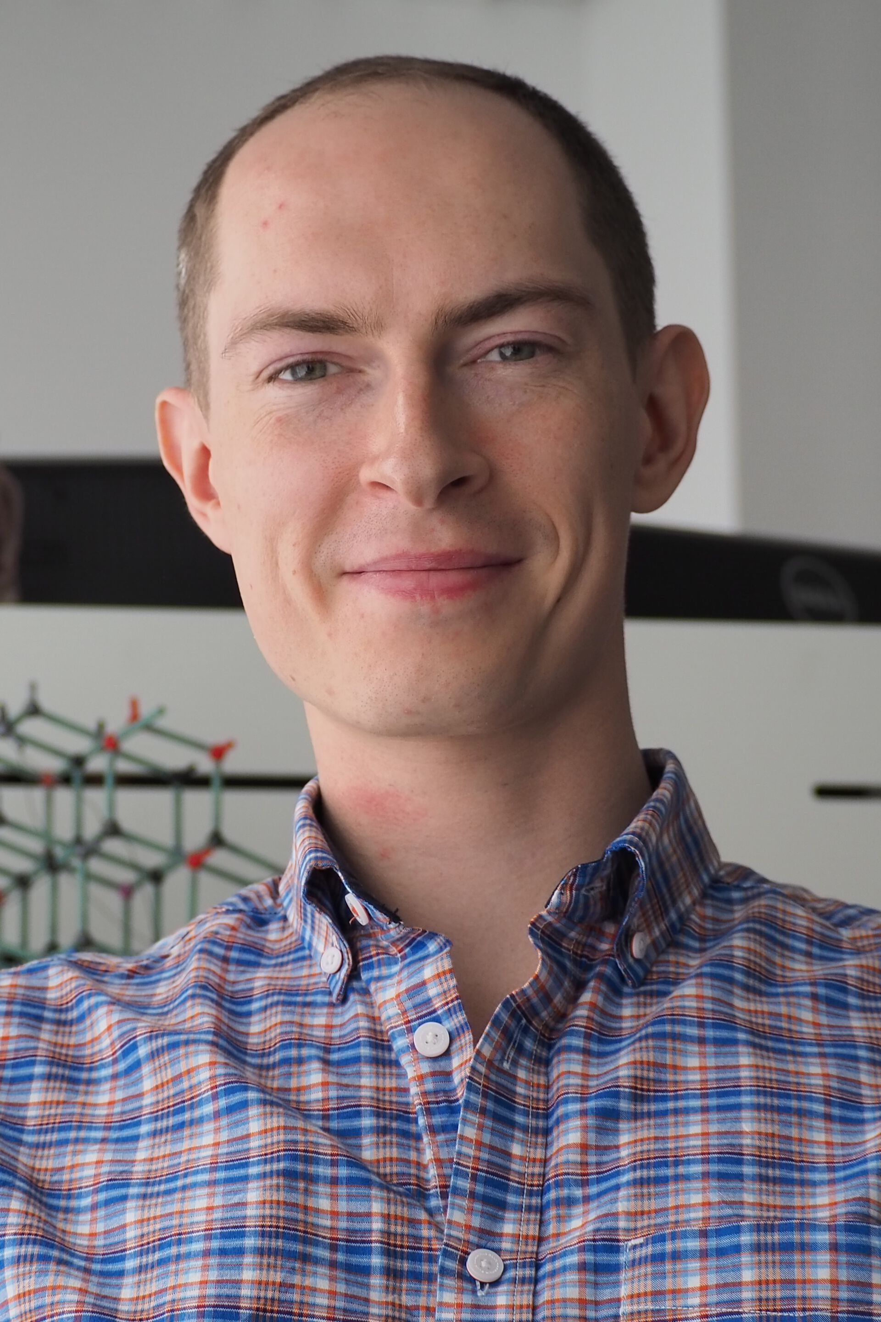

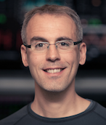
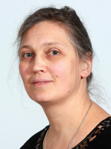
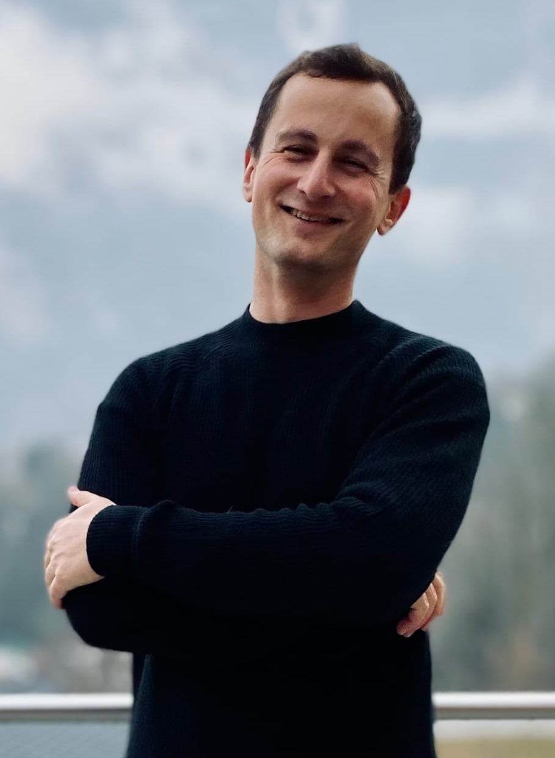
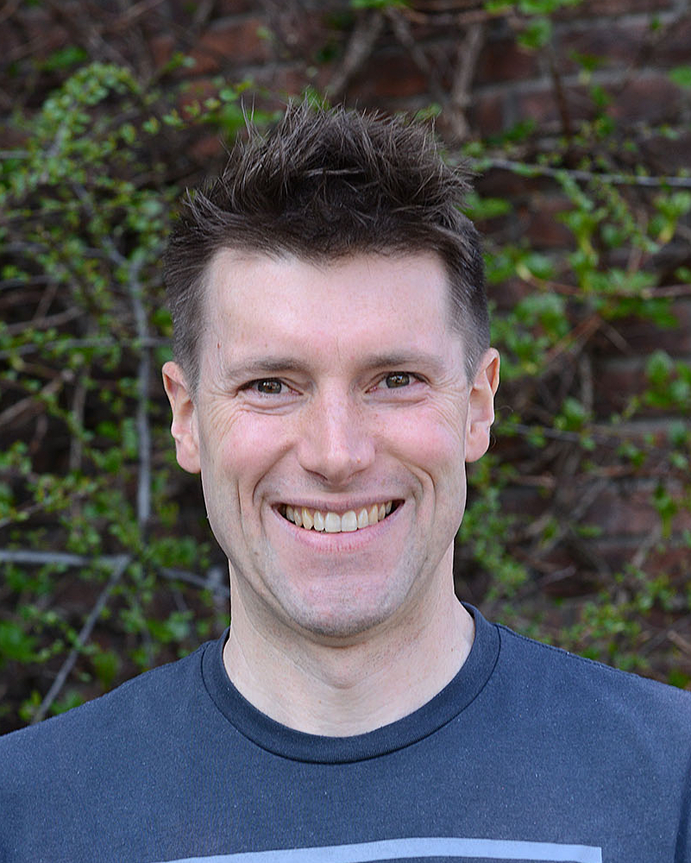
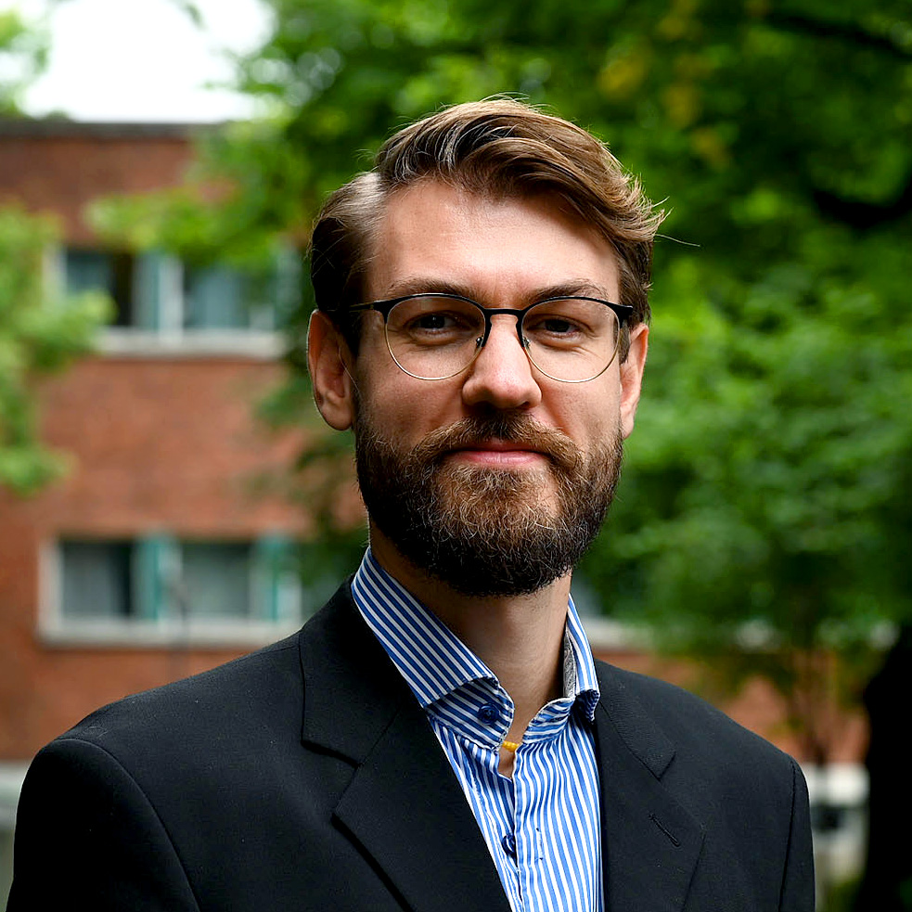
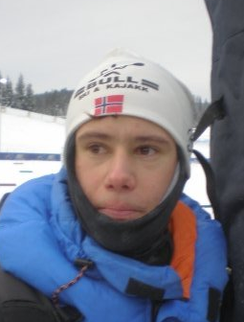
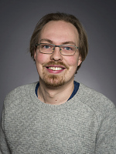
The Standard Model of HEP
Lots of new master student are showing up, just like the particles from cosmic rays in the 50’s
MSc/PhD Students
“Had I foreseen that, I would have gone into botany”
Wolfgang Pauli
New HEP particles beyond the current SM are welcome!
Engineers
Professors
“Young man, if I could remember the names of these particles, I would have been a botanist”
Enrico Fermi til sin unge student, Leon Lederman
Researchers/postdocs
Holmenkollstafett, lunches, quizzes, lønningspils, julebord …
“The future of TRC looks bright”
Eirik Gramstad

Slide 4
Saturday May 9!

