Slide 1
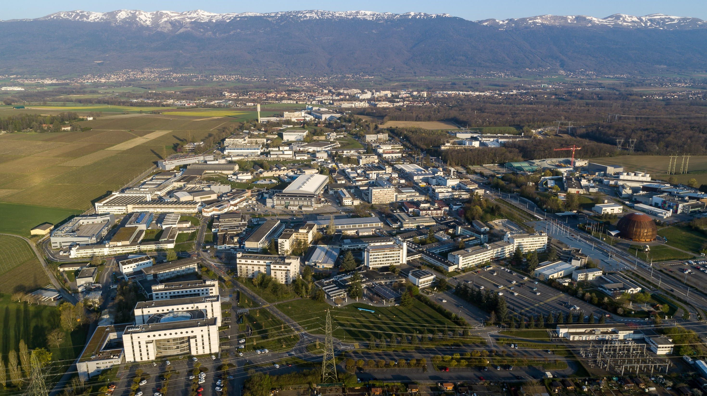
Welcome to CERN!
When?
Where?
Who?
How much?
What?
How?
Why?

Slide 2
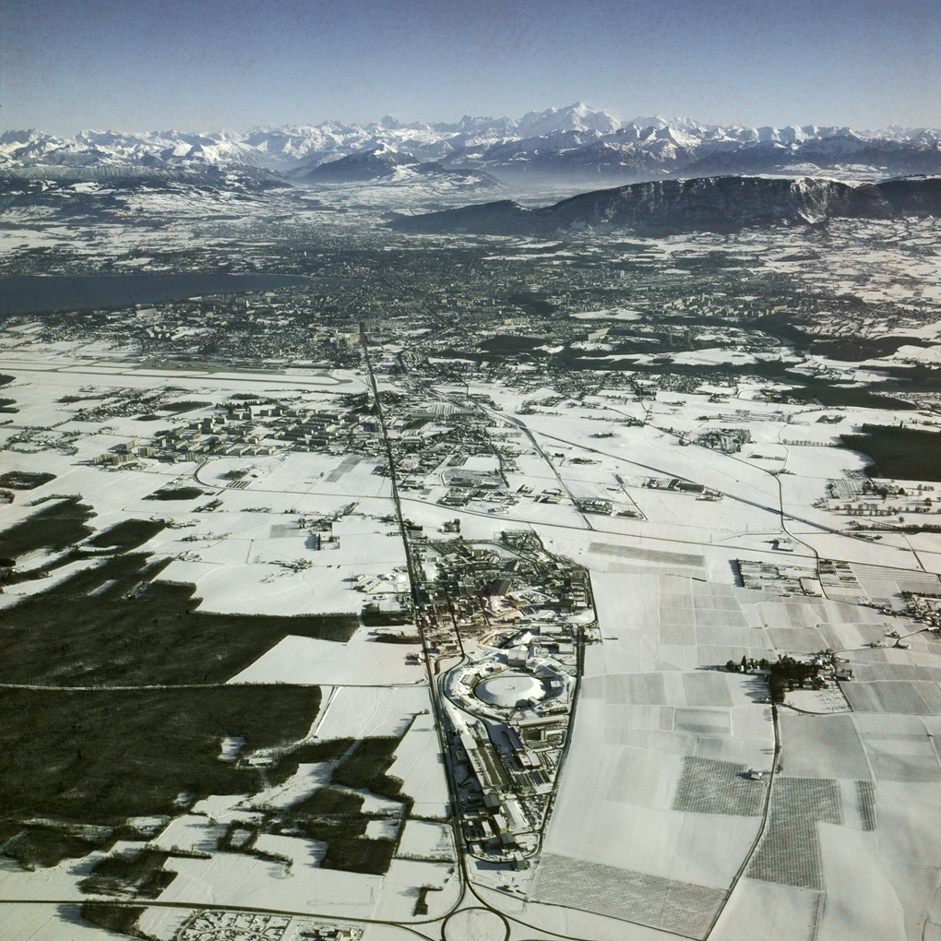
A short history of CERN
End of the 40’s: “Brain drain” towards the USA
December 1949: Louis de Broglie
(European Culture Conference)
1952: “Conseil Européen pour la Recherche Nucléaire” (CERN)
Organisation Européenne pour la Recherche Nucléaire
created on 29.9.1954
12 Member-states: B,CH, D, DK, F,GB, GR, I, N, NL, S, YU
40 ha in Meyrin (CH, GE)
Building the first two machines: SC and PS

Slide 3
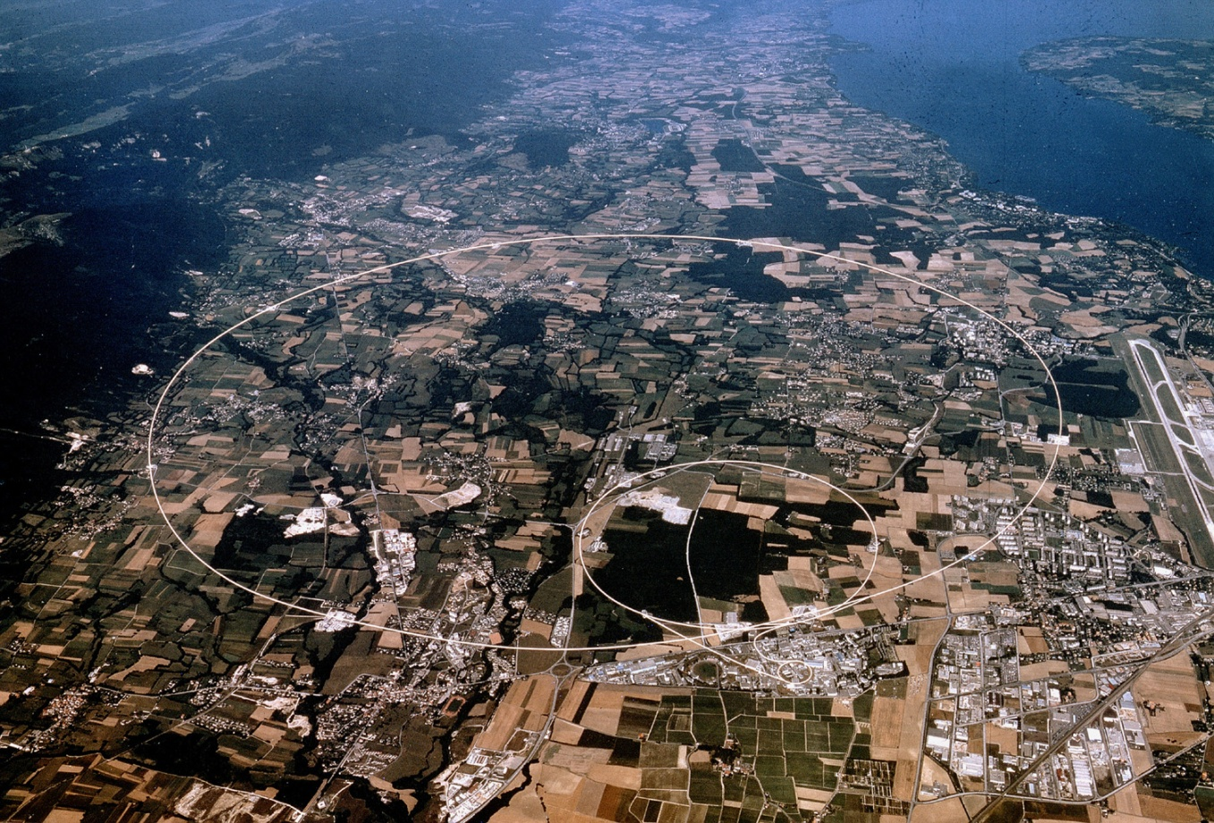
CERN today
490ha F
112ha CH

Slide 4
Châlet Aurel
ALICE
CMS, CCC, AMS, SPS BA3
Antimatter Factory
ISOLDE
Computer Centre
SM18
ATLAS
Linac2
LEIR
SynchroCyclotron
Reception
YOU ARE HERE
(6/2-008)
YOU were HERE
(Restaurant 1)

Slide 5
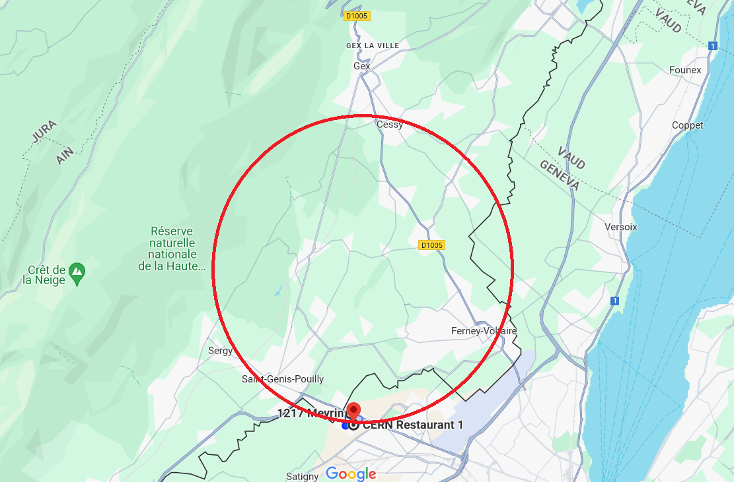
CERN today
CMS
490ha F
112ha CH
SM18
Welcome to CERN - D.Manglunki – February 2026

Slide 6
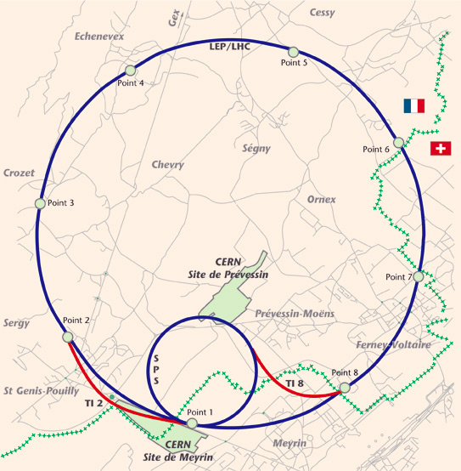
CMS
AMS
CCC
ALICE
LHCb
SM18
ATLAS
Welcome to CERN - D.Manglunki – February 2026

Slide 7
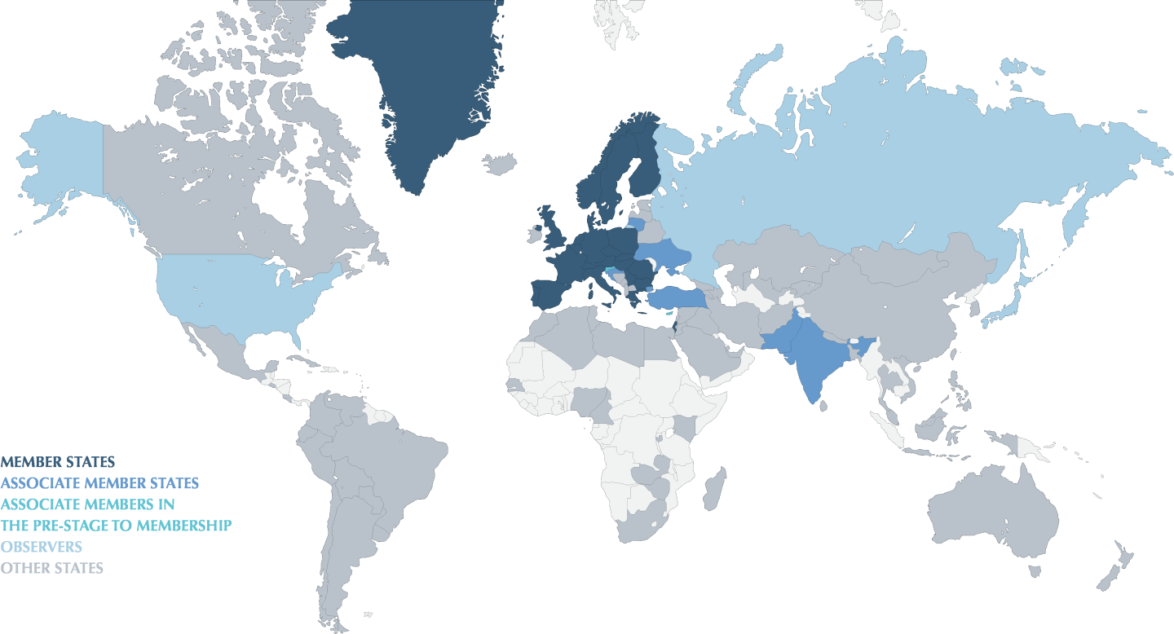
CERN today
25 Member States: Austria, Belgium, Bulgaria, Czech Republic, Denmark, Estonia, Finland, France, Germany, Greece, Hungary, Israel, Italy, Netherlands, Norway, Poland, Portugal, Romania, Serbia, Slovak Republic, Slovenia, Spain, Sweden, Switzerland, and United Kingdom.
Associate Member States: Brazil, Croatia, Cyprus, India,Ireland, Latvia, Lithuania, Pakistan, Türkiye, and Ukraine.
Observers: Japan, United States of America, the European Union, and UNESCO.

Slide 8
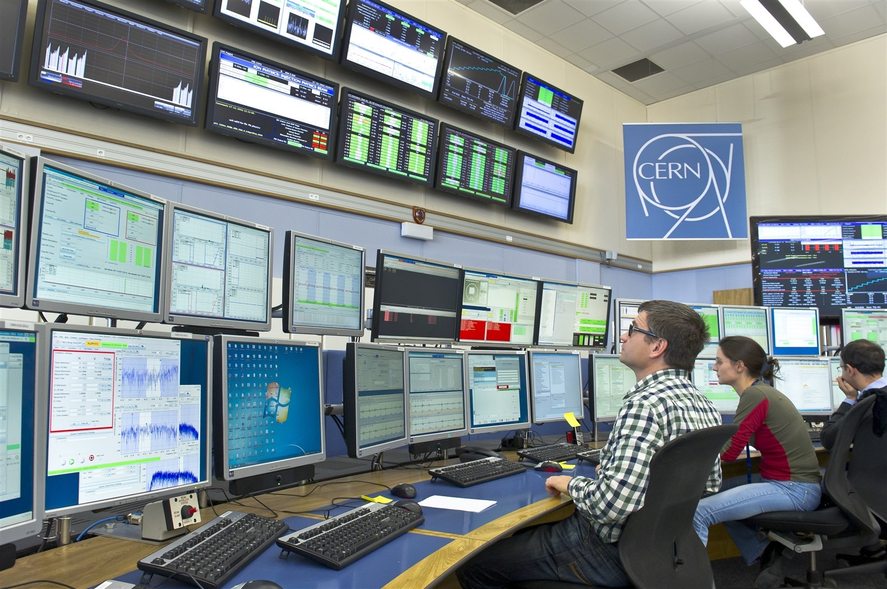
A few numbers
Budget (2022): 1405 MCHF
Staff (2021): 2676 out of which:
  87 research physicists
  1219 engineers
  844 technicians
  473 clerks and administrative staff
  53 manual workers
Fellows: ~800
Users: 12 400 scientists of 110 nationalities, from 560 institutes in more than 70 countries.
Electrical consumption:
~1.3 TWh/year (~200 MW from May to December)

Slide 9
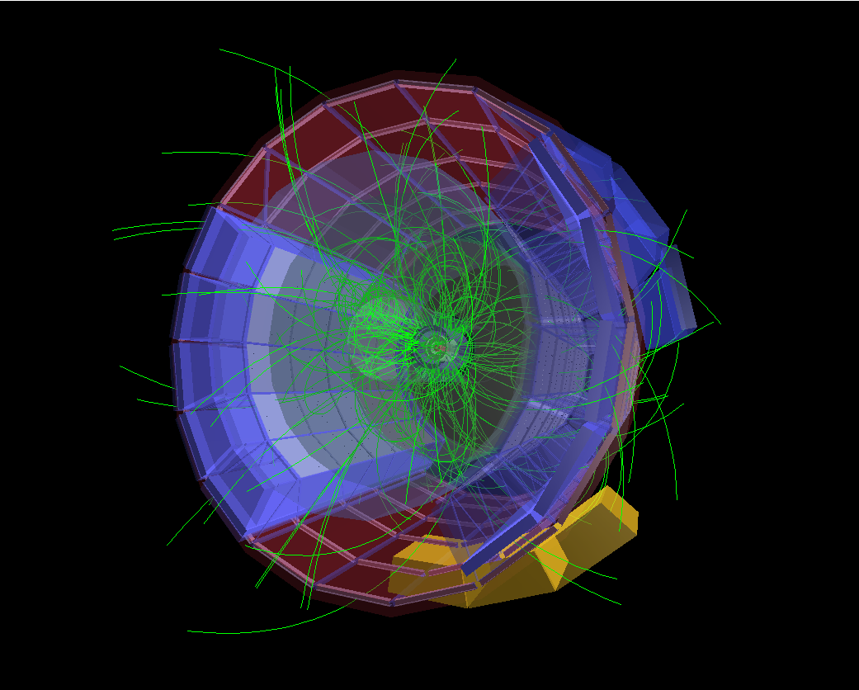
High Energy Physics
1 eV = one electron-Volt:
kinetic energy acquired by a particle carrying the same charge as the electron (e), experiencing a potential difference of 1 Volt
(chemistry, atomic and molecular physics, electronics)
1 keV = 1000 eV
1 MeV = 1000 keV = 1 million electron-Volts
(nuclear physics)
1 GeV = 1000 MeV = 1 billion electron-Volts
1 TeV = 1000 GeV = 1 trillion electron-Volts
(particle physics or High Energy Physics))

Slide 10
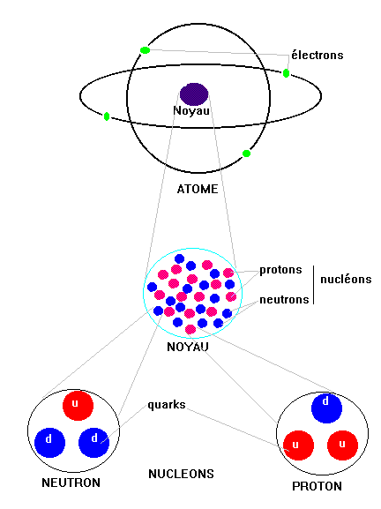
The Quark model
Question:
“What is it that holds the atomic nucleus together?”
Yukawa’s answer:
“Protons and neutrons exchange pions”
Study of pions, leading to the discovery of a whole realm of new particles
The quarks model

Slide 11
The four interactions
Gravitation
  cohesion of the solar system
  pendulum
Electromagnetism
  cohesion of the atoms
  telephone
Strong nuclear interaction
  cohesion of the atomic nucleus
  nuclear fission power plants
Weak nuclear interaction
  neutron disintegration
  fusion energy

Slide 12
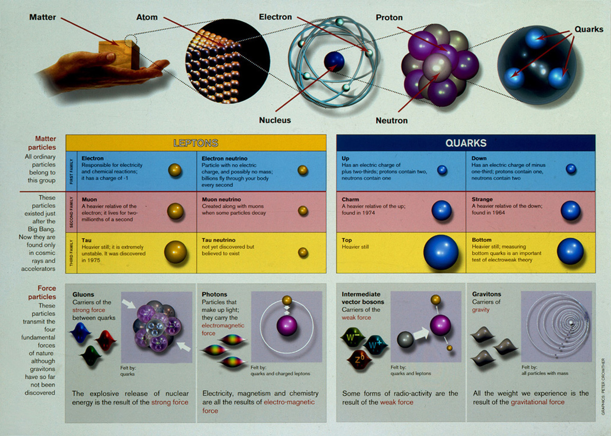
Le “modèle standard”
The Standard Model

Slide 13
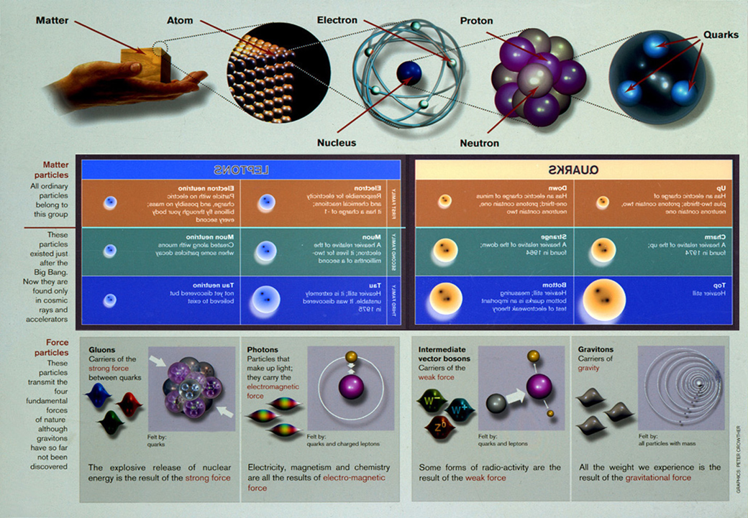
The Standard Model
Anti

Slide 14
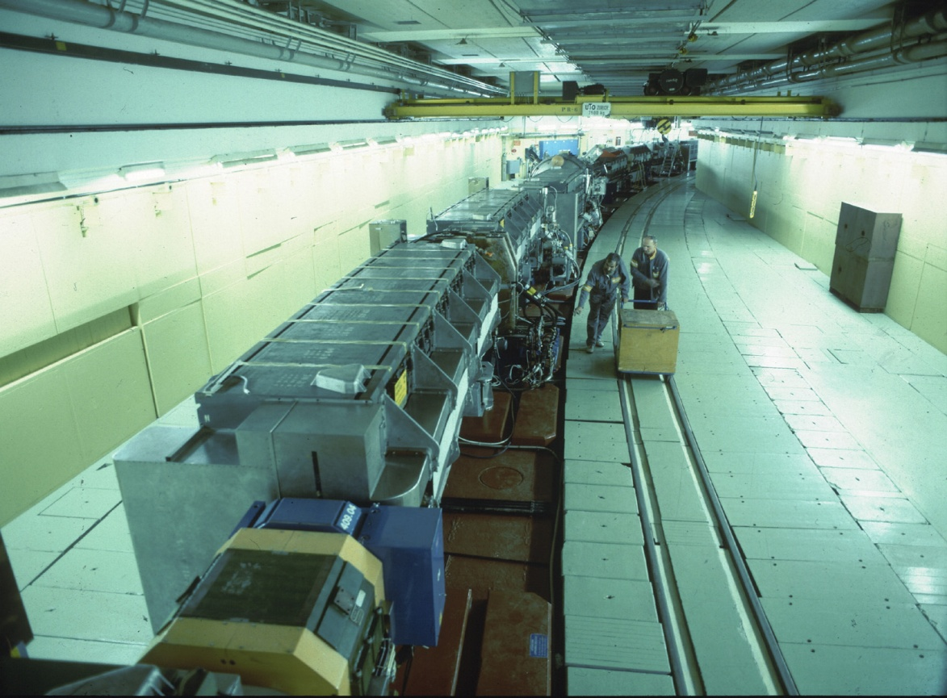
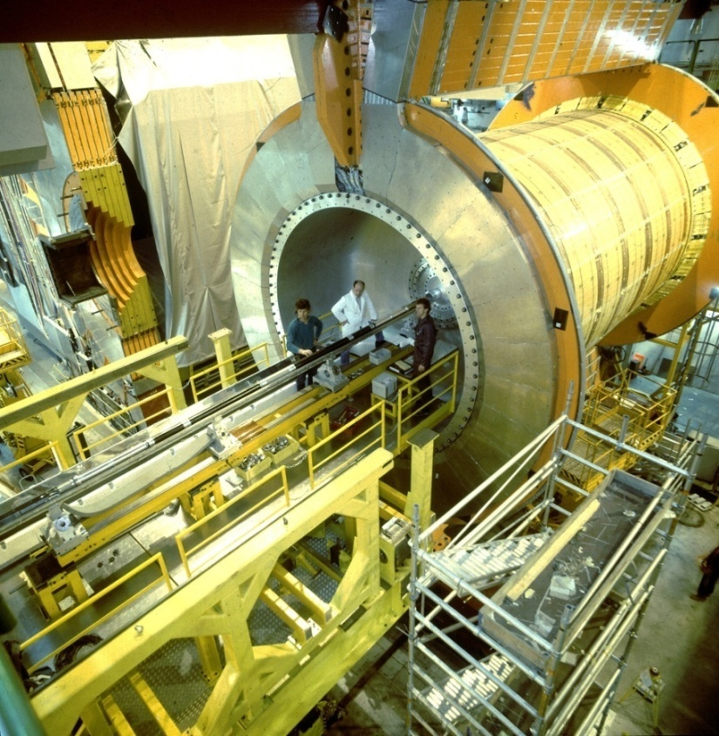
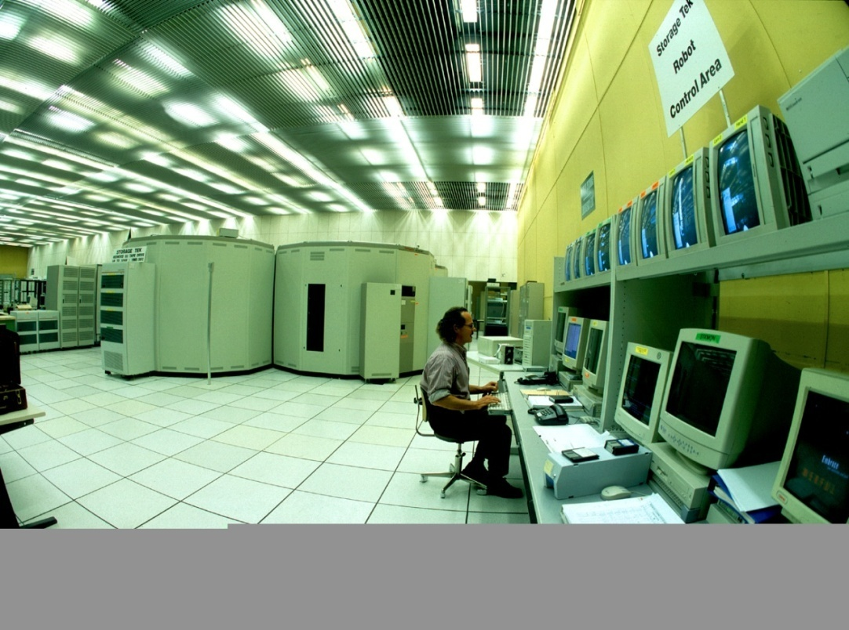
The tools
Accelerators
Detectors
Computers

Slide 15
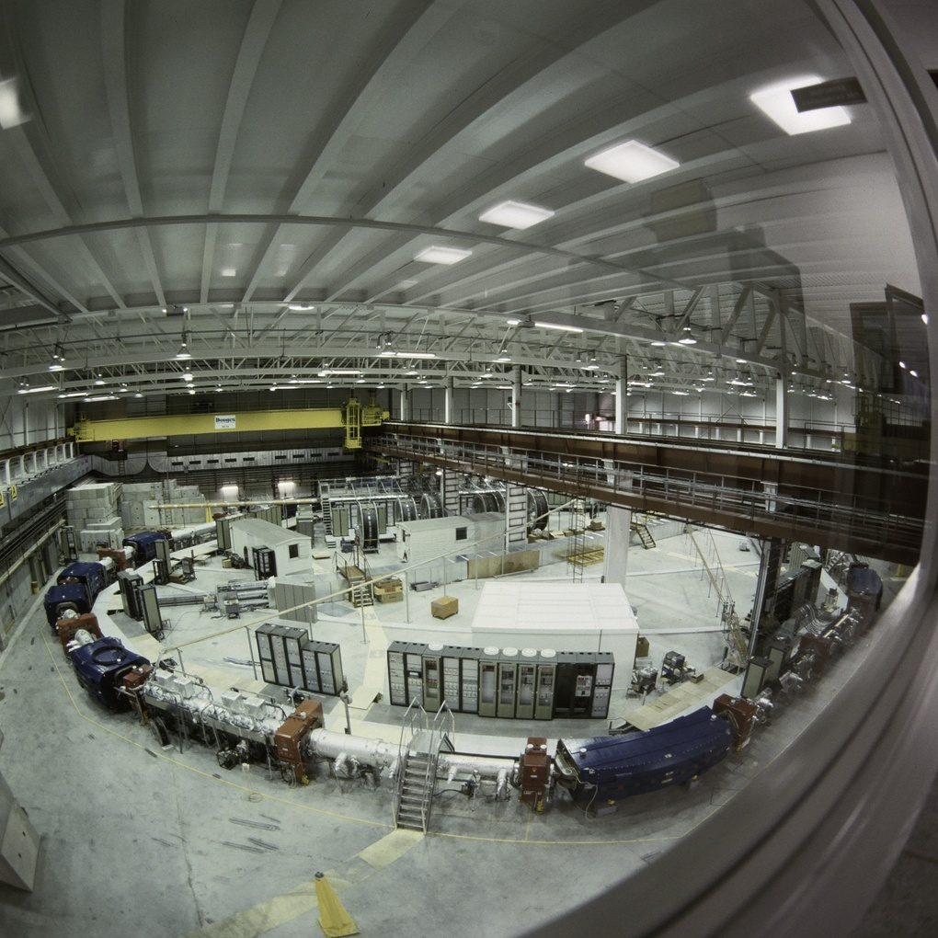
Accelerators
Send projectile particle against target particle
  The collision energy, in turn, produces new particles: E = mc²
Colliders: two projectiles are sent against each other

Slide 16
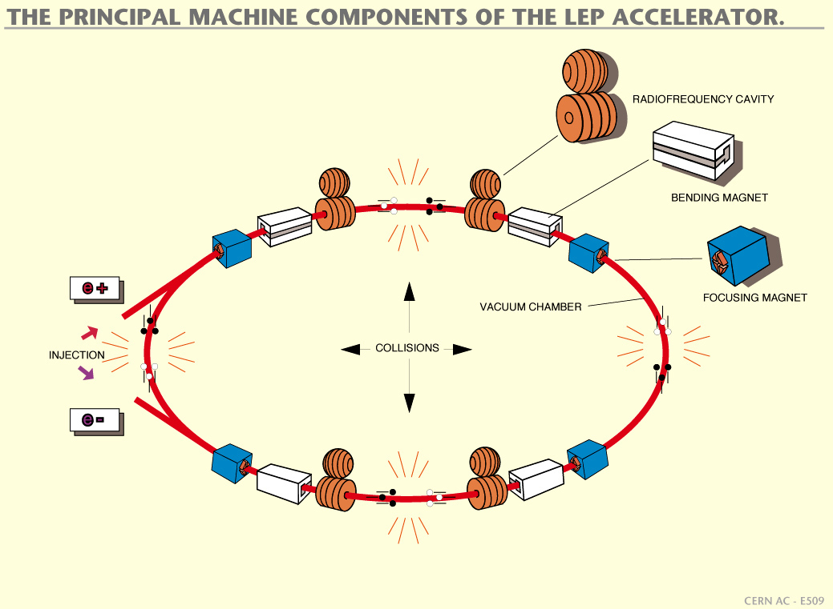

Slide 17
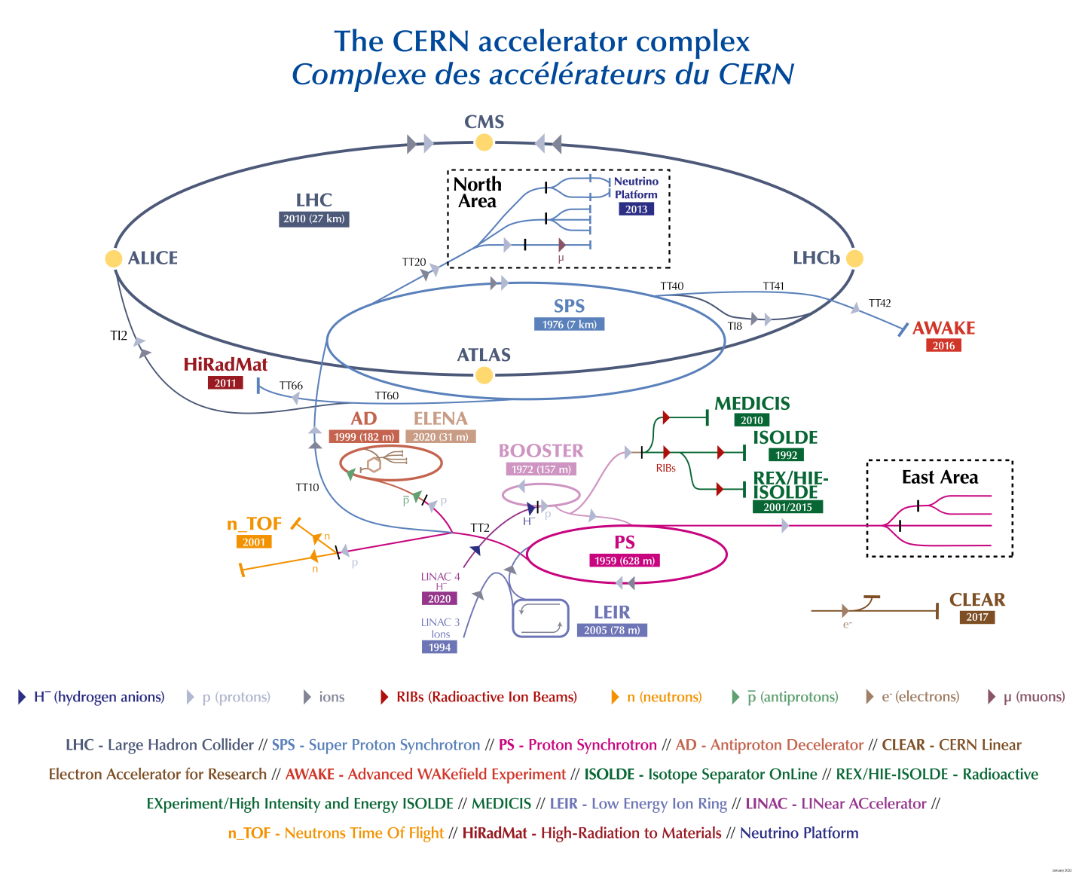

Slide 18
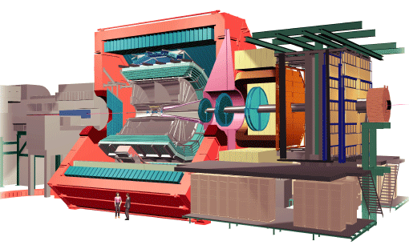
Detectors
Based on the principle of the interaction between charged particles and matter
Identification of the resulting particles
Measurement of their energy
Bubble chambers, wire chambers, spark chambers, scintillators, semi-conductors ...

Slide 19
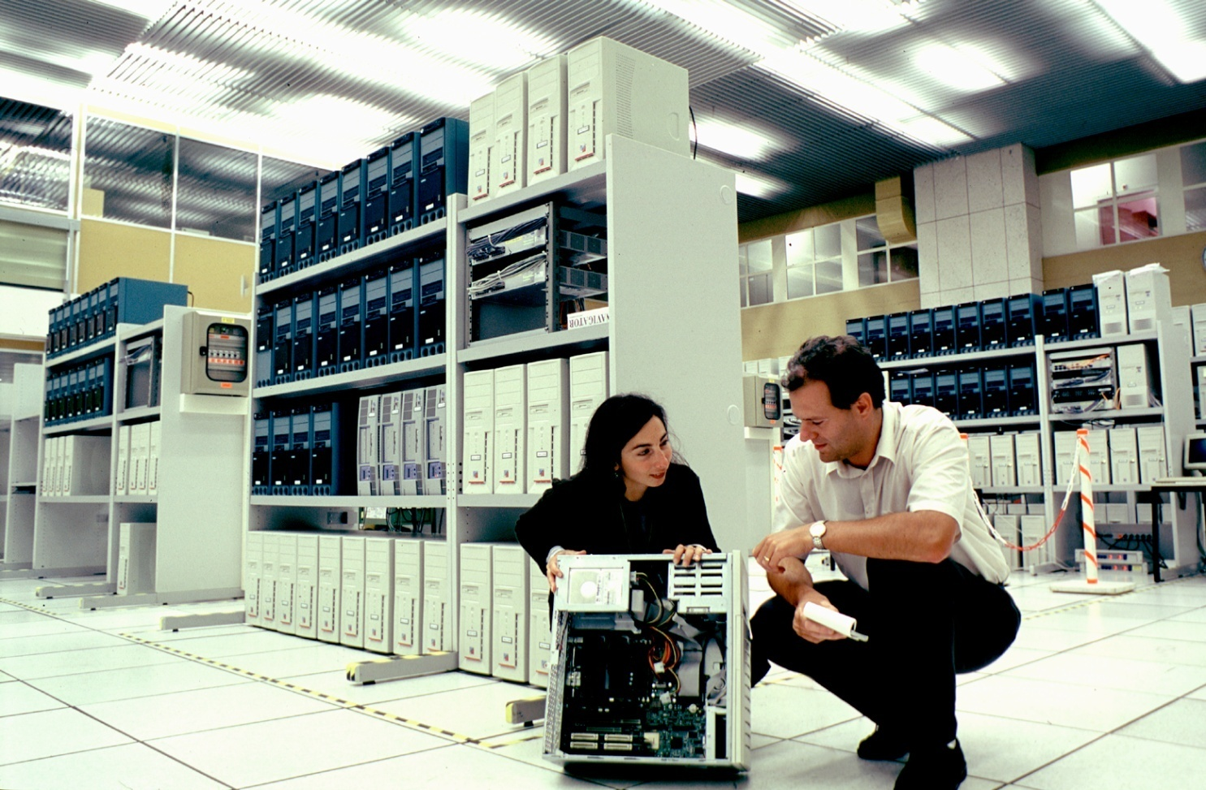
Computers
TH computations, simulations , ...
Accelerator controls
Detector controls
Data analysis

Slide 20
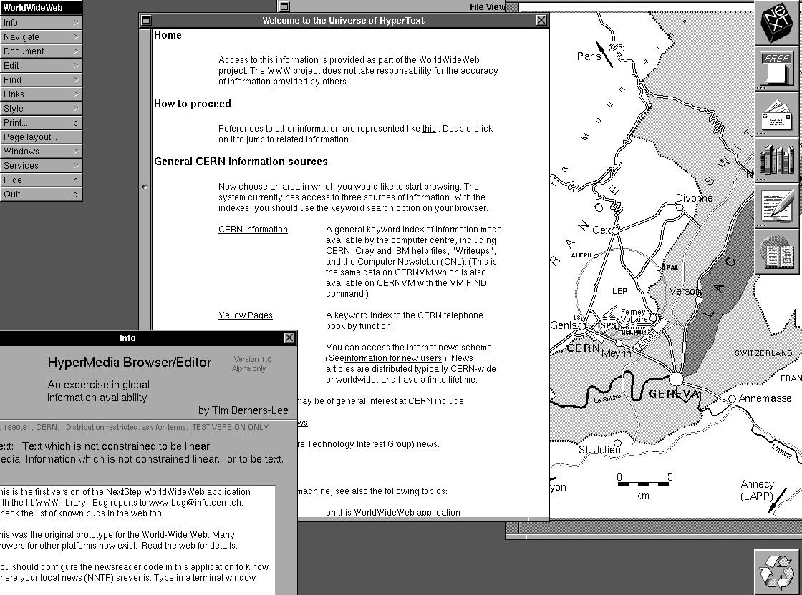
CERN’s usefulness
Fundamental research
Technological leaps
Technology transfer to the industry
Examples (non exhaustive list):
  superconductivity
  synchrotron light
  medical accelerators and detectors
  control systems
  supercomputers
New ideas:
  W W W
  Energy amplifier

Slide 21
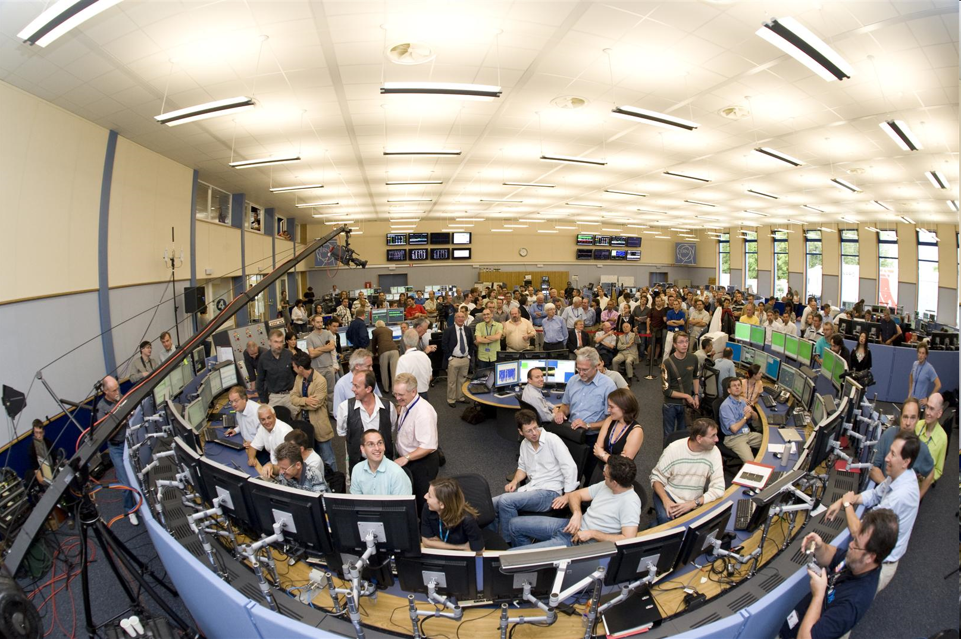
Thanks for your attention!

Slide 22
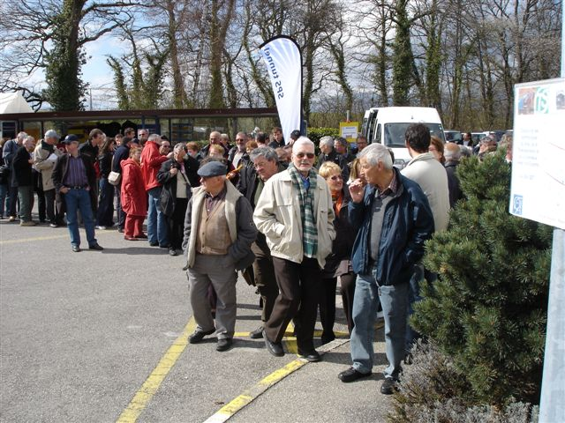
A virtual visit of our accelerator complex…

Slide 23
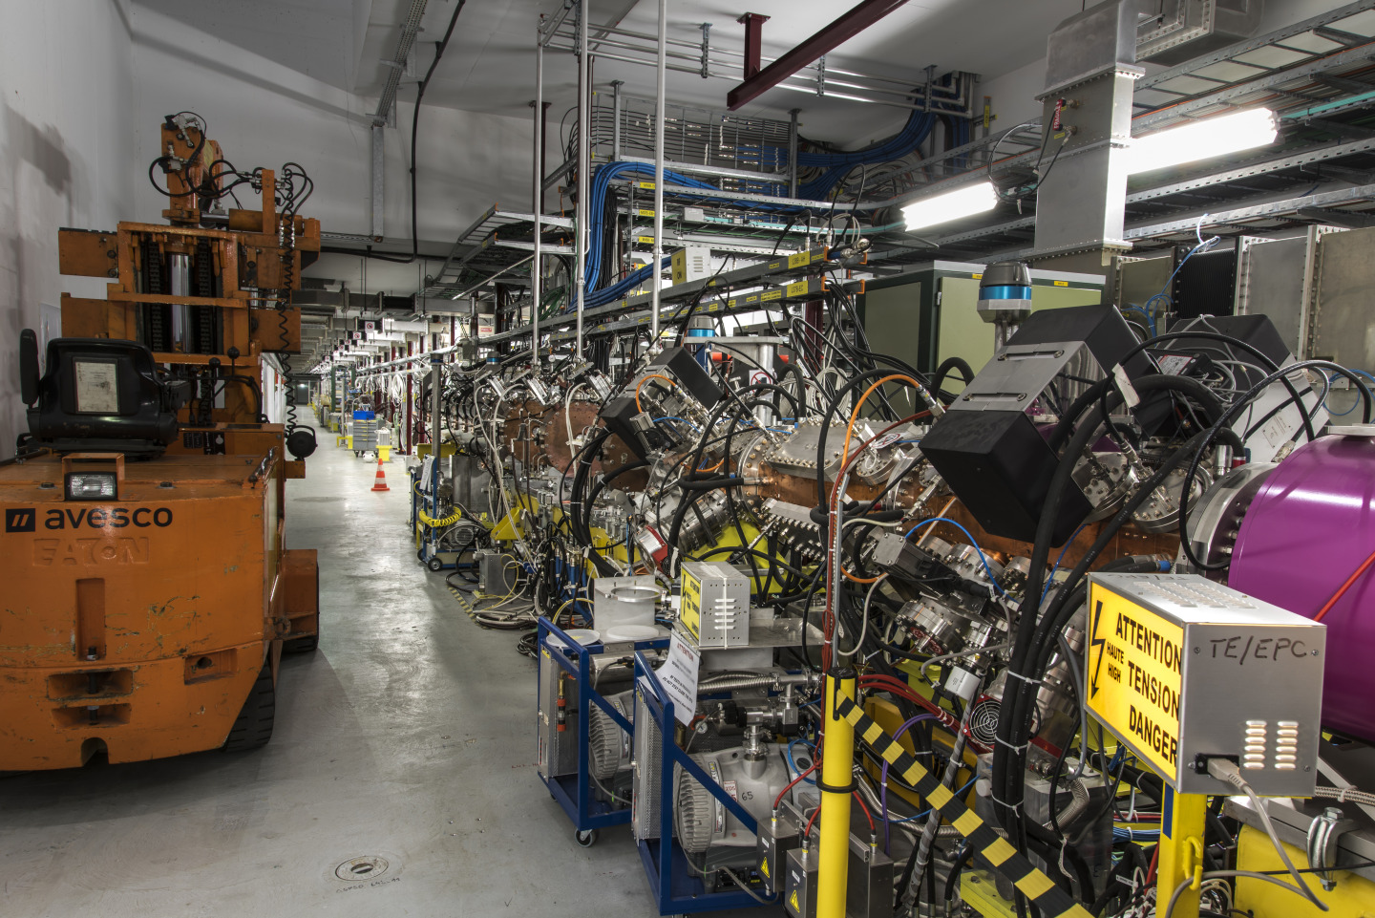

Slide 24
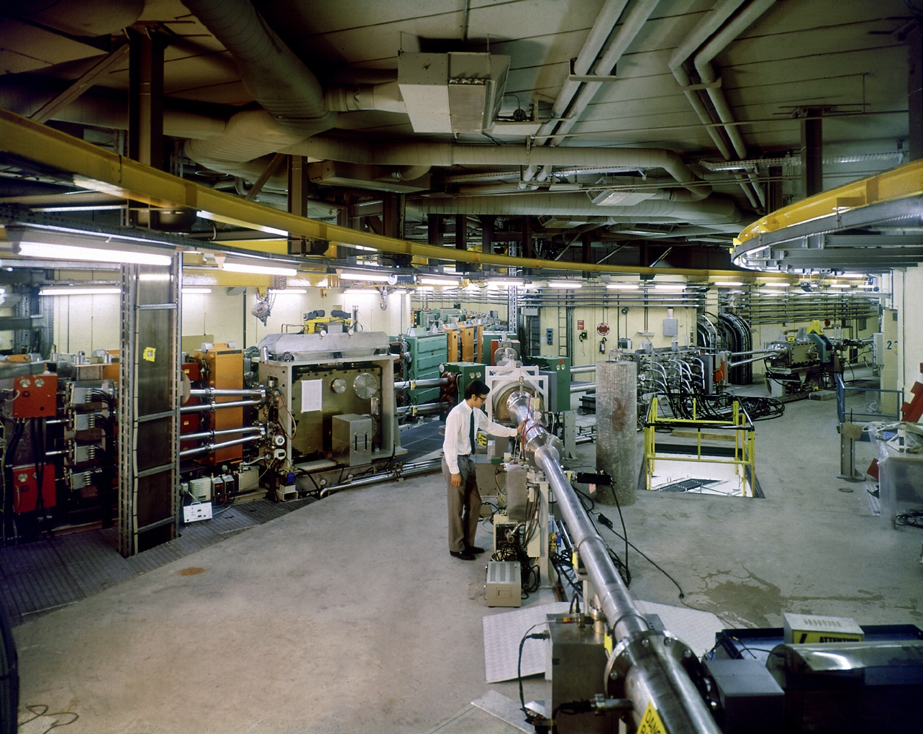

Slide 25
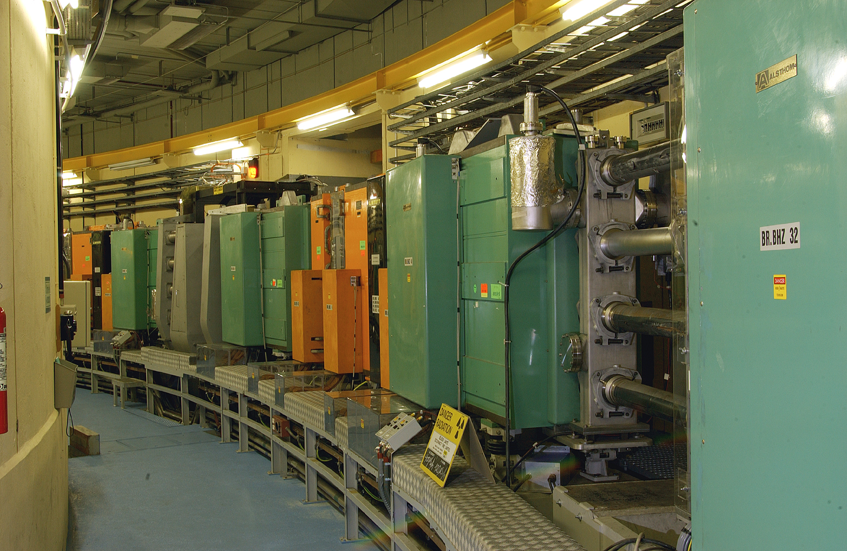

Slide 26
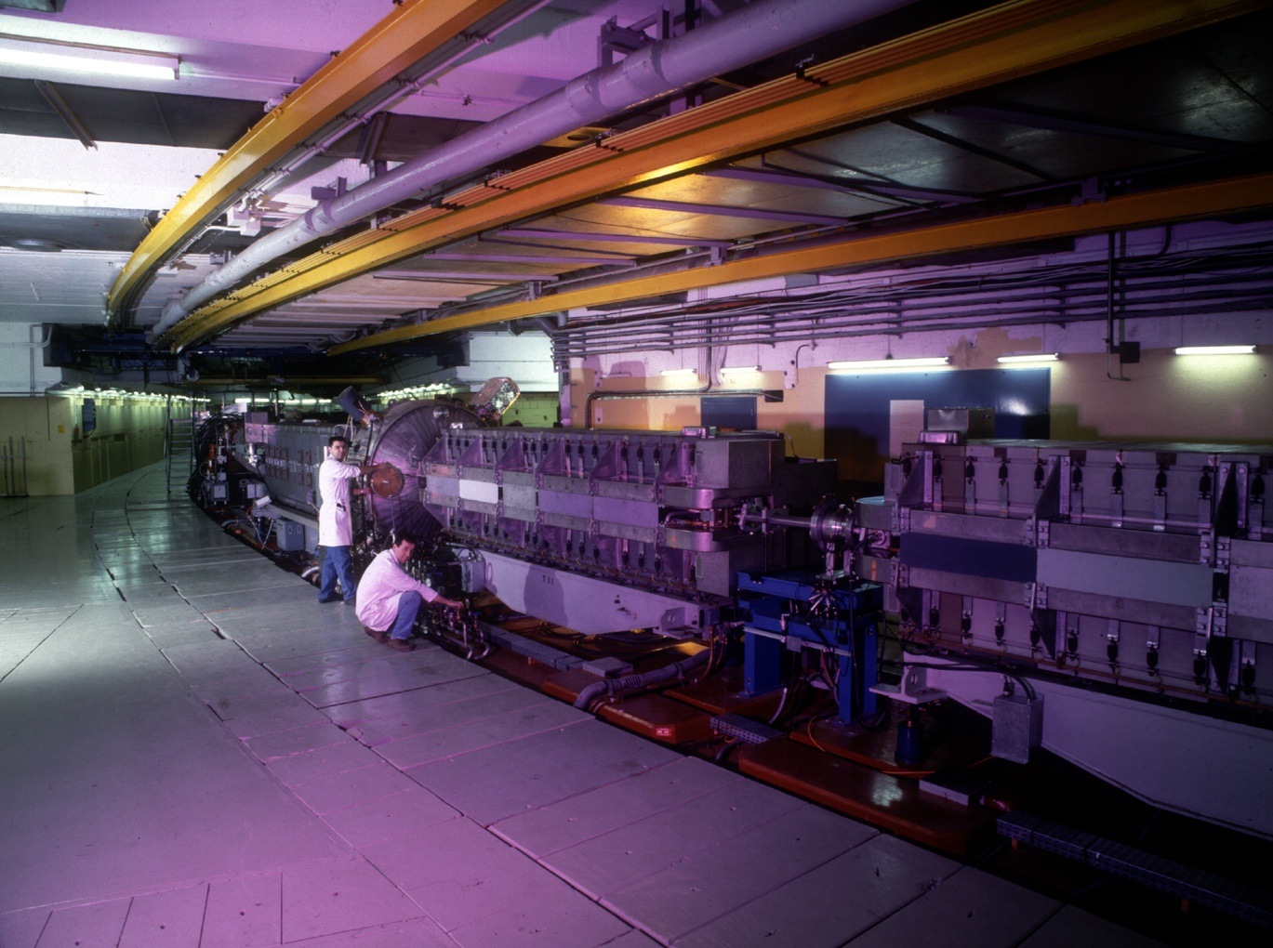

Slide 27
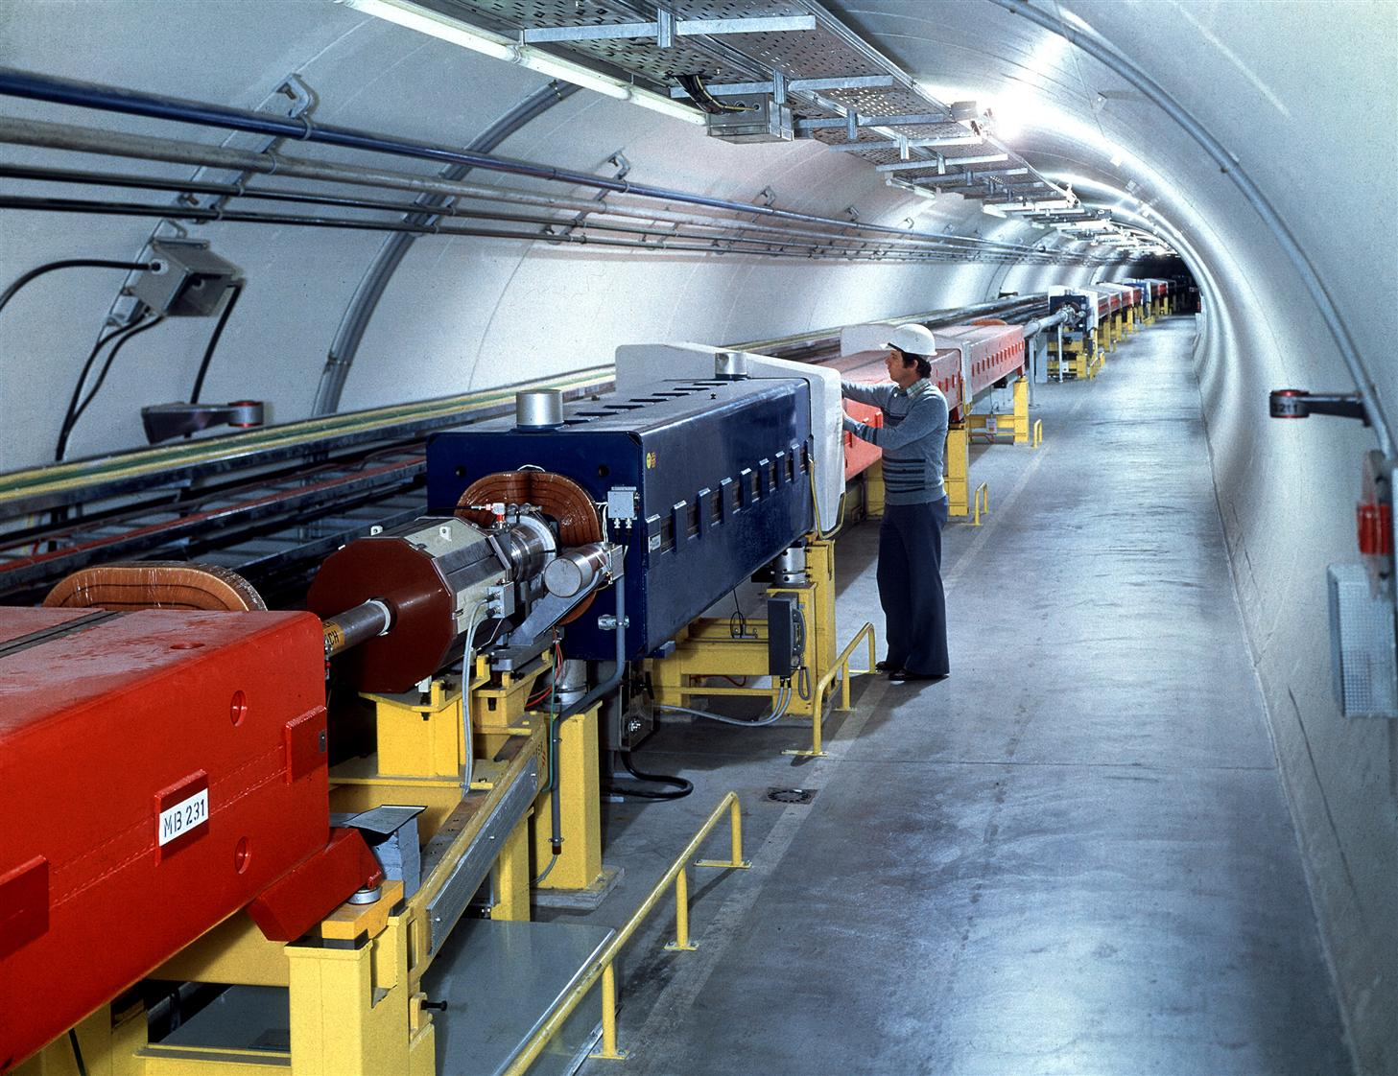

Slide 28
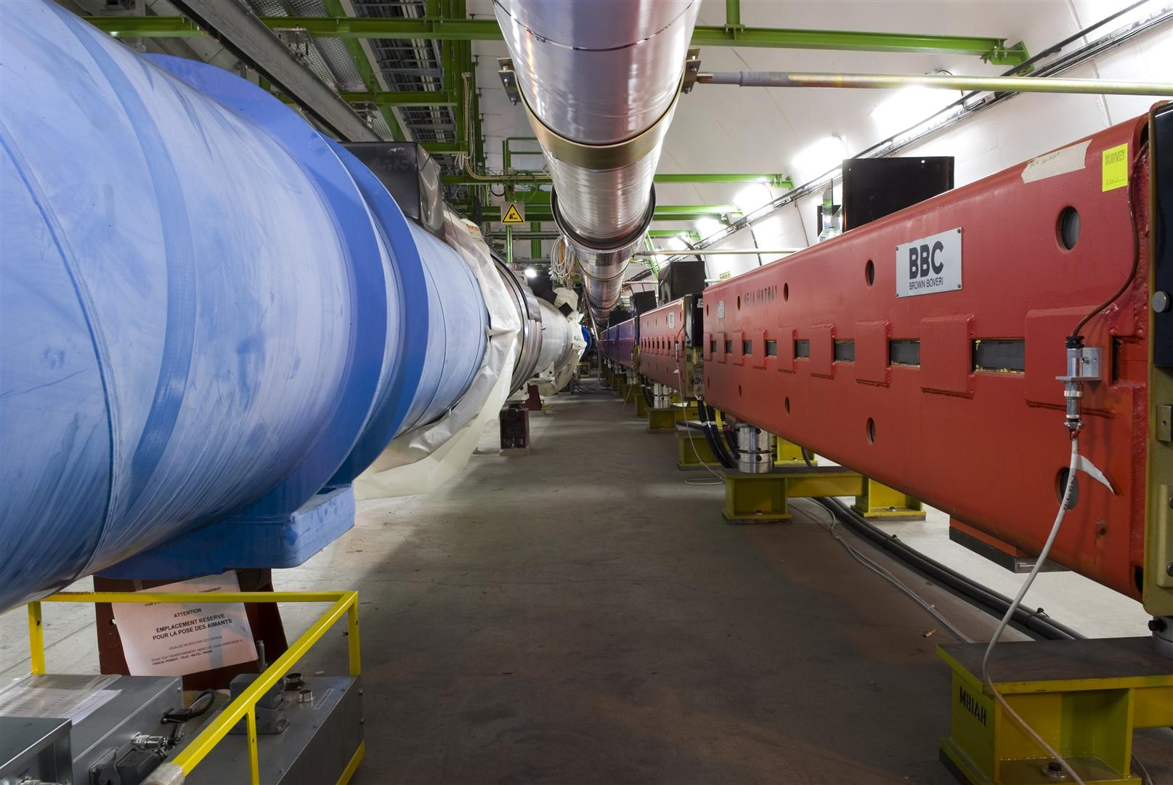

Slide 29
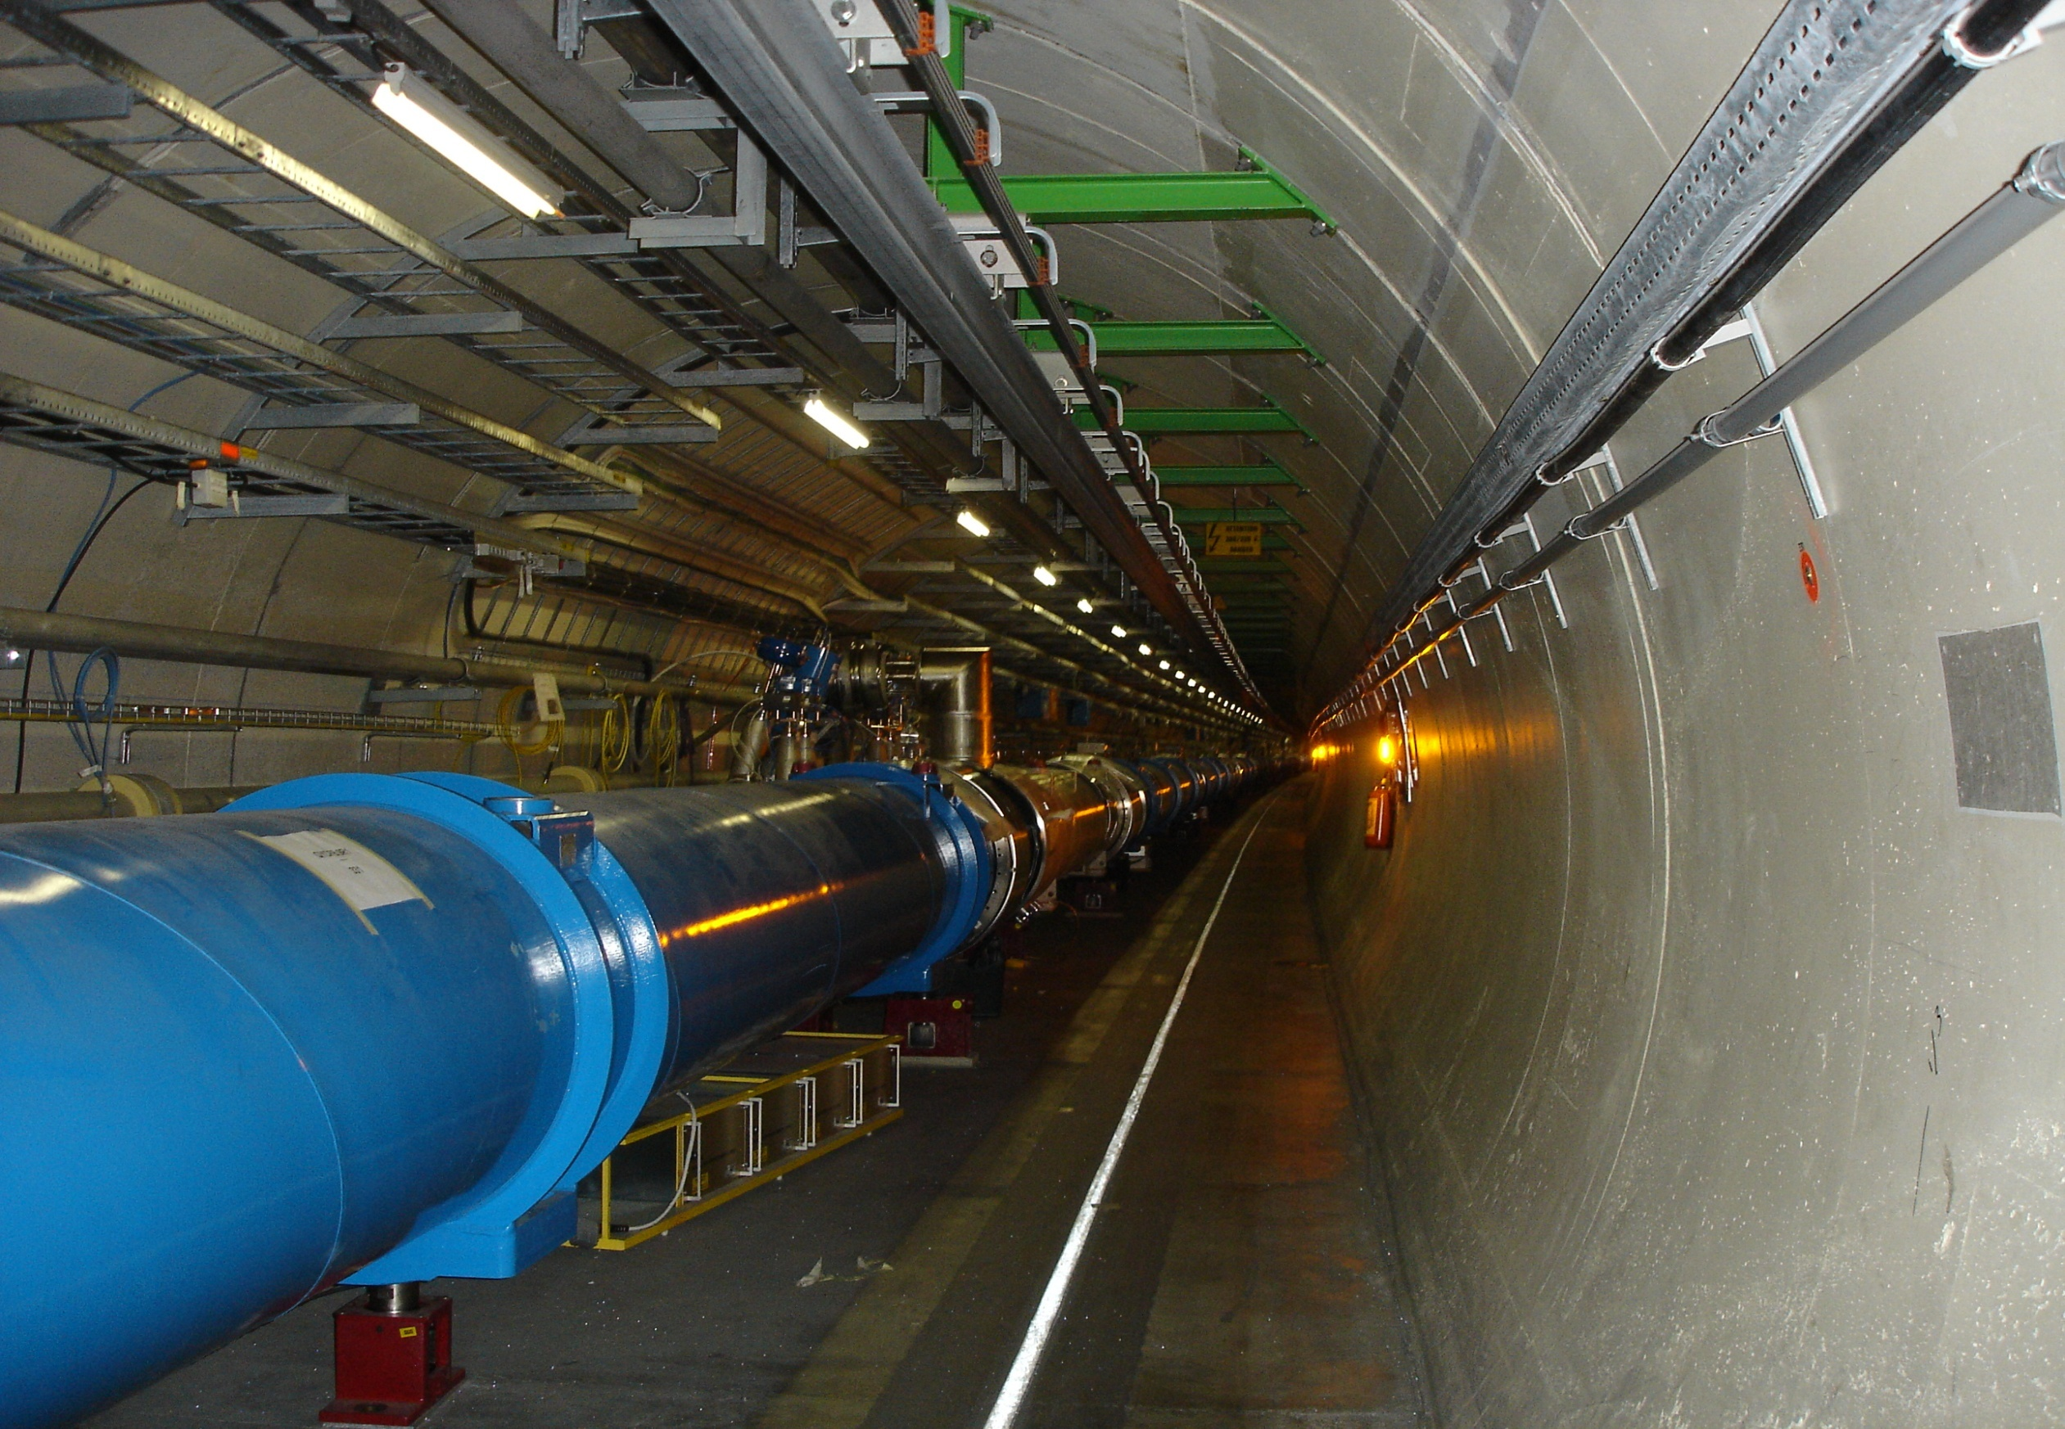

Slide 30
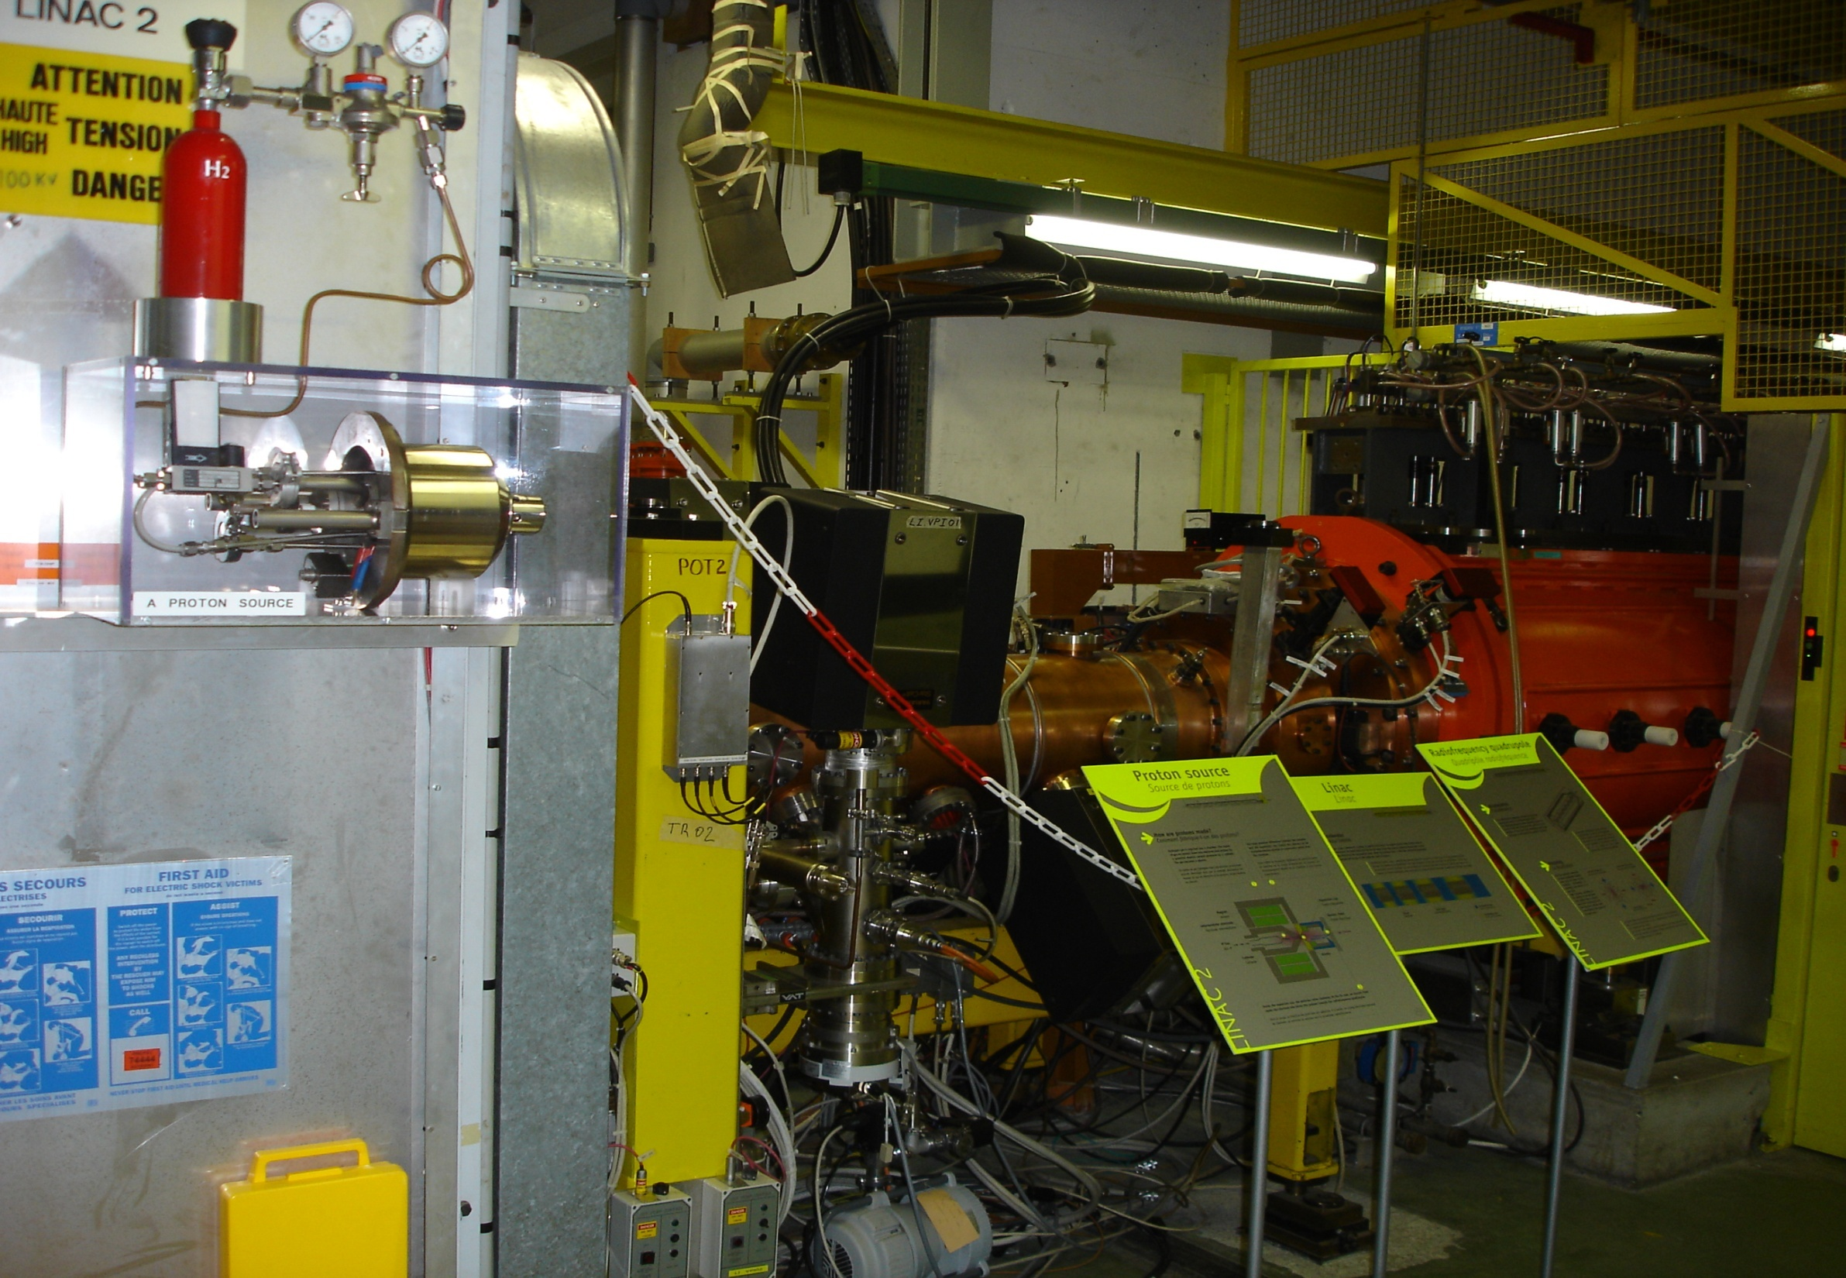
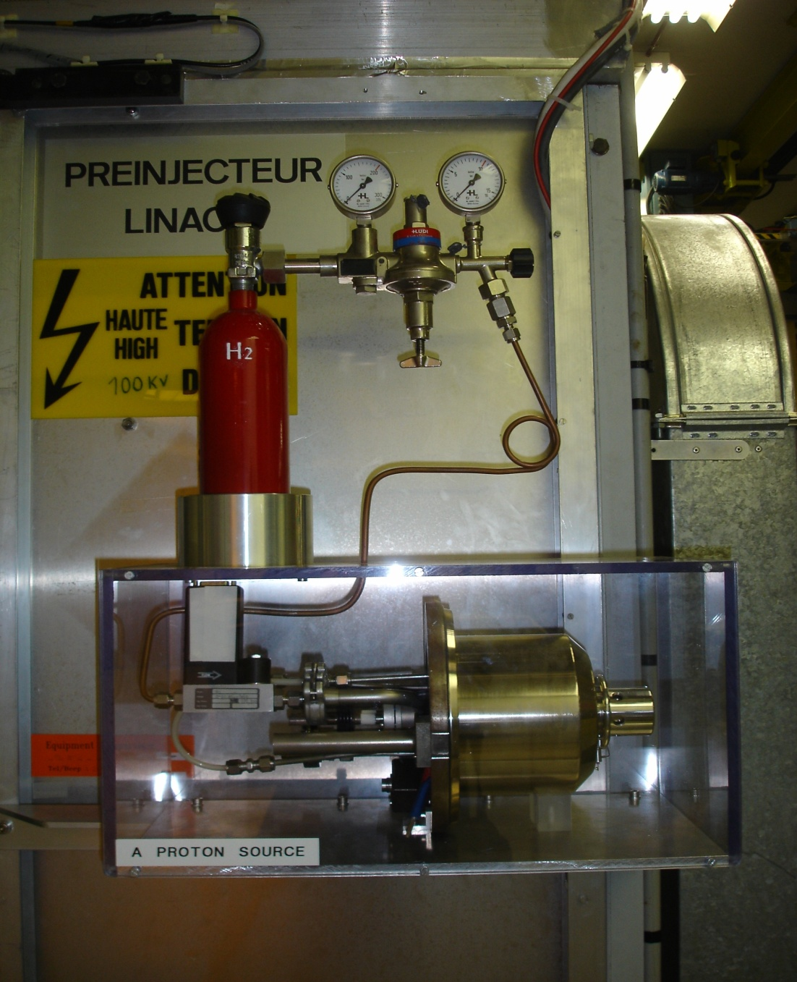

Slide 31
