Slide 1
Introduction to longitudinal beam dynamics
Course objectives:
Give an overview of the longitudinal dynamics of beam particles in accelerators
Understand the issue of synchronization between the particles and the accelerating cavity
The course will focused on synchrotrons and the synchrotron motion
We will discuss radio-frequency resonators and the transit time factor

Slide 2
Part 2

Slide 3
Part 2 covers:
LONGITUDINAL PHASE SPACE AND SEPARATRIX
CASE 1: NO ACCELERATION (ABOVE TRANSITION):
  STATIONARY BUCKET
  SEPARATRIX
CASE 2: ACCELERATION (ABOVE TRANSITION)
RF BUCKET PARAMETERS
  PHASE SPACE AREA
  BUCKET AREA OR LONGITUDINAL ACCEPTANCE
  BUCKET WIDTH
  BUCKET HIGHT
  SINGLE PARTICLE LONGITUDINAL EMITTANCE

Slide 4
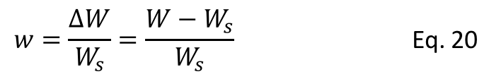

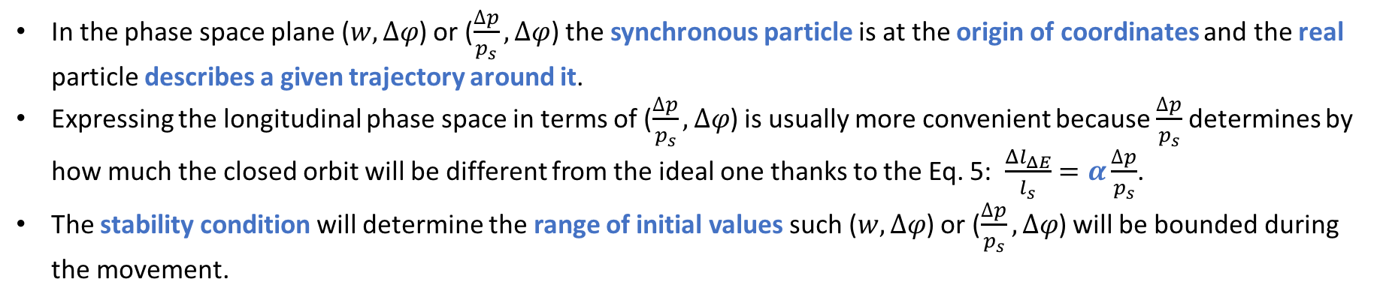
LONGITUDINAL PHASE SPACE AND SEPARATRIX
In the phase space plane ($w,∆φ$) or ($\frac{∆p}{p_{s}},∆φ$) the synchronous particle is at the origin of coordinates and the real particle describes a given trajectory around it.
Expressing the longitudinal phase space in terms of ($\frac{∆p}{p_{s}},∆φ$) is usually more convenient because $\frac{∆p}{p_{s}}$ determines by how much the closed orbit will be different from the ideal one thanks to the Eq. 5: $\frac{{Δl}_{ΔE}}{l_{s}}=α\frac{∆p}{p_{s}}$.
The stability condition will determine the range of initial values such ($w,∆φ$) or ($\frac{∆p}{p_{s}},∆φ$) will be bounded during the movement.
As we said in Part I, in order to obtain the first equation of motion, Eq. 25, we have assumed that the beam energy can be change only by the applied RF field, and we have neglected any other energy variation due to interaction with the environment or the synchrotron radiation.
We are dealing with a conservative system and therefore there has to be an invariant and this is usually the energy. Let’s calculate the invariant.
From Part I:
$$w=\frac{∆W}{W_{s}}=\frac{W−W_{s}}{W_{s}}$$ | Eq. 20
$$∆φ=φ−φ_{s}$$ | Eq. 21

Slide 5
To obtain the invariant we cross multiply equations 25 and 34, the first and second equation of motion, and we integrate:
$$\dot{w}=\frac{qV_{max}Ω_{s}}{2πW_{s}} (sin⁡(Δφ+φ_{s})−sinφ_{s})$$ | Eq. 25
FIRST EQUATION OF MOTION
$$\dot{Δφ=}\frac{δ(Δφ)}{δt}={hΓ_{s}Ω}_{s}w$$ | Eq. 34
SECOND EQUATION OF MOTION
$${hΓ_{s}Ω}_{s}wdw=\frac{qV_{max}Ω_{s}}{2πW_{s}}\left(\sin\left(Δφ+φ_{s}\right)−sinφ_{s}\right)dφ$$ | Eq. 45
Now we integrate Eq. 45 and define as integration constant, C, the one that for $∆φ$=w=0 ➔ Total Energy = 0:
$$\int{wdw−}\int_{φ_{s}}^{φ}{\frac{qV_{max}}{2π{hΓ_{s}W}_{s}}\left(\sin\left(Δφ+φ_{s}\right)−sinφ_{s}\right)dφ}=C$$ | Eq. 46
$${\frac{1}{2}w^{2}}_{}+\frac{qV_{max}}{2πh{{Γ_{s}W}_{s}}_{}}\left(\cos\left(Δφ+φ_{s}\right)−cosφ_{s}+Δφsinφ_{s}\right)=Total Energy=Hamiltonian$$ | Eq. 47
Kinetic energy
Potential energy (for a sinusoidal RF field)
“This first integral is the equation of the trajectories in phase space.
The value of the energy of the system is given by the initial conditions”.

Slide 6
For a general RF field, the Hamiltonian is:
The potential energy is “minus” the integral of the RF voltage
$${\frac{1}{2}w^{2}}_{}−\int_{φ_{s}}^{φ}{\frac{q}{2πh{{Γ_{s}W}_{s}}_{}}\left[V\left(φ^{′}\right)−V\left(φ_{s}\right)\right]dφ^{′}}=Total Energy=Hamiltonian$$ | Eq. 48
The voltage function can be single harmonic (one RF system): $V\left(φ\right)=V_{max}sinφ$
The voltage function can be double harmonic (two RF systems): $V\left(φ\right)=V_{max}^{A}sinφ+V_{max}^{B}sin⁡(nφ+∅)$
where n is the frequency ratio of both RF systems and $∅$ is the relative phase between them.
It can be shown that:
$$\frac{∂Hamiltonian}{∂∆φ}=−\frac{δ}{δt}\left(\frac{ΔW}{Ω_{s}}\right)$$ | Eq. 49
$$\frac{∂Hamiltonian}{∂\left(\frac{ΔW}{Ω_{s}}\right)}=\frac{δ}{δt}∆φ$$ | Eq. 50
Canonical Hamiltonian equations
$$\dot{w}=\frac{qV_{max}Ω_{s}}{2πW_{s}} (sin⁡(Δφ+φ_{s})−sinφ_{s})$$ | Eq. 25
FIRST EQUATION OF MOTION
$$\dot{Δφ=}\frac{δ(Δφ)}{δt}={hΓ_{s}Ω}_{s}w$$ | Eq. 34
SECOND EQUATION OF MOTION

Slide 7
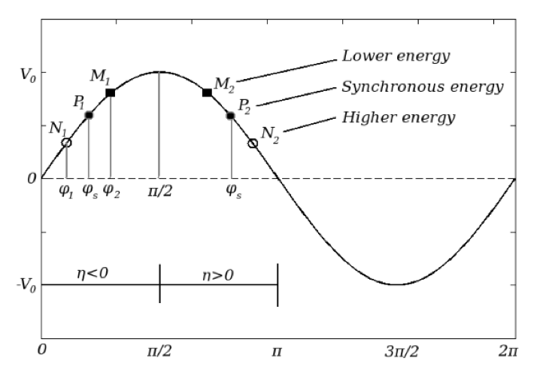


The stability of the particle motion can be better understood from the plot of the RF potential.
Let’s plot the potential energy of the Hamiltonian of Eq. 47
$$U\left(Δφ\right)=\frac{qV_{max}}{2πh{{Γ_{s}W}_{s}}_{}}\left(\cos\left(Δφ+φ_{s}\right)−cosφ_{s}+Δφsinφ_{s}\right)$$ | Eq. 51
CASE 1: NO ACCELERATION (ABOVE TRANSITION) ➔ STATIONARY BUCKET
Let’s study the potential energy when there is no acceleration and we are above transition ➔ $φ_{s}=π$
$$U\left(Δφ\right)=\frac{qV_{max}}{2πh{{Γ_{s}W}_{s}}_{}}\left(1−cos{Δφ}\right)=\frac{qV_{max}}{2πh{{Γ_{s}W}_{s}}_{}}\left(1+cos{φ}\right)$$ | Eq. 52
with $∆φ=φ−φ_{s}$
$$[\frac{π}{2},π]$$

Slide 8
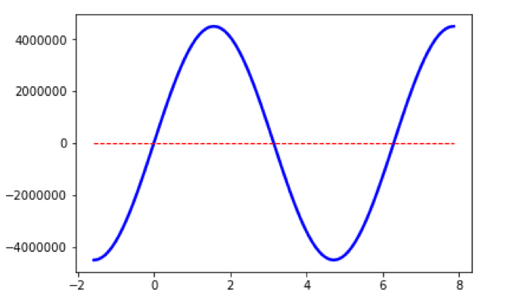
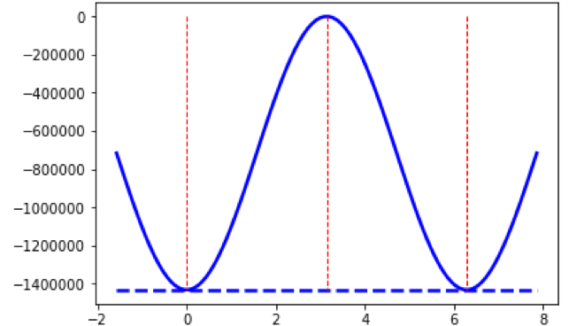
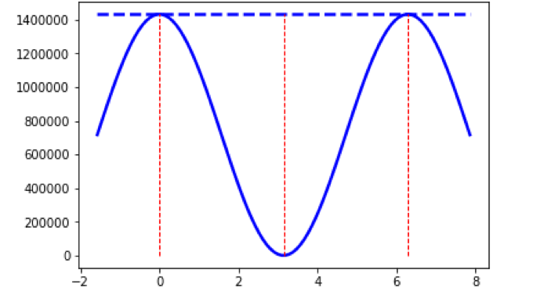
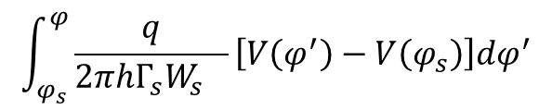
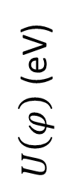

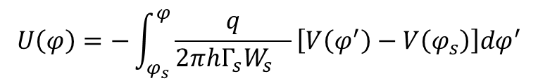




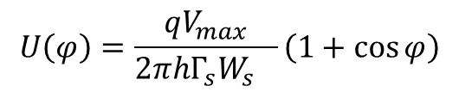
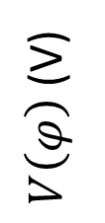

# case 1: SPS protons above transition, no acceleration, q = 1, V_{max} = 4.5e6 V
$V\left(φ\right)$ (V)
$$V\left(φ\right)=V_{max}sinφ$$
$$V\left(φ_{s}\right)=V_{max}sinφ_{s}=0$$
➔ “no acceleration”
$U\left(φ\right)$ (eV)
$$\int_{φ_{s}}^{φ}{\frac{q}{2πh{{Γ_{s}W}_{s}}_{}}\left[V\left(φ^{′}\right)−V\left(φ_{s}\right)\right]dφ^{′}}$$
The potential energy is “minus” the integral of the RF voltage
$$U\left(φ\right)=−\int_{φ_{s}}^{φ}{\frac{q}{2πh{{Γ_{s}W}_{s}}_{}}\left[V\left(φ^{′}\right)−V\left(φ_{s}\right)\right]dφ^{′}}$$
$U\left(φ\right)$ (eV)
$$φ_{s}=π$$
$$π−φ_{s}$$
$$U\left(φ\right)=\frac{qV_{max}}{2πh{{Γ_{s}W}_{s}}_{}}\left(1+cos{φ}\right)$$
$$φ$$

Slide 9
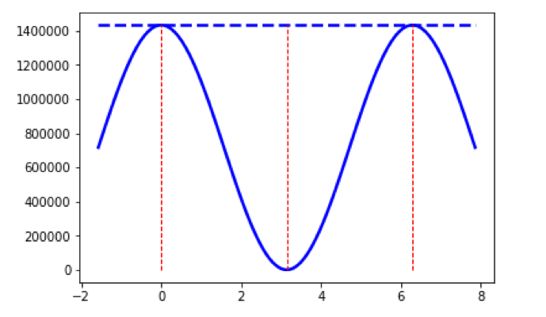



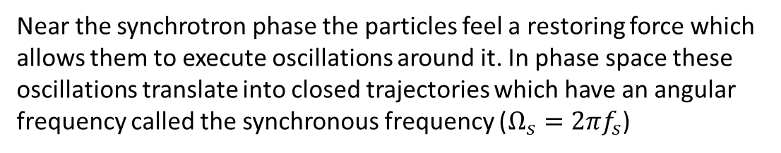
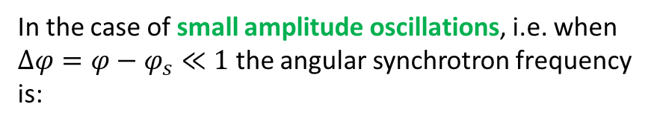
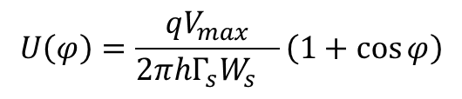
$$U\left(φ\right)=\frac{qV_{max}}{2πh{{Γ_{s}W}_{s}}_{}}\left(1+cos{φ}\right)$$
Near the synchrotron phase the particles feel a restoring force which allows them to execute oscillations around it. In phase space these oscillations translate into closed trajectories which have an angular frequency called the synchronous frequency ($Ω_{s}=2πf_{s}$)
$U\left(φ\right)$ (eV)
$$φ_{s}=π$$
In the case of small amplitude oscillations, i.e. when $∆φ=φ−φ_{s}≪1$ the angular synchrotron frequency is:
$$Ω_{sy}^{}=\sqrt{−\frac{q{hΓ_{s}V}_{max}cosφ_{s}}{2πW_{s}}}Ω_{s}^{}$$ | Eq. 35’
$$φ$$
# case 1: SPS protons above transition, no acceleration, q = 1, V_{max} = 4.5e6 V
However, the trajectories of the particles with large deviation from $φ_{s}$are not bounded any more by the potential well and so their motion is not oscillatory.
The division of the phase space into regions of bounded and unbounded motion in synchrotrons is the reason of grouping the particles into bunches.
The boundary between both regions is called the SEPARATRIX.
The phase space area enclosed by the separatrix is called the BUCKET.

Slide 10



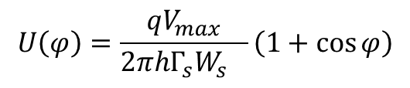
Let’s now calculate the trajectories in phase space that correspond to the plotted potential below:
$U\left(φ\right)$ (eV)
$$φ_{s}=π$$
$$U\left(φ\right)=\frac{qV_{max}}{2πh{{Γ_{s}W}_{s}}_{}}\left(1+cos{φ}\right)$$
# case 1: SPS protons above transition, no acceleration, q = 1, V_{max} = 4.5e6 V
$$φ$$
First let’s calculate the Hamiltonian or total energy of the system, which is a constant:
$$Hamiltonian=Total Energy=Kinetic energy+ U\left(φ\right)={\frac{1}{2}w^{2}}_{}+\frac{qV_{max}}{2πh{{Γ_{s}W}_{s}}_{}}\left(1+cos{φ}\right)$$ | Eq. 53
The simplest thing to do is to calculate the total energy when the kinetic energy is 0, i.e. w=0, and the potential energy is maximum. The potential energy is maximum when $φ=0$.
$$Hamiltonian=Total Energy=0+ U\left(0\right)=\frac{qV_{max}}{πh{{Γ_{s}W}_{s}}_{}}$$ | Eq. 54
We put Eq. 54 in Eq. 53 and solve for w:

Slide 11
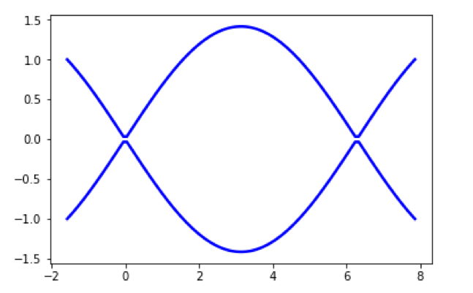

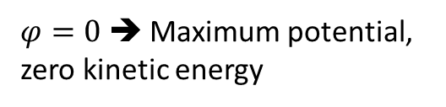
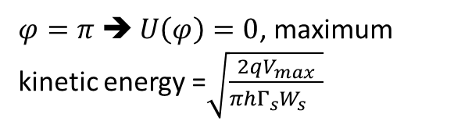






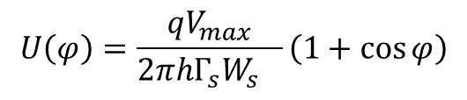

$$Hamiltonian=Total Energy=\frac{qV_{max}}{πh{{Γ_{s}W}_{s}}_{}}={\frac{1}{2}w^{2}}_{}+\frac{qV_{max}}{2πh{{Γ_{s}W}_{s}}_{}}\left(1+cos{φ}\right)$$ | Eq. 55
$$w=\sqrt{\frac{qV_{max}}{πh{{Γ_{s}W}_{s}}_{}}\left(1−cos{φ}\right)}$$ | Eq. 56
$$U\left(φ\right)=\frac{qV_{max}}{2πh{{Γ_{s}W}_{s}}_{}}\left(1+cos{φ}\right)$$
Separatrix
$U\left(φ\right)$ (eV)
$$φ_{s}=π$$
$$π−φ_{s}$$
$$φ_{s}=π$$
Stationary bucket ➔ particles are not accelerated
$w\left(φ\right)$ (eV)
0
$$π−φ_{s}$$
Bucket
$$φ$$
$$φ$$
$φ=0$ ➔ Maximum potential, zero kinetic energy
$φ=π$ ➔ $U\left(φ\right)=0$, maximum kinetic energy =$\sqrt{\frac{2qV_{max}}{πh{{Γ_{s}W}_{s}}_{}}}$
In a stationary bucket, the synchronous particle is always at $w\left(φ\right)=0,φ=φ_{s}=0 or π \left(below or above transition\right) because V=qV_{max}sinφ_{s}=0!$

Slide 12
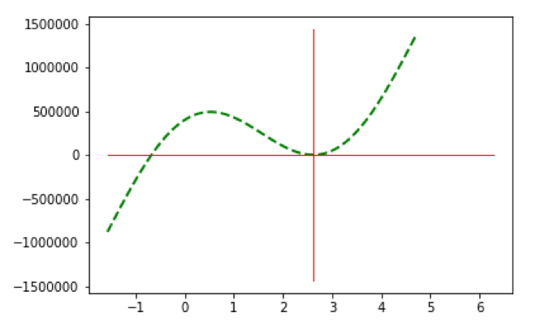






CASE 2: ACCELERATION (ABOVE TRANSITION)
$$φ_{s}=π−\frac{π}{6}$$
$$[\frac{π}{2},π]$$
$$U\left(Δφ\right)=\frac{qV_{max}}{2πh{{Γ_{s}W}_{s}}_{}}\left(\cos\left(Δφ+φ_{s}\right)−cosφ_{s}+Δφsinφ_{s}\right)$$ | Eq. 51
# case 1: SPS protons above transition, acceleration, q = 1, V_{max} = 4.5e6 V, $φ_{s}=π−\frac{π}{6}$
Bounded motion
$$φ_{u}$$
$U\left(φ\right)$ (eV)
$$φ_{s}=π−\frac{π}{6}$$
$$φ$$

Slide 13
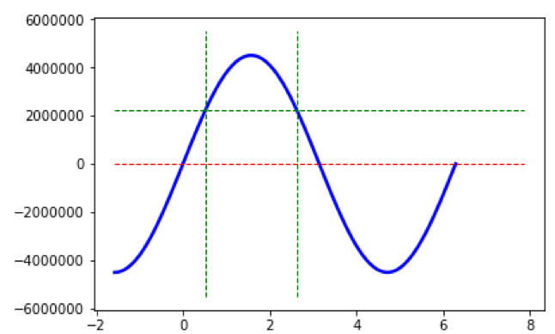
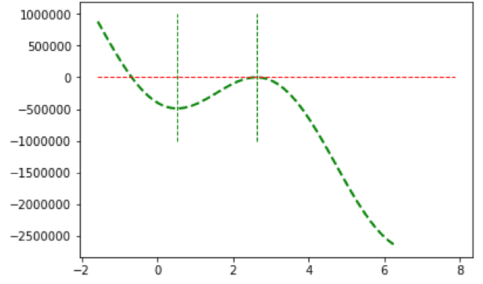
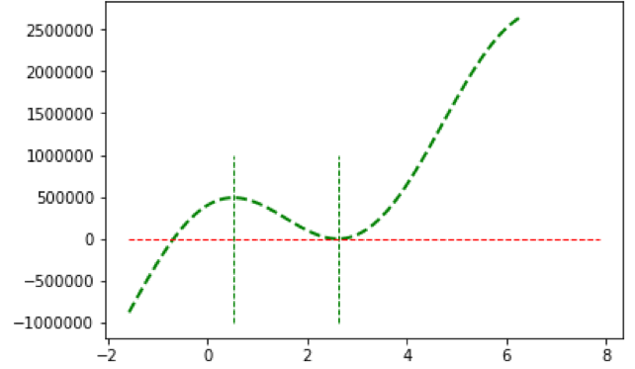



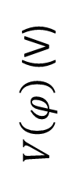






$$V\left(φ_{s}\right)=V_{max}sinφ_{s}=V_{max}sin⁡(π−\frac{π}{6})$$
$V\left(φ\right)$ (V)
$$φ_{s}=π−\frac{π}{6}$$
$$π−φ_{s}$$
$$V\left(φ\right)=V_{max}sinφ$$
$−U\left(φ\right)$ (eV)
$$\int_{φ_{s}}^{φ}{\frac{q}{2πh{{Γ_{s}W}_{s}}_{}}\left[V\left(φ^{′}\right)−V\left(φ_{s}\right)\right]dφ^{′}}$$
$$U\left(φ\right)=−\int_{φ_{s}}^{φ}{\frac{q}{2πh{{Γ_{s}W}_{s}}_{}}\left[V\left(φ^{′}\right)−V\left(φ_{s}\right)\right]dφ^{′}}$$
$U\left(φ\right)$ (eV)
$$φ_{s}=π−\frac{π}{6}$$
$$π−φ_{s}$$
$$U\left(Δφ\right)=\frac{qV_{max}}{2πh{{Γ_{s}W}_{s}}_{}}\left(\cos\left(Δφ+φ_{s}\right)−cosφ_{s}+Δφsinφ_{s}\right)$$ | Eq. 51
$$φ_{u}$$

Slide 14
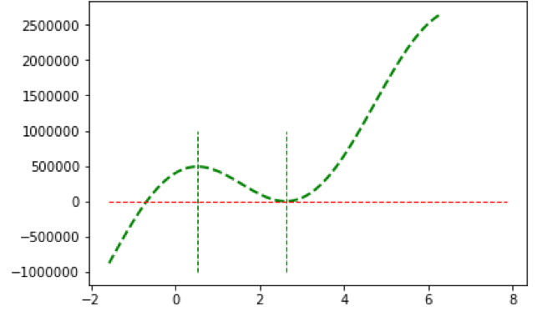






Let’s now calculate the trajectories in phase space that correspond to the plotted potential before
First let’s calculate the Hamiltonian or total energy of the system, which is a constant.
The simplest thing to do is to calculate the total energy when the kinetic energy is 0, i.e. w=0, and the potential energy is maximum. The potential energy is maximum when $φ=π−φ_{s}$.
First point where particles are still bounded within the separatrix
$U\left(φ\right)$ (eV)
$$φ_{s}=π−\frac{π}{6}$$
The second point where particles are still bounded is $φ_{u}$
$$π−φ_{s}$$
$$φ_{u}$$
$$U\left(π−φ_{s}\right)=U(φ_{u})$$
For single RF systems the total energy or separatrix can be calculated analytically by replacing $φ=π−φ_{s}$ in Eq. 51:
$$U\left(Δφ\right)=\frac{qV_{max}}{2πh{{Γ_{s}W}_{s}}_{}}\left(\cos\left(Δφ+φ_{s}\right)−cosφ_{s}+Δφsinφ_{s}\right)$$ | Eq. 51
First replace $Δφ$ by $φ−φ_{s}$, and then $φ=π−φ_{s}$ to obtain:

Slide 15

$$H_{sep}=U(π−φ_{s})=\frac{qV_{max}}{2πh{{Γ_{s}W}_{s}}_{}}\left(−2cos{φ_{s}}+(π−{2φ}_{s})sinφ_{s}\right)$$ | Eq. 57
The phase space trajectory is then:
$$H_{sep}=\frac{1}{2}w^{2}+U\left(φ\right)=\frac{1}{2}w^{2}+\frac{qV_{max}}{2πh{{Γ_{s}W}_{s}}_{}}\left(cosφ−cos{φ_{s}}+(φ−φ_{s})sinφ_{s}\right)$$ | Eq. 58
Solving for $w(φ)$ we get:
$${w\left(φ\right)=\sqrt{2\left(H_{sep}−U(φ)\right)} }_{}$$ | Eq. 59
Coming back to the second point where particles are still bounded within the separatrix, denoted $φ_{u}$ in the previous figure, we know the energy deviation there should be zero, i.e. $ω=0$. In this case:
$$H_{sep}=\frac{1}{2}w^{2}+U\left(φ_{u}\right)=\frac{qV_{max}}{2πh{{Γ_{s}W}_{s}}_{}}\left(cosφ_{u}−cos{φ_{s}}+(φ_{u}−φ_{s})sinφ_{s}\right)=U(π−φ_{s})$$ | Eq. 60
=0
$$\left(cosφ_{u}−cos{φ_{s}}+(φ_{u}−φ_{s})sinφ_{s}\right)=\left(−2cos{φ_{s}}+(π−{2φ}_{s})sinφ_{s}\right)$$ | Eq. 61
$$cosφ_{u}+φ_{u}sinφ_{s}=\cos\left(π−φ_{s}\right)+\left(π−φ_{s}\right)sinφ_{s}$$ | Eq. 62
$$\left(φ_{u}−\left(π−φ_{s}\right)\right)sinφ_{s}=\cos\left(π−φ_{s}\right)−cosφ_{u}$$ | Eq. 63

Slide 16
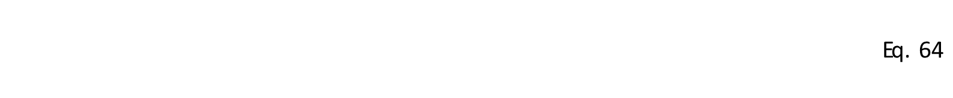
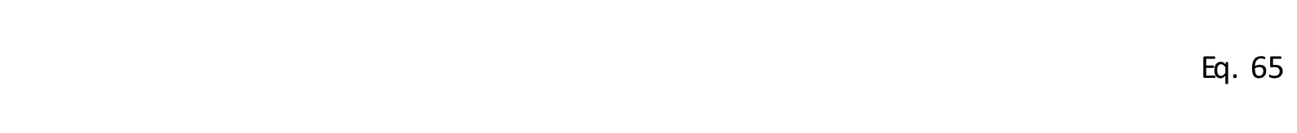

The term $φ_{u}−\left(π−φ_{s}\right)$ is called the bucket width
The bucket height at $φ_{s}$can be evaluated from Eq. 59:
$${w\left(φ\right)=\sqrt{2\frac{qV_{max}}{2πh{{Γ_{s}W}_{s}}_{}}\left(\left(π−φ_{s}−φ\right)sinφ_{s}−(cosφ+cosφ_{s})\right)} }_{}$$ | Eq. 64
$${w\left(φ_{s}\right)=\sqrt{2\frac{qV_{max}}{2πh{{Γ_{s}W}_{s}}_{}}\left(\left(π−2φ_{s}\right)sinφ_{s}−2cosφ_{s}\right)} }_{}$$ | Eq. 65
bucket height at $φ_{s}$

Slide 17
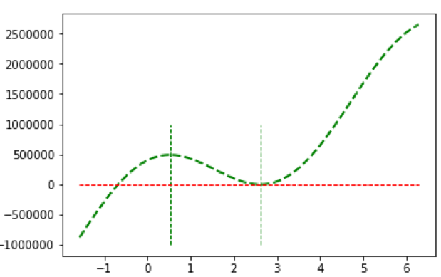
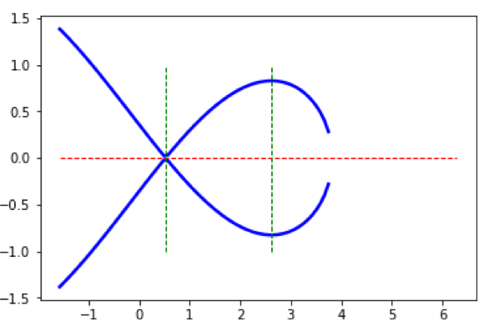


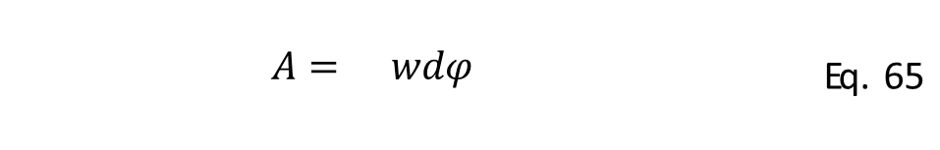
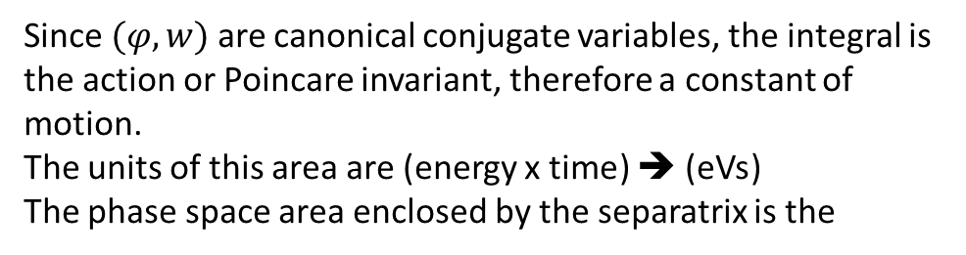
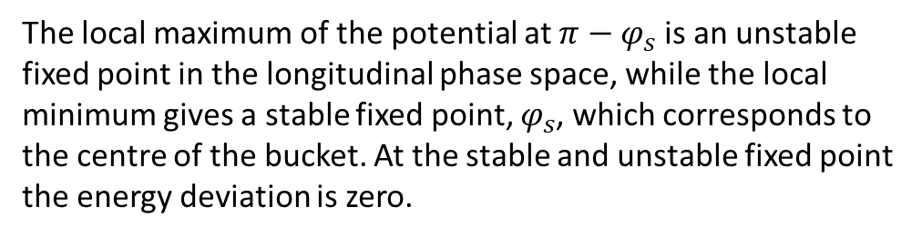







RF bucket parameters
Phase space area
Phase space area enclosed by the particle trajectory is:
$U\left(φ\right)$ (eV)
$${A=\oint{wdφ}}_{}$$ | Eq. 65
$$π−φ_{s}$$
$$φ_{s}=π−\frac{π}{6}$$
$$φ_{u}$$
Since $(φ,w)$ are canonical conjugate variables, the integral is the action or Poincare invariant, therefore a constant of motion.
The units of this area are (energy x time) ➔ (eVs)
The phase space area enclosed by the separatrix is the
$$π−φ_{s}$$
$$φ_{s}=π−\frac{π}{6}$$
bucket area
$w\left(φ\right)$ (eV)
Bucket height (=maximum energy deviation of the separatrix) ➔ Eq. 65
$$φ_{u}$$
The local maximum of the potential at $π−φ_{s}$ is an unstable fixed point in the longitudinal phase space, while the local minimum gives a stable fixed point, $φ_{s}$, which corresponds to the centre of the bucket. At the stable and unstable fixed point the energy deviation is zero.
Synchronous particle
$$φ_{u}−\left(π−φ_{s}\right)$$
Bucket witdth

Slide 18
Using Eq. 59 and the symmetry around the $φ$ axis, one can write for the bucket area:
$$A=2\int_{φ_{1}}^{φ_{u}}{w\left(φ\right)dφ}{=2\int_{φ_{1}}^{φ_{u}}{\sqrt{2\left(H_{sep}−U(φ)\right)}dφ} }_{}$$ | Eq. 66
bucket area
or longitudinal acceptance
where $φ_{1}=π−φ_{s}$, and $φ_{u}$ can be found from Eq. 63
In the special case of a stationary bucket ($φ_{s}=0$ or $π$), the bucket area and height can be calculated analytically ➔ exercise

Slide 19
LONGITUDINAL EMITTANCE AND BUNCH CHARACTERISTICS
All calculated variables in the previous slides, where calculated to the full extend of the stable area.
In practice, in order to avoid particle losses only a fraction of the stable area is usually occupied by the beam, enclosed by a single particle trajectory in phase space.
This area is called single particle emittance.
single particle longitudinal emittance
The trajectory of this particle can be derived from Eq. 59, but now we replace H_{sep} by the new value of the Hamiltonian at a phase where the trajectory crosses the horizontal axis. We call this phase $φ_{1}$ and the Hamiltonian $H_{c}=U(φ_{1})$.
The second point at $φ_{2}$ also satisfies that the energy deviation is 0, therefore:
$$U\left(φ_{1}\right)=U\left(φ_{2}\right)$$ | Eq. 67
For a single RF system this means:
$$cosφ_{1}+φ_{1}sinφ_{s}=cosφ_{2}+φ_{2}sinφ_{s}$$ | Eq. 68
After identifying the two turning points, the area under a given trajectory can be calculated from the integral:
$$ε_{l}{=2\int_{φ_{1}}^{φ_{2}}{\sqrt{2\left(H_{c}−U(φ)\right)}dφ} }_{}$$ | Eq. 69
single particle longitudinal emittance

