Slide 1
Cryo Bucket for R&D
Lorenzo Meier, Saba Parsa
14 July 2025 update: 10 Nov 2025

Slide 2
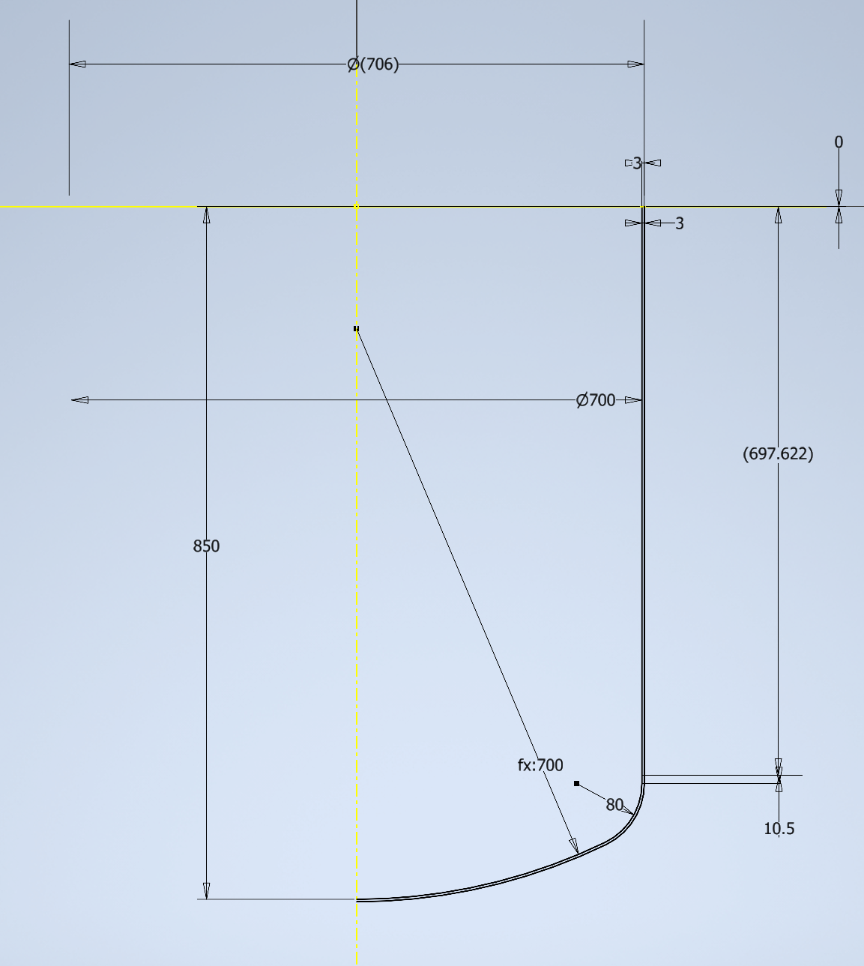
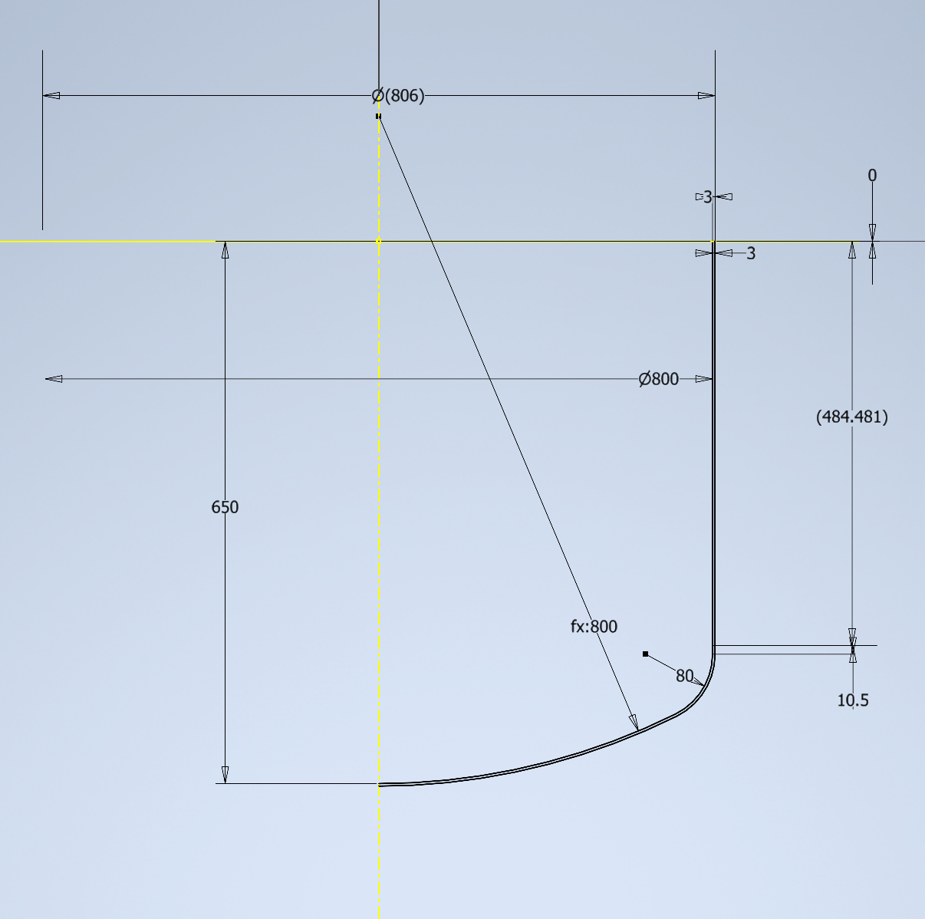
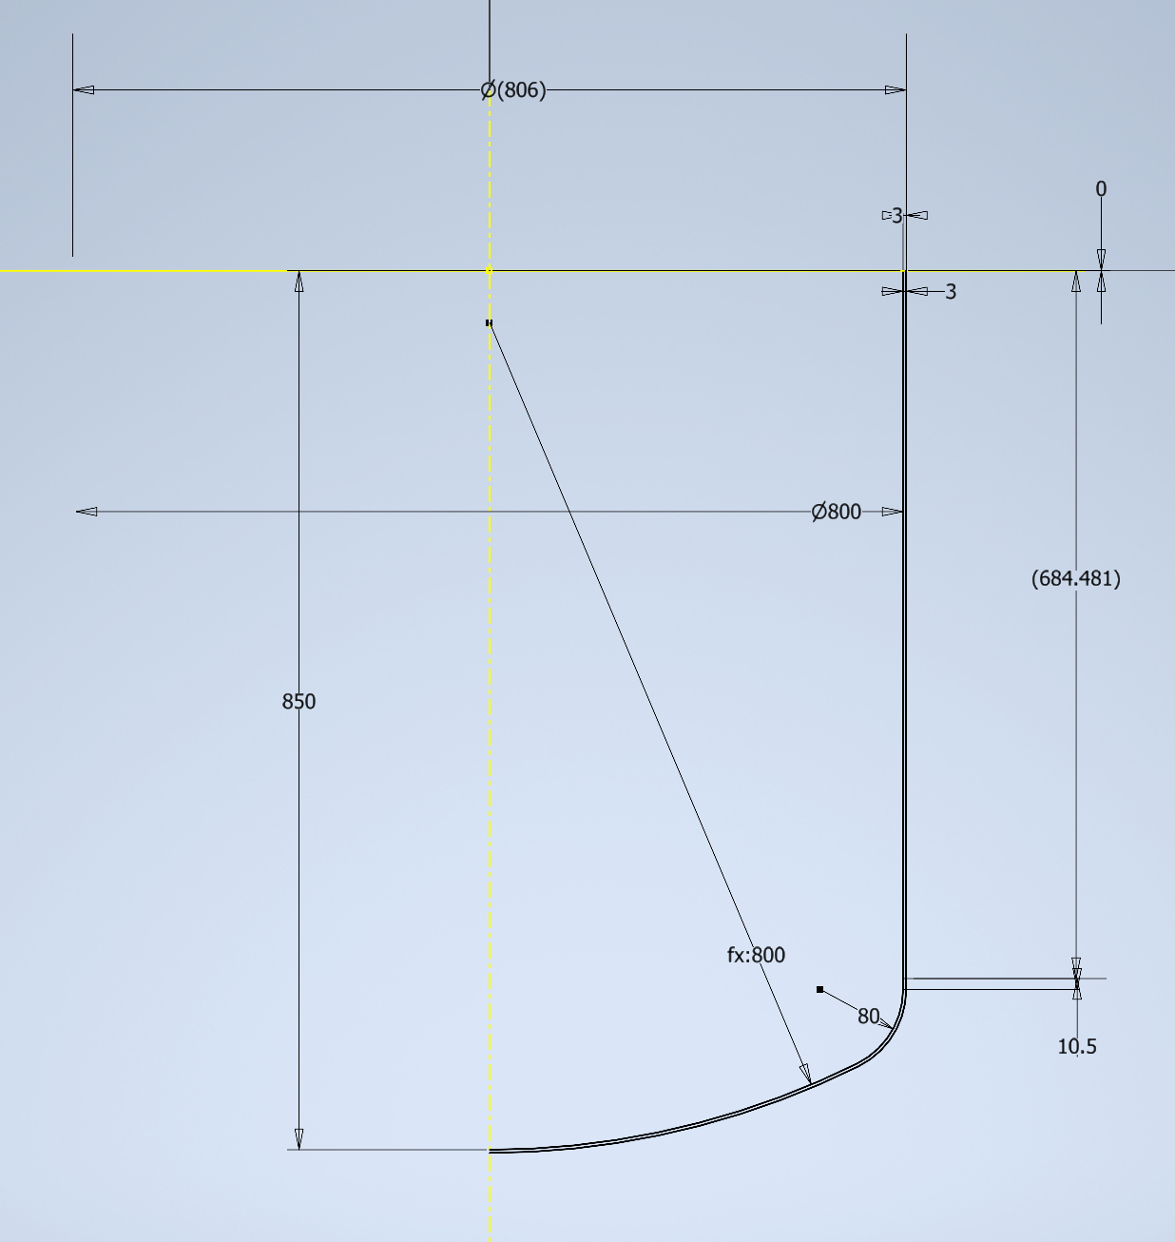
Bucket design choice for the Full Size Single Cube
Full size single cube TPC has dimensions 50x50x30
Vertical orientation: Cathode plane up, charge readout bottom -> Bucket 70 cm diameter, 85cm depth
Horizontal orientation: Cathode plane and change readout on the sides -> Bucket 80 cm diameter, 65 cm depth
Volume: ~265 liters
Volume: ~ 300 liters
Volume: ~350 liters

Slide 3
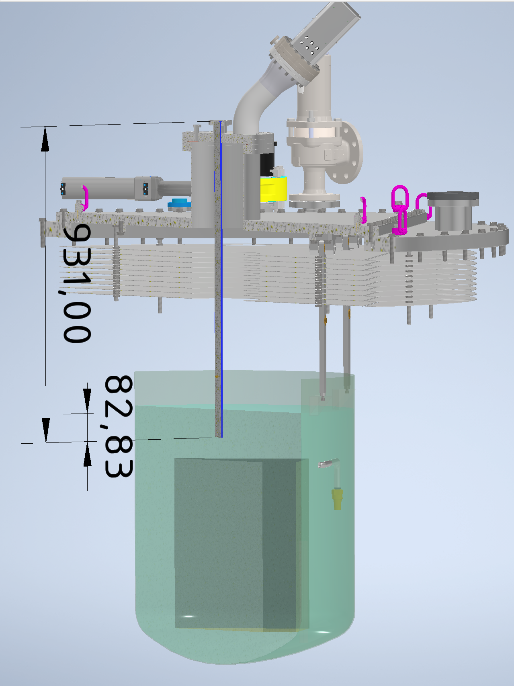
Feed-through choices for the Full Size Single Cube
Prefer to remove the cross piece on top of the top lid
Lower the HV feed-through flange
Use Hello Kitty HV feedthrough ~ 90 cm long
We have 3x CF40 and a bent CF100 flange available
Can we reorganize readout cables with this setup?
Simple connector feedthrough + using the FSD Feedthrough at warm
LRS: Colds side: 1 samtec connector / Warm side: 1 samtec connector
LED: 1 SMA connector
CRS: Cold side: 1 data connector + 1 power connector / Warm side: 1 data connector + 1 power connector
RTD: FSD RTD box 20 Sensors

Slide 4
Scheme
FSD LRS CF40
FSD CRS CF40
LRS CF40
CRS CF40
Is this going to working?
How to secure the FSD flanges in warm? A trolley with
LRS cold cable 2m
CRS cold cables 2m
PACMAN box
Cathode
50 cm
Light Module
30 cm
50 cm

Slide 5
Cryo bucket test
dimensions:
Volume: 393 Liters
Depth: 850 mm
inner diameter: 794 mm
Straight wall: 695 mm
Temperature sensors: This is RTD cable 1 from FSD
sensor 0: -0.5 cm from top edge
sensor 1: -6.5 cm from top edge
sensor 2:-10.5 cm from top edge
sensor 3: 6 cm above bottom
sensor 4: 2cm above bottom
sensor 10: Camera RTD
sensor 11: Valve outlet
LEDs
T2-1: White LED
T2-2: White LED ? (They are connected?)
T3-1: Orange LED 1
T3-2: Orange LED 2
Cryo Camera
RTD is inside the cryocamera box better to keep it in range [-40 to 30˚C]
Heater resistor [we operated it at 11 V from Tuesday]

Slide 6
3 Nov 2025 Monday:
9:30 vacuum at 1.4 e-4 mbar, Lori performed He leak check. no leak was found.
10:30 pressurize the cryostat with Ar gas. VR3 open 15% .Inlet filters started to cool down.
12:40 started cooldown with increased flow. VR3 gradually opened to 100%.
12:50: sensor 4 submerged. Level @2cm above bottom
12:58: sensor 3 submerged. Level @6cm above bottom
13:48: sensor 2 submerged. Level @-10cm from top
13:50: sensor 1 submerged. Level @-6.5cm from top
13:57: sensor 0 submerged. Level@-0.5cm from top >> 14:11 it came out of liquid again.
The Cryo Duck is happily floating in the bucket.
Cryo camera is working fine
RTD Max temperature: 45 C at 13:00
RTD Min temperature: -60 C at 17:30 on Monday, and -84C at 10:30 on Tuesday >> started heater after this.
14:00 stopped filling about 2cm below the top edge of bucket, after the first splash of LAr at the bottom of detector cryostat on sensor 17.
Total LAr used ~ 600 Liters
There is quite some amount of boiling in the bucket. the temperature sensors in the detector cryostat are showing a steady decrease. but it is still too warm to have a stable level without boiling.
>> We are going to leave it over night and see how quickly the level drops
LAr level drop:
16:30 sensor 1 got out of liquid
18:45 sensor 2 got out of liquid

Slide 7
4 Nov 2025 Tuesday
8:45 Started LN line to cool and fill the Green filter Nitrogen compartment Started LAr line to fill again the bucket and bottom of the cryostat to be ready for recirculation
11:12 Diff-Pressure Level meter of the detector cryostat became live at -3965cm from the cryostat top
11:15 Stopped the LAr fill. There is at least 20 cm liquid above the pump. we think this is enough for recirculation.
Total LAr used today ~600 Liters
LAr surface in the bucket is very stable. There is no boiling in the bucket.
The duck is still alive and floating in the bucket!
Now we have to wait until the LN Green filter is full.
11:40 The LN level meter became live at 70 cm indication
13:09 The LN passed the set point of 110 cm. The PID did not activate. The LV was not pushed to the PLC.
The level meter script is running on RPi 130.92.128.171 >> This script is pushing to grafana and PLC gateway: 130.92.128.150:20001
The SlowControl machine is node 4 of the new 4-node server in GL. This machine had the firewall on and thus blocking the UDP socket.
sudo systemctl stop firewalld.service
sudo systemctl disable firewalld.service
Restart the push to PLC and it was working again @13:50
13:25 Strated the pump gradually and reaching 53%
13:50 The Liquid flow meter FLA3 and FLA2 started to read a reliable flow of 5 kg/min >> liquid surface is very wavy. sprinkle is splashing a lot of liquid+gas around.
14:03 There was an increase of the flow to 14 kg/min >> Looking at the camera it became very quiet surface. It seems there is no more gas in the line. The pump works better now.
We are in stable recirculation.
overpressure is stable at 307 mbar and exhaust valve is closed. (PID set point is 320)
LN pressure is set to 1.85 bar >> This defines our cooling

Slide 8
5 Nov 2025 Wednesday:
8:15 Preparing to drain LAr to the storage
set both cryostat pressures to 250mbar. open exhaust link.
stopped pump >> Grafana alarms went off >> Stopped grafana alarms
changed nitrogen pressure to 2.4bar
8:28 Opened bucket drain valve.
It is draining very slowly.
The level of LAr in detector cryostat, DP level meter started to rise
11:30 Bucket is empty, LAr Level 213 mm from bottom.
12: 18 Started the pump to transfer LAr to storage from 20% gradually to 55%
12:35 The storage overpressure valve opened
There was too fast LAr transfer and gas exhaust was saturated. gas flow meter showing max 2000 liter/min.
pump was powered off until the situation is stable. then transfer was resumed.
12:58 The storage overpressure valve opened again. pump was again at 55%.
This time the exhaust pipe could catch it, and gas flow started to slowly drop. Storage cryostat is getting cold already.
13:40 Storage DP level meter became live.
13:46 Transfer completed. Storage DP level meter: 94.9 mm. pump is off.
14:20 Heater is ON, with PID on temperature set to 26C. We will keep it ON over night. >> Powered off heater the next morning on 6 Nov.
Bucket Cryo-operation was successful!

Slide 9
Full-size Cube TPC status
The field cage resistors are being replaced from 1 Gohm to 100 Mohm?
The Light feedthrough
CF40 is produced, there was a short on the preamp power lines.
Cyril was working on it.
Charge tile and charge feedthrough is still in unknown state
Which ArClight do we put in?
We have two newly produced ArCLights.
>> Give them ID numbers please.
Time for the Full-size Cube run:
Mid November-First December?

