Slide 1



The third-nearest-neighbour Hubbard model:
Van Hove singularities and RG methods
Thomas Sheerin
ERG2026, University of Sussex
4th September 2026
TPS, M. Ramirez, C. A. Hooley and L. C. Rhodes, arXiv:2608.07714
tps3@st-andrews.ac.uk

Slide 2
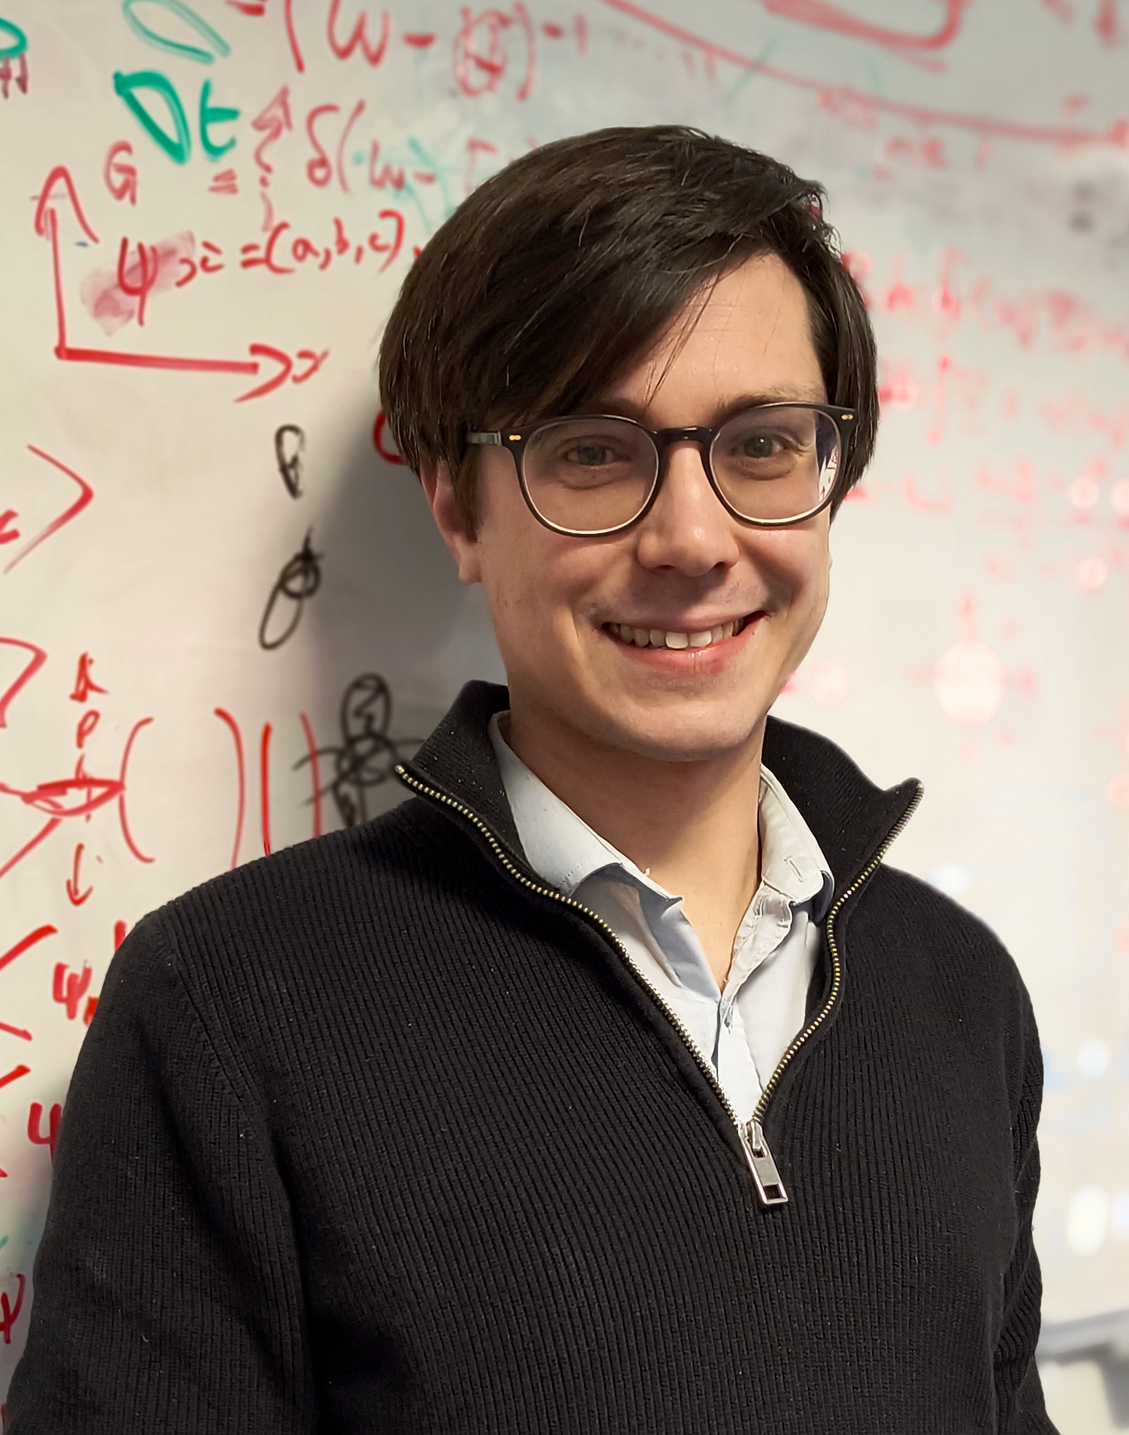

Acknowledgements
1
Acknowledgements
Luke Rhodes (St Andrews)
Chris Hooley (Coventry)
Maria Ramirez (St Andrews master’s student)

Slide 3
Outline
2
Outline
Introduction
Manipulation of (higher-order) Van Hove singularities.
Comparing weak-coupling RG methods for finite-density fermions.
The third-nearest-neighbour square-lattice Hubbard model.
Results
Phase diagrams at Van Hove filling.
Doping away from Van Hove filling.
Summary.

Slide 4
Outline
3
Outline
Introduction
Manipulation of (higher-order) Van Hove singularities.
Comparing weak-coupling RG methods for finite-density fermions.
The third-nearest-neighbour square-lattice Hubbard model.
Results
Phase diagrams at Van Hove filling.
Doping away from Van Hove filling.
Summary.

Slide 5
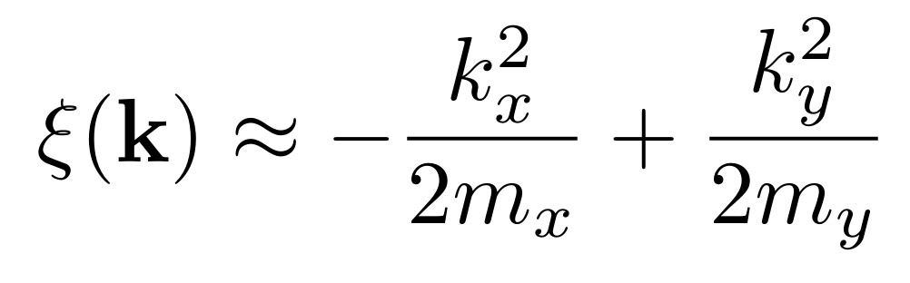
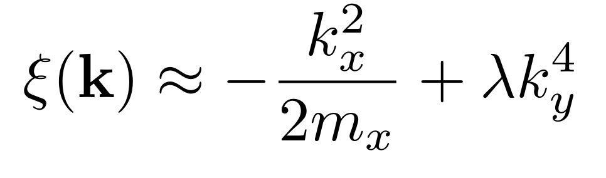
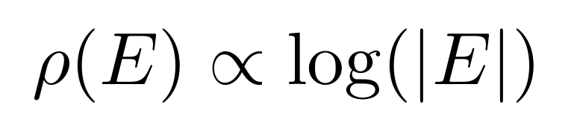
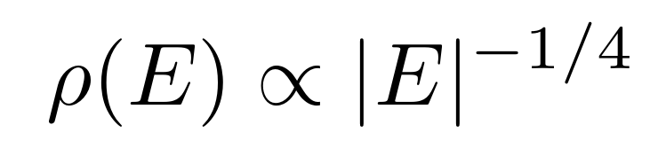




Introduction: VHSs
4
Introduction #1: Manipulation of Van Hove singularities
Two-dimensional Van Hove singularity (VHS): non-analyticity (divergence here) in density of states $ρ\left(E\right)$. Tune to Fermi level $→$ strong correlations.
Ordinary VHS:
Higher-order VHS:
other powers possible
$$k_{y}$$
$$k_{y}$$
$$k_{x}$$
$$k_{x}$$
Stronger correlations

Slide 6
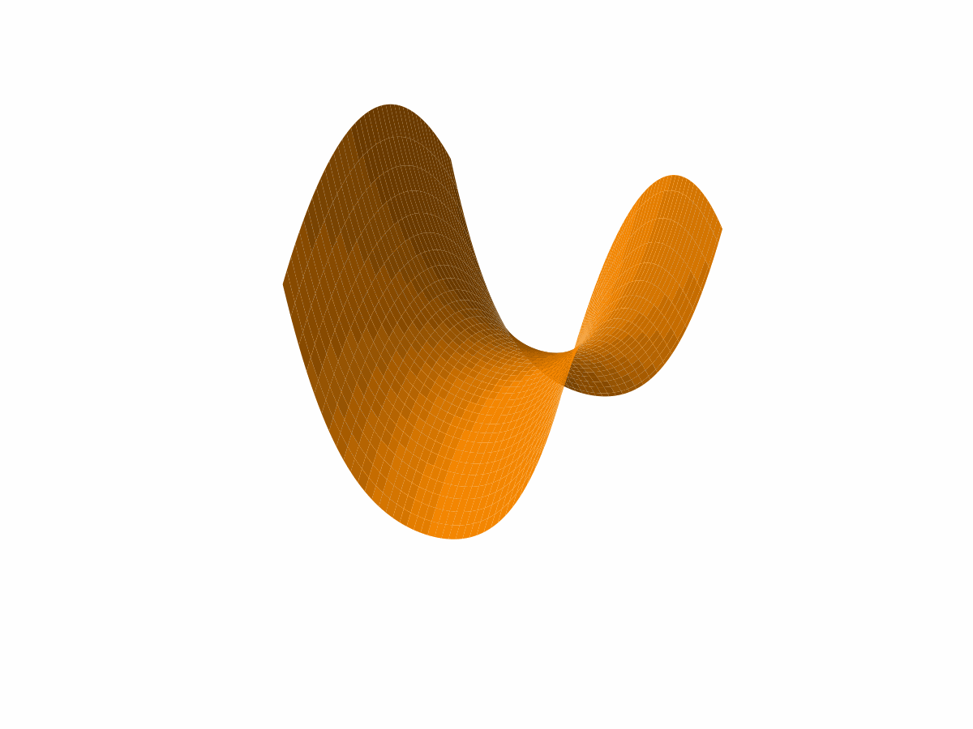
Introduction: VHSs
5
Ordinary VHSs: well understood. Higher-order VHSs: newer topic. Much research in $∼$ last 10 years [1-6].
Theoretical questions:
What happens to system’s phase diagram when we tune a VHS from ordinary to higher-order (keeping everything else fixed)?
What happens when we move a higher-order VHS away from the Fermi level?
[1] Efremov, Shtyk, Rost et al., Phys. Rev. Lett. 123, 207202 (2019) [2] Isobe, Fu, Phys. Rev. Res. 1, 033206 (2019)
[3] Lin, Nandkishore, Phys. Rev. B 102, 245122 (2020) [4] Kang, Fang, Kim et al., Nature Phys. 18, 301 (2022)
[5] Classen, Betouras, Annu. Rev. Condens. Matter Phys. 16, 229 (2025) [6] Beck, Bodky, Dürrnagel et al., Phys. Rev. Lett. 136, 106503 (2026)

Slide 7


Introduction: comparing RG methods
6
Introduction #2: Comparing weak-coupling RG methods for finite-density fermions
Two common weak-coupling methods for lattice models of itinerant electrons: parquet RG and truncated-unity FRG.
Parquet RG (“g-ology”):
Only retain a few “important” patches of the Fermi surface, e.g.:
$$g_{1}$$
$$g_{2}$$
Van Hove point
Inter-patch interactions

Slide 8
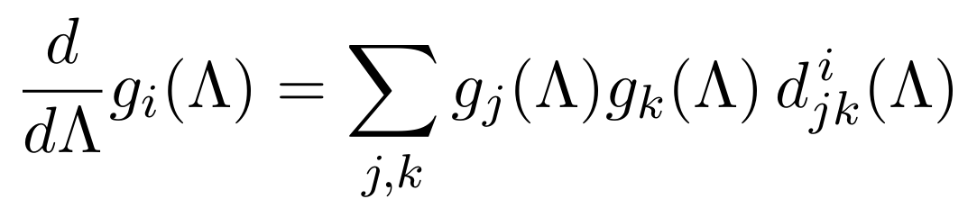
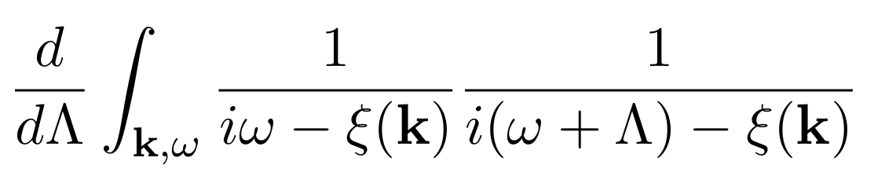

Introduction: comparing RG methods
7
Gives small number of 4-point couplings ($g_{1}$, $g_{2}$, … , $g_{n}$).
Use one-loop field-theoretic RG to find flow of $g_{i}\left(Λ\right)$, where $Λ$ is IR frequency cutoff [7-10]:
$∝$ $\frac{d}{dΛ}$(bare particle-hole or particle-particle bubbles)
(e.g. )
Neglect self-energy flow.
[7] Furukawa, Rice, Salmhofer, Phys. Rev. Lett. 81, 3195 (1998) [8] Maiti, Chubukov, AIP Conf. Proc. 1550, 3 (2013)
[9] Whitsitt, Sachdev, Phys. Rev. B 90, 104505 (2014) [10] Classen, Chubukov, Honerkamp, Scherer, Phys. Rev. B 102, 125141 (2020)

Slide 9
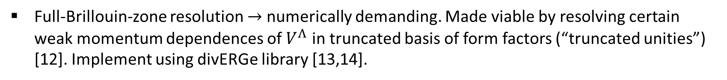

Introduction: comparing RG methods
8
Truncated-unity FRG (TUFRG):
Start from Wetterich equation; make Ansatz for effective action (suppress spin labels):
No frequency dependence
Truncate at 4th order in fields $→$ weak coupling
Bare – no self-energy feedback
(though could be included)
$→$ one-loop flow equation [11]
Full-Brillouin-zone resolution $→$ numerically demanding. Made viable by resolving certain weak momentum dependences of $V^{Λ}$ in truncated basis of form factors (“truncated unities”) [12]. Implement using divERGe library [13,14].
[11] Metzner, Salmhofer, Honerkamp et al., Rev. Mod. Phys. 84, 299 (2012) [12] Lichtenstein, Sánchez de la Peña, Rohe et al., Comp. Phys. Commun. 213, 100 (2017)
[13] Profe, Kennes, Klebl, SciPost Phys. Codebases 26 (2024) [14] Profe, Kennes, Klebl, “Codebase release 0.5 for divERGe”, SciPost Phys. Codebases 26–r0.5 (2024)

Slide 10
Introduction: comparing RG methods
9
Parquet RG
TUFRG
Methods very similar: same order in couplings, both account for inter-channel competition, both neglect (in our study) frequency dependence and $Σ$.
Only major difference: parquet RG only accounts for patches while TUFRG sees whole Brillouin zone.
How well do their results compare?

Slide 11
Outline
10
Outline
Introduction
Manipulation of (higher-order) Van Hove singularities.
Comparing weak-coupling RG methods for finite-density fermions.
The third-nearest-neighbour square-lattice Hubbard model.
Results
Phase diagrams at Van Hove filling.
Doping away from Van Hove filling.
Summary.

Slide 12
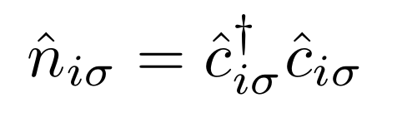
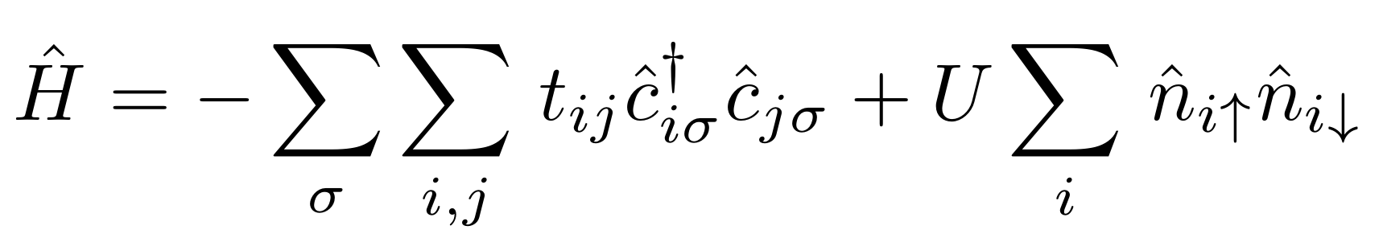
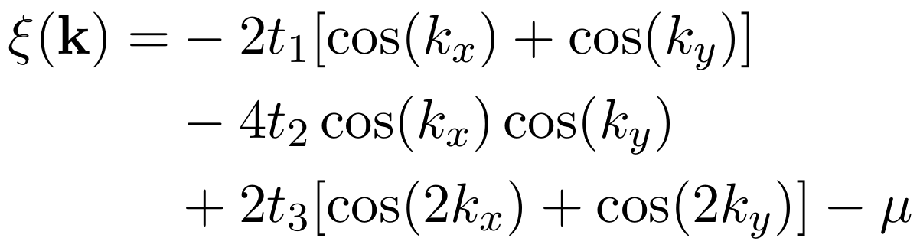

3rd-nearest-neighbour Hubbard model
11
Square-lattice Hubbard model with 3rd-nearest-neighbour hopping:
( )

Slide 13
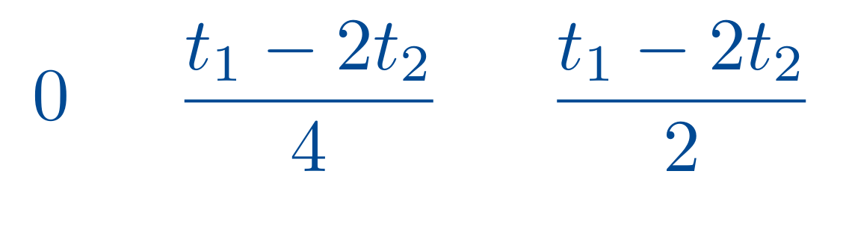
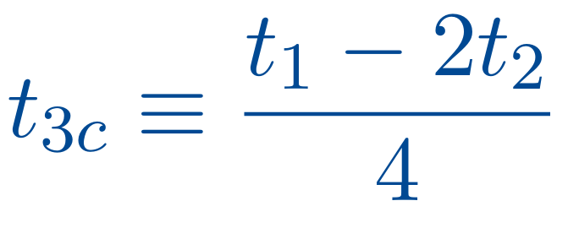
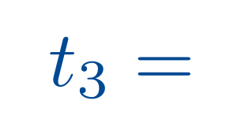
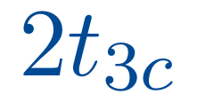
















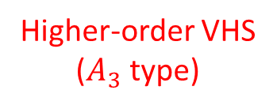

3rd-nearest-neighbour Hubbard model
12
$$k_{y}$$
$$X$$
$$M$$
$$k_{y}$$
$$X$$
$$M$$
$$k_{y}$$
$$X$$
$$M$$
Fermi surface
$$Γ$$
$$Γ$$
$$Γ$$
$$k_{x}$$
$$k_{x}$$
$$k_{x}$$
Higher-order VHS
($A_{3}$ type)
Ordinary VHSs
Ordinary VHS
$$X$$
$$X$$
$$X$$
“Single-VHS case”
“Higher-order-VHS case”
“Split-VHS case”

Slide 14
Outline
13
Outline
Introduction
Manipulation of (higher-order) Van Hove singularities.
Comparing weak-coupling RG methods for finite-density fermions.
The third-nearest-neighbour square-lattice Hubbard model.
Results
Phase diagrams at Van Hove filling.
Doping away from Van Hove filling.
Summary.

Slide 15
Results at Van Hove filling
14
1. At Van Hove filling

Slide 16
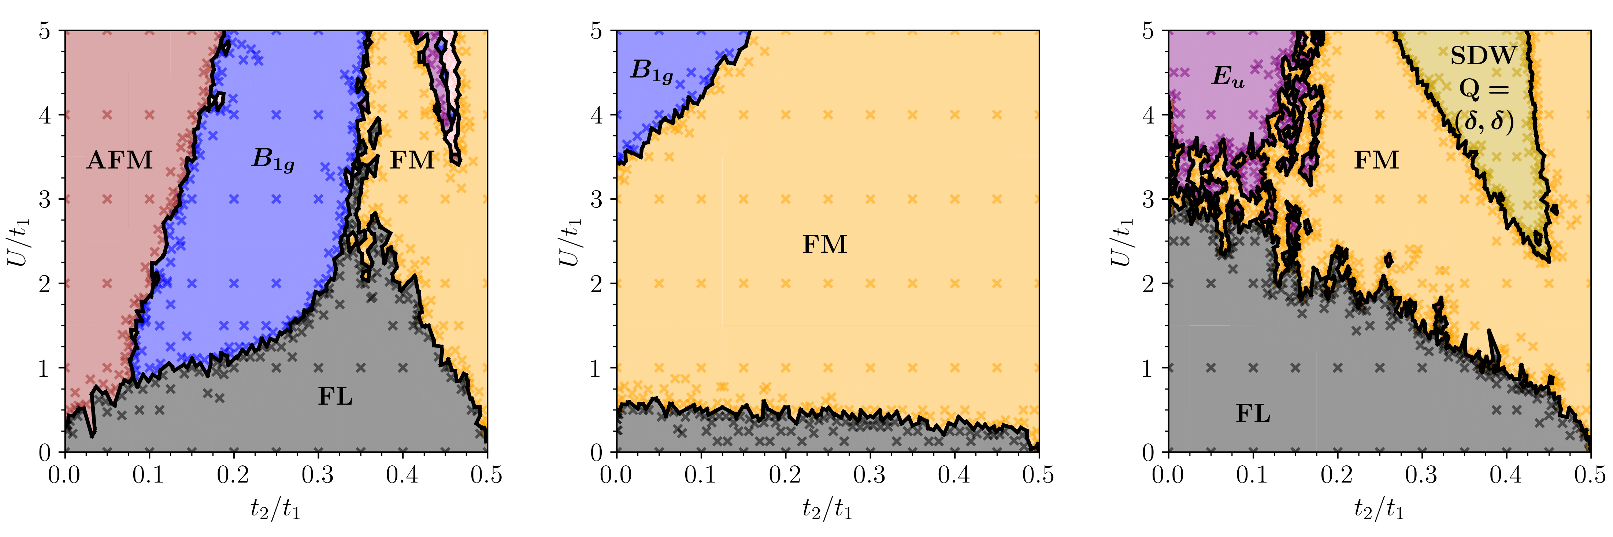
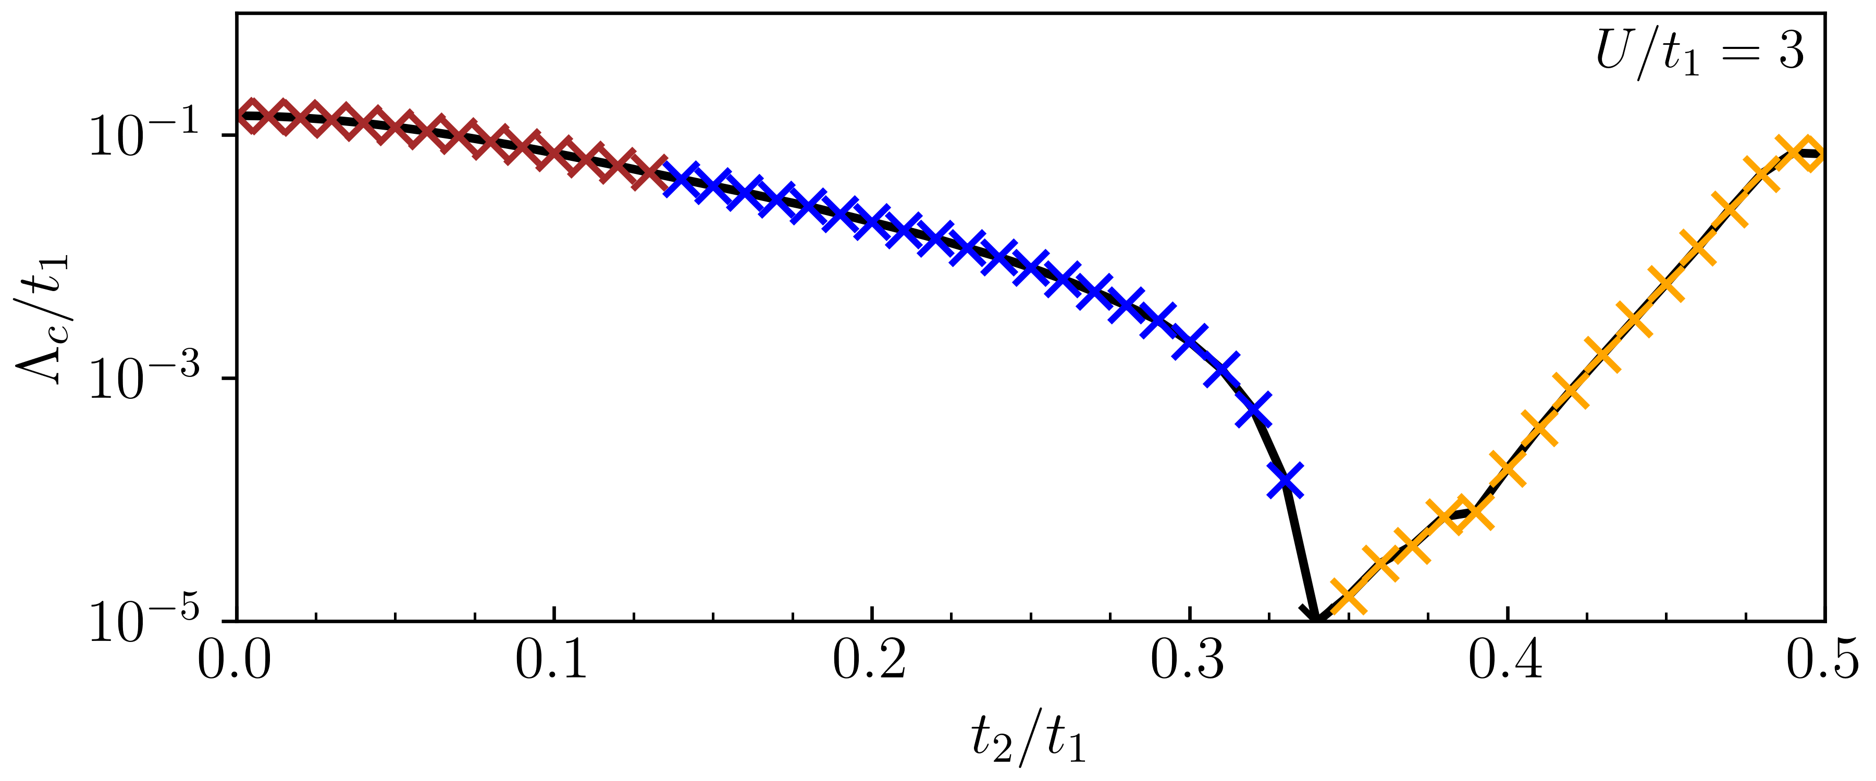
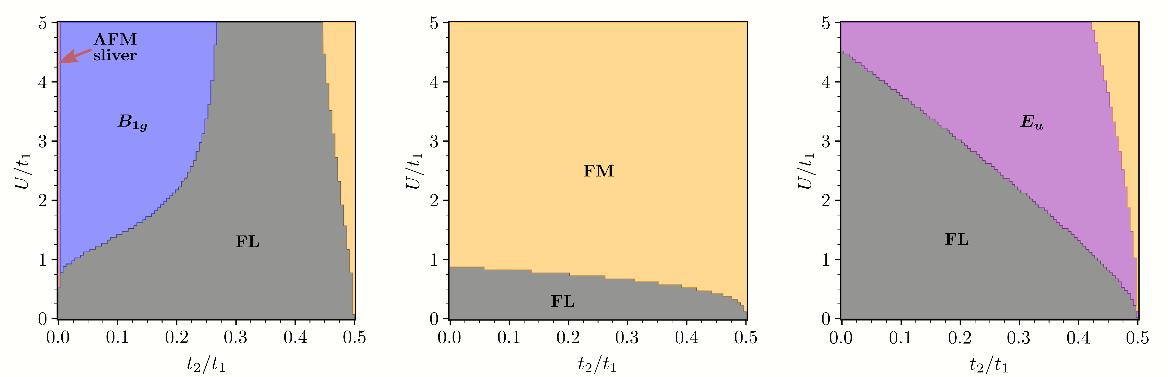
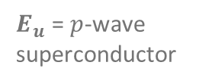


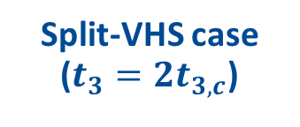



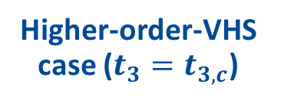


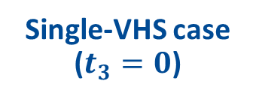
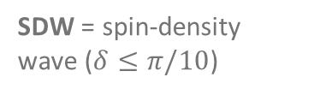


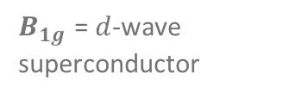



Results at Van Hove filling
15
Single-VHS case ($t_{3}=0$)
Higher-order-VHS case ($t_{3}=t_{3,c}$)
Split-VHS case ($t_{3}=2t_{3,c}$)
FL = Fermi liquid
$E_{u}$ = $p$-wave superconductor
TUFRG:
$B_{1g}$ = $d$-wave superconductor
1.
2.
FM = ferromagnet
2nd n.n. hopping
AFM = antiferromagnet
$$k_{y}$$
$$X$$
$$M$$
$$k_{y}$$
$$X$$
$$M$$
$$k_{y}$$
$$X$$
$$M$$
SDW = spin-density wave ($δ≤π/10$)
Parquet RG:
$$Γ$$
$$Γ$$
$$Γ$$
$$k_{x}$$
$$k_{x}$$
$$k_{x}$$

Slide 17

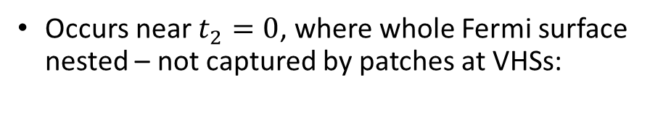
Results at Van Hove filling
16
Single-VHS case ($t_{3}=0$)
1. Missing AFM in single-VHS case, parquet RG:
TUFRG:
Occurs near $t_{2}=0$, where whole Fermi surface nested – not captured by patches at VHSs:
1.
$\sim \left(π,π\right)$ nesting
Parquet RG:

Slide 18
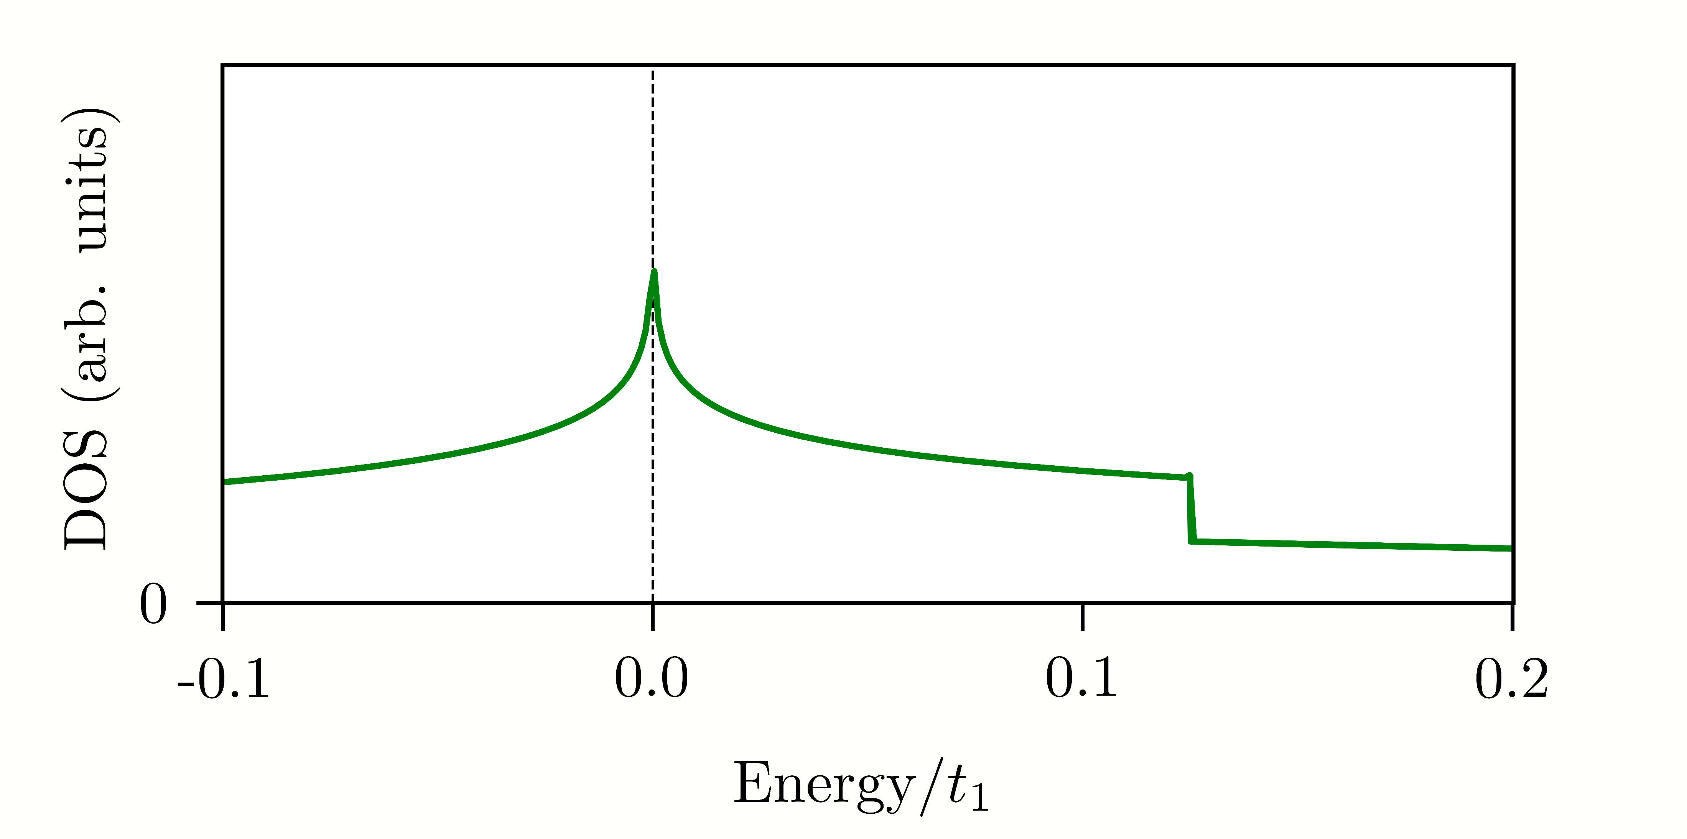

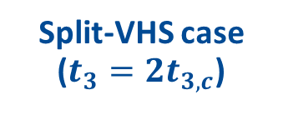
Results at Van Hove filling
17
Split-VHS case ($t_{3}=2t_{3,c}$)
2. Weak-coupling $p$-wave SC in split-VHS case, parquet RG:
Due to band maximum between split saddle points?
TUFRG
Band max.
VHS
$$X$$
2.
Saddle points
Parquet RG
Low-energy step in DOS. Visible to TUFRG, not to parquet RG.

Slide 19
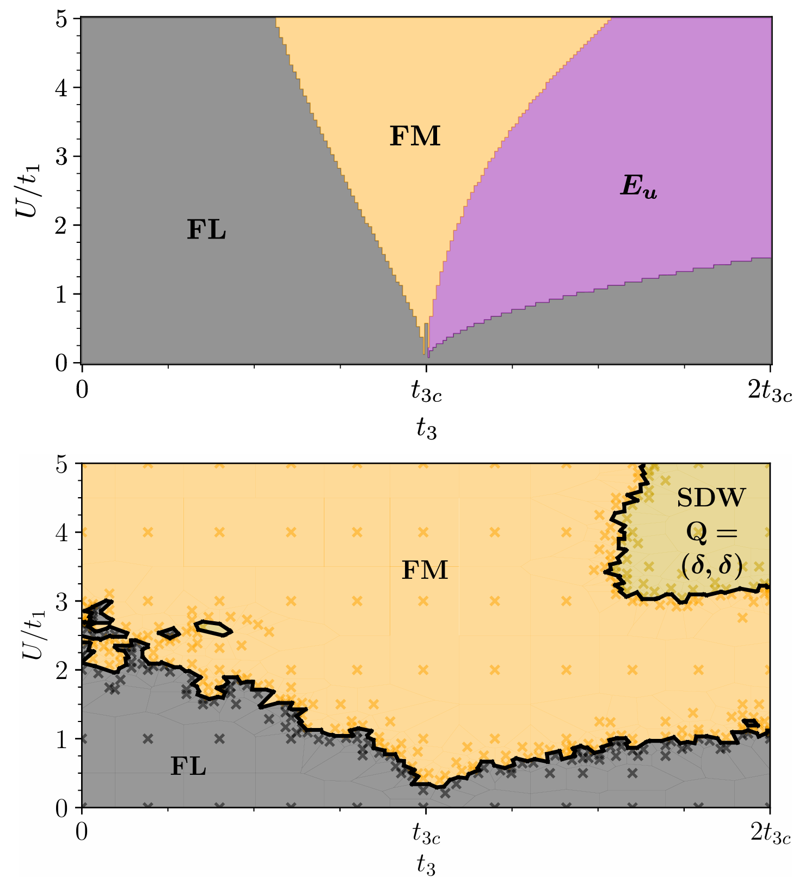

Results at Van Hove filling
18
Now continuously change $t_{3}$. Fix $t_{2}/t_{1}=0.375$ ($d_{xy}$ band in Sr$2$RuO$4$ [15]). No more parquet RG:
TUFRG:
$$\left(=0.125t_{1}\right)$$
Nothing discontinuous happens at the higher-order Van Hove case ($t_{3c}$) $→$ effects realized over appreciable range of $t_{3}$ values (at this value of $t_{2}/t_{1}$)?
[15] Scaffidi, Romers, Simon, Phys. Rev. B 89, 220510(R) (2014)

Slide 20
Results away from Van Hove filling
19
2. Dope away from Van Hove filling

Slide 21

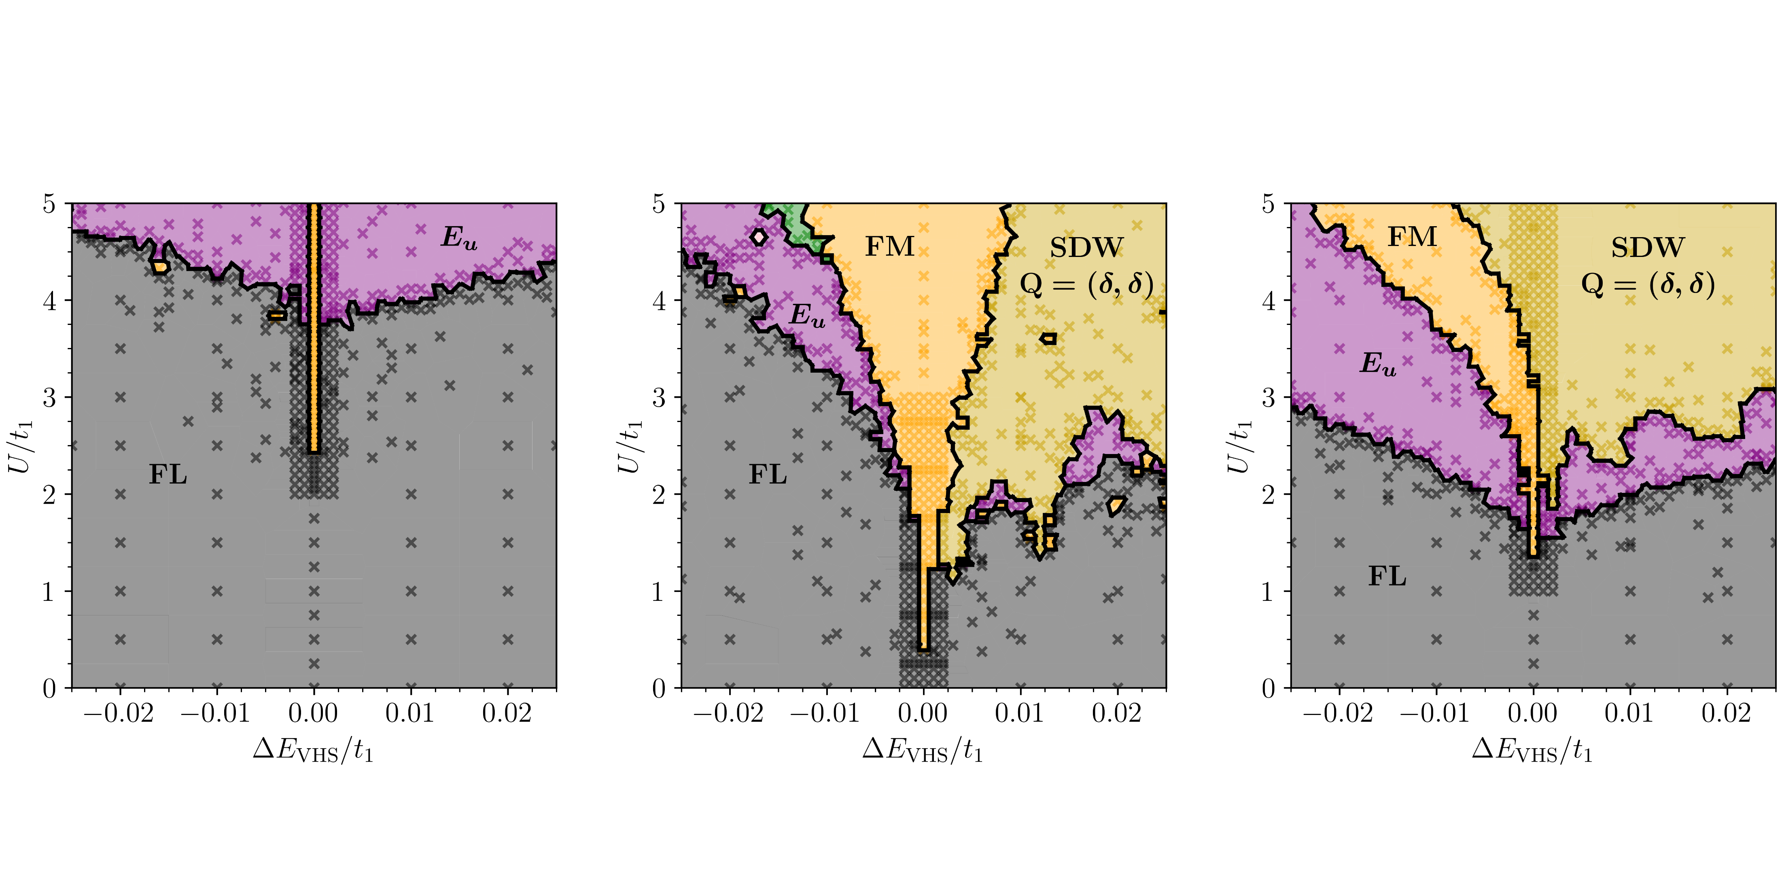
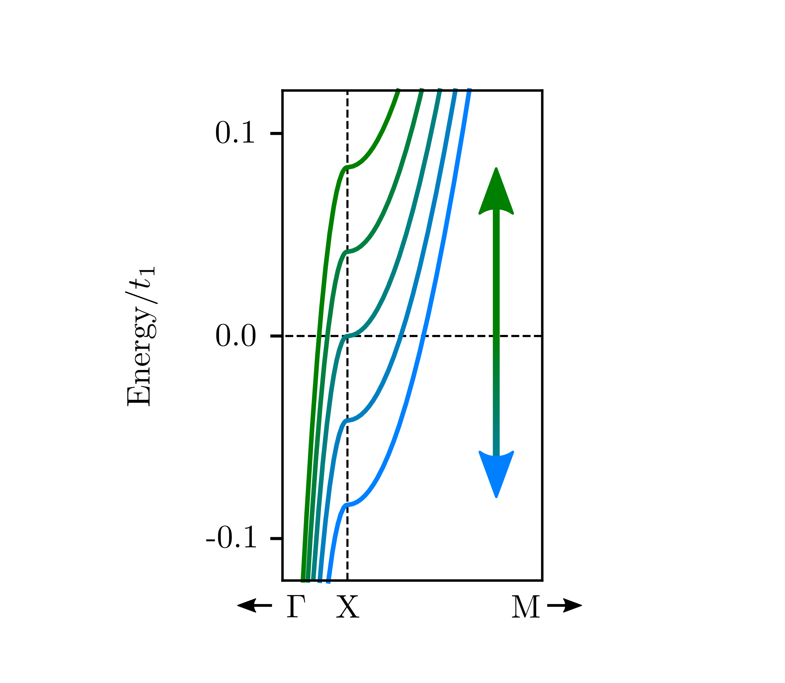
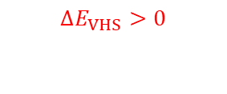
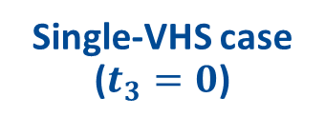
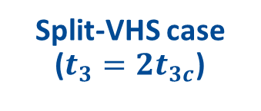
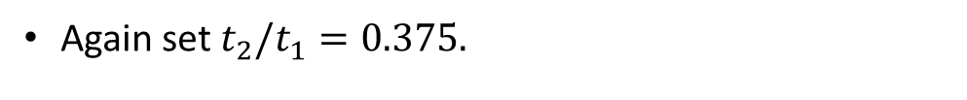
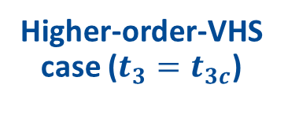
Results away from Van Hove filling
20
Again set $t_{2}/t_{1}=0.375.$
Single-VHS case ($t_{3}=0$)
Higher-order-VHS case ($t_{3}=t_{3c}$)
Split-VHS case ($t_{3}=2t_{3c}$)
TUFRG:
$$ΔE_{VHS}>0$$
Ferromagnetic phase very thin. Some stabilization due to split/higher-order VHSs?

Slide 22
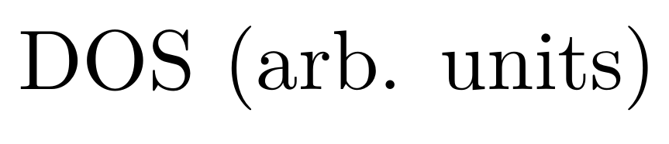



Results away from Van Hove filling
21
Symmetric
Asymmetric
Weaker asymmetry
$$⇒$$
$$⇒$$
$$⇒$$
Asymmetric (well known [2])
Symmetric peak
Symmetric
Step due to max.
-0.1
0.0
0.1
-0.1
0.0
0.1
-0.1
0.0
0.1
[2] Isobe, Fu, Phys. Rev. Res. 1, 033206 (2019)

Slide 23
Outline
22
Outline
Introduction
Manipulation of (higher-order) Van Hove singularities.
Comparing weak-coupling RG methods for finite-density fermions.
The third-nearest-neighbour square-lattice Hubbard model.
Results
Phase diagrams at Van Hove filling.
Doping away from Van Hove filling.
Summary.

Slide 24
Summary
23
Weak-coupling RG methods:
Higher-order Van Hove singularities: tune between ordinary and higher order? Perturb away from Fermi level?
1. Parquet RG
2. TUFRG
Effects realized over range around $t_{3c}$:
(patches)
(full band structure)
More sensitive to doping:
Fair qualitative agreement, important differences.
TPS, M. Ramirez, C. A. Hooley and L. C. Rhodes, arXiv:2608.07714

Slide 25
1
Extra slides
E1
Extra Slides

Slide 26
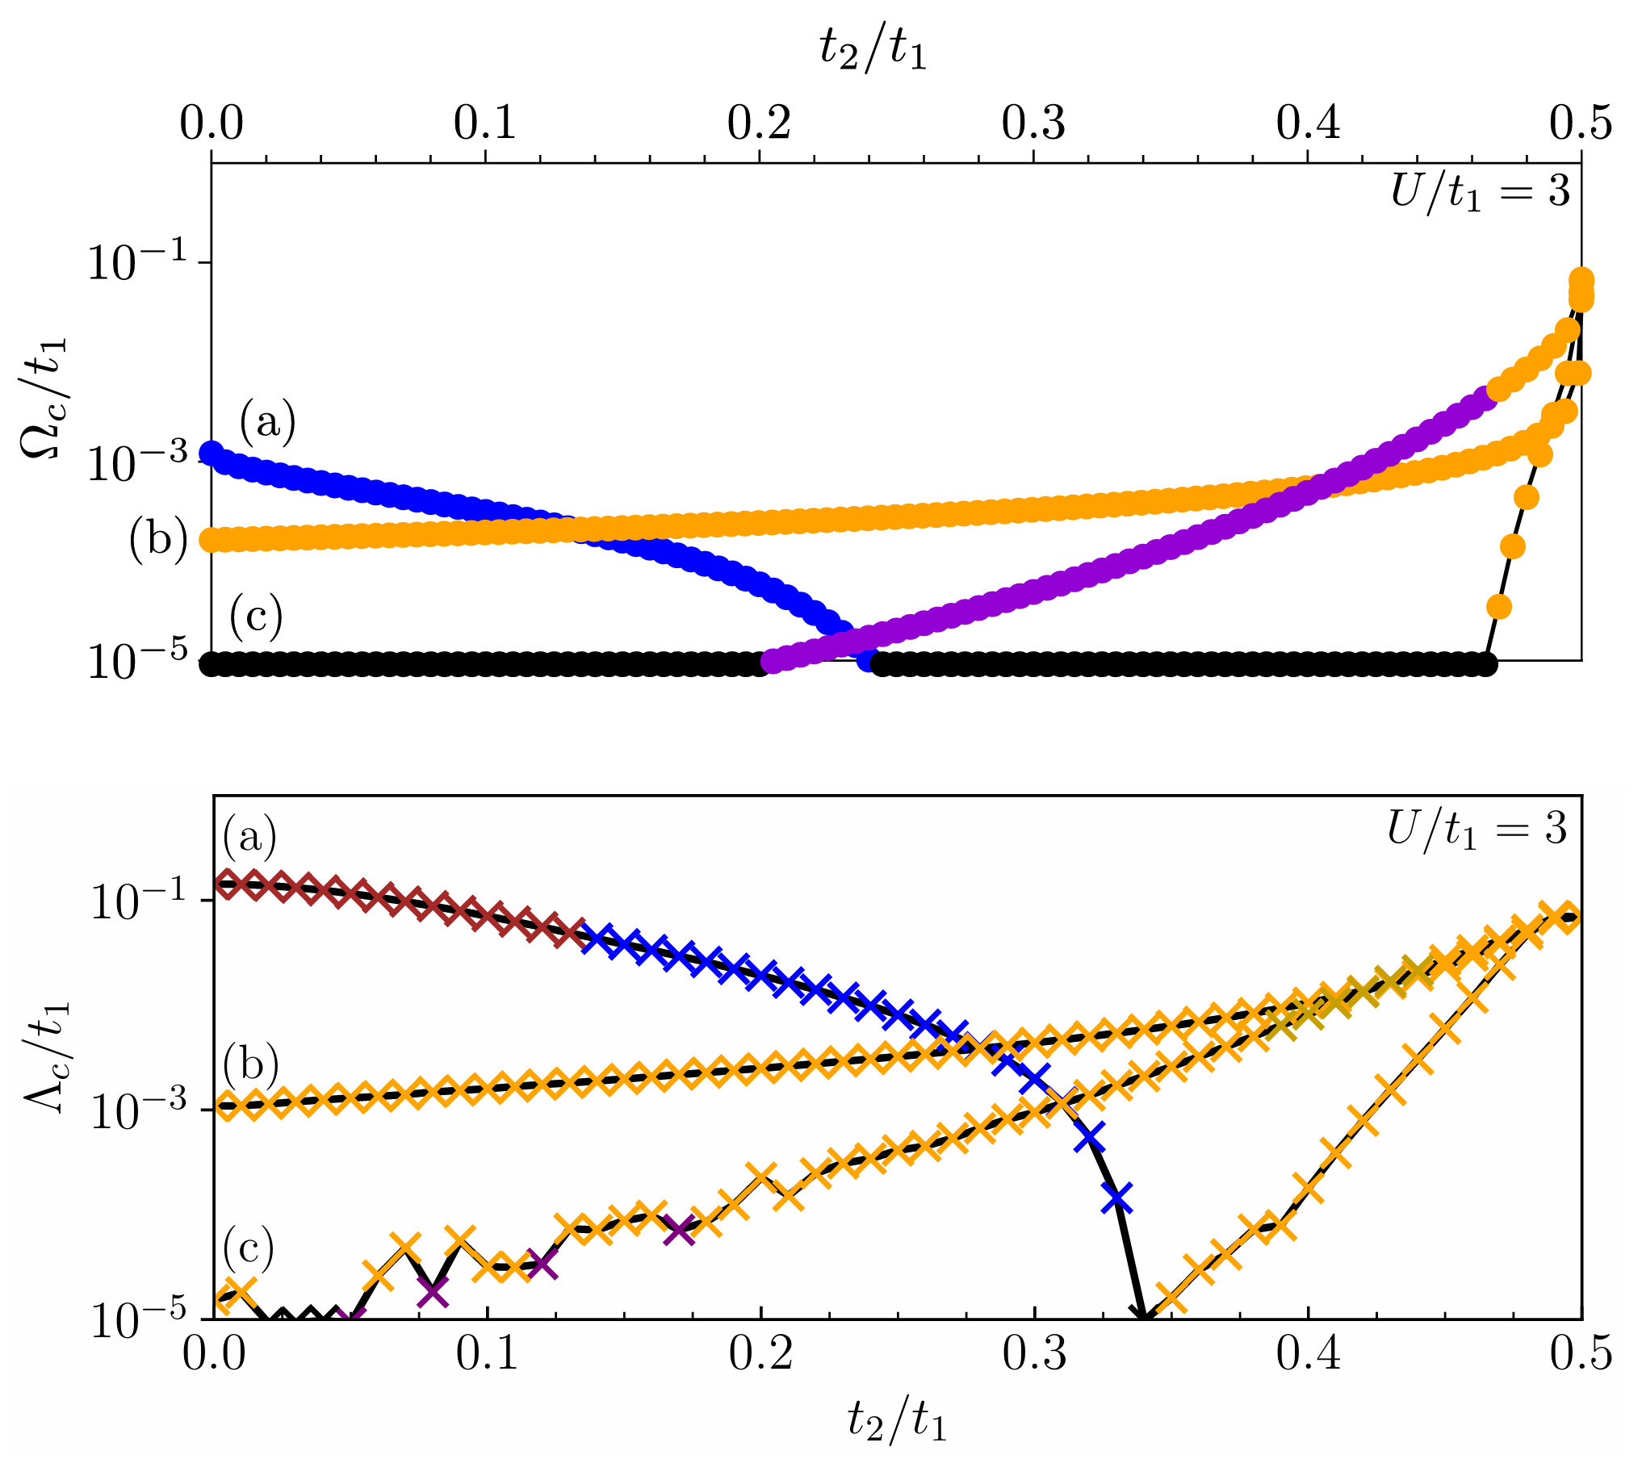



Extra slide
E2
Critical scale $Λ_{c}$: scale at which couplings diverge; measure of transition temperature. Fix $U=3t_{1}$:
Fermi liquid
Parquet:
$E_{u}$ ($p$-wave) SC
$B_{1g}$ ($d$-wave) SC
Ferromagnet
Antiferromagnet
$\left(δ,δ\right)$ SDW
TUFRG:
Again, broad agreement but some issues with parquet RG.
(a) Single-VHS (b) Higher-order VHS (c) Split-VHS

Slide 27



Extra slide
E3
$$t_{2}/t_{1}=0.375$$
Parquet:
TUFRG:
$$\left(=0.125t_{1}\right)$$
$$\left(=0.125t_{1}\right)$$

Slide 28
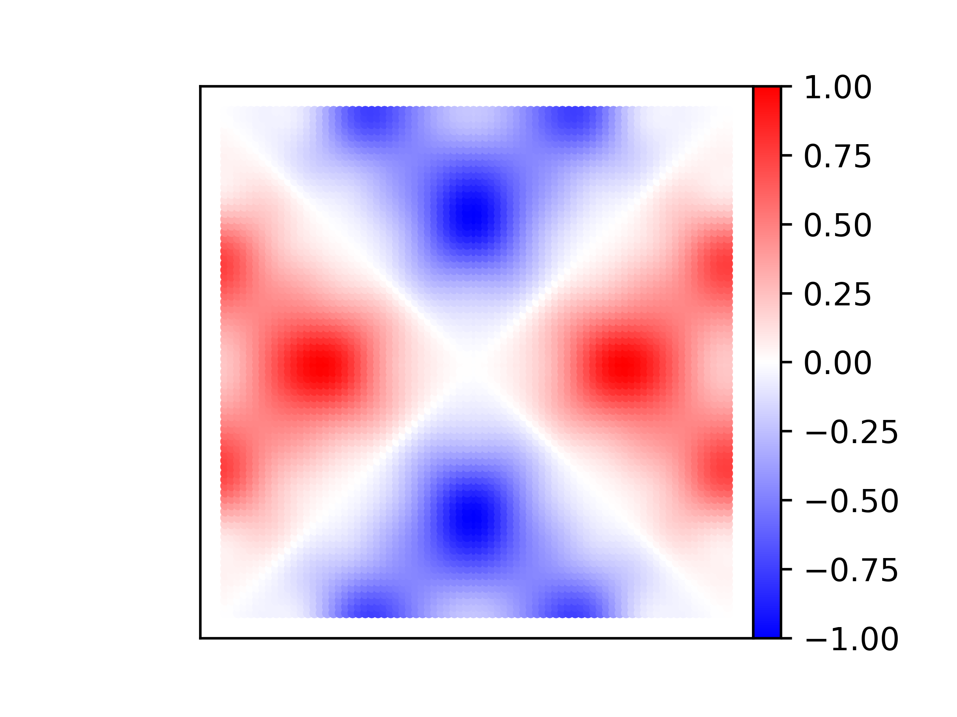
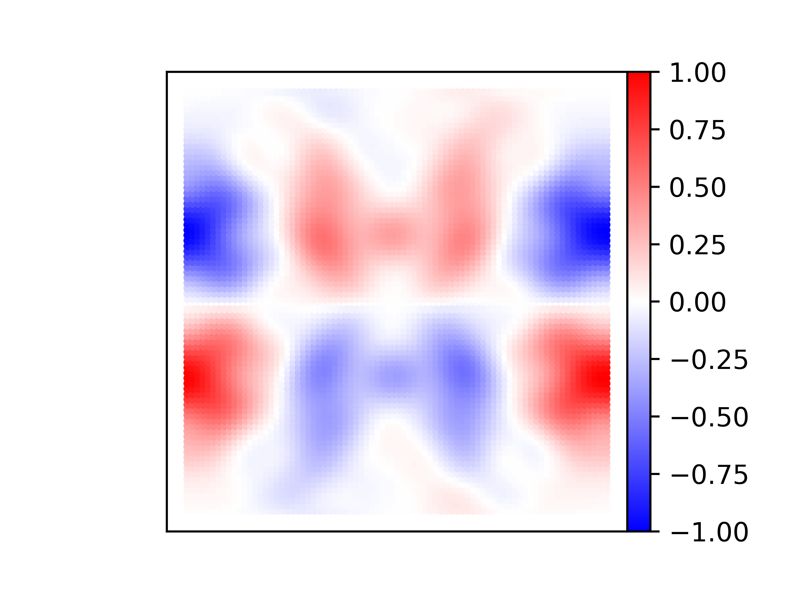


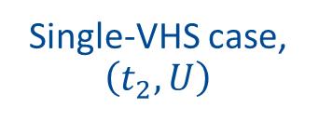




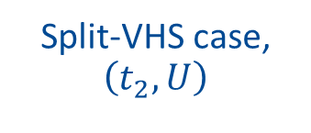


Extra slide
E4
Some superconducting gap functions:
Single-VHS case, $\left(t_{2},U\right)$
Split-VHS case, $\left(t_{2},U\right)$
$$X$$
$$M$$
$$X$$
$$M$$
$$Γ$$
$$Γ$$
$$Re Δ\left(k\right)$$
$$Re Δ\left(k\right)$$

Slide 29
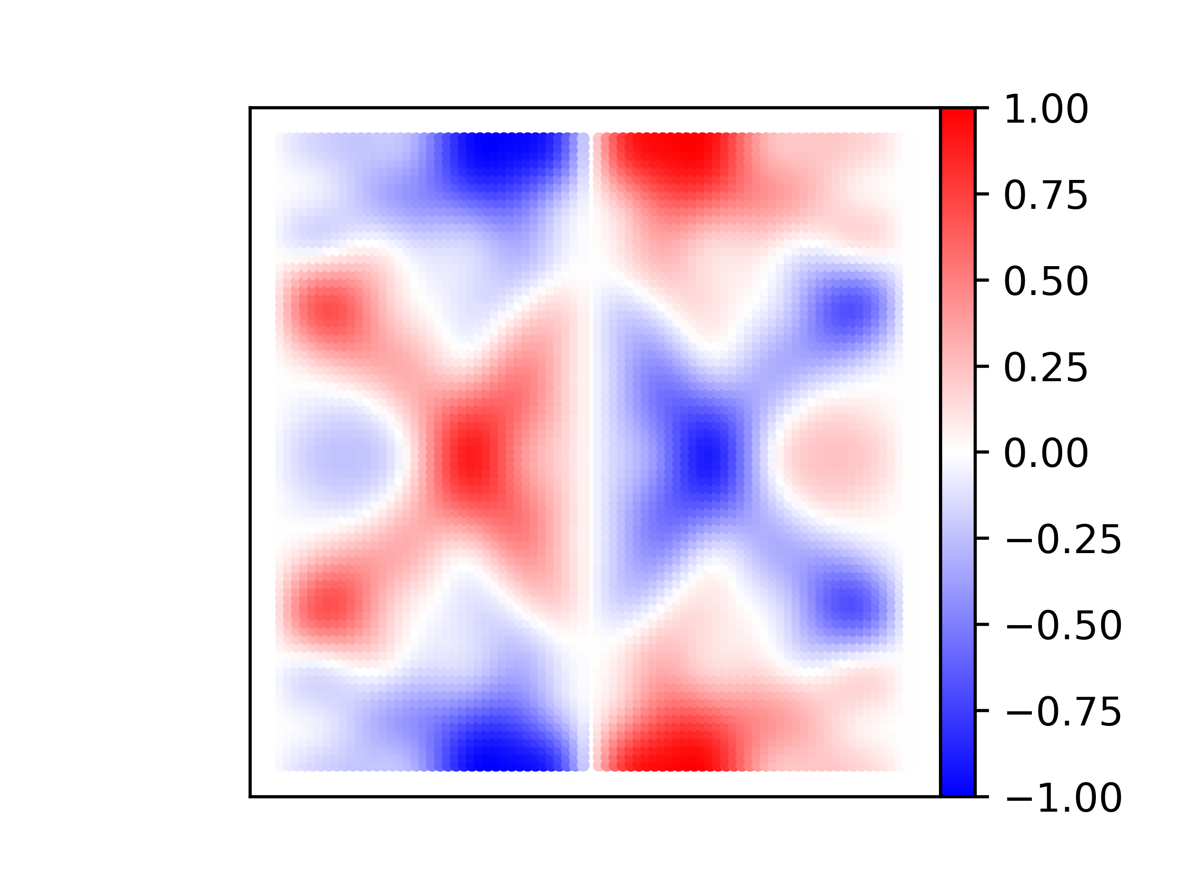
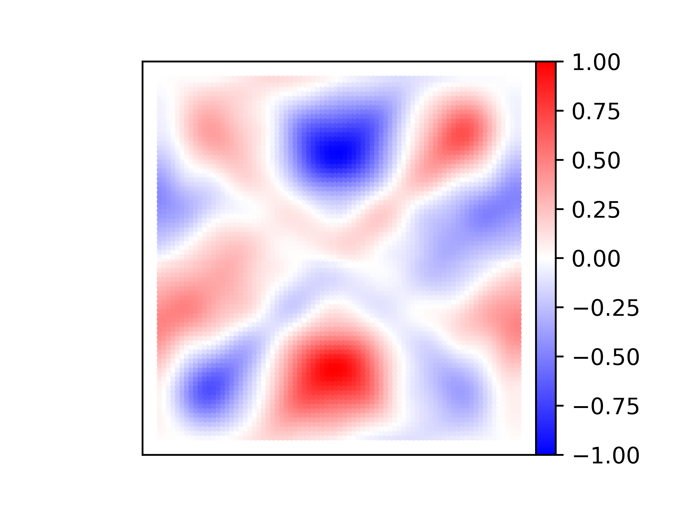


Extra slide
E5
$$X$$
$$M$$
$$X$$
$$M$$
$$Γ$$
$$Γ$$
$$Re Δ\left(k\right)$$
$$Re Δ\left(k\right)$$

