Slide 1


Non-Fermi-liquid metals and phase reconstruction: an FRG perspective
Chris Hooley
Centre for Fluid and Complex Systems, Coventry University
ERG2026, University of Sussex
Friday 4th September 2026

Slide 2







Acknowledgments
Sam Ridgway
former PhD student
Matt Trott
former PhD student
Luke Rhodes
EPSRC Fellow, St Andrews
Maria Ramirez
former MPhys student
Thomas Sheerin
former PhD student, now postdoc at St Andrews – talk at 15.20 today

Slide 3
Outline
Background: metals close to uniform order (magnetic or nematic).
Our work on quantum critical metals:
  a functional renormalisation group analysis, revealing a new non-Fermi-liquid fixed point;
  a better soft-cutoff fRG treatment, revealing a family of such fixed points;
  an analysis of what happens if the boson is a gauge boson.
A teaser for Thomas’s talk: phase competition near a higher-order Van Hove point.
Summary and outlook.

Slide 4
Outline
Background: metals close to uniform order (magnetic or nematic).
Our work on quantum critical metals:
  a functional renormalisation group analysis, revealing a new non-Fermi-liquid fixed point;
  a better soft-cutoff fRG treatment, revealing a family of such fixed points;
  an analysis of what happens if the boson is a gauge boson.
A teaser for Thomas’s talk: phase competition near a higher-order Van Hove point.
Summary and outlook.

Slide 5
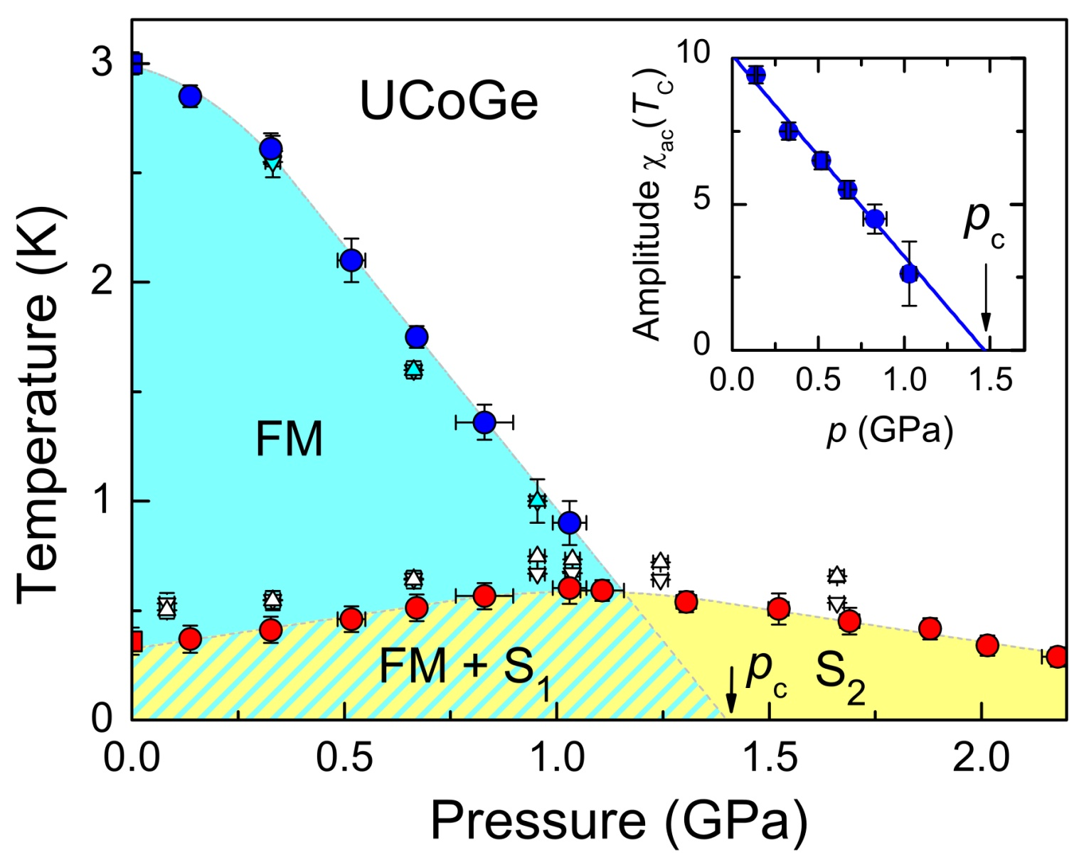
Phase diagram of UCoGe
1. Background: metals close to uniform order
E. Slooten, T. Naka, A. Gasparini, Y. K. Huang, and A. De Visser, Phys. Rev. Lett. 103,
097003 (2009).

Slide 6
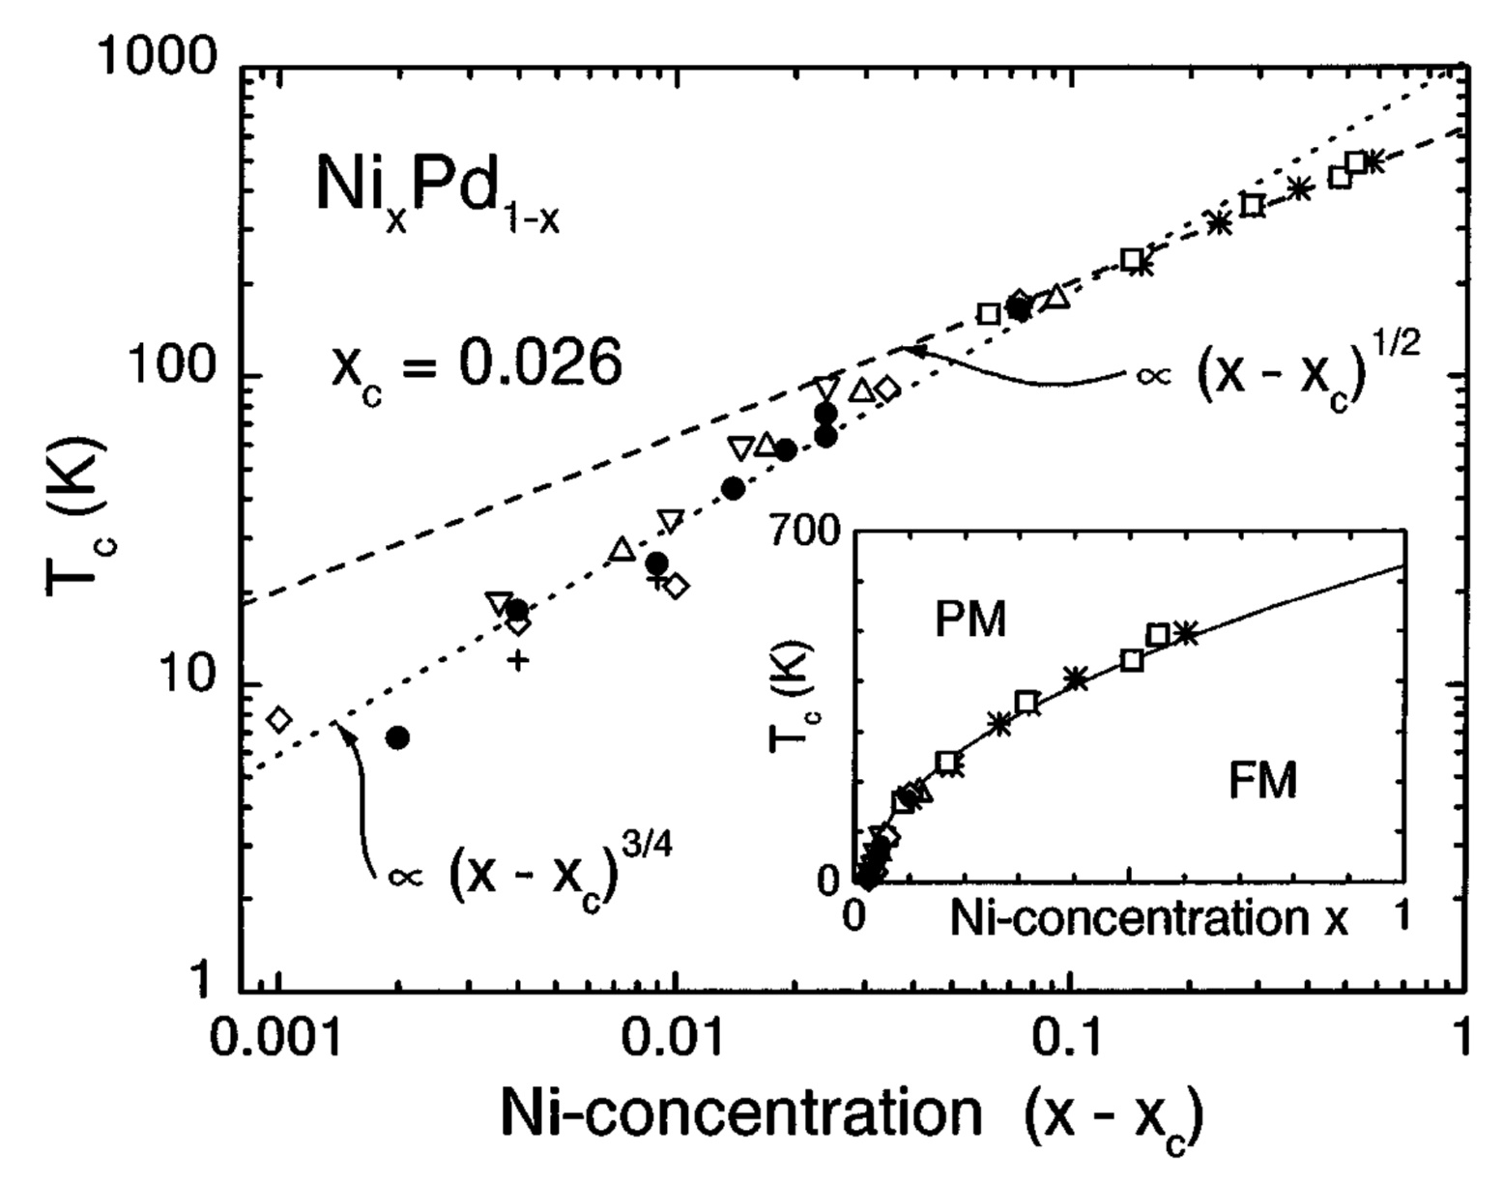
Phase diagram of Ni_{x}Pd_{1-x}
1. Background: metals close to uniform order
M. Nicklas, M. Brando, G. Knebel, F. Mayr, W. Trinkl, and A. Loidl,
Phys. Rev. Lett. 82, 4268 (1999).

Slide 7
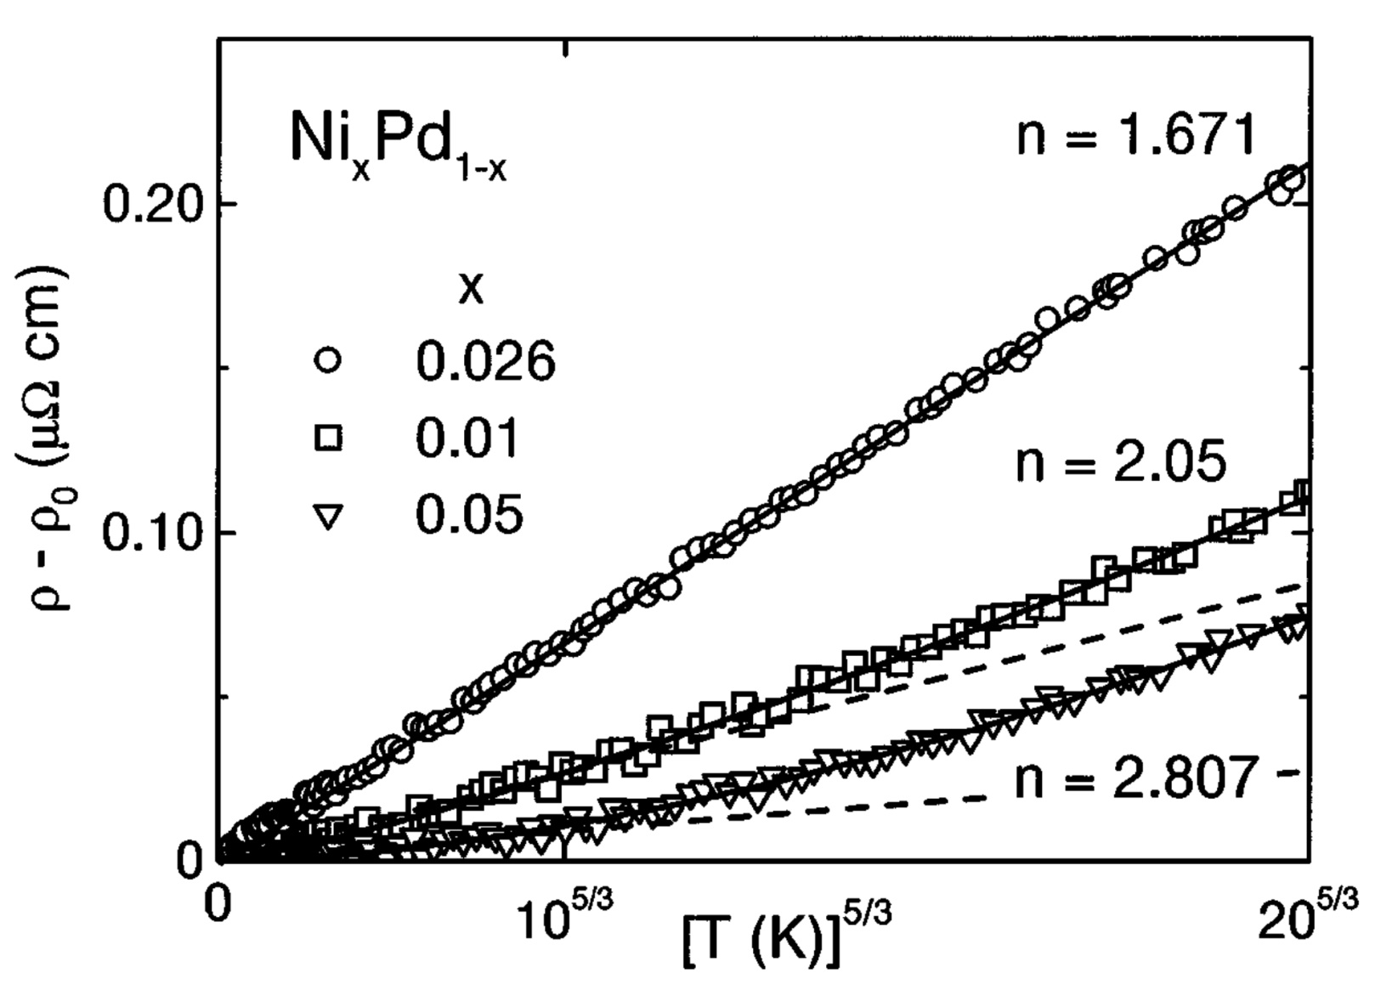
Anomalous resistivity power-law
1. Background: metals close to uniform order
M. Nicklas, M. Brando, G. Knebel, F. Mayr, W. Trinkl, and A. Loidl,
Phys. Rev. Lett. 82, 4268 (1999).

Slide 8
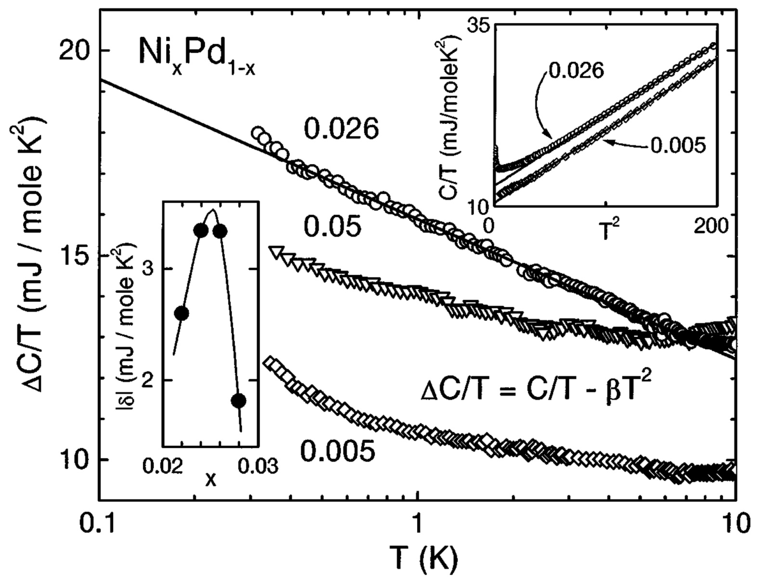
Anomalous specific heat
1. Background: metals close to uniform order
M. Nicklas, M. Brando, G. Knebel, F. Mayr, W. Trinkl, and A. Loidl, Phys. Rev. Lett. 82, 4268 (1999).

Slide 9
Outline
Background: metals close to uniform order (magnetic or nematic).
Our work on quantum critical metals:
  a functional renormalisation group analysis, revealing a new non-Fermi-liquid fixed point;
  a better soft-cutoff fRG treatment, revealing a family of such fixed points;
  an analysis of what happens if the boson is a gauge boson.
A teaser for Thomas’s talk: phase competition near a higher-order Van Hove point.
Summary and outlook.

Slide 10
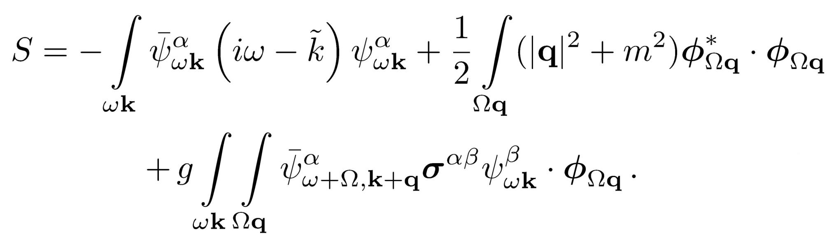
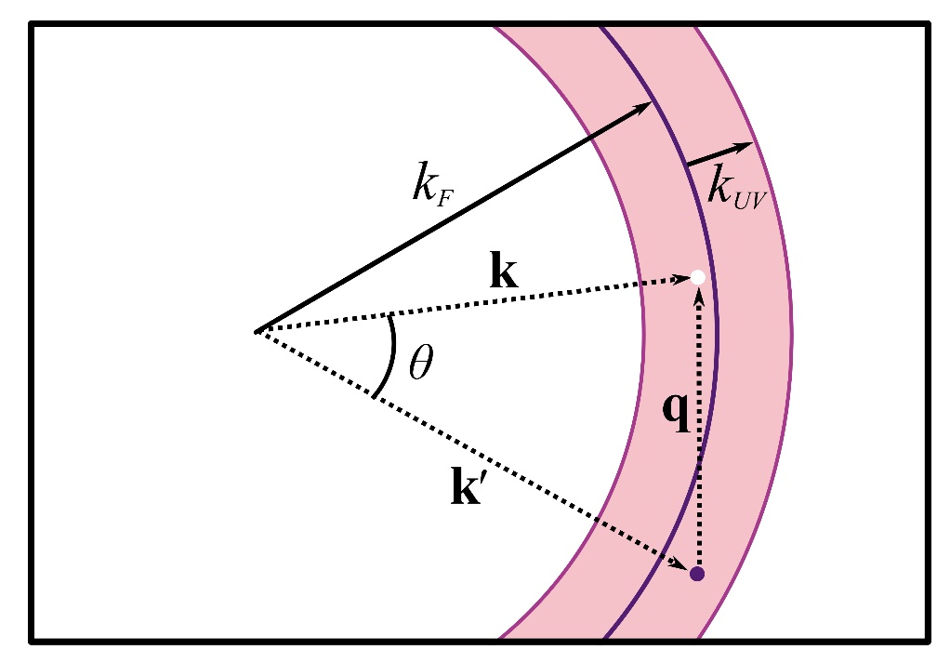
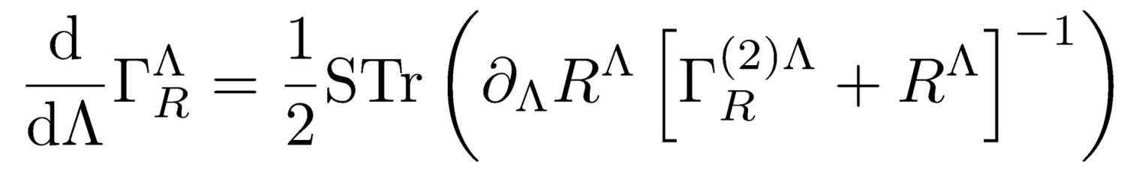
Fermion-boson model; FRG equation
2(a). Functional RG with self-consistency for the vector ferromagnet

Slide 11
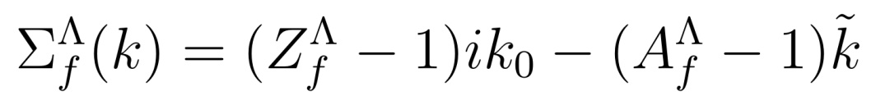
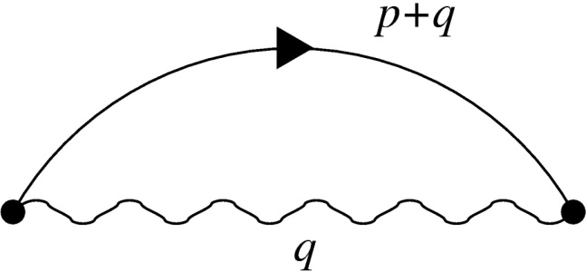
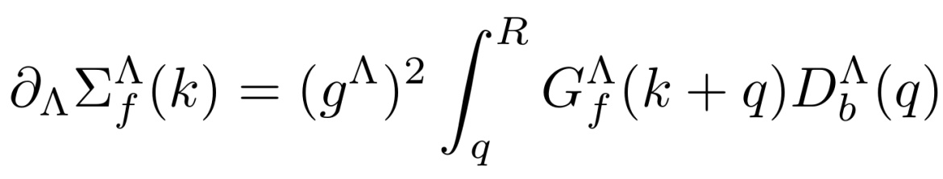
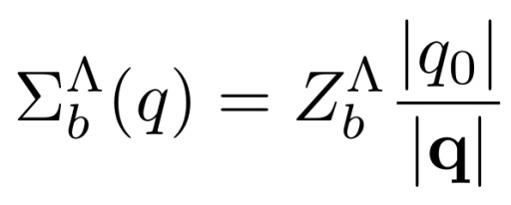
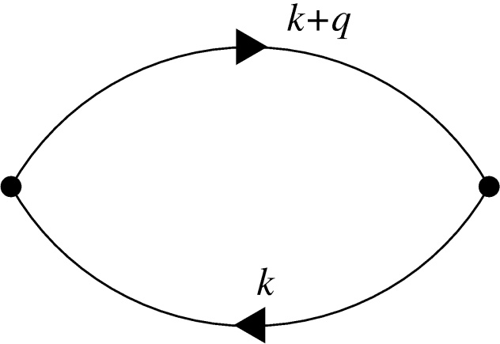
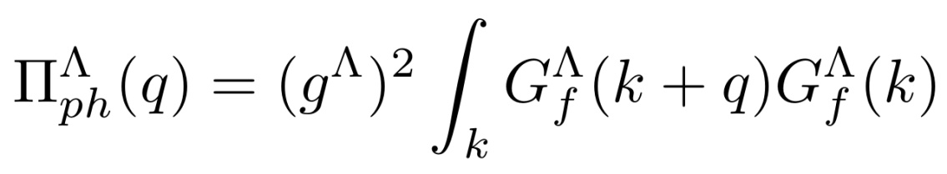
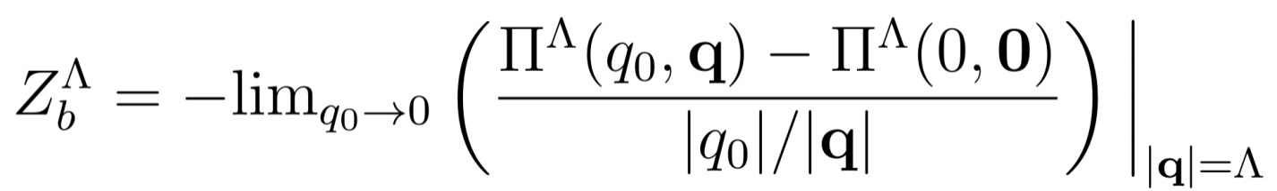
Equations for self-energies
2(a). Functional RG with self-consistency for the vector ferromagnet

Slide 12
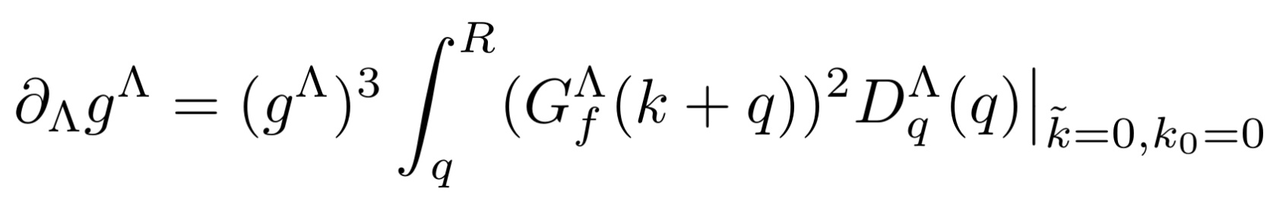
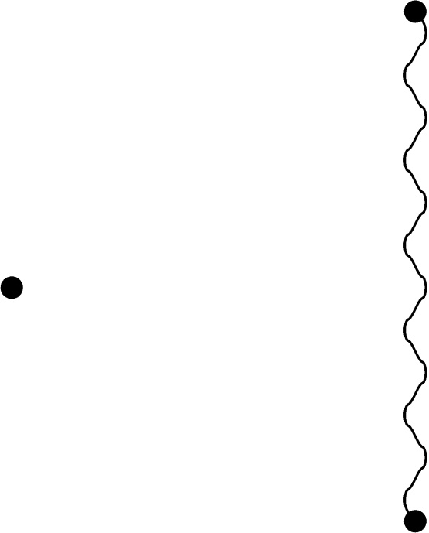



Flow of Yukawa coupling
2(a). Functional RG with self-consistency for the vector ferromagnet
$$k+q$$
$$q$$
$$k+q$$

Slide 13
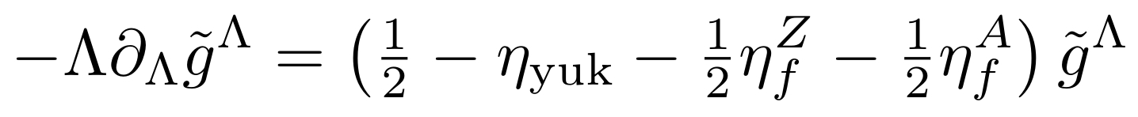
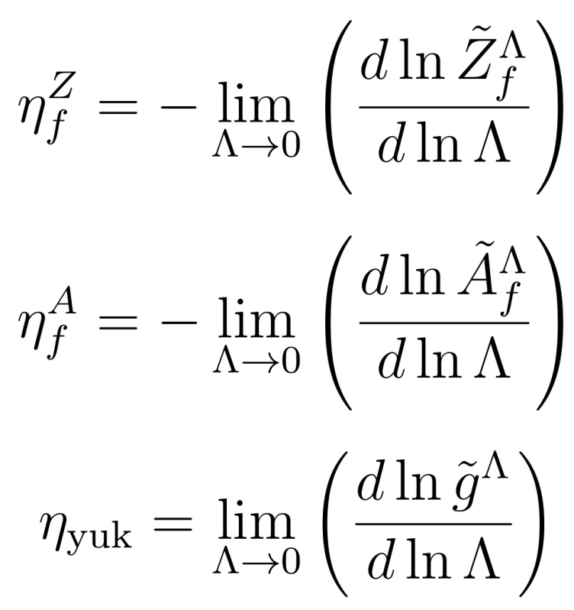
Closed flow equation for coupling
2(a). Functional RG with self-consistency for the vector ferromagnet

Slide 14
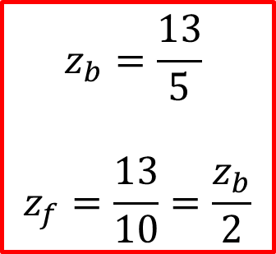
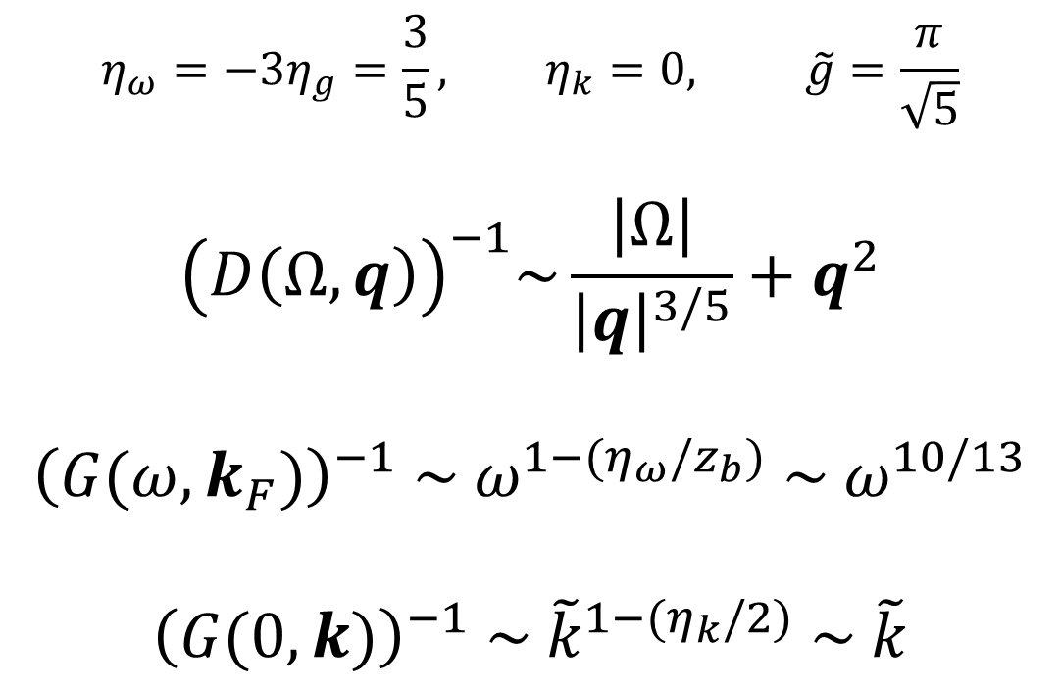
A new non-Fermi-liquid fixed point
2(a). Functional RG with self-consistency for the vector ferromagnet
$$η_{ω}=−3η_{g}=\frac{3}{5}, η_{k}=0, \tilde{g}=\frac{π}{\sqrt{5}}$$
$${\left(D\left(Ω,q\right)\right)}^{−1}\sim \frac{\left|Ω\right|}{{\left|q\right|}^{3/5}}+q^{2}$$
$${\left(G(ω,k_{F})\right)}^{−1} \sim ω^{1−(η_{ω}/z_{b})} \sim ω^{10/13}$$
$${\left(G(0,k)\right)}^{−1} \sim {\tilde{k}}^{1−(η_{k}/2)} \sim \tilde{k}$$
$$z_{b}=\frac{13}{5}$$
$$z_{f}=\frac{13}{10}=\frac{z_{b}}{2}$$

Slide 15
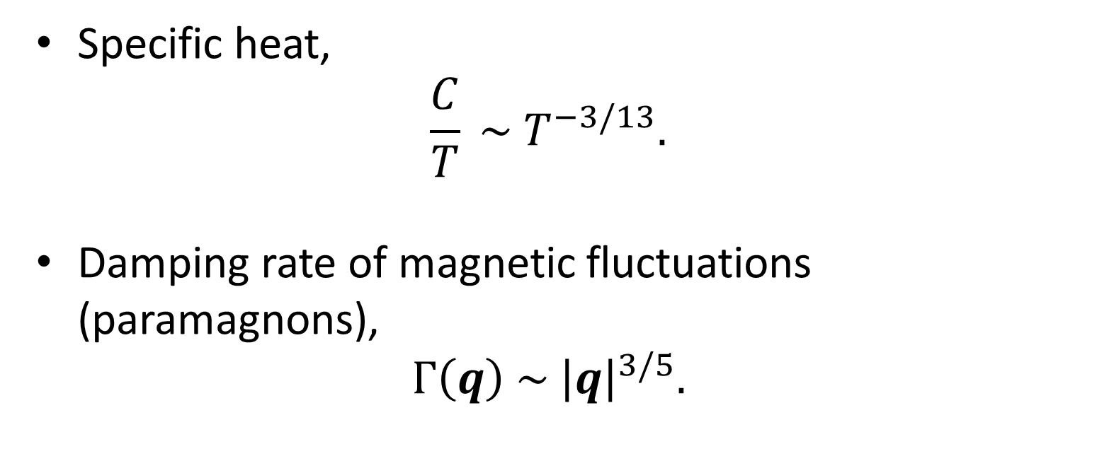
Experimental consequences
2(a). Functional RG with self-consistency for the vector ferromagnet
Specific heat,
$$\frac{C}{T} \sim T^{−3/13}.$$
Damping rate of magnetic fluctuations (paramagnons),
$$Γ\left(q\right) \sim {\left|q\right|}^{3/5}.$$

Slide 16
Outline
Background: metals close to uniform order (magnetic or nematic).
Our work on quantum critical metals:
  a functional renormalisation group analysis, revealing a new non-Fermi-liquid fixed point;
  a better soft-cutoff fRG treatment, revealing a family of such fixed points;
  an analysis of what happens if the boson is a gauge boson.
A teaser for Thomas’s talk: phase competition near a higher-order Van Hove point.
Summary and outlook.

Slide 17
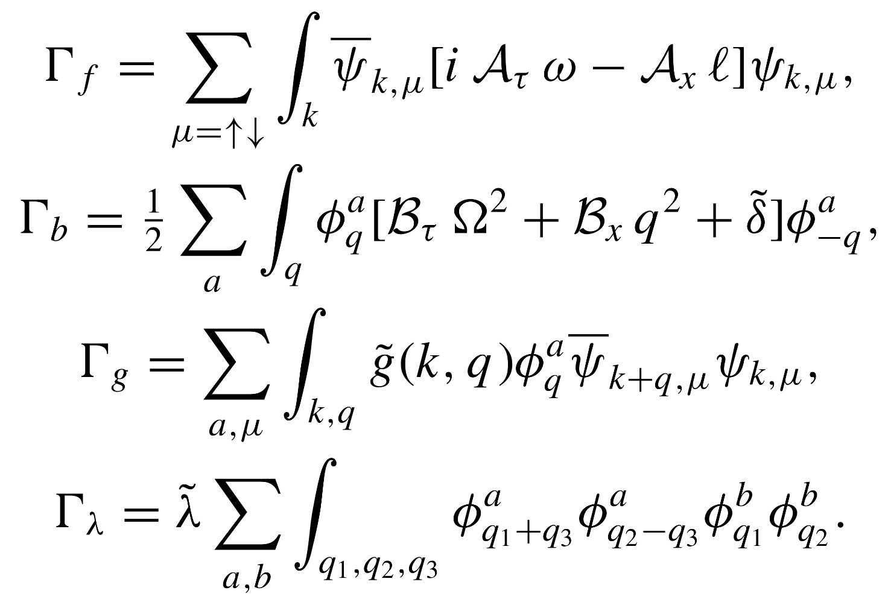
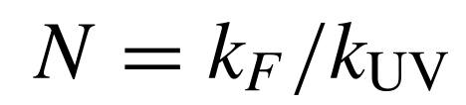

A model that starts with undamped bosons
2(b). Functional RG with a soft frequency regulator for the nematic case
$N_{b}$ flavours of boson

Slide 18
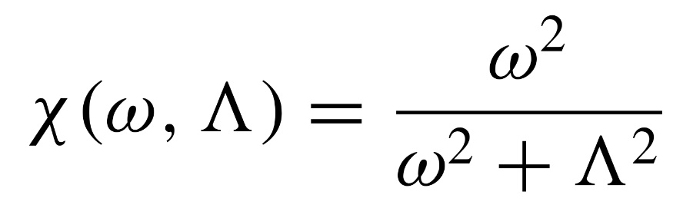
A soft frequency fermion regulator
2(b). Functional RG with a soft frequency regulator for the nematic case

Slide 19
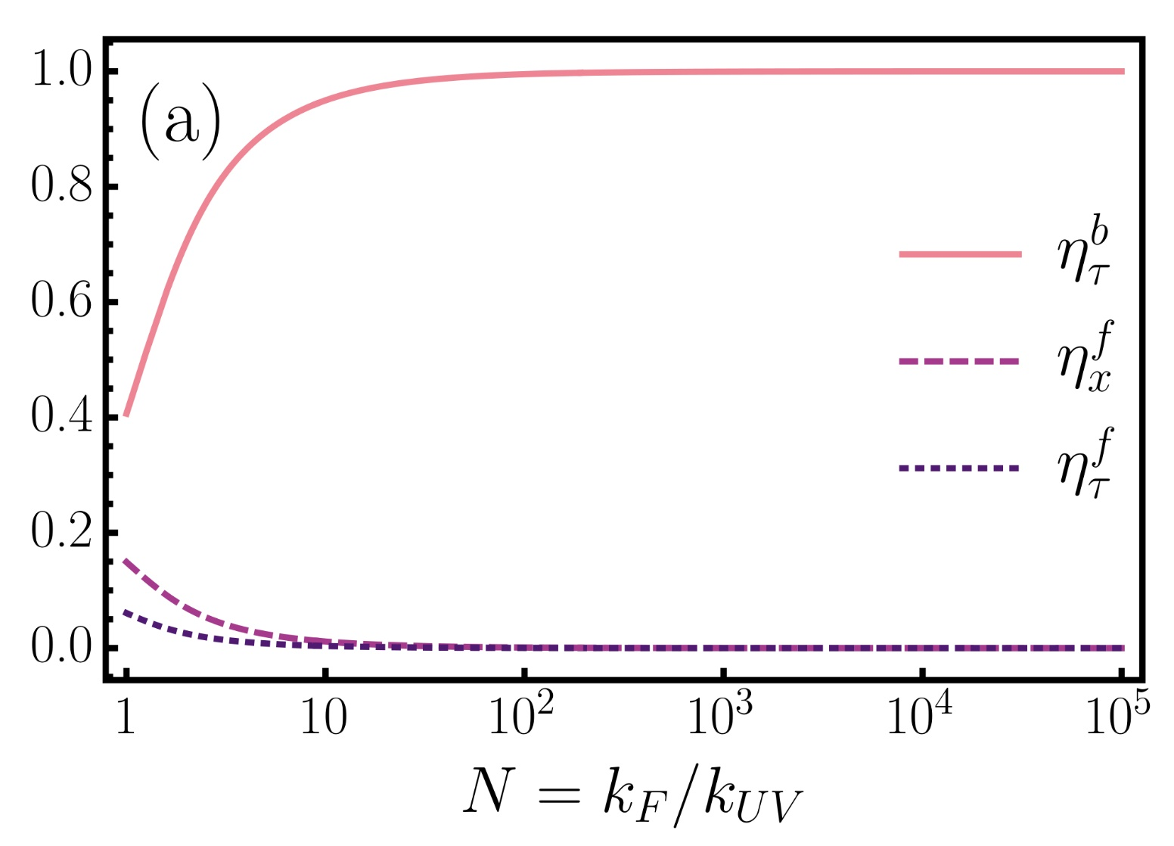

Results: $N_{b}=1$ for a range of $N$
2(b). Functional RG with a soft frequency regulator for the nematic case

Slide 20
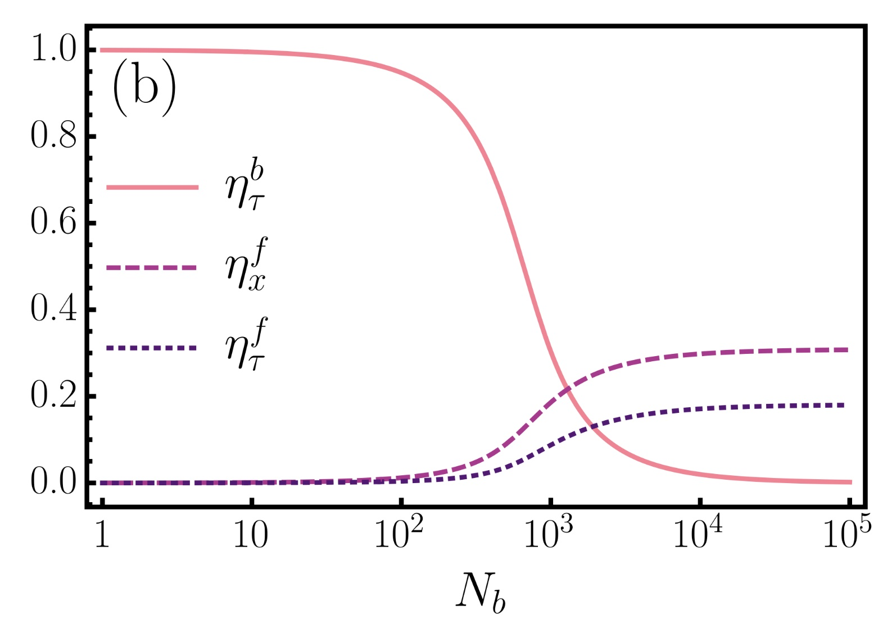

Results: $N={10}^{3}$ for a range of $N_{b}$
2(b). Functional RG with a soft frequency regulator for the nematic case

Slide 21
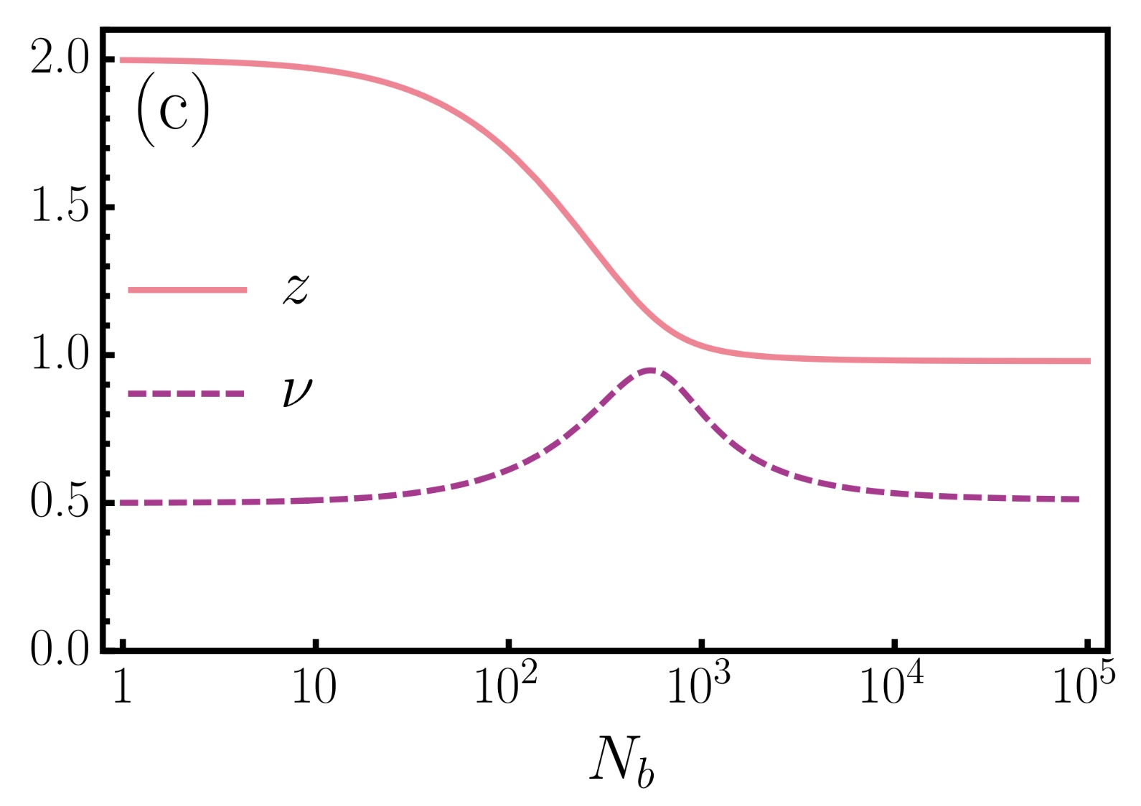

Results: $N={10}^{3}$, exponent crossover
2(b). Functional RG with a soft frequency regulator for the nematic case
N.B. – This matches the exponent observed in quantum Monte Carlo treatments of the nematic quantum critical point.
Y. Schattner, S. Lederer, S. A. Kivelson, and E. Berg, Phys. Rev. X 6, 031028 (2016).

Slide 22
Outline
Background: metals close to uniform order (magnetic or nematic).
Our work on quantum critical metals:
  a functional renormalisation group analysis, revealing a new non-Fermi-liquid fixed point;
  a better soft-cutoff fRG treatment, revealing a family of such fixed points;
  an analysis of what happens if the boson is a gauge boson.
A teaser for Thomas’s talk: phase competition near a higher-order Van Hove point.
Summary and outlook.

Slide 23
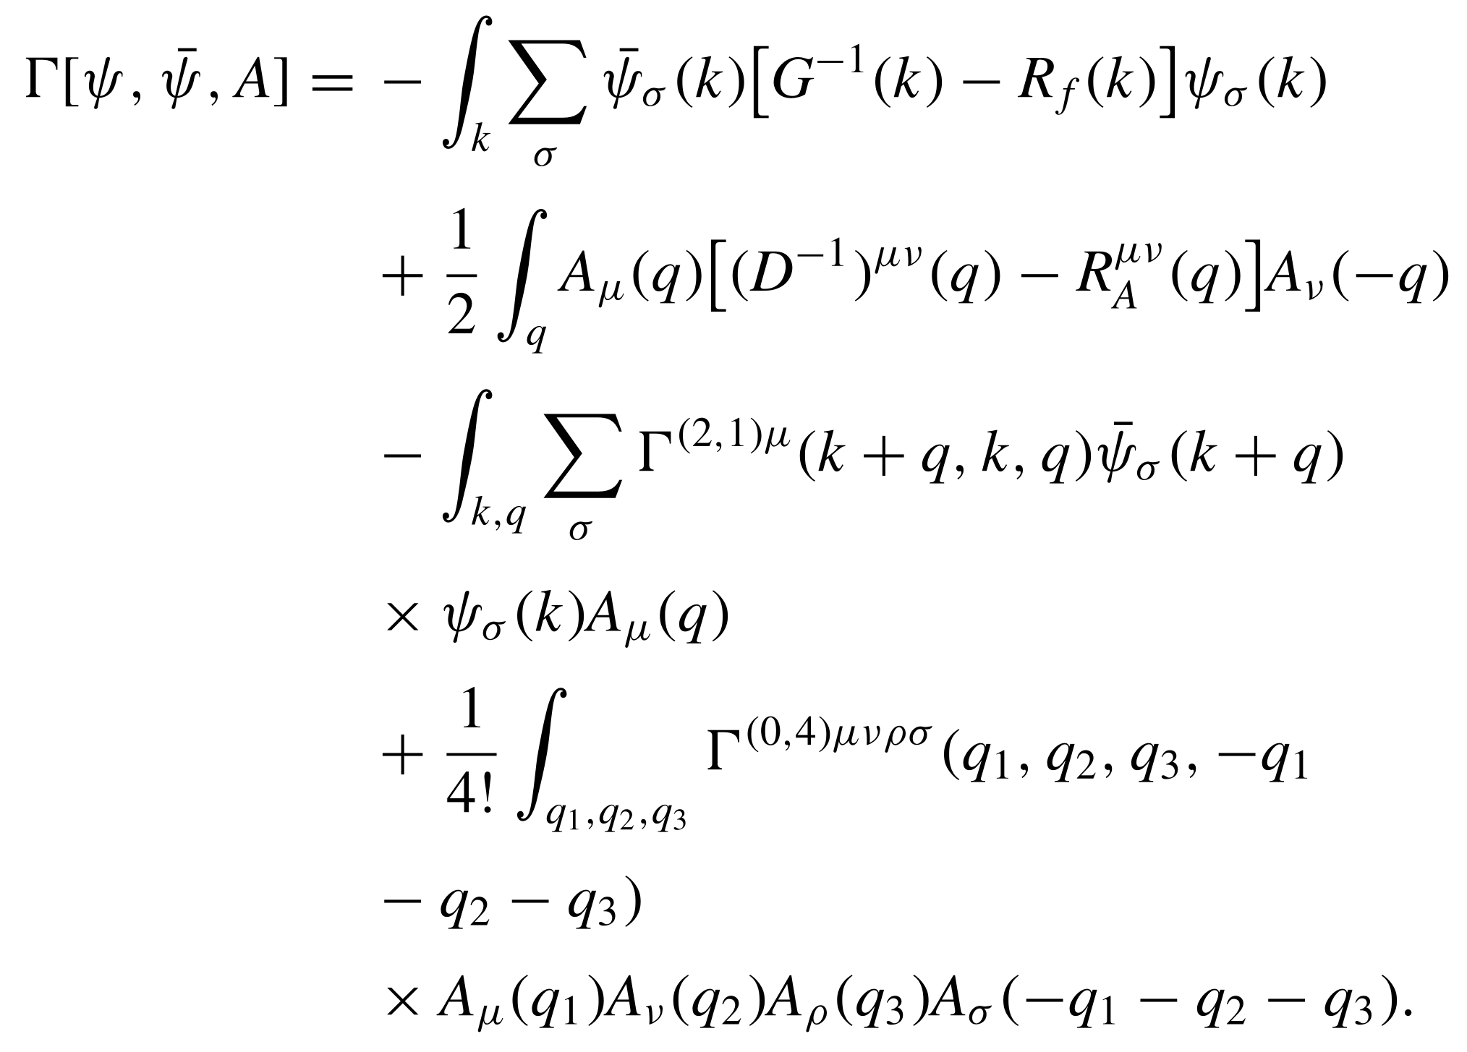
Ansatz for low-energy effective action
2(c). Functional RG with modified Ward-Takahashi identities for the case of a gauge boson

Slide 24
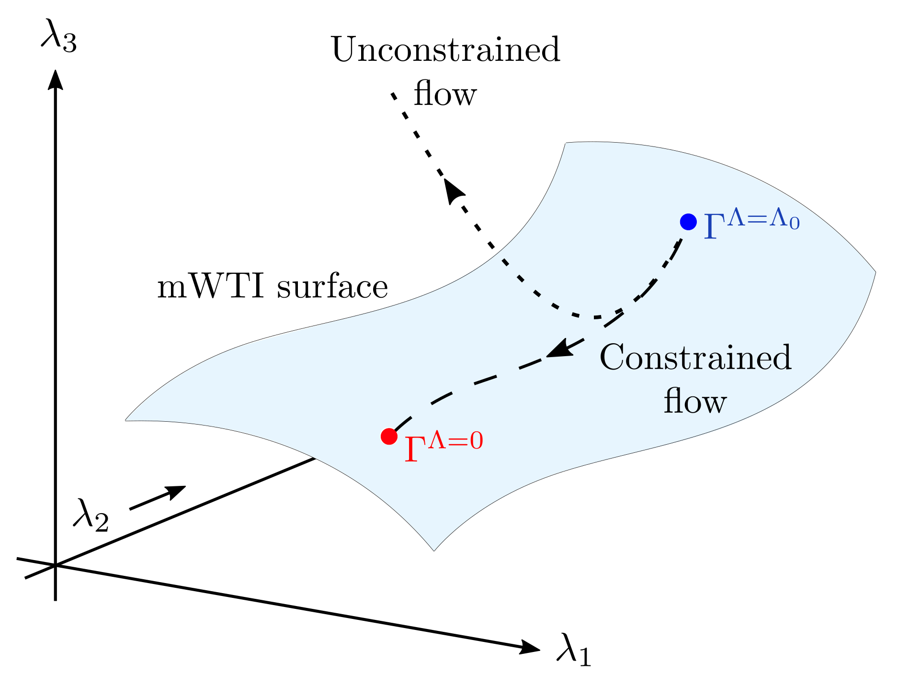
Constrained vs. unconstrained flow
2(c). Functional RG with modified Ward-Takahashi identities for the case of a gauge boson

Slide 25
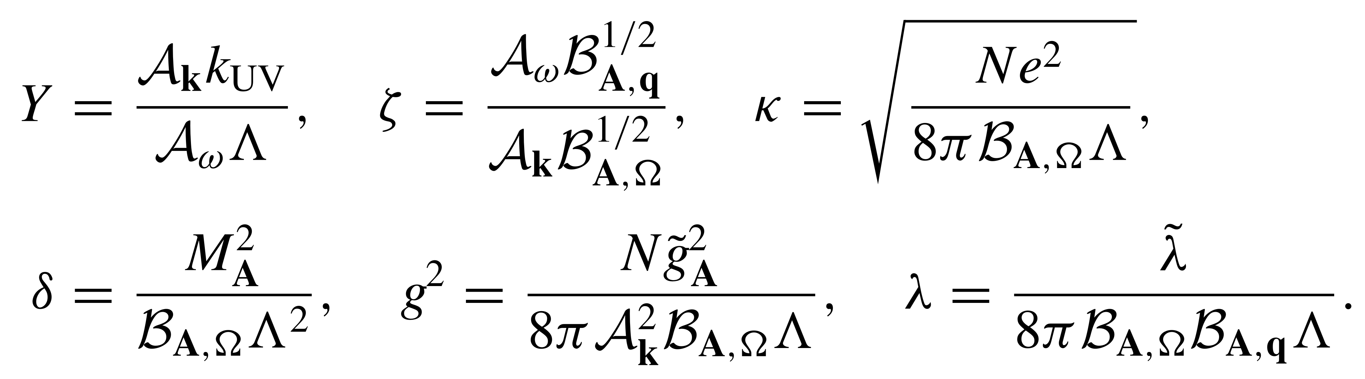
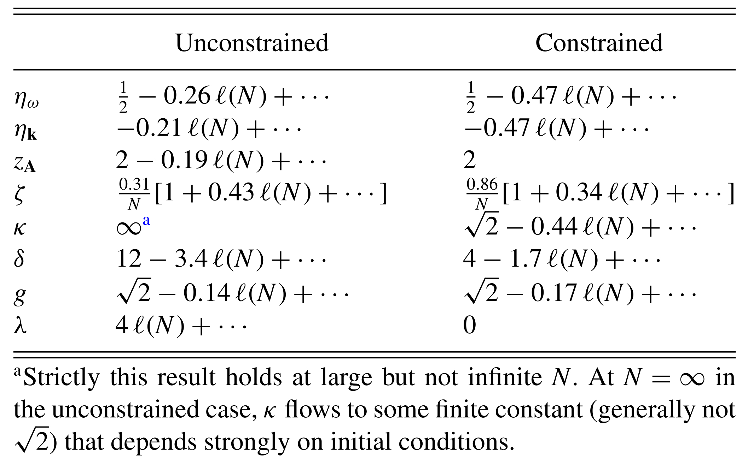
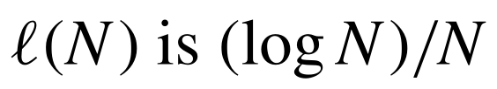
Fixed-point properties
2(c). Functional RG with modified Ward-Takahashi identities for the case of a gauge boson

Slide 26
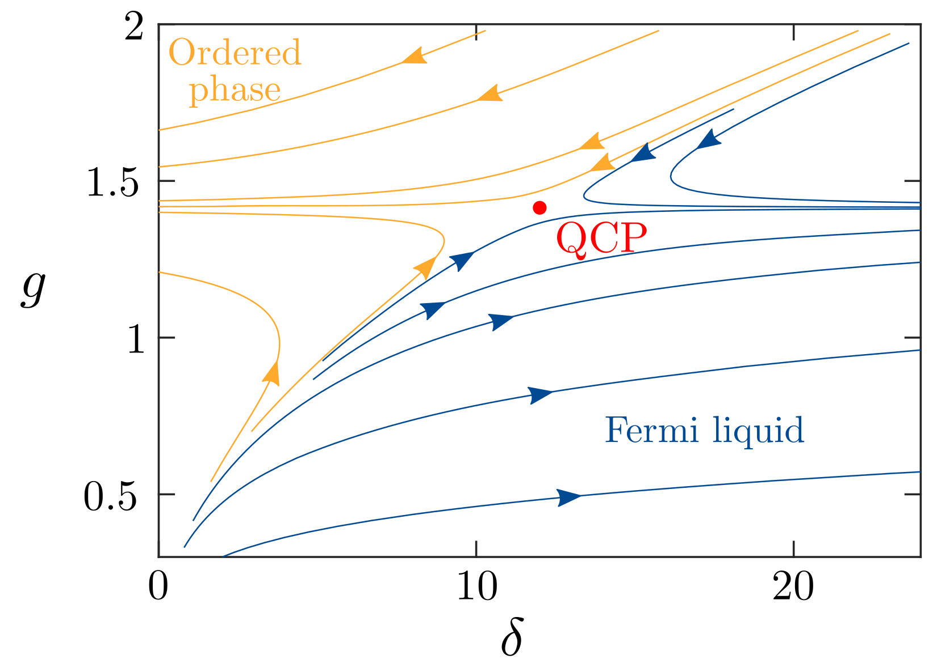
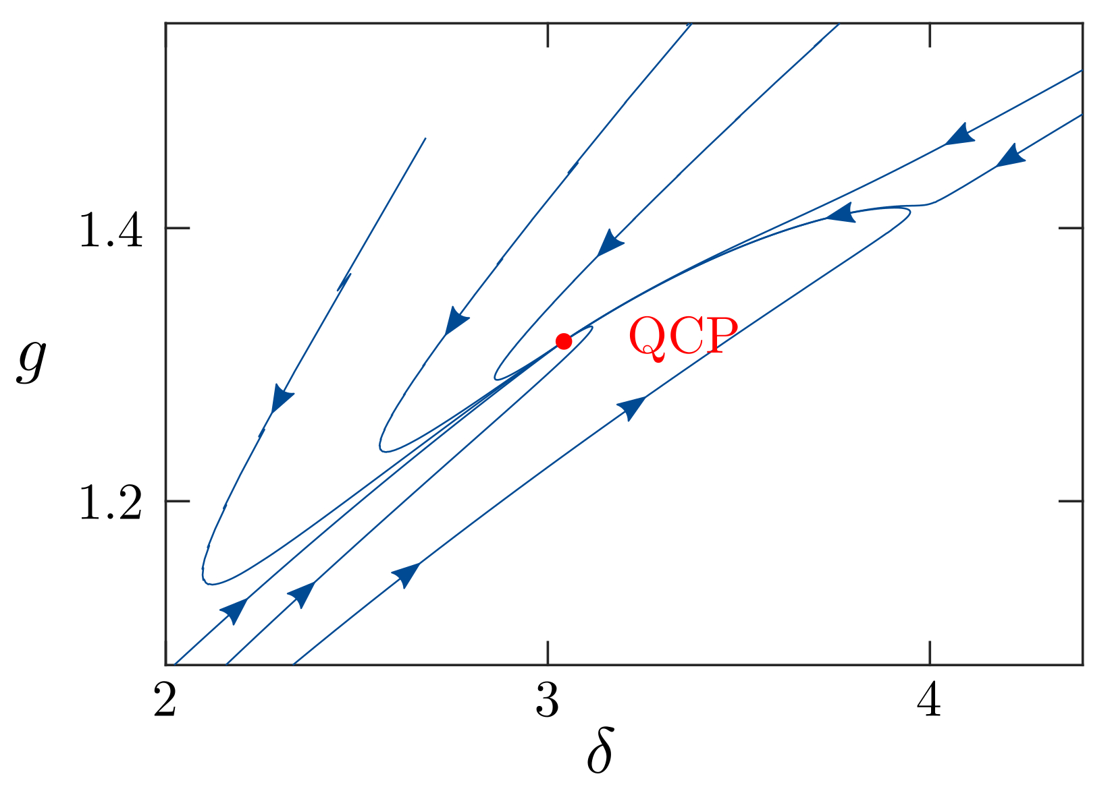
Flow: unconstrained (left) vs constrained (right)
2(c). Functional RG with modified Ward-Takahashi identities for the case of a gauge boson

Slide 27
Outline
Background: metals close to uniform order (magnetic or nematic).
Our work on quantum critical metals:
  a functional renormalisation group analysis, revealing a new non-Fermi-liquid fixed point;
  a better soft-cutoff fRG treatment, revealing a family of such fixed points;
  an analysis of what happens if the boson is a gauge boson.
A teaser for Thomas’s talk: phase competition near a higher-order Van Hove point.
Summary and outlook.

Slide 28
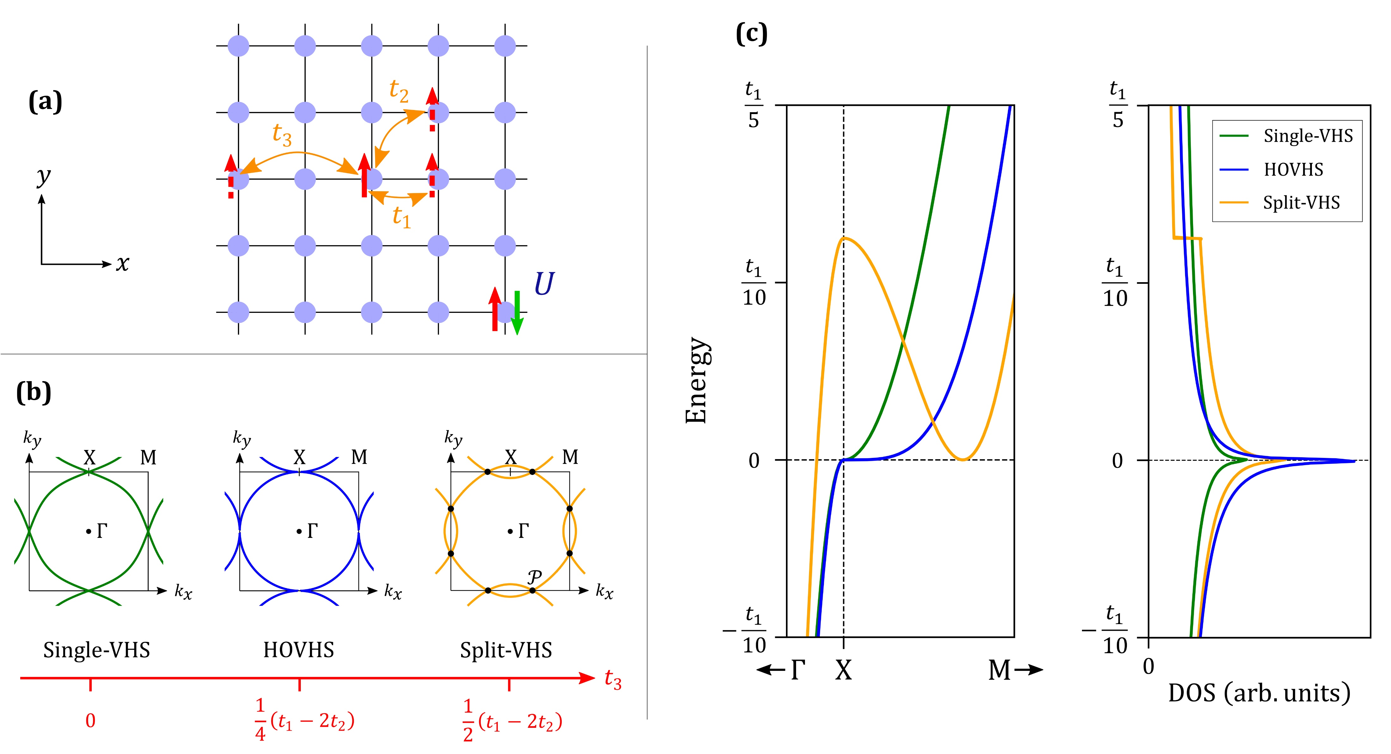
Lattice models and Van Hove singularities
3. Phase competition near a higher-order Van Hove point

Slide 29
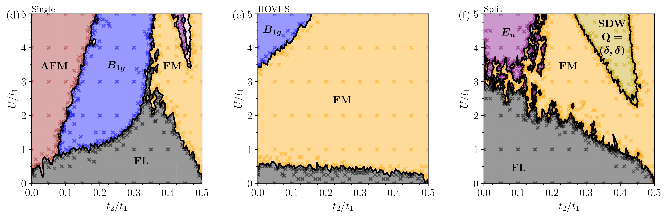
Phase diagrams at Van Hove filling
3. Phase competition near a higher-order Van Hove point

Slide 30
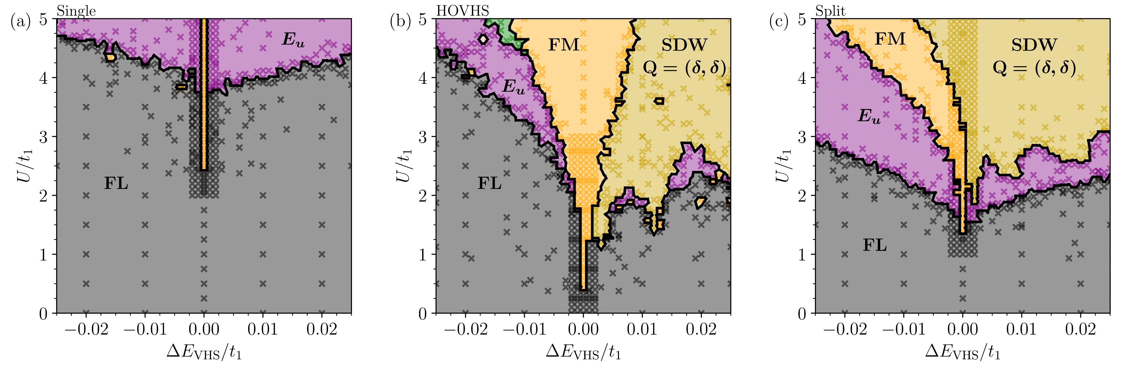
Doping away from Van Hove filling
3. Phase competition near a higher-order Van Hove point
For more details, see the talk by Thomas Sheerin, 15.20 today, room 144

Slide 31
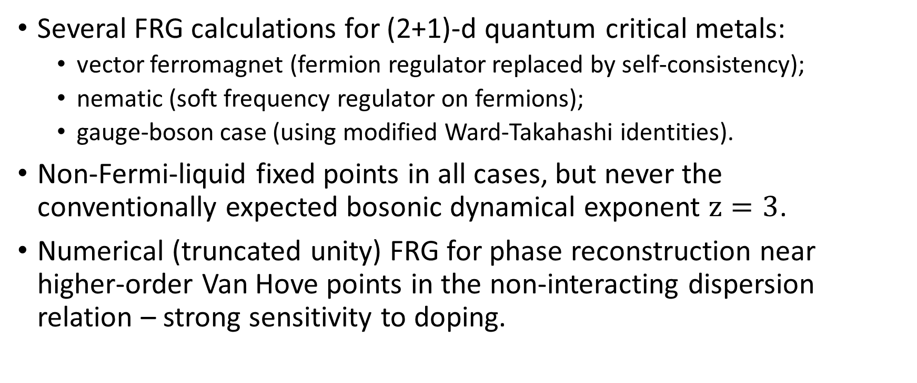
Summary
Several FRG calculations for (2+1)-d quantum critical metals:
  vector ferromagnet (fermion regulator replaced by self-consistency);
  nematic (soft frequency regulator on fermions);
  gauge-boson case (using modified Ward-Takahashi identities).
Non-Fermi-liquid fixed points in all cases, but never the conventionally expected bosonic dynamical exponent $z=3$.
Numerical (truncated unity) FRG for phase reconstruction near higher-order Van Hove points in the non-interacting dispersion relation – strong sensitivity to doping.

