Slide 1
Fermions and the Renormalisation Group
Freddie King
Based on work by Dr. Charlie Cresswell-Hogg and Prof. Daniel Litim
(2502.04473, 2207.10115, 1702.05749, 2406.00100, 2212.06815)

Slide 2
Introduction to Fermions in the FRG
Fermions and the Renormalisation Group at Large N: https://arxiv.org/pdf/2502.04473

Slide 3
Fermionic QFTs
Why study?
⦁ d=2+1 QFTs with relativistic fermions → 2D ‘Dirac materials’
e.g. Wehling, Black-Schaffer, Balatsky 2014

Slide 4
Fermionic QFTs
Why study?
⦁ d=2+1 QFTs with relativistic fermions → 2D ‘Dirac materials’
⦁ Interacting CFTs dual to gravitational theories (AdS/CFT)
e.g. Wehling, Black-Schaffer, Balatsky 2014
Maldacena ‘99

Slide 5
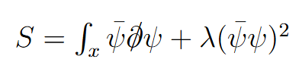


Fermionic QFTs
Why study?
⦁ d=2+1 QFTs with relativistic fermions → 2D ‘Dirac materials’
⦁ Interacting CFTs dual to gravitational theories (AdS/CFT)
⦁ Self interacting fermions → perturbatively non-renormalizable
→ non-perturbative tool?
→ FRG: Wetterich equation
→ reveals UV fixed point
→ concrete example of ‘asymptotic safety’
e.g. Wehling, Black-Schaffer, Balatsky 2014
Maldacena ‘99
Gross, Neveu ’74,
Rosenstein, Warr ‘91

Slide 6
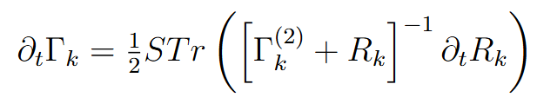
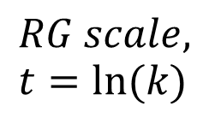



FRG for Fermions
$$Effective action, Γ_{k}$$
$$Hessian$$
⦁ Flow equation - supertrace
has minus for fermions!
Wetterich ’93
Ellwanger ’93
Morris ‘93
$$RG scale, t=ln⁡(k)$$
$$Regulator,R_{k}$$

Slide 7

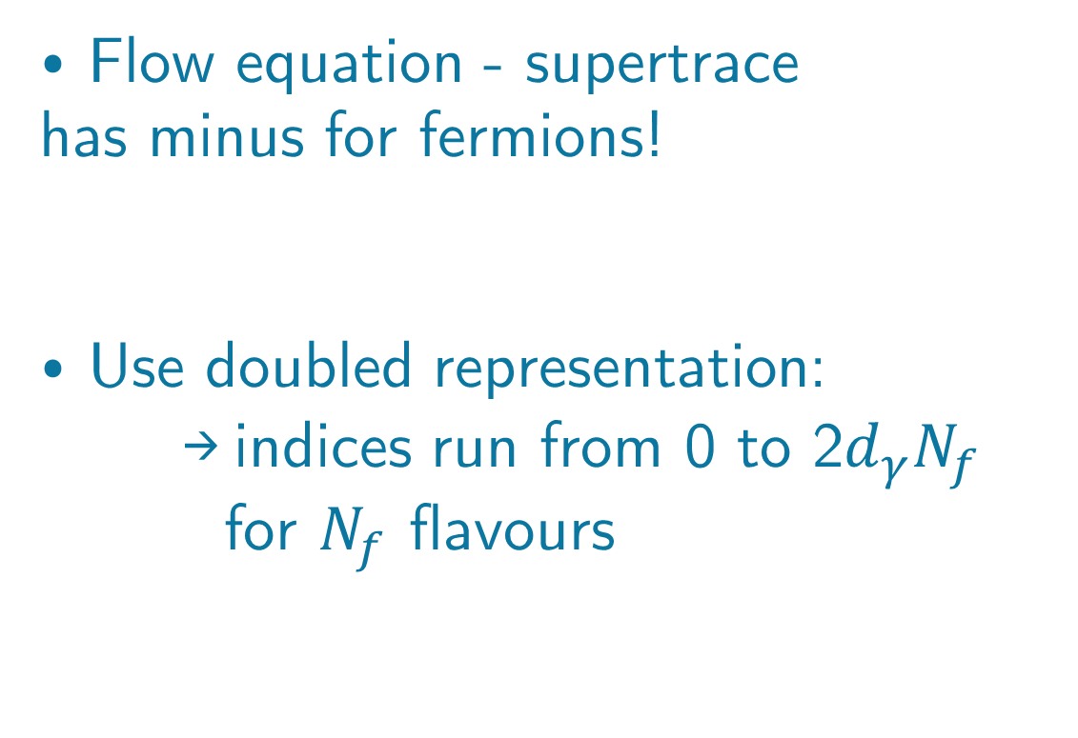
FRG for Fermions
$$Effective action, Γ_{k}$$
$$Hessian$$
⦁ Flow equation - supertrace
has minus for fermions!
⦁ Use doubled representation:
→ indices run from 0 to 2$d_{γ}N_{f}$ for $N_{f}$ flavours
Wetterich ’93
Ellwanger ’93
Morris ‘93
$$RG scale, t=ln⁡(k)$$
$$Regulator,R_{k}$$

Slide 8

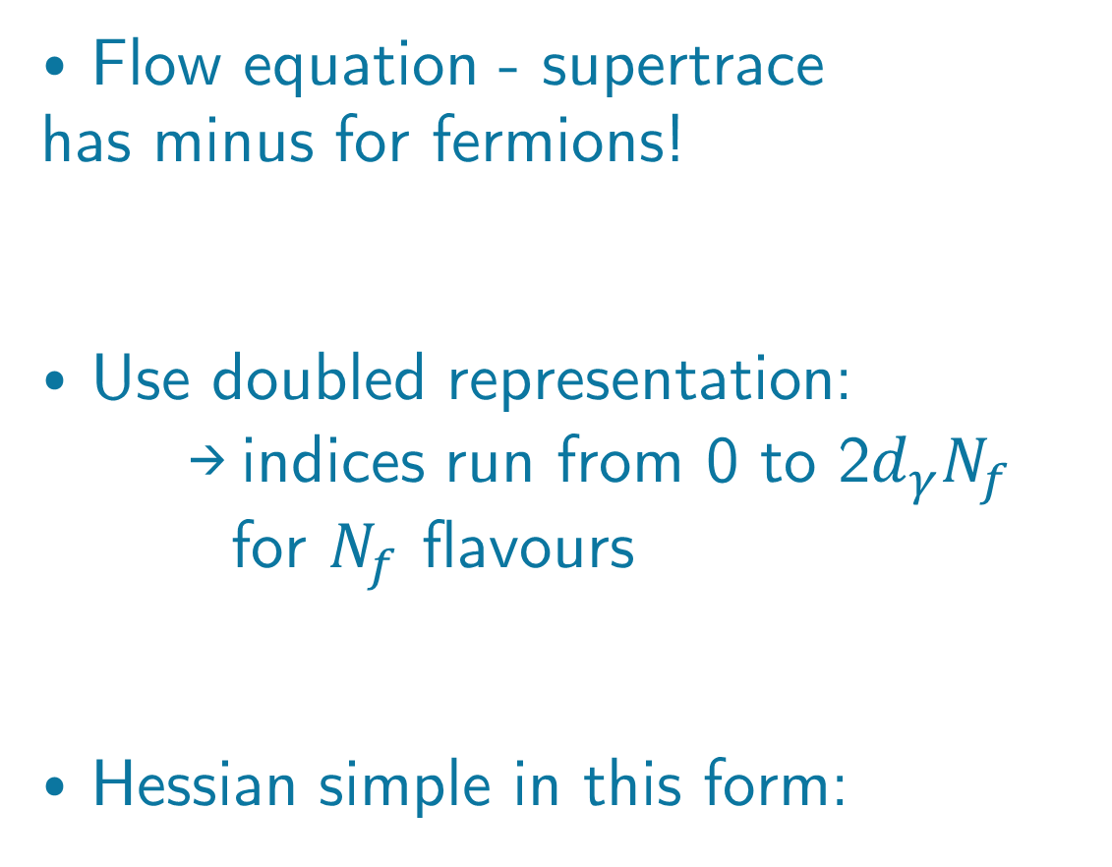
FRG for Fermions
$$Effective action, Γ_{k}$$
$$Hessian$$
⦁ Flow equation - supertrace
has minus for fermions!
⦁ Use doubled representation:
→ indices run from 0 to 2$d_{γ}N_{f}$ for $N_{f}$ flavours
⦁ Hessian simple in this form:
Wetterich ’93
Ellwanger ’93
Morris ‘93
$$RG scale, t=ln⁡(k)$$
$$Regulator,R_{k}$$

Slide 9
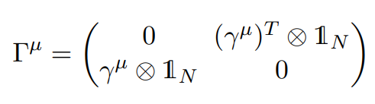
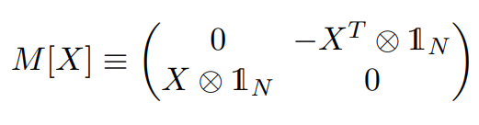
Flow Ansatz
⦁ Introduce matrices to simplify structure

Slide 10

Flow Ansatz
⦁ Introduce matrices to simplify structure
⦁ Choose regulator with convenient matrix structure (same as kinetic term)

Slide 11


Flow Ansatz
⦁ Introduce matrices to simplify structure
⦁ Choose regulator with convenient matrix structure (same as kinetic term)
⦁ Make ansatz for effective action
Dirac matrix basis

Slide 12
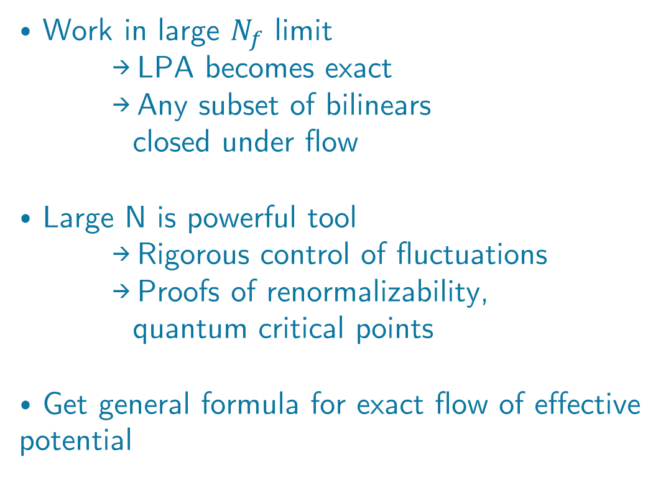
Exact Flow
Cresswell-Hogg, Litim 2025
⦁ Work in large $N_{f}$ limit
→ LPA becomes exact
→ Any subset of bilinears
closed under flow
⦁ Large N is powerful tool
→ Rigorous control of fluctuations
→ Proofs of renormalizability, quantum critical points
⦁ Get general formula for exact flow of effective potential
e.g. Moshe, Zinn-Justin 2003

Slide 13
Exact Flow
Compute Hessian
Cresswell-Hogg, Litim 2025
⦁ Work in large $N_{f}$ limit
→ LPA becomes exact
→ Any subset of bilinears
closed under flow
⦁ Large N is powerful tool
→ Rigorous control of fluctuations
→ Proofs of renormalizability, quantum critical points
⦁ Get general formula for exact flow of effective potential
e.g. Moshe, Zinn-Justin 2003

Slide 14
Exact Flow
Compute Hessian
Cresswell-Hogg, Litim 2025
⦁ Work in large $N_{f}$ limit
→ LPA becomes exact
→ Any subset of bilinears
closed under flow
⦁ Large N is powerful tool
→ Rigorous control of fluctuations
→ Proofs of renormalizability, quantum critical points
⦁ Get general formula for exact flow of effective potential
Large N → drop subleading term
e.g. Moshe, Zinn-Justin 2003

Slide 15
Exact Flow
Compute Hessian
Cresswell-Hogg, Litim 2025
⦁ Work in large $N_{f}$ limit
→ LPA becomes exact
→ Any subset of bilinears
closed under flow
⦁ Large N is powerful tool
→ Rigorous control of fluctuations
→ Proofs of renormalizability, quantum critical points
⦁ Get general formula for exact flow of effective potential
Large N → drop subleading term
Regulator scale derivative
+ denominator
e.g. Moshe, Zinn-Justin 2003

Slide 16
Exact Flow
Compute Hessian
Cresswell-Hogg, Litim 2025
⦁ Work in large $N_{f}$ limit
→ LPA becomes exact
→ Any subset of bilinears
closed under flow
⦁ Large N is powerful tool
→ Rigorous control of fluctuations
→ Proofs of renormalizability, quantum critical points
⦁ Get general formula for exact flow of effective potential
Large N → drop subleading term
Regulator scale derivative
+ denominator
e.g. Moshe, Zinn-Justin 2003
Project to const. fields (LPA)

Slide 17


Exact Flow
Compute Hessian
Cresswell-Hogg, Litim 2025
⦁ Work in large $N_{f}$ limit
→ LPA becomes exact
→ Any subset of bilinears
closed under flow
⦁ Large N is powerful tool
→ Rigorous control of fluctuations
→ Proofs of renormalizability, quantum critical points
⦁ Get general formula for exact flow of effective potential
Large N → drop subleading term
Regulator scale derivative
+ denominator
e.g. Moshe, Zinn-Justin 2003
Project to const. fields (LPA)
$$f$$

Slide 18

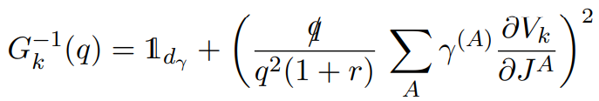
Exact Flow
Compute Hessian
Cresswell-Hogg, Litim 2025
⦁ Work in large $N_{f}$ limit
→ LPA becomes exact
→ Any subset of bilinears
closed under flow
⦁ Large N is powerful tool
→ Rigorous control of fluctuations
→ Proofs of renormalizability, quantum critical points
⦁ Get general formula for exact flow of effective potential
Large N → drop subleading term
Regulator scale derivative
+ denominator
e.g. Moshe, Zinn-Justin 2003
Project to const. fields (LPA)
$$f$$

Slide 19

Exact Flow
⦁ Gross-Neveu: only have ‘scalar’ bilinears

Slide 20

Exact Flow
⦁ Gross-Neveu: only have ‘scalar’ bilinears
⦁ Use optimised regulator for analytic flow
Litim, 2000

Slide 21


Exact Flow
⦁ Gross-Neveu: only have ‘scalar’ bilinears
⦁ Use optimised regulator for analytic flow
⦁ Introduce dimensionless variables
Litim, 2000

Slide 22

Exact Flow
⦁ Gross-Neveu: only have ‘scalar’ bilinears
⦁ Use optimised regulator for analytic flow
⦁ Introduce dimensionless variables
⦁ Get exact flow!
(After rescaling by overall constant factor)
Litim, 2000

Slide 23
Results from Gross-Neveu Studies
Line of Fixed Points in Gross-Neveu Theories : https://arxiv.org/pdf/2207.10115
Critical Fermions with Spontaneously Broken Scale Symmetry : https://arxiv.org/pdf/2212.06815
Fermion Mass Generation without Symmetry Breaking: https://arxiv.org/pdf/2406.00100

Slide 24
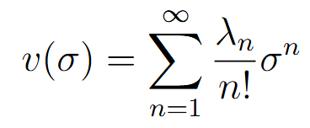
Beta Functions
⦁ Start with naive assumption of analyticity

Slide 25
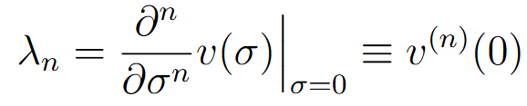
Beta Functions
⦁ Start with naive assumption of analyticity
⦁ Gives easy way to project onto couplings

Slide 26
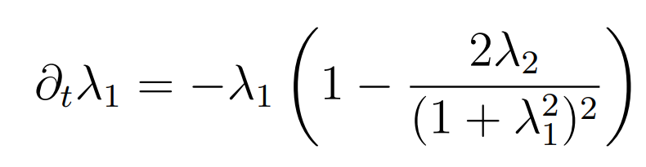
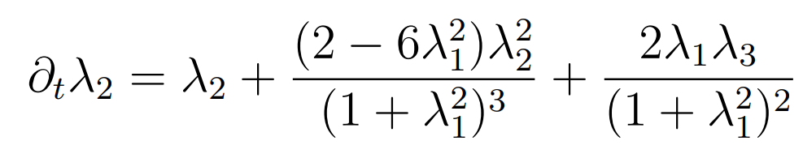
Beta Functions
⦁ Start with naive assumption of analyticity
⦁ Gives easy way to project onto couplings
⦁ Can apply to the flow equation to obtain beta functions e.g. in d=3
Mass is ‘Natural’ t’Hooft ‘80
Cresswell-Hogg, Litim 2023

Slide 27
Fixed Points
⦁ Setting the scale derivatives to zero gives the conditions for a fixed point (scale invariance)

Slide 28

Fixed Points
⦁ Setting the scale derivatives to zero gives the conditions for a fixed point (scale invariance)
⦁ Two fixed points:
1) Gaussian fixed point (free)
$$λ_{1,∗}=λ_{2,∗}=…=λ_{n,∗}=0$$

Slide 29

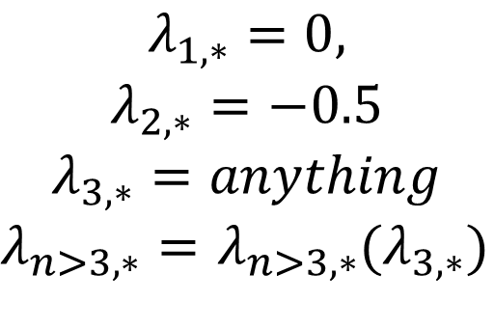
Fixed Points
⦁ Setting the scale derivatives to zero gives the conditions for a fixed point (scale invariance)
⦁ Two fixed points:
1) Gaussian fixed point (free)
2) Non-Gaussian fixed point (interacting)
→ Sextic coupling is free – line of fixed points!
$$λ_{1,∗}=λ_{2,∗}=…=λ_{n,∗}=0$$
$$λ_{1,∗}=0,$$
$$λ_{2,∗}=−0.5$$
$$λ_{3,∗}=anything$$
$λ_{n>3,∗}=$ $λ_{n>3,∗}(λ_{3,∗})$
e.g. Wilson ’73,
Gawedzki, Kupiainen ’85

Slide 30

Critical Exponents
⦁ Linearise around a fixed point to determine critical behaviour
Stability matrix

Slide 31
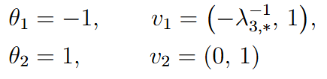

Critical Exponents
⦁ Linearise around a fixed point to determine critical behaviour
⦁ Stability matrix:
→ Eigenvalues = critical exponents
→ Eigenvectors = eigenperturbations
⦁ Compute for GN model →
Stability matrix
GFP
NGFP

Slide 32
Critical Exponents from Global Flows
Marchais, Litim, Mati 2017, Cresswell-Hogg 2022
⦁ Can find general formula for critical exponents to all orders

Slide 33

Critical Exponents from Global Flows
Marchais, Litim, Mati 2017, Cresswell-Hogg 2022
⦁ Can find general formula for critical exponents to all orders
⦁ Make small perturbation around fixed point solution

Slide 34

Critical Exponents from Global Flows
Marchais, Litim, Mati 2017, Cresswell-Hogg 2022
⦁ Can find general formula for critical exponents to all orders
⦁ Make small perturbation around fixed point solution
⦁ Linearise flow equation
⦁ Solve by separation of variables

Slide 35


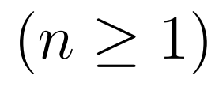
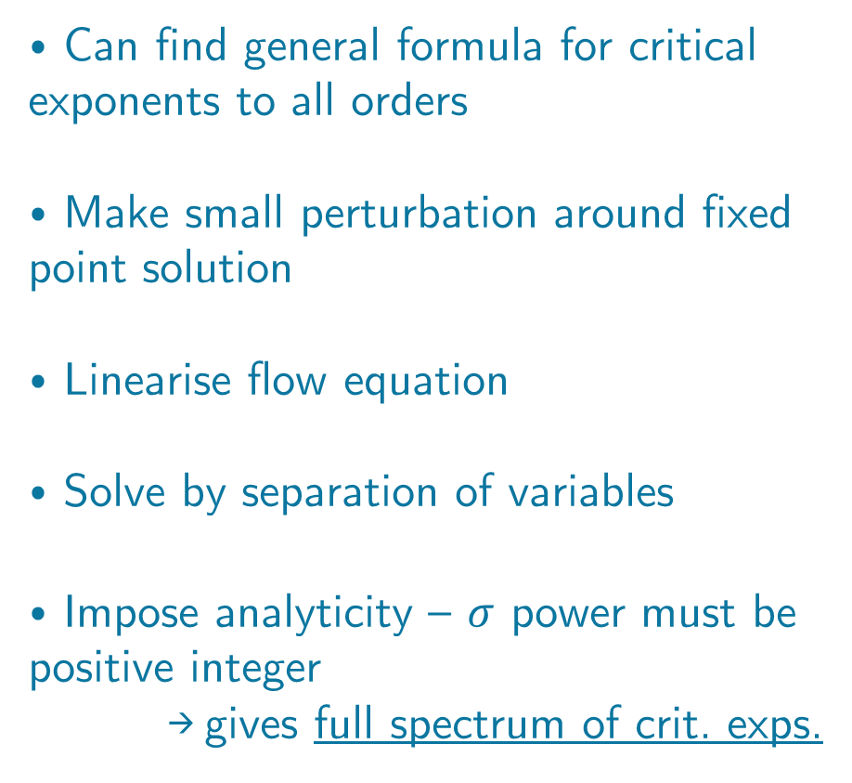
Critical Exponents from Global Flows
Marchais, Litim, Mati 2017, Cresswell-Hogg 2022
⦁ Can find general formula for critical exponents to all orders
⦁ Make small perturbation around fixed point solution
⦁ Linearise flow equation
⦁ Solve by separation of variables
⦁ Impose analyticity – $σ$ power must be positive integer
→ gives full spectrum of crit. exps.
Analyticity
Finite number of relevant perturbations
→ predictive

Slide 36
Exact Solution
⦁ An exact solution is available - method of characteristics

Slide 37
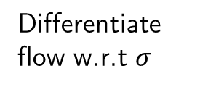
Exact Solution
Differentiate flow w.r.t $σ$
⦁ An exact solution is available - method of characteristics

Slide 38
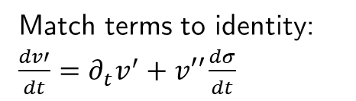
Exact Solution
Differentiate flow w.r.t $σ$
Match terms to identity: $\frac{dv′}{dt}=∂_{t}v^{′}+v′′\frac{dσ}{dt}$
⦁ An exact solution is available - method of characteristics

Slide 39
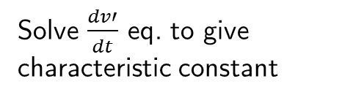
Exact Solution
Differentiate flow w.r.t $σ$
Match terms to identity: $\frac{dv′}{dt}=∂_{t}v^{′}+v′′\frac{dσ}{dt}$
⦁ An exact solution is available - method of characteristics
Solve $\frac{dv′}{dt}$ eq. to give characteristic constant

Slide 40
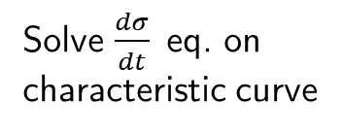
Exact Solution
Differentiate flow w.r.t $σ$
Match terms to identity: $\frac{dv′}{dt}=∂_{t}v^{′}+v′′\frac{dσ}{dt}$
⦁ An exact solution is available - method of characteristics
Solve $\frac{dσ}{dt}$eq. on characteristic curve
Solve $\frac{dv′}{dt}$ eq. to give characteristic constant

Slide 41

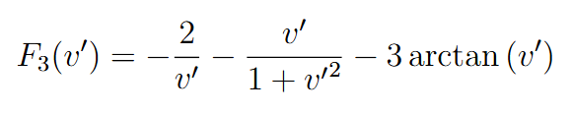
Exact Solution
Differentiate flow w.r.t $σ$
Match terms to identity: $\frac{dv′}{dt}=∂_{t}v^{′}+v′′\frac{dσ}{dt}$
⦁ An exact solution is available - method of characteristics
⦁ Solution in terms of hypergeometric functions – simple representation for d=3
Solve $\frac{dσ}{dt}$eq. on characteristic curve
Solve $\frac{dv′}{dt}$ eq. to give characteristic constant

Slide 42
Exact Solution
Differentiate flow w.r.t $σ$
Match terms to identity: $\frac{dv′}{dt}=∂_{t}v^{′}+v′′\frac{dσ}{dt}$
⦁ An exact solution is available - method of characteristics
⦁ Solution in terms of hypergeometric functions – simple representation for d=3
⦁ Fixed point solutions obtained when characteristic function G = constant
Solve $\frac{dσ}{dt}$eq. on characteristic curve
Solve $\frac{dv′}{dt}$ eq. to give characteristic constant

Slide 43
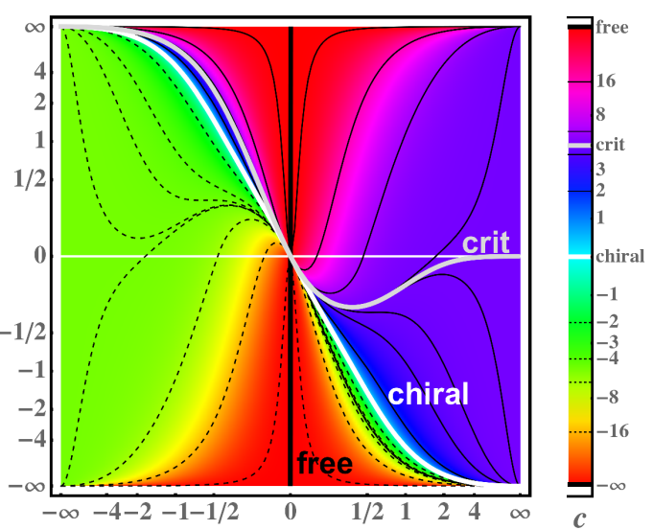


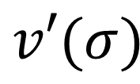
Properties of Fixed Point Solutions
Critical Fermions with Spontaneously Broken Scale Symmetry : https://arxiv.org/pdf/2212.06815
⦁ Can plot the fixed point solutions →
$$σ$$
$$G$$
$$v′(σ)$$

Slide 44
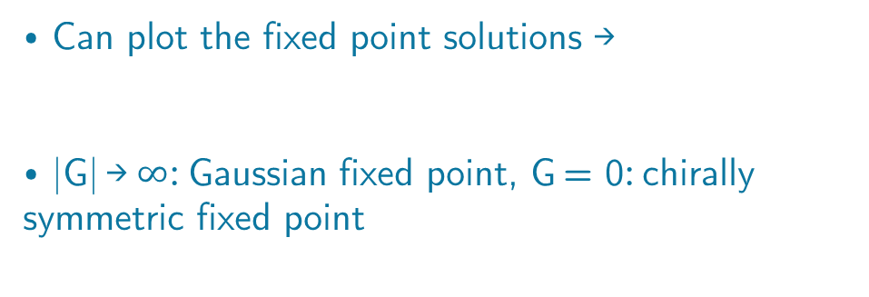
Properties of Fixed Point Solutions
Critical Fermions with Spontaneously Broken Scale Symmetry : https://arxiv.org/pdf/2212.06815
⦁ Can plot the fixed point solutions →
⦁ |G| →$∞$: Gaussian fixed point, G = 0: chirally symmetric fixed point
$$σ$$
$$G$$
$$v′(σ)$$

Slide 45
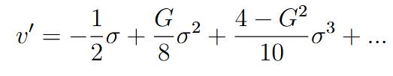
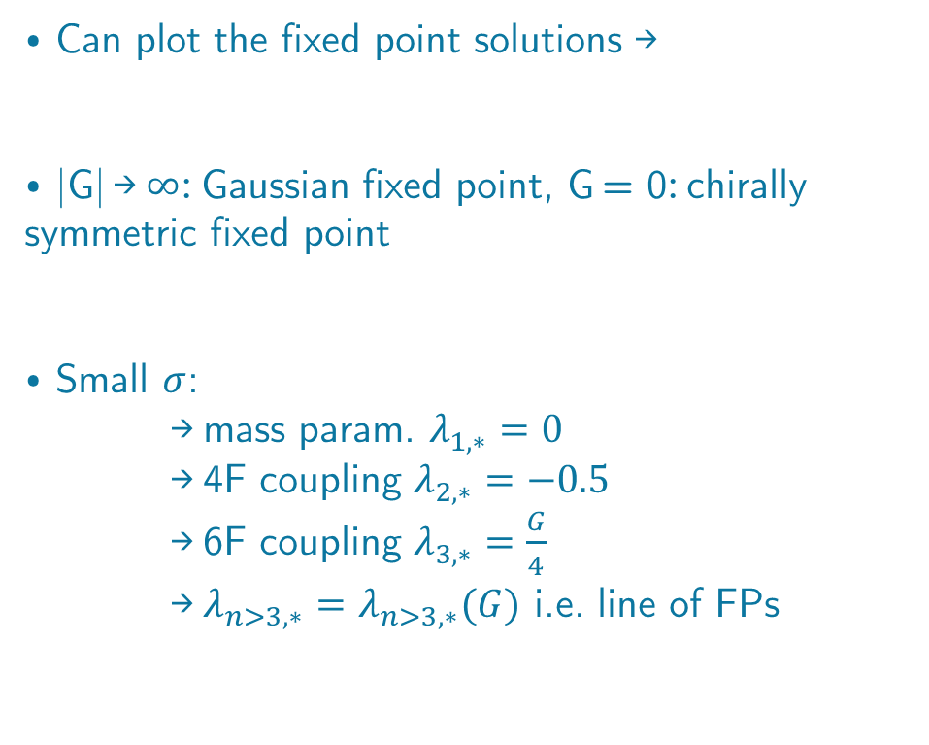
Properties of Fixed Point Solutions
Critical Fermions with Spontaneously Broken Scale Symmetry : https://arxiv.org/pdf/2212.06815
⦁ Can plot the fixed point solutions →
⦁ |G| →$∞$: Gaussian fixed point, G = 0: chirally symmetric fixed point
⦁ Small $σ$:
→ mass param. $λ_{1,∗}=0$
→ 4F coupling $λ_{2,∗}=−0.5$
→ 6F coupling $λ_{3,∗}=\frac{G}{4}$
→ $λ_{n>3,∗}=$ $λ_{n>3,∗}(G)$ i.e. line of FPs
$$σ$$
$$G$$
$$v′(σ)$$

Slide 46
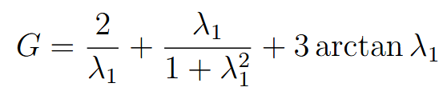
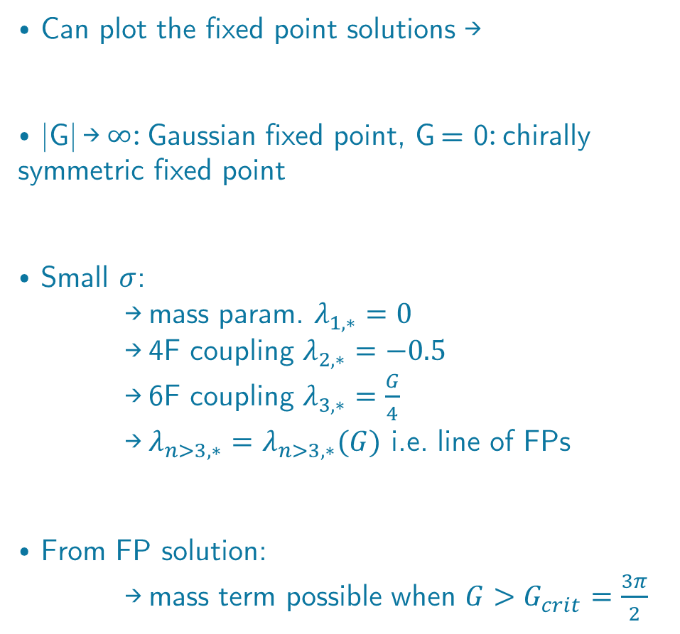

Properties of Fixed Point Solutions
Critical Fermions with Spontaneously Broken Scale Symmetry : https://arxiv.org/pdf/2212.06815
⦁ Can plot the fixed point solutions →
⦁ |G| →$∞$: Gaussian fixed point, G = 0: chirally symmetric fixed point
⦁ Small $σ$:
→ mass param. $λ_{1,∗}=0$
→ 4F coupling $λ_{2,∗}=−0.5$
→ 6F coupling $λ_{3,∗}=\frac{G}{4}$
→ $λ_{n>3,∗}=$ $λ_{n>3,∗}(G)$ i.e. line of FPs
⦁ From FP solution:
→ mass term possible when $G>G_{crit}=\frac{3π}{2}$
Mass terms for $G>G_{crit}$
$$σ$$
$$G$$
$$v′(σ)$$

Slide 47
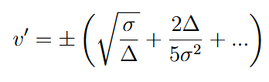
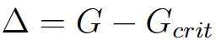
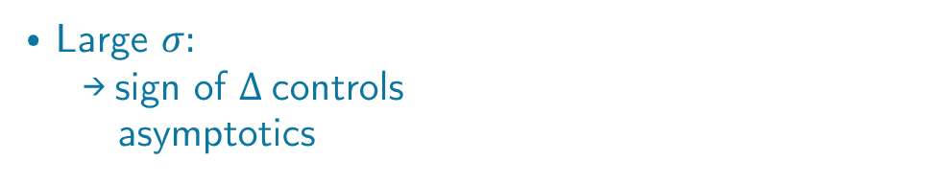
Properties of Fixed Point Solutions
Critical Fermions with Spontaneously Broken Scale Symmetry : https://arxiv.org/pdf/2212.06815
⦁ Large $σ:$
→ sign of $∆$controls
asymptotics
$$σ$$
$$G$$
$$v′(σ)$$

Slide 48
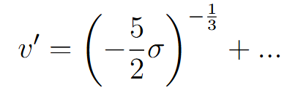
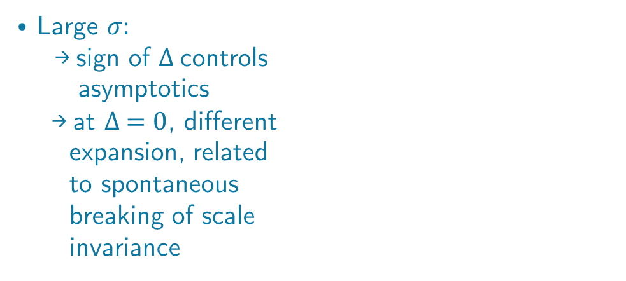

Properties of Fixed Point Solutions
Critical Fermions with Spontaneously Broken Scale Symmetry : https://arxiv.org/pdf/2212.06815
⦁ Large $σ:$
→ sign of $∆$controls
asymptotics
→ at $∆ =0$, different
expansion, related
to spontaneous
breaking of scale
invariance
$$Δ=0$$
$$σ$$
Bardeen, Moshe, Bander ‘84
$$G$$
$$v′(σ)$$

Slide 49
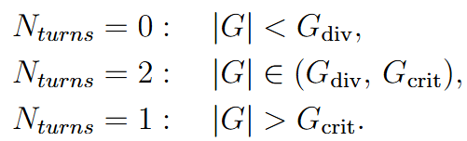
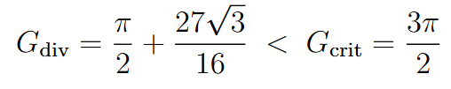

Properties of Fixed Point Solutions
Critical Fermions with Spontaneously Broken Scale Symmetry : https://arxiv.org/pdf/2212.06815
⦁ Large $σ:$
→ sign of $∆$controls
asymptotics
→ at $∆ =0$, different
expansion, related
to spontaneous
breaking of scale
invariance
$$Δ=0$$
$$σ$$
Bardeen, Moshe, Bander ‘84
⦁ Can classify solutions by number of turning points – look at condition from flow equation when v’’ diverges!
$$G$$
$$v′(σ)$$

Slide 50
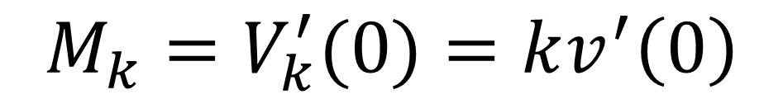
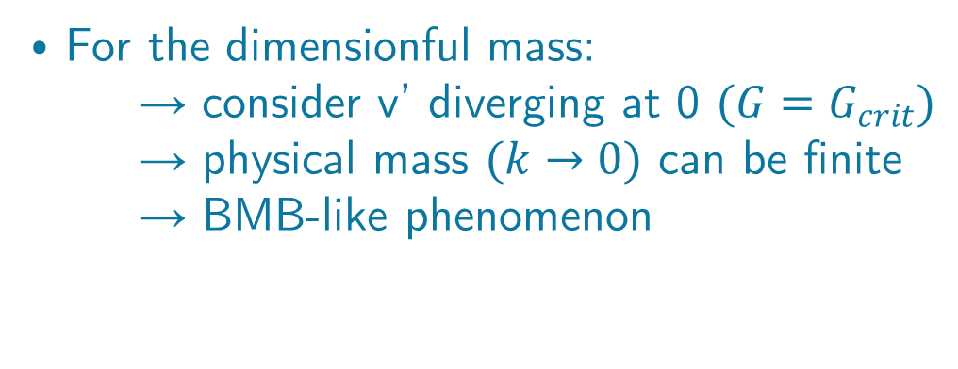
Spontaneous Breaking of Scale Invariance
Dimensionful mass
⦁ For the dimensionful mass:
→ consider v’ diverging at 0 $(G=G_{crit})$
→ physical mass $(k→0)$ can be finite
→ BMB-like phenomenon
$$M_{k}=V_{k}^{′}(0)=kv^{′}\left(0\right)$$
Bardeen, Moshe, Bander ‘84

Slide 51


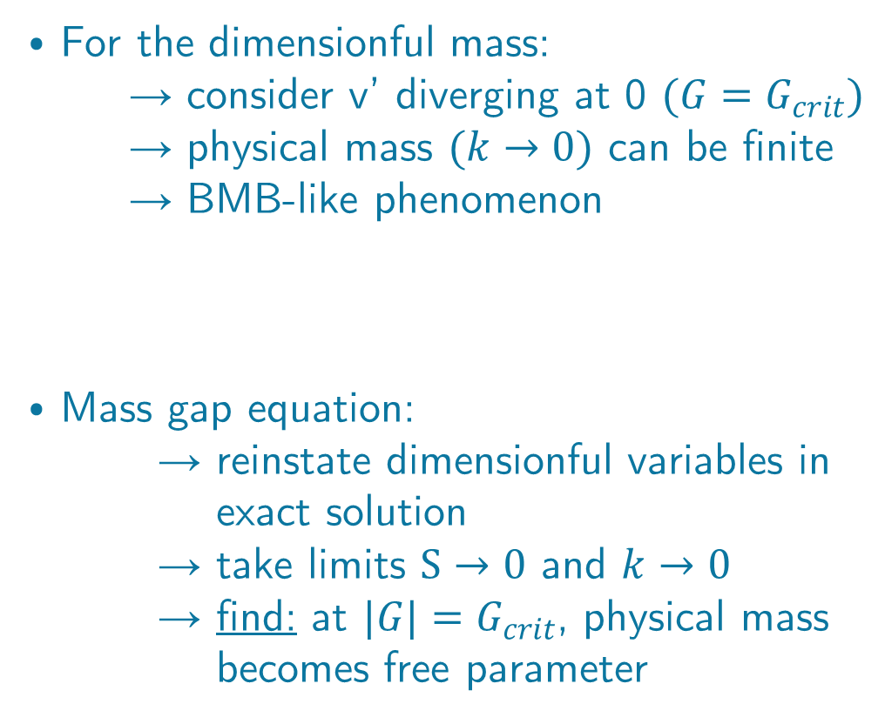
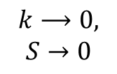
Spontaneous Breaking of Scale Invariance
Dimensionful mass
⦁ For the dimensionful mass:
→ consider v’ diverging at 0 $(G=G_{crit})$
→ physical mass $(k→0)$ can be finite
→ BMB-like phenomenon
⦁ Mass gap equation:
→ reinstate dimensionful variables in exact solution
→ take limits $S→0$ and $k→0$
→ find: at $|G|=G_{crit}$, physical mass becomes free parameter
$$M_{k}=V_{k}^{′}(0)=kv^{′}\left(0\right)$$
Bardeen, Moshe, Bander ‘84
$$k⟶0,$$
$$S→0$$

Slide 52
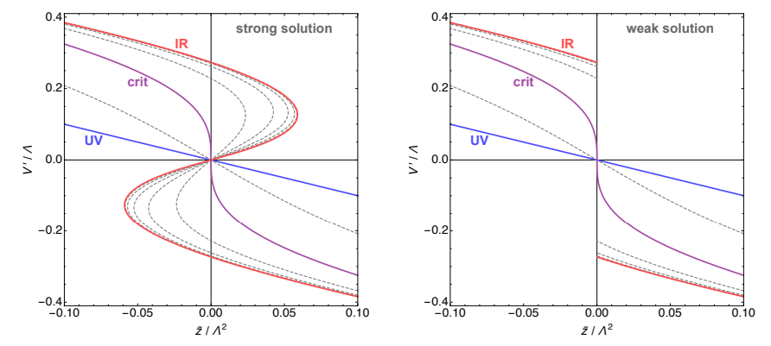

Mass Generation
⦁ Dynamical mass generation in flow of potential:
Fixed points of fermionic quantum field theories, 2023
⦁ Can flow with exact solution using initial condition:

Slide 53
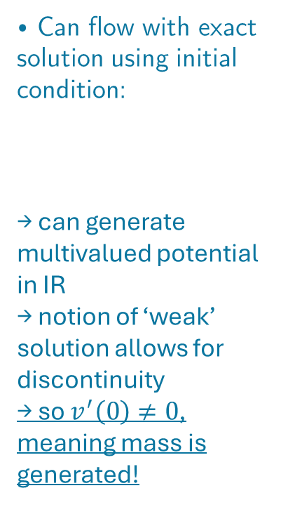
Mass Generation
⦁ Dynamical mass generation in flow of potential:
Fixed points of fermionic quantum field theories, 2023
⦁ Can flow with exact solution using initial condition:
→ can generate multivalued potential in IR
→ notion of ‘weak’ solution allows for discontinuity
→ so $v^{′}\left(0\right)≠0$, meaning mass is generated!

Slide 54

Application to U(1)$⊗$U(1) chirally symmetric model

Slide 55
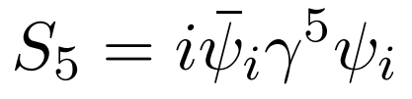

Pseudo-Scalar Flow
⦁ Can also introduce ‘pseudo-scalar’ bilinear

Slide 56
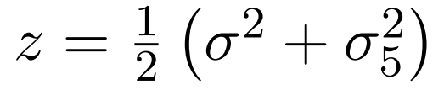
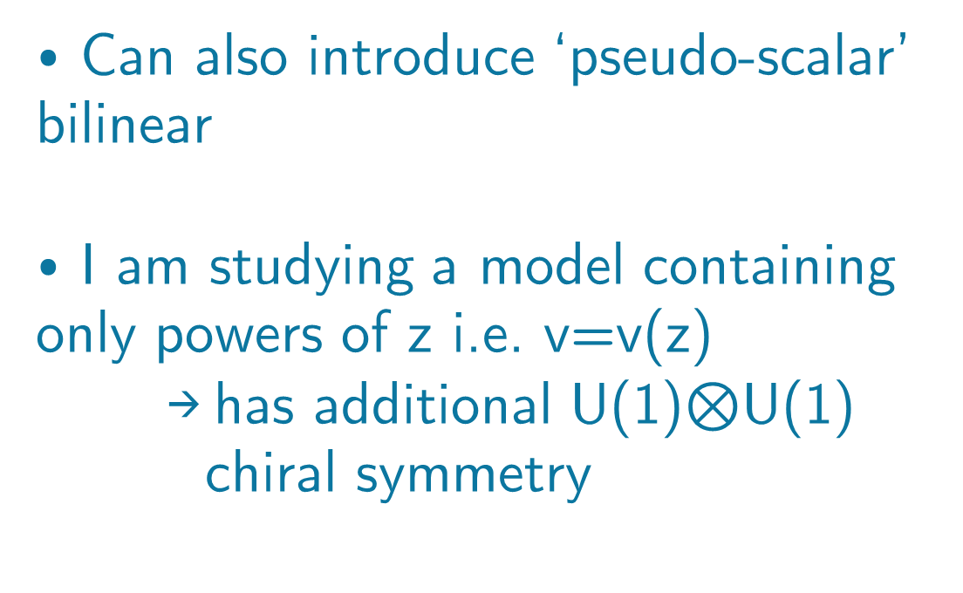
Pseudo-Scalar Flow
⦁ Can also introduce ‘pseudo-scalar’ bilinear
⦁ I am studying a model containing only powers of z i.e. v=v(z)
→ has additional U(1)$⊗$U(1) chiral symmetry

Slide 57


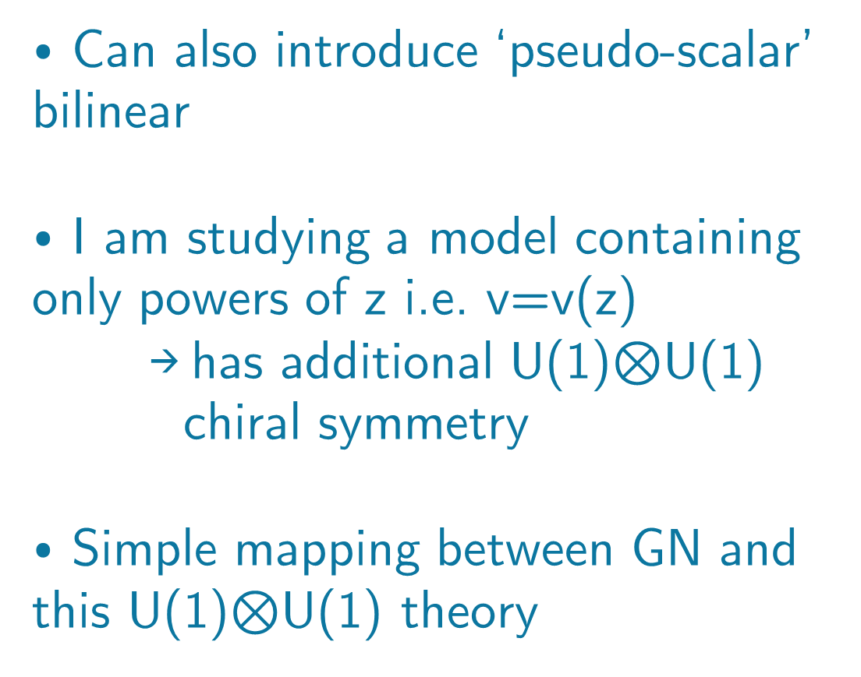
Pseudo-Scalar Flow
⦁ Can also introduce ‘pseudo-scalar’ bilinear
⦁ I am studying a model containing only powers of z i.e. v=v(z)
→ has additional U(1)$⊗$U(1) chiral symmetry
⦁ Simple mapping between GN and this U(1)$⊗$U(1) theory
$$σ=\sqrt{2z}$$

Slide 58
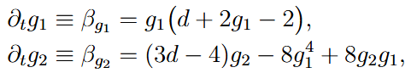
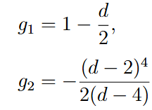



Analogous Results
⦁ By same token, calculate beta
functions, fixed points and critical exponents (assume analyticity)
→ only valid for chirally symmetric solutions
$(G=0, G→∞)$
Same but analyticity cuts odd couplings
Global flows
d=3

Slide 59


Analogous Results
⦁ By same token, calculate beta
functions, fixed points and critical exponents (assume analyticity)
→ only valid for chirally symmetric solutions
$(G=0, G→∞)$
⦁ Generic expansions non-analytic
→ small z: $Gz^{1.5}\sim$pseudo 6F coupling
Same but analyticity cuts odd couplings
Global flows
d=3

Slide 60


Analogous Results
⦁ By same token, calculate beta
functions, fixed points and critical exponents (assume analyticity)
→ only valid for chirally symmetric solutions
$(G=0, G→∞)$
⦁ Generic expansions non-analytic
→ small z: $Gz^{1.5}\sim$pseudo 6F coupling
→ large z: $G<−\frac{3π}{4}$ → $v^{′}$ diverges to $−∞$ as $z→0$
Same but analyticity cuts odd couplings
Global flows
d=3

Slide 61


Analogous Results
⦁ Plot exact solution under mapping
→ analytic continuation for
negative z, requires imaginary G

Slide 62

Analogous Results
⦁ Plot exact solution under mapping
→ analytic continuation for
negative z, requires imaginary G
→ all $G>3π/4$ curves
multivalued (different convention – factor of 2)

Slide 63

Analogous Results
⦁ Plot exact solution under mapping
→ analytic continuation for
negative z, requires imaginary G
→ all $G>3π/4$ curves
multivalued (different convention – factor of 2)
⦁ Turning point classification almost identical to GN in z > 0 region
→ except only true for G negative

Slide 64

Analogous Results
⦁ Plot exact solution under mapping
→ analytic continuation for
negative z, requires imaginary G
→ all $G>3π/4$ curves
multivalued (different convention – factor of 2)
⦁ Turning point classification almost identical to GN in z > 0 region
→ except only true for G negative
⦁ For z < 0, solutions always multivalued
→ every curve has one turning point

Slide 65
Outlook

Slide 66






Mass Generation in U(1)$⊗$U(1) Theory
⦁ Analogous BMB type expansion at $G_{crit}$
⦁ Mass gap equation identical once correct mass identified:
⦁ Check: flow with exact global eigenperturbation from NGFP (UV) to GFP (IR)
→ to do: try with i.c. $∝z$ to see analogous mass generation
$$Z=k^{4}z$$
$$M_{k}^{z}=\lim_{Z→0}{\sqrt{2Z}V_{k}^{′}\left(Z\right)}$$

Slide 67


Gross-Neveu-Yukawa Theory
⦁ Work also done incorporating terms $\sim φ^{n}{(\overline{ψ}ψ)}^{m}$ into the flow
→ different phase diagram
→ new mechanism for mass generation (scalar vev)
→ spontaneous breaking of scale invariance can give
rise to dilaton
⦁ Do with U(1)$⊗$U(1) theory → more symmetry to break, non-trivial physics?
Sextic GN coupling
Yukawa coupling
Dilaton Physics from Asymptotic Freedom: https://arxiv.org/pdf/2502.00107
Scale symmetry breaking and generation of mass at quantum critical points: https://arxiv.org/pdf/2311.16246

Slide 68

Summary
⦁ Large N useful tool, provides exact results
→ used with Wetterich eq. to find fixed points, critical exponents in GN theory
→ good understanding of exact fixed point solutions
→ concrete mechanisms of mass generation, spontaneous breaking of scale invariance
⦁ Now studying U(1)$⊗$U(1) model.
To do:
→ explore mass generation
→ incorporate Yukawa interactions

