Slide 1
CERN’s Experimental Areas
Fabian Metzger (BE-EA-LE) with input from many others!
28.11.2025

Slide 2
Introduction
Overview about CERN
North Experimental Area
East Experimental Area
Modelling & Simulations
Beam Dump Facility and Search for Hidden Particles

Slide 3
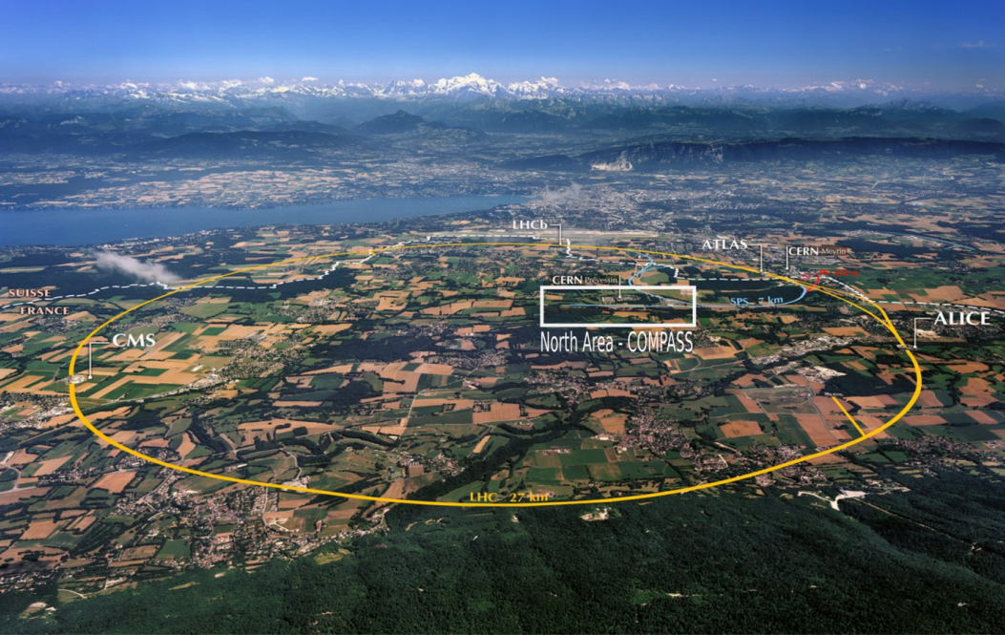
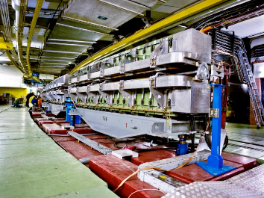
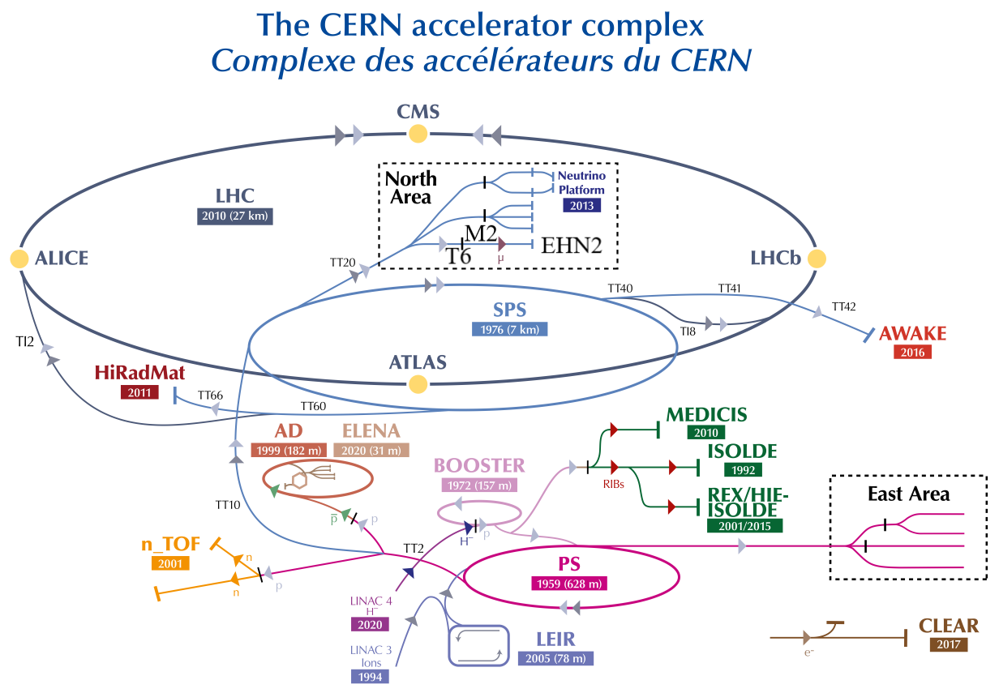
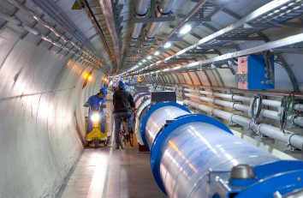
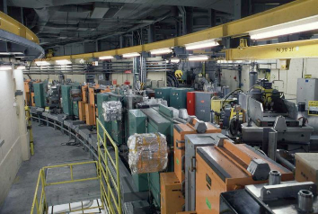
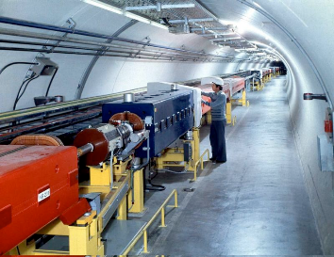
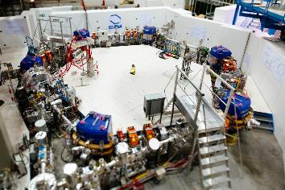
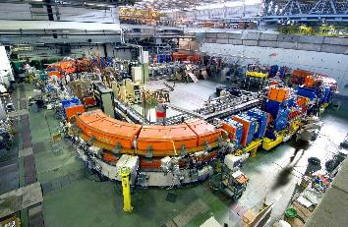
CERN and the Accelerators
E. Lopienska
H. Pekeler

Slide 4
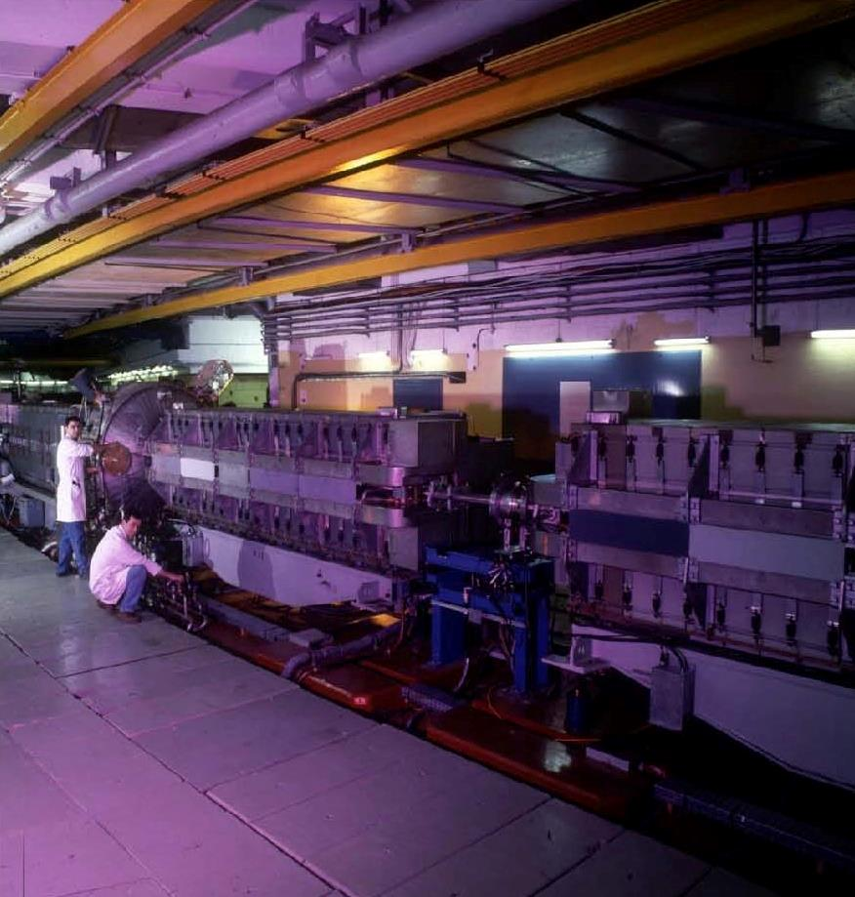
Proton Synchrotron
The oldest operating synchrotron at CERN
(Small) circumference of 628m
Accelerates from 2GeV to max. 26GeV
Various extraction techniques and cycle lengths possible
Sends beam to:
SPS
East Area
Antimatter Facility
nTOF

Slide 5
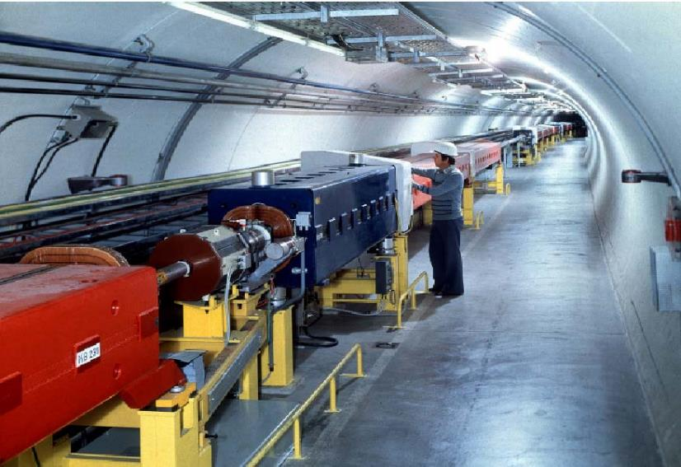
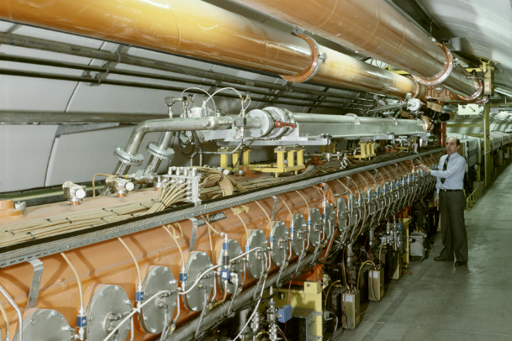
Super Proton Synchrotron
Normal-conducting accelerator
6.9km circumference and about 30m underground
Accelerates up to 450GeV with intensities up to 5×10¹³ protons per cycle
Provides slow extracted beam to the North Area
Fast extraction to LHC, AWAKE and HiRadMat

Slide 6
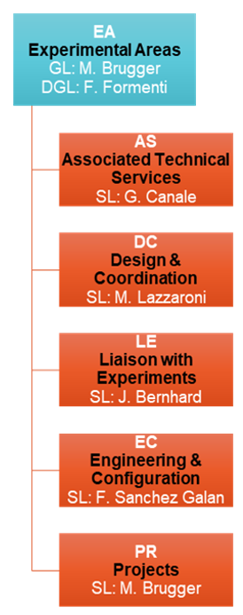

What Do We Do in Our Group?
Areas & Machines, Experiments, Users
GL: M. Brugger
DGL: R. Folch
Operation & Engineering / Scientific Support
Technical Services & Supply
Fixed Target Experiments
LHC Experiments & Forward Detectors
~80
~8km
~20 / 2000
Providing technical and engineering support
User, physics and service oriented
Group Members
10 Beamlines
~30 Experimental Areas
Experiments & Facilities / Users
Staff, Fellows, Associates, Students, Contractors 1/3 – 1/3 – 1/3
100-150 User Teams
linking to equipment and service groups
Design, Operation, Coordination, Support

Slide 7
North Area

Slide 8
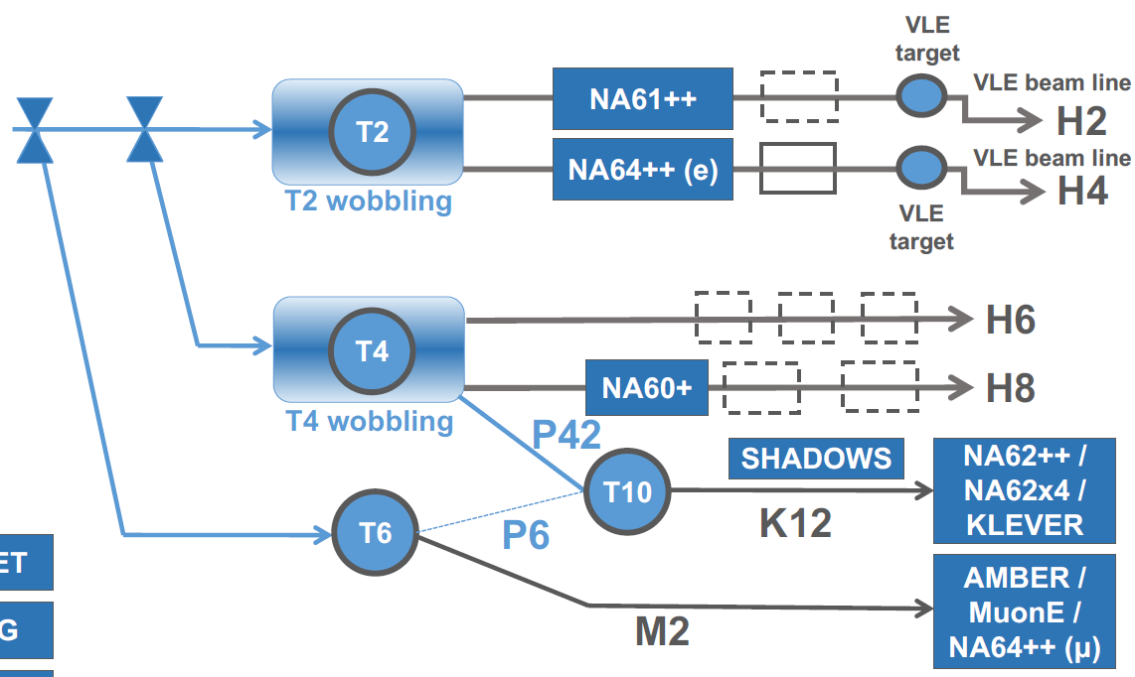
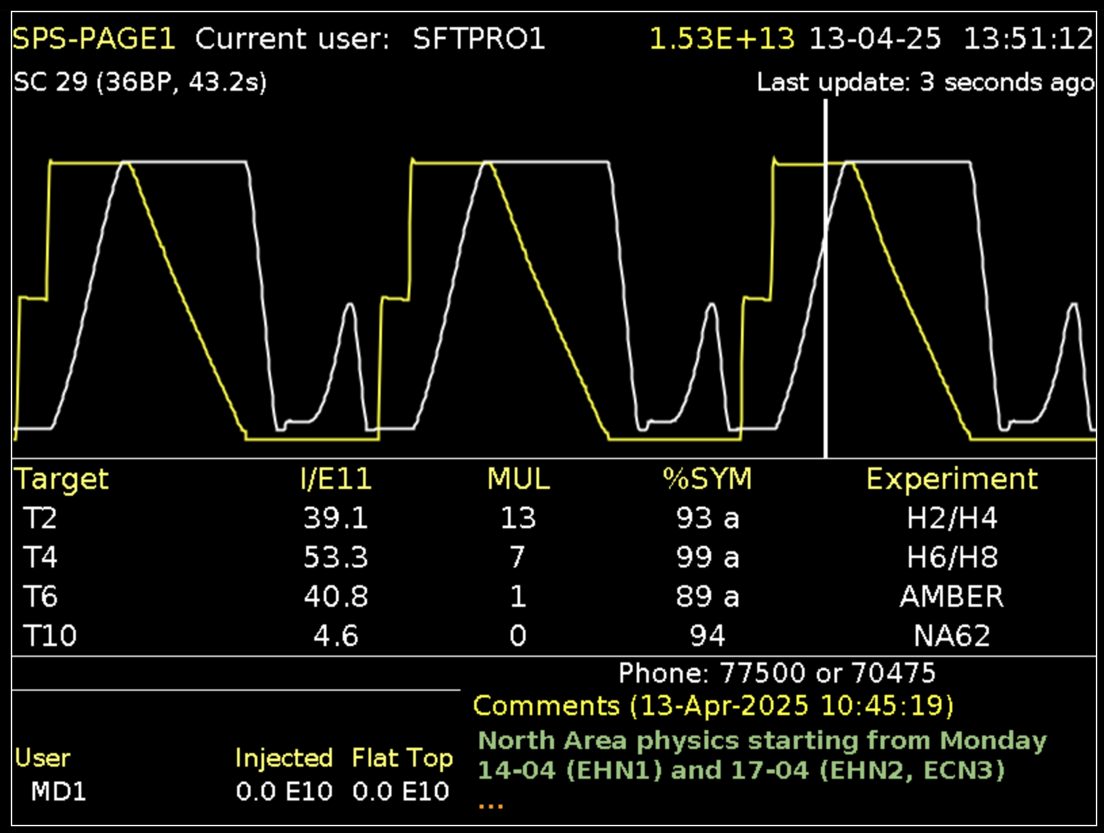

North Area Secondary Beamlines
Spill duration: 4.8s flat top
Typically: 2 cycles / SPS supercycle for NA and
~ 3000 spills/day
Supercycle structure depends on the physics program of all the facilities served by the SPS including LHC, AWAKE, HiRadMat and the Machine Development program
The 400GeV/c primary beam is slowly extracted to three primary targets → T2, T4 and T6
NA61
SPS beam
@400GeV/c
NA64
EHN1
NA62
ECN3
AMBER
NA64$μ$
MUonE
EHN2

Slide 9
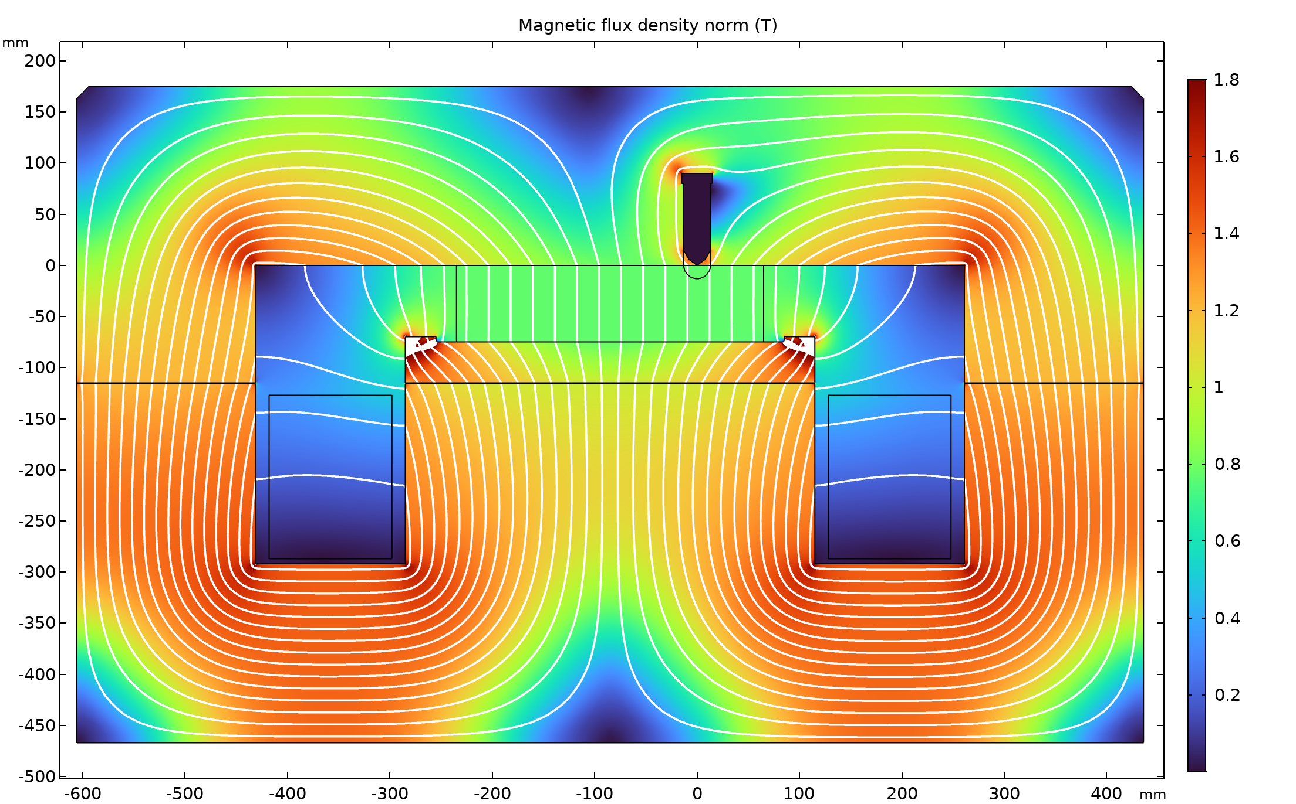
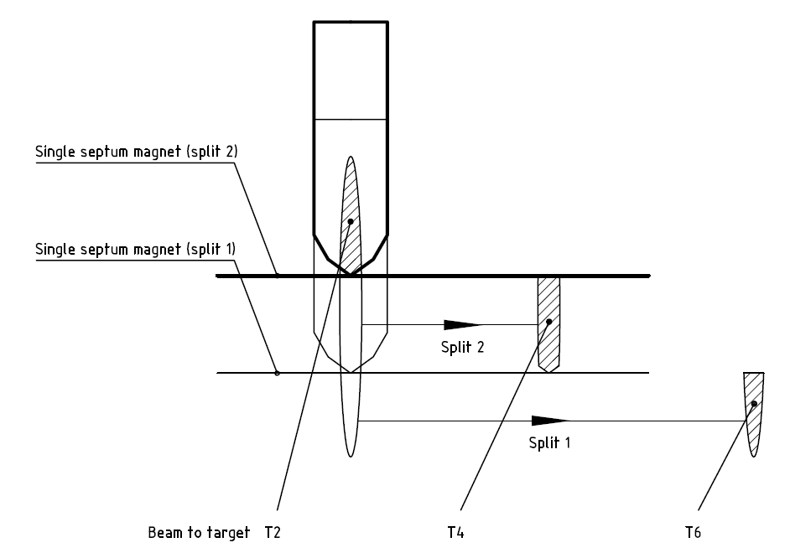
How to Make Three Primary Beams - Splitting
We serve three production targets starting from one proton beam from the SPS
Depending on user schedule, sharing between targets needs to be adapted
Making use of splitter magnets
Beam is smeared vertically over the magnet aperture
Beam going through uniform field gets deflected
Beam going through hole continues straight ahead
Smearing is adapted when different sharing is needed
Septum hole
Uniform field
J. Kurdej

Slide 10
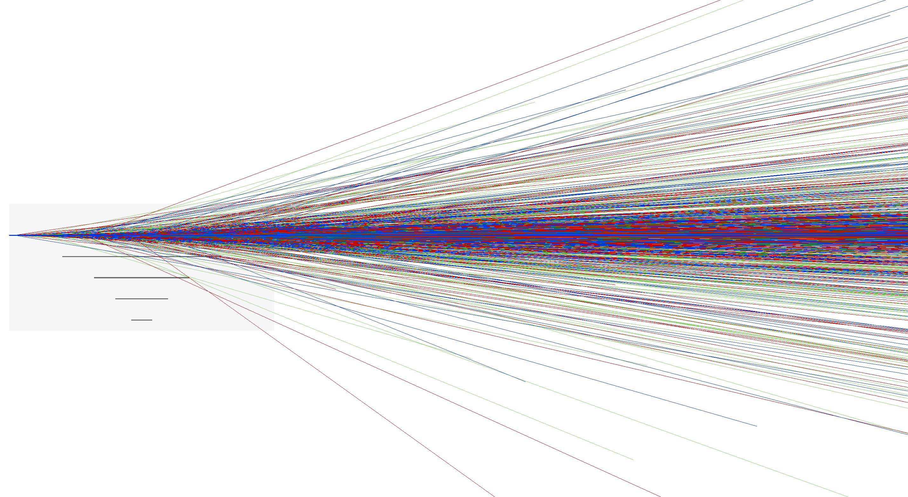
Secondary Beams
Secondary beams are produced from interaction of primary beam in a target
We use typically beryllium due to high melting point
Secondary particles go mostly in forward direction
Multiple species are produced, not only one
With magnets, one can define momentum and beam shape
After momentum selection particles have same momentum but different velocity
Collimators define beam shape and particle rate
Hadron beams consist mostly of:
Pions
Kaons
(Anti)Protons
Muons (typically from decays) are constant background
500mm
240mm

Slide 11
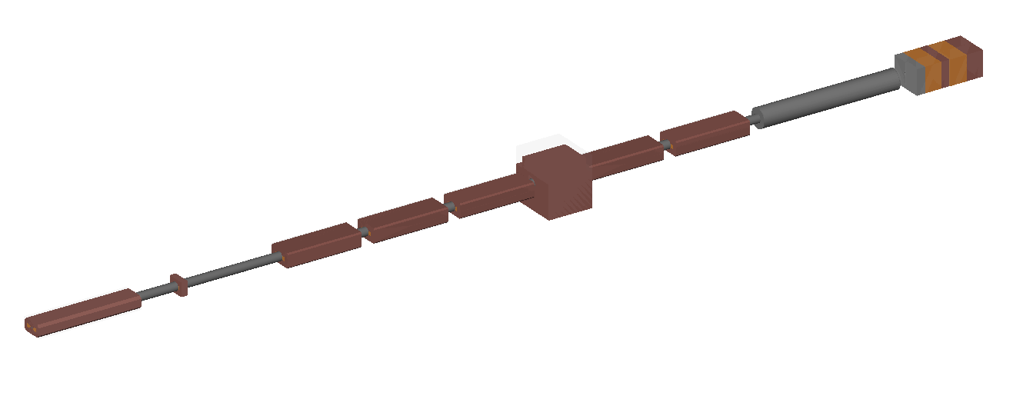
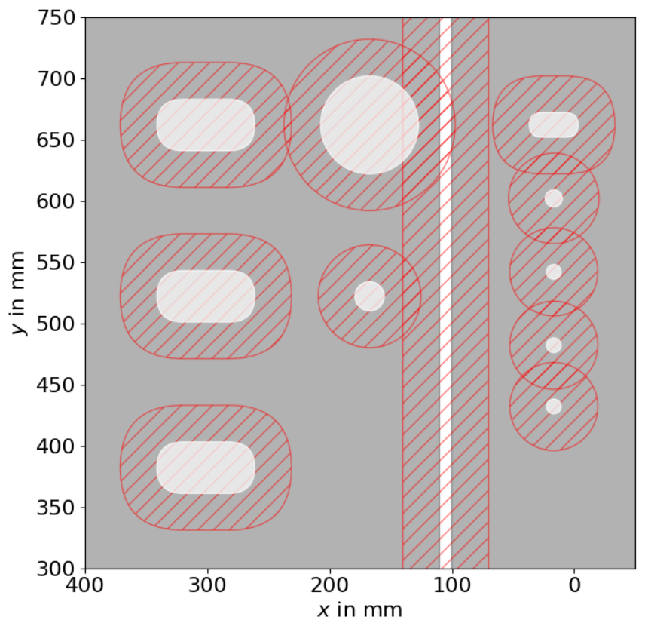
How to Make Multiple Secondary Beams - Wobbling
H6
H8
Primaries
P42
B1
B2
B3
T4
The general idea is quite simple: Excurse the primary beam in a way to collide with the target at an angle and offset such that a spectrometer selects desired momenta for various beamlines
In this note, all the information about the geometry can be found
The task is: Find a set of magnetic fields to serve the beamlines
We use the “Wobbling Configurator” → There is an analytic solution!
Beam momenta of all beamlines strongly coupled!
H6
H8
P42
Front-face of the target attenuator

Slide 12
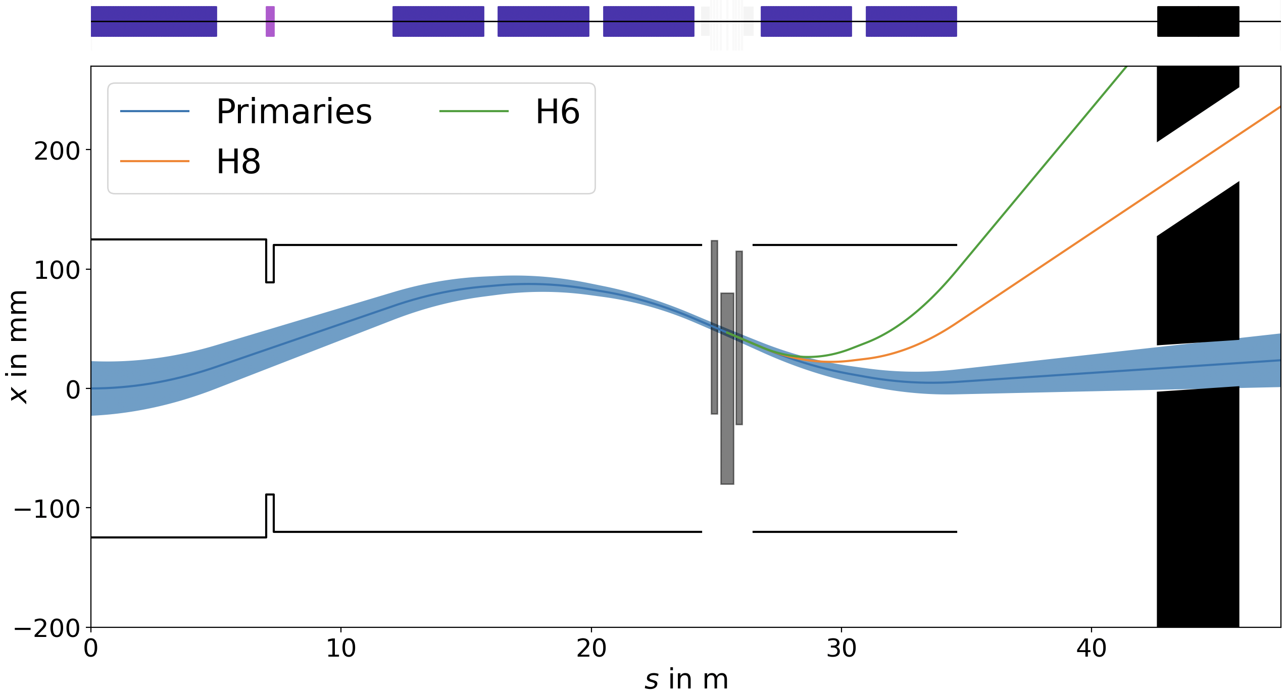

XTAX: Target Attenuator
VXSS: Big Vacuum Chamber
TBIU/D: Target Beam Instrumentation Up/Down-stream
Current T4 Region
y
The “Wobbling”
s
T4 Target + Diagnostics
XTAX
Not to scale!
B1
B2
B3
VXSS
P42 MSNs
Quad
Beam Direction
TBIU
TBID
Primaries hit the target off-centre with an angle → Produced secondaries of desired momenta go to H6/H8 while primaries need to follow P42 line
Number of protons defined by needs of NA62 and chosen T4 target length (set by needs of test beam users)
In future: two different cycles that relax these constraints!
B1
B2
B3
TAX
x
TBIU
TBID
$$μ± 7σ$$
T4
s

Slide 13
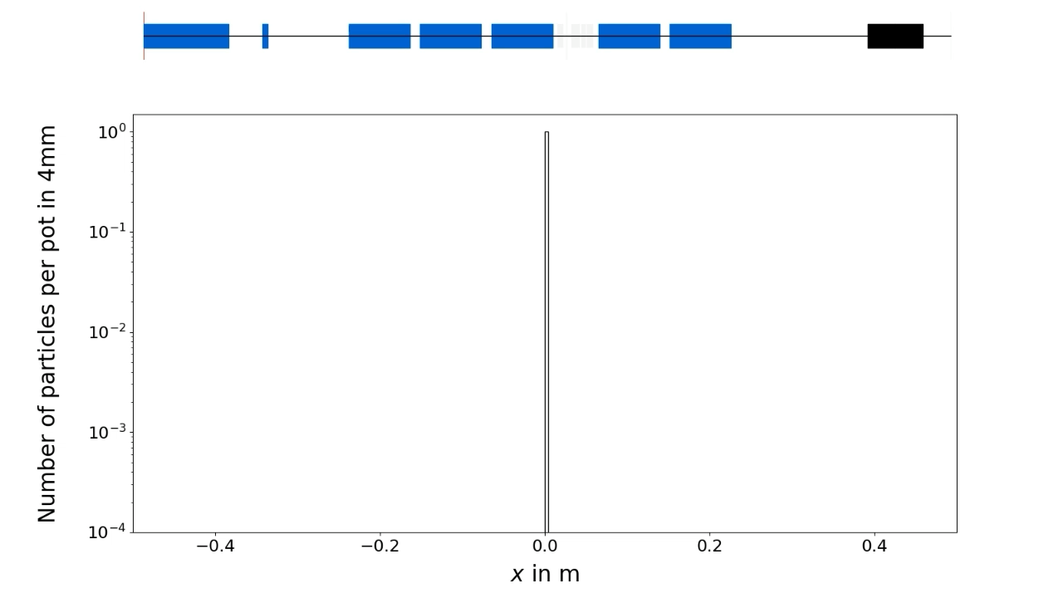
How to Make Multiple Secondary Beams - Wobbling

Slide 14
How to Make Multiple Secondary Beams - Wobbling

Slide 15
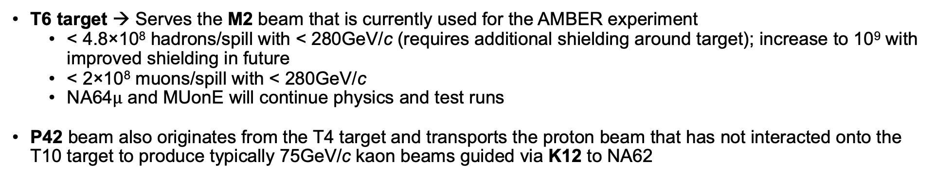
Beam Characteristics
Parameter | T2 Target |  | T4 Target
Beamline | H2 | H4 | H6 | H8
p attenuated primary / secondary beam in GeV/c | 400 / 360 | 400 / 360 | - / 205 | 400 / 360
Maximum Δp/p in % | ±2.0 | ±1.4 | ±1.5 | ±1.5
Maximum intensity/spill (hadrons/electrons) | 10⁷ / 10⁶ | 10⁷ / 10⁷ | 10⁷ / 10⁵ | 10⁷ / 10⁵
Available particle types | Primary protons or pure electrons or pure/mixed hadrons or pure muons
Ion beam availability | Yes | Yes | No | Yes
T6 target → Serves the M2 beam that is currently used for the AMBER experiment
< 4.8×10⁸ hadrons/spill with < 280GeV/c (requires additional shielding around target); increase to 10⁹ with improved shielding in future
< 2×10⁸ muons/spill with < 280GeV/c
NA64$μ$ and MUonE will continue physics and test runs
P42 beam also originates from the T4 target and transports the proton beam that has not interacted onto the T10 target to produce typically 75GeV/c kaon beams guided via K12 to NA62

Slide 16
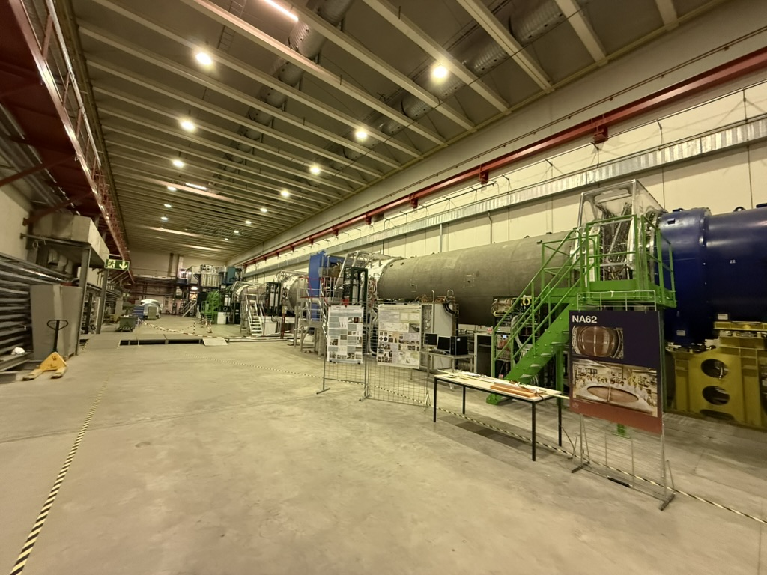
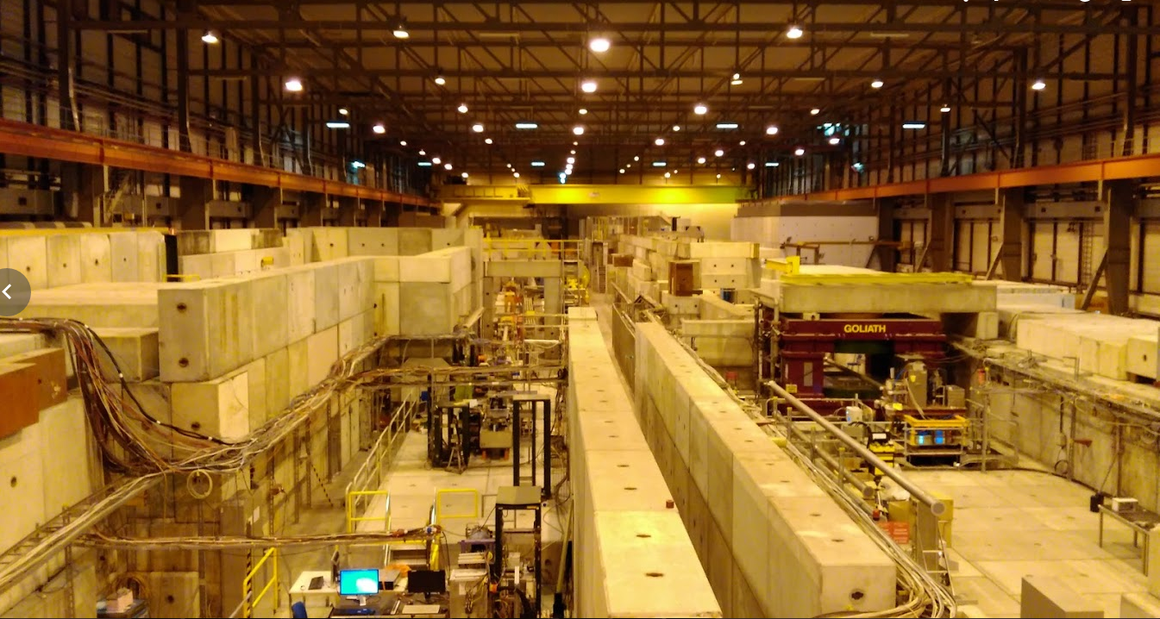
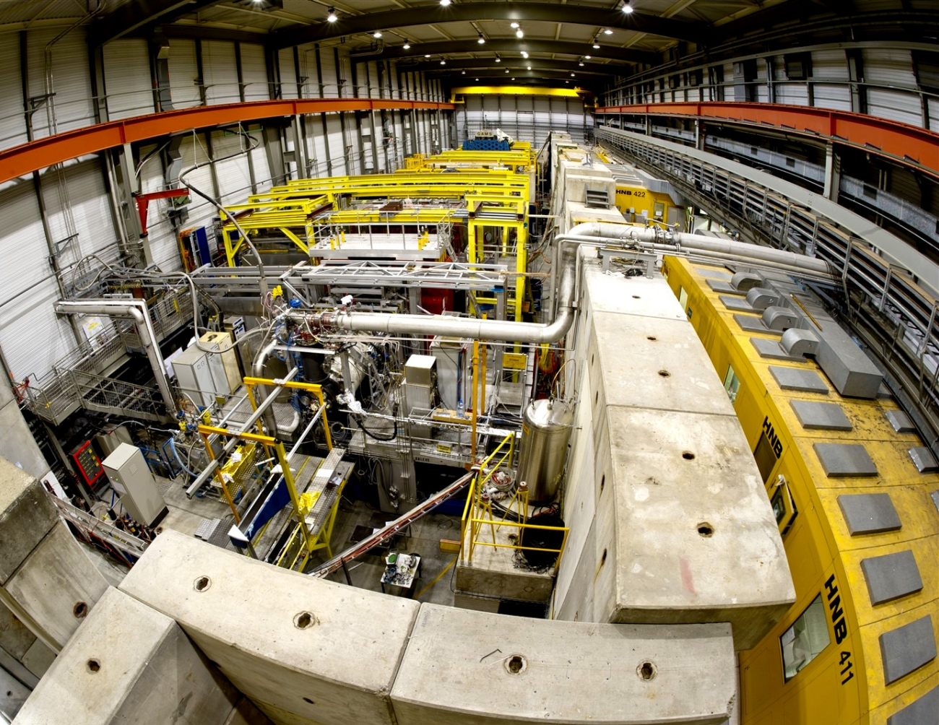
EHN1
H8
H2
H6
H4
ECN3
EHN2
B. Parsamyan

Slide 17
East Area

Slide 18
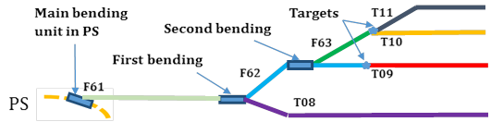
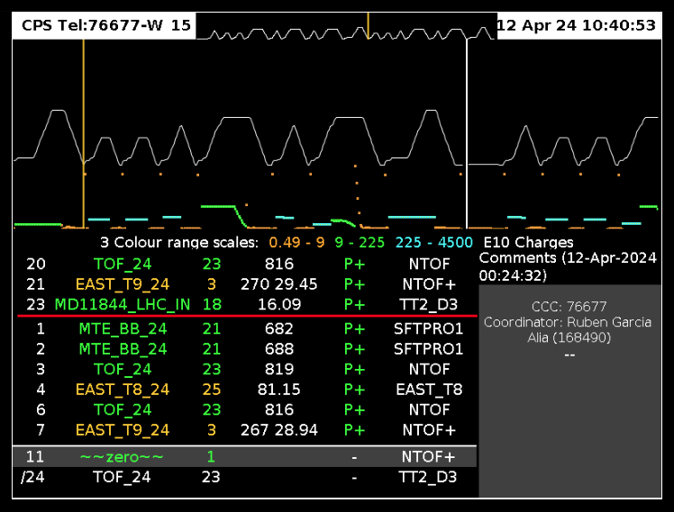
East Area Secondary Beamlines
Spill duration: 0.4s flat top
Usually : 1-2 cycles per minute per East Destination
Max 3.3×10¹⁰ protons/second per destination (limited by RP for secondary lines)
Max 6.6×10¹⁰ protons/second for T08
Supercycle structure dependent on all users (SPS, nTOF, …)

Slide 19
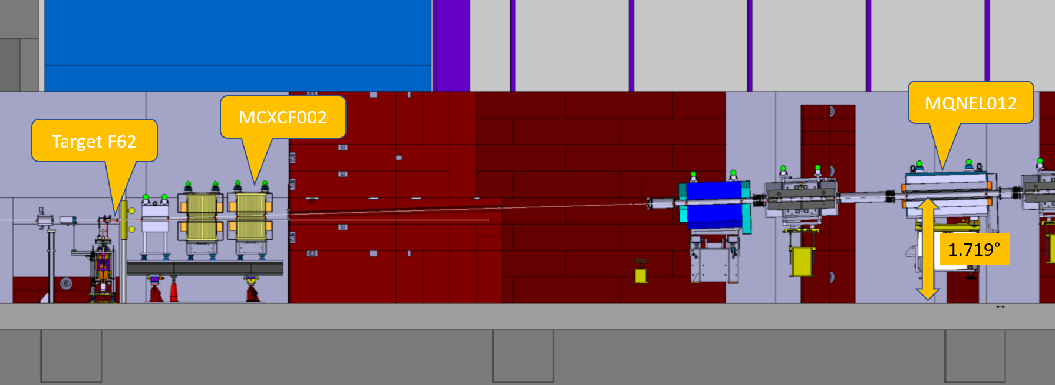
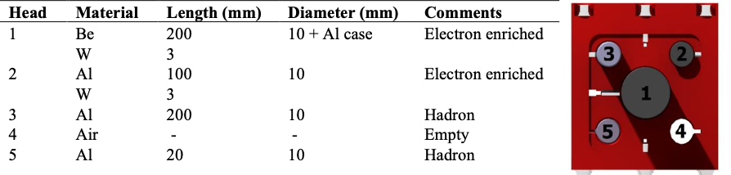
Beam Characteristics
Parameter | T09 | T10 |  | T11
p_{max} of secondary beam in GeV/c | 16 | 12 | 3.5
Δp/p in % | ±0.7 to ±15
Maximum intensity/spill (hadrons/electrons) | 10⁶
Available particle types | Pure electrons (T09 only) or mixed electrons (T10) or mixed/pure hadrons or pure muons
T11 serves the CLOUD experiment which is a permanent installation
30-35 mrad vertical production angle
Multi-target configuration

Slide 20
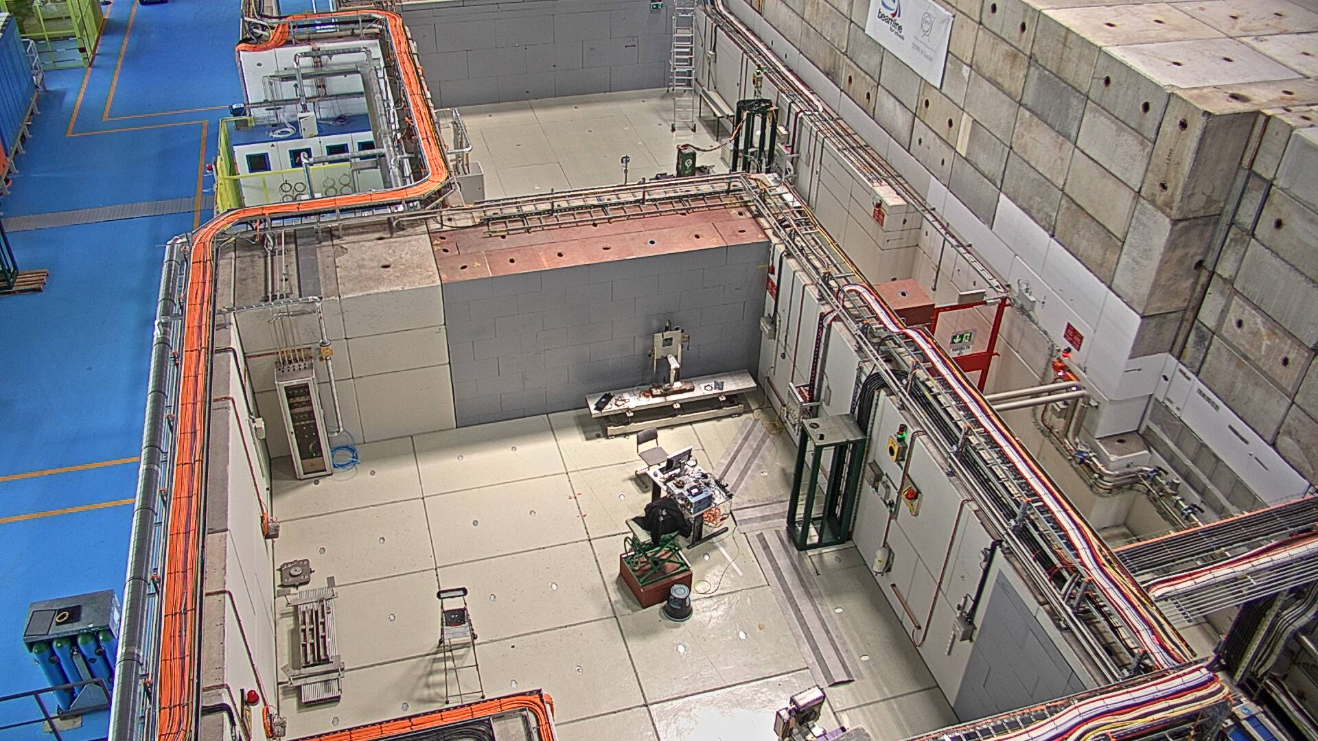
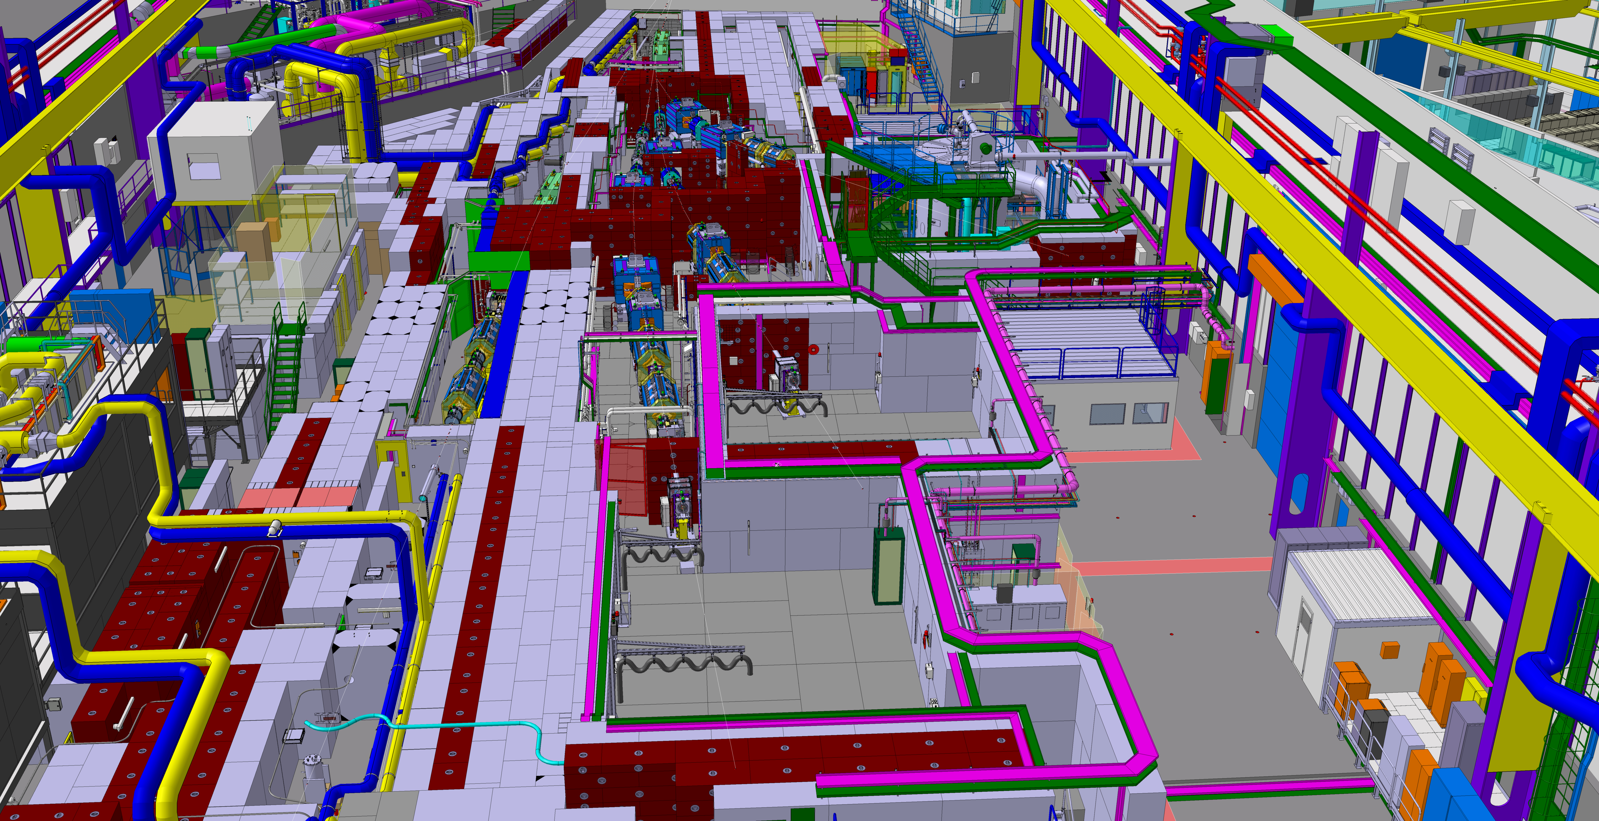
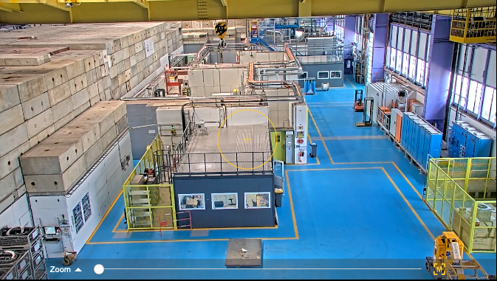
Beam
T09
Beam
T11
T10
T10
T11
T08
T10
T09
T08
T09
Beam

Slide 21
Modelling & Simulations

Slide 22


Simulation of Secondary Beamlines
Secondary beams can provide a wide range of particles over a wide range of momenta
Useful for detector calibration and development
Exploit particle-matter interaction
Composite spectra based on beamline and materials
Several ten to hundred components along the line (up to 1km long!)
Experiments rely on knowledge of beam properties and background
Multi-Species Beam Spectra
#
p
Experiment
Converter Target
Beam Dump
Target

Slide 23

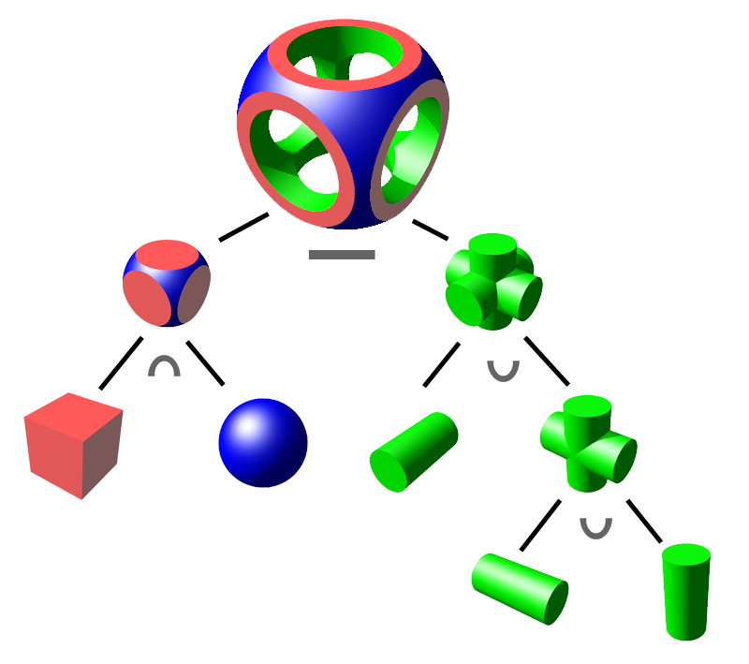
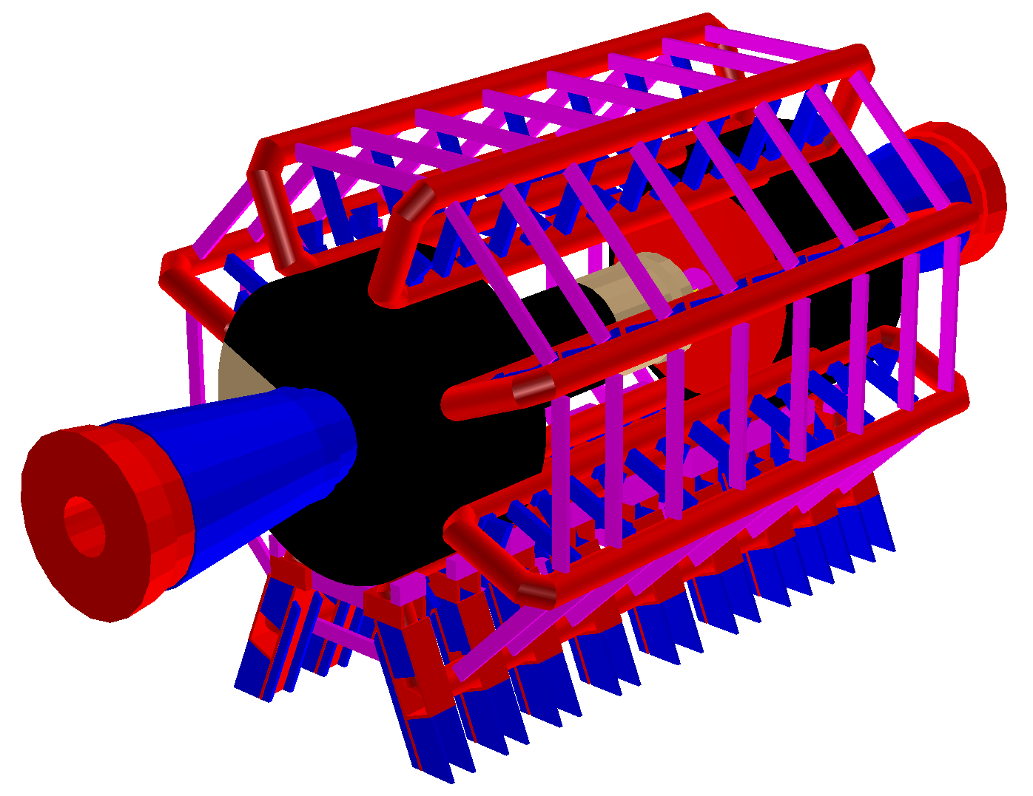
Geant4
http://geant4.web.cern.ch
Use a 3D radiation transport model to predict detector response and compare to data using Monte Carlo
Detailed 3D geometry - complex and specialised to an experiment
Often includes magnetic field for particle identification
Geant4 is one of the most common software libraries for creating these models
Open-source C++, regular development by community
All subatomic particles, huge array of physics models
Constructive Solid Geometry
Simplified ATLAS Geometry
L. Nevay

Slide 24

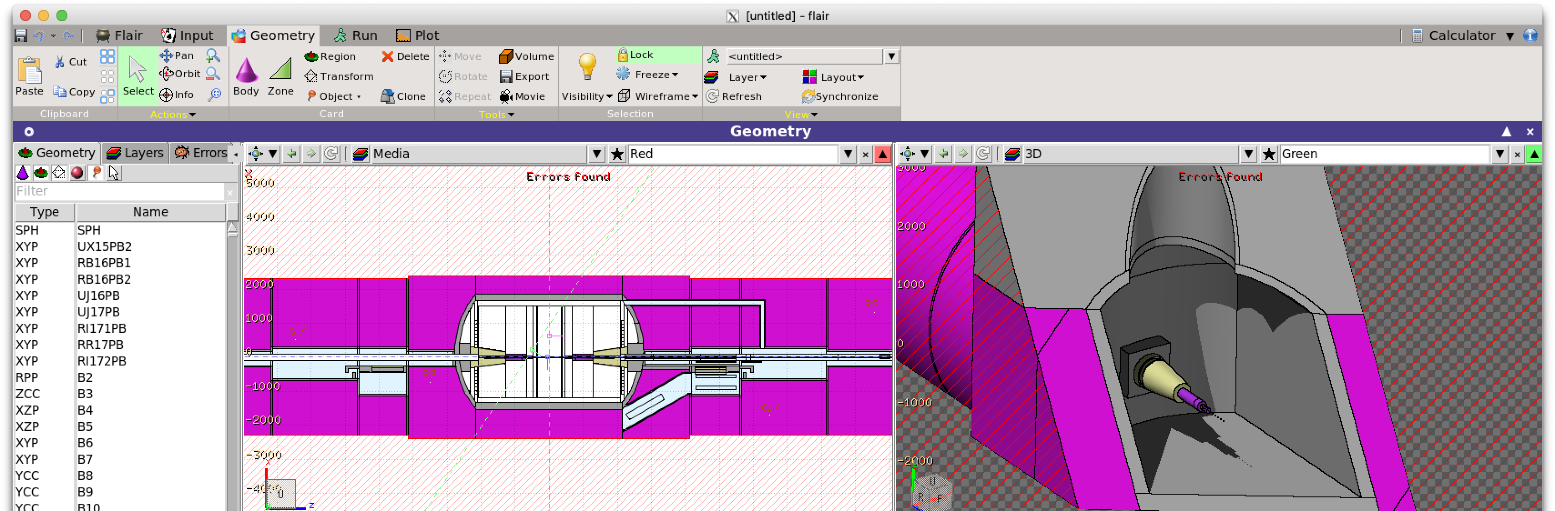
FLUKA
FLUKA is typically used for radiation shielding applications and machine protection
Also used for variety of nuclear applications
Certified for radiological protection by many organisations
Therefore, they often require a FLUKA model at some point
Written in Fortran, but huge efforts are there to translate to C++
Would mean rewriting a lot of Geant4 code → Decided to make use of the existing libraries
Uses combinatorial geometry without hierachy
https://fluka.cern
L. Nevay

Slide 25
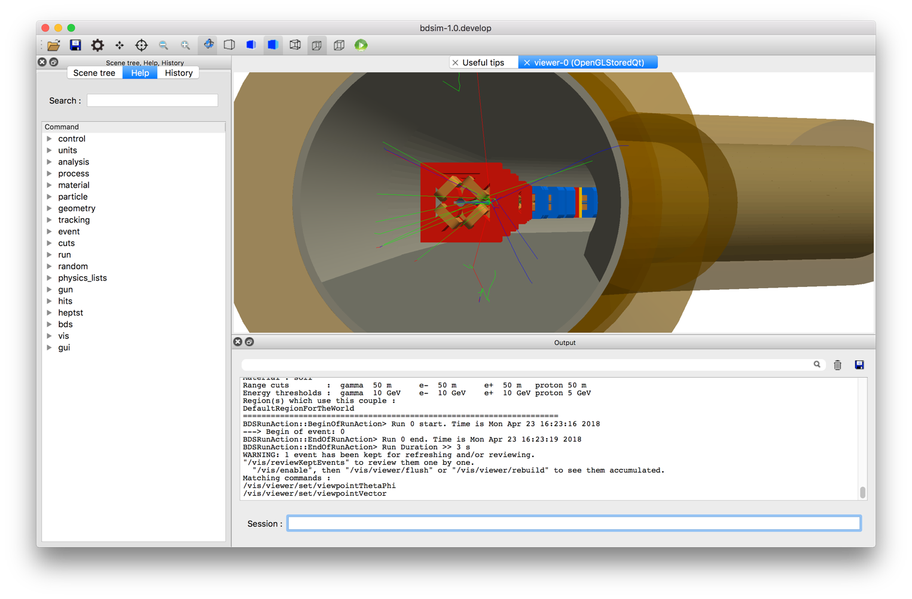

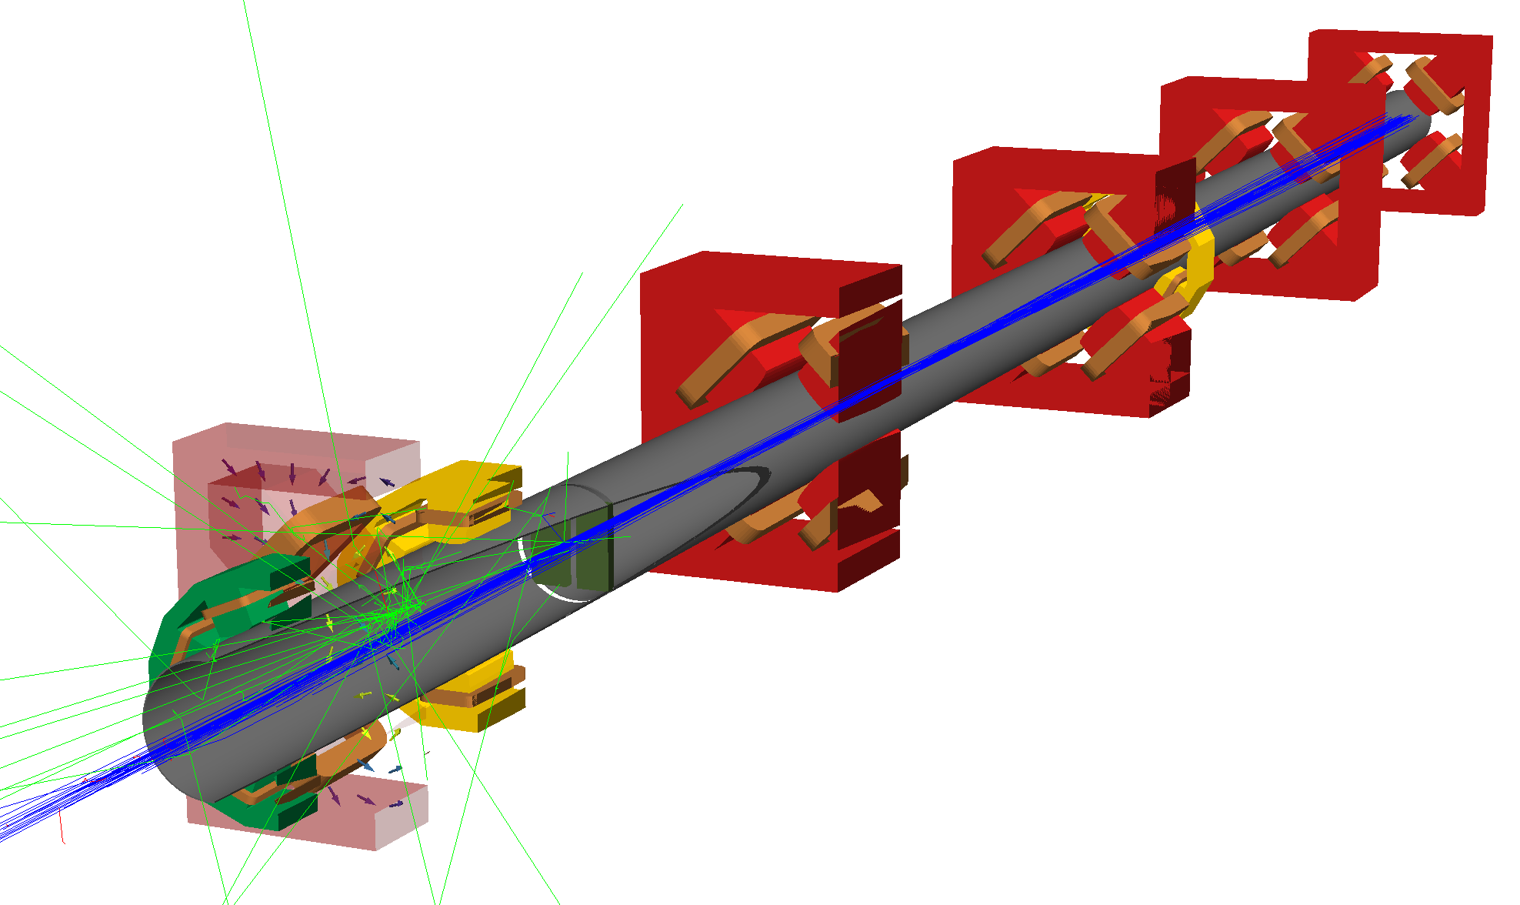
BDSIM
Automatic Geant4 models of accelerators
Library of scalable accelerator components
Make a model in minutes to weeks, not years
Convert from other accelerator codes easily
Applied to many experiments and machines
CERN North & East Areas, ILC / CLIC, AWAKE, XFEL undulators, LHC collimation, Laserwires, FASER, KLEVER, NA62, ATLAS non-collision backgrounds, MAGIX at MESA, FCC MDI, LhARA
Benefit from community-driven Geant4
Physics models constantly updated and improved
Comp. Phys. Comm. (252), July 2020, 107200
L. Nevay

Slide 26
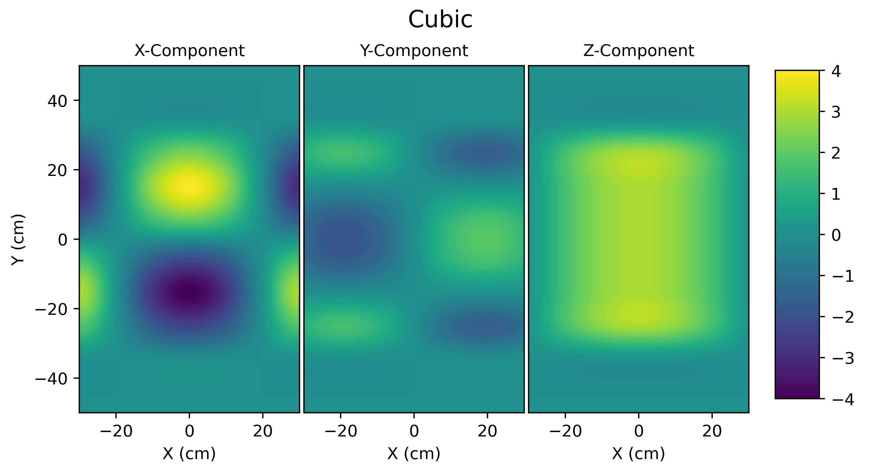
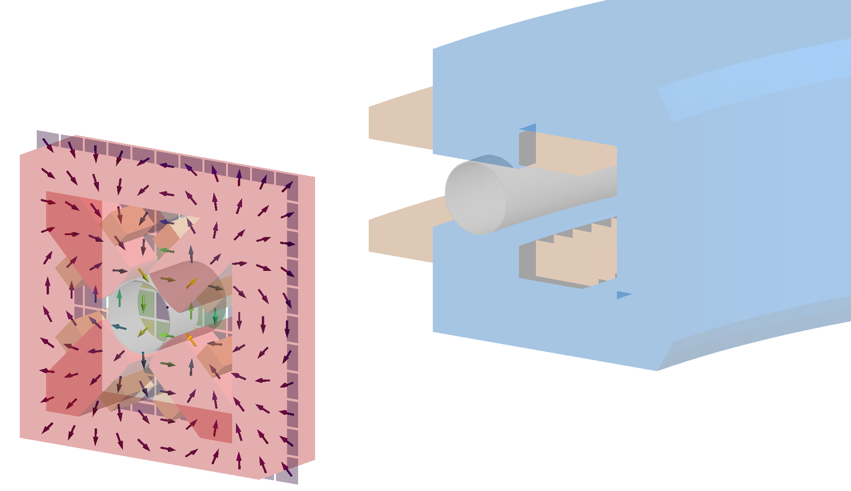
Customisation
Generic geometry is not always suitable
Ability to include custom geometry
Can overlay E or B or combined EM field maps → 1D to 4D with numerical interpolation
Supports all Geant4 physics lists
Cross-section biasing per volume
Beam distribution generator for accelerators
3D scoring meshes and beam loss monitor scoring
Automatic tunnel building following beamline
Field map interpolation
Custom field map attached to geometry
L. Nevay

Slide 27
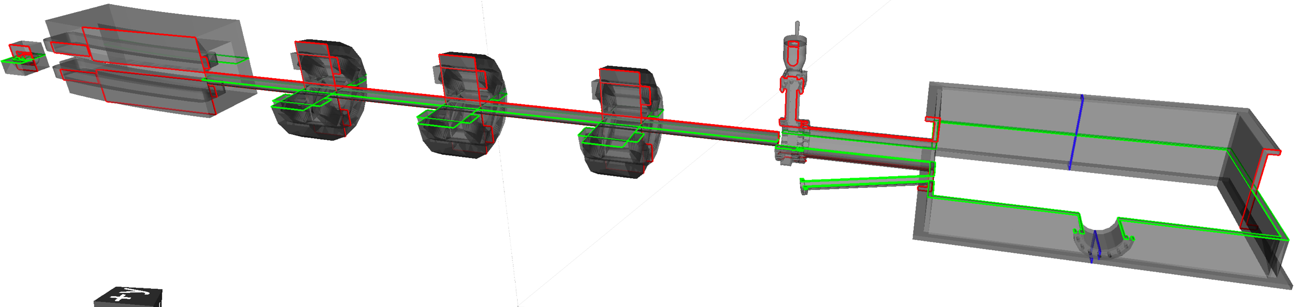
pyg4ometry
Ability to import / place it in a Geant4 model
Creation of geometry from scratch
Conversion of detailed geometry from another format (different mathematical form)
Place custom components in Geant4 / BDSIM
Have parity with models in Geant4 & FLUKA
FLUKA
CAD/STEP
GDML from BDSIM
STL from vacuum
company
Python Geant4
Faraday cup
Sector bend
Quadrupole triplet
Gate valve
10.1016/j.cpc.2021.108228
10.18429/JACoW-IPAC2024-MOPS24
Laser vacuum chamber
S. Boogert

Slide 28
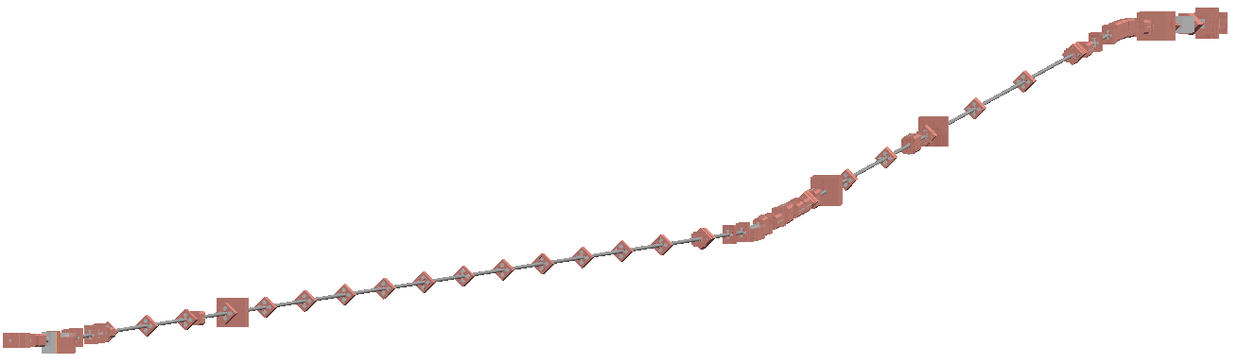
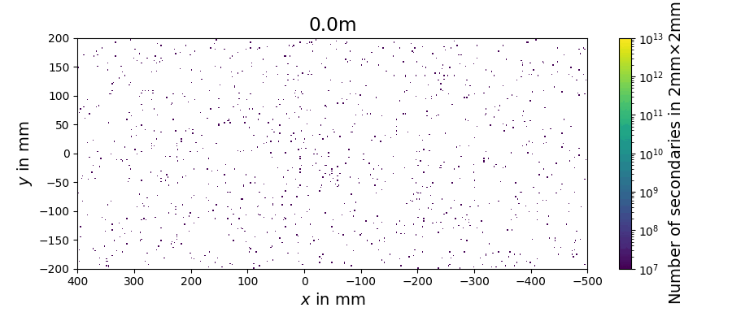
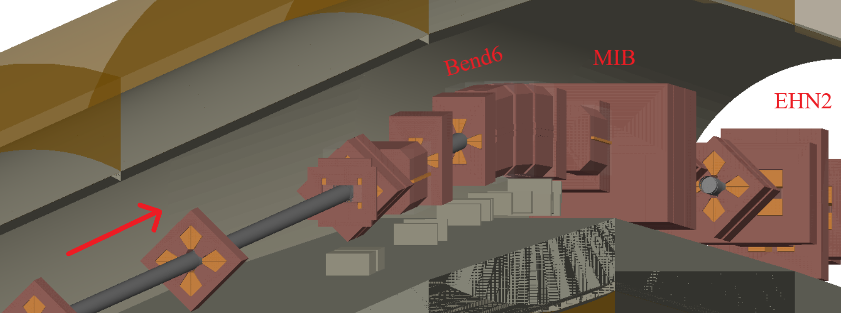
M2 Beamline
400GeV/c protons to produce hadrons and electrons
Hadron beams for AMBER
Pions decay to produce muon beams for AMBER/NA64/MUonE
Electron mode also possible
Multi-stage simulation
Custom geometry and field maps throughout
Experiment
Muon Section
Protons
XTAX
Hadron Section
Target

Slide 29
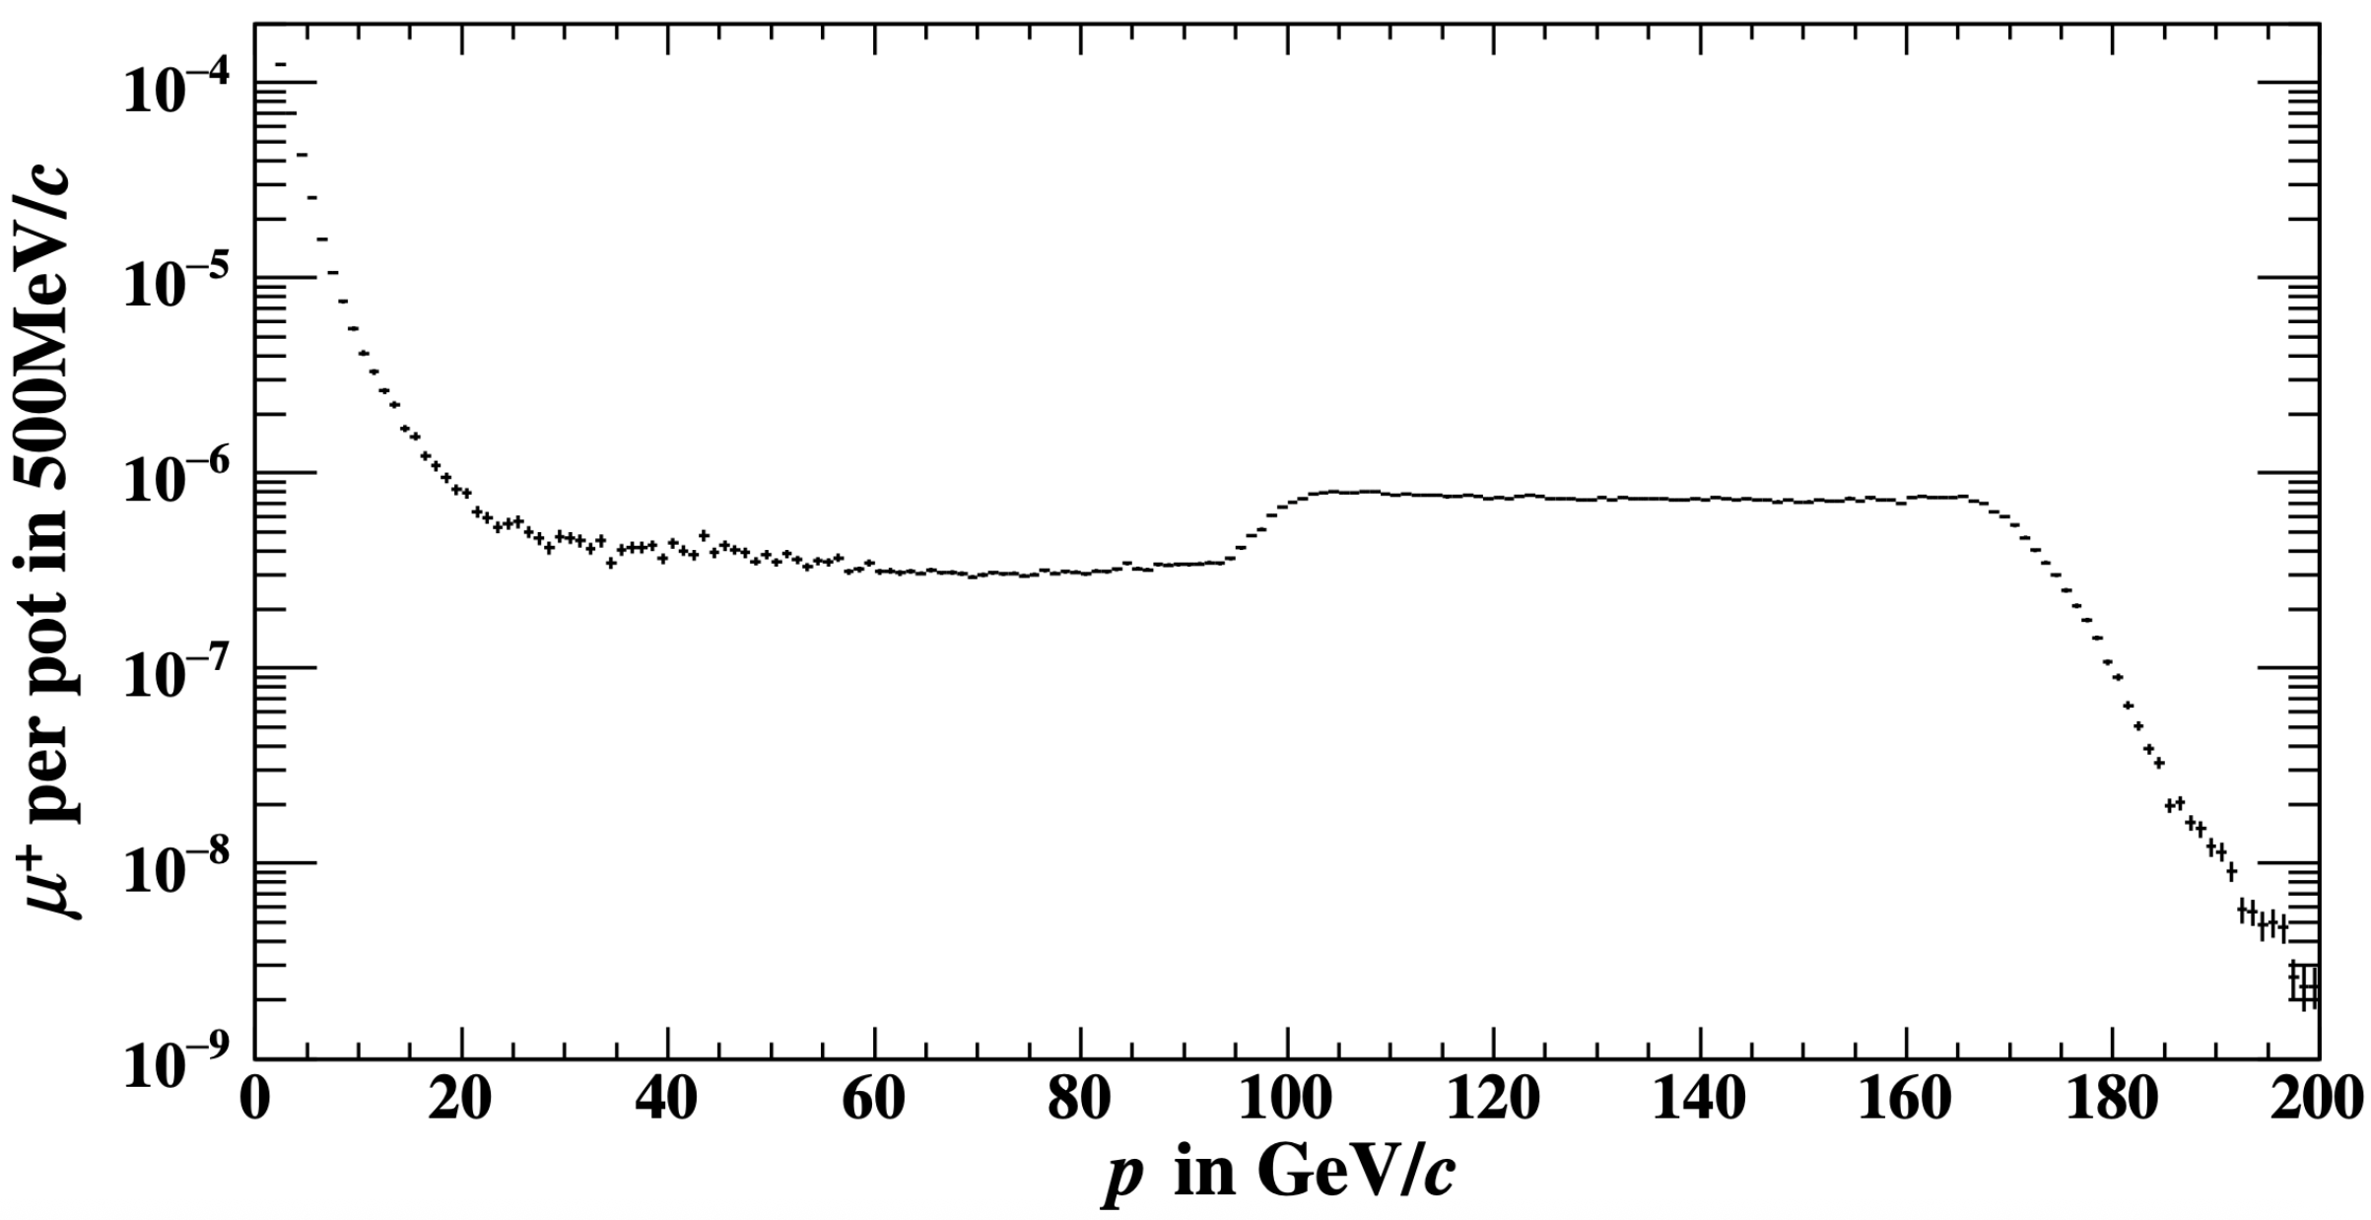
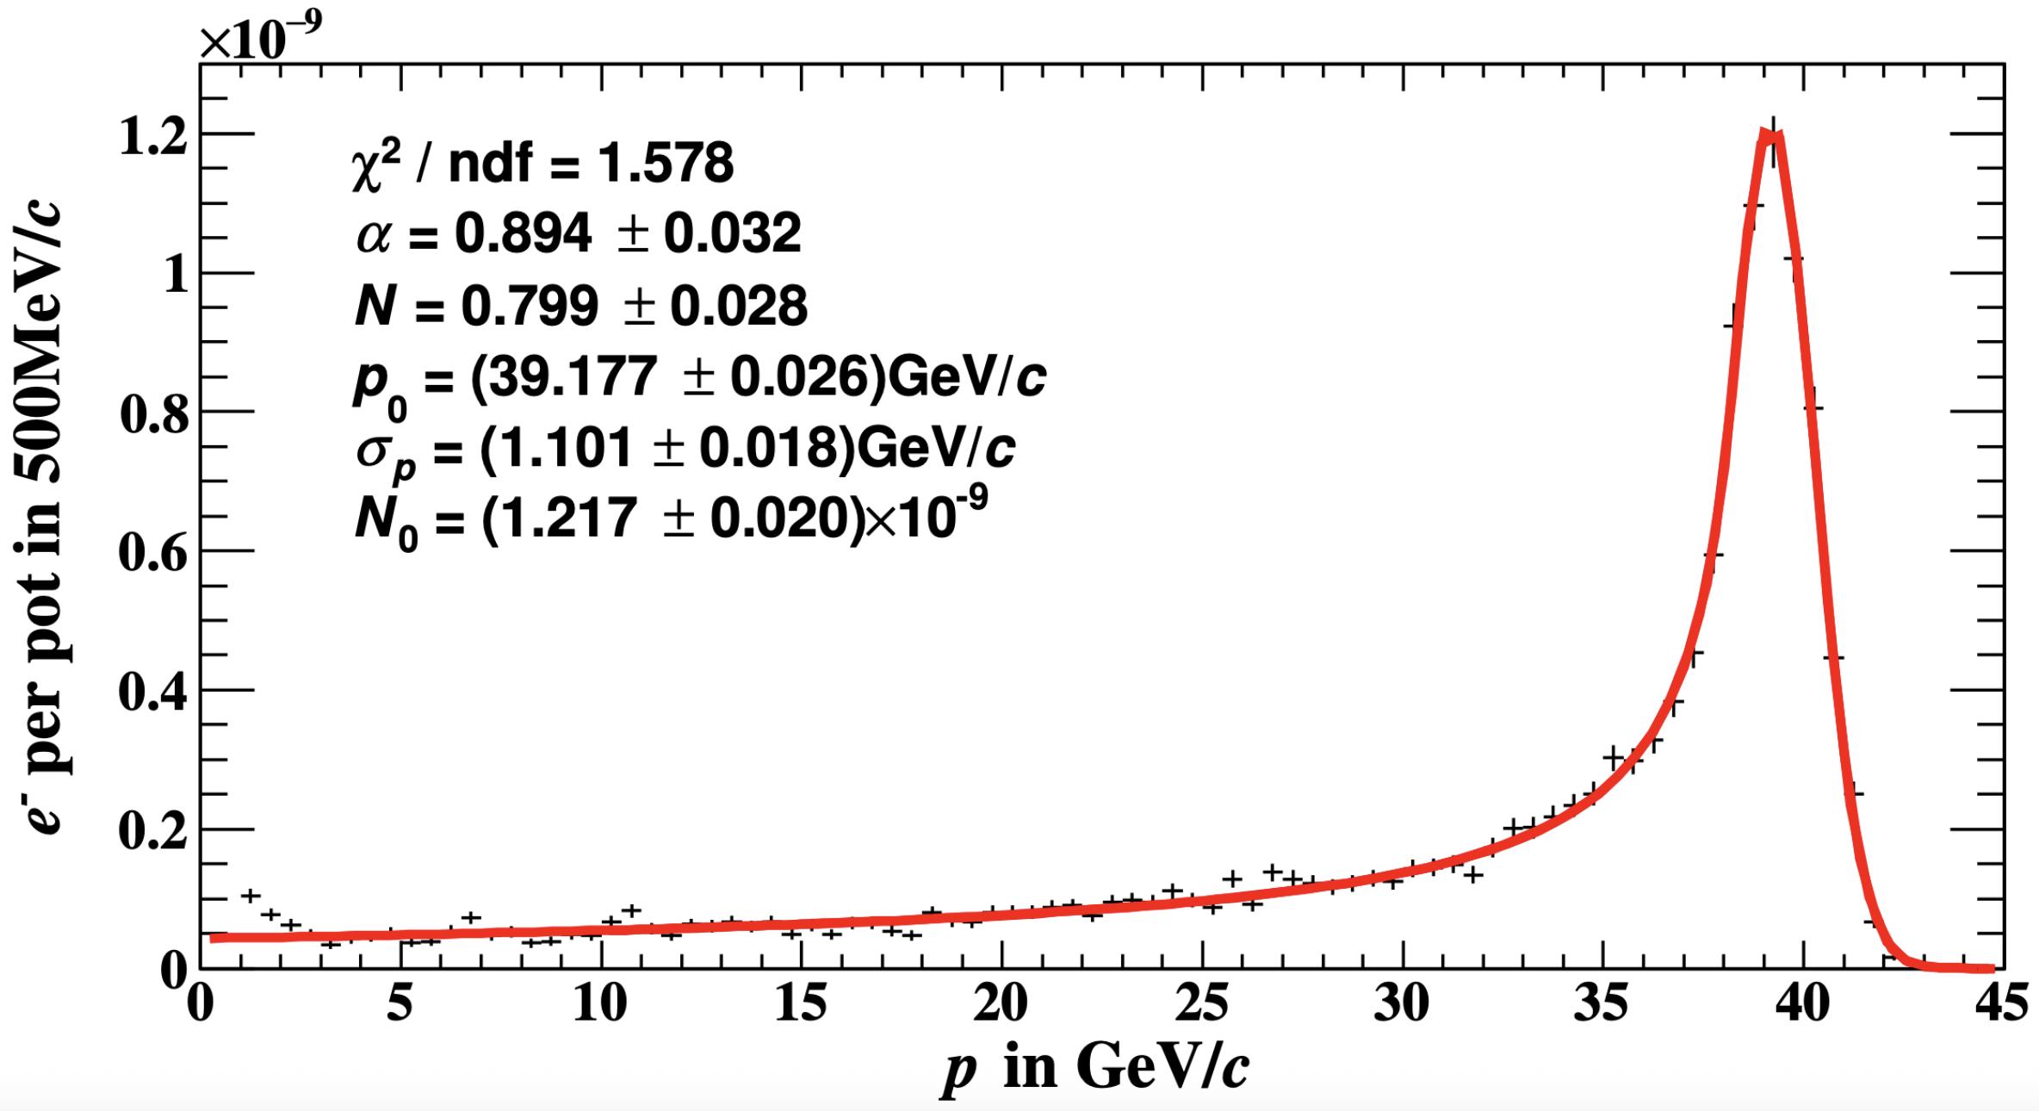
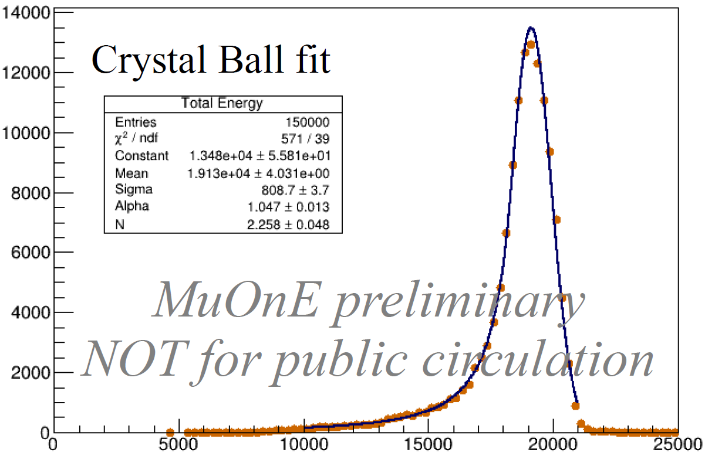
M2 Beamline
Muon spectrum at end of hadron section
Simulations start with protons on target
Full particle production included
Use biasing techniques for muon mode
Muon splitting for enhancement of muon rate
Cross-section biasing for estimation of hadron contamination in muon beam
No biasing possible for electron mode
Measurement
Simulation
Electron spectrum

Slide 30
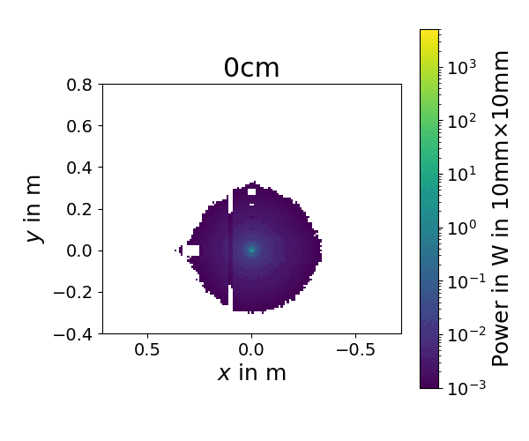
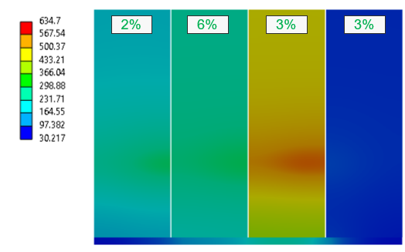
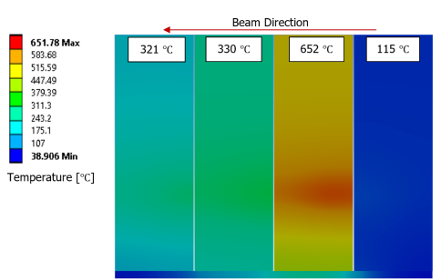
Calorimetry
Transverse shower along beam axis for 150×10¹¹ protons with 400GeV/c on P4 XTAX
Beam parameters
Number of protons | 1.5×10¹³
Momentum | 400 GeV/c
Cycle length | 14.4s
Total beam power | 67kW
Jura
Saleve
Geant4
Temperature evolution simulated with ANSYS based on energy loss from Geant4/FLUKA
Vacuum chamber
Power at front face
Primary protons
H6
H8
P42
Neutrals
FLUKA
Spectrometer shadow
Positive secondaries
Negative secondaries
For the “positive” wobbling of +120/+180 GeV/c
[A. Petrellese]

Slide 31
What comes next?

Slide 32
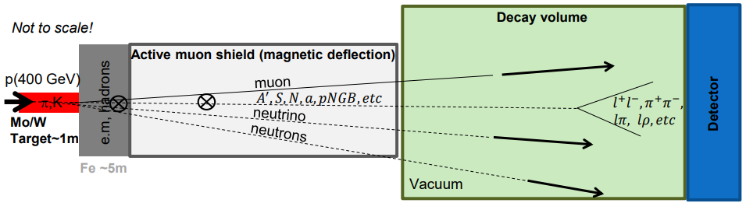
Beam Dump Facility / Search for Hidden Particles
Direct search for Feebly Interacting Particles
Exploit 4×10¹⁹ protons (400 GeV/c) per year for 6×10²⁰ POT over 15 years
SHiP Physics Proposal: Rep. Prog. Phys. 79 (2016) 124201 published 2016
SPS Beam Dump Facility Comprehensive Design Study: CERN-2020-002 published
High ppp & POT Overcome small cross-section of hidden particles
High ρ, Z & A Maximize p⁺ interaction
Shortest λ Force absorption of K & π to reduce muon & neutrino background
M. Fraser

Slide 33

Beam Delivery to BDF/SHiP
We need to transport 400×10¹¹ protons per spill to BDF
Today, we typically extract about 250×10¹¹ to the whole NA
Compared to today’s P42 operation mode, we will have about 90× higher power transported in SHALLOW tunnels
BDF/SHiP
Need to minimise losses due to multiple reasons:
Radiation protection (we transport 2MW)
Meet proton requirements for BDF/SHiP
Minimise background
Complete redesign of the transfer line happening in LS3

Slide 34


Beam Transport Through T4
Stay clear region:
To minimise losses, we need to reduce material seen by the beam as much as possible → But we still go through the secondary target area!
y
HI-ECN3 beam
Target box
s
Axis of machine
Fixed-target
beam
Target plates
x
s

Slide 35


Background for BDF/SHiP
SHiP will operate with a magnetic muon shield to remove any background from the experiment
Works very well for particles created in the beam dump
Beam-induced background can be problematic as potentially off-axis
We talk about 10⁴ muons generated from 4×10¹³ protons → We need to make use of dedicated techniques to estimate the background properly: rate plus spatial and angular shapes
Biasing techniques to enhance muon production
Muon splitting
Still, optics designed to transport 7σ without losses! → Dedicated simulations needed to estimate distributions

Slide 36
Conclusion
How to make mutiple primary and secondary beams starting from one primary beam
Splitting and Wobbling
Characteristics of beams in the East and North Area
Up to 24GeV/c available in the East and up to 400GeV/c in the North Area
Primary and secondary beams possible
Ion momenta up to 150GeV/c/n
Methods for simulating secondary beams with BDSIM/Geant4
Programmatic model building
Estimation of beam and background distributions
Design of a new beamline for the Beam Dump Facility and SHiP experiment
Minimise beam losses for background reduction and mitigation of radiation protection constraints
Dedicated studies to estimate (low) background necessary

Slide 37
Carrer Possibilities
Student Opportunities
Doctoral Student Programme
Graduate Programme
Additional info for Germans
Our Group
BE-EA
HI-ECN3
Physics Beyond Colliders
Contact me in case of any question:
fabian.metzger@cern.ch

Slide 38



HI-ECN3 and BDF
HI-ECN3 Irradiation Opportunities Workshop
The unique neutron-dominated radiation field generated around the BDF spallation target is of interest for:
Electronics and Materials irradiation
Nuclear astrophysics
“CERN’s RME Strategy Panel is mandated to assess interest from the scientific community and recommend possible synergies for irradiation testing that can be carried out parasitically at the BDF once the SHiP experiment is operational after LS4.”
Beam characteristics:
300kW average power
2.3MW total beam power over 1s → Competing with spallation sources
Transporting the beam through shallow transfer tunnels challenging due to RP
M. Fraser

Slide 39

HI-ECN3 and BDF
Position | TID in Gy/yr | Si1MeVN_{eq} in cm⁻²/yr | HEH_{eq} in cm⁻²/yr | Particles’ fraction
BHFIM1 (4 x 10¹⁹ POT/year) | 10⁷ - 10⁸ | 10²⁰ | 10¹⁷ | Neutrons (N): 66% Photons (Ph): 33% Charged Hadrons (CH): 1%
BHFIM2 (4 x 10¹⁹ POT/year) | 10⁷ | 10¹⁹ | 10¹⁶ | N: 79% Ph: 20% CH: 1%
R2E@4m (2 x 10¹⁶ POT/hour) | 10¹ | 10¹³ | 10¹¹ | Neutrons (N): 99% Charged Hadrons (CH): <1%
R2E@10m (2 x 10¹⁶ POT/hour) | 10⁰ | 10¹² | 10¹¹ | N: 99% CH: <1%
R2E@20m (2 x 10¹⁶ POT/hour) | 10⁻¹ | 10¹¹ | 10¹⁰ | N: 99% CH: <1%
R2E@20m
Atmospheric-neutron channel
R2E@10m
R2E@4m
X
BHFIM2
Beam
SHiP experiment
Z
BHFIM1
P. Pelissou

