Slide 1
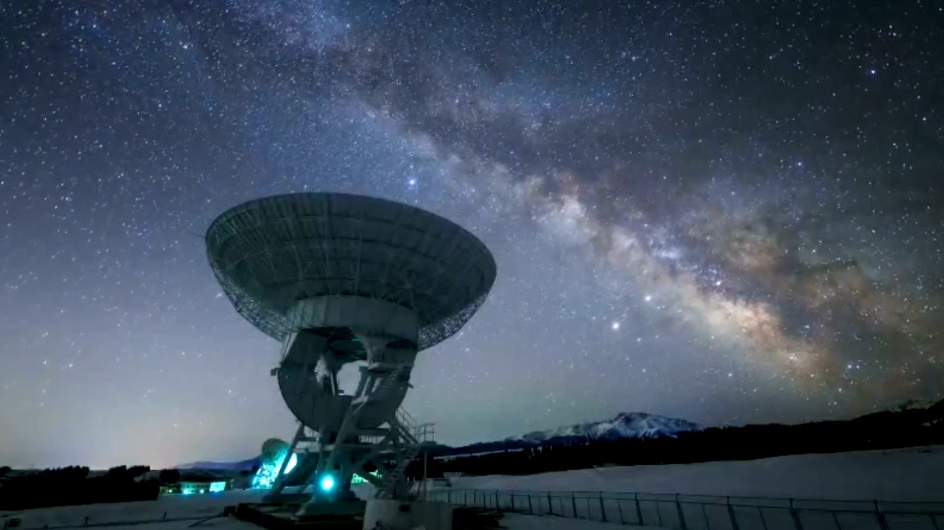



Repurposing Large Language Models for Cosmology
Daniel Schiller
15.12.25, Aachen, Glühwein Workshop
Based on arXiv:2506.14757
Large Language Models – The Future of Fundamental Physics?
With C. Heneka, F. Nieser, A. Ore and T. Plehn

Slide 2
Foundation Models
Foundation Model: long pretraining + short finetuning
Typical use case:
Huge dataset for your data modality
Small dataset for your actual task
Pretrain on huge dataset
⇒ Learn self-supervised a good data representations
Finetune on small dataset for downstream task
Problem: Physics datasets are limited
Particle Physics: ≈1B jets
Square Kilometer Array: ∽10k sky maps
Notes:
2:00

Slide 3
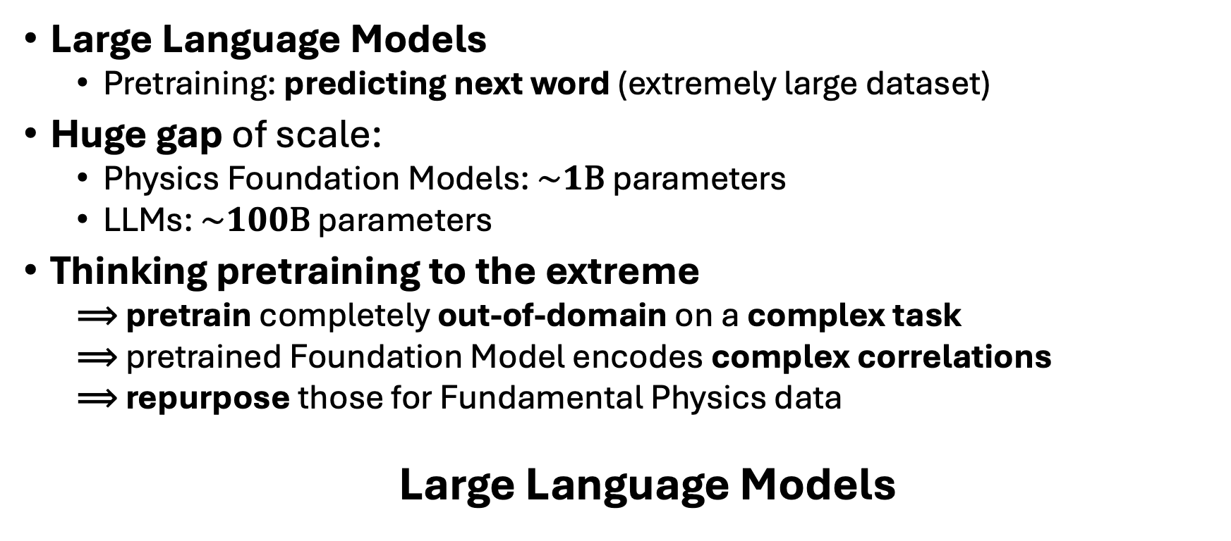
Foundation Models in Industry
Large Language Models
Pretraining: predicting next word (extremely large dataset)
Huge gap of scale:
Physics Foundation Models: $\sim 1\text{B}$ parameters
LLMs: $\sim 100\text{B}$ parameters
Thinking pretraining to the extreme
⟹ pretrain completely out-of-domain on a complex task
⟹ pretrained Foundation Model encodes complex correlations
⟹ repurpose those for Fundamental Physics data
Large Language Models

Slide 4
LLM architecture
Unembedding & Softmax:
Maps representations to a categorical distribution
LLM backbone:
Learns causal correlations between representations
Embedding:
Maps discrete tokens to a latent representation
[Hello]
[World]
Notes:
5:00

Slide 5
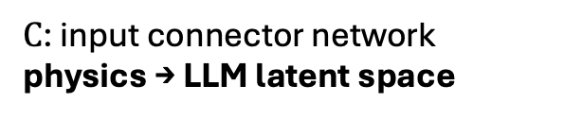
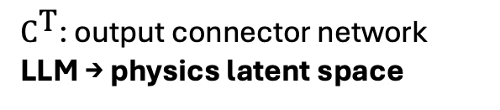

LLMs with numerical data
Using a transformer with multimodal input
$𝒫$: Softmax, Gaussian, …
${\text{C}}^{\text{T}}$: output connector network
LLM → physics latent space
Here: Qwen2.5 (360M parameters)
$\text{C}$: input connector network
physics → LLM latent space
physics data (numerical token)
linguistic token
Notes:
6:00

Slide 6
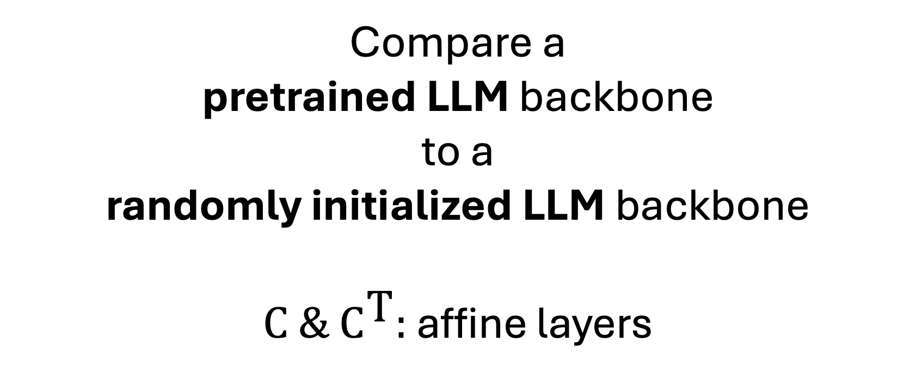
Does linguistic pretraining help?
Compare a
pretrained LLM backbone
to a
randomly initialized LLM backbone
$\text{C} \& {\text{C}}^{\text{T}}:$ affine layers

Slide 7
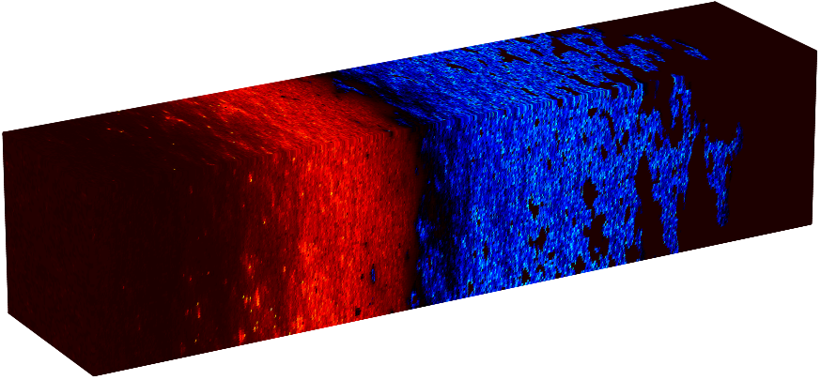
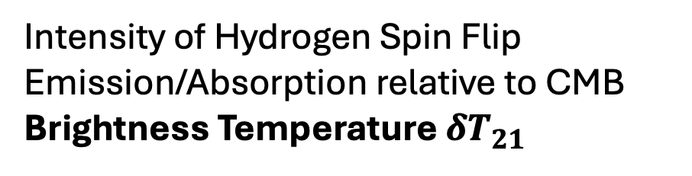
Lightcone Large Language Model (L3M)
Data: simulated lightcones
Depends on initial conditions and 6 parameters:
Sky
Intensity of Hydrogen Spin Flip Emission/Absorption relative to CMB
Brightness Temperature $δT_{21}$
Time
Notes:
7:00

Slide 8
Regression with frozen backbone
Task: regress 6 simulation parameters from global $δT_{21}$ signal
different lightcones
Notes:
8:00

Slide 9
Regression with frozen backbone
Network prediction
multivariate Gaussian
affine map,
trained
frozen
affine map,
trained
new token,
embedding trained
first global signal value
last global signal value

Slide 10
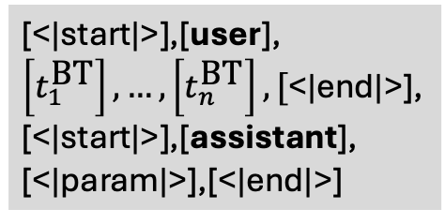

Regression with frozen backbone
[<|start|>],[user],
$\left[t_{1}^{\text{BT}}\right],…,\left[t_{n}^{\text{BT}}\right],[$<|end|>],
[<|start|>],[assistant],
[<|param|>],[<|end|>]
Minimal input:
$\left[t_{1}^{\text{BT}}\right],…,\left[t_{n}^{\text{BT}}\right],[$<|param|>]
Chat inspired input:
Notes:
9:00

Slide 11
Generation
Represent lightcone as a sequence of tokens
Task: next token/patch prediction
Conditional Flow Matching for parameterizing the conditionals
patch:
14 x 14
pixels
slice:
10 x 10
patches
Notes:
10:00

Slide 12
Generation with partial backbone finetuning
Notes:
11:00

Slide 13
Generation
Backbone completely finetuned
Notes:
12:00

Slide 14
Generation
Backbone completely finetuned
Notes:
12:00

Slide 15
Summary
Repurposed (open-source) Large Language Models
Added connector networks and finetuned backbone
Novel interpretation of Foundation Models
Try out finetuning an open-source LLM!
some LLMs have interesting features, e.g. 3d position encoding
Paper: 2506.14757, Code: github.com/heidelberg-hepml/L3M
Notes:
13:00

Slide 16
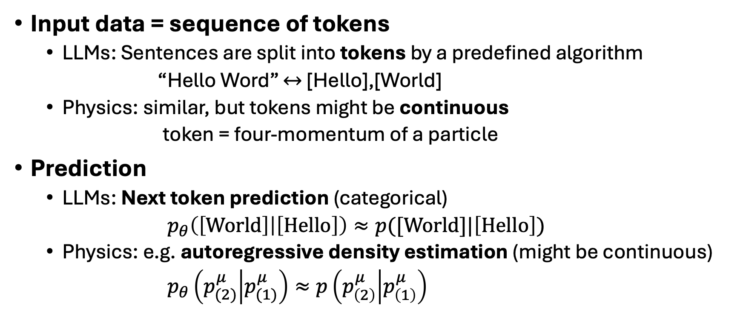
LLMs and Physics Foundation Models
Input data = sequence of tokens
LLMs: Sentences are split into tokens by a predefined algorithm
“Hello Word” $↔$ [Hello],[World]
Physics: similar, but tokens might be continuous
token = four-momentum of a particle
Prediction
LLMs: Next token prediction (categorical)
$p_{θ}\left(\left[\text{World}\right] | \left[\text{Hello}\right]\right)≈p([\text{World}]|\left[\text{Hello}\right])$
Physics: e.g. autoregressive density estimation (might be continuous)
$p_{θ}\left(p_{(2)}^{μ} | p_{(1)}^{μ}\right)≈p\left(p_{\left(2\right)}^{μ} | p_{\left(1\right)}^{μ}\right)$
Notes:
3:00

Slide 17
LLM Architecture

Slide 18
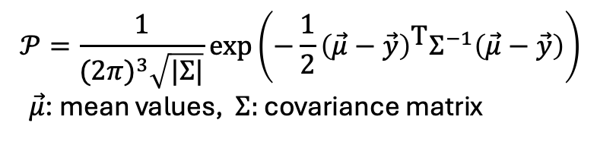
Regression Results
$$𝒫=\frac{1}{{(2π)}^{3}\sqrt{|Σ|}}\text{exp}\left(−\frac{1}{2}{\left(\vec{μ}−\vec{y}\right)}^{\text{T}}Σ^{−1}\left(\vec{μ}−\vec{y}\right)\right)$$
$\vec{μ}$: mean values, $Σ:$ covariance matrix

Slide 19
Regression Results

Slide 20
Regression results
samples from the learned multivariate normal distribution

Slide 21
Regression with frozen backbone
Notes:
9:00

Slide 22
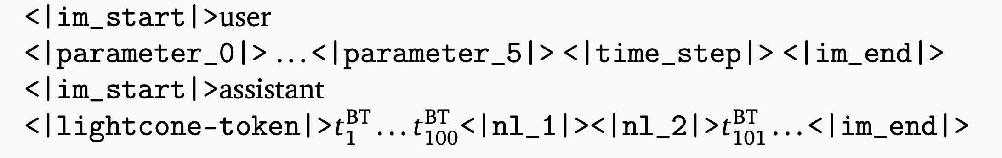
Generation
Train on sublightcones
12 spatial slices → 1,200 patches!
Data augmentations:
Translations, rotations, reflections
Input prompt:
8 affine input connectors
1 affine output connector
parameters
time step of the first slice

Slide 23

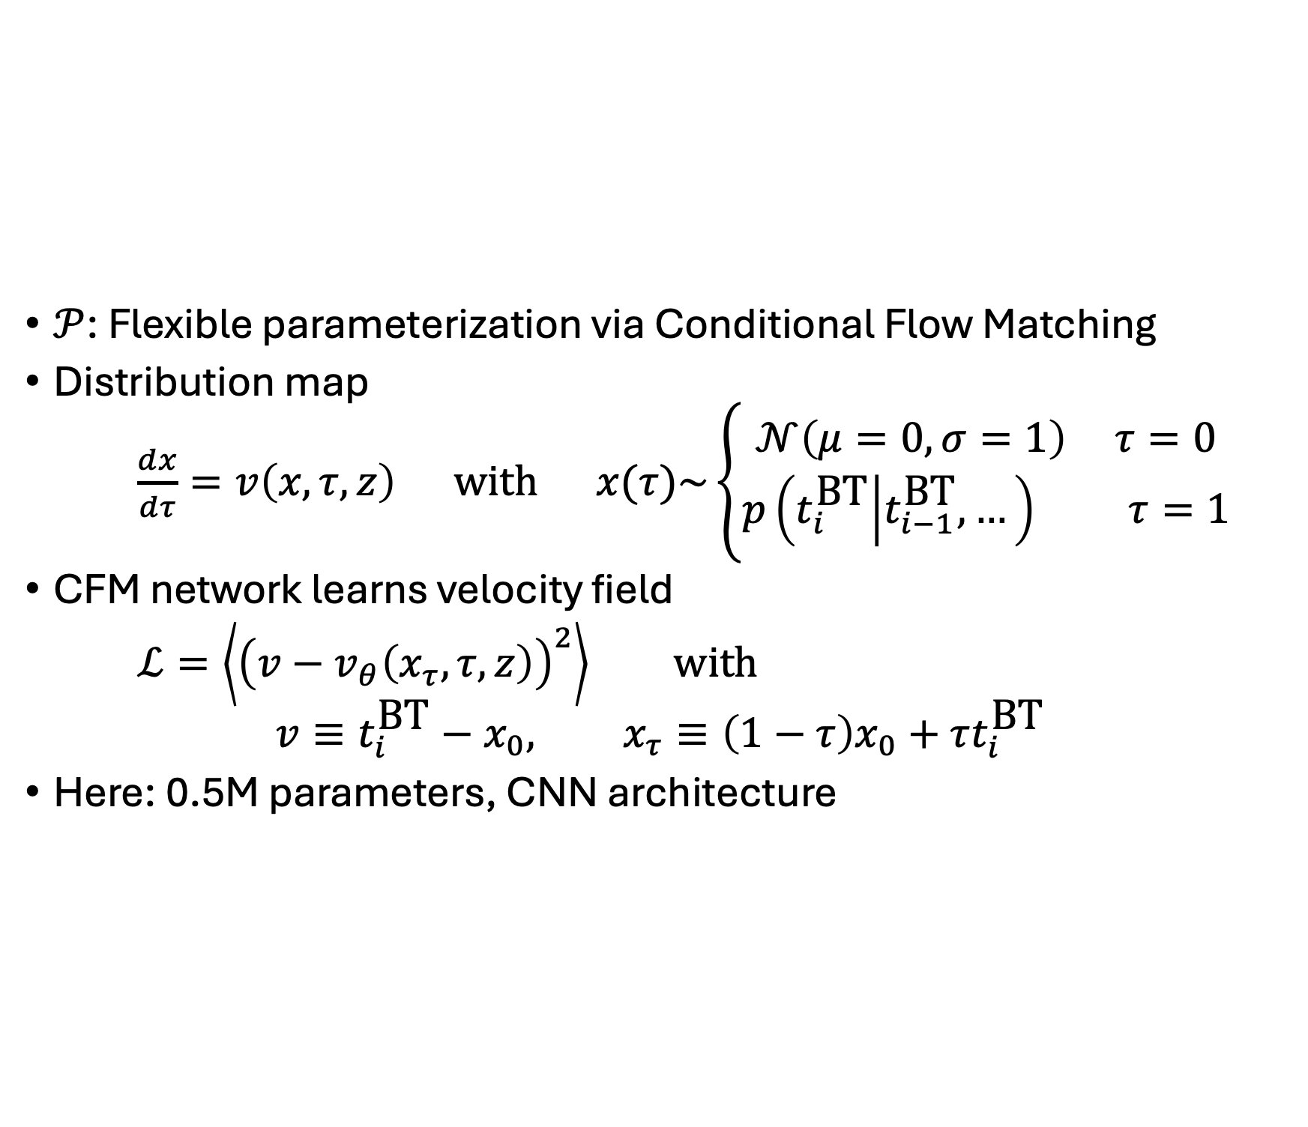
Conditional Flow Matching
$𝒫$: Flexible parameterization via Conditional Flow Matching
Distribution map
$\frac{dx}{dτ}=v\left(x,τ,z\right) \text{with} x(τ)\sim \left\{\begin{aligned}𝒩\left(μ=0,σ=1\right) τ=0 \\ p\left(t_{i}^{\text{BT}} | t_{i−1}^{\text{BT}},…\right) τ=1\end{aligned}\right.$
CFM network learns velocity field
$ℒ=\left\langle {\left(v−v_{θ}\left(x_{τ},τ,z\right)\right)}^{2}\right\rangle \text{with}$
$$v≡t_{i}^{\text{BT}}−x_{0}, x_{τ}≡\left(1−τ\right)x_{0}+τt_{i}^{\text{BT}}$$
Here: 0.5M parameters, CNN architecture
noise
ODE time
given by ${\text{C}}^{\text{T}}$
target PDF

Slide 24



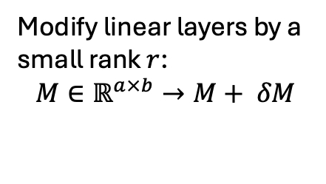
Generation
Complete backbone training:
Partial backbone training with LoRA:
Modify linear layers by a small rank $r$:
$$M∈ℝ^{a×b}→M+ δM$$
frozen
trained
$$δM=$$
$$ℝ^{a×r}$$
$$ℝ^{r×b}$$
Notes:
11:00

Slide 25
Generation Results

Slide 26
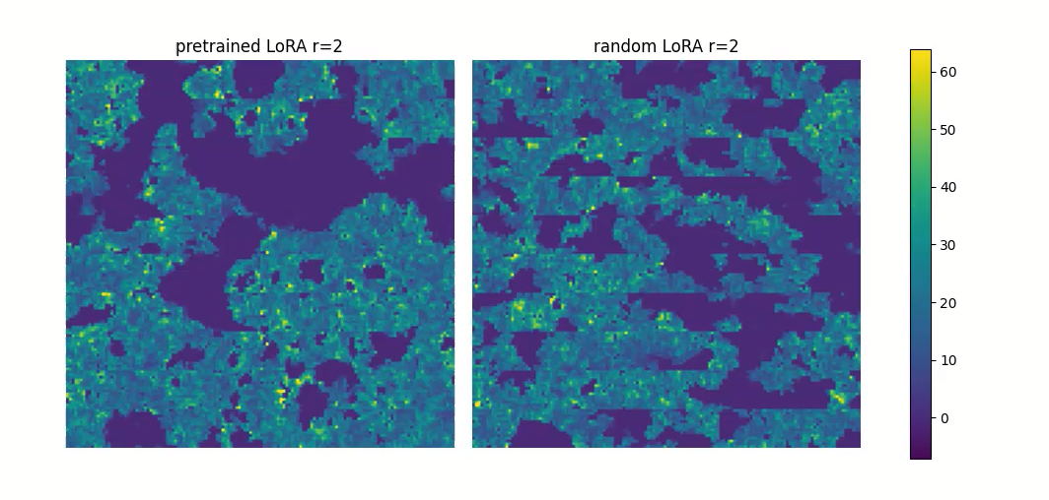
Generation with finetuned backbone
Notes:
12:00

