Slide 1
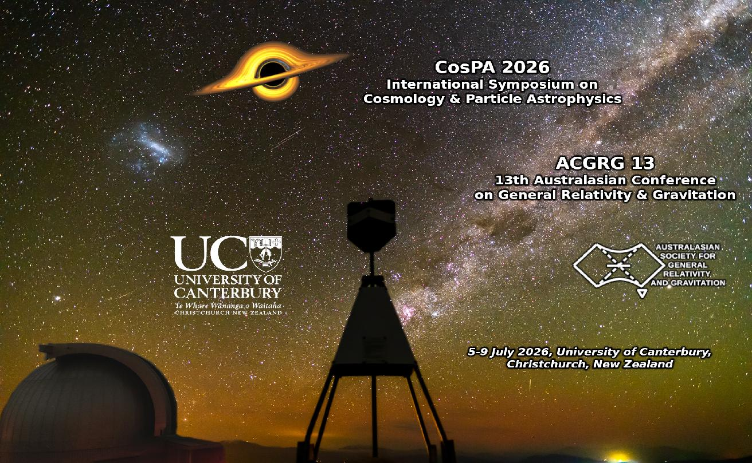
CosPA 2026 /ACGRG13
International Symposium on Cosmology & Astoparticle Physics
and
13th Australasian Conference on General Relativity & Gravitation

Slide 2

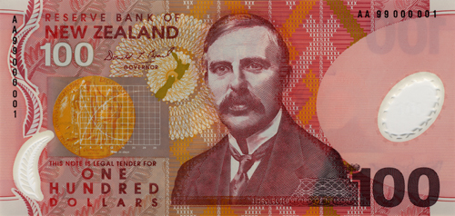
Kate Sheppard
Visit Kate Sheppard House
83 Clyde Road, Ilam
(next to Campus,
paid entry)
Ernest Rutherford
Visit Rutherford’s Den Arts Centre
2 Worchester Boulevard
(city centre, free entry)

Slide 3
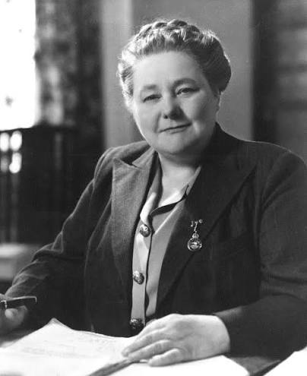
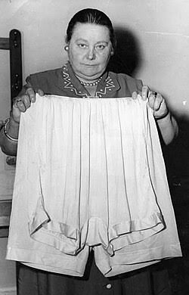
Mabel Howard
MP, 1943-1969
Cabinet Minister
1947-1949
DLW’s “auntie”

Slide 4

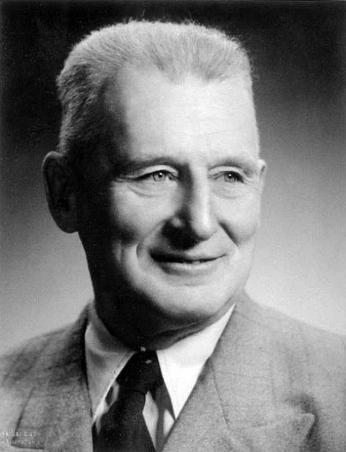
Rewi Alley
activist, writer, 1897-1987
Moved to Shanghai 1927, CCP member 60 years,
Gung ho,
Close friend of Chinese leaders
(Visit Memorial Garden, Springfield, 58km)

Slide 5
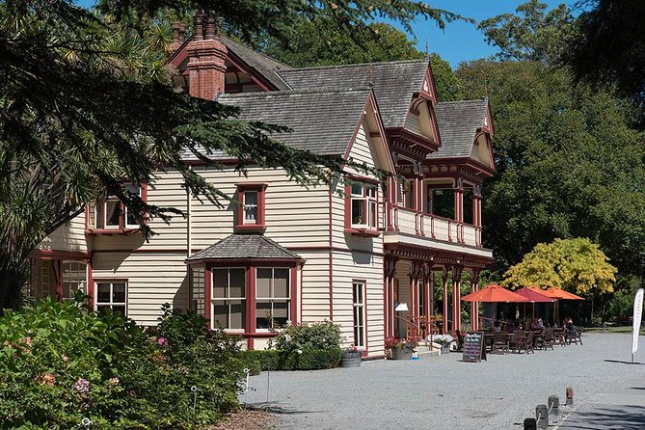
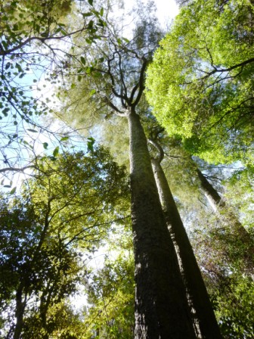
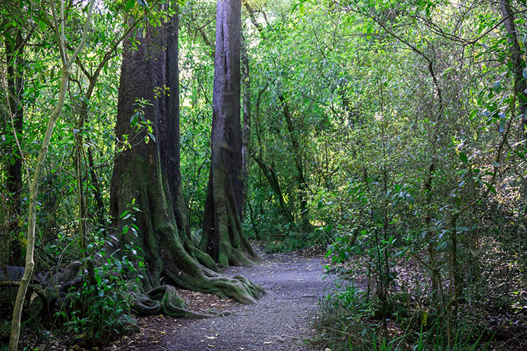
Riccarton House,
Deans Cottage, Riccarton Bush
Visit
Riccarton Bush open 6am-7pm,
(15 minute walk from campus, free entry)

Slide 6
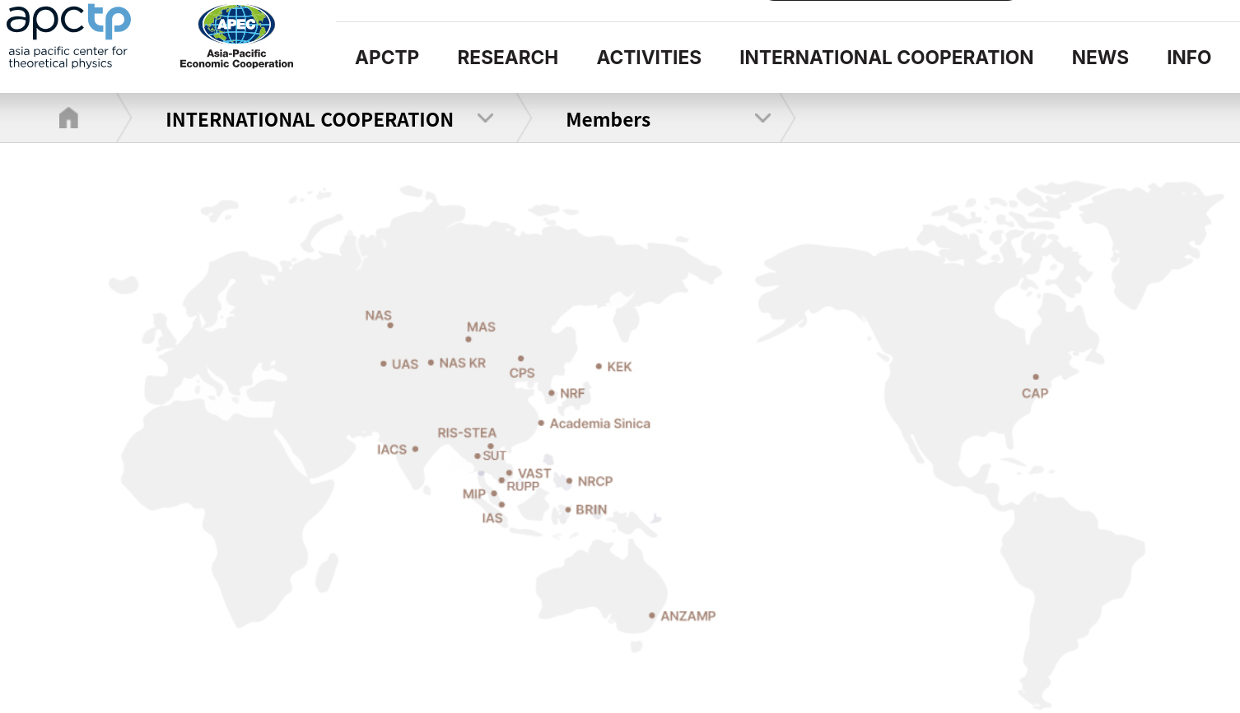
Why do Kiwis have a “chip on the shoulder”?

Slide 7
CosPA 2026 /ACGRG13 … further info
For CosPA2026/ACGRG13 participants without eduroam wifi access – use this guest account (reversing 2 key letters in the account name! Second password character is zero.)
Guest Account: CosAP26
Guest Password: R0yKerrsPl&ce
EMERGENCY EVACUATION PROCEDURES
… please listen …

