Slide 1


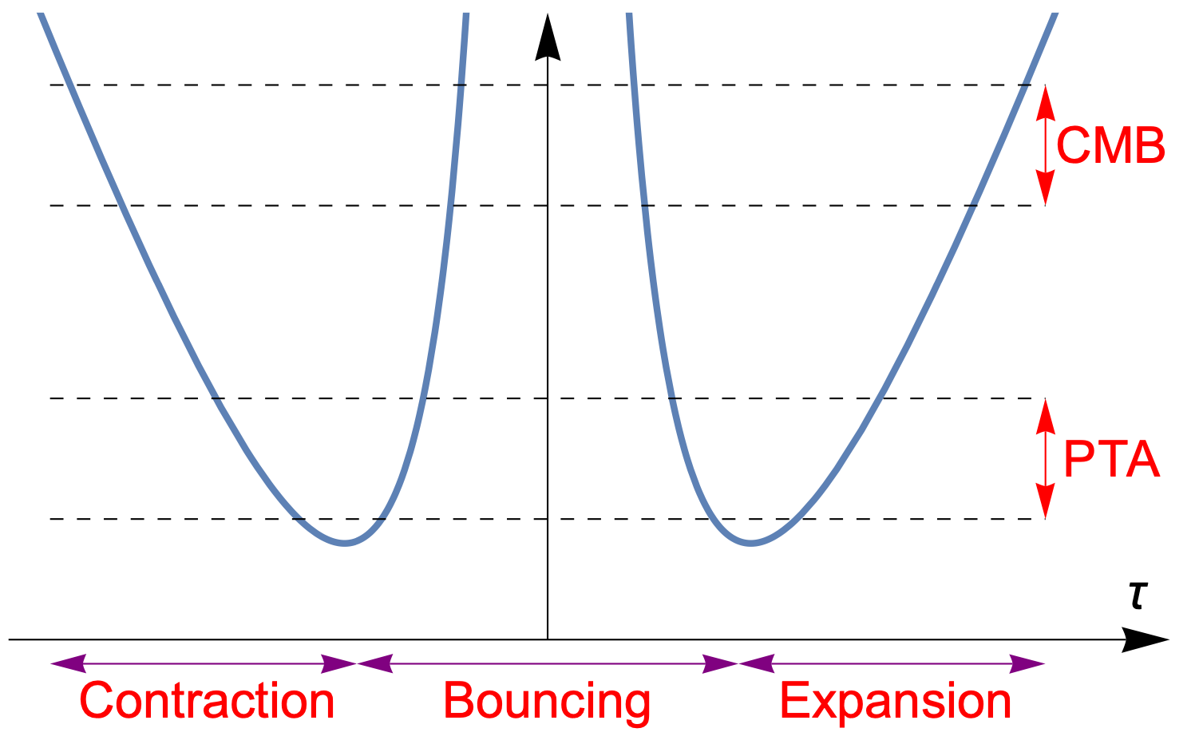
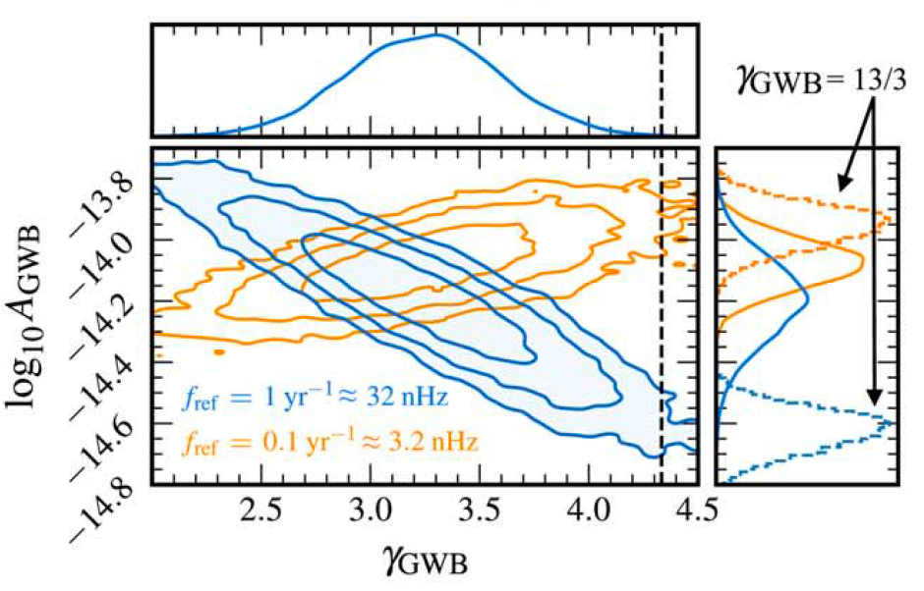
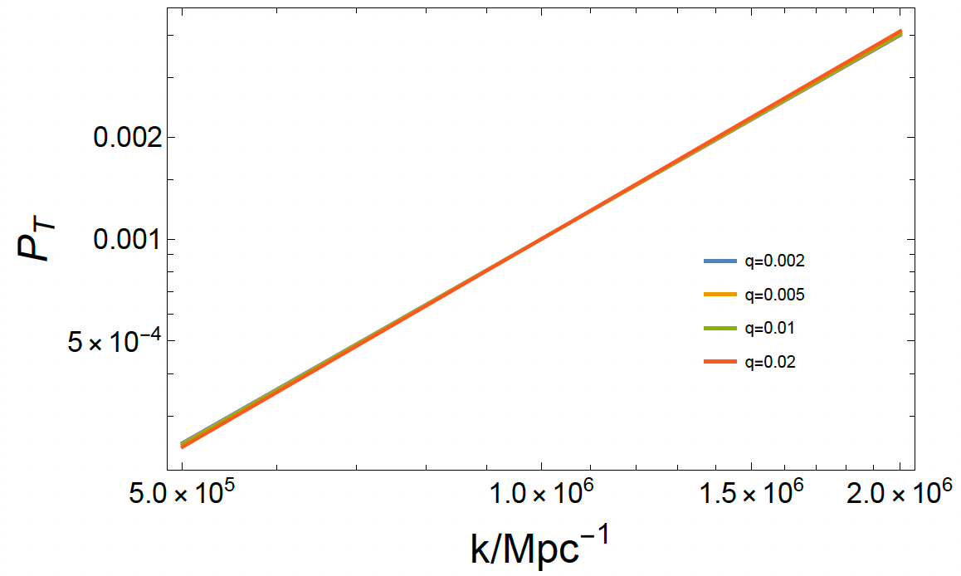
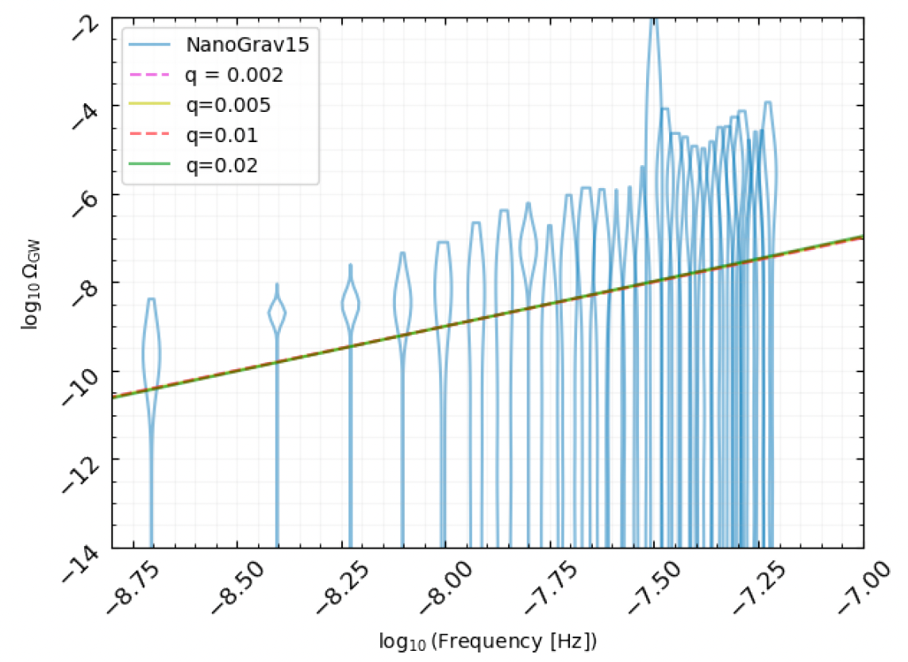
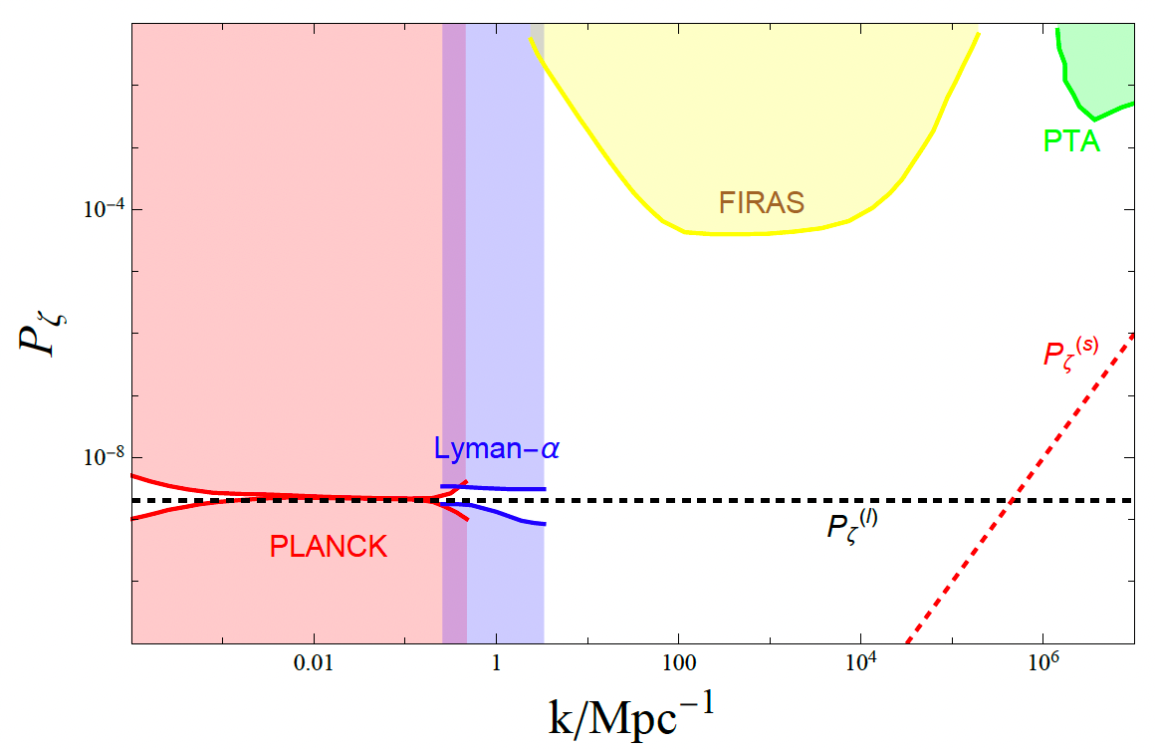
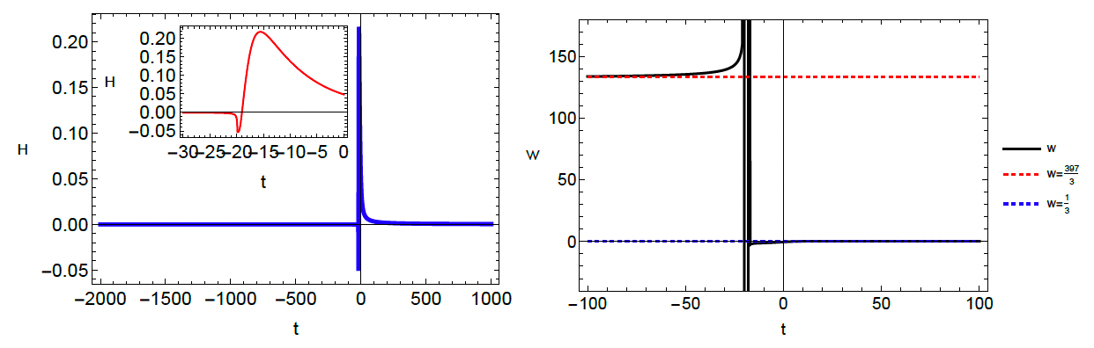











CosPA 2026 / ACGRG 13
Interpreting Pulsar Timing Array data of Gravitational waves with bouncing cosmology
Taotao Qiu*, Mian Zhu** (Phys. Rev. D 111, 043508(2025))
Question: What would be the source of the gravitational waves observed by PTA data?
Content: We construct a bounce cosmological model which can interpret the PTA results.
Results: Primordial GW from bounce model can be candidate of nHz SGWB sources.
I. Introduction
The signal of stochastic gravitational wave background reported by PTA groups in 2023 strongly supports a blue primordial tensor spectrum with $n_{T}=1.8±0.3$ [1].
Blue spectrum is not usual in standard inflation scenario, but can be generated naturally in a bounce model with slow-contracting phase [2].
III. Gravitational waves generation
Equation of motion:
where
Tensor power spectrum:
spectral index:
$$ν_{k}^{′′}+\left(k^{2}−\frac{a^{′′}}{a}\right)ν_{k}=0$$
$$ν_{k}≡aγ_{k}/(2\sqrt{M_{p}})$$
$$P_{T}≡2×\frac{k^{3}}{2π^{2}M_{p}^{3}}{\left|γ_{k}\right|}^{2}$$
$$\sim {\left(\frac{H_{+}}{M_{p}}\right)}^{2}{\left(\frac{q}{1−q}\right)}^{\frac{2q}{1−q}}{\left(\frac{k}{a_{B}H_{+}}\right)}^{\frac{2}{1−q}}$$
BOUNCE
$$q<0.0476$$
$$Ω_{GW}(k)≡\frac{1}{3H^{2}}\frac{dρ_{GW}}{d\ln{k}}≃{10}^{−6}P_{T}(k)$$
II. The bounce scenario
The scale factor of the bounce universe is:
where in the contracting phase, the EoS $w=−1+2/(3q)$, in expanding phase, $w≃1/3$. This scenario can be realized in the model:
$$a\left(τ\right)\sim \left\{\begin{aligned}{\left(τ_{−}−τ\right)}^{\frac{q}{1−q}}, τ<τ_{−} \\ e^{α^{2}τ^{2}/2}, τ_{−}<τ<τ_{+} \\ \left[1+ℋ_{+}(τ−τ_{+})\right], τ>τ_{+}\end{aligned}\right.$$
IV. Curvature perturbations
Large scales:
background field $φ$;
Small scales:
spectator field $σ$with
Lagrangian:
$$L\left(φ,X\right)=\left[1−g\left(φ\right)\right]M_{p}^{2}X+β_{2}X^{2}−M_{p}^{4}V(φ)$$
$$L_{σ}=−M_{p}^{2}f^{2}Υ\left(φ\right){\left(∂σ\right)}^{2}$$
References:
*:Huazhong University of Science and Technology (qiutt@hust.edu.cn), **: Jagiellonian University.
[1] A. Afzal et al., Astrophys. J. Lett. 951, L11 (2023); G. Agazie et al., Astrophys. J. Lett. 951, L8 (2023); J. Antoniadis et al., Astron. Astrophys. 678, A50 (2023); D. J. Reardon et al., Astrophys. J. Lett. 951, L6 (2023); H. Xu et al., Res. Astron. Astrophys. 23, 075024 (2023).
[2] TQ, Xian Gao and Emmanuel N. Saridakis, Phys. Rev. D 88 (2013) 4, 043525.

