Slide 1
Development of A Novel Compton Camera for MeV Gamma Ray Measurement
CosPA 2026 International Symposium on Cosmology & Particle Astrophysics
Mengjiao Xiao
Shanghai Jiao Tong University
2026-07-08
CosPA 2026 & ACGRG 13, 5-9 July, 2026, University of Canterbury, Christchurch, NZD

Slide 2

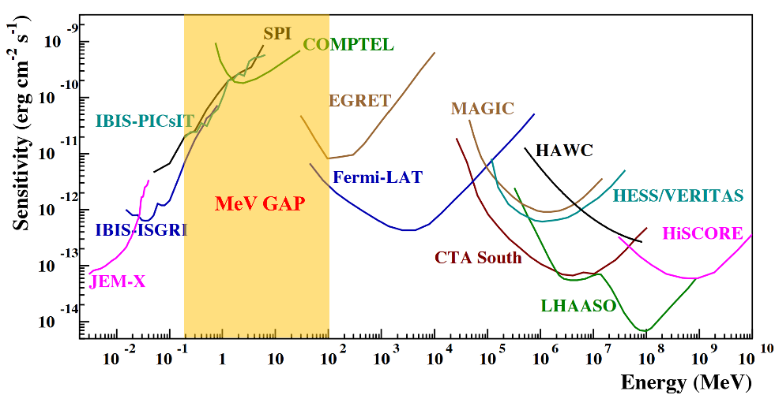
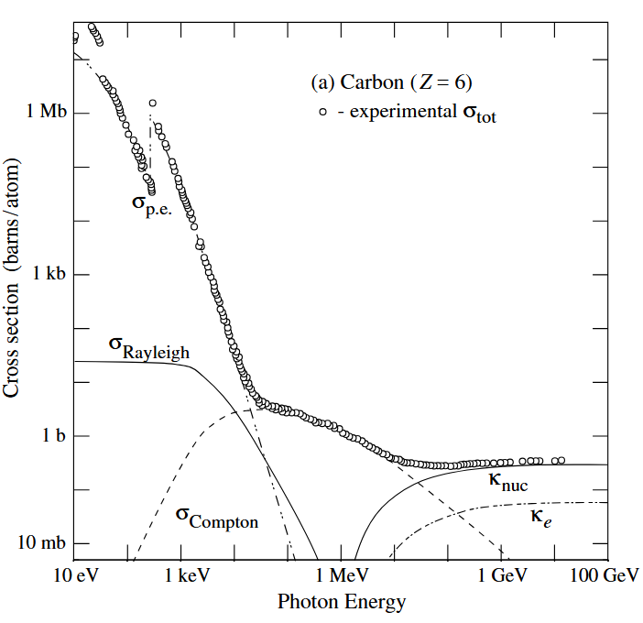
I. MeV Gamma & Detection
  MeV gamma: unexplored energy region in gamma astronomy → “MeV gap”.
  暗物质湮灭
CosPA 2026 & ACGRG 13, 5-9 July, 2026, University of Canterbury, Christchurch, NZD

Slide 3
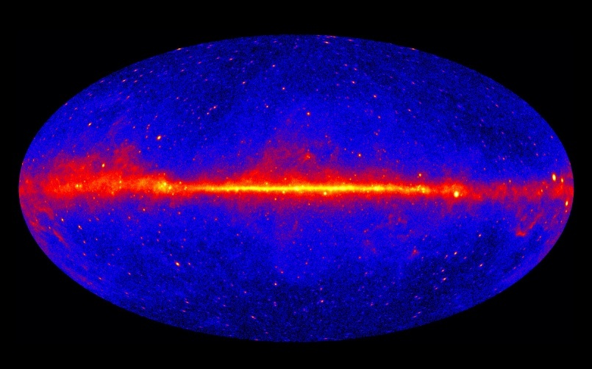
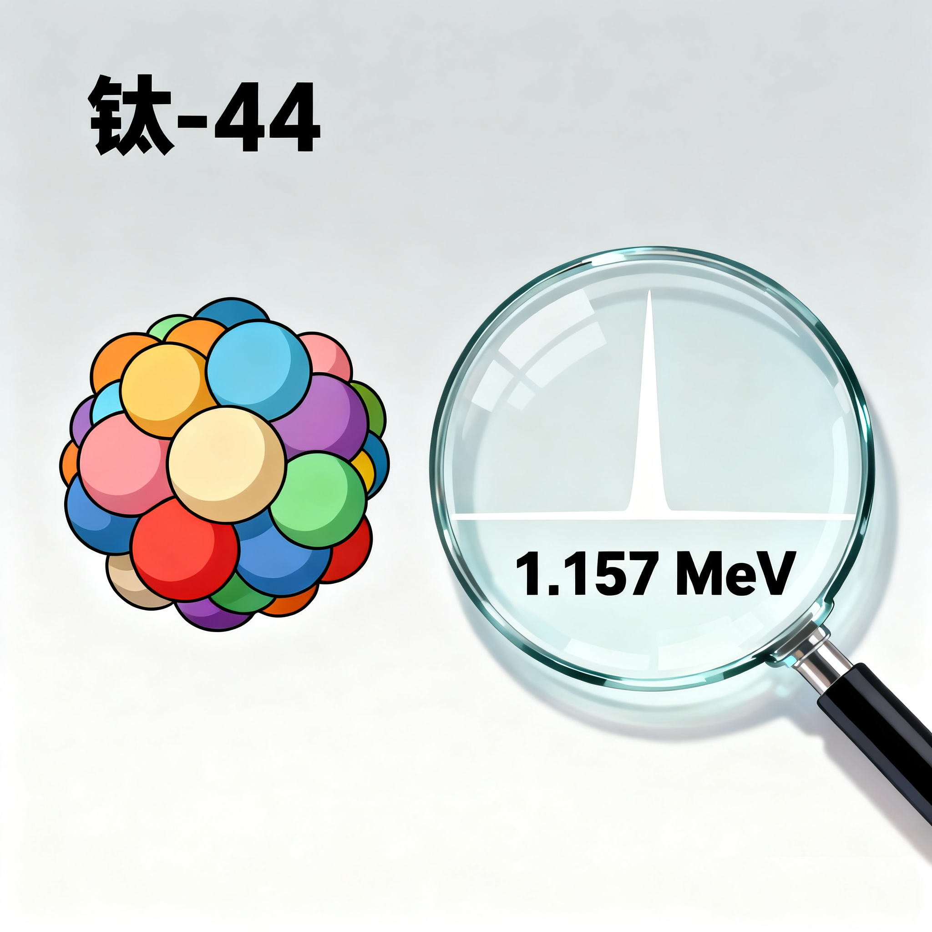
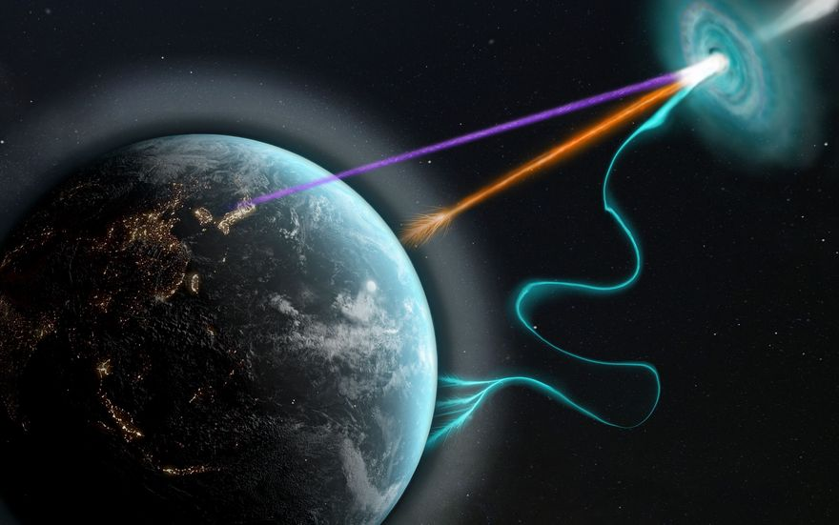
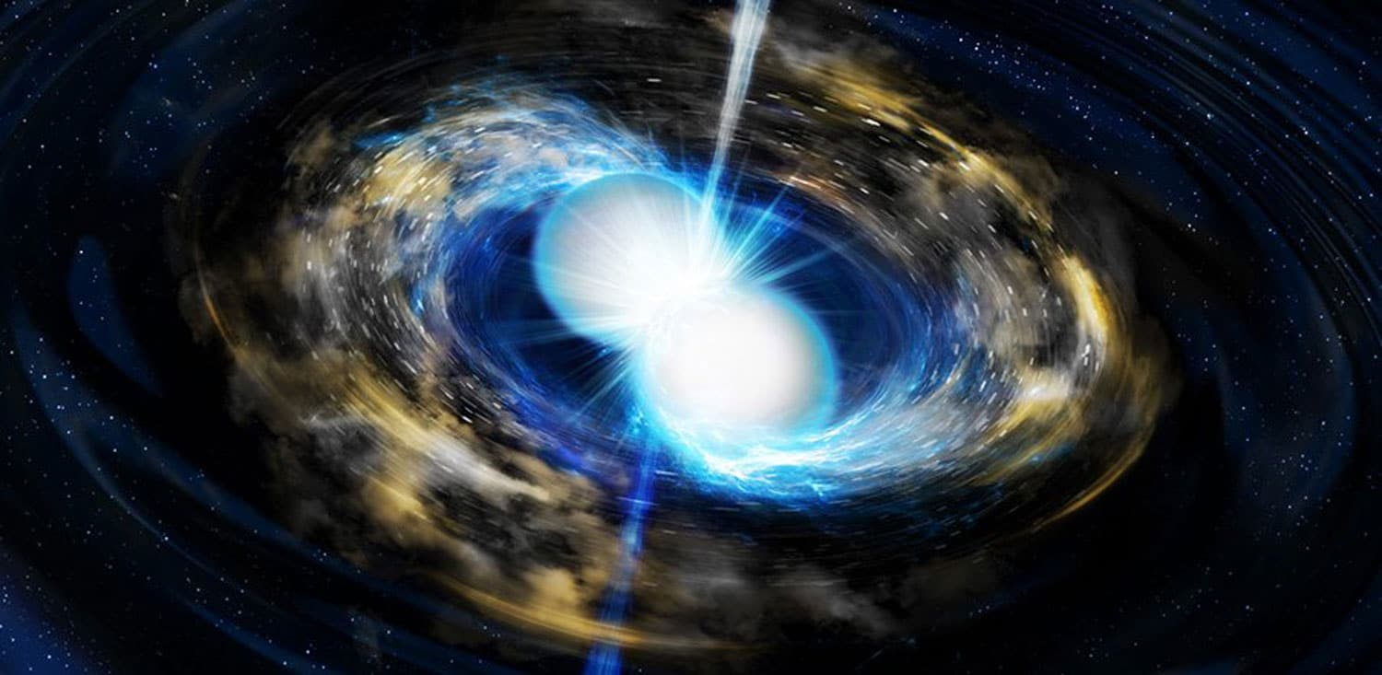
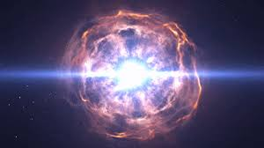
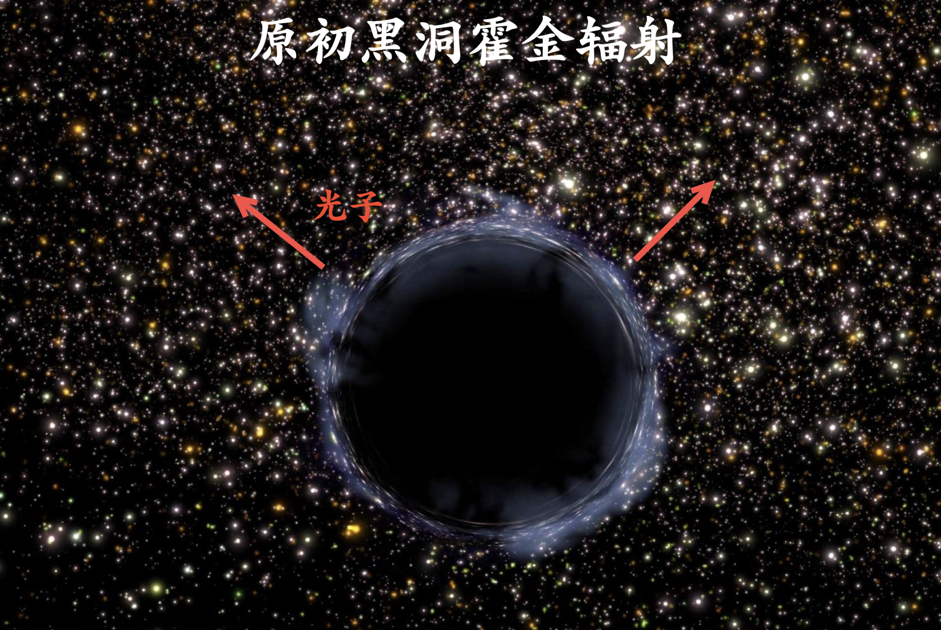
I. MeV Gamma & Detection
  MeV gamma: unexplored energy region in gamma astronomy → “MeV gap”.
  暗物质湮灭
  Precise measurement: probe primordial black hole, nucleosynthesis & chemical evolution of the Galaxy, dark matter annihilation, etc.
CosPA 2026 & ACGRG 13, 5-9 July, 2026, University of Canterbury, Christchurch, NZD

Slide 4



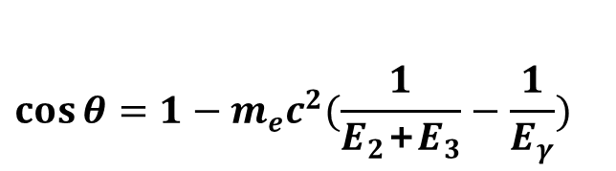

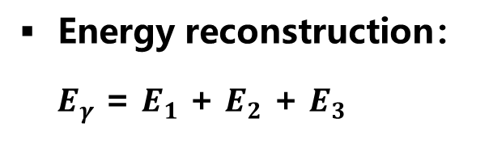

I. MeV Gamma & Detection
Nex-generation MeV gamma-ray measurement: multiple-layer Compton imaging.
$$γ$$
  Energy reconstruction：
  $E_{γ}$ = $E_{1}$ + $E_{2}$ + $E_{3}$
Veto
$$θ$$
1st scattering ($r_{1}$, $E_{1}$)
  Angular reconstruction:
Tracking
2nd scattering ($r_{2}$, $E_{2}$)
  $$\cos{θ}=1−m_{e}c^{2}(\frac{1}{E_{2}\text{+}E_{3}}−\frac{1}{E_{γ}})$$
Absorption ($r_{3}$, $E_{3}$)
Calorimeter
Key: on-orbit tracking-calorimeter, precisely measure E & track/positions.
CosPA 2026 & ACGRG 13, 5-9 July, 2026, University of Canterbury, Christchurch, NZD

Slide 5
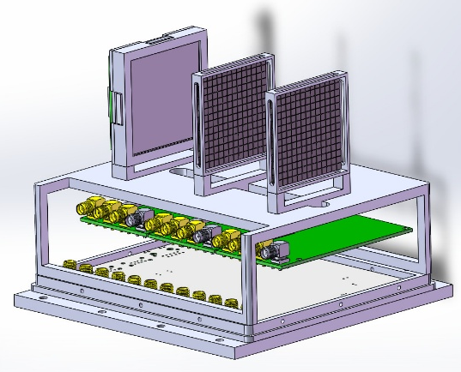
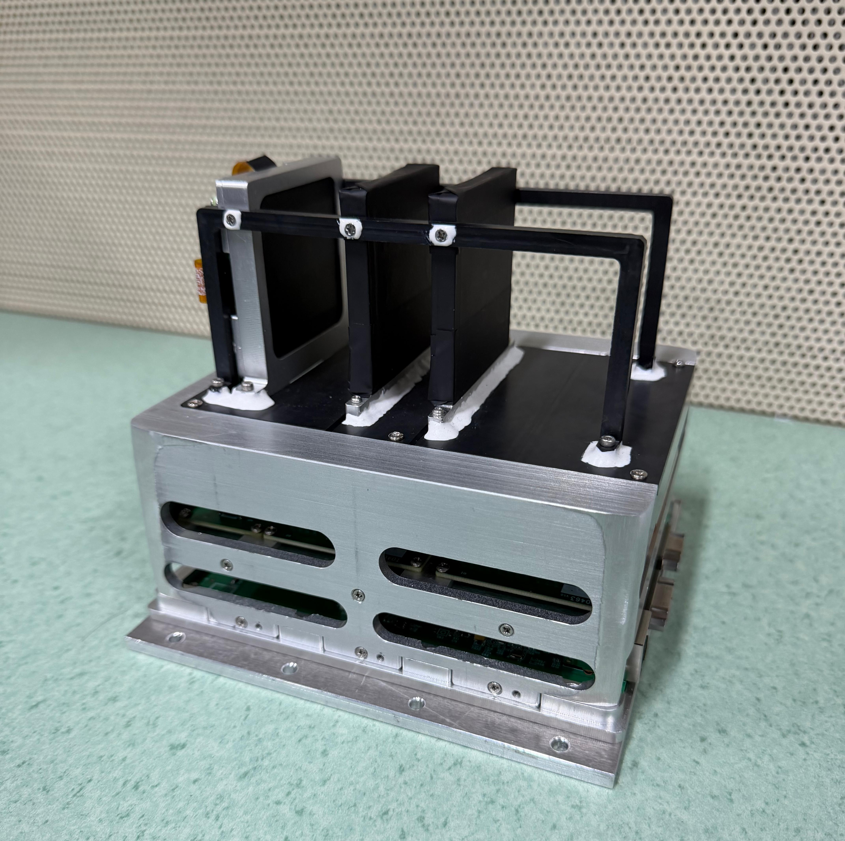
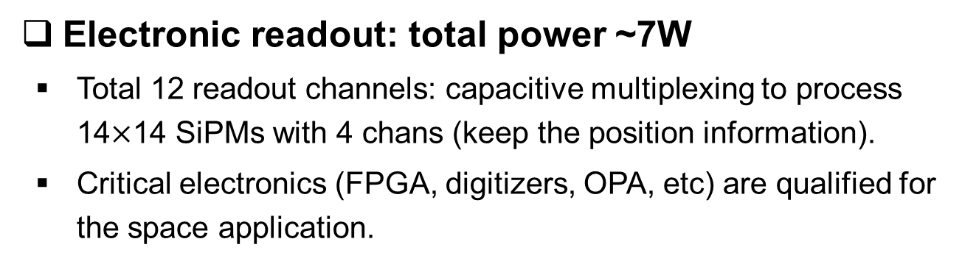
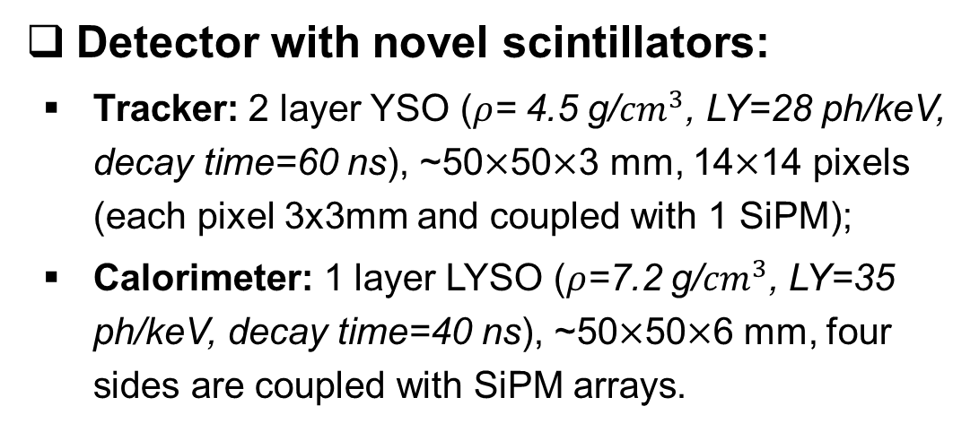
II. Novel Compton camera
  Detector with novel scintillators:
    Tracker: 2 layer YSO ($ρ$= 4.5 g/${cm}^{3}$, LY=28 ph/keV, decay time=60 ns), ~50$×$50$×$3 mm, 14$×$14 pixels (each pixel 3x3mm and coupled with 1 SiPM);
    Calorimeter: 1 layer LYSO ($ρ$=7.2 g/${cm}^{3}$, LY=35 ph/keV, decay time=40 ns), ~50$×$50$×$6 mm, four sides are coupled with SiPM arrays.
  Electronic readout: total power ~7W
    Total 12 readout channels: capacitive multiplexing to process 14$×$14 SiPMs with 4 chans (keep the position information).
    Critical electronics (FPGA, digitizers, OPA, etc) are qualified for the space application.
Pathfinder of SJTU micro-satellite serial projects！
CosPA 2026 & ACGRG 13, 5-9 July, 2026, University of Canterbury, Christchurch, NZD

Slide 6
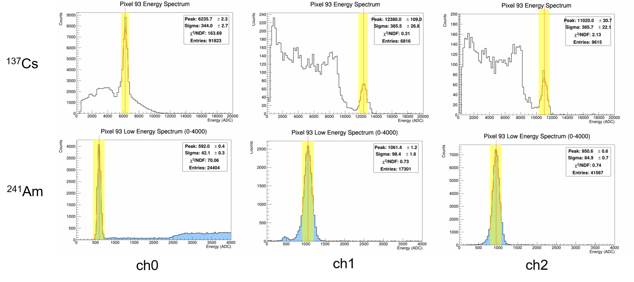
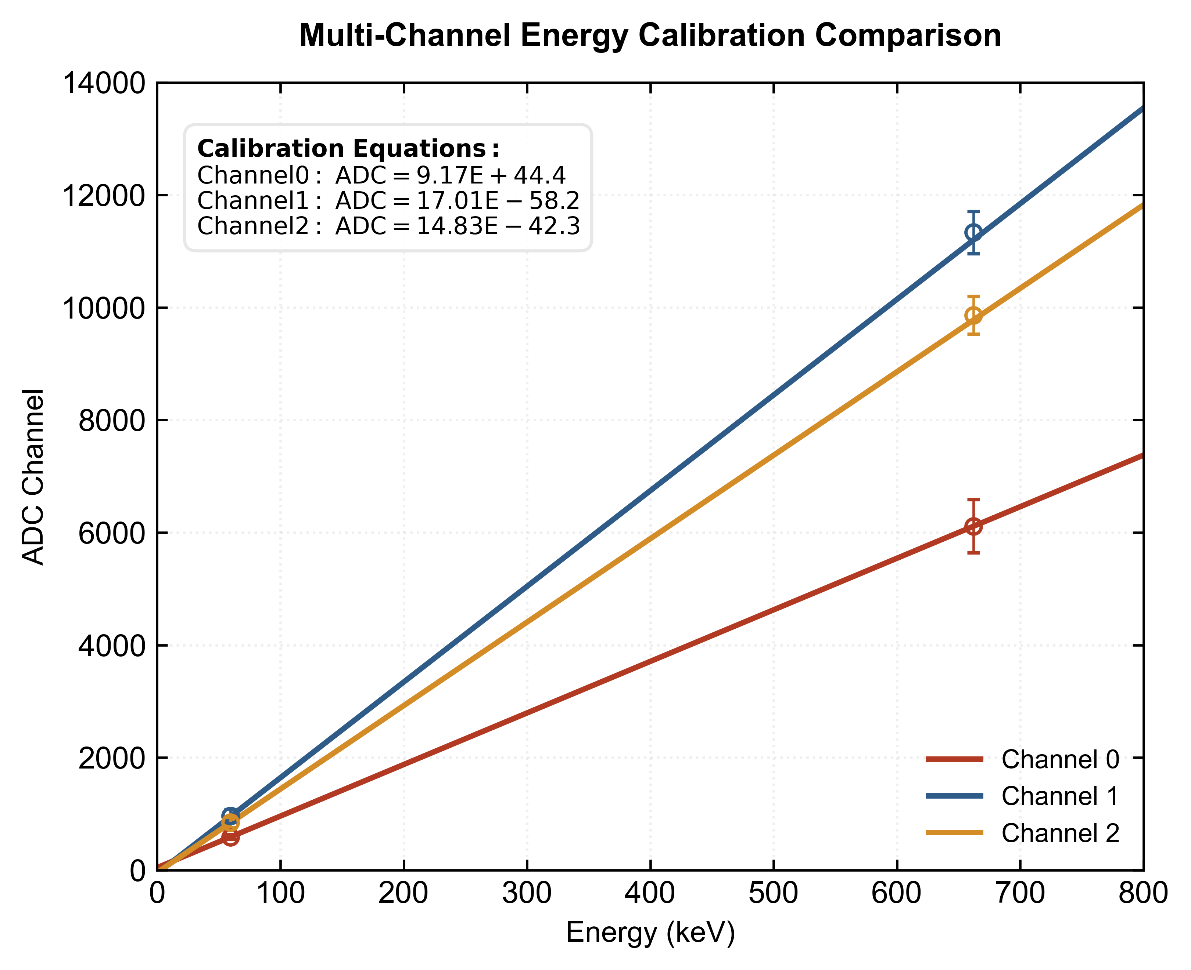
II. Novel Compton camera
  Calibration: energy response
  Energy calibration using radioactive sources of ²⁴¹Am (59.5 keV) and ¹³⁷Cs (662 keV).
  Energy resolution <5%, nonlinearity <1% @662 keV.
CosPA 2026 & ACGRG 13, 5-9 July, 2026, University of Canterbury, Christchurch, NZD

Slide 7
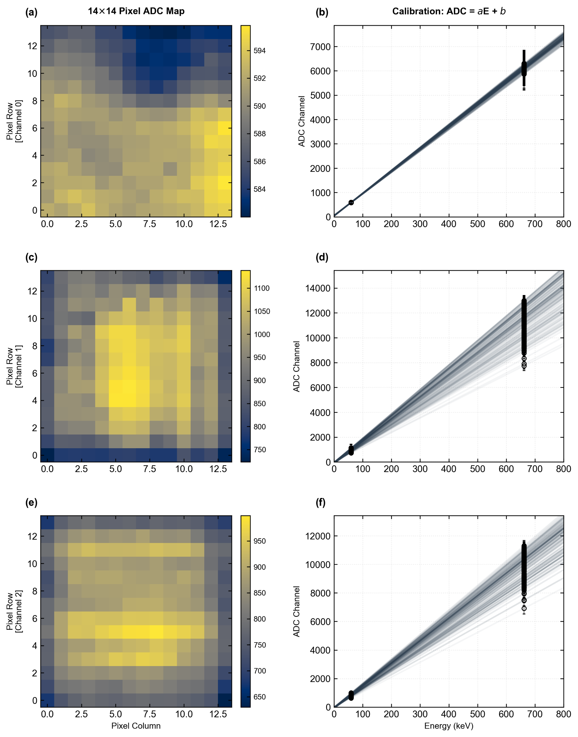
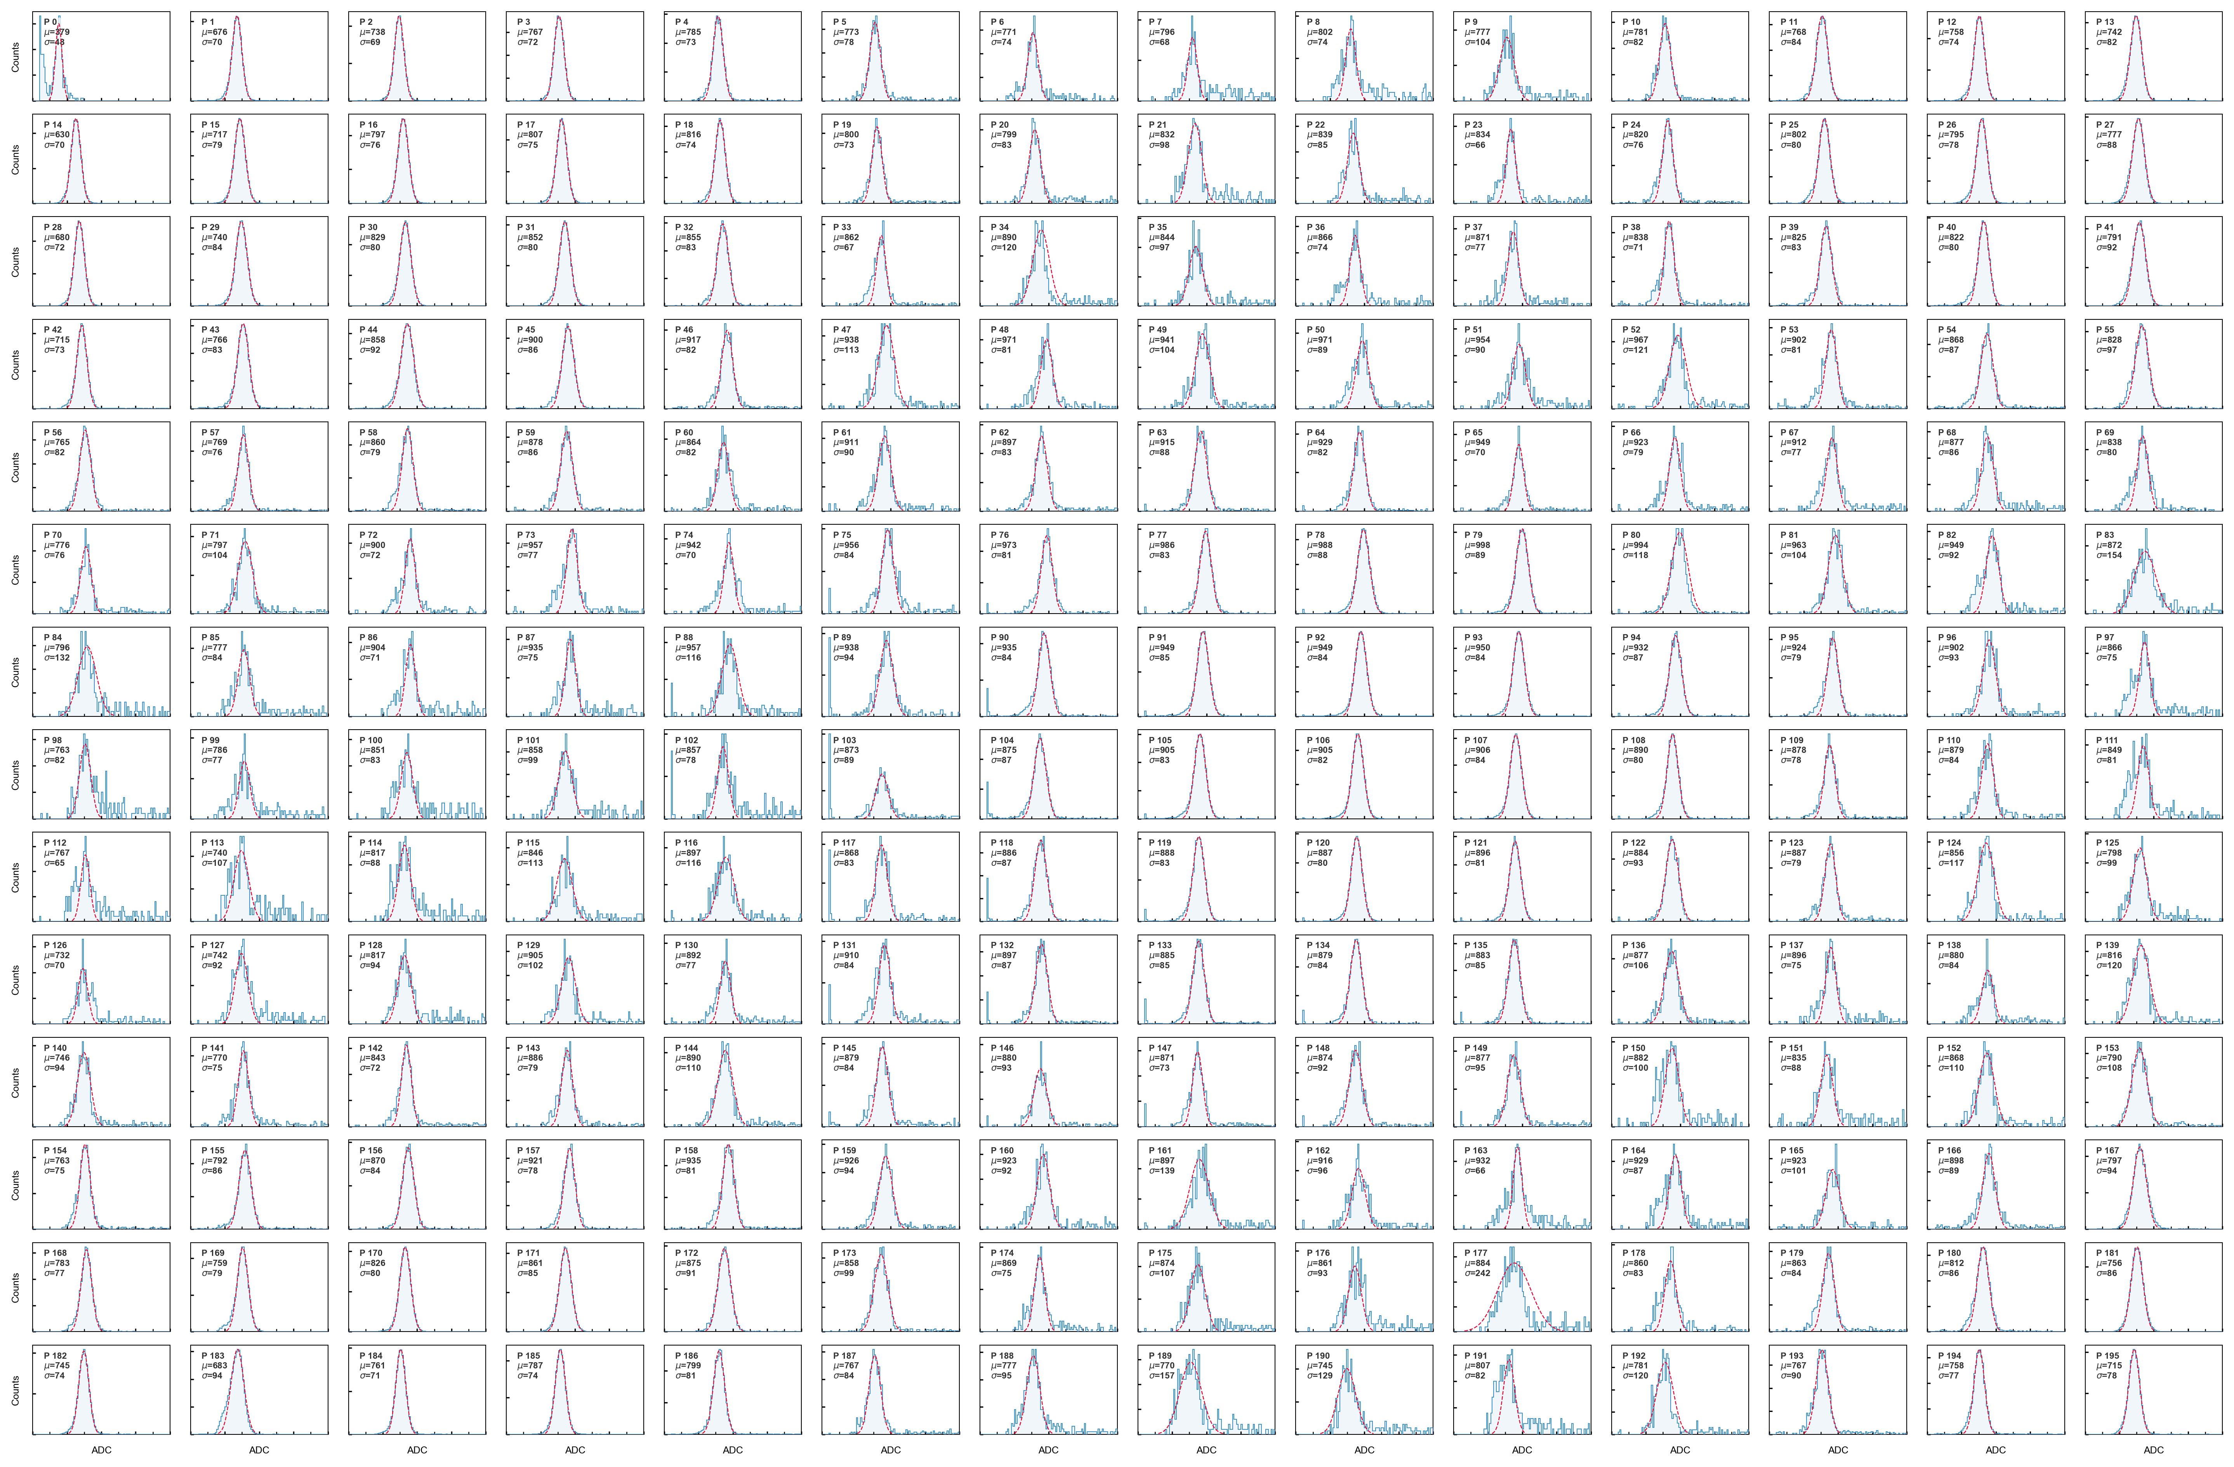
II. Novel Compton camera
  Calibration: nonuniformity correction
  Studied the energy response for individual pixel using radioactive isotopes and mapping the nonuniformity.
CosPA 2026 & ACGRG 13, 5-9 July, 2026, University of Canterbury, Christchurch, NZD

Slide 8
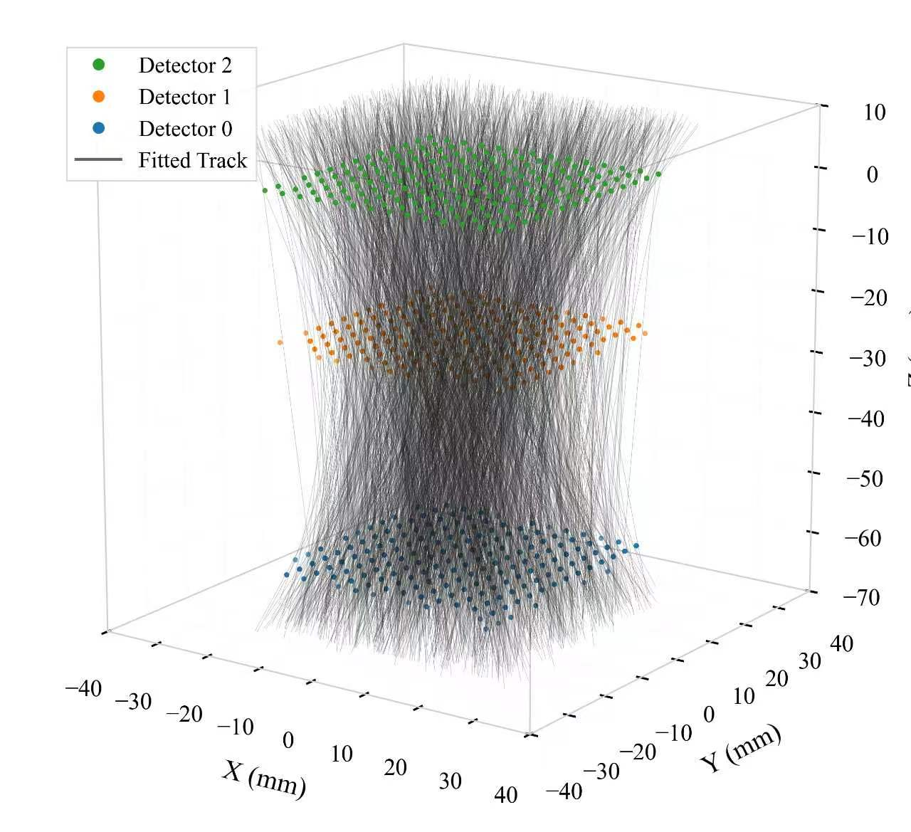
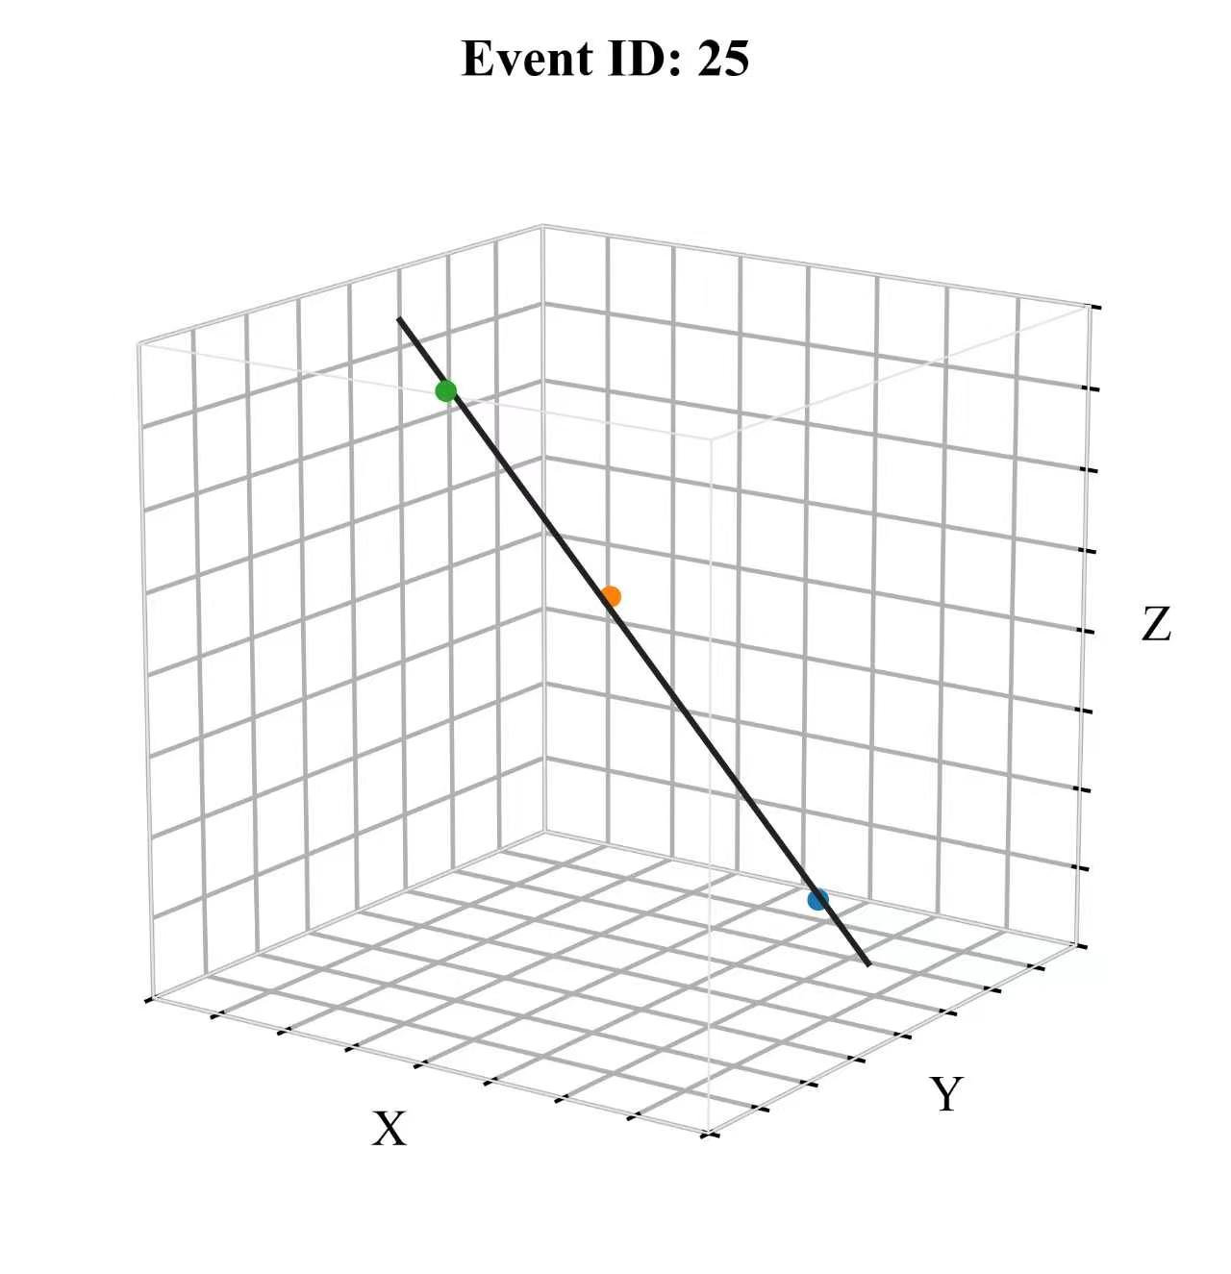
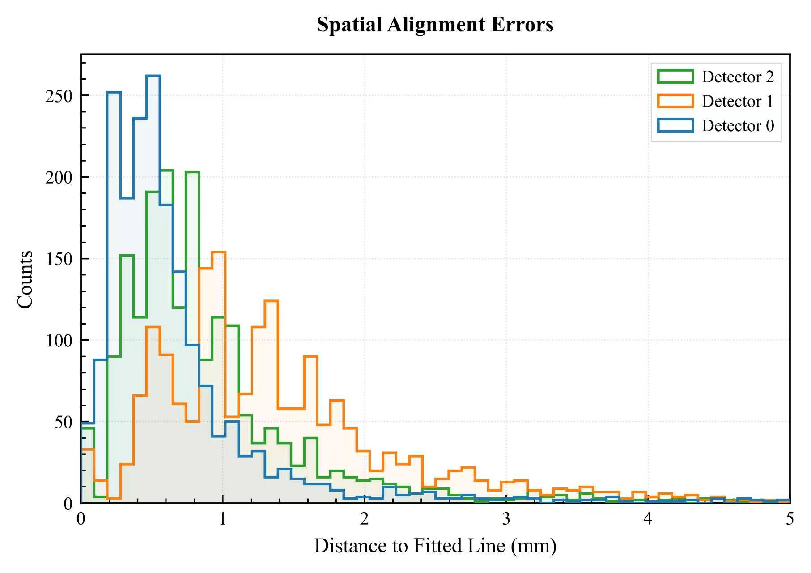
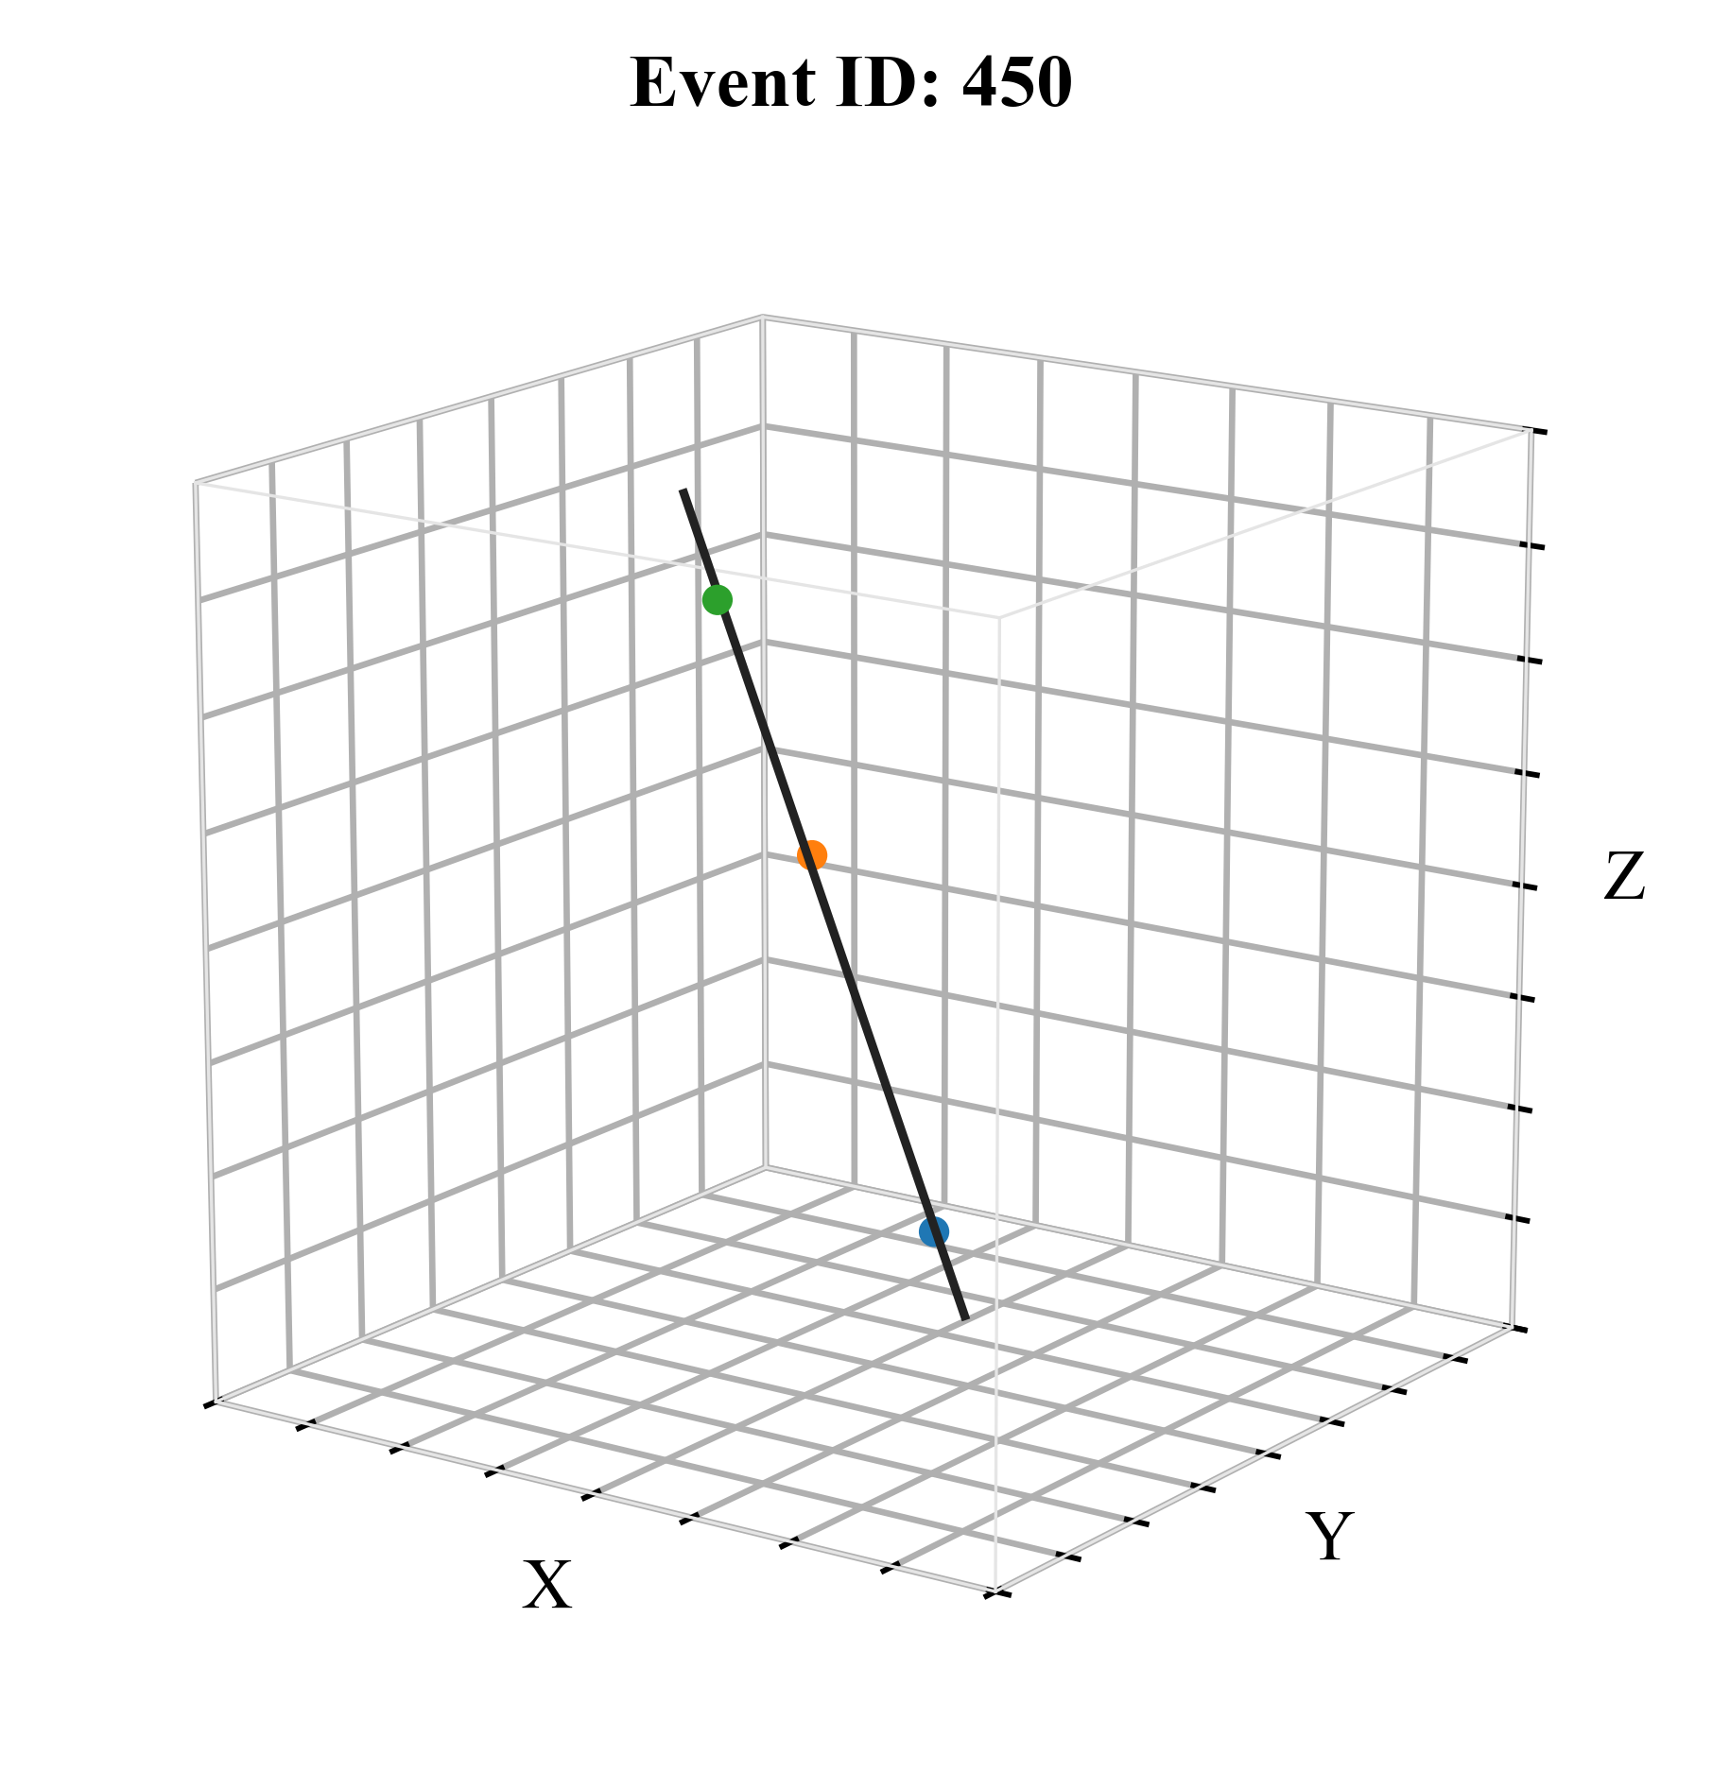
II. Novel Compton camera
  Benchmark test (muons): validation of track reconstruction.
  Hit’s energy and position are coupled with each other (capacitive multiplexing readouts).
  Use muon to validate the track reconstruction: fit muon trajectories across the detectors and evaluate the spatial alignment errors (assumed the straight muon tracks).
CosPA 2026 & ACGRG 13, 5-9 July, 2026, University of Canterbury, Christchurch, NZD

Slide 9
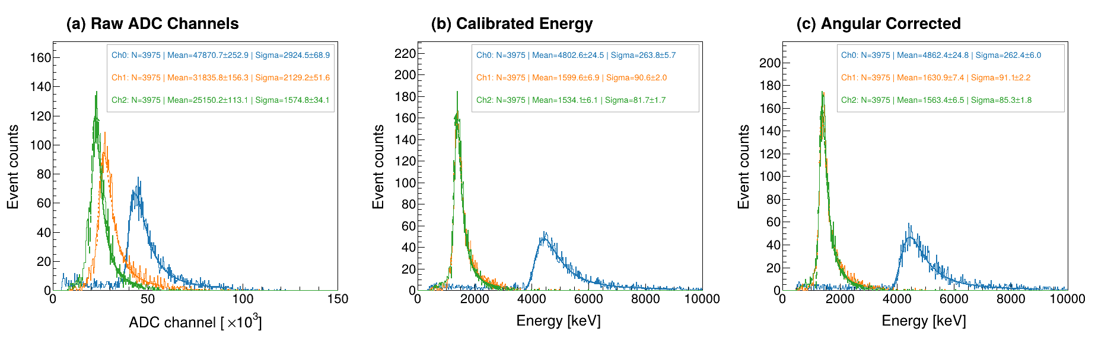
II. Novel Compton camera
  Benchmark test (muons): MIP energy spectrum
  Energy calibration and correction are applied to cosmic muon events across the three channels based on the reconstructed position and incident angle.
  The energy resolution is significantly improved as expected.
Res_ch0=6.1%
Res_ch1=6.7%
Res_ch2=6.3%
Res_ch0=5.5%
Res_ch1=5.7%
Res_ch2=5.3%
Res_ch0=5.4%
Res_ch1=5.6%
Res_ch2=5.4%
CosPA 2026 & ACGRG 13, 5-9 July, 2026, University of Canterbury, Christchurch, NZD

Slide 10
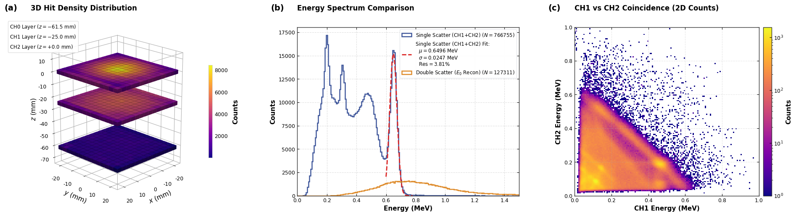
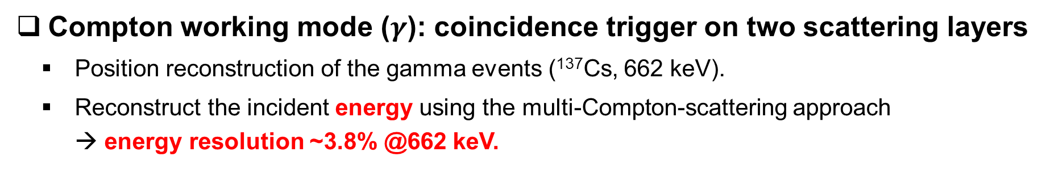
II. Novel Compton camera
  Compton working mode ($γ$): coincidence trigger on two scattering layers
  Position reconstruction of the gamma events (¹³⁷Cs, 662 keV).
  Reconstruct the incident energy using the multi-Compton-scattering approach → energy resolution ~3.8% @662 keV.
CosPA 2026 & ACGRG 13, 5-9 July, 2026, University of Canterbury, Christchurch, NZD

Slide 11
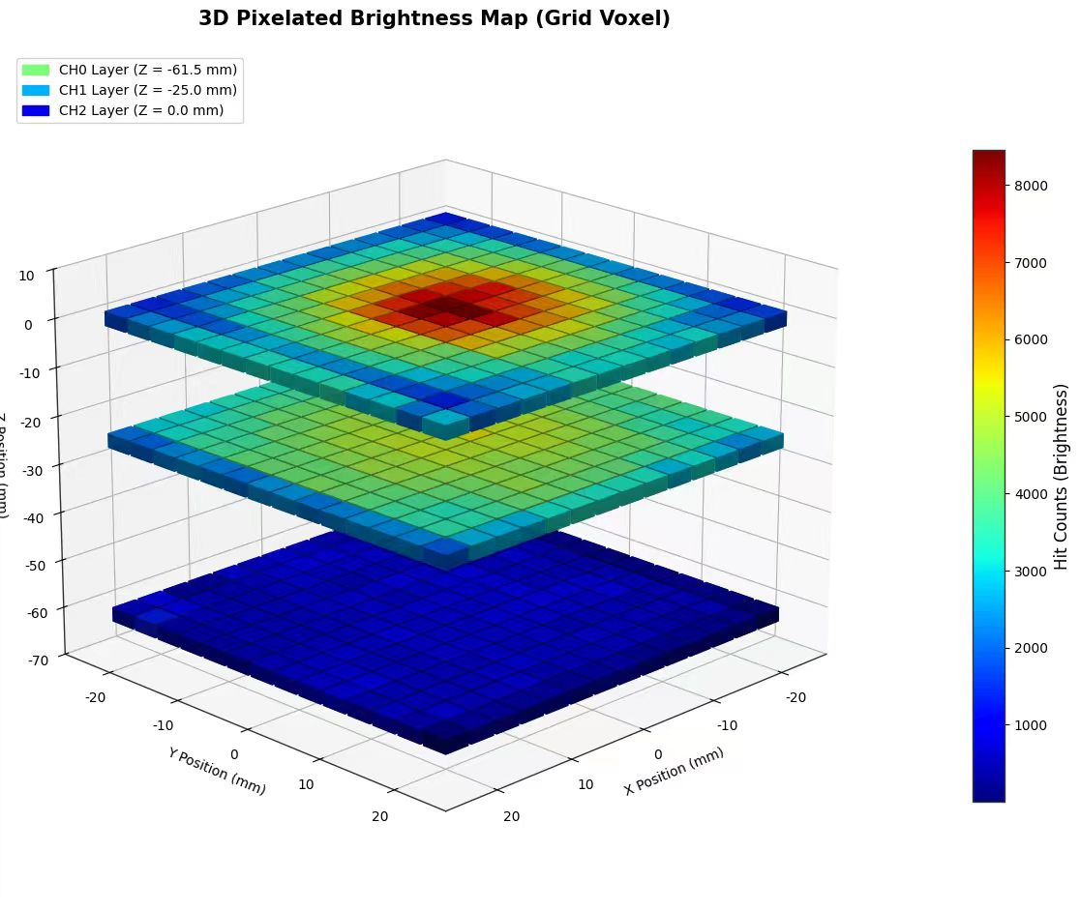
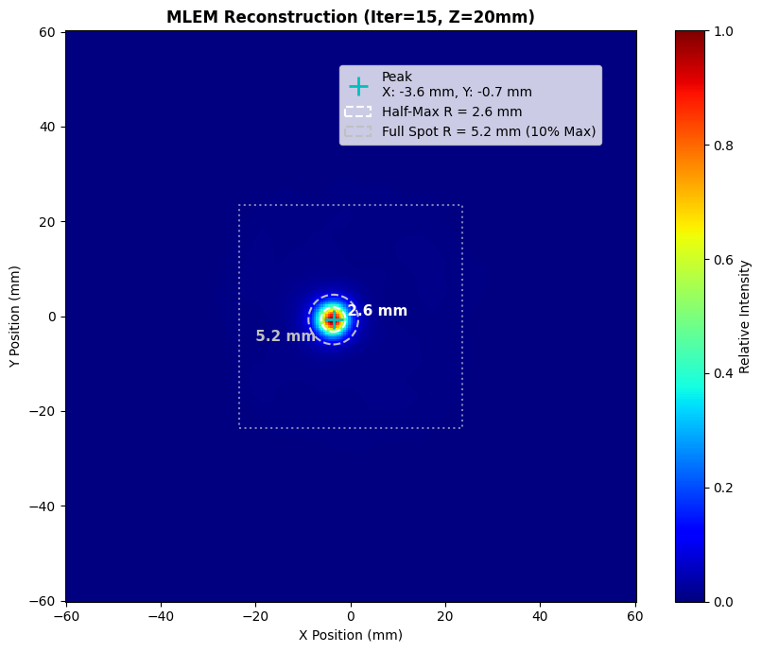
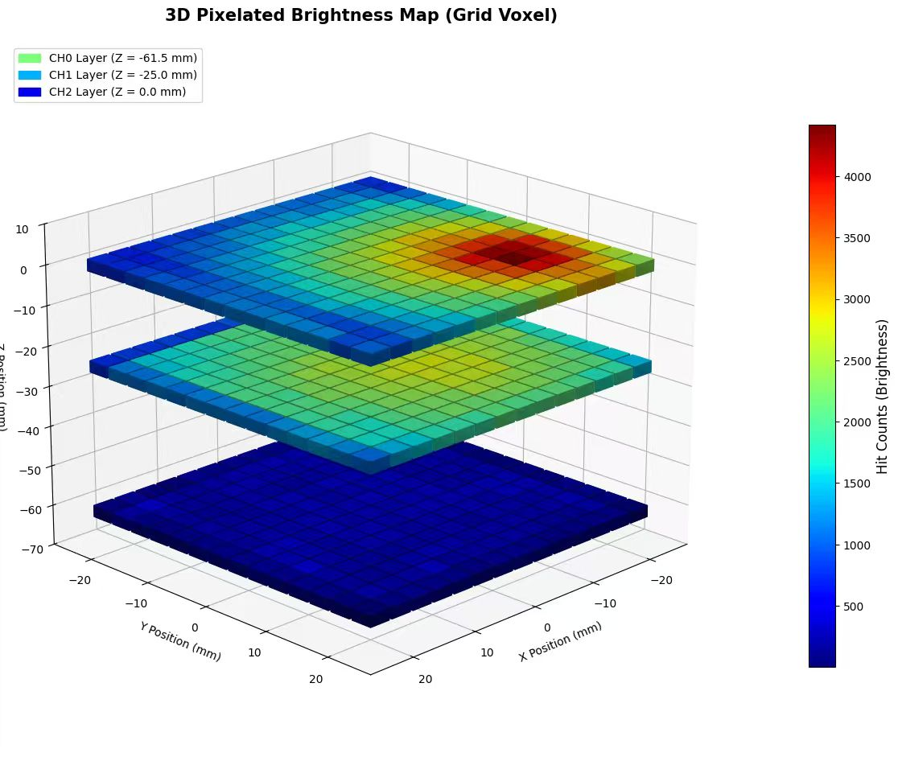
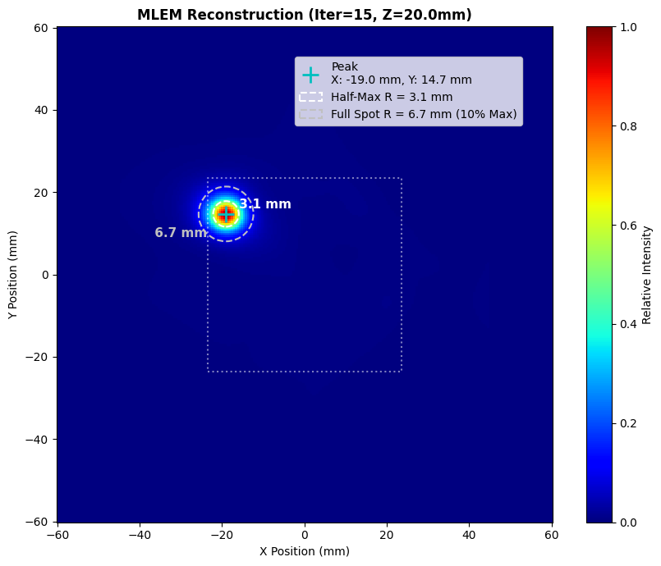
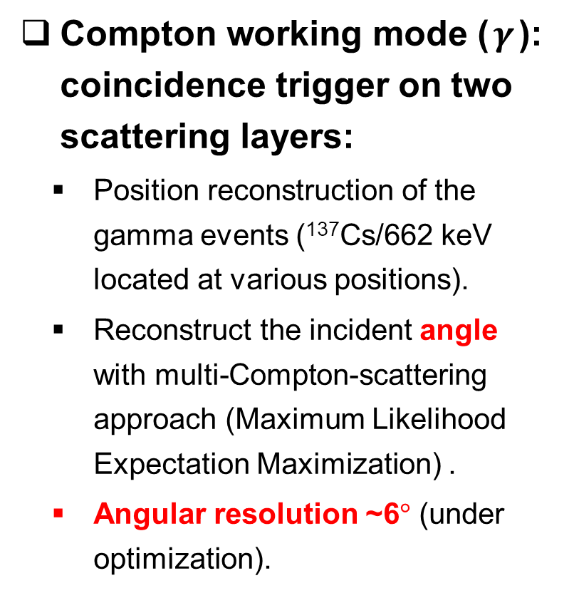
II. Novel Compton camera
  Compton working mode ($γ$): coincidence trigger on two scattering layers:
  Position reconstruction of the gamma events (¹³⁷Cs/662 keV located at various positions).
  Reconstruct the incident angle with multi-Compton-scattering approach (Maximum Likelihood Expectation Maximization) .
  Angular resolution ~6$°$ (under optimization).
CosPA 2026 & ACGRG 13, 5-9 July, 2026, University of Canterbury, Christchurch, NZD

Slide 12
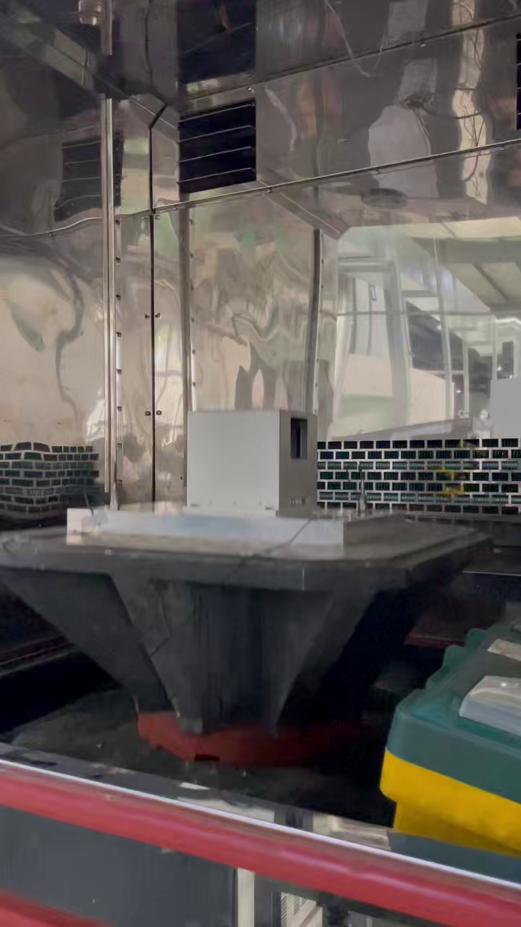
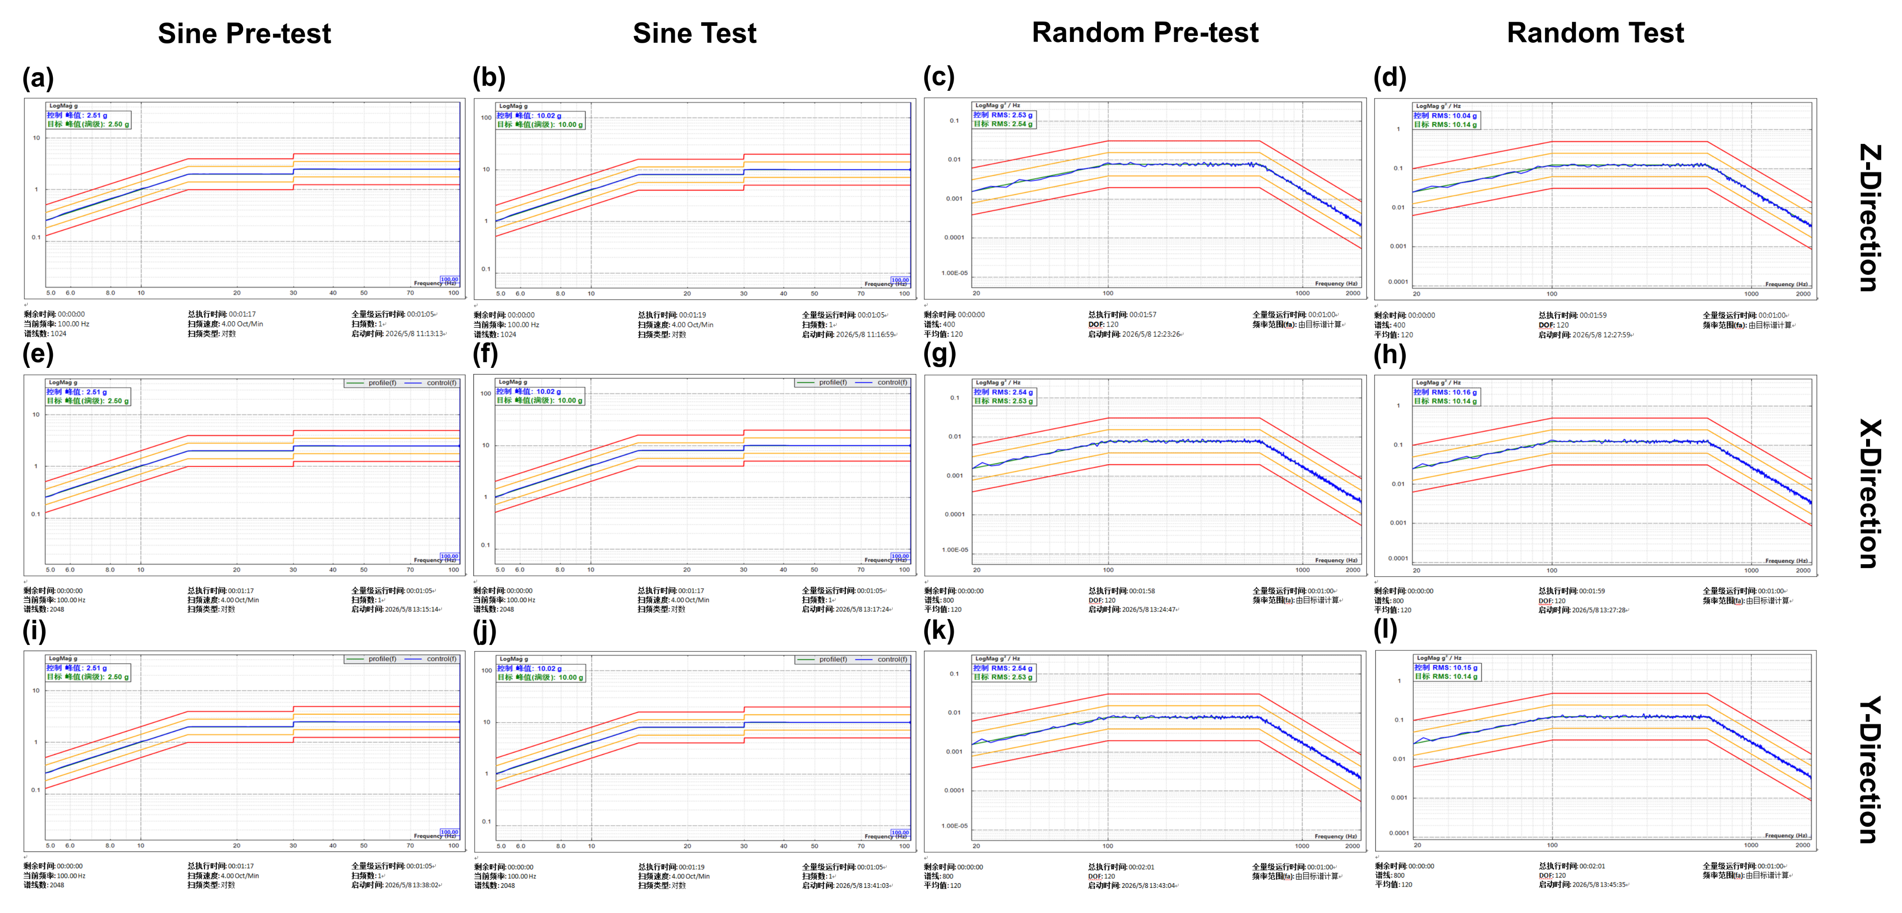
II. Novel Compton camera
  On satellite: key environment tests, vibration
  Sinusoidal & random vibration tests (up to 10G) along three directions have been performed to meet the satellite requirement → Passed!!
CosPA 2026 & ACGRG 13, 5-9 July, 2026, University of Canterbury, Christchurch, NZD

Slide 13
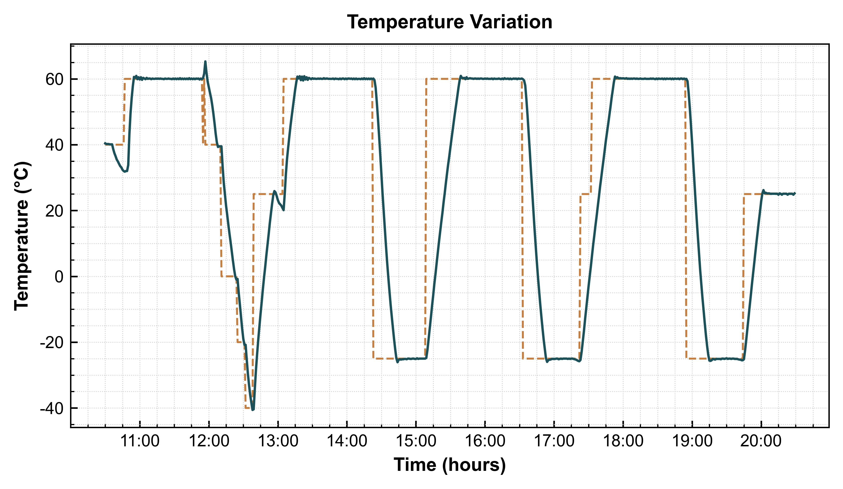
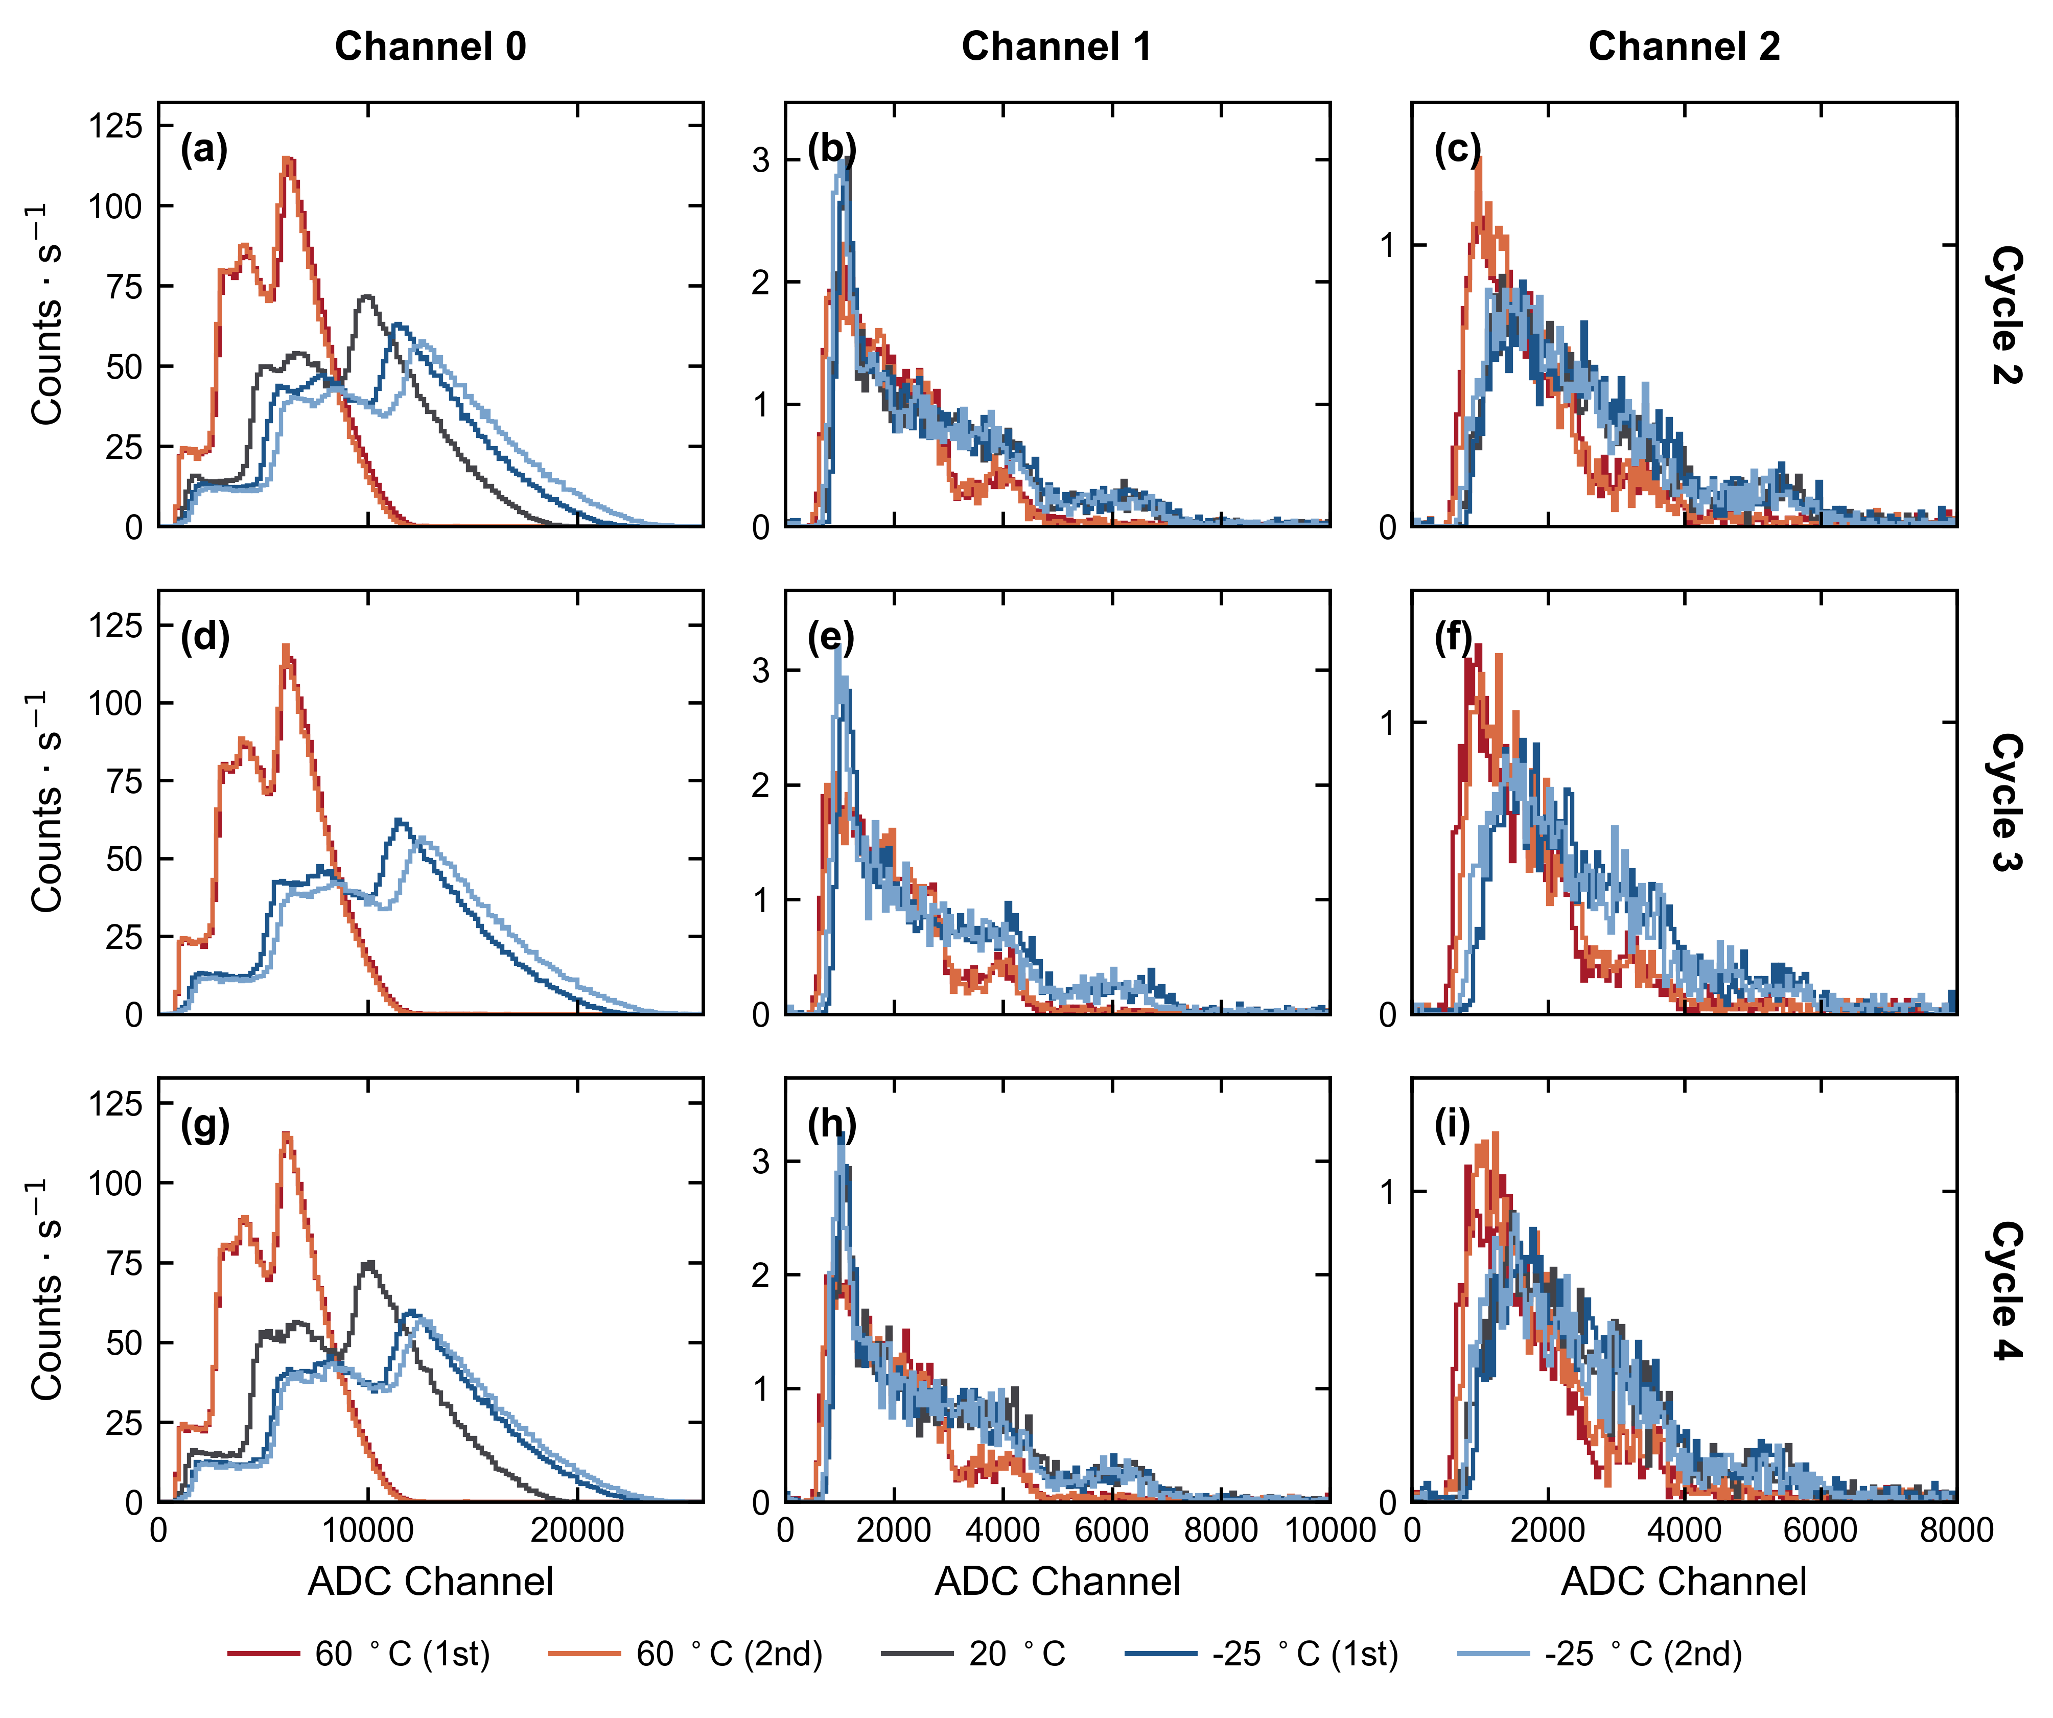
II. Novel Compton camera
  On satellite: key environment tests, thermal cycle
  Many thermal cycles (-25°C to 60°C) have been conducted & detector’s performance is monitored during the test → Camera still functional at 60°C & temperature-dependent energy scale has been built!
CosPA 2026 & ACGRG 13, 5-9 July, 2026, University of Canterbury, Christchurch, NZD

Slide 14
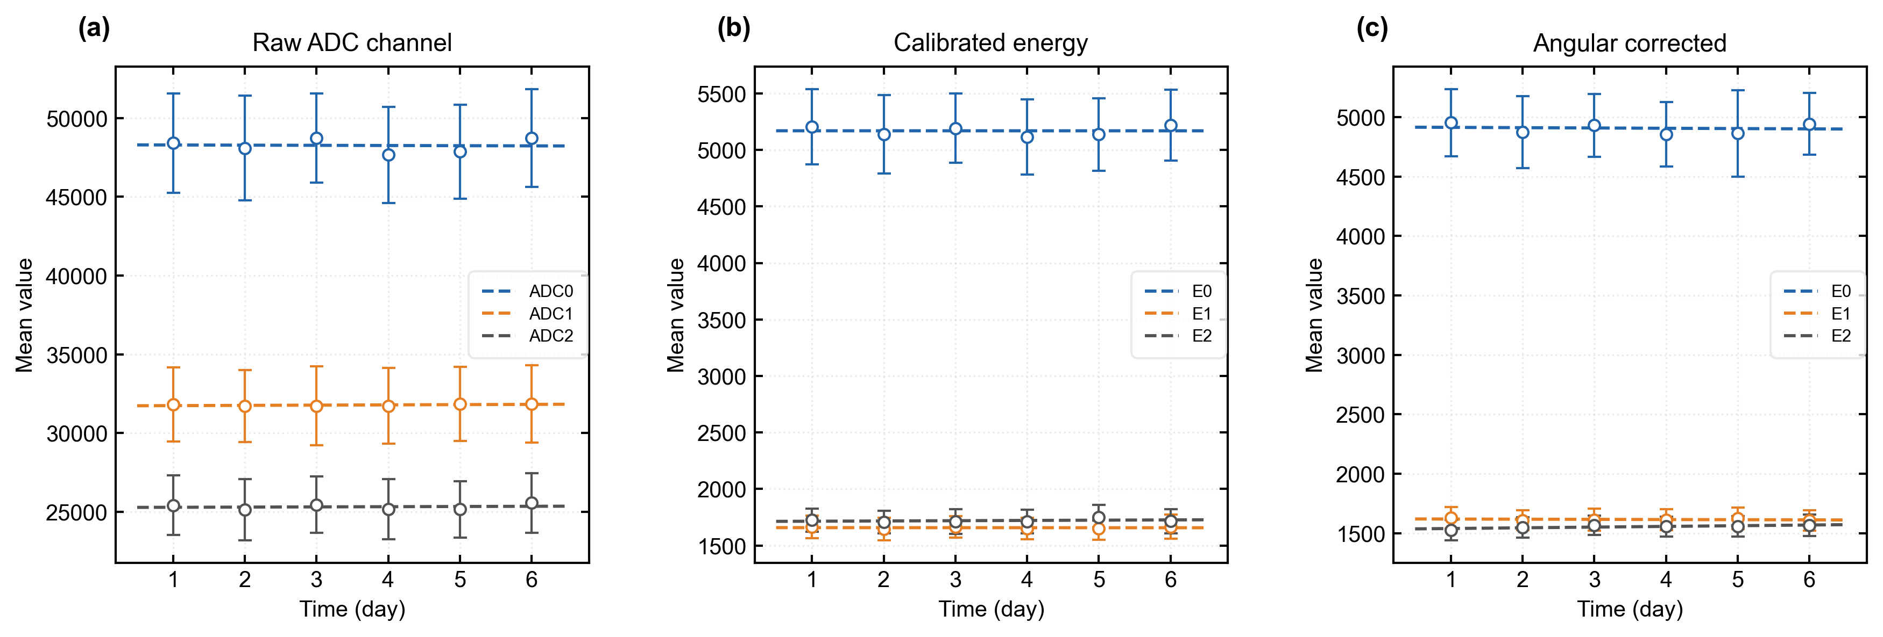
II. Novel Compton camera
  On satellite: key environment tests, aging/stability
  Monitoring the detector response (muons) for long-term operation →Extremely stable!
CosPA 2026 & ACGRG 13, 5-9 July, 2026, University of Canterbury, Christchurch, NZD

Slide 15
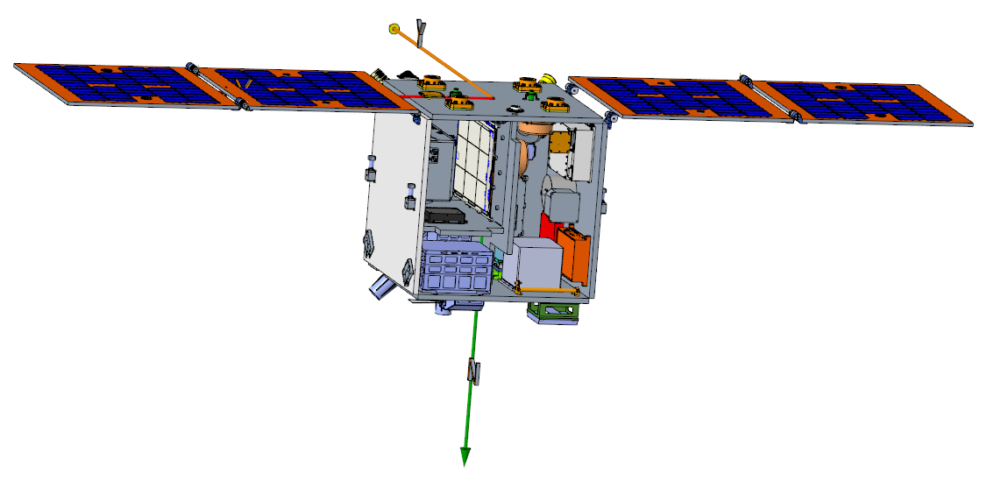
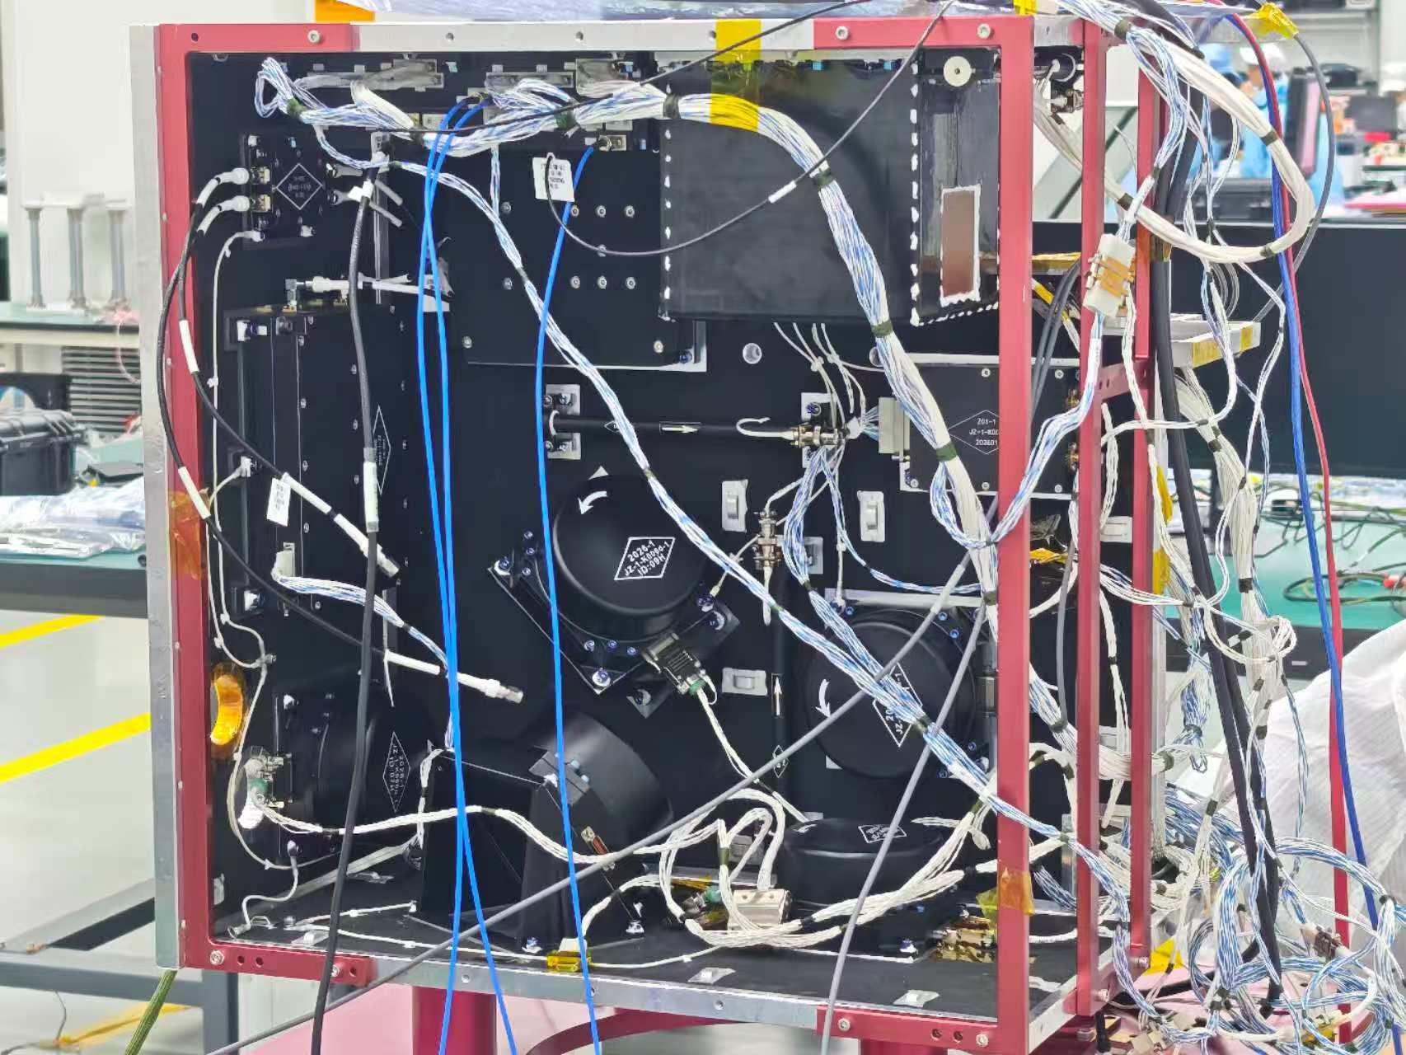
II. Novel Compton camera
  On satellite: integration with the satellite, done!
  Orbit height is 525 km and the camera points to the Galactic Center, to be launched in summer of 2026!!
CosPA 2026 & ACGRG 13, 5-9 July, 2026, University of Canterbury, Christchurch, NZD

Slide 16
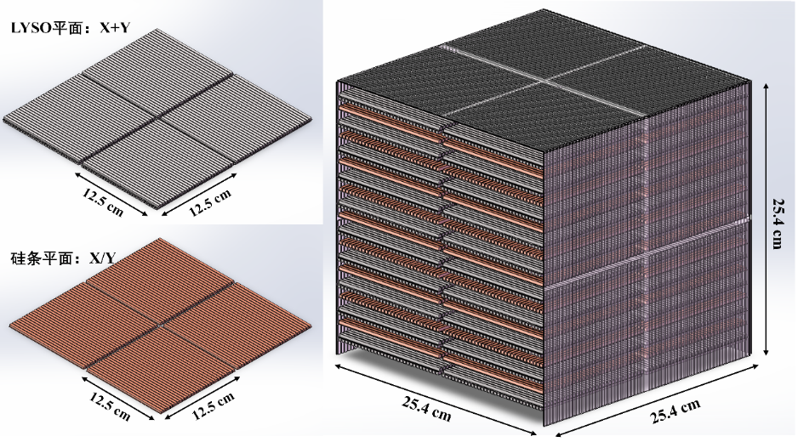
III. Beyond the MeV Gamma
  Pathfinder：~1 kg payload focuses on MeV gamma, piggyback on commercial satellite in 2026
  1st stage: ~30 kg payload, simultaneously measures MeV gamma & low-energy cosmic antinuclei, to be launched (primary payload) in 2027, funded by SJTU State Key Laboratory of Dark Matter Physics.
注：上海交大牵头“面向未来MeV伽马射线空间探测的技术研发和理论研究”已获科技部重点研发专项（青年科学家）资助（National Key R&D Program of China, 2025.12-2030.11）
CosPA 2026 & ACGRG 13, 5-9 July, 2026, University of Canterbury, Christchurch, NZD

Slide 17
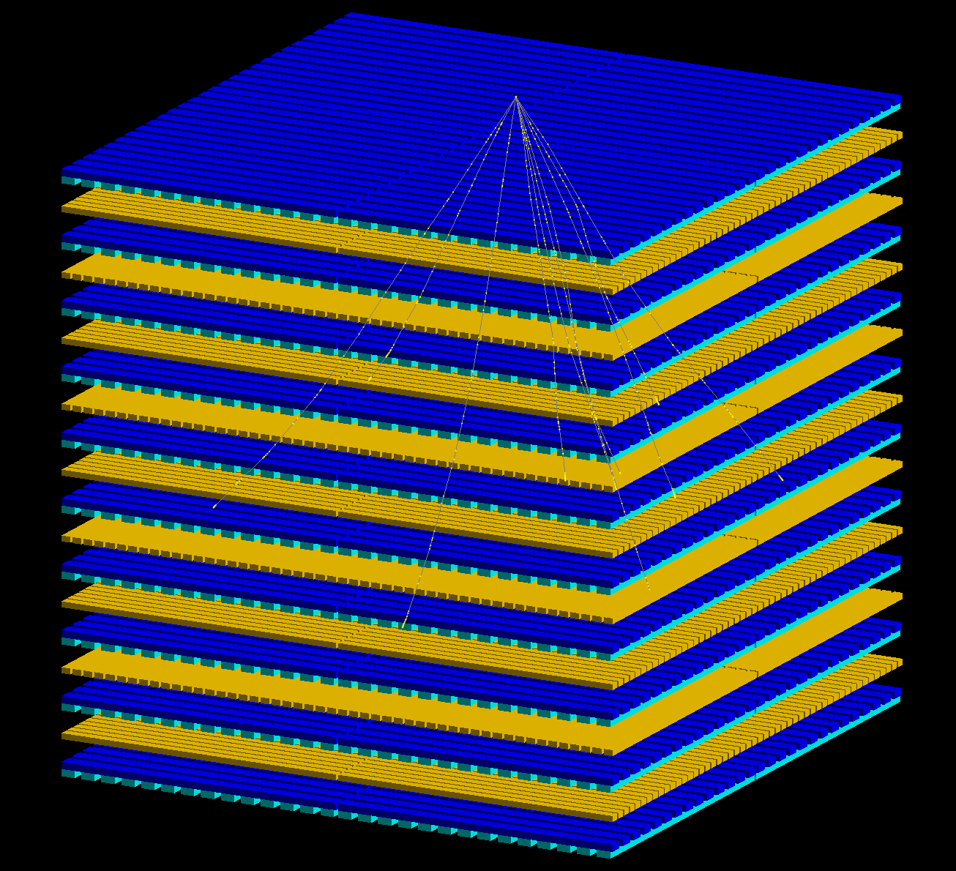
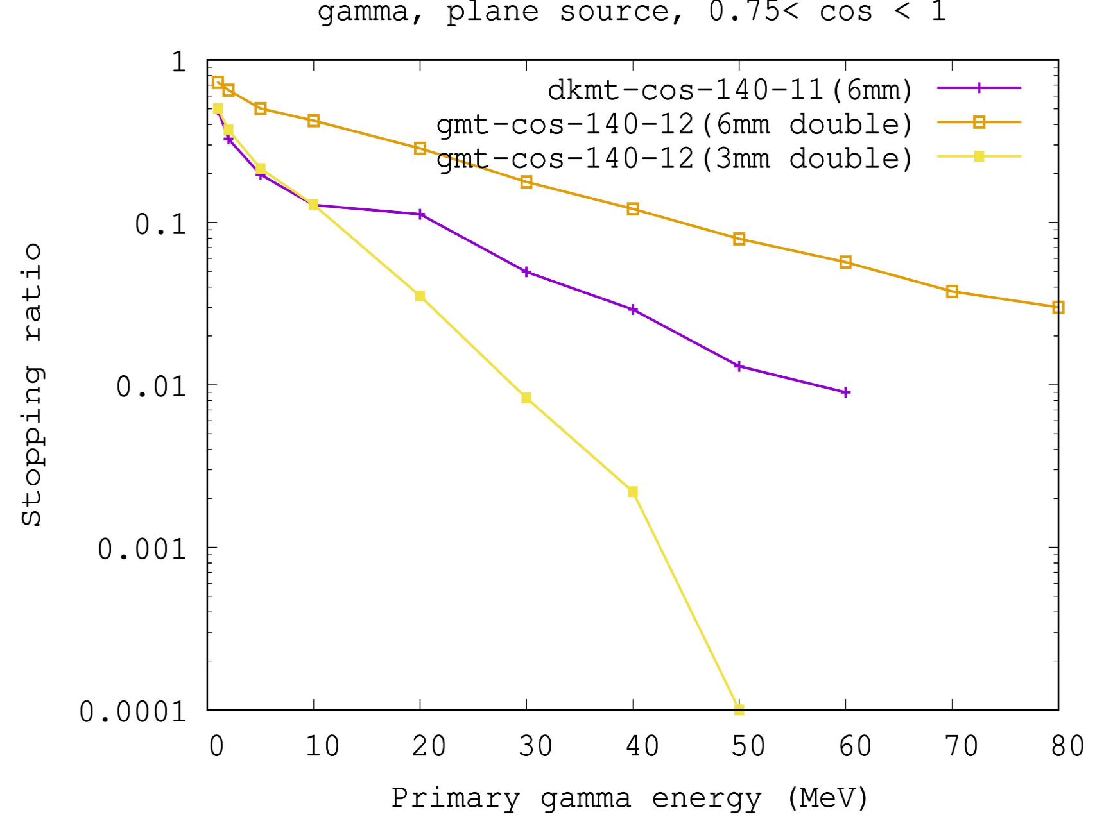
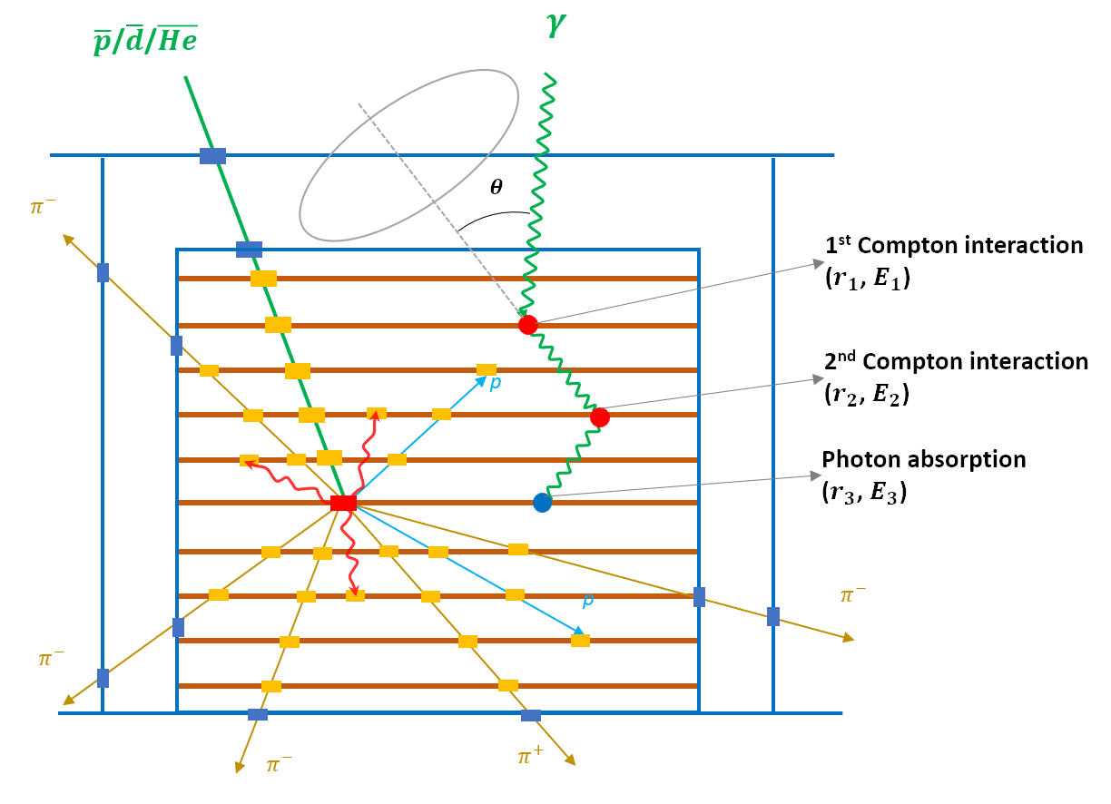
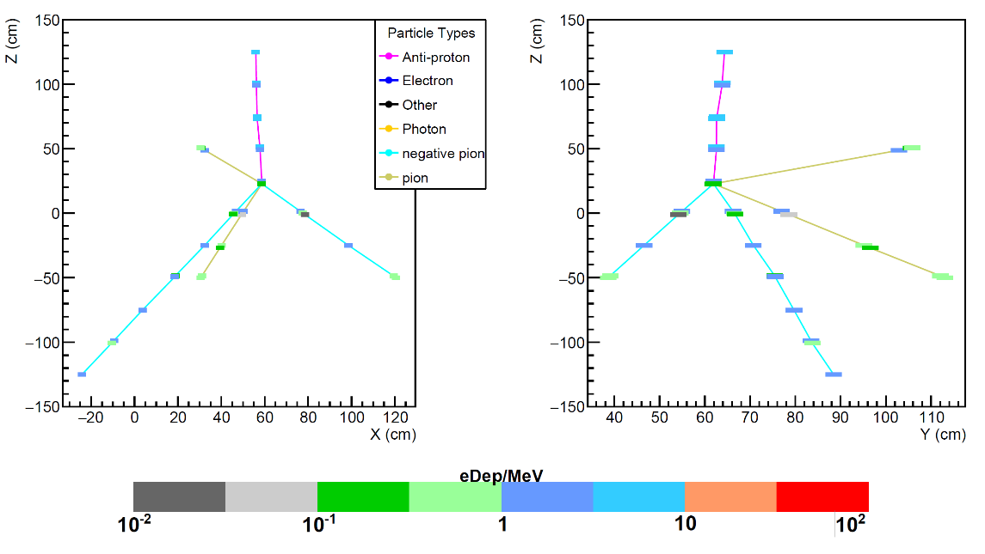
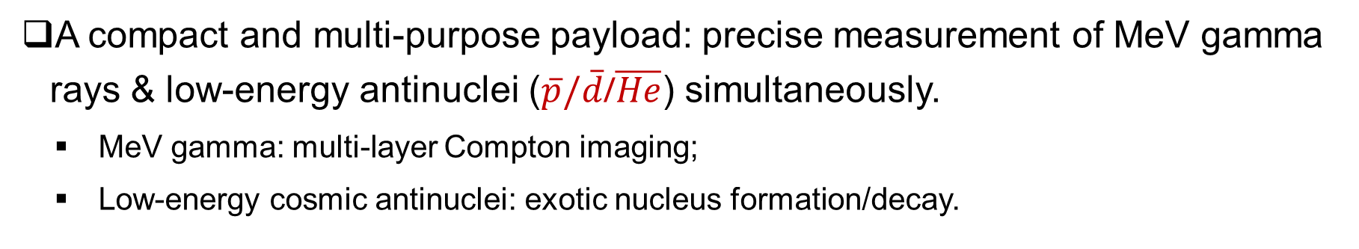
III. Beyond the MeV Gamma
A compact and multi-purpose payload: precise measurement of MeV gamma rays & low-energy antinuclei ($\overline{p}/\overline{d}$/$\overline{He}$) simultaneously.
  MeV gamma: multi-layer Compton imaging;
  Low-energy cosmic antinuclei: exotic nucleus formation/decay.
CosPA 2026 & ACGRG 13, 5-9 July, 2026, University of Canterbury, Christchurch, NZD

Slide 18
Summary & Outlook
MeV gamma provides a unique window for many cutting-edge researches: gamma-ray bursts, dark matter annihilation, primordial black hole, nucleosynthesis & chemical evolution of the Galaxy, etc.
A novel Compton camera as a pathfinder of SJTU micro-satellite serial projects has been delivered for MeV gamma measurement, stay tune for the upcoming data!
A muti-purpose compact micro-satellite payload is under developing, and welcome collaborators!
CosPA 2026 & ACGRG 13, 5-9 July, 2026, University of Canterbury, Christchurch, NZD

Slide 19
Thank You!

Slide 20
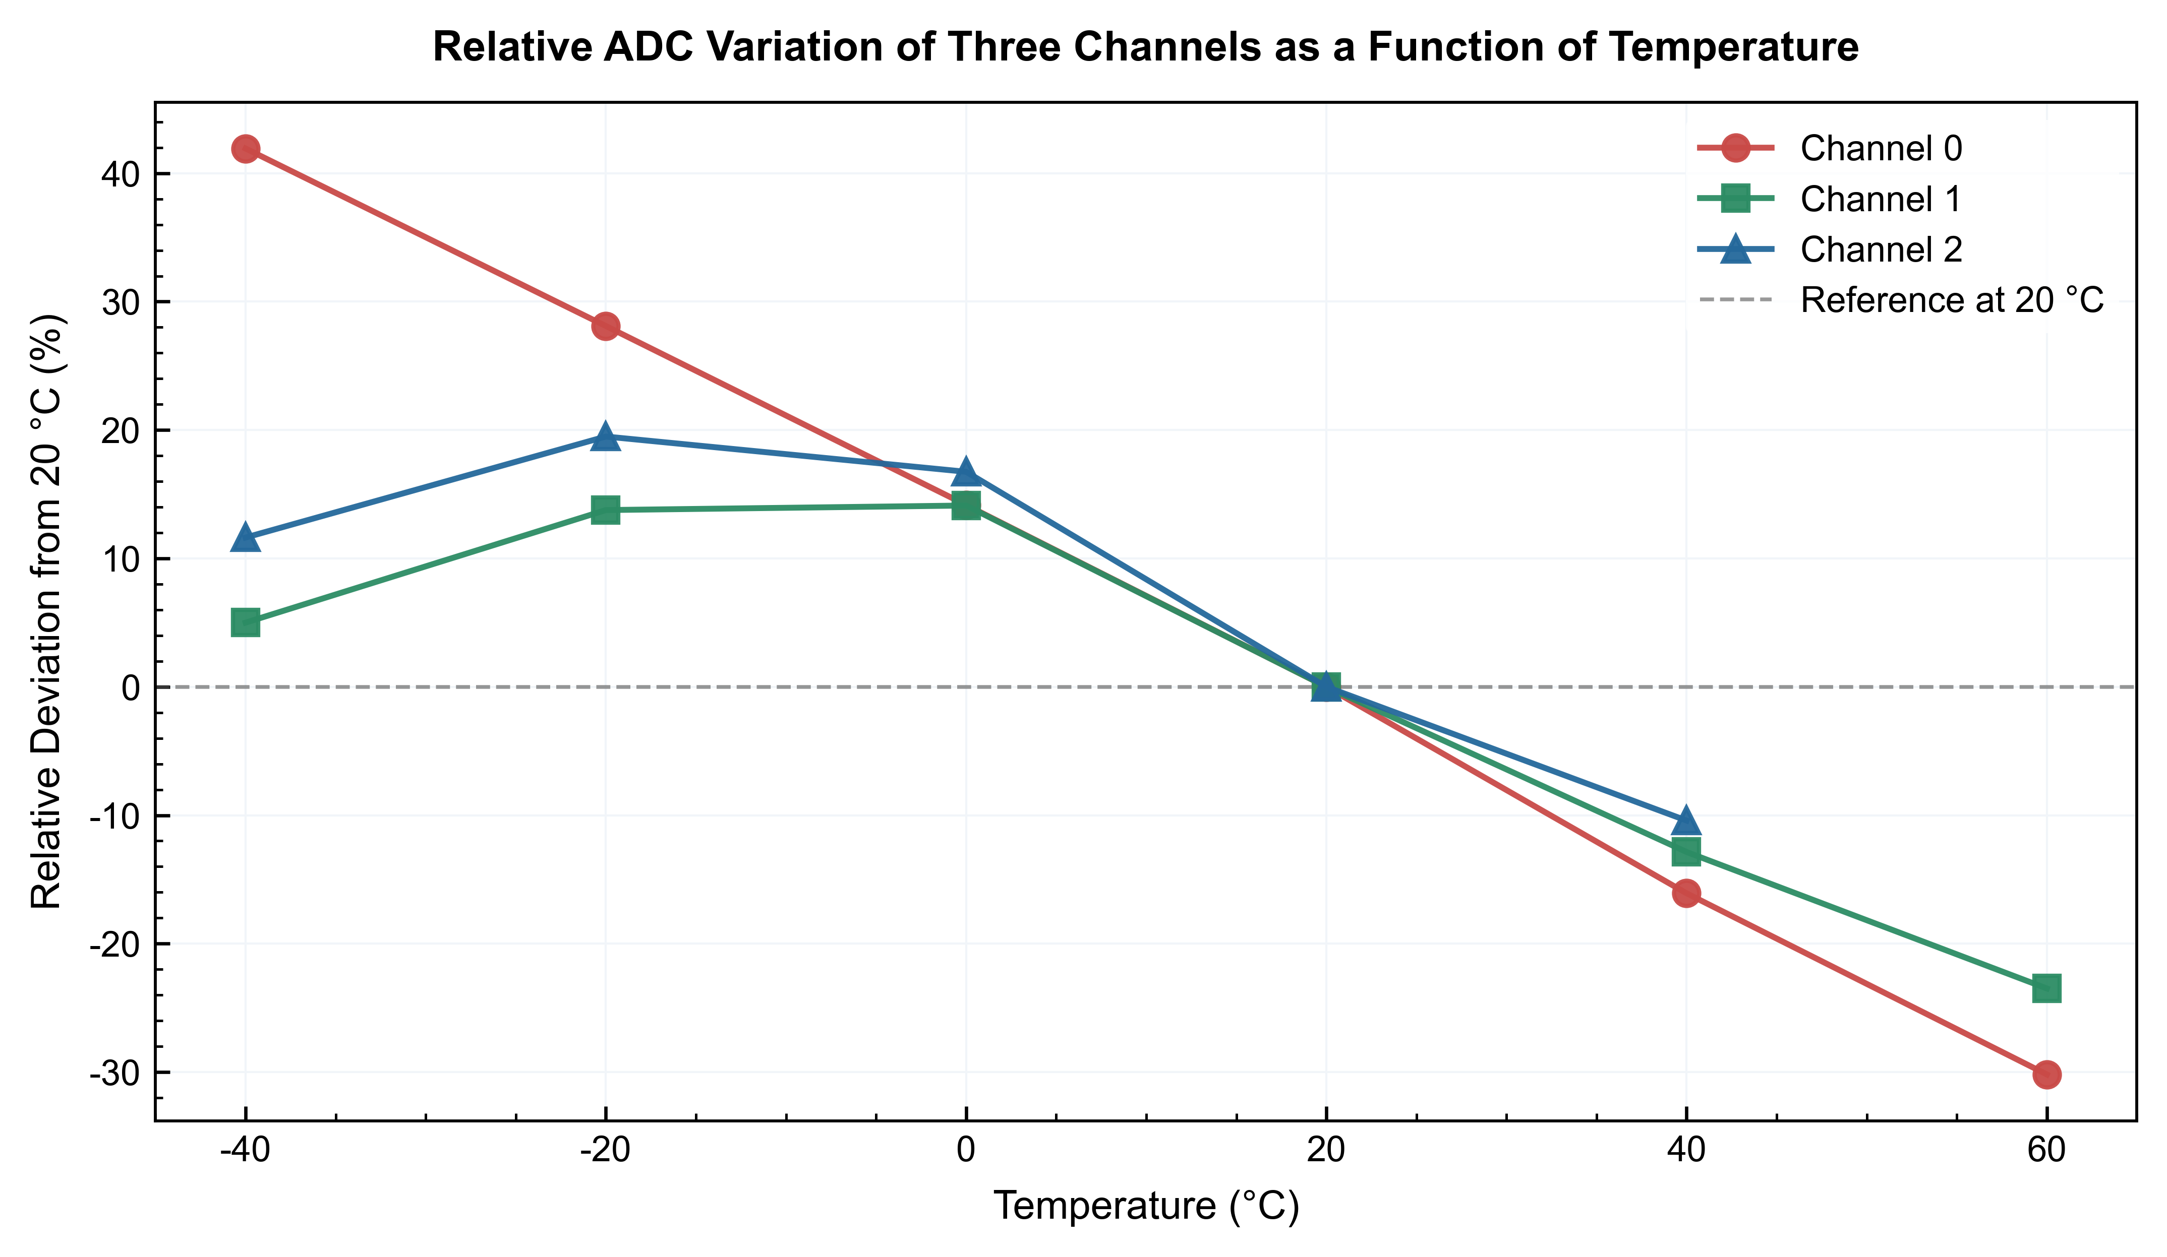
Novel Compton camera
  Key environment tests: thermal cycle
  Multiple-channel spectral response remained stable throughout three sets of thermal cycling tests conducted at temperatures ranging from -25°C to 60°C.
CosPA 2026 & ACGRG 13, 5-9 July, 2026, University of Canterbury, Christchurch, NZD

Slide 21
Multi-purpose Payload
  LYSO/YSO array：
    10 layers, 3mm XY strips orthogonal placed；
    SiPM reads out energy & time from each strip at two ends.
  Silicon array：
    9 layers, 5mm XY strips orthogonally placed；
    ASIC to read out the charge.
  Payload：~30$×$30$×$30 cm, ~30kg.
CosPA 2026 & ACGRG 13, 5-9 July, 2026, University of Canterbury, Christchurch, NZD

Slide 22
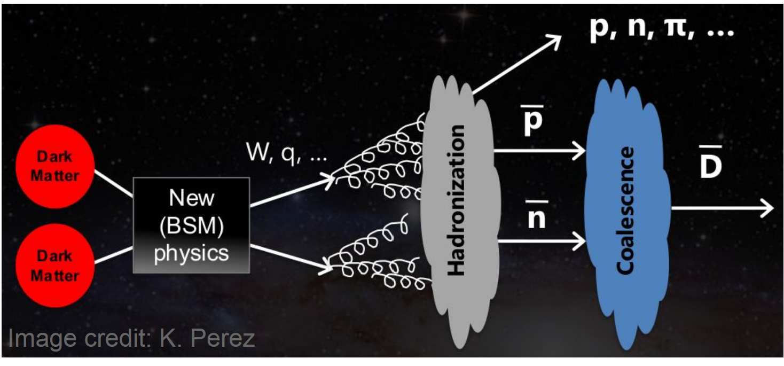
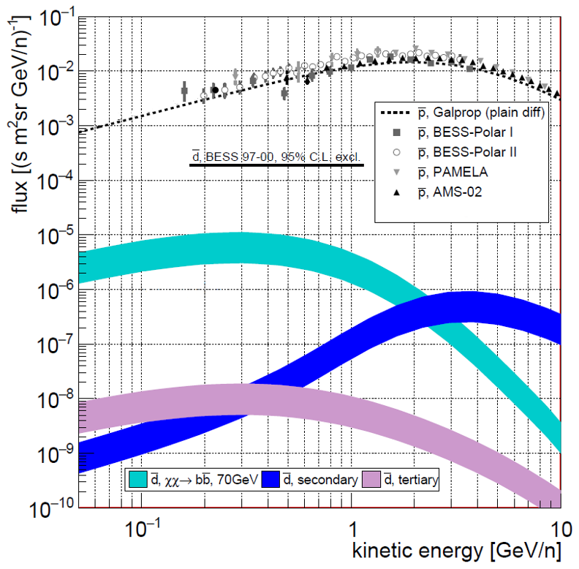
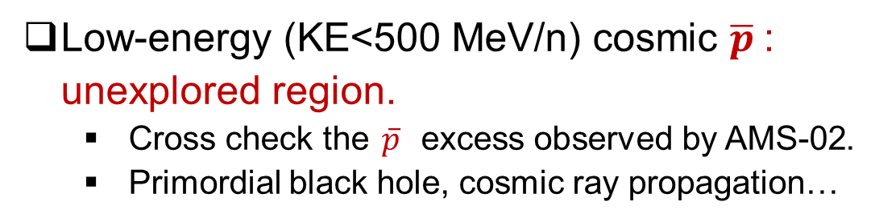
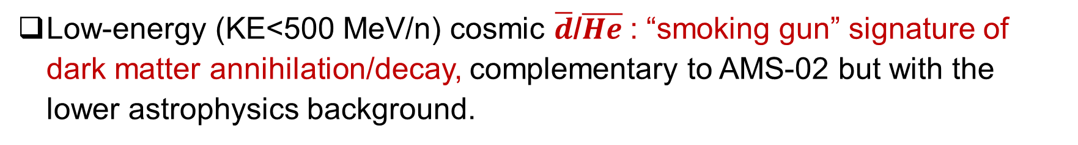
Low-Energy Antinuclei
  Low-energy (KE<500 MeV/n) cosmic $\overline{d}$/$\overline{He}$: “smoking gun” signature of dark matter annihilation/decay, complementary to AMS-02 but with the lower astrophysics background.
  Low-energy (KE<500 MeV/n) cosmic $\overline{p}$: unexplored region.
    Cross check the $\overline{p}$ excess observed by AMS-02.
    Primordial black hole, cosmic ray propagation…
CosPA 2026 & ACGRG 13, 5-9 July, 2026, University of Canterbury, Christchurch, NZD

Slide 23
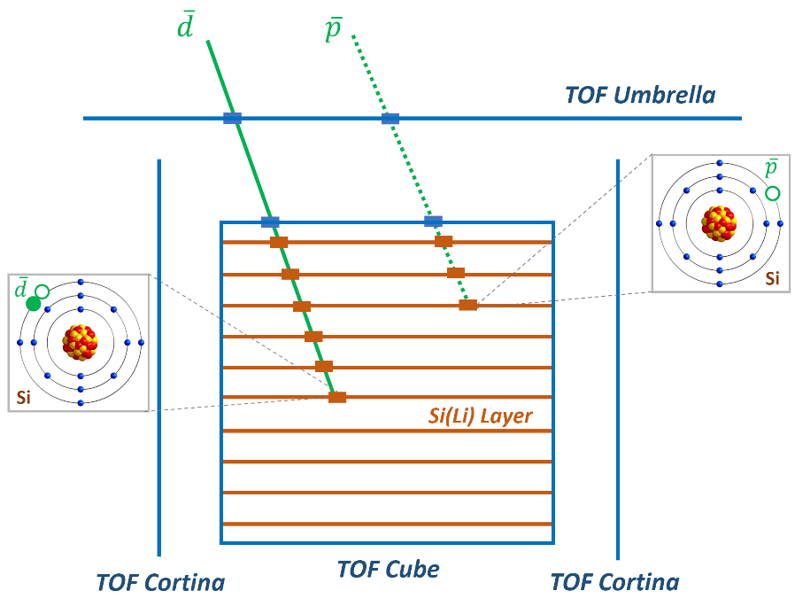
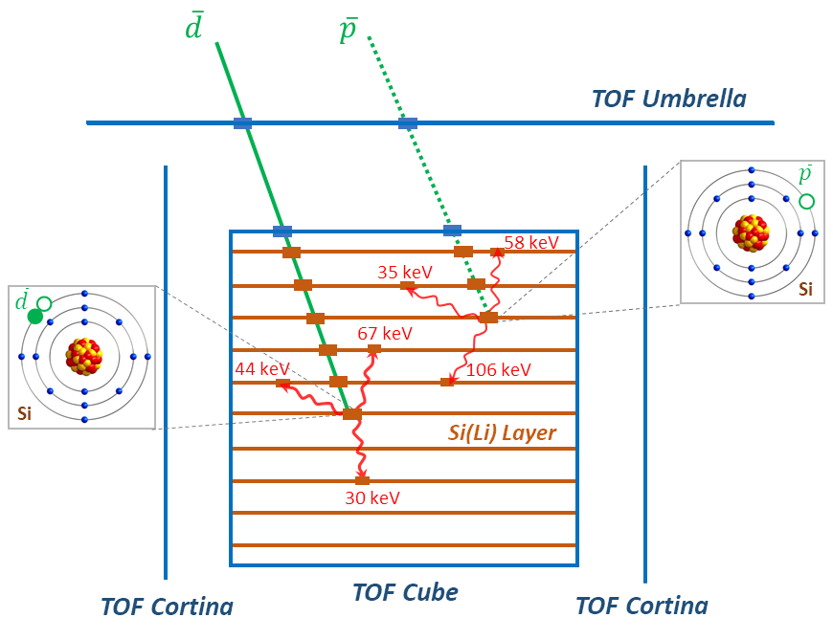



Low-Energy Antinuclei
Novel detection technique: exotic atomic formation and decay.
Stopping range: heavier antiparticle (same $β$) stopped in deeper layers
Exotic atom decay: x-rays with characteristic energies
Annihilation: multiplicity of charge particles (i.e. $π^{±}$)
Validated at KEK with $\overline{p}$ beam and applied at GAPS Antarctic balloon experiment (SJTU is the only Chinese institute), but yet used in space.
CosPA 2026 & ACGRG 13, 5-9 July, 2026, University of Canterbury, Christchurch, NZD

Slide 24


I. MeV Gamma Physics
https://arxiv.org/pdf/2102.06714
https://arxiv.org/pdf/2411.00087
CosPA 2026 & ACGRG 13, 5-9 July, 2026, University of Canterbury, Christchurch, NZD

