Slide 1
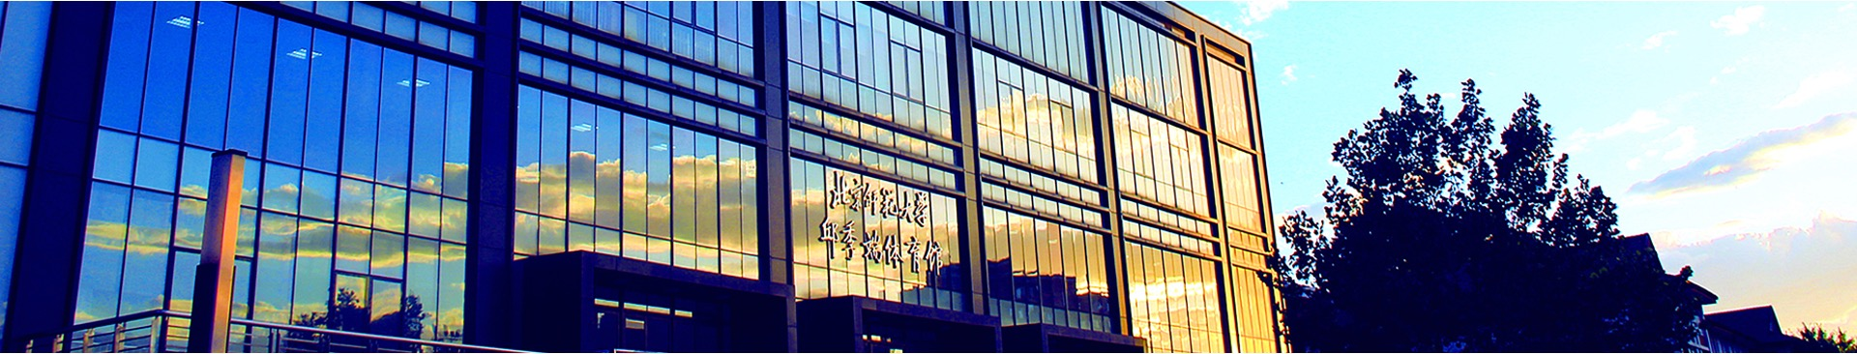
Mass-Sheet Degeneracy in Time-delay Cosmography
Bin Hu
Beijing Normal University
CosPA2026 @ Christchurch, New Zeeland

Slide 2

Outline
1. Hubble Tension
SH0ES, CCHP, Cepheid, TRGB, DESI
2. Time Delay Cosmography
Internal Mass-Sheet Degeneracy, Rui+ 2026 MNRAS
External Mass-Sheet Degeneracy, Lin+ 2026 ApJS
3. Site and 1.93m Telescope

Slide 3
1. Hubble Tension

Slide 4
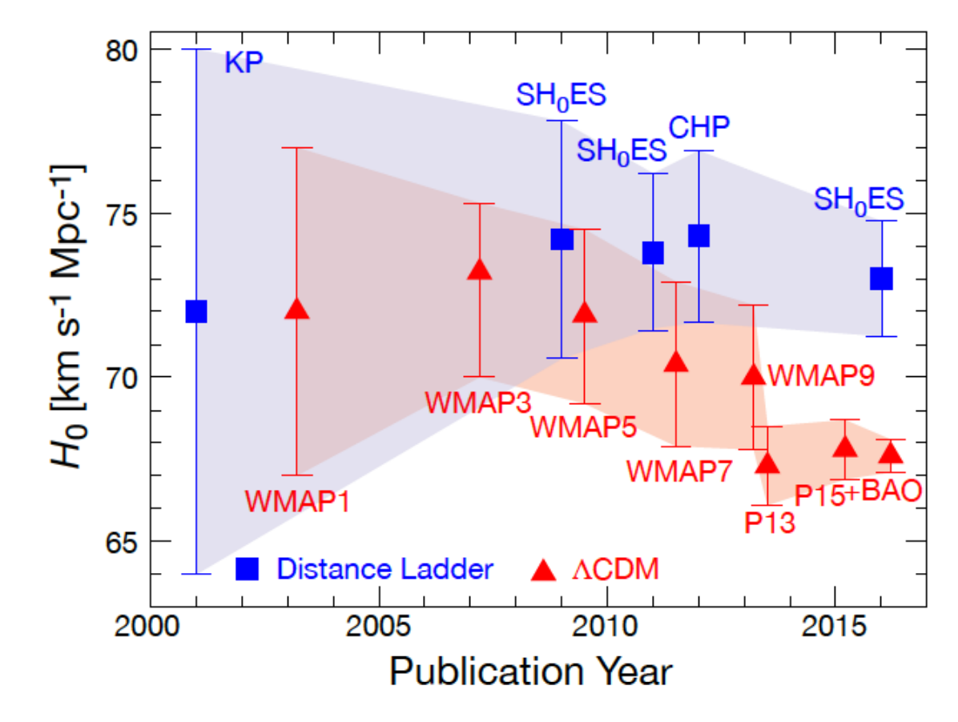
> 4 sigma

Slide 5
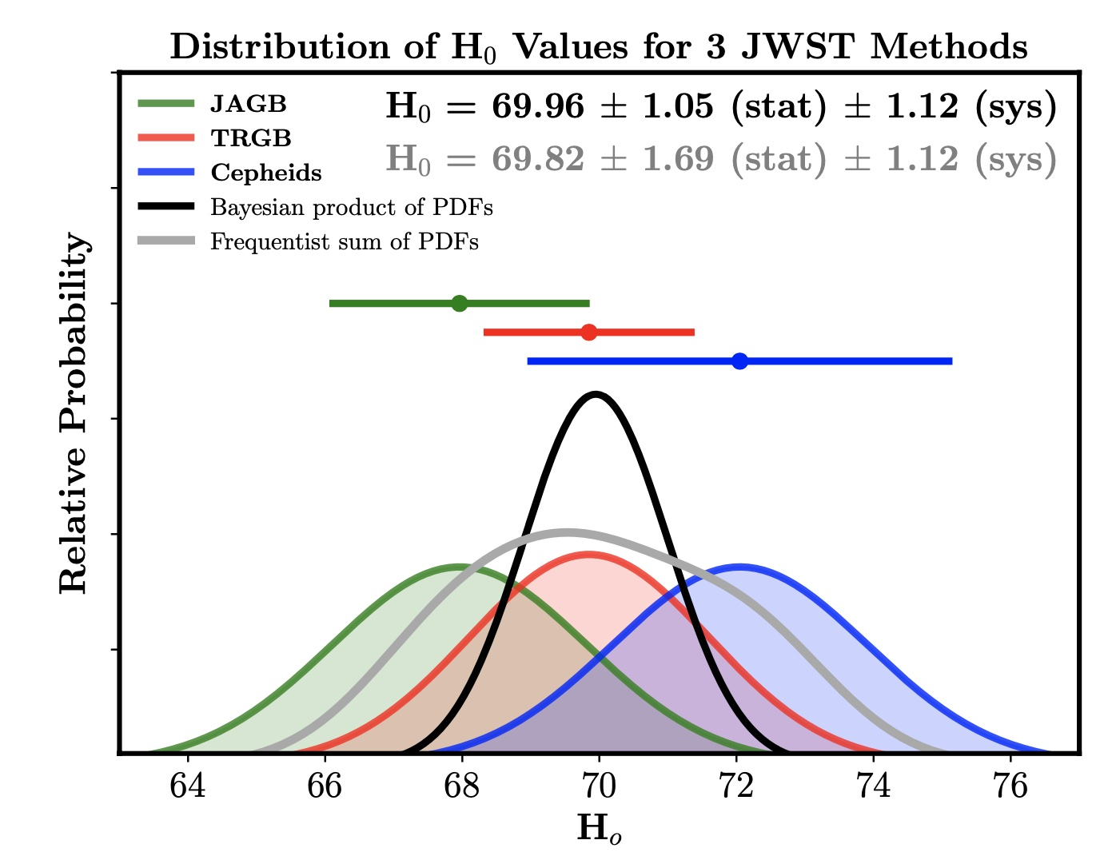
Freedman+ 2024

Slide 6
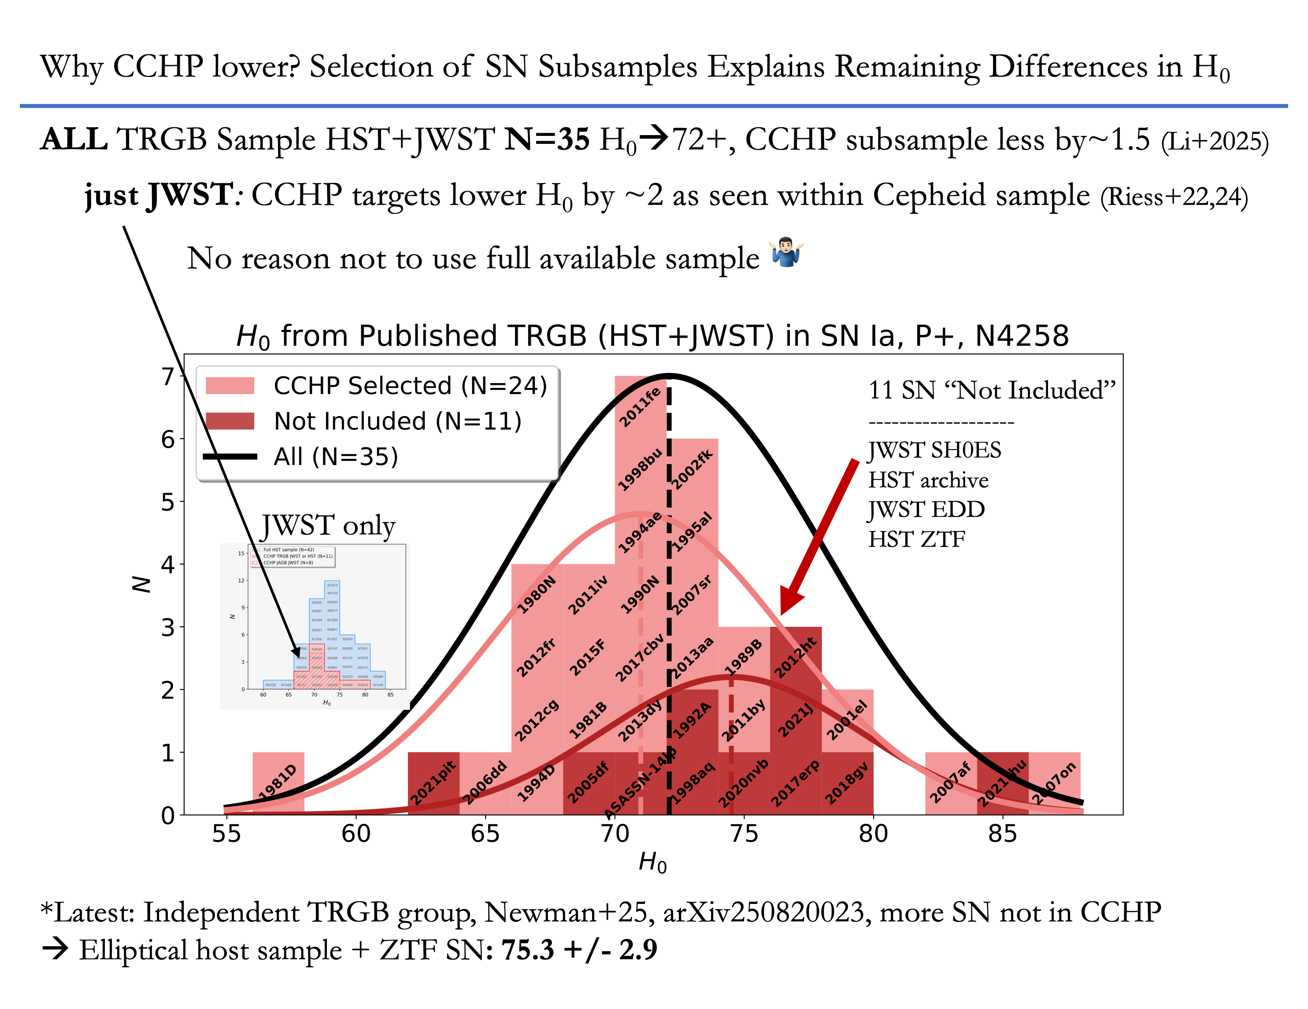
[2504.08921]

Slide 7
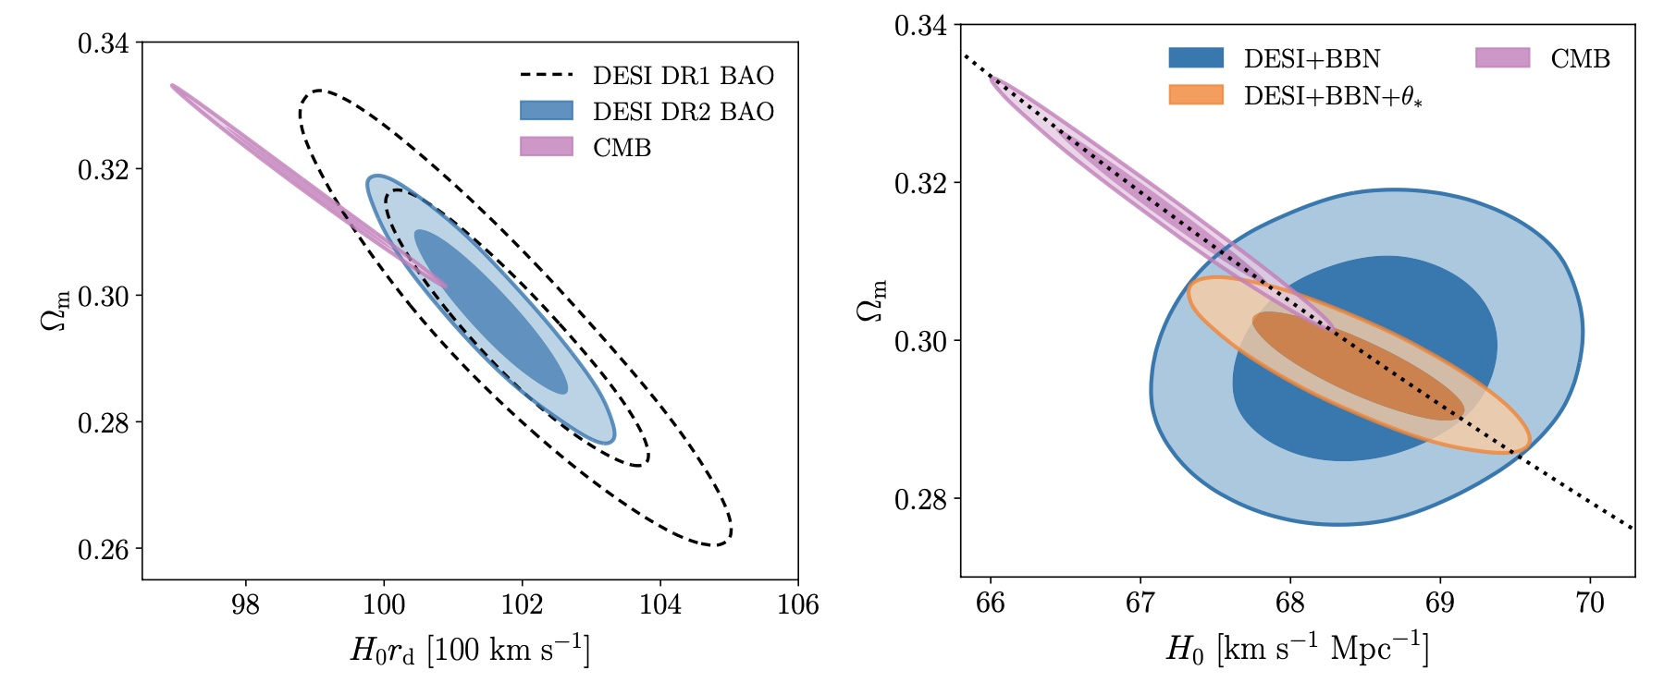
DESI-DR2

Slide 8
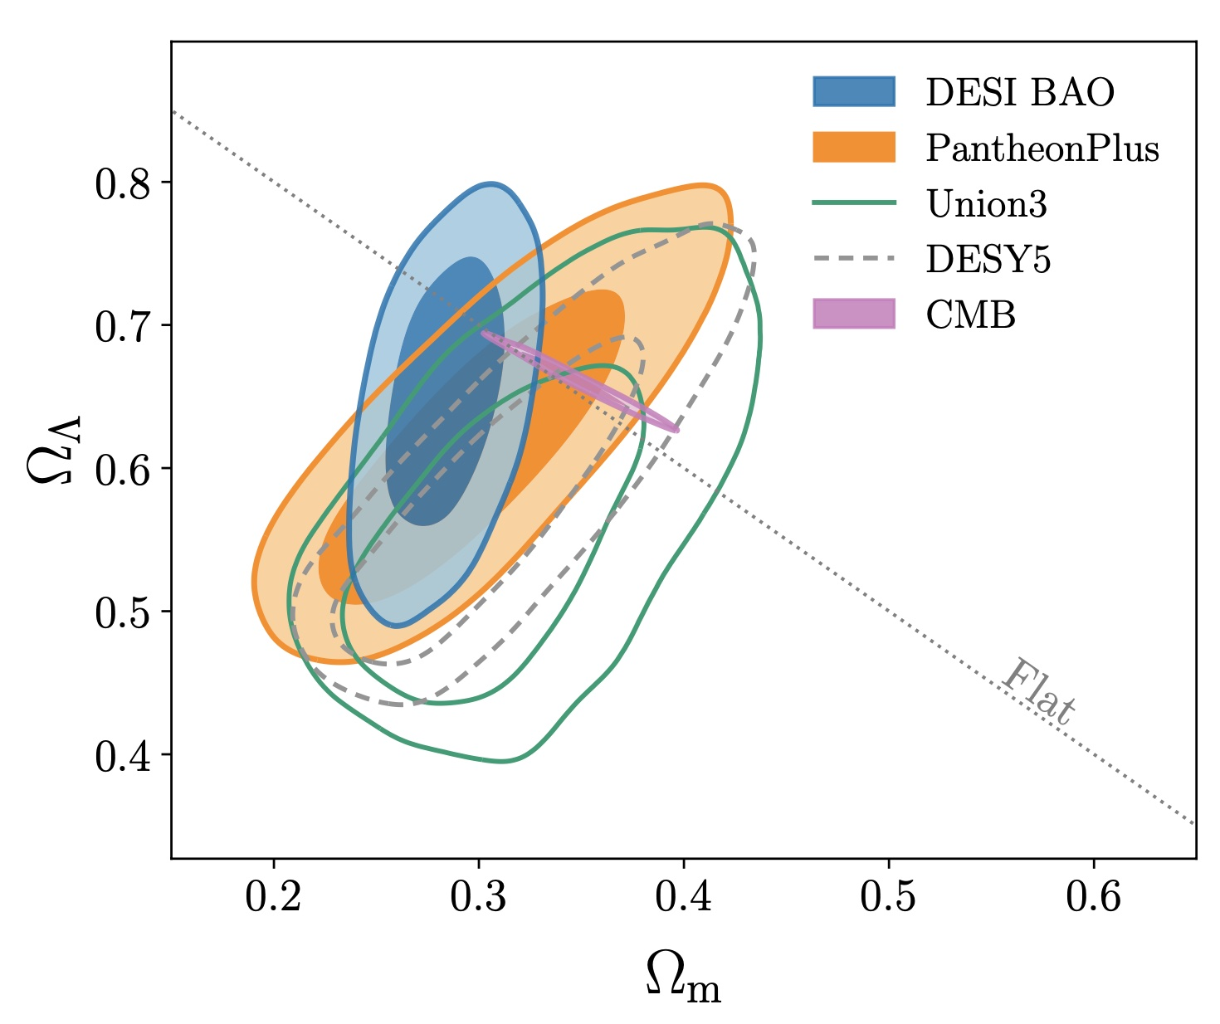
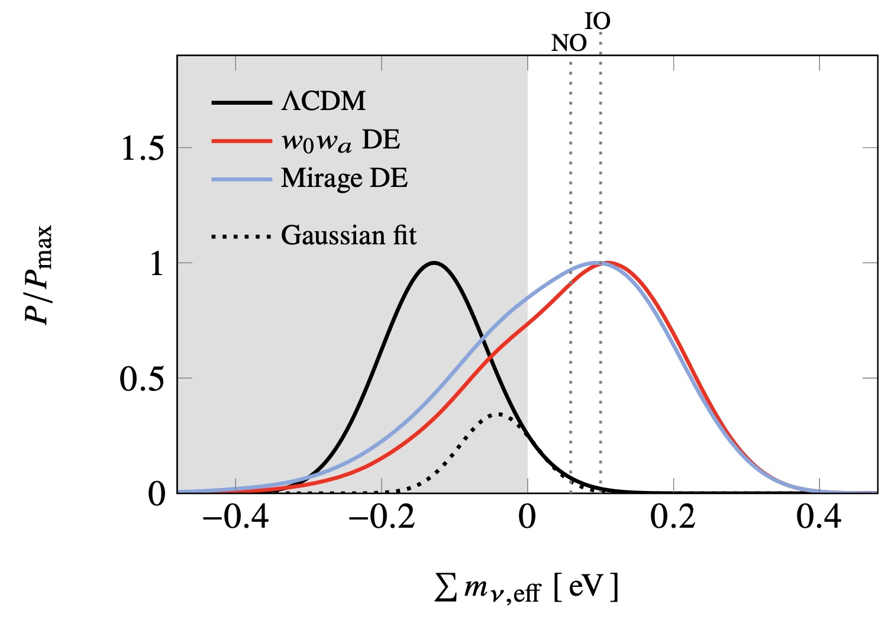
Matter density：Galaxy Survey < CMB
[arXiv: 2407.10965]

Slide 9
2. Time Delay Cosmography

Slide 10
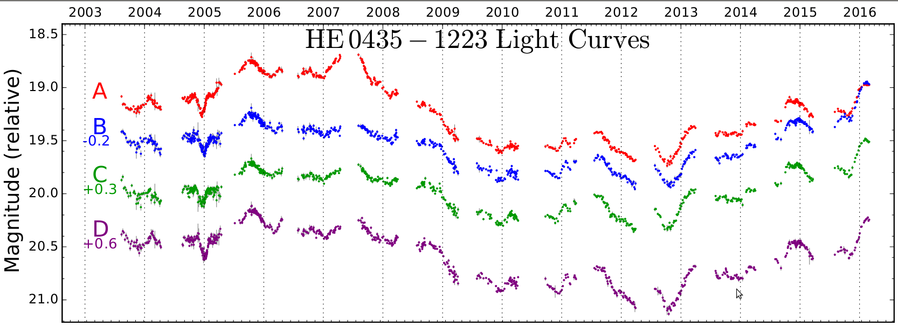

Hot disc instability

Slide 11

H0LiCOW
adding internal MSD

Slide 12
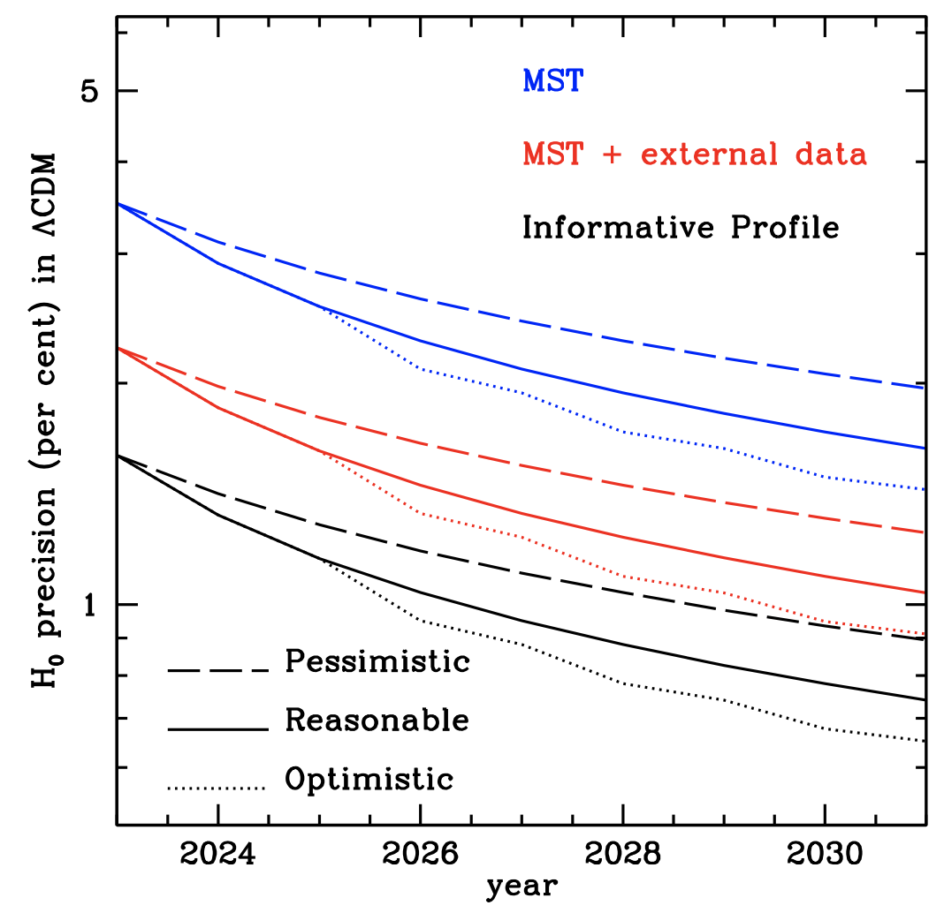
There is an opportunity to monitor widely separated glQSO system with 3 day cadence
2%
50 glQSO over 5 yrs
can reach H0~2%

Slide 13
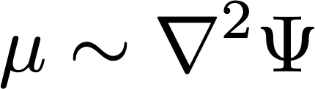


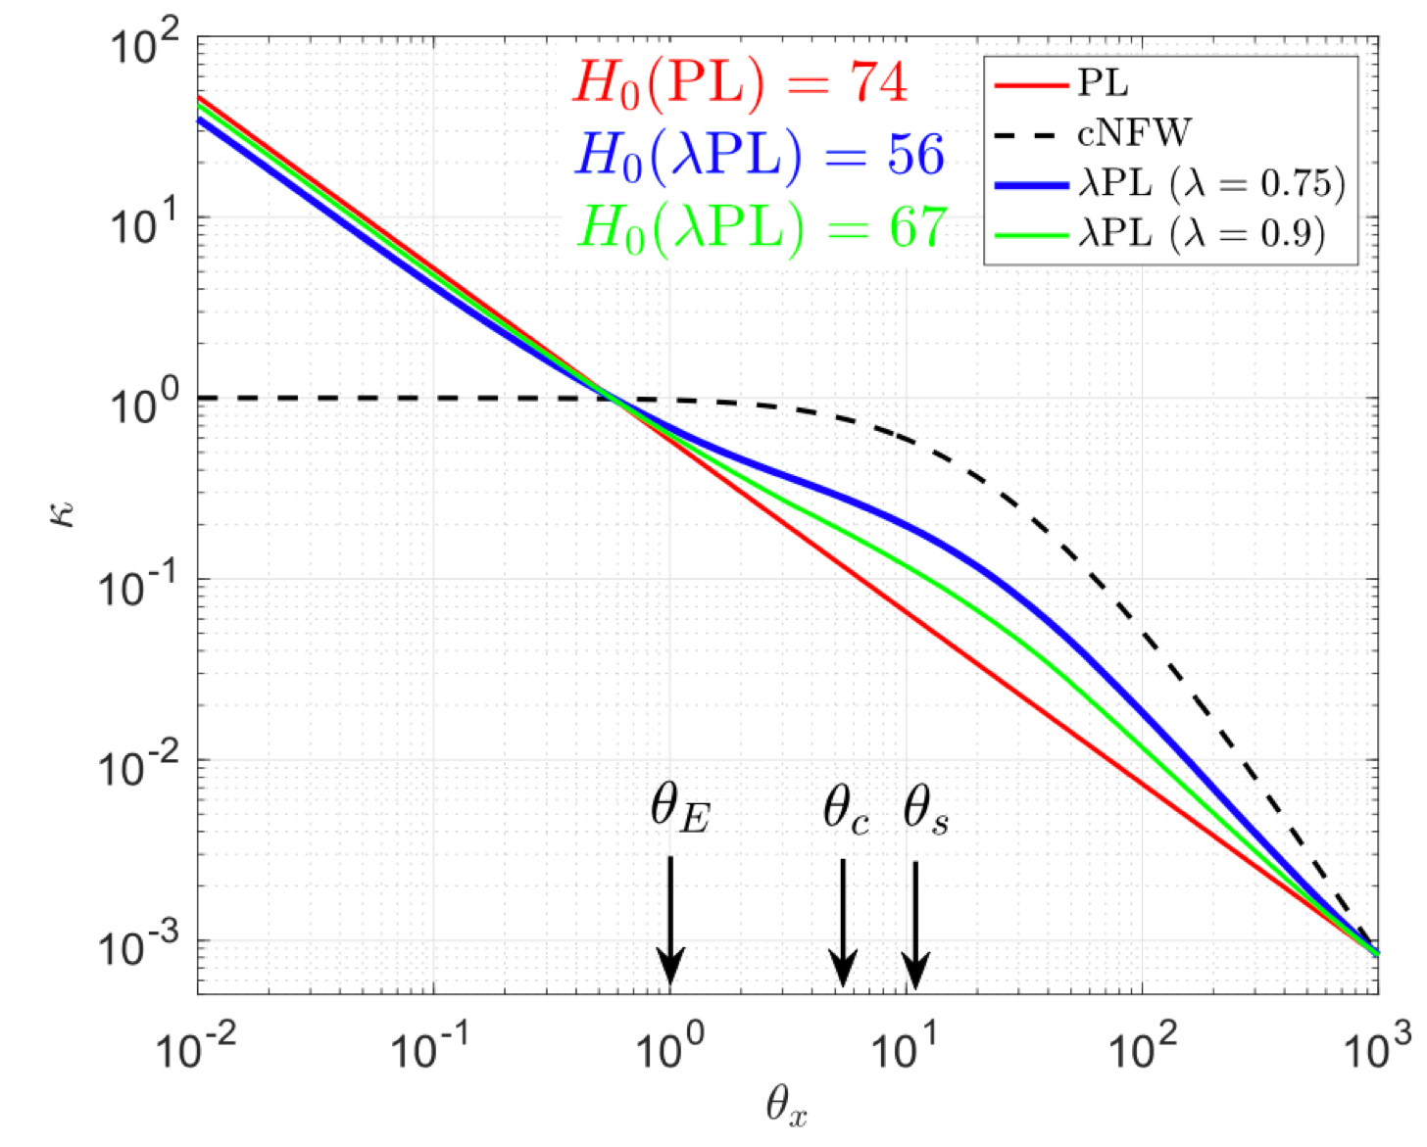
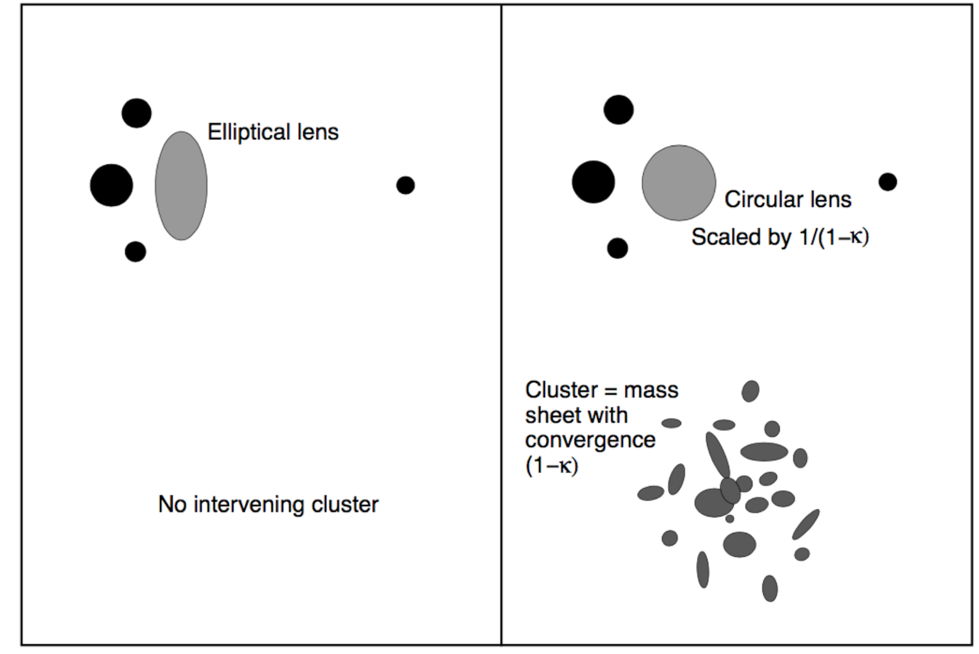
Internal Mass-Sheet Degeneracy
External Mass-Sheet Degeneracy
Systematics of TDCosmography

Slide 14
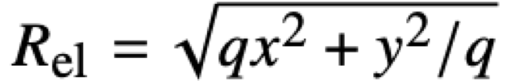
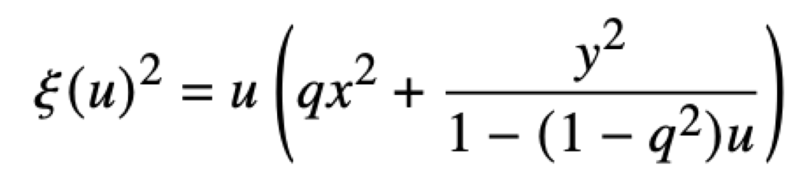
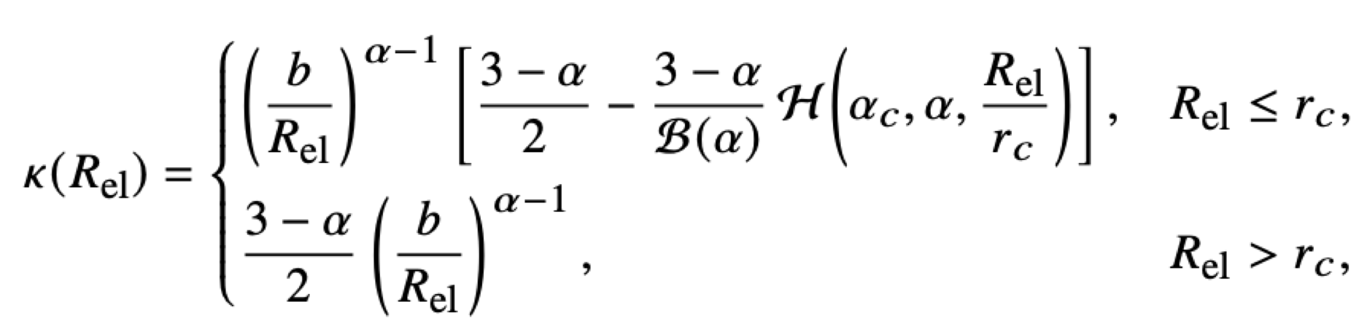
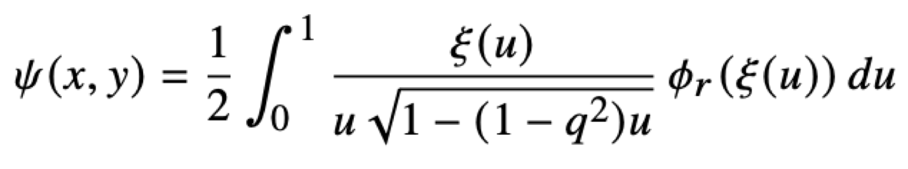
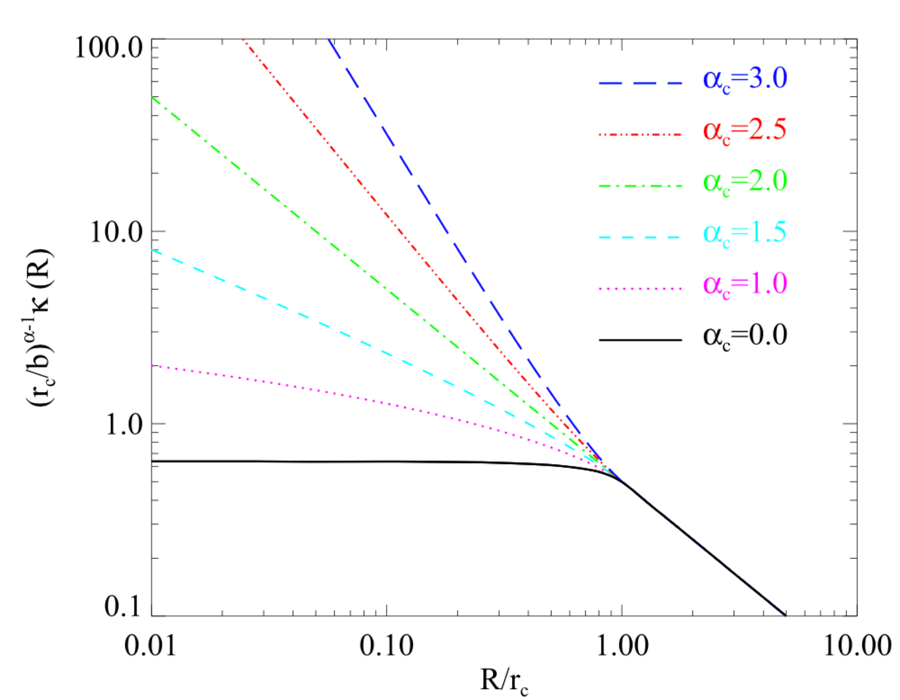
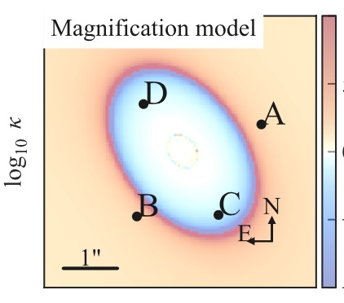
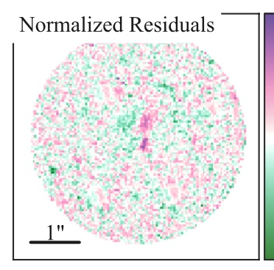
Internal MSD: Broken Power Law Model
[Du+ 2020 ApJ]

Slide 15
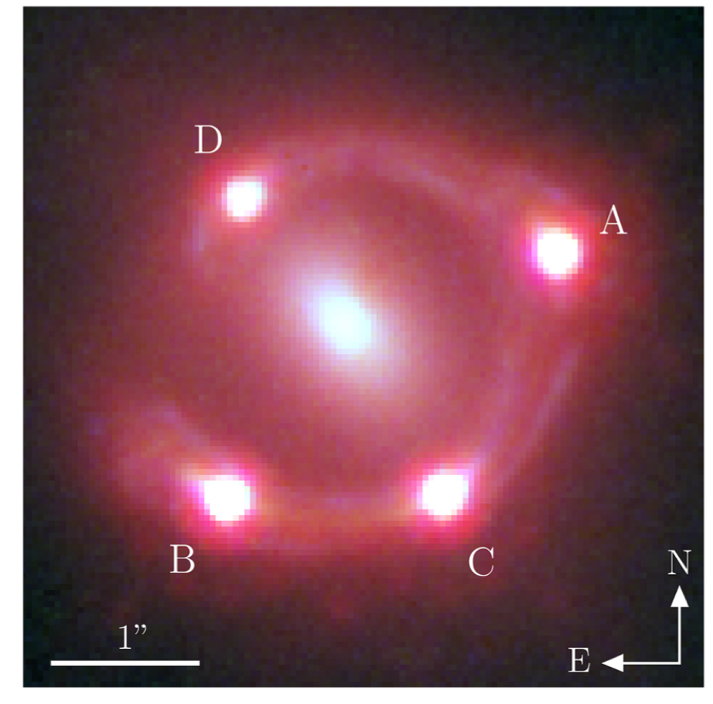
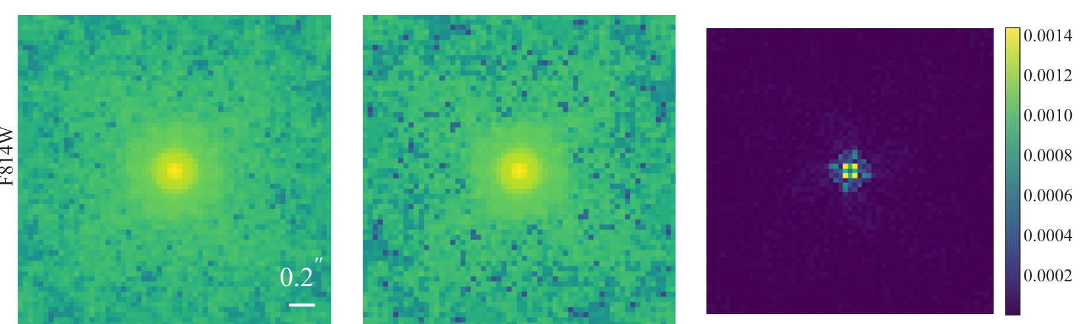
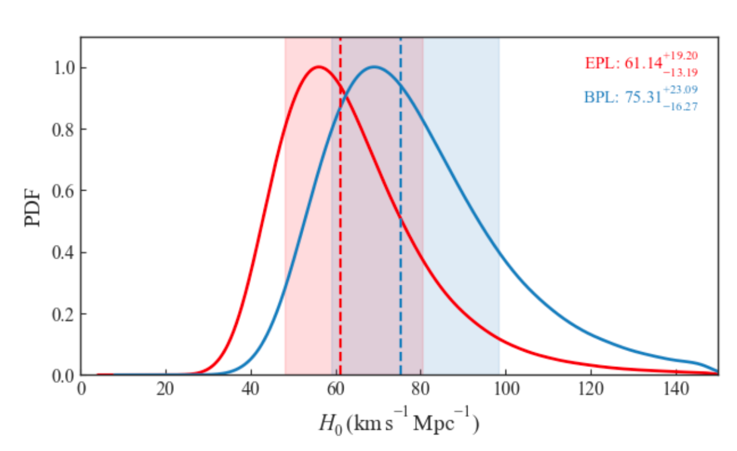
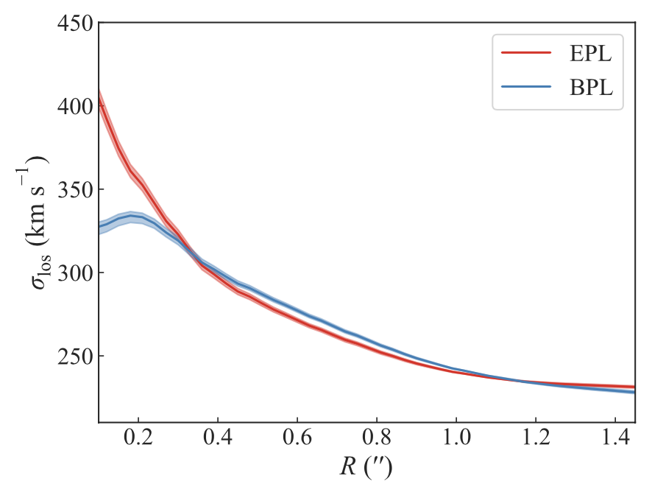
Cored mass profile gives a higher H0
[Rui+ MNRAS 2026]
PSF (EPL)
PSF (BPL)
PSF residual
WGD 2038–4008

Slide 16
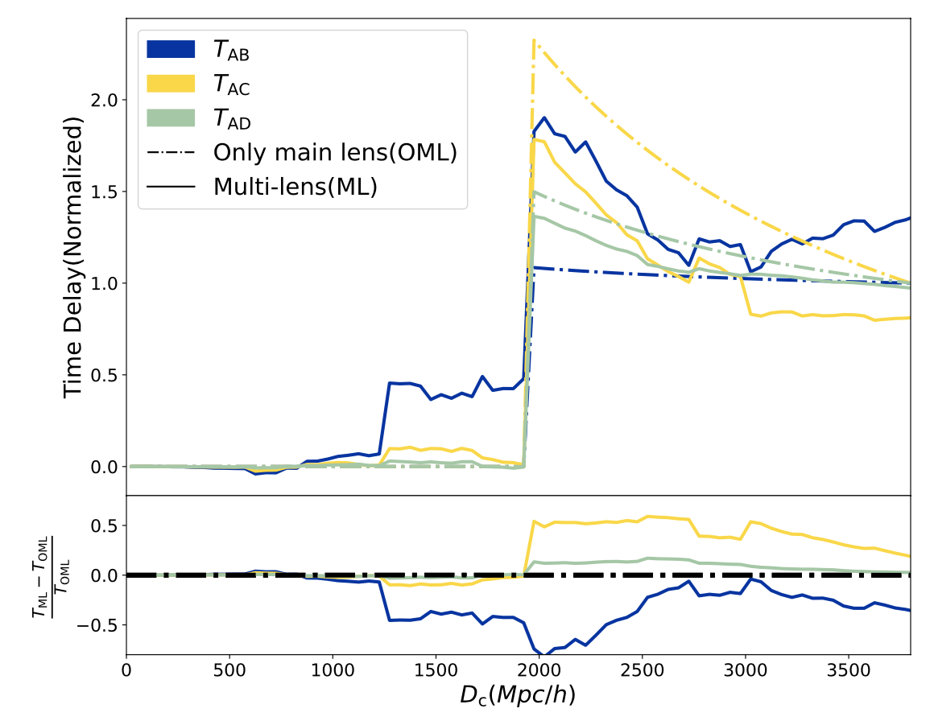
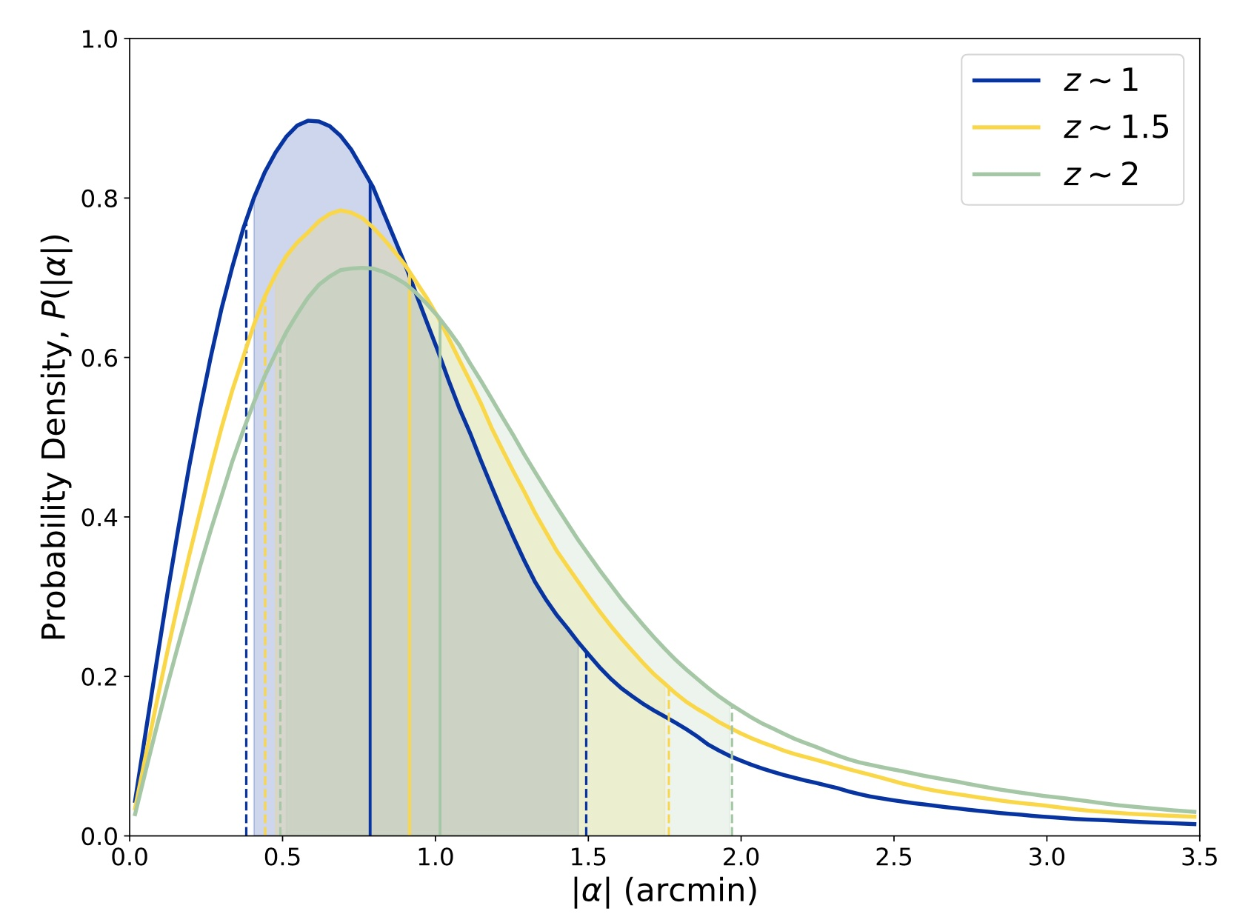
LoS Mass-Sheet Degeneracy
[Lin+ ApJS 2026]
WL deflection angle

Slide 17
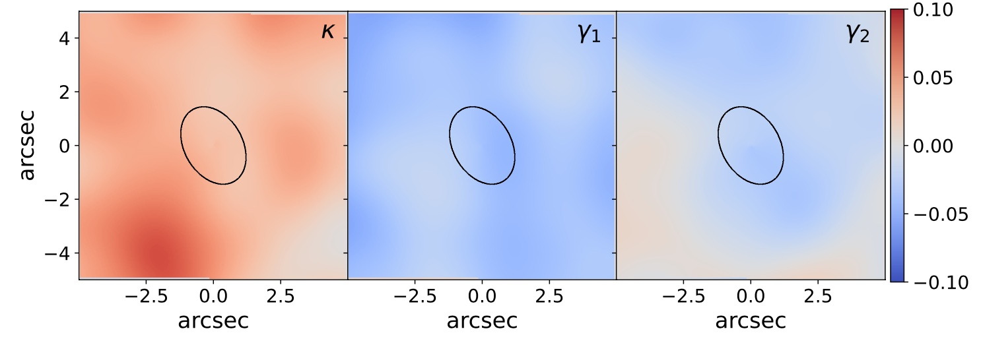
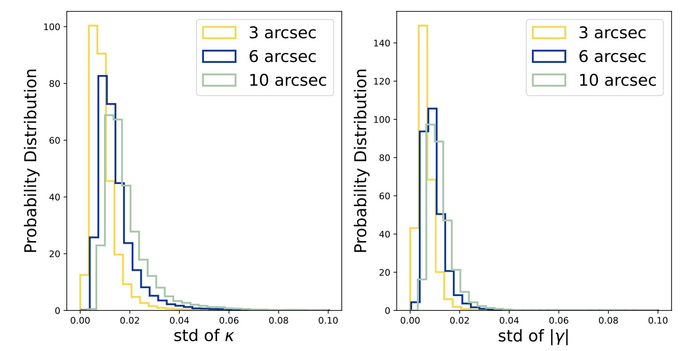
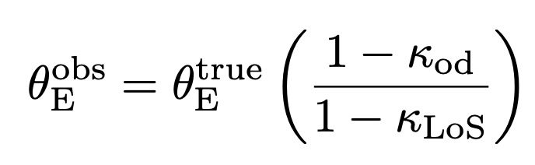
ds
main
lens
od

Slide 18
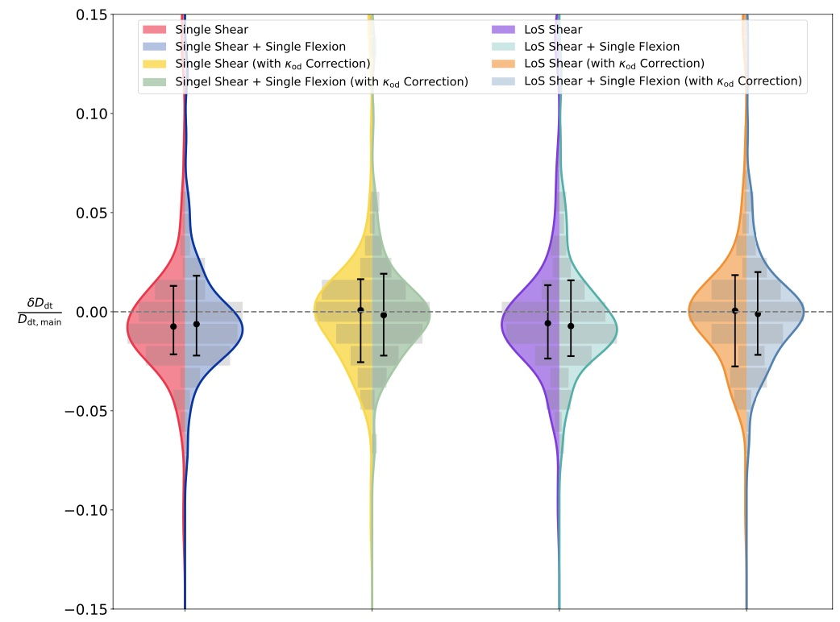
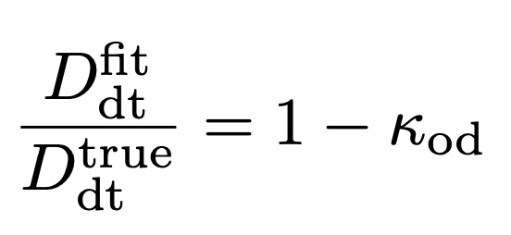
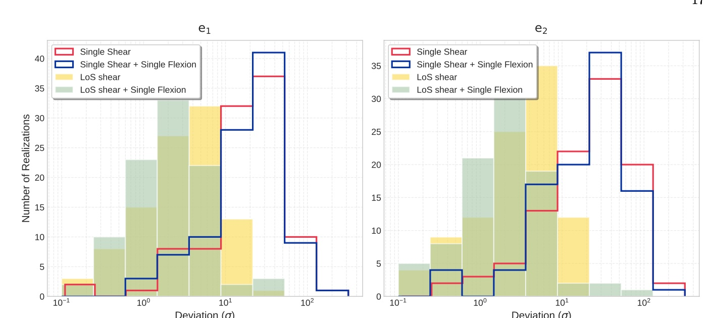
0.5%-0.8% bias

Slide 19
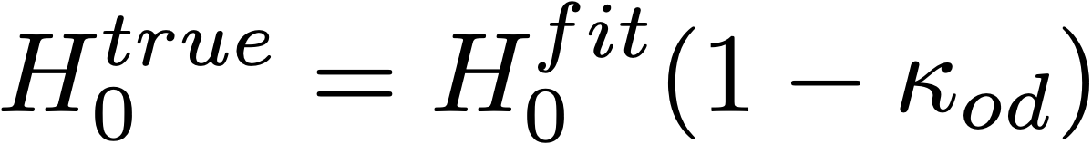
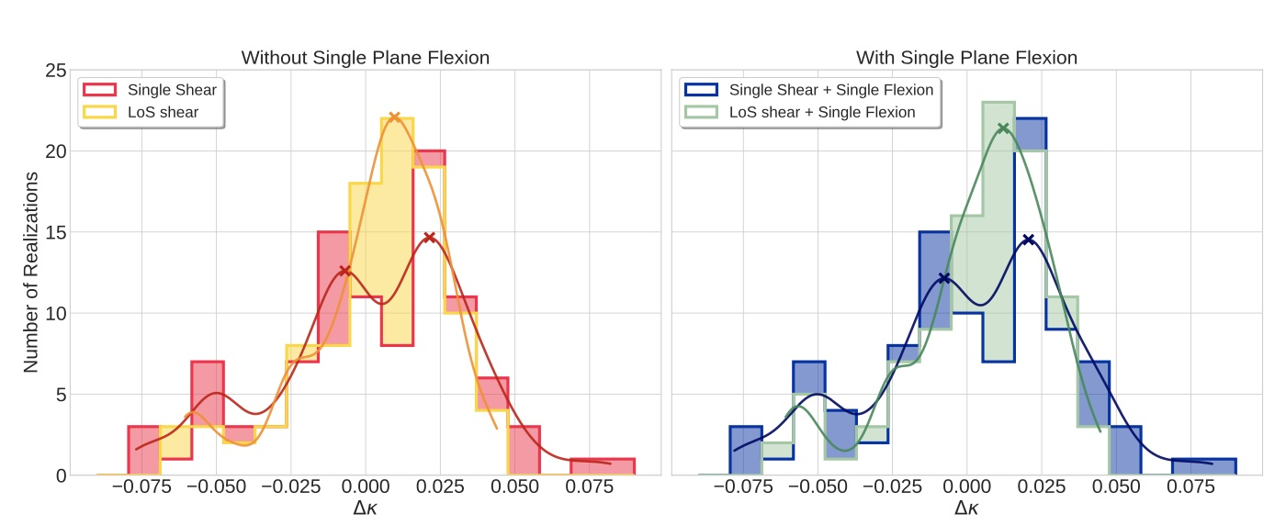
Flexion is irrelevant, but multi-plane is relevant.
Kappa_od can over estimate the distance by 0.5-0.8%
H0 is over estimated by 0.5-0.8%

Slide 20
Summary
Internal Mass-Sheet Degeneracy requests for more flexible mass modelling for the main lens galaxy
External Mass-Sheet Degeneracy asks for multi-plane modelling along LoS to achieve unbiased 1% distance estimation

Slide 21
3. Site & MOST-1.93

Slide 22
Global Distribution of General-purpose Optical Telescope (2m)
China West is a blank area, it has 2.5 hr time lag from East
[credit: Fu Jianning]

Slide 23
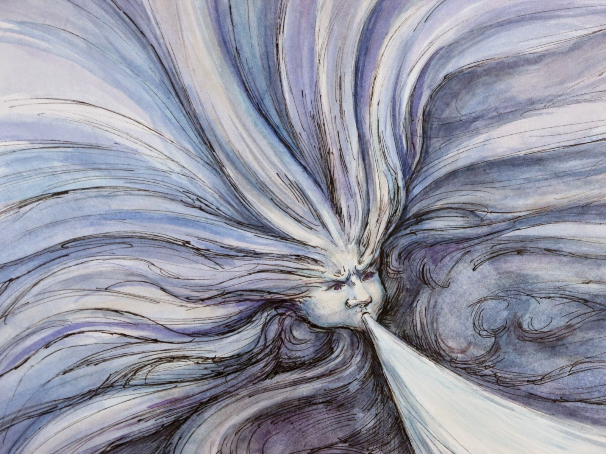

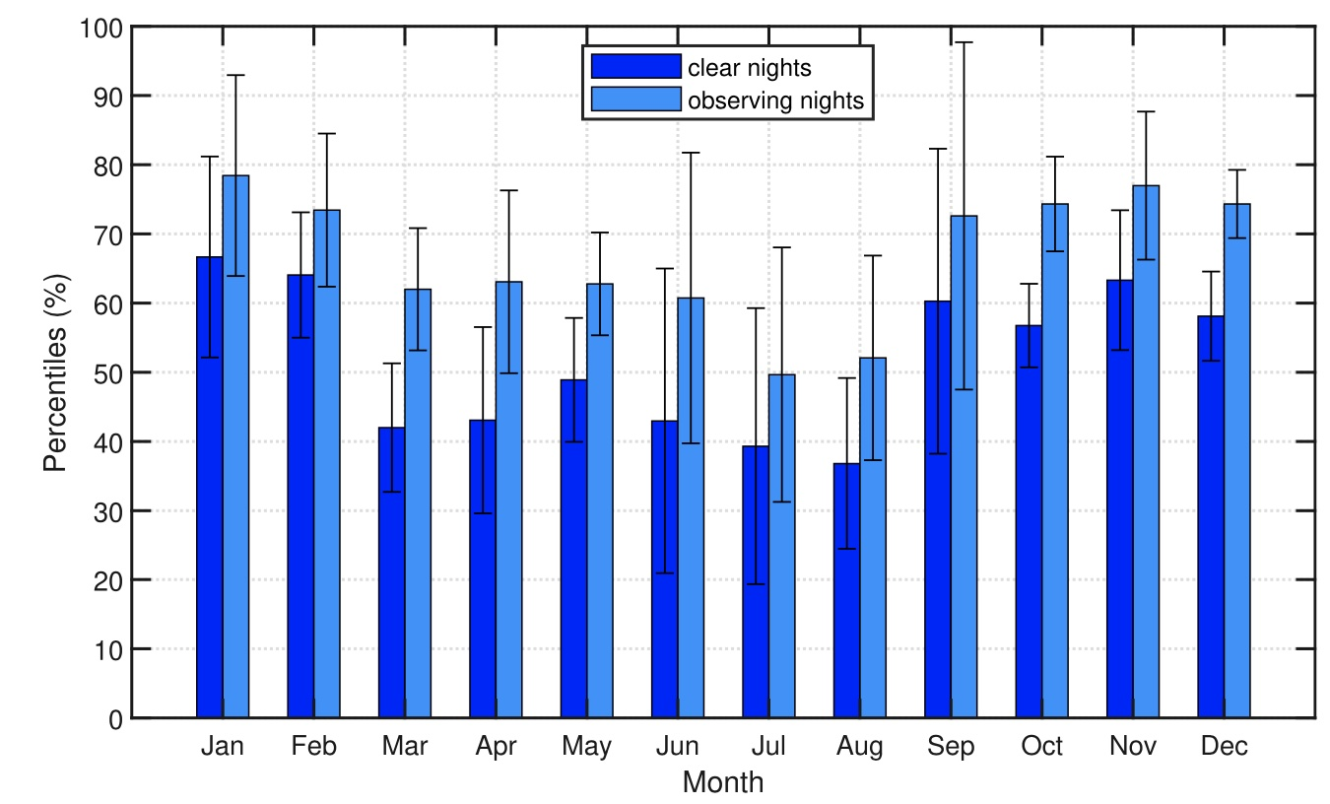

The Last Tear of the Atlantic
Observing night: 220+/yr, excellent July/August
[2023, RAA, 23 045015]
2017-2021
Ali@XAO

Slide 24
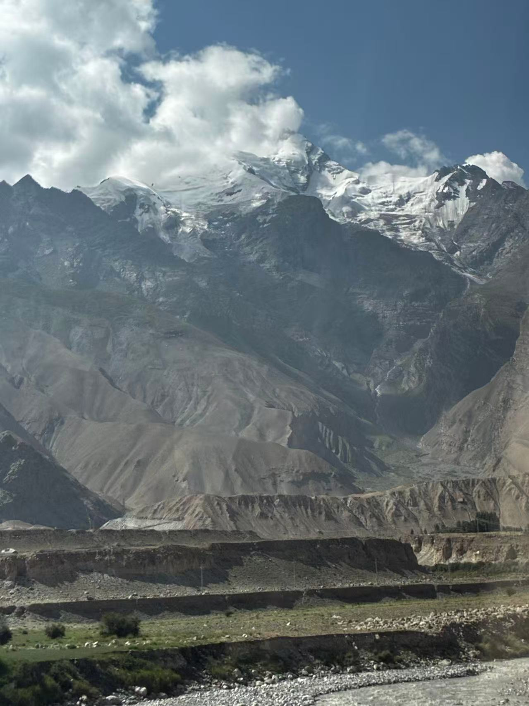
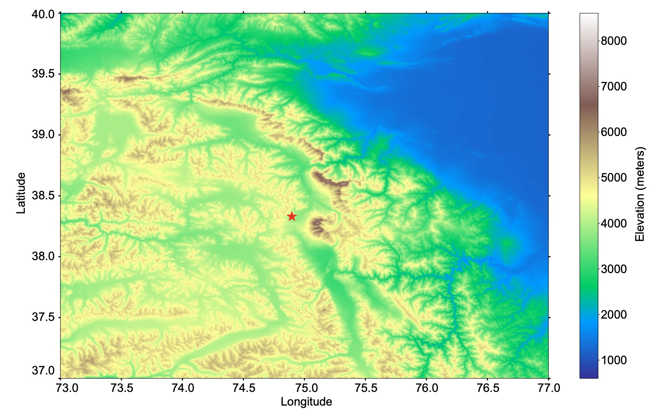
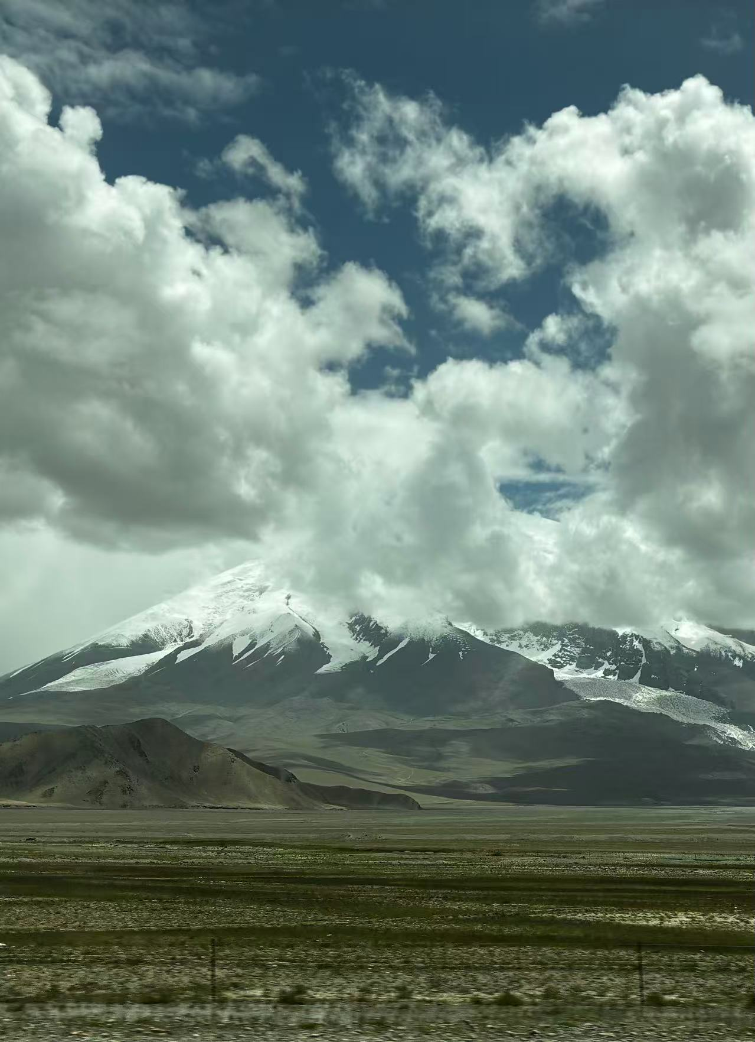
[2025，MNRAS，Zhang+]
中国/China
塔里木盆地
Tarim basin
公格尔峰7700m
Kongur Tagh
Kongur
慕士塔格峰7500m
Mustagh-Ata
塔吉克斯坦
Tajikistan
11km
Mustagh

Slide 25
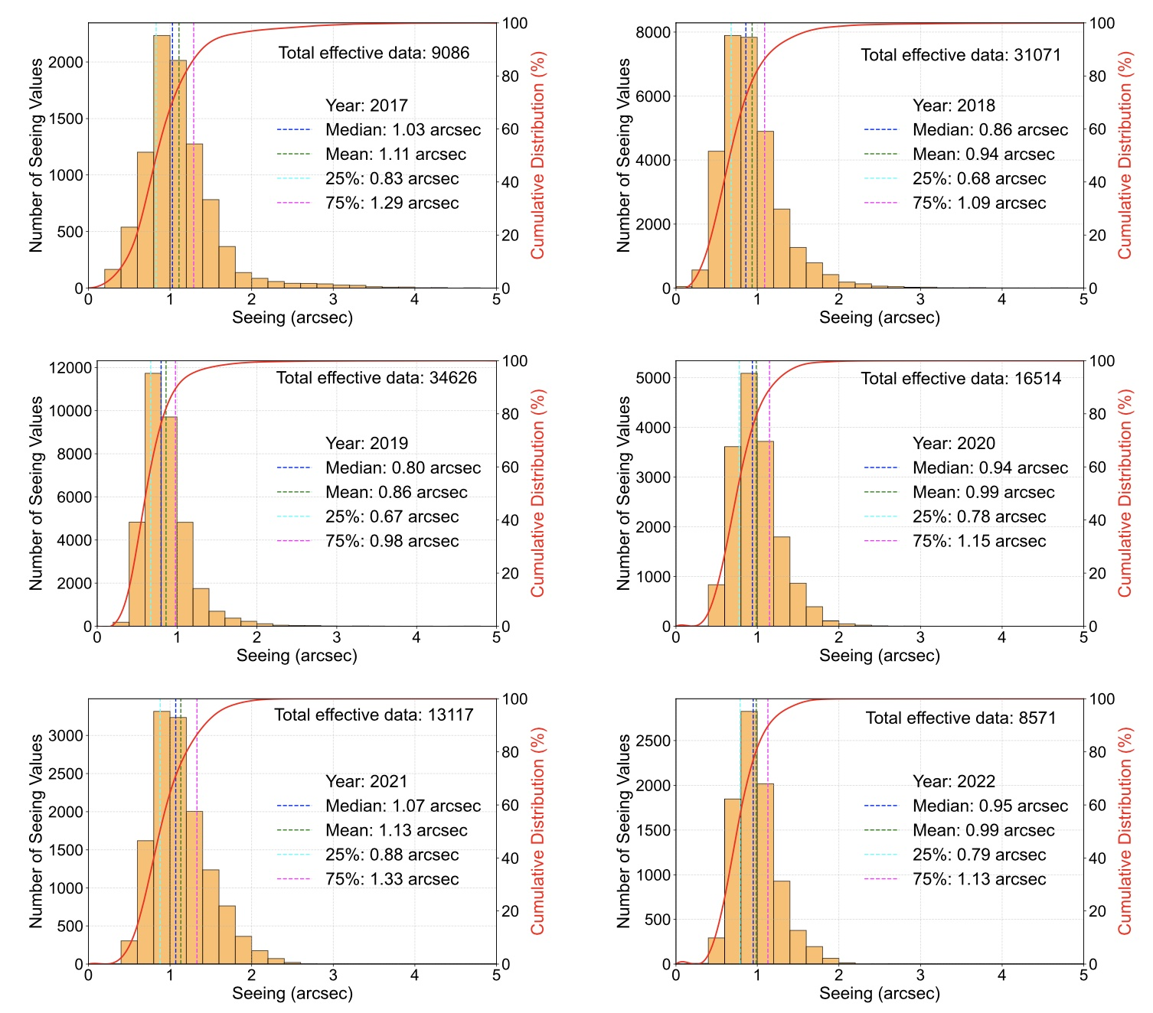
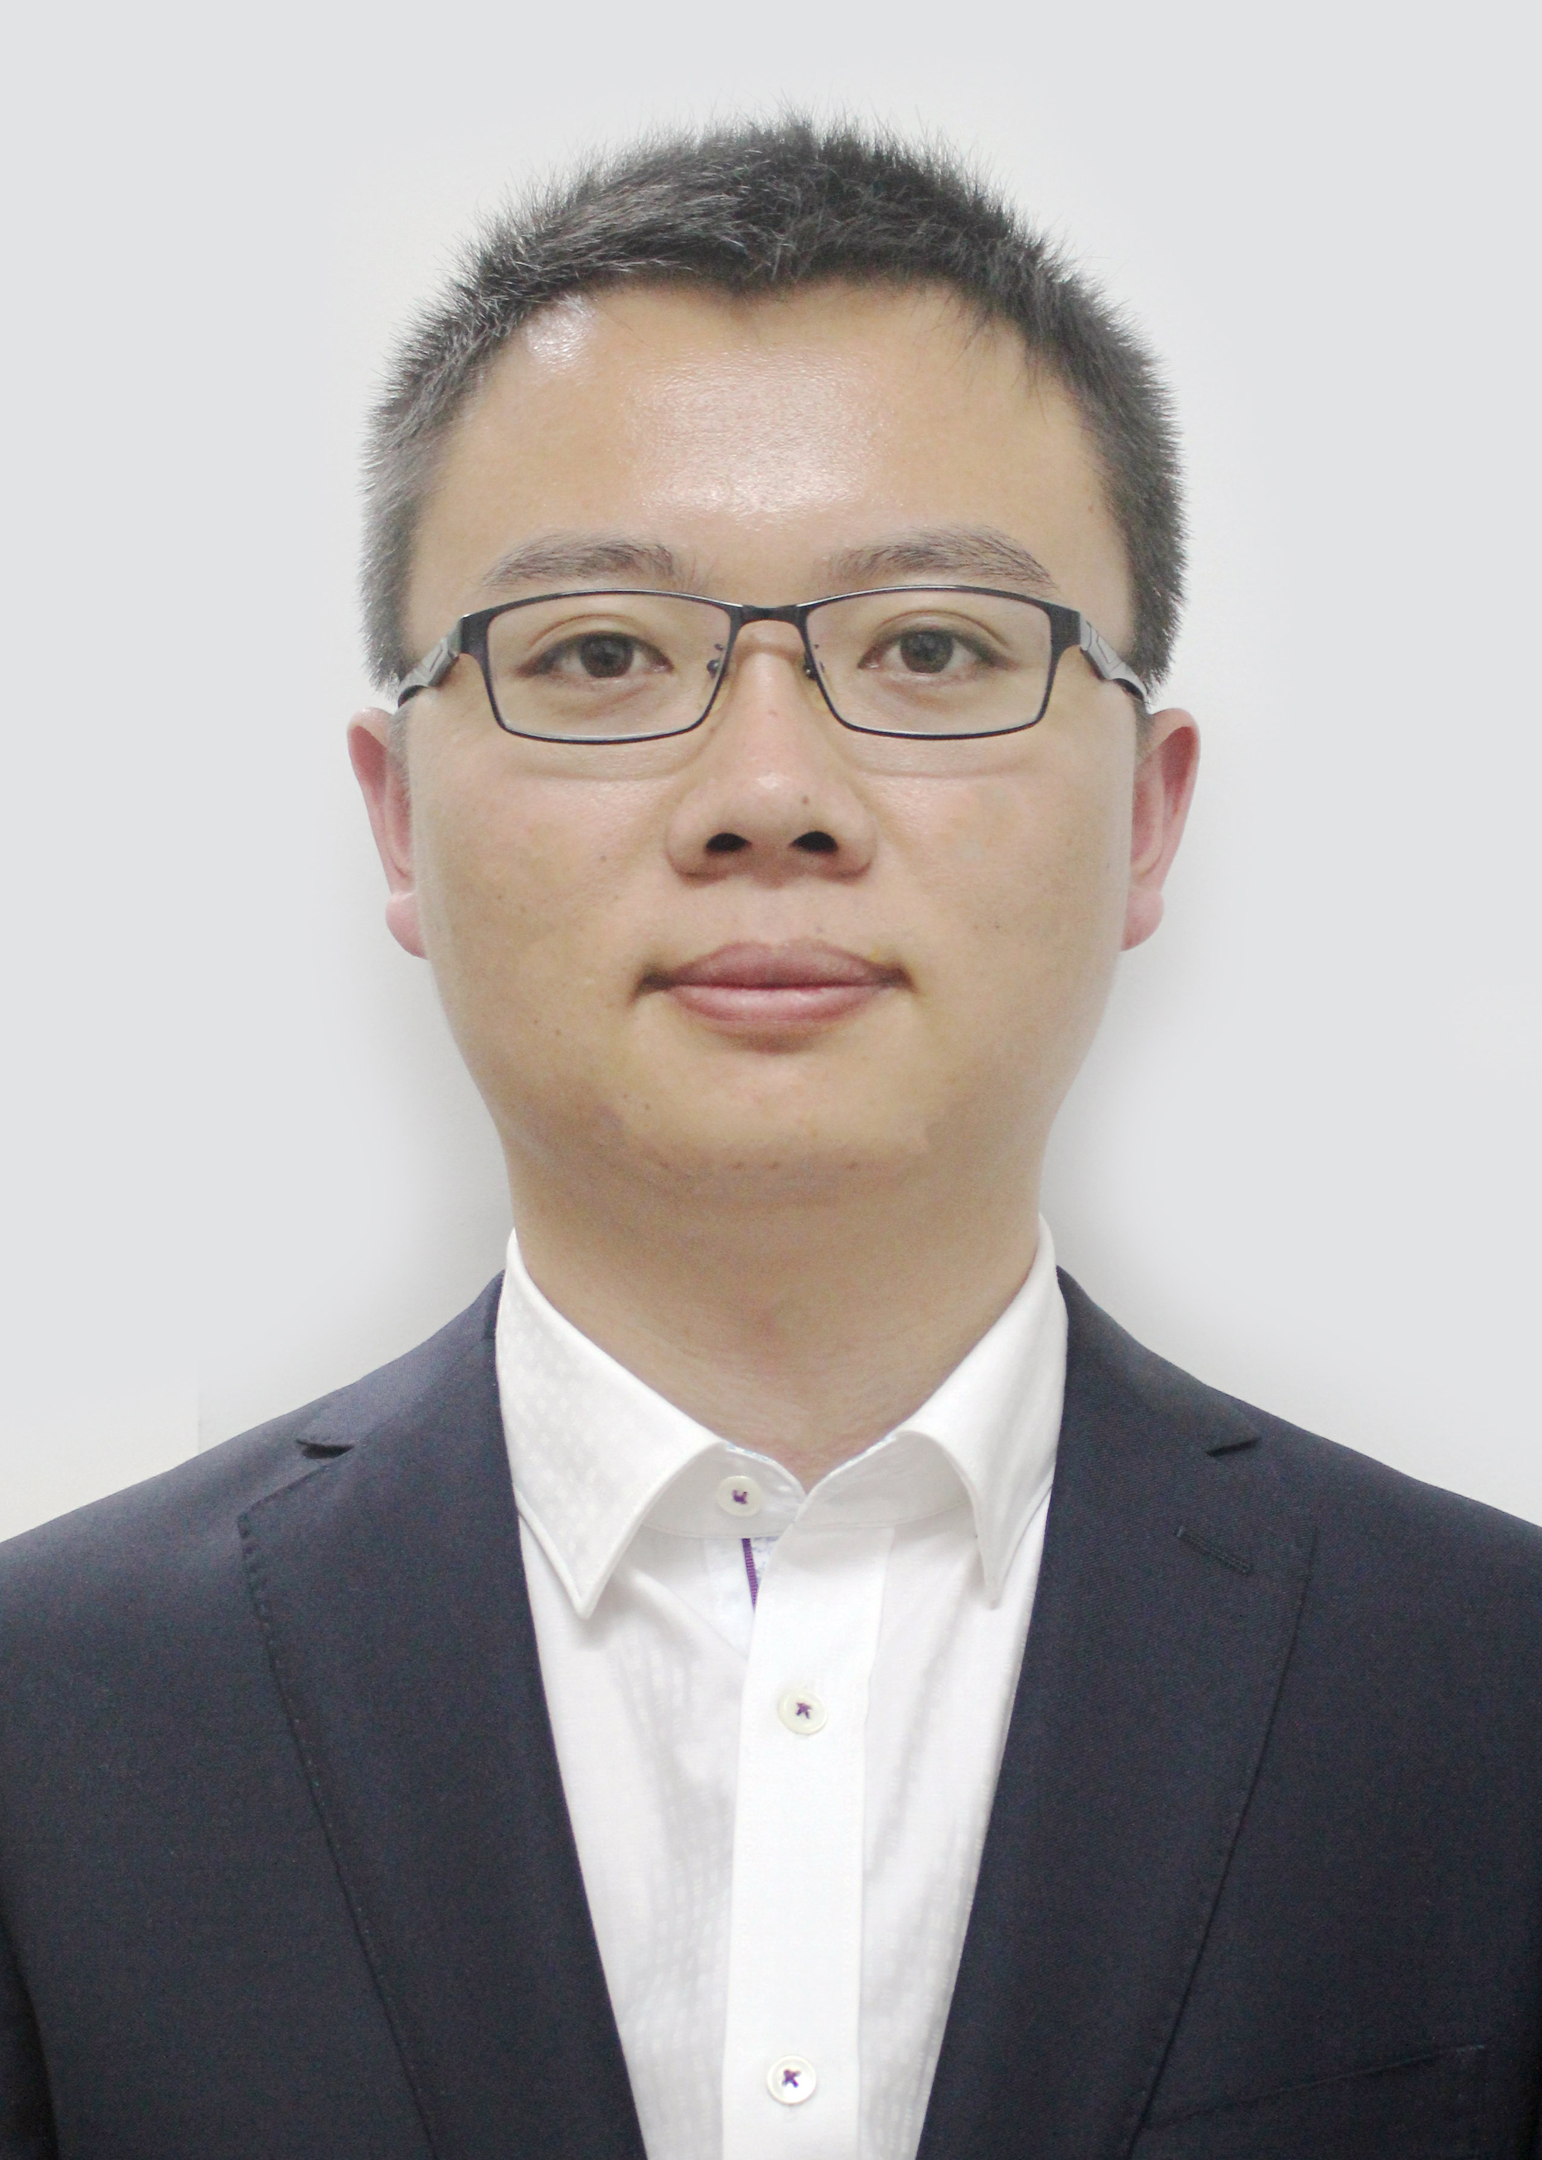
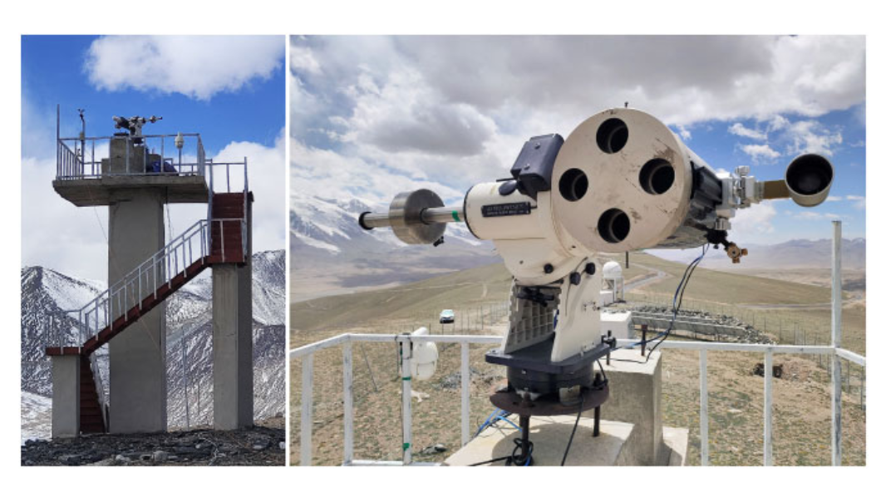
Seeing Over 6yrs
Zhang Jicheng @BNU
[Zhang+，2025，
MNRAS 539.2077Z]

Slide 26
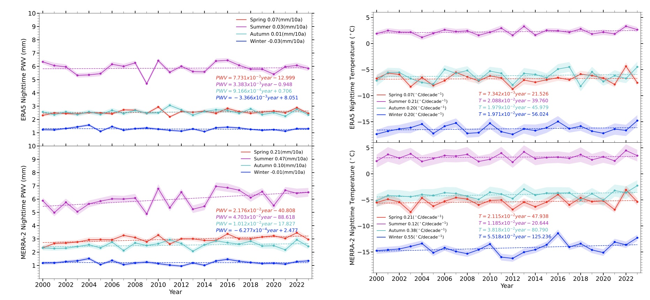
PWV: 1mm @ Winter; 6 mm @ Summer
[Zhang+，2024，MNRAS，535，3543]

Slide 27
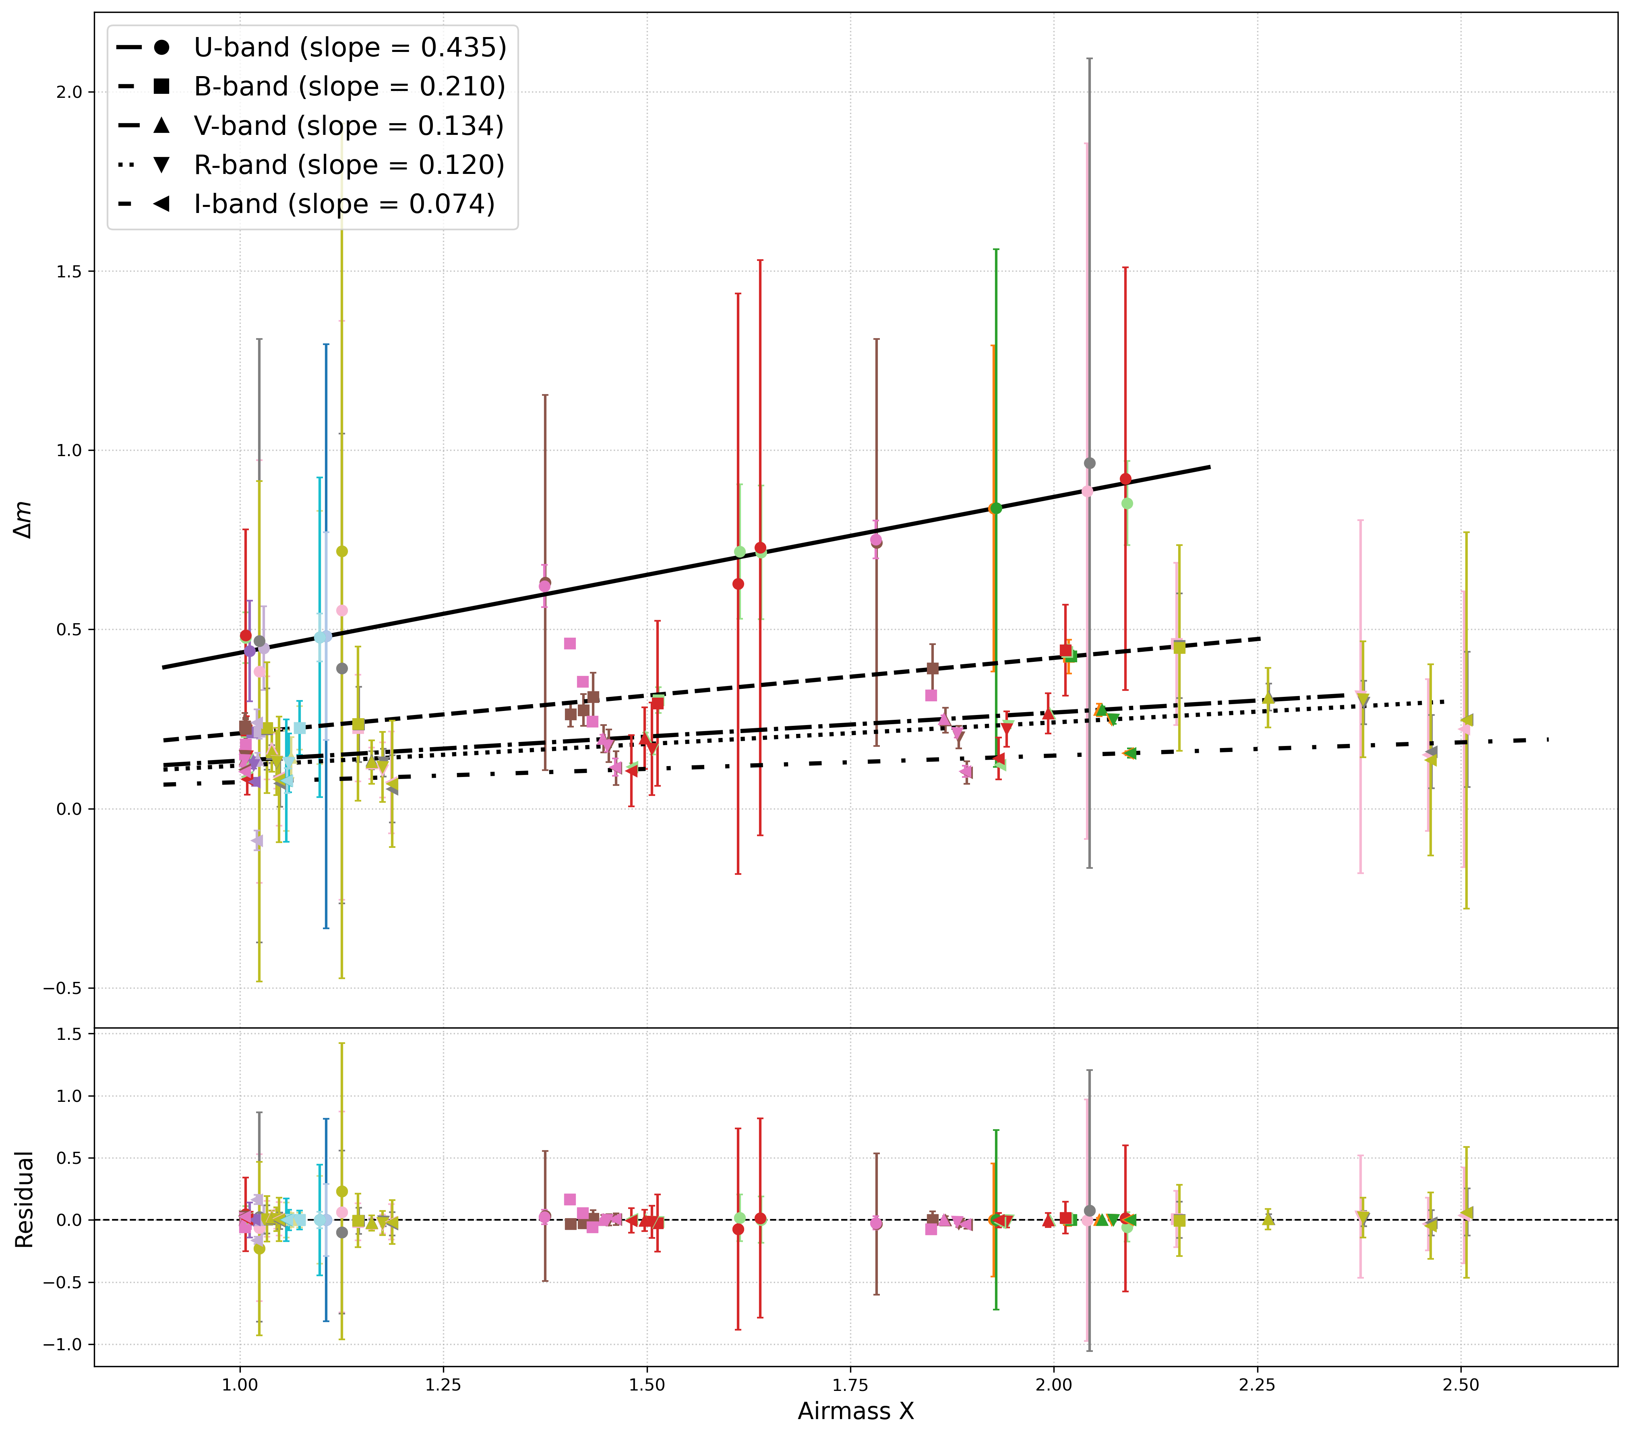
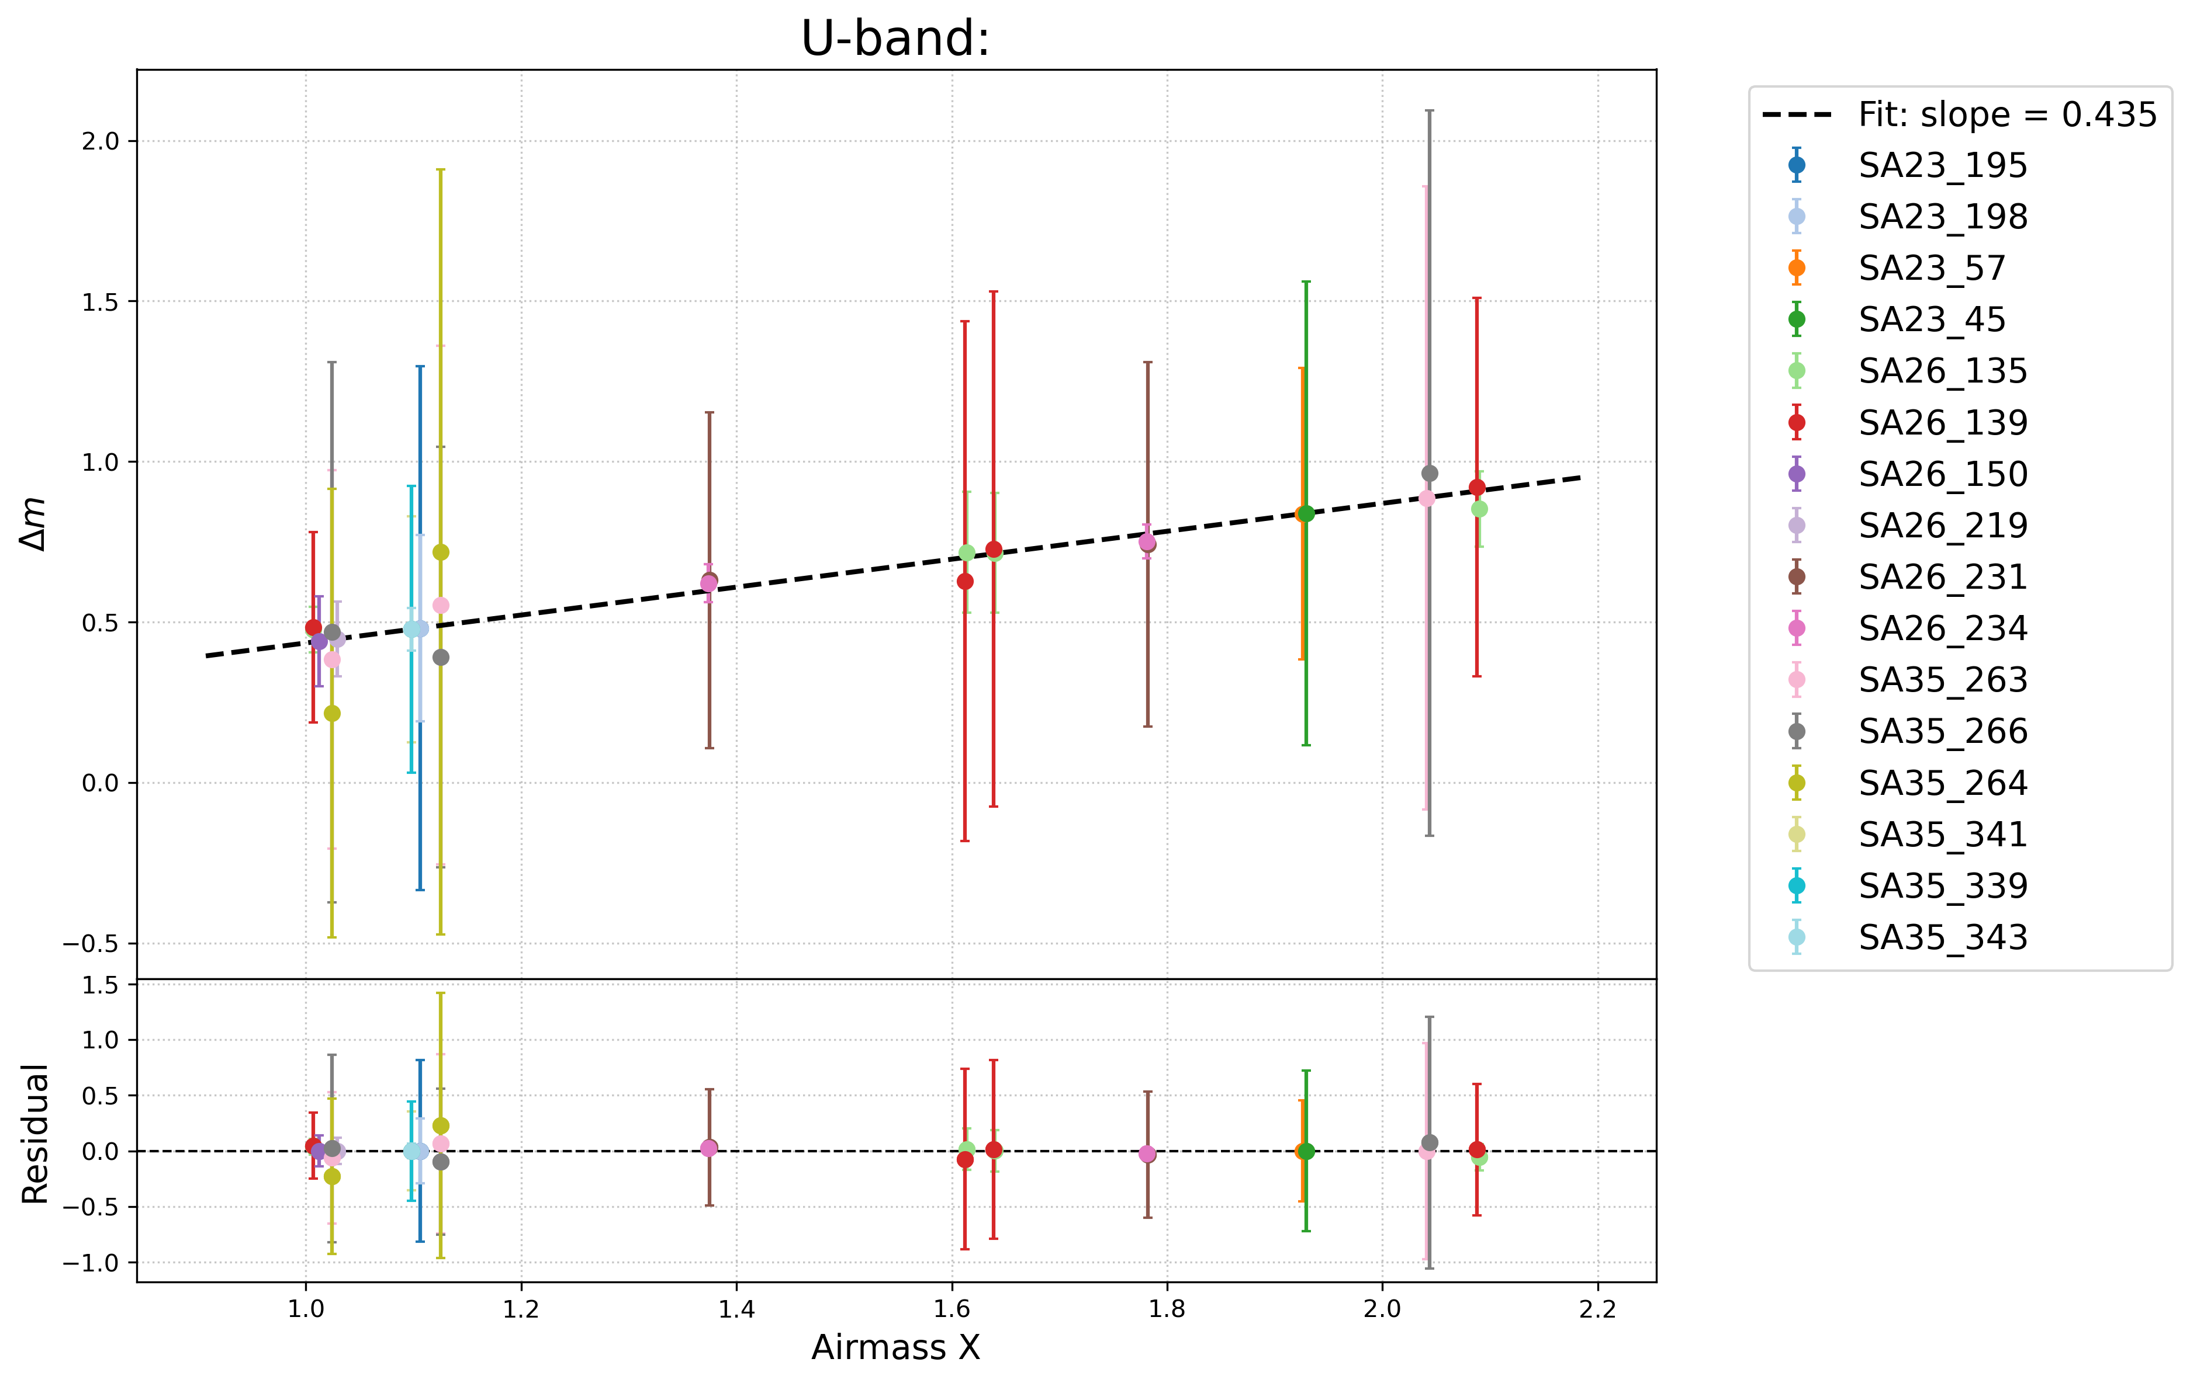
March 2026 u-band extinction 0.44
Mugstagh Site 2026
Xinlong Site 2016
kU=0.435 (0.59); kB=0.21 (0.431); kV=0.134 (0.282); kR=0.12 (0.217); kI=0.074 (0.156)
Deeper in u-band about 1 mag

Slide 28
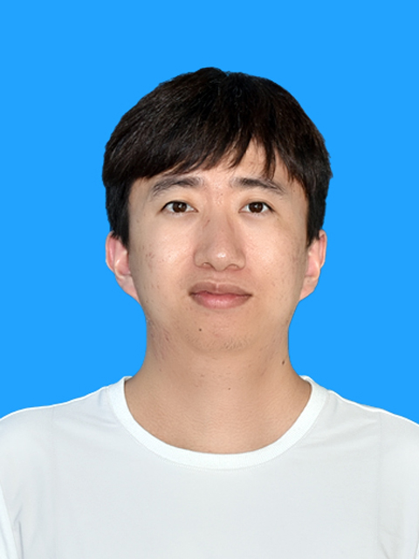
Observable Region
Dong Jiang @ BNU

Slide 29
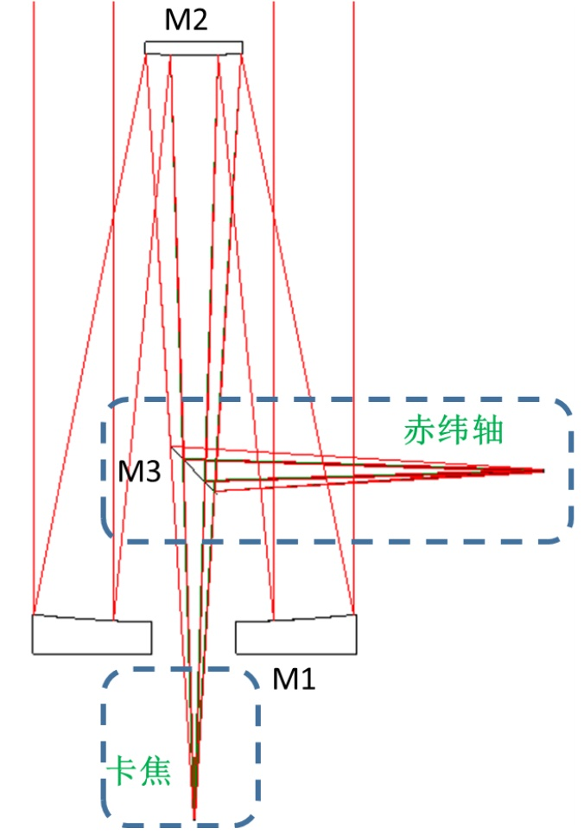
Mechanical Sys：Fork Mount，Truss Tube
Optics Sys：Ritchey-Chretien
Focus：Cassegrain (folded)、Declination、Coudé
Cassegrain
folded
focus
Declination focus
spectrograph
Cassegrain
focus
3-color imager
Coude
focus

Slide 30
Parameters
Aperture | 1.93m | Elevation | 4500m
Seeing | 0.89’’ (mid value) | Pointing | RMS<1’’
Spectragraph | 500/1500/2000/5000 | Tracking | RMS<0.3’’
CCD | 4k/15mu | FoV | 20’
Polarisation | resol 77000 Pol accur 0.1% | Sky Brightness | 21.77 (V)
Photograph | ugi / vrz (320~1100) | Optical Efficiency | >45% (350-1100)

Slide 31
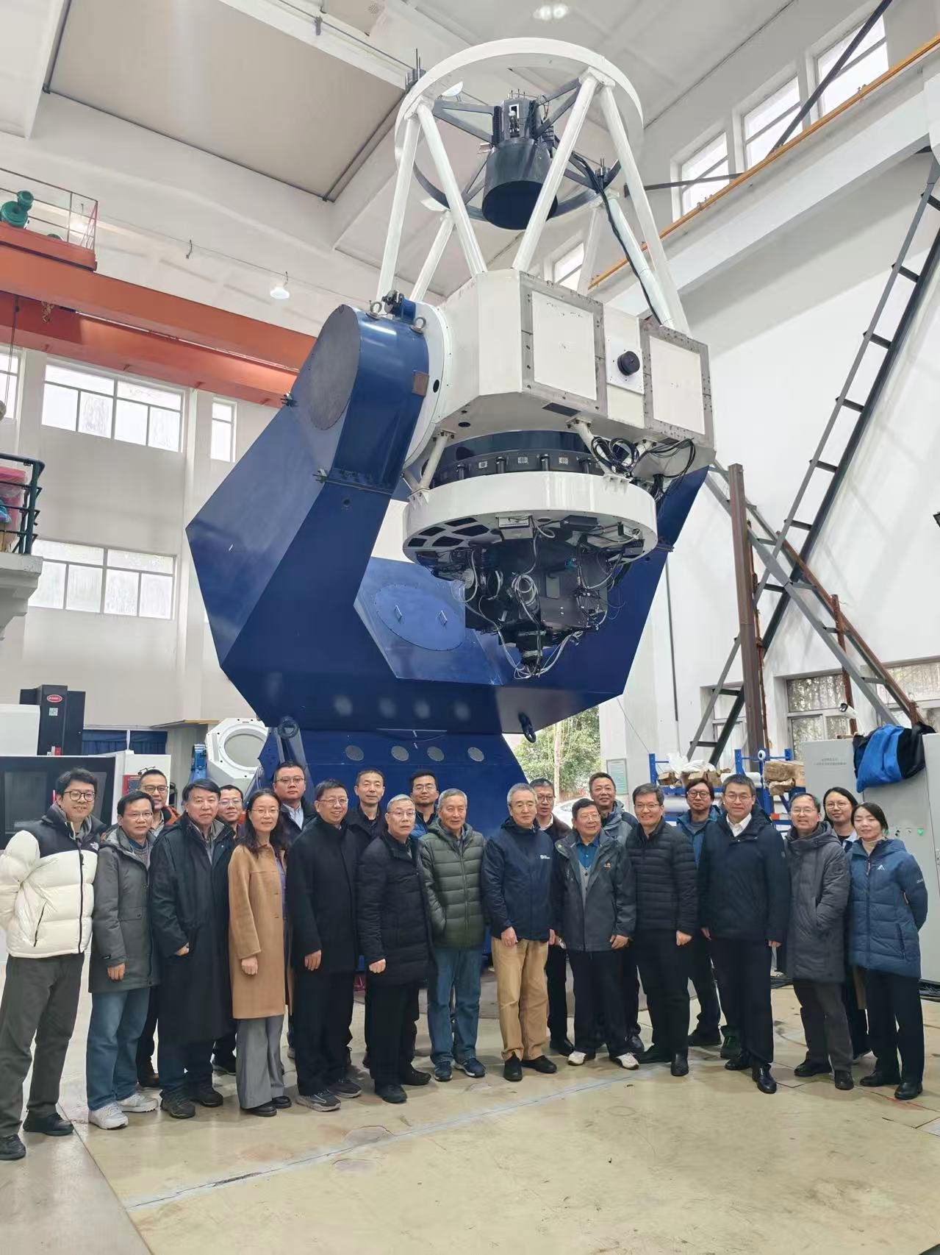
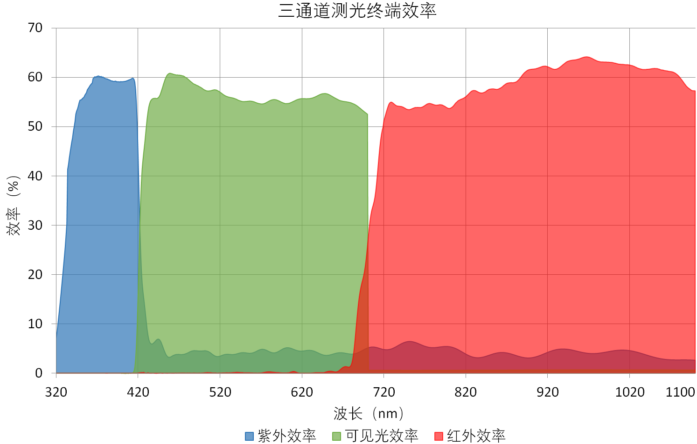
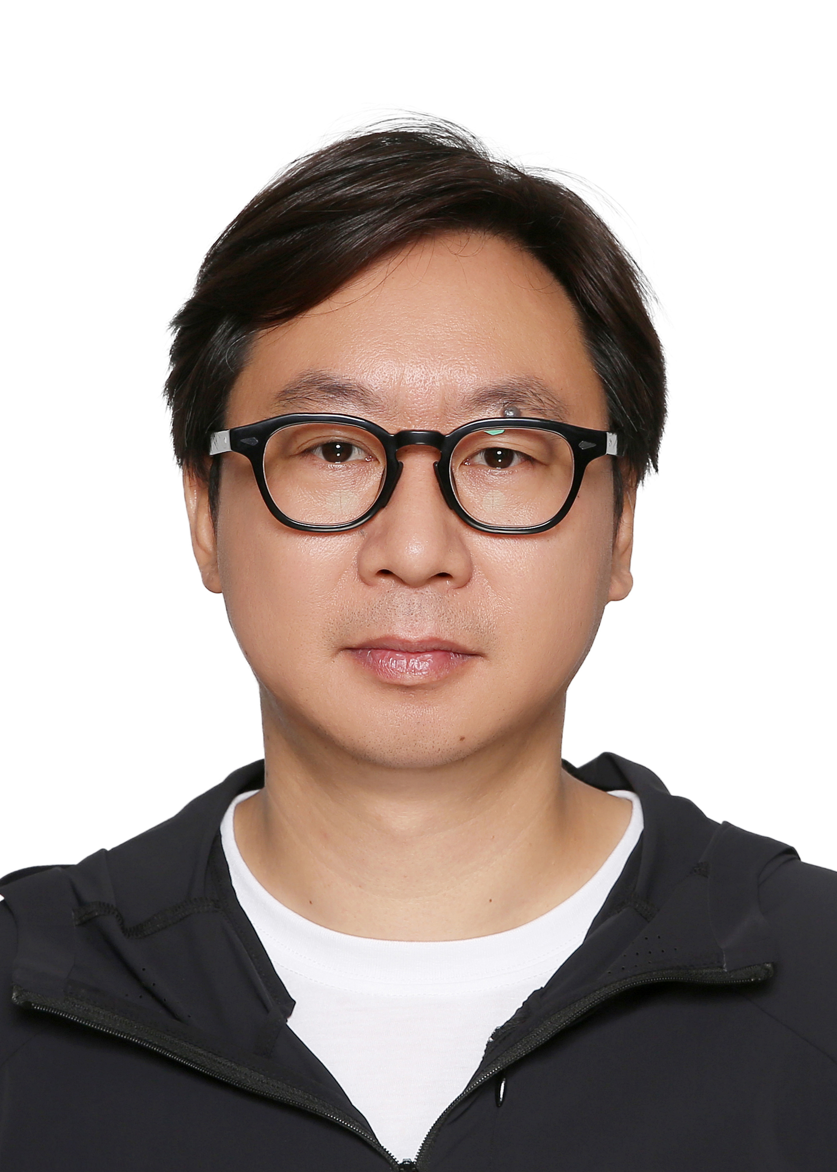
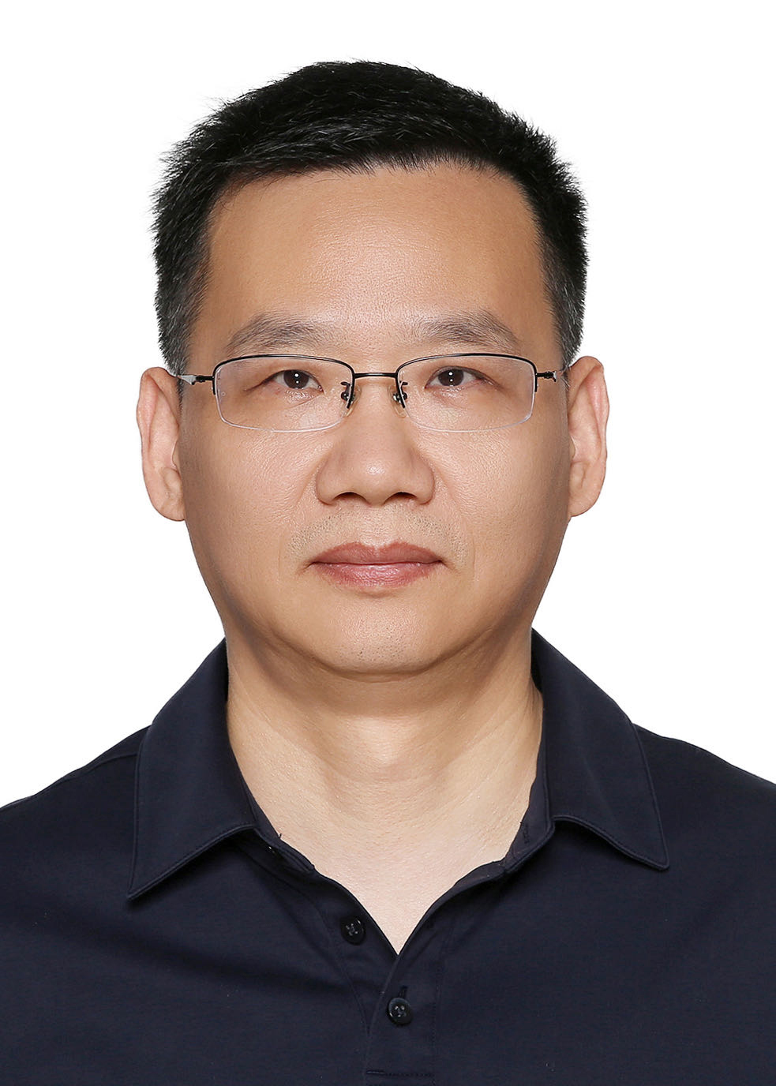
3-color imager
Throughputs 53%
天光所实测星象
Jiang Xiang
Kou Songfeng

Slide 32



Spectrograph
540-1000nm
310-560nm
Ji Hangxin
 | Wave length | Resolution | Peak efficiency | Slit
Blue | 310-560 | 500，1500，2000，5000， | >40% >25% | 0.8’’ 1.5’’
Red | 540-1000

Slide 33

July 7 2026, FWHM=0.8’’

Slide 34




Mock Data Challenge

Slide 35
Summary
Muztag-Ata Site has World class observational condition, eg. UV transmittance & Excellent July/August
Aiming for a autorobsotic telescope at 4500m
Milli-mag photometry accuracy, limiting Mag=24 (PS)
Complimentary Spectrograph for photo-survey, limiting Mag=21 (PS), 18 (gal)
3-color simultaneous photograph：AGN disk size, Microlensing, 5yr high cadence monitoring for glQSO can reach H0~2%

