Slide 1

Core-collapse supernova simulations coupled with dark photons
Kanji Mori
Department of Physics, Keio University
KM, T. Takiwaki, & K. Kohri, PRD, 113, L041303 (2026)

Slide 2

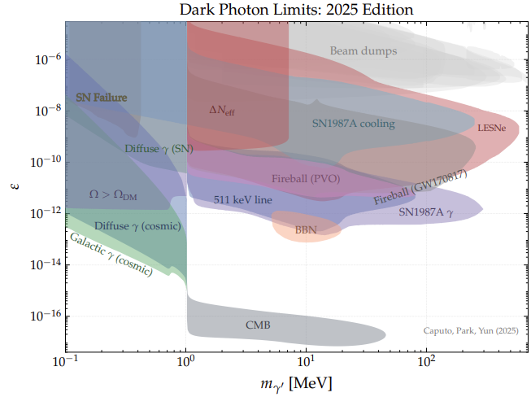
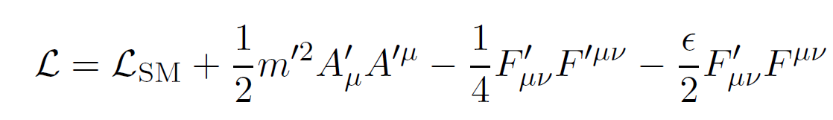
Dark Photon
ⒸHiggs-tan
Hypothetical boson that arises from an extra U(1) symmetry
A dark matter candidate
Interact with photons through kinetic mixing:
Kinetic mixing
Caputo et al., (2025) arXiv:2511.15785

Slide 3
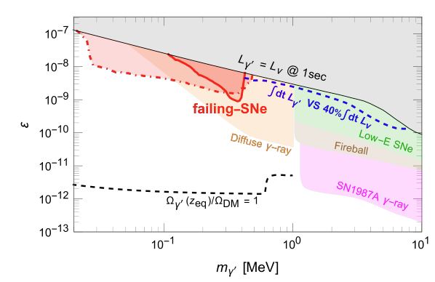
Supernova Failure by ~100 keV Dark Photons?
Caputo et al., PRL 134 (2025) 151002
Dark photons produced in the stellar core can prevent supernova explosion.
⇒ a new constraint on dark photons
Assumption: If the exotic cooling rate exceeds 20% of the neutrino heating rate, explosion will be failed.
⇒ Simulations are needed to verify the idea!

Slide 4
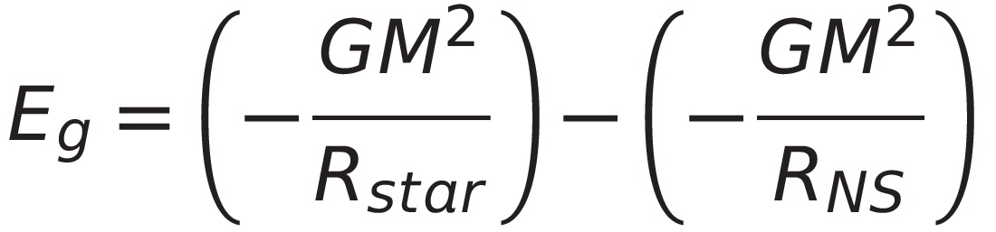
Neutrino-driven Supernova Explosion
Fe
Gravitational energy release
≈ 10⁵³ erg
~5000 km
~10 km
Neutrino energy
E_{ν} = 10⁵³ erg
~1 s
1% energy transfer through neutrino-nucleon interactions
Kinetic energy of ejecta
Neutron star
E_{exp} = 10⁵¹ erg (= 1 Bethe)
~10 km
Neutrino heating is essential for successful supernova explosion

Slide 5
Dark Photon Production in Supernovae
Resonant production of dark photons
γ'
Since DPs freely escape from the star, DP production leads to an additional cooling process.
DPs may cancel neutrino heating and prevent supernova explosion.
ν
Stalled shock
Shock
ν
PNS
PNS
γ'
γ'
ν
[Caputo et al., PRL 134 (2025) 151002]
ν
ν
For details on DP production rates, see
ν
[An, Pospelov & Pradler, PLB (2013)]
[Chang, Essig & McDermott, JHEP (2017)]
γ'

Slide 6
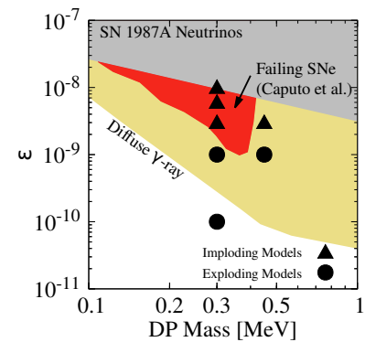
Neutrino-radiation Hydrodynamic Simulations Coupled with Dark Photons
Code: 3DnSNe [Takiwaki, Kotake & Suwa MNRAS 461 (2016) L112]
Neutrino transport: IDSA [Liebendörfer, Whitehouse, & Fischer ApJ 698 (2009) 1174]
Dimension: 2D (axisymmetric)
EoS: LS220
Dark photon production:
nucleon bremsstrahlung (n+p -> n+p+γ’)
Progenitor: 14+9M☉ merger model
“SN 1987A progenitor model”
[Urushibata et al., MNRAS 473 (2018) L101]
Resolution: N_{r}×N_{θ} = 512×128

Slide 7
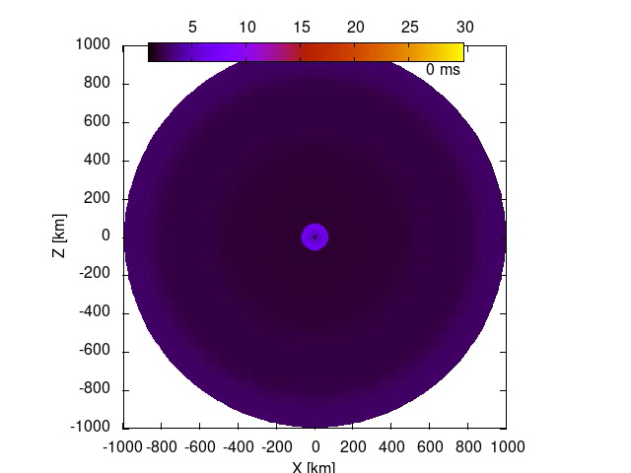
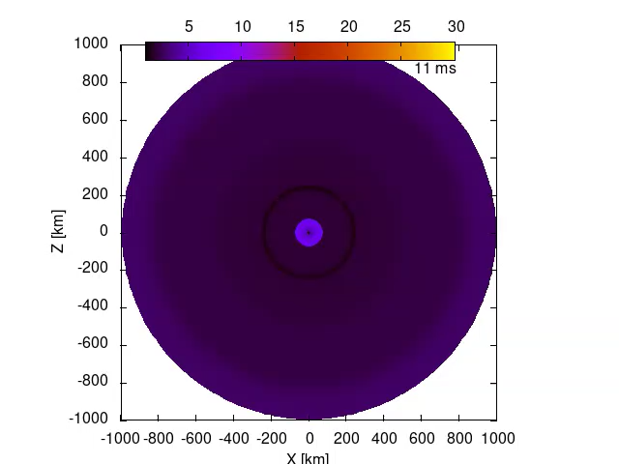
Model with dark photon
(m_{γ’} = 0.3 MeV, ε= 3×10⁻⁹)
Model without dark photon
Entropy plot
Dark photons hinder SN explosion!

Slide 8
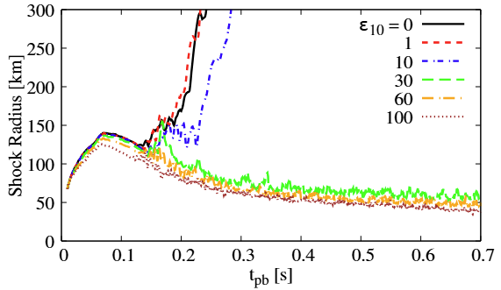
Shock Radius
(ε₁₀=10¹⁰ε)
When dark photons are considered, the shock revival is delayed.
When ε is sufficiently large, the shock is not revived until the end of the simulations.
Successful explosion
Failed explosion
m_{γ’} = 0.3 MeV
KM, Takiwaki, & Kohri, PRD, 113, L041303 (2026)

Slide 9
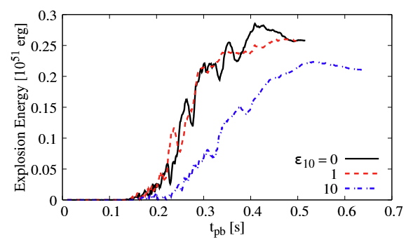

Explosion Energy
(~ kinetic energy of supernova ejecta)
KM, Takiwaki, & Kohri, PRD, 113, L041303 (2026)
(ε₁₀=10¹⁰ε)
When dark photons are considered, supernova explosion becomes weaker.

Slide 10
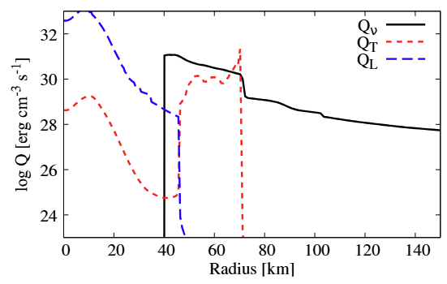
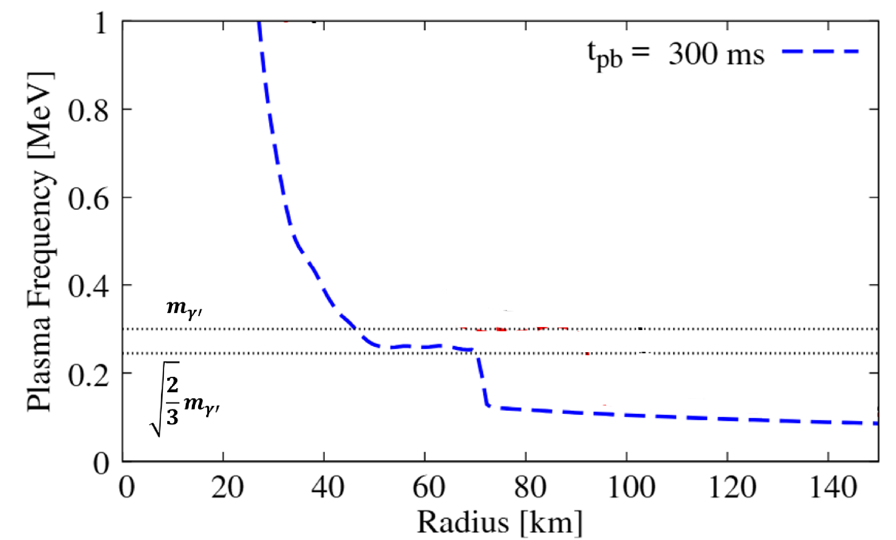
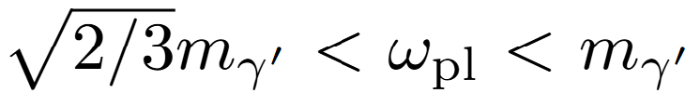
Dark Photon Production
Heating & cooling rates @ t_{pb}=300 ms
Plasma frequency (“photon mass”)
In-medium resonance condition:
ν-heating rate
DP-cooling rate
(T-mode)
m_{γ’} = 0.3 MeV,
ε= 3×10⁻⁹
DP-cooling rate
(L-mode)
Resonance
KM, Takiwaki, & Kohri, PRD, 113, L041303 (2026)
The (T-mode) resonance appears when m_{γ’} is close to plasma frequency.
Production of dark photons in the neutrino heating region!

Slide 11
SN 1987A Explosion Condition
Condition for successful SN 1987A explosion:
ε≲3×10⁻⁹ for m_{γ’} = 0.30-0.45 MeV
SN explodability can provide a new constraint on dark photons!
Qualitatively consistent with Caputo et al.
Sensitivity studies on uncertain factors (e.g. EoS) are, of course, important to make the constraint more confident.
KM, Takiwaki, & Kohri, PRD, 113, L041303 (2026)

Slide 12
What if dark photons are heavier?
e-e+ mass
Caputo et al., (2025) arXiv:2511.15785
KM, Takiwaki, & Kohri, PRD, 113, L041303 (2026)
If dark photons are heavier than 1 MeV, they can decay into e-e+.
→ Dark photons can energize supernovae.

Slide 13
Summary
Dark photons (m_{γ’}~0.3 MeV) will hinder SN explosion.
Production of dark photons in the neutrino heating region causes cooling.
A new constraint can be obtained based on SN explodablity.
We verified the argument with self-consistent simulations.
Sensitivity studies on simulation uncertainties would be important.

Slide 14
Explosion Mechanism of Core-collapse SNe
Core collapse
Core bounce
Shock propagation
~1000 km
~10 km
Shock
ν
ν
Fe
ρ_{c}~3×10¹⁴ g/cm³
Fe
PNS
ν
ν
Bounce shock
~1 s
SN explosion
Shock breakout
Shock
~ day
PNS
PNS

Slide 15
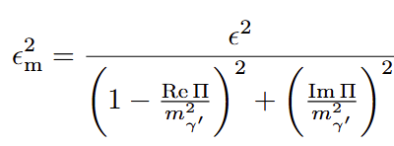

Dark Photon Production in Supernovae
Resonant production of dark photons
γ'
Effective mixing parameter in plasma:
ν
Stalled shock
Shock
ν
PNS
Π: Polarization tensor
PNS
γ'
γ'
If ,
ν
dark photons are resonantly produced!
ν
ν
[An, Pospelov & Pradler, PLB (2013)]
[Chang, Essig & McDermott, JHEP (2017)]
ν
DP cooling may cancel neutrino heating and prevent supernova explosion.
γ'
[Caputo et al., PRL 134 (2025) 151002]

Slide 16
What if dark photons are heavier?
The constraint disappears when dark photons are heavier, because the resonance appears in the cooling region.
Impact on PNS convection?
KM, Takiwaki, & Kohri, PRD, 113, L041303 (2026)

