Slide 1
PRODUCTION COVER
“15+5 Min Parallel Talk”
This version: 5 July 2026.

Slide 2


Stone Skipping Black Holes in Ultralight Dark Matter Solitons
arXiv 2602.11512
Alan Zhang
Yourong Wang
J. Luna Zagorac
Richard Easther
CosPA 2026,
University of Canterbury
Front Cover: “Lake Mapourika, NZL”

Slide 3
Ultralight Dark Matter
A Scalar DM Candidate
m ~ 10⁻²² eV, behaves like CDM on large scales but self-smoothing at small scales.
λdB ~ kpc at Galactic Velocities
Wave mechanics of astrophysical proportions.

Slide 4
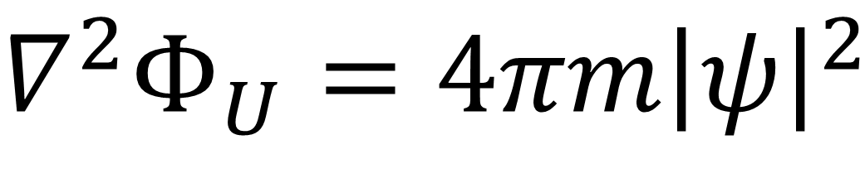
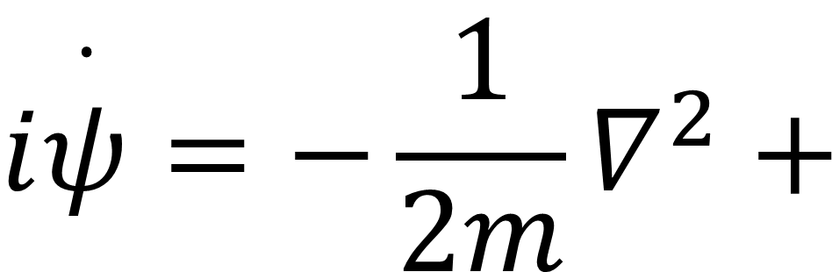


Ultralight Dark Matter
$$i\overset{·}{ψ}=−\frac{1}{2m}∇^{2}+$$
$$V$$
$$ψ$$
$$∇^{2}Φ_{U}=4πm{\left|ψ\right|}^{2}$$
A nonlinear modification to Schrödinger Equation,
giving the wavefunction an associated mass density.

Slide 5
Ultralight Dark Matter
Solitons at Halo Centres
Coherent ground state. Excitations carry dynamics.
(Self) Gravity
Quantum Pressure

Slide 6
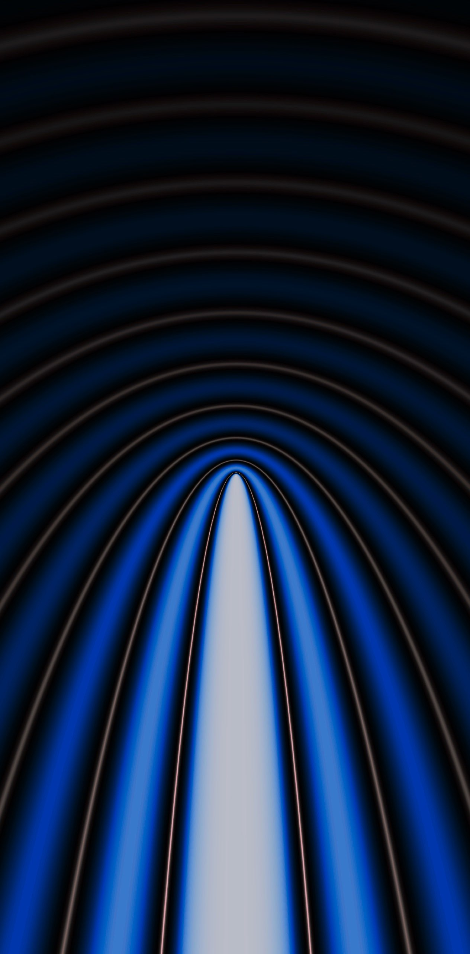
Dynamical Friction
Massive perturbers lose momentum to the wake in interstellar medium they create
Dynamical Friction. I. Chandrasekhar, S. (1943)
Wang & Easther (2110.03428)

Slide 7
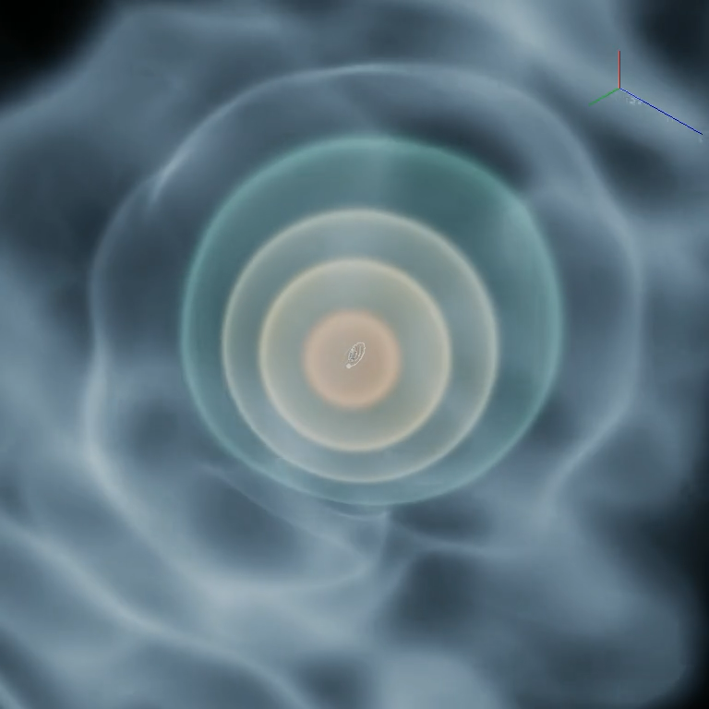
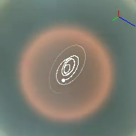
3D Animation of Stone Skipping
Mass BH : Mass Soliton = 0.01

Slide 8
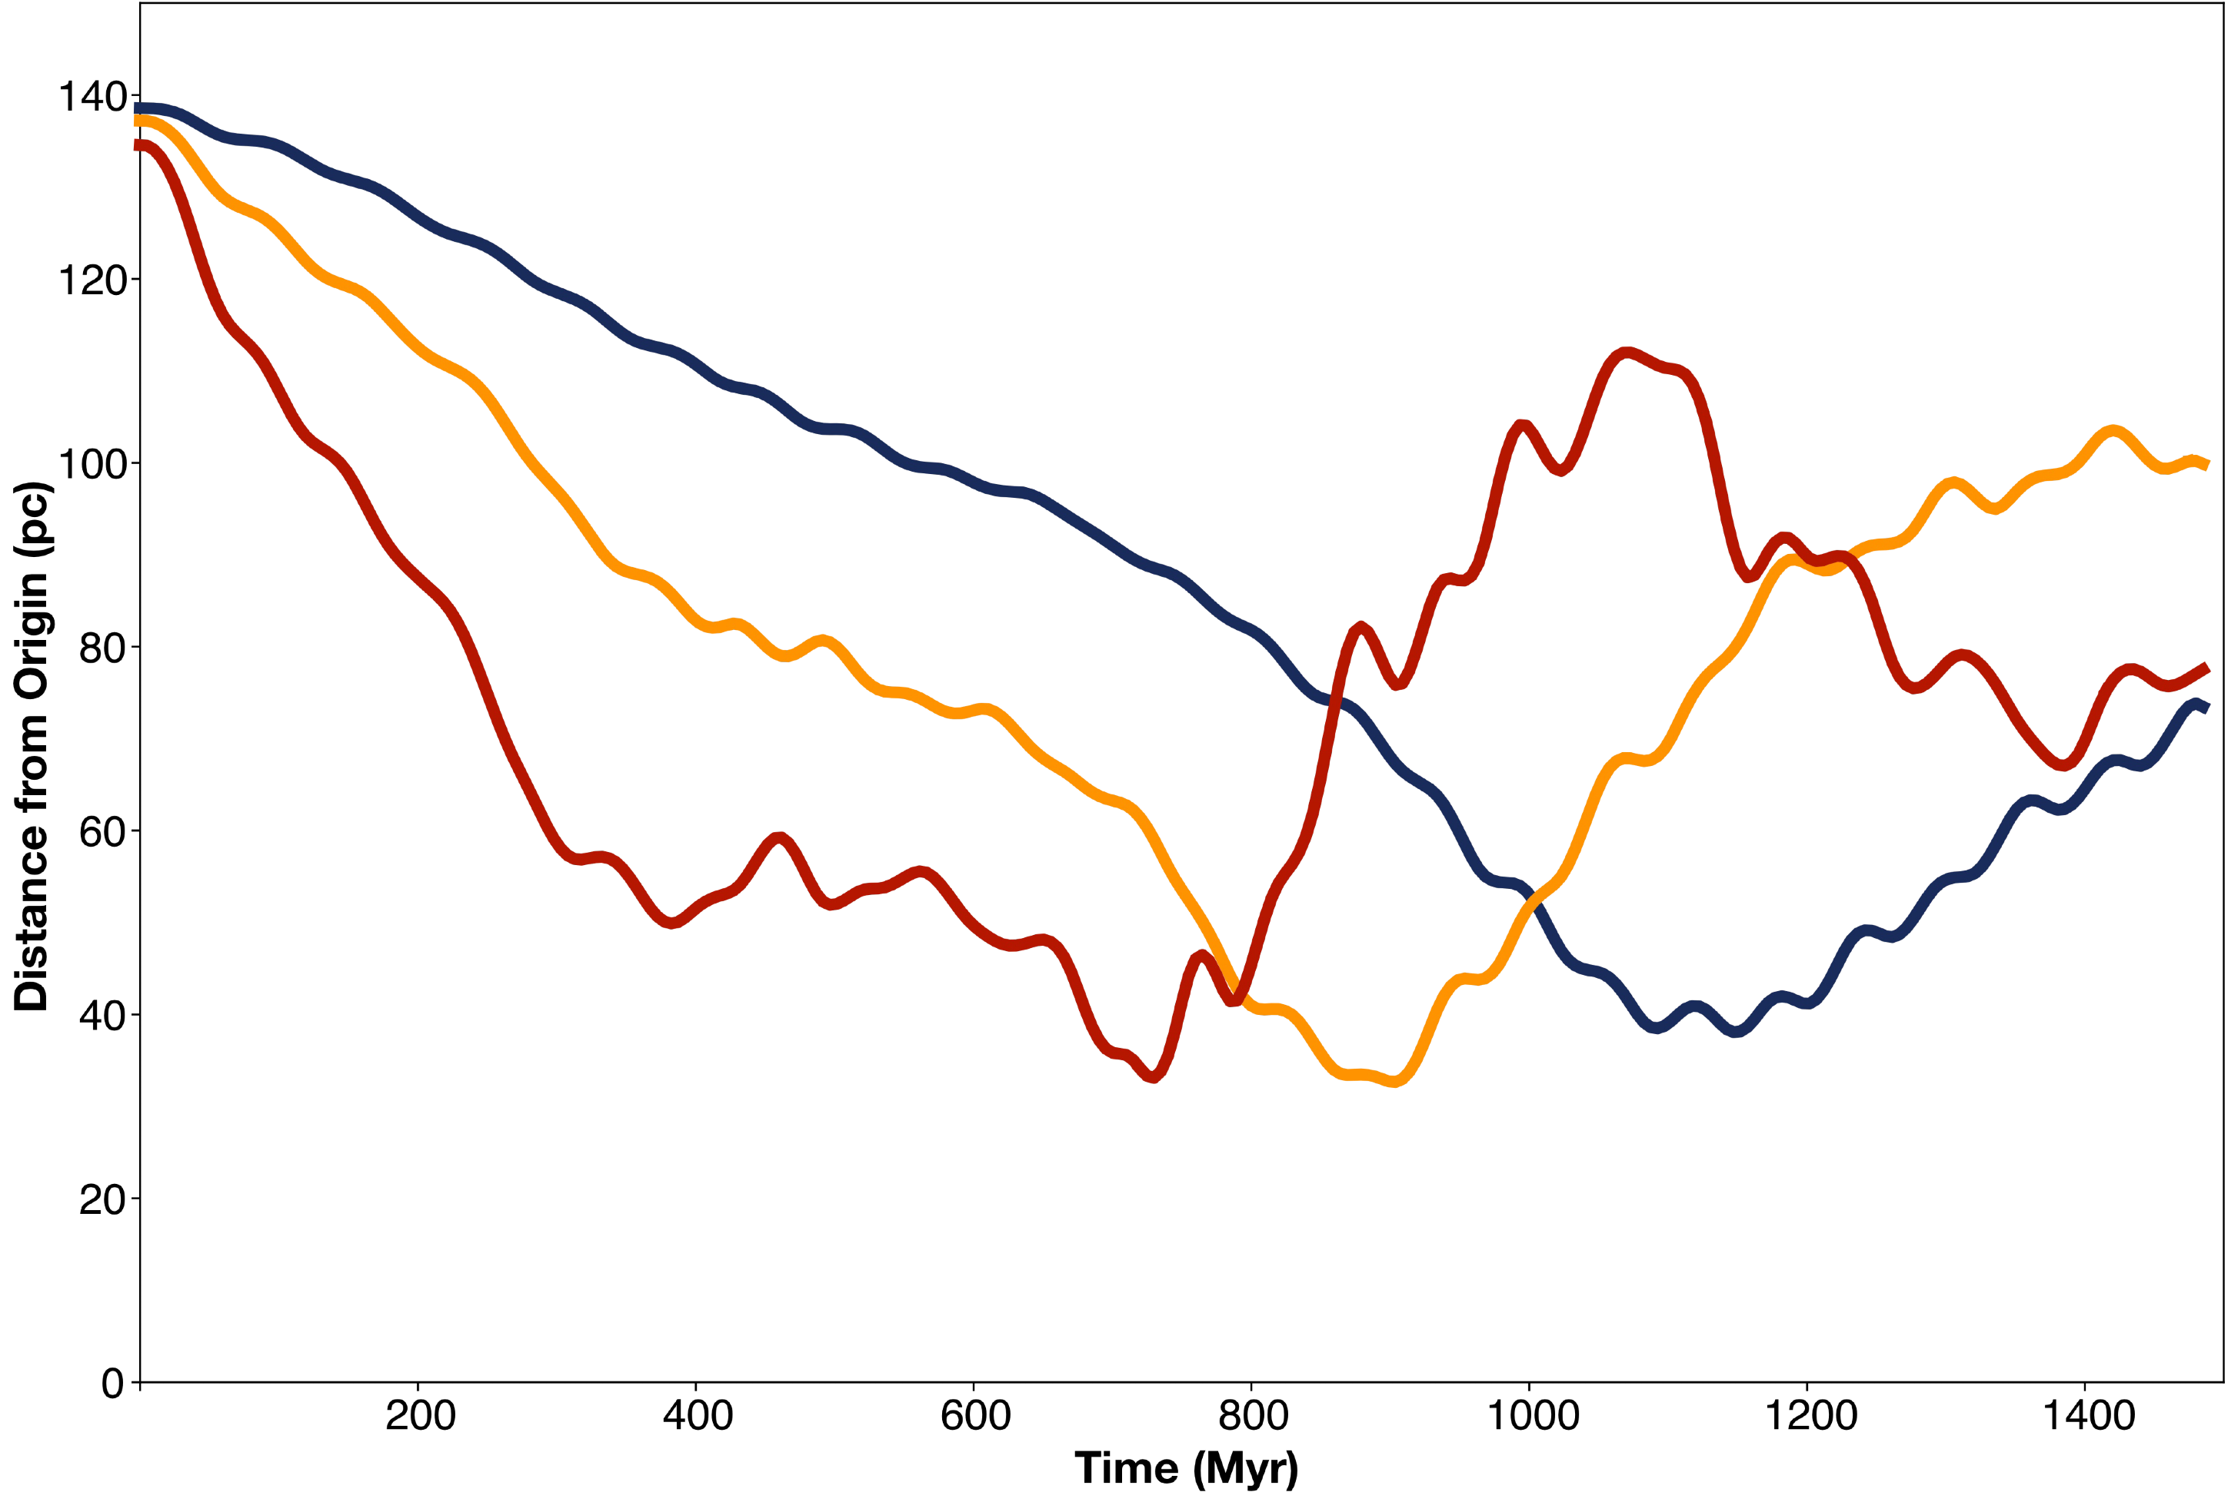
Time evolution of the orbital radius of black holes in initially circular orbits and masses 1, 2, and 5% of the soliton mass
6

Slide 9
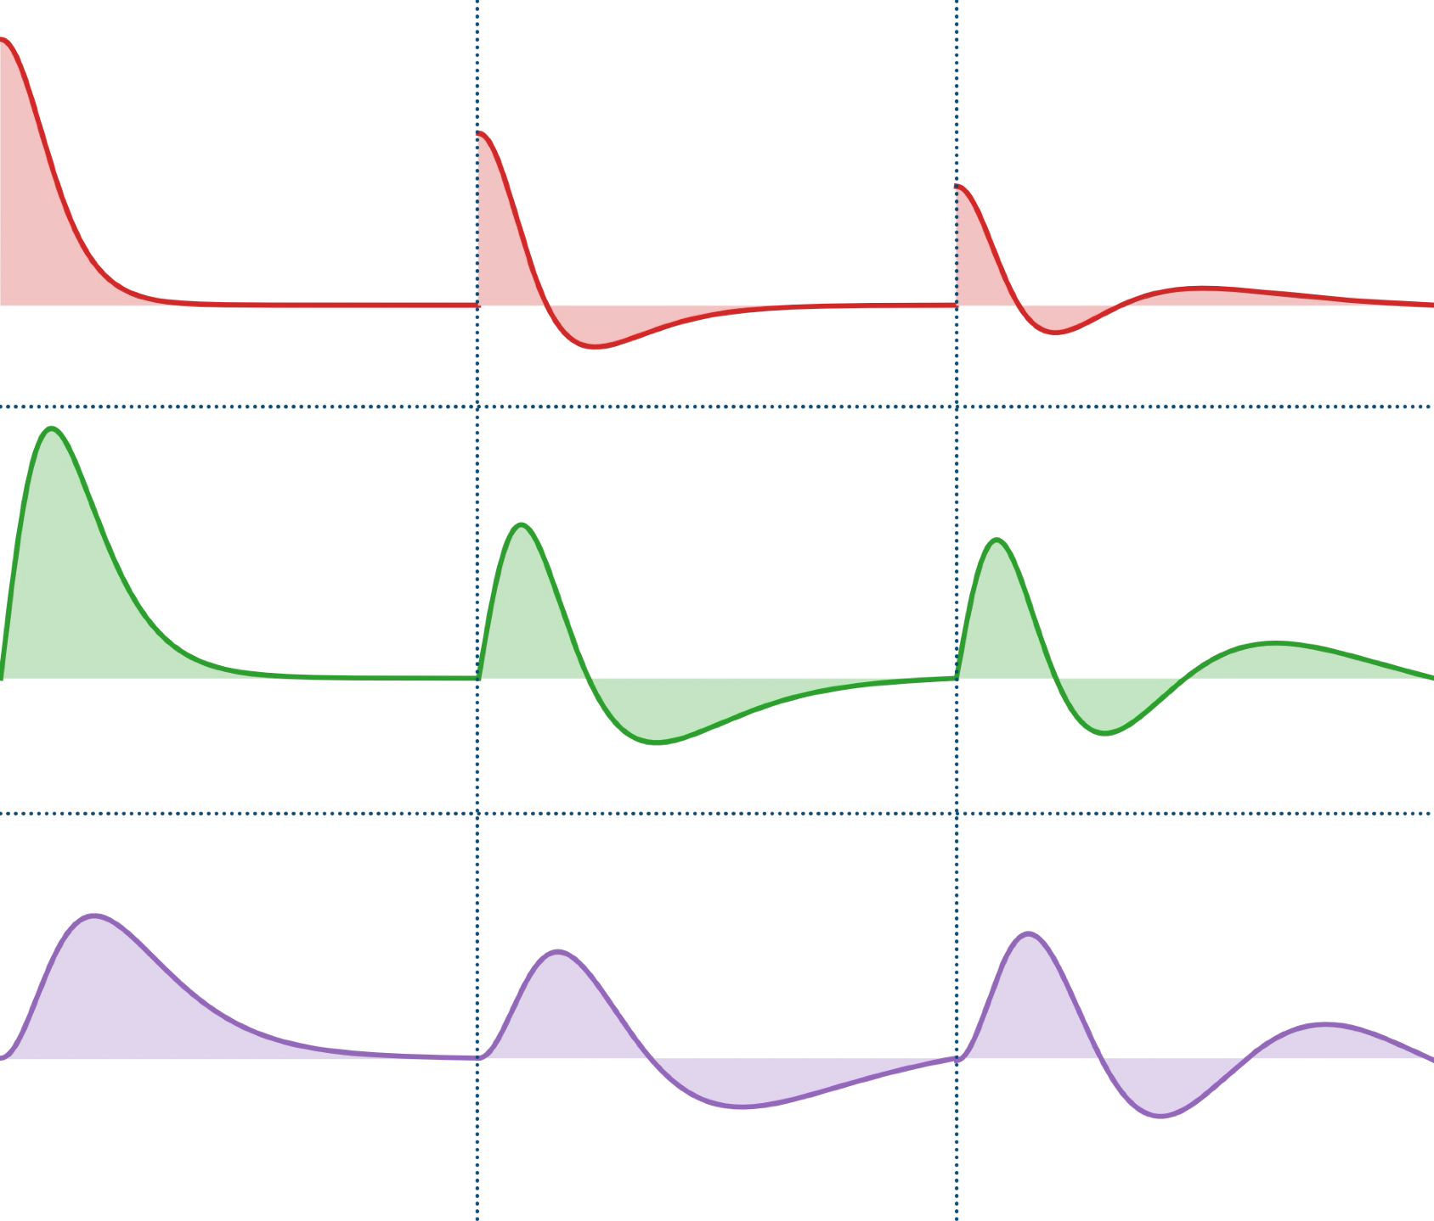







Modes of a Perturbed Soliton
$$n=0$$
$$n=1$$
$$n=2$$
Linearise ψ around the soliton ground state
$$ψ(r,t)=\underset{nlm}{∑}c_{nlm}(t)ψ_{nlm}(r)$$
Here, $ψ_{nlm}$ solve the Schrödinger equation in the ground state potential.
$$l=0$$
“Radial”
$$l=1$$
“Dipole”
$$l=2$$
“Quadrupole”
7
Radial profiles $f_{nl}(r)$ for $n=0,1,2$ and $l=0,1,2$

Slide 10


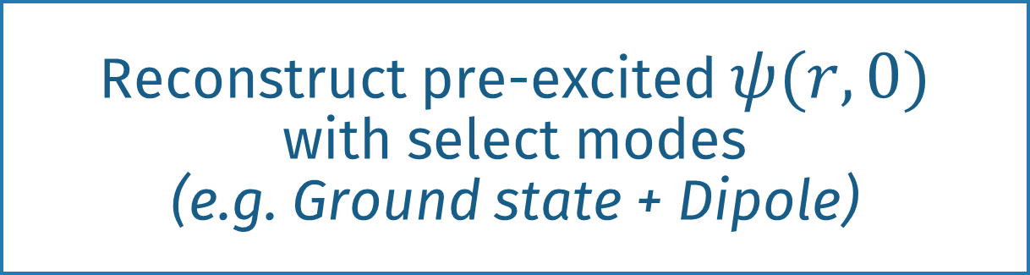
Modes of a Perturbed Soliton
Full Schrödinger-Poisson Sim.
Fully coupled, stone skipping
Mode-Controlled Test-Particle Sim.
Massless particle, no backreaction
Effective dynamical friction
BH
Compute Mode Decomposition
$$\{c_{nlm}(t)\}$$
Reconstruct pre-excited $ψ(r,0)$
with select modes
(e.g. Ground state + Dipole)
Inspect trajectories in new simulation
Eigenmode framework: Zagorac+2022.
Mode-control scheme: Zhang+2026.
8

Slide 11
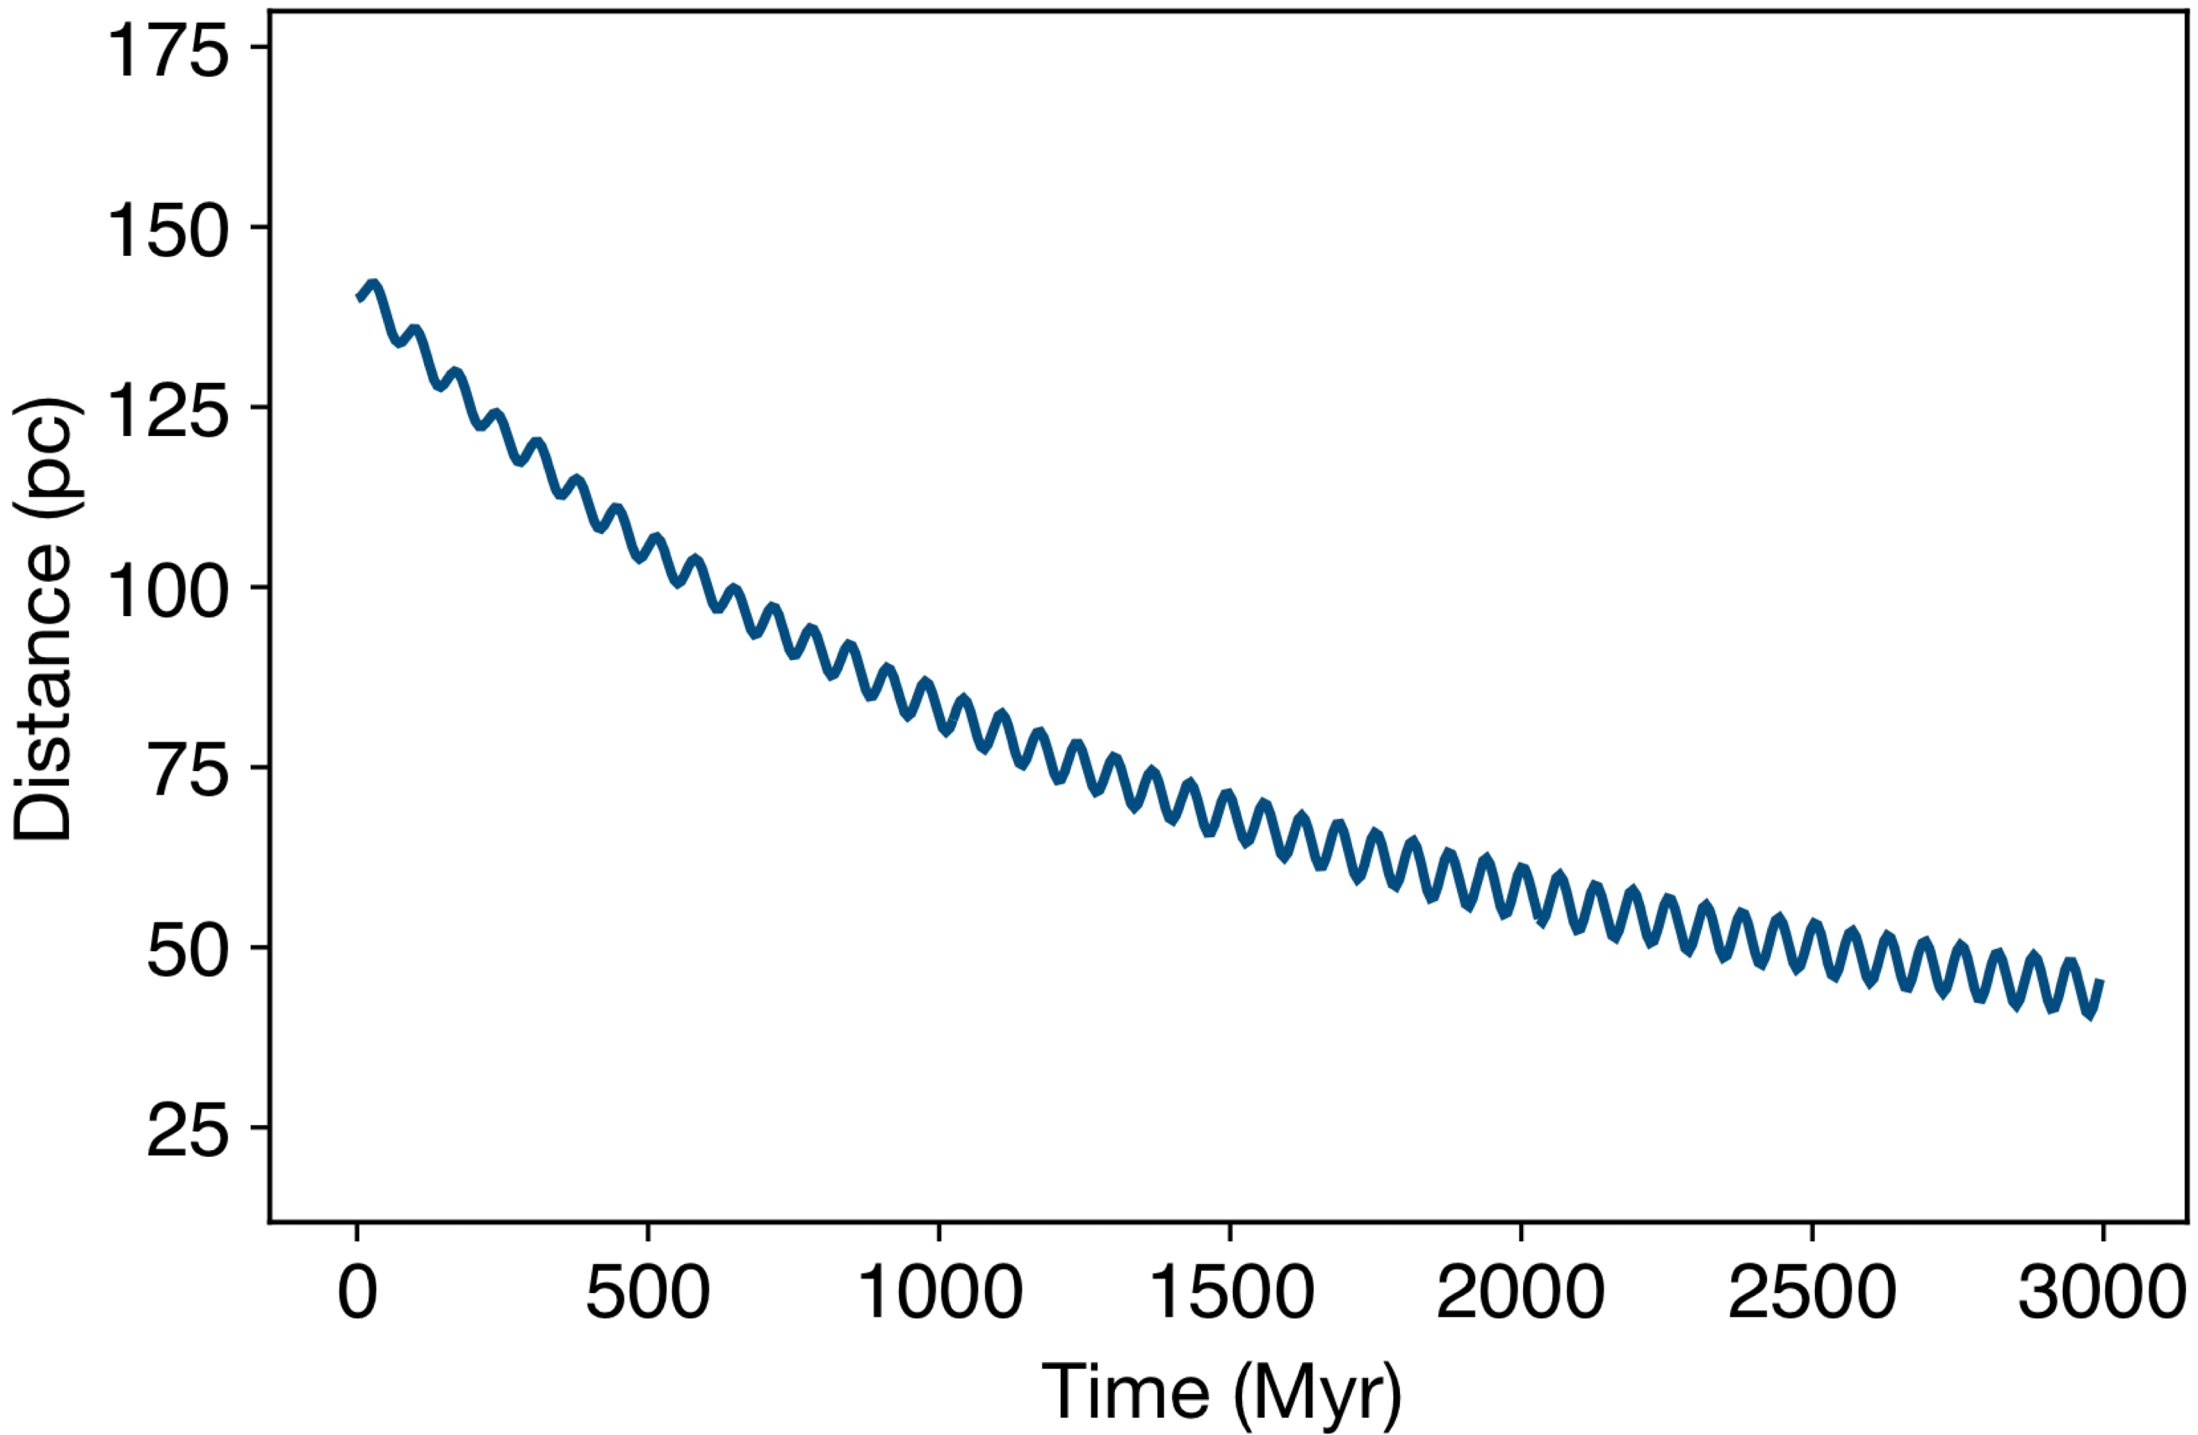
Radial: 0
Dipole: 0
Test particle orbital radius vs. time
with different soliton perturbations
9

Slide 12
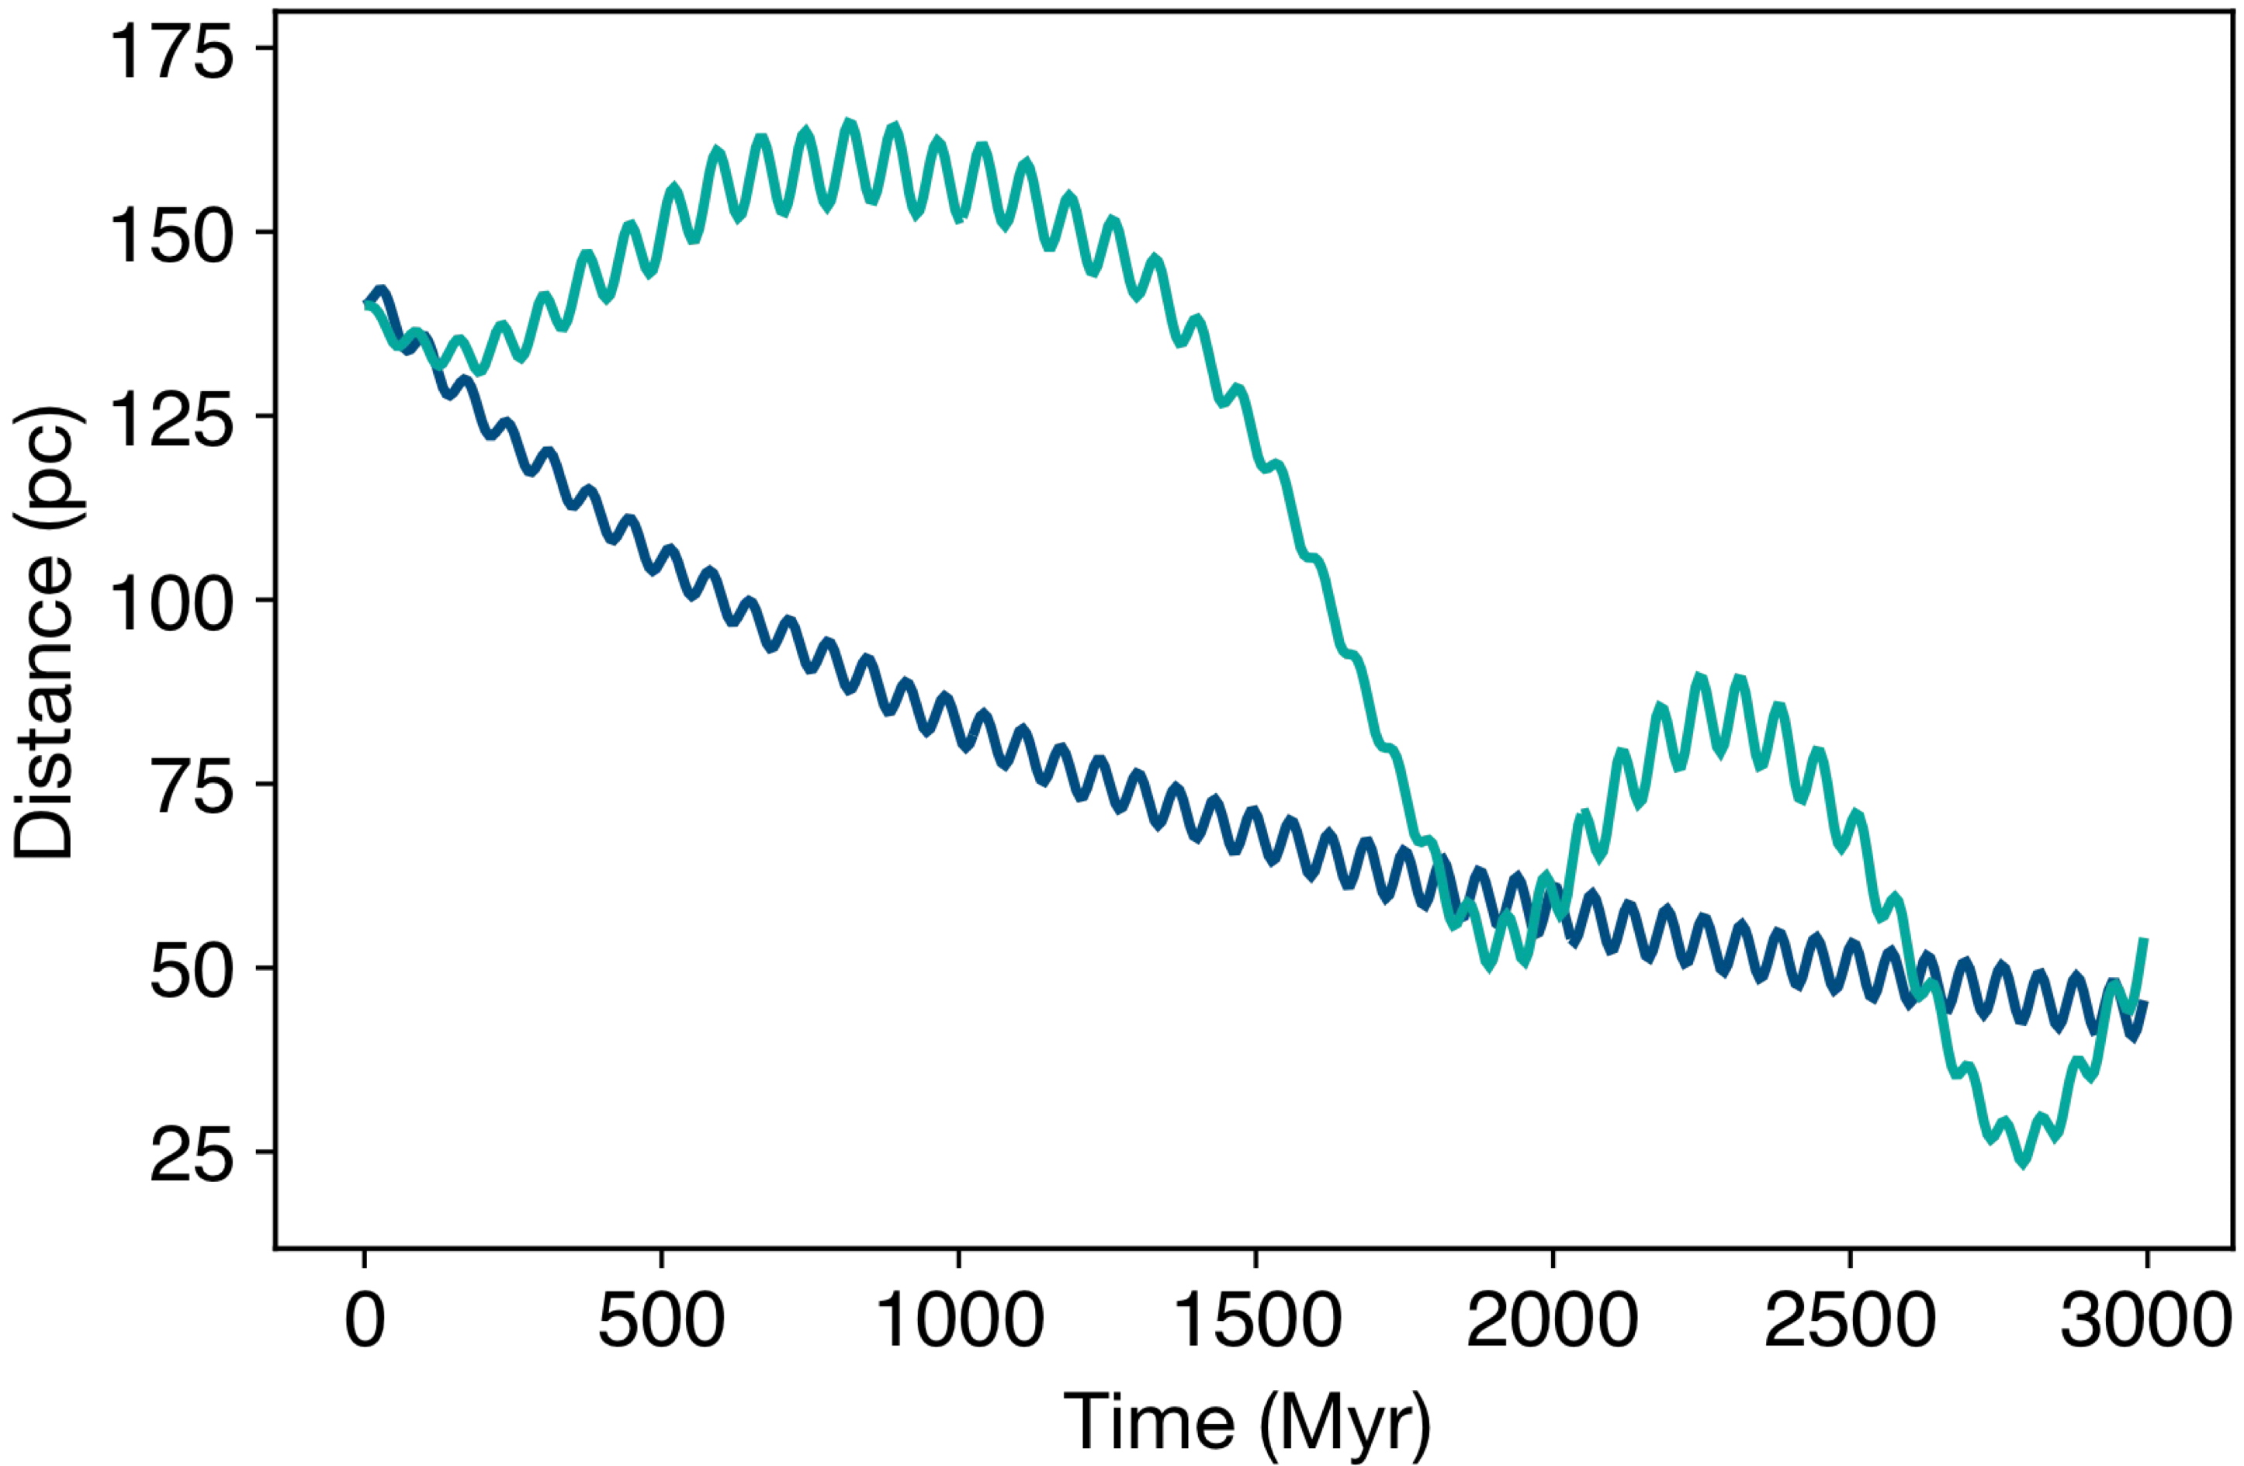
Radial: 0
Dipole: 1
Radial: 0
Dipole: 0
Test particle orbital radius vs. time
with different soliton perturbations
9

Slide 13
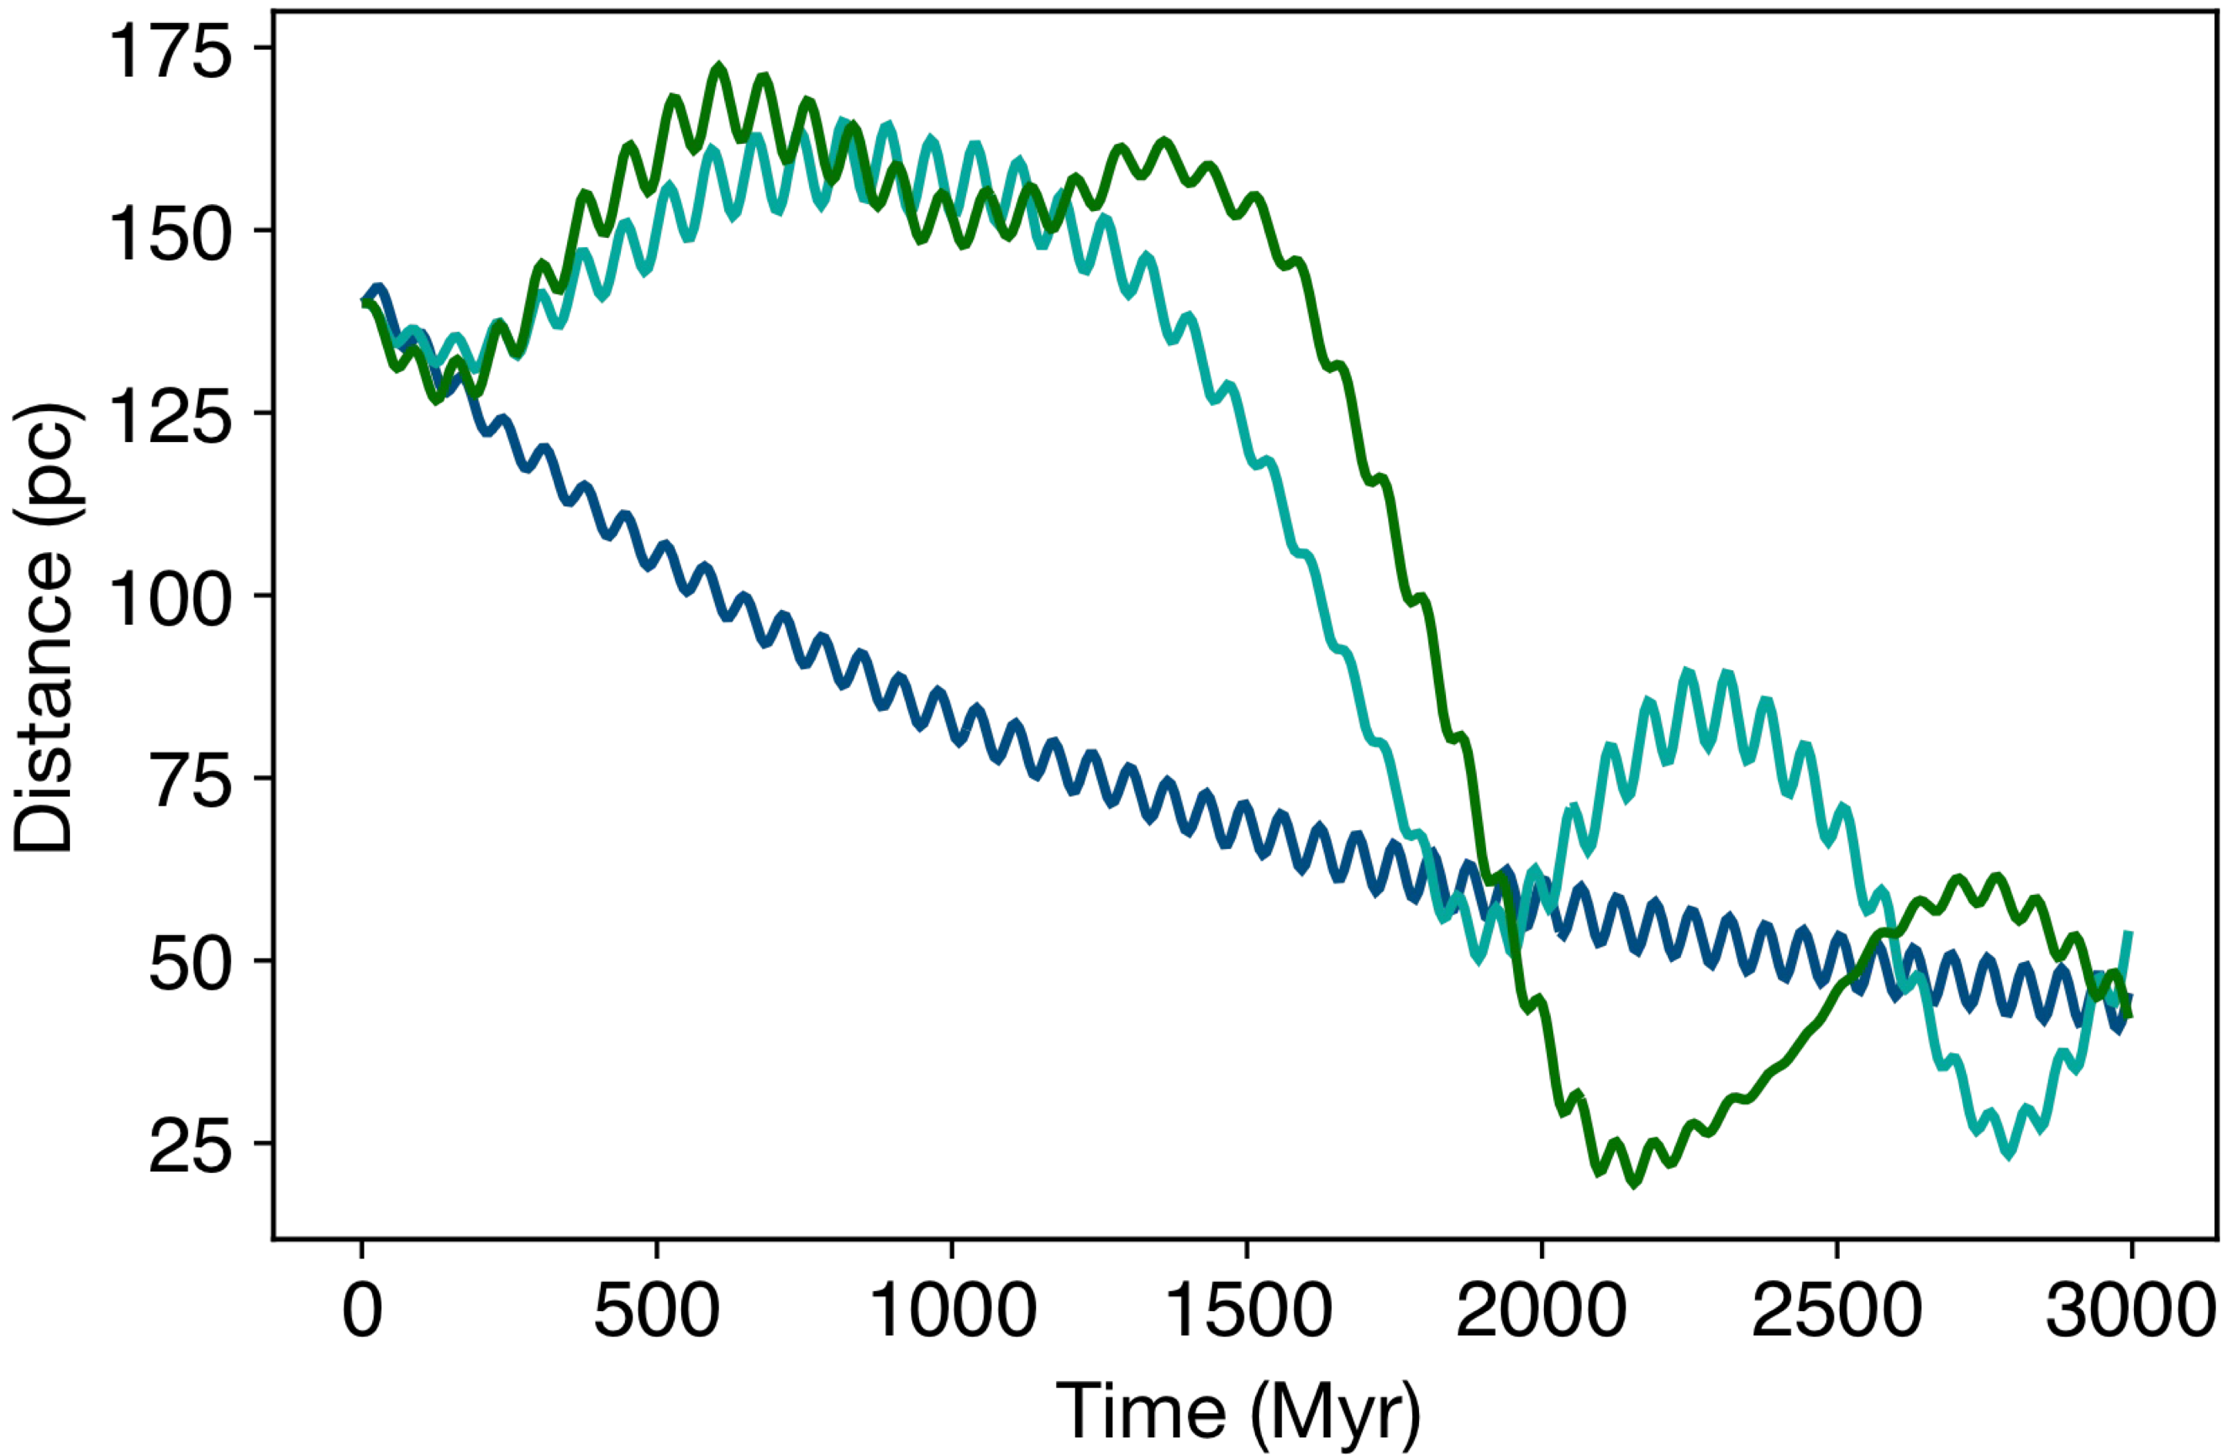
Radial: 0
Dipole: 3
Radial: 0
Dipole: 1
Radial: 0
Dipole: 0
Test particle orbital radius vs. time
with different soliton perturbations
9

Slide 14
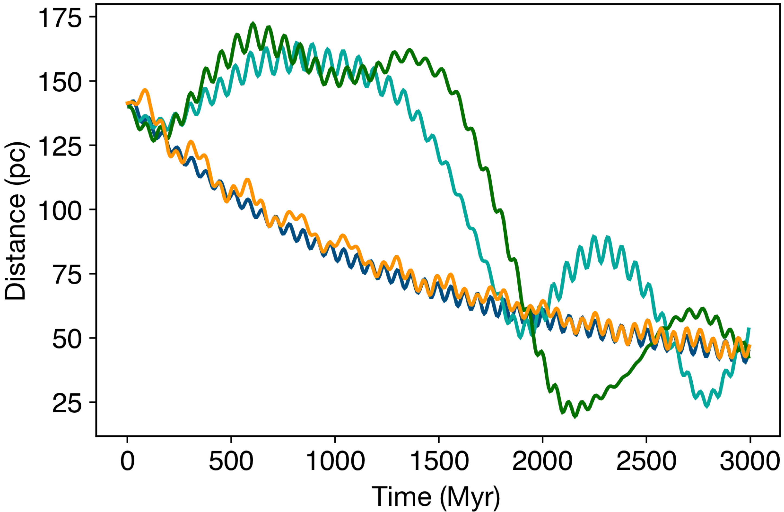
Radial: 0
Dipole: 3
Radial: 0
Dipole: 1
Radial: 0
Dipole: 0
Radial: 3
Dipole: 0
Test particle orbital radius vs. time
with different soliton perturbations
9

Slide 15
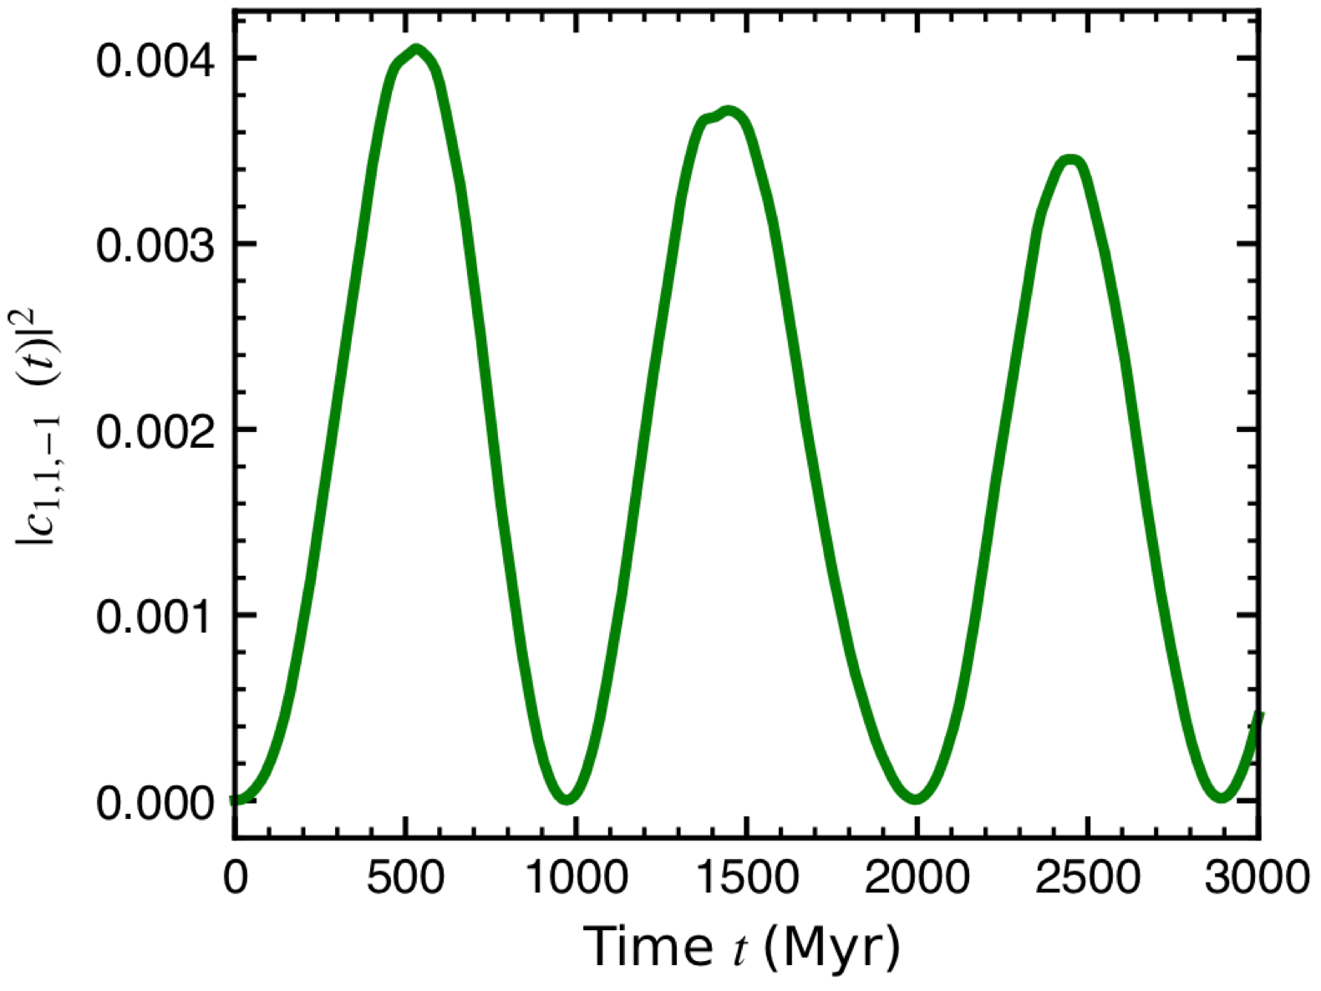

Soliton Stone Skipping is a Dipole Resonance
A forced–damped oscillator. BH gravity excites the Soliton's dipole mode, which in turn resonates with the orbit. Two-way energy transfer.
More significant for single BH: binaries scramble the dipole signal.
Implication: ULDM excitations modifies inspiraling behaviour and naive dynamical friction predictions.
Amplitude of the dipole component $|c_{1,1,−1}(t)|^{2}$ for the stone skipping run with a single black hole
10

Slide 16
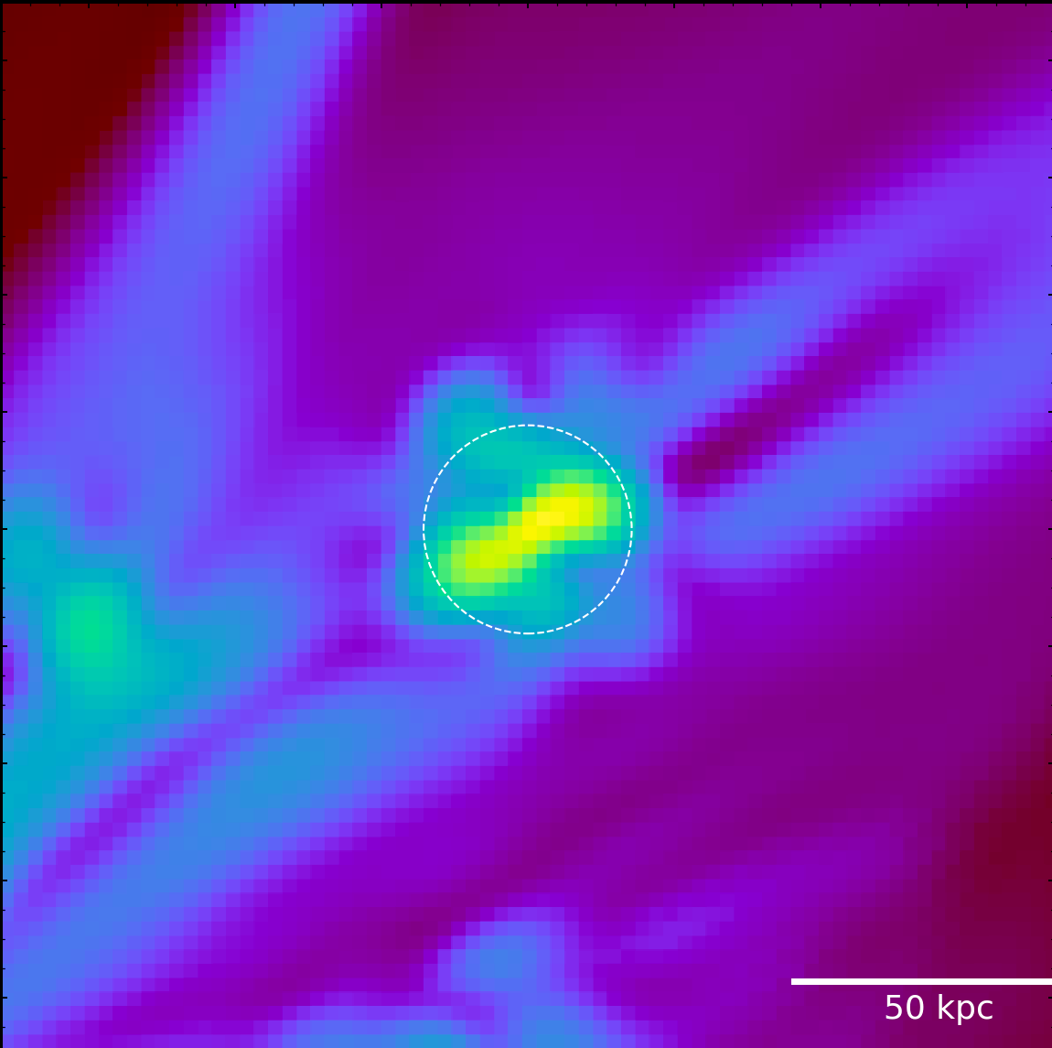
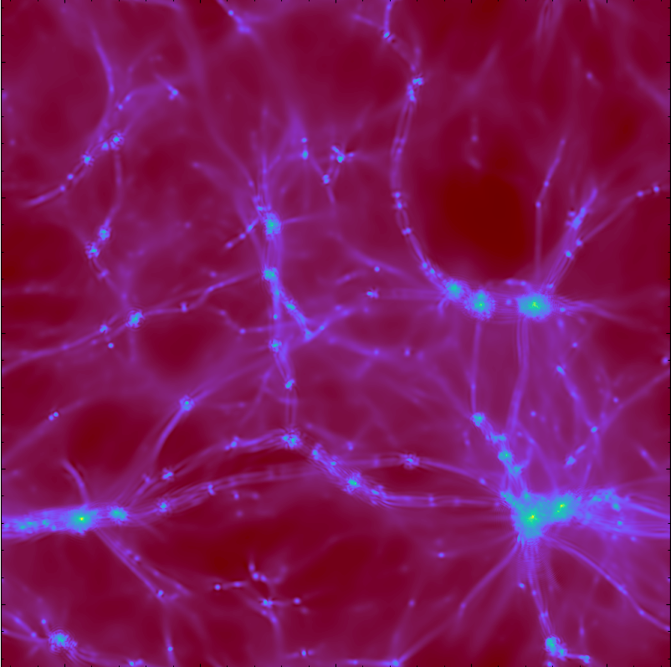
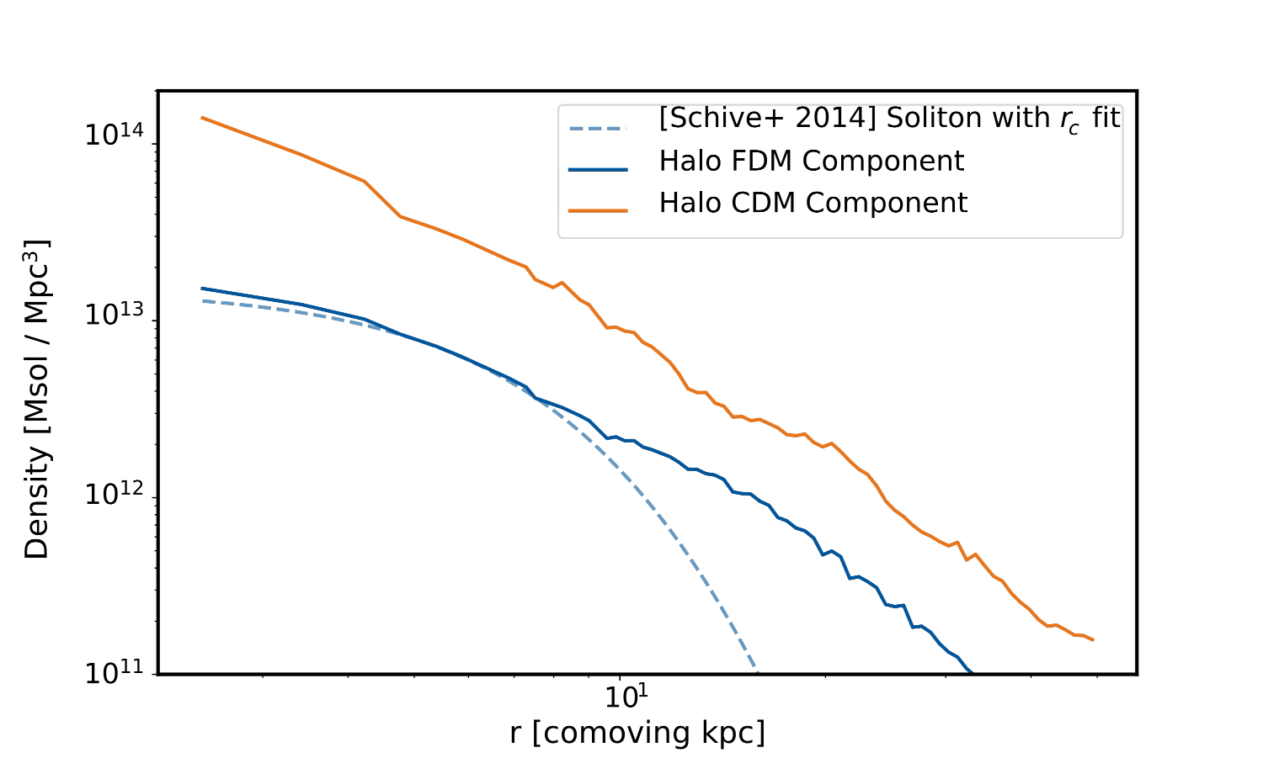
Cosmology Context / Ongoing
z = 2, ma = 10⁻²³ eV, fDM = 0.25, Provisional
Mixed DM Structure Formation for LyA - Wang 2604.06038, Under revision at MNRAS
Try the Latest AxioNyx 1.1: FWPhys.com/AxioNyx
11

Slide 17
Can we reliably distinguish a sub-dominant FDM component in the Universe?
And, if so, what summary statistics is better at doing it?
Mixed DM Structure Formation for LyA - Wang 2604.06038, Under revision at MNRAS
Try the Latest AxioNyx 1.1: FWPhys.com/AxioNyx
12

Slide 18

Summary
Stone skipping: dipole resonance, not Chandrasekhar drag
Single-perturber phenomenon: binaries phase-scramble
Modified inspiral when MBH ≪ Msoliton
What’s Next?
Accretion of ULDM by BHs (development / testing)
Cosmological solitons + complex object inspiral (open)
Let’s Chat!
yourong.wang@uni-goettingen.de
FWPhys.com/PyUL · FWPhys.com/axionyx
Rear Cover: “Fimbabach, CHE”

