Slide 1


WimPyDD and WimPyC: Python codes to exploit the complementarity between WIMP direct detection and indirect detection
Sunghyun Kang
Based on
“WimPyC: an extension module of WimPyDD for the calculation of WIMP capture in celestial bodies”, Sunghyun Kang, Stefano Scopel, Gaurav Tomar, arXiv: 2510.21185
&
"WimPyDD: An object–oriented Python code for the calculation of WIMP direct detection signals", Injun Jeong, Sunghyun Kang, Stefano Scopel., Gaurav Tomar, Comput.Phys.Commun. 276 (2022), 108342, arXiv: 2106.06207
CosPA 2026 / ACGRG 13

Slide 2
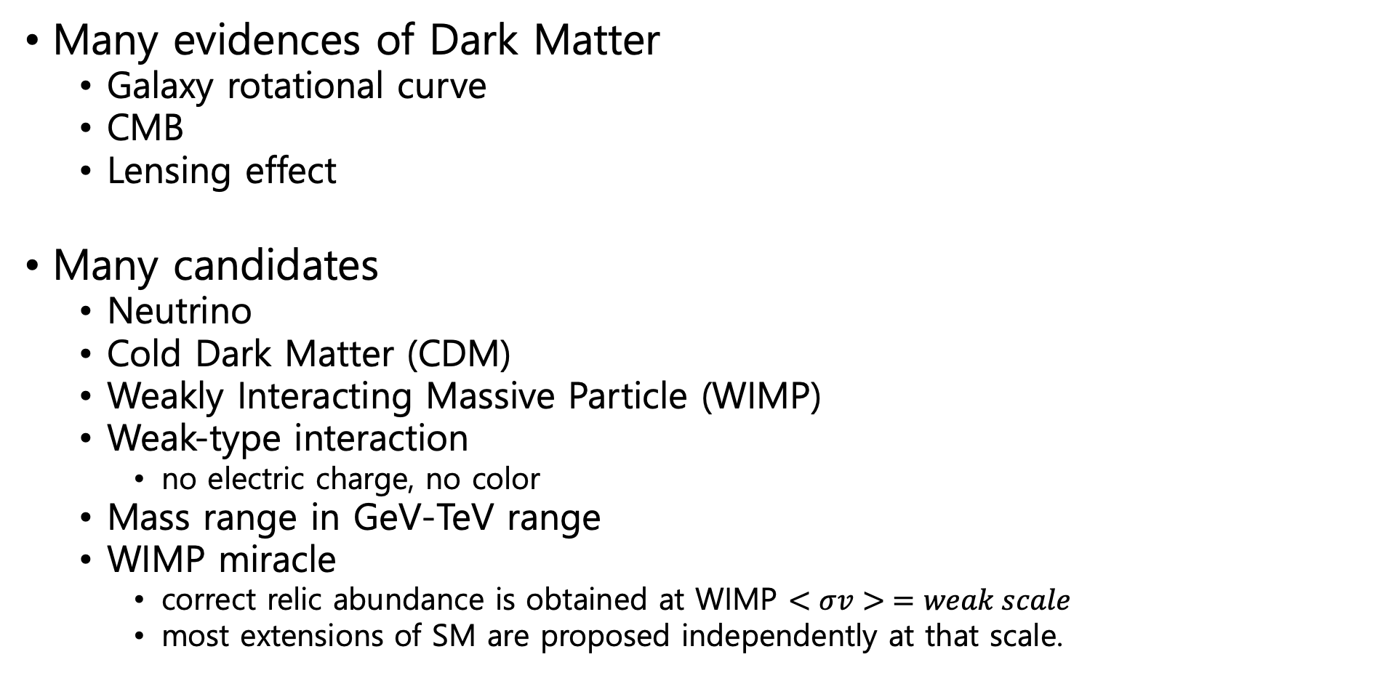
Dark Matter and WIMPs
Many evidences of Dark Matter
  Galaxy rotational curve
  CMB
  Lensing effect
Many candidates
  Neutrino
  Cold Dark Matter (CDM)
  Weakly Interacting Massive Particle (WIMP)
  Weak-type interaction
    no electric charge, no color
  Mass range in GeV-TeV range
  WIMP miracle
    correct relic abundance is obtained at WIMP $<σv> =weak scale$
    most extensions of SM are proposed independently at that scale.
2

Slide 3
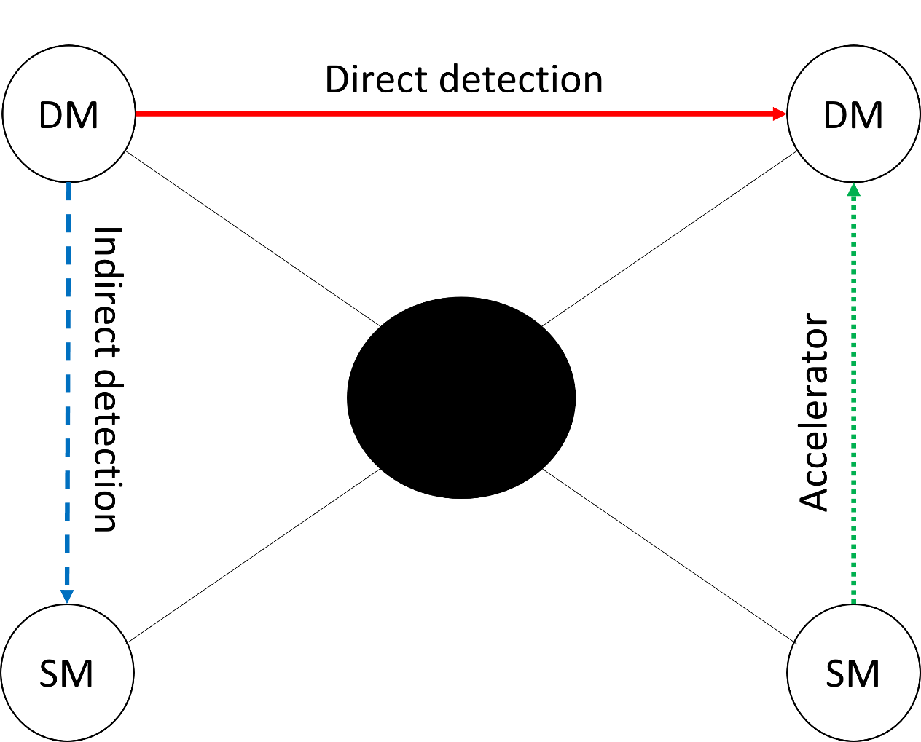
Detection strategies
Direct detection: DM interacts with SM particles (left to right)
Indirect detection: DM annihilation (top to bottom)
Accelerator: DM creation (bottom to top)

Slide 4
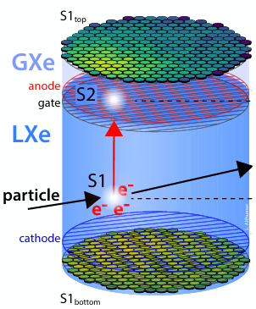
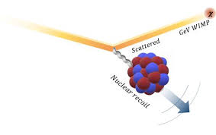
Direct Detection (DD)
The signals are WIMP-nucleus recoil events
Low probability requires high exposure
Underground to avoid background
Depend on features of targets and experimental set-ups
Different nuclear targets and background subtraction:
  COSINE, LZ, XENONnT, PandaX-4T, PICO-60 and ect.
XENON-nT

Slide 5
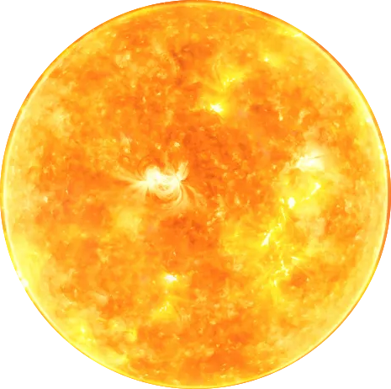

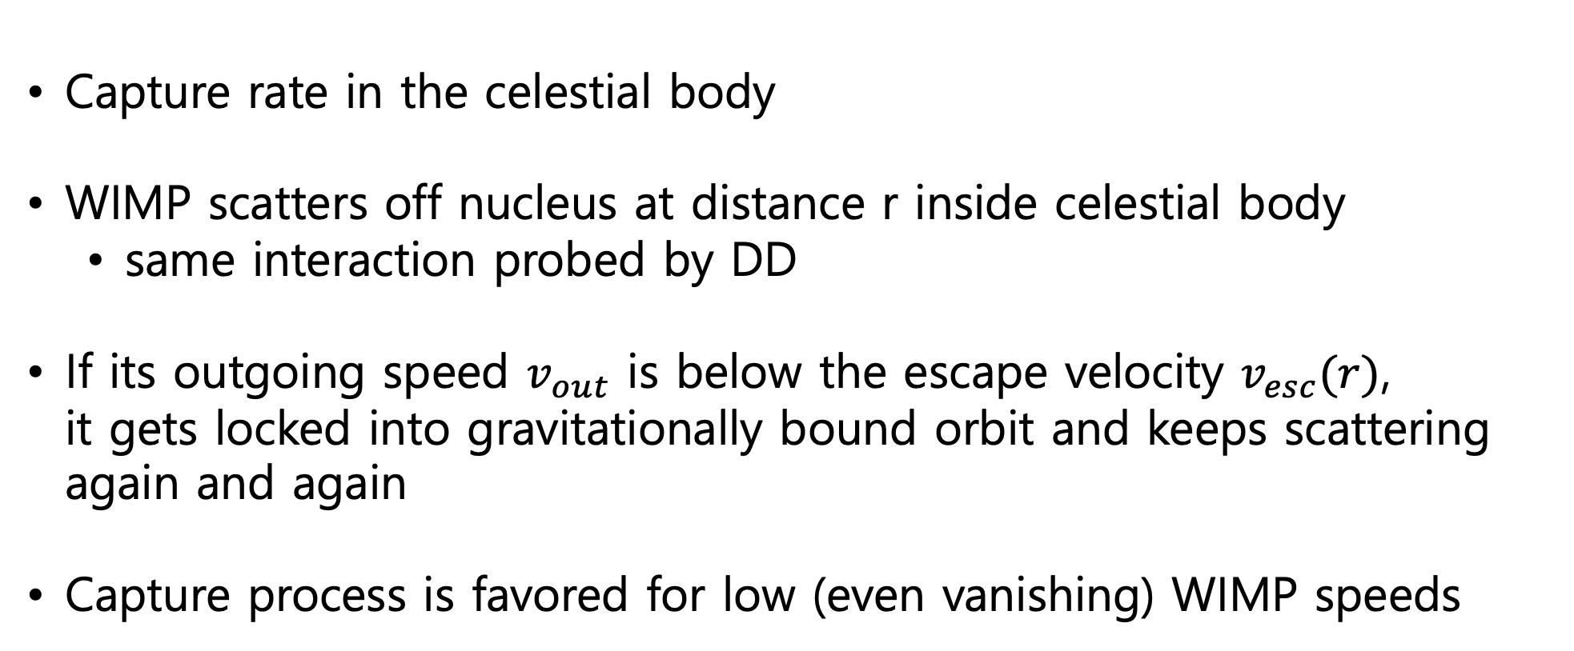




Indirect Detection (NT)
$$χ$$
nucleus
$$v_{out}>v_{esc}\left(r\right)$$
$$χ$$
Capture rate in the celestial body
WIMP scatters off nucleus at distance r inside celestial body
  same interaction probed by DD
If its outgoing speed $v_{out}$ is below the escape velocity $v_{esc}(r)$,
it gets locked into gravitationally bound orbit and keeps scattering again and again
Capture process is favored for low (even vanishing) WIMP speeds
$$χ$$
$$v_{out}<v_{esc}\left(r\right)$$

Slide 6
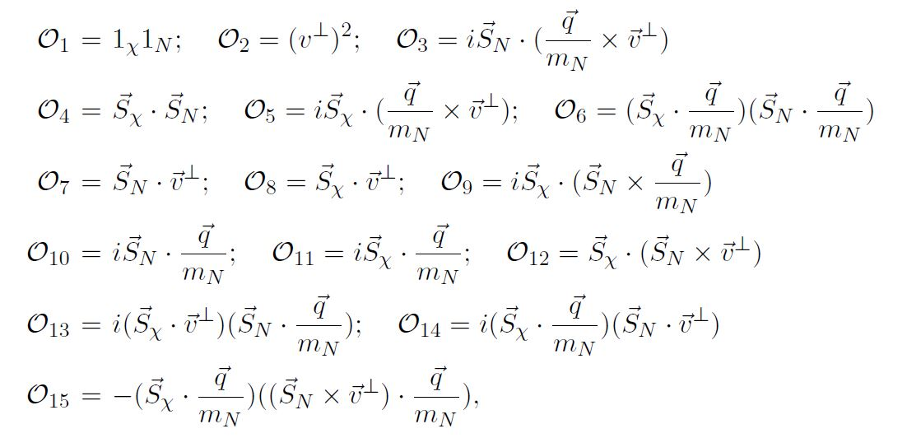

Non-Relativistic Effective Theory (NREFT)
WIMP is slow, so that the recoil events are non-relativistic
NREFT provides a general and efficient way to characterize results
with mass of WIMP and coupling constants
${ℋ=Σ}_{i=1}^{N}\left(c_{i}^{n}𝒪_{i}^{n}+c_{i}^{p}𝒪_{i}^{p}\right)$
Non-relativistic process
  all operators must be invariant
  by Galilean transformations
  ($v \sim {10}^{−3}c$ in galactic halo)
Building operators using:
$i\frac{\vec{q}}{m_{N}}, {\vec{v}}^{⊥}, {\vec{S}}_{χ}, {\vec{S}}_{N}$
Operators spin up to 1/2

Slide 7
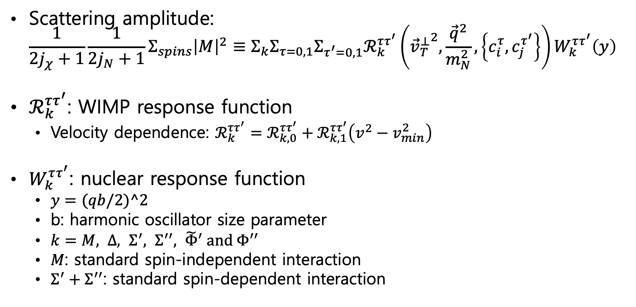
Non-Relativistic Effective Theory (NREFT)
Scattering amplitude:
$\frac{1}{2j_{χ}+1}\frac{1}{2j_{N}+1}Σ_{spins}{\left|M\right|}^{2}≡Σ_{k}Σ_{τ=0,1}Σ_{τ^{′}=0,1}ℛ_{k}^{ττ^{′}}\left({{\vec{v}}_{T}^{⊥}}^{2},\frac{{\vec{q}}^{2}}{m_{N}^{2}}, \left\{c_{i}^{τ},c_{j}^{τ^{′}}\right\}\right)W_{k}^{ττ^{′}}\left(y\right)$
$ℛ_{k}^{ττ^{′}}$: WIMP response function
  Velocity dependence: $ℛ_{k}^{ττ^{′}}=ℛ_{k,0}^{ττ^{′}}+ℛ_{k,1}^{ττ^{′}}\left(v^{2}−v_{min}^{2}\right)$
$W_{k}^{ττ^{′}}$: nuclear response function
  $y=(qb/2)^2$
  b: harmonic oscillator size parameter
  $k=M, Δ, Σ^{′}, Σ^{′′}, {\tilde{Φ}}^{′} \text{and} Φ^{′′}$
  $M$: standard spin-independent interaction
  $Σ^{′}+Σ^{′′}$: standard spin-dependent interaction

Slide 8
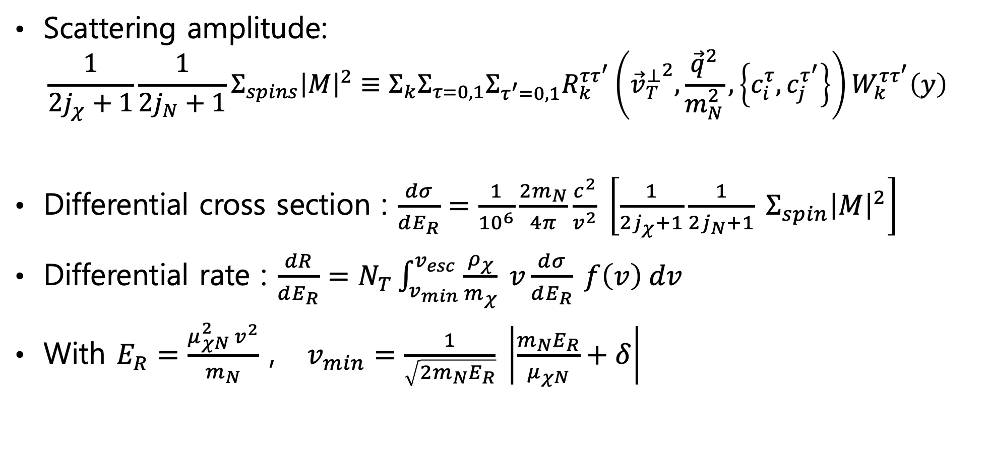
Non-Relativistic Effective Theory (NREFT)
Scattering amplitude:
$\frac{1}{2j_{χ}+1}\frac{1}{2j_{N}+1}Σ_{spins}{\left|M\right|}^{2}≡Σ_{k}Σ_{τ=0,1}Σ_{τ^{′}=0,1}R_{k}^{ττ^{′}}\left({{\vec{v}}_{T}^{⊥}}^{2},\frac{{\vec{q}}^{2}}{m_{N}^{2}}, \left\{c_{i}^{τ},c_{j}^{τ^{′}}\right\}\right)W_{k}^{ττ^{′}}\left(y\right)$
Differential cross section : $\frac{dσ}{dE_{R}}=\frac{1}{{10}^{6}}\frac{2m_{N}}{4π}\frac{c^{2}}{v^{2}} \left[\frac{1}{2j_{χ}+1}\frac{1}{2j_{N}+1} Σ_{spin}{\left|M\right|}^{2}\right]$
Differential rate : $\frac{dR}{dE_{R}}=N_{T}\int_{v_{min}}^{v_{esc}}{\frac{ρ_{χ}}{m_{χ}} }v\frac{dσ}{dE_{R}} f\left(v\right) dv$
With $E_{R}=\frac{μ_{χN}^{2} v^{2}}{m_{N}}$ , $v_{min}=\frac{1}{\sqrt{2m_{N}E_{R}}} \left|\frac{m_{N}E_{R}}{μ_{χN}}+δ\right|$

Slide 9
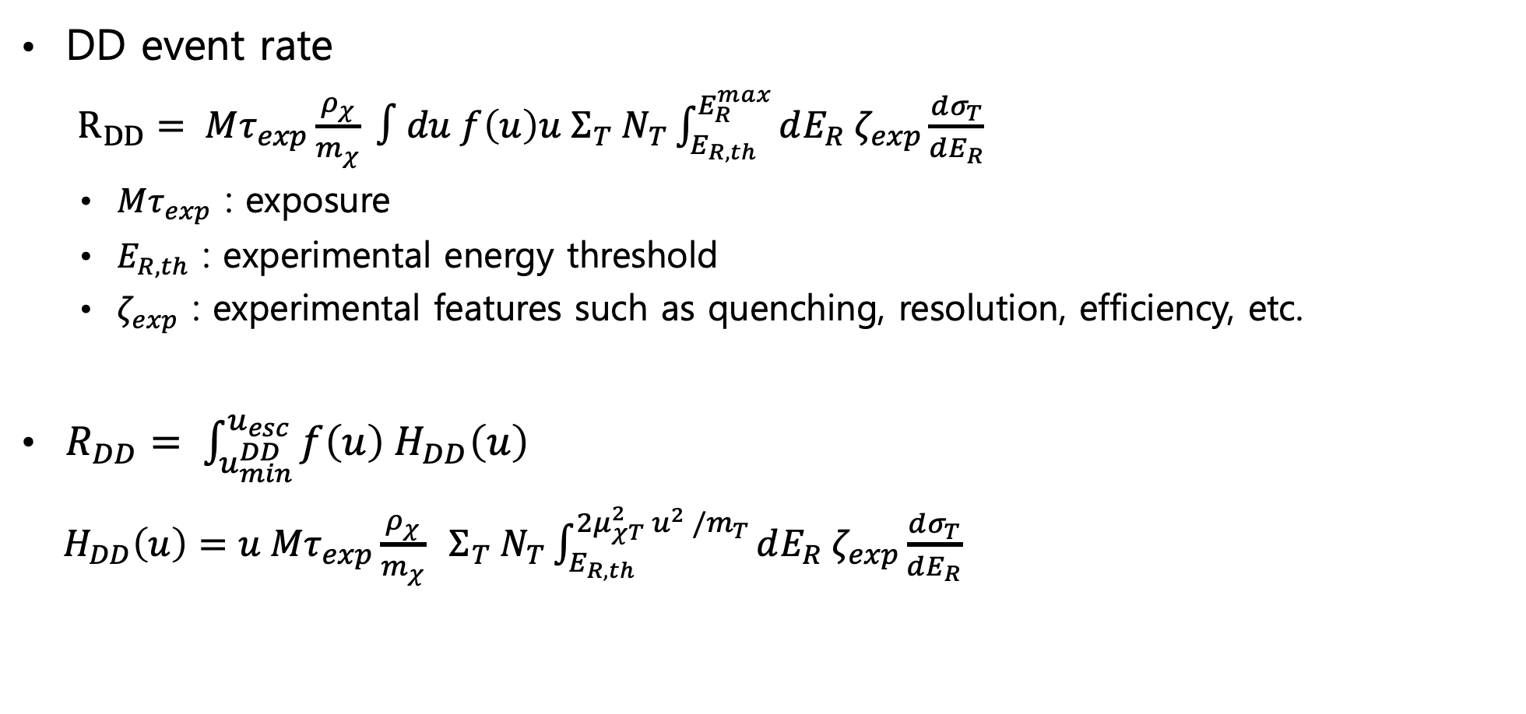
DD event rate
DD event rate
$R_{DD}= Mτ_{exp}\frac{ρ_{χ}}{m_{χ}} ∫du f\left(u\right)u Σ_{T} N_{T}\int_{E_{R,th}}^{E_{R}^{max}}{dE_{R} ζ_{exp}\frac{dσ_{T}}{dE_{R}}}$
  $Mτ_{exp}$ : exposure
  $E_{R,th}$ : experimental energy threshold
  $ζ_{exp}$ : experimental features such as quenching, resolution, efficiency, etc.
$R_{DD}= \int_{u_{min}^{DD}}^{u_{esc}}{f\left(u\right) H_{DD}\left(u\right)}$
$H_{DD}\left(u\right)=u Mτ_{exp}\frac{ρ_{χ}}{m_{χ}} Σ_{T} N_{T}\int_{E_{R,th}}^{2μ_{χT}^{2} u^{2} /m_{T}}{dE_{R} ζ_{exp}\frac{dσ_{T}}{dE_{R}}}$

Slide 10
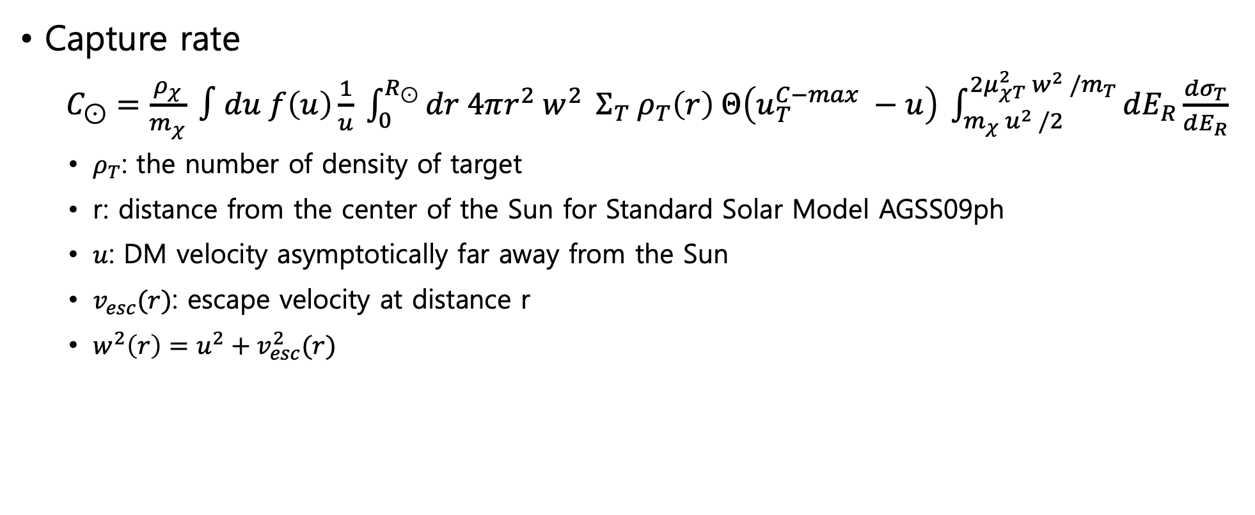
Capture rate
Capture rate
$C_{⊙}=\frac{ρ_{χ}}{m_{χ}} ∫du f\left(u\right)\frac{1}{u} \int_{0}^{R_{⊙}}{dr 4πr^{2} w^{2} }Σ_{T} ρ_{T}\left(r\right) Θ\left(u_{T}^{C−max} −u\right) \int_{m_{χ} u^{2} /2}^{2μ_{χT}^{2} w^{2} /m_{T}}{dE_{R}\frac{dσ_{T}}{dE_{R}}}$
  $ρ_{T}$: the number of density of target
  r: distance from the center of the Sun for Standard Solar Model AGSS09ph
  $u$: DM velocity asymptotically far away from the Sun
  $v_{esc}(r)$: escape velocity at distance r
  $w^{2}\left(r\right)=u^{2}+v_{esc}^{2}(r)$

Slide 11
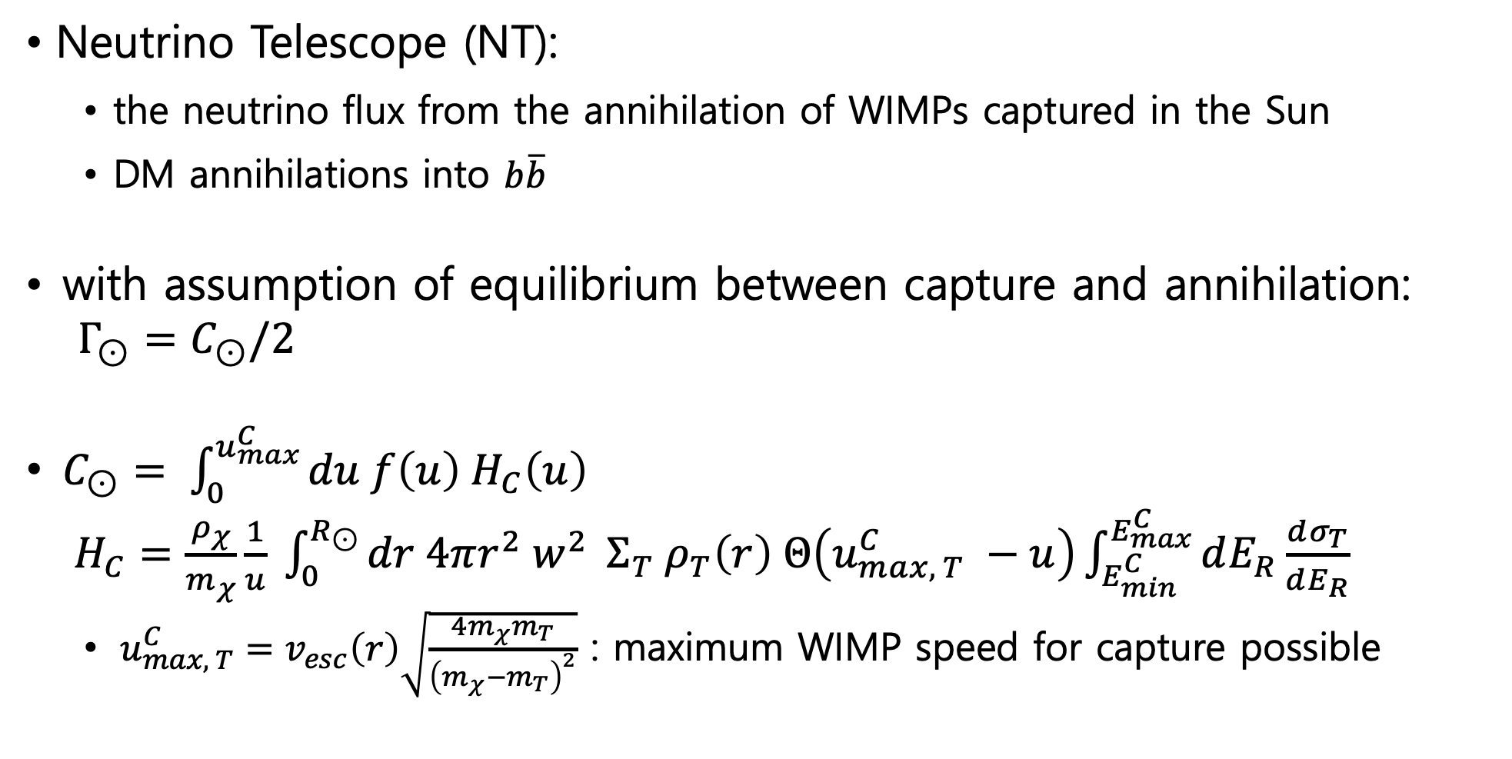
Capture rate
Neutrino Telescope (NT):
  the neutrino flux from the annihilation of WIMPs captured in the Sun
  DM annihilations into $b\overline{b}$
with assumption of equilibrium between capture and annihilation:
$Γ_{⊙}=C_{⊙}/2$
$C_{⊙}= \int_{0}^{u_{max}^{C}}{du f\left(u\right) H_{C}\left(u\right)}$
$H_{C}=\frac{ρ_{χ}}{m_{χ}}\frac{1}{u} \int_{0}^{R_{⊙}}{dr 4πr^{2} w^{2} }Σ_{T} ρ_{T}\left(r\right) Θ\left(u_{max, T}^{C} −u\right)\int_{E_{min}^{C}}^{E_{max}^{C}}{dE_{R}\frac{dσ_{T}}{dE_{R}}}$
  $u_{max, T}^{C}=v_{esc}\left(r\right)\sqrt{\frac{4m_{χ}m_{T}}{{\left(m_{χ}−m_{T}\right)}^{2}}}$ : maximum WIMP speed for capture possible

Slide 12
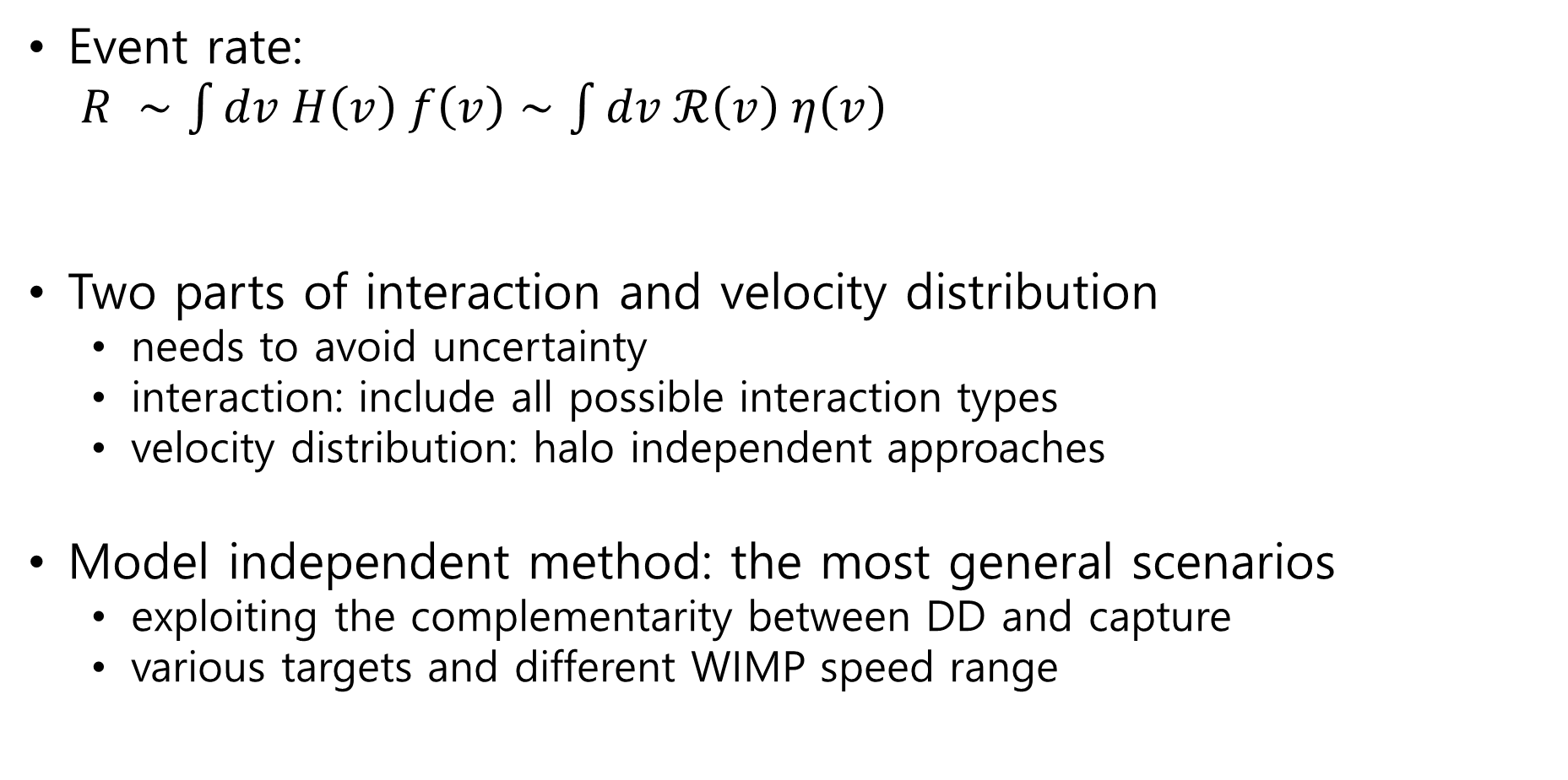
Event rate
velocity distribution
Event rate:
$R ∼\int{dv H\left(v\right) f\left(v\right)}∼\int{dv ℛ\left(v\right) η\left(v\right)}$
Two parts of interaction and velocity distribution
  needs to avoid uncertainty
  interaction: include all possible interaction types
  velocity distribution: halo independent approaches
Model independent method: the most general scenarios
  exploiting the complementarity between DD and capture
  various targets and different WIMP speed range
interaction

Slide 13
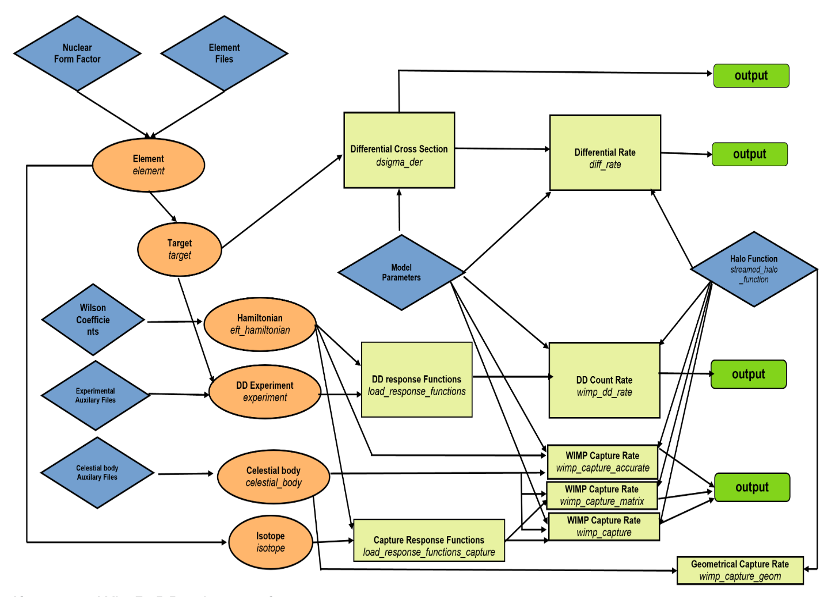
WimPyDD & WimPyC
All calculations above can be done through WimPyDD and WimPyC !!!
I. Jeong, S. Kang, S. Scopel, G. Tomar, “WimPyDD: An object-oriented Python code for the calculation of WIMP direct detection signals”, Computer Physics Communications, 2022.108342 (arXiv: 2106.06207)

Slide 14
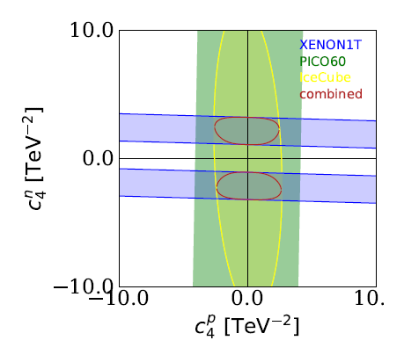

Complementarity between Direct Detection and Capture in the Sun:
Interaction-Independent bounds
$$R ∼\int{dv H\left(v\right) f\left(v\right)}∼\int{dv ℛ\left(v\right) η\left(v\right)}$$
𝜒
+
nucleus
=
v>_{out}v_{esc}(r)
𝜒
𝜒
V_{out}<v_{esc}(r)

Slide 15
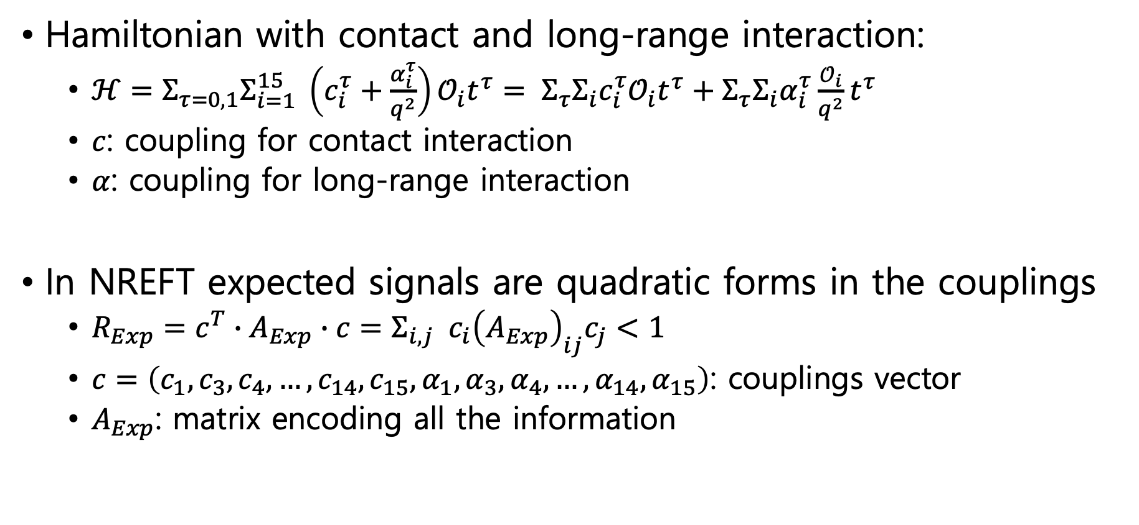
Bracketing DD experiments
Hamiltonian with contact and long-range interaction:
  $ℋ=Σ_{τ=0,1}Σ_{i=1}^{15} \left(c_{i}^{τ}+\frac{α_{i}^{τ}}{q^{2}}\right)𝒪_{i}t^{τ}= Σ_{τ}Σ_{i}c_{i}^{τ}𝒪_{i}t^{τ}+Σ_{τ}Σ_{i}α_{i}^{τ}\frac{𝒪_{i}}{q^{2}}t^{τ}$
  $c$: coupling for contact interaction
  $α$: coupling for long-range interaction
In NREFT expected signals are quadratic forms in the couplings
  $R_{Exp}=c^{T}∙A_{Exp}∙c=Σ_{i,j} c_{i}{\left(A_{Exp}\right)}_{ij}c_{j}<1$
  $c=\left(c_{1},c_{3},c_{4}, …, c_{14},c_{15},α_{1},α_{3},α_{4}, …,α_{14},α_{15}\right)$: couplings vector
  $A_{Exp}$: matrix encoding all the information
S. Kang, I. Jeong, S. Scopel “Bracketing the direct detection exclusion plot for a WIMP of spin one half in non-relativistic
effective theory”, j.astropartphys.2023.102854 (arXiv:2209.03646)

Slide 16
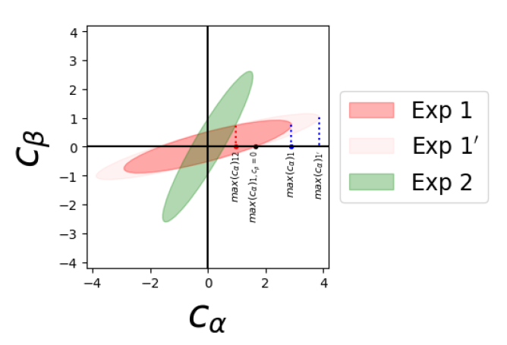
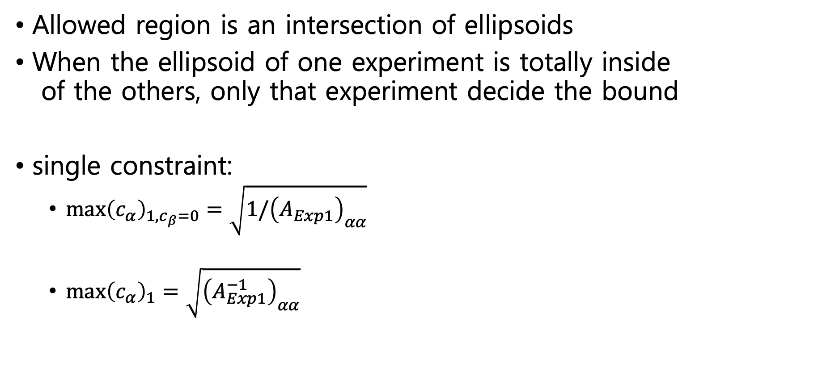
Bracketing DD experiments
Allowed region is an intersection of ellipsoids
When the ellipsoid of one experiment is totally inside
of the others, only that experiment decide the bound
single constraint:
  ${\max\left(c_{α}\right)}_{1,c_{β}=0}=\sqrt{1/{\left(A_{Exp1}\right)}_{αα}}$
  ${\max\left(c_{α}\right)}_{1}=\sqrt{{\left(A_{Exp1}^{−1}\right)}_{αα}}$
A. Brenner, G. Herrera, A. Ibarra, S. Kang, S.S. and G. Tomar, "Complementarity of experiments in probing the non-relativistic effective theory of dark matter-nucleon interactions", JCAP06(2022)026 (arXiv: 2203.04210)

Slide 17
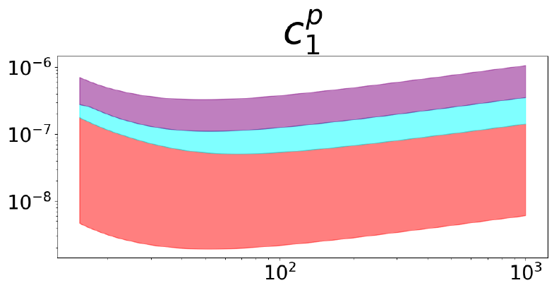




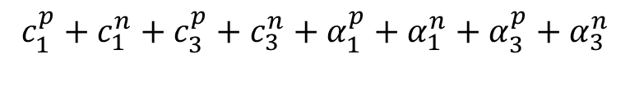

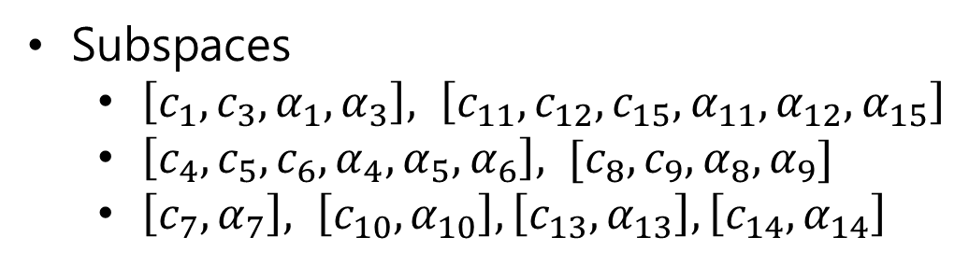
Bracketing: LMI exclusion bands
This point is excluded
no matter what the model is
$$c_{1}^{p}+c_{1}^{n}+c_{3}^{p}+c_{3}^{n}+α_{1}^{p}+α_{1}^{n}+α_{3}^{p}+α_{3}^{n}$$
$$c_{1}^{p}+c_{1}^{n}+c_{3}^{p}+c_{3}^{n}$$
$$c_{1}^{p}$$
$$c_{1}^{p}+c_{1}^{n}$$
$$c_{1}^{p}$$
$$m_{χ}$$
Each line represents single coupling, proton-neutron interference, interference between only contact (or long) range interaction(if exist), interference between contact and long-range interaction
Subspaces
  $\left[c_{1},c_{3},α_{1},α_{3}\right], \left[c_{11},c_{12},c_{15},α_{11},α_{12},α_{15}\right]$
  $\left[c_{4},c_{5},c_{6},α_{4},α_{5},α_{6}\right], [c_{8},c_{9},α_{8},α_{9}]$
  $\left[c_{7},α_{7}\right], \left[c_{10},α_{10}\right], \left[c_{13},α_{13}\right], \left[c_{14},α_{14}\right]$
S. Kang, I. Jeong, S. Scopel “Bracketing the direct detection exclusion plot for a WIMP of spin one half in non-relativistic
effective theory”, j.astropartphys.2023.102854 (arXiv:2209.03646)

Slide 18
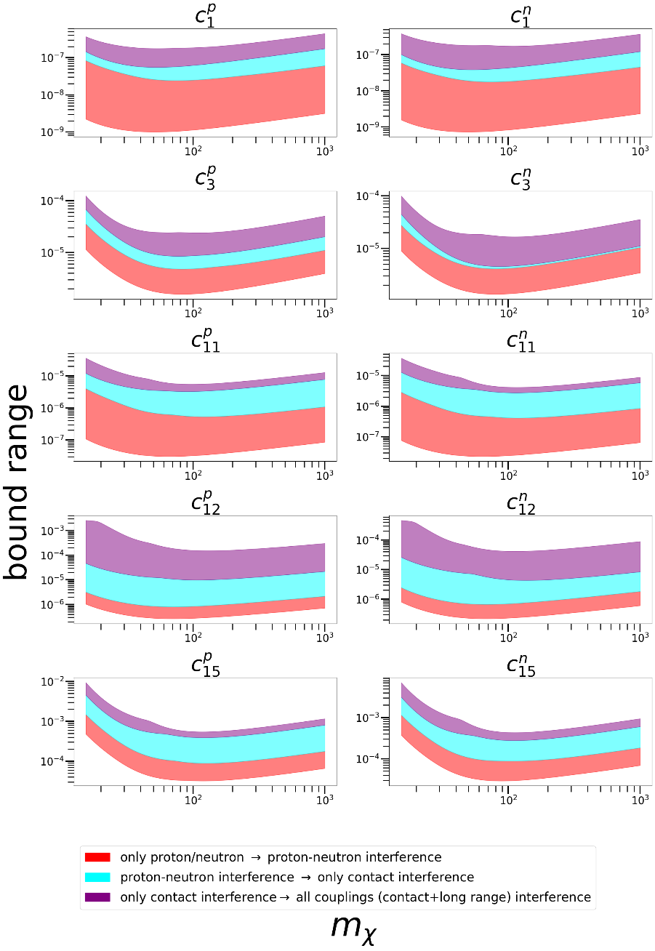
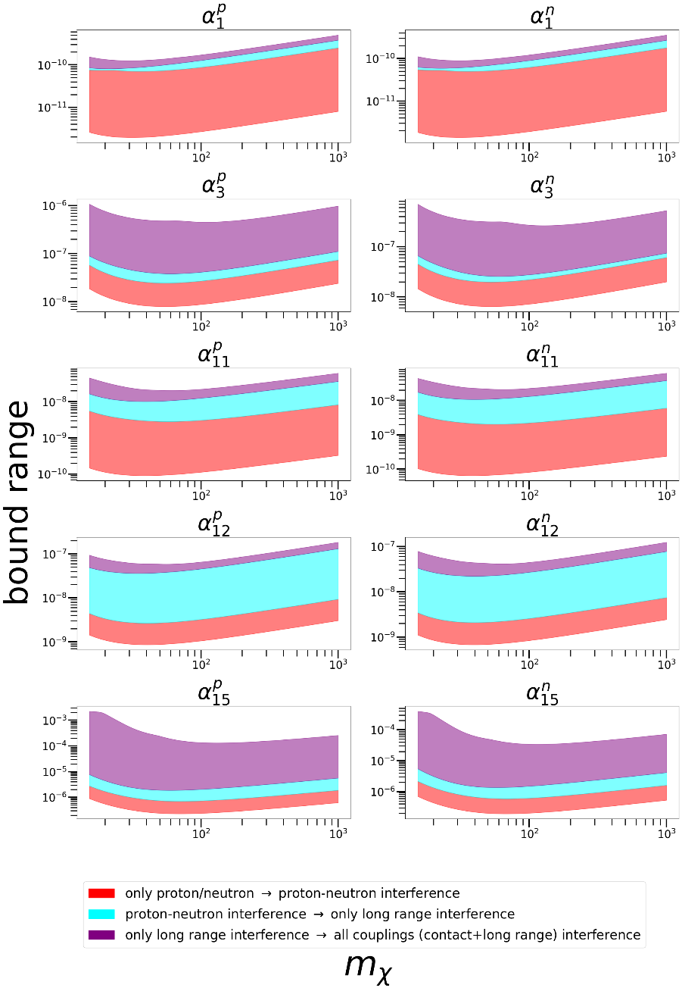
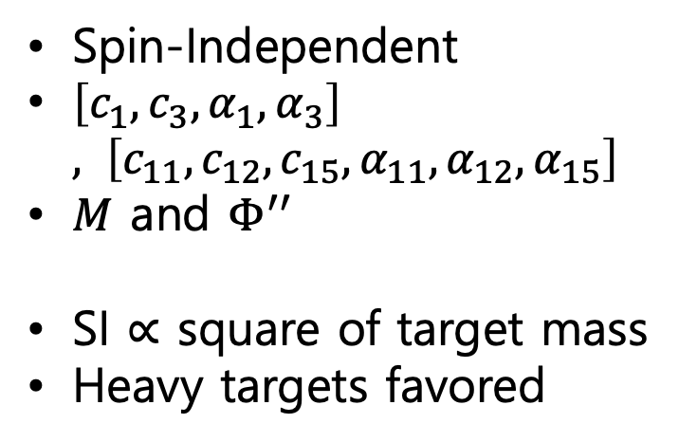
Bracketing: LMI exclusion bands
Spin-Independent
$\left[c_{1},c_{3},α_{1},α_{3}\right], \left[c_{11},c_{12},c_{15},α_{11},α_{12},α_{15}\right]$
$M$ and $Φ^{′′}$
SI $∝$ square of target mass
Heavy targets favored
S. Kang, I. Jeong, S. Scopel “Bracketing the direct detection exclusion plot for a WIMP of spin one half in non-relativistic
effective theory”, j.astropartphys.2023.102854 (arXiv:2209.03646)

Slide 19
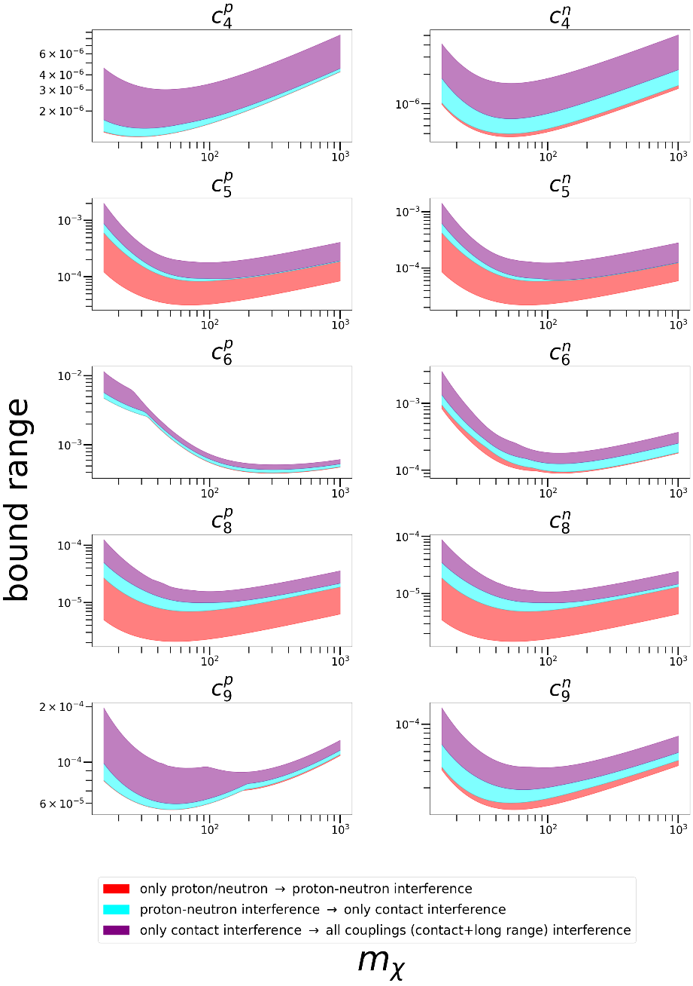
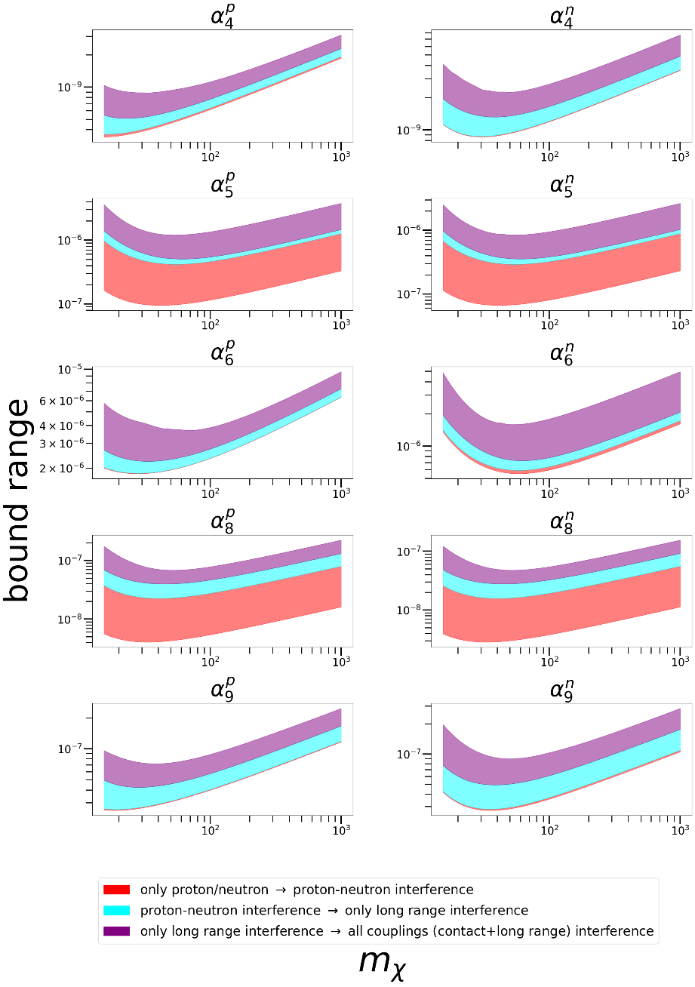
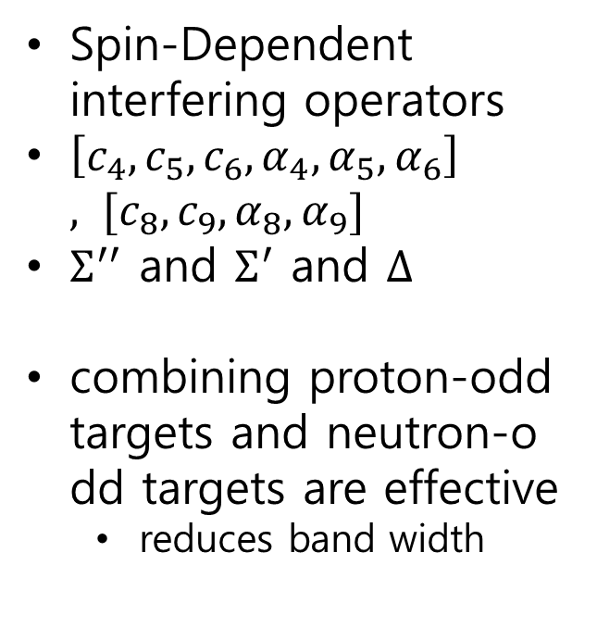
Bracketing: LMI exclusion bands
Spin-Dependent
interfering operators
$\left[c_{4},c_{5},c_{6},α_{4},α_{5},α_{6}\right], [c_{8},c_{9},α_{8},α_{9}]$
$Σ^{′′}$ and $Σ^{′}$ and $Δ$
combining proton-odd targets and neutron-odd targets are effective
  reduces band width
S. Kang, I. Jeong, S. Scopel “Bracketing the direct detection exclusion plot for a WIMP of spin one half in non-relativistic
effective theory”, j.astropartphys.2023.102854 (arXiv:2209.03646)

Slide 20
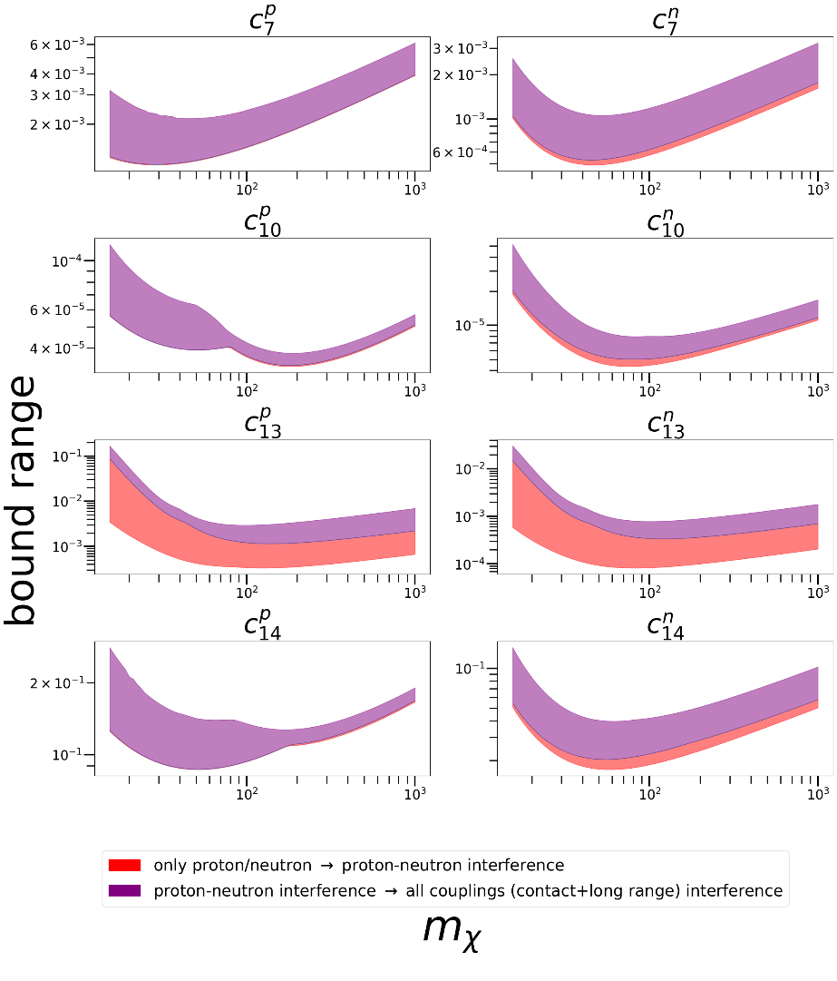
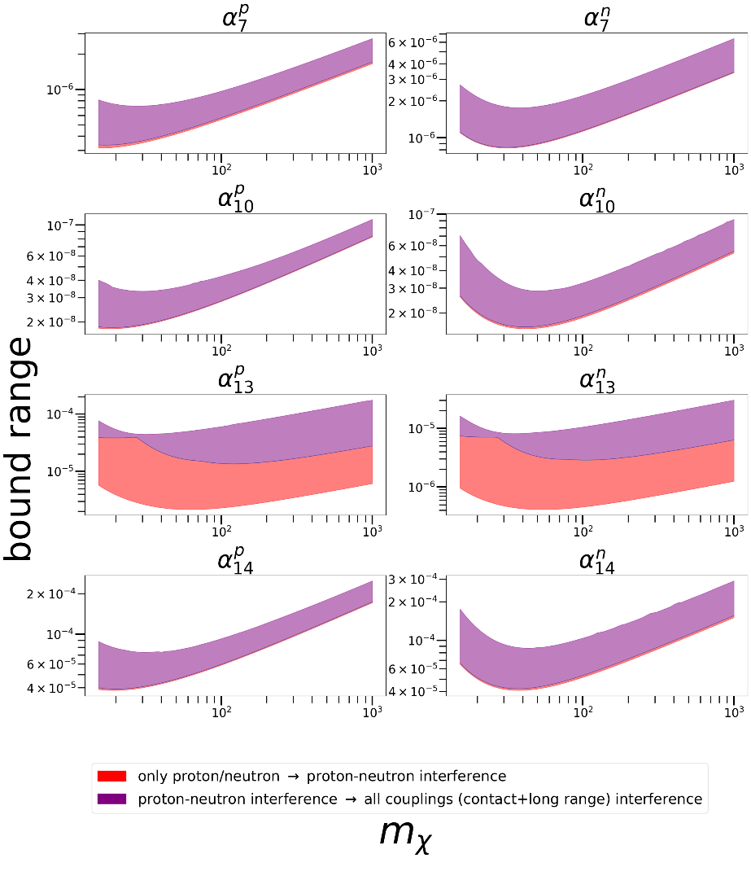
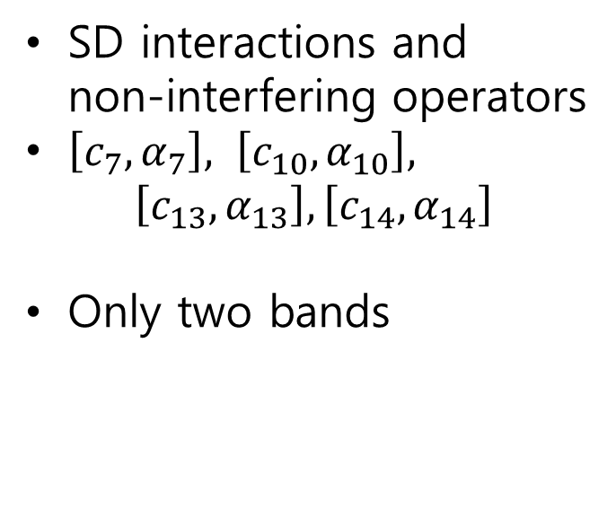
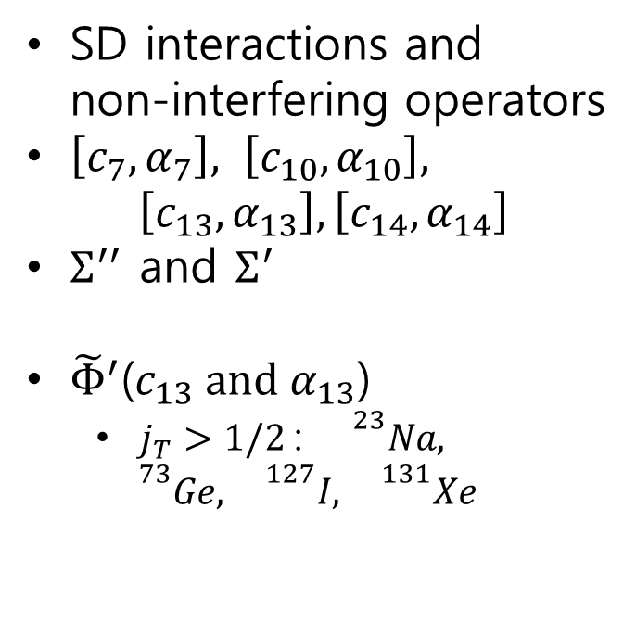
Bracketing: LMI exclusion bands
SD interactions and
non-interfering operators
$\left[c_{7},α_{7}\right], \left[c_{10},α_{10}\right],$
$\left[c_{13},α_{13}\right], \left[c_{14},α_{14}\right]$
$Σ^{′′}$ and $Σ^{′}$
${\tilde{Φ}}^{′}$($c_{13} \text{and} α_{13}$)
  $j_{T}>1/2$: ${}^{23}Na,$
  $${}^{73}Ge, {}^{127}I, {}^{131}Xe$$
SD interactions and
non-interfering operators
$\left[c_{7},α_{7}\right], \left[c_{10},α_{10}\right],$
$\left[c_{13},α_{13}\right], \left[c_{14},α_{14}\right]$
Only two bands
S. Kang, I. Jeong, S. Scopel “Bracketing the direct detection exclusion plot for a WIMP of spin one half in non-relativistic
effective theory”, j.astropartphys.2023.102854 (arXiv:2209.03646)

Slide 21
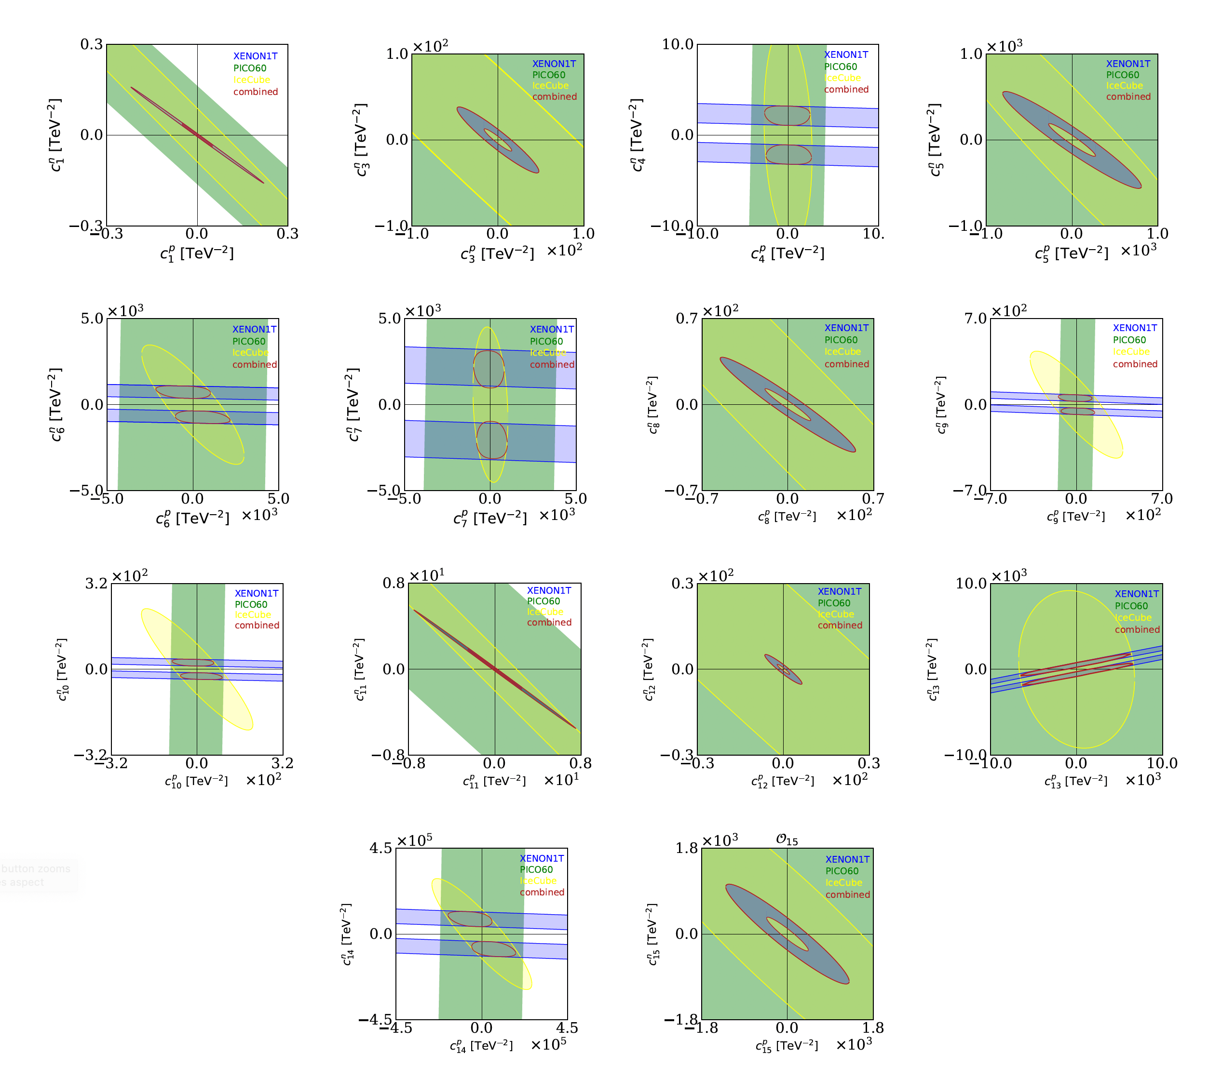
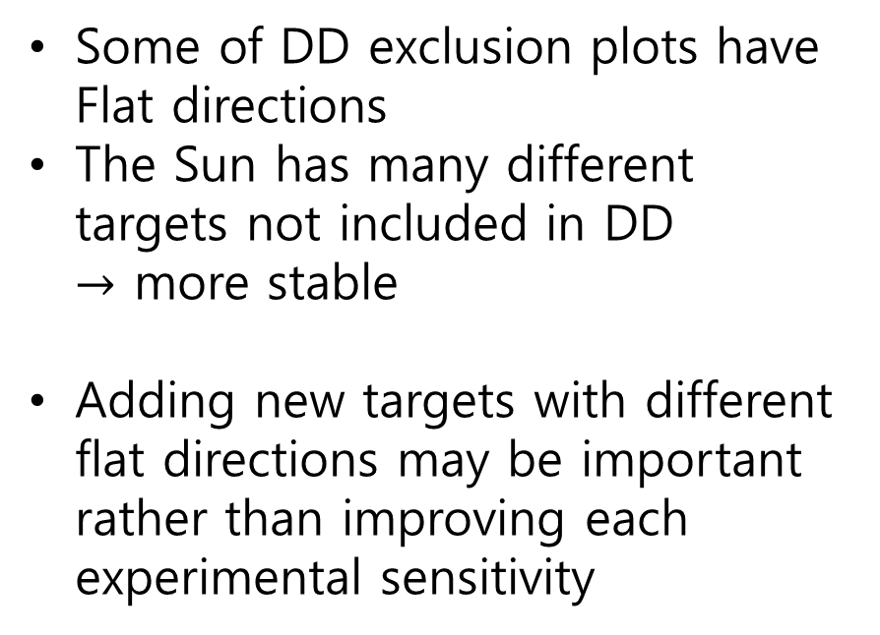
Bracketing DD experiments and capture
Some of DD exclusion plots have Flat directions
The Sun has many different targets not included in DD
$→$ more stable
Adding new targets with different flat directions may be important rather than improving each experimental sensitivity
A. Brenner, G. Herrera, A. Ibarra, S. Kang, S.S. and G. Tomar, "Complementarity of experiments in probing the non-relativistic effective theory of dark matter-nucleon interactions", JCAP06(2022)026 (arXiv: 2203.04210)

Slide 22
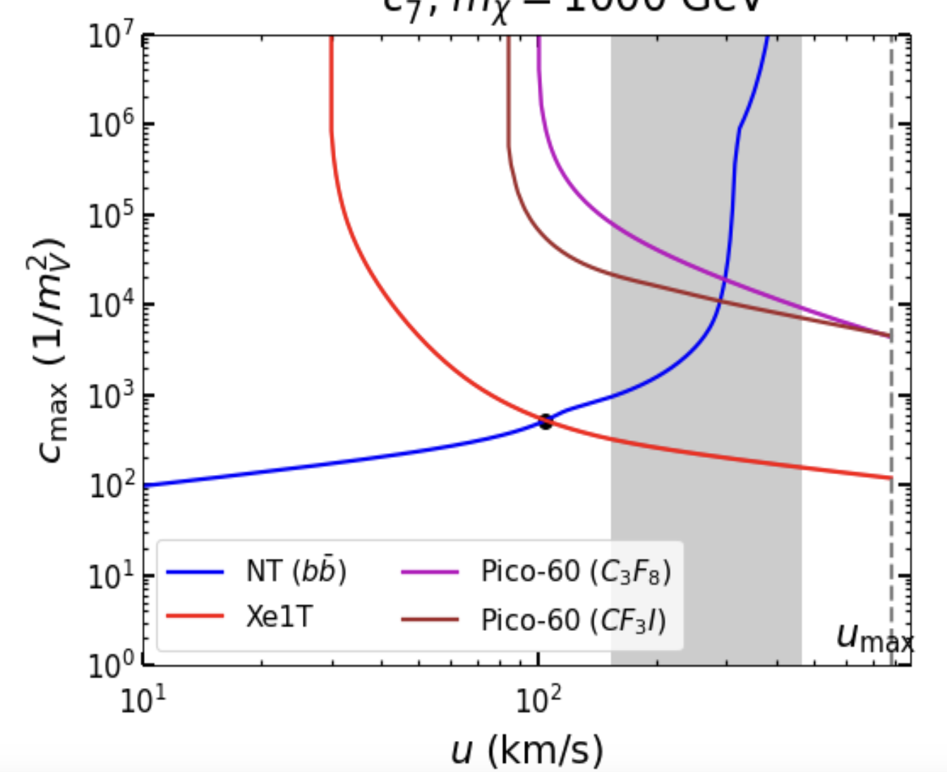
Complementarity between Direct Detection and Capture in the Sun:
Halo-Independent bounds
$$R ∼\int{dv H\left(v\right) f\left(v\right)}∼\int{dv ℛ\left(v\right) η\left(v\right)}$$
𝜒
+
nucleus
=
v>_{out}v_{esc}(r)
𝜒
𝜒
V_{out}<v_{esc}(r)

Slide 23
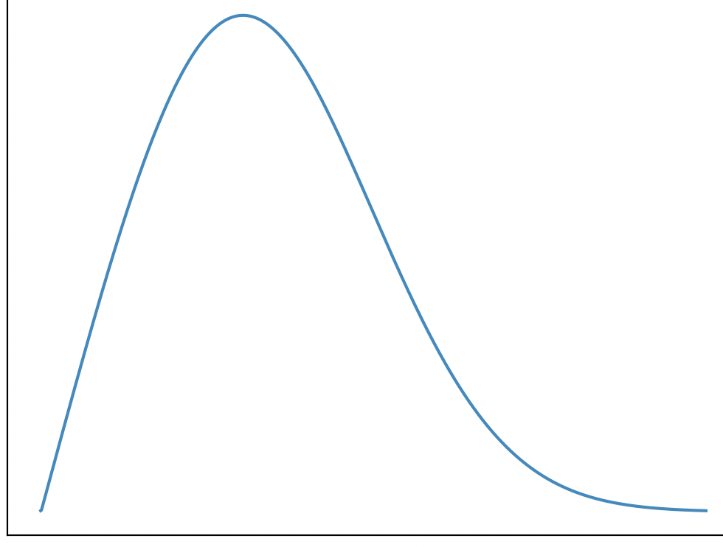
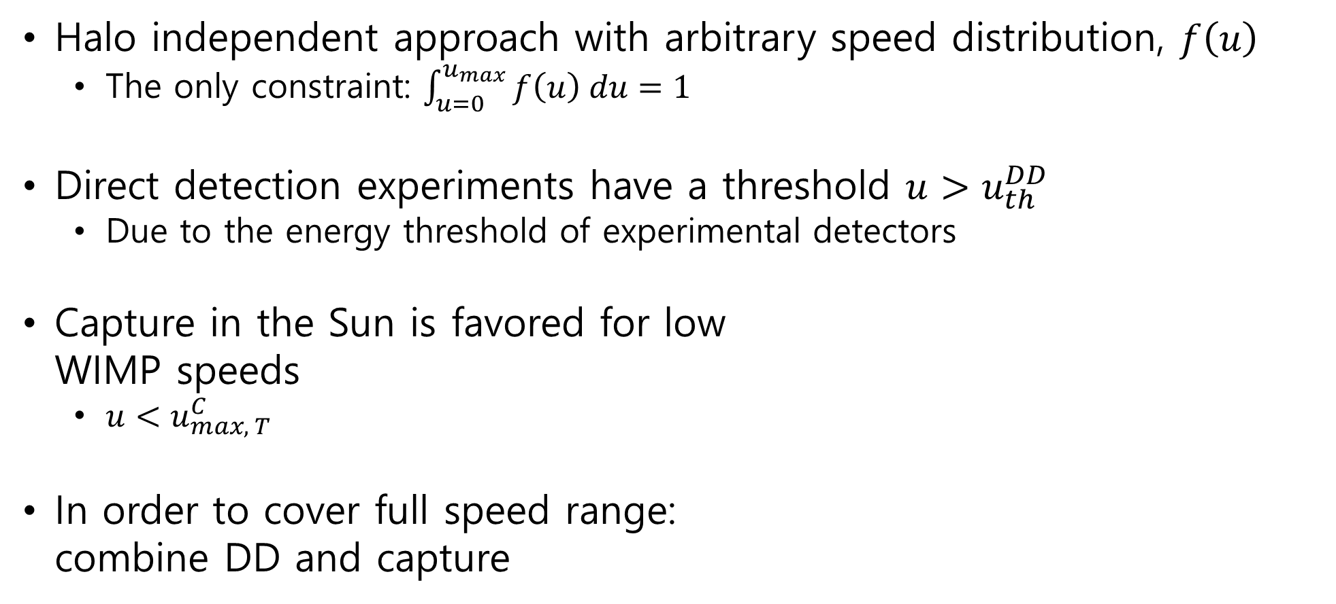
Halo independent approach
Halo independent approach with arbitrary speed distribution, $f\left(u\right)$
  The only constraint: $\int_{u=0}^{u_{max}}{f\left(u\right) du=1}$
Direct detection experiments have a threshold $u>u_{th}^{DD}$
  Due to the energy threshold of experimental detectors
Capture in the Sun is favored for low
WIMP speeds
  $u<u_{max, T}^{C}$
In order to cover full speed range:
combine DD and capture
Capture in the Sun
Direct Detection
F. Ferrer, A. Ibarra, S. Wild “A novel approach to derive halo-independent limits on dark matter properties”, JCAP09(2015)052

Slide 24
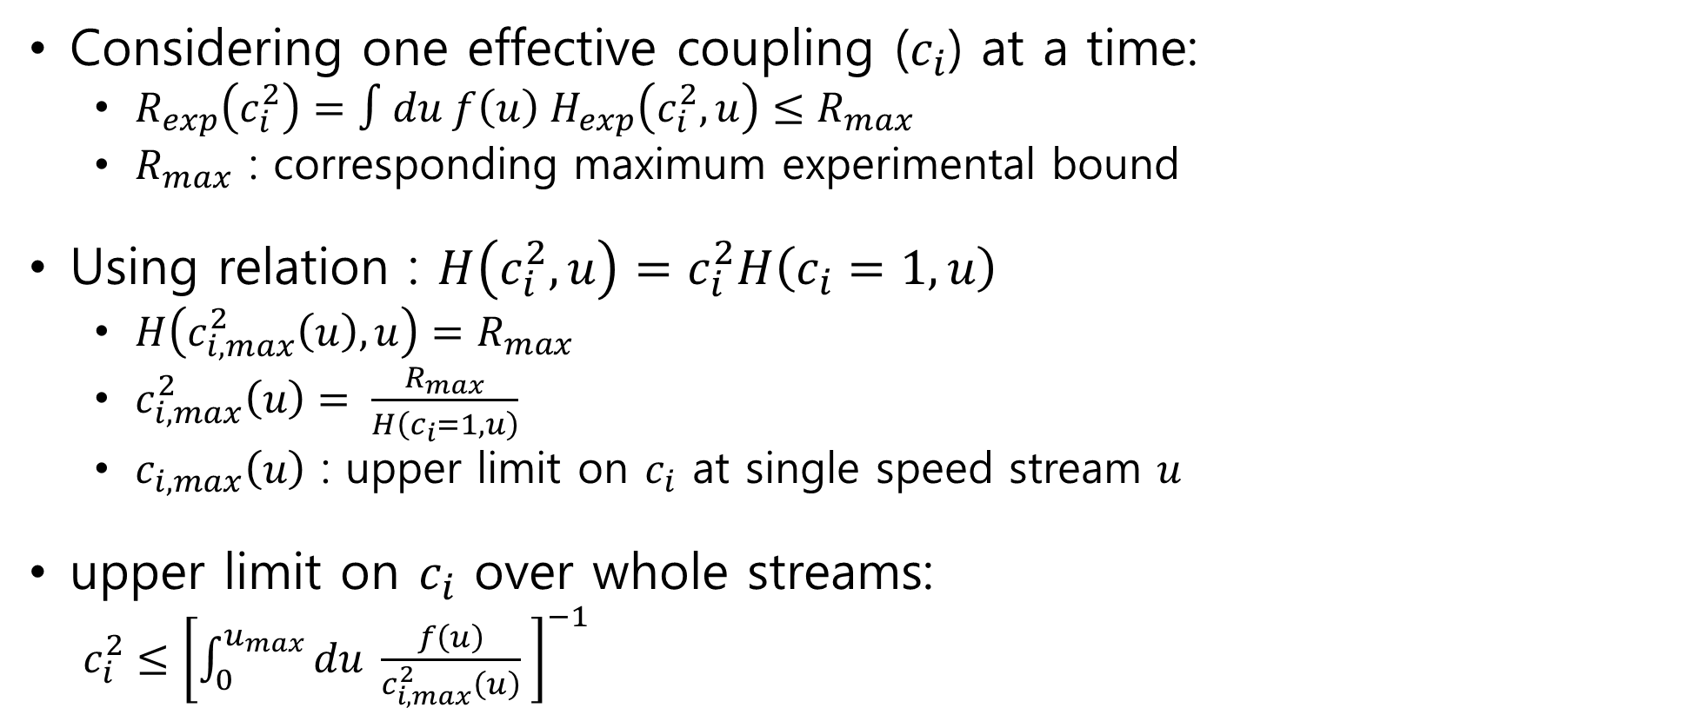
Halo independent approach
Considering one effective coupling ($c_{i}$) at a time:
  $R_{exp}\left(c_{i}^{2}\right)=∫du f\left(u\right) H_{exp}\left(c_{i}^{2},u\right)≤R_{max}$
  $R_{max}$ : corresponding maximum experimental bound
Using relation : $H\left(c_{i}^{2},u\right)=c_{i}^{2}H\left(c_{i}=1,u\right)$
  $H\left(c_{i,max}^{2}\left(u\right),u\right)=R_{max}$
  $c_{i,max}^{2}\left(u\right)= \frac{R_{max}}{H\left(c_{i}=1,u\right)}$
  $c_{i,max}\left(u\right)$ : upper limit on $c_{i}$ at single speed stream $u$
upper limit on $c_{i}$ over whole streams:
$c_{i}^{2}≤{\left[\int_{0}^{u_{max}}{du \frac{f\left(u\right)}{c_{i,max}^{2}\left(u\right)} }\right]}^{−1}$
F. Ferrer, A. Ibarra, S. Wild “A novel approach to derive halo-independent limits on dark matter properties”, JCAP09(2015)052

Slide 25
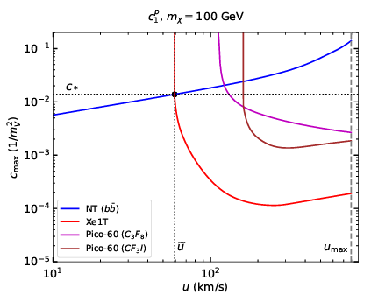
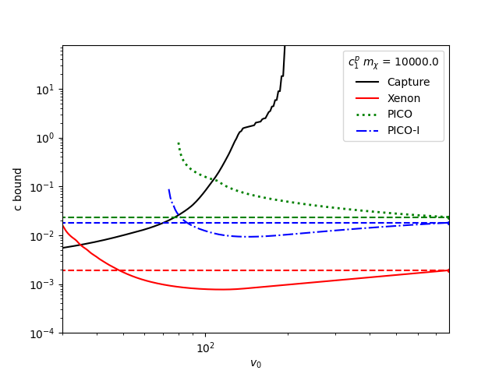

Halo independent approach
$c_{∗}=c_{max}^{NT}\left(\tilde{u}\right)=c_{max}^{DD}\left(\tilde{u}\right)$ : halo independent limit
$\tilde{u}$: intersection speed of NT and DD
To cover whole speed range,
one may combine DD and NT
  $u_{T}^{C−max}=v_{esc}\left(r\right)\sqrt{\frac{4m_{χ}m_{T}}{{\left(m_{χ}−m_{T}\right)}^{2}}}$
  ${\left(u_{th}^{DD}\right)}^{2}=\frac{m_{T}}{2μ_{χT}^{2}}E_{R,th}$
S. Kang, A. Kar, S. Scopel, JCAP03(2023)011
F. Ferrer, A. Ibarra, S. Wild “A novel approach to derive halo-independent limits on dark matter properties”, JCAP09(2015)052

Slide 26

Halo independent approach case I
Intersection:
  ${\left(c^{NT}\right)}_{max}^{2}\left(u\right)≤c_{∗}^{2}$ for $0≤u≤\tilde{u}$
  ${\left(c^{DD}\right)}_{max}^{2}\left(u\right)≤c_{∗}^{2}$ for $\tilde{u}≤u≤u_{max}$
  $c^{2}≤c_{∗}^{2}{\left[\int_{0}^{\tilde{u}}{du f\left(u\right)}\right]}^{−1}=\frac{c_{∗}^{2}}{δ}$
  $c^{2}≤c_{∗}^{2}{\left[\int_{\tilde{u} }^{u_{max}}{du f\left(u\right)}\right]}^{−1}=\frac{c_{∗}^{2}}{1−δ}$
  $δ= \int_{0}^{\tilde{u}}{du f\left(u\right)}$
  $c^{2}≤2c_{∗}^{2}$
$$2$$
$$3$$
$$1$$
S. Kang, A. Kar, S. Scopel, JCAP03(2023)011
F. Ferrer, A. Ibarra, S. Wild “A novel approach to derive halo-independent limits on dark matter properties”, JCAP09(2015)052

Slide 27
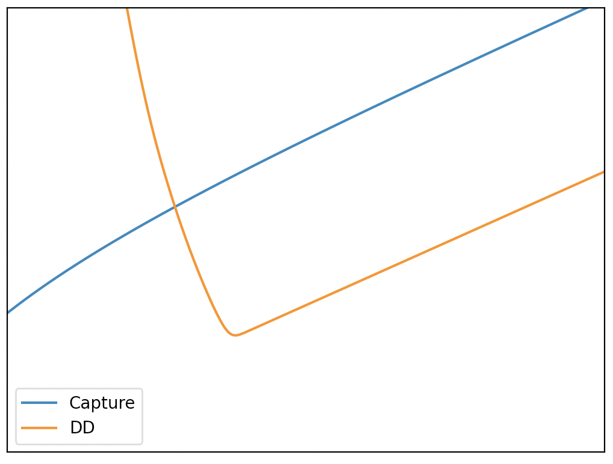

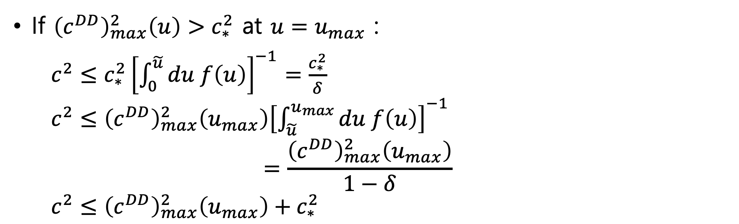





Halo independent approach case II
If ${\left(c^{DD}\right)}_{max}^{2}\left(u\right)>c_{∗}^{2}$ at $u=u_{max}$ :
  $c^{2}≤c_{∗}^{2}{\left[\int_{0}^{\tilde{u}}{du f\left(u\right)}\right]}^{−1}=\frac{c_{∗}^{2}}{δ}$
  $c^{2}≤{\left(c^{DD}\right)}_{max}^{2}\left(u_{max}\right){\left[\int_{\tilde{u} }^{u_{max}}{du f\left(u\right)}\right]}^{−1}$
  $$=\frac{{\left(c^{DD}\right)}_{max}^{2}\left(u_{max}\right)}{1−δ}$$
  $c^{2}≤{\left(c^{DD}\right)}_{max}^{2}\left(u_{max}\right)+c_{∗}^{2}$
$$c_{max}^{DD}$$
$$c_{max}$$
$$c_{∗}$$
$$\tilde{u}$$
$$u$$
$$u_{max}$$
Halo independent limit may depend on $u_{max}$
F. Ferrer, A. Ibarra, S. Wild “A novel approach to derive halo-independent limits on dark matter properties”, JCAP09(2015)052

Slide 28
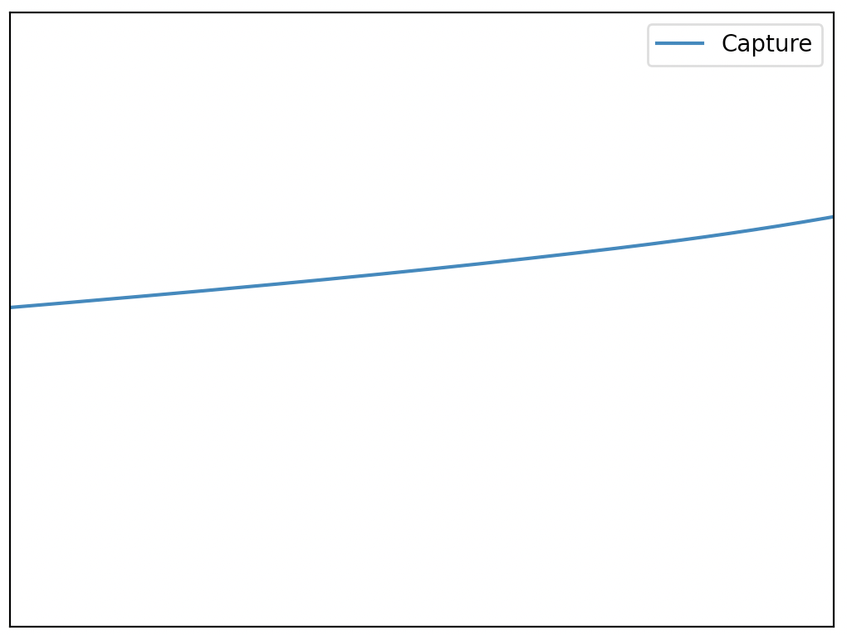

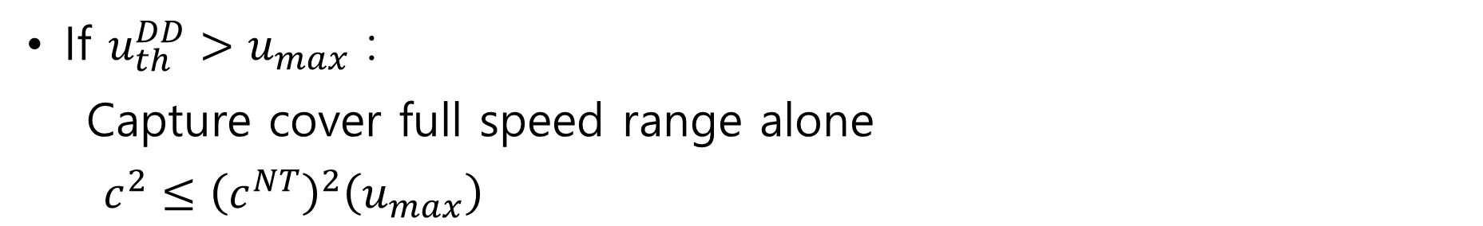
Halo independent approach case III
If $u_{th}^{DD}>u_{max}$ :
  Capture cover full speed range alone
  $c^{2}≤{\left(c^{NT}\right)}^{2}\left(u_{max}\right)$
$$c_{max}^{NT}$$
$$c_{max}$$
$$u$$
$$u_{max}$$
Halo independent limit may depend on $u_{max}$
F. Ferrer, A. Ibarra, S. Wild “A novel approach to derive halo-independent limits on dark matter properties”, JCAP09(2015)052

Slide 29
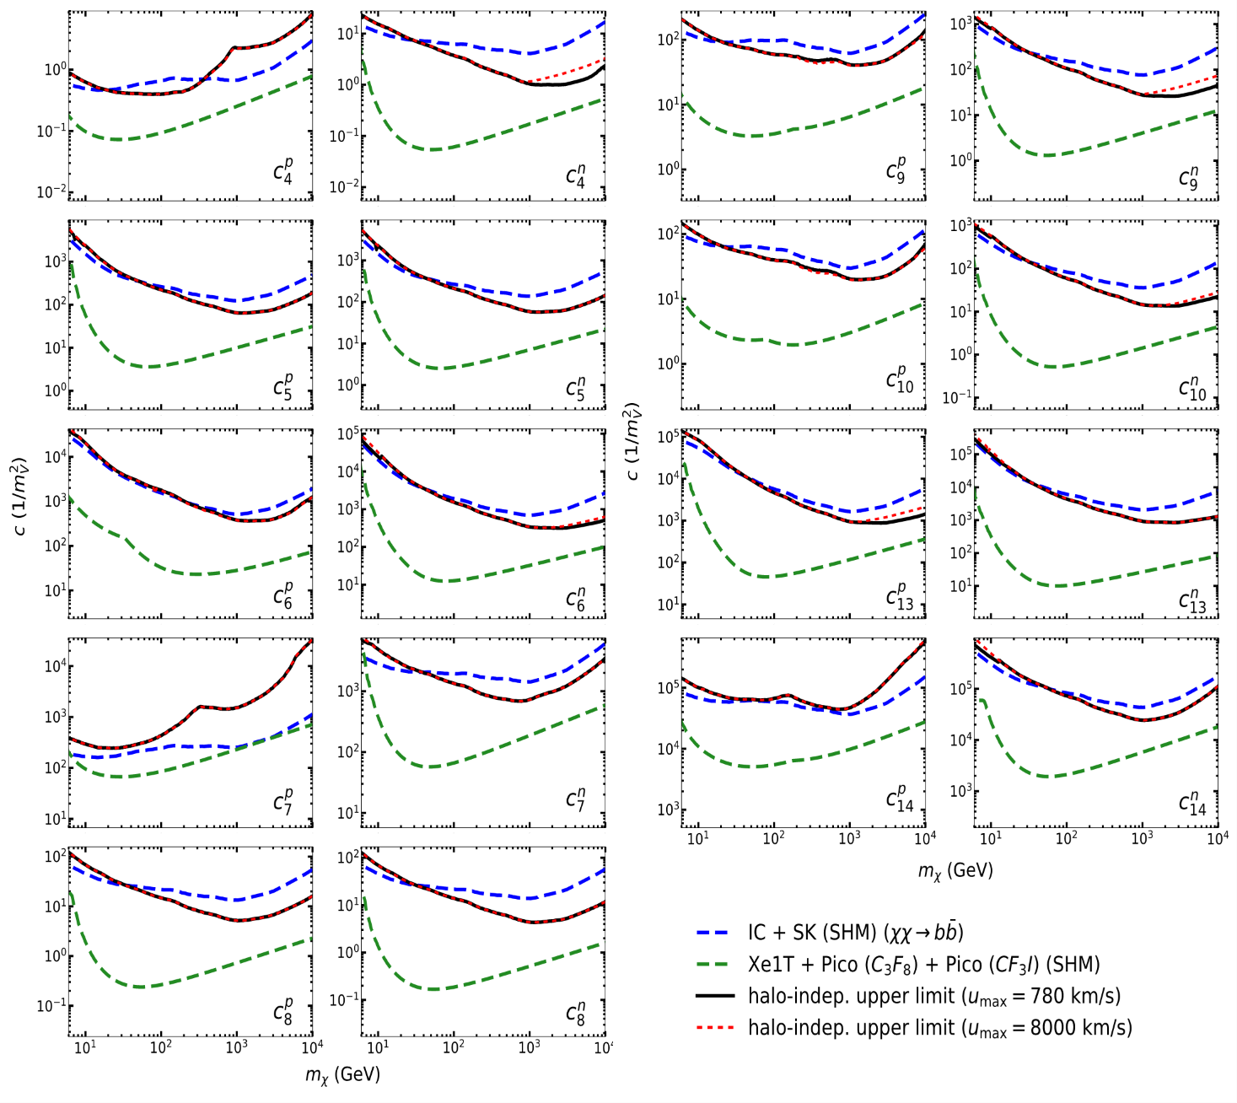
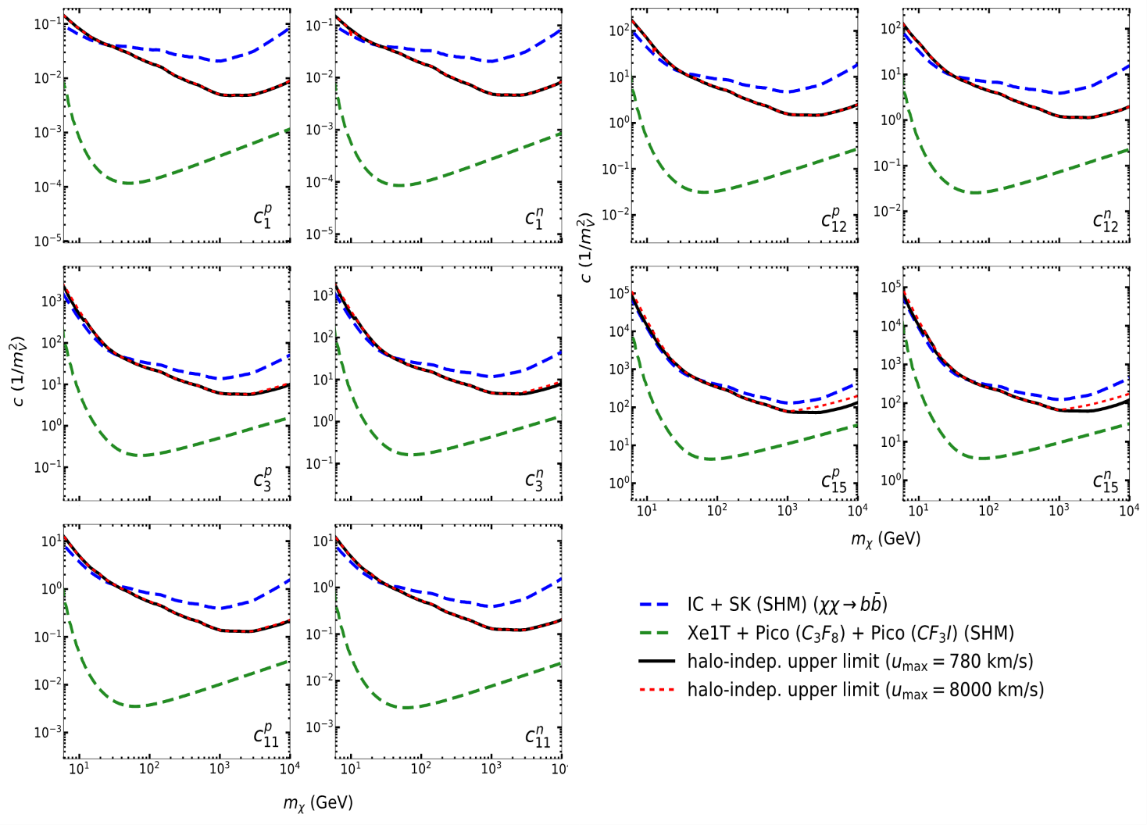
Halo independent approach
S. Kang, A. Kar, S. Scopel, “Halo-independent bounds on the non-relativistic effective theory of WIMP-nucleon scattering from direct detection and neutrino observations”, JCAP03(2023)011 (arXiv:2212.05774)

Slide 30
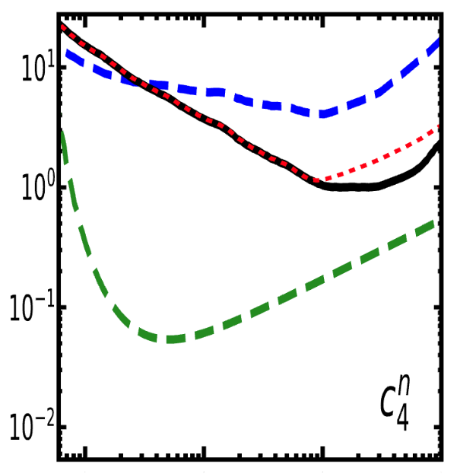
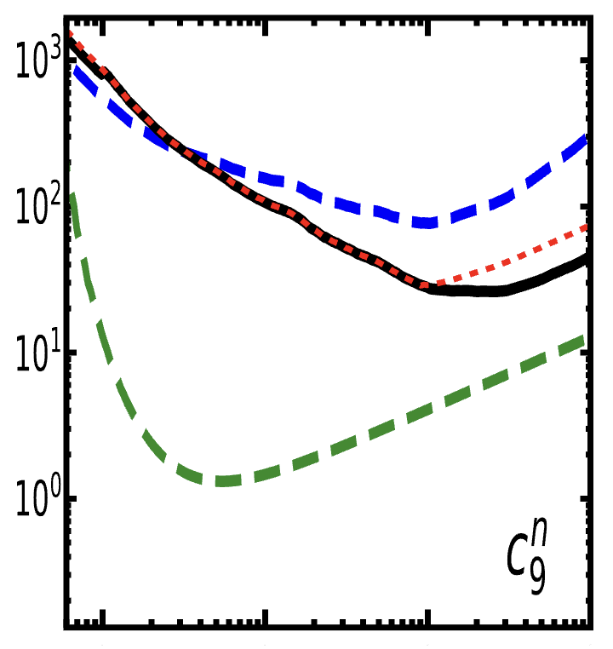



Dependence on $u_{max}$
Case II, ${\left(c^{DD}\right)}_{max}^{2}\left(u\right)>c_{∗}^{2}$ at $u=u_{max}$ : $c^{2}≤{\left(c^{DD}\right)}_{max}^{2}\left(u_{max}\right)+c_{∗}^{2}$
Case III, $u_{th}^{DD}>u_{max}$ : $c^{2}≤{\left(c^{NT}\right)}_{max}^{2}\left(u_{max}\right)$
$u_{max}$: 780 km/s $→$ 8000 km/s
Effect of large $u_{max}$ is mild: factor less than 2
S. Kang, A. Kar, S. Scopel, “Halo-independent bounds on the non-relativistic effective theory of WIMP-nucleon scattering from direct detection and neutrino observations”, JCAP03(2023)011 (arXiv:2212.05774)

Slide 31



Relaxation factor
Relaxation factor
  $r_{f}^{2}=\frac{2c_{∗}^{2}}{{\left(c_{SHM}^{exp}\right)}^{2}}=2c_{∗}^{2} \int_{0}^{u_{max}}{du\frac{f_{M}\left(u\right)}{{\left(c^{exp}\right)}_{max}^{2}\left(u\right)}=2c_{∗}^{2}<\frac{1}{{\left(c^{exp}\right)}_{max}^{2}}> ≅2c_{∗}^{2}<\frac{1}{{\left(c^{exp}\right)}_{max}^{2}}>_{bulk}}$
  $\int_{bulk}{du f_{M}\left(u\right)≈0.8}$
S. Kang, A. Kar, S. Scopel, “Halo-independent bounds on the non-relativistic effective theory of WIMP-nucleon scattering from direct detection and neutrino observations”, JCAP03(2023)011 (arXiv:2212.05774)

Slide 32

Relaxation factor
High relaxation factor:
the halo-independent method can weaken the bound
$r_{f}^{2}=\frac{2c_{∗}^{2}}{{\left(c_{SHM}^{exp}\right)}^{2}}=2c_{∗}^{2} \int_{0}^{u_{max}}{du\frac{f_{M}\left(u\right)}{{\left(c^{exp}\right)}_{max}^{2}\left(u\right)}=2c_{∗}^{2}<\frac{1}{{\left(c^{exp}\right)}_{max}^{2}}> ≅2c_{∗}^{2}<\frac{1}{{\left(c^{exp}\right)}_{max}^{2}}>_{bulk}}$
S. Kang, A. Kar, S. Scopel, “Halo-independent bounds on the non-relativistic effective theory of WIMP-nucleon scattering from direct detection and neutrino observations”, JCAP03(2023)011 (arXiv:2212.05774)

Slide 33

WimPyDD & WimPyC
User-friendly Python code
  object-oriented
  customizable
  portable
Calculates expected rates in any scenarios
  arbitrary spins
  inelastic scattering
  generic WIMP velocity distribution
Published and can be downloaded:
  https://wimpydd.hepforge.org/
I. Jeong, S. Kang, S. Scopel, G. Tomar, “WimPyDD: An object-oriented Python code for the calculation of WIMP direct detection signals”, Computer Physics Communications, 2022.108342 (arXiv: 2106.06207)

Slide 34

WimPyDD
Calculates DD expected rates in any scenarios
Three main components
  Wilson coefficients
  response functions
  halo function
WimPyDD is transparent and fast, suitable for large parameter space
WimPyDD is used by the LZ collaboration:
  Phys.Rev.Lett. 133 (2024) 22, 221801 (e-Print: 2404.17666)
  Phys.Rev.D 109 (2024) 9, 092003 (e-Print: 2312.02030 )
I. Jeong, S. Kang, S. Scopel, G. Tomar, “WimPyDD: An object-oriented Python code for the calculation of WIMP direct detection signals”, Computer Physics Communications, 2022.108342 (arXiv: 2106.06207)
34

Slide 35
WimPyDD
Three main routines
  WD.dsigma_der: calculates the differential cross section on target
  WD.diff_rate: calculates the differential rate
  without including the response of the detector.
  WD.wimp_dd_rate: calculates the integrated expected rates
  including the response of the detector
Four input classes
  element
  target: a single element or linear combination of elements
  eft_hamiltonian: with arbitrary combination of operators and Wilson coefficients
    Two operator bases available: Anand et al. arXiv:1308.6288 (spin=0,1/2)
    Gondolo et al., arXiv:2008.05120 (any WIMP spin)
  experiment: experimental set-up information
I. Jeong, S. Kang, S. Scopel, G. Tomar, “WimPyDD: An object-oriented Python code for the calculation of WIMP direct detection signals”, Computer Physics Communications, 2022.108342 (arXiv: 2106.06207)

Slide 36



WimPyDD
Three main routines
  WD.dsigma_der: calculates the differential cross section on target
  WD.diff_rate: calculates the differential rate
  without including the response of the detector.
  WD.wimp_dd_rate: calculates the integrated expected rates
  including the response of the detector
I. Jeong, S. Kang, S. Scopel, G. Tomar, “WimPyDD: An object-oriented Python code for the calculation of WIMP direct detection signals”, Computer Physics Communications, 2022.108342 (arXiv: 2106.06207)

Slide 37

WimPyC
Three main new routines
  WD.wimp_capture: calculates the capture rate
  WD.wimp_capture_matrix: calculates the matrix for the capture rate
  WD.load_response_functions_capture: loads the response functions
Two new classes
  isotope: without including the response of the detector
  celestial_body
S. Kang, S. Scopel, G. Tomar, “WimPyC: an extension module of WimPyDD for the calculation of WIMP capture in celestial bodies”, arXiv: 2510.21185

Slide 38




WimPyC
Set-up a new celestial body: The input string is the name of the directory WimPyDD/WIMP_Capture/Celestial_bodies/Sun containing the celestial body information
Folder content
list of isotopes
S. Kang, S. Scopel, G. Tomar, “WimPyC: an extension module of WimPyDD for the calculation of WIMP capture in celestial bodies”, arXiv: 2510.21185

Slide 39

WimPyC
Calculate response functions: Once you calculate the response functions for each isotopes you can use it for the other celestial bodies sampling in corresponding energy range.
tabulated response functions for WIMP Capture
recoil energy
S. Kang, S. Scopel, G. Tomar, “WimPyC: an extension module of WimPyDD for the calculation of WIMP capture in celestial bodies”, arXiv: 2510.21185

Slide 40



WimPyC
Sun, NREFT operators
Earth, NREFT operators
Sun, SI interaction, inelastic scattering
S. Kang, S. Scopel, G. Tomar, “WimPyC: an extension module of WimPyDD for the calculation of WIMP capture in celestial bodies”, arXiv: 2510.21185

Slide 41

WimPyC
Jupiter
White Dwarf
N.B.: at high cross section optical thin regime no longer valid
(Capture rate eventually saturated by geometrical limit)
Main Sequence Star
S. Kang, S. Scopel, G. Tomar, “WimPyC: an extension module of WimPyDD for the calculation of WIMP capture in celestial bodies”, arXiv: 2510.21185

Slide 42

additional components of WimPyC module
S. Kang, S. Scopel, G. Tomar, “WimPyC: an extension module of WimPyDD for the calculation of WIMP capture in celestial bodies”, arXiv: 2510.21185

Slide 43

WimPyC vs. other codes for WIMP capture in celestial bodies
WimPyC can not be used when the speed of the WIMP is relativistic (neutron stars) and in the case of multiple scattering. And it can not calculate additional effects such as thermalization, equilibration, evaporation.

Slide 44

Download and install quickly

Slide 45
Summary
The complementarity between WIMP direct detection and WIMP capture in the Sun allows to obtain bounds that do not depend on
the WIMP-nucleus interaction or the WIMP velocity
WimPyC is the extension of WimPyDD that allows to calculate WIMP capture in celestial bodies in virtually any scenario
Using WimPyDD and WimPyC, one can easily correlate direct detection experiments and capture in celestial bodies

Slide 46
Back-up

Slide 47
Extensive tests to validate WimPyC against published results:
Sun, NREFT operators
Earth, NREFT operators
Sun, SI interaction, inelastic scattering
S. Kang, S. Scopel, G. Tomar, “WimPyC: an extension module of WimPyDD for the calculation of WIMP capture in celestial bodies”, arXiv: 2510.21185

Slide 48
Extensive tests to validate WimPyC against published results:
Jupiter
White Dwarf
N.B.: at high cross section optical thin regime no longer valid, multiple scatters set in (Capture rate eventually saturated by geometrical limit)
Main Sequence Star
S. Kang, S. Scopel, G. Tomar, “WimPyC: an extension module of WimPyDD for the calculation of WIMP capture in celestial bodies”, arXiv: 2510.21185

Slide 49





Extensive tests to validate WimPyC against published results:
Match specific high—energy DM model (Anapole DM) to non-relativistic effective theory
Massless propagator
N.B.: for a massless propagator the capture rate diverges at low momentum transfer. Such events correpond to WIMPs locked on orbits of very large aphelion.
WimPyC allows to regularize the capture rate by removing orbits that cross Jupiter ( “Jupiter cut”).
Matricial techniques using wimp_capture_matrix and wimp_dd_matrix (allowed regions inside ellipsoids)
Speed response function H_{C}(u) for halo-independent analysis
S. Kang, S. Scopel, G. Tomar, “WimPyC: an extension module of WimPyDD for the calculation of WIMP capture in celestial bodies”, arXiv: 2510.21185

