Slide 1


Spherically Symmetric Fluid Simulations of Black Hole Accretion in Self-Interacting Dark Matter Halos
Tan Chen (陈坦)
arXiv:2607.02151
Collaborators: Meng Zhe, Bin Hu, Bocheng Zhu, Fan Zhou,
Liang Gao, Rong-Gen Cai
July 6th 2026, Christchurch, CosPA 2026

Slide 2
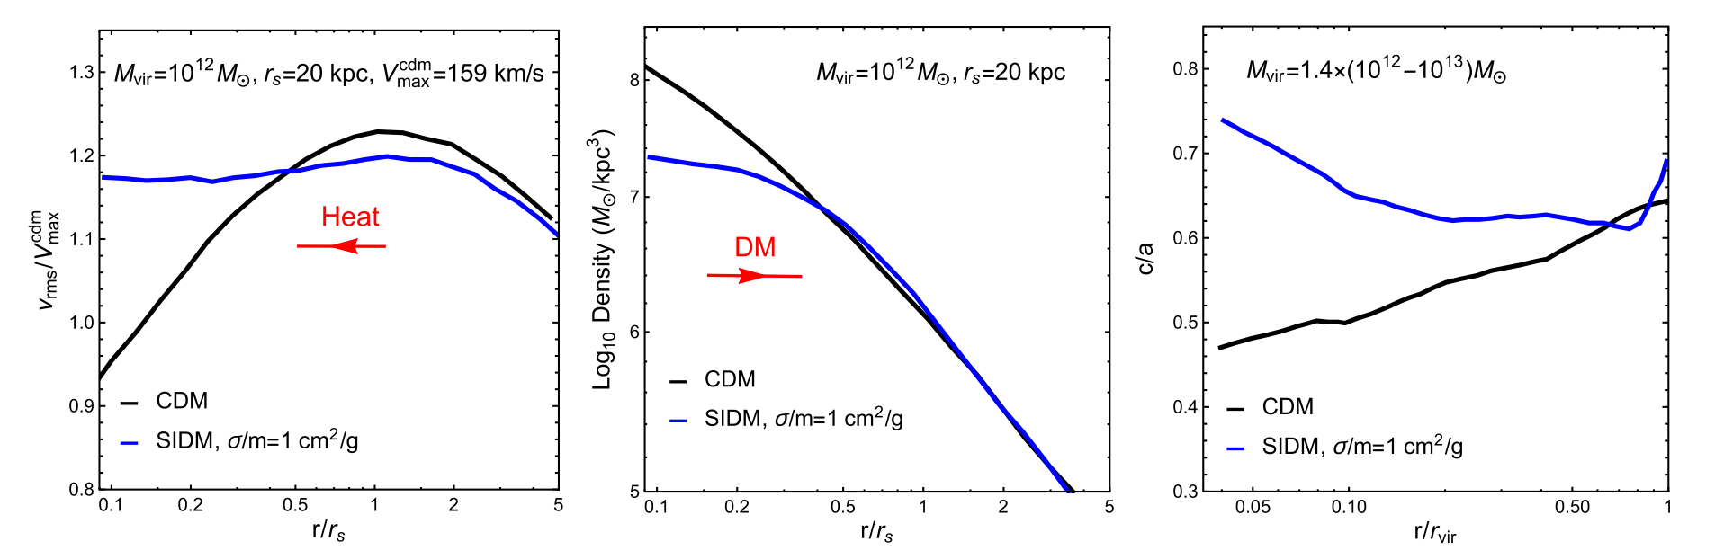
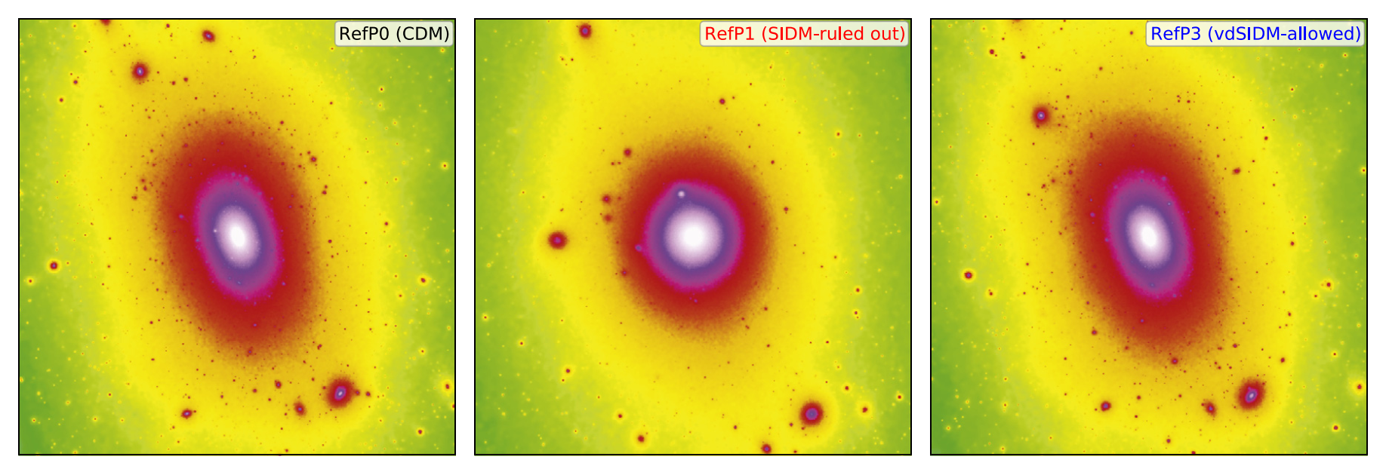
SIDM
SIDM
CDM
Collisional
Core
Spherical
Collisionless
Cusp
Triaxial
Tulin & Yu, Phys. Rept., 2018

Slide 3
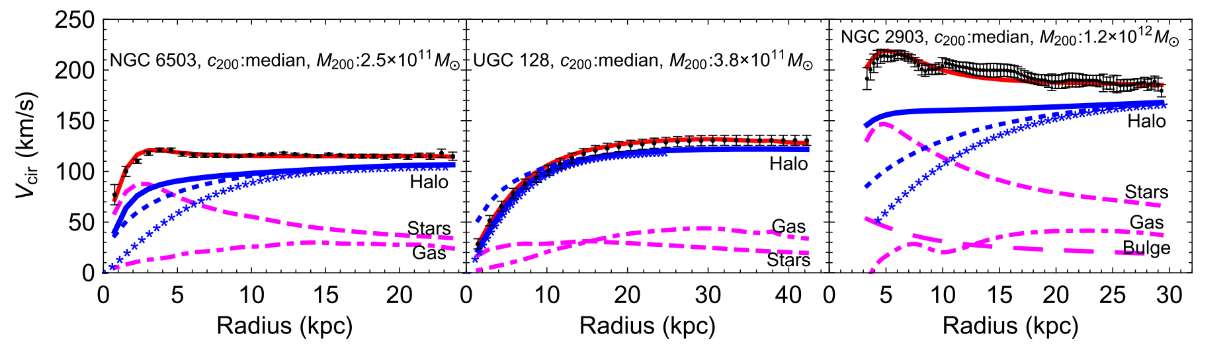
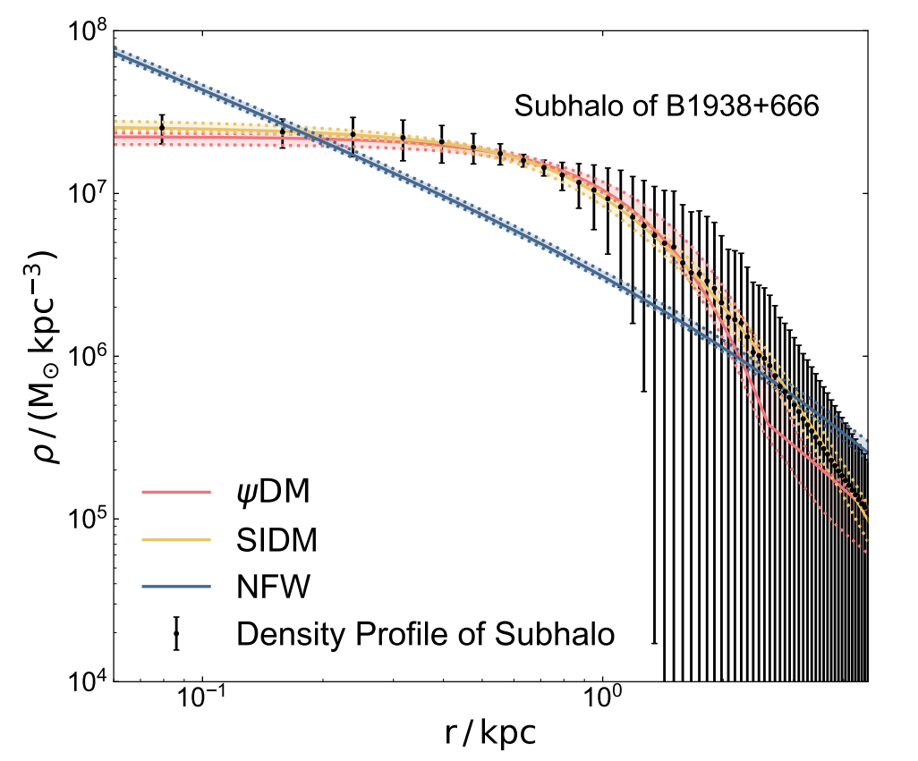
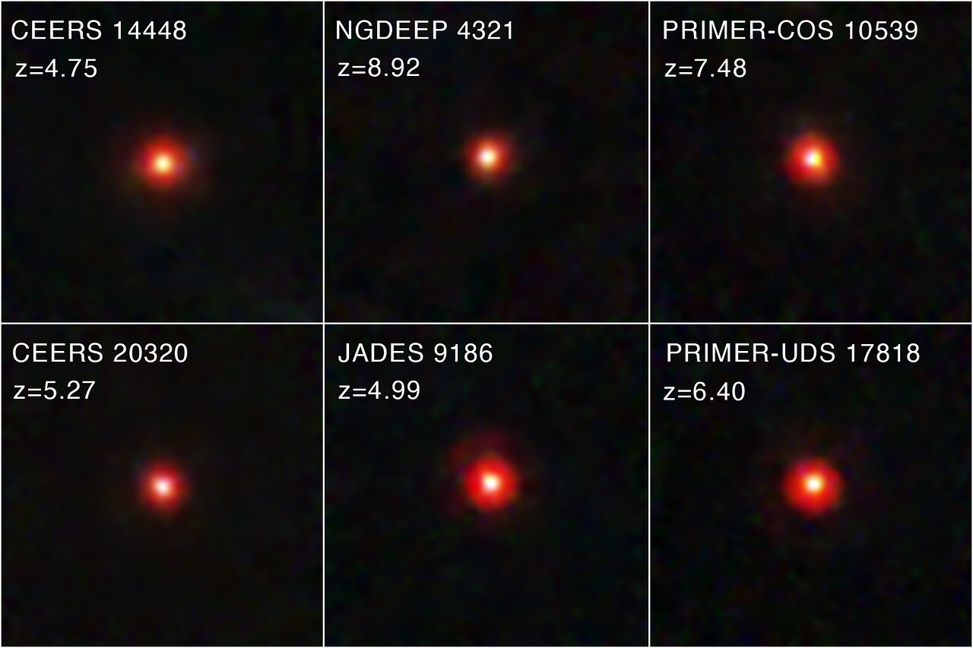
Possible motivations
Diversity
Kamada et al., PRL, 2017
Subhalo
Little Red dots
Credit: NASA, ESA, CSA, STScI, D. Kocevski (Colby College)
Lei et al., ApJL, 2025

Slide 4
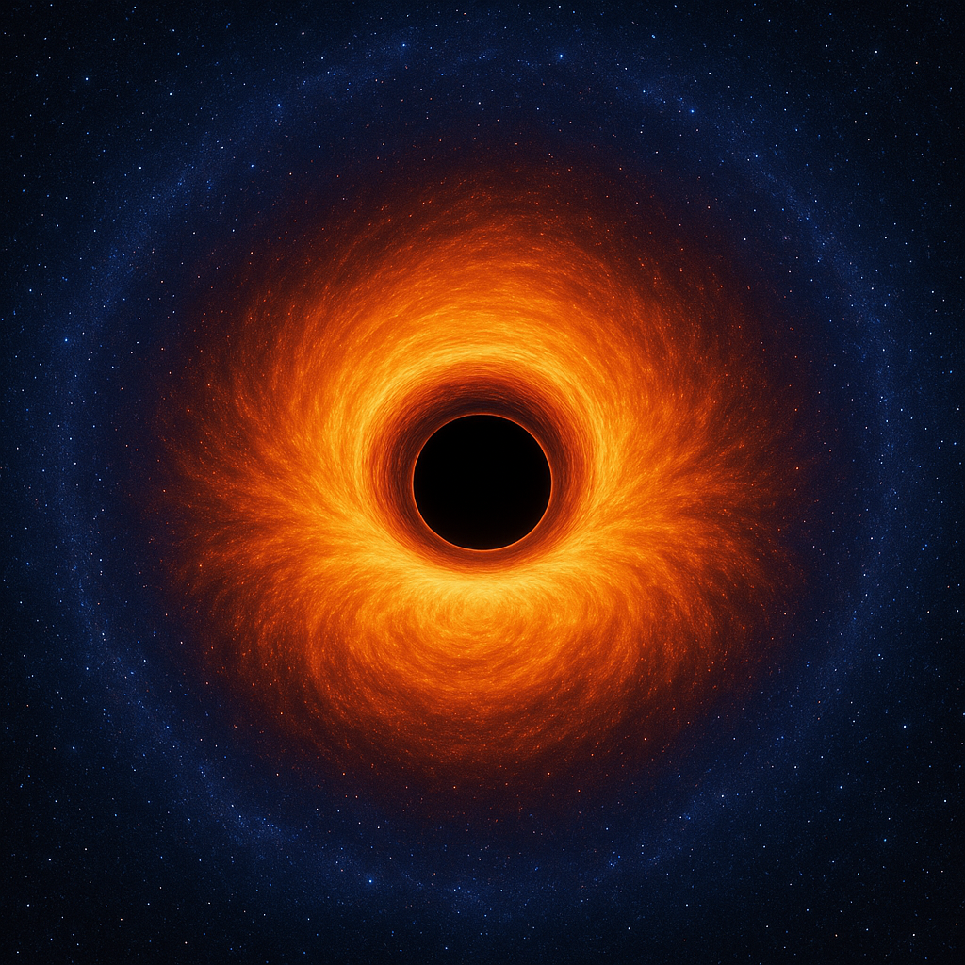
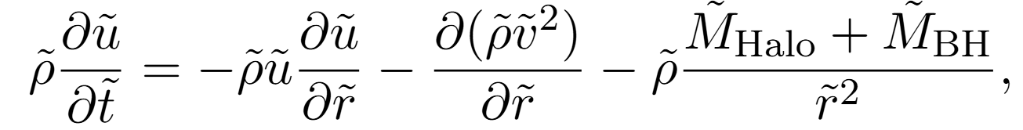
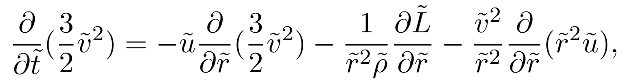
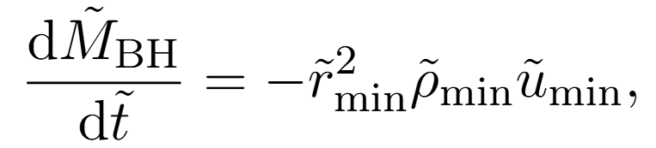
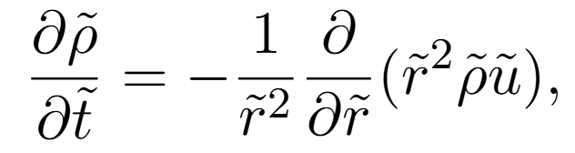
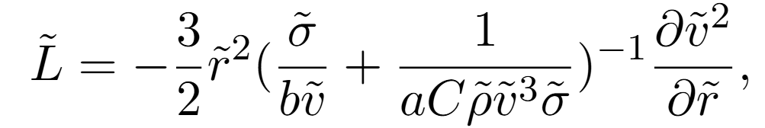
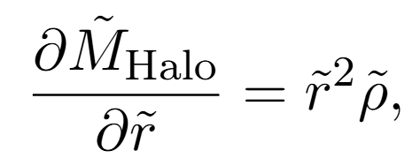
Black hole accretion in SIDM halos
Accretion Model
Momentum Conservation
Energy conservation
Black hole accretion
Continuity
Heat flow definition
Halo mass definition

Slide 5
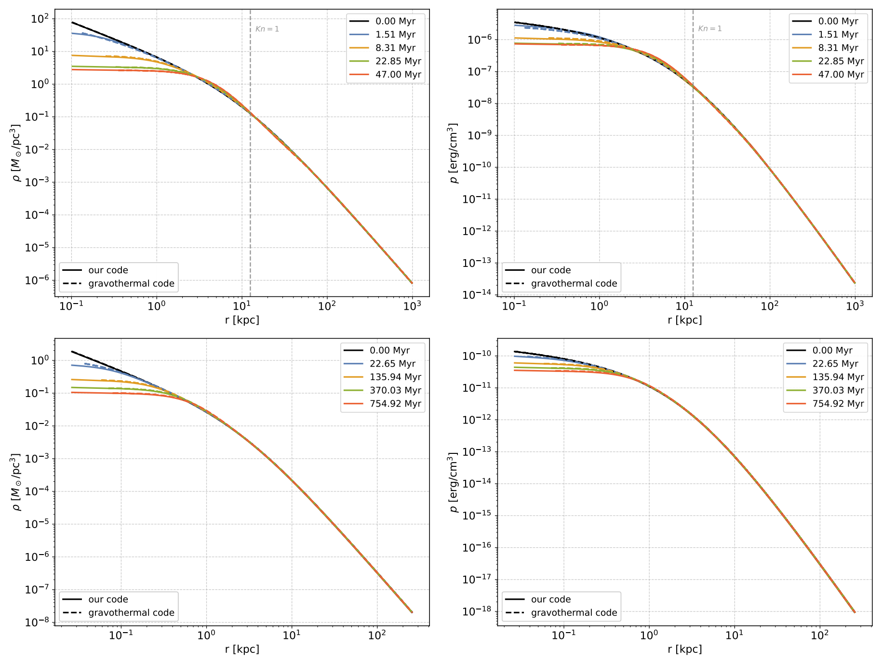
Validation without black hole
Comparison with gravothermal fluid code

Slide 6
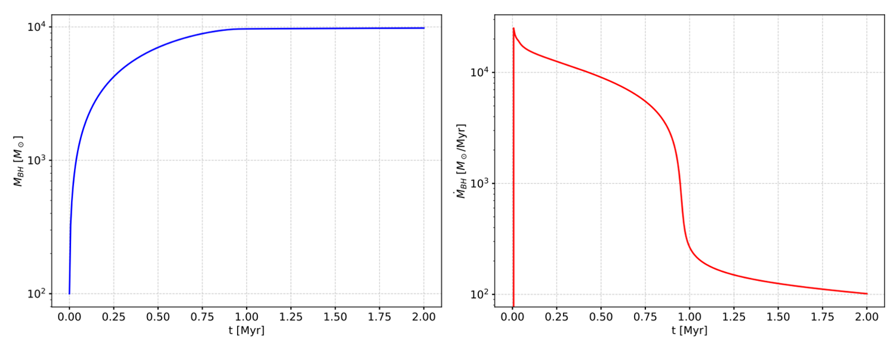
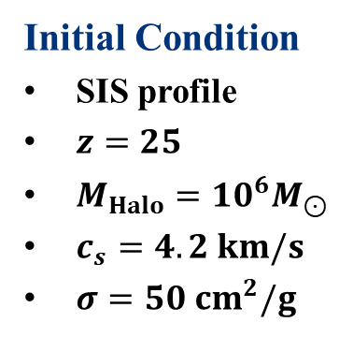
BH accretion with SIS profile
Initial Condition
SIS profile
$z=25$
$M_{Halo}=10^{6}M_{⊙}$
$c_{s}=4.2 km/s$
$σ=50 cm^{2}/g$

Slide 7
BH accretion with SIS profile
Initial Condition
SIS profile
$z=25$
$M_{Halo}=10^{6}M_{⊙}$
$c_{s}=4.2 km/s$
$σ=50 cm^{2}/g$

Slide 8
Heat conduction

Slide 9
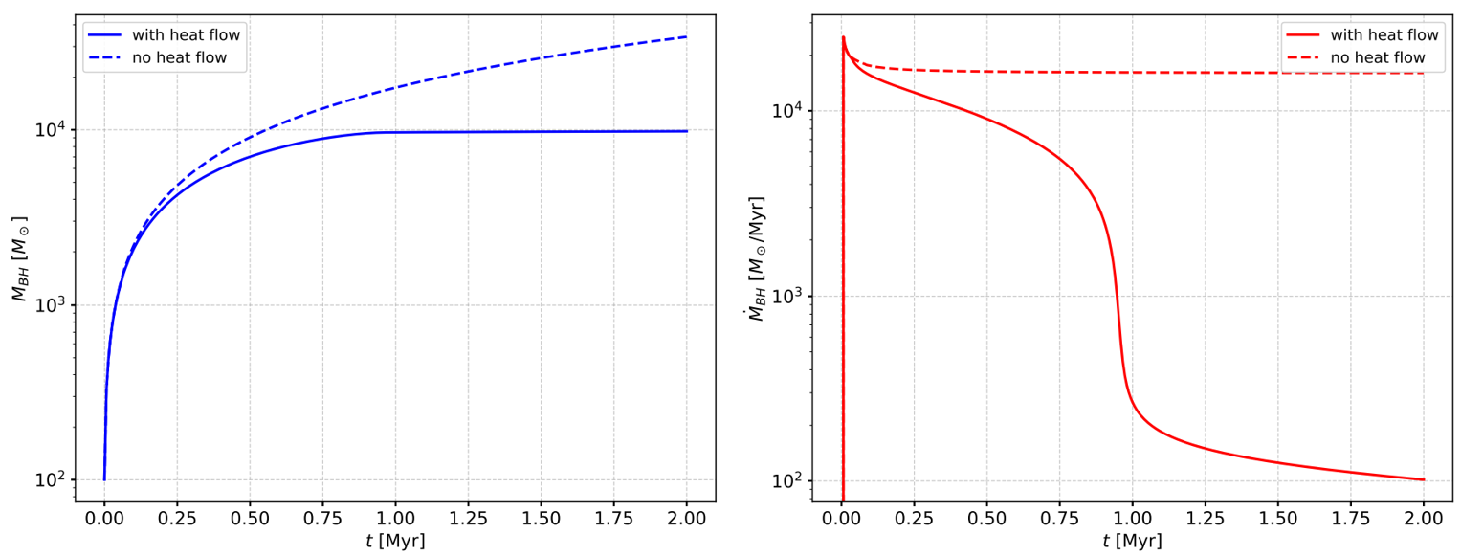
Heat conduction

Slide 10
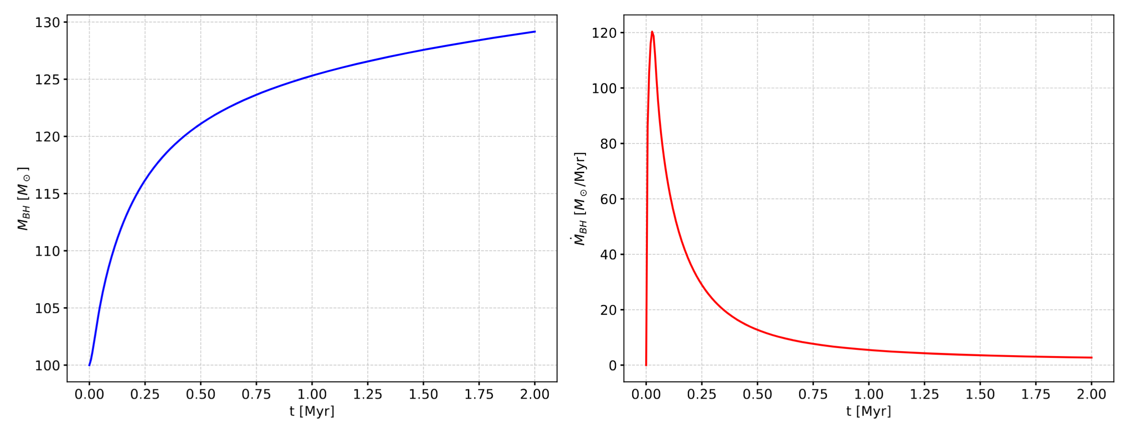
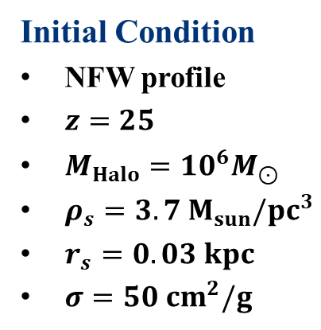
BH accretion with NFW profile
Initial Condition
NFW profile
$z=25$
$M_{Halo}=10^{6}M_{⊙}$
$ρ_{s}=3.7{ M}_{sun}/pc^{3}$
$r_{s}=0.03 kpc$
$σ=50 cm^{2}/g$

Slide 11
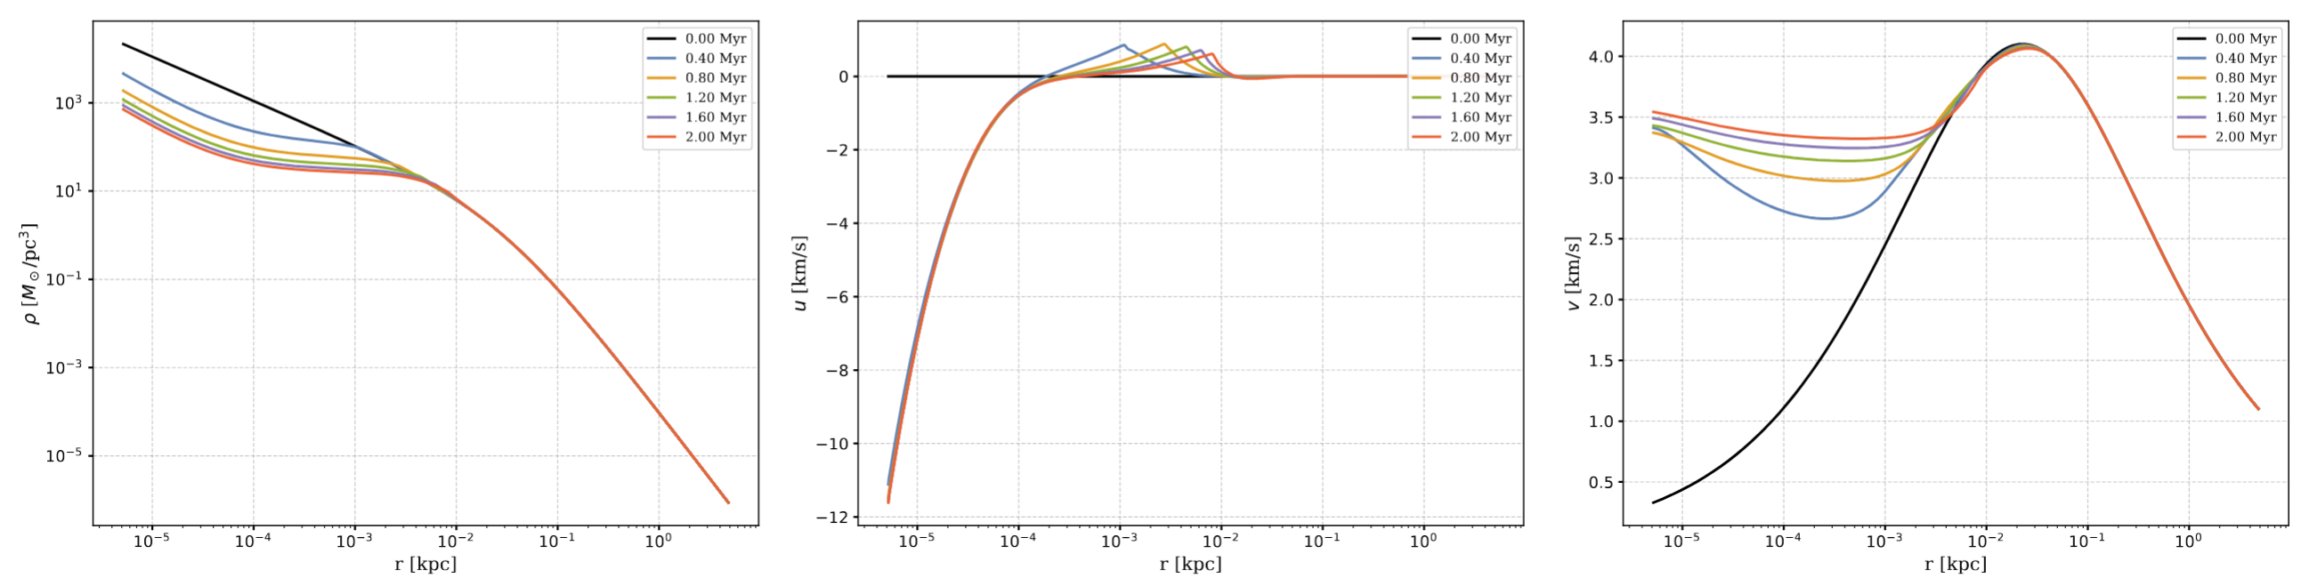
BH accretion with NFW profile
Initial Condition
NFW profile
$z=25$
$M_{Halo}=10^{6}M_{⊙}$
$ρ_{s}=3.7{ M}_{sun}/pc^{3}$
$r_{s}=0.03 kpc$
$σ=50 cm^{2}/g$

Slide 12
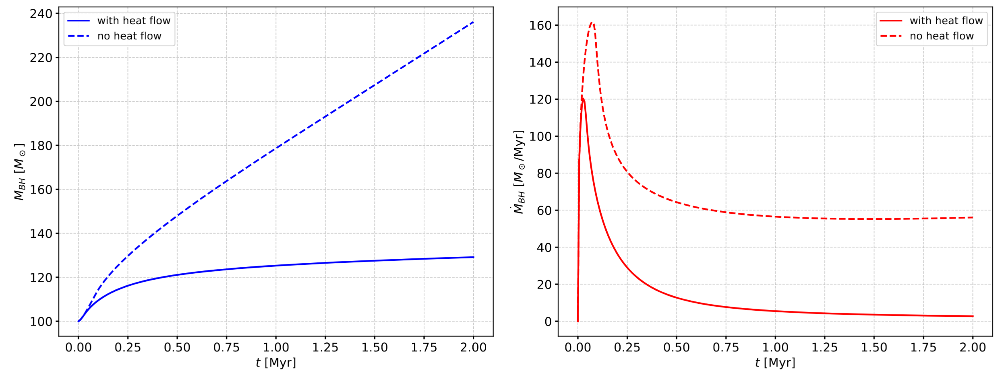
Heat conduction

Slide 13
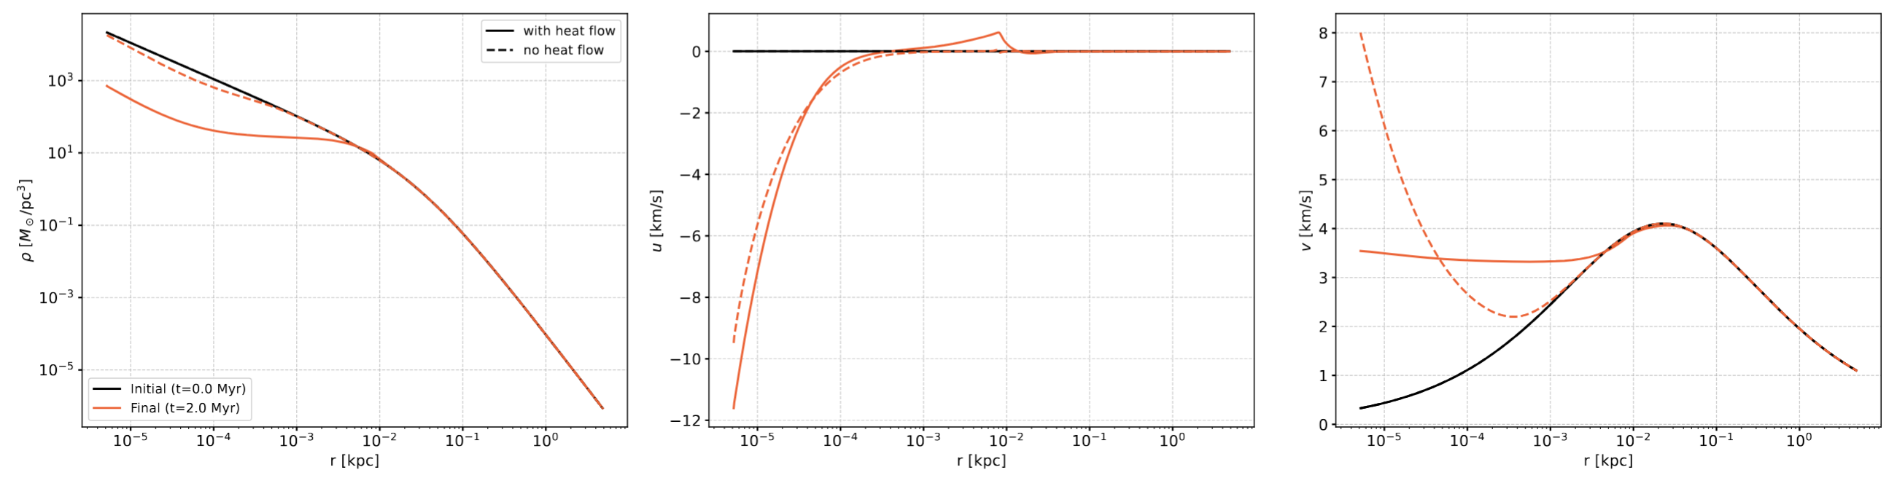
Heat conduction

Slide 14
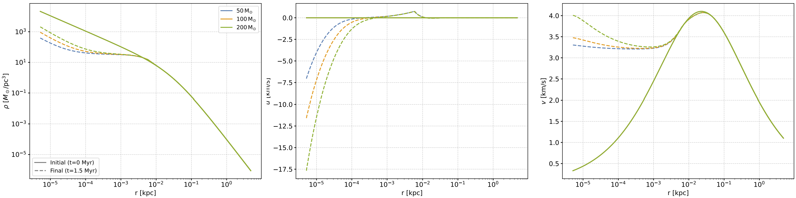
Dependence on initial black-hole mass

Slide 15
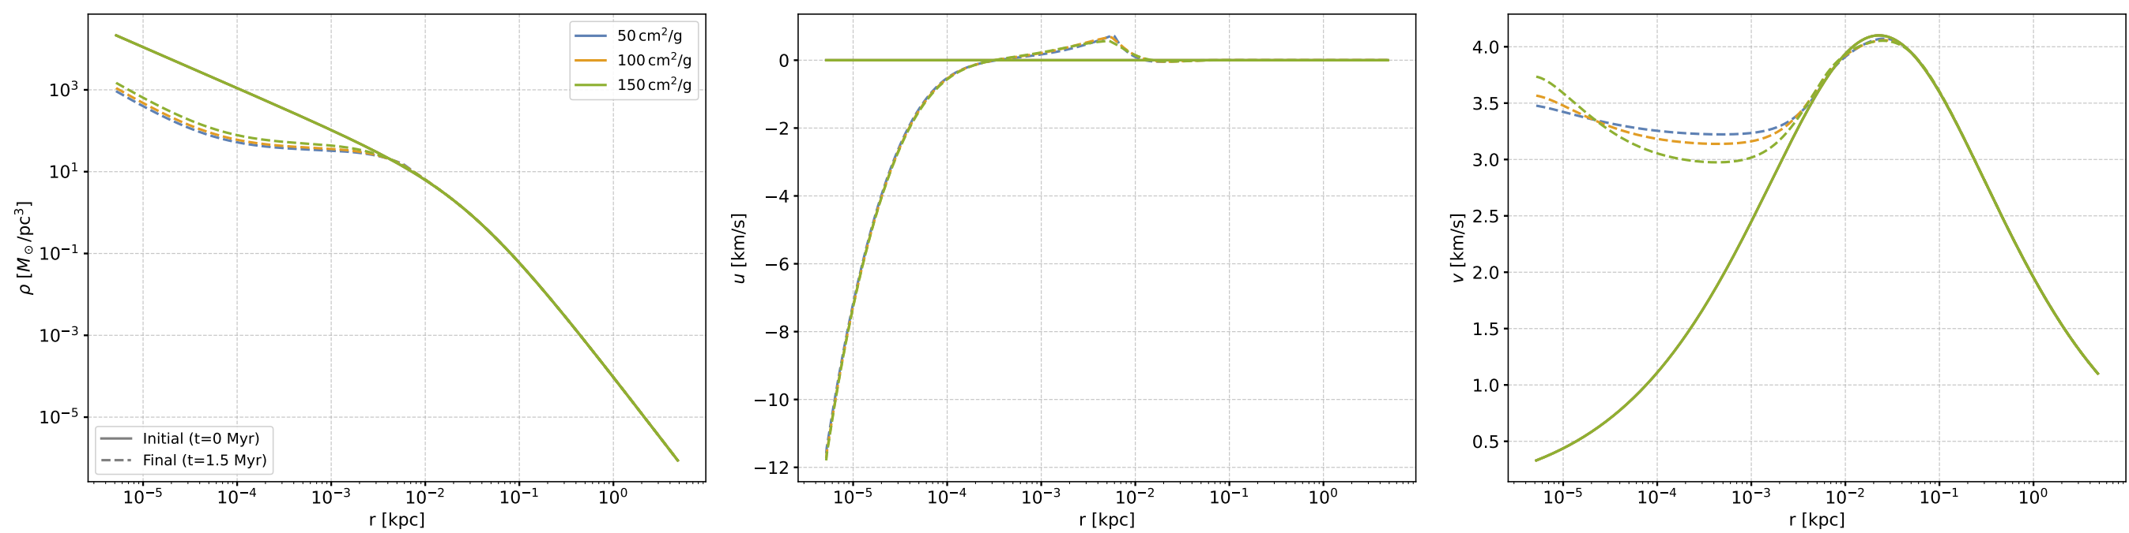
Dependence on cross section

Slide 16
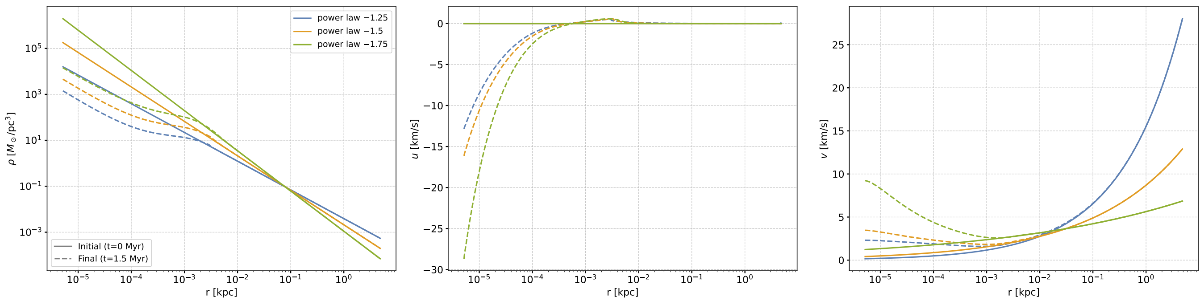
Dependence on inner density slope

Slide 17
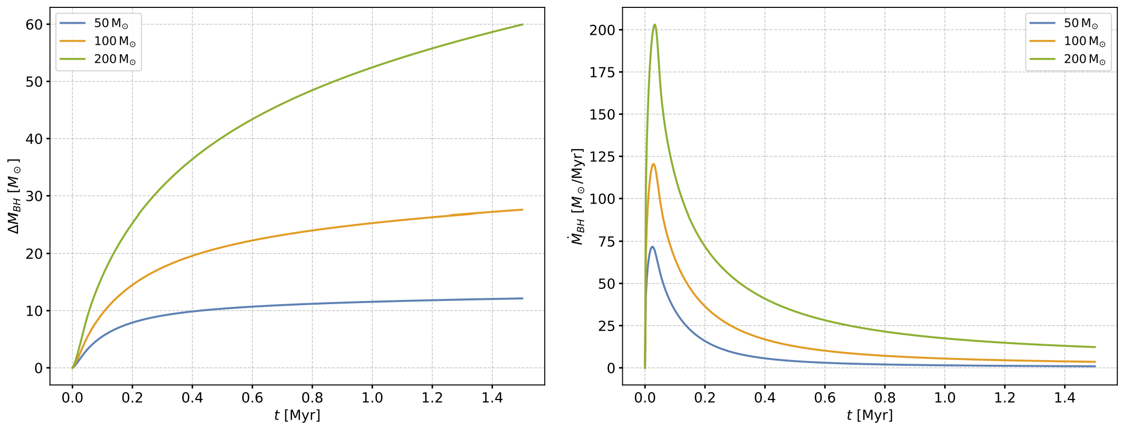
Dependence on initial black-hole mass

Slide 18
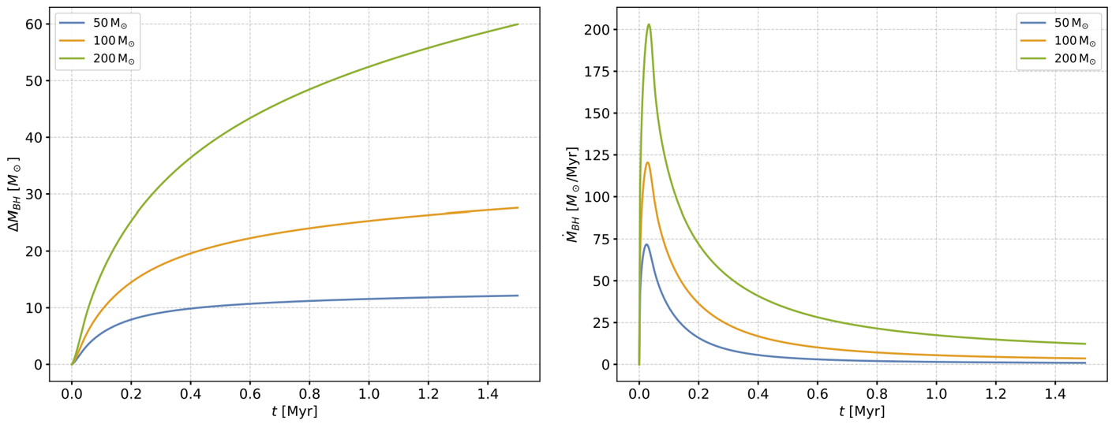
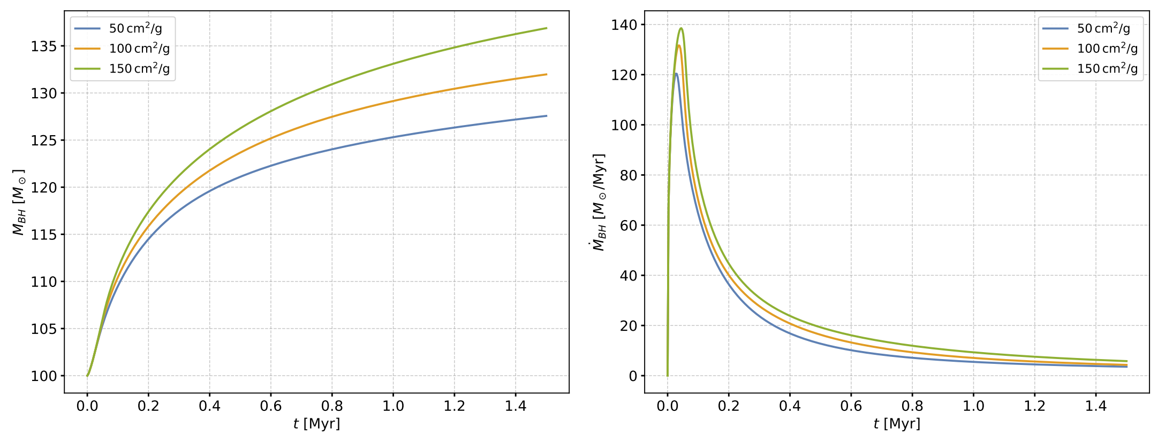
Dependence on cross section

Slide 19
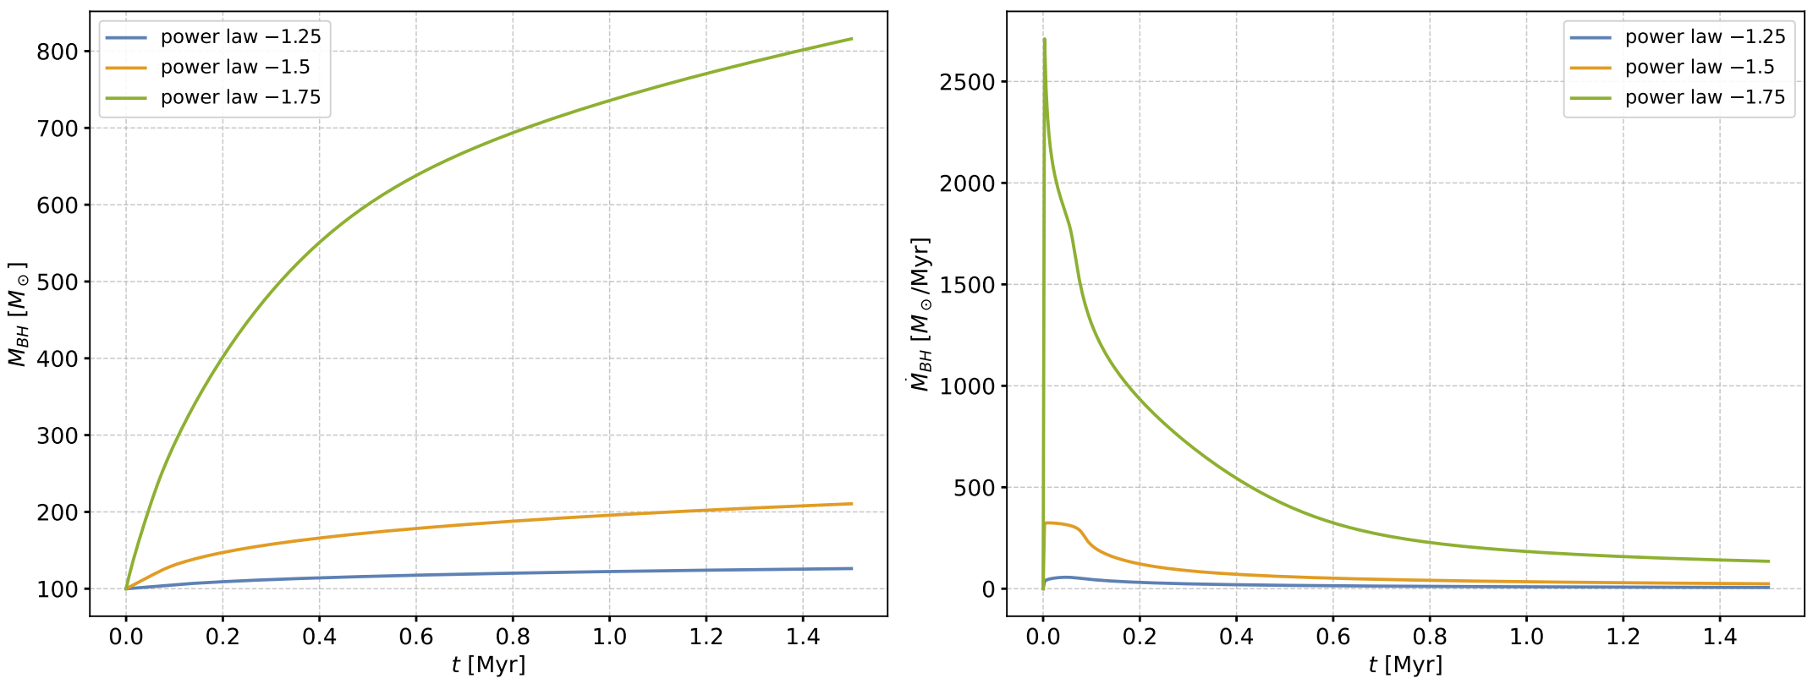
Dependence on inner density slope

Slide 20
Conclusion & Outlook
We investigate black hole accretion in SIDM halos using a self-gravitating fluid model with thermal conduction.
We develop a robust one-dimensional spherically symmetric hydrodynamic code based on an operator-splitting finite-volume method.
We find an SIS-like environment facilitates rapid accretion. Larger initial black hole masses, steeper density profiles, and higher scattering cross-sections significantly enhance the accretion rate.
We are currently working on extensions that include baryonic physics, angular momentum, and comparison with SIDM N-body simulations.

Slide 21
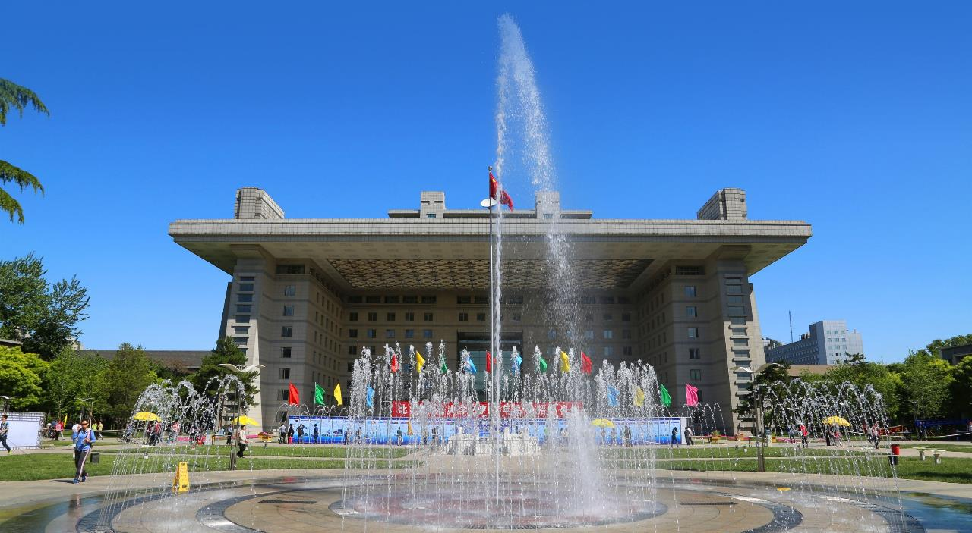


Thanks!
学为人师 行为世范

Slide 22
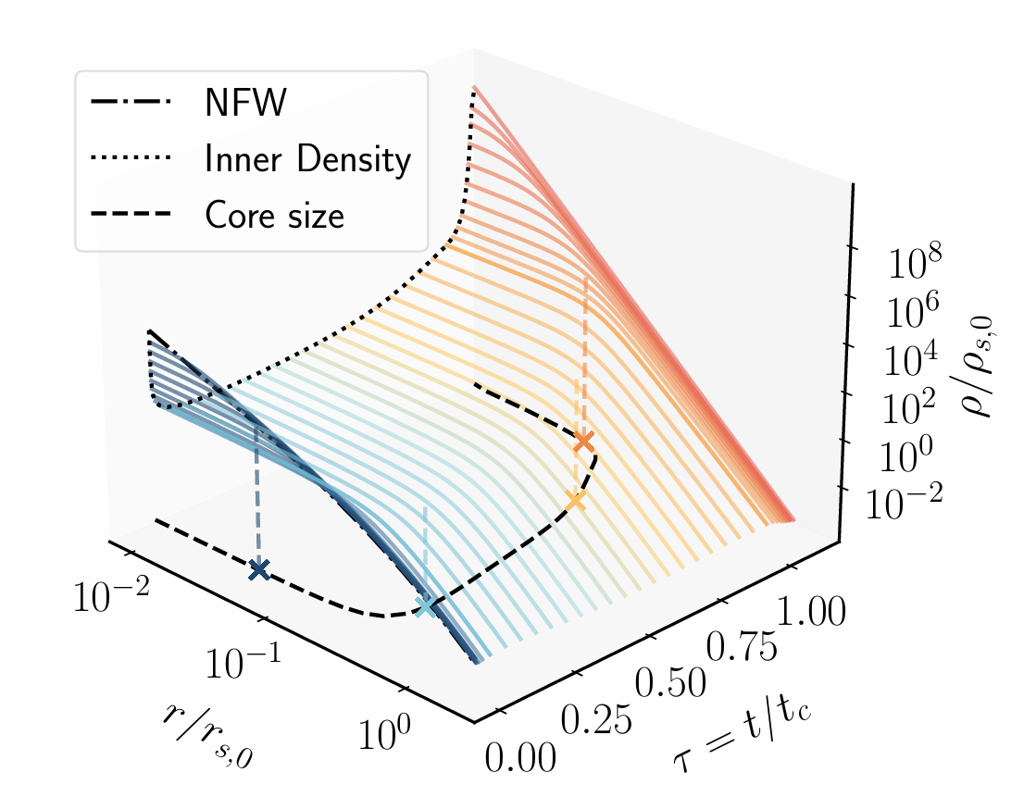
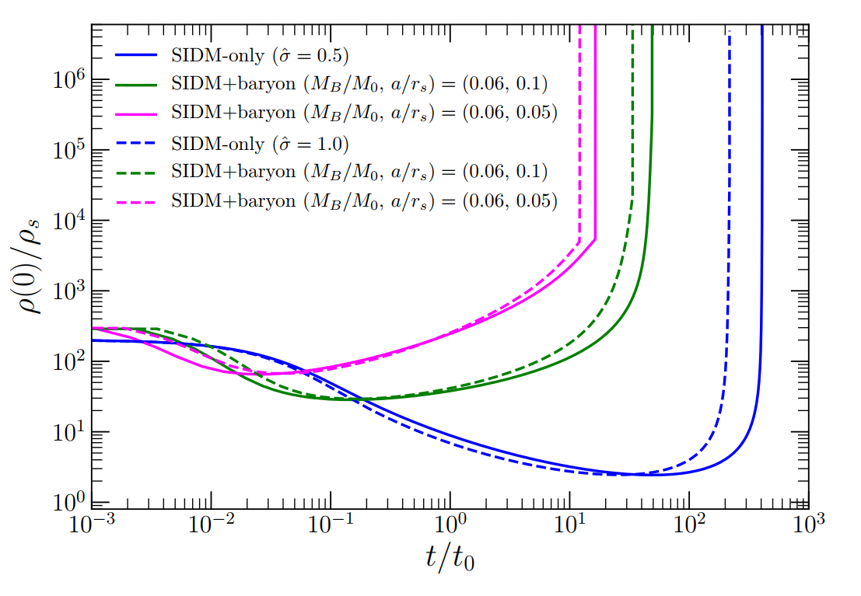
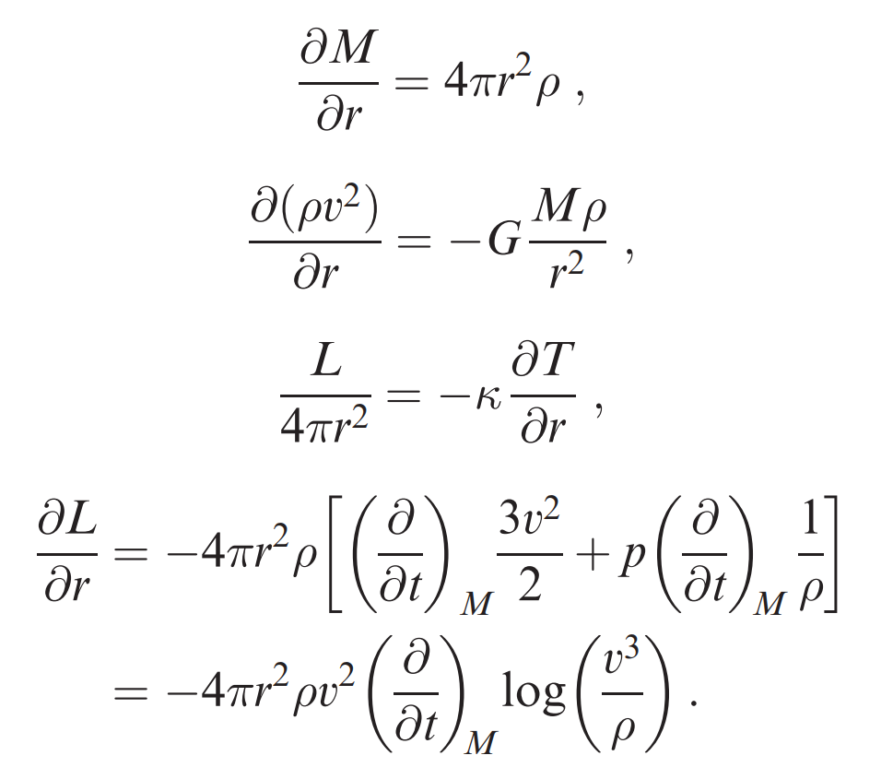
SIDM evolution
SIDM Halo Evolution
Gravothermal Model
Hou et al., JCAP, 2025
Balberg et al., 2002, ApJ
Feng et al. 2025, arXiv

Slide 23
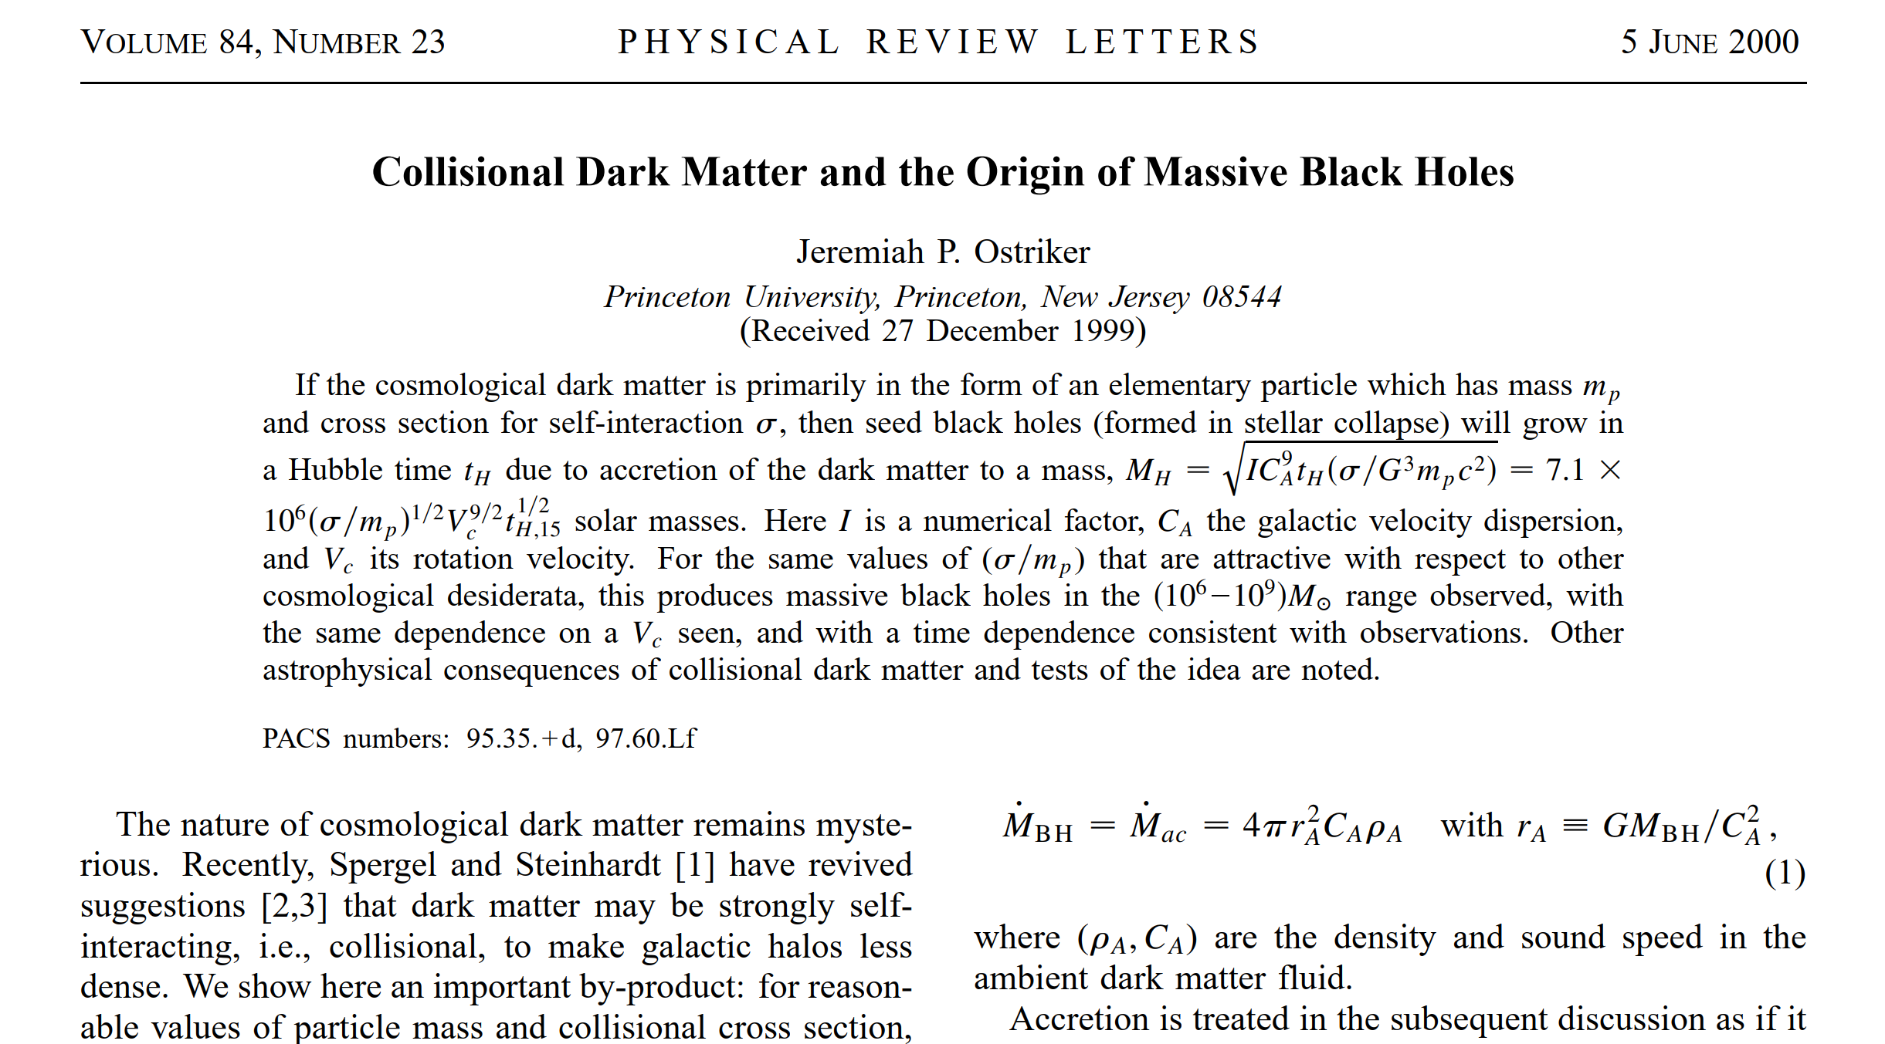
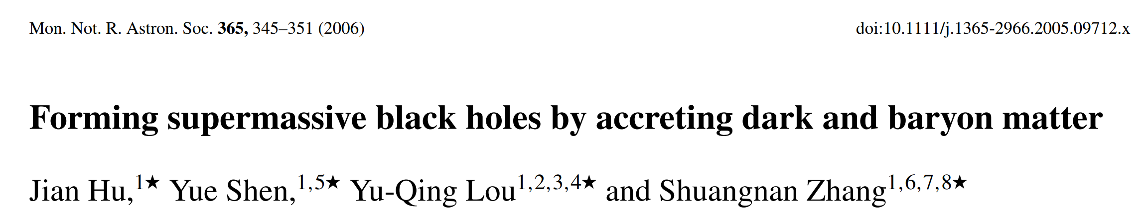
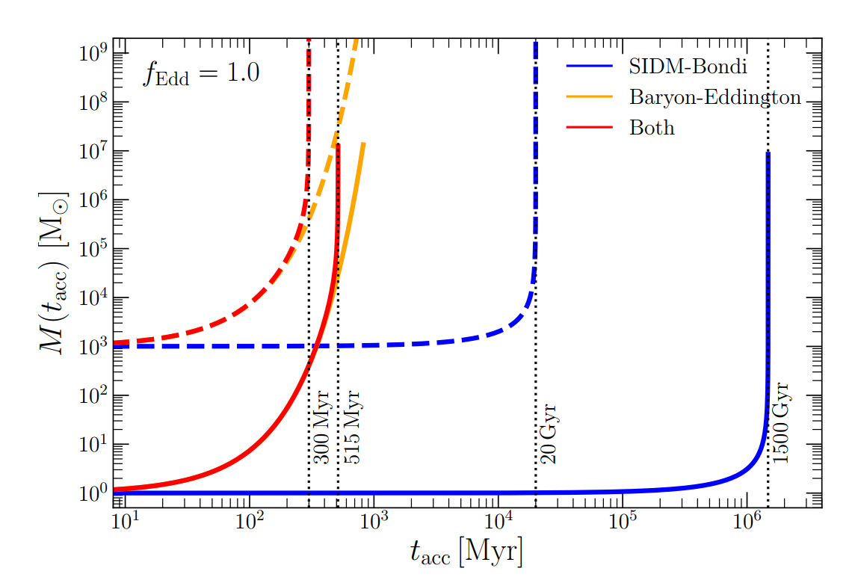
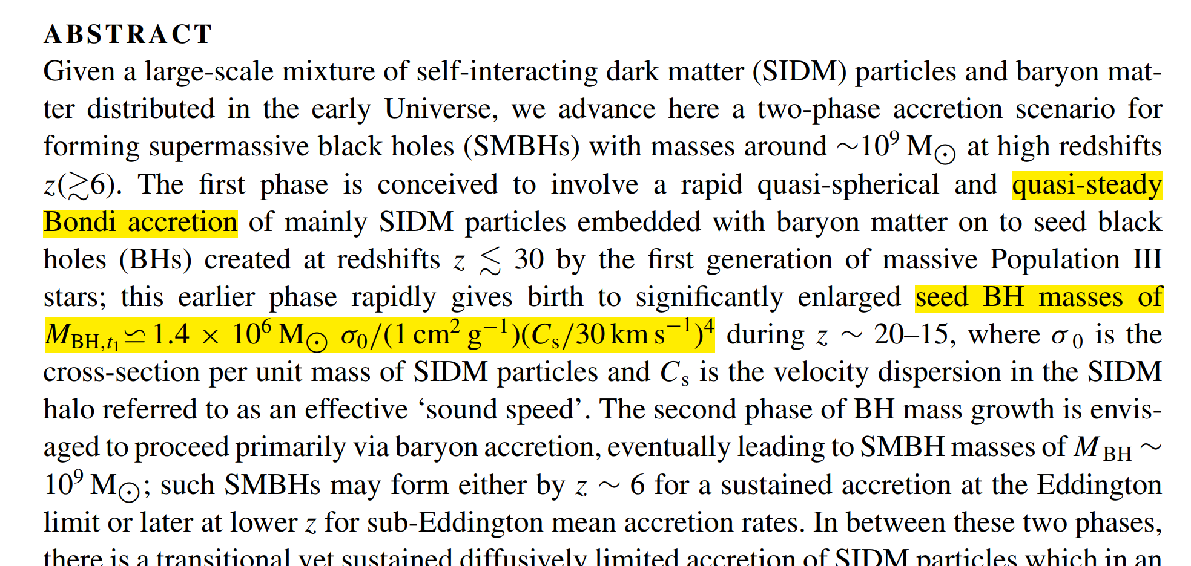
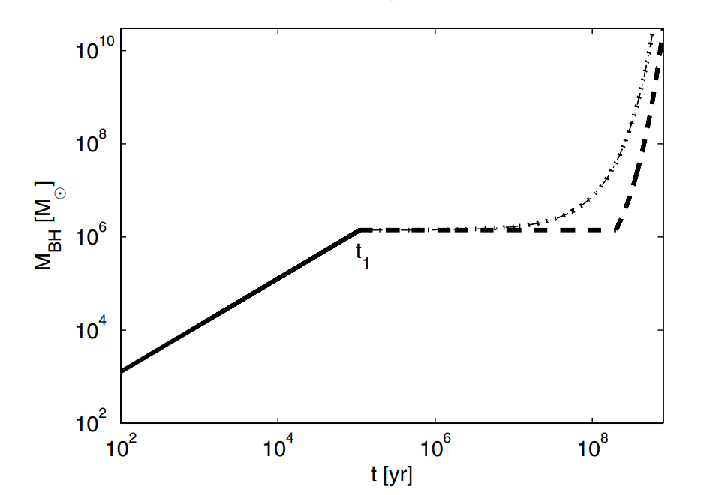
Black hole accretion
Feng et al. 2025, arXiv

Slide 24
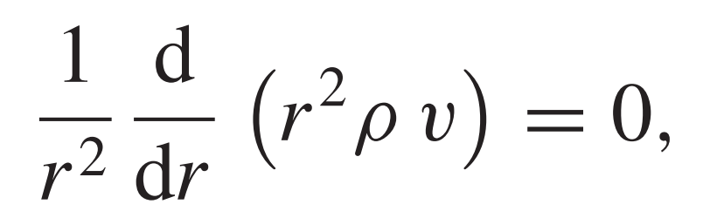
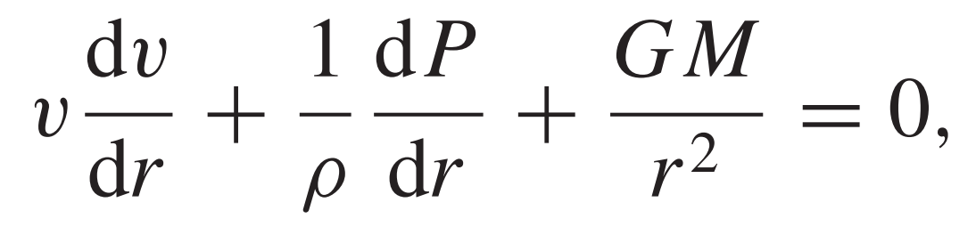
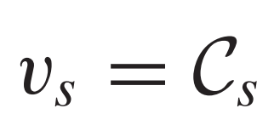
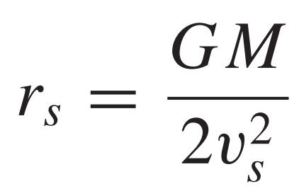

Bondi accretion
Bondi accretion formula
Steady accretion
Short mean free path region
Hydrostatic equilibrium
Sonic point
Bondi radius
Hou et al., JCAP, 2025
Bondi accretion speed
$$\dot{M}=4πr_{s}^{2}ρ_{s}v_{s}$$

Slide 25
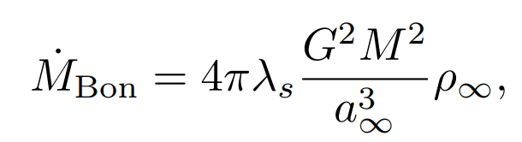

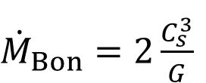
Shortcomings
$$\dot{M}=4πr_{s}^{2}ρ_{s}v_{s}$$
Bondi accretion for NFW profile
Bondi accretion for SIS profile
Requirements
Steady condition
No conduction
Requirements
Fixed SIS profile
No conduction
${\dot{M}}_{Bon}=2\frac{C_{s}^{3}}{G}$

Slide 26
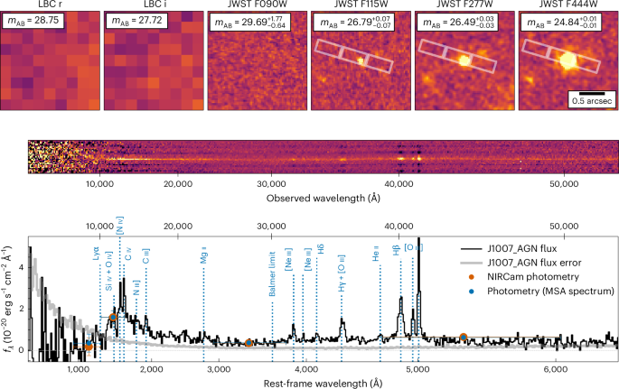
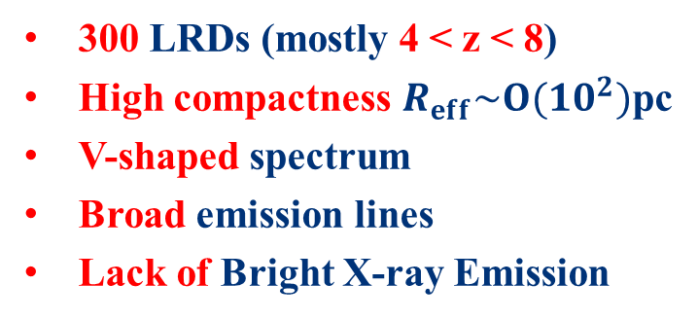
Little Red Dots
300 LRDs (mostly 4 < z < 8)
High compactness $R_{eff}\sim O(10^{2})$pc
V-shaped spectrum
Broad emission lines
Lack of Bright X-ray Emission
Photometry and discovery spectroscopy of J1007_AGN at z ≈ 7.3
Schindler et al. 2025, Nat. Astron.
JWST near-infrared images of six LRDs at redshifts z ≈ 5–9
Credit: NASA, ESA, CSA, STScI, D. Kocevski (Colby College)

Slide 27
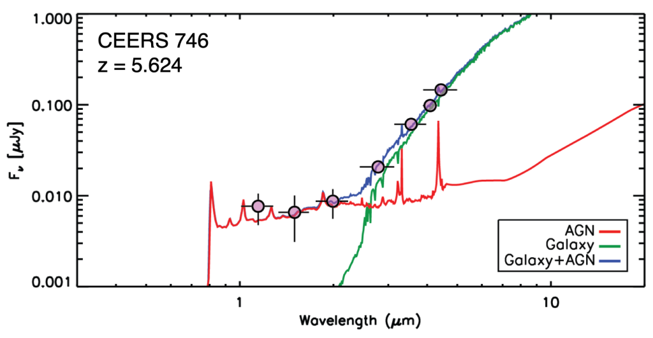
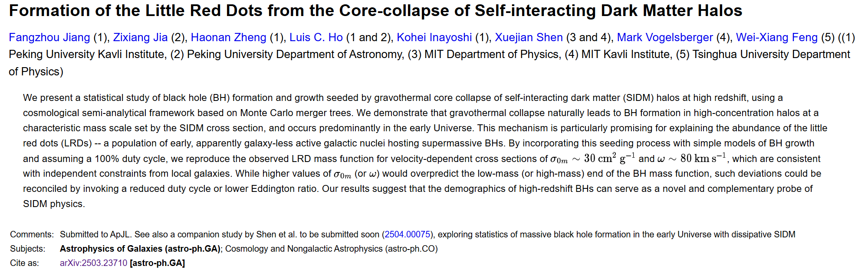
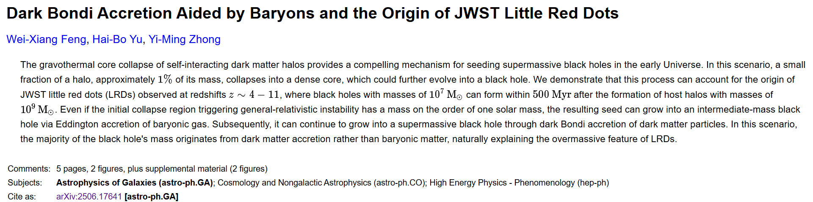
AGN + host galaxy
Spectrum fitting
Abundance? Compactness?
SIDM!
Credit: Kocevski et al.
Feng et al. 2025, arXiv

Slide 28

