Slide 1
Gravitational Wave Astronomy with the TianQin Space Observatory
Yi-Ming Hu (胡一鸣)
On behalf of the TianQin Collaboration
9th July 2026 @ University of Canterbury
CosPA 2026 / ACGRG 13

Slide 2
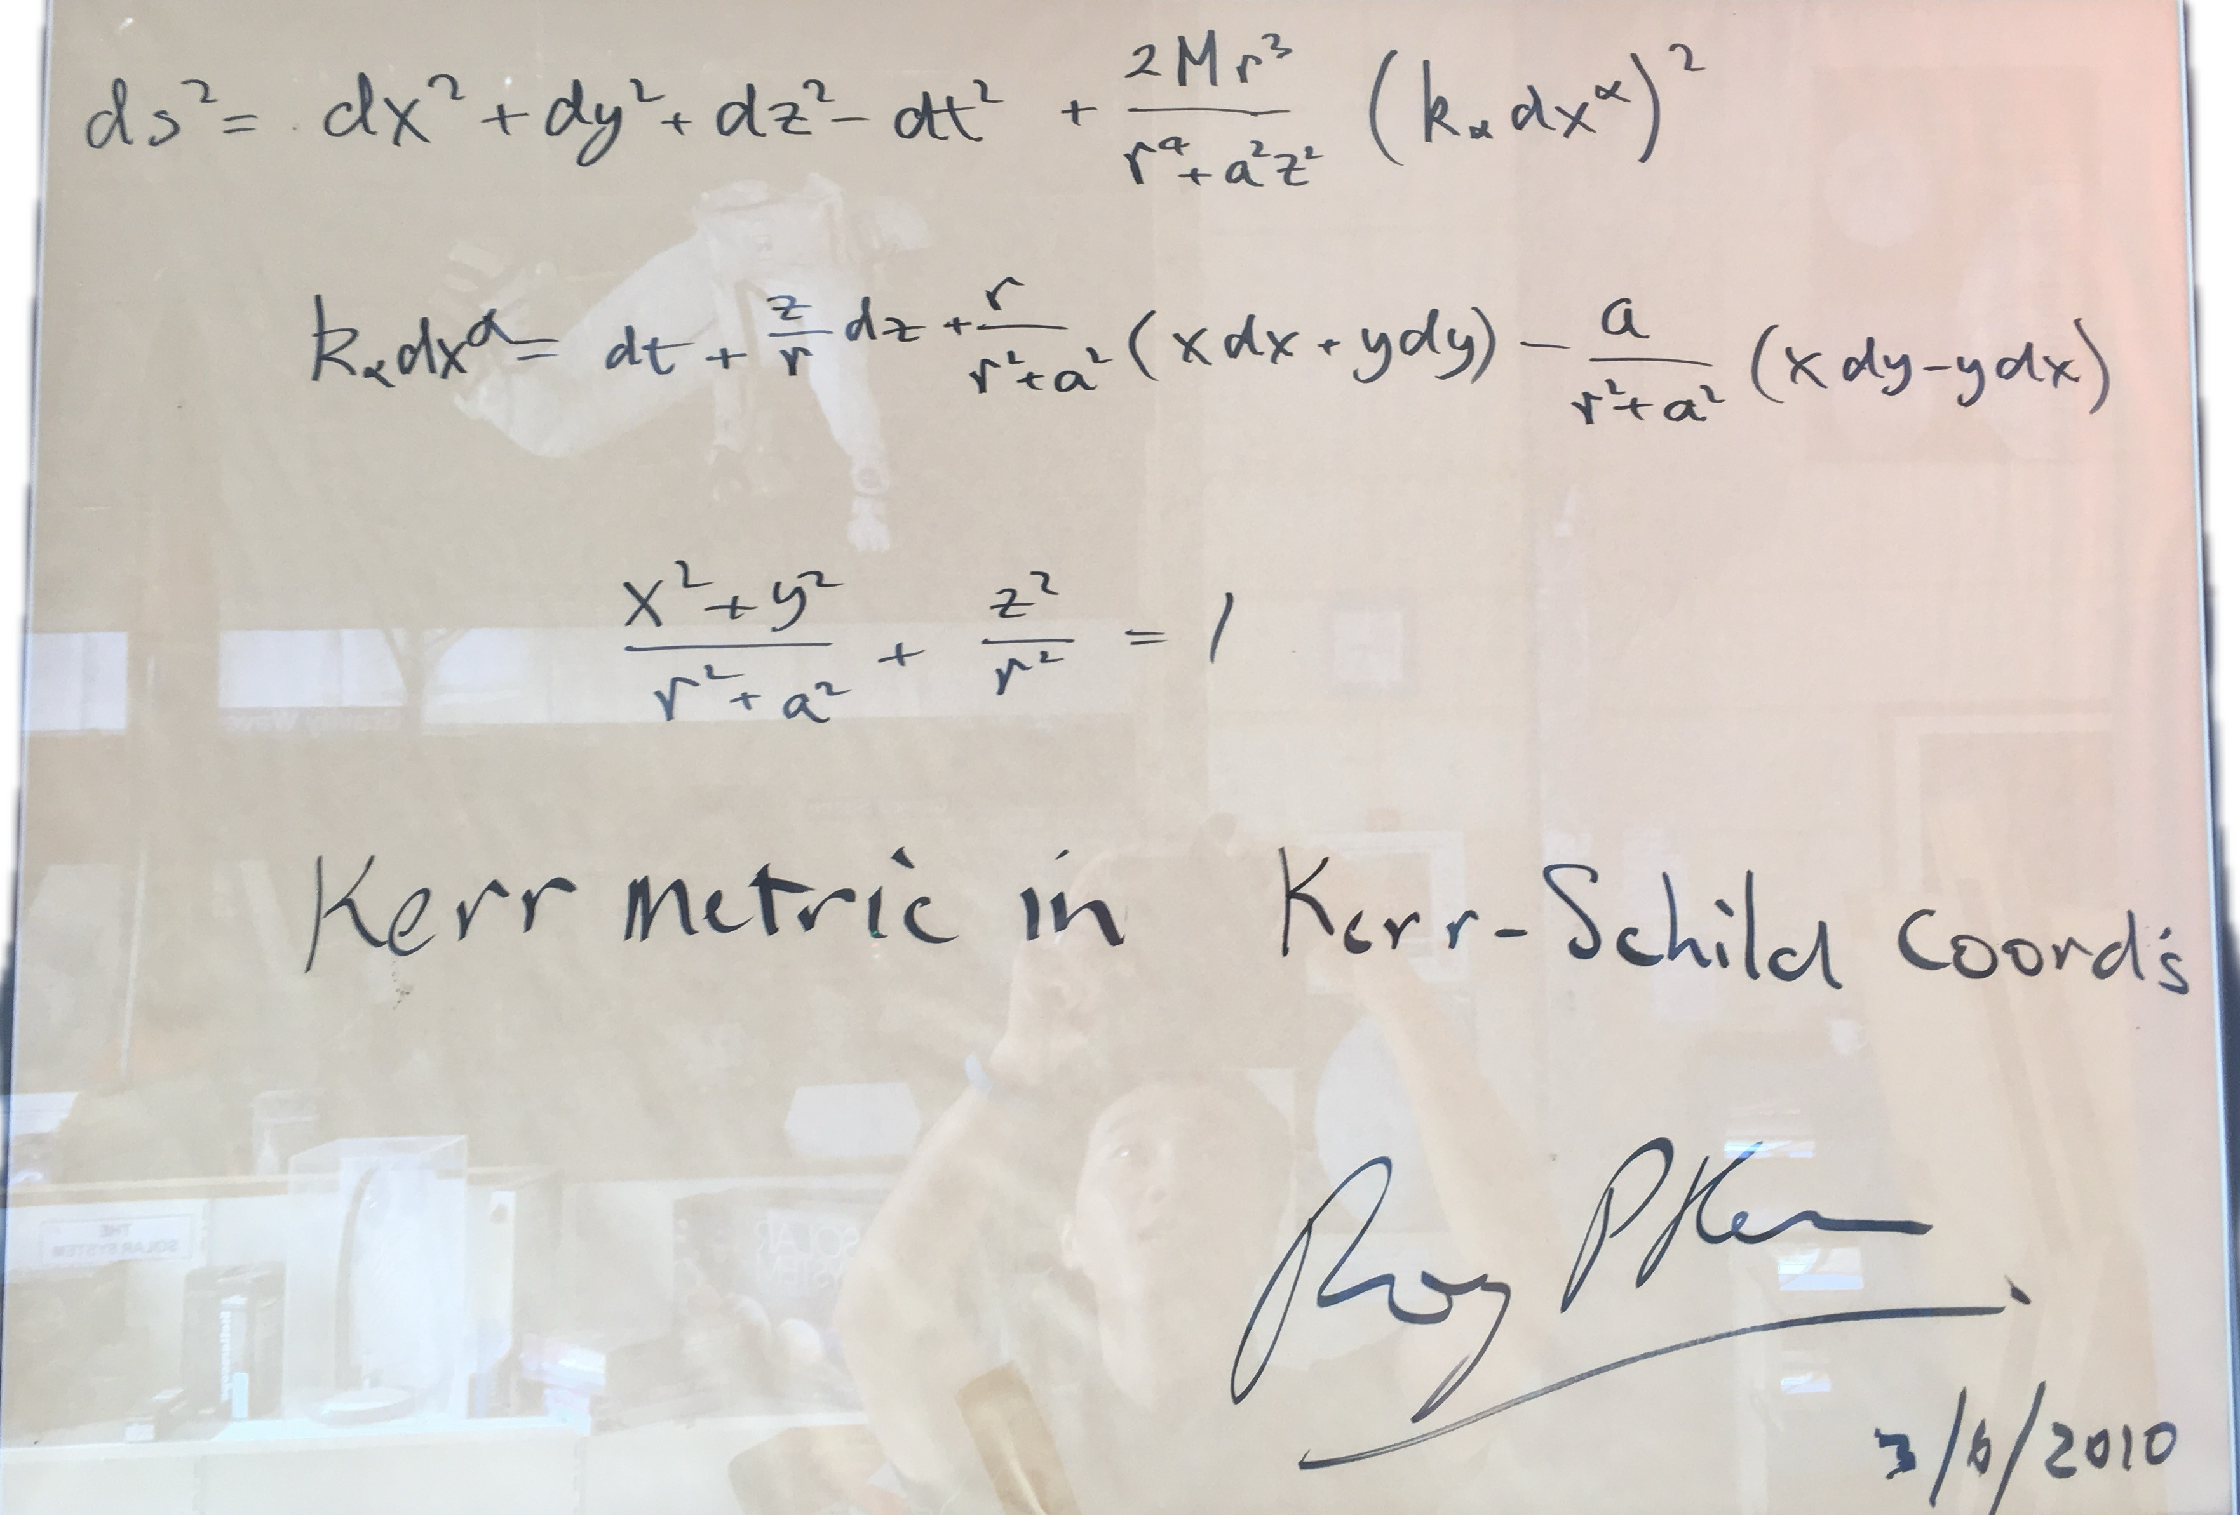
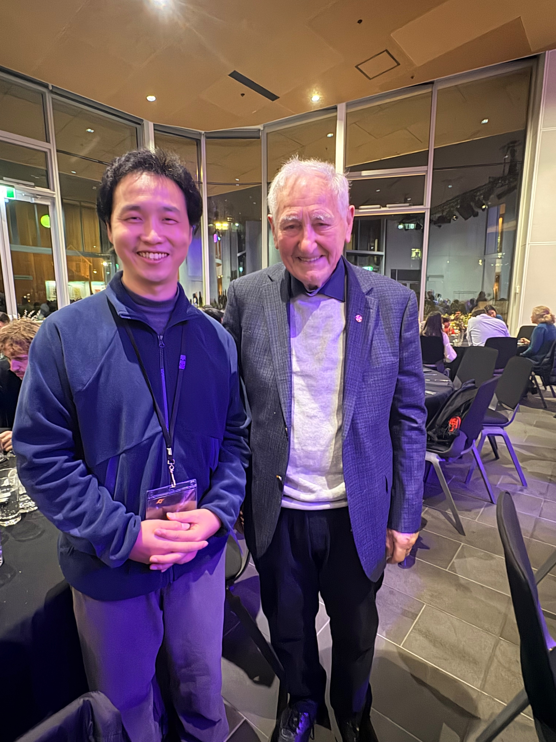

Slide 3
Content
Roadmap of TQ
GW astronomy with TQ
Conclusion/Discussion
What is TianQin

Slide 4

Where is TianQin
Zhuhai
Hong Kong
Macau

Slide 5

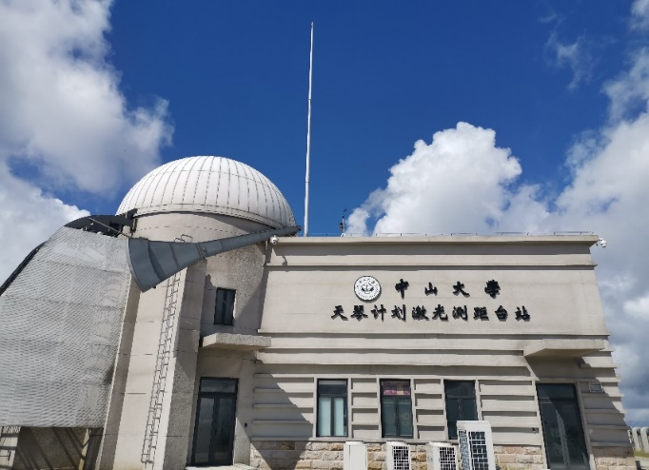
Where is TianQin
Lunar Ranging facility
TianQin Building
Cave Lab
Ground simulation
facility

Slide 6




























TianQin Collaboration
Jun Luo
Leader of TianQin

Slide 7
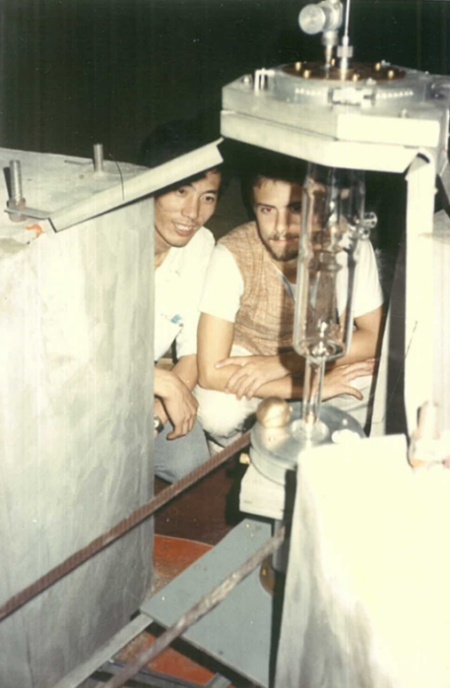
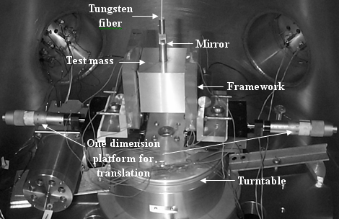
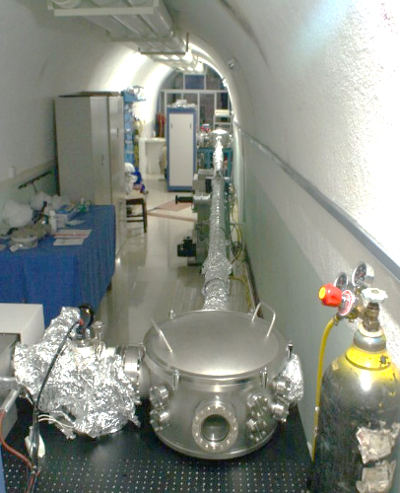
The path leading to TianQin
Early experiments
(since 1980’s)
Inertial Sensor
(since 2001)
Laser Interferometry
(since 2002)

Slide 8
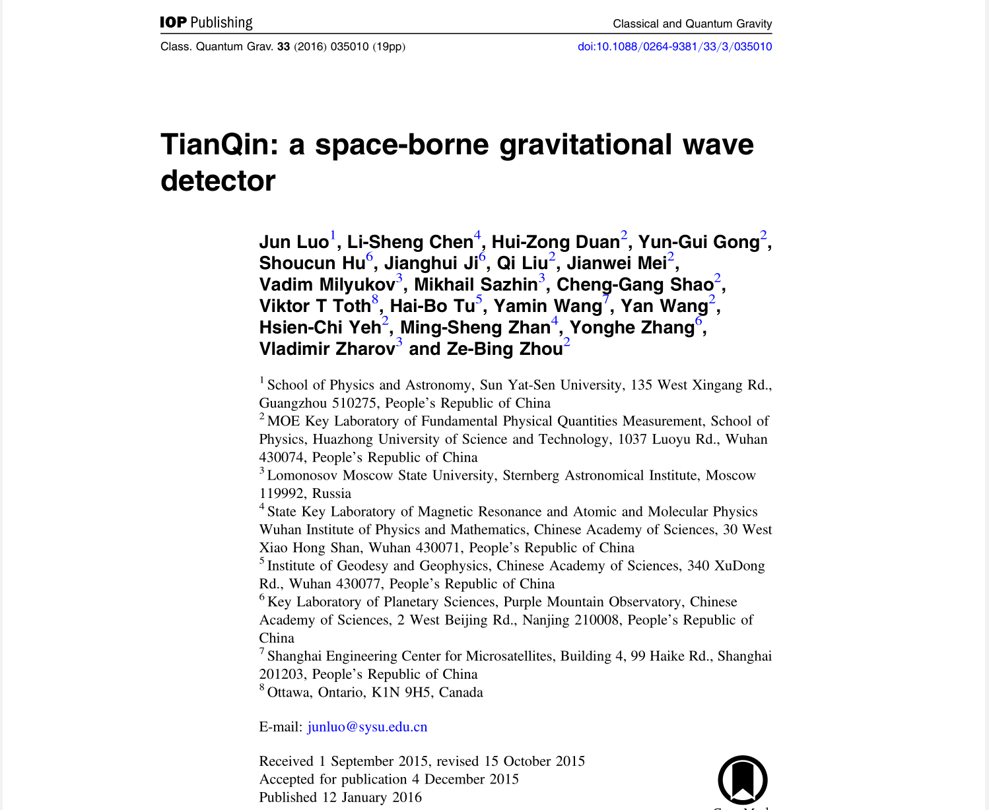
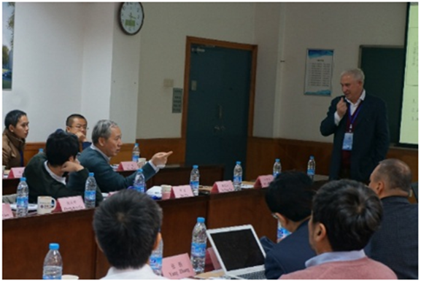
The beginning of TianQin
TianQin officially proposed on
March 24, 2014

Slide 9
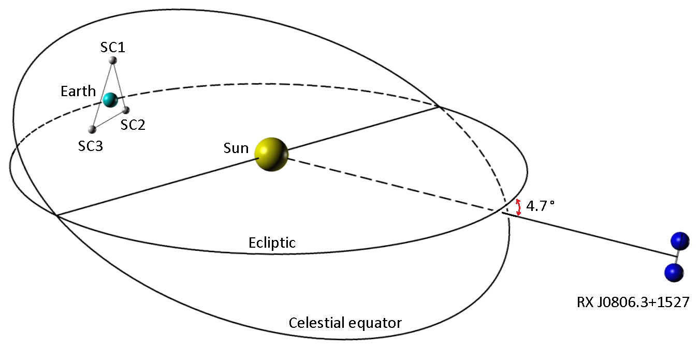
TianQin
Orbit: geocentric, radius ~ 10⁵km
Constellation: normal triangle
Advantages: deployment, tracking & communication, data transfer
Launch date (target): 2035
Luo et al., Class. Quant. Grav. 33 (2016) no.3, 035010.
Notes:
This is an illustration of TianQin in the solar system.
TianQin will be a space-based gravitational wave detector consisted of three identical spacecraft.
In this picture, in the middle is the Sun, to the left is the Earth, and TianQin is formed by three spacecraft surrounding the Earth.
A special feature of TianQin is its geocentric orbit. Because of this, the orbital plane of TianQin is fixed in space and the orbital radius is about 100,000 (a hundred thousand) kilometers.
By using the geocentric orbit, TianQin will have some advantages in terms of deployment, orbital stability, spacecraft control, and communication. We expect to launch TianQin around 2035.

Slide 10
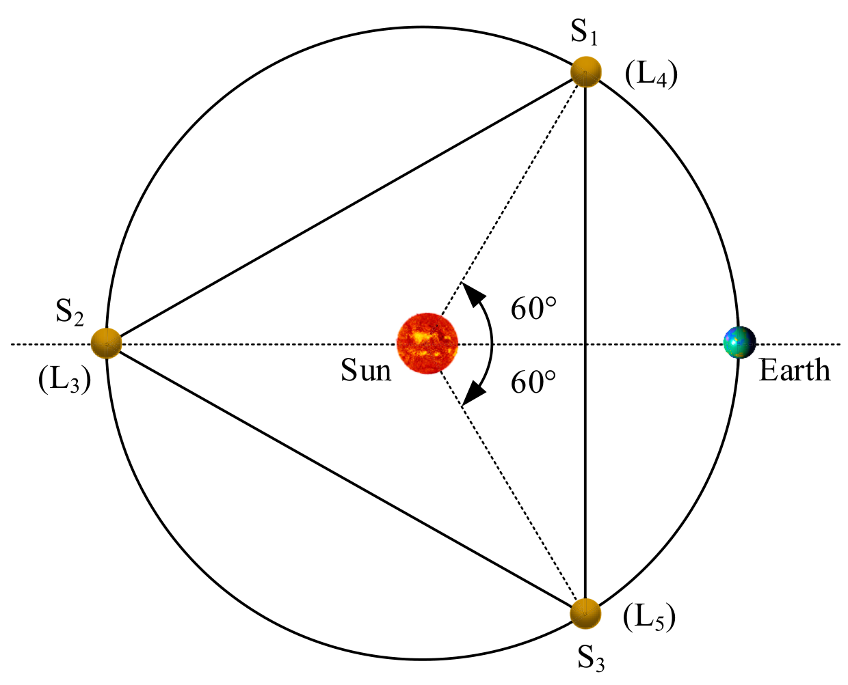
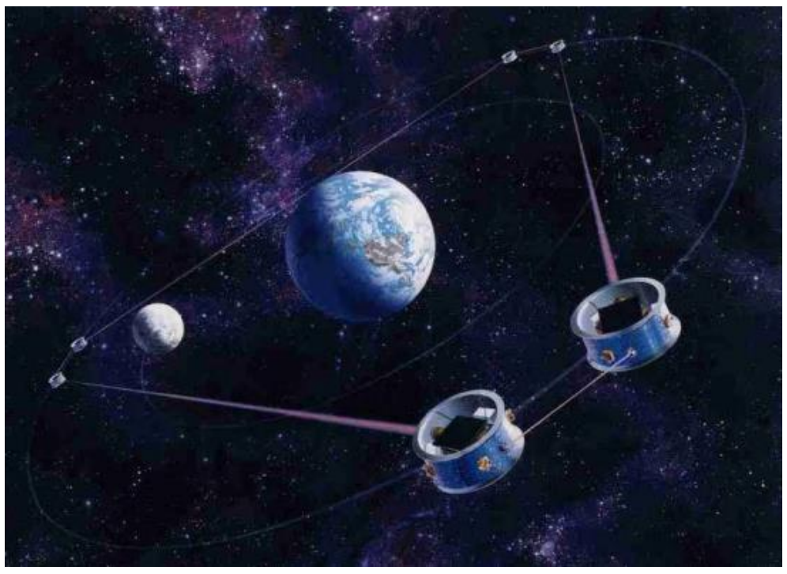
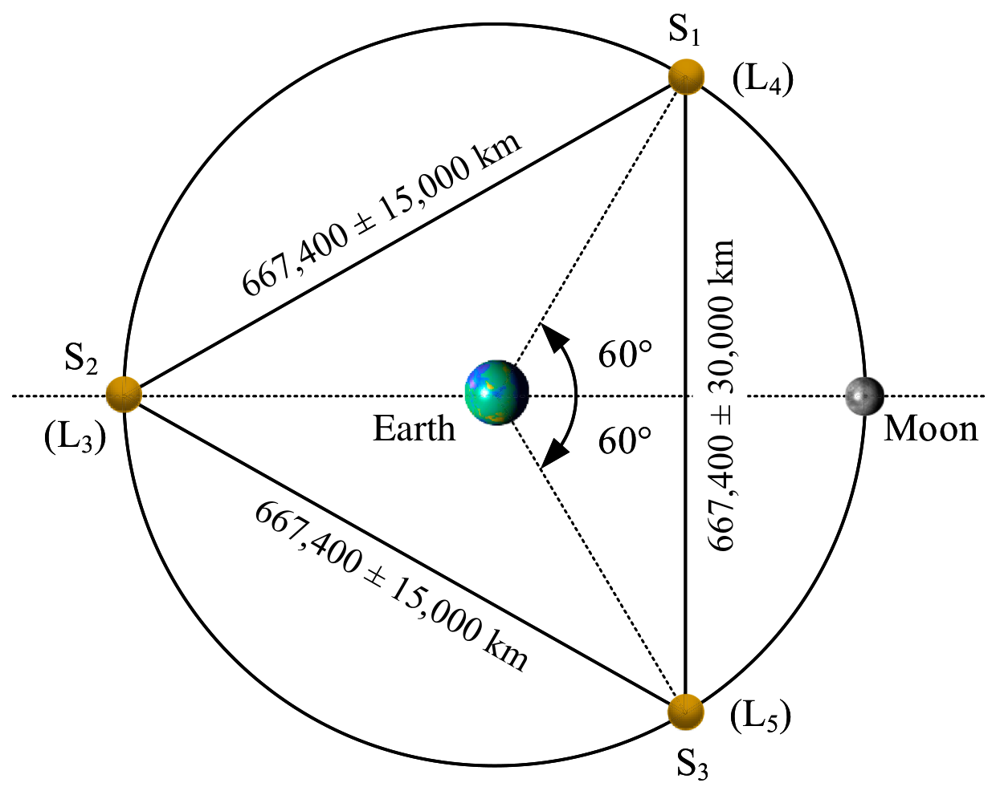
Key difficulty with geocentric orbit missions
LAGRANGE
(Conklin et al, arXiv:1111.5264)
ASTROD-GW
(Ni, Int.J.Mod.Phys.D 22 (2013) 1341004)
SAGITTARIUS/OMEGA
(Hellings, Contemporary Physics, 37:6, 457-469, 1996)
Modified from Qiao et al, Space Sci. Technol. 2023;3:Article 0015

Slide 11
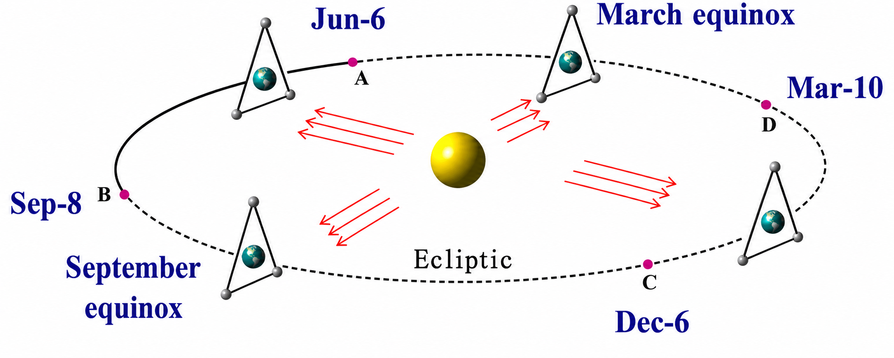
Solution from TianQin
Vertical orbital plane and “3 month on + 3 month off”detection scheme

Slide 12
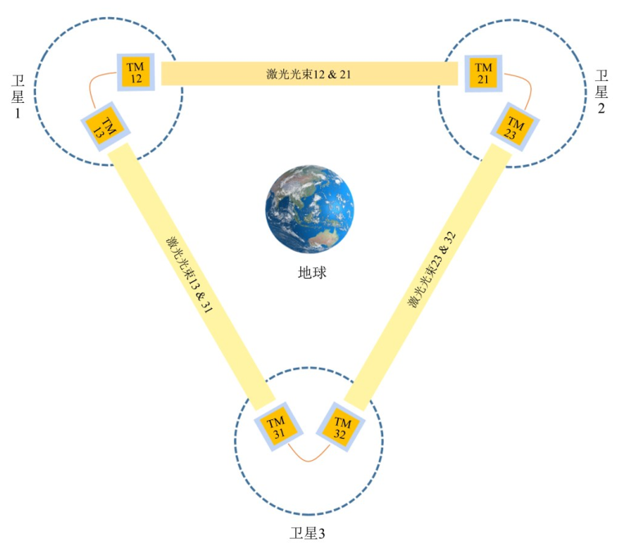
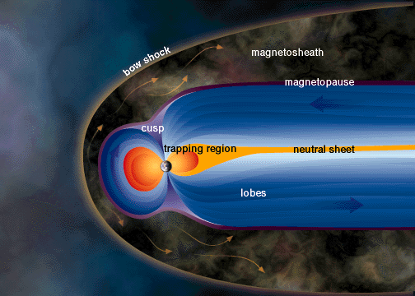
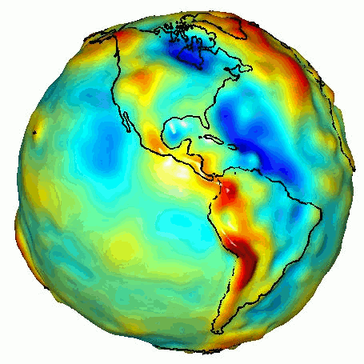
Challenging environment
Near Earth gravity environment
Near Earth plasma environment
solar wind
Gif by NASA / University of Texas Center for Space Research
Wei Su, Modified from ESA

Slide 13
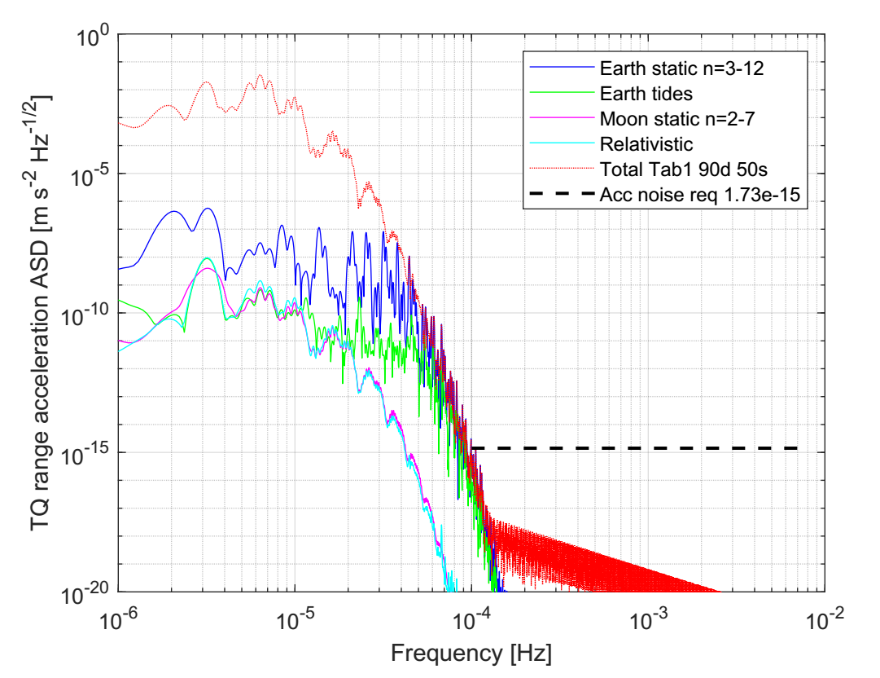
Conceptual issues
Can the orbits be stable?
IJMPD 28, 1950121 (2019), PRD 103, 103026 (2021), PRD 109, 083033 (2024)
Will the complex Earth gravity impair the GW detection?
PRD 103, 062001 (2021), PRD 107, 102004 (2023)
Will moon eclipse disrupt GW detection by TianQin?
PRD 103, 042007 (2021)
How to deal with large variation of the solar angle?
CQG 38, 155015 (2021), PRD 109, 102007 (2024)
How will the space plasma affect GW detection?
PRD 106, 082006 (2022)
Zhang, et al., 2021, Phys.Rev.D 103, 062001
There is no fundamental obstacle to the TianQin mission concept.

Slide 14
Content
Roadmap of TQ
GW astronomy with TQ
Conclusion/Discussion
What is TianQin

Slide 15
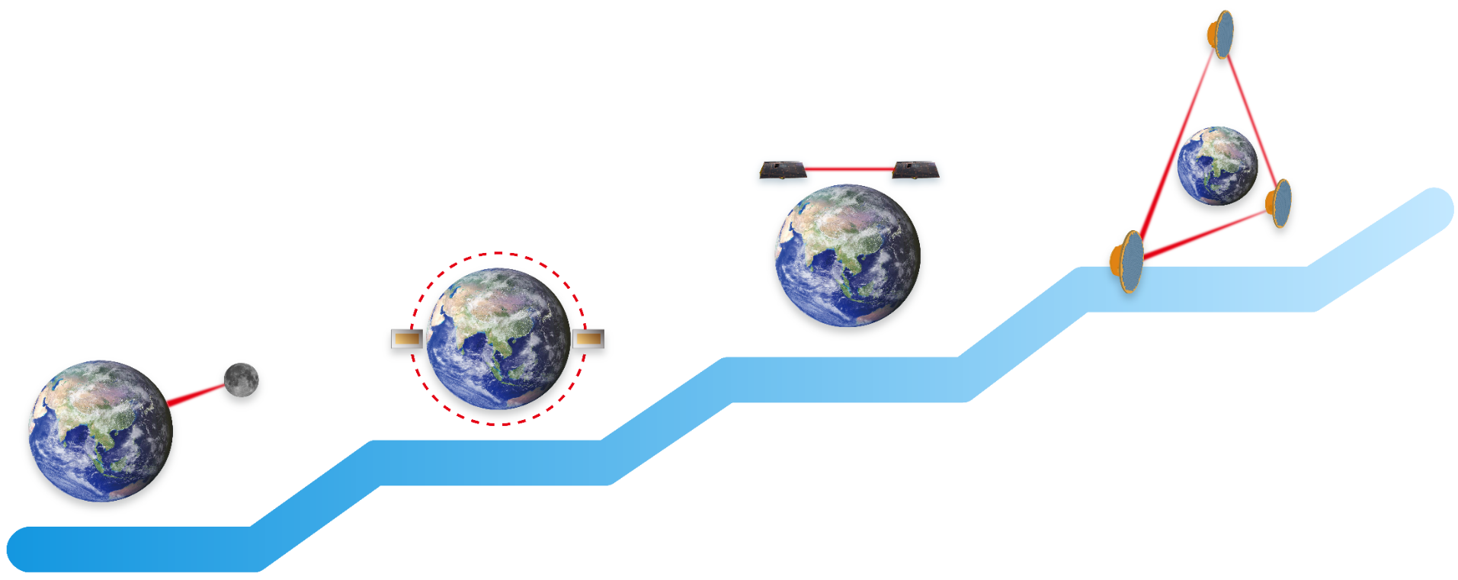
Working toward TianQin-2035
Lunar Laser Ranging
TianQin 1
TianQin 2
TianQin 3
3
2
Laser
Interferometry
GW detection
1
Inertial
Reference
0
Lunar
Laser
Ranging
The“0123” roadmap

Slide 16

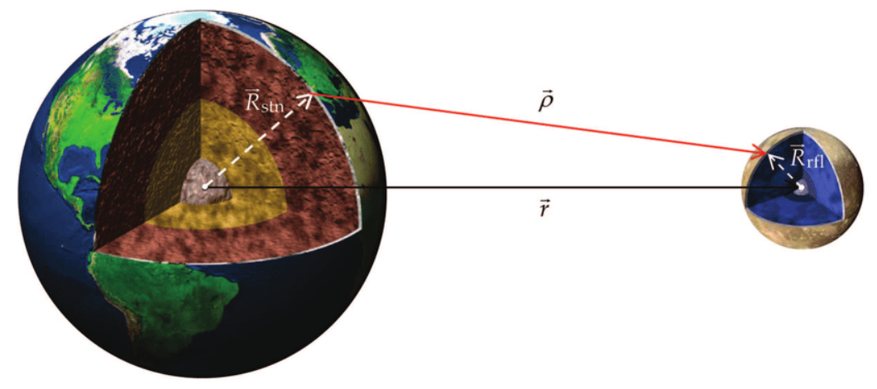
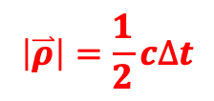
Step“0”: LLR
Fundamental physics, Moon and Earth Physics
High precision positioning of the TianQin spacecraft
$$\left|\overset{⃑}{ρ}\right|=\frac{1}{2}c∆t$$
Image credit: Turyshev and Williams, IJMPD, 2007
Notes:
The TianQin spacecraft are using geocentric orbits, so it is possible to use laser ranging technology to obtain high precision orbit information.
The basic idea is to send a laser pulse to the Moon and to measure the time needed for the photons to return.

Slide 17
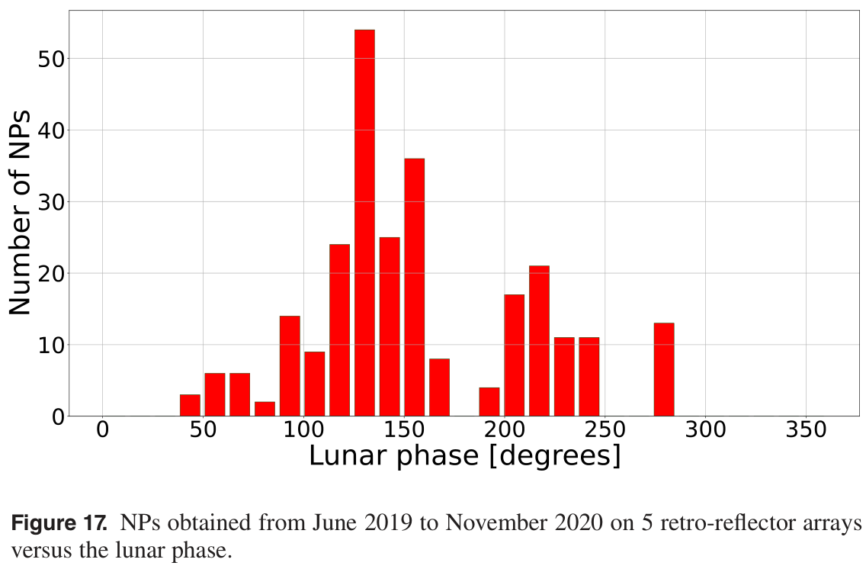
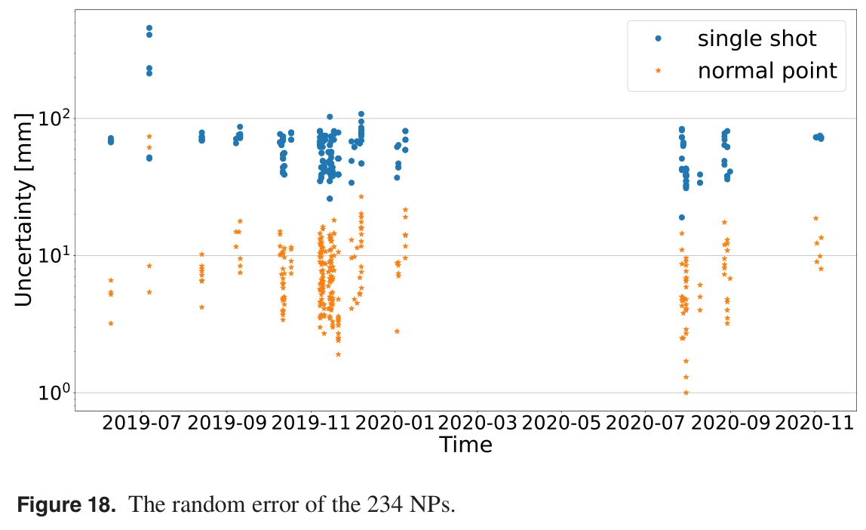
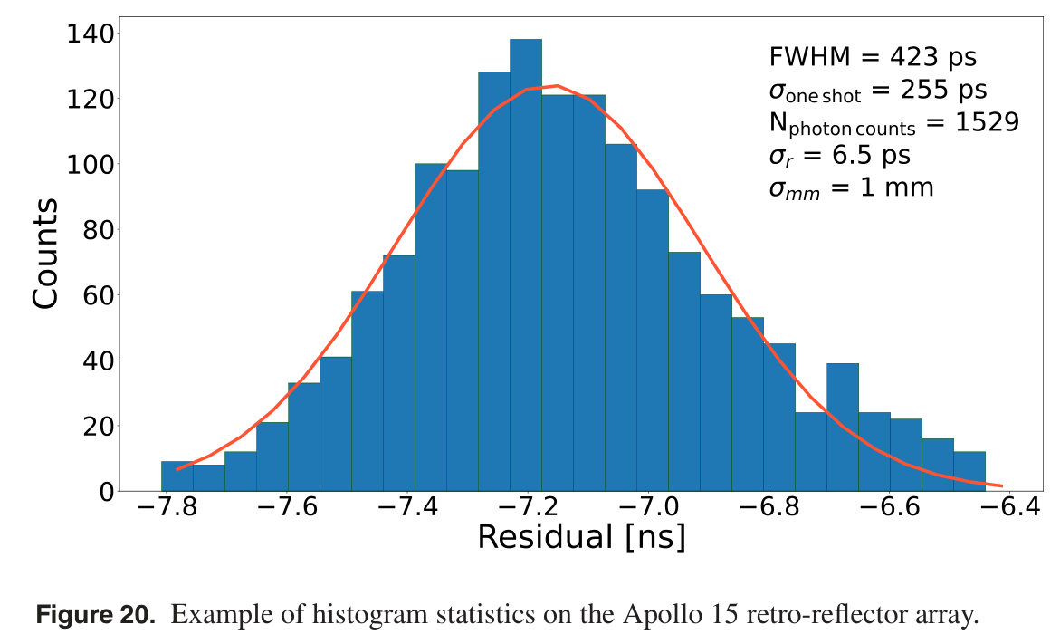
Step“0”: LLR
The LLR project of TianQin
Zhang et al, 2022, Class.Quant.Grav. 39, 125005
Notes:
A preliminary analysis shows that the statistical errors in most of the normal points are better than 1 centimeter, so this precision is enough for the determination of spacecraft orbits of TianQin.

Slide 18
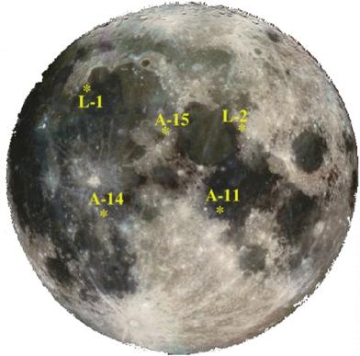
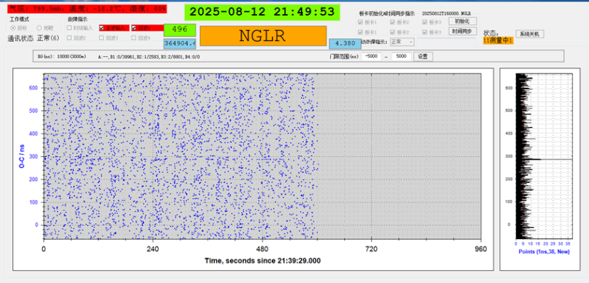
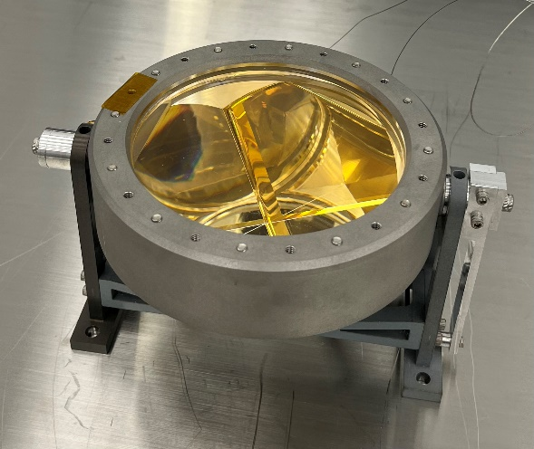
Step“0”: LLR
Successful ranging of NGLR-1 on Aug 13, 2025
NGLR-1
The Next Generation Lunar Retroreflector (NGLR).
Credit. D. Currie (U Maryland, College Park, MD, USA).
Notes:
A preliminary analysis shows that the statistical errors in most of the normal points are better than 1 centimeter, so this precision is enough for the determination of spacecraft orbits of TianQin.

Slide 19
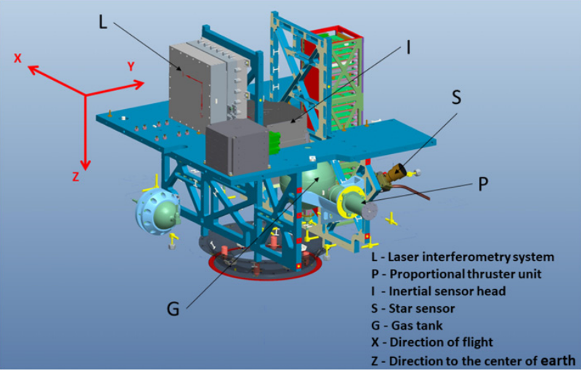
Step“1”: TianQin-1
  Objective: to test the inertial reference technology with one satellite
Parameters of TianQin-1
Orbit: | Heliosyncrohronous
Altitude: | 628 km
Mass: | 103 kg
Lifetime (req.): | 6 months
Six key technologies tested
Inertial sensor
Micro-Newton thruster
Drag-free control
Laser interferometer
Stable temperature control
Stable CoM control

Slide 20
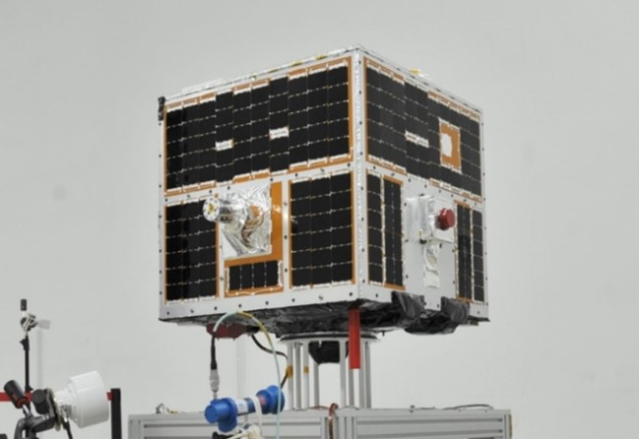
Step“1”: TianQin-1
2019.12.20 Launch
2021.01.21 Decommission
Items | Index | Mission goal | Test result
Inertial sensor | Acc. Noise | 8×10⁻¹² m/s² / Hz^{1/2} @0.1Hz | ＜5×10⁻¹² m/s² / Hz^{1/2} @0.1Hz
DF | Res. Acc. | ＜1×10⁻⁷m/s²/Hz^{1/2} @0.1Hz | ＜3×10⁻⁹ m/s²/Hz^{1/2} @0.1Hz
Micro-g Thruster | Range | 1~50 μN | 0.1~50 μN
 | Precision | ＜1 μN | ＜0.1 μN
Laser Interferometer | Precision | 1 nm | ＜0.025 nm
 | Noise | 0.1 nm/Hz^{1/2}@0.1Hz | ＜30 pm/Hz^{1/2}@0.1Hz
Temperature | Stability | ±50 mK/orbit | ±3 mK/orbit
CoM | Precision | ≤ 0.1 mm (per axis) | X：±0.011 mm Y：±0.020 mm Z：±0.022 mm
Luo et al., Class.Quant.Grav. 37 (2020) 18, 185013 • e-Print: 2008.09534

Slide 21
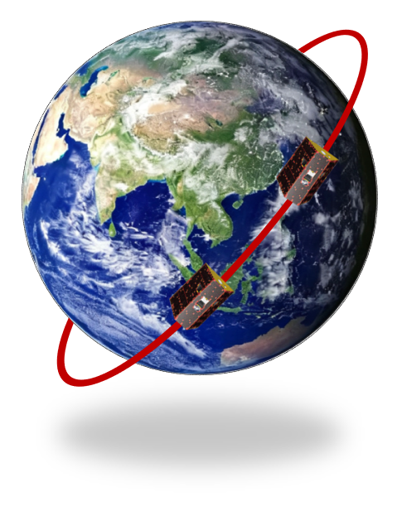
Step“2”: TianQin-2
  Objective: to test the inter-satellite laser interferometry technology with a pair of satellites
Key parameters：
Orbit type：89° Polar orbit
Orbit altitude：450~500 km
SC separation：~200 km
Mission duration：3 yrs
Key technology goal:
Displacement measurement noise 20 nm/Hz^{1/2} through evaluation.
Key technologies to be tested:
  1-Narrow line-width laser 2-Frequency stabilization 3-Ultra-stable OB
  4-Weak light phase locking 5-Intersatellite beam pointing 6-Duo satellite pointing control

Slide 22
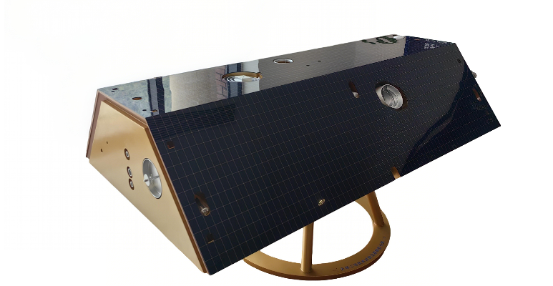
Step“2”: TianQin-2
  Timeline
2021: Project initiation
2022: Scheme design
2023: Principle verification and detailed design
2024: Electrical prototype development
2025: Qualification prototype verification and flight model production initiation
2026: Flight model development and satellite delivery

Slide 23
Step“3”: TianQin-3
  Space-based GW detection
Key technologies
Inertial reference
Laser interferometry
Data analysis

Slide 24
Content
Roadmap of TQ
GW astronomy with TQ
Conclusion/Discussion
What is TianQin

Slide 25
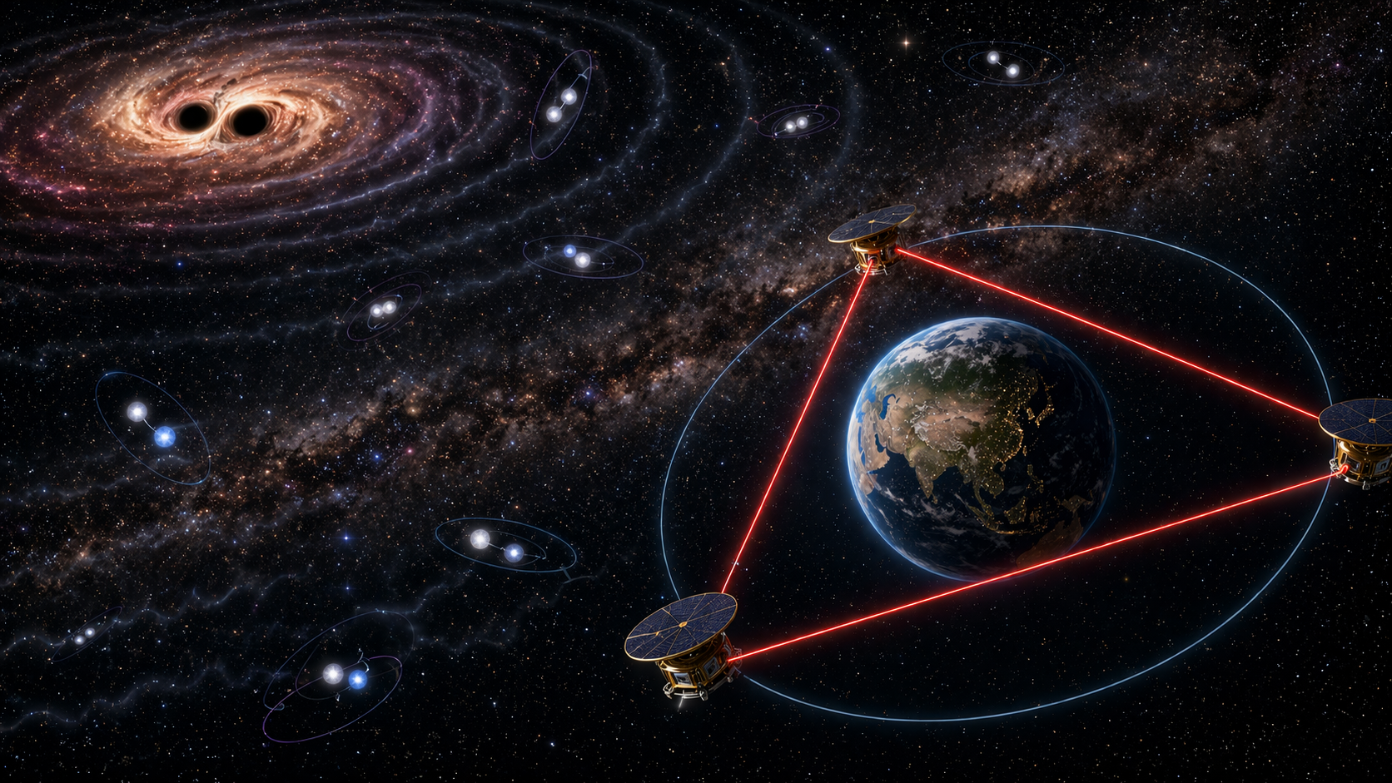
TianQin
25

Slide 26
TQ Science Case
Sources：
  Galactic Compact Binaries
  Stellar-Mass Binary Black Hole Inspirals
  Massive Binary Black Hole Mergers
  Extreme Mass-Ratio Inspirals
  Stochastic Gravitational-Wave Background

Slide 27
Astronomy Whitepaper
2025 Rep. Prog. Phys. 88 056901

Slide 28
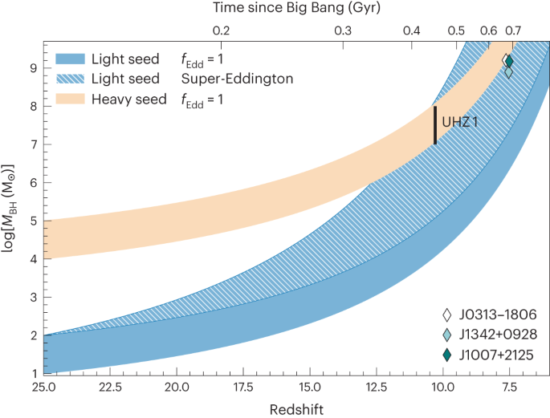
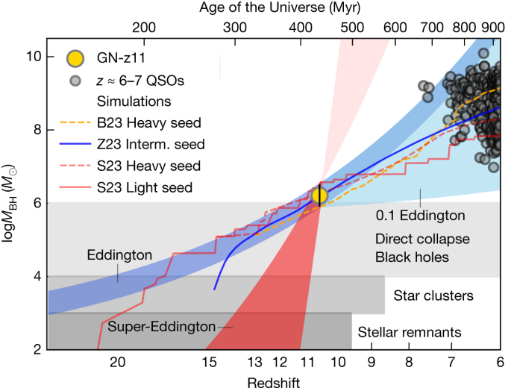
1.Formation and Evolution of MBH
Evolution of MBH
Challenge: how does massive black hole birth and grow
Light seed / heavy seed?
Nature Astronomy, 8, 126–133 (2024)
Nature, 627, 59–63 (2024）

Slide 29
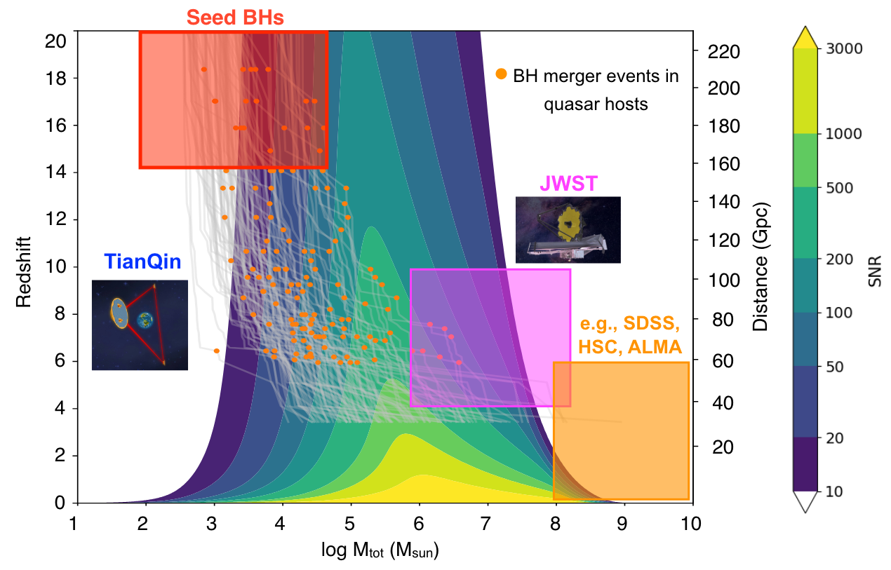
1.Formation and Evolution of MBH
Evolution of MBH
MBH formation/growth remains unclear.
TianQin's timely observations aid:
  Multi-messenger confirmation
  Origin understanding
  Environment exploration
Li EK, … HYM*, … 2025 Rep. Prog. Phys. 88 056901

Slide 30
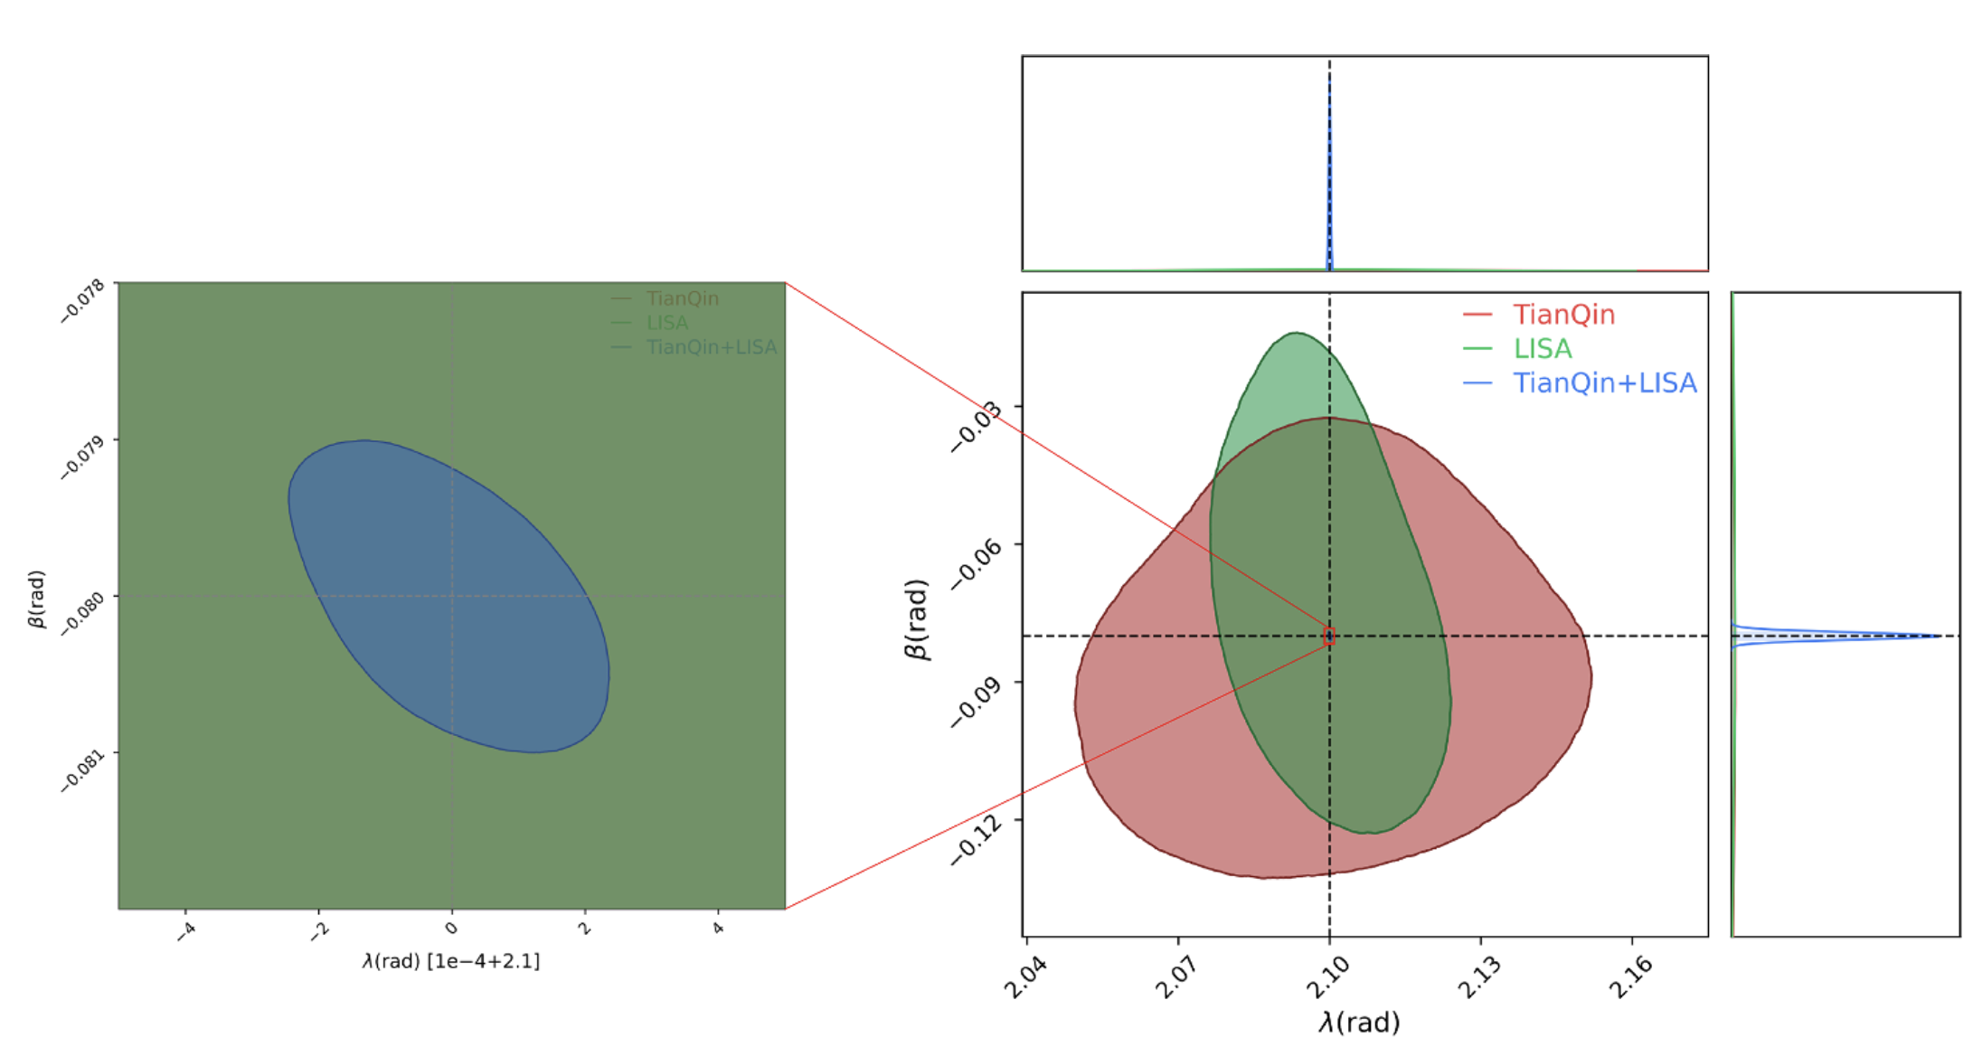
1.Formation and Evolution of MBH
Evolution of MBH
Network of detectors can greatly improve parameter estimation precision
Gao J, HYM*, … PRD 111 (2025) 2, 023039

Slide 31
2.Stellar Physics
Formation channel distinction
BBHs can form by isolated binary, cluster, AGN, etc.
Ground based detectors struggle to distinguish
Space detectors like TianQin can determine origin through eccentricity observation
Wang, Harry, Nitz, HYM*, PRD 109 (2024) 6, 063029
Wang, Williams, Harry, HYM*, PRD 113 (2026) 6, 063040

Slide 32
2.Stellar Physics
Evolution in AGN disks
AGN disk can foster numerous binaries
Perfect target for multi-messenger
TianQin observation can pinpoint properties of the disk
Lyu, Li, Shi, HYM*, CPL in press

Slide 33
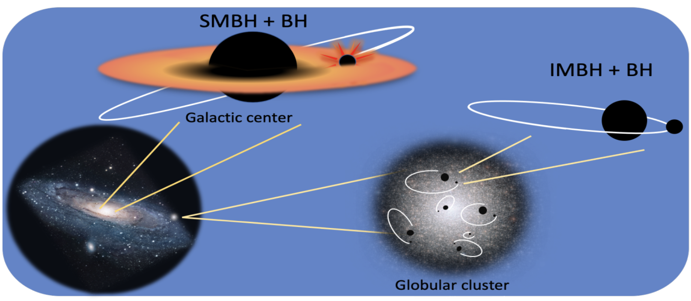
3.Sources around MBHs
Large mass ratio inspirals
EMRI
SMBH+BH
light IMRI
IMBH+BH
heavy IMRI
SMBH+IMBH
Li EK, … HYM*, … 2025 Rep. Prog. Phys. 88 056901

Slide 34
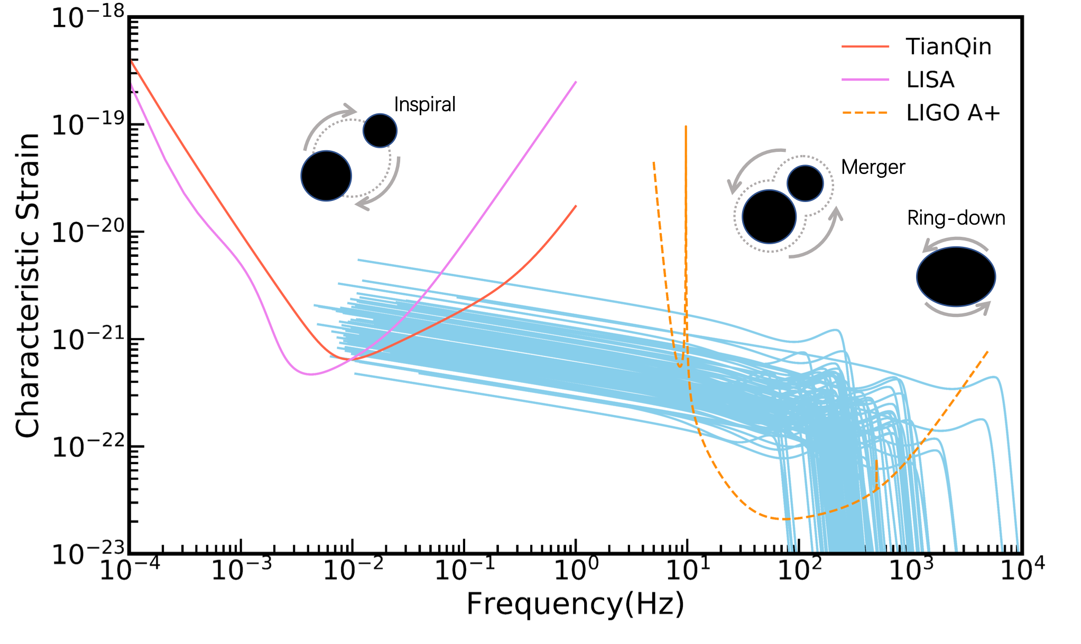
3.Sources around MBHs
Better sensitivity at higher frequencies
Liu S, … HYM*, PRD 105 (2022) 2, 023019

Slide 35
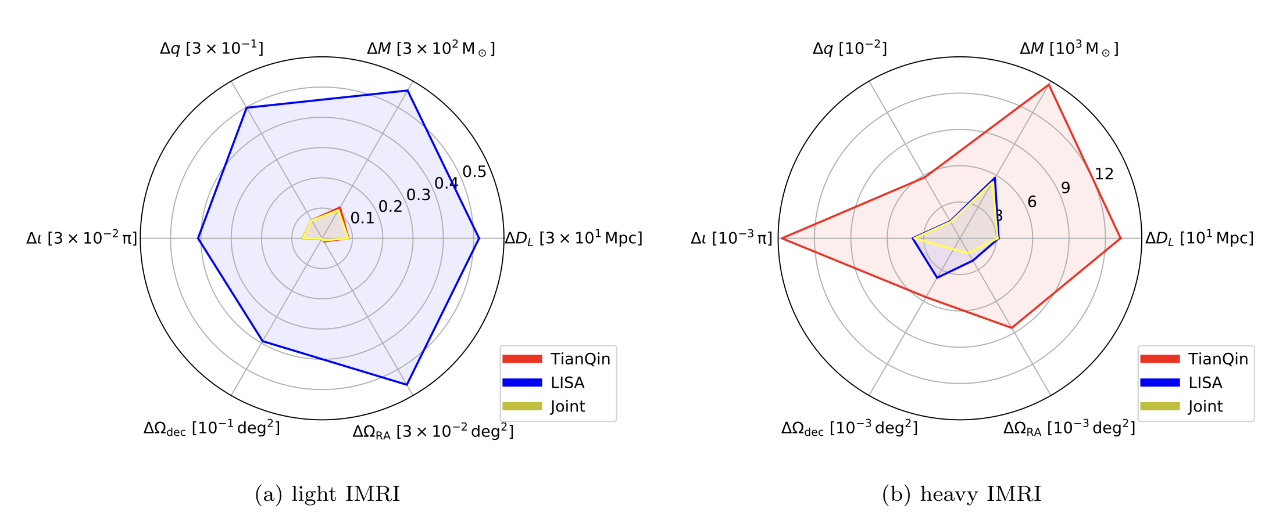
3.Sources around MBHs
Large mass ratio inspirals
TianQin performs better for light IMRIs
LISA more suited for heavy IMRIs
Torres-Orjuela, A, … HYM*, SCPMA 67 (2024) 5, 259511

Slide 36
Content
Roadmap of TQ
GW astronomy with TQ
Conclusion/Discussion
What is TianQin

Slide 37
Conclusion/Discussion
TianQin: Space GW mission
Team gathered, step-by-step 0123
Science: distinguish formation channels (GCB); distinguish seed model (MBH); complementary to LISA/Taiji (IMRI)
Jobs opening!
Please talk to me, or huyiming@sysu.edu.cn

Slide 38
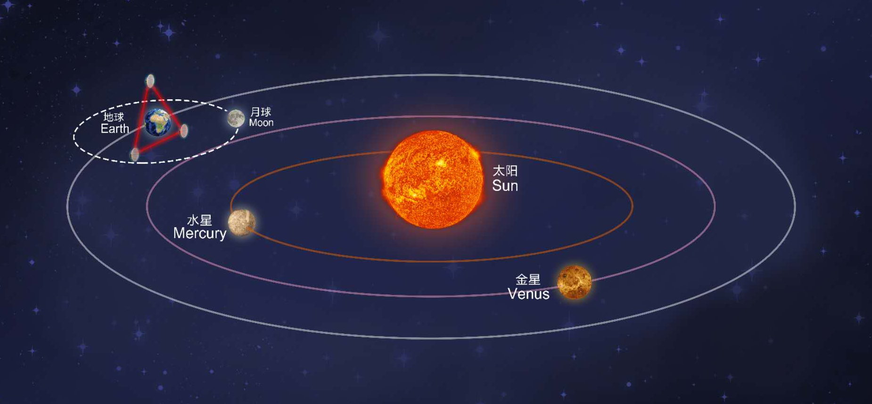
Thanks

Slide 39
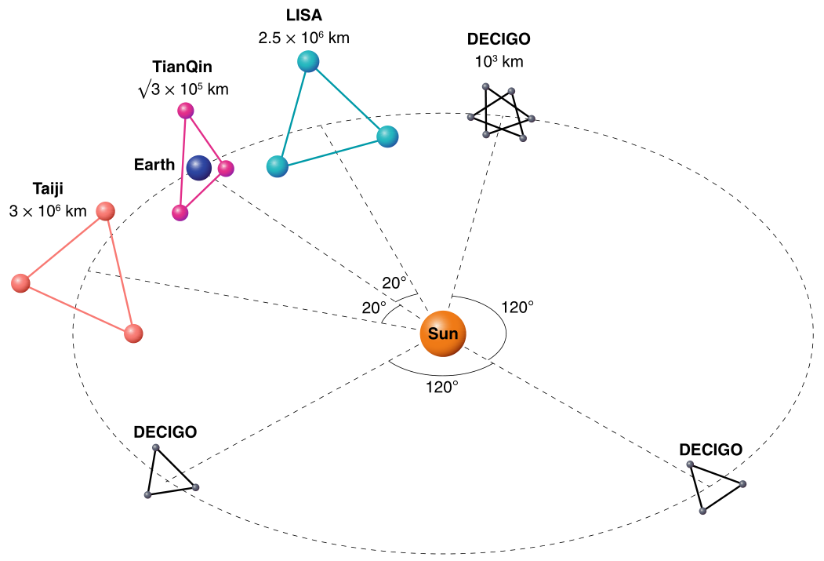
TianQin vs other space-based GW detectors
Key features of TianQin:
Geocentric orbit
Fixed orbital plane: facing J0806.3+1527
Intermediate armlength: ~1.710⁸m
Consequences:
Different response to GWs
Different sensitivity band
Gong et al., Nature Astron. 5 (2021) 9, 881-889 • e-Print: 2109.07442

Slide 40
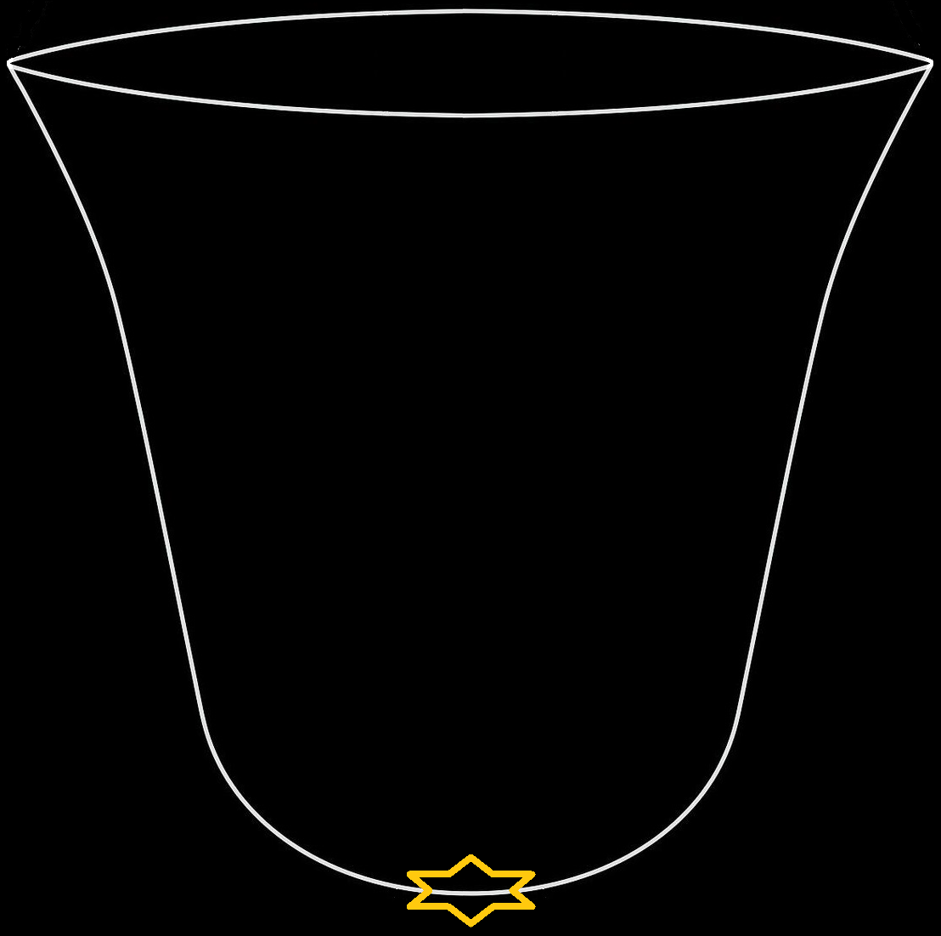
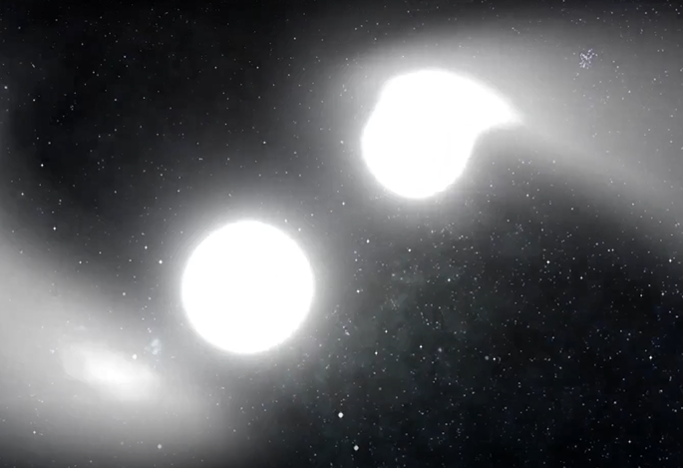
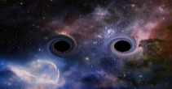
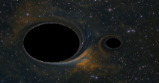
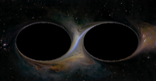
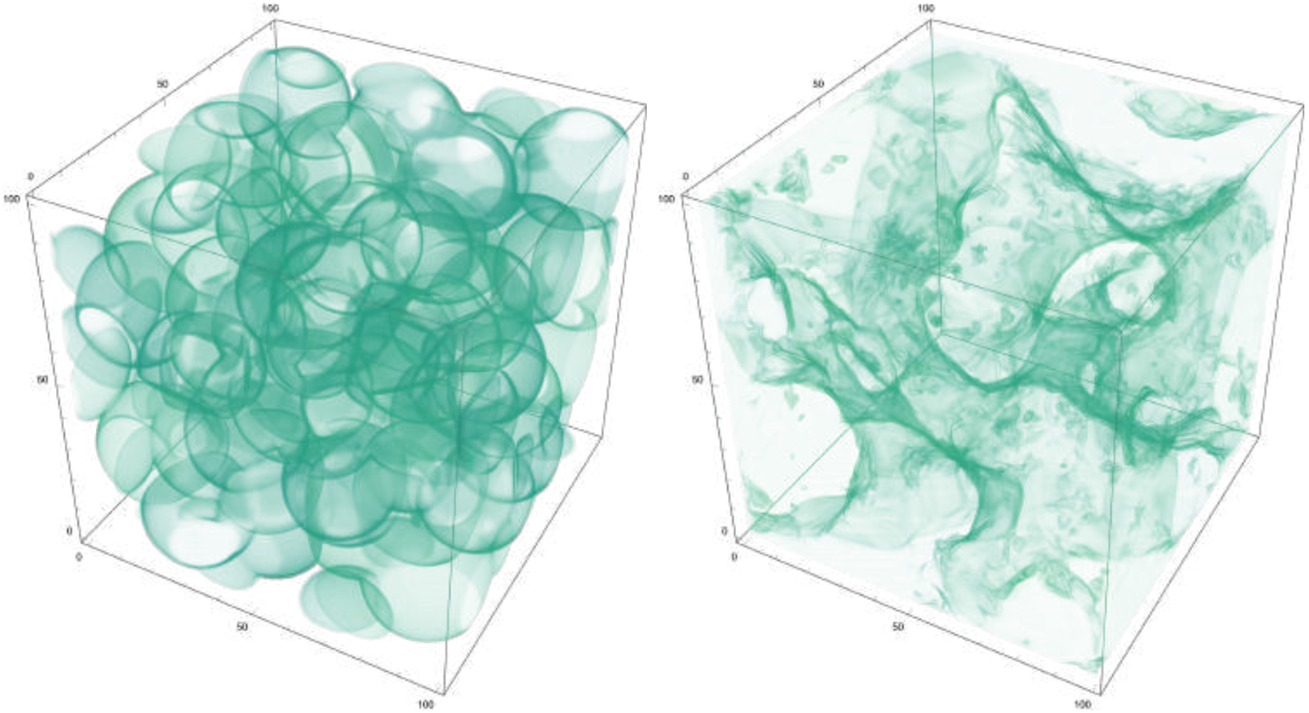
Science opportunities with TianQin
The Expanding Universe
Typical GW Sources
Typical Masses
Astrophysics：
Origin and growth history of MBHs
Nature and surroundings of MBHs
Astrophysics of stellar mass BHs
Formation and evolution of GCBs
Fundamental physics:
Nature of gravity and BHs
Possible new physics
Cosmology:
Expansion history of the universe
Now
(13.7 10⁹ years)
GCB
(Milky Way)
1M⊙+1M⊙
???
(~12.4 10⁹ years)
SBHB
z~O(0.1)
Formation of the solar system
(910⁹ years)
10M⊙+10M⊙
Cosmic Noon
(2~3  10⁹ years)
EMRI
z~O(2~3)
10⁶M⊙+10M⊙
First stars and galaxies
(Several  10⁸ years)
MBHB
z~O(10)
10⁶M⊙+10⁶M⊙
Electro-Weak Sym. Breaking
FoPT
t<O(10⁻¹⁰s)
Big Bang
TianQin
Breakthroughs/significant boosts to science in many different fields

