Slide 1
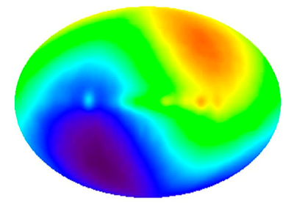
Directional variations of cosmological parameters from the Planck CMB data
Ming-chung Chu and Boris Ng
The Chinese University of Hong Kong
COSPA 2026
July 5 – 10, 2026, Christchurch, NZ
Supported by RGC AoE/P-404/18, 14300223

Slide 2


Anisotropic Universe?
Foreground
Bianchi Type I
CMB Dipoles
This Photo by Unknown Author is licensed under CC BY-SA-NC

Slide 3
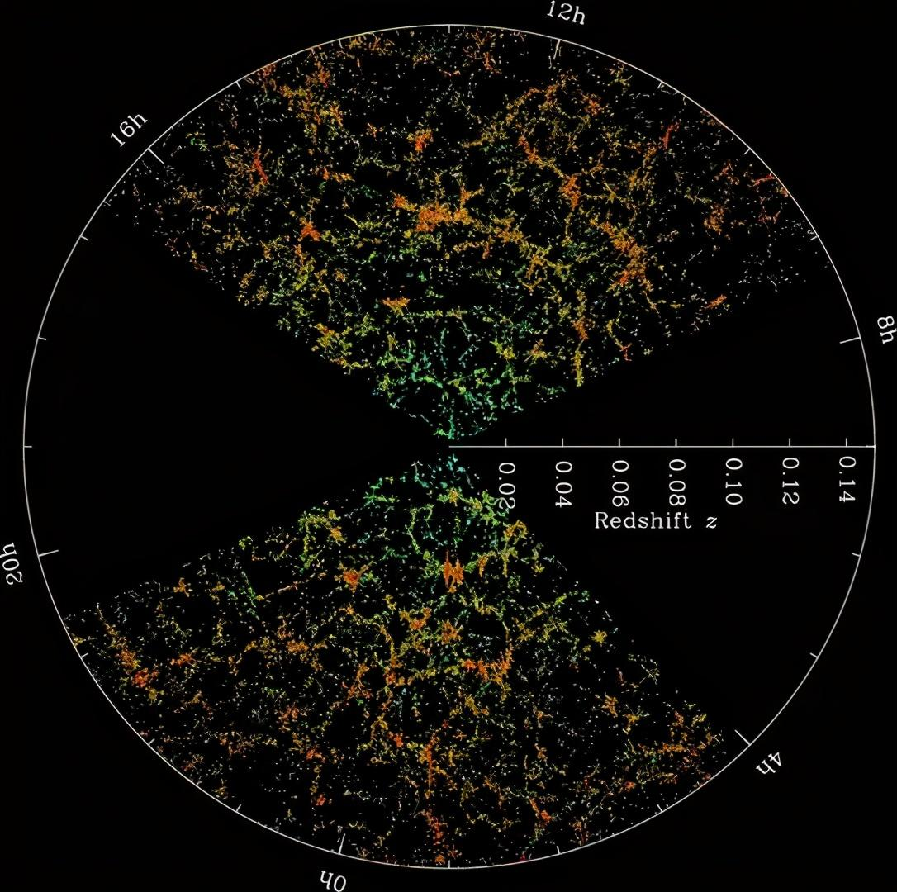
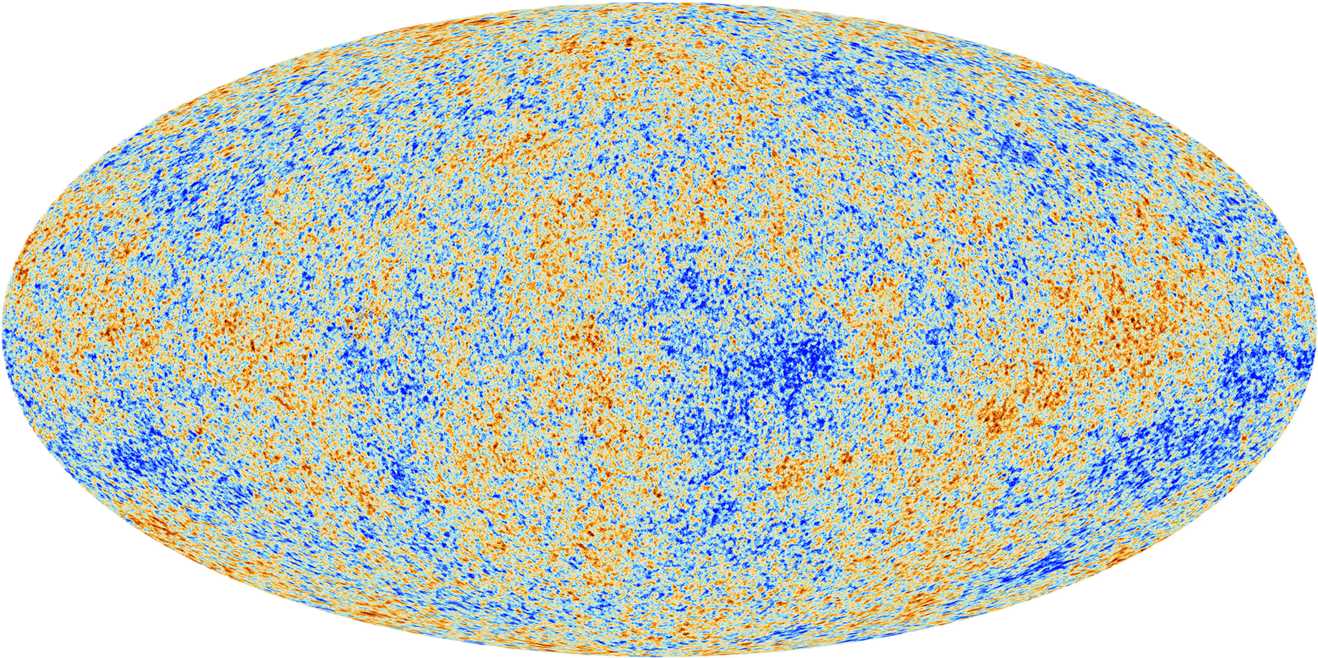

Is the universe isotropic?
Cosmological Principle
  Homogeneity: No special spot
  Isotropy: No special direction
Flat FLRW metric:
Often cited “proofs” of the cosmological principle
Cosmic Microwave Background (CMB):
Highly uniform, δT/⟨T⟩ $∼{10}^{−5}$
Large-scale Structure (LSS)
Planck
SDSS
Credit: University of Vermont & SDSS

Slide 4
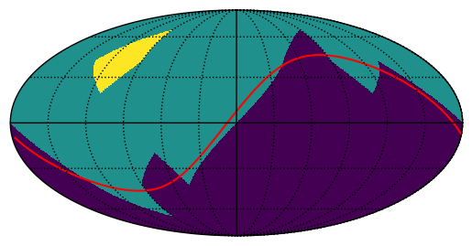
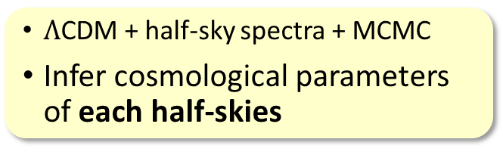
Dipoles of Cosmological parameters from CMB
Yeung & Chu, PRD 105, 083508 (2022)
Divide the sky into 48 pixels (Healpix)
Take half-skies centering on each pixel
Analyze CMB temperature half-sky power spectra
Analytical half-sky
Pixel of interest
Masked out pixels
$Λ$CDM + half-sky spectra + MCMC
Infer cosmological parameters of each half-skies
Pixelated half-sky

Slide 5
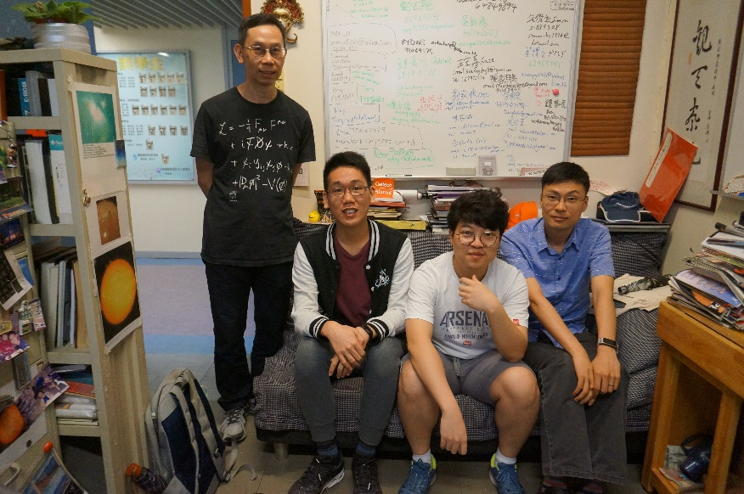
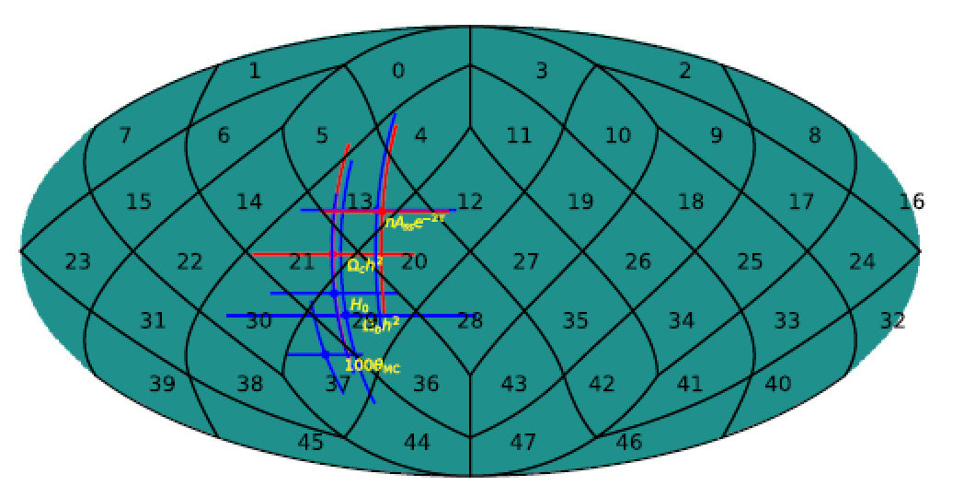
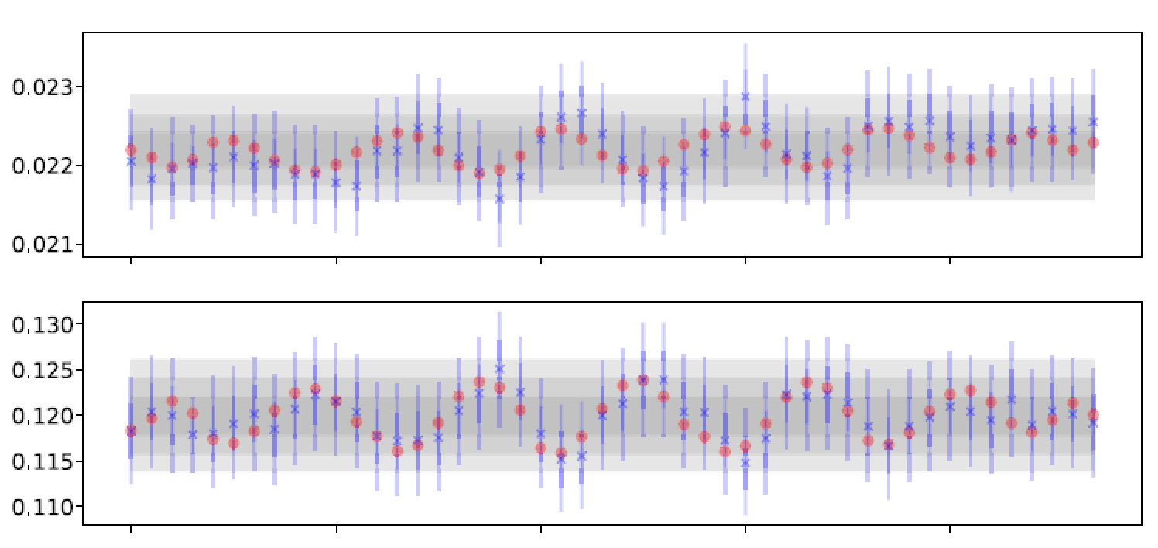
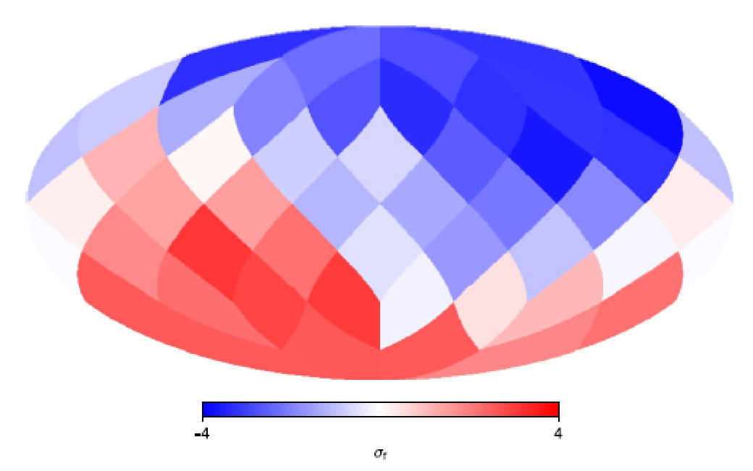
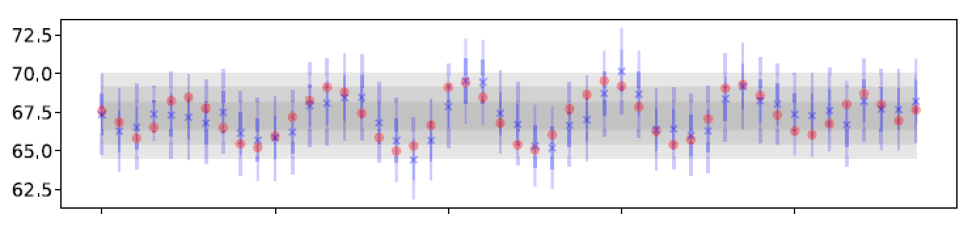

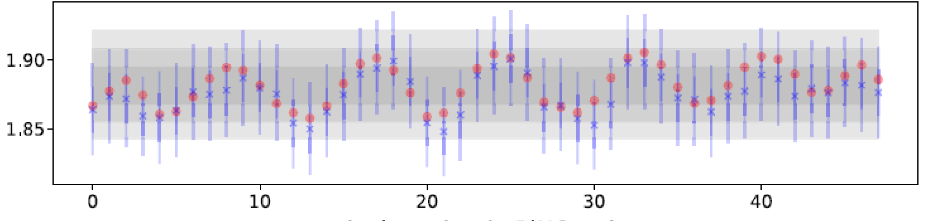



CMB Parameter Dipoles
Pixel No. in RING order
Yeung & Chu, PRD 105, 083508 (2022)
Shek Yeung
Ω_{b}h²
100$θ_{∗}$
Δθ_{MC}
Ω_{c}h²
directional variation ~ 3σ
H₀
Dipole axis
High $H_{0}$
70.1
A_{s}e^{−2τ}
Pixel No. in RING order
Low $H_{0}$
64.4

Slide 6
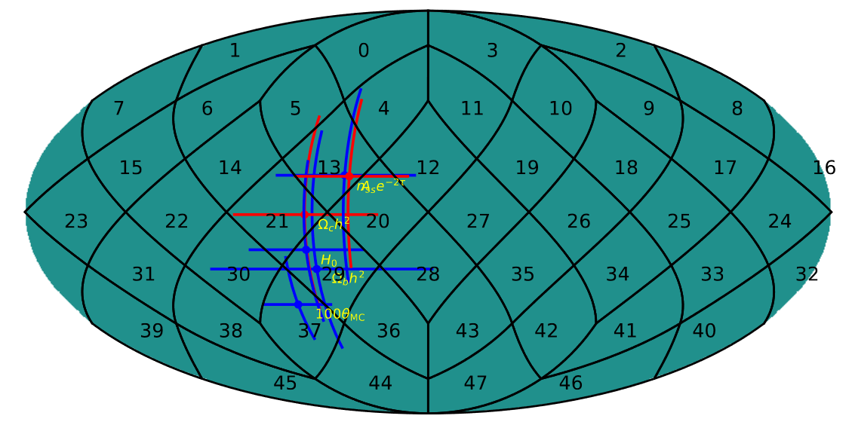
CMB Dipoles
Shek Yeung
Yeung & Chu, PRD 105, 083508 (2022)
Dipole directions are roughly aligned/anti-aligned, ~ 45º from CMB kinematic dipole

Slide 7
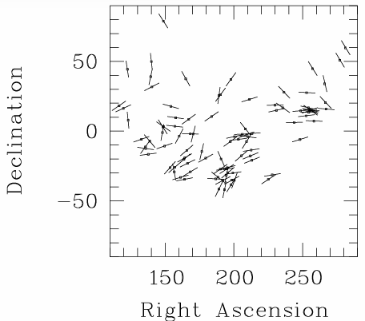
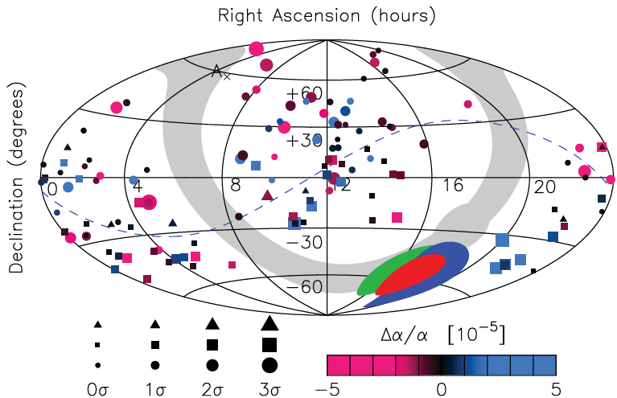
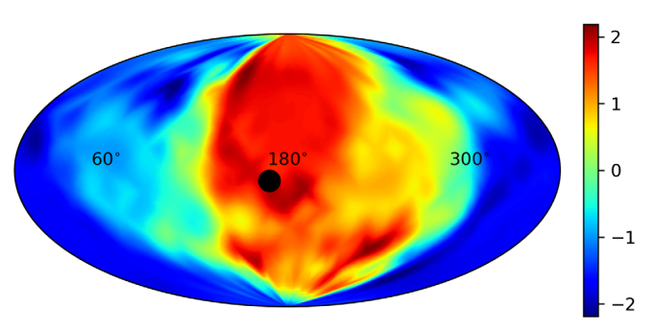


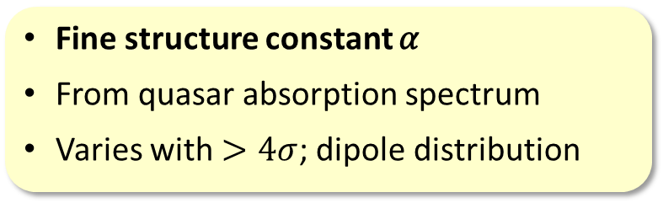

Other Anisotropic Observations
Quasar polarization
Zhao & Santos, Universe 3, 9 (2015).
Quasars polarization vector
Related to the spinning axis of Quasars
Rotational direction of spiral galaxies
Dipole distribution
Hutsemékers, A&A 332, 410–428 (1998)
$α$ variation
All associated with directions close to CMB Dipole
Fine structure constant 𝛼
From quasar absorption spectrum
Varies with $>4σ$; dipole distribution
Type Ia Supernovae
Enhanced acceleration near CMB kinematic dipole direction
Higher $H_{0}$
CMB Kin. Dipole
King et. al., MNRAS 422, 3370–3414 (2012)
Lower $H_{0}$
Luongo et. al, PRD 105, 103510 (2022)

Slide 8
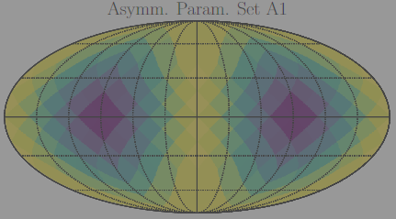
II. Bianchi Type I Models?

Slide 9

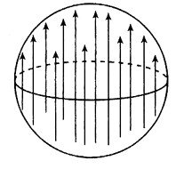
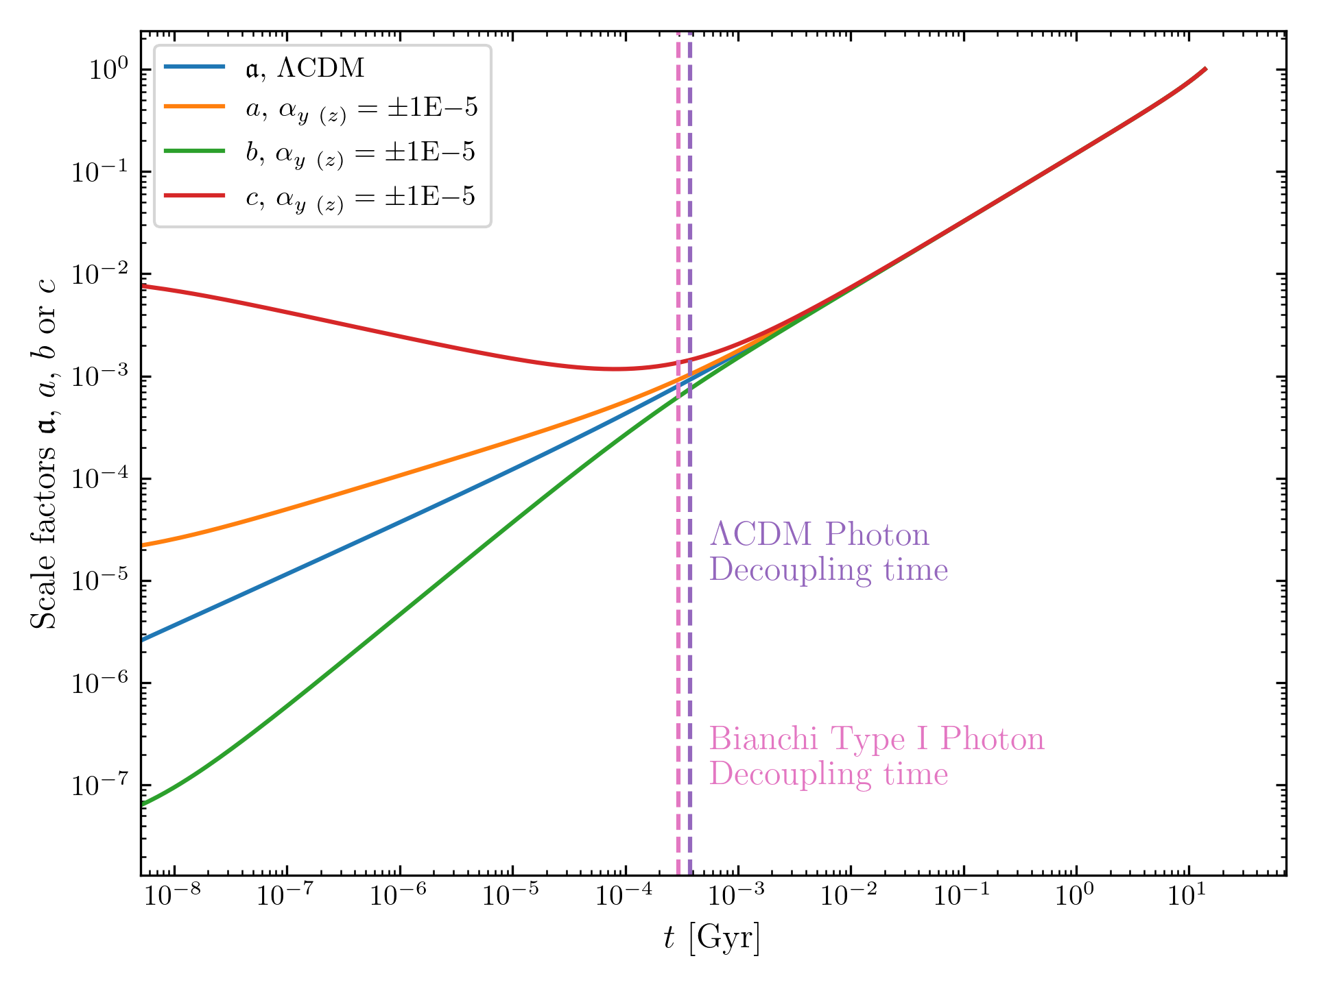

Bianchi Type I Model
Homogeneous but anisotropic metrics
Boris Ng
U. Oregon
a, b, c: Bianchi Type I (BTI) scale factors
a ≠ b ≠ c in general
Homogeneous, anisotropic
Ng, Chu, PRD 112, 023553 (2025).
10⁰
G_{μν} = 8πGT_{μν} ; ∇_{μ}T^{μν} = 0
10⁻²
c
Asymmetry parameters:
10⁻⁴
a
$α_{y}=\frac{H_{y0}}{H_{x0}}−1$, $α_{z}=\frac{H_{z0}}{H_{x0}}−1$
ΛCDM
b
‘0’ denotes today’s value
10⁻⁶
10⁻⁸
10⁻⁸ 10⁻⁶ 10⁻⁴ 10⁻² 10⁰
t (Gyr)

Slide 10
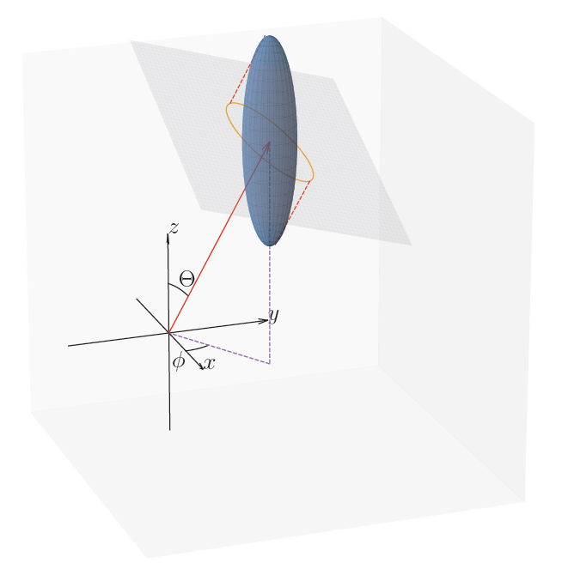




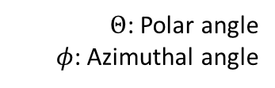
Anisotropic observables
Boris Ng
null geodesic: comoving distance is
Sound waves at decoupling form an ellipsoidal surface in the comoving frame
Anisotropic observables can be constructed, e.g.
Hubble parameter: ${\dot{a}}_{eff}/a_{eff}$
CMB/BAO angular acoustic angles $θ\left(Θ,φ\right)=\frac{r\left(Θ,φ\right)}{D_{c}\left(Θ,φ\right)}$
$Θ$: Polar angle
$φ$: Azimuthal angle
$$θ$$
$$r$$
$$D_{C}$$

Slide 11
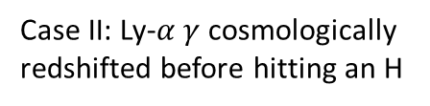



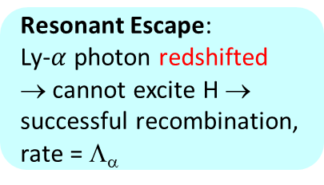
Modified Recombination
Peebles’ simplified recombination formalism
Re-excitement:
Recombination is undone
Case I: Ly-$α$ $γ$ meets a ground state H atom and excites it
H
$$e^{−}$$
H
Ly-$α$ $γ$
Case II: Ly-$α γ$cosmologically redshifted before hitting an H
H
Resonant Escape:
Ly-$α$ photon redshifted → cannot excite H → successful recombination, rate = Λ_{α}
H
Cosmological redshift: Hubble parameter
changes decoupling time
Photon/baryon ratio

Slide 12
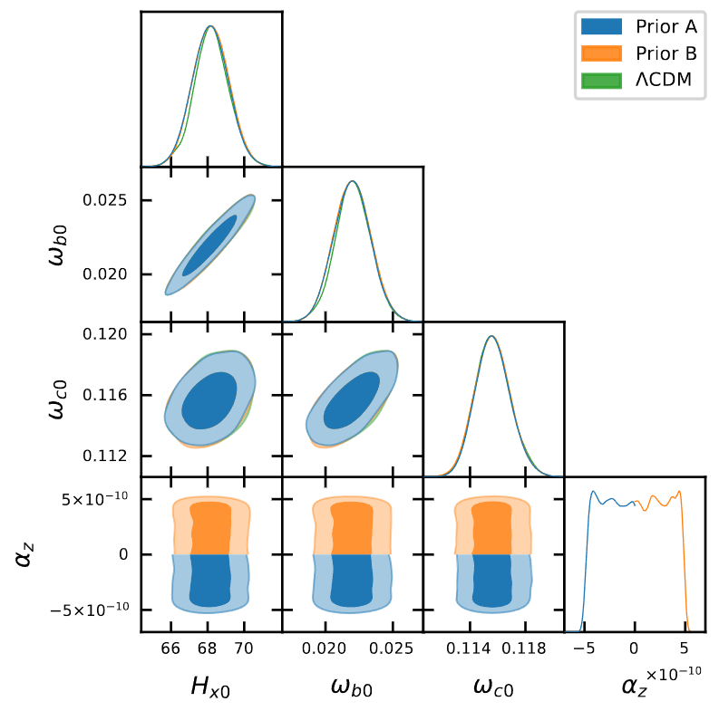

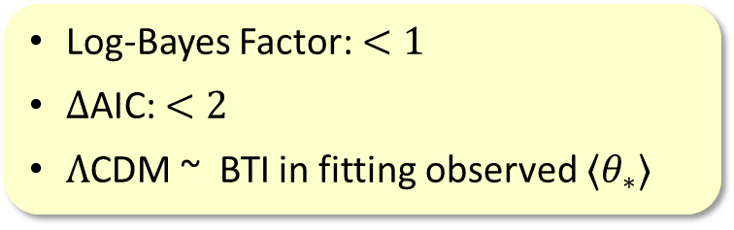
Constraints w/ Self-Consistent Recombination
Data: $⟨θ_{∗}⟩$+ δT/T < 2 × 10⁻⁵, 10⁻³
Prior A: α_{z} < 0, Prior B: α_{z} > 0
Assume a = b ≠ c. Weak correlation with standard parameters
|α_{z}| < [$𝒪\left(\text{10}\text{−}10\right)$ or $𝒪\left(\text{10}\text{−}8\right)$]
Consistent with previous works
Boris Ng
ω_{b0}
Log-Bayes Factor: $<1$
$Δ$AIC: $<2$
$Λ$CDM ~ BTI in fitting observed $⟨θ_{∗}⟩$
ω_{c0}
Not worth a bare mention
Ng, Chu, PRD 112, 023553 (2025).
α_{z}
H_{x0}
ω_{b0}
ω_{c0}
α_{z} ×10¹⁰

Slide 13
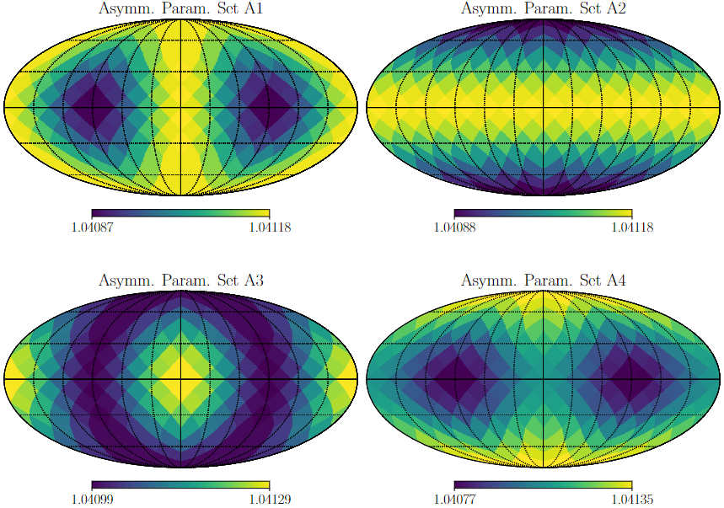
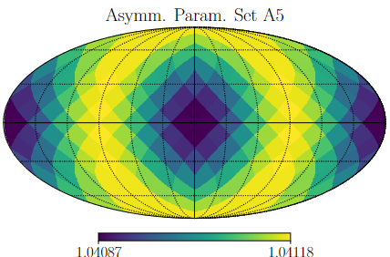
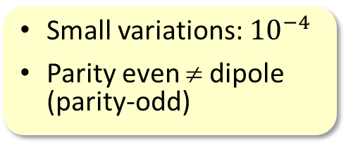


Directional variations of parameters in BTI
Boris Ng
BTI cannot explain the observed large-scale CMB anisotropy!
$ω_{b0}$, $ω_{c0}$, $H_{x0}$ $∼$ Planck values
Δθ_{MC}
$$100θ_{∗}(Θ,φ)$$
directional variation ~ 3σ
Small variations: ${10}^{−4}$
Parity even ≠ dipole (parity-odd)
Ng & Chu, PRD 112, 103545 (2025)

Slide 14
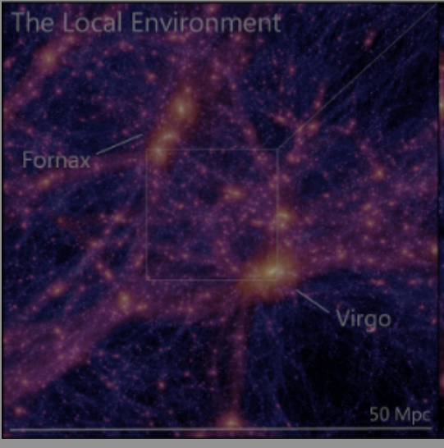
III. Foreground/Local effects?
https://dirac.ac.uk/sibelius-dark-a-galaxy-catalogue-of-the-local-volume-from-a-constrained-realisation-simulation/

Slide 15
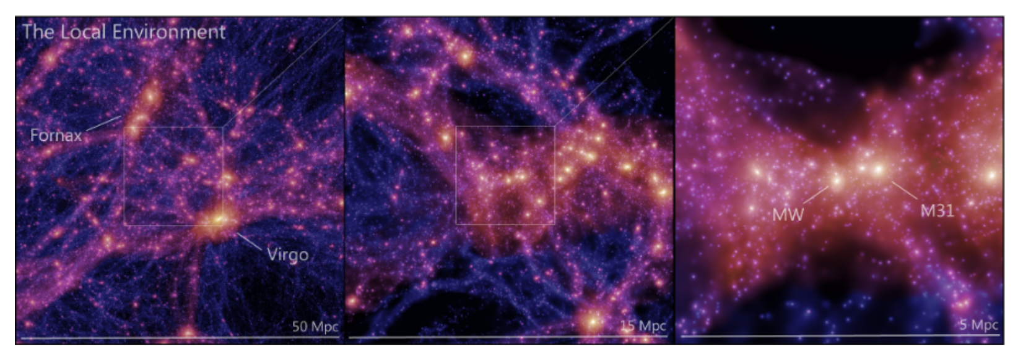
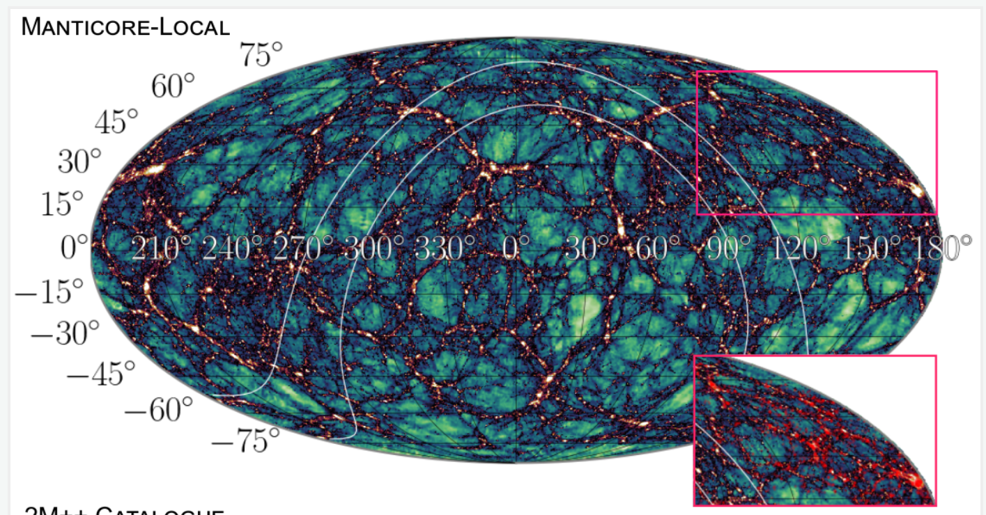
Constrained realization simulations
ΛCDM N-body simulations conditioned to reproduce the current structures in the local universe (2MASS+/2M++ galaxy surveys)
https://dirac.ac.uk/sibelius-dark-a-galaxy-catalogue-of-the-local-volume-from-a-constrained-realisation-simulation/
Sibelius-Dark
MANTICORE-LOCAL
https://cosmictwin.org/

Slide 16
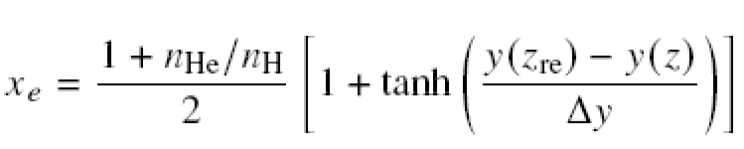
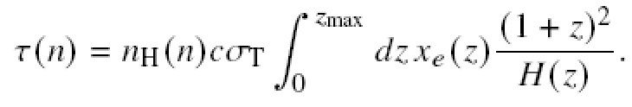
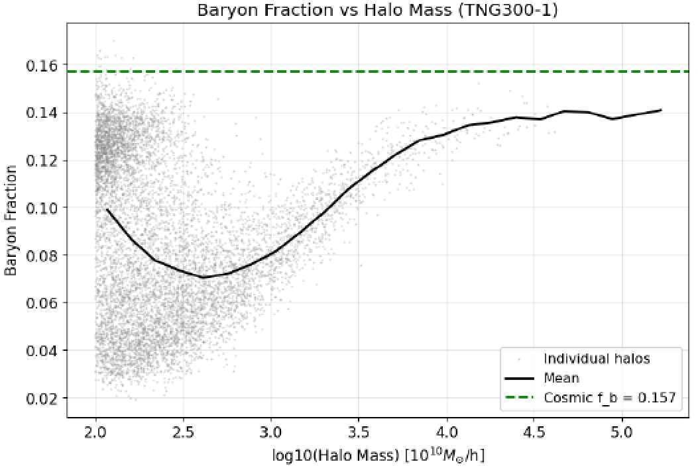

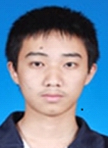
Reconstructing the CMB Optical Depth
For pixel n
Halo mass distribution from Sibelius or Manticore × baryon mass fraction from TNG300-1
Yiwei Li
Wangzheng Zhang

Slide 17
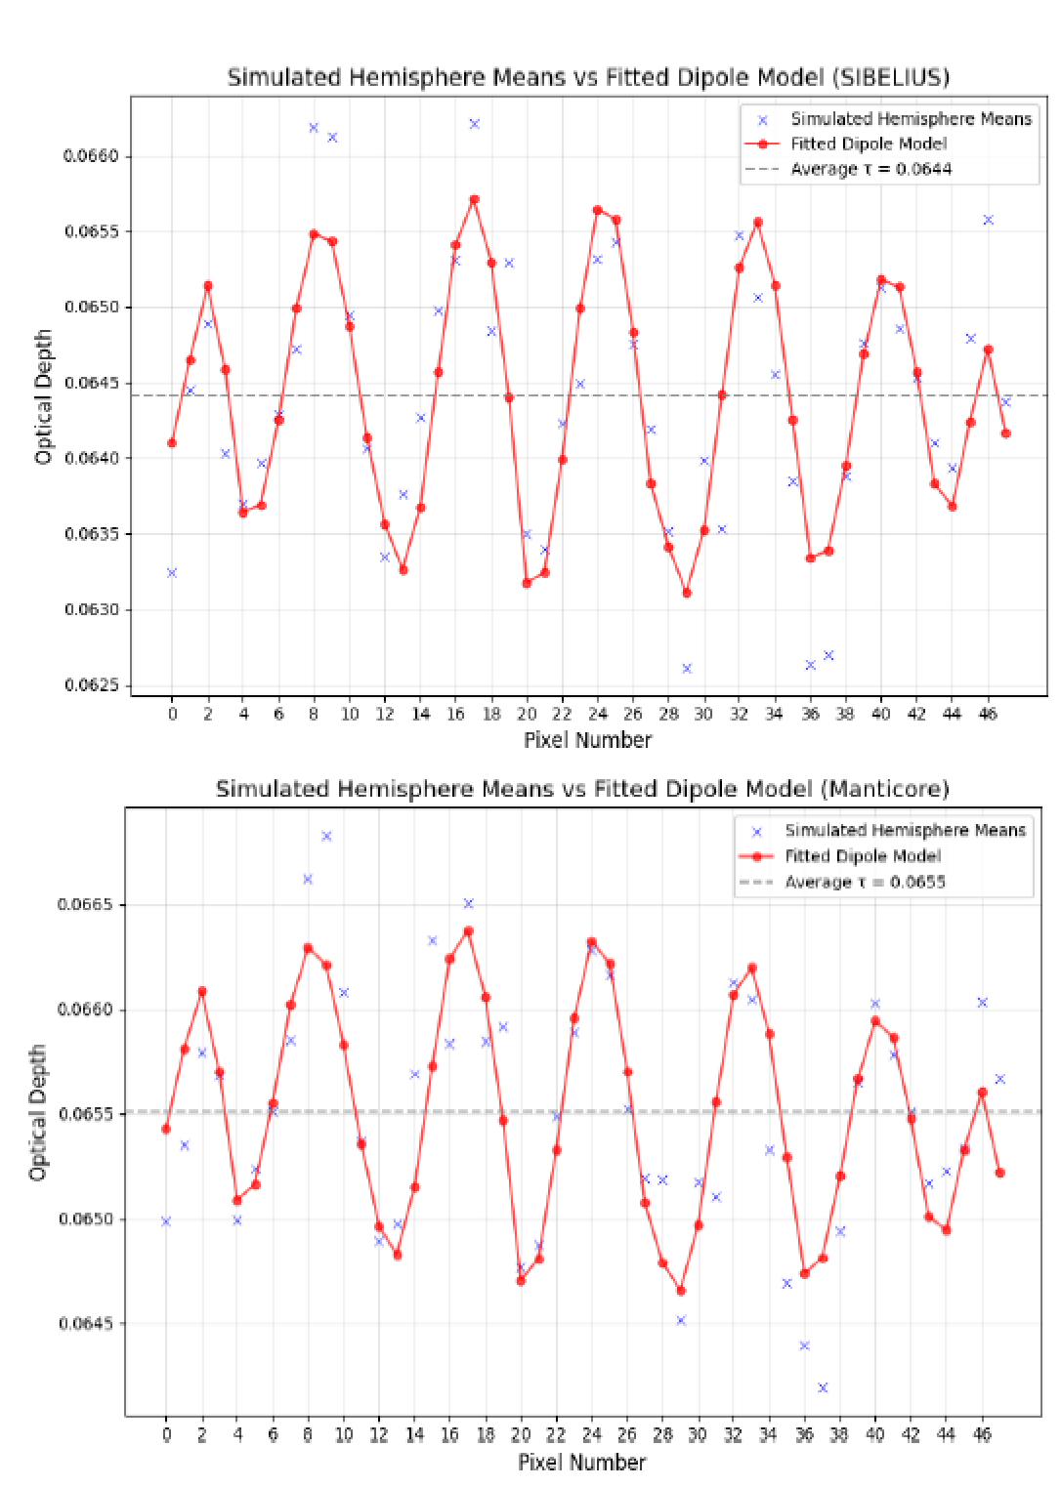
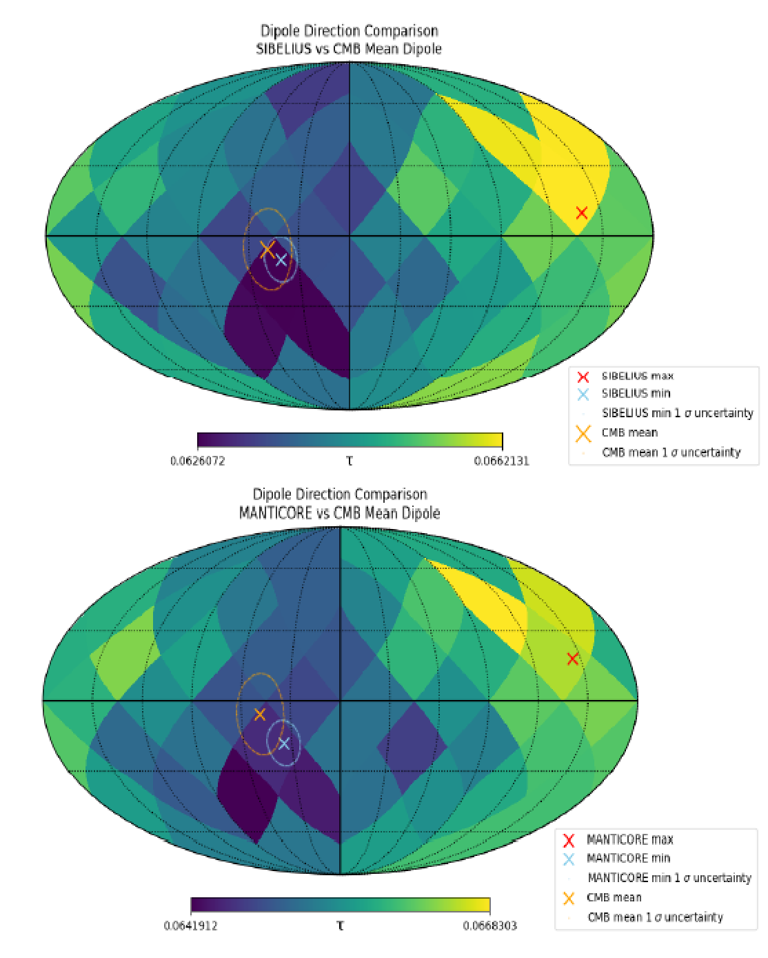
Preliminary results
Y. Li, W. Zhang, M.-C. Chu, 2026
τ
Dipole direction
SIBELIUS
CMB
SIBELIUS
Δθ_{MC}
τ
directional variation ~ 3σ
CMB
MANTICORE
MANTICORE

Slide 18

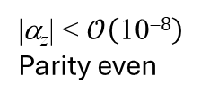

Summary
c
a
ΛCDM
b
Foreground
t (Gyr)
|α_{z}| < $𝒪\left(\text{10}\text{−}8\right)$
Parity even
Maybe!
CMB Dipoles
Bianchi Type I
High $H_{0}$
Dipole axis
70.1
Low $H_{0}$
64.4
Ω < 10⁻⁹ rad/yr
This Photo by Unknown Author is licensed under CC BY-SA-NC

Slide 19
Directional variations of cosmological parameters from the Planck CMB data
Ming-chung Chu and Boris Ng
The Chinese University of Hong Kong
COSPA 2026
July 5 – 10, 2026, Christchurch, NZ
Supported by RGC AoE/P-404/18, 14300223

Slide 20
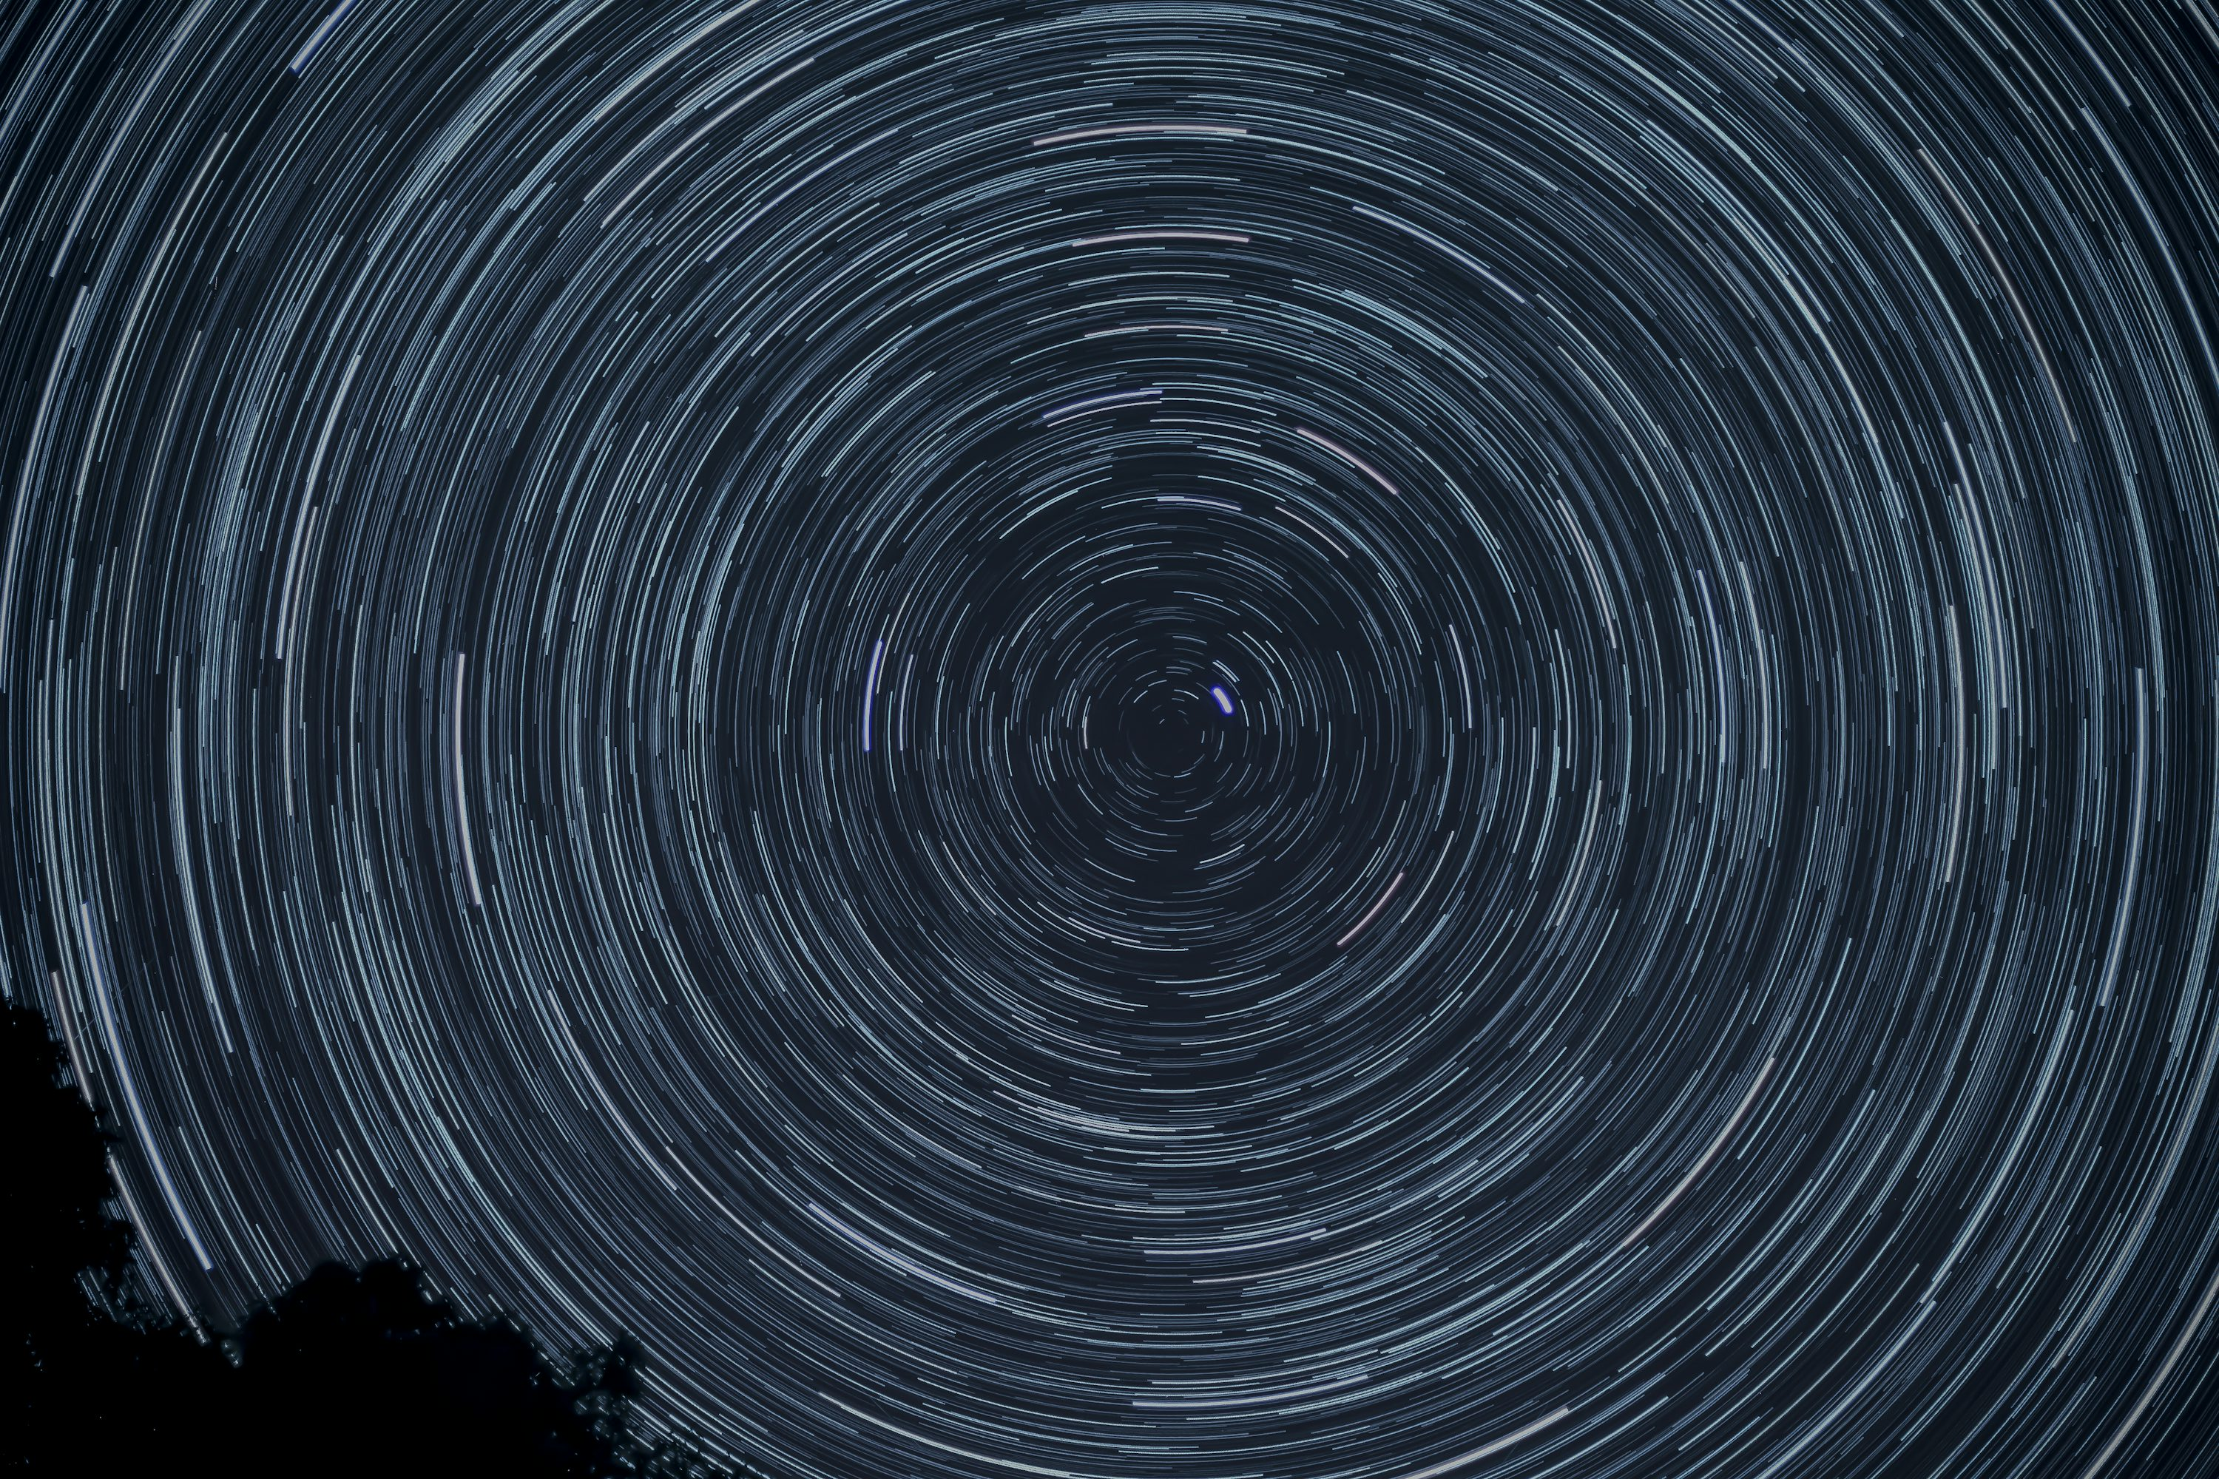
III. Rotating Universe?
Credit: patmcmanaman

Slide 21
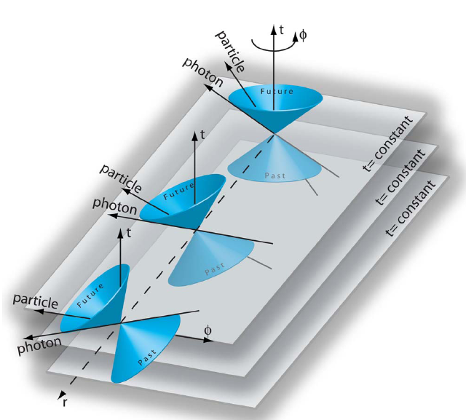
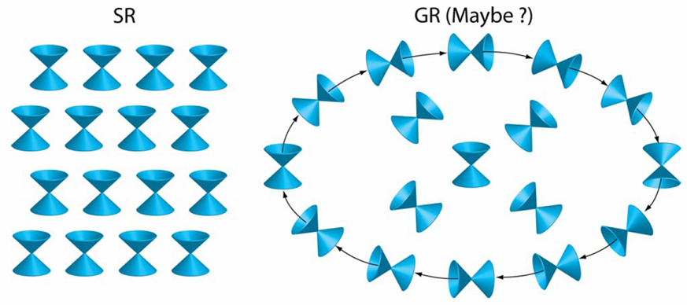
Gödel’s Rotating, Static Universe (1949)
There exists closed time-loops: after completing an orbit, one goes back to the starting point at an earlier time!
Light cones in standard cosmology
Gödel’s universe
t
t
t
t
at rotation axis
x
A universal time with the future all pointing in the direction of decreasing density/temperature
Futures are not ‘parallel’
K. Gödel, Rev. Mod. Phys. 21: 447–450 (1949).
W. Rindler, Am. J. Phys. 77, 498 (2009).
At large r, fast particles go backward in time
http://en.wikipedia.org/wiki/G%C3%B6del_metric

Slide 22
CMB Constraint of Rotating Universe
Treat the rotation as perturbations; use CMB data to constrain rotation speed Ω
  For closed universe (Hawking 1969)
    < 10⁻¹⁴ - 7 × 10⁻¹⁷ rad/yr
  For open universe (Hawking 1969)
    < 2 × 10⁻¹⁷ rad/yr
  For flat universe (Barrow et al. 1985)
    < 1.5×10⁻¹⁵ rad/yr
Bianchi models (1st order effect) uniform Ω
RW model (2nd order) Ω(r)
For flat ΛCDM universe (Su and Chu 2009)
< 10⁻⁹ rad/yr

Slide 23

Our Rotating Universe Model
Su, Chu, ApJ 703, 354 (2009).
Simon Su 蘇士俊
Effect of Rotation on CMB
Add rotational perturbations to the flat RW model (standard model)
Ω(r, η): angular velocity
  Allows non-uniform rotation
Flat RW model
  Supported by observation
2nd order perturbations, f, h, k
  Parity symmetry
Ω < 10⁻⁹ rad/yr
Original WMAP
at CMB decoupling
Rotation + WMAP

Slide 25
Summary
Dipoles in Cosmological parameters from CMB
Bianchi Type I models?
Rotating universe?
Foreground effects?

Slide 26
Outline
Dipoles in Cosmological parameters from CMB
Bianchi Type I models?
Rotating universe?
Foreground/Local effects?

