Slide 1

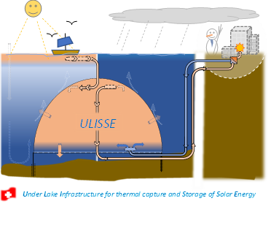

Sustainable HEP 2026 Online Workshop – 5th Edition, 8-10 July
Submitted talk (Session Large scale projects and policy making - I): 8 July 2026, 17:00
The ULISSE Project: an Opportunity for
CERN’s waste heat large-scale recycling
William van Sprolant
CvS énergies sàrl
(talk:10 min, 5 min Q&R)
Full Proposal available on the
Sustainable HEP 2026 website
https://indico.global/event/16058/contributions/mine
(O₂)
(Image generated by Artisanal Intelligence)

Slide 2
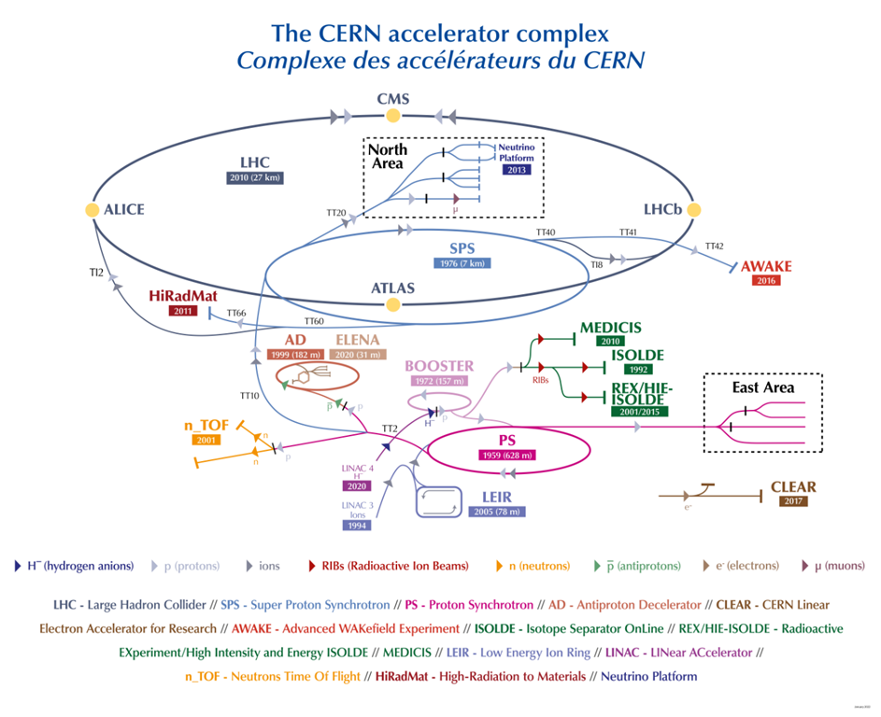
CERN’s Energy & Water requirements
2024 (LHC) ≈ 1.3 TWh & 2.9 M m^{3 (*)}
(potable cooling water roughly ½ for the LHC)
+155 TJ fossil fuels ∑≈ 5% of annual budget (1.5 G CHF)
(*) : + 2.5 M m³/ TWh Cooling Water for nuclear electricity
production (source: Électricité de France)
2030 (HI-LHC) ≈ 1.5 TWh/y & 3 M m³ ^{(*)}
2040 (FCC-ee) ≈ 1.8 TWh/y & 3.5 M m^{3 (*)}
2070 (FCC-hh) ≈ 4 TWh/y & ? M m^{3 (*)}
All electricity is ultimately converted trough cooling water into waste heat (1TWh => 3.6 PJ)
How could we recover waste heat (in Summer Operation), make use of it (in annual Winter Shutdown) and thereby indirectly reduce our electricity consumption ?
Image © CERN
ULISSE project proposal @ CERN (Sustainable HEP 2026) W. van Sprolant / CvS énergies sàrl 8 July 2026

Slide 3
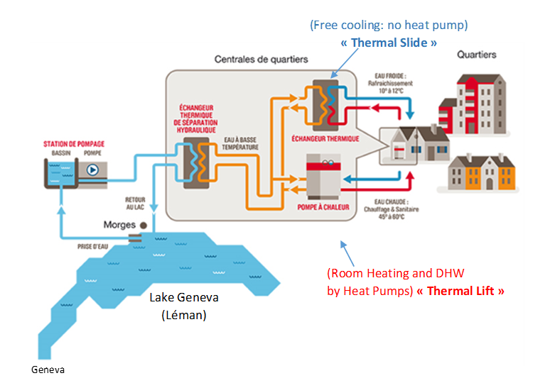

Under Lake Infrastructure for thermal capture and Storage of Solar Energy (ULISSE)
(for district Cooling & Heating services)
Summer semester Heat Storage of Solar-Direct (Lake) & -Indirect (Air Conditioning) & Industrial Waste Heat (Datacentres, CERN …).
Winter semester Electrical Efficiency Booster of Thermal Lacustrine Networks (TLN) and Potable Water “free preheating” (CORSAIRE).
ULISSE (≈ 20% heat losses of the reservoir) induces external thermal lake convection, improving vital lake bed Oxygenation (O₂) and Nutriments Circulation (N, P), capture of benthic gas productions (CO₂ , CH₄).
Lake Protection against persistent thermal stratification and eutrophication, exacerbated by Global Warming.
A Closed-Circuit between ULISSE & TLN protect the infrastructure against Quagga mussel’s invasion.
Summer Solar Heat
Central Pumping Station
Epilimnion
Suction Strainer
Lake
19˚ ˚C (Winter)
Thermal Lacustrine Network (TLN) “Hot Pipe” (19-25˚C)
O₂
&
Nut.
Cooling
Services
Local
pump
25˚ C (Summer)
Free
preHeating Exchanger
Public or Local
Potable Water Network Winter “Free preHeating”
(CORSAIRE process)
ULISSE
∆T
15-19 K
Heat Exchanger
e
“Free Cooling”
or Heat Pump
Heat
Pump
3-4˚ C (Winter)
local
pump
Heating
Services
Example of a conventional TLN
MorgesLac of Morges (VD)
6-7˚ C (Summer)
TLN “Cold Pipe” (3-7˚C)
ULISSE project proposal @ CERN (Sustainable HEP 2026) W. van Sprolant / CvS énergies sàrl 8 July 2026

Slide 4
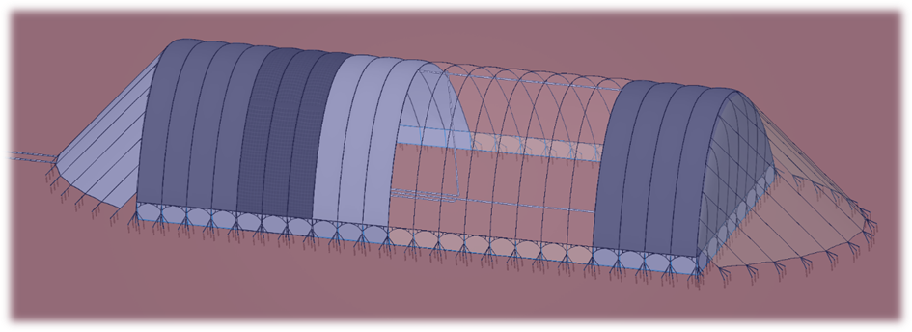
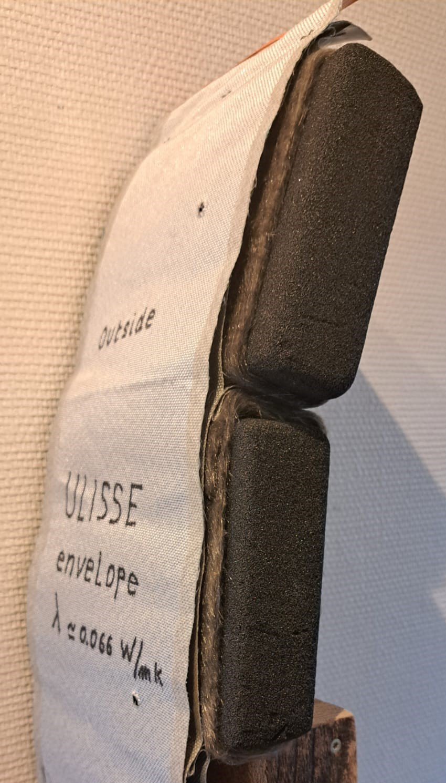
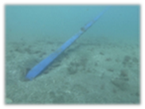
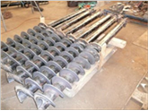
Perspective view of the ULISSE sub-lake heat storage reservoir (unit volume 1 M m³ )
Self-sustaining Insulated envelope: 49’000 m²; lake bed footprint: 26’000 m²; buoyancy: ≈ 4’000 t & Heat storage capacity: 84 TJ (23 GWh) @ ∆T = 20˚K
(Closed-Circuit version adapted for CERN waste heat storage)
Outside layer
(2 fiberglass textiles + stainless steel reinforcing wires, 2x9 t/m)
5-10 cm Cellular glass blocks
+ basalt felt coat
(thermal insulation)
Isolated Endcap
5 cm Cellular glass blocks
(+3 fiberglass textiles)
Hyperbolic section: 3’800 m²
Endcap Deflector
(2 fiberglass. text.)
Inside layer
(1 fiberglass textile)
Internal upper tubular strainer
(hot water injection/Extraction) ≈ 20-25˚C
Closed-Circuit Interconnection
water mains with the TLN
(GeniLac, CERN)
55 m
Lake bed
≈ 6-7˚C
Internal lower tubular strainer
(cold water injection/extraction) ≈ 3-6˚C
100 m
Non-Insulated Closure Curtain
(fiberglass textile)
≈ 5 m
∑: 270 Screw-in Anchors
(25 t unit holding capacity)
Anchoring cables in front of Closure Curtain
(≈ 5 m distance from lake bed)
Semi-rigid
Insulated
envelope
262 m for 1 M m³ (22 x 12 m transverse hyperbolic arch strips)
≈ 80 %
Seasonal Heat Storage Efficiency
Screw-in Anchor
Impact of inking
at the bottom of the lake
ULISSE project proposal @ CERN (Sustainable HEP 2026) W. van Sprolant / CvS énergies sàrl 8 July 2026

Slide 5

ULISSE & CORSAIRE case study on the TLN GeniLac & Geneva’s PWN
(Exploratory Study of the ULISSE project funded by the SFOE (SOUR Call 1-2021)
350 buildings connected in 2045
245 GWh-thermal
Summer « free cooling »
COPsys : 18
250 GWh-thermal
Winter Room Heating
& Domestic Hot Water
COPsys : 3,4 – (3,2 @ 2050)
+ 27 GWh-th
Natural gaz (backup)
Vengeron main pumping station, Nominal flow 10 m³/s
T_{lake}≈ 6/3˚C, ∆T_{lake} : 3 K => 125 MW-t (Nominal Thermal Power)
CERN’s FCC-hh feasibility study examining the possibility of feeding its cooling water into the GeniLac network (https://doi.org/10.1140/epjst/e2019-900087-0 : § 9.4: Waste heat recovery, pg. 996)
ULISSE project proposal @ CERN (Sustainable HEP 2026) W. van Sprolant / CvS énergies sàrl 8 July 2026

Slide 6
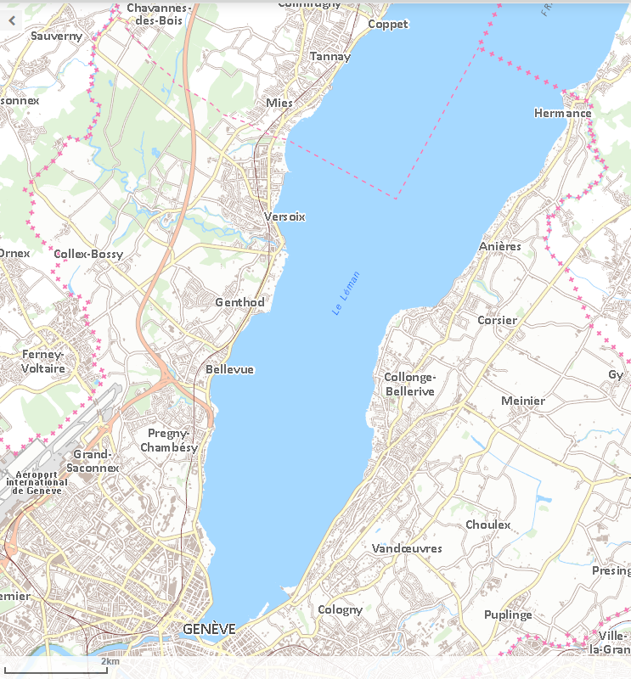
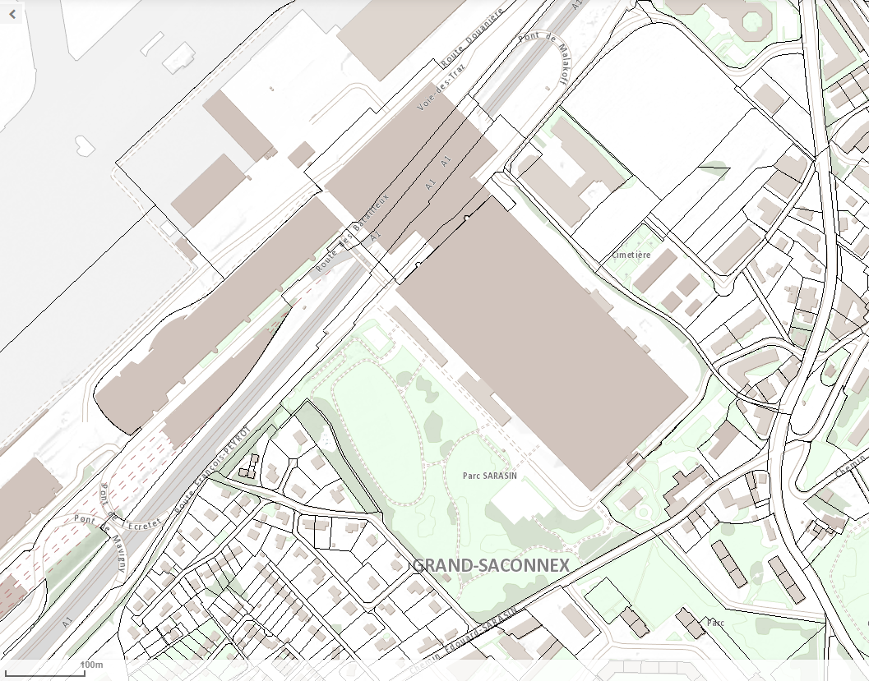
ULISSE for GeniLac (case study)
12-6 Reservoirs of 1-2 M m³ = 12 M m³ @ ∆T 15 K :
0,72 PJ = 200 GWh => 17’000 toe
Winter semester Electricity GeniLac (2050):
without ULISSE : ≈ 80 GWh (100%)
with ULISSE : ≈ 40 GWh (0,50%)
Lake water volume reduction: 49 => 12 M m³
LHC
(P7)
Insulated supply pipe
HDPE, DN 1000 x 6 km,
Flow rate: 0.75 m³/s
Reservoir ULISSE
100 x 550 m, 2 x1 M m³
(125 TJ or 35 GWh-t)
Crépine
GeniLac
(- 45 m
10 m³/s)
Main
pump station
“Vengeron”
LHC
(P8)
Scale ratio
Crépines
GLN &
EP Prieuré
(- 35 m)
FCC
(PB)
PALEXPO
StEP
Prieuré
StP
Arquebuse
ULISSE project proposal @ CERN (Sustainable HEP 2026) W. van Sprolant / CvS énergies sàrl 8 July 2026

Slide 7
Water and Energy flows for GeniLac heat pumps in winter semester 2050
(without ULISSE and CORSAIRE free preheating)
TLN GeniLac
Total winter semester electricity consumption (circulation pump + heat pump) : 10 + 69 = 79 GWh
ULISSE project proposal @ CERN (Sustainable HEP 2026) W. van Sprolant / CvS énergies sàrl 8 July 2026

Slide 8
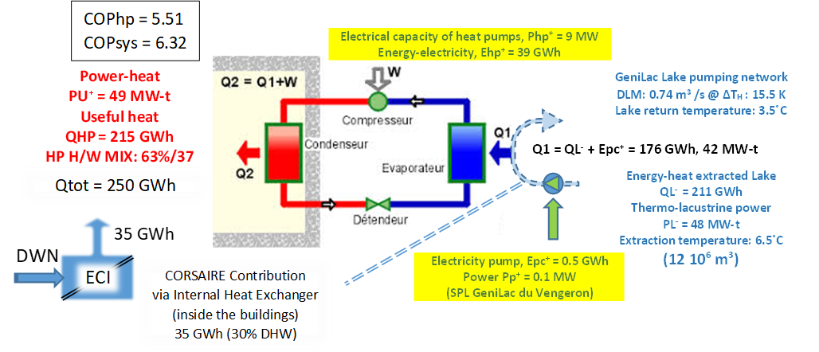
Water and Energy flows for GeniLac heat pumps in winter semester 2025/35
(CORSAIRE heat exchanger INSIDE buildings, without Urban PWN free preheating)
TLN GeniLac
Total winter semester electricity consumption (circulation pump + heat pump) : 0,5 + 39 = 39,5 GWh
ULISSE project proposal @ CERN (Sustainable HEP 2026) W. van Sprolant / CvS énergies sàrl 8 July 2026

Slide 9
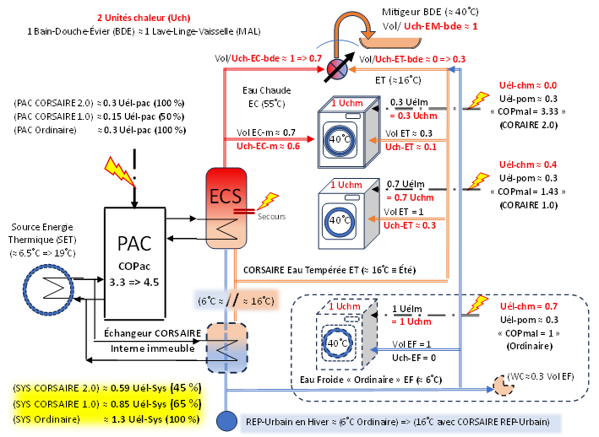
Electricity Impact by free preheating in building or district Potable Water Network (PWN)
(CORSAIRE) for Washing Machines (including outside lake regions !)
ECS: Eau Chaude Sanitaire = Sanitary Hot Water (SHW)
BDE = Batch Shower and Washbasin (BSW)
CORSAIRE 2.0 @ SHW supply !
=> 100% Electric Heating Suppression of WM
Total Electricity Reduction (TER) : 65% ! COPsys ≈ 2.9 (188 %)
CORSAIRE 1.0
=> 30% Electric Heating Suppression of WM
Total Electricity Reduction (TER) : 45% ! COPsys ≈ 2 (130 %)
Without CORSAIRE (Ordinary) 100% Electric Heating of WM
Total Electricity Consumption (TEC) : 100 %
COPsys ≈ 1.54 (100 %)
9
ULISSE project proposal @ CERN (Sustainable HEP 2026) W. van Sprolant / CvS énergies sàrl 8 July 2026

Slide 10
Conclusion
With ULISSE seasonal sub-lake heat storage, CERN’S WASTE HEAT COULD BOOST District Thermal Lacustrine Networks (TLNS) while protecting the lakes against global warming.
HALF the WINTER SEMESTER ELECTRICITY CONSUMPTION of TLNs for Cooling and Heating services.
The CORSAIRE “free” preheating (without heat pump) of the Potable Water Networks (PWN), inside the buildings or trough the district PWN, could provide “free” ≈ 1/3 HEAT, for Domestic Hot Water (DHW) and for Washing Machines/Dishwashers, which REDUCE 30 % corresponding ELECTRICITY and up to 70 % if they are connected to DHW (CORSAIRE 2.0)!
Applied to CERN, 1 TWh (3.6 PJ) electricity in summer semester Operation could (in winter semester Shutdown) furnishing 80 % or 800 GWh (2.9 PJ) of his waste heat and saves indirectly (by the users) 150 GWh electricity (15% of 1 TWh electricity of CERN).
In the event of a Long Shutdown, ULISSE can be recharged directly using heat from the lake, with a slightly lower temperature (25 ↘ 20˚ C) but nevertheless with a satisfactory COPsys (5-6). In this way, no need for a backup heat source or boiler.
The ULISSE consortium for the Advanced Research Phase (ARP) of the project, followed by a demonstration pilot in 2030, is now looking for partners. CERN is also invited to join the ULISSE consortium to explore the feasibility of integrating the waste heat from the futures HI-LHC and perhaps FCC ....
ULISSE project proposal @ CERN (Sustainable HEP 2026) W. van Sprolant / CvS énergies sàrl 8 July 2026

Slide 11
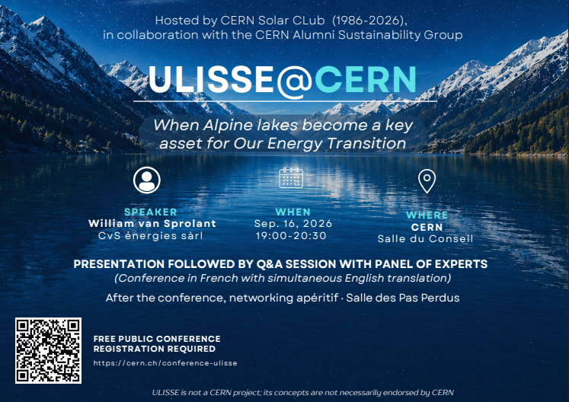
Save the date !
Public Presentation of ULISSE @ CERN
Council Chamber, 16 September 2026, 19:00 - 20:30
https://indico.cern.ch/event/1676946/

Slide 12
Thank you for your attention
Contact: William van Sprolant
Email: cvs-energies@mecacerf.ch
Mobile: (+41) 079 449 60 50
Full Proposal available on the
Sustainable HEP 2026 website
https://indico.global/event/16058/contributions/mine
(O₂)
(Image generated by Artisanal Intelligence)
ULISSE project proposal @ CERN (Sustainable HEP 2026) W. van Sprolant / CvS énergies sàrl 8 July 2026

Slide 13

Appendix
The ULISSE Exploratory study, with the GeniLac case study, funded by the SFOE (Swiss Federal Office of Energy) in the framework of the SWeeT programme of the Swiss Energy Transition 2050. The study took place at the host institute HEPIA (Geneva University of Applied Sciences for Landscape, Engineering and Architecture), from September 2021 to the end of May 2023.
The ULISSE project report, appendixes (Eng. & French), and poster of the SFOE SWEET conference 2023 are available on the SWEET-DeCarbCH research consortium website:
https://www.sweet-decarb.ch/news/article/ulisse
and on the ARAMIS database of research, innovation and evaluation projects financed or executed by the Confederation: https://www.aramis.admin.ch/Texte/?ProjectID=49267&Sprache=en-US
ULISSE project proposal @ CERN (Sustainable HEP 2026) W. van Sprolant / CvS énergies sàrl 8 July 2026

Slide 14
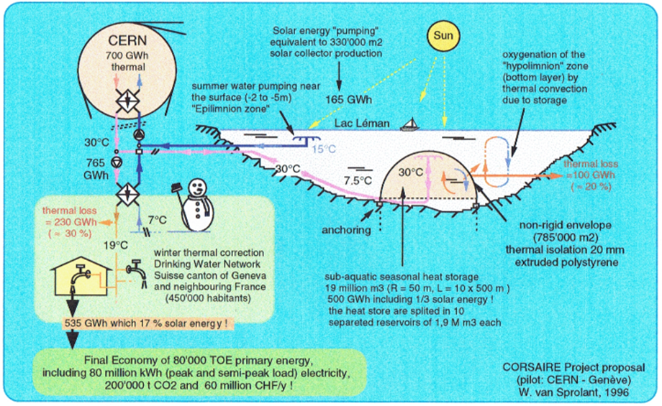

Origin: from VERCAD and CORSAIRE to the ULISSE project
1992, “VERCAD” Project proposal (W.v.S.) for “Great Geneva” region (first low temperature district thermal network supplied by industrial waste heat from CERN, Cheneviers waste incineration plant, etc.).
1995, W.v.S. master thesis EPFL: CERN’s Waste heat recycling in Geneva’s Winter Temperature Correction of the Potable Water Network (CORSAIRE “free” preheating without Heat Pump).
1996, additional Seasonal Lacustrine Heat Storage for CERN’s cooling water and solar heat: “CORSAIRE” Project proposal on the EPS 10th General Conference of the European Physical Society, Sevilla, Spain, September 9-13, 1996.
2026, the Exploratory study of the “ULISSE” Project granted with a subsidy by the Swiss federal office of energy (SFOE), In the framework of the Swiss Energy Transition Strategy 2050 (best ranked on 77 proposals of the SOUR Call-2021 for “out-the-box rethinking” projects).
ULISSE project proposal @ CERN (Sustainable HEP 2026) W. van Sprolant / CvS énergies sàrl 8 July 2026

Slide 15
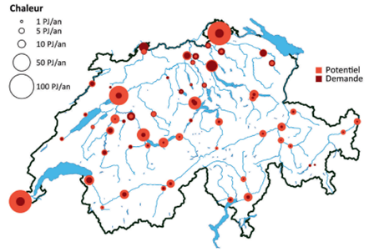
Development of Thermal Lacustrine Networks (TLN)
Swiss Energy Strategy 2050 provides for massive development of urban Thermal Networks, supplied with renewable energies and waste heat for Cooling and Heating services.
30% of the Swiss population is located near the 15 largest Swiss lakes and could potentially be connected to a TLN.
Thermal potential of lakes exceeds local needs by several times (25 PJ cooling & 135 PJ Heat)
TLN are very effective for summer air conditioning by "free cooling" (without heat pumps, COP ≈ 18).
In winter the heating of buildings needs Heat Pumps and is 4 to 5 times less efficient (COP ≈ 3) who increases the winter electricity consumption of TLN !
Local requirements:
135 PJ Heat
25 PJ Cooling
TLN MorgesLac of Morges (VD)
Source: Thermal use of surface waters A. Gaudard; M. Schmid,
Eawag; A. Wüest, Eawag and EPFL, AQUA & GAS Nº 6
ULISSE project proposal @ CERN (Sustainable HEP 2026) W. van Sprolant / CvS énergies sàrl 8 July 2026

Slide 16
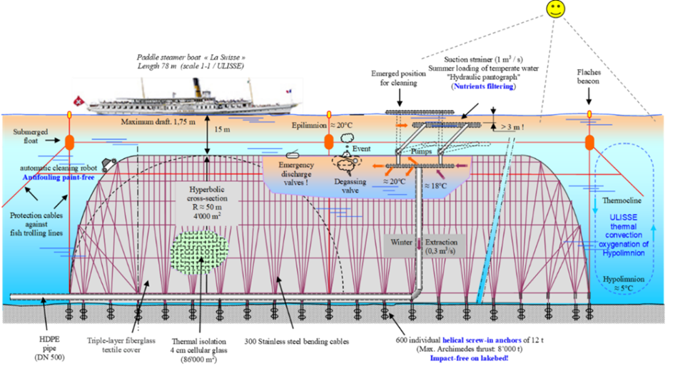
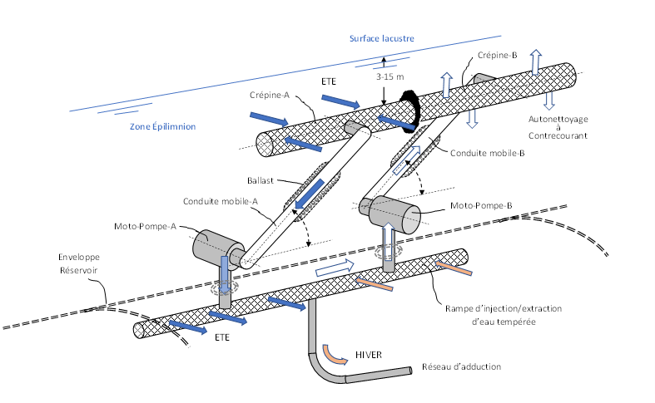
ULISSE Thermal Lacustrine Network Booster
Under-lake seasonal heat storage reservoir providing a WINTER HEAT SOURCE of around 20-25°C, instead of usual 5-6°C
Double the global efficiency or halve the electricity consumption of the heat pumps and reduce by 95% the electricity for pumping and circulating the water in the Thermal Lacustrine Networks (TLN).
Indirect solar heat storage (TLN air conditioning, waste heat) Direct solar heat storage (lake)
Hydrothermal pantographe
Annual cycle:
1. 2 moths Summer Loading (SL)
2. 2 moths Autumn Stagnation (AS)
3. 6 moths Winter Discharging (WD)
4. 2 moths Spring Stagnation (SS)
(Image generated by Artisanal Intelligence)
ULISSE project proposal @ CERN (Sustainable HEP 2026) W. van Sprolant / CvS énergies sàrl 8 July 2026

Slide 17
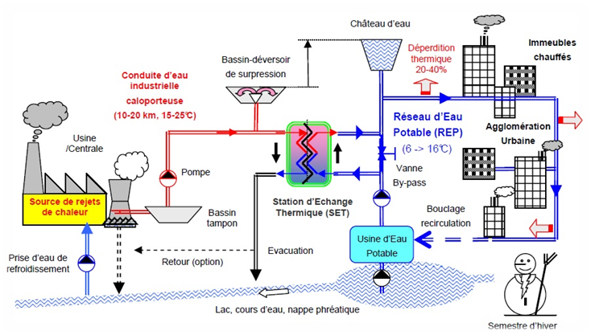
Second way to use ULISSE => CORSAIRE “free preheating” of the Potable Water Network (PWN)
(basic object of my energy master thesis at EPFL 1995)
“The Potable Water Network is a thermal network that is ignored “
ULISSE (or a waste heat source outside lake regions by an ordinary Thermal Network) could correcting the winter temperature drop (5 to 10˚C) of the Urban Potable Water Network (PWN) by the CORSAIRE “free preheating” (heat exchange without heat pump).
Provide 30% of heat for domestic hot water (DHW) and reduce electricity consumption of washing/dishwasher’s machines.
Reduce 10% Heat Demand Index (HDI for room heating and DHW) of all residential buildings of a city.
Seasonal evolution DHW energy vs PWN temperature
or ULISSE
electricity
waste heat source outside lake region
Urban CORSAIRE free preheating exchanger (or inside buildings)
ULISSE project proposal @ CERN (Sustainable HEP 2026) W. van Sprolant / CvS énergies sàrl 8 July 2026

Slide 18
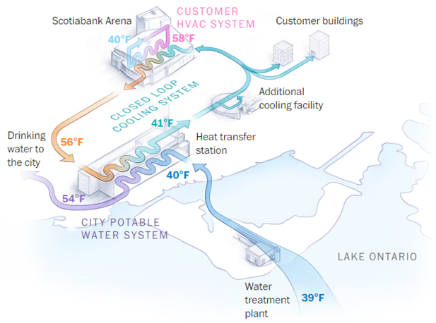
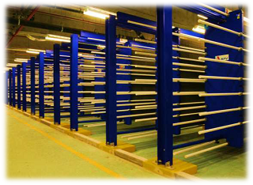

Since 2006, CORSAIRE “free preheating” principle used (in summer) in the Canadian city of Toronto (3 million inhabitants) !
Deep Lake Water Cooling” (DLWC) facility, 360 MW heat from Toronto’s down town air conditioning injected into the City Potable Water Network (PWN) via the Heat transfer station (free heating exchanger or free cooling) !
(5˚C)
(13,3˚C)
(4,4˚C)
Heat exchangers on Toronto’s City Potable Water Network (2006)
(400’000 m³/day, 4 ˚C => 12 ˚C)
(12,2˚C)
Source: ENWAVE
(4˚C)
2021-2023, proposal of the ULISSE project for the SOUR Call 1-2021 of SFOE…
ULISSE project proposal @ CERN (Sustainable HEP 2026) W. van Sprolant / CvS énergies sàrl 8 July 2026

Slide 19
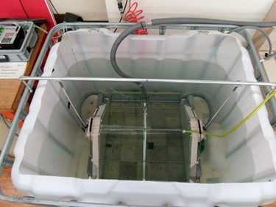
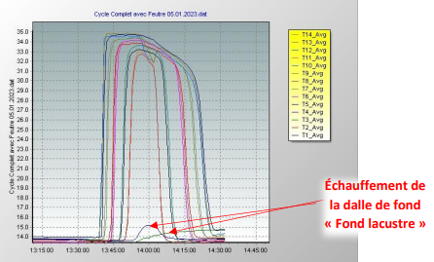
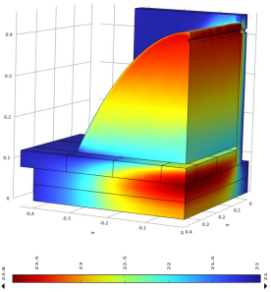
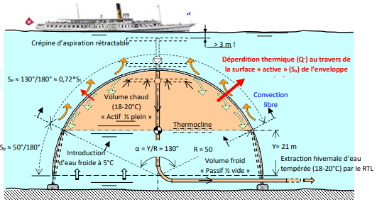
≈ 80% Seasonal Storage efficiency of the ULISSE Reservoir
Physical Mock-up
Time Scale Factor : 13715
(1 min Mock-up = 10 days)
3) Numerical simulation of the Mock-up
(COMSOL Multiphysics)
Physical reproduction of a
full cycle Mock-up
2) Theoretical model
of the UISSE Reservoir
ULISSE project proposal @ CERN (Sustainable HEP 2026) W. van Sprolant / CvS énergies sàrl 8 July 2026

Slide 20
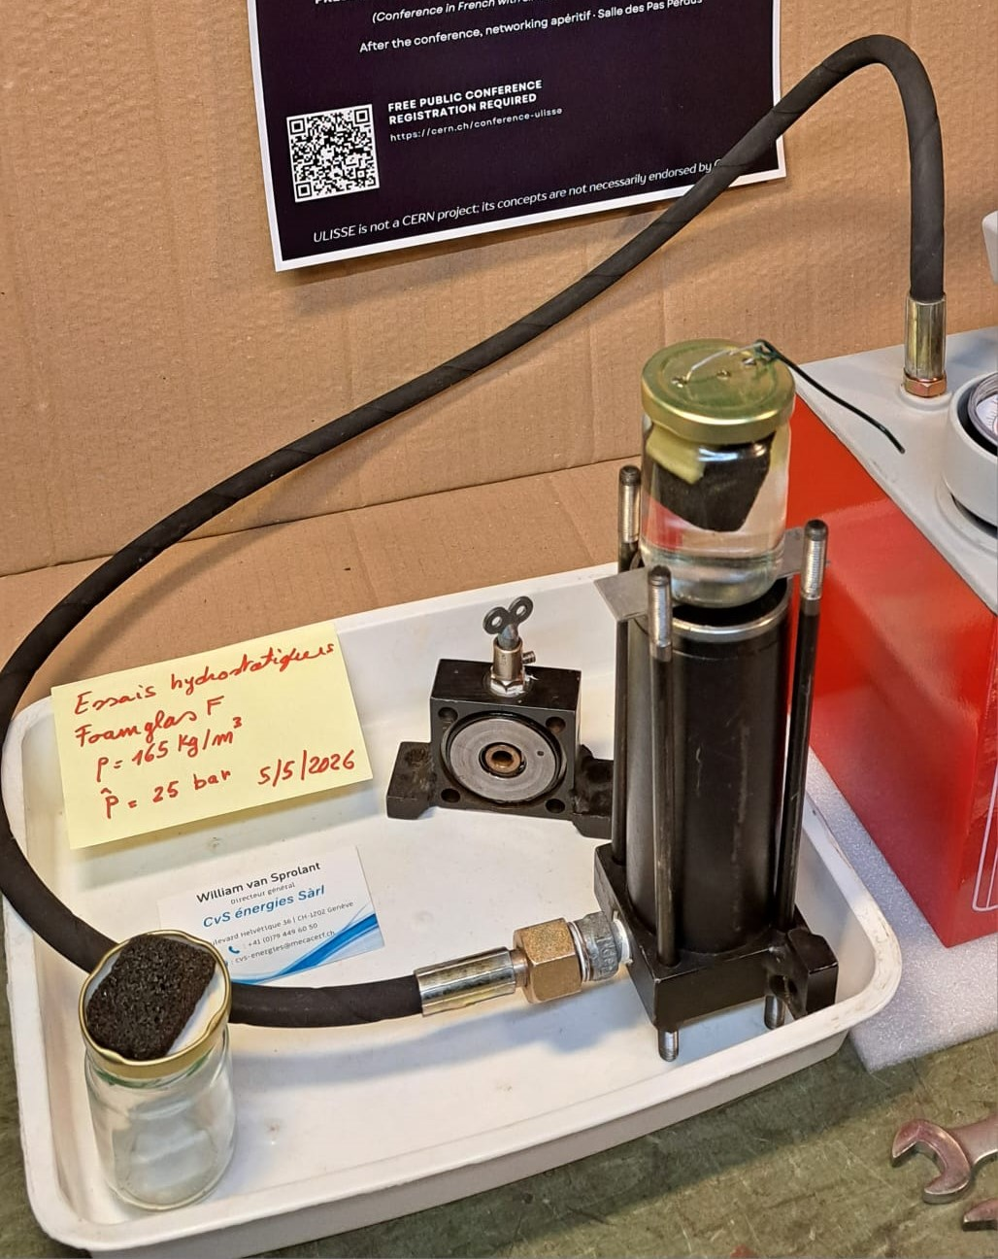
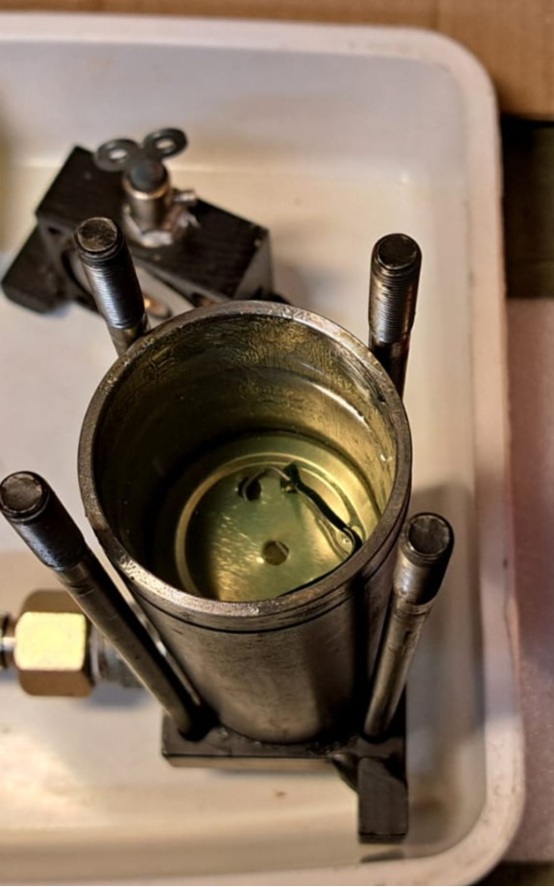
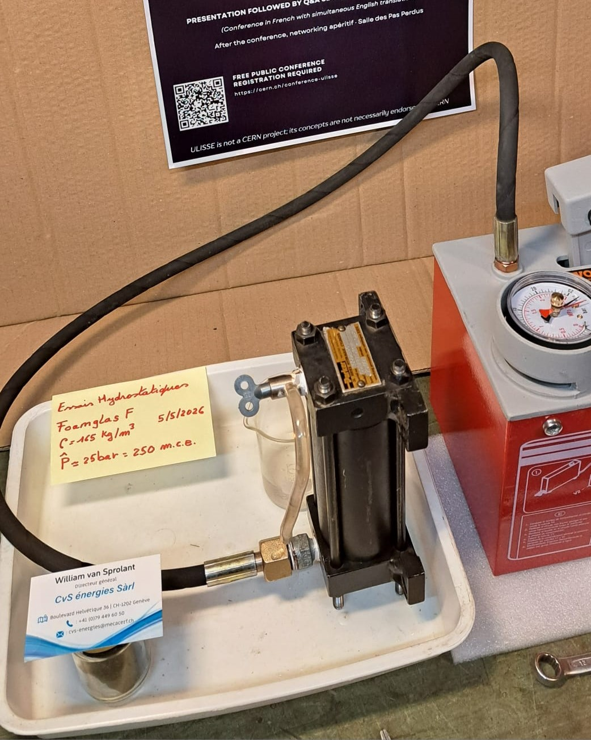
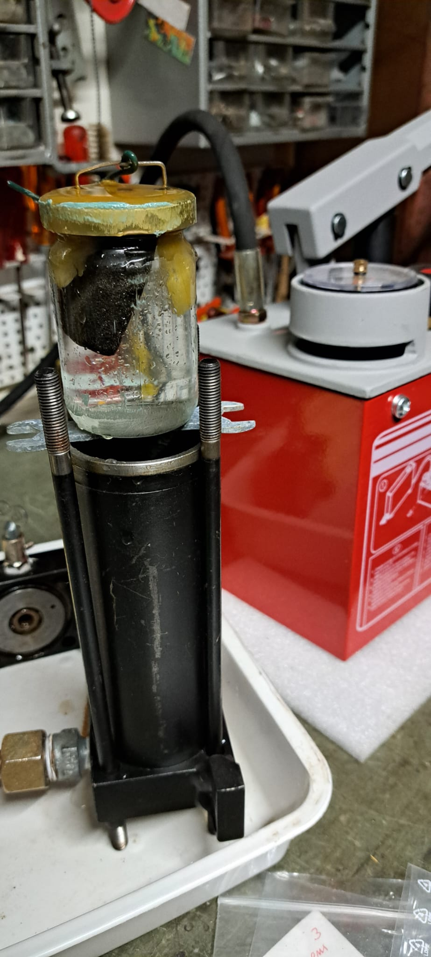
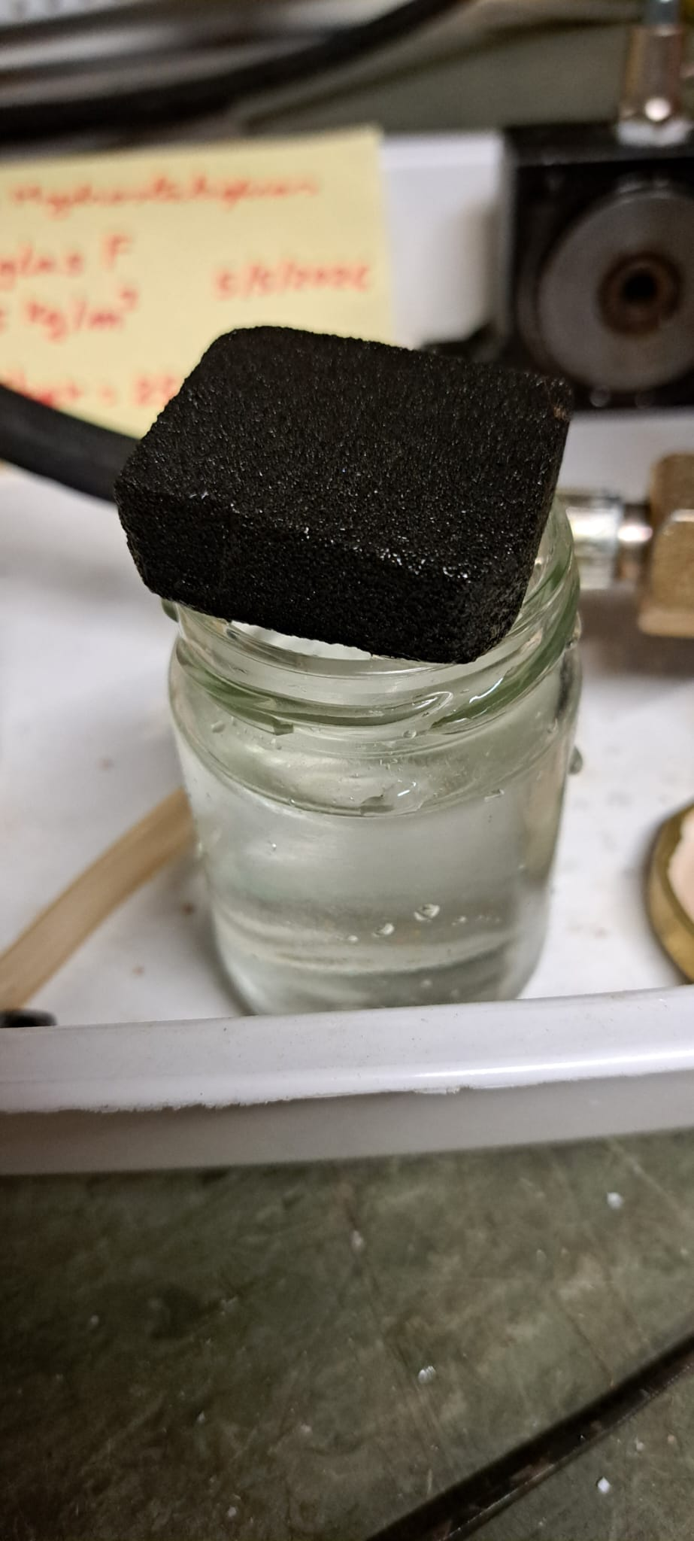
Hydrostatic Pressure Test of the Cellular glass
(Thermal insulation blocks)
P = 10 up to 25 Bar
(maximum pump capacity)
250 m Equivalent Lake Depth
Foamglas F (165 kg/m³)
Duty Under Test
Full integrity of the sample after 3 weeks under pressure

Slide 21
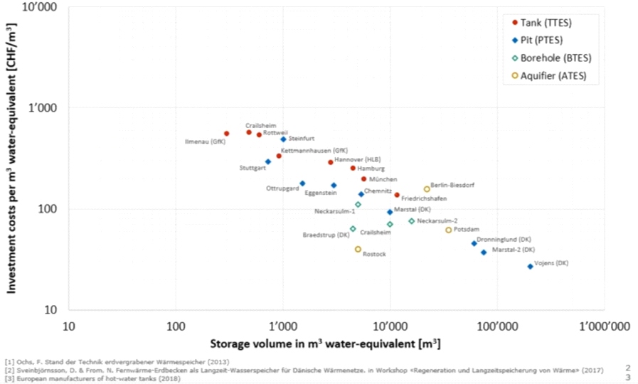
Investment cost of different types of hot water storage (source: HSLU Hochschule Luzern)
Size effect which tends in a linear regression towards 10 CHF/m³ @ 1 M m³ => ULISSE
Tank In
a building
(?1
'000 CHF/m
)
3
Denmark’s (World’s?) largest solar thermal tank
Vojens Tank 200’000 m³
(1/10 ULISSE)
ULISSE: 1 M m³
(10 CHF/m³)
ULISSE project proposal @ CERN (Sustainable HEP 2026) W. van Sprolant / CvS énergies sàrl 8 July 2026

Slide 22
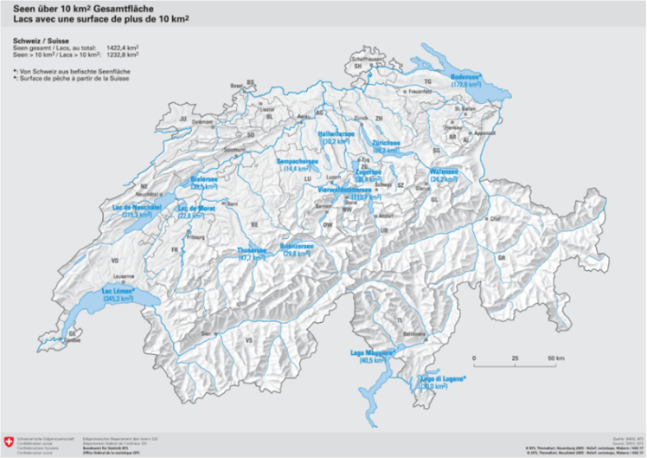
National electricity saving potential of ULISSE and CORSAIRE “inside” (via TLN)
≈ 50 x TLN GeniLac ≈ 2 TWh
(≈ 30% of the Swiss population is located near the 15 largest Swiss lakes > 10 km² @ 2050)
With conservative assumptions @ 2050 (without ULISSE):
1/4 Swiss population connected on TLN (Qc = 0,25 x 200 PJ)
widespread use of room heating and DHW via TLN networks
Heat supply Qc = 50 PJ/year @ COP-0 = 3,18 (*)
Winter electricity (E-0) for heat pumps and lake pumps:
E-0 =Qc/COP-0 = 50 PJ/3,18 = 15,7 PJ (4,36 TWh)
With ULISSE & CORSAIRE (COP-1 = 6,32 *)
- E-1 =Qc/COP-1 = 50 PJ/6,32 = 7,9 PJ (2,19 TWh)
Net winter electricity saving ∆E:
∆E = E-0 – E-1= 7,8 PJ or 2,17 TWh
≈ 50 TLN GeniLac => 50 X 40 GWh saving (*) = 2 TWh
(*) : GeniLac case study
ULISSE project proposal @ CERN (Sustainable HEP 2026) W. van Sprolant / CvS énergies sàrl 8 July 2026

Slide 23
National CORSAIRE electricity saving potential @ 2050 (outside lake regions !)
With the conservative assumption that in 2050, only half (P1=0,5) of the buildings (outside lake regions) are connected to a public PWN free heating system (excluding TLN: P2 = 0,25), resulting in 6,75 PJ (*) of heat supplied for DHW avoids 0,69 TWh electricity (outside lake regions !)
(*)
6,75 PJ : 200 PJ x (P1-P2) x P3 x P4 = 200 PJ x 0,25 x 0,45 x 0,3 = 6,75 PJ
6,75 PJ, without free heating, would by supplied by heat pumps with a COP of 2,73 => 0,69 TWh-e
200 PJ : National heat demand for Room Heating & DHW production; P3 @ 2050 : RH/DHW = 0,45
P5 @ 2050 = 0,3 part of DHW production liberated by the free heating and ELECTRICITY SAVINGS OF WASHING/DISHWASHING MACHINES !
ULISSE project proposal @ CERN (Sustainable HEP 2026) W. van Sprolant / CvS énergies sàrl 8 July 2026

Slide 24
Global National electricity production saving potential by ULISSE & CORSAIRE @ 2050
ULISSE and CORSAIRE globally (TLN + outside lake regions), could providing nearly 60 PJ of heat (30% of national needs), potentially constitutes a Net Winter semester Electricity Saving (NWES):
  NWES = 2,17 TWh (TLN) + 0,69 TWh (PWN outside lake regions) = 2,86 TWh (Net)
Taking into account of 10-12% losses in transformation and transport of electricity during the winter semester, (8-10% annual), Net 2,86 TWh require a gross production of minimum 3,18 TWh ≈ 1/3 of the 9 TWh Swiss structural winter semester electricity deficit in 2050 (ZERO-baseline scenario, strategic variant “balanced annual budget by 2050”, SFOE EP2020+).
ULISSE project proposal @ CERN (Sustainable HEP 2026) W. van Sprolant / CvS énergies sàrl 8 July 2026

Slide 25
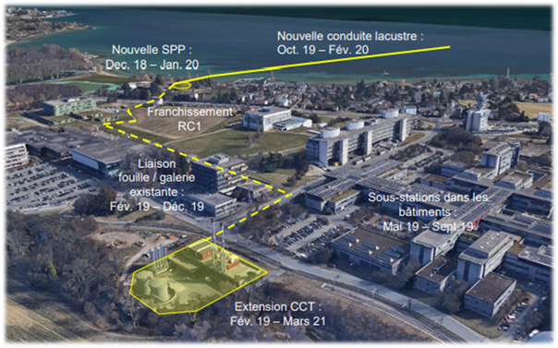

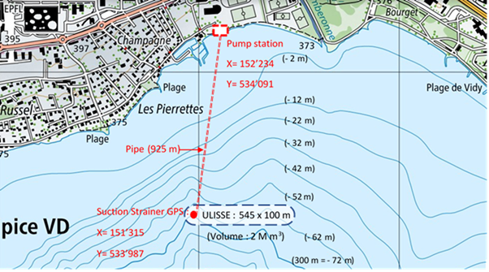
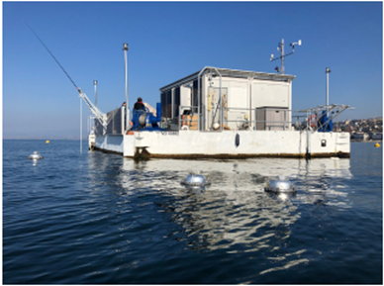
Next step ULISSE & CORSAIRE
ULISSE :
Continuing numerical simulation of the ULISSE Reservoir
Potential implementation in the 15 largest Swiss lakes
In-depth environmental lake impact
Hydrodynamic behaviour against the lake currents
Drone for cleaning the envelope and inspecting the Reservoirs
Prototype of an intermediate/reduced-size Reservoir in a closed basin or a lake
Pilot + Demonstration of full-size Reservoir (1 or 2 M m³) on the TLN of EPFL – UNIL campuses; observation of physical and environmental behaviour against the lake with the LéXPLORE platform laboratory.
LéXPLORE platform
ULISSE project proposal @ CERN (Sustainable HEP 2026) W. van Sprolant / CvS énergies sàrl 8 July 2026

Slide 26
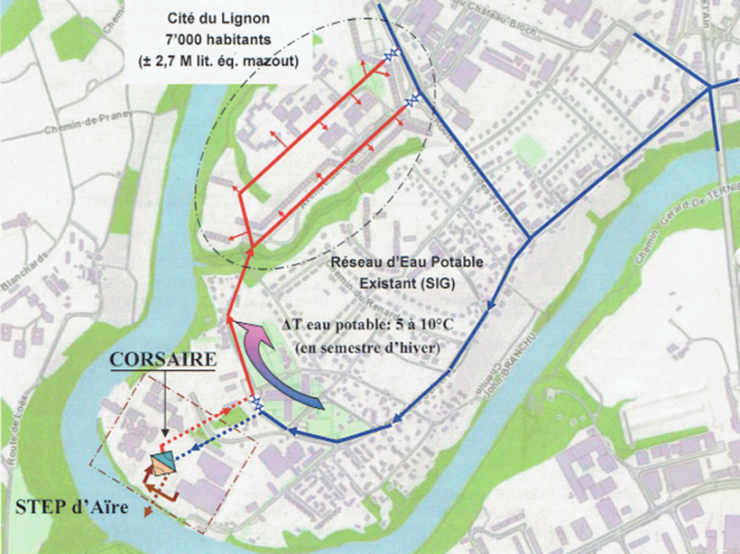
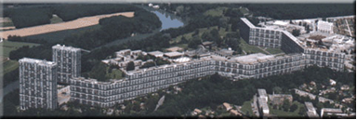
CORSAIRE :
Reactivation of the CORSAIRE project (Geneva’s energy master plan 2001-2005)
Following study points should be taken up:
Master thesis of W. van Sprolant EPFL 1995
Heat loss of the PWN
Physical integrity of the PWN under winter free heating
Sanitary integrity of the tap water undergoing a winter temperature correction
Social acceptance of the winter modification of the tap water temperature
Pilot + Demonstration of CORSAIRE free heating on the Cité du Lignon (Geneva).
Cité du Lignon in Geneva
2’780 housings,
6’500 inhabitants
ULISSE project proposal @ CERN (Sustainable HEP 2026) W. van Sprolant / CvS énergies sàrl 8 July 2026

