Slide 1
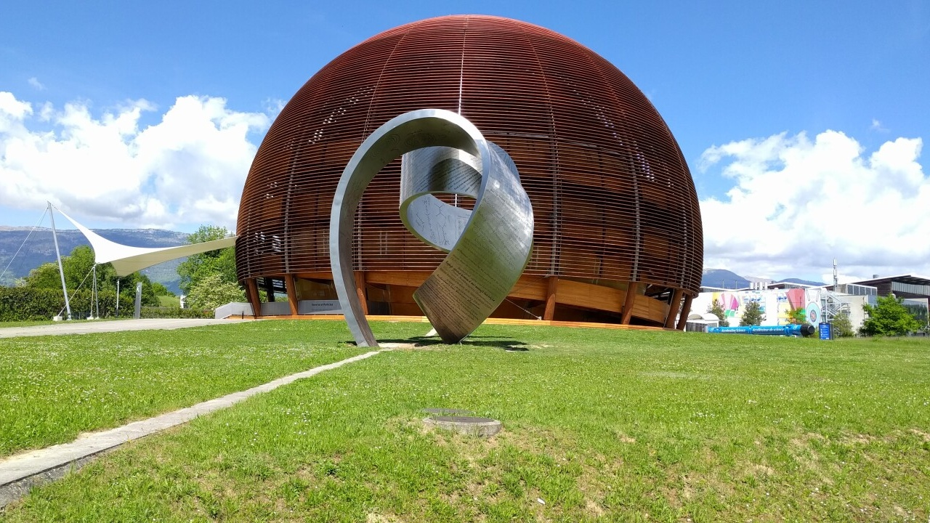
The CERN LDG Sustainability Panel
Ben Shepherd
Accelerator Science and Technology Centre, UKRI STFC
Sustainable HEP – 5th edition
10 July 2026

Slide 2
Overview
Role of CERN’s Lab Directors’ Group: LDG
LDG Sustainability Panel: building a green strategy
Sustainability considerations for accelerators
  Maximising positive benefits
  Lifecycle Assessment: LCA
  Impacts of future big facilities
Next steps

Slide 3
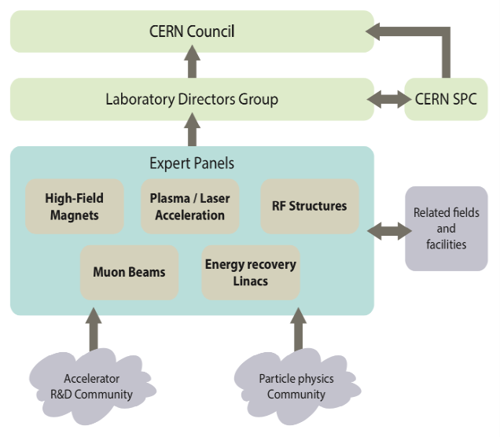
Introduction
CERN Lab Directors Group (LDG)
Formed in 2021
Reporting to CERN Council
Originally five working groups
Sustainability WG added in January 2024
High-field magnets
RF structures
Novel acceleration
Muon colliders
Energy recovery linacs

Slide 4
Motivation
Accelerator-based research infrastructures
  Big and getting bigger
  Act as discovery and precision engines
  Many other societal benefits
  Significant environmental impacts
Governments have adopted net zero targets
Public demand for clean infrastructure
Critical to assess and reduce our environmental impacts
European Strategy on Particle Physics 2024:
  Recommendation to implement a sustainability strategy

Slide 5
LDG Sustainability Working Group
Walib Kaabi, IJClab
Caterina Bloise, INFN
Ben Shepherd, UKRI-STFC
Hannah Wakeling, ISIS-II
Andrea Klumpp, DESY
Patrick Koppenburg, NIKHEF
Johannes Gutleber, FCC
Yuhui Li, CEPC
Benno List, ILC
Emilio Nanni, C³
Vladimir Shiltsev, LHeC
Steinar Stapnes, CLIC & MuC
Maxim Titov, CEA
Roberto Losito, CERN
Mandate:
to develop guidelines and a minimum set of key indicators for the sustainability assessment of future accelerators
Representatives from multiple accelerator labs:
  CERN, DESY, STFC, NIKHEF, URFU
Experts from future collider projects:
  FCC, CEPC, ILC, CLIC, Muon Collider
Co-chairs

Slide 6

Input to Strategy Update
europeanstrategy.cern
European Strategy for Particle Physics 2025 Update (ESPPU)
Sustainability considerations included for first time
Significant contributions from LDG Sustainability WG
“
For new proposed projects, a detailed life cycle assessment should be carried out at each stage, from concept to design and implementation,
in order to quantify and minimise environmental impact.
The particle physics community should continue and intensify its efforts
to develop and adopt sustainable solutions.
An effective balance between in-person and online meetings should be considered in order to mitigate the environmental impact of carbon-intensive travel.
”

Slide 7

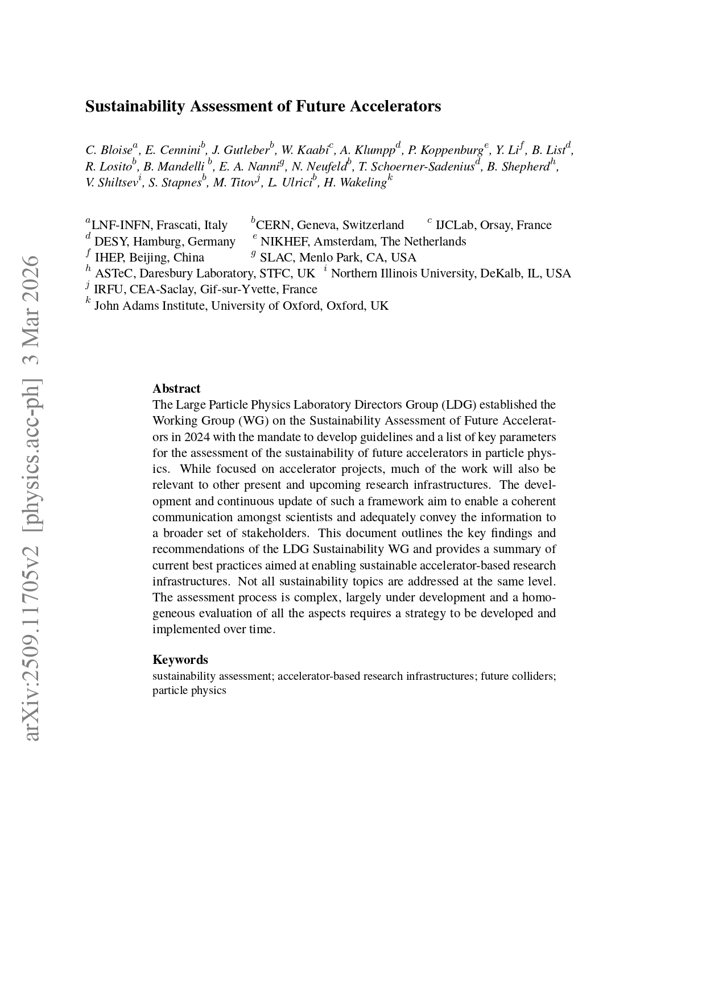
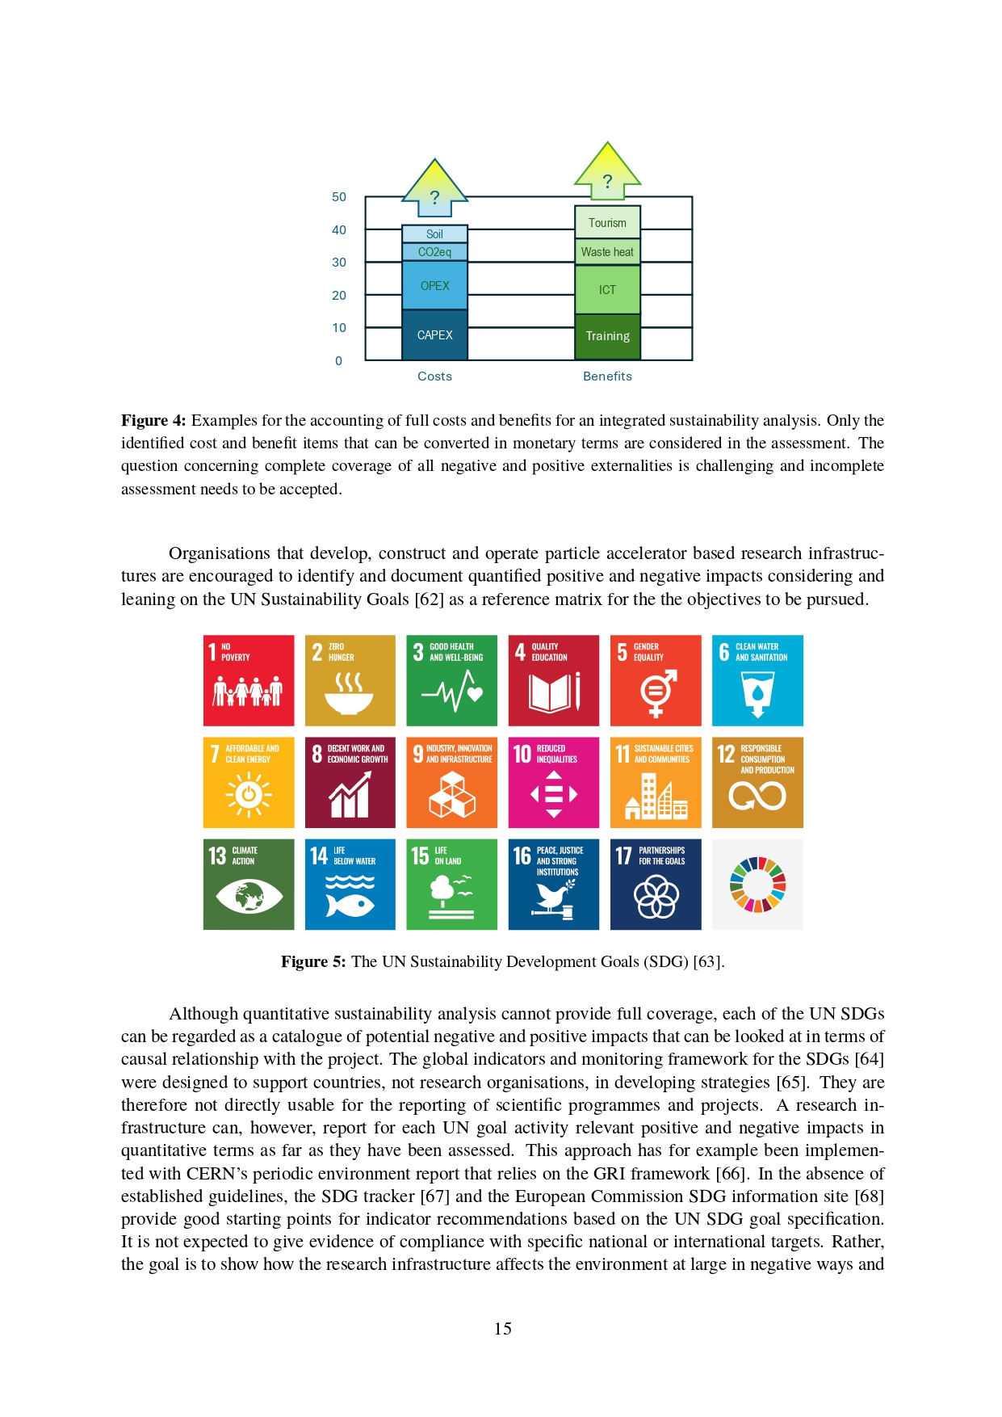
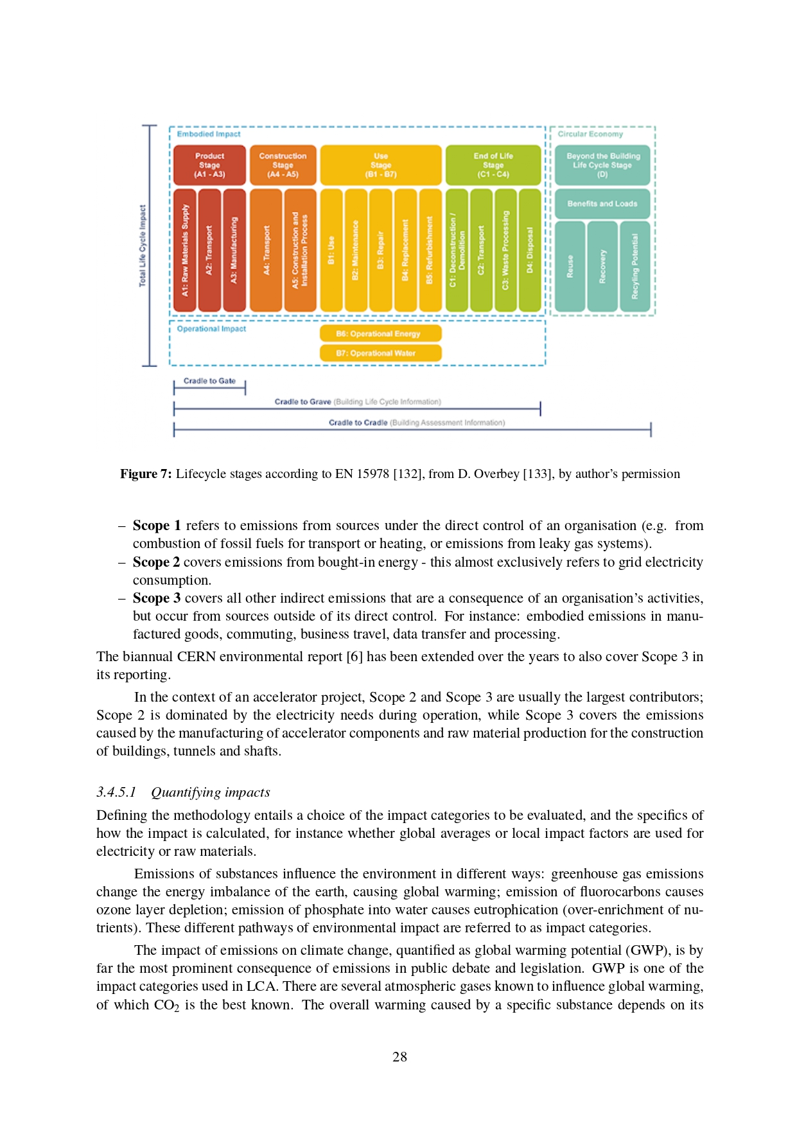
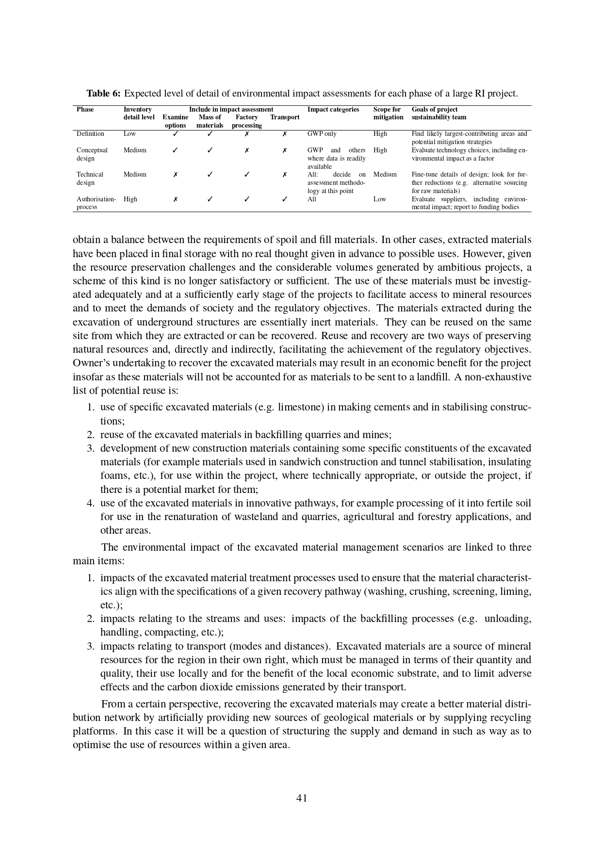
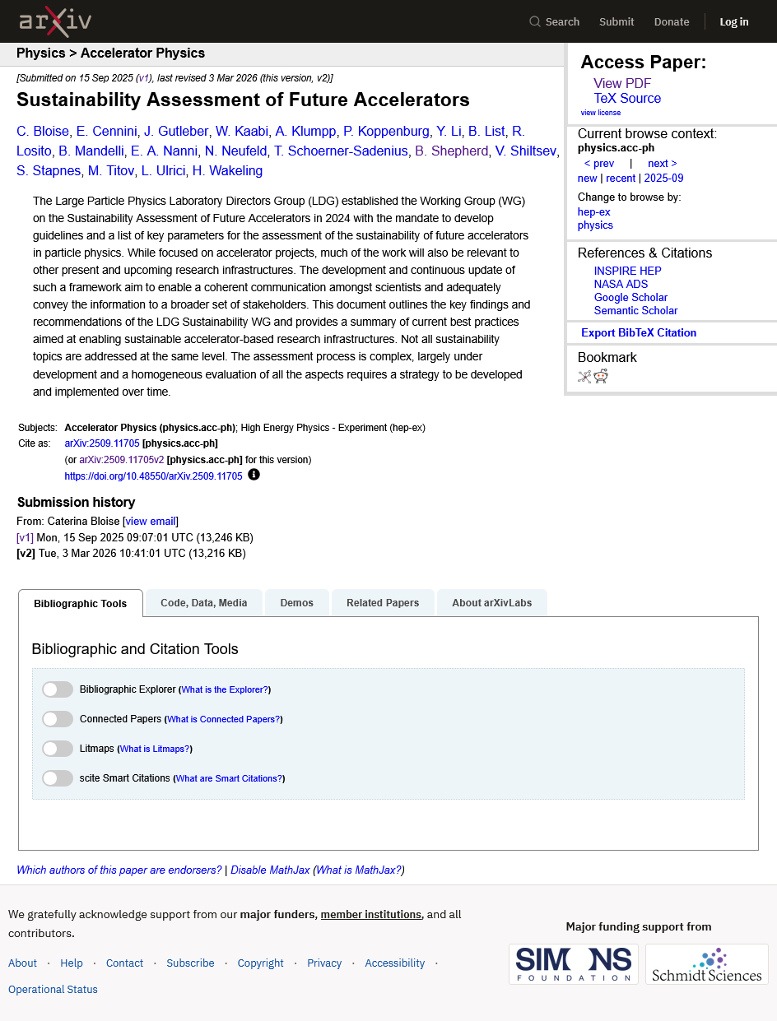
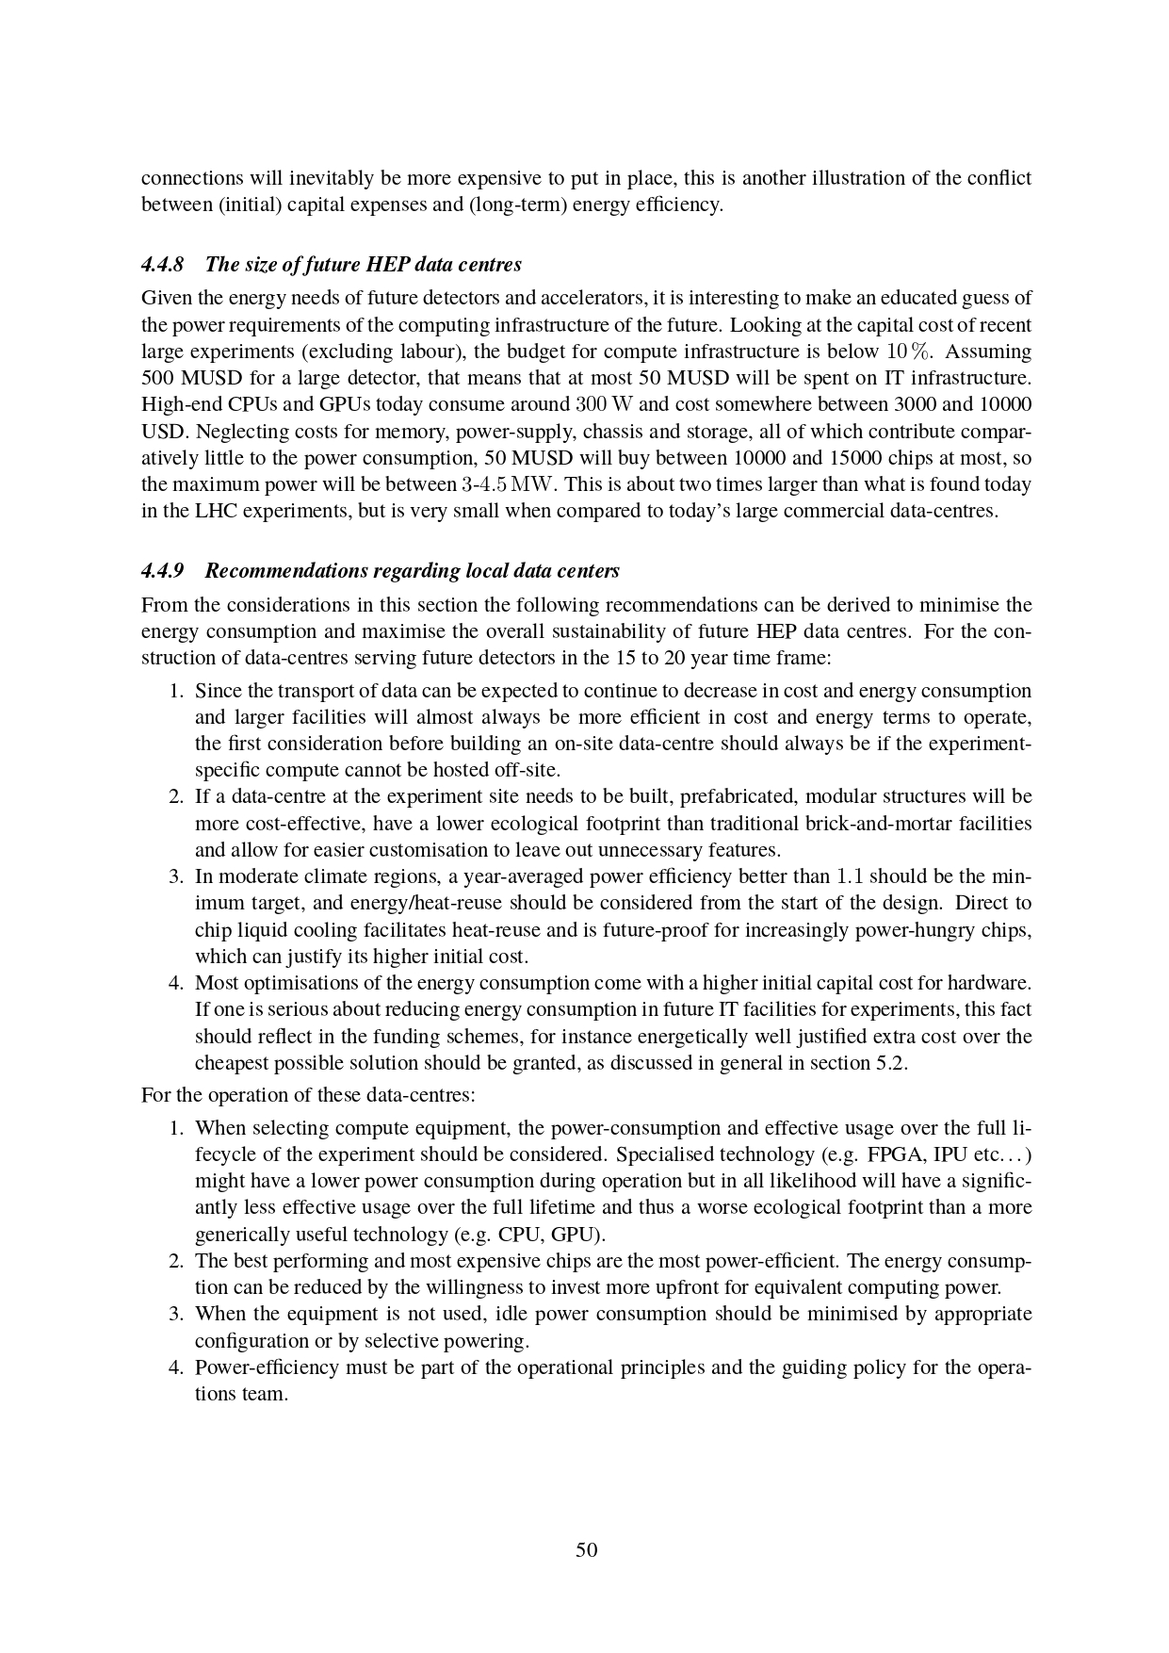
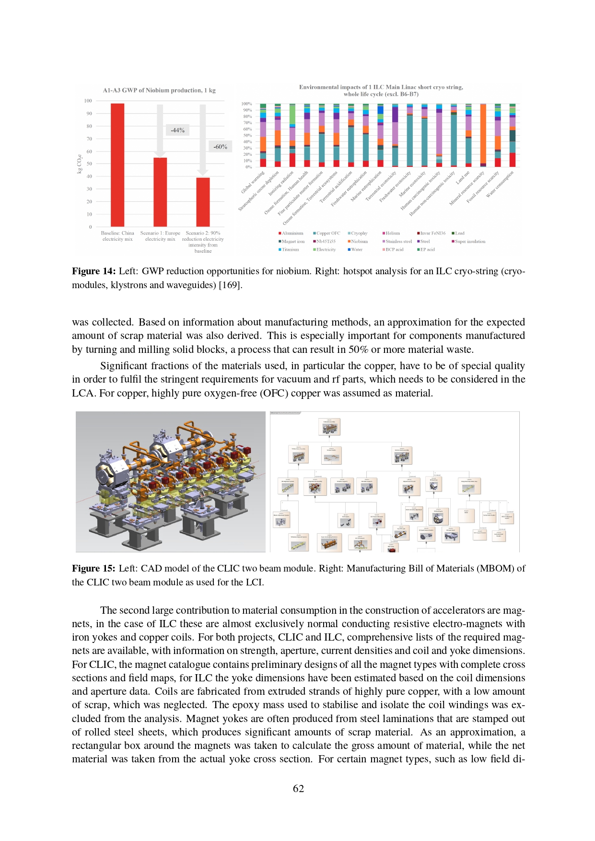
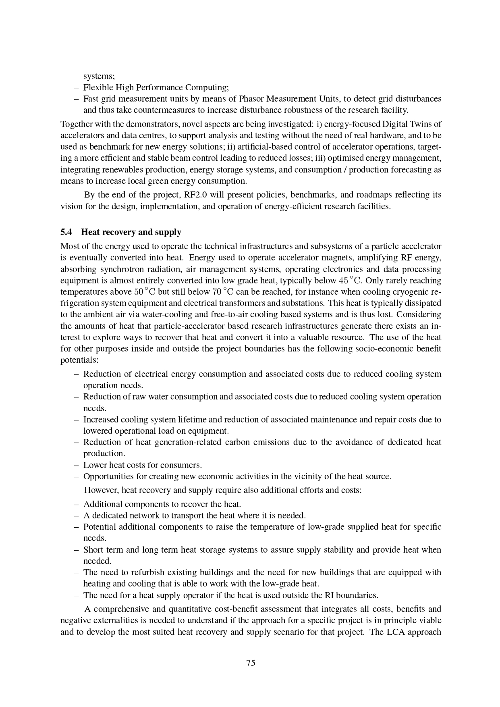
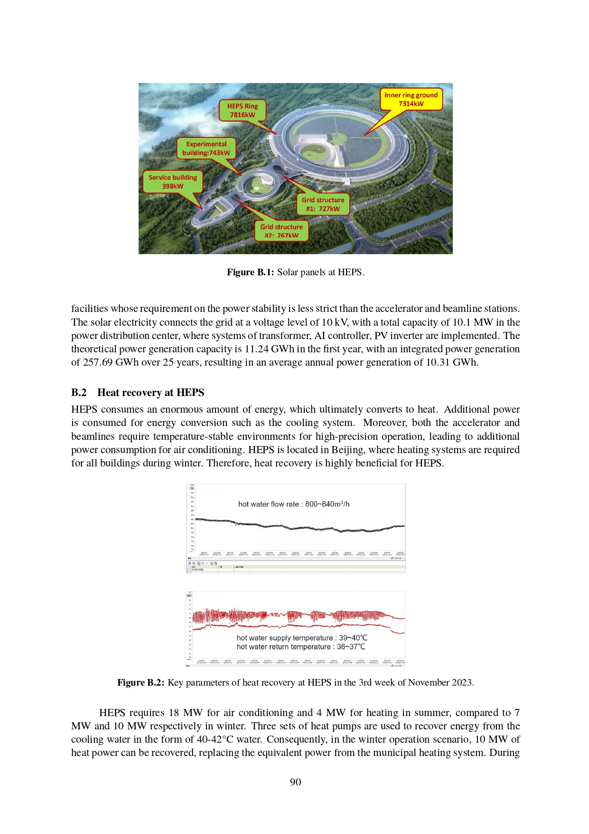
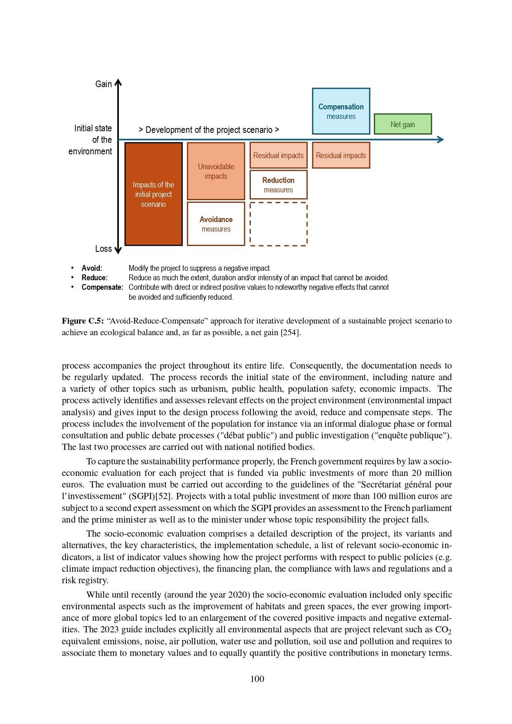
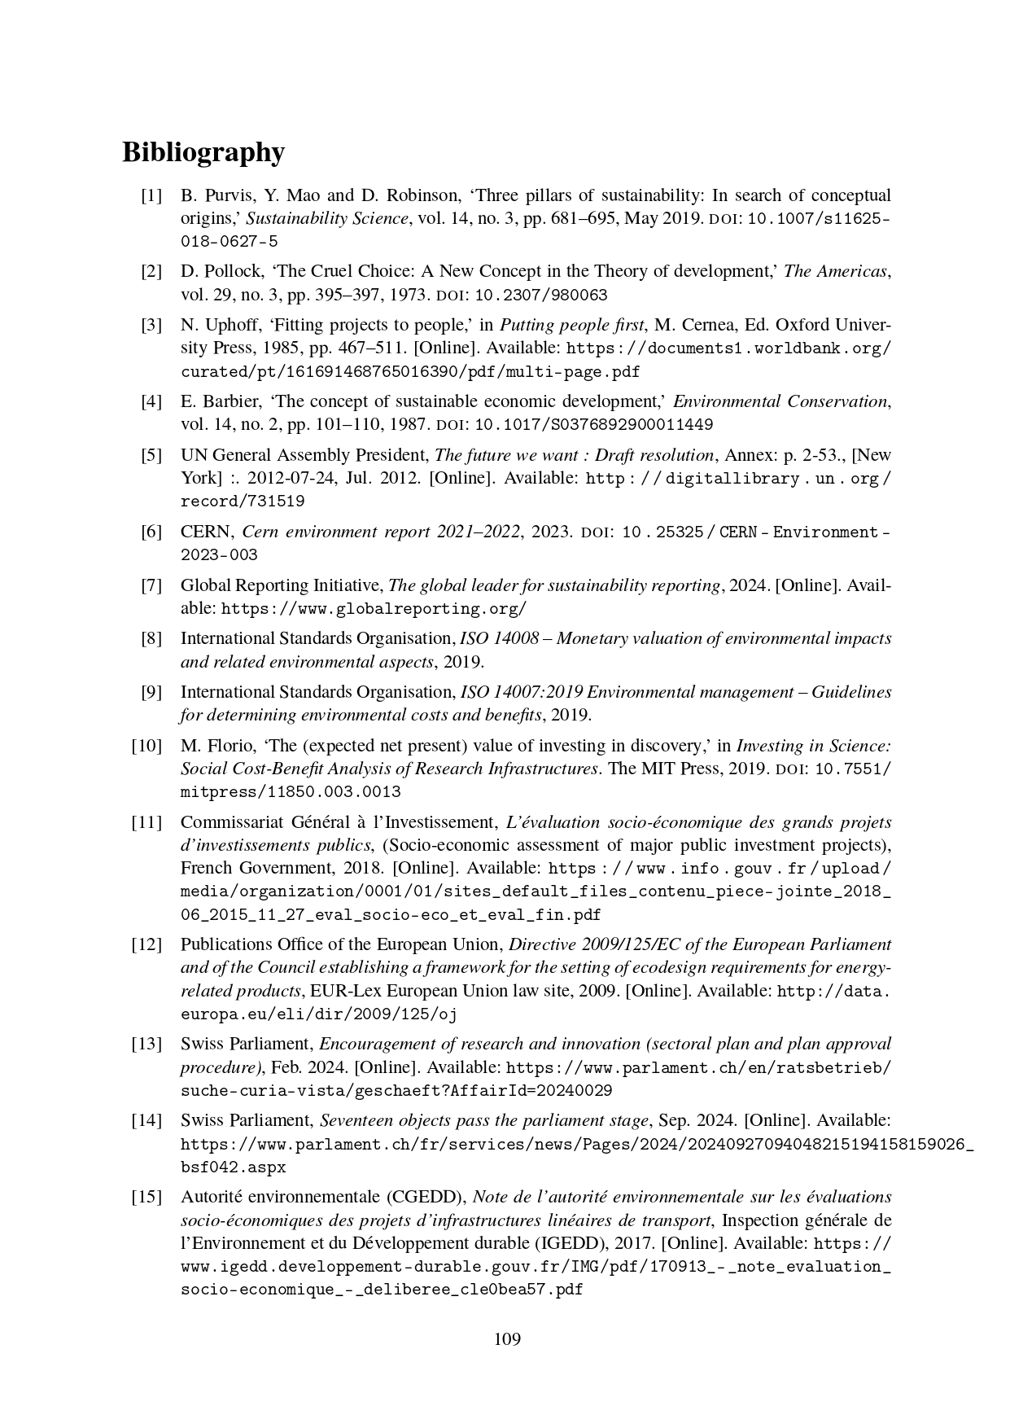
Sustainability Assessment of Future Accelerators
Report published September 2025, revised March 2026
Access via arXiV: https://arxiv.org/abs/2509.11705v2

Slide 8
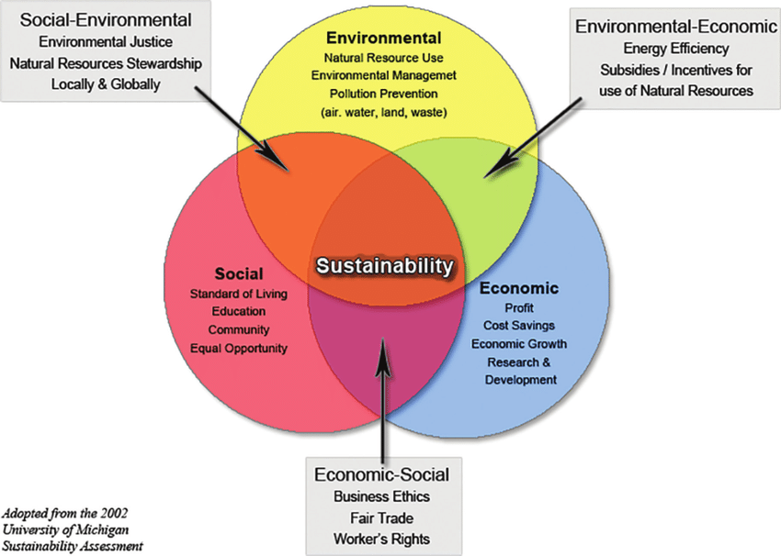






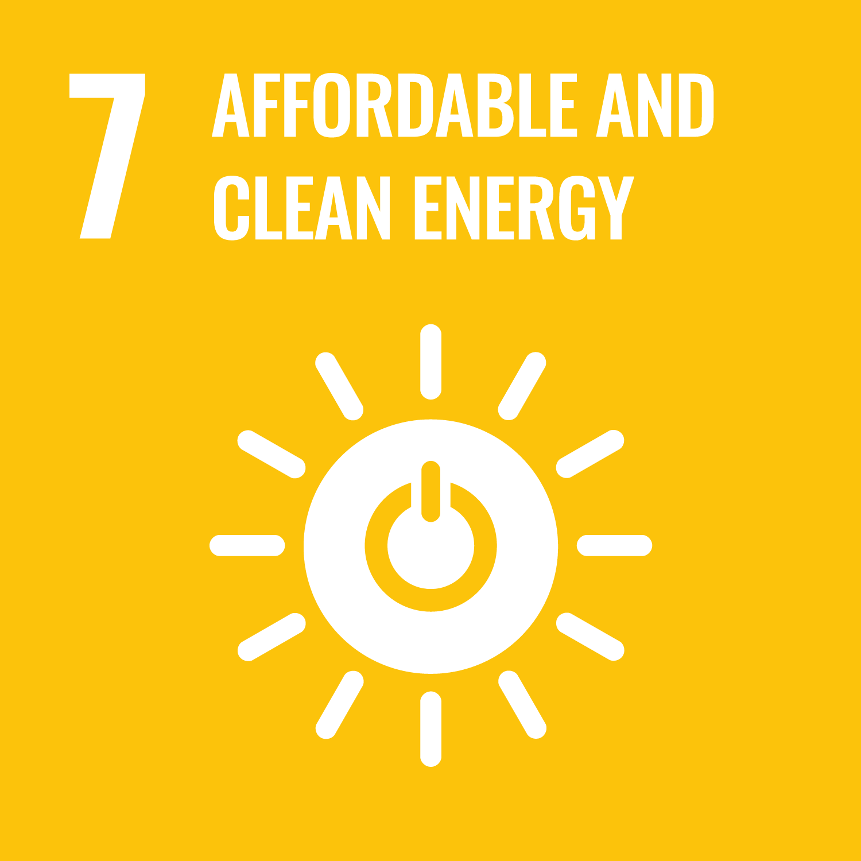










Three Pillars of Sustainability
UN Sustainable Development Goals (SDGs)

Slide 9
Positive Externalities
Accelerator facilities have positive benefits
Fundamental physics knowledge
Education and training
Engagement of international science communities
Industrial spillover
Open information and computing technologies
Cultural goods
Environmental benefits
Innovation and R&D
International collaboration

Slide 10
Lifecycle Analysis (LCA)
Tool for identifying and quantifying greenhouse gas emissions
(and other environmental impacts)
Four stages
Definition of goal and scope
Life Cycle Inventory (LCI)
Life Cycle Impact Assessment (LCIA)
Life Cycle Interpretation

Slide 11
LCA Goals
Planning
Comparison of alternatives
Biggest impact
Engineering
Detailed decision-making
Compliance
Procurement
Supplier selection
Demonstrate value for money
Motivation and goals are phase-dependent

Slide 12
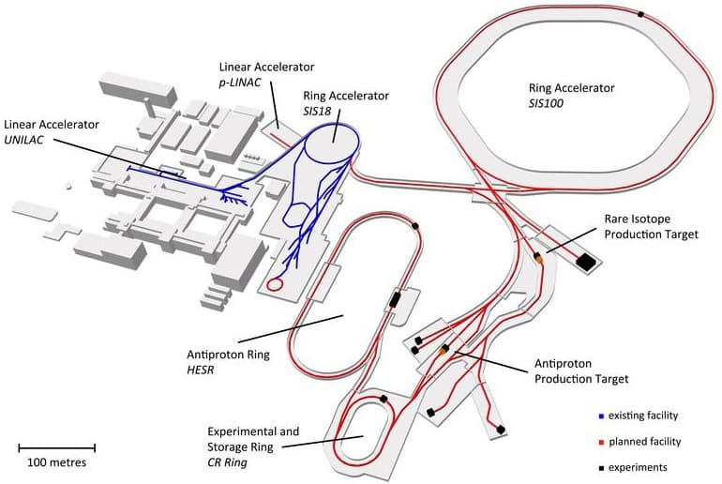
LCA Functional Units
For commercial LCAs,
functional unit is usually the
‘thing’ being manufactured:
car, fridge, pair of jeans, …
For an accelerator project, usually define as
  Beam delivery system
  Detectors
  All supporting infrastructure
Need consistent definition
to compare project proposals
Specify
  Which systems – and how to treat existing systems
  Which programme phases – first run, upgrades, decommissioning?
  Breadth of supporting infrastructure: buildings, cryoplants, data centres, roads

Slide 13
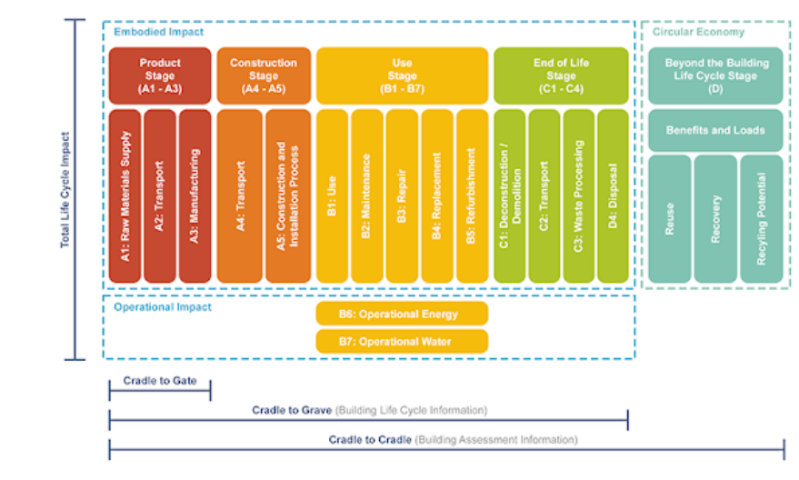
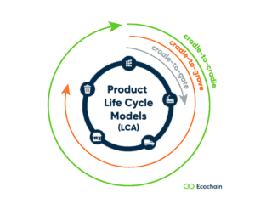
LCA System Boundaries
Define system boundaries in relation to lifecycle model
EN 15978 (for example) defines LCM of building projects
  Product stage: raw materials production
  Construction stage: transport and installation
  Usage stage
  End of life
Options for analysis boundaries:
  Cradle-to-grave: full life including operation and demolition
  Cradle-to-gate: raw material and component production
  Cradle-to-cradle: recycling materials into the same use
The final stage often poses issues:
  Infrastructure is often reused for subsequent projects
  (see PS, LEP etc)

Slide 14
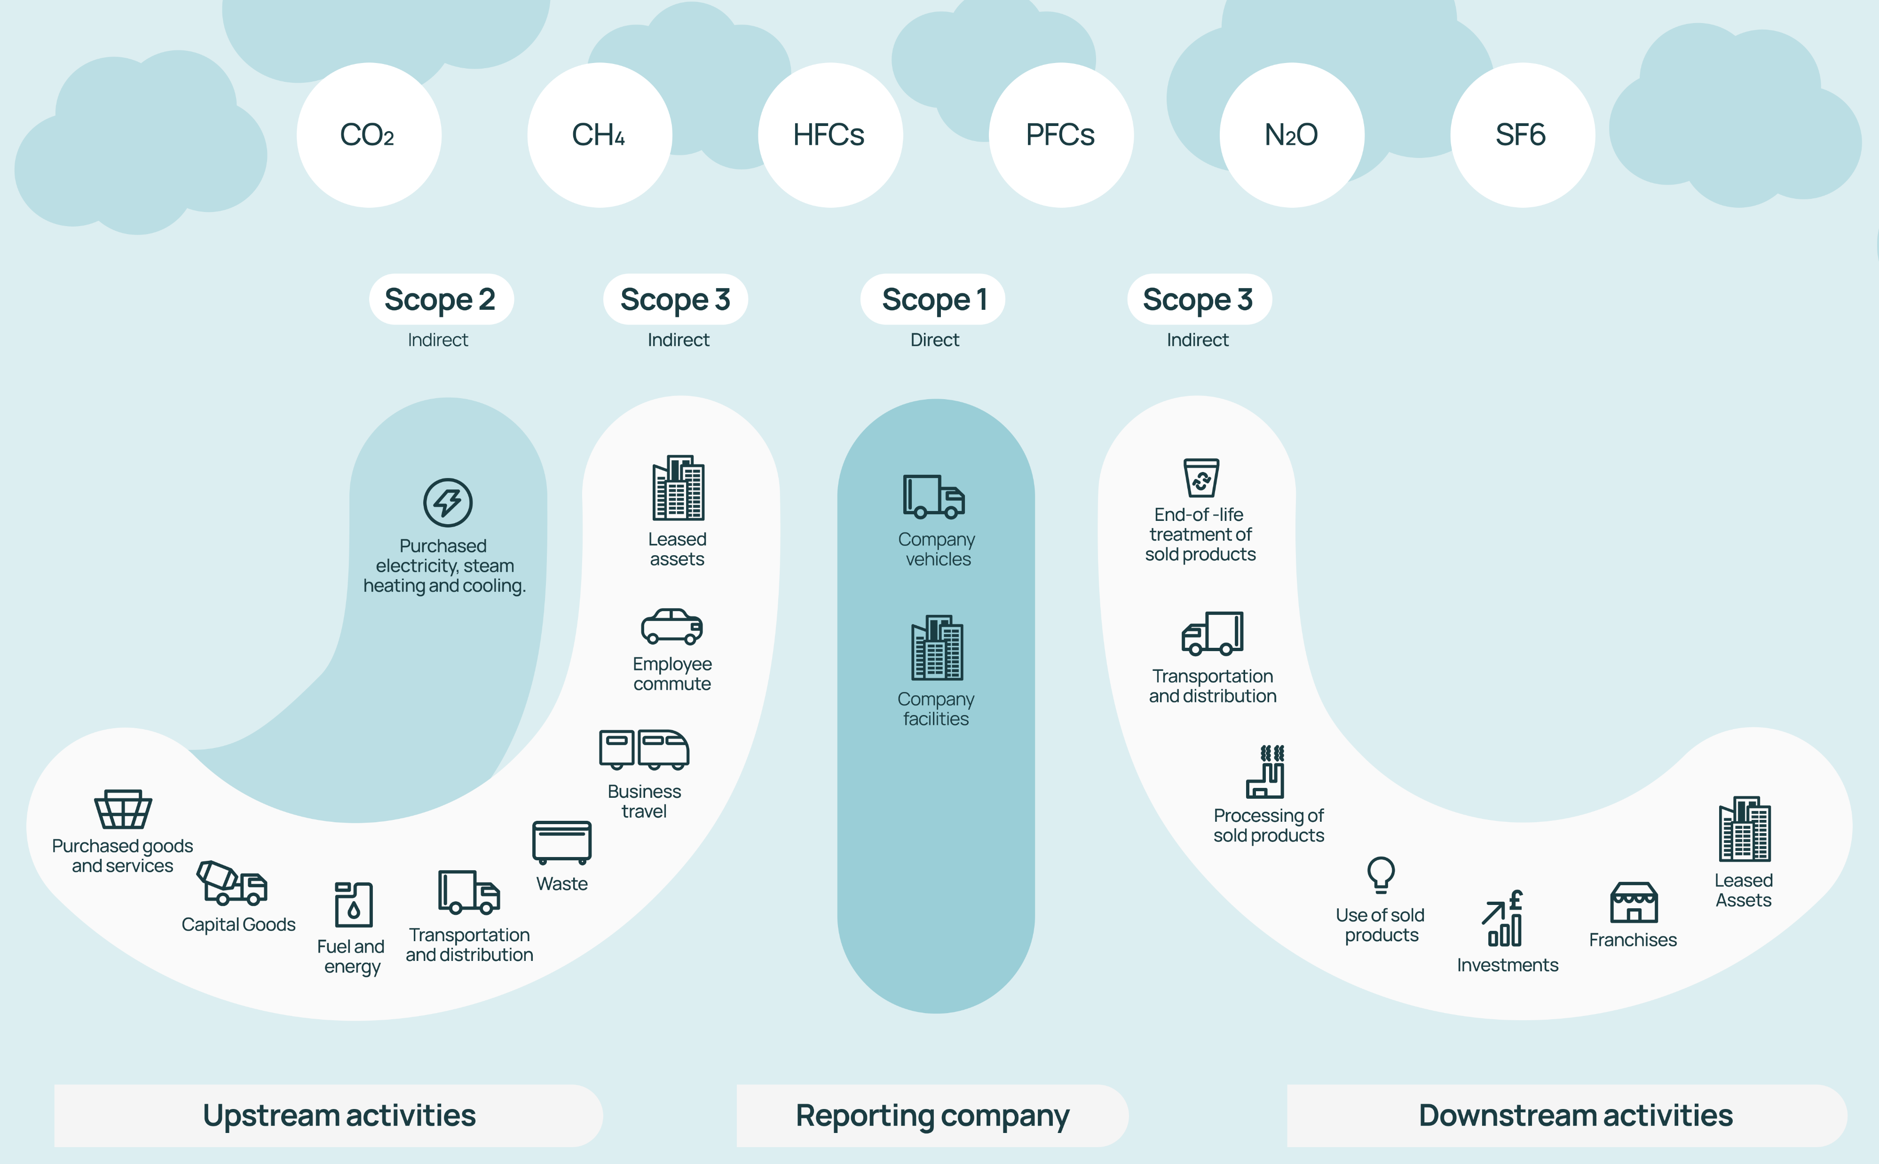
LCA Scopes
Scopes 1, 2, 3 defined in widely-used Greenhouse Gas Protocol
Largest contributors for accelerator projects:
  Scope 3 during manufacture and build phase
  Scope 2 during operation phase

Slide 15
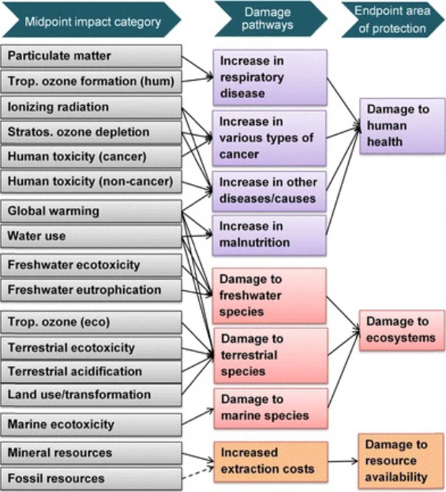
LCA Impact Categories
Quantifying impact
Many different pathways of environmental impact
Midpoint categories: direct effects
  Global warming potential (GWP) most frequently-cited
  Ozone layer depletion
  Eutrophication (nutrient over-enrichment)
  Land use change
  …
Endpoint categories
  Calculated by weighting midpoint impacts
  Broader grouping: impact on human health, ecosystems, resources
ReCiPe 2016: most common LCA metric

Slide 16
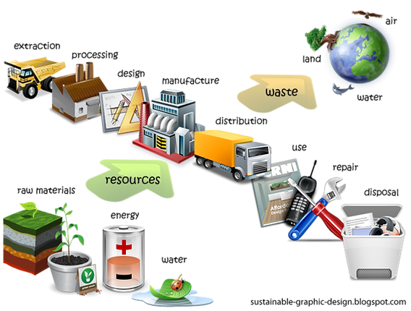
LCA Inventory and Assessment
Life Cycle Inventory: model flow of materials and products contributing to the functional unit during its lifecycle
Published LCA databases contain impact data for these materials
  e.g. ecoinvent (PSI) and GLAD
Life Cycle Assessment: use data to calculate overall impact
Commercial and open-source software tools are available
  e.g. SimaPro, OpenLCA, One Click LCA
Key issue for accelerators: we use ‘unusual’ materials without a large amount of available data
  e.g. niobium for accelerator cavities, NdFeB for magnets

Slide 17
LCA Interpretation
Performed throughout LCA process (not just at end) with the aim of guiding focus and improving accuracy of results
Sensitivity analysis
Hotspot analysis
Contribution analysis
Benchmarking
Uncertainty evaluation
Impact of choices
Dominant materials or processes
Phasing of impact categories
Compare to other analyses
Result accuracy

Slide 18
Accelerator Lifecycle Assessment: our recommendations
Perform LCAs throughout design stages
Use LCAs to reduce impact
Use common methods
Investigate widely-used components
Publish reference data on materials

Slide 19
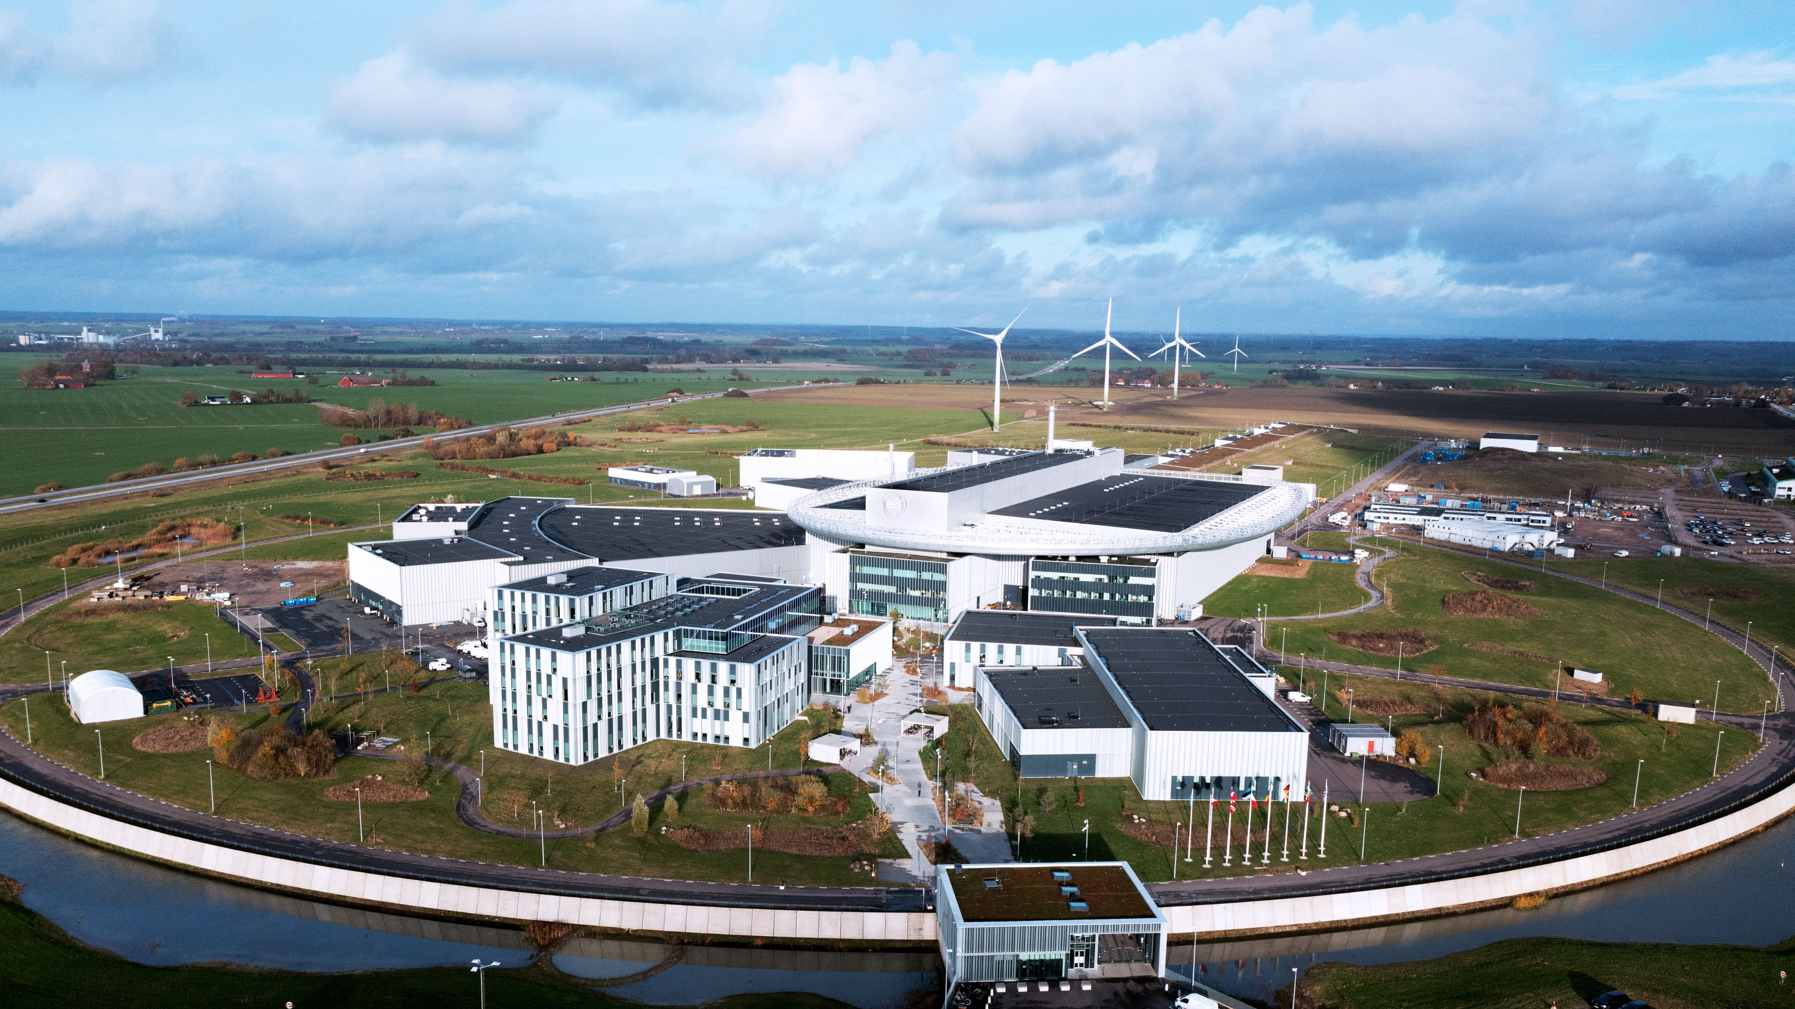
Impact assessment of accelerators

Slide 20
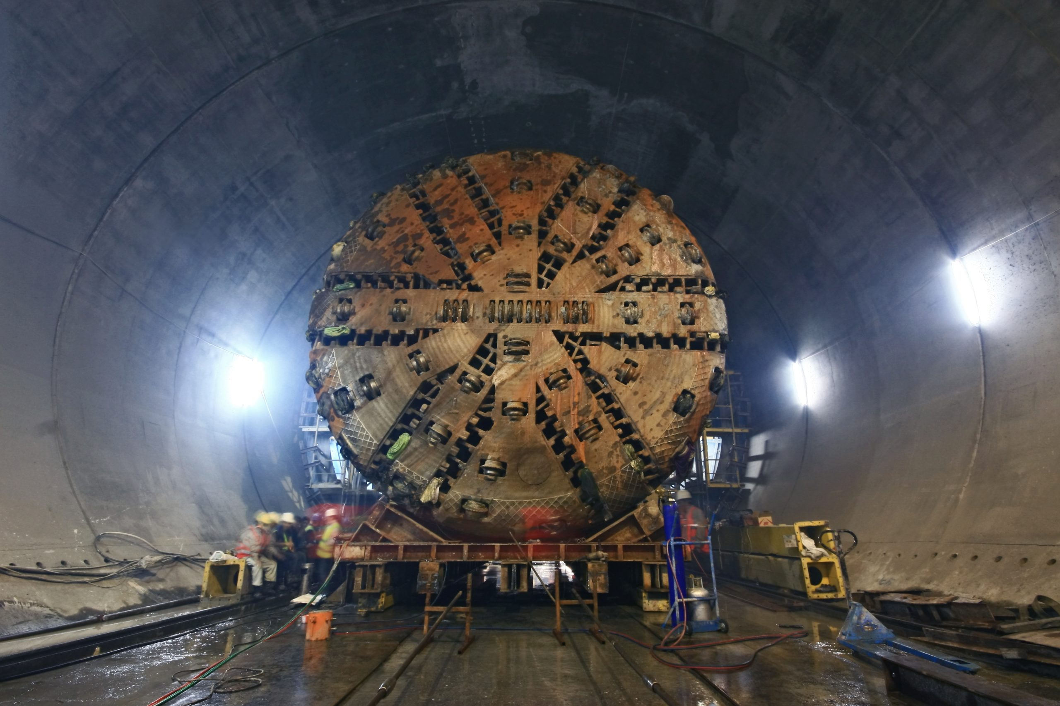
Construction phase
Product Stage
(A1 – A3)
Construction Stage
(A4 – A5)
Define consistent Product Breakdown Structure (PBS)
  Civil engineering infrastructure
  Raw material supply
  Transport to and from factories
  Manufacturing processes
  Amounts of scrap produced
  Assembly of components on site
  Construction and installation
Carry out LCA process early in the design phase
  Results will be less accurate
  More opportunity for improvements
  Embed sustainability concerns into design mindset
A4: Transport
A1: Raw Materials Supply
A5: Construction and Installation Process
A2: Transport
A3: Manufacturing
Project phase | LCA detail level | Scope for mitigation
💡 Definition | Low | High
📝 Conceptual design | Medium | High
📐 Technical design | Medium | Medium
🛍️ Authorisation process | High | Low

Slide 21
Machine operation phase
Use Stage
(B1 – B7)
Beamlines
  Energy use is likely biggest contributor
Particle detectors
  Direct emissions of gases
Data centres
  Energy and water use
Representative annual figures:
  3 MW running power, 0.3 MW standby
  250 operating days
  19 GWh per year
  1-11 ktCO₂e, location dependent
  Likely equivalent to construction emissions after 1-2 years’ operation
Biggest subsystems:
  AC, water cooling
  RF
  Magnets
B1: Use
B2: Maintenance
B3: Repair
B4: Replacement
B5: Refurbishment
B6: Operational Energy
B7: Operational Water

Slide 22
Decommissioning phase
End of Life Stage
(C1 – C4)
Accelerators often outlive original planned lifespan
Components often ‘recycled’ into successor facilities
  PS @ CERN (1959) → still part of LHC
  HERA @ DESY → ALPS-II uses original dipoles
Disposal complicated by activated materials
  Usually ‘very low level’
  Beam dumps, targets can reach medium levels
  Activation level depends on beam type, history, material
  Legalities vary by jurisdiction
C1: Deconstruction / Demolition
C2: Transport
C3: Waste Processing
D4: Disposal

Slide 23
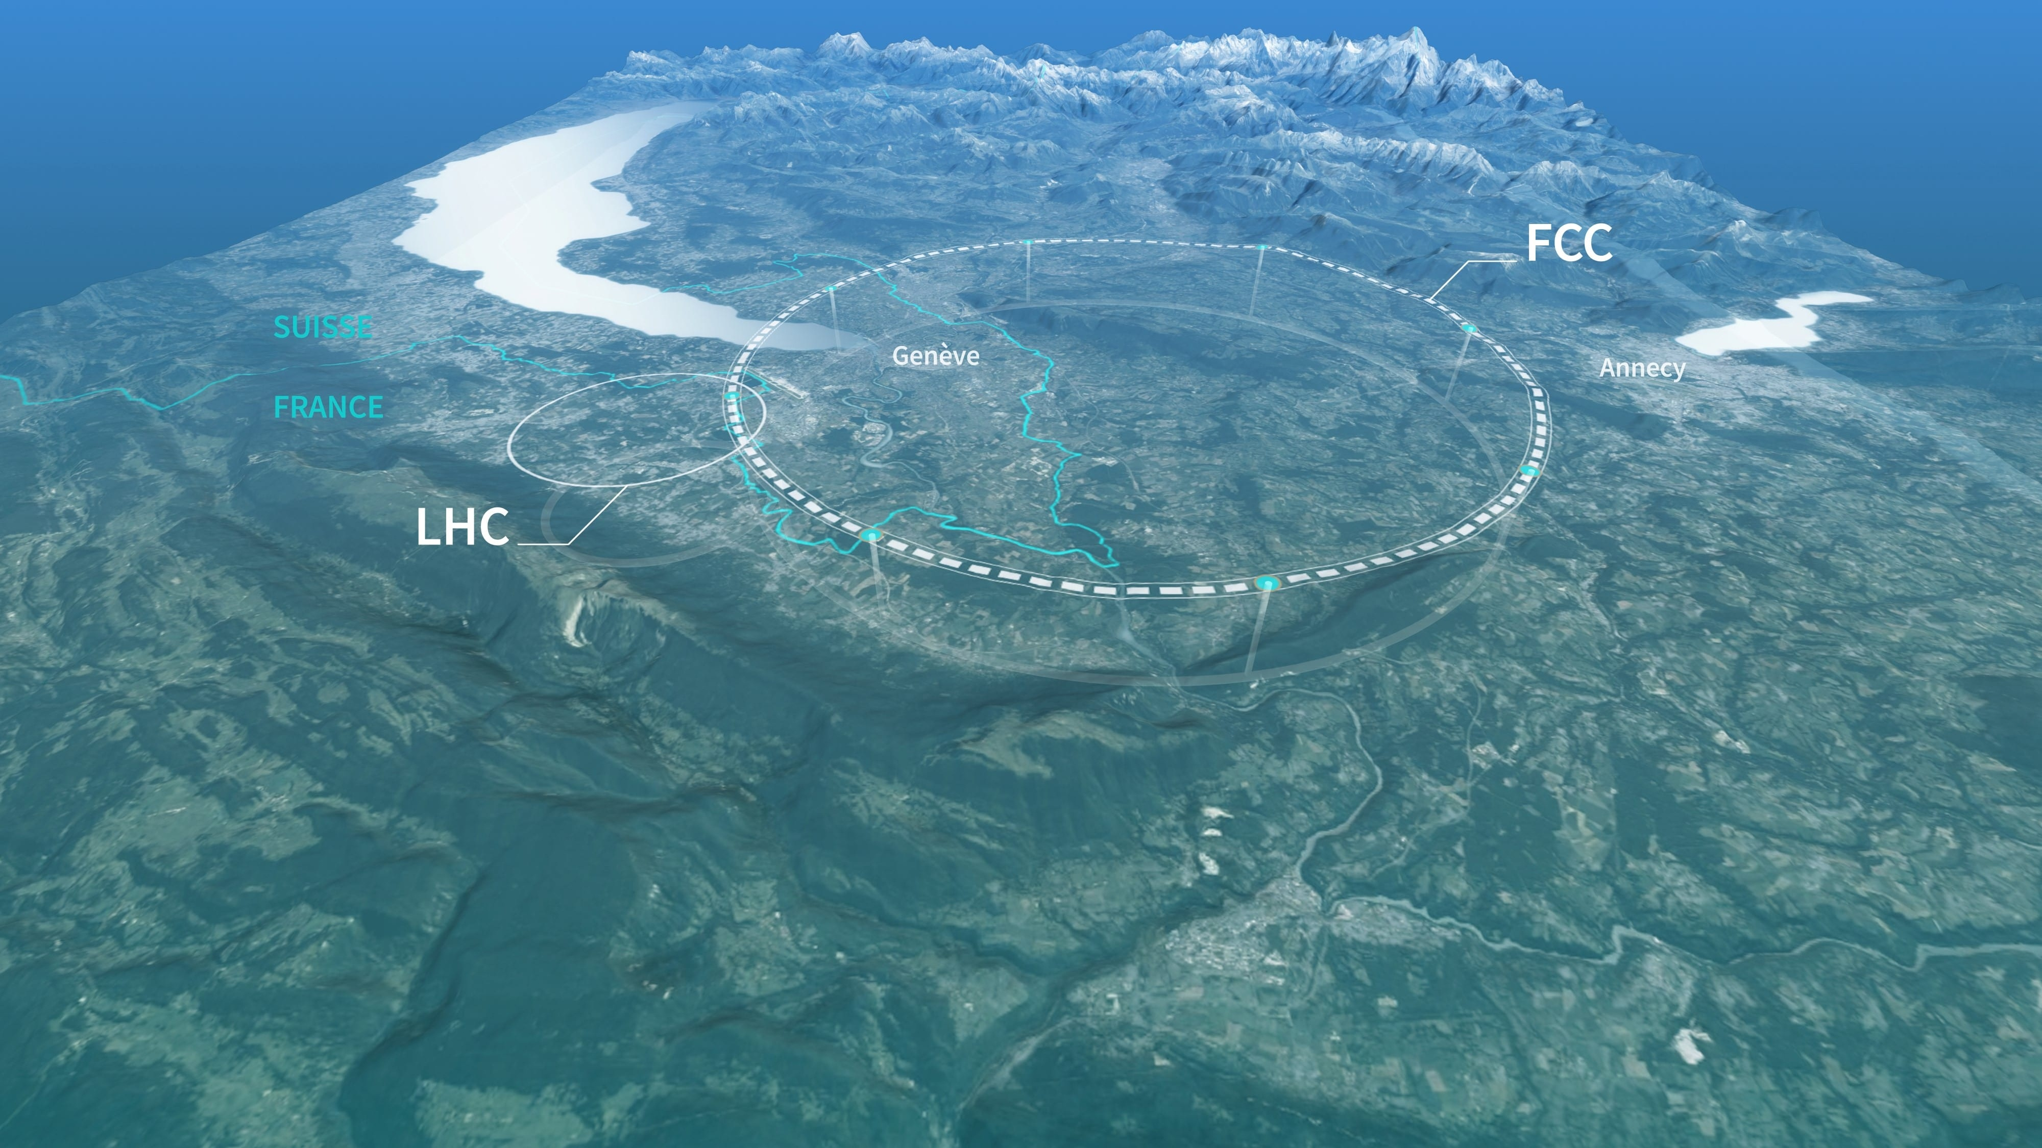
GHG emissions for future facilities

Slide 24

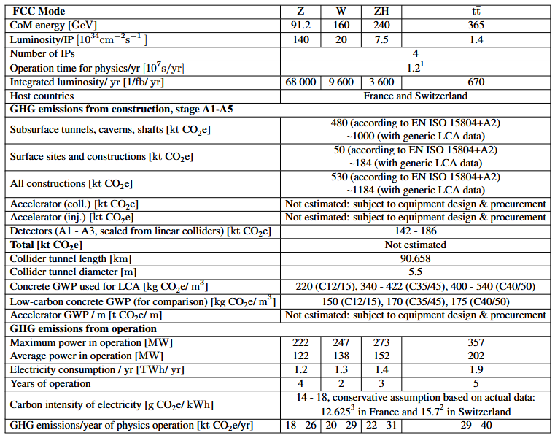
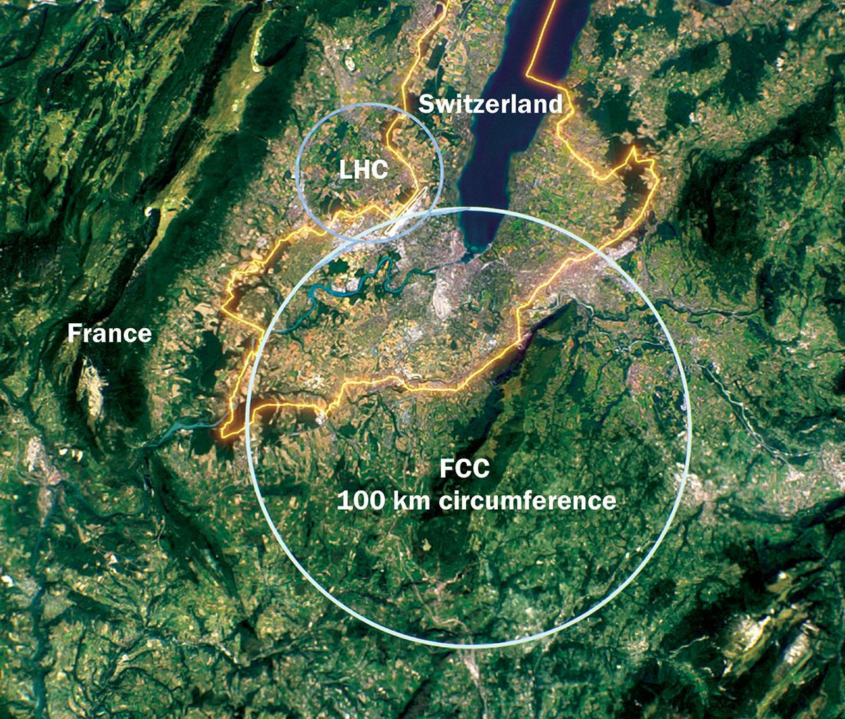
Future Circular Collider: FCC-ee
🎯 Most mature LCA
Proposed 90km staged circular collider: 91 GeV for Z bosons up to 365 GeV for tt̄ collisions
LHC pre-accelerator complex as hadron injector

Slide 25

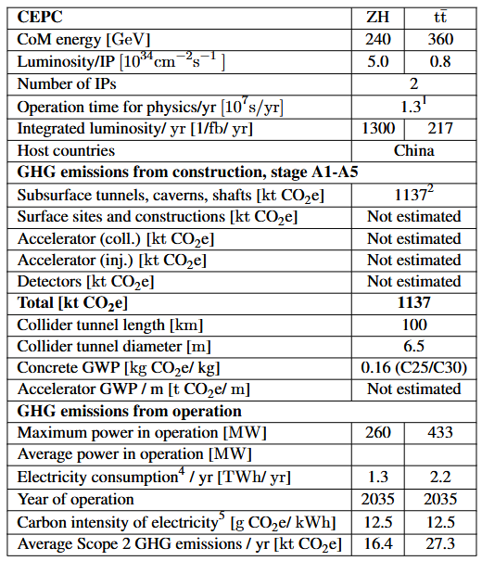
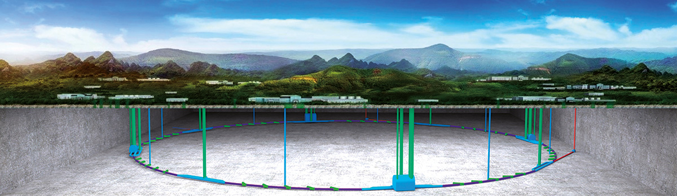
Chinese Electron-Positron Collider: CEPC
📍 Site choice dominates emissions
Higgs factory, 240 GeV with potential upgrade to 360 GeV
100km tunnel, 2 IPs
No site fixed yet
  Estimated grid intensity varies between 12.5 gCO₂e/kWh (Qinghai) to
  673 gCO₂e/kWh (Neimenggu)

Slide 26

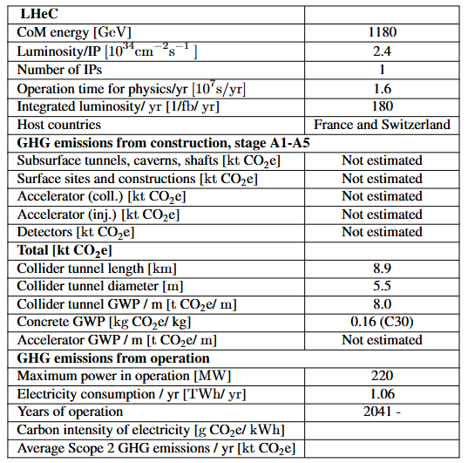
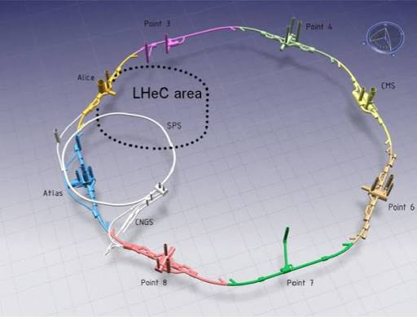
Large Hadron-Electron Collider: LHeC
♻️ Energy recovery technology
Design based on energy recovery linac
Reuse beam power rather than the beam itself
1.18 TeV collision energy, 1 IP
Short: 8.9 km for collider tunnel

Slide 27


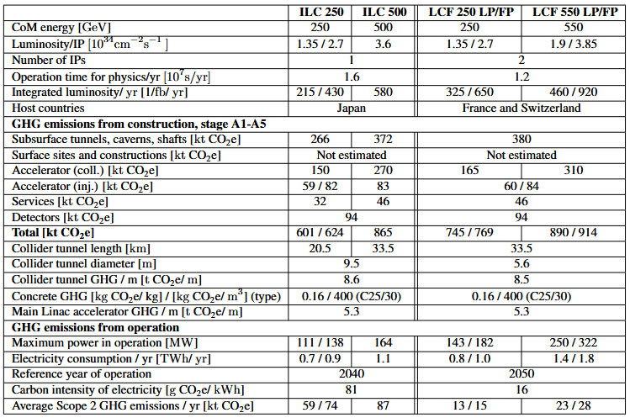
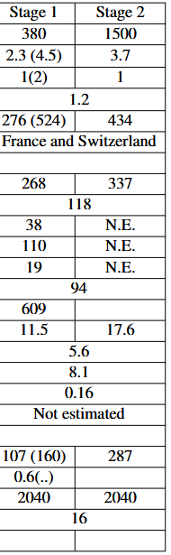
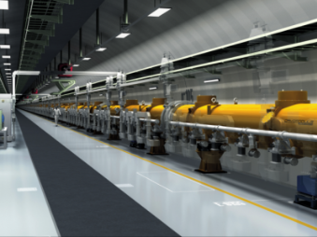
Linear Colliders: ILC and CLIC
⚖️ Most complete comparative studies
CLIC
ILC: 250/500 GeV
CLIC: 380/1500 GeV
Comprehensive comparative assessments carried out

Slide 28
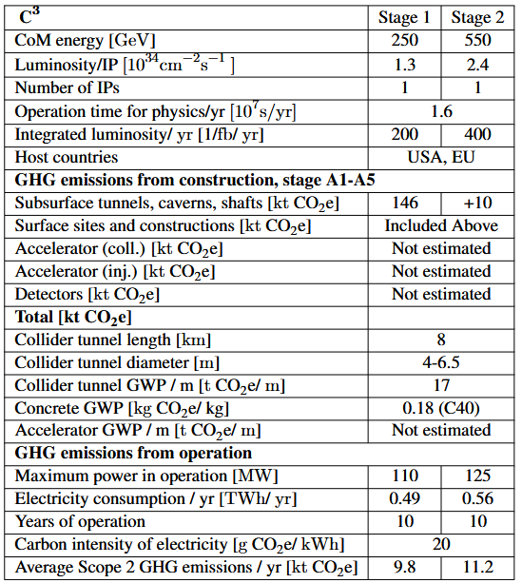
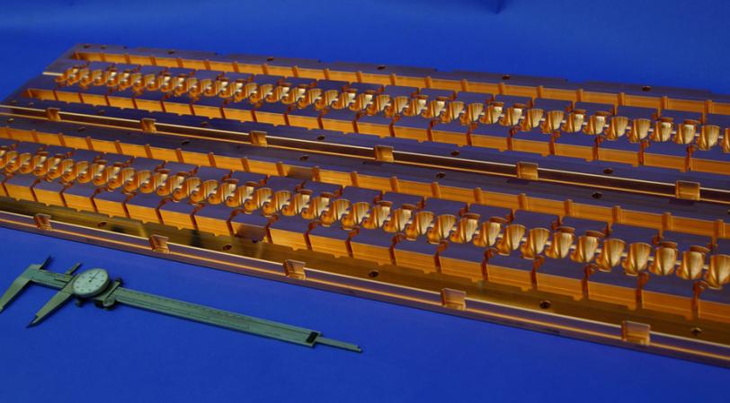
Cool Copper Collider: C³
🏗️ Smallest construction footprint
High-gradient normal-conducting cavities operating at cryogenic temperatures
250/550 GeV collision energies

Slide 29

Greener Accelerators

Slide 30
Improved materials for civil engineering
Sustainable construction needs standardisation, regulation,
and partnership with industry and NGOs
Strategies to reduce concrete use in tunnels
Start early
Establish requirements
Optimise tunnel shape: ⭕ > ⏹️
Use TBMs, not drilling and blasting
Work with geology, not against it
Precast segments

Slide 31
Responsible procurement
Supplier selection
💰 Cost
🌳 Environment
👨‍👨‍👧‍👧 Society
🚨 Risk
Helps reduce overall cost
Encourage public acceptance
Improve risk management
Establish an Environmental, Social and Governance (ESG) policy
Use standard ISO 20400:2017

Slide 32
Energy optimisation
AVOID
REDUCE
COMPENSATE
Start with technical requirements
Eco-design approach: reduce energy consumption
Explore compensation measures, e.g. waste heat recovery
This may trigger repeated design cycles
Use official national value for grid intensity
Calculate monetary value of fossil energy used – shadow pricing

Slide 33
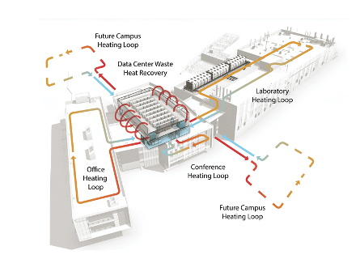
Heat recovery
All electricity used ends up as heat
Typically low-grade heat, <45°C
Usually dissipated to ambient air
Could be used to heat office buildings or nearby homes
Reduced energy, water usage
Longer lifetime for cooling equipment
Reduced heating-linked emissions
Lower heating costs
Potential for new activities locally
Extra equipment (recovery, transport, heat increase, storage)
Refurbishment of existing buildings
Establishment of heat supplier

Slide 34

Energy recovery
E_{z}(z)
Viable due to advances in SRF technology
High cavity Q factors (10¹⁰) enable long-lasting energy storage
Multi-turn ERLs enable high-energy operation
  CBETA @ Cornell: 150 MeV in 4 passes
LHeC: ERL-based design keeps
wall-plug power under 100 MW
  PERLE: demonstrator facility
  under design now
Electron-Ion Collider:
ERLs to cool proton beams
accelerating
decelerating

Slide 35
R&D investment in green technologies
RF sources
High-efficiency klystrons
Fast Reactive Tuners
High-temperature superconductors
Reduce cryogenic system load
Permanent magnets
Ideal for fixed-field devices
ESRF upgrade: 54% energy reduction
Ongoing R&D into tuneable PM systems
Increasing from 2K to 4K cuts cryogenic power by 66%

Slide 36
Conclusions Next Steps
Sustainability is now a strategic requirement for future accelerators
Environmental impact must be assessed across the full lifecycle
Construction and operation dominate greenhouse-gas emissions
Major opportunities exist through design choices, efficiency and innovation
Sustainability must be considered alongside scientific and
socio-economic value
Develop common sustainability assessment standards
Expand LCA databases for accelerator materials and components
Improve environmental reporting across future projects
Strengthen collaboration between laboratories and projects
Continue R&D on energy-efficient accelerator technologies
https://arxiv.org/abs/2509.11705v2

